Slide 1
Numerical simulations studies on monolithic active pixel sensor
Tamazirt juba

Slide 2
Outline
Implementation of a Simulation on a monolithic pixel sensor with Dead Zones.
Introducing Luminosity for Monte-Carlo simulations.
Tamazirt juba

Slide 3
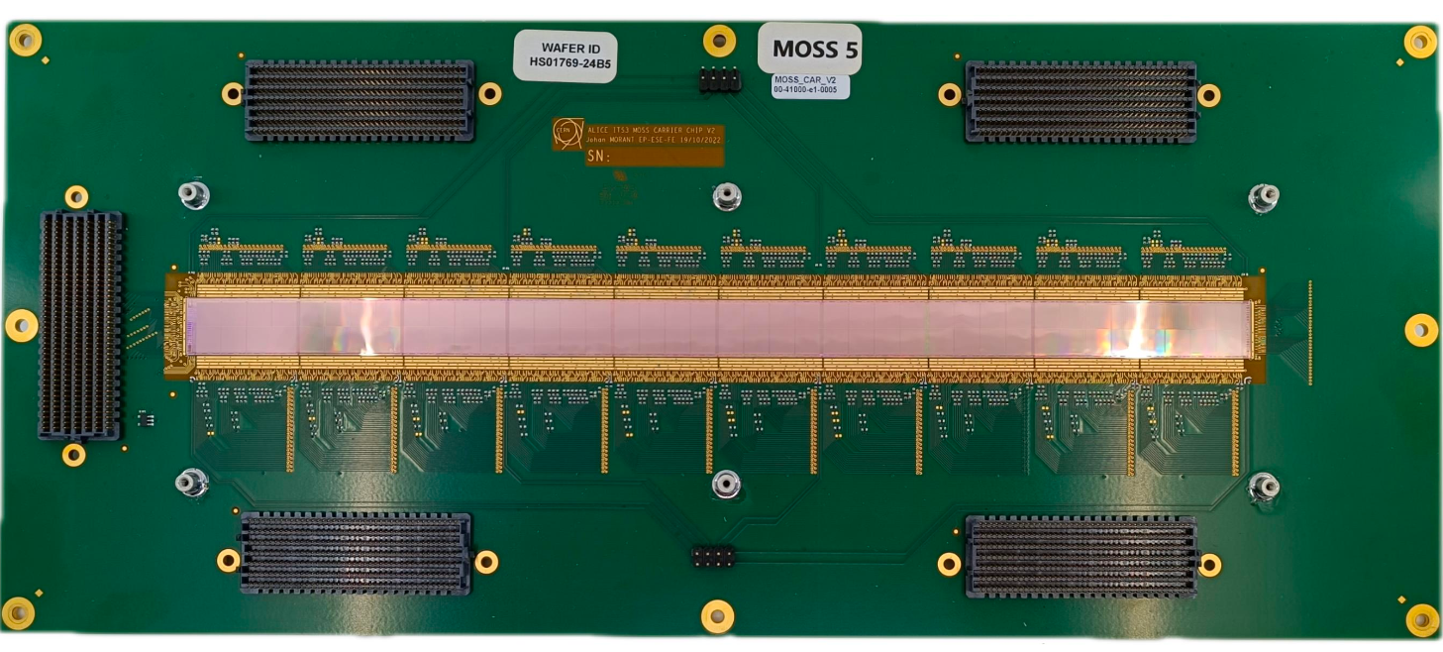
Simulations with a realistic geometry
Reminder
Monte carlo simulation and Rebinning
y
x
too many pixels to perform a the fit in a reasonnable amount of time !!!
18µm
pixellisation:
21020 nXpix
320 nYpix
18µm
pixel
18µm
18µm
Dead zones
Presentation for FCCIS WP2.5 meeting

Slide 4
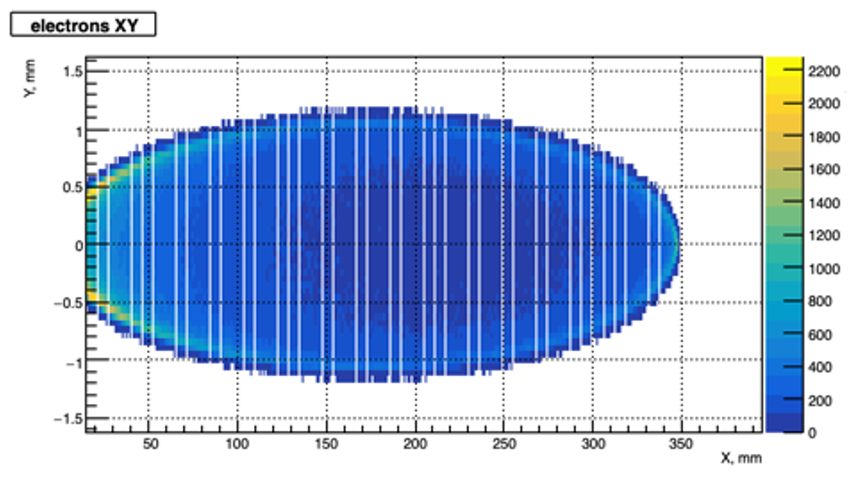
Simulations on Monolithic Active Pixel Sensor MAPS
Reminder
Monte carlo simulation and Rebinning
Rebinning on x axis by 16
Rebinning on y axis by 3
warning! 5 rows of dead pixels instead of 2 for better visualisation
320 pixels (16)
320 pixels (16)
80 nYpix (3)
dead zone 34 pixels (2)
dead zone 34 pixels (2)
1320 nXpix with
60 dead zones
Presentation for FCCIS WP2.5 meeting

Slide 5
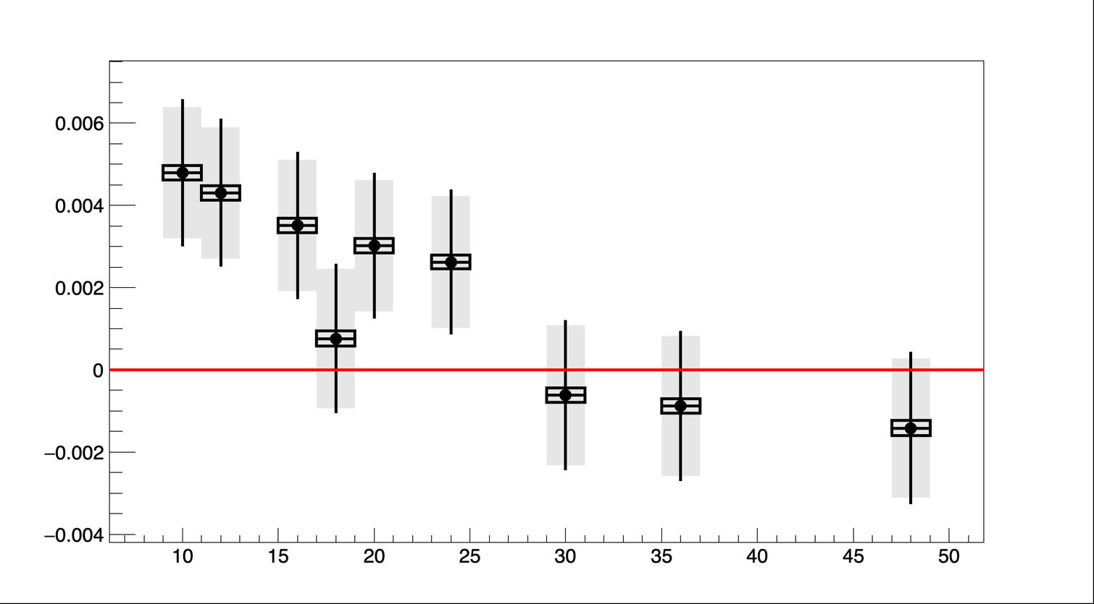
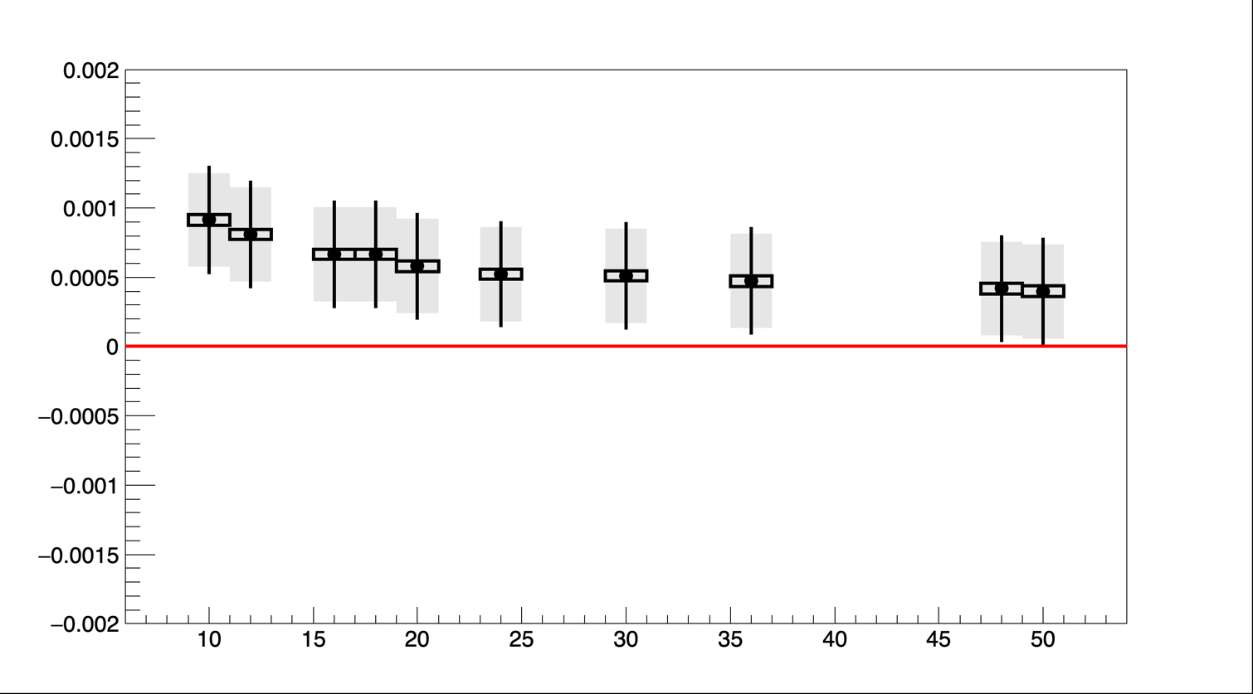
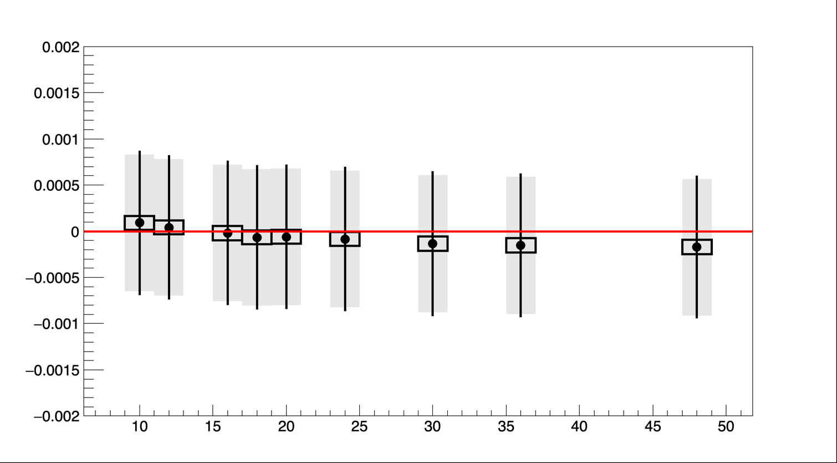
Updated simulations with a realistic geometry
Results: Scan over pixel sizes
E_{fit}-E_{gen.} Gev
Average of single
fit uncertainty
𝛏3𝝵z fit- 𝛏3𝝵z gen
R_{y}=2
R_{y}=3
Standard deviation of fit values
stat uncertainty
on average of
fit values
average of
fit value
5 6 8 6 10 12 10 12. 16 R_{x}
5*2
6*2
8*2
6*3
10*2
12*2
10*3
12*3
16*3
𝛏3𝝵y fit- 𝛏3𝝵y gen
5 6 8 6 10 12 10 12 16 R_{x}
Beam energy extraction (ellipse coordinates) is significantly affected by the pixel size (few per-mil level)
    Interesting correlation with vertical pixel size ! (why ?)
Significant effect on longitudinal polarization too (why situation improves when pixel area increases ?)
Much smaller impact on vertical polarization (small fraction of per-mille)
5 6 8 6 10 12 10 12. 16 R_{x}
Presentation for FCCIS WP2.5 meeting

Slide 6
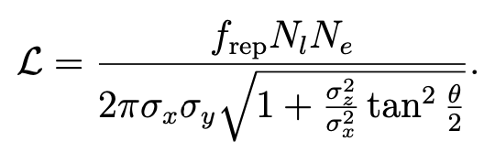

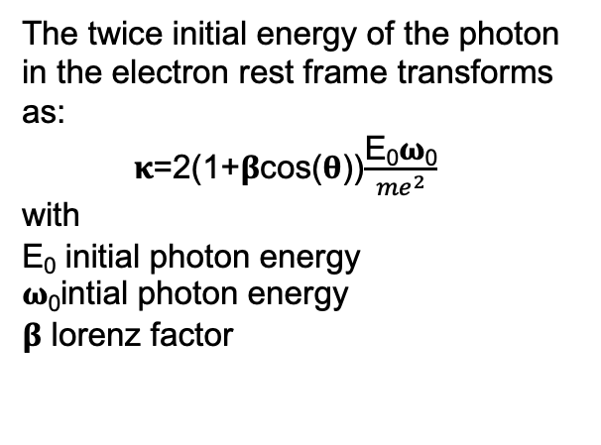
Simulation improvements
Now compute interaction luminosity in the simulation (fixed number of event before)
Inclusion of laser-electron crossing angle
Proper computation of beam size and phase space correlations
The twice initial energy of the photon in the electron rest frame transforms as:
𝛋=2(1+𝛃cos(𝛉))$\frac{\text{E}\text{0}\text{ω}\text{0}}{{me}^{2}}$
with
$\text{E}\text{0}$ initial photon energy
𝛚₀intial photon energy
𝛃 lorenz factor
$$σ_{x,y,z}=\sqrt{σ_{e,x,y,z}^{2}+σ_{l,x,y,z}^{2}}$$
60 seconds of data
acquisition 5*10⁷ events
Dx =28.657235 mm
Dy = 0 mm
Dpx = -0.002141052
Dpy = 0
εx = 0.0007 mm*rad
εy = 0.0000019 mm*rad
βx = 392.6665065 m
βy = 62.0644514 m
αx = 2.38195451
αy = -3.12325768
Presentation for FCCIS WP2.5 meeting

Slide 7
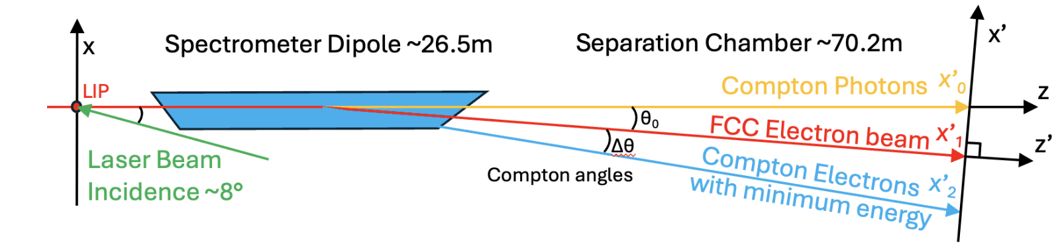
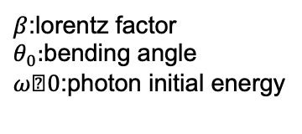

Updated simulations with a realistic geometry
Eb =$\frac{{me}^{2}}{2ω_{0}(1+βcos⁡(θ_{in})}\frac{X2−X1}{X1−X0}$(1-$\frac{\frac{X2−X1}{X1−X0}+2}{{(2γθ_{0})}^{2}})$
$β$:lorentz factor
$θ_{0}:$bending angle
$ω﷮0$:photon initial energy
Presentation for FCCIS WP2.5 meeting

Slide 8
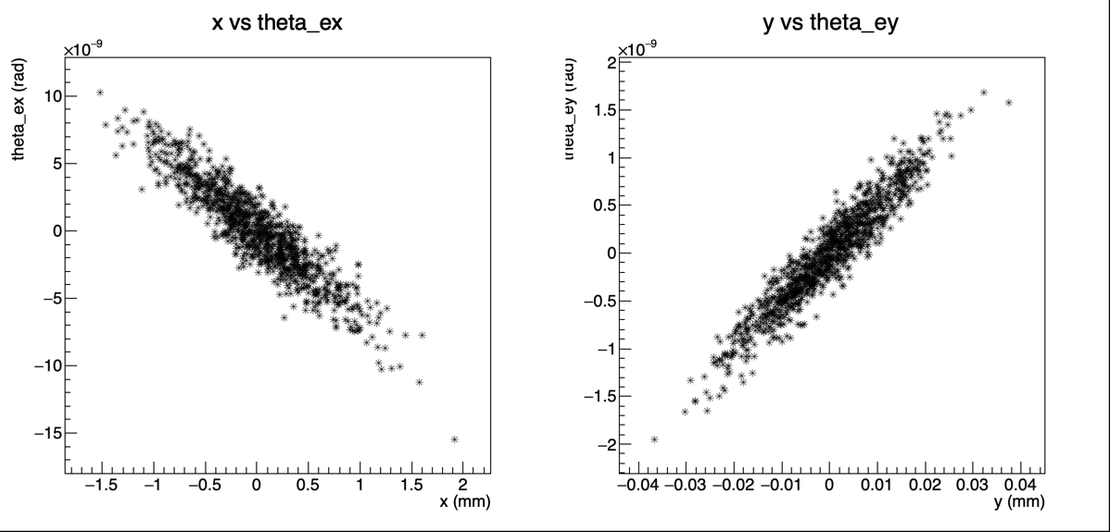
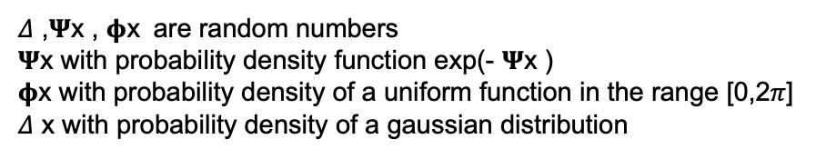
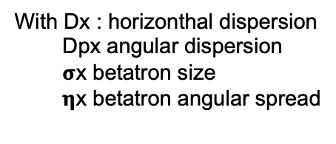
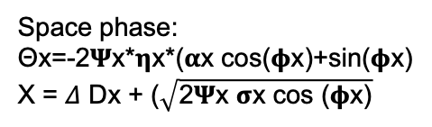
Simulation improvements
Now compute interaction luminosity in the simulation (fixed number of event before)
Inclusion of laser-electron crossing angle
Proper computation of beam size and phase space correlations
Space phase:
Θx=-2𝚿x*𝛈x*(𝛂x cos(𝛟x)+sin(𝛟x)
X = 𝛥 Dx + ($\sqrt{\text{2}\text{Ψ}\text{x} \text{σ}\text{x} \text{cos}\text{ (}\text{φ}\text{x}\text{)}}$
With Dx : horizonthal dispersion
Dpx angular dispersion
$\text{σ}\text{x}$ betatron size
𝛈x betatron angular spread
𝛥 ,𝚿x , $\text{φ}\text{x}$ are random numbers
𝚿x with probability density function exp(- 𝚿x )
$\text{φ}\text{x}$ with probability density of a uniform function in the range [0,2𝜋]
𝛥 $\text{x}$ with probability density of a gaussian distribution
Electron sampling
according to the
electron beam size
Presentation for FCCIS WP2.5 meeting

Slide 9
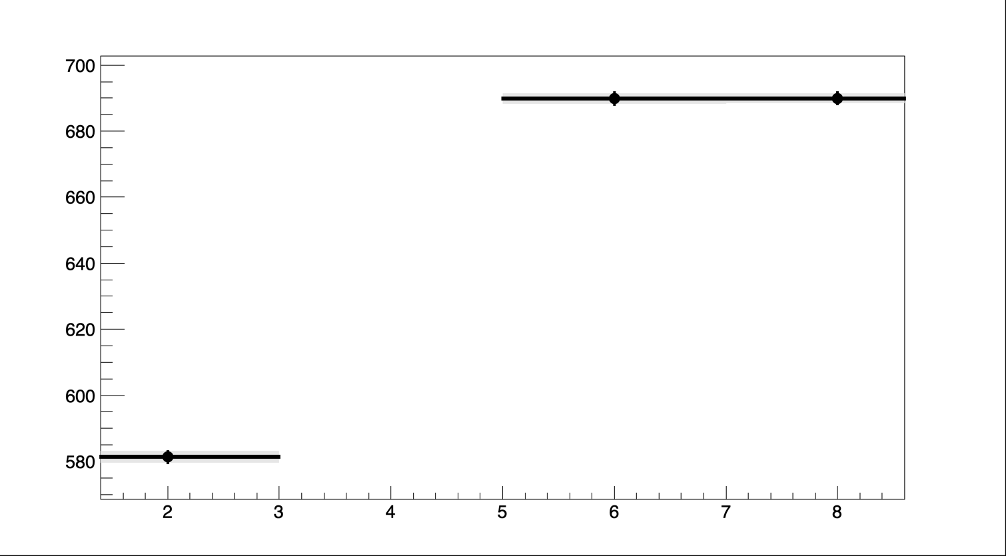
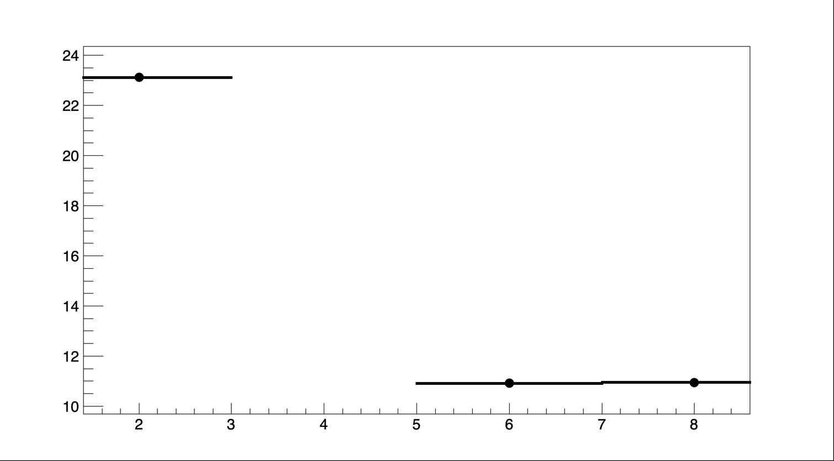
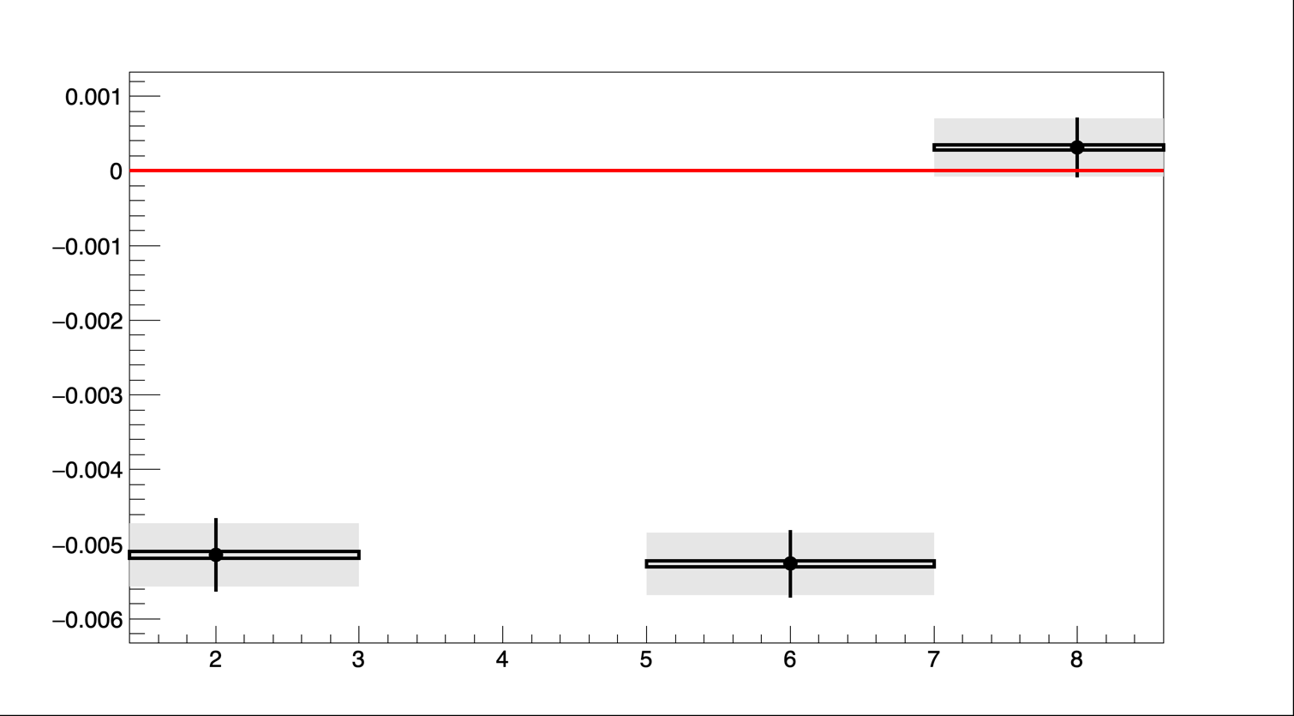
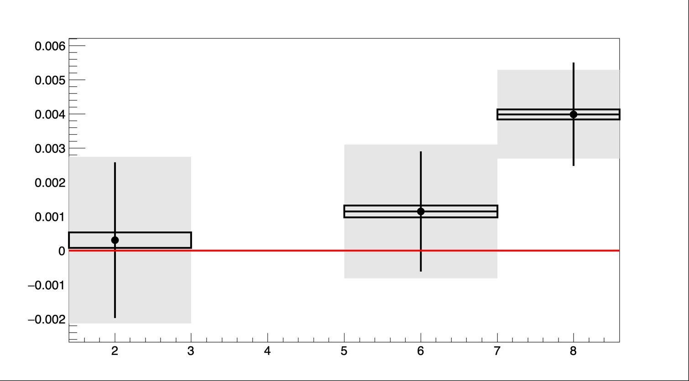
Numerical results
𝛏3𝝵z fit- 𝛏3𝝵z gen
𝛔xfit μm
𝛔yfit μm
Lumi w/ previous beam paramteter values
Correct space
phase correlation
θin = 0.13
θin =0.13
θin =0
Vertical and horizonthal beam sizes values become respectively 10.88μm and 680μm
Efit-Ebeam(Gev)
Laser crossing angle reduces the bias on longitudinal polarization extraction but increases it on vertical polarization.
Presentation for FCCIS WP2.5 meeting

Slide 10
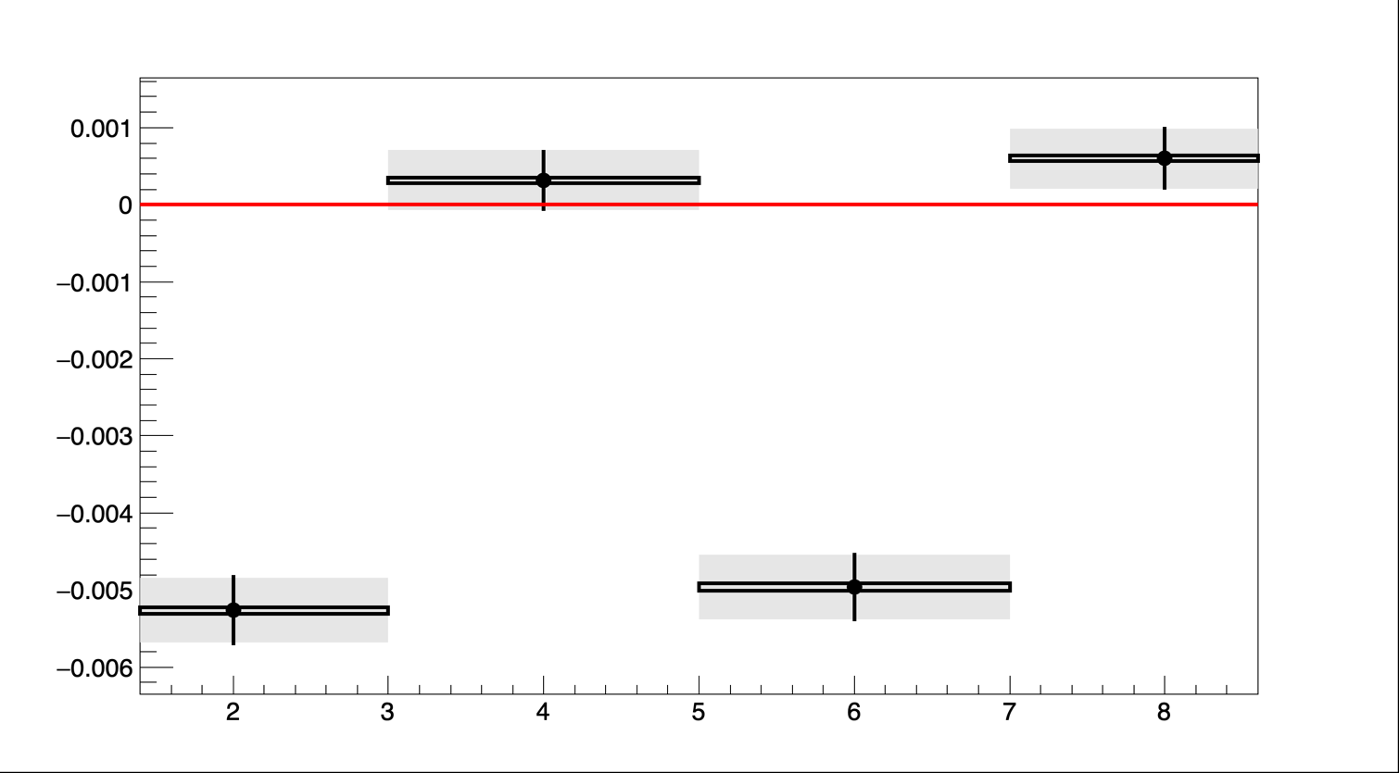
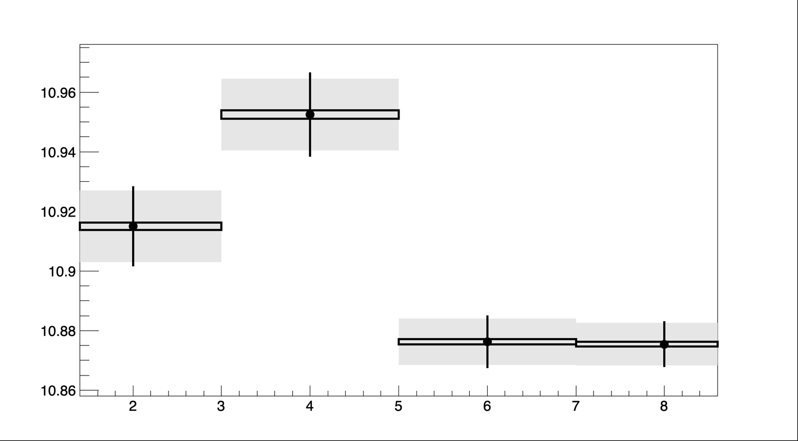
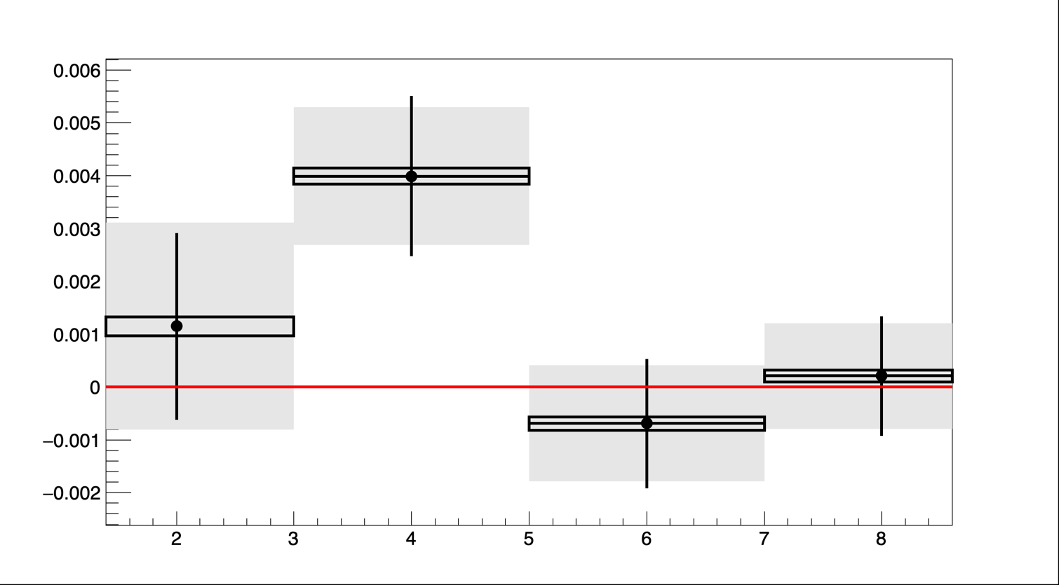

Numerical results (2/2)
Rebin y= 3
Rebin y=1
Θ=0.13
Θ=0
Θ=0.13
Θ=0
PZ1fit-PZ1exp
Unexpected behavior but $σ_{y}≪$pixel size
σyfit
Not understood at this stage
Efit-Ebeam Gev
Much better behavior
Prefer 18um vertical pixel size (Ry=1) otherwise too large wrt effective vertical beam size on detector.
Residual effect of crossing angle on ellipse position and polarization still to understand
Presentation for FCCIS WP2.5 meeting

Slide 11
Conclusion - prospects
Conclusion
Now the software allows for more realistic simulation and accounting of phase space correlations, actual luminostiy and laser-electron beams crossing angle
Studies related to pixel size to be performed again with these parameters
Small vertical pixel size seem essential 18um looks ok at this stage
Impact of leser-electron crossing angle to be understood. Large bias on longitudinal polarization not explained.
Prospects and ongoing steps:
Store fit correlation matrix and analyze may possibly help understanding fancy correlations (on-going)
Take over Gabriela’s work on the fit the asymmetries (now with proper simulation of the luminosity and total cross-section that depends on longitudinal polarizaiton parameters)
In the future: possibly perform a simultaneous fit of electrons and photons to improve parameter extraction.

Slide 12
Thank you for your attention

Slide 13
Backup

Slide 14
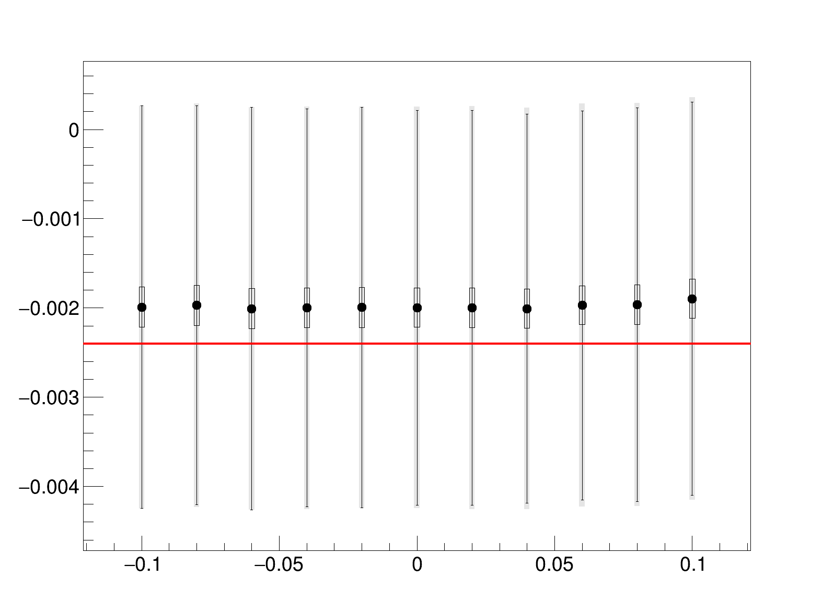
Extracted X1
Vertical Polarization Extraction:
A small bias is observed in the extracted vertical polarization.
The uncertainty is slightly larger when dead zones are included.
Beam Energy Extraction:
A significant bias of order 10⁻⁴ is observed in the extracted beam energy.
The deviation is more pronounced between cases with and without dead zones.

