Slide 1
BDF Vacuum Vessel Feedthrough Connection
Gemma Humphreys, Jean-Louis Grenard, Christophe Mucher
23.05.2025

Slide 2
Objectives of the brainstorming
Discuss requirements for feedthroughs and if they are enough defined
Discuss different possible solutions and assess if PRO/CONS are well identified
Discuss if other solutions can be envisaged

Slide 3
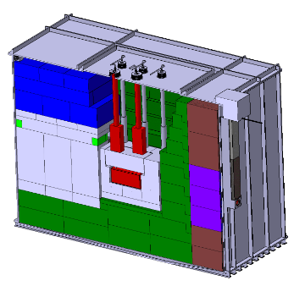
BDF Vessel Baseline
Baseline Design
Helium vessel
Initial design had a small opening in the roof for all feedthroughs
Concept made use of the overhead crane for removal
All connections wanted outside of vessel
  Reduce leakage
  Any failure risks are in same location
But having feedthrough on top is not an option for TCC8 configuration (limited by available lifting height)
~11m
~8m
Crane ++ concept
~8.5m
→ How we came to the next proposal
Baseline Document: View of Vol. 2 (2020): SPS Beam Dump Facility: Comprehensive Design Study

Slide 4
BDF Vacuum Vessel – Current Concept
Primary Functions:
Minimise activation of the surrounding air
Maintain vacuum level of 10⁻³ mbars
House the target, related proximity shielding and relevant cooling components
Maintain target alignment with the beamline
Keep beam line vacuum continuity
Auxiliary Functions:
Contain a system to ease the removal of the target and shielding
Provide structural integrity
Integrate with the safety systems
Allow for integration of coolant pipes into the vessel
Vacuum vessel door
Vacuum vessel flanges connections
External Dimensions (without guide rails):
  6410 x 2050 x 2965mm
Internal Dimensions:
  6210 x 1750 x 2665mm
Volumes:
  Internal = 28.96m³
  External = 38.96m³
Empty Weight:
  ~25000kg
Foreseen Internal Load:
  ~142000kg
Guide Rails

Slide 5
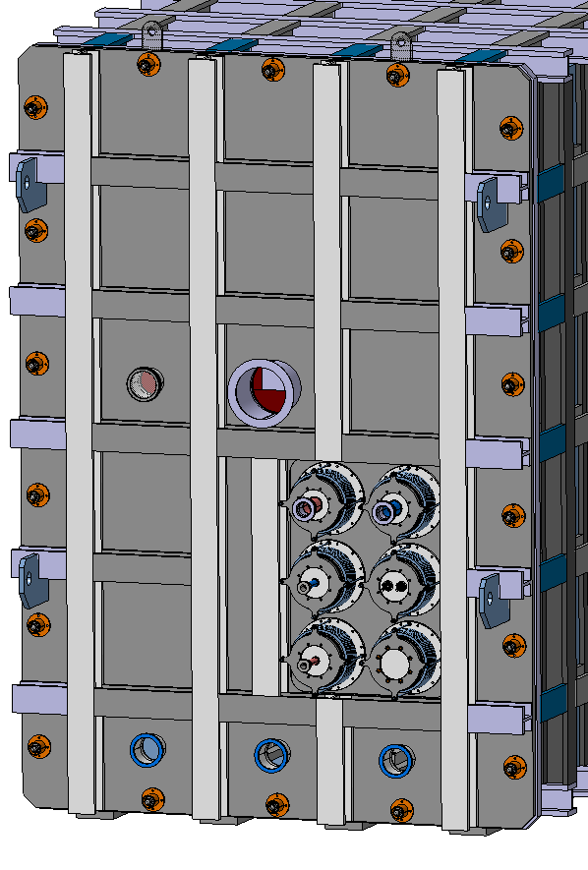
Vacuum Vessel Feedthroughs
Beam pipe
Feedthrough Requirements:
Frequency of opening vessel and exchanging the target
  Once per year vessel opening
  Once per 5 years target exchange
Must have a method to correct for misalignment (e.g. bellows)
  Manufacturing tolerances
  Thermal expansion
  Misalignment from pipe weight
Prevent leaks when in operation or when disconnecting the pipes for vessel opening
Maintain vacuum
Allow for simple and fast connection/disconnection
Ideally remotely compatible
2 x DN50 Helium Cooling Pipes
(Target)
Thermocouples
Spare
2 x DN25 Water Cooling Pipes
(Proximity Shielding)
Pumping ports

Slide 6
Feedthrough Parameters
Focusing only on the cooling feedthrough connections:
Target
  2 x DN50 Pipes
  Helium
  Temperature: ~200°c
  Pressure: ~16 bar
  Leak rate: 10⁻⁶mbar.l/s
Proximity Shielding
  2 x DN25 Pipes
  Water
  Temperature: ~30°c
  Pressure: Up to 16 bar
Note: Target and Proximity shielding feedthroughs must be integrated separately

Slide 7
Human vs Robotic Intervention
Dose rate in this area:
  Integrated: 1 – 5 kGy/year
  Residual: 500-800 µSv/h
Human intervention – relatively quick and simple process for connection and disconnection
  Vacuum vessel length optimised for radiation levels to be low enough for human intervention at the door
Robotic Intervention – takes more time and requires area to be easily accessible by robots

Slide 8
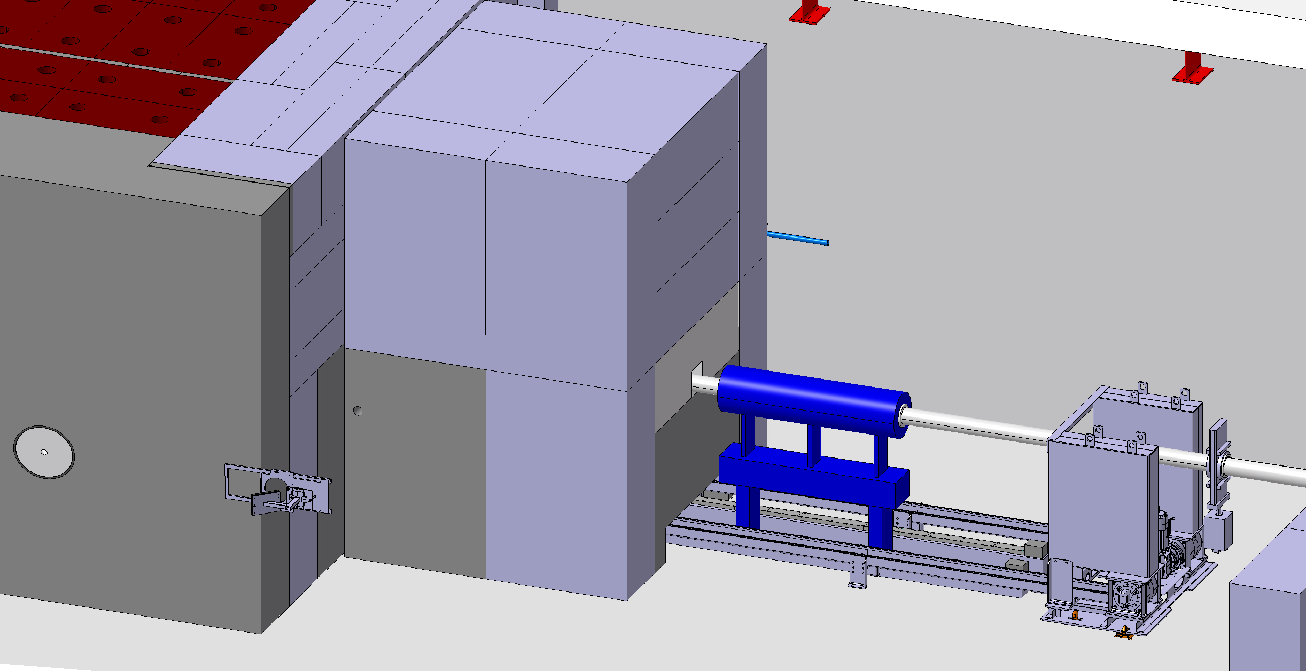
Target Removal Tentative Sequence

Slide 9
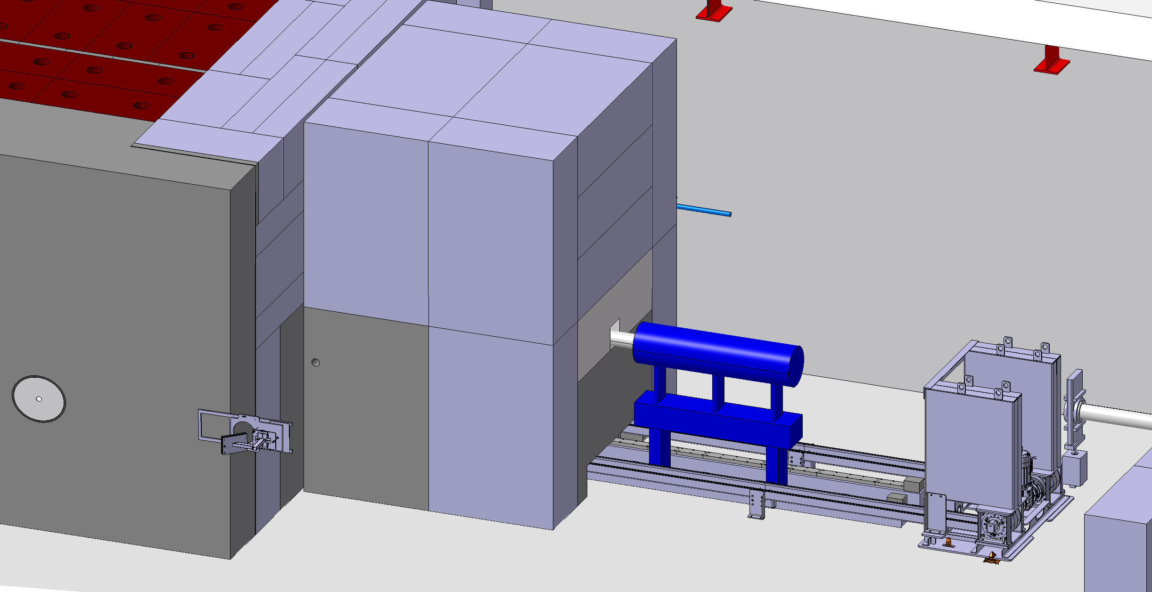
Beam Line Removal

Slide 10
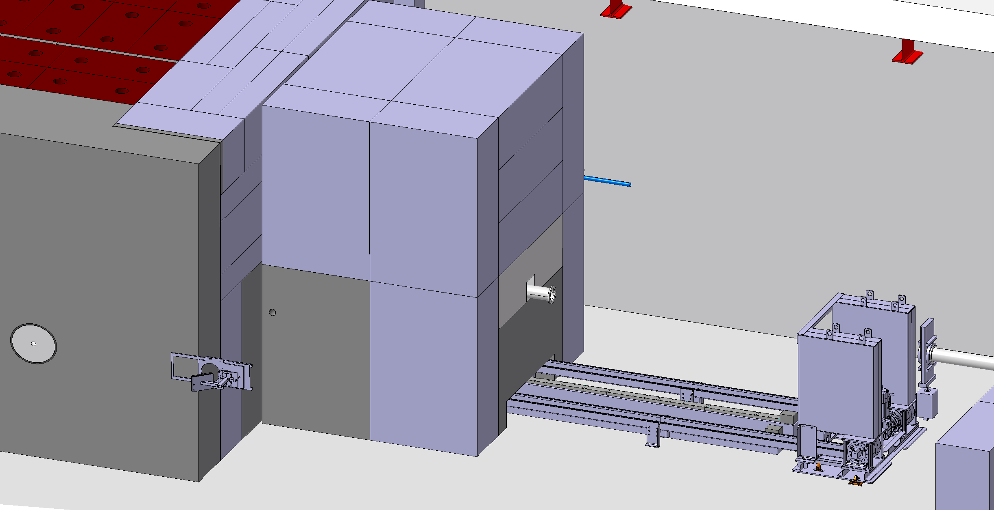
Beam Instrumentation Package Removal

Slide 11
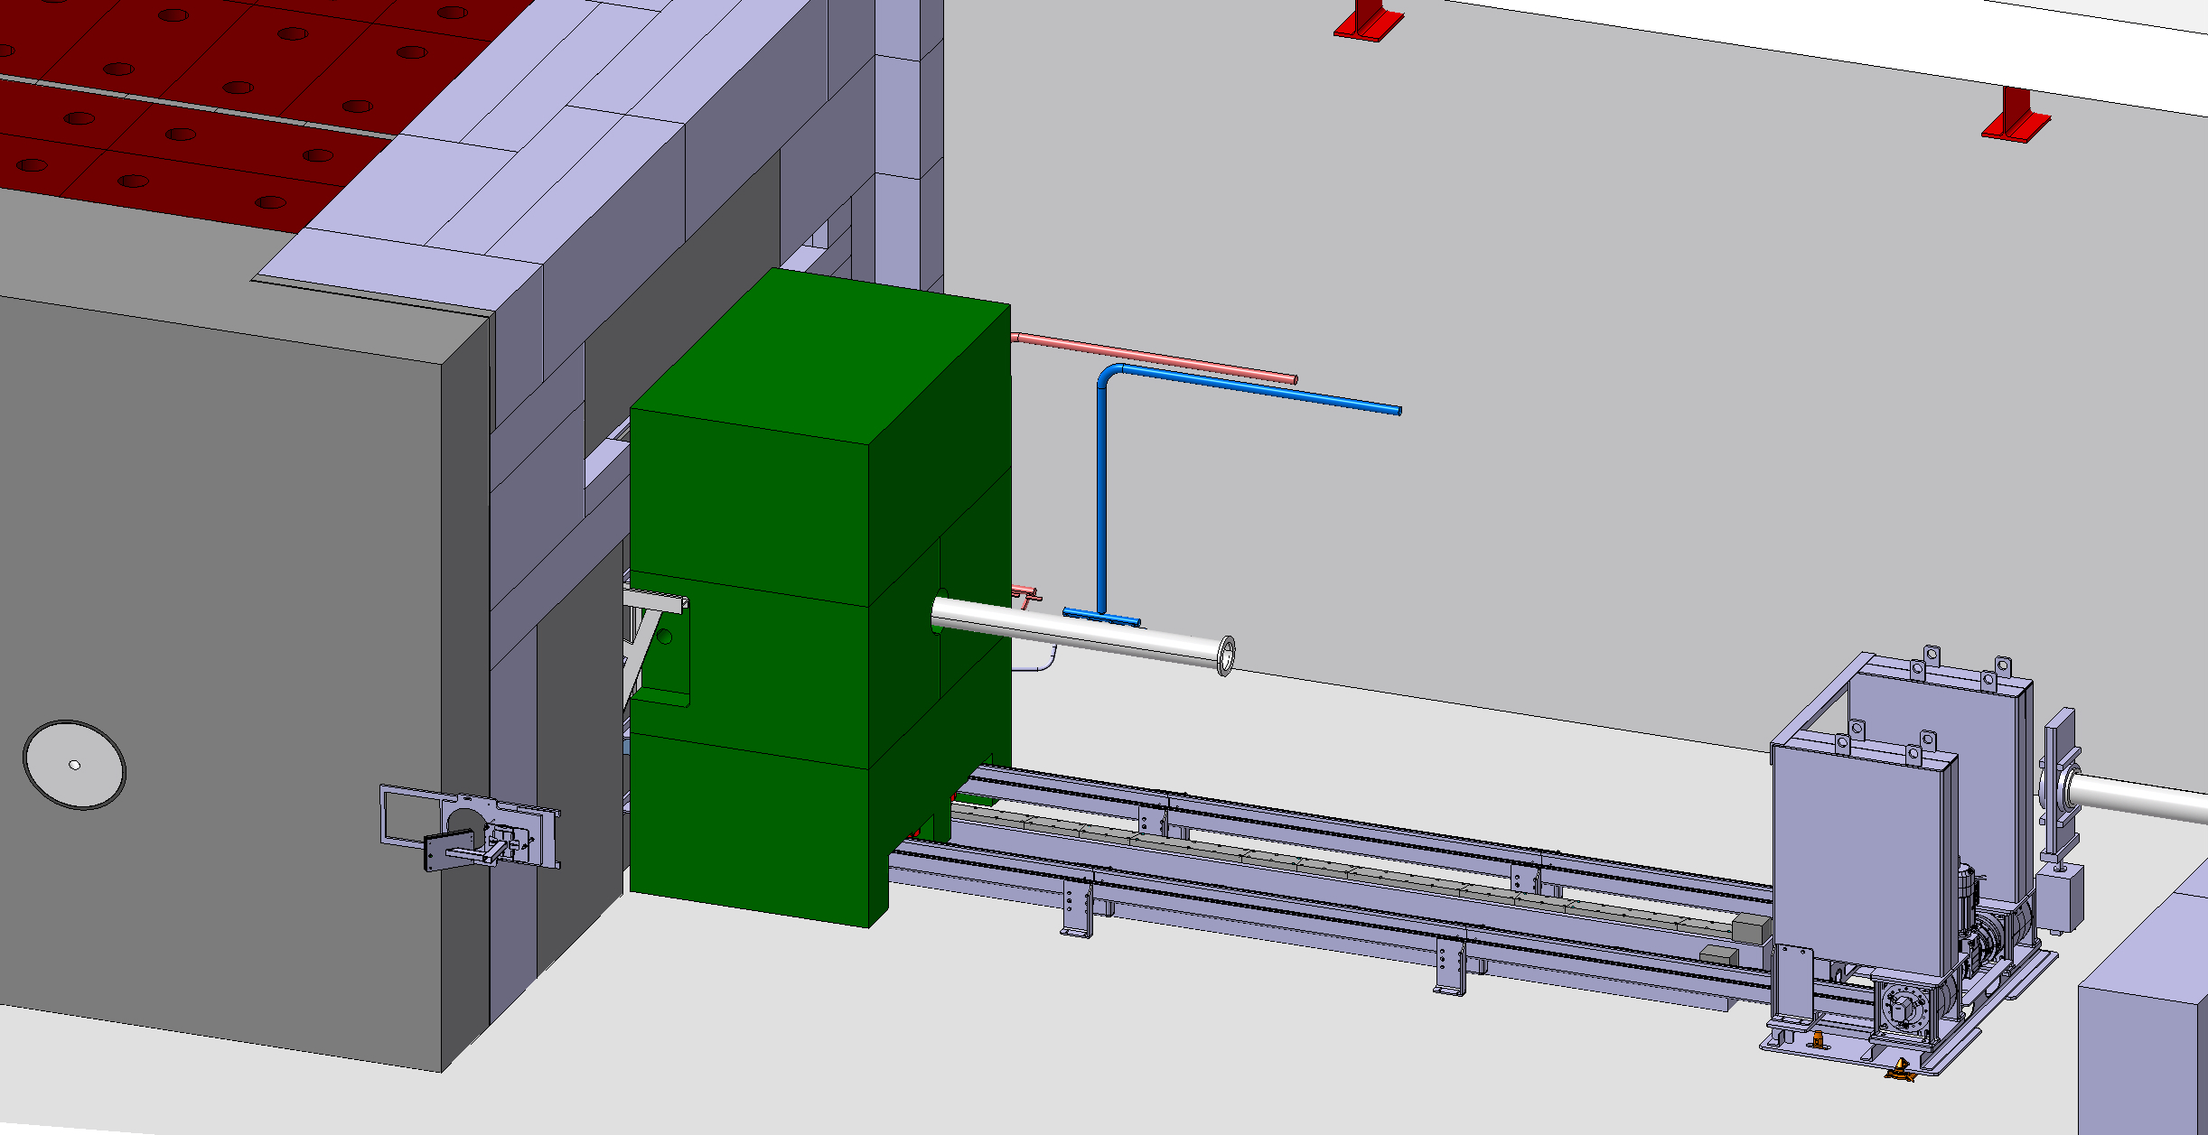
Collimator Shielding Removal

Slide 12
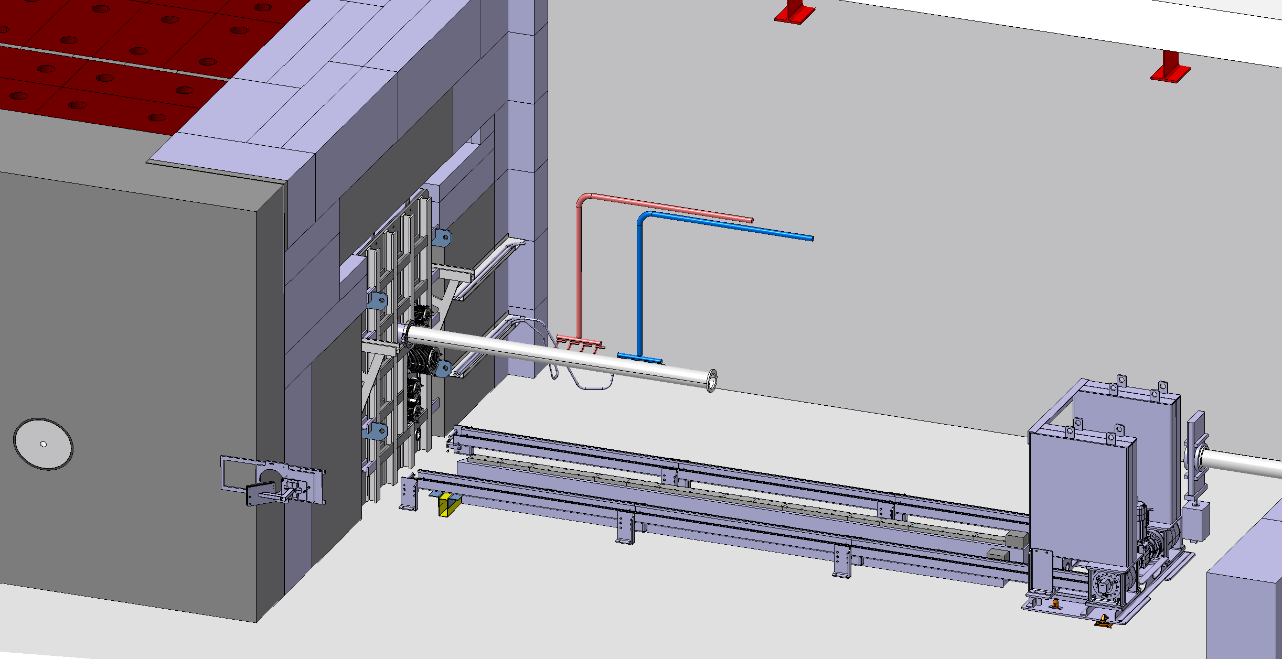
Collimator Removal

Slide 13
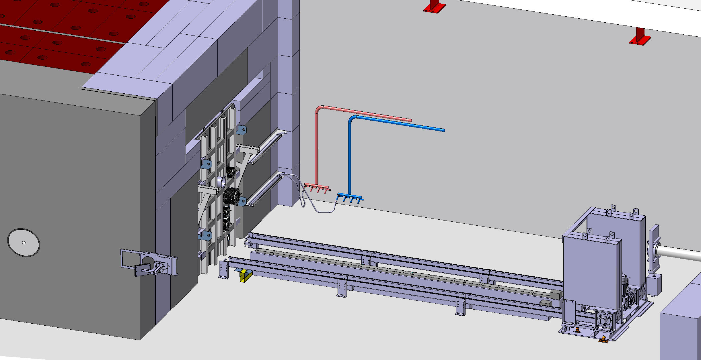
Beam Pipe Removal

Slide 14
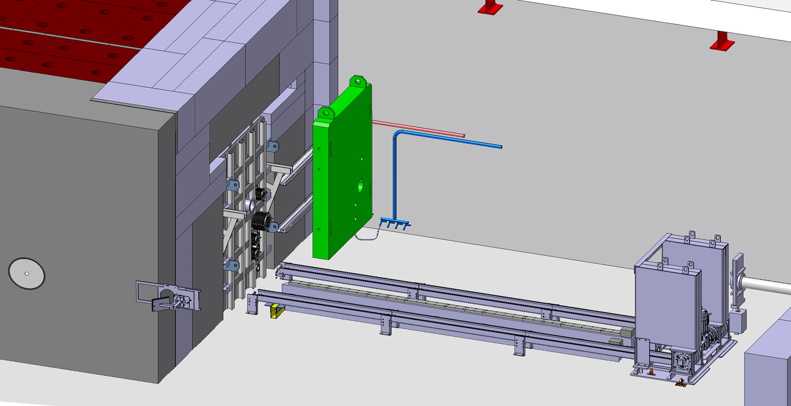
Installation of Lifting and Shielding Tool for Vessel Door

Slide 15
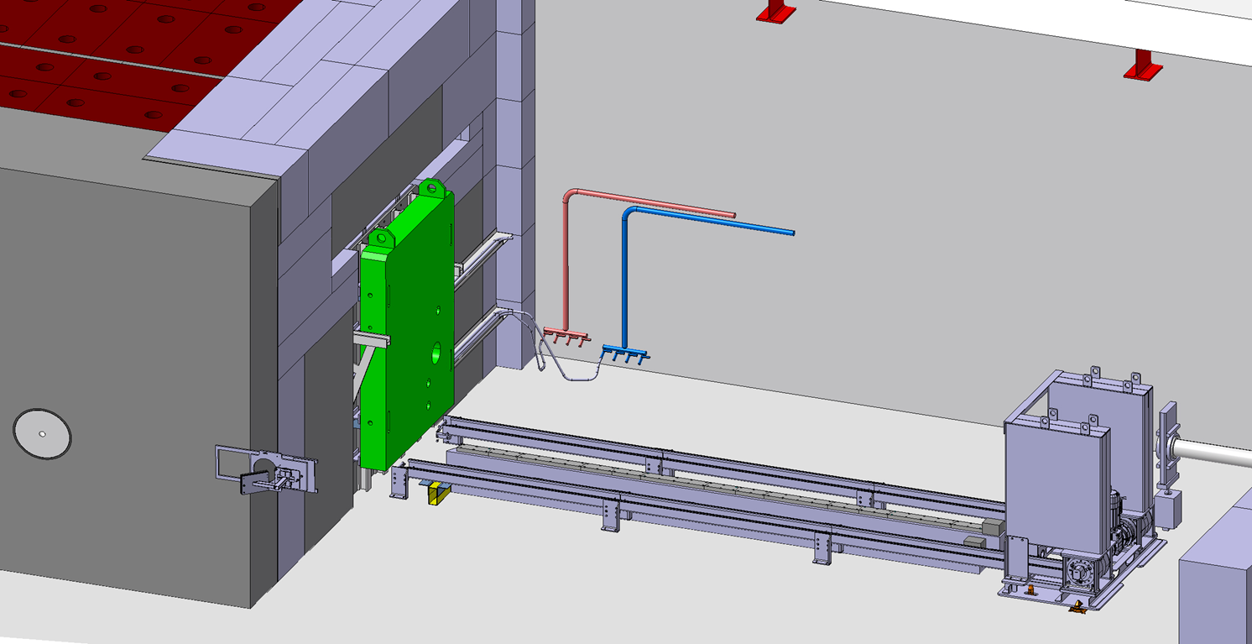
Disconnection of Utilities and Vacuum Vessel Door Unbolting

Slide 16
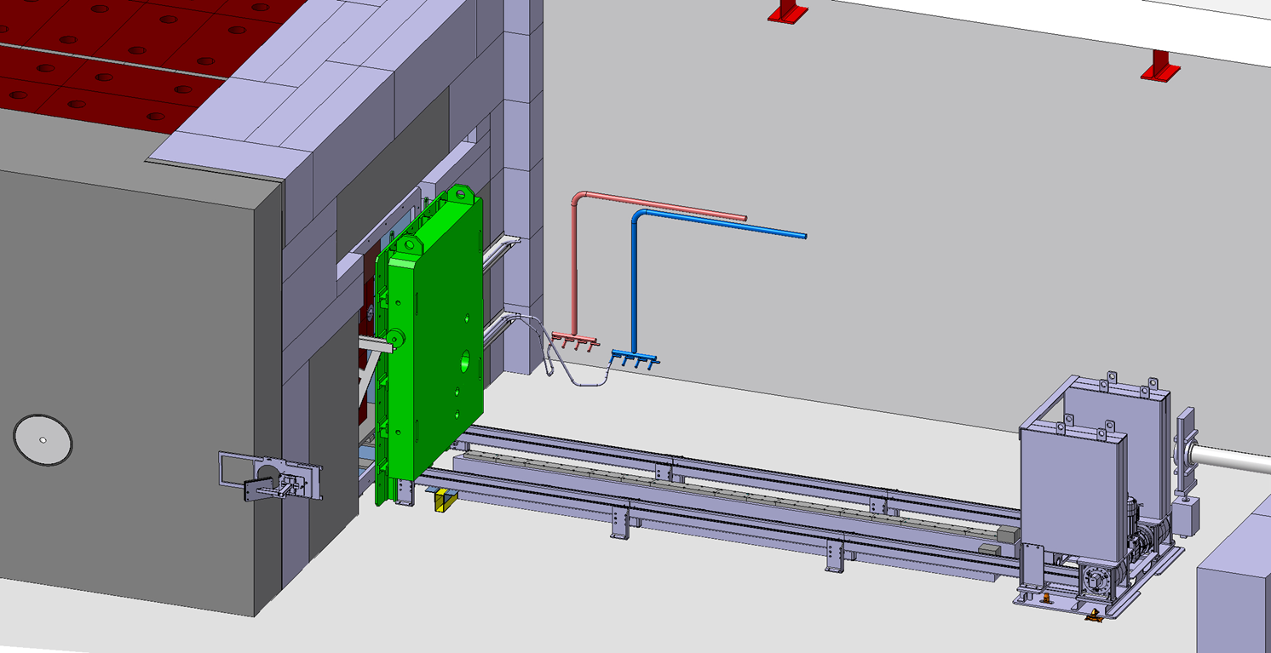
Vacuum Vessel Door Removal 1/2

Slide 17
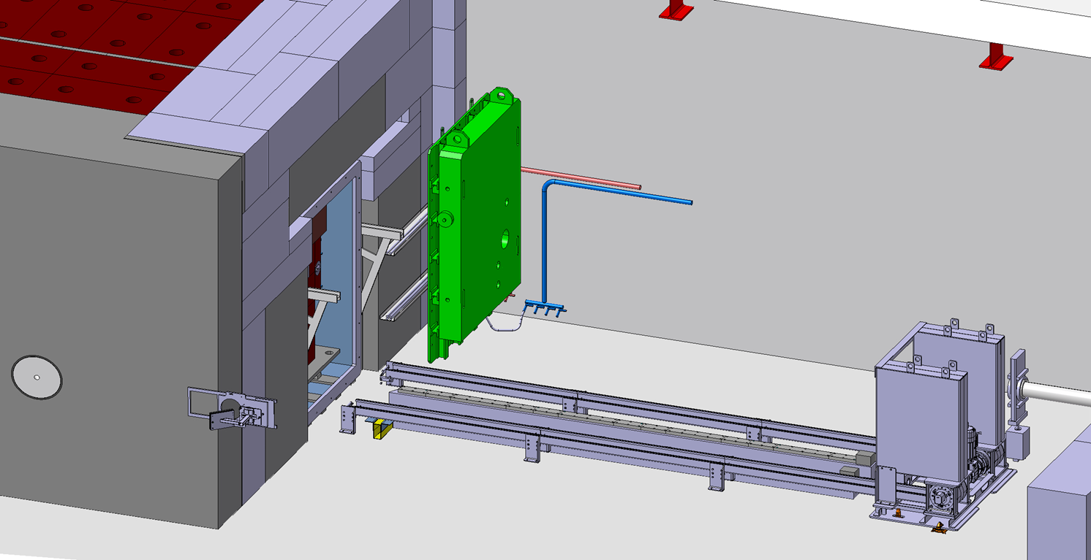
Vacuum Vessel Door Removal 2/2

Slide 18
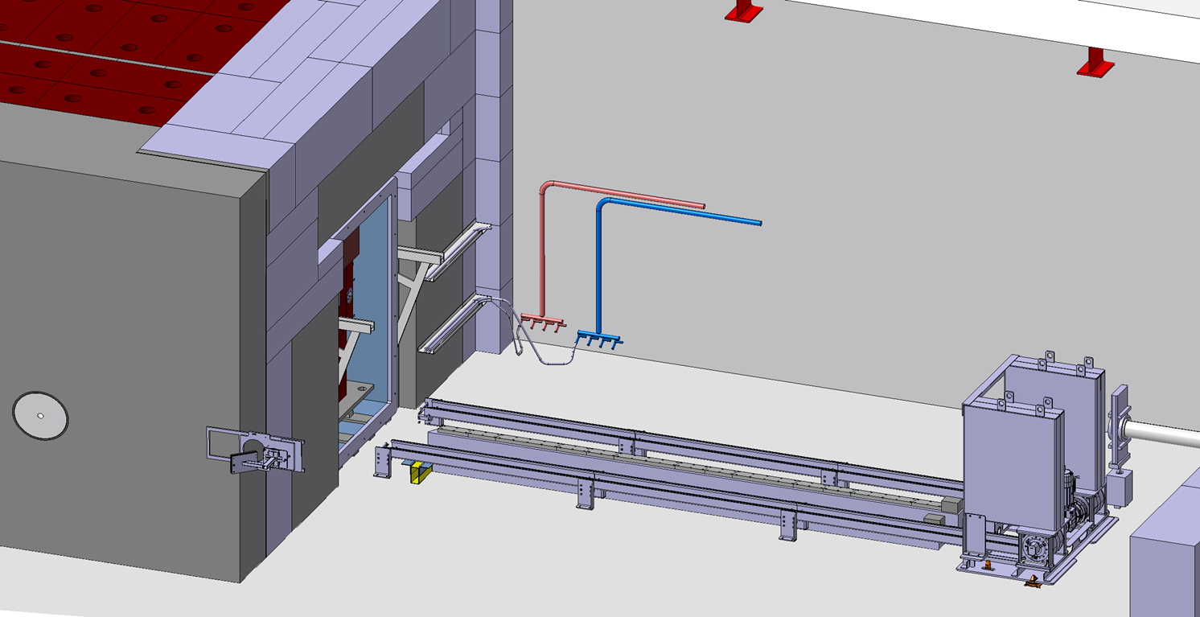
Vacuum Vessel Open

Slide 19
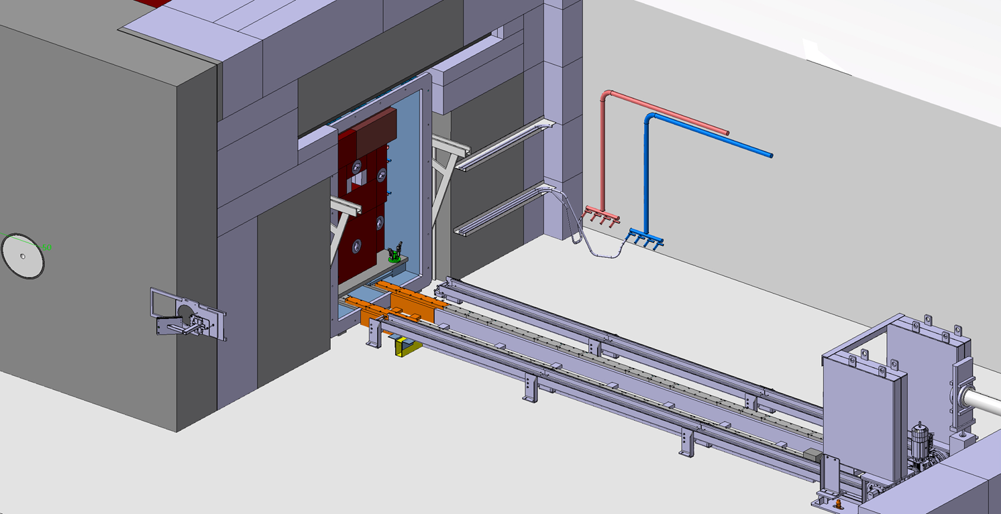
Transfer Rail Installation

Slide 20

Push/pull Chain Mechanism Connection 1/2

Slide 21
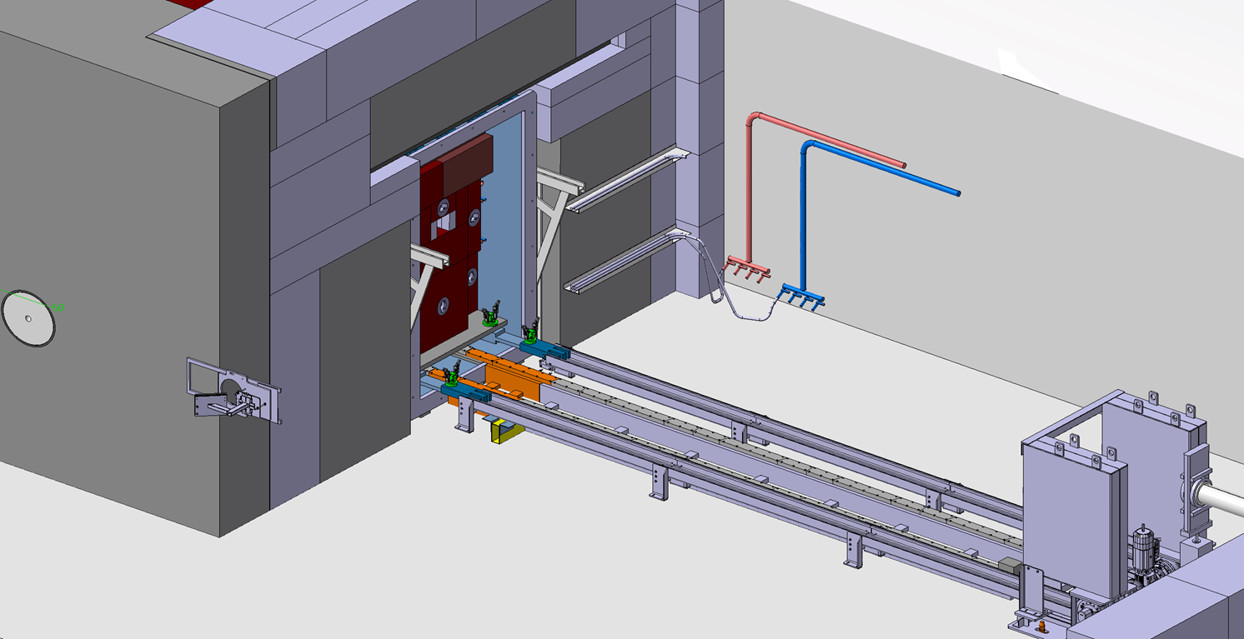
Push/pull Chain Mechanism Connection 2/2

Slide 22
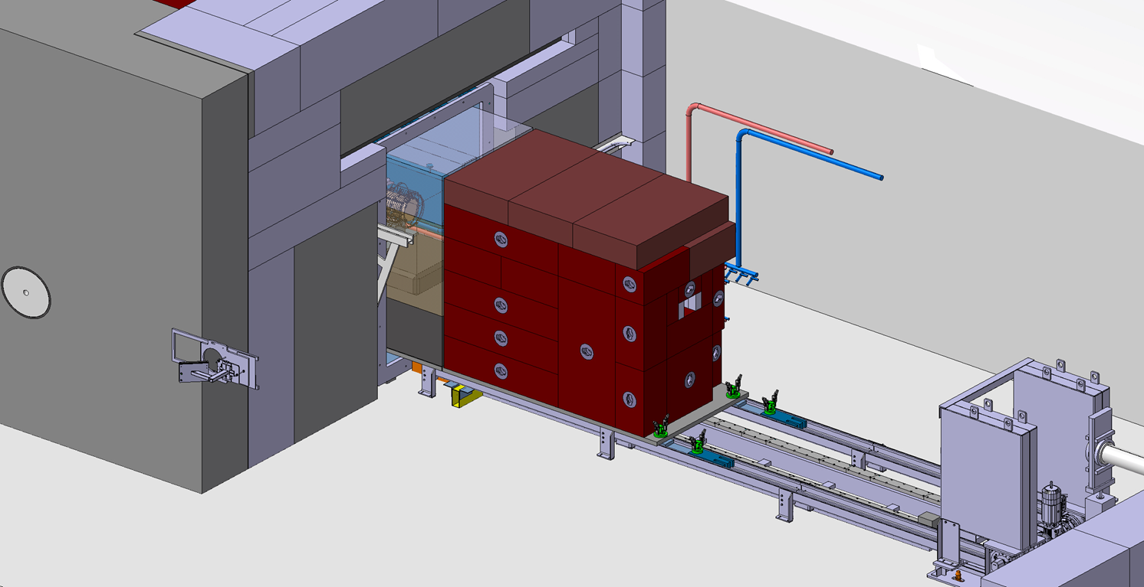
Trolley Extraction 1/2

Slide 23
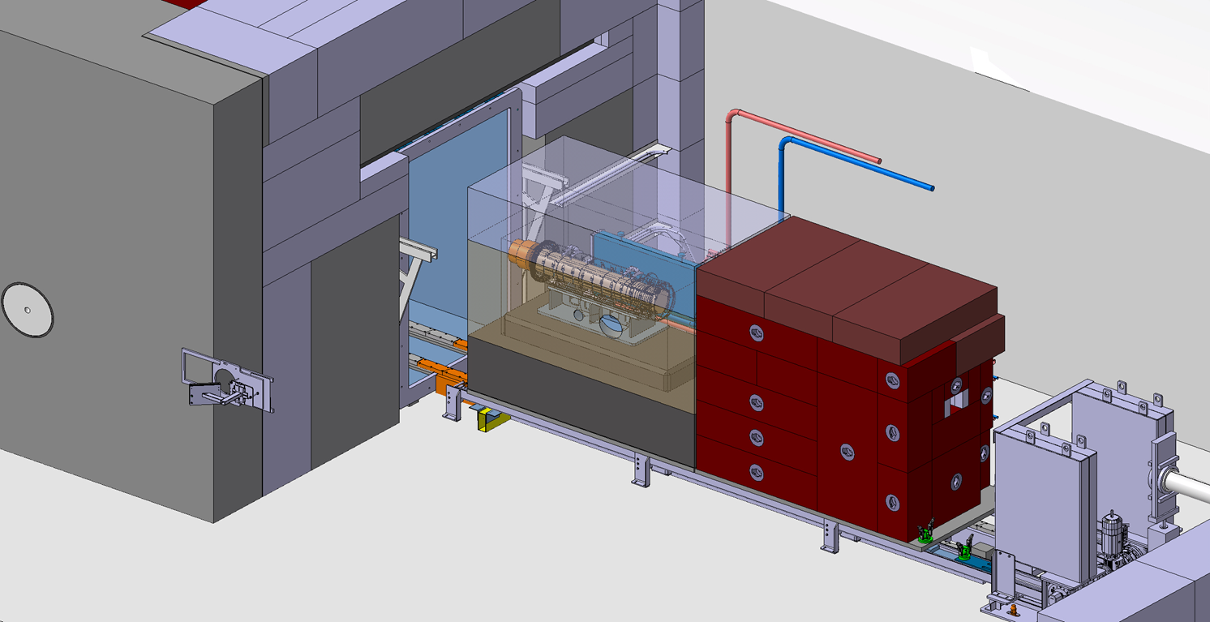
Trolley Extraction 2/2

Slide 24
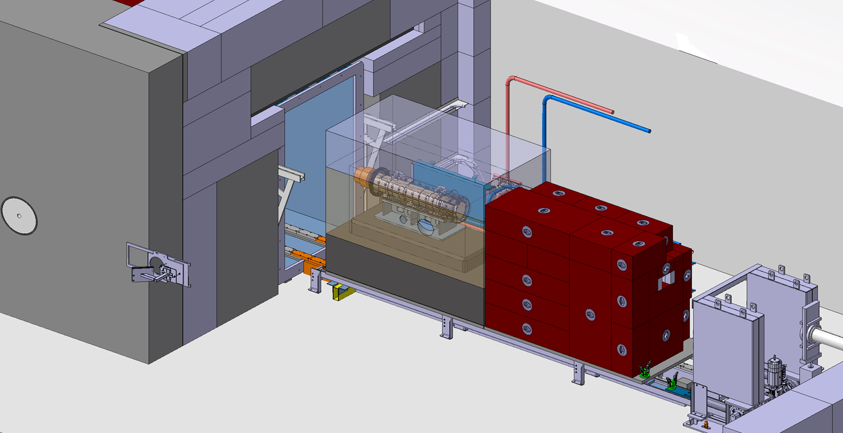
Upstream Shielding Partial Removal

Slide 25
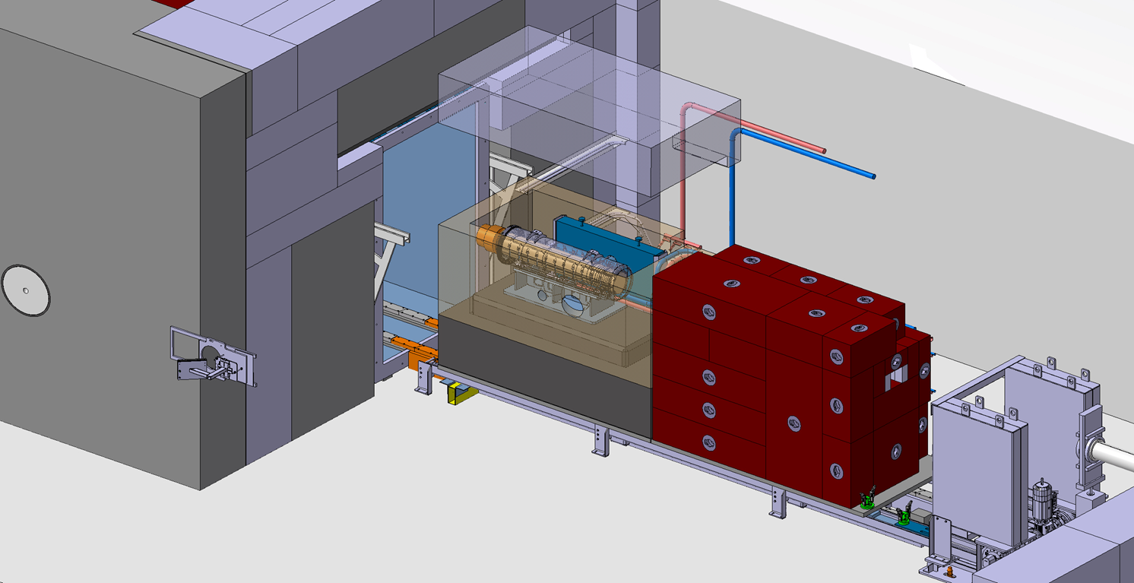
Proximity Shielding Upper Copper Removal

Slide 26
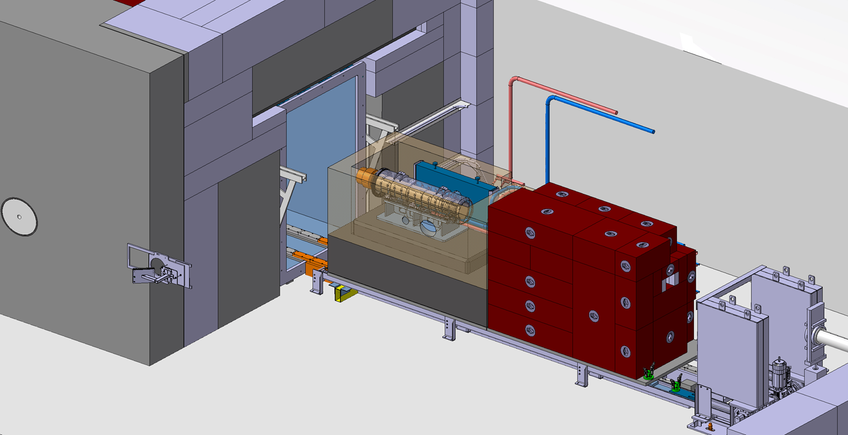
Proximity Shielding Upper Copper Removed

Slide 27
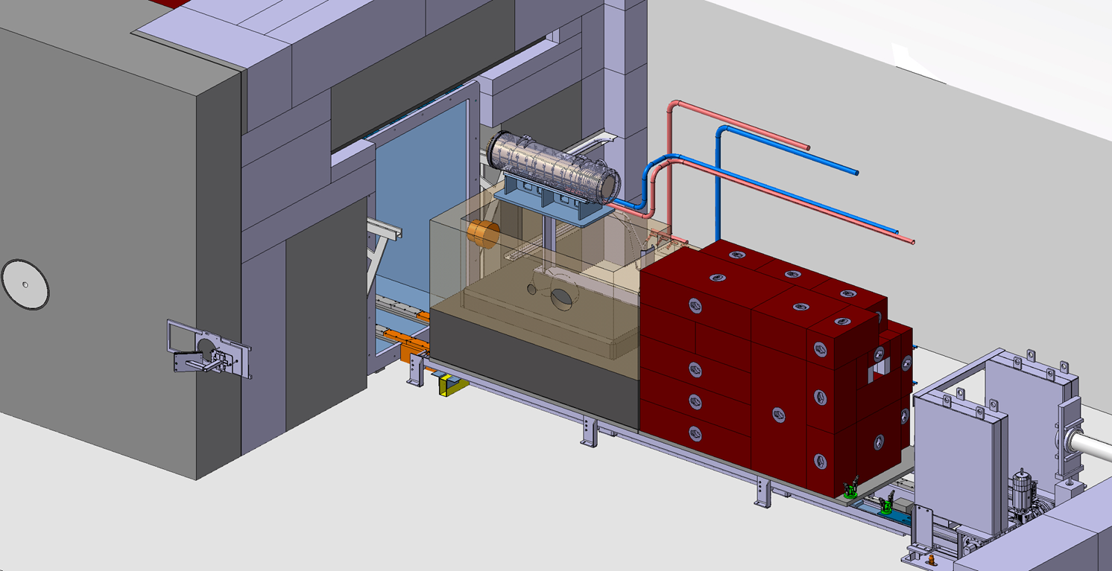
Target Removal

Slide 28
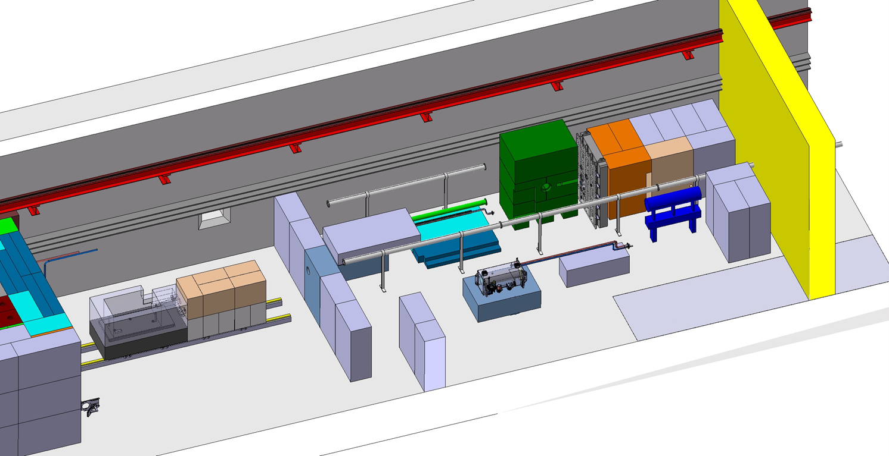
Space Requirement for Target Exchange

Slide 29
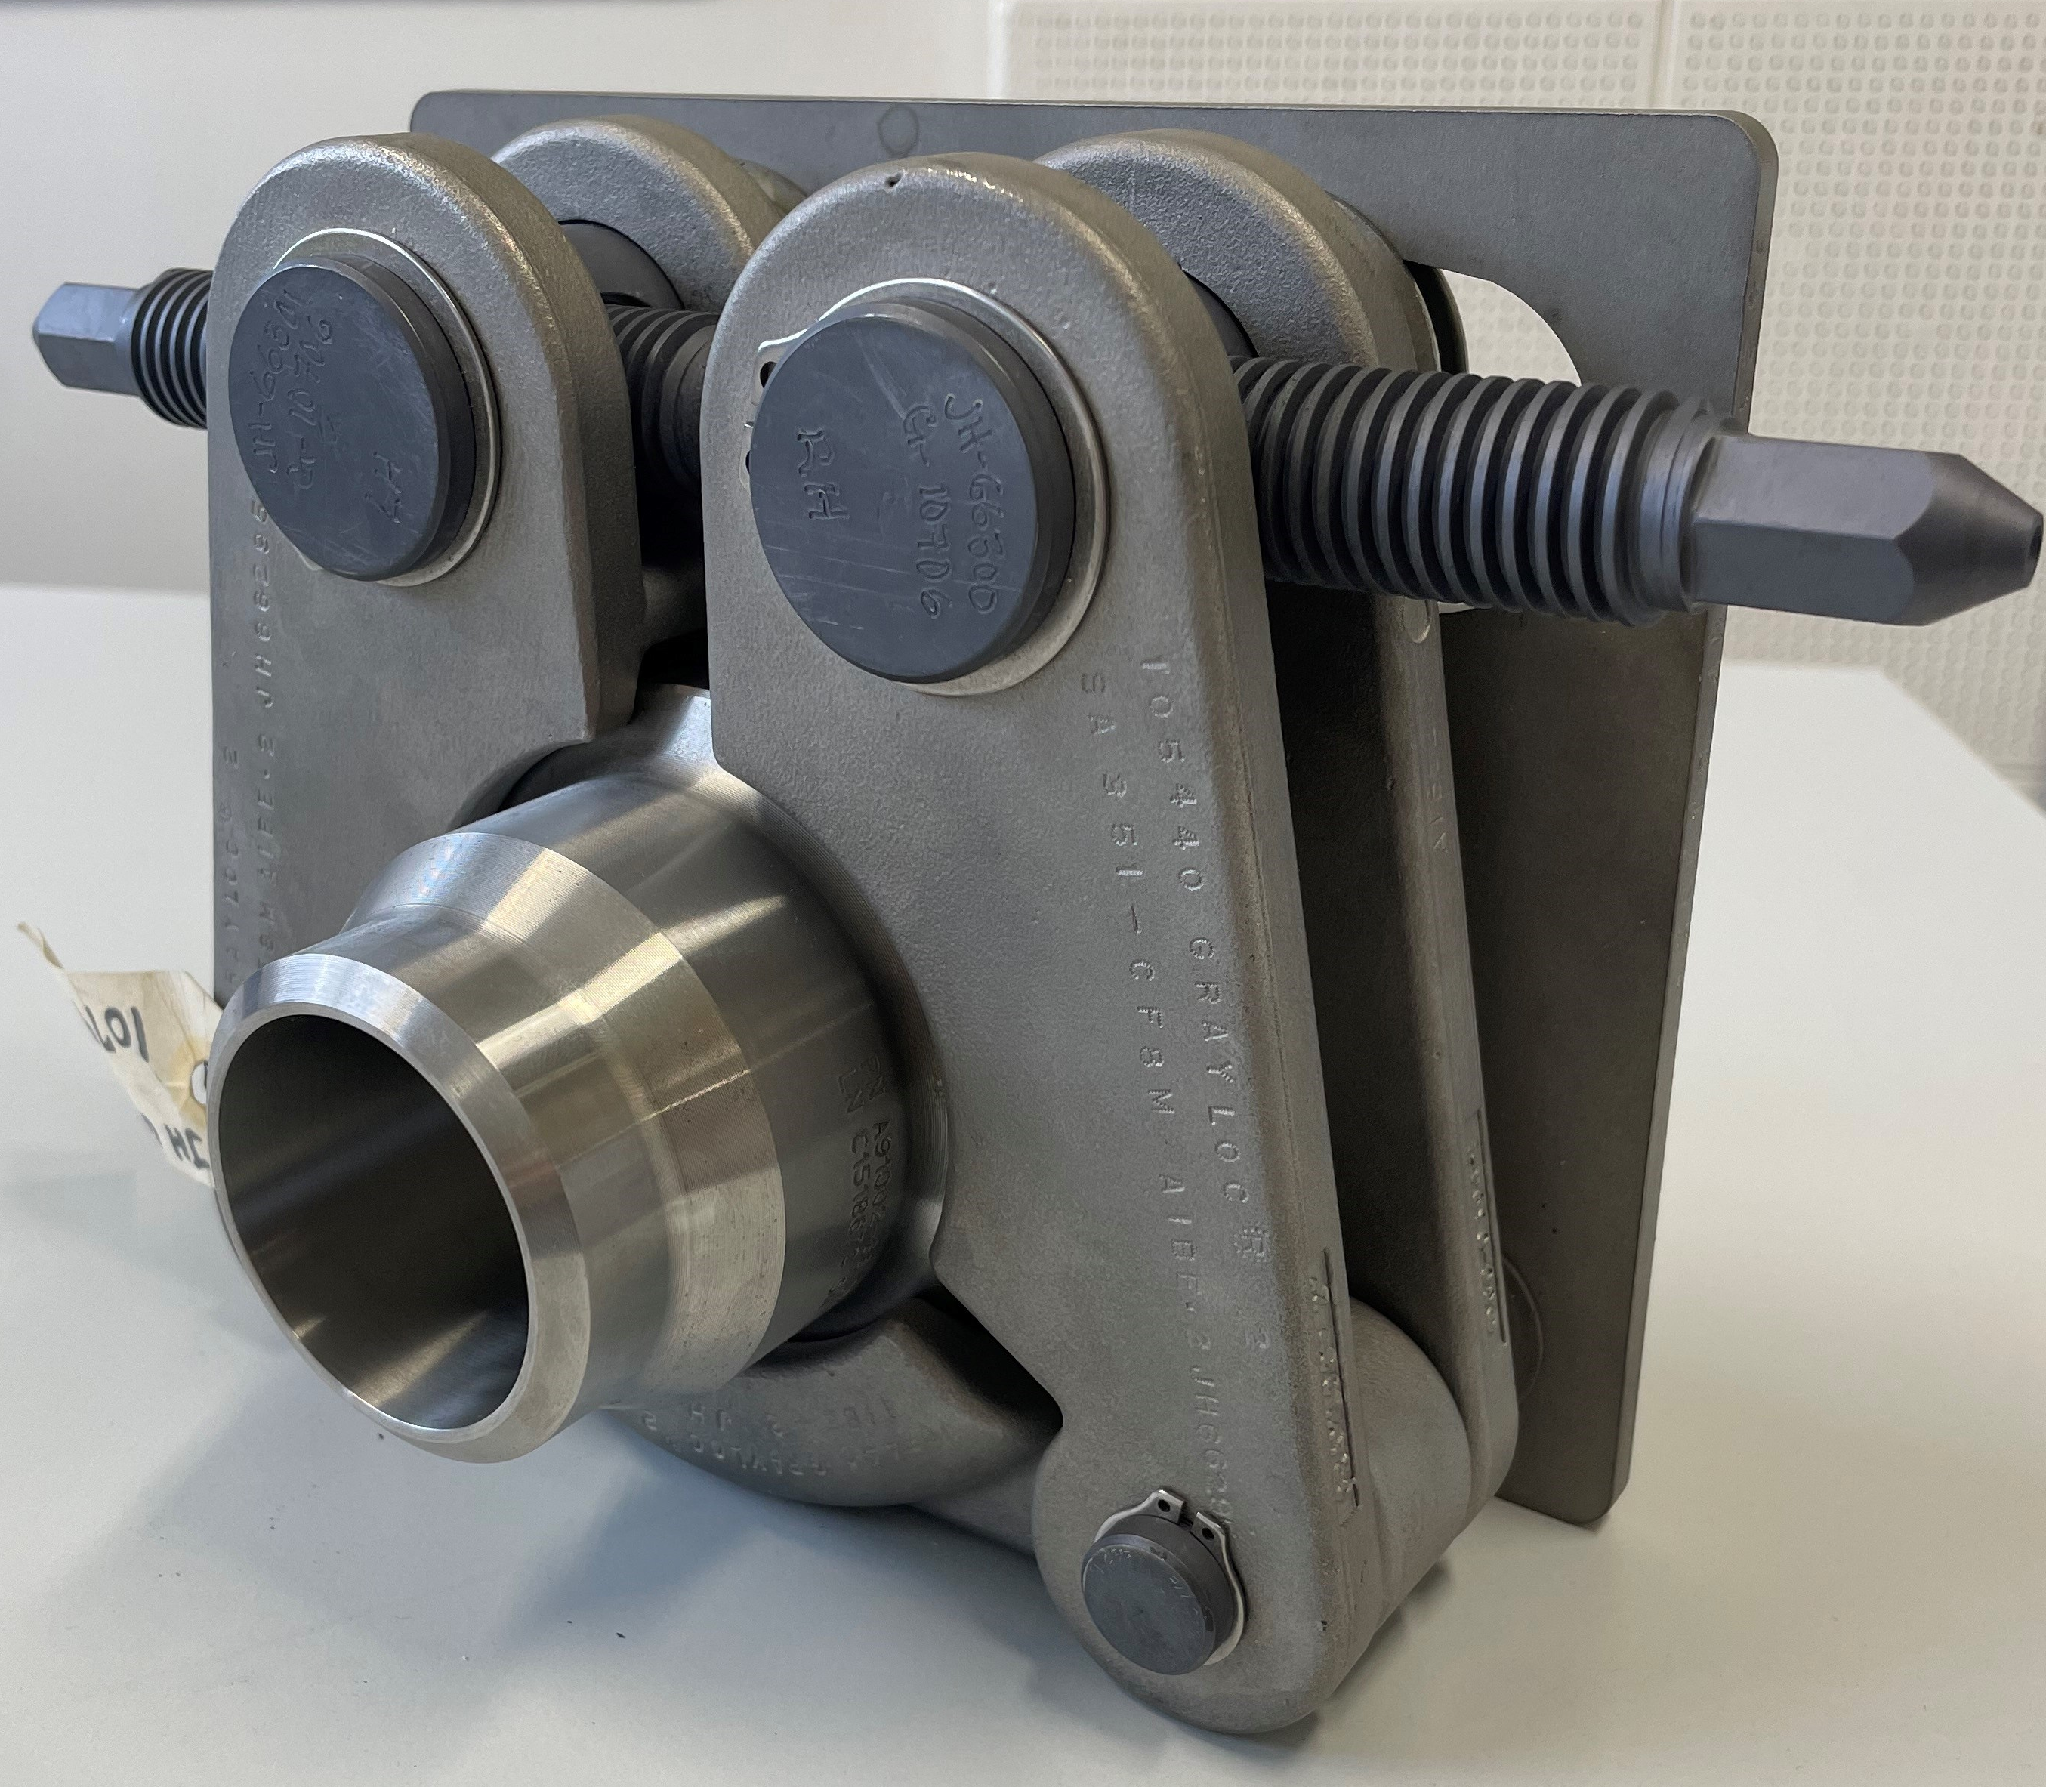
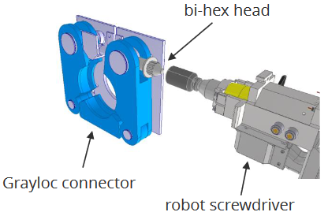
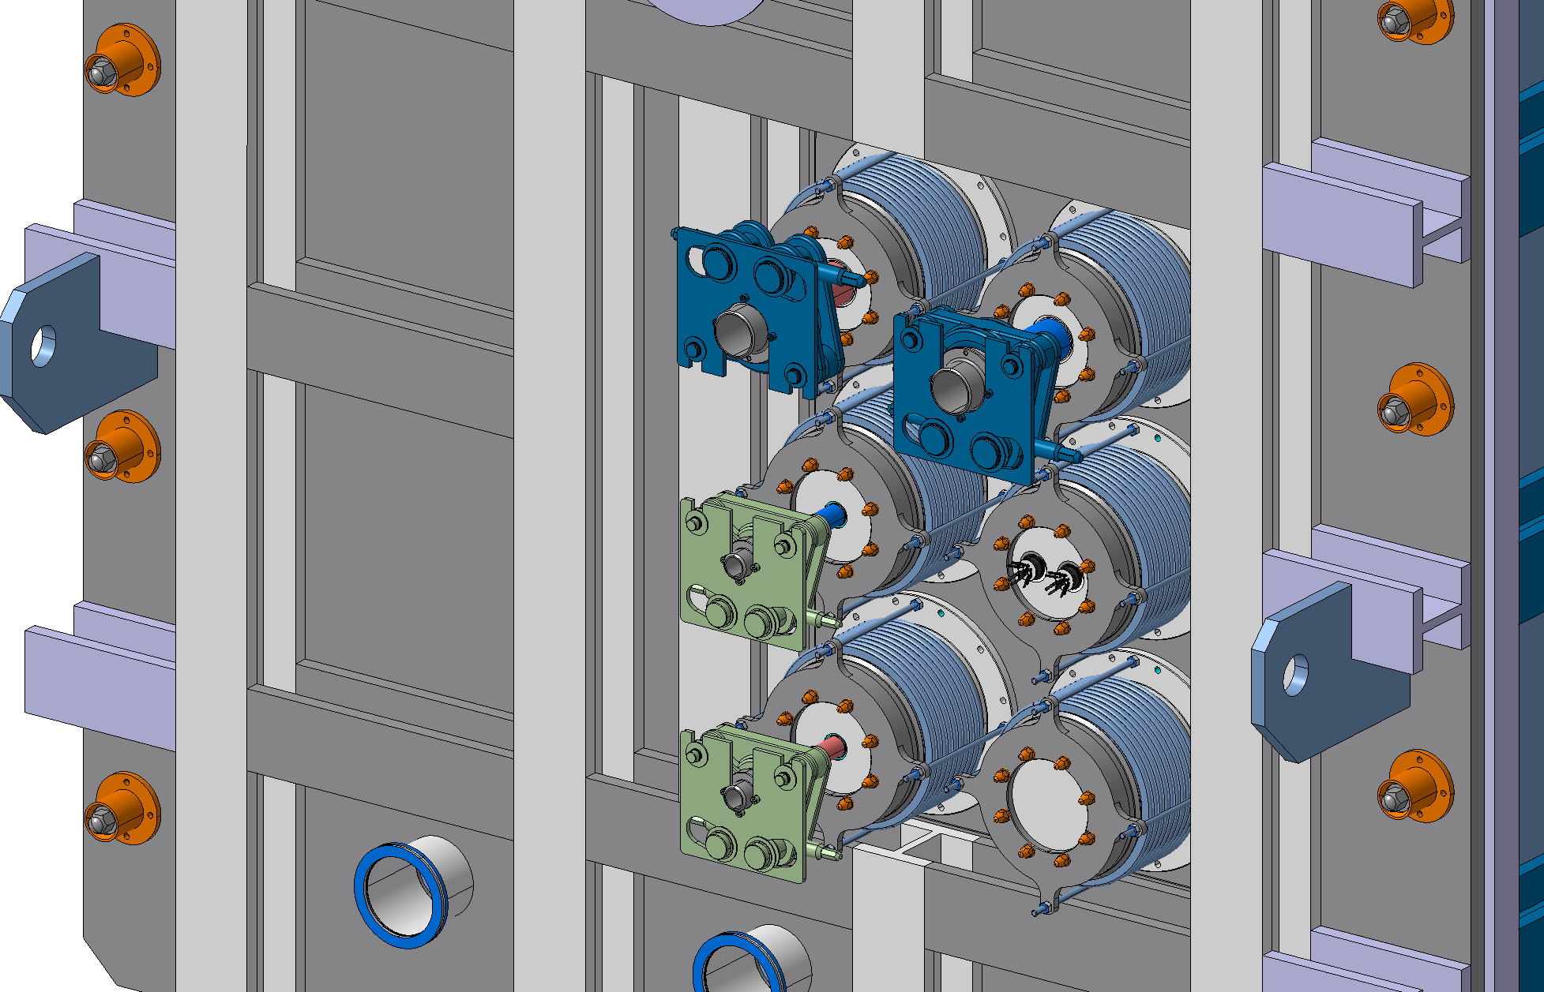
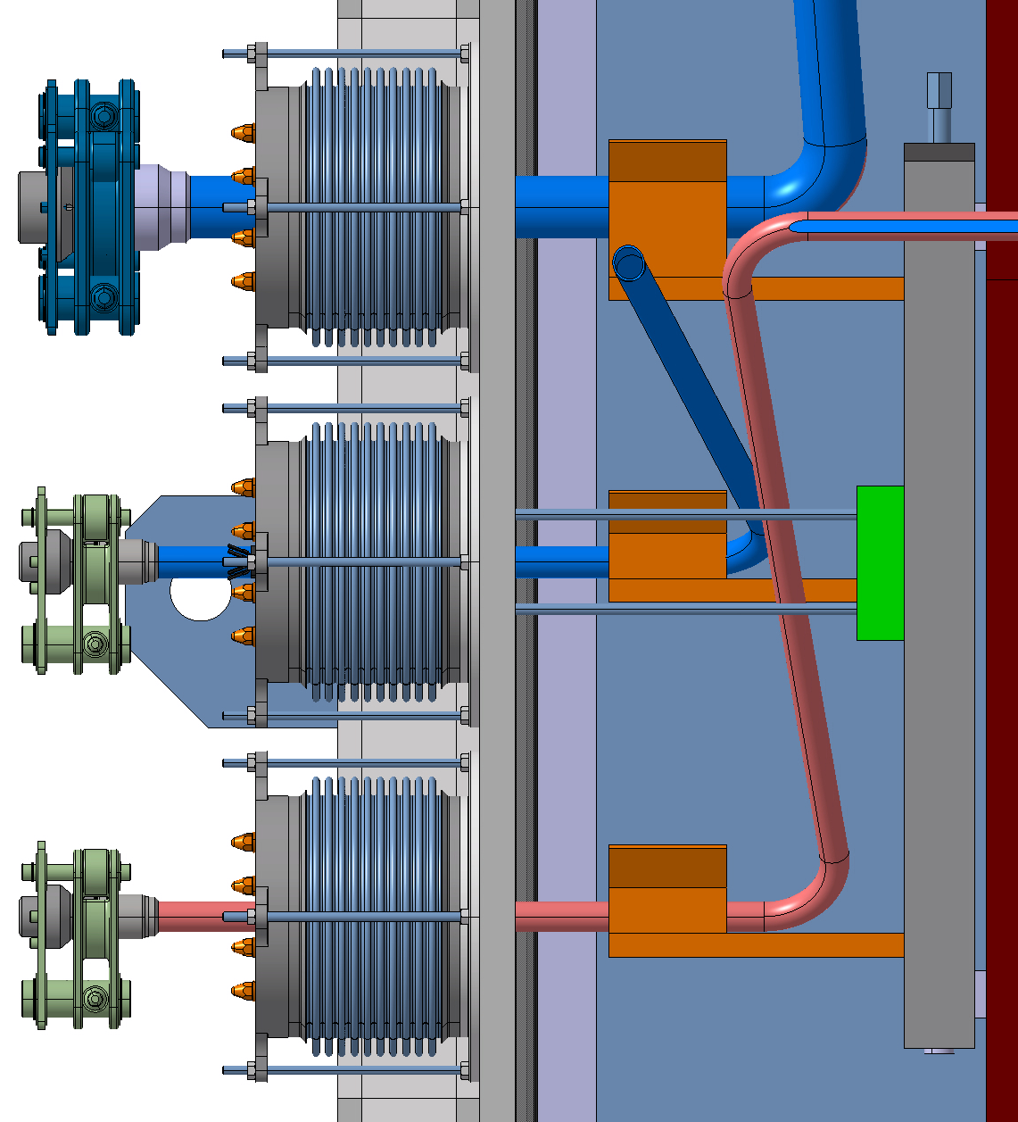
Current Configuration
Weight of the connector is around 10kg and currently unsupported, weight of pipes would also rest on connector
Remotely Operated Flange Connections
DN200 Bellows
Rigid pipes from within vacuum vessel, likely connected to flexible ones onwards from vessel

Slide 30
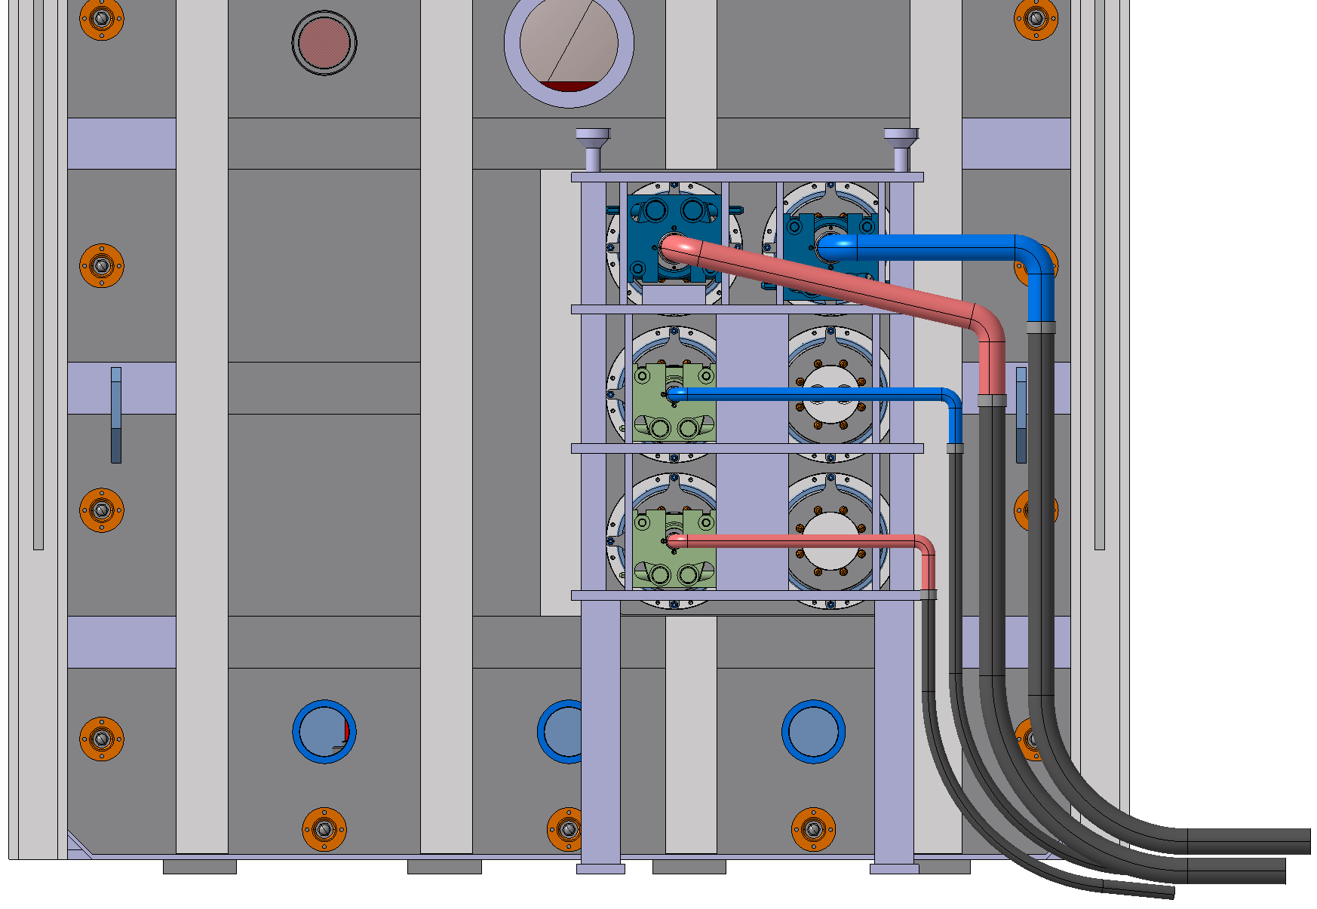
Alternative Options – Support Module
Support frame attached to floor which connectors are held in.
Assembly still uses connector, bellows and rigid pipes which change to flexible ones.
Advantages | Disadvantages
Freedom to customise a support completely optimised to the application | Collimator position may need to change Hard to access remotely Need all connectors to align with the designated slots

Slide 31
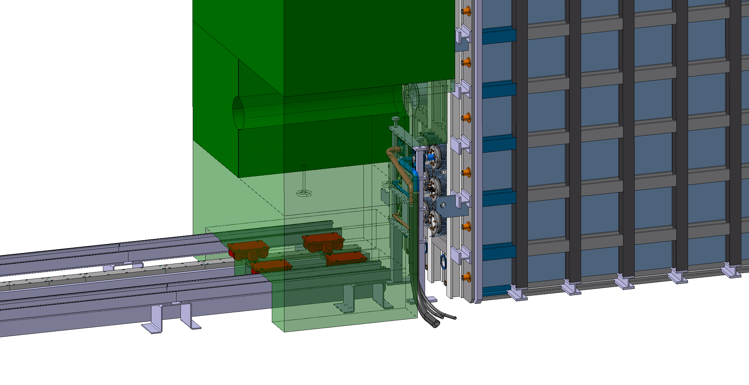
Support Module Removal

Slide 32
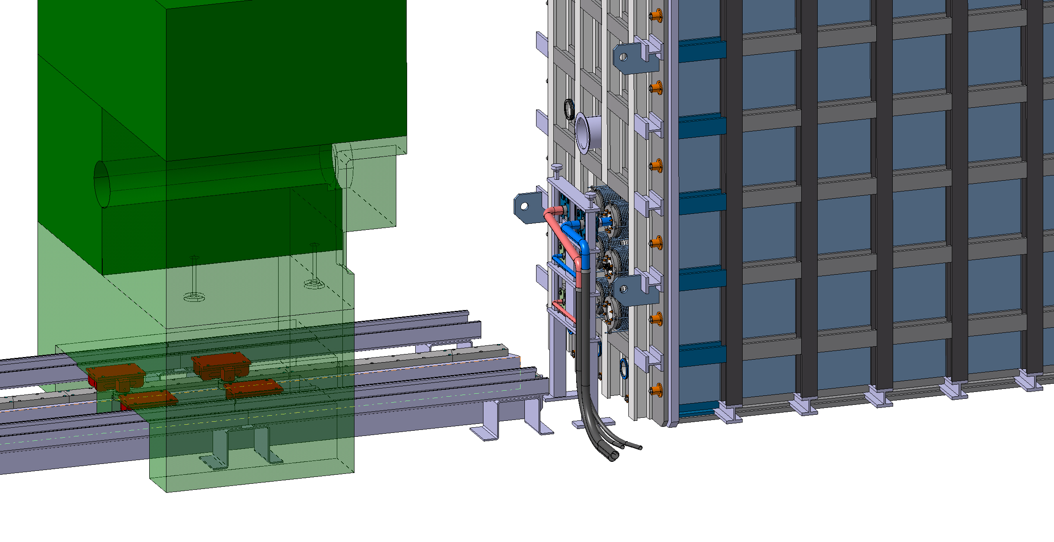
Support Module Removal – Collimator Moved

Slide 33

Support Module Removal – Connectors Disconnected

Slide 34
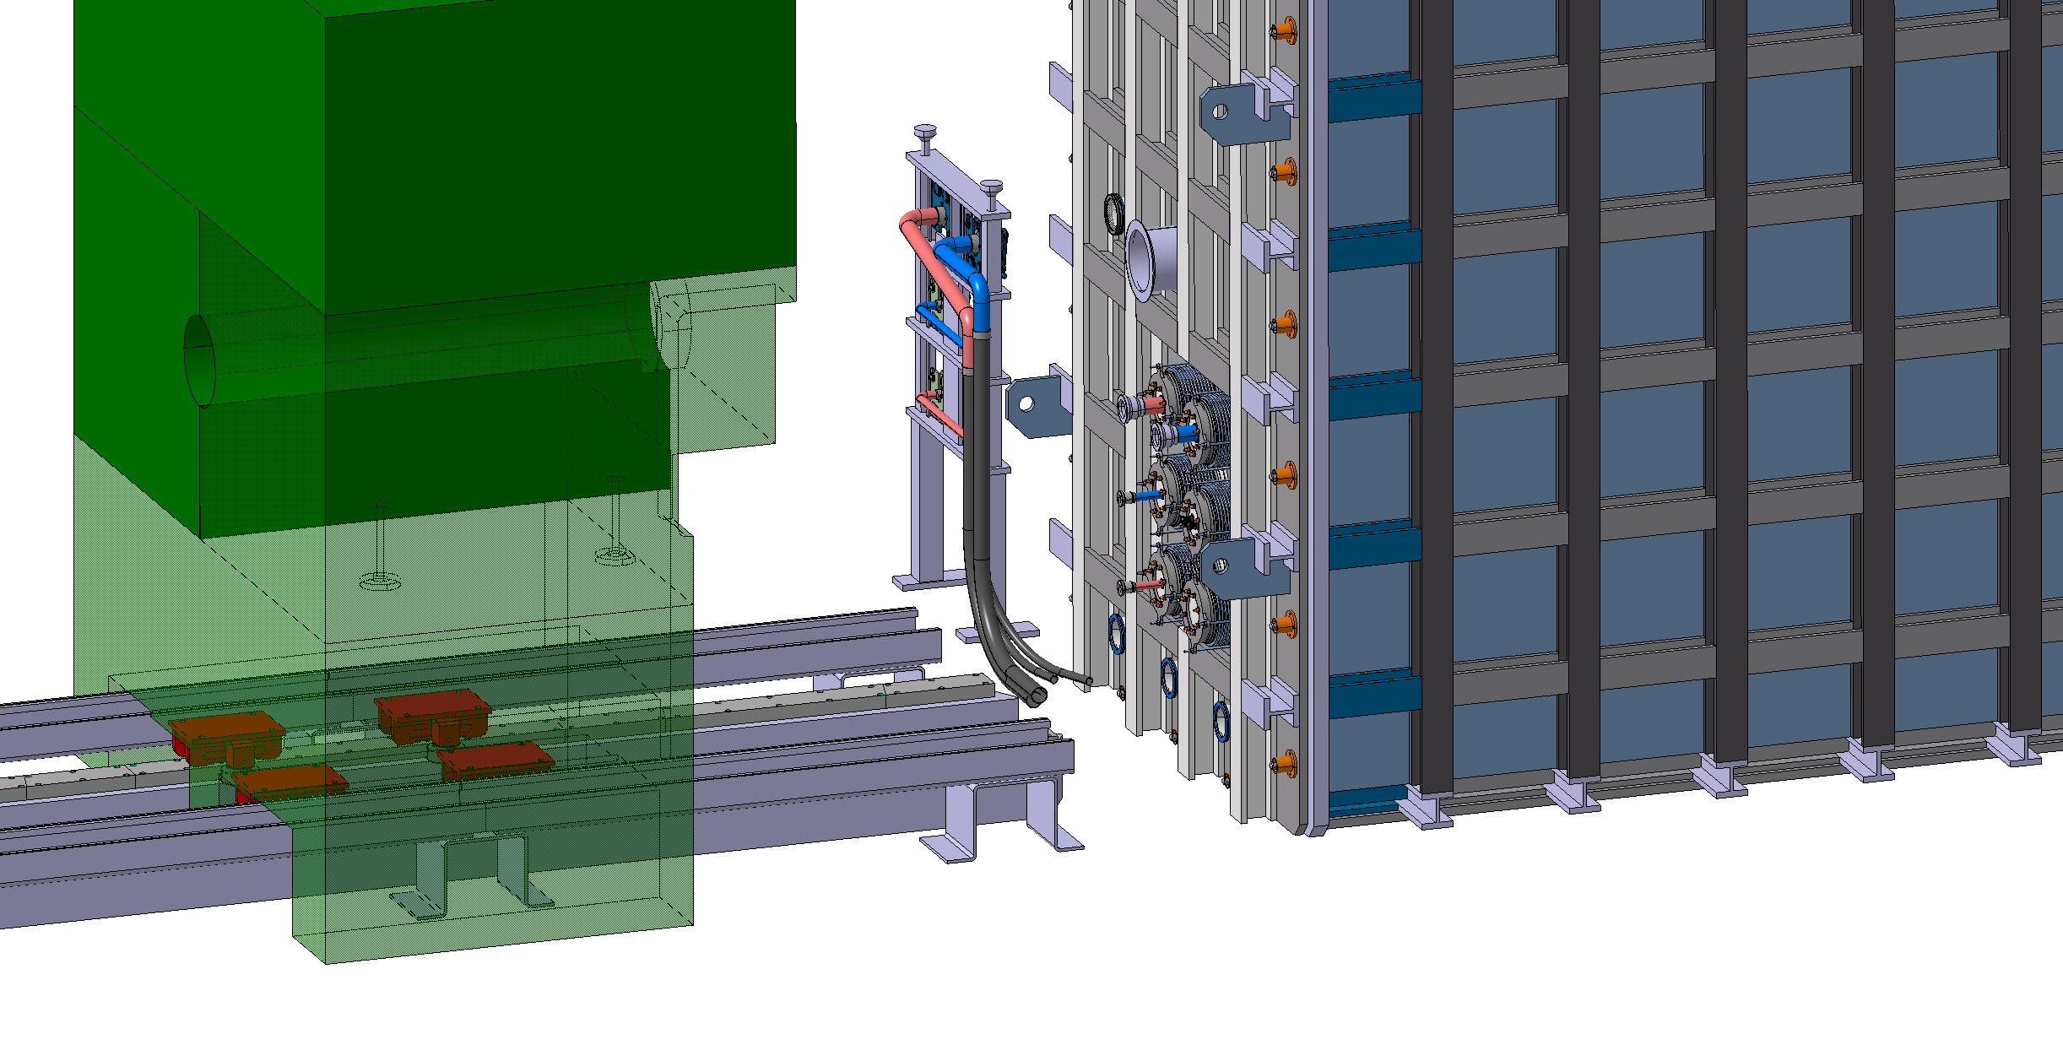
Support Module Removal – Connector Module Moved

Slide 35
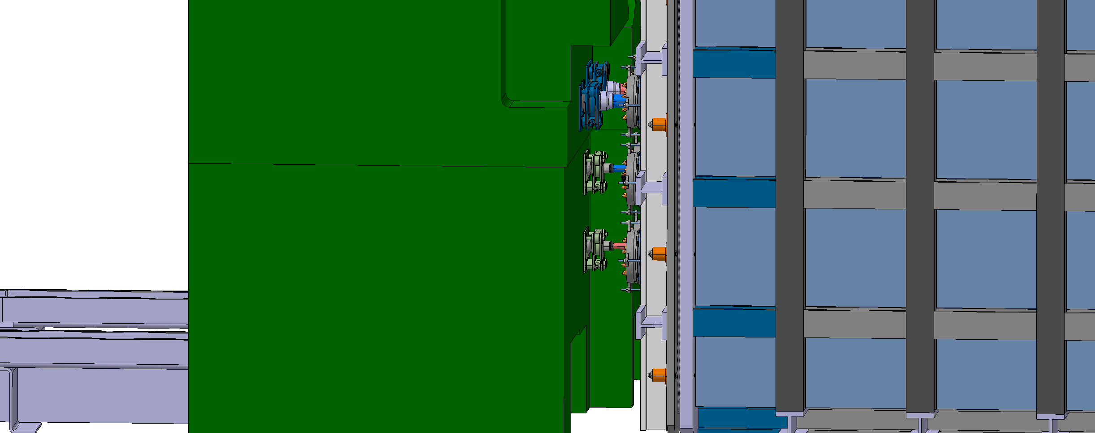
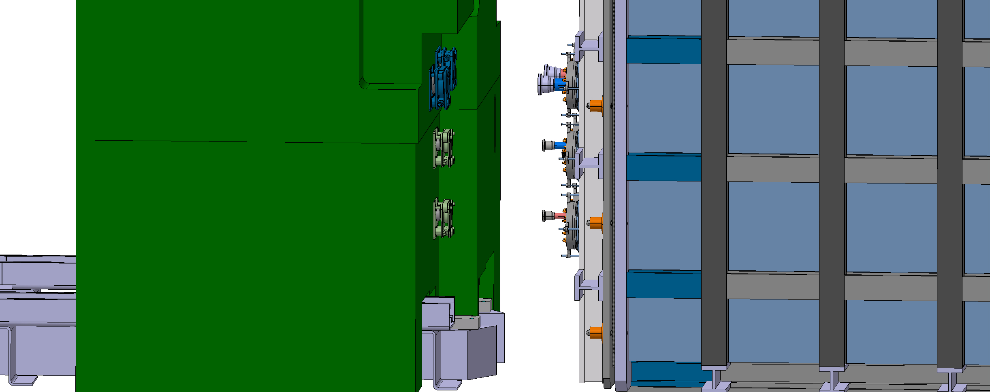
Alternative Options – Collimator Support
Attach connectors to collimator for support. Assembly still uses bellows and rigid pipes
Advantages | Disadvantages
Don’t need an additional unit to support connector | Difficult to access the connectors further away to loosen them Collimator would need to have dedicated pipe holes running through it Collimator heat could dissipate into pipes

Slide 36
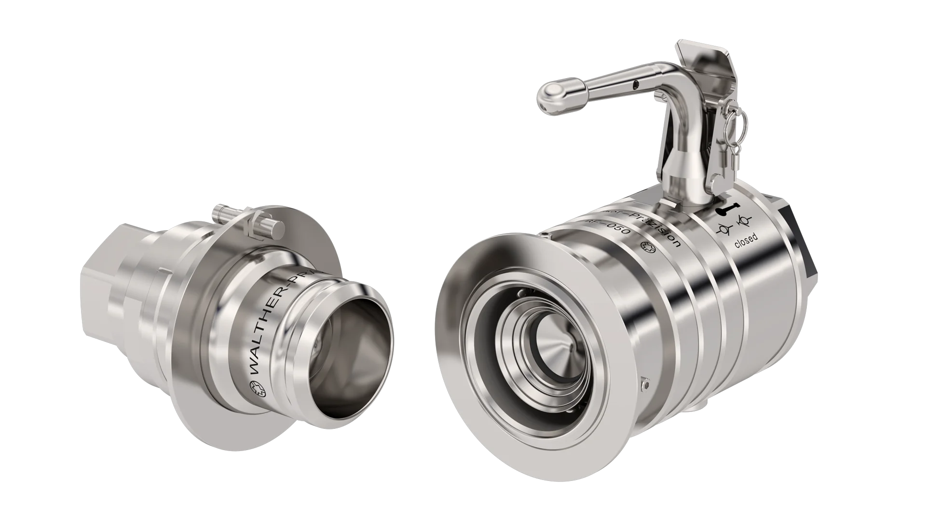
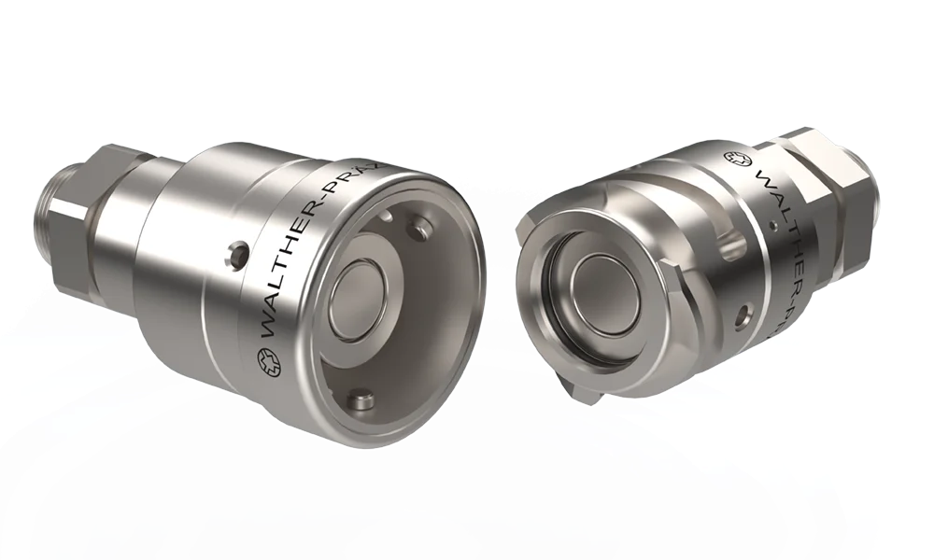
Alternative Options – Flexible Pipes
Flexible hoses with a twist-lock/push-lock mechanism into either side of the vacuum vessel door
Note:
Pipes within vessel would need to be long enough to partially open the door before disconnecting the pipe
Would likely need a pipe support within the vessel to prevent strain on connection
Advantages | Disadvantages
Removes need for bellows and flange connector Flexible pipes naturally correct for misalignment Uses less space on the door | Door structure would need to be changed Pipes could be more prone to wear and tear More potential for spills during connection and disconnection
Possible for DN25
Possible for DN25 and DN50
Walther-prazision

Slide 37
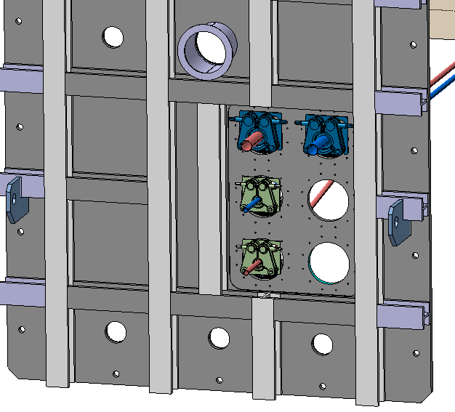
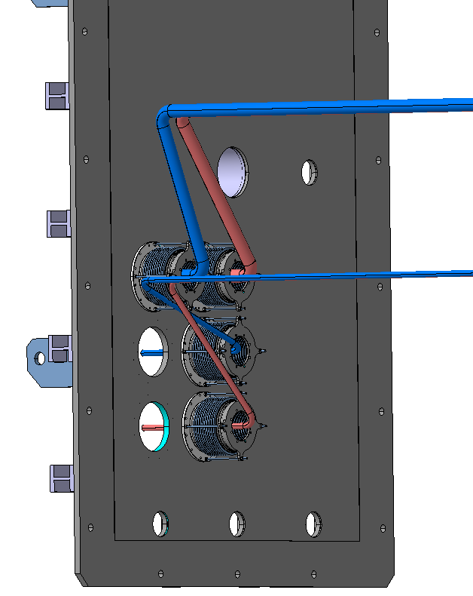
Alternative Options – Bellows Connected Internally
Bellows attached to the door internally, connectors bolted to the door externally, rigid pipes
Advantages | Disadvantages
Connector fully supported by door Connector could remain attached to the door | Introduces complications for removal Bellow size would increase to give access to screws Connector is constrained and reduces misalignment correction

Slide 38
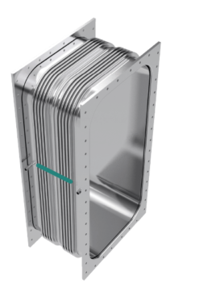
Alternative Options – Large Bellow
One connection set for the target, one for the proximity shielding
Advantages | Disadvantages
Would only require 2 bellows and 2 connectors | The connector would be very heavy and complicated Reduces ease to redesign later in the design process Larger connector would require more torque for tightening Could reduce misalignment capabilities as each pipe is constrained to their designated slot

Slide 39
Questions
Are there alternative solutions?
Is a solution which is remotely compatible that doesn’t involve using bellows a viable option?
What are the main restrictions for remote handling of connections?
Are there any issues that would arise from any of these options that haven’t been covered?
Under what conditions would human intervention not be possible for connection and disconnection?
What other questions should we be asking?

