Slide 1
Beam-Loss Monitoring at LCLS
Alan Fisher
SLAC National Accelerator Laboratory
Menlo Park, California, USA
7th DITANET Workshop on Beam-Loss Monitoring
2011 December 5 to 7
DESY, Hamburg, Germany

Slide 2
Collaborators
SLAC
Physics
  Alberto Fassò
  Heinz-Dieter Nuhn
  Mario Santana
Electronics and Firmware
  Michael Browne
  John Dusatko
  Ken Leung
  Jeff Olsen
Software
  Dayle Kotturi
  Stephen Norum
  Luciano Piccoli
Argonne National Laboratory
Physics
  Jeffrey Dooling
  Bingxin Yang
Electronics and Mechanical
  William Berg

Slide 3


SLAC and San Francisco Bay
Napa
Berkeley
Golden Gate
Oakland
San Francisco
Stanford
SLAC
Silicon Valley
San Jose

Slide 4
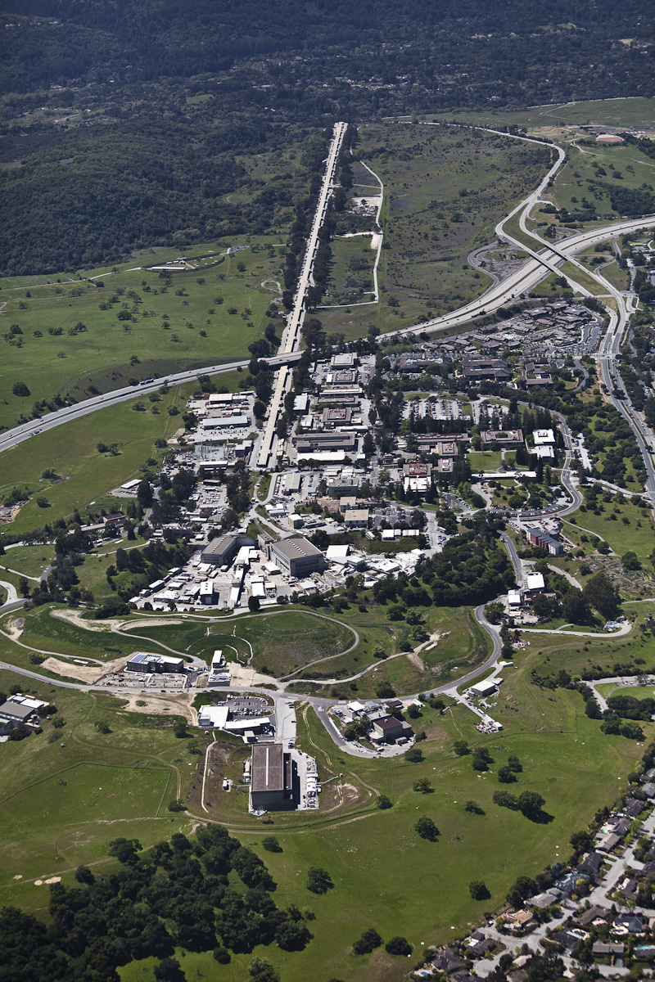
Aerial View of SLAC, Looking to the West

Slide 5
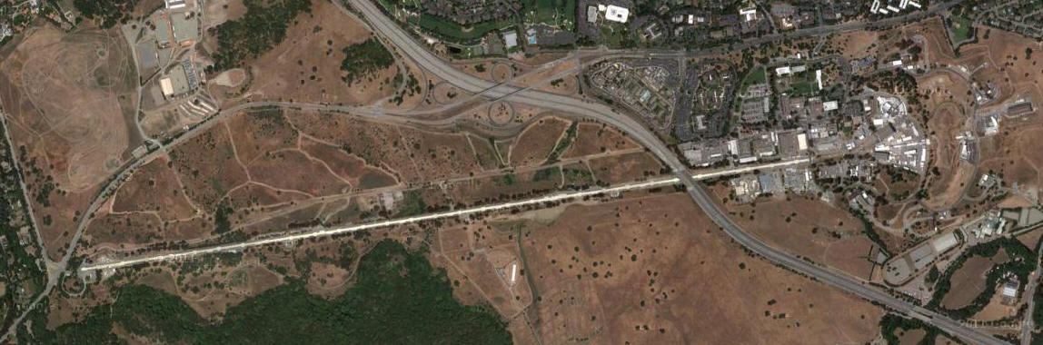
Sharing the SLAC Linac
LCLS
X rays to users
132-m undulator
Beam transport
1-km linac
RF gun
RF gun
Undulators
X rays to users
SLAC Linac
3 km
Beam transport
FACET
2 km
1-km linac
LCLS-3?
LCLS-2
LCLS: Linac Coherent Light Source
  X-ray free-electron laser, 480 eV to 9.6 keV
FACET: Facility for Advanced Accelerator Experiment Tests
  Primary experiment: Plasma-wakefield acceleration
  User facility for other tests with the SLAC beam

Slide 6
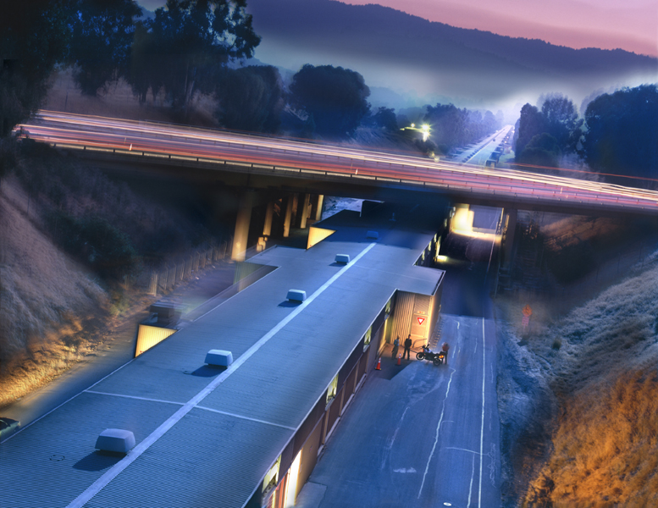
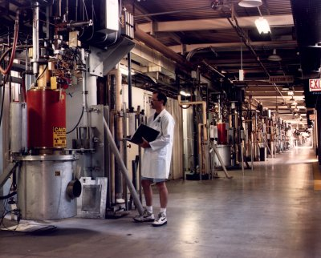
Klystron Gallery
A simple 3-km “garden shed” above the linac tunnel, housing:
  About 250 65-MW, 2.856-GHz klystrons, pulsed at 120 Hz
  Controls, magnet power, and cooling water

Slide 7
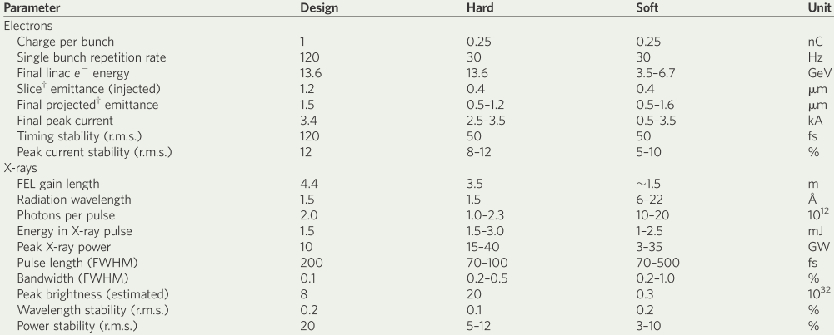
LCLS Parameters
gun
Measurements at 20 pC
L1S
μ wall
L2-linac
L3-linac
undulator
4-14 GeV
DL1
135 MeV
BC1
250 MeV
BC2
4.3 GeV

Slide 8
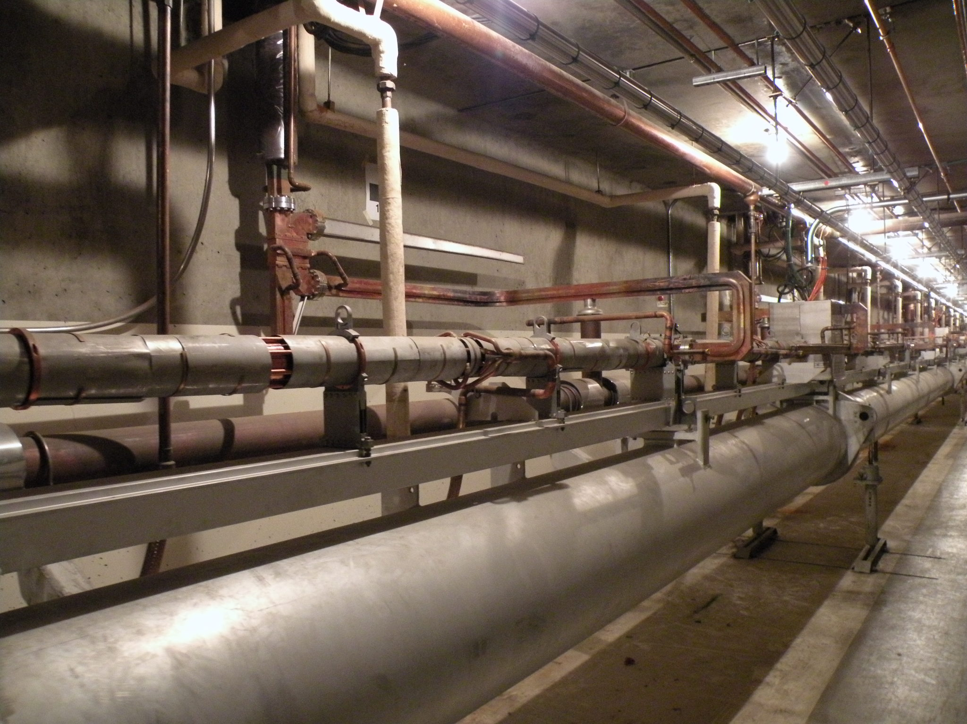
SLAC Linac
7.6 m up to ground level
Bypass beamlines (LCLS-2 and 3)
Waveguides
(from ground level)
Cooling water
Pumping manifold
3-m linac section
Support and alignment

Slide 9
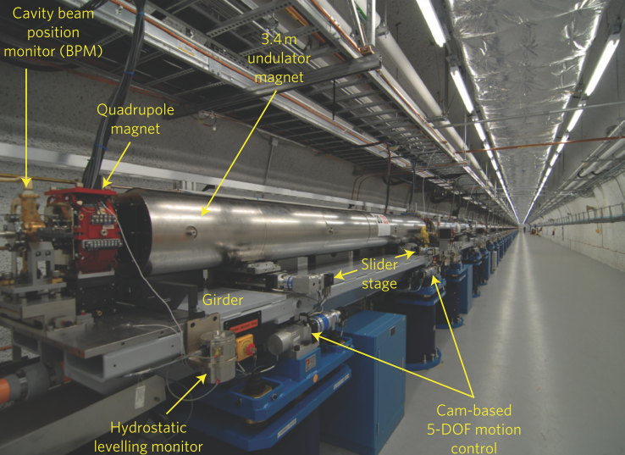
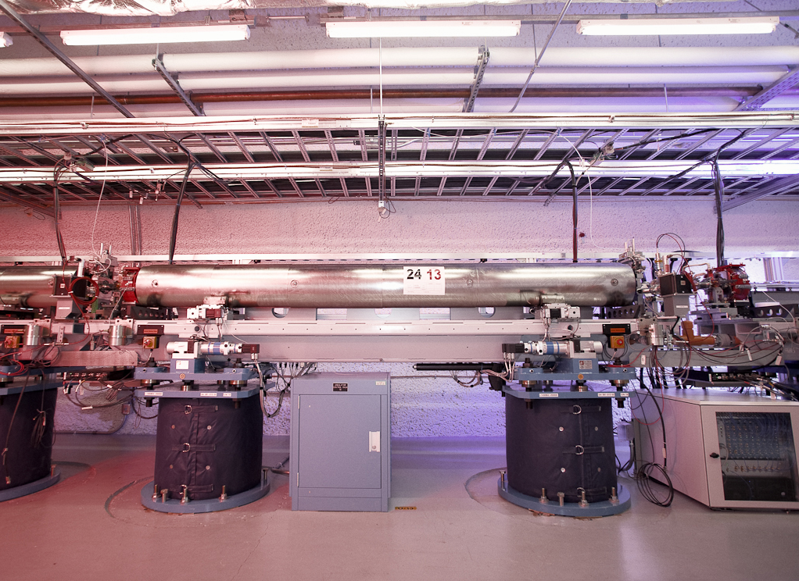
The LCLS Undulator
Undulator Hall
200-m tunnel
through the hill
1 of 33 Girders
3.4-m-long undulator section
on a table with 5-axis motion

Slide 10
Beam Losses: Requirements and Devices
Losses in different regions: Linac, beam transport, undulator
  Different sensitivities to losses
  The LCLS undulator is the most demanding
Different requirements: Personnel Protection System (PPS), Machine Protection System (MPS), or diagnostics
Different devices:
  PPS: BSOICs
  MPS: LIONs, PICs
  Diagnostics: PLICs, fiber-PLICs, BLMs
Different processing schemes: Oscilloscopes, waveform digitizers, and a separate machine-protection network of “link nodes”

Slide 11
From the “SLAC-Speak” Dictionary
Personnel-Protection System (PPS)
  BSOIC: Beam Shut Off Ionization Chamber.
    Usually just outside the beam housing
    Trips at 1 mGy/hour
Machine-Protection System (MPS)
  PIC: Protection Ionization Chamber
    Localized beam loss inside the beam housing
    Signal over programmable threshold stops beam
  LION: Long IONization Chamber
    Distributed beam loss inside the beam housing
    Gas-dielectric coaxial cable with a length of several meters

Slide 12
More SLAC-Speak: Beam-Loss Diagnostics
PLIC: Panofsky’s Long Ionization Chamber.
  Gas-dielectric coaxial cable running along the linac or a beamline
  Spread in arrival time of loss pulses at the cable’s end gives loss locations within several meters
  Devised by SLAC’s founding director, Wolfgang K.H. Panofsky
Fiber PLIC
  Fiber-optic cable along a transport line
  Scintillation and Cherenkov emission in the fiber gives a waveform similar that of the PLIC cable
BLM
  Any other beam-loss monitor
This talk focuses on the BLMs used for the LCLS undulator sections.

Slide 13
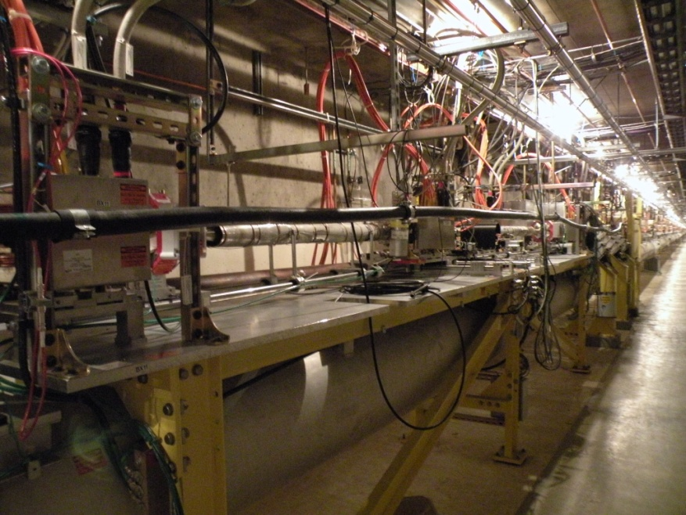
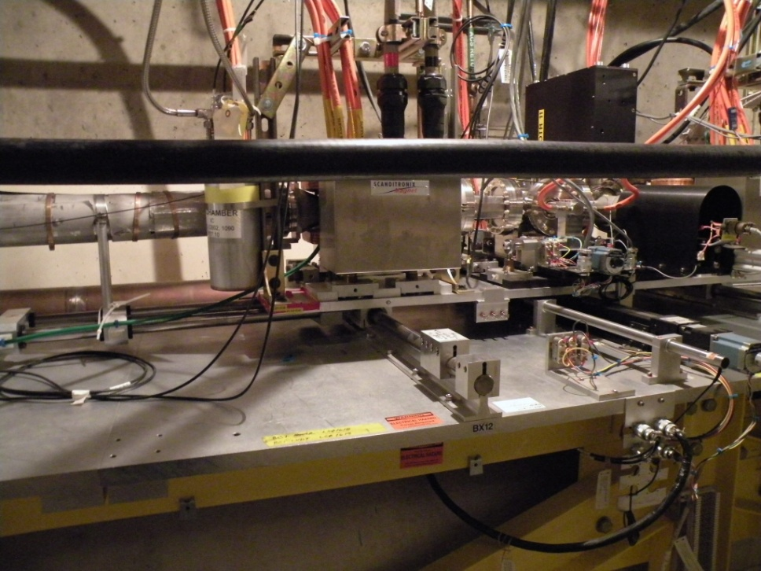
PLIC and PIC at Bunch Compressor 1
PLIC
PIC

Slide 14
Sources of Elevated Radiation at Undulators
Limits based on demagnetization of Nd₂Fe₁₄B permanent magnets
Electron-beam steering errors
  MPS loss monitors should trip the beam
  Orbit excursion: Software also trips beam if |x| > 2 mm or |y| > 1 mm
Unintentional insertion of material into beam path
  MPS trips beam
Intentional insertion of material into beam path
  Beam-finder wires:
    Crossed pair of 40-µm carbon wires at upstream end of each undulator
    Mechanism inserts pair directly into center of beampipe
    End of undulator is scanned in x or y through the beam
      Like a wire scanner, but wire and beampipe move together
  Screen (optical transition radiation) and wire scanners in transport line
    Before use, insert beam stop (“tune-up dump”, TD-UND) at start of undulator
Background radiation from upstream, and beam halo
  Suppressed by collimator between TD-UND and undulator

Slide 15
Demagnetization and BLM Requirements
The next several slides are based on Heinz-Dieter Nuhn’s 2007 review of the Physics Requirements Document for beam-loss in the undulator.
Alderman [1] estimated the loss of magnetization due to deposited radiation
  0.01% magnetization loss from absorbing a fluence of 10¹¹ fast neutrons/cm²
More recently, Sasaki [2] challenged fast neutron as the damaging factor
  Instead proposed photons and electrons
  Did not provide a relation between integrated dose and damage
1. J. Alderman et al., “Radiation Induced Demagnetization of Nd-Fe-B Permanent Magnets”, Advanced Photon Source Report LS-290 (2001).
2. S. Sasaki et al., “Radiation Damage to Advanced Photon Source Undulators”, Proceedings PAC2005.
H.D. Nuhn

Slide 16
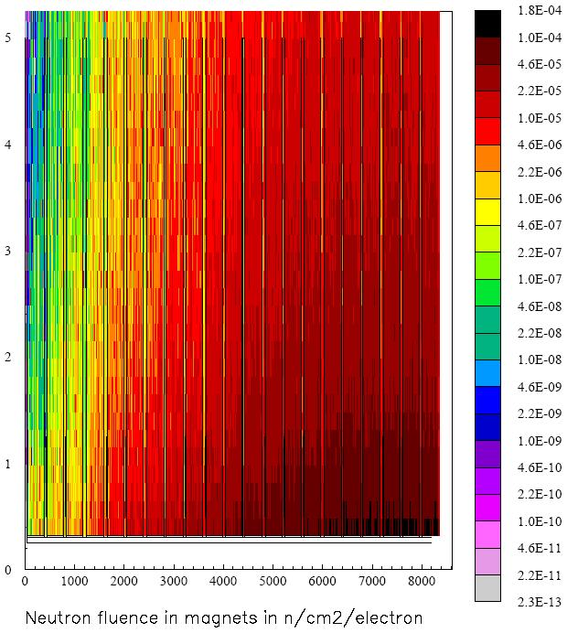
Simulated Neutron Fluence for e⁻ on C Foil
Fassò [3] used FLUKA to simulate the radiation deposited in the permanent-magnet blocks of the LCLS undulator:
  Single electron strikes a 100-µm diamond foil upstream of the first undulator
  Plot shows neutron fluence with distance in the upper jaw
Maximum fluence is
1.8×10⁻⁴ n/(cm²·e⁻)
3. A. Fassò, “Dose Absorbed in LCLS Undulator Magnets, I. Effect of a 100-µm Diamond Profile Monitor”, SLAC RP-05-05, May 2005.
Neutron Fluence [n/(cm²·e⁻)] along Undulator
Height above beam [cm]
Distance along undulator [cm]
H.D. Nuhn

Slide 17
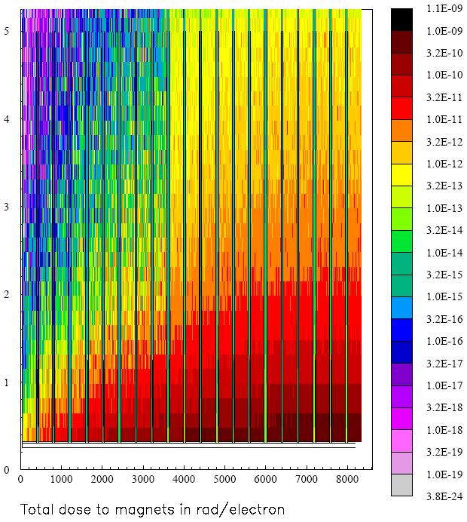
Simulated Total Dose for e⁻ on C Foil
Corresponding deposited dose [3]
Maximum is 1.0×10⁻⁹ rad/e⁻ = 1.0×10⁻¹¹ Gy/e⁻
Dose [rad/e⁻] along Undulator
Height above beam [cm]
Distance along undulator [cm]
H.D. Nuhn

Slide 18
Include Quadrupole Focusing
But a later version of FLUKA, including quadrupole focusing, found a much lower dose
  Old simulations showed increasing loss with distance from BFW
    Due to diverging beam hitting vacuum chamber
  In new simulations, quadrupoles confine the beam
  Loss peaks 5 to 10 undulator sections after BFW, depending on beam energy

Slide 19
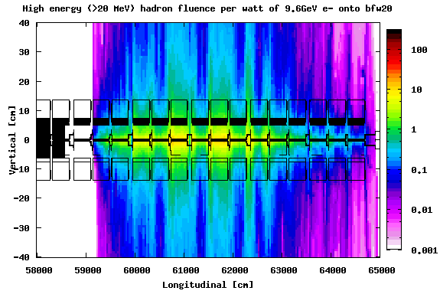
With Focusing: Hadron Fluence
9.6-GeV Electrons Hitting BFW 20
cm⁻² s⁻¹ W⁻¹
M. Santana

Slide 20
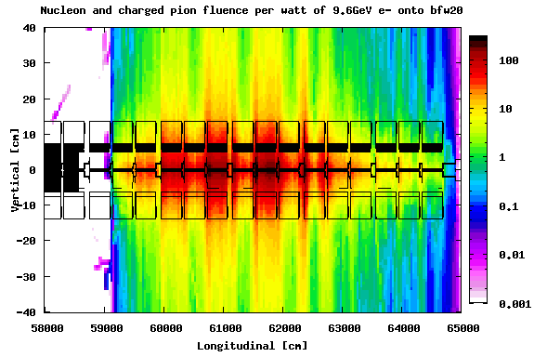
With Focusing: Nucleon and Charged Pions
9.6-GeV Electrons Hitting BFW 20
cm⁻² s⁻¹ W⁻¹
M. Santana

Slide 21
Radiation Limit Estimates for e⁻ on C Foil
Neutron Fluence for 0.01 % magnet damage (Alderman) | 10¹¹ | n/cm²
Maximum neutron fluence in LCLS magnets from hit on 100 micron C foil (Fasso) | 1.8×10⁻⁴ | n/(cm²·e⁻)
Maximum total dose in LCLS magnets from hit on 100 micron C foil (Fasso) | 1.0×10⁻¹¹ | Gy/e⁻
Ratio of neutron fluence to total dose | 1.8×10⁷ | n/(cm²·Gy)
Maximum total dose in LCLS magnets for 0.01 % damage | 5.6×10³ | Gy
Nominal LCLS lifetime | 20 | years
Maximum permissible average neutron flux in magnets | 160 | n/(cm²·s)
Corresponding flux limit per pulse at 120 Hz | 1.3 | n/(cm²·pulse)
Maximum permissible average dose rate in magnets | 8.8 | µGy/s
Corresponding dose limit per pulse at 120 Hz | 73 | nGy/pulse
< 100 nGy/pulse at 120 Hz < 10 µGy/s
H.D. Nuhn

Slide 22
2007 Undulator Irradiation Test (T-493)
13.7-GeV electron beam stopped in a copper dump
9 samples of magnet material positioned nearby
FLUKA used to calculate locations to obtain a range of doses
Dosimeters measure absorbed radiation
Magnetization measured before and after exposure
Integrated beam current recorded to 10%
H.D. Nuhn

Slide 23
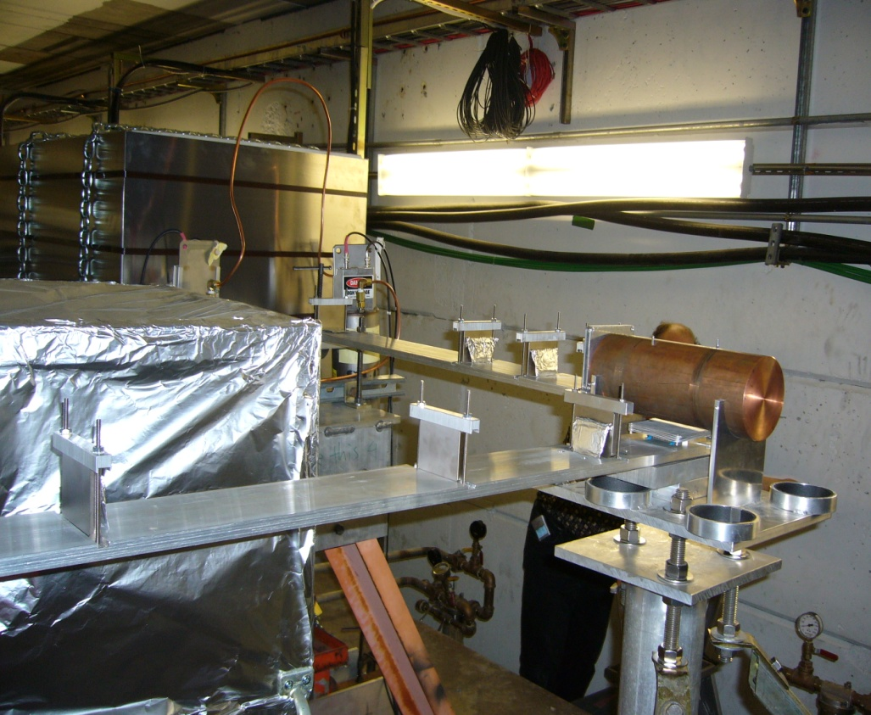
Magnet-Block Locations (Top View)
Top View
M9
Magnet Blocks
M8
5 magnet blocks in the
transverse direction
Copper Cylinder
M7
Heat Shield
M6
4 magnet blocks in the
forward direction
r
Beam Direction
z
M1
M2
M3
M4
M5
H.D. Nuhn

Slide 24
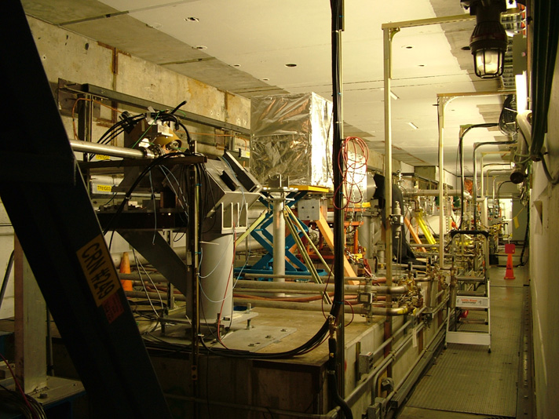
Beamline in End Station A
Copper block
H.D. Nuhn

Slide 25
Demagnetization after 37×10¹⁵ Electrons
 | r | z | ΔT estimate | Demag. | σ_{Demag}
 | [cm] | [cm] | [°C] | [%] | [%]
Mag1 | 0 | 27 | 0.0 | 9.675 | 0.004
Mag2 | 0 | 40 | 0.0 | 2.804 | 0.003
Mag3 | 0 | 56 | 0.0 | 1.166 | 0.003
Mag4 | 0 | 101 | 0.0 | 0.386 | 0.008
Mag5 | 7 | 12 | 0.0 | 4.889 | 0.004
Mag6 | 24.9 | 12 | 0.0 | 0.329 | 0.004
Mag7 | 50.4 | 12 | 0.0 | 0.013 | 0.003
Mag8 | 88.4 | 12 | 0.0 | -0.003 | 0.003
Mag9 | 149 | 12 | 0.0 | -0.023 | 0.004
Dump |  |  | 10-20
H.D. Nuhn

Slide 26
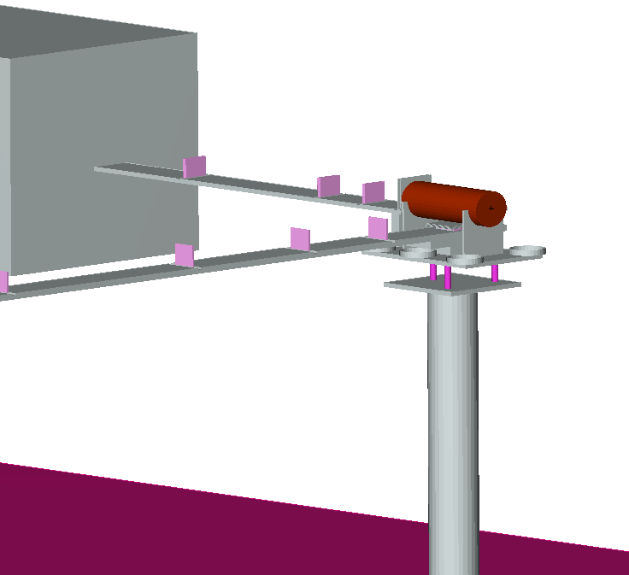
Detailed FLUKA Model of the Experiment
13.7-GeV electron beam hitting the copper dump
Compute total dose, electromagnetic dose, neutron energy spectra
Quantity scored using a binning identical to that used for mapping the magnetization loss
M4
M3
M2
M1
Beam
M6
M5
M8
M7
M9
J. Vollaire

Slide 27
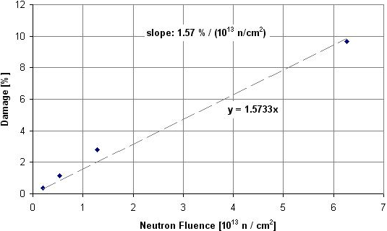
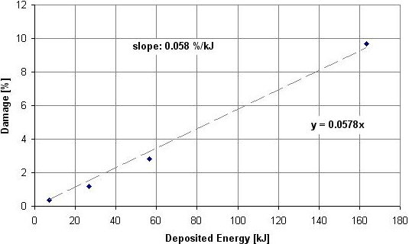
Damage Gradients
M1
M1
M2
M2
M3
M3
M4
M4
Threshold Estimates for 0.01 % Damage
Source | T-493
Deposited Energy | 170 J
Dose | 700 Gy
Neutron Fluence | 0.64×10¹¹ n/cm²
Fluence is consistent with Alderman [1]
H.D. Nuhn

Slide 28
2007 Requirements for Undulator BLMs
One BLM will be mounted at the upstream end of each undulator segment.
The BLM will provide a digital value proportional to the amount of energy deposited in the device for each electron bunch.
The monitor shall be able to detect and measure (with a precision of better than 10%) radiation levels corresponding to magnet dose levels as low as 100 nGy/pulse and up to the maximum expected level of 100 µGy/pulse.
The monitor needs to be designed to withstand the highest expected radiation levels of 10 mGy/pulse without damage.
The radiation level received from each individual electron bunch needs to be reported after the passage of that bunch, to allow the MPS to trip the beam before the next bunch at 120 Hz.
H.D. Nuhn

Slide 29
Requirements: BLM Size and Calibration
Each BLM device will measure the total amount of absorbed dose covering the full area in front of the undulator magnets.
  Magnet cross-section seen by the beam: 56.5 mm wide by 66 mm high
  Vertical extent of magnet is: 6.8 mm < |y| < (6.8+66) mm = 72.8 mm
    Total height = 145.6 mm
    Allowed a horizontal cut-out of 7 mm, for mounting without breaking vacuum
  Horizontal extent of magnet is: ±28.25 mm
    At maximum insertion, −6 mm: −34.25 mm < x < 22.25 mm
    At maximum extraction, +80 mm: 51.75 mm < x < 108.25 mm
    Total range = 142.5 mm
  The BLM should require only rough alignment for full coverage.
Each BLM device will be calibrated based on the radiation generated by the interaction of a well known beam with the BFW devices.
  The calibration geometry will be simulated by Radiation Physics using FLUKA to obtain the calibration factors, i.e., the ratio between the maximum estimated damage in a magnet and the voltage produced by each BLM device.
H.D. Nuhn

Slide 30
The Resulting BLM Design
BLMs were designed and built by Argonne National Laboratory (ANL)
  A partner with SLAC in building LCLS
Mounted on the side of the BFW assembly
Fused-silica Cherenkov radiator
  Y-shaped to fit around beampipe
  Aluminum coating on exterior surfaces, to reflect light to uncoated exit surface
  Vertical extent is 63 mm, less than half the 146-mm magnet height
Small photomultiplier with fused-silica window: Hamamatsu R7400U-06
Black anodized-aluminum housing
Horizontal translation slide allows optional travel in x with undulator
8.1-mm-thick tungsten (W) plate on upstream side to enhance shower
  2.3 radiation lengths
  Vertical extent is 44 mm, less than the radiator’s height
  Does not travel with the undulator section

Slide 31
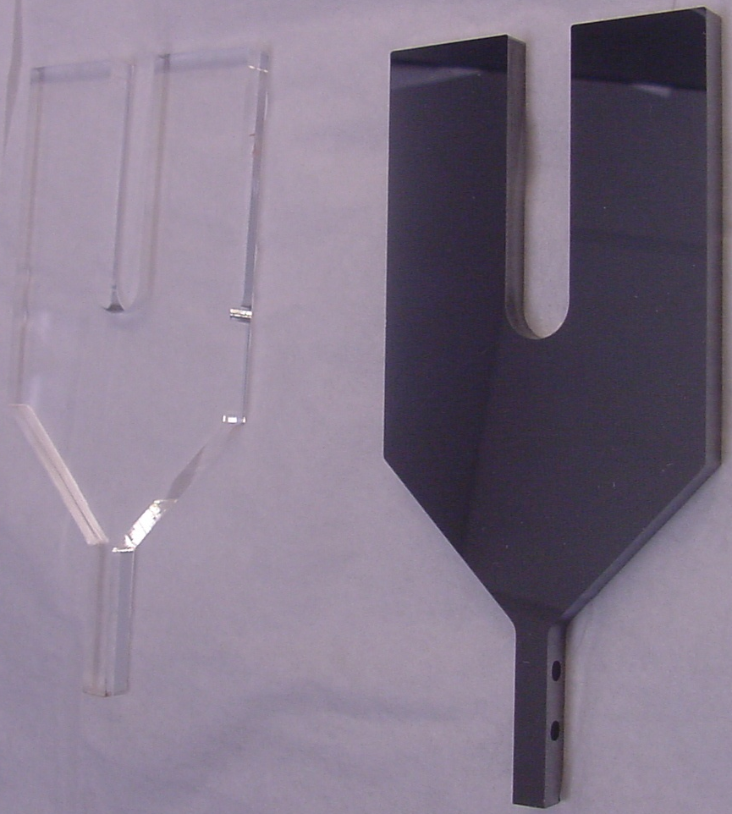
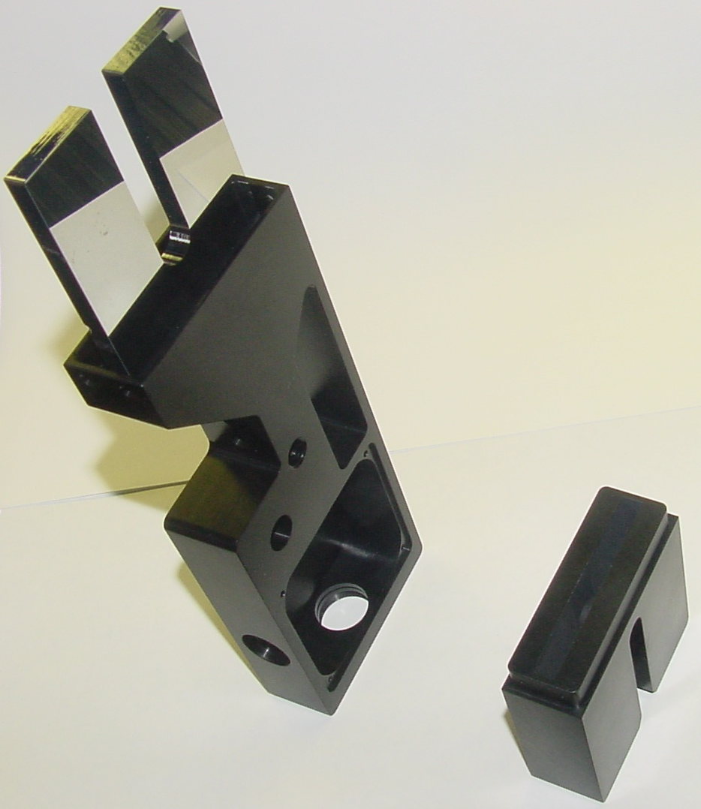
Argonne BLM: Cherenkov Radiator
Before and After Aluminum Coating
Mounted in Housing
Uncoated regions:
Photomultiplier mounted at end
Fiber injects “heartbeat” light pulse on side

Slide 32
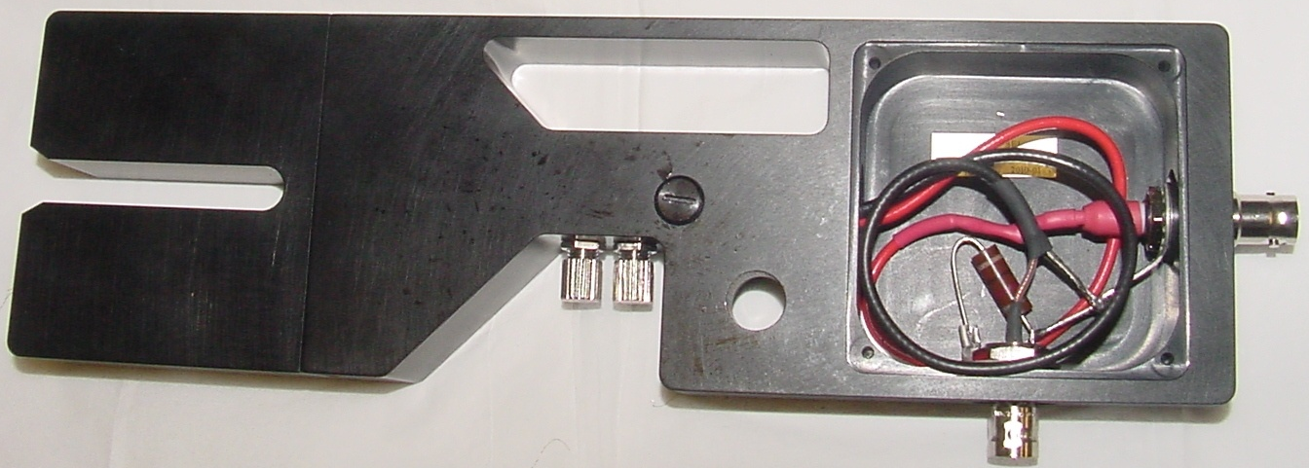
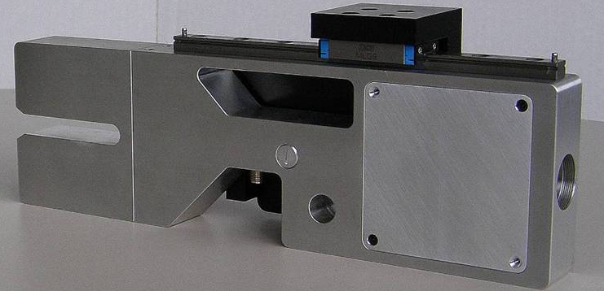
Argonne BLM: Assembled
0 to −1 kV
(SHV)
Heartbeat
(fiber)
Signal (BNC)
Translation slide
W. Berg

Slide 33
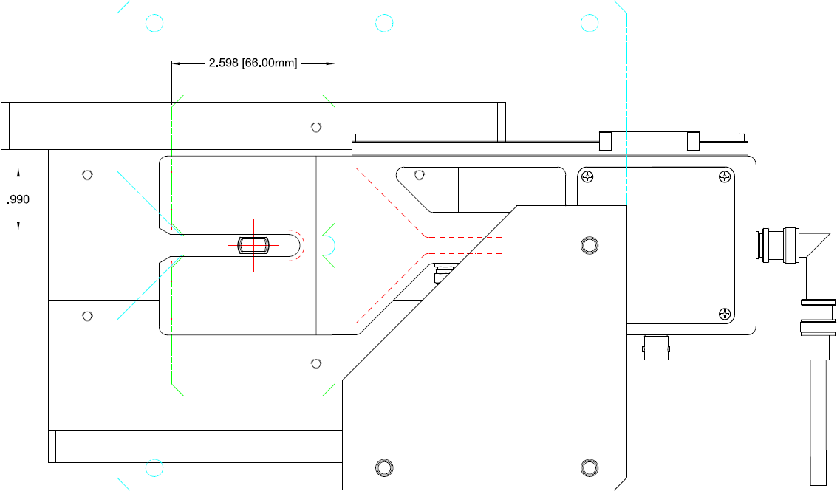
Sketch of Argonne BLM on Undulator
56.5
Magnet
Translation slide
66
BFW housing
25
HV
72
44
Slot for W plate
Beampipe
PMT
Cherenkov radiator
Signal
241
W. Berg

Slide 34
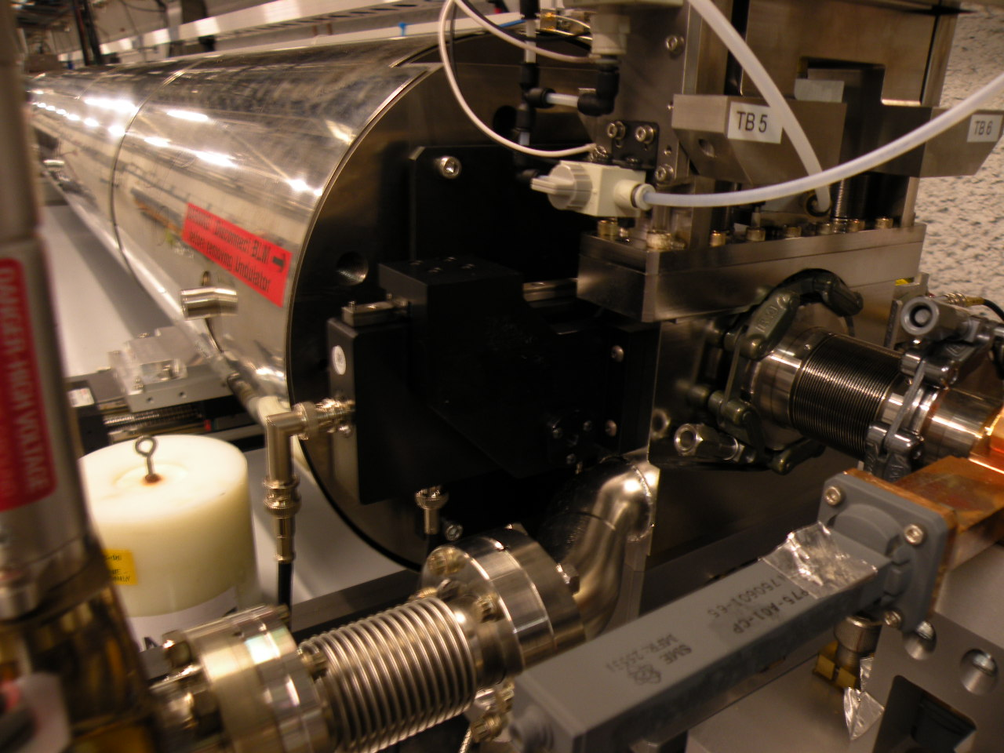
Argonne BLM on Undulator
Undulator section
Translation slide
BFW
BLM
RF BPM
HV
Signal

Slide 35
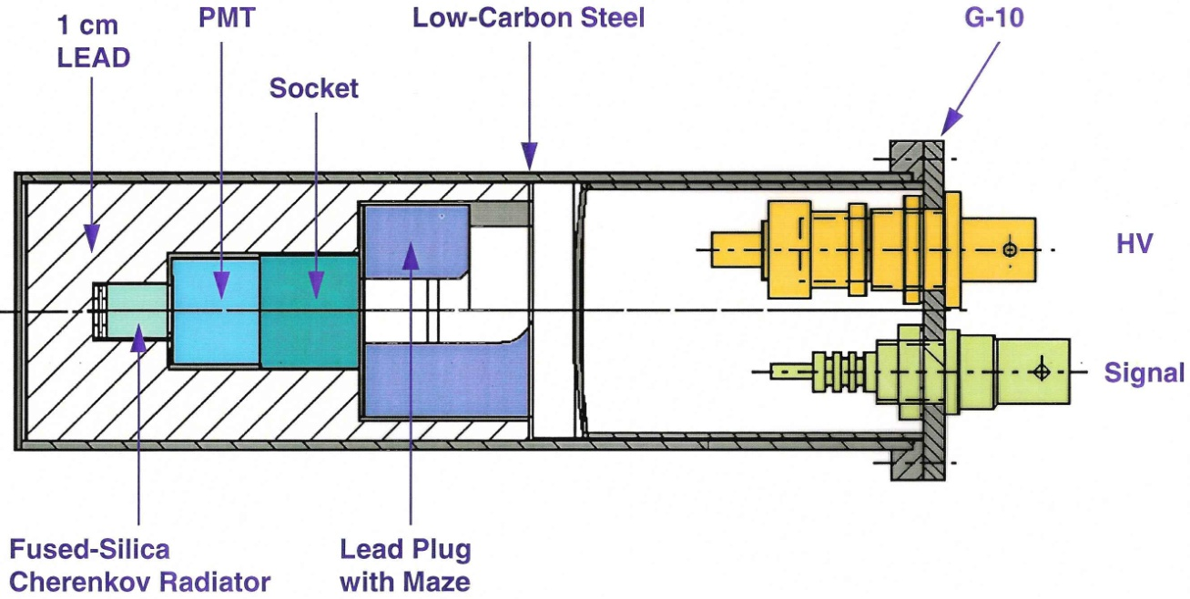
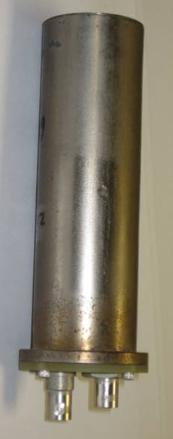
PEP-II BLMs
Signal
HV
In the 1990s, I built 98 Cherenkov BLMs for PEP-II
  Cherenkov chosen for insensitivity to synchrotron radiation
  Wide dynamic range:
    Small losses of a well stored beam: Count PMT pulses over 1 second
    Loss when topping off one bunch in a full ring: Integrate PMT charge over one turn
      Gate spans several turns around injection time
      Peak-hold circuit records worst ring turn during gate (not always the first turn)
  Initially suggested by Artem Kulikov

Slide 36
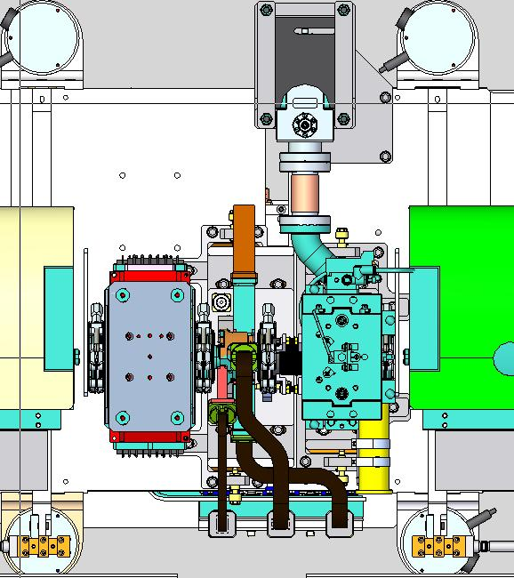
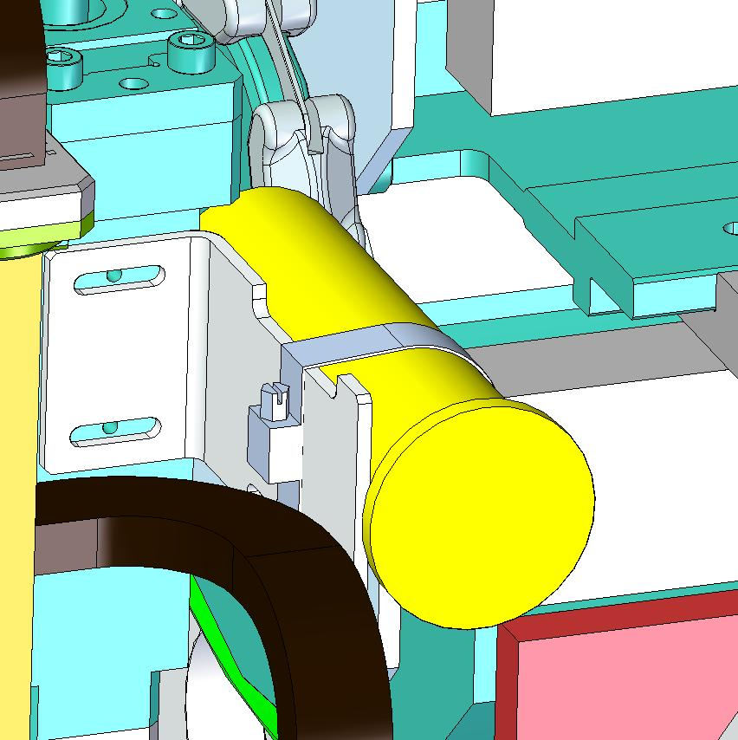
PEP-II BLMs on LCLS
In 1998, Argonne tested a PEP-II BLM on the Advanced Light Source
  They made a new version of the PEP-II BLM for APS losses
  They then modified this design again for LCLS—and sent it back to SLAC
But ANL had only 5 of 33 BLMs ready when LCLS started in April 2009
  Put these 5 BLMs on every 8th girder (1, 9, 17, 25, 33)
  Since PEP-II was shut down in April 2008, a PEP BLM was moved to each of the 33 undulator girders
Undulator
BFW
Argonne BLM
PEP-II BLM

Slide 37
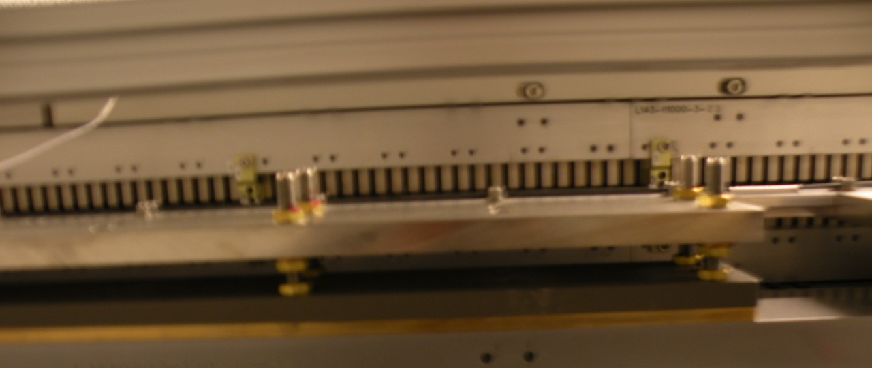
Fiber-PLICs on LCLS
At the same time (for LCLS commissioning), some simple 1-mm plastic optical fiber was run along the undulator, close to the beampipe
  The full 132-m length of the undulator is monitored by two fibers, each spanning half the distance (due to attenuation)
  Waveforms are digitized for a PLIC-style display
  Software can trip the beam if the maximum on the fibers is over a programmable threshold

Slide 38
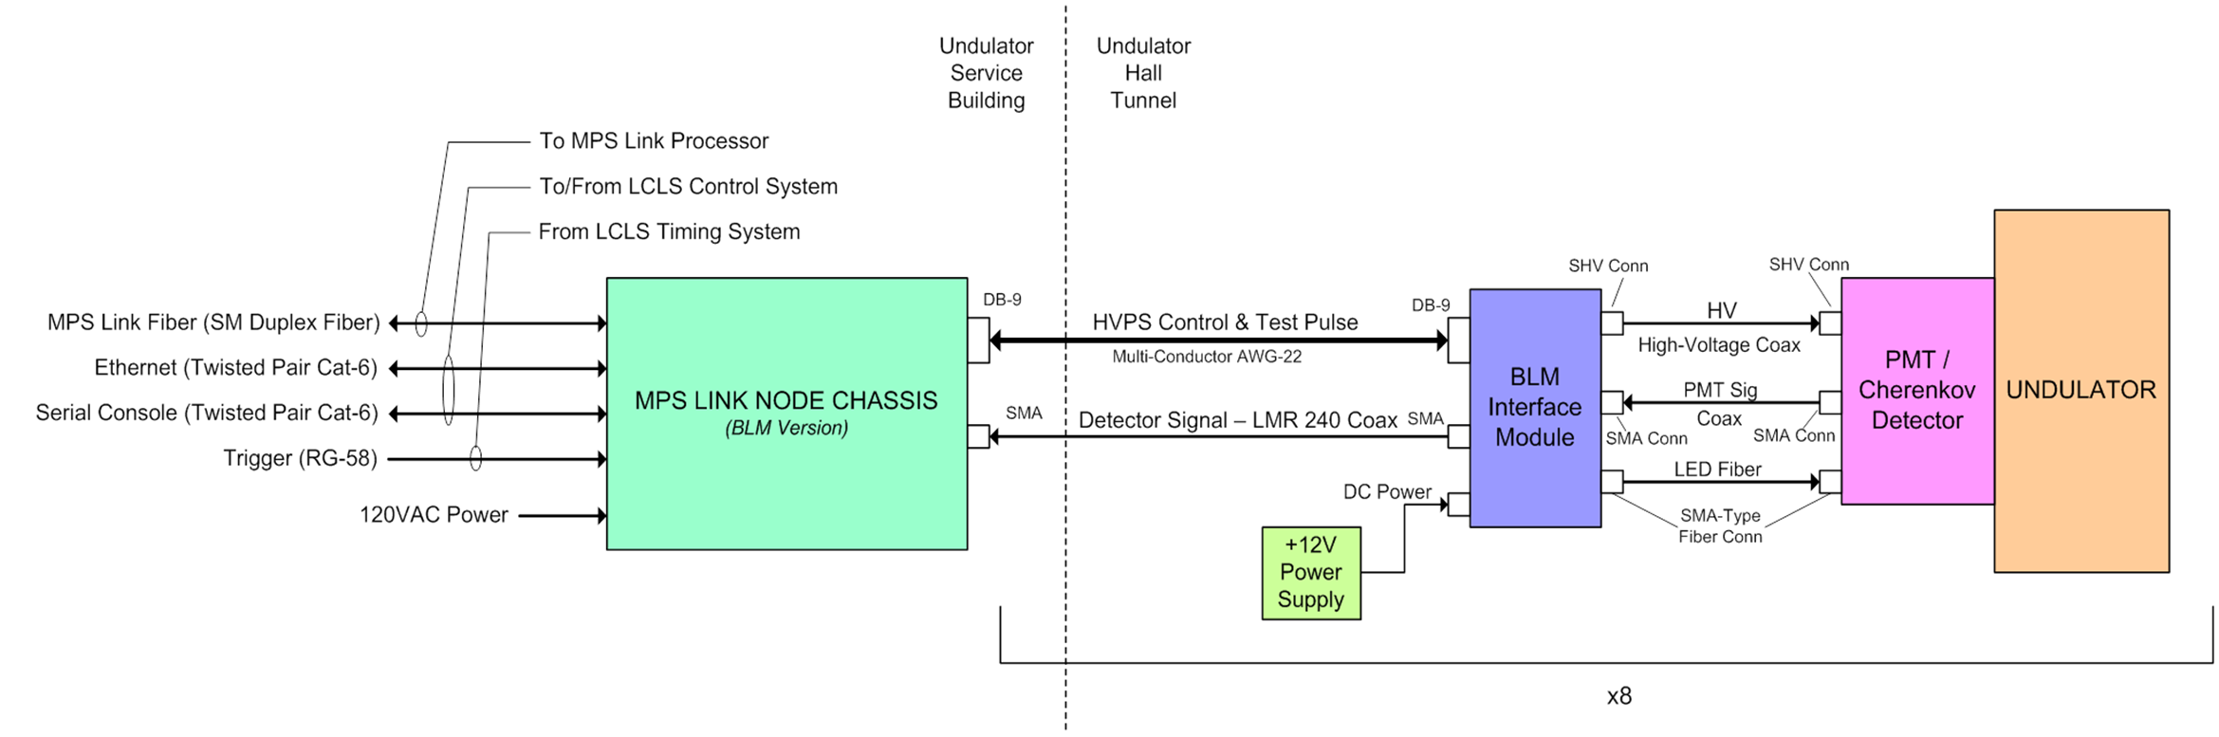
Signal-Processing Architecture
J. Dusatko

Slide 39
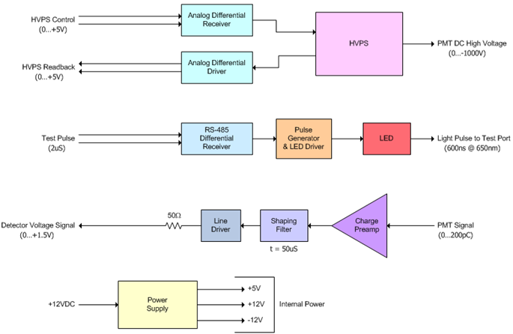
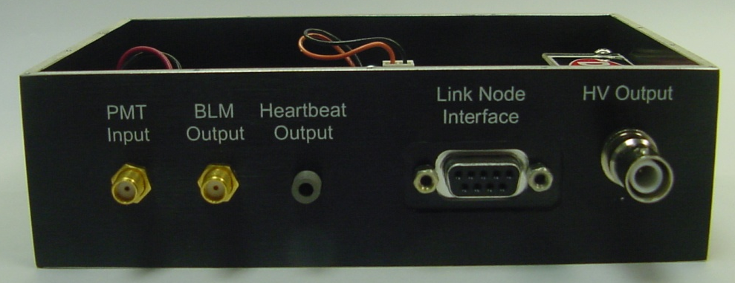
Interface Box near each Argonne BLM
  DC-to-DC converter
  “Heartbeat”: Periodic light pulses sent through a fiber to test the PMT
  Integrates PMT pulse and sends link node a waveform with amplitude proportional to PMT charge
  There are no interface boxes for PEP BLMs. Their signals are integrated in the link node.
W. Berg

Slide 40
“Link Node” Electronics Outside the Tunnel
“Link nodes” are input processors for MPS
  Different versions for different devices
Six link nodes for BLMs are in two support buildings above the tunnel
  Read signals at 360 Hz
    SLAC beams run at 120 Hz maximum, but on various subsets of a 360-Hz clock
  Four 2-channel interface cards
    Drive the heartbeat pulse, and drive/receive the HV control/readback
  PMT signals pass through interface and go to 8-channel digitizer card (QADC)
    Either integrates PMT pulses (PEP BLMs) or gets peak voltage (Argonne BLMs)
      Mode determined by choice of resistors
    FPGA of QADC totals losses in 60-, 30-, 10-, and 1-Hz intervals
      Compares these sums to a user-specified threshold
      Each BLM has one threshold for all sums: Limit is in dose per second, which can be exceeded by one large hit or several smaller ones
  Motherboard FPGA has embedded processor, running EPICS under RTEMS
    LCLS control system uses EPICS, plus Matlab for physicist software and tests
    MPS fault reporting uses dedicated software and a separate communication link to the master “link processor”, but EPICS also displays faults to users

Slide 41
Block Diagram of a BLM Link Node
J. Dusatko

Slide 42
Three Measurements: Beam, Test, Pedestal
1/360 s = 2.8 ms
Beam pulse:
Must fall inside gate set by FPGA
Heartbeat pulse: Triggered independently to test FPGA gate timing
Pedestal:
Find and subtract any DC offset
J. Dusatko

Slide 43
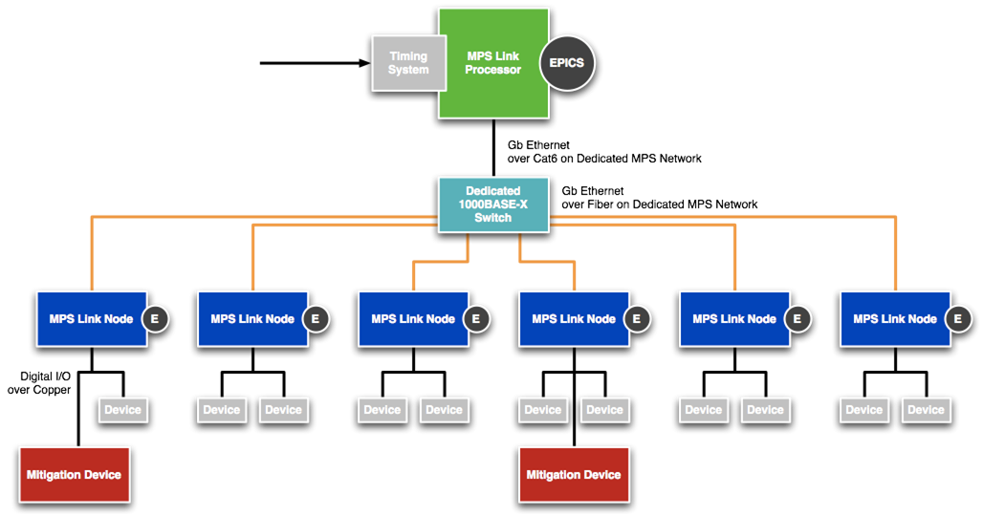
MPS Architecture
“Device”: Measures beam or machine state (BLM, valve status,…)
“Mitigation Device”: Halts beam or reduces beam rate until reset
J. Dusatko

Slide 44
Problems with Argonne BLMs
Only 5 available until October 2010
Difficult to manufacture Y-shaped radiator
  Standard optical cutting and polishing was not possible
  Had to flame cut; interior surfaces were flame polished
  Trouble with cracking during coating process
Radiator is inefficient in getting light to PMT
  Geometry requires many reflections, with some reflection loss each time
  Internal reflection from exit surface to PMT
    Argonne concerned that index-matching grease might migrate and interfere with HV
      But no problems observed with the grease used on PEP BLMs
BLM and front-end electronics grounded to girder
  Possible ground loop for loss signal sent on coax to electronics outside tunnel
  But no problems from ground loops have been observed

Slide 45
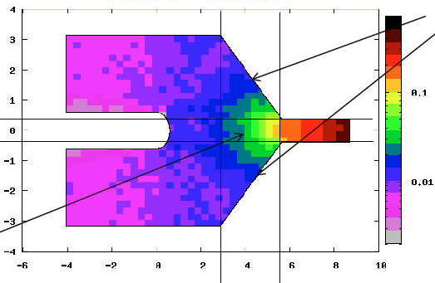
Strong Variation in Optical Coupling
Calculation using 90% reflectivity
Triangular regions
Wedge into stem
Arms
Wedge
Stem
J. Dooling

Slide 46
Problems with PEP BLMs
Not designed to fit around beampipe
Too large for available longitudinal slot: Placed several cm from beampipe
No “heartbeat” light pulse to verify operation
  Fibers would have degraded in some PEP-II locations with high radiation
  No suitable interval without beam in a storage ring
PEP BLM signals are integrated by the QADC card of the link node
  Link node is a noisy environment: Crosstalk from clocks, noise
    QADCs are not noisy if pulled outside the link node
  Majority of measurements in a 1-second sum are made when there is no beam
    Recall that link nodes acquire at 360 Hz
    When losses are low, the 1-second sum is dominated by noise and cannot be used for accumulating a dose
  The QADC’s voltage mode does not appear to pick up noise from the link node
    Fortuitously, the Argonne BLMs have cleaner sums
Little money for this last-minute installation
  Instead of individual HV supplies, 2 PEP-II supplies powered all PEP BLMs

Slide 47
BLM Data is Asynchronous
Diagnostic information about beam losses is not “beam synchronous”
  MPS handles BLM trips on each shot, but users don’t see these exchanges
  Using these signals for diagnostics was an afterthought
  In EPICS, each BLM has its own boundaries for the various sums
    No correlation from one BLM to the next in which beam pulses are included in, say, the 1-second sum
  EPICS updates the loss display at 1 Hz, not at 360 Hz
    The “typical” loss signal shown is from every 360th pulse, but even at the maximum rate of 120 Hz, it is more likely that EPICS is showing a pulse without a beam
Remedies
  A simple remedy will be implemented soon: Show the worst loss (and the worst sum) in the past second, not the loss at one arbitrary clock interval
  Beam-synchronous data—all BLMs on one beam pulse, with correlation to other instruments on the same pulse—can be retrofitted by adding a pulse ID to the message stream sent to the link processor

Slide 48
Other Link-Node Problems
FPGA registers for loss sums are too short: Will overflow with large losses
  Correction requires new release of firmware and corresponding changes to EPICS interface
  Careful testing of any release is needed to avoid MPS failure during operations
  Change will be made in January

Slide 49
Summary
LCLS has a system of Cherenkov beam-loss monitors to protect the undulator magnets
Developed with machine protection in mind, but with considerable diagnostic capabilities, some not yet implemented
The BLM sums do not yet provide an adequate record of total dose
  Too much noise when reading the PEP detectors (pick-up in link node)
  Installing the full set of Argonne BLMs has helped
  Dose tracking should be possible after January’s firmware change
  Dose tracking is now only done by placing thermoluminescent detectors on each girder
I hope that ideas from your experiences will be helpful in developing a system for LCLS-II

