Slide 1
SuperKEKB transverse diagnostics

Slide 2
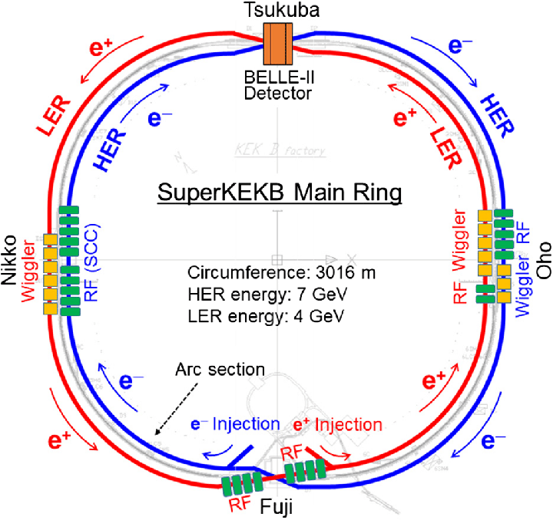
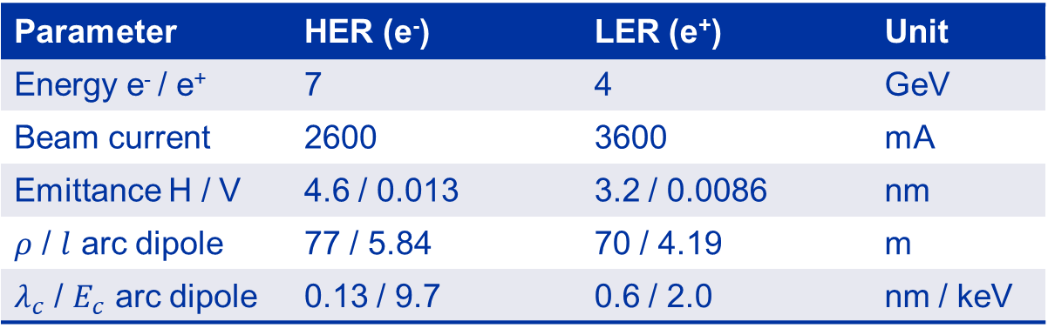
SuperKEKB
Parameter | HER (e⁻) | LER (e⁺) | Unit
Energy e⁻ / e⁺ | 7 | 4 | GeV
Beam current | 2600 | 3600 | mA
Emittance H / V | 4.6 / 0.013 | 3.2 / 0.0086 | nm
$ρ$ / $l$ arc dipole | 77 / 5.84 | 70 / 4.19 | m
$λ_{c}$ / $E_{c}$ arc dipole | 0.13 / 9.7 | 0.6 / 2.0 | nm / keV
visible SR for horizontal beam size monitoring (1/beam)
  imaging system
  double slit interferometer
  coronagraph for halo monitoring (R&D)
x-ray SR for vertical beam size monitoring (1/beam)
  pinhole
  coded aperture
  X-ray interferometer (R&D)
Relevance for FCCee
most similar machine in operation
high-current and not-so-low energy
(impedance, power load…)
similar operation scenarios and diagnostics requirements
(top-up, lumi feedbacks, SBLs..)

Slide 3
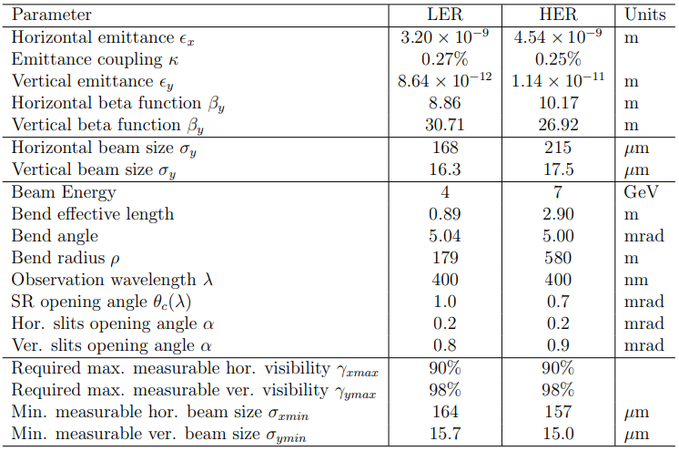
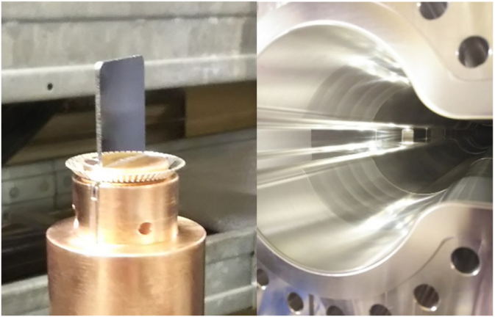
Visible diagnostics
Suitable for horizontal size measurements, longitudinal diagnostics and more “exotic” beam physics studies
Source consists of ad-hoc weak dipoles to reduce hard x-rays w.r.t. arc dipoles
Gold-coated diamond mirrors replace beryllium mirrors used for KEKB.
Better conductivity to dissipate 150 W/mrad SR and reduce mirror deformation
Photon critical energy $E_{c}$ 1.3 0.8 keV
Source parameters of visible diagnostics

Slide 4
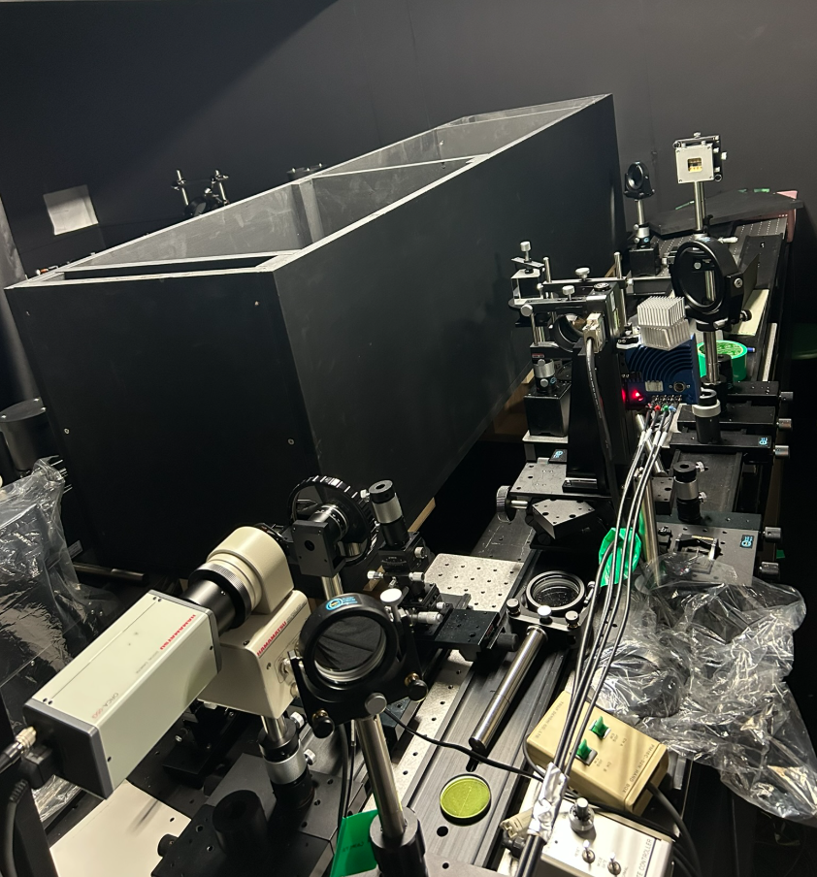
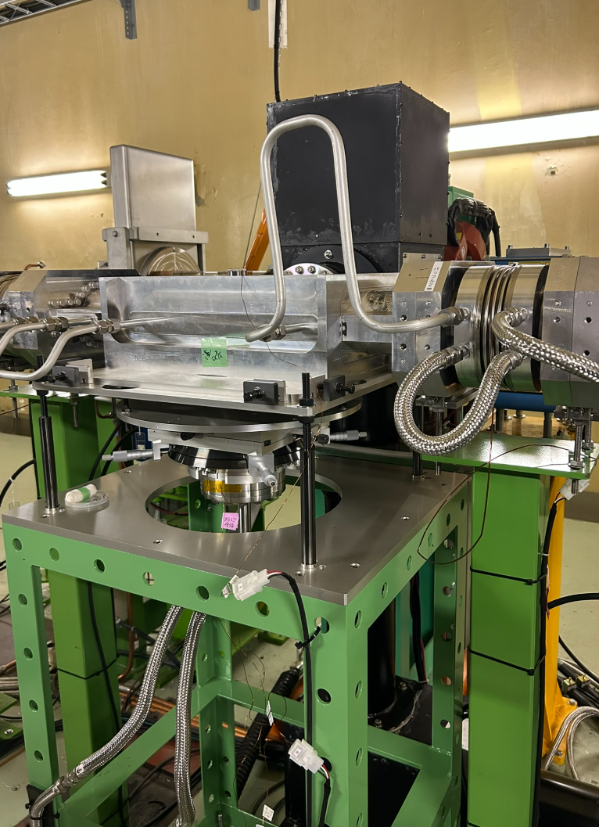
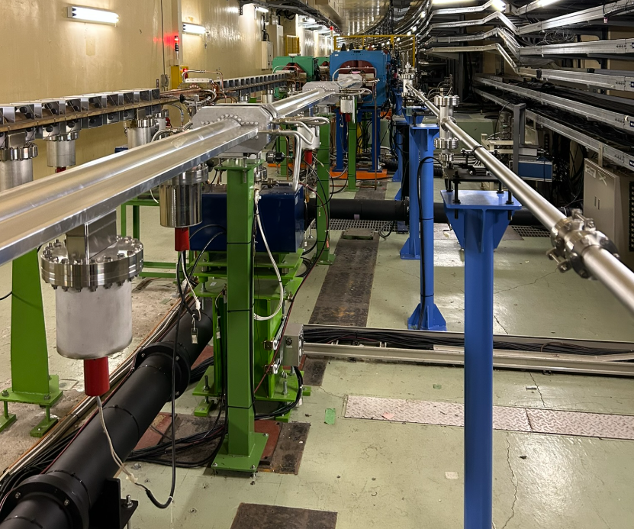
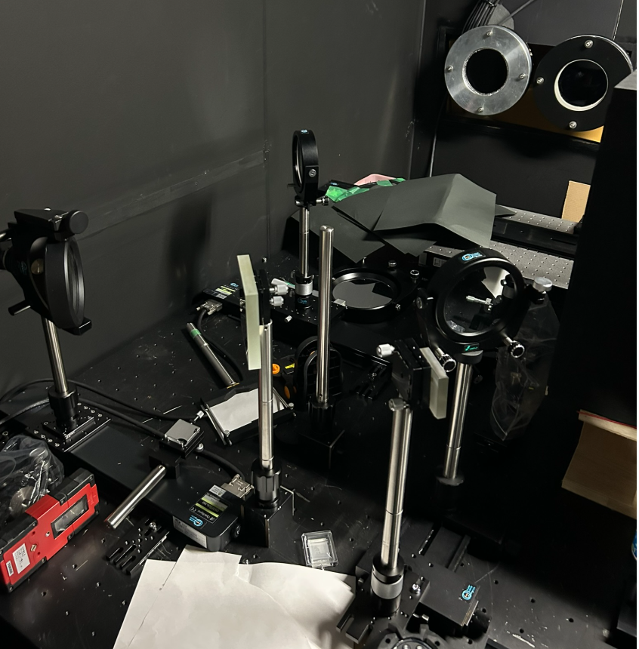
Visible diagnostics line
Light extracted with ~40m air-tight optical line to optical hitch in surface building
SR distributed across family of monitors
beam imaging for emittance and SBL-induced blow-up monitor
interferometer for redundant emittance measurement
coronagraph for halo-monitoring
extraction tank

Slide 5
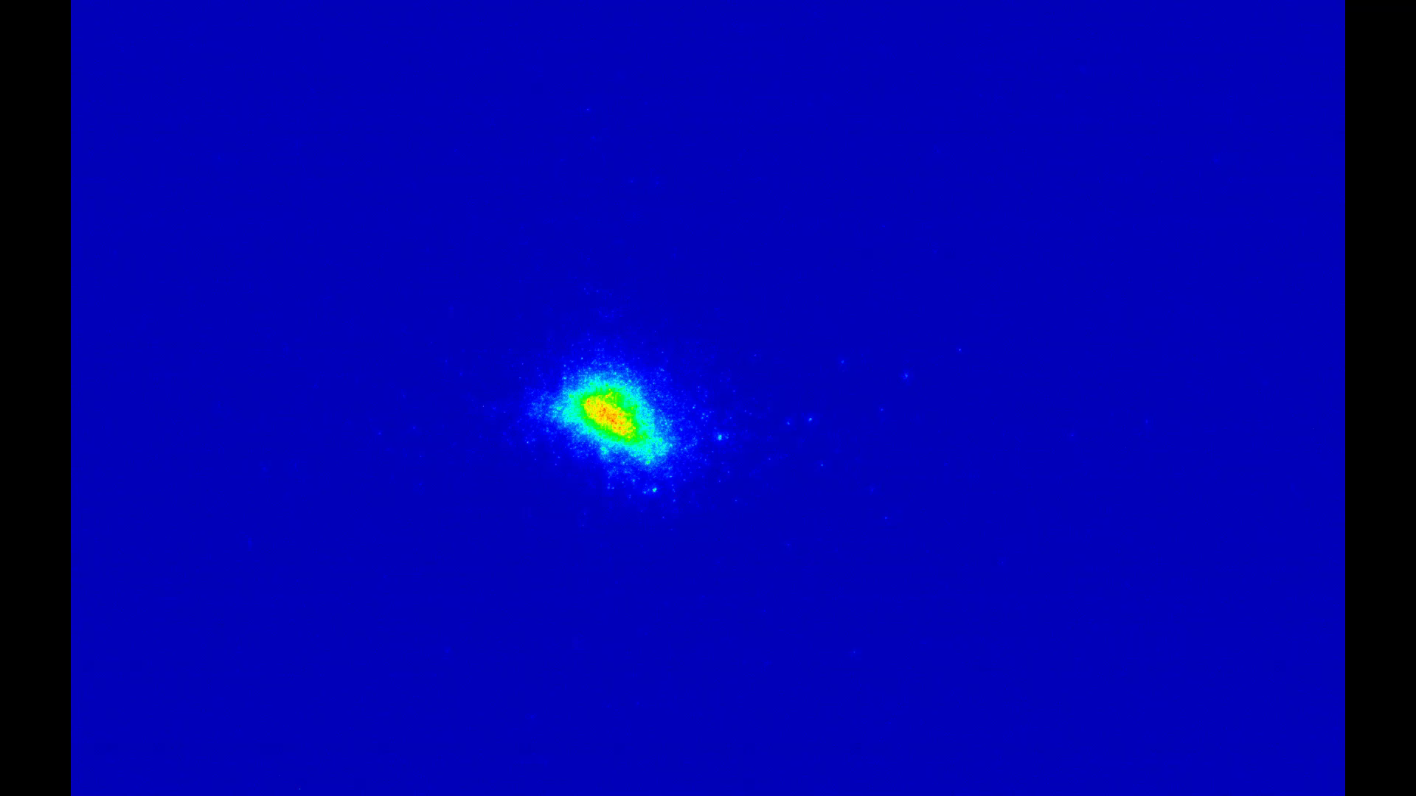
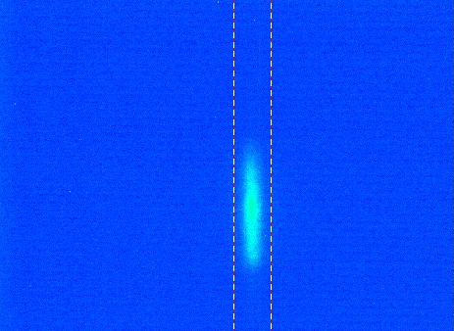
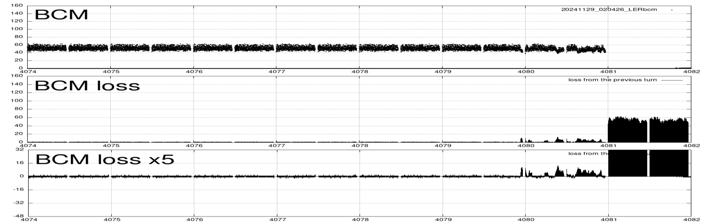
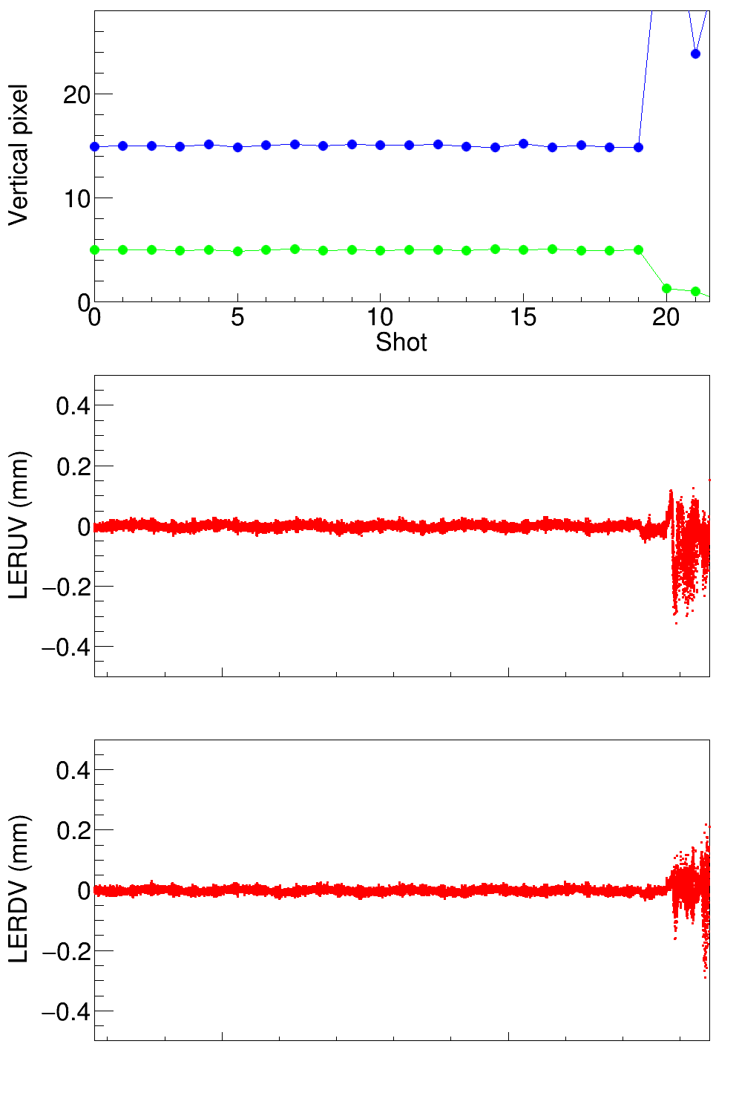
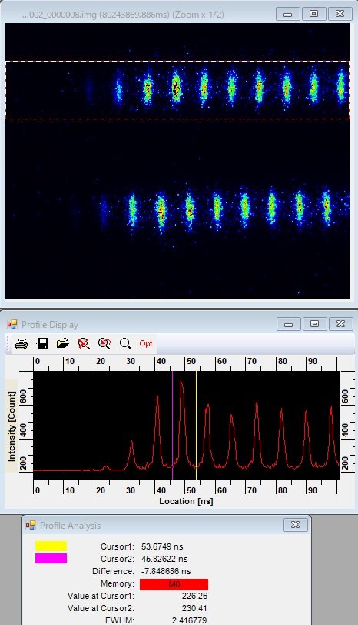
Visible diagnostics applications
credit H. Ikeda, G. Mitsuka, T. Mitsuhashi
injection oscillations
injected beam quality
SBL diagnostics
injected beam
stored beam
Halo monitoring
HER
LER
streak measurements

Slide 6
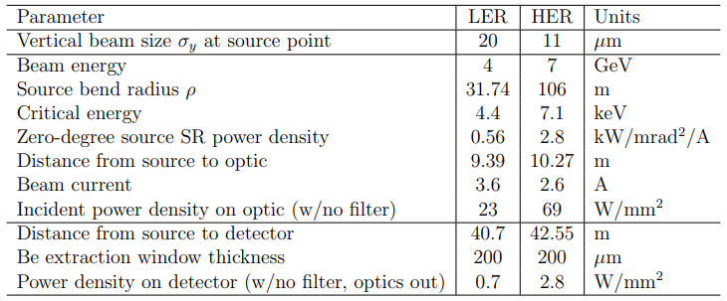
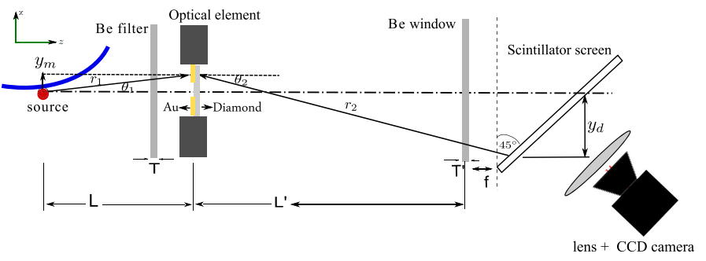
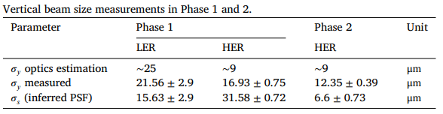
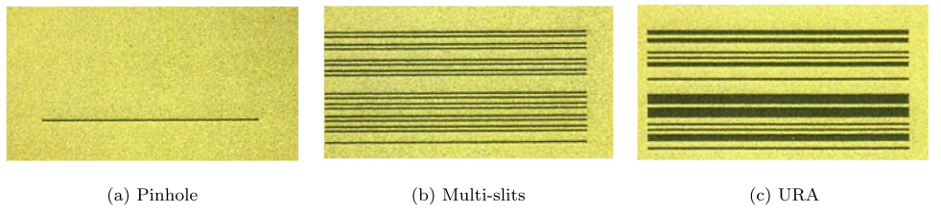
X-ray diagnostics
Suitable for accurate vertical size measurements
line used with pinhole or coded aperture
bunch-by-bunch and turn-by-turn
Source parameters of x-ray diagnostics
Schematics of SuperKEKB x-ray monitor and patterns used for optical elements
Achieved vertical size measurements

Slide 7
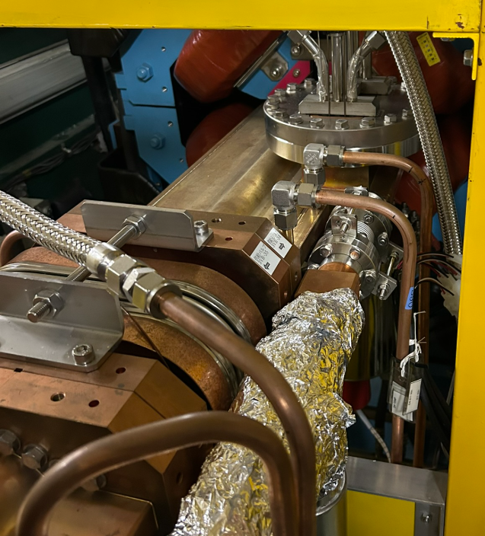
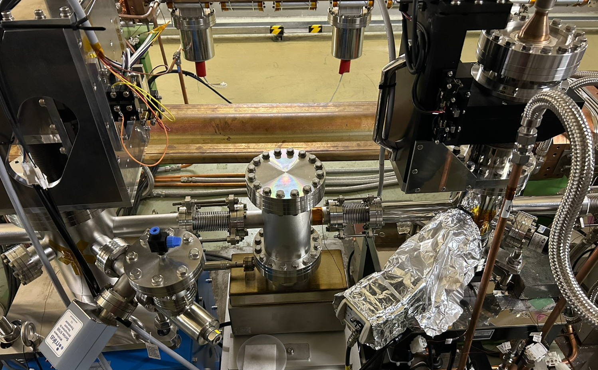
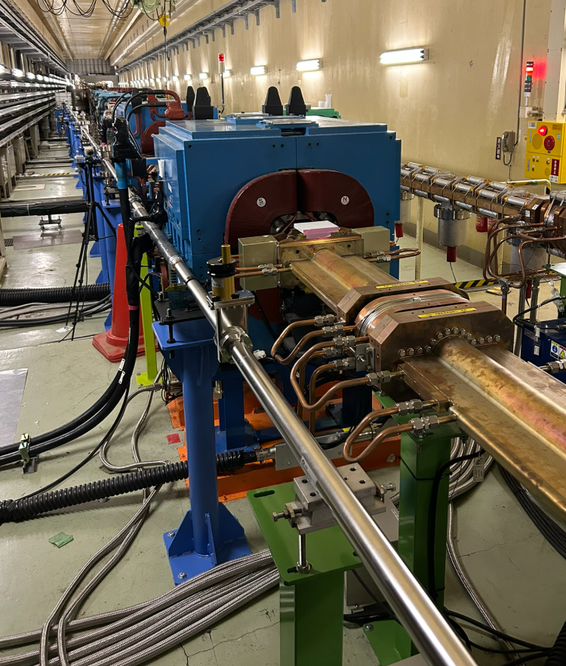
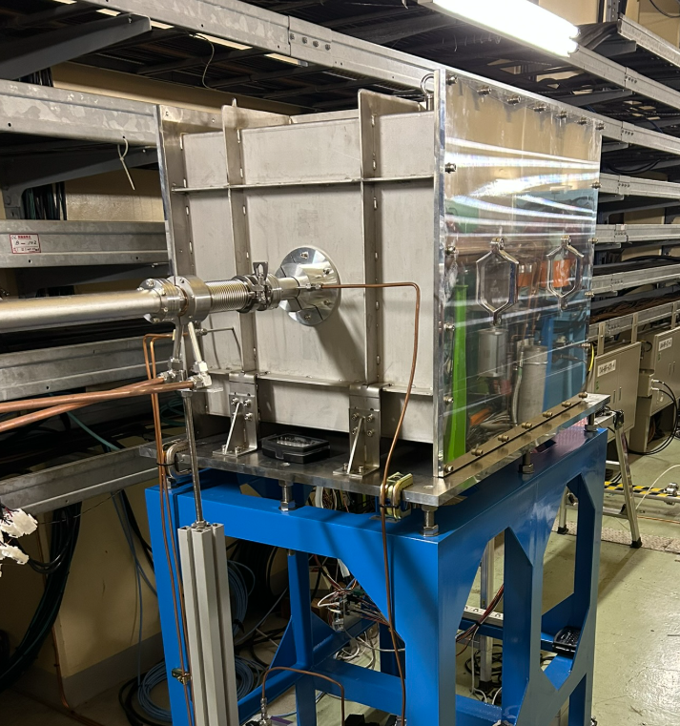
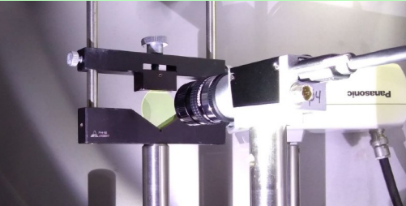
X-ray diagnostics line
extraction tank
interferometer tank
coded aperture tank
YAG screen
instrumentation hutch
(~1Gy/d)

Slide 8
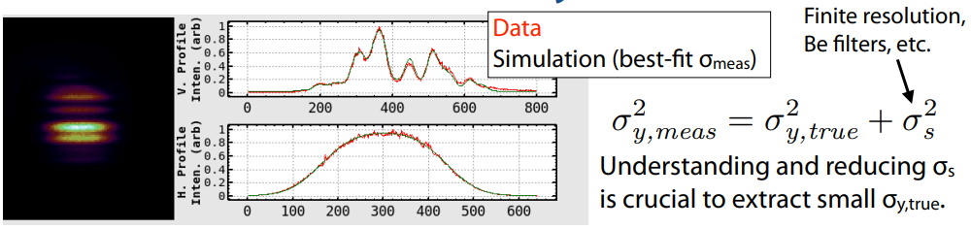
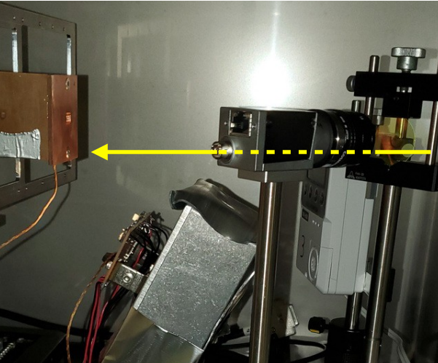
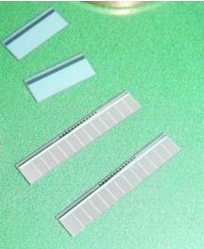
X-ray diagnostics applications
credit G. Mitsuka
Main application of XRM is accurate measurement of (average) vertical emittance
New Si-pixel detector for bunch-by-bunch measurements (beam instabilities)
…X-ray interferometer under development on same line as XRM
use similar gold+diamond slits
use K-edge filters for monochromatization

Slide 9
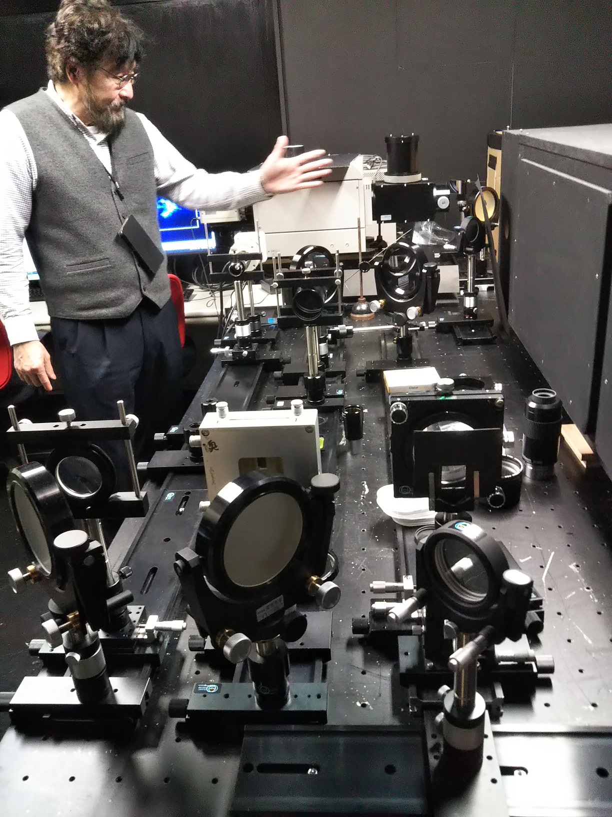
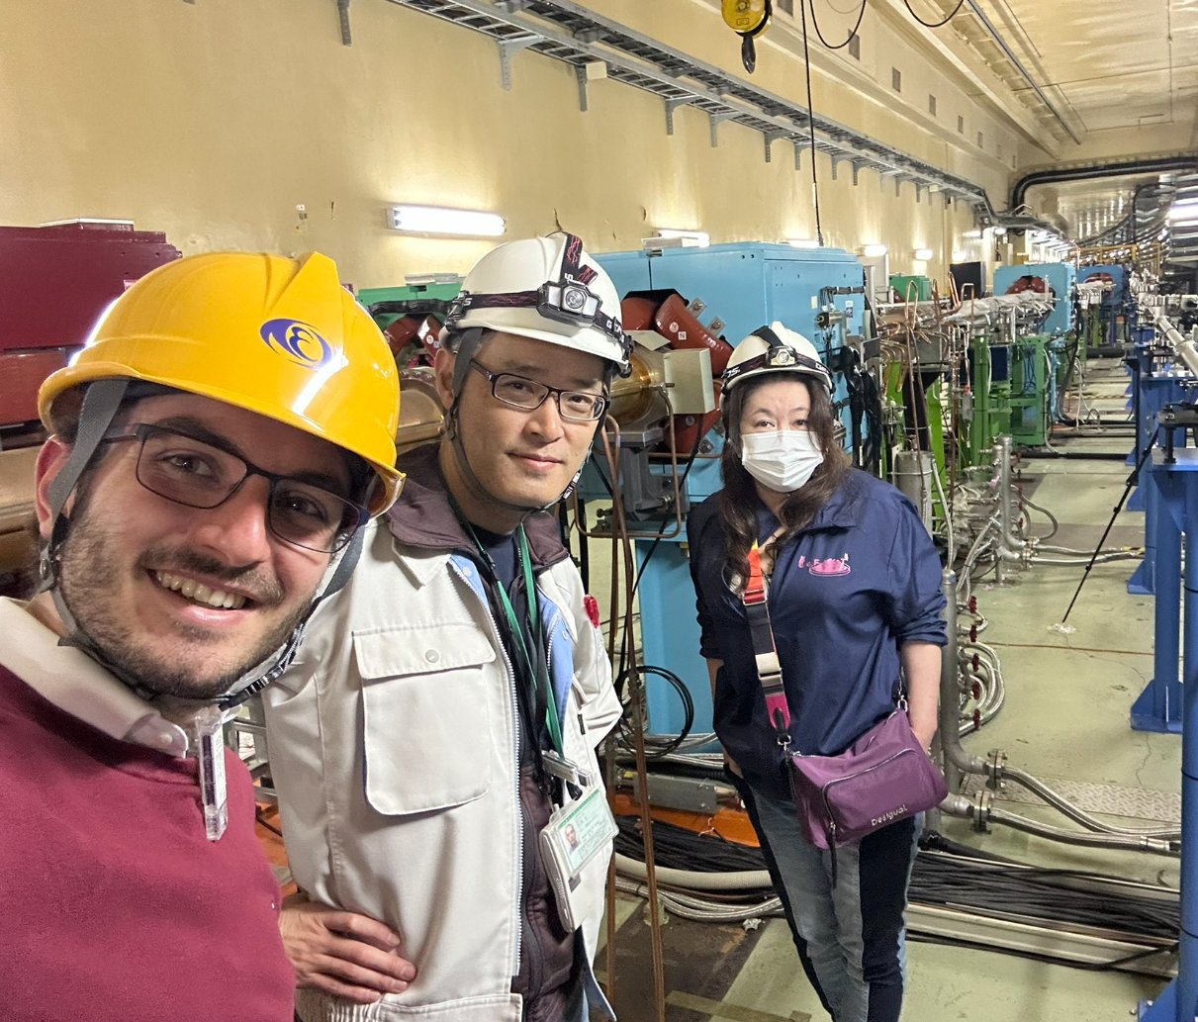
Take-home message
Collaboration between CERN and SuperKEKB in the FCC framework potentially very fruitful
SuperKEKB is nowadays the closest machine to FCCee
CERN practical experience with lepton collider diagnostics is limited to few LEP highlanders
KEK may have already technical solutions for potential FCCee problems
…and SuperKEKB diagnostics team is very friendly and open to collaboration!

