Slide 1
TSC – 2024 statistics
ALL TSC committees: 2024 – 1, 2, 3

Slide 2
All Technical Studentship positions 2024:
Electrical/Electronics Engineering; IT, Mathematics and Robotics, Material and Surface Science, General/Civil Engineering, Applied Physics

Slide 3
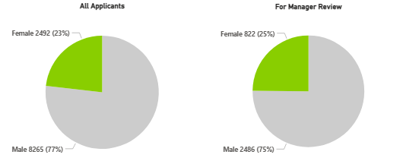
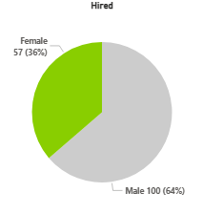
Gender
ALL TSC applications: 10 757

Slide 4
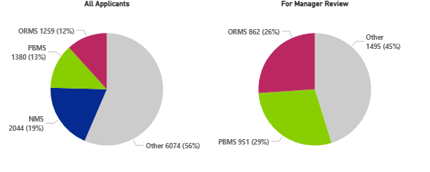
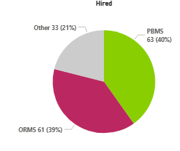
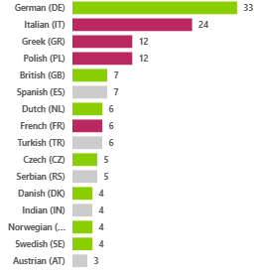
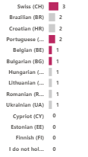
Nationality

Slide 5

Ratio of Proportional Hires and Country Contribution

Slide 6
ADMIN 2024

Slide 7
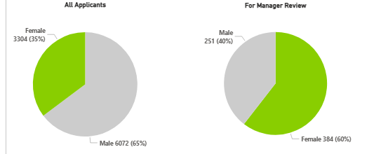
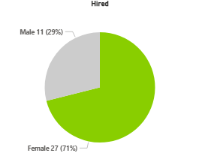
Gender
ALL ADMIN applications: 9 376

Slide 8
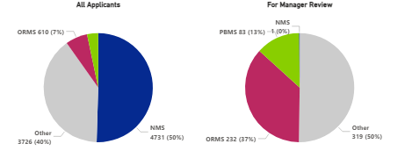
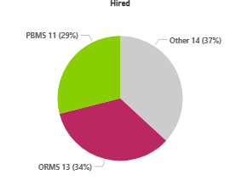
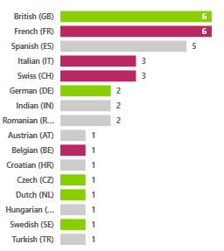

Nationality

Slide 9
Ratio of Proportional Hires and Country Contribution

Slide 10
DOCT 2024

Slide 11
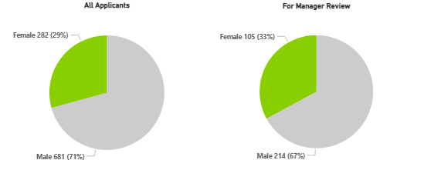
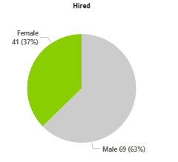
Gender
ALL DOCT applications: 963

Slide 12
Nationality
*22 IT INFN DOCTs were deducted from the statistics

Slide 13
Ratio of Proportional Hires and Country Contribution
*22 IT INFN DOCTs were deducted from the statistics

Slide 14
Thank YOU!

