Slide 1
EP-DT Group Meeting
Welcome/Bienvenue!
June 11, 2025
Burkhard Schmidt

Slide 2
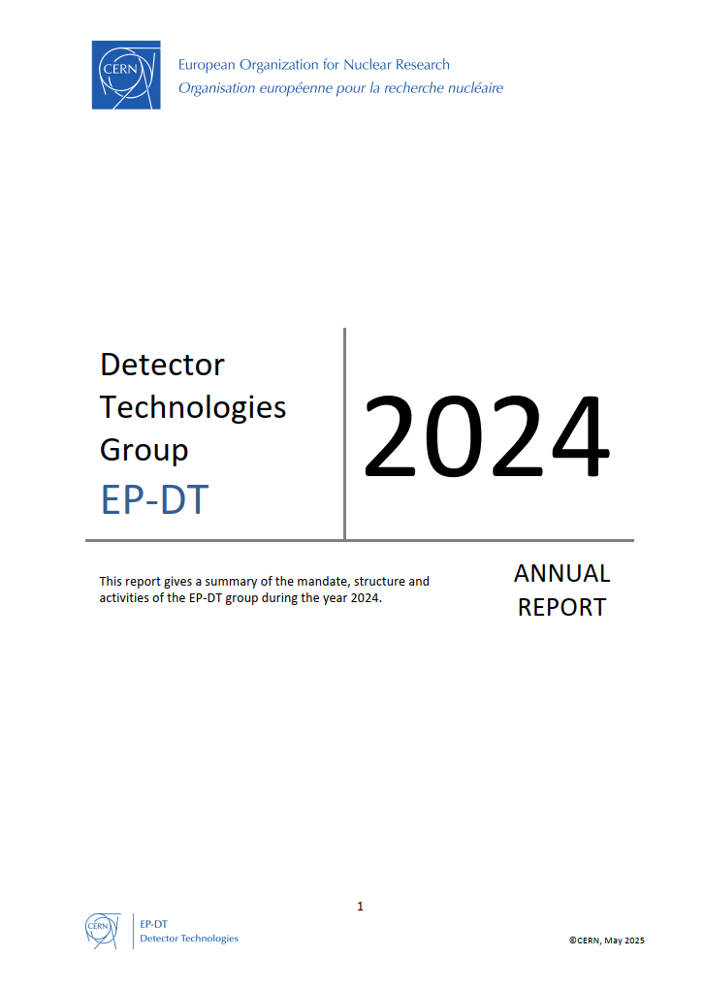
Outline
Overview of the EP-DT Group
Changes in the Group Structure
News about Building 140
Update of the European Strategy for Particle Physics - What are the options?
Services provided by the EP-DT Group
MPT workshop
Gas System Service
CO2 Cooling Systems
Magnet Control System and other Services of DI
Activities of the group on projects not mentioned in the following presentations can be found in the EP-DT Annual Report
Concluding remarks

Slide 3

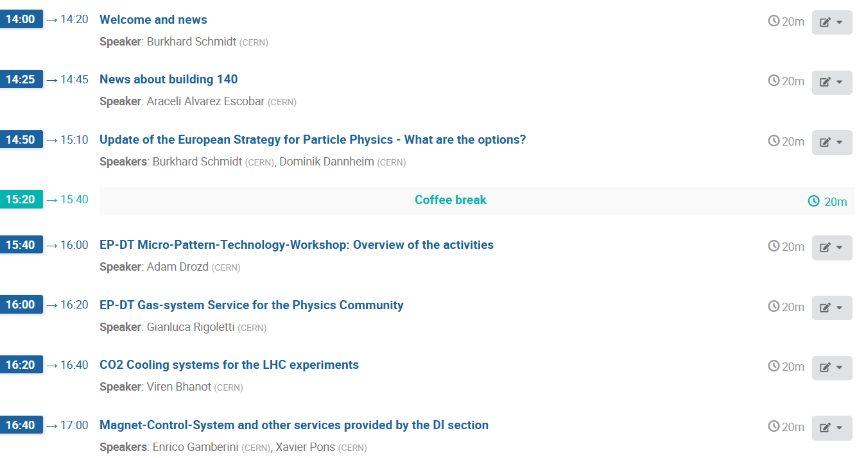

Slide 4
EP-DT Composition and Structure
Section | Persons
Technology &Physics (TP) SL: Thierry Gys | MPE: 11 MPA: 7
Detector Development (DD) SL: Petra Riedler | MPE: 21 MPA: 8
Fluidic Systems (FS) SL: Paolo Petagna | MPE: 28 MPA: 12
Detector Interface (DI) SL: Xavier Pons | MPE: 11 MPA: 3
Engineering Facilities (EF) SL: Hans Danielsson | MPE: 13 MPA: 1
Engineering Office (EO) SL: Corrado Gargiulo | MPE: 14 MPA: 4
Construction & Operations (CO) SL: Antti Onnela | MPE: 21 MPA: 0
Personnel | FTE 2025 (2024)
Staff | 85 (84)
Fellows /GRADs | 39 (32)
PJAS | 2 (2)
Doct. Students | 15 (17)
Tech. Students | 10 (12)
Trainees | 7 (5)
FSU PH-02 (S 302): FSU PH-40 (S 287): | 32 (25) 15 (16)
Contributing Retirees | 5 (5)
Total | 210 (200)
Comments:
The number of Staff members is rather stable: positions of colleagues retiring are kept in the group
1 Staff members (included in the counting) is on long term sick-leave
Many Fellows, DOCT and TECH are affiliated to DT, but are only partially on DT quota.
The FSUs in the FS and EF sections are crucial to fulfil our mission (~25% of the workforce).

Slide 5
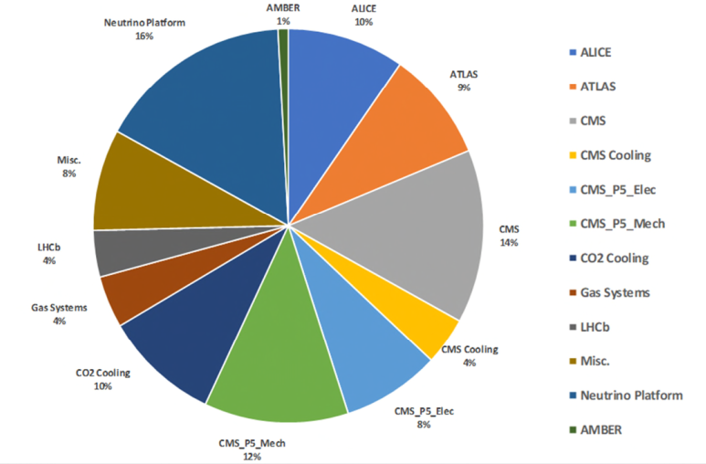
FSU Activities in EP-DT
Total of hours for 2024: ~60,000 hours (~40 FTE) for a cost of about 4 MCHF
The total FSU personal number is going up: the two units have no 47 members in total.
FSUs are an important resource to respond to urgent needs of the experiments
For both new FSU contracts (S287, MPT Workshop, and S302, EP Technical Support), we work with the previous contractors and largely with the same personnel.

Slide 6
EP-DT Summer Students 2025
Those of you who arrived already: Welcome to EP-DT!
We wish a very profitable time at CERN!
We provide again an opportunity to present your work during stay at CERN
We have scheduled four sessions during the summer, in which you will have an opportunity to present your work: July 22, August 5, 19 and 26 (always AM)
Proposal for EP-DT Summer Student Presentations:

Slide 7
EP-DT composition and age profile
Professionnal Categories in 201
6
About 70% of the group is on an IC contract, 30% on an LD contract, no change over the past years.
30% of the group is above 55 and will retire in the coming years, this are 40% of the ICs.
Under the present conditions, only about 45% of the LDs can be retained.
In total 43% of the personnel will change. This is huge challenge to maintain the competencies we have.
On top of this, we have the unforeseen…

Slide 8
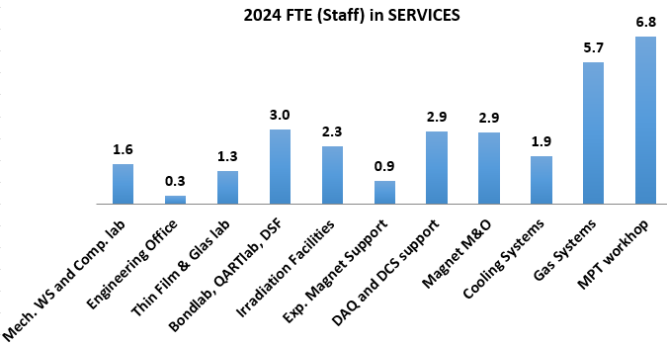
DT Staff involvement in Services
Pure Services have been reduced to a minimum in some areas (e.g. Mech. WS and Engineering Office); the resources are assigned to projects (mainly ATLAS and CMS trackers, and ALICE)
Some of the services are crucial for the world-wide detector physics community, e.g. the MPT workshop, the Irradiation Facilities, the Bond- QART-labs, the DSF, the magnetic field measurement service etc., the DQ and DCS support.
Some services are based on Service Level Agreements with the experiments

Slide 9
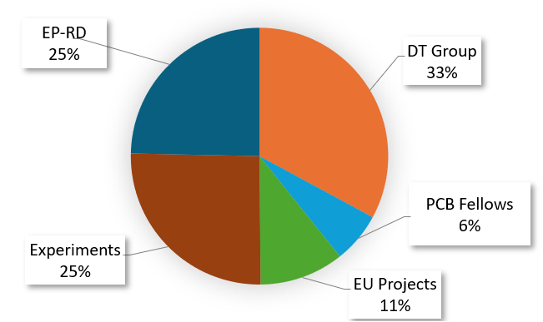
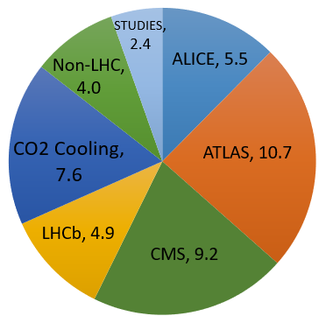
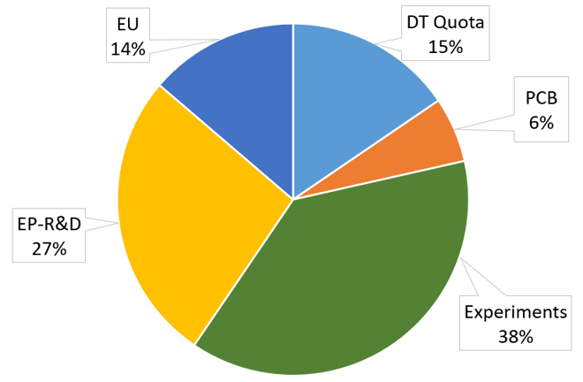
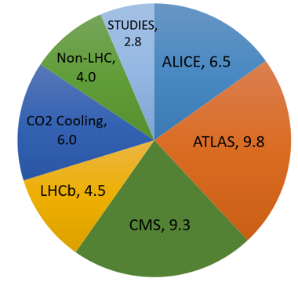
DT Staff and Fellows in Projects
Involvement of Staff and Fellows
In Projects 2024 vs. 2025
Funding Source of Fellows/Graduates
2024 vs. 2025
Involvement in projects related to the upgrade of the LHC experiments is more than 85%.
The remaining 15% are shared between other experiments and project studies.
DT based Fellows (and Students) are mainly on non-DT resources
Very good collaboration with ATLAS, CMS, NA62 and NP for funding Fellows/Students
Fellows represent 50% of the resources for R&D

Slide 10
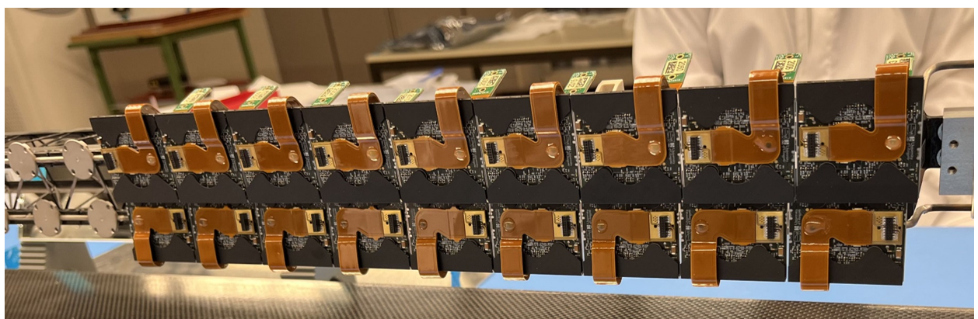
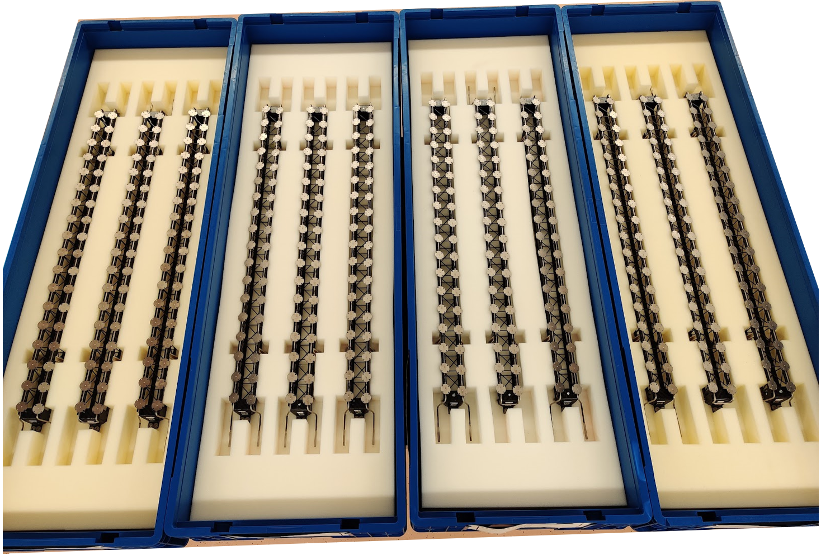
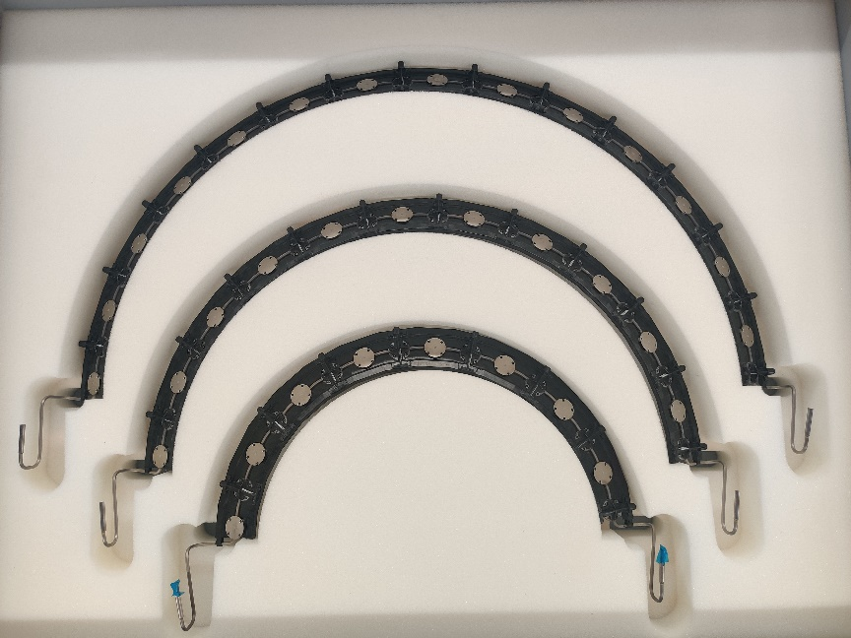
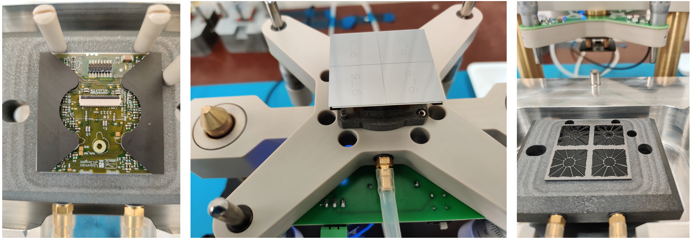


ATLAS Phase II Upgrade: ITk Pixel Outer Barrel
EP-DT plays a leading role in the ATLAS ITk Pixel Outer Barrel Modules, Bare & Loaded Local Supports, Global Mechanics & Integration (close collaboration with EP-ADE-TK, Uni. Genève, Bonn & CPPM for our deliverables)
Pre-production of ~90 QUAD Pixel modules @ CERN almost completed; Assembly activities in DSF progressively transitioning into production (600 modules to be built & 1200 tested in the next ~20 months)
Production of Bare Local Supports ongoing; 70-80% of individual components (e.g. Ti evaporators, CFRP parts) finished, with focus now on assemblies and QC testing: 30 Functional Longerons & 9 Functional Inclined Half Rings completed so far (i.e. ~40% and ~9% of the total production respectively)
Pre-production activities for OB Loaded Local Supports very advanced @ CERN; Site qualification formalities mostly completed for Cell Loading & Cell Integration. Assembly, testing and thermal cycling of 1st Longeron (partially populated) successfully completed. PRRs planned in Q3 2025 and Q4 2025 to launch production
1st Preproduction Loaded Longeron during assembly @ CERN
12x Production L2 Functional Longerons
Example of Production Functional IHRL2, IHRL3 & IHRL4
Various steps during the Cell Loading process @ CERN

Slide 11
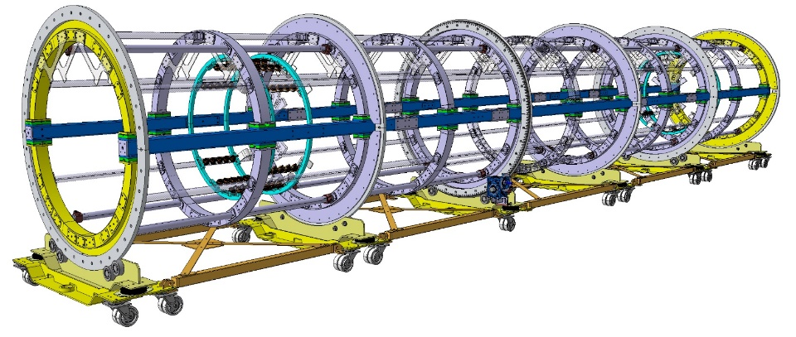
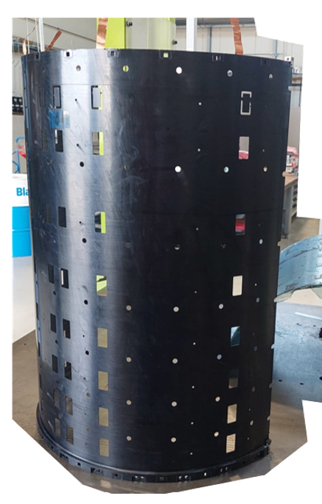
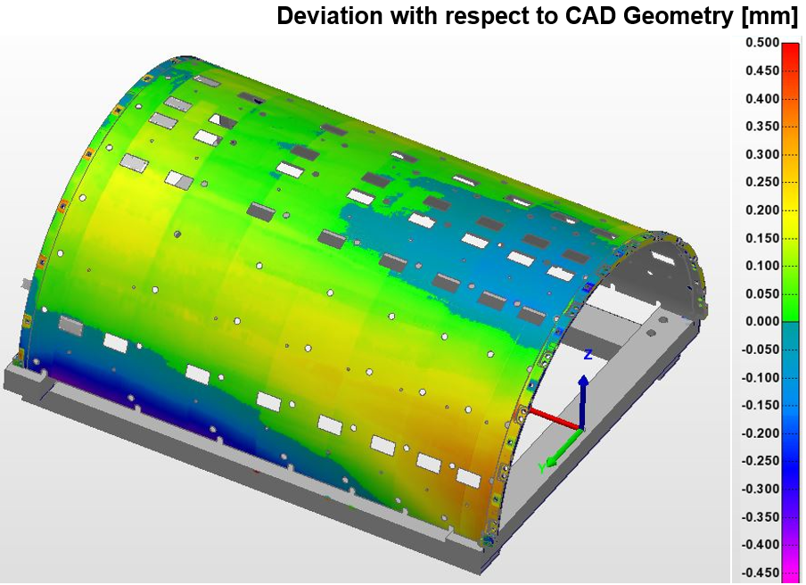
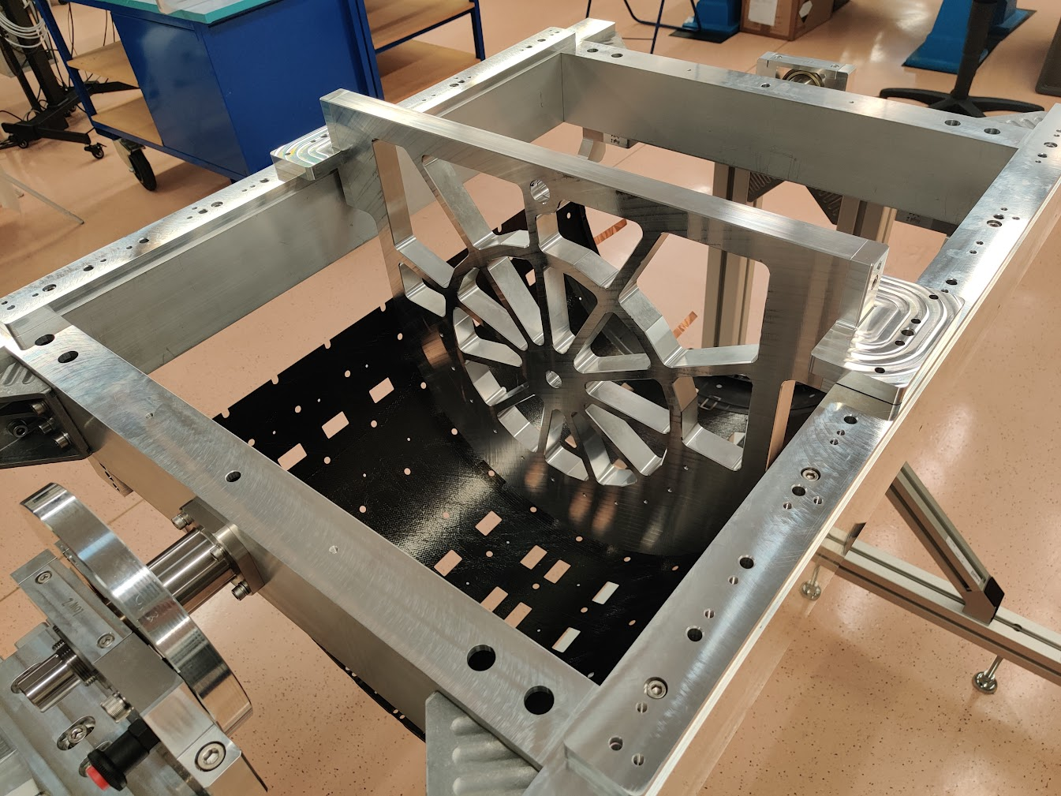
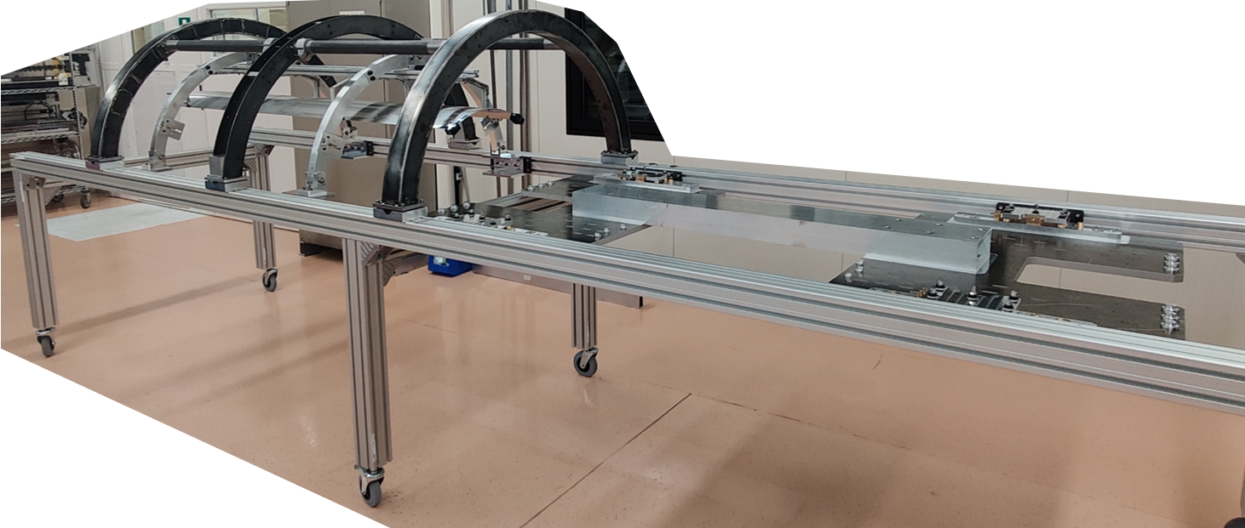
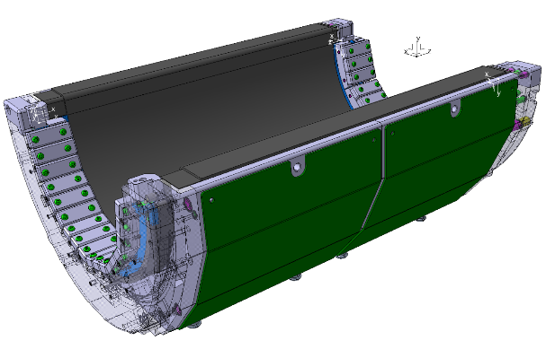
ATLAS Phase II Upgrade: ITk Pixel Outer Barrel
Important effort to finalise the detailed design of the OB Global Support structures, particularly the Half Layer Shells, their moulds and insert gluing tools. Layer 2 mostly completed, with attention now shifting to layers 3 & 4
Significant progress in the optimisation of the service routing and the design of the Ti cooling pipe extensions (i.e. inlet capillaries, exhausts); collaboration with EN-MME to complete qualification of brazed and welded joints
Design of integration tooling for Inclined Units, OB Half Layers and Outer System very advanced; Various prototypes and mock-ups of different tools have been built and are in the final testing stages
Global Mechanics & Integration PRR planned for this summer before launching procurement and production of these items; L2 Half Layer Shells needed by the end of 2025, for detector integration to begin in Q1 2026
DT commitments in ATLAS ITk Pixel OB extend to the end of LS3. Ensuring sufficient resources and minimising gaps (e.g. contract ends, retirements) will be crucial to meet very challenging project schedule, which relies on a high level of parallelisation
Full-size prototype of L3 HLS with results of 3D laser scan
CAD model and partial mock-up of the OB/OS Integration Tool
L3 HLS Prototype installed in its handling frame during the gluing of the IHR positioning inserts
L2 HLS Mould

Slide 12
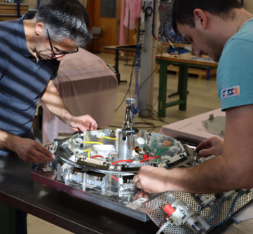
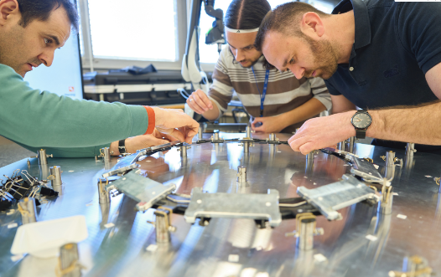
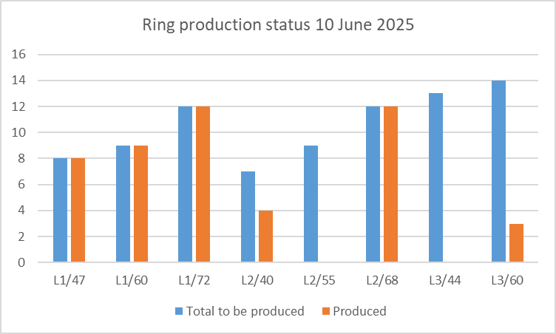
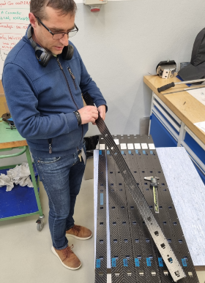
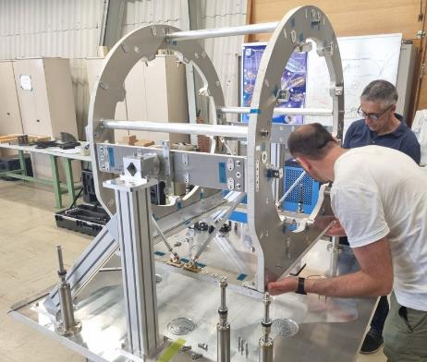
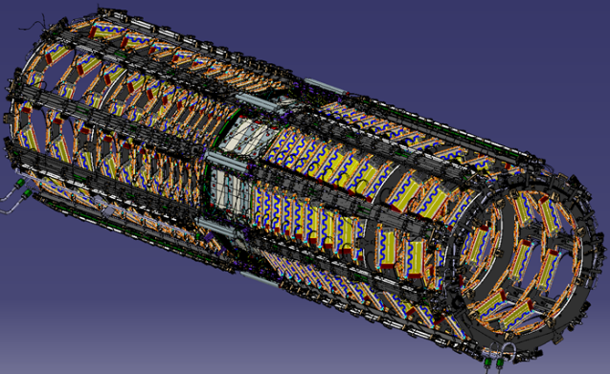
CMS Phase 2 Upgrade Tracker: TBPS
Production of “Tilted Ring” support/cooling structures in full speed (1 Ring / week) since Sep 2024.
Status: 48 of 84 Rings produced, including all for layer 1. Target: Ring production completed by June 2026.
Production of “Beams” for supporting the Rings
First (of six) “Ring stacking tools” ready
Continuous Catia design work on TBPS integration and services arrangements

Slide 13
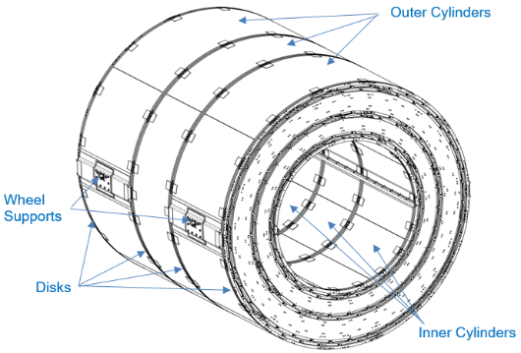
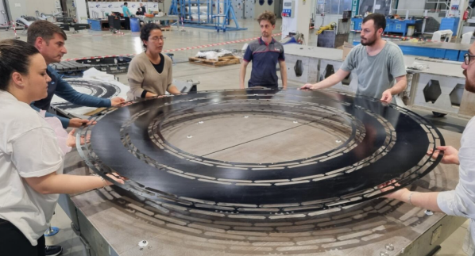
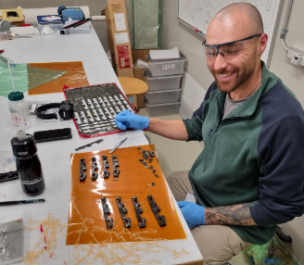
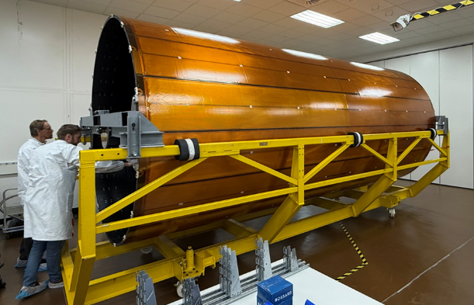
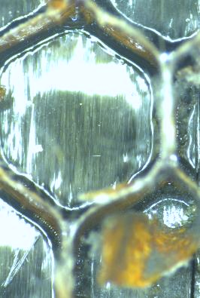

CMS Phase 2 Upgrade Tracker: Other DT contributions
TB2S sub-detector: Production of large composite parts on-going in industry (on EP-DT designs and specifications), and production of smaller high-precision parts in EP-DT composites workshop
Connection between carbon skin and honeycomb core. Good quality (sample) Bad quality (BTST)
BTST (BTL-Tracker Support Tube): Discovered major quality problems in BTST sandwich structures, produced in industry. Investigations and repairs being done by Tracker team (CMX + DT + Purdue + Cornell)

Slide 14

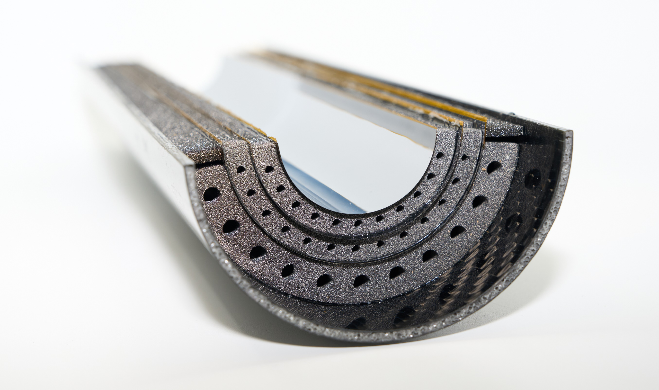

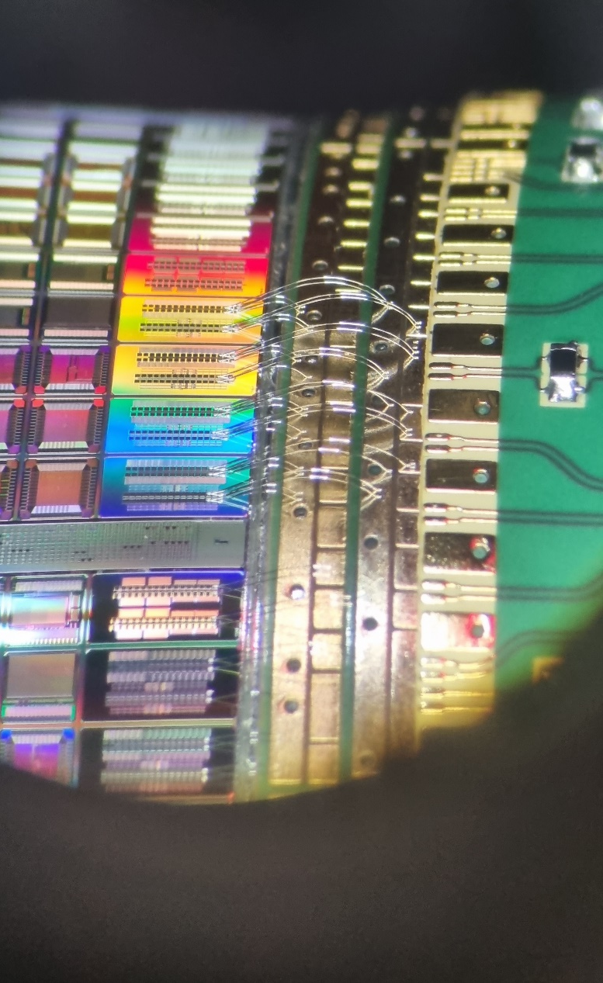
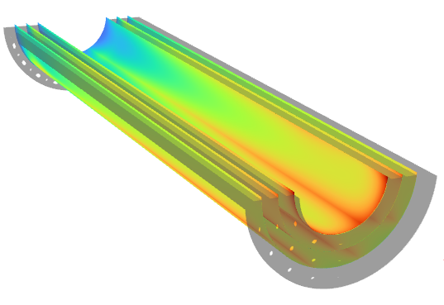
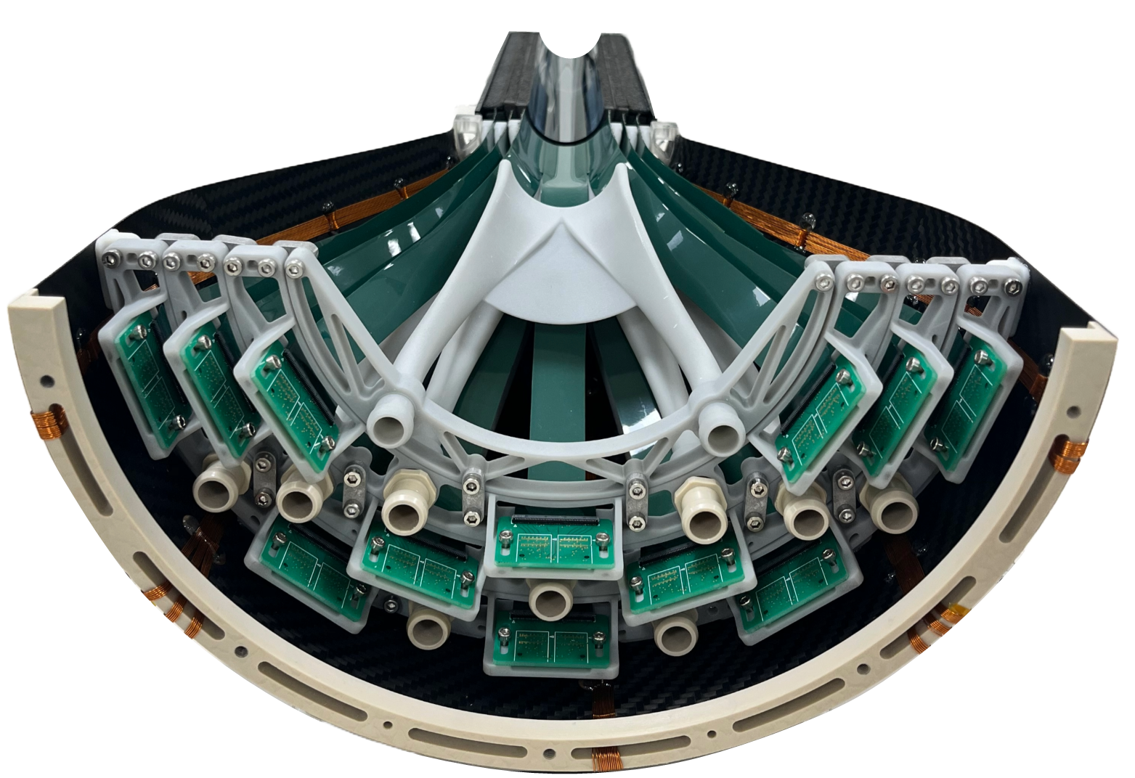

ALICE Inner tracking system 3
Mechanics and Cooling:
Based on ultralight carbon foam materials, which serve both as structural support and as air-cooling radiators.
Experimental results:
ΔT_overall < 7 °C; Total power = 60 W
Sensor aeroelastic stability (RMS)= 0.4µm
No thermoelastic failure within 10-60 °C.
Services integration:
Airflow distributors (polymer 3d printed)
Data and power (Wire-bonds at the edge extremities to FPCs, wires, VTRx..)

Slide 15
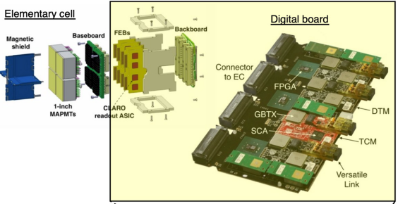
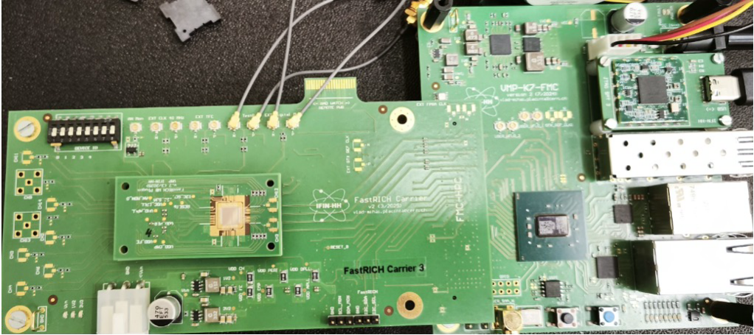
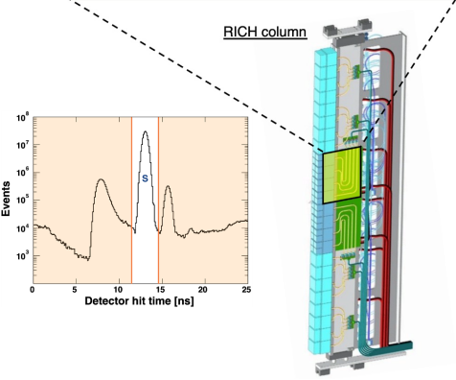
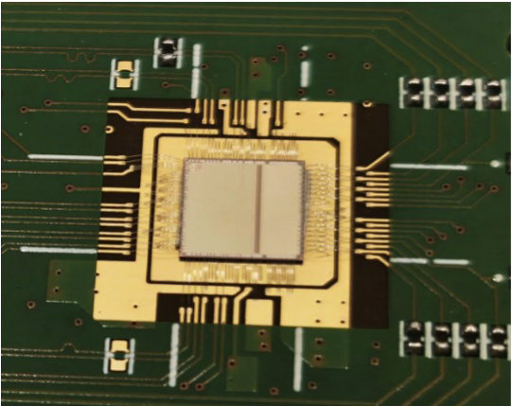
LHCb LS3 Enhancements
RICH LS3 Enhancements
New readout electronics including FastRICH ASIC
Time of Arrival of Cherenkov photons
25 ps time bin resolution
Improve PID performance in Run 4

Slide 16
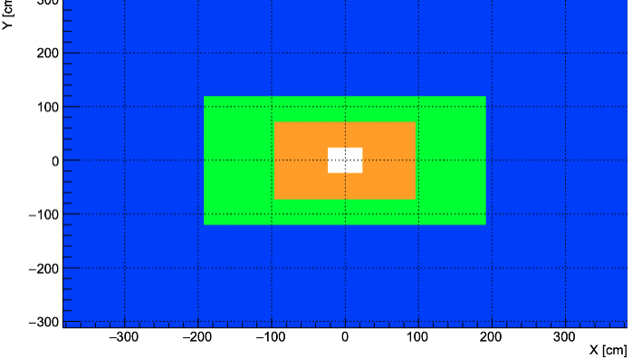
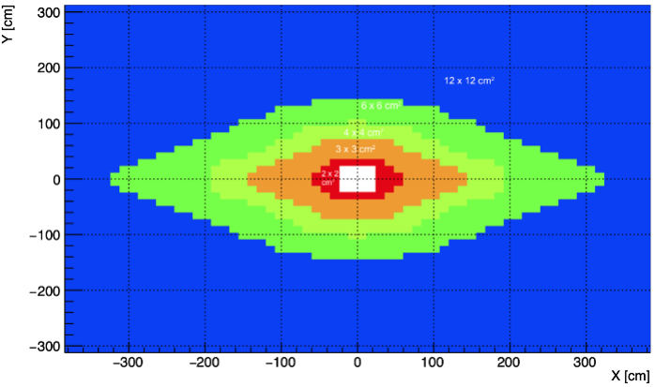
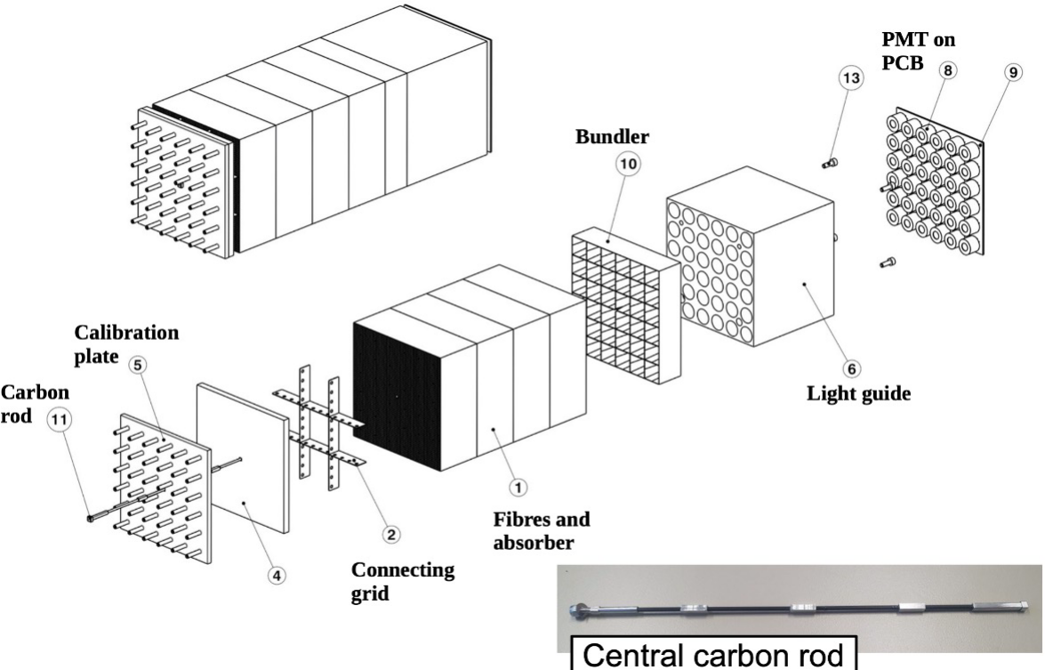
LHCb LS3 Enhancements
ECAL LS3 Enhancements
Current ECAL has been operating smoothly for ~15 years!
Radiation damage and high pile-up current limiting factors for Run 4 and 5
Replacement of inner 4x4 cm2 with
2x2 cm2 new SpaCal-W
3x3 cm2 new SpaCal-Pb
Before LS3
After LS3

Slide 17
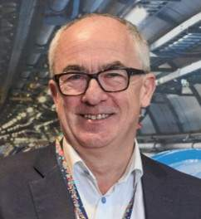
CERN’s main scientific priorities for 2026–2030
Completing the High Luminosity LHC (HL-LHC) and the timely completion of the upgrades of the ATLAS and CMS experiments. This must be our collective top priority.
Building consensus through the European Strategy for Particle Physics (ESPP) process for the Future Circular Collider (FCC) or an alternative flagship project for CERN.
Proactively engaging with key stakeholders to consolidate the collective sense of ownership and build political consensus for CERN’s long-term future.
Progressing with the planning and decision making for proposed upgrades of the ALICE and LHCb experiments.
Developing a long-term vision and roadmap to exploit the CERN injector complex, in order to deliver an exciting, diverse programme of experiments for Physics Beyond Colliders.

Slide 18
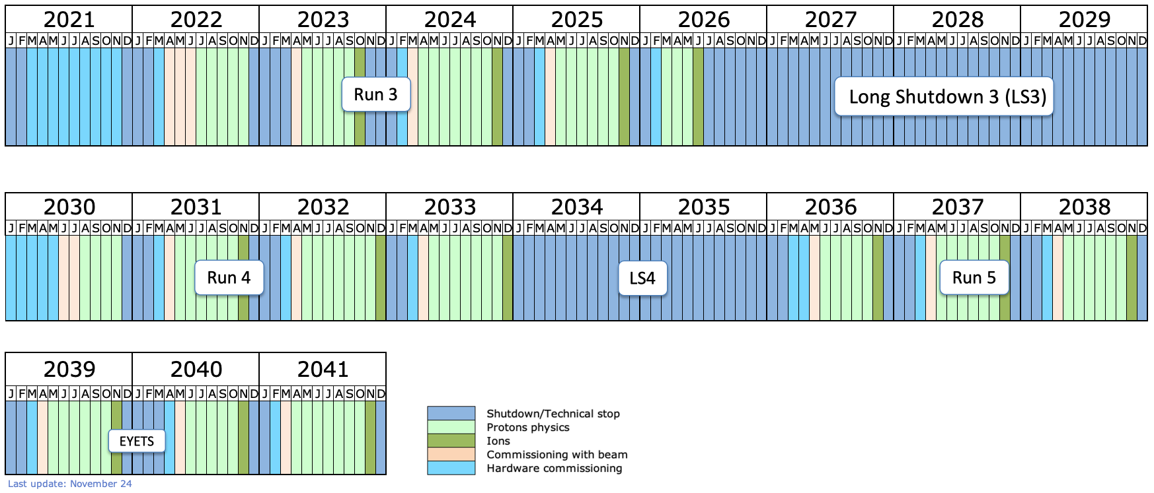
Detector Upgrades: LHC Timeline
today
LS2: Upgrade of accelerator and detectors (Phase I)
LS3: Upgrade HL-LHC and Phase II ATLAS&CMS North Area Upgrade (SHiP)
start HL-LHC
LS4: Upgrade Phase IIb ALICE&LHCb

Slide 19
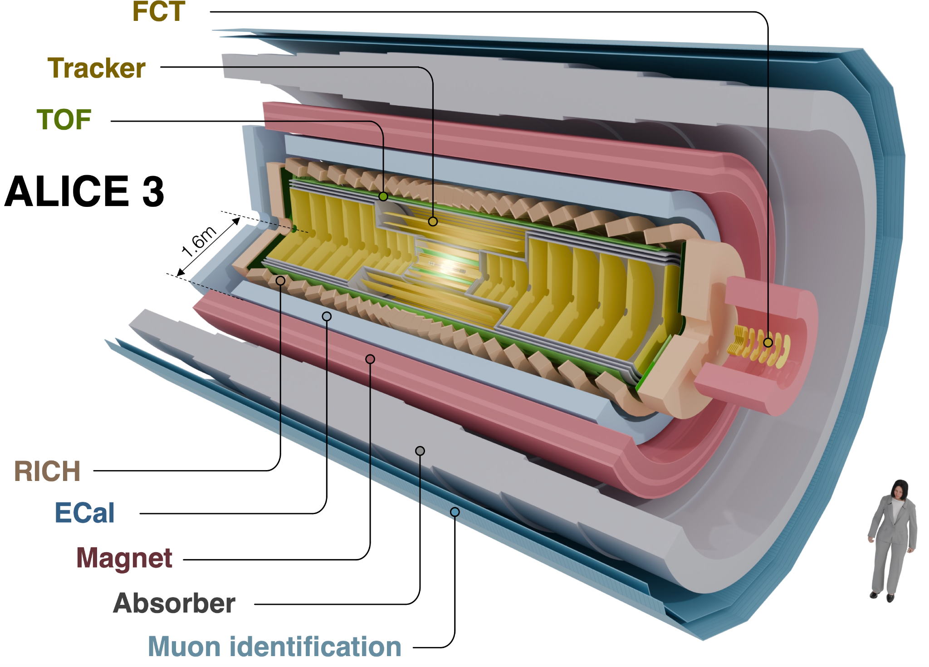
ALICE & LHCb upgrades: Scoping Options
CERN-LHCC-2024-010
CERN-LHCC-2025-002
Scoping options:
Without ECAL
Reduced field (2 T → 1T)
Reduced acceptance |η| < 2.5
Estimated core cost range: 116 - 170 MCHF
The Research Board recommended that ALICE
concentrates on the scoping options without ECal,
and with acceptance that can be afforded with the
resources available.
Estimated core costs [MCHF]:
182 156 125
The Research Board recommended that LHCb
concentrates on the Middle scoping scenario,

Slide 20
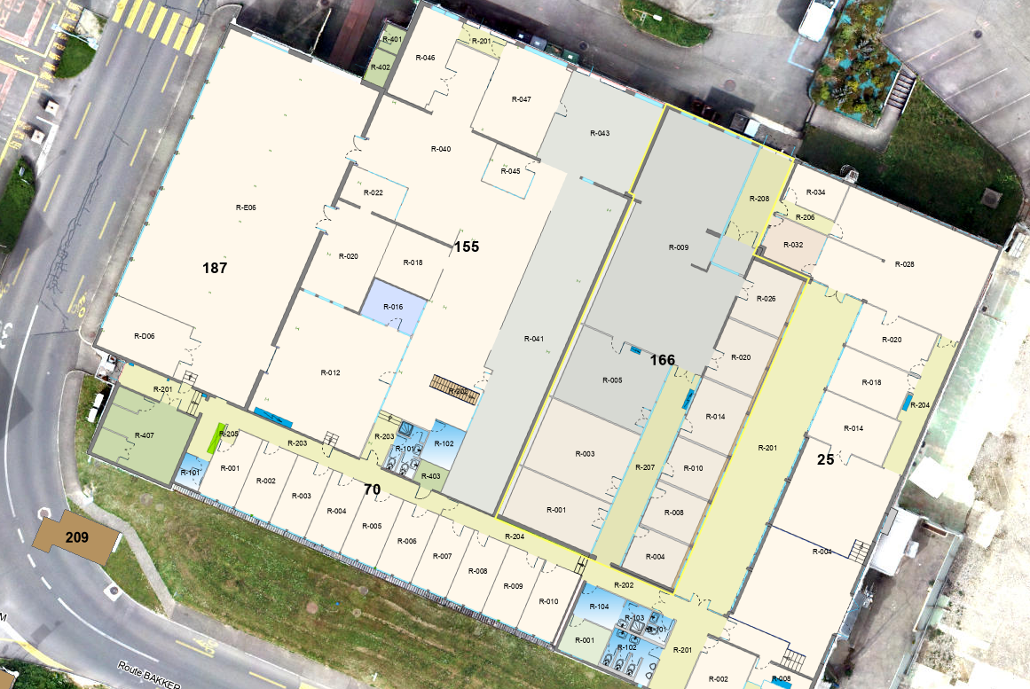
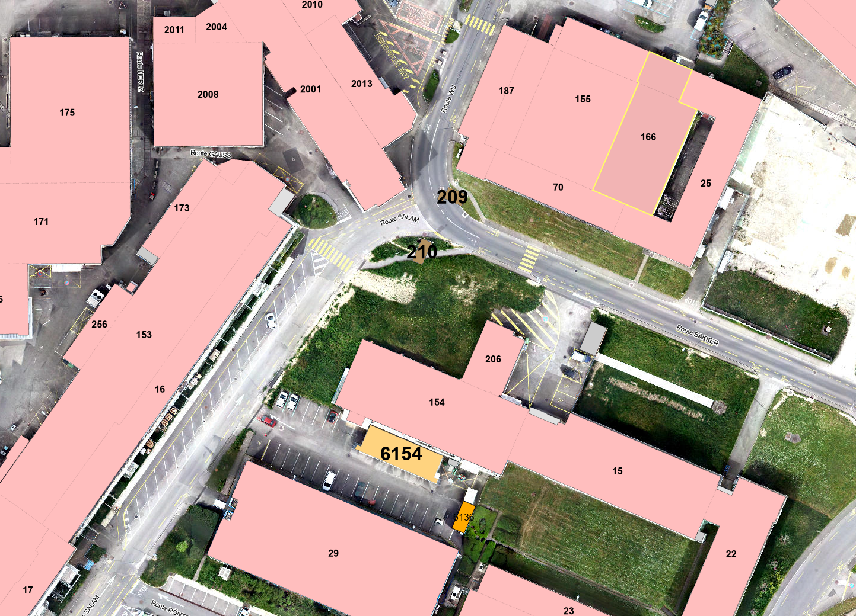
Plans for relocation of DT colleagues
in buildings 25 and 166
DT-EO ATLAS team
B25/R → B15/1
DT-EO ALICE team
B25/R →B29/1
DT-CO and EO
CMS team
B25/R → B155
B166/R →
B22/R + 15/R+S
Secretariat + Management
B166/R
Workshop manager,
no moving

Slide 21
Concluding remarks
We are living in very challenging times, from many viewpoints!
We are committed to support the CERN experiments with the resources available, which are very tight.
Contribute to the timely completion of the upgrades of ATLAS and CMS, partially with more volatile resources (TECH, DOCT, GRAE, FSUs etc.).
Define better our contribution for the future upgrades of ALICE and LHCb, which are fundamental for the group for the 2030s.
The collaboration with the teams of the experiments is very good.
Building 140 is another challenge, including the temporary relocation of offices, but progress has been finally very good over the past year
The age-profile of persons on ICs is a concern as 30% of the staff will retire before the end of the decade.
It is important to maintain the expertise and facilities of EP-DT and the various services we provide.
We have to ensure continuity of the competencies in the DT group!

