Slide 1

Update of the European Strategy for Particle Physics 2026 - What are the options? EP-DT group meeting 2025 June 11, 2025 B. Schmidt, D. Dannheim

Slide 2
European Strategy for Particle Physics (ESPP)
The ESPP is the process by which “approximately every 5 years”, the European particle physics community updates
the strategy and priorities of the field.
It also provides recommendations on activities beyond the scientific programme: training and careers of the young people,
knowledge transfer, environmental impact, education, communications and outreach, etc.
First ESPP in 2006; first update in 2013; second update in 2020; ongoing update to be concluded in 2026.
Bottom-up process involving the community.
Driven by physics (in the brought sense), with awareness of financial and technical feasibility.
ESPP produces the European roadmap in the worldwide context of the field.
Particle physics requires global coordination, given the number, size and complexity of the projects.
Colleagues from Asia and the Americas are involved in the process.
The Strategy is adopted by the CERN Council.
Note - The ESPP provides input and recommendations to the Council about the community’s aspirations and priorities.
It does not approve projects.
- Adoption of the ESPP by the Council does not automatically imply approval of all projects recommended by it.
Projects are individually approved by the Council through a separate decision process.
Small projects approved through MTP. For big projects, approval is usually based on additional documentation beyond
the input to the ESPP (e.g. Technical Design Reports, etc.)
The CERN DG is responsible for the implementation of the Strategy
From the DG, Fabiola Gianotti

Slide 3
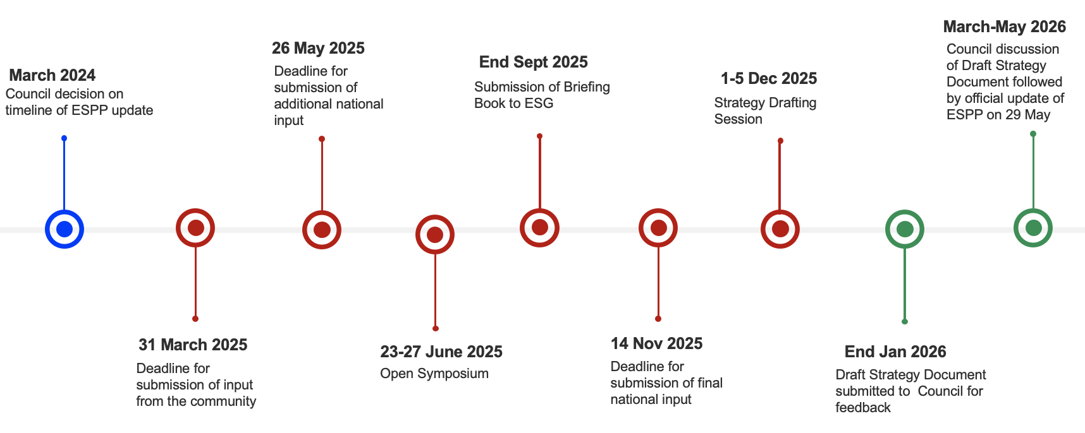
Timeline for the ESPP update 2026
All work and steps of the ESPP update, but the Council approval, will take place in 2025
March 31: deadline for submission of the community input
June 23-27: Open Symposium in Venise
December 1-5: Strategy Drafting Session in Monte Verità, Ascona, Switzerland
May 29, 2026: adoption of the Strategy update by CERN Council at an extraordinary session in Budapest
→ conclusion of the process

Slide 4
Comments of the President of Council, Costas Fountas, in the FCC week in May 2025
The next two years are critical for FCC and the ESPP in general.
It is well known that there is no consensus in the council for going ahead with FCC and there is not yet consensus in the community.
The main issue is related to the affordability of the FCC.
Two critical steps will point to the way forward:
The results of the feasibility study along with the associated panel reports will be presented to the council in November 2025
The council meeting in May 2026 with topic the update of the ESPP.
Thereafter the ability of the CERN management to attract external collaborators who could provide significant contributions to the FCC project is critical.
This is closely related to the governance question of the next flagship project of CERN and clearly it involves negotiations between CERN potential contributors which may be states or private entities.
Throughout this time the CERN council will be closely involved in defining the terms of the negotiations and intervening as needed to express the will of the member states.

Slide 5
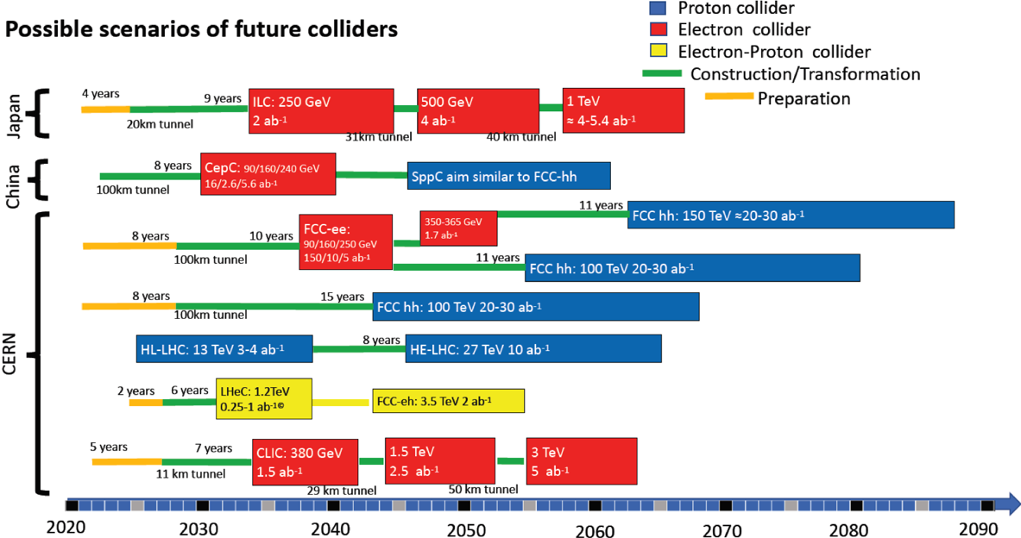
Possible Scenarios for Future Colliders as of 2019
Scenarios shown at the ESPP Open Symposium
in Granada in May 2019
Everything shifted by
at least 5 years

Slide 6

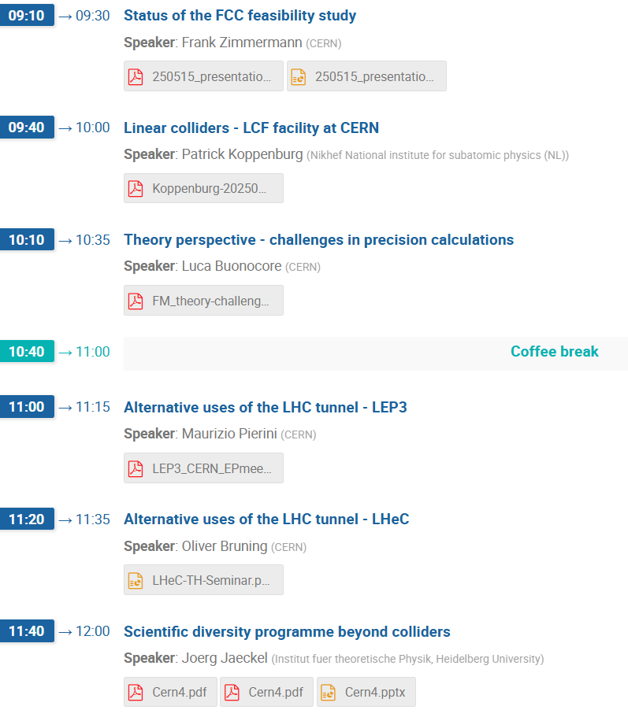

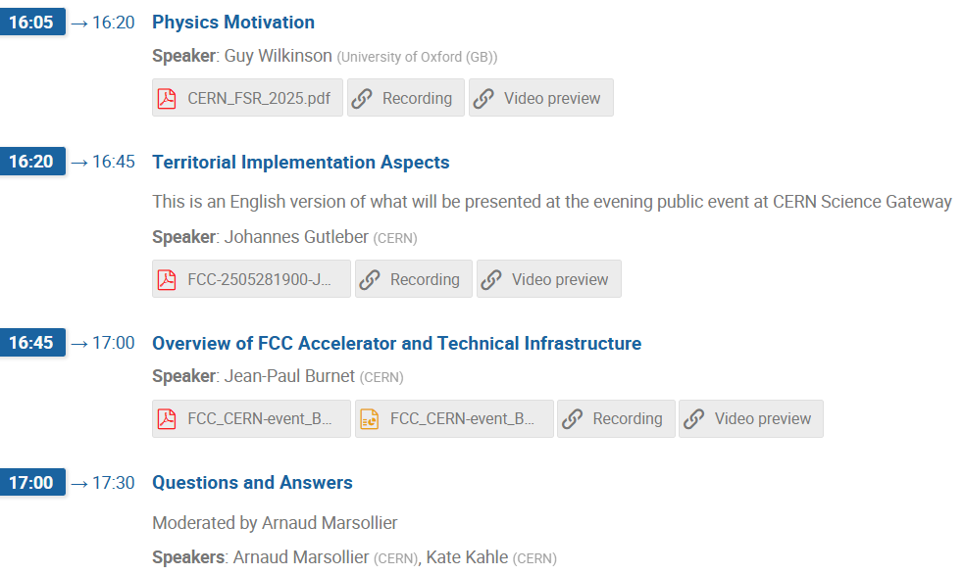
Most of the slides shown in the following are from
Presentations made in the above meetings

Slide 7
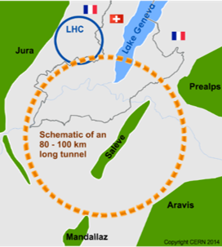
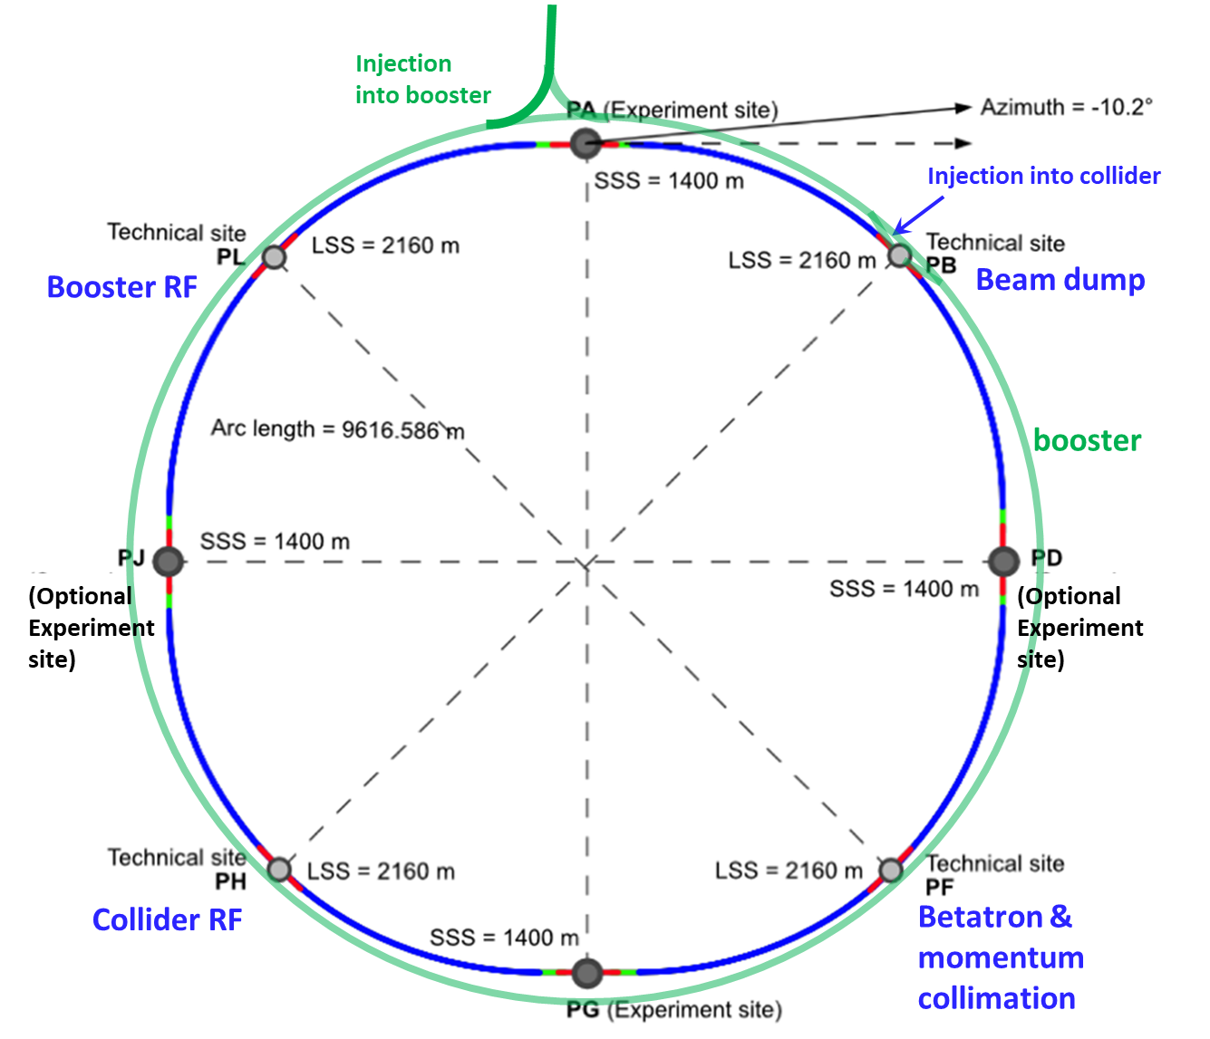
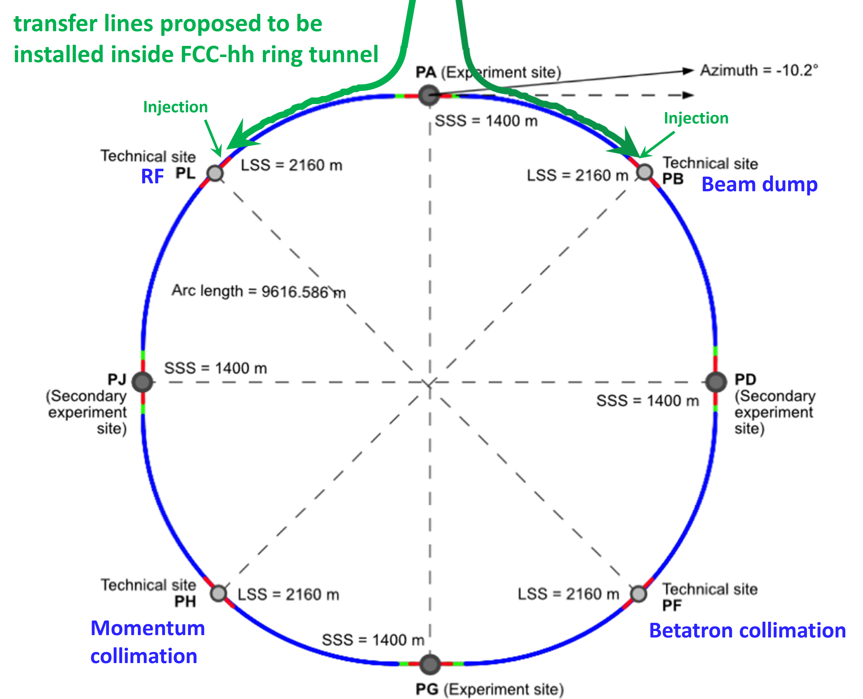
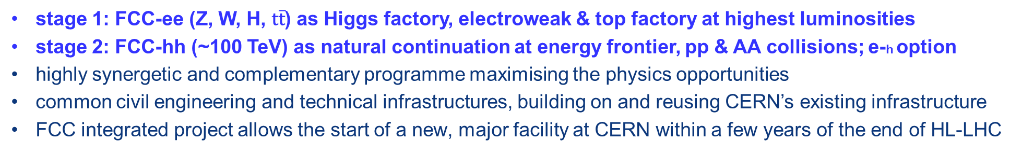
Integrated program for the Future Circular Collider
stage 1: FCC-ee (Z, W, H, $\text{t}\overline{\text{t}}$) as Higgs factory, electroweak & top factory at highest luminosities
stage 2: FCC-hh (~100 TeV) as natural continuation at energy frontier, pp & AA collisions; e-h option
highly synergetic and complementary programme maximising the physics opportunities
common civil engineering and technical infrastructures, building on and reusing CERN’s existing infrastructure
FCC integrated project allows the start of a new, major facility at CERN within a few years of the end of HL-LHC
Presented by
Frank Zimmermann
FCC-ee
FCC-hh
2020 - 2045
2045 - 2065
2070 -

Slide 8
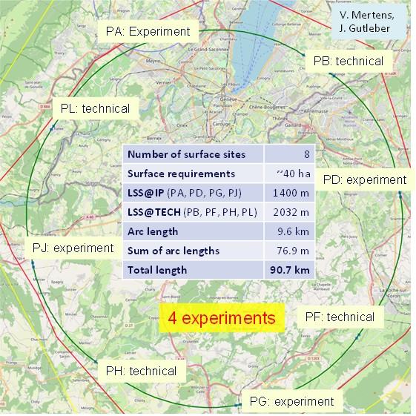
Reference layout and implementation: 90.7 km
Layout chosen out of ~ 100 initial variants, based on geology and surface constraints (land availability, access to roads, etc.), environment, (protected zones), infrastructure (water, electricity, transport), machine performance etc.
“Avoid-reduce-compensate” principle of EU and French regulations
Overall lowest-risk baseline:
90.7 km ring, 8 surface points,
4-fold symmetry
(Reduction from the 97.8 km and the 12 surface sites in 2019)

Slide 9
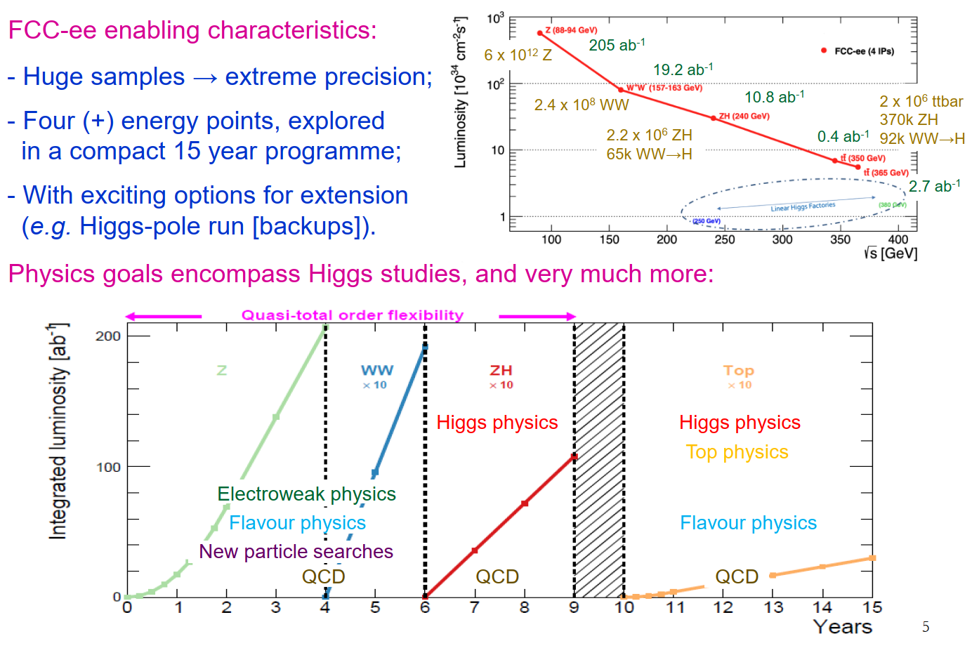
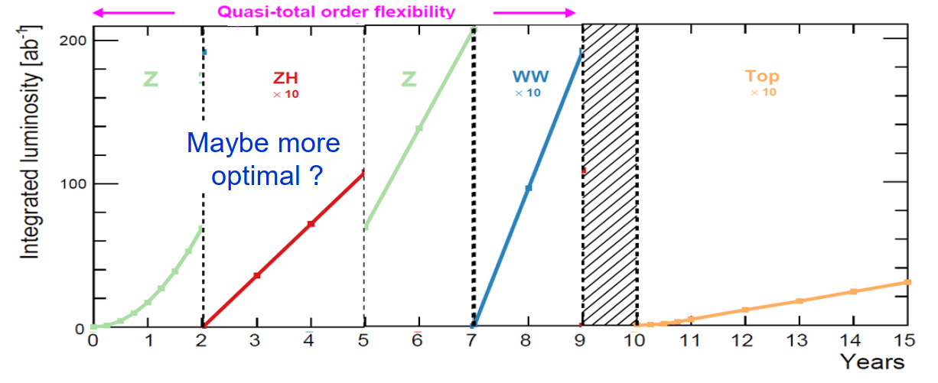
FCC-ee essentials and enabling characteristics
Presented by
Guy Wilkinson

Slide 10
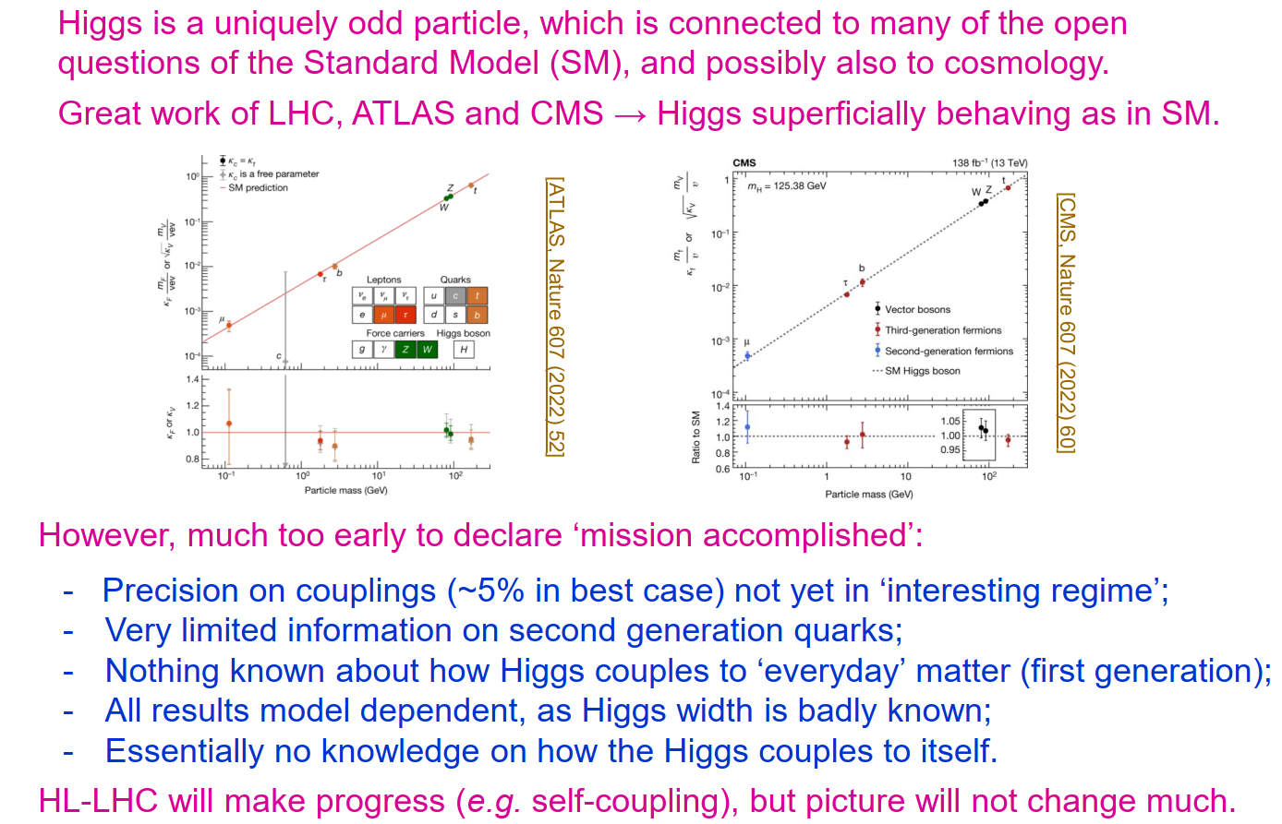
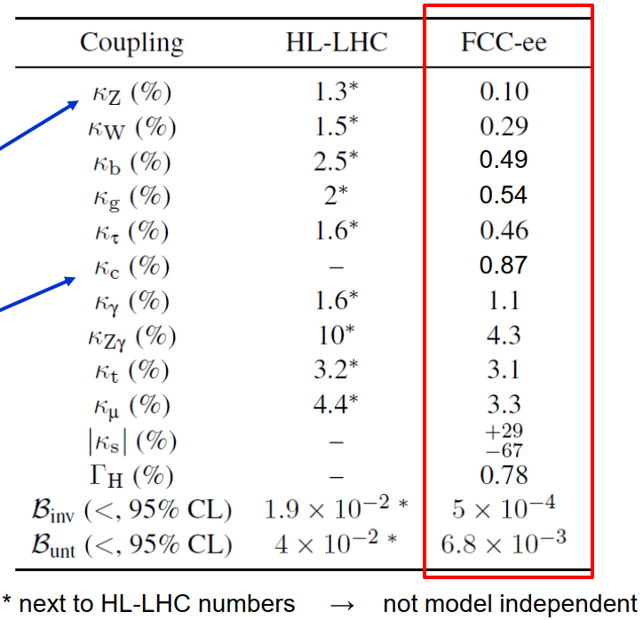
Higgs physics at the end of the HL-LHC
Presented by
Guy Wilkinson
FCC-ee reaches
~0.1% precision
Access to 2nd
gen. quarks

Slide 11
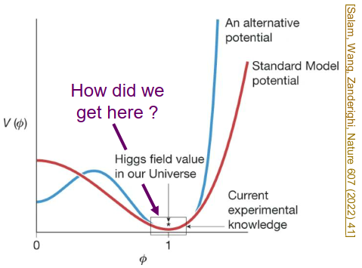
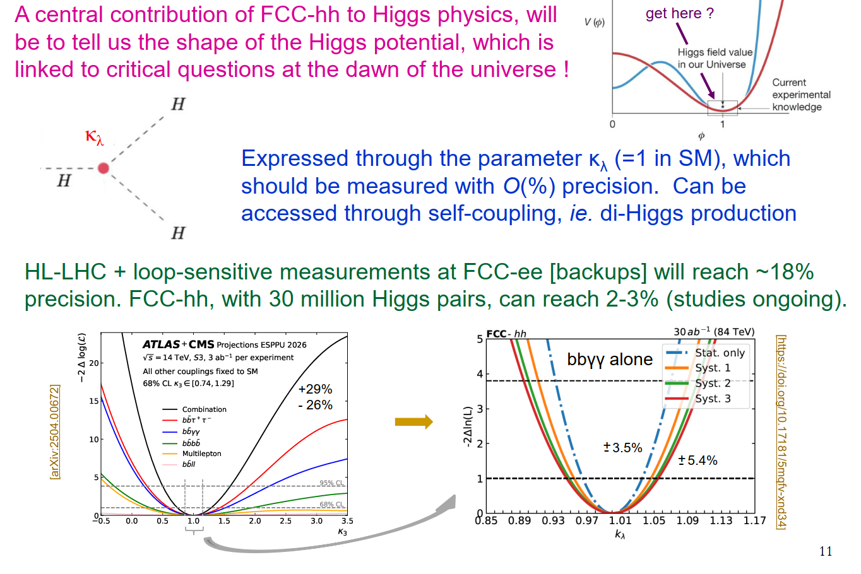
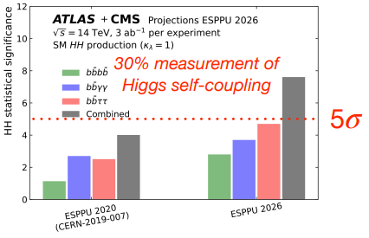
Higgs self-coupling at HL-LHC and FCC-hh
A central contribution of FCC-hh to Higgs physics, will be to tell us the shape of the Higgs potential, which is linked to critical questions at the dawn of the universe !

Slide 12

FCC-ee cost estimate, FSR 2025
Capital cost for construction of the FCC-ee is summarised below. This cost includes construction of the entire new infrastructure and all equipment for operation at the Z, WW and ZH working points.
Domain | Cost [MCHF]
Civil engineering | 6,160
Technical infrastructures | 2,840
Injectors and transfer lines | 590
Booster and collider | 4,140
CERN contribution to four experiments | 290
FCC-ee total | 14,020
+ four experiments (non-CERN part) | 1,300
FCC-ee total incl. four experiments | 15,320
Operation of the FCC collider at the $\text{t}\overline{\text{t}}$working point will require later installation of additional RF cavities and associated cryogenic cooling infrastructure with a corresponding total cost of 1,260 MCHF.

Slide 13
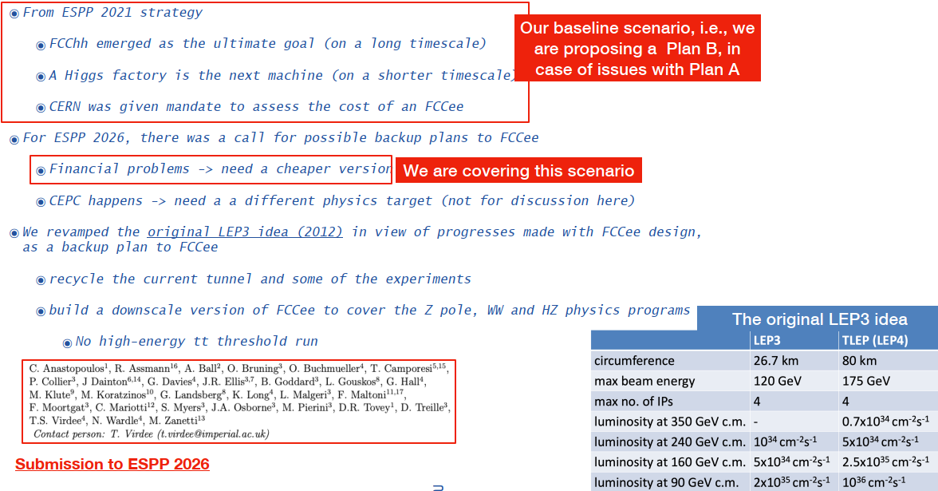
Alternative uses of the LHC tunnel - LEP3
Presented by
Maurizio Pierini

Slide 14
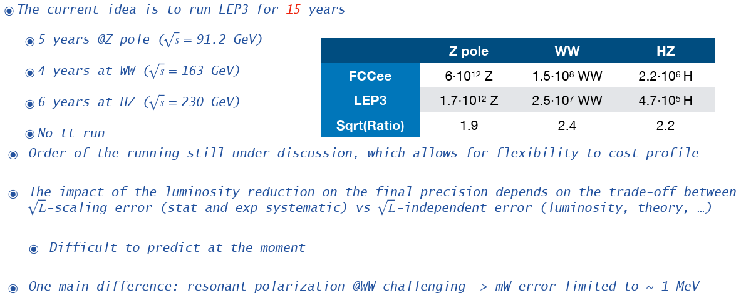
The LEP3 Physics Program in a nutshell

Slide 15
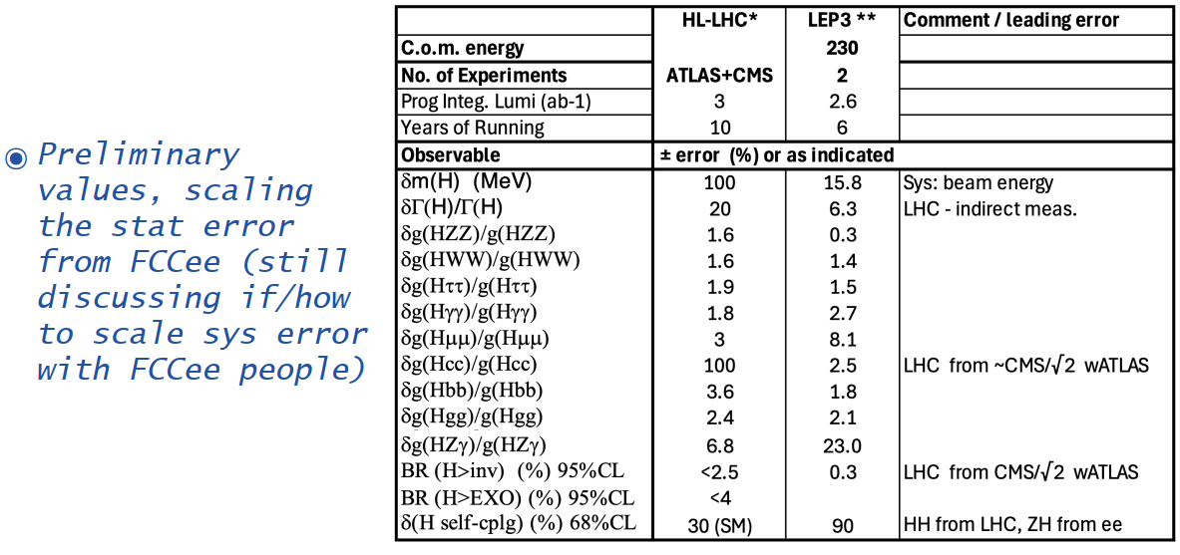
Physics Performance Comparison HL-LHC / LEP3
Higgs Physics

Slide 16
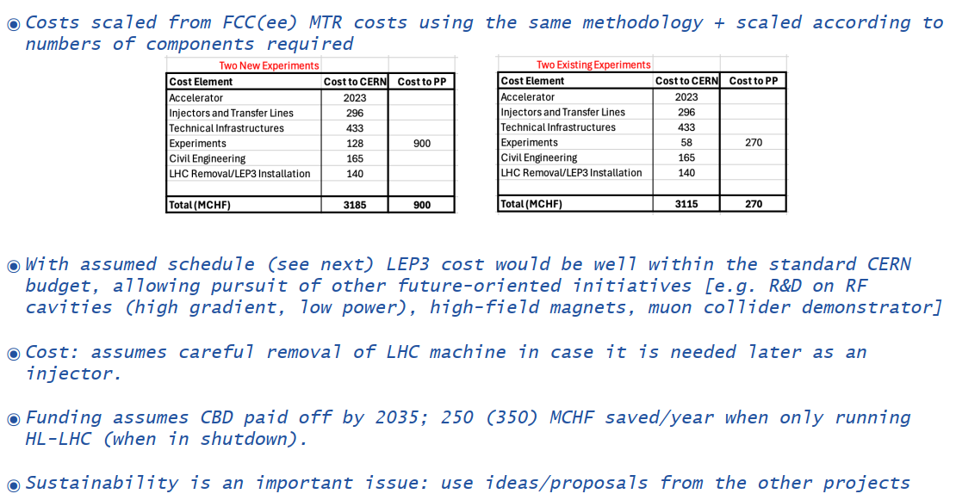
Cost Estimation and time-line for LEP3
A construction budget
of ~3.5 BCHF
is required.
The operations budget
will be high due to
Synchrotron Radiation!
LEP3 could be operational within ~ 5 years from the end of HL-LHC operation

Slide 17
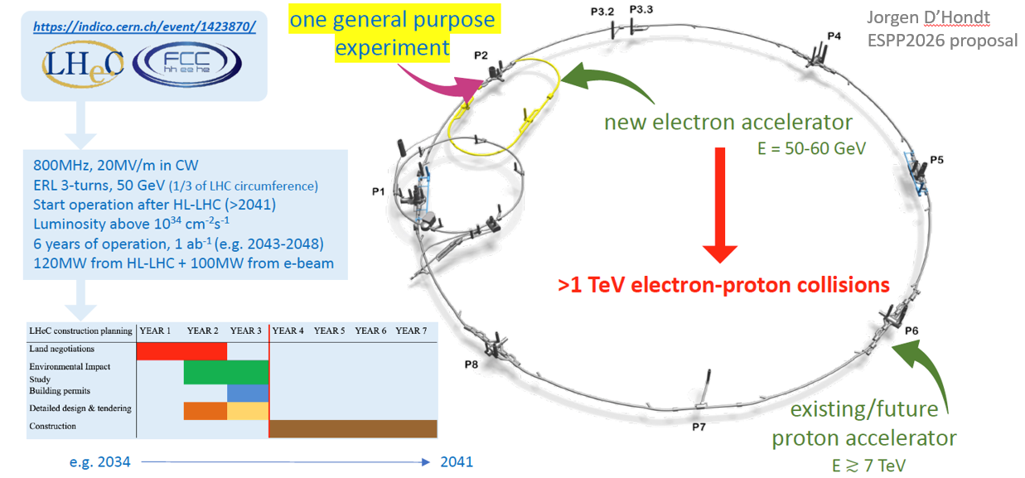
Alternative uses of the LHC tunnel - LHeC
Presented by:
Oliver Bruning
Required Budget : 1 – 1.8 BCHF (CERN-ACC-2018-0061) (~10% of FCC ee)

Slide 18
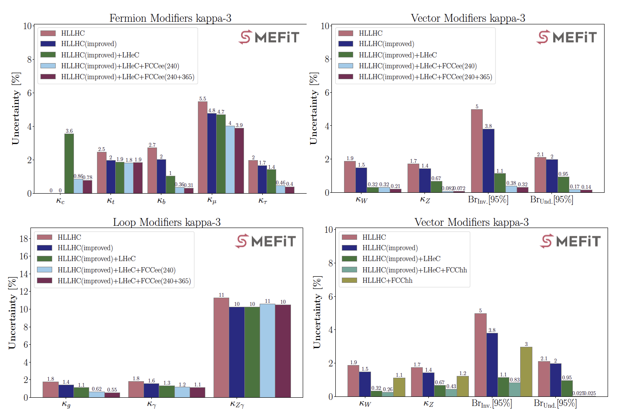
Some physics highlights of LHeC: Higgs physics
The LHeC is partially a Higgs Factory with several couplings significantly improved over HL-LHC expectations, and some even more accurately compared to FCC-ee at 240 GeV.
significantly improved:
κ_{t}, κ_{τ}, κ_{g}
greatly improved:
κ_{b}, κ_{W}, κ_{Z}
first time ever:
κ_{c}
Figure:
The relative uncertainty on the fermion, vector and loop coupling modifiers obtained in the kappa-3 framework, for different combinations of the HL-LHC, HL-LHC (with improved PDFs from the LHeC), LHeC, and FCC-ee.
first time ever

Slide 19
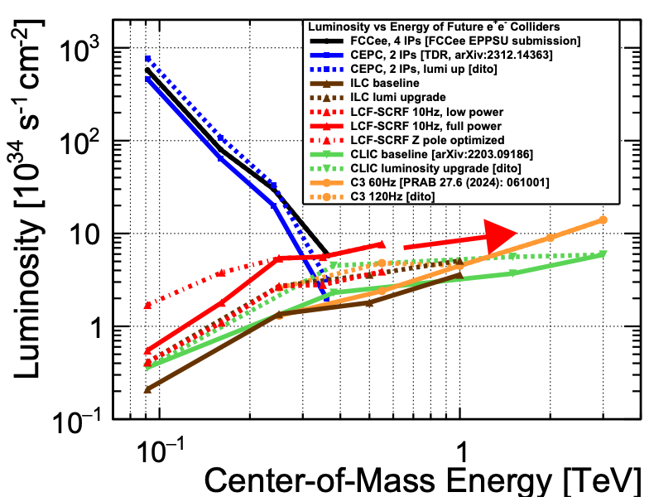
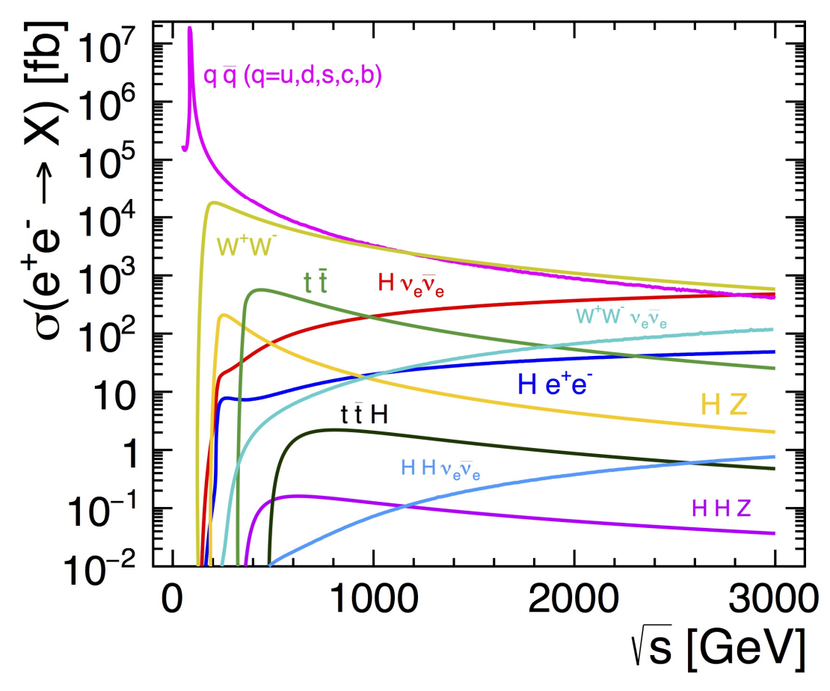
Motivation for a Linear Lepton Collider
Synchrotron radiation losses in circular lepton colliders limit energy and luminosity reach and efficiency
Linear lepton colliders can reach higher centre-of-mass energies at lower power budget
Linear colliders can be extended in length (staged construction) to increase the energy towards multi-TeV
→ Unique combination of high collision energies with high luminosity and clean e⁺e⁻ environment
Flexible running and upgrade scenarios, adaptable to physics results and advancements in accelerator technology
Probe various Higgs- and top-production processes dominant at different energy scales
Sensitivity to new physics with electroweak-sized coupling strength or through mixing with known particles
Energy and luminosity reaches for circular and linear colliders:
Complementary Higgs measurements by accessing wide energy range:
Radiation off top-quarks: e⁺e⁻→ttH
Measure top Yukawa coupling
Needs √s≳500 GeV
Double-Higgs prod.: e⁺e⁻→HHν_{e}ν_{e}
Measure tri-linear self coupling
Needs high √s ≳1.5 TeV

Slide 20
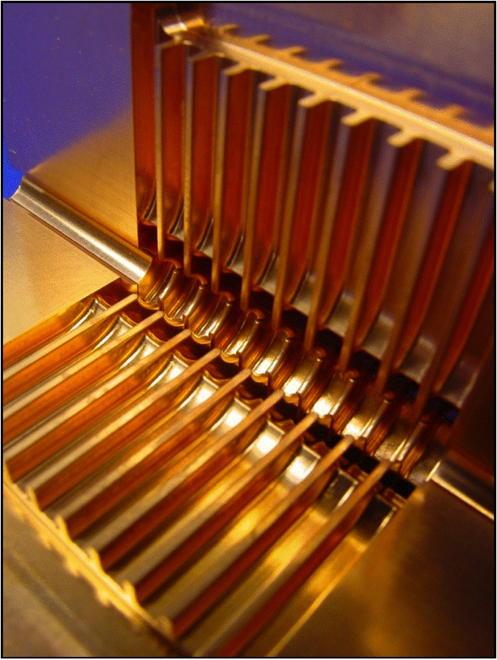
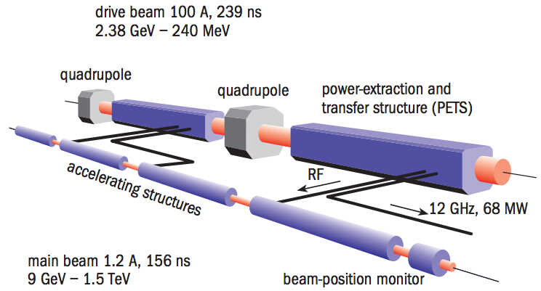
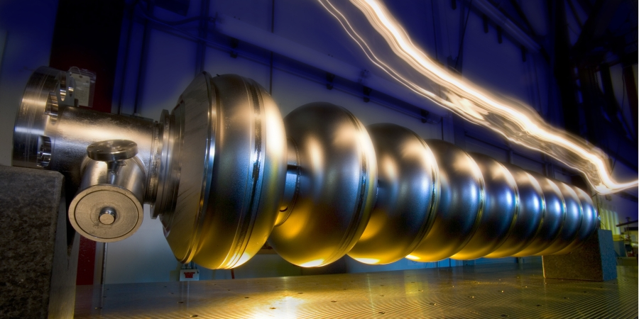
Linear Collider acceleration technologies
Linear collider requires very high acceleration gradients + low emittance to reach high centre-of-mass energy + luminosity
Various technologies under study, with different levels of maturity
Focus of CERN studies on CLIC: >450M CHF investements in R&D since 1992
CLIC technology
244 ns
1.91 GeV
ILC technology
176 ns
2-beam acceleration scheme operated at room temperature
Gradient 72-100 MV/m
Demonstrated in CTF3 test facility at CERN
C³ technology
Plasma-Wakefield Acc.
Normal-conducting coupling accelerators operated at cryogenic temperature
Gradient 70-120 MV/m
Component + system R&D in progress
Electric field of plasma wave is used to accelerate e⁻, e⁺
Gradient ≳10 GV/m
Early-stage R&D, e⁺ acc. not shown
Superconducting RF cavities
Gradient 32 MV/m
Industrialized technology, used e.g. for XFEL

Slide 21
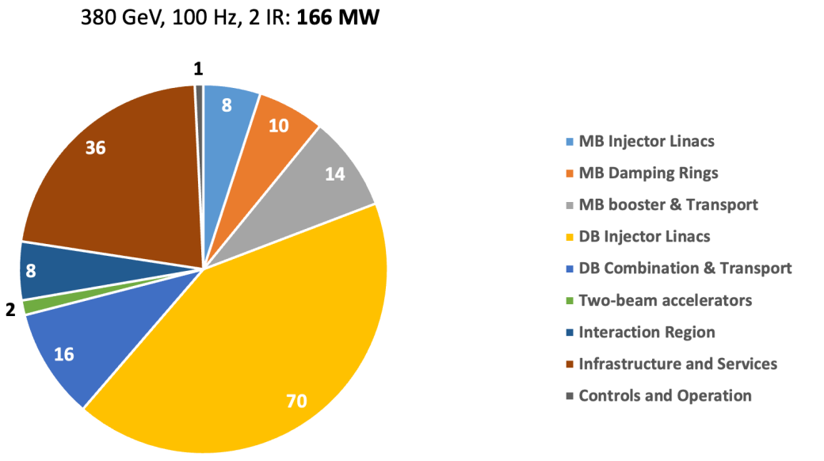
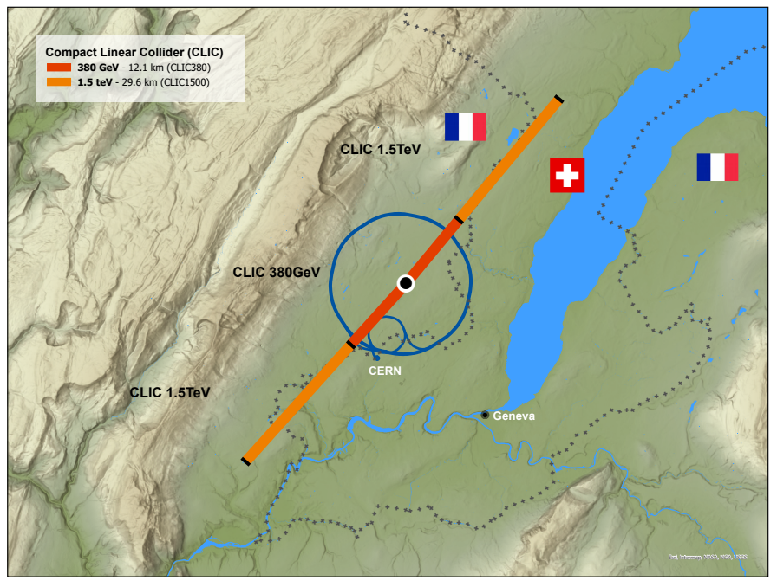
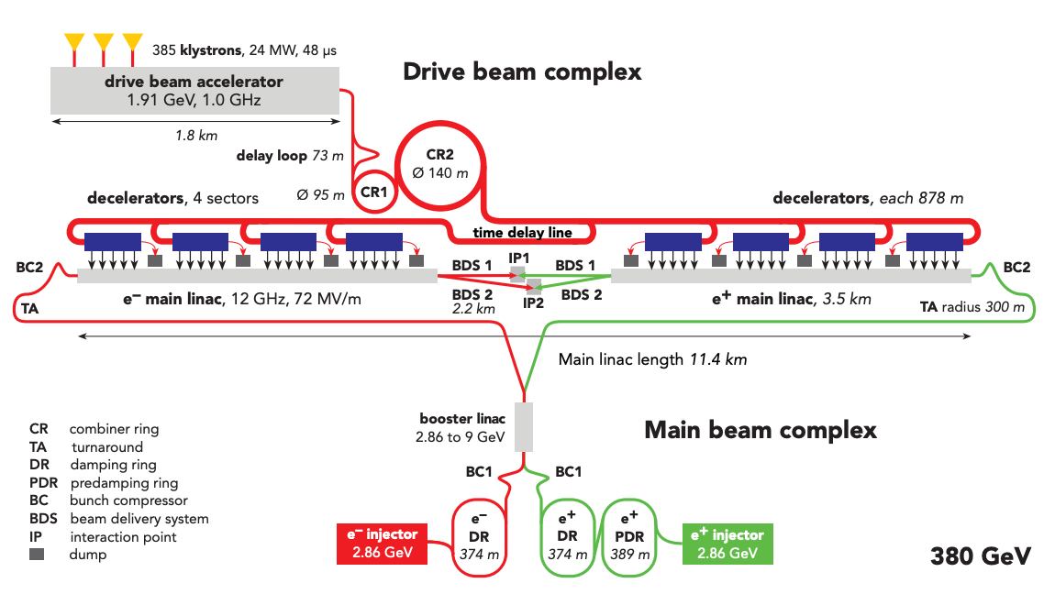
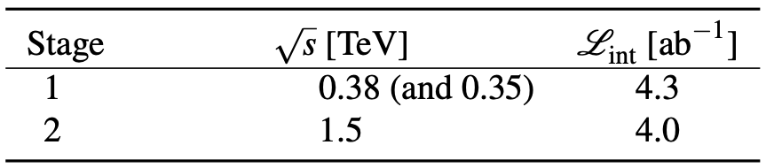
CLIC staged implementation
New 2025 staging baseline optimised for luminosity performance, cost and power:
380 GeV: 12.1 km tunnel, 100 Hz operation, P=166 MW, L_{tot} = 4.5 x 10³⁴ cm⁻² s⁻¹
1.5 TeV: 29.6 km tunnel, 50 Hz operation, P=282 MW, L_{tot} ~ 5.6 x 10³⁴ cm⁻² s⁻¹
2 interaction points, flexible sharing of luminosity
Single drive beam for both stages (feasible up to 2 TeV)
3x higher luminosity / power, compared to 2018 design (0.82 TWh/y @380 GeV; 1.4 TWh/y @1.5 TeV)
https://indico.cern.ch/event/1439855/contributions/6461475/

Slide 22
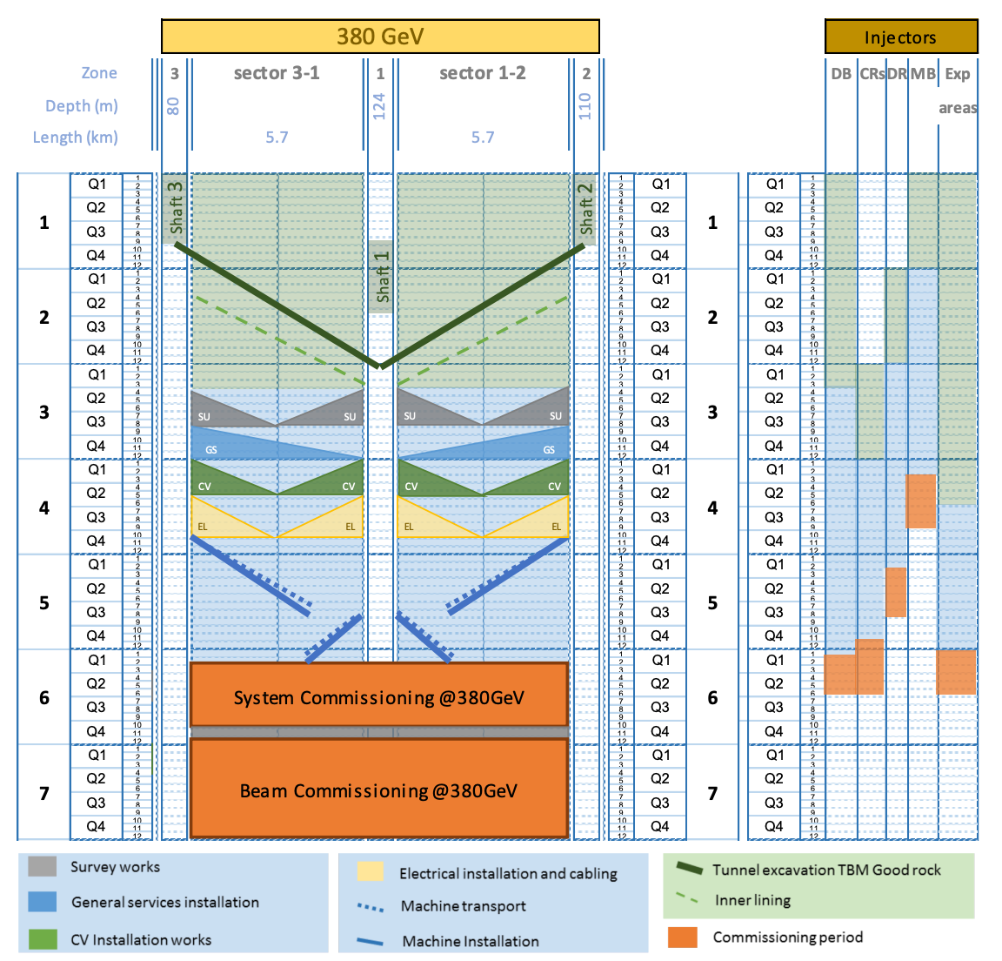
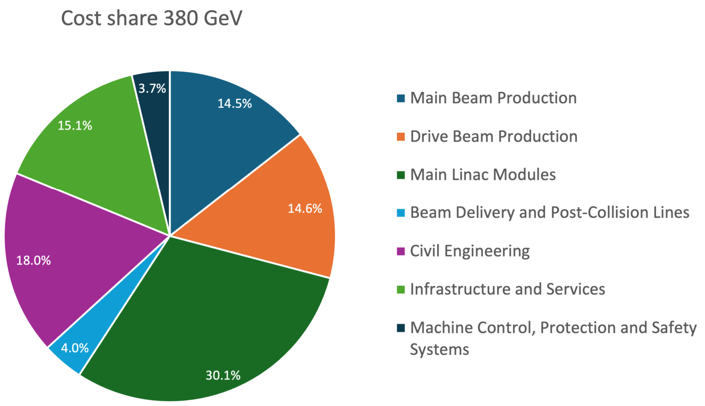
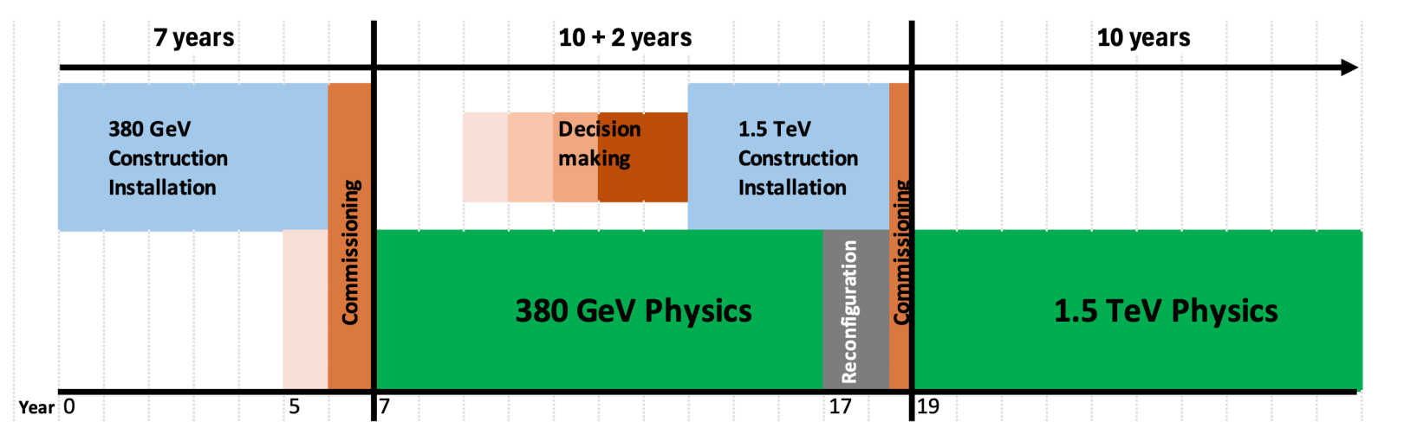
CLIC schedule and cost
Construction schedule for 380 GeV stage
First stage can be constructed in 7 years, starting ~2034-35
Cost of 380 GeV stage: 7.2 BCHF
Alternative 250 GeV 1st stage: 6.5 BCHF
Alternative 550 GeV 1st stage: 9.4 BCHF
Construction of 2nd stage with minimal interference (2y gap)
Cost of upgrade to 1.5 TeV: 7.1 BCHF
Cost of detector (CLICdet design): ~400 MCHF
Physics program covers ~10 years per stage, accumulating ≳4 ab⁻¹ per stage
Operation cost @ 380 GeV: 137 MCHF / y + ~650 FTEy / y
Energy cost: 66 MCHF / y @ 380 GeV (112 MCHF /y @ 1.5 TeV)
Construction cost share for 380 GeV
Construction and operation schedule for 2-stages

Slide 23
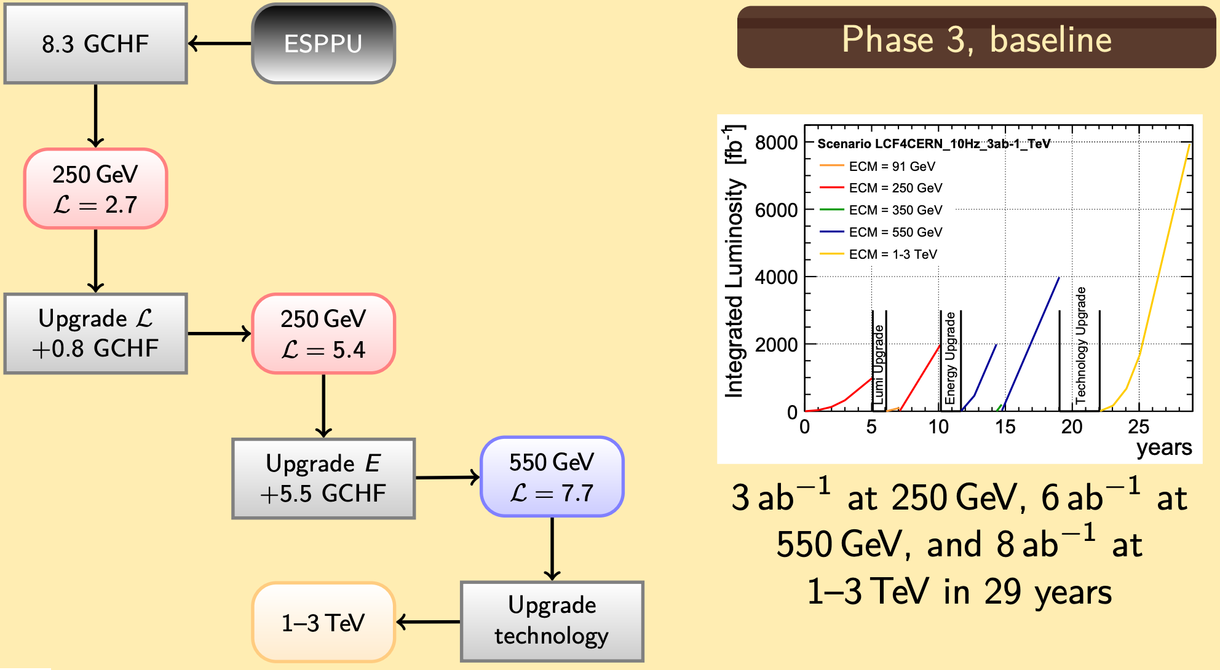
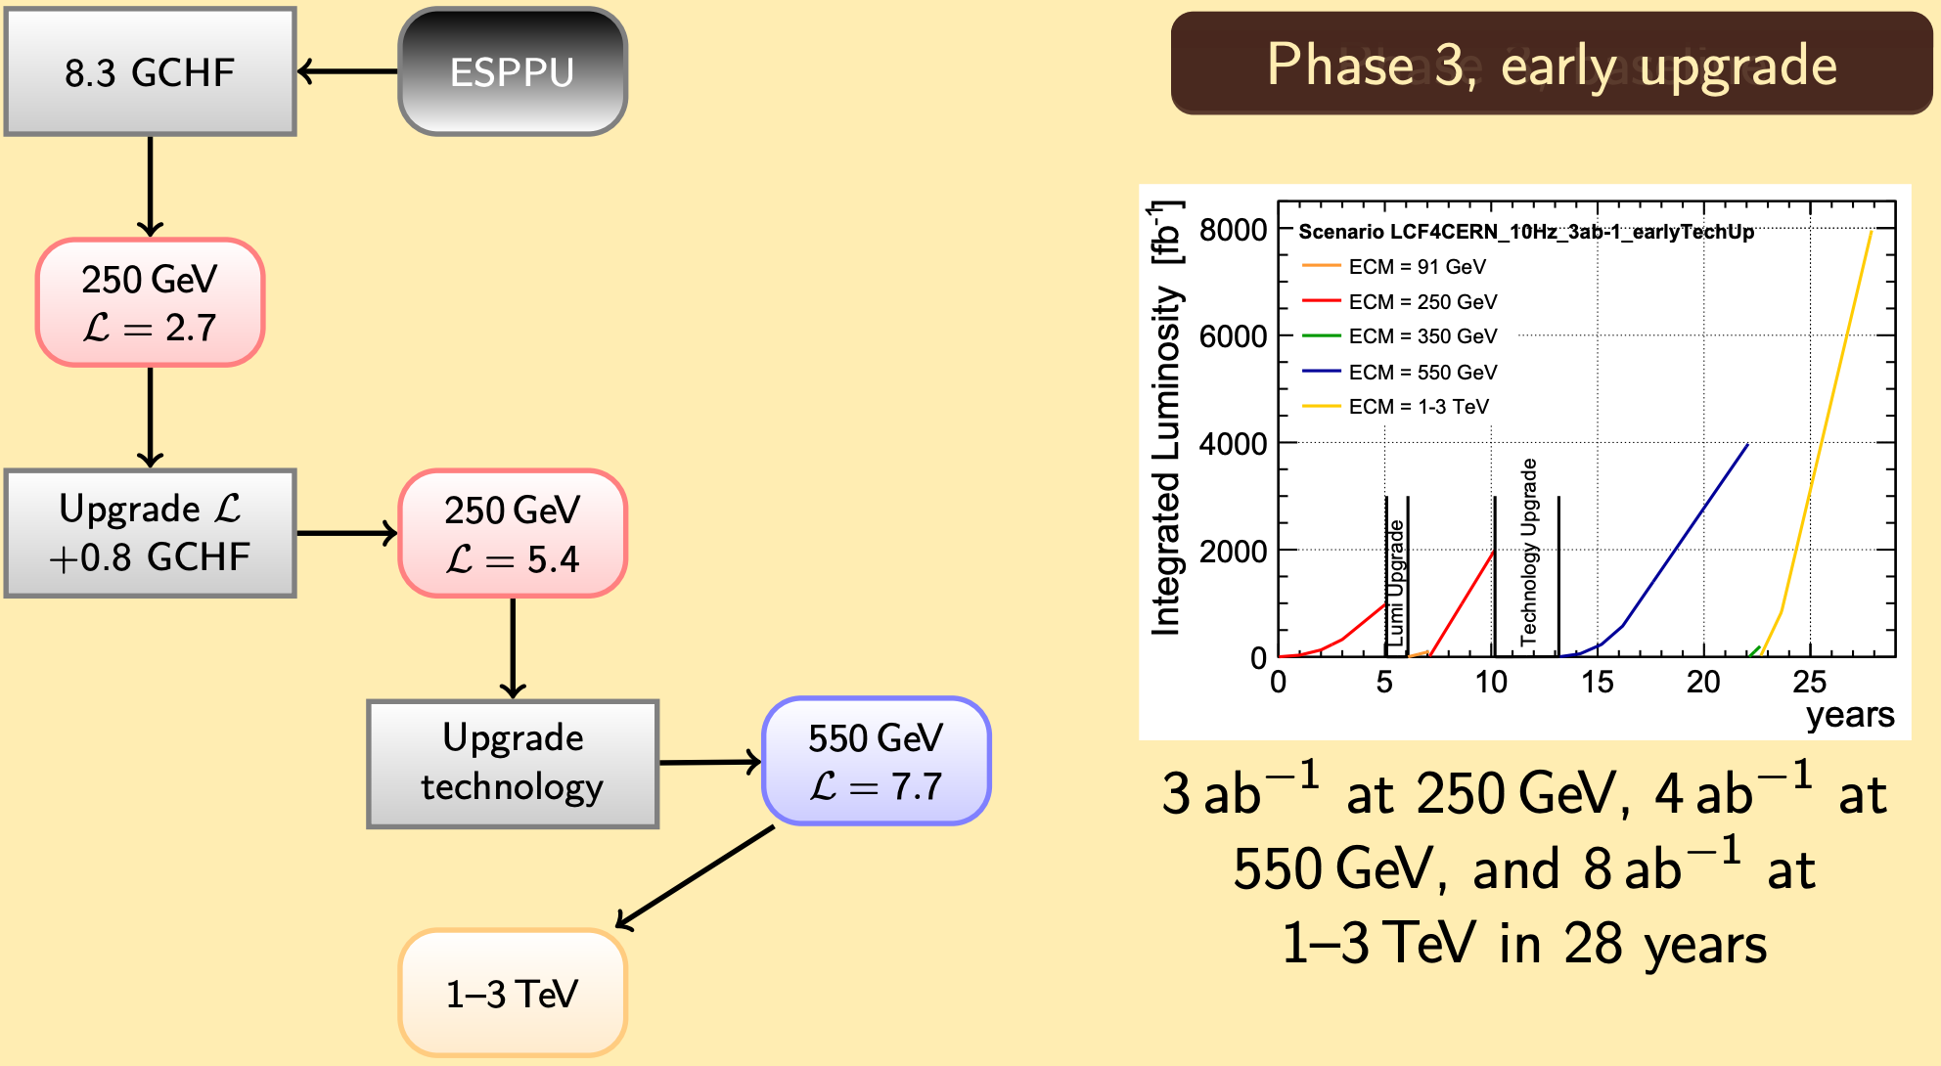
Other options for CERN-based Linear Coll.
CLIC underground civil-engineering footprint is also compatible with alternative acceleration technologies
Strategy submission “Linear Collider Facility @ CERN (LCVision)” discusses several options with SCRF stages
Pros: first stage(s) based on already industrialized SCRF technology
Cons: high cost of initial stages (250 GeV: 9.1 BCHF; 550 GeV: +5.5 BCHF), long down times
Such alternative options show the versatility of the Linear Collider concept
LCVision initiative helps to engage the world-wide ILC community in a CERN-based project
However: CLIC technology remains preferred Lin. Coll. option for CERN in terms of energy reach, feasibility and cost
P. Kloppenburg
https://indico.cern.ch/event/1527581/contributions/6497901/

Slide 24
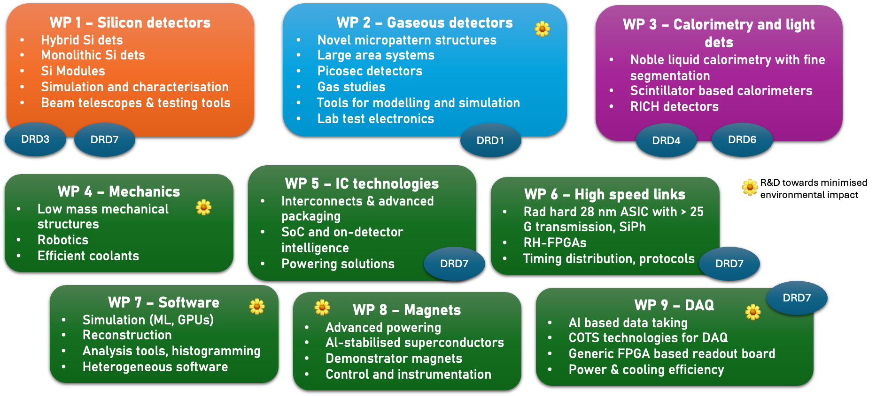

R&D on Experimental Technologies in EP-DT
Since 2020: strategic R&D for future colliders at CERN is performed within EP R&D program (~8M CHF / y)
FCC-ee / CLIC detector requirements are main drivers of the R&D
Strong contribution from EP-DT: 3 of the 9 Work Packages are co-convened / hosted by EP-DT (WP 1, 2, 4)
Activities are embedded in world-wide DRD collaborations and have been co-funded by AIDAinnova
Synergies with HL-LHC upgrade projects, also outside EP R&D (e.g. imaging calorimetry in CMS-HGCAL)
DRD8

Slide 25
Conclusions
FCC-ee and FCC-hh together offer an integrated programme in collider physics that is well matched to continuing the search for physics beyond the Standard Model (‘New Physics’) in the post HL-LHC era;
A precise characterisation of the Higgs boson is central to this programme, but of equal importance is the high sensitivity to New Physics provided by the ultra precise electroweak and heavy flavour measurements and by new particle searches, at both FCC-ee and the energy frontier.
A comprehensive and deep-reaching collider programme for CERN and the global HEP community that will address many of the most profound open questions in fundamental physics.
An e+e− collider in the LHC tunnel, referred to as LEP3, is proposed as a backup option
Compared to the linear e+e− colliders proposed, LEP3 provides similar luminosity for ZH production, higher luminosity at lower energies and options for multiple experiments, all at much lower cost.
LEP3 is a reasonable backup option, leaves room (time, budget, resources) for further develop-ment of a machine that can probe directly the energy frontier at a constituent √s ~ 10 times LHC.
CLIC is a mature option for a Linear Collider at CERN by ~2041
Provides a rich physics program with flexible upgrade options towards multi-TeV
Required resources compatible with CERN’s current budget + moderate external contributions
Challenging detector requirements of all future projects lead to opportunities for R&D in EP-DT

Slide 26
Additional material

Slide 27
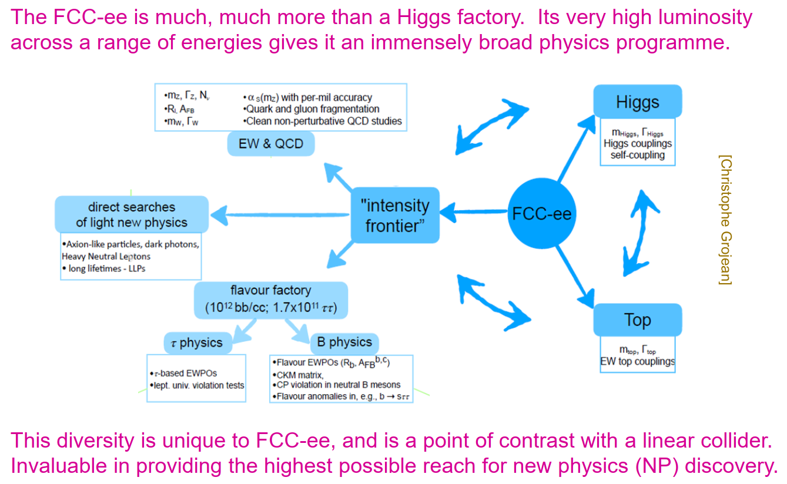
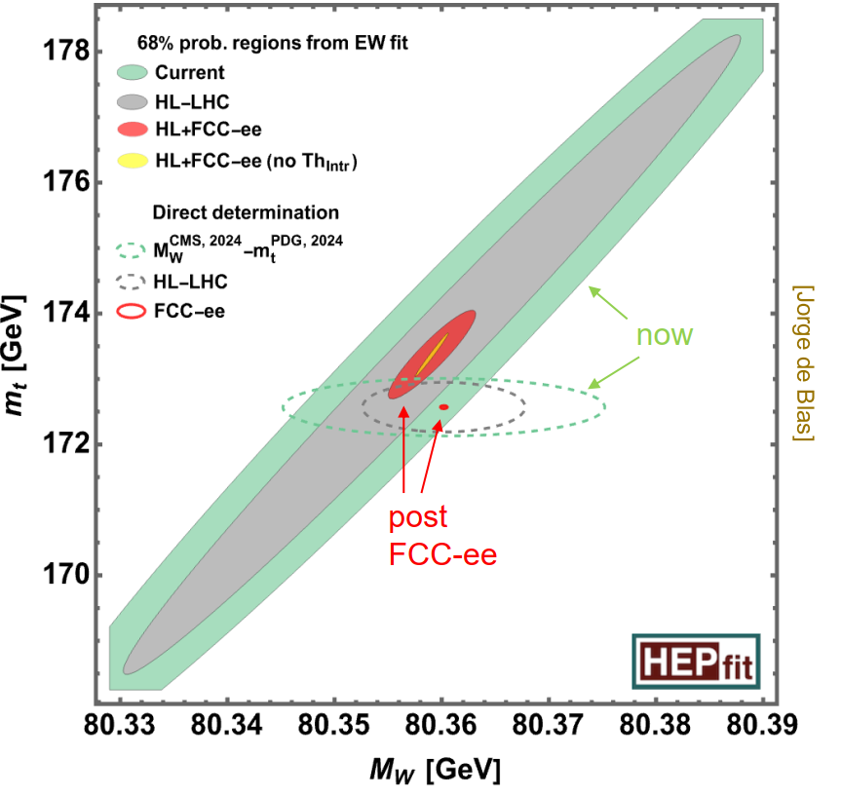
Physics Potential of the FCC-ee

Slide 28
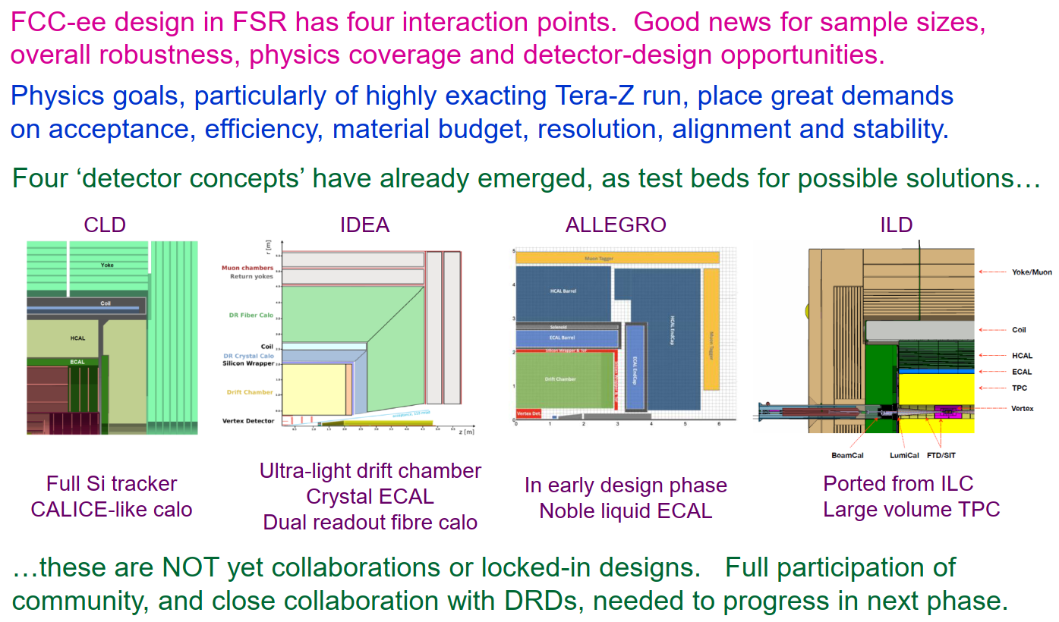
Detector Opportunities at the FCC-ee

Slide 29
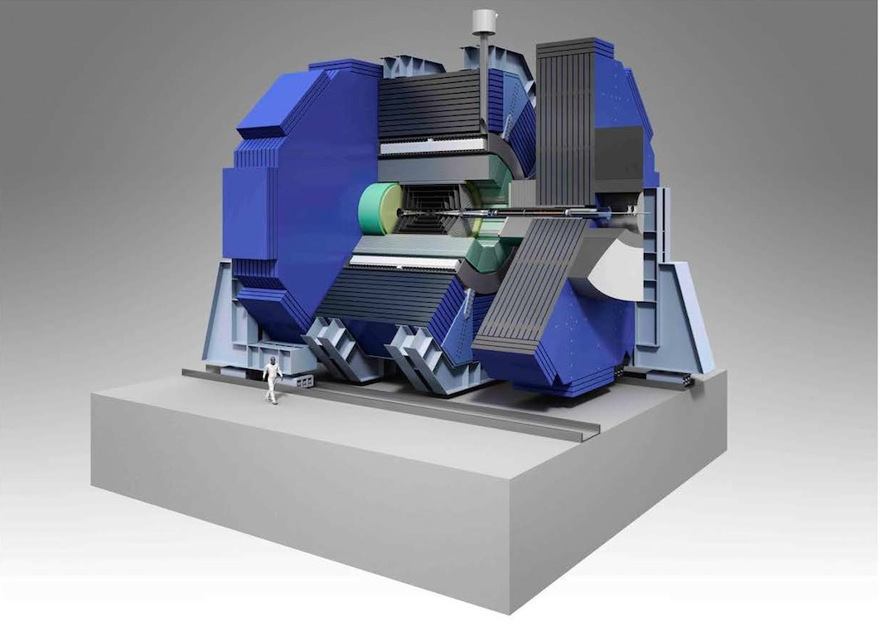
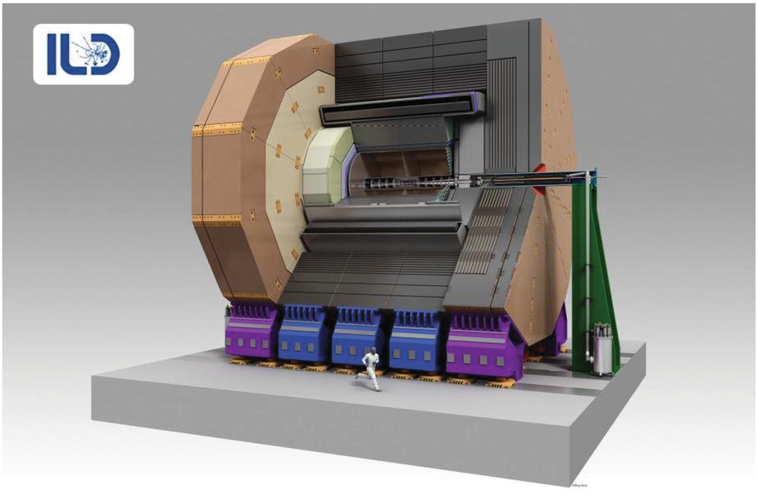
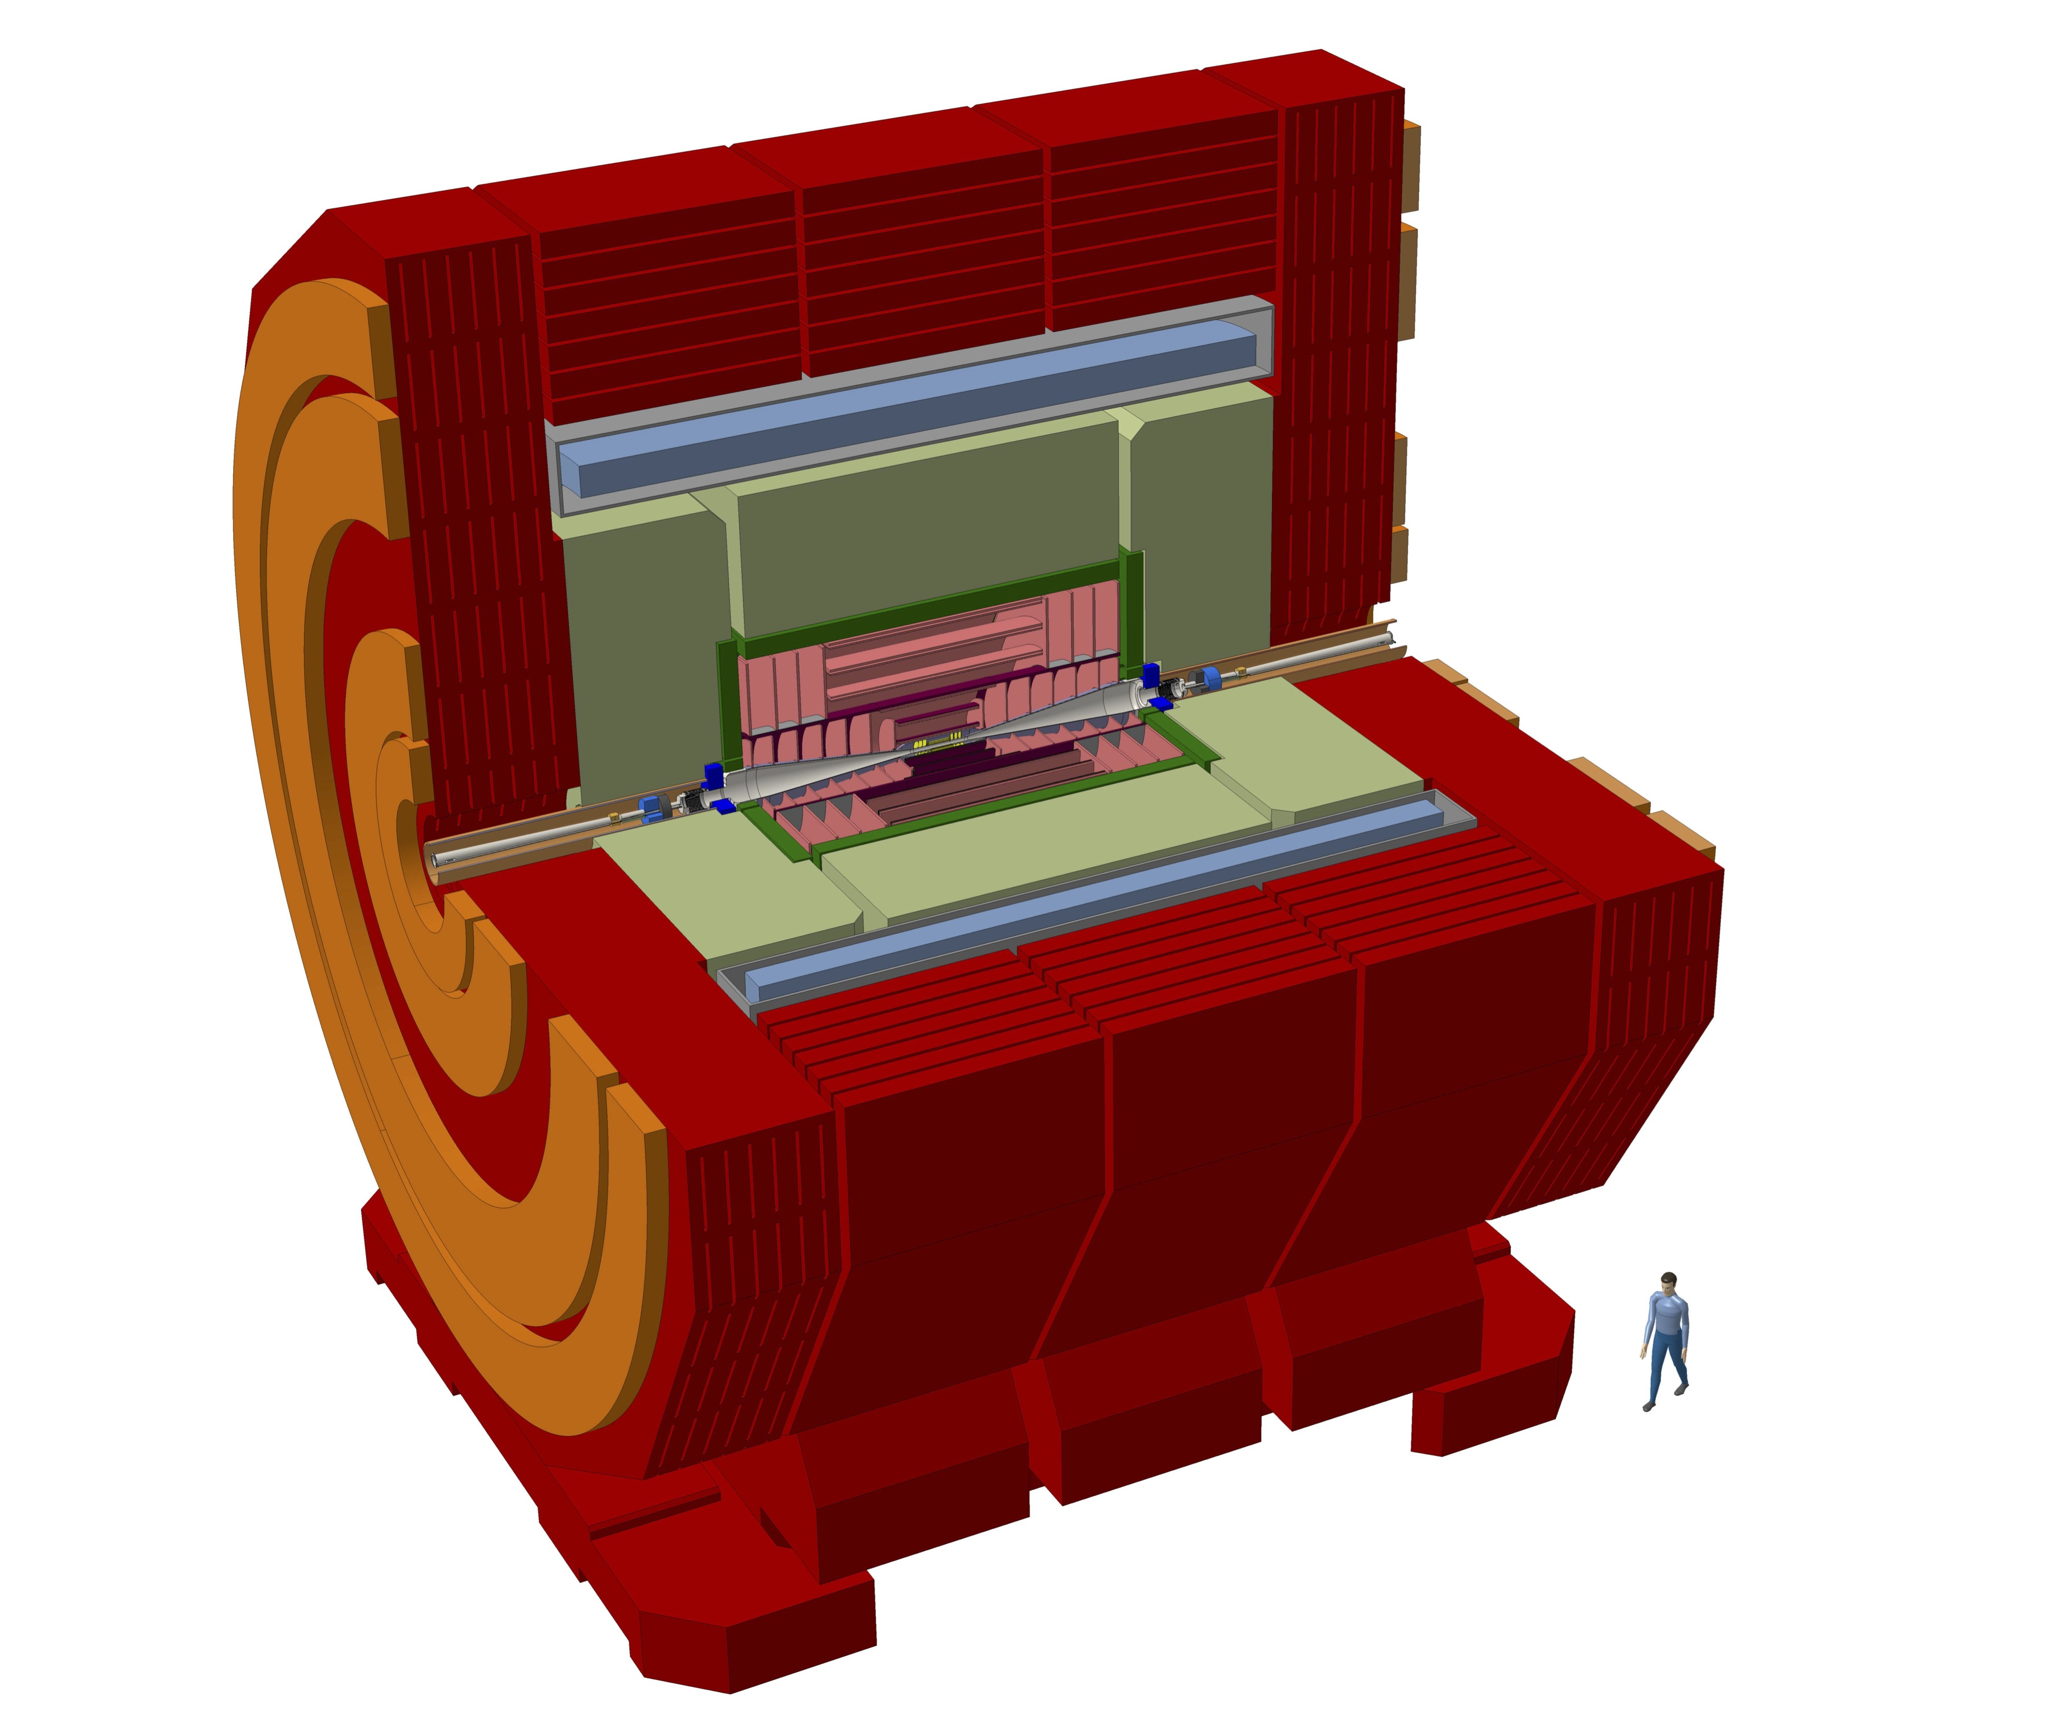
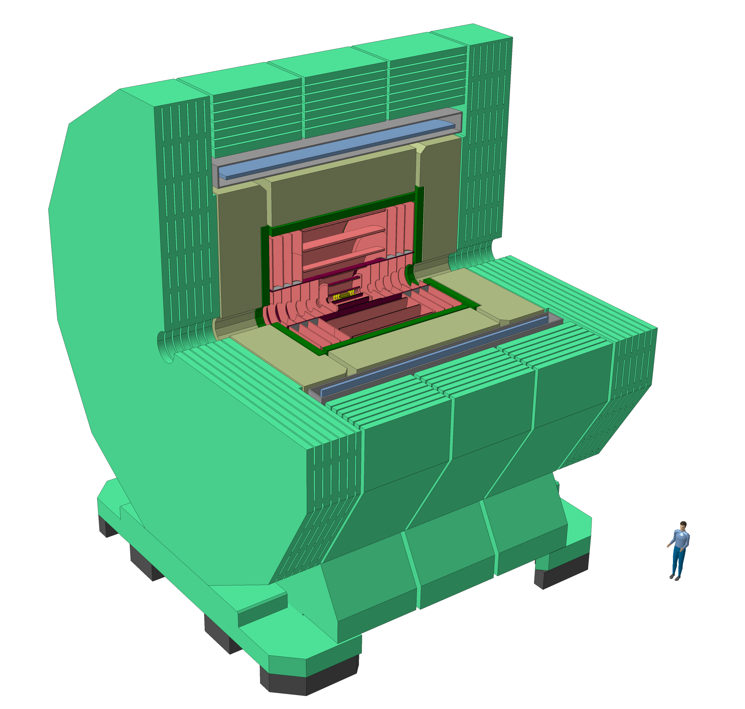
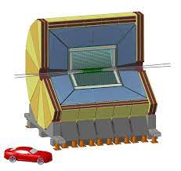
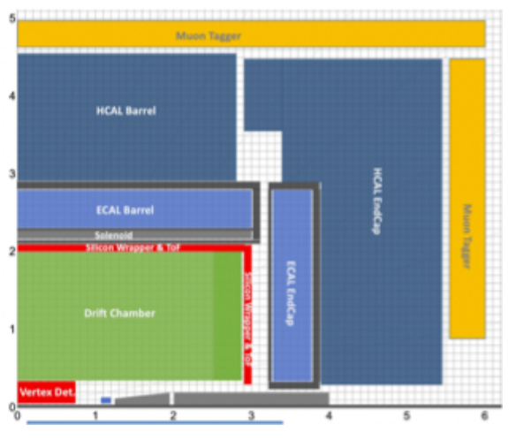
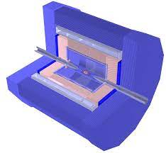
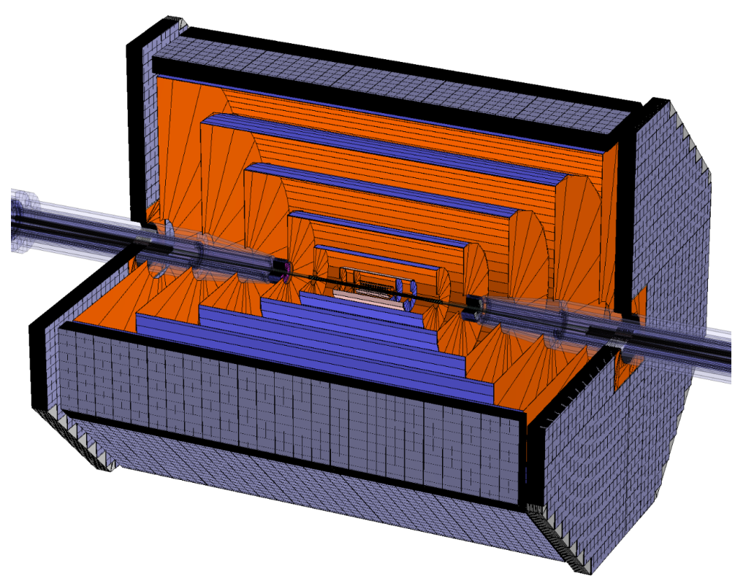
Detectors for Lepton Colliders
Physics requirements + background conditions at Lepton Colliders lead to challenging detector-design constraints
Optimized detector concepts for each of the accelerator proposals
Main differences between linear and circular options:
Low duty cycle in Lin. Coll. → Power-pulsing to reduce average power
Higher-energy Lin. Coll. Stages impact calorimeter + outer tracker designs
SiD
ILD
CLICdet
CLD
Vertex detector and tracker
Very high granularity
Dense integration of functionalities
ultra-light materials
Low-power design (+ power pulsing for Lin. Coll.)
Air cooling
Time resolution down to ~10 ns
Calorimetry
Fine segmentation in R, phi, Z
Ultra-compact active layers
Pushing integration to limits
Power pulsing for Lin. Coll.
Time resolution down to ~1 ns
ultra – light
IDEA
Noble LAr/LCr
CEPC baseline
FST
ultra – heavy
and compact

Slide 30
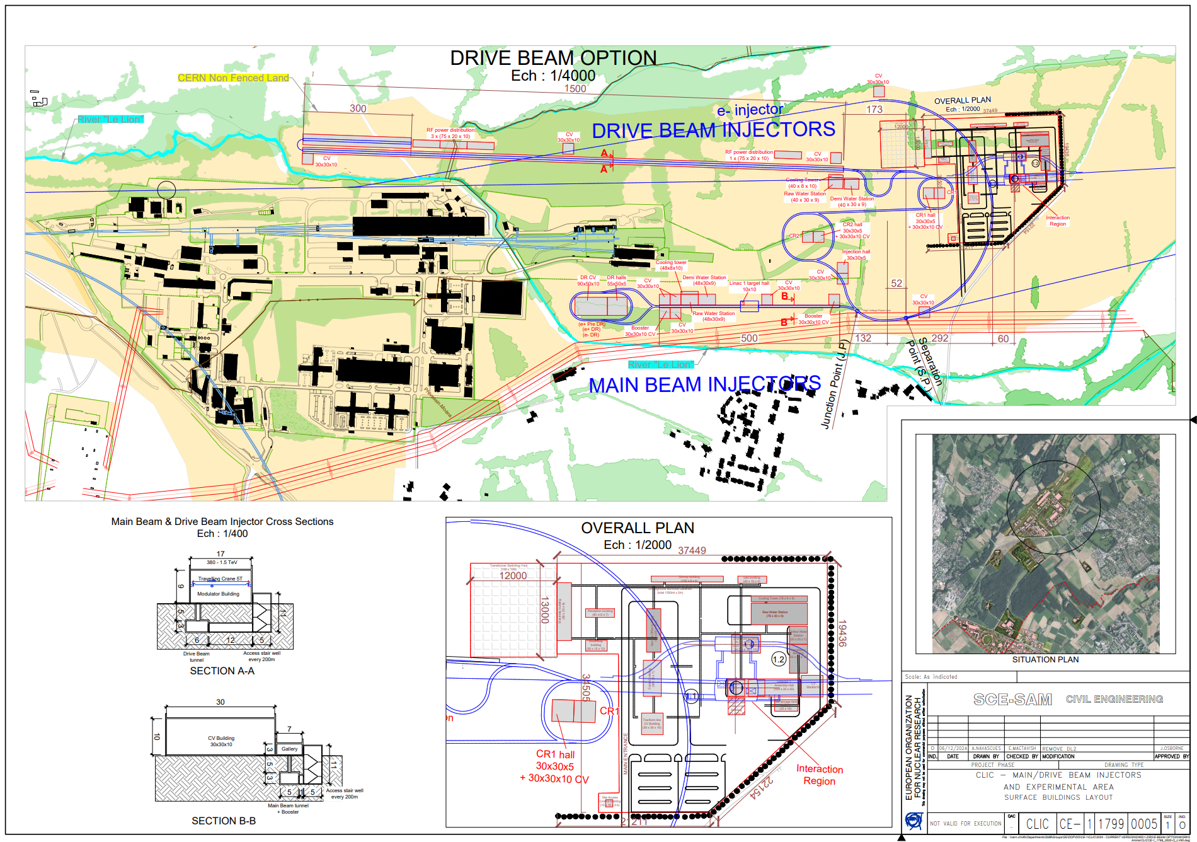
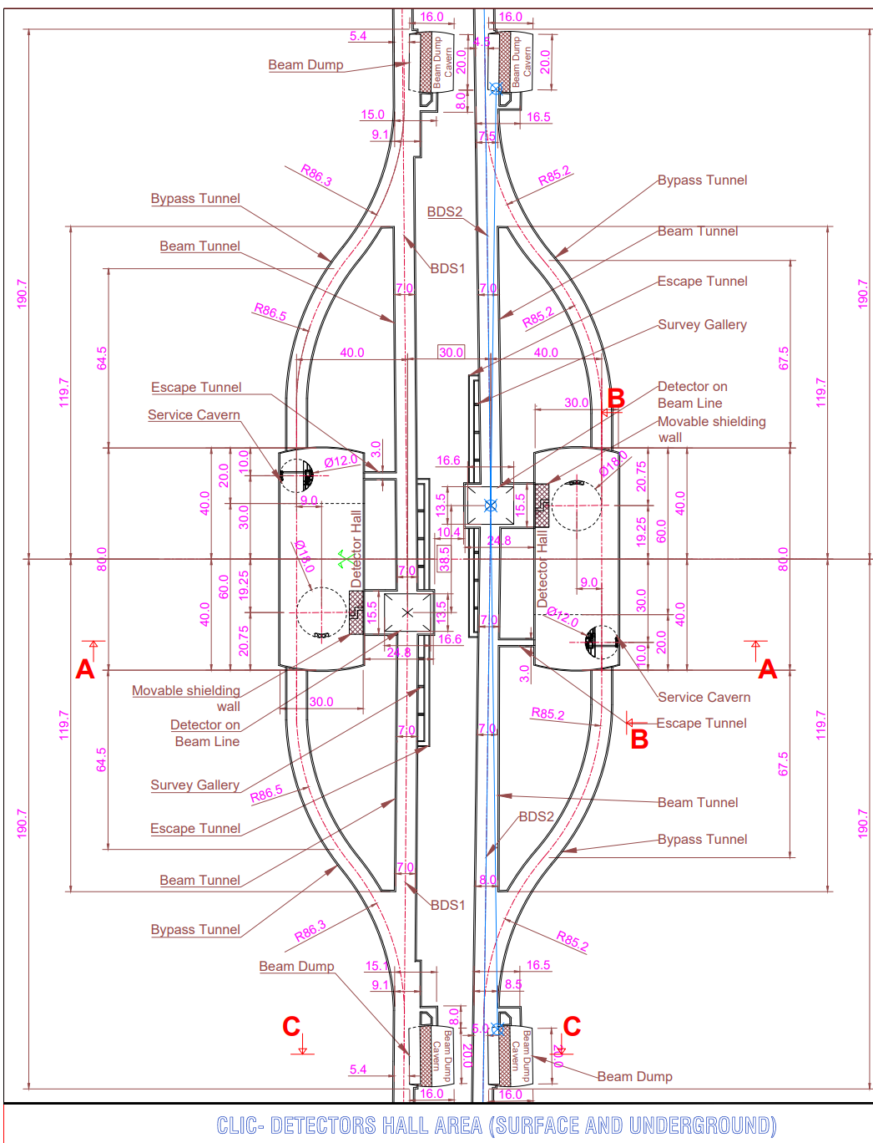


CLIC siting and civil engineering
Layout of Injector and Experimental complexes @ CERN Prévessin
Layout of injector and experimental complex optimised to be entirely located on CERN land
Avoiding all existing CERN infrastructure and the key environmental concern of the river "Le Lion”
Option for two experimental caverns → Independent operation and servicing of 2 experiments
Main LINACs in Molasse rock → simplifies construction
Layout 2 interaction regions
Option for 2 exp. caverns
Geological profile of two-stage linear collider

Slide 31



CLIC technological readiness and further R&D
Technology readiness and R&D for the CLIC accelerator
CLIC accelerator objectives and activities in the next phase
Resources required for accelerator R&D until construction start

Slide 32

CERN funding for Lin. Coll. and FCC
https://indico.cern.ch/event/1428865/contributions/6010440/

