Slide 1

Detector Technology Group Meeting
Detector Interface Section
Magnet Services
June 2025
X. Pons on behalf of the DT-DI Section

Slide 2
Detector Interface Section
The Detector Interface provides hardware and software support in control, safety and data acquisition systems for experiments infrastructure.
Magnet
Support
Detector
Support
Experiment
Data
Data Acquisition Support

Slide 3
Detector Interface Section – Magnet Services
EP-DT has a long tradition supporting the experimental magnets
Since the initial design phases of the ATLAS and CMS magnet control in the 90’s with the old TA3 group
DT-DI has been responsible of the Magnet Control Project (MCP) for the LHC Experimental Magnets
Later, during the operation of the LHC, and agreement was established with the experiments to define the DT-DI’s support in terms of operation and maintenance.
This agreement also included the support for the Detector Safety Systems (DSS)

Slide 4
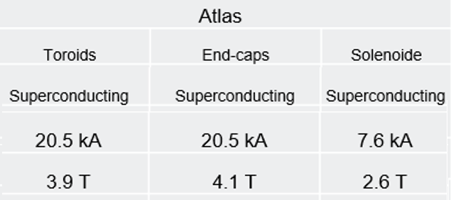
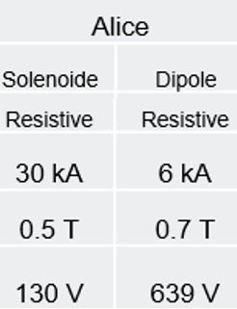
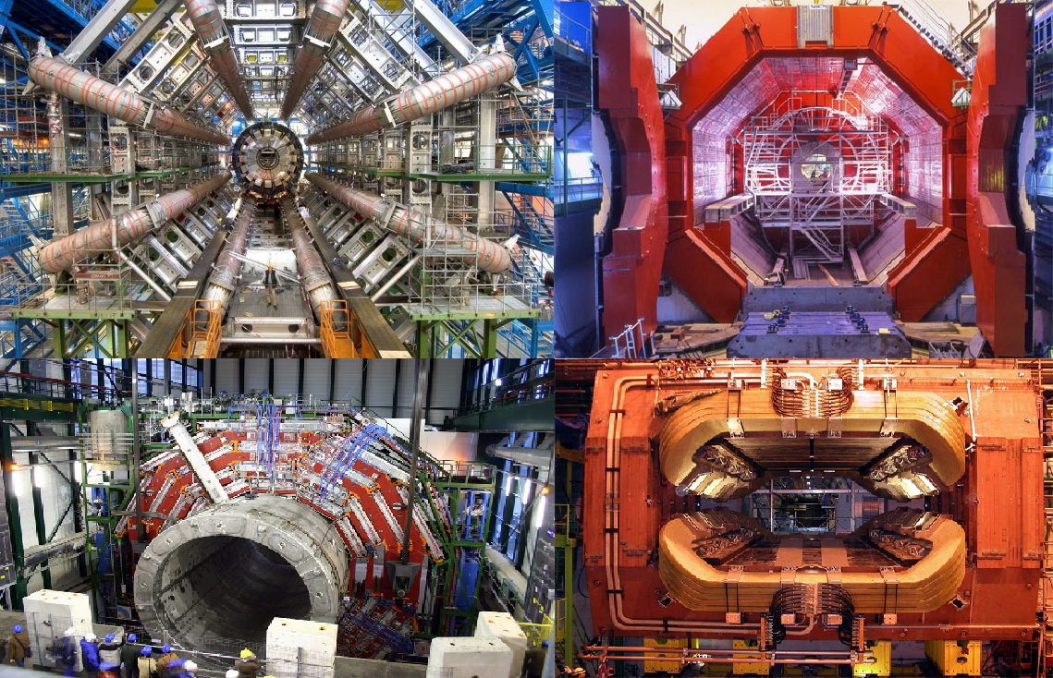
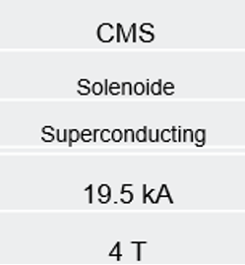
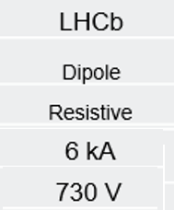
LHC Experimental Magnets
1.1 T

Slide 5
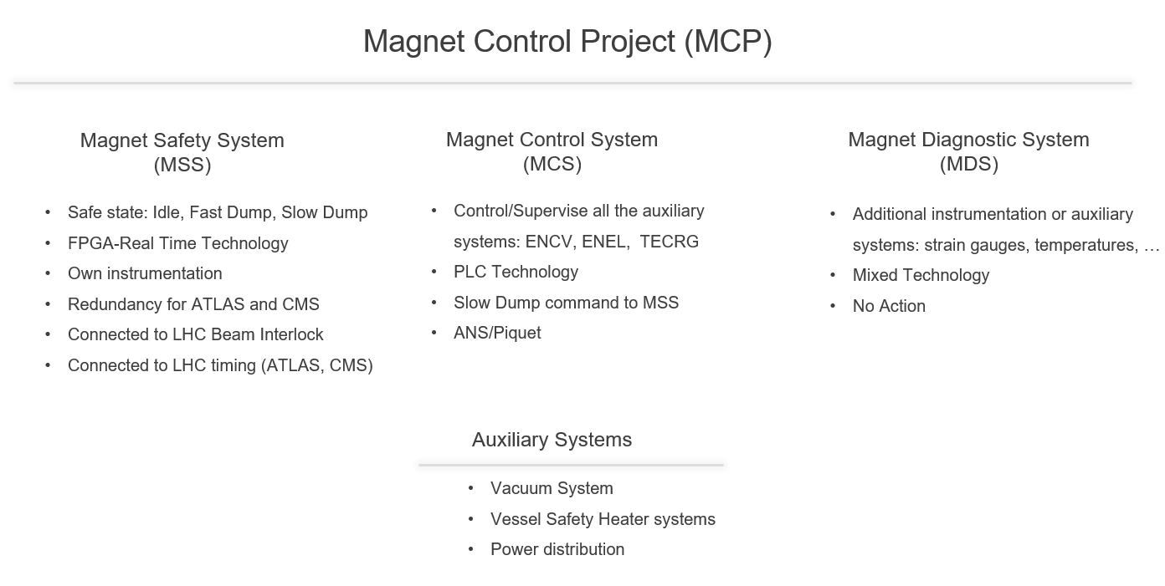

Slide 6
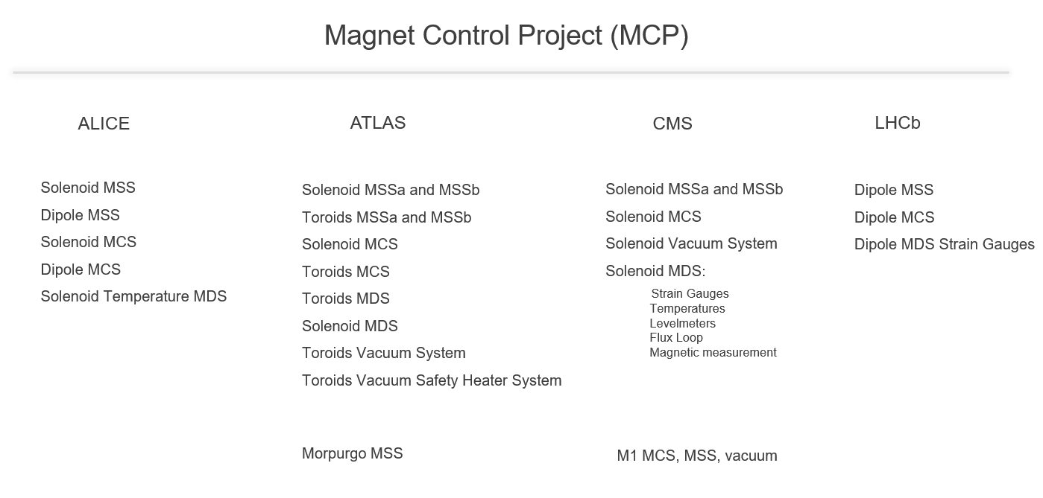
DT-DI is also providing support to the: Compass, AeGis, Vertex 1 and 2, M1 and M2 and T2K (Old UA1) magnets

Slide 7
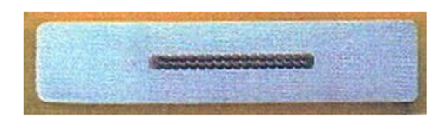
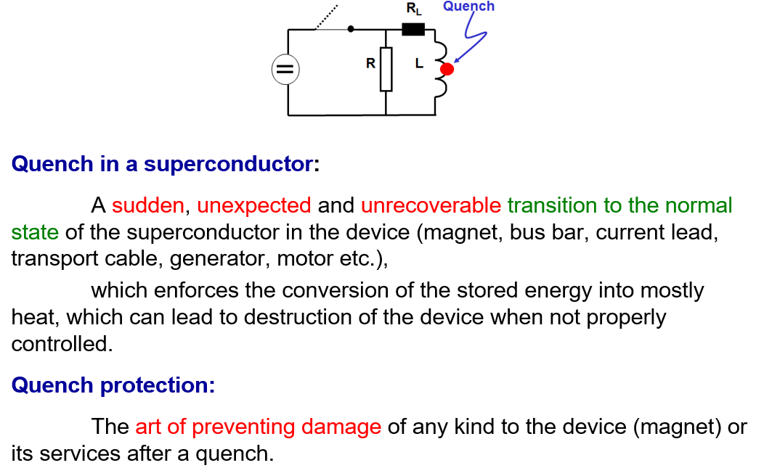
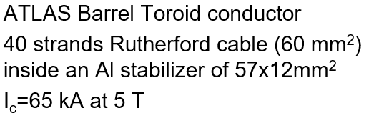
Why a Magnet Safety System?
Prof. H Ten Kate: CERN Accelerator School on Superconductivity for Accelerators, Erice 2013

Slide 8
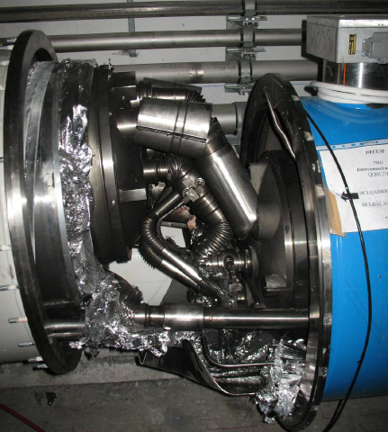
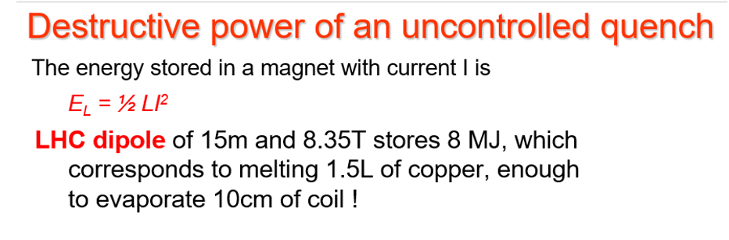
Why a Magnet Safety System?
LHC Dipole interconnection September 2008

Slide 9
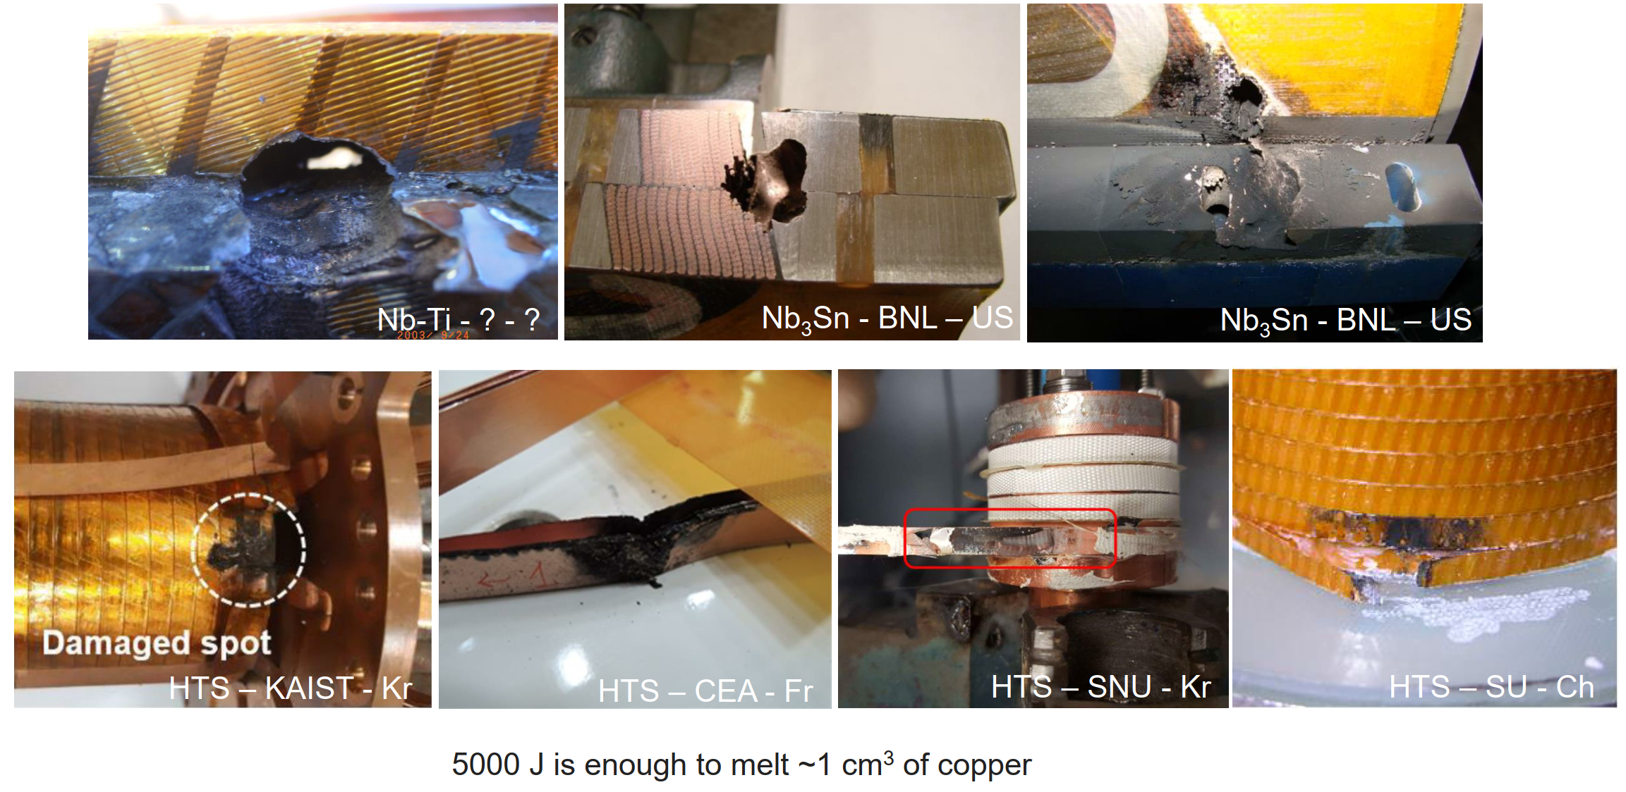
Why a Magnet Safety System?

Slide 10




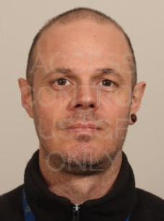

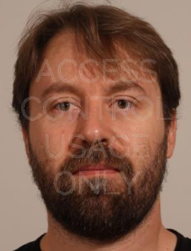


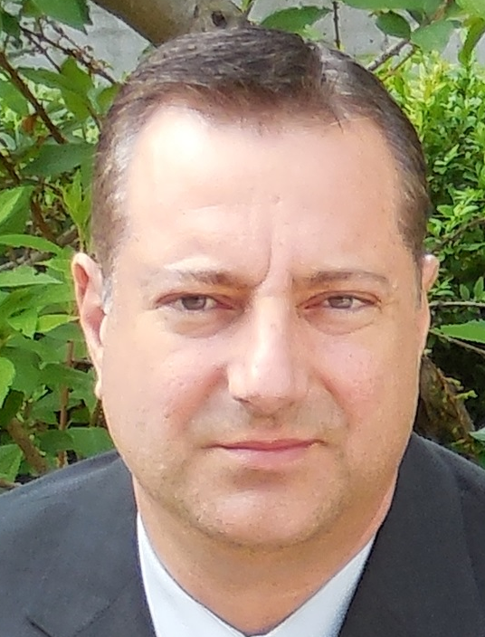

Magnet Control Project (MCP 2025)
ALICE
ATLAS
CMS
LHCb
Workshop / FSU
Giulio Malaguti
Laurent Deront
Jarl Pettersen
Maciej Ostrega
Giulio Malaguti
Jerome Bourachot
Bayram Dinger
MSS Software Experts
MCS/MSS Hardware Experts
MCS Software Experts
Murat Dinger
Sylvain Ravat
Laurent Deront
Xavier Pons
Maciej Ostrega
Sylvain Ravat
Valentina Reynaud
Marc Carrichon

Slide 11
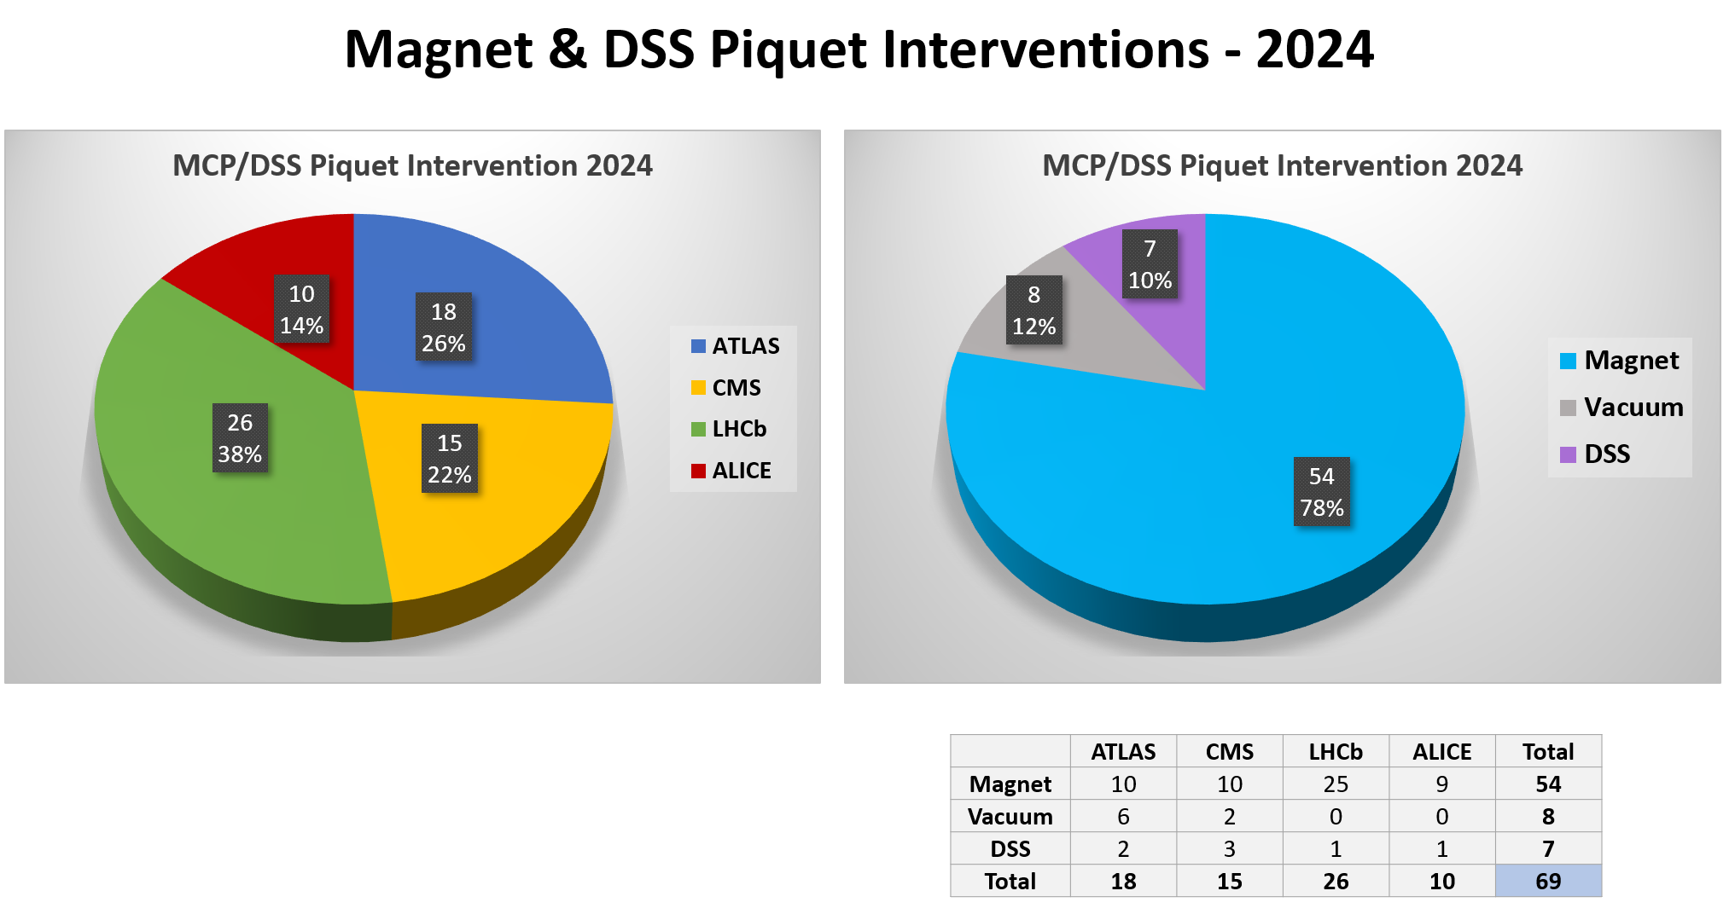
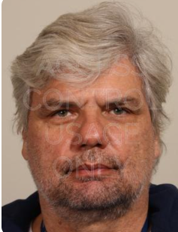


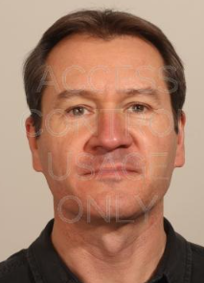
Maciej Ostrega
G. Malaguti
J Pettersen
X Pons
K Barth
(ALICE)
A Meynet
(CMS)
J Vizdal
(ATLAS)
L Roy
(LHCb)

Slide 12
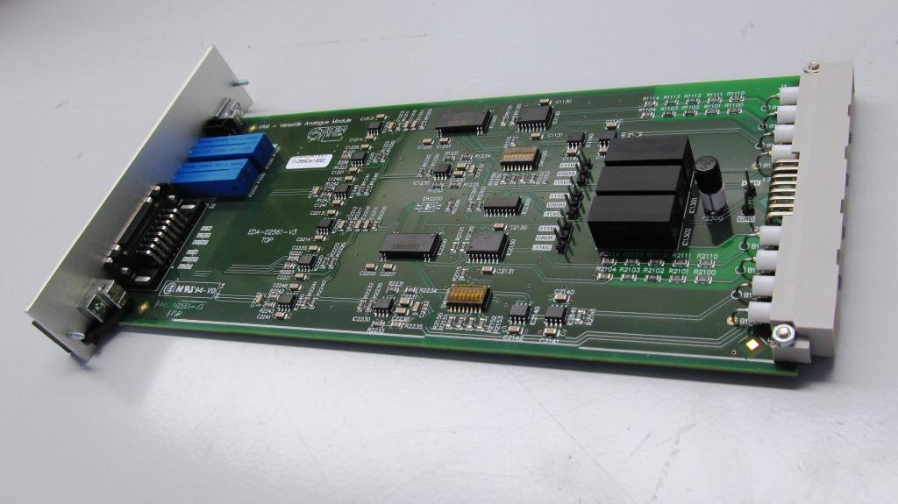
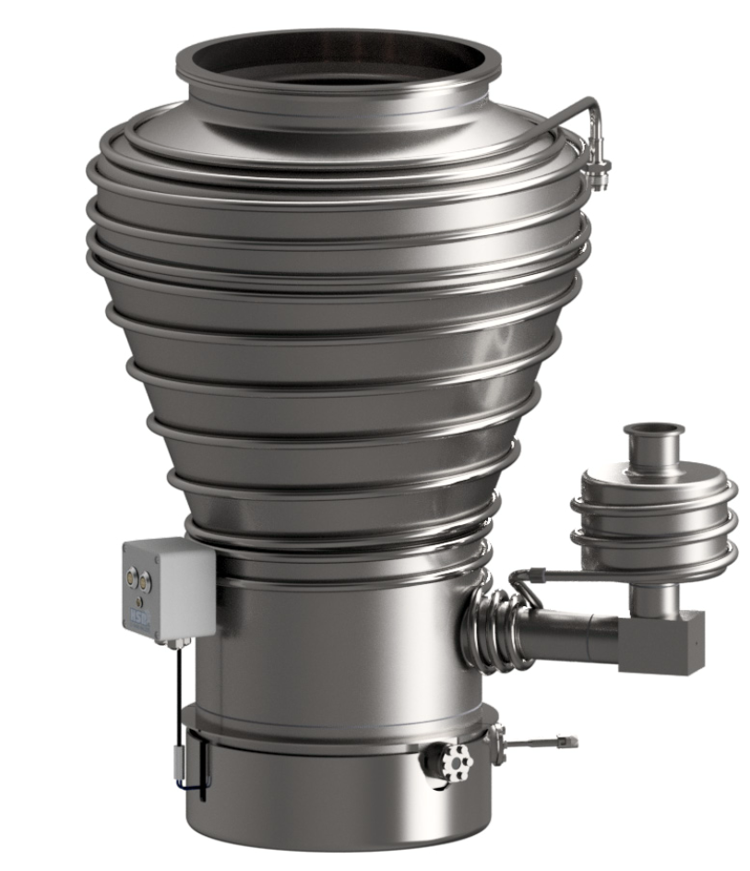
LS3 Activities
1- Replace the battery charger of the MSS and QH
2- Replace the batteries
3- MDS: New updated MDS
4- MSS Interfaces:
- Update of the DI Interfaces
- Updated of the DI/DO Interfaces
- VAM
5- Replace the cRIO-FPGA + modules
VAM – Quench detection board
Vacuum Activities
1- To install the diffusion pumps
2- To Install the DC power for these diffusion pumps =>
2.1 New DC power supply rack
2.2 New EXD6 power cabinet
3- Maintenance of the primary pumps (replace by new ?)
4- Maintenance of the diffusion pumps (last year before run)
5- Replacement of the Vacuum gauges
ATLAS new diffusion pump

Slide 13
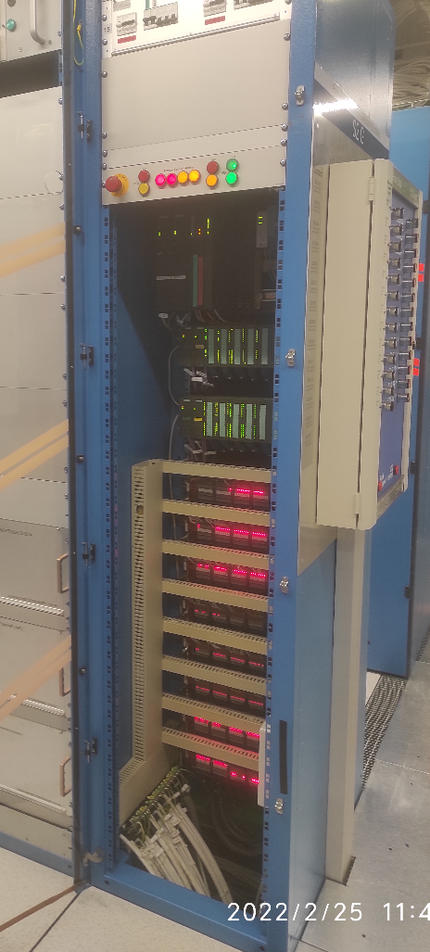
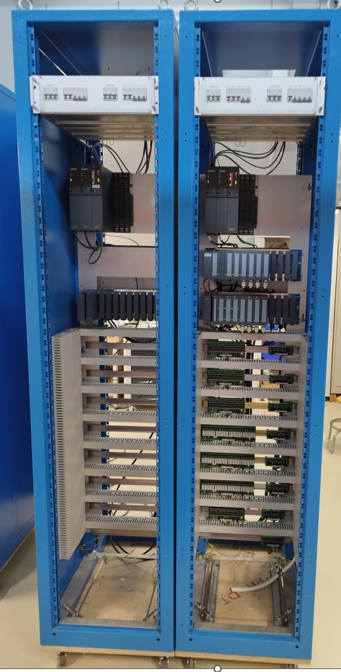
About Detector Safety System
Recently DT-DI established an agreement with the LHC Experiments and in collaboration with BE-ICS in order to provide support for the LS3 upgrade of the Detector Safety System (DSS) to the new version DSS2
Basically, consist in a production of 50 racks with the new redundant PLC based on Siemens S7-1500 and the replacement of all the connections
OLD DSS
Siemens S7-300
New DSS
Siemens S7-1500

Slide 14
Thank you for your attention, questions?

Slide 15
Backup

Slide 16
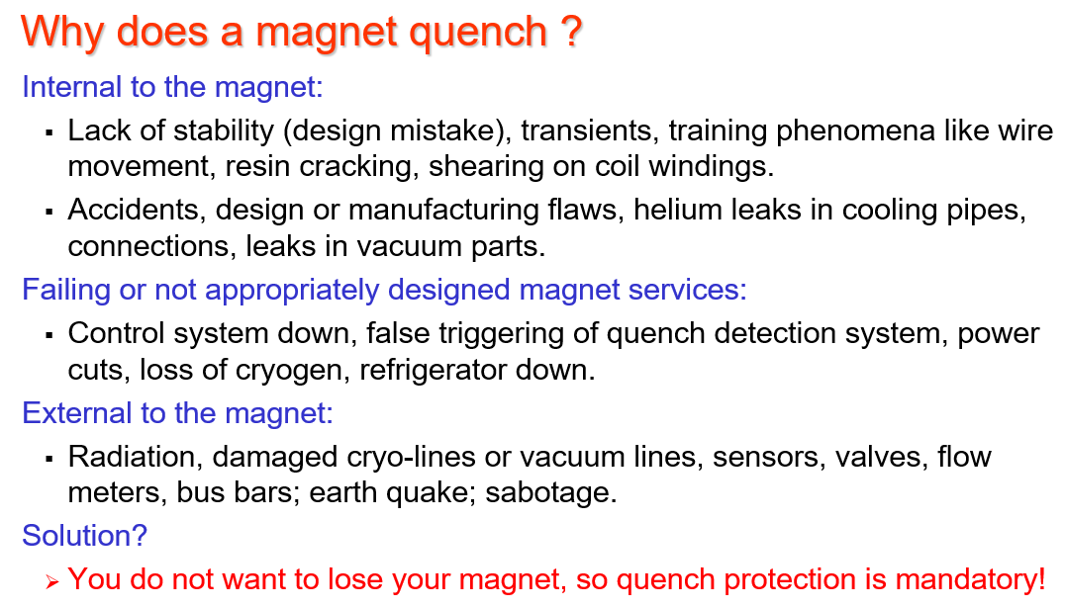
Introduction 2. Why a Magnet Safety System?
Prof. H Ten Kate: CERN Accelerator School on Superconductivity for Accelerators, Erice 2013
DT-DI MSS is a quench protection system

Slide 17
MSS2 Hardware Architecture Overview
ANALOGUE INPUT INTERFACE BOARD
Dual Analogue Input Range
Multiple signal range, hardware programmable range:
x1, x10, x100, x1000
set by DIP switch.
Signal isolation 1500Vrms.
Power supply circuit isolated 3 kV by DC-DC converter between channel - channel-FPGA_AI - Power_Supply
Each channel has its own selectable current source by DIP_SWITCH.
0.01 mA, 0.1 mA, 1mA, 10 mA.
MSS2 Analogue Input interface board
Optional low pass filter
Optional gain and offset adjustment
Time and level discrimination done at FPGA level
EDMS

Slide 18
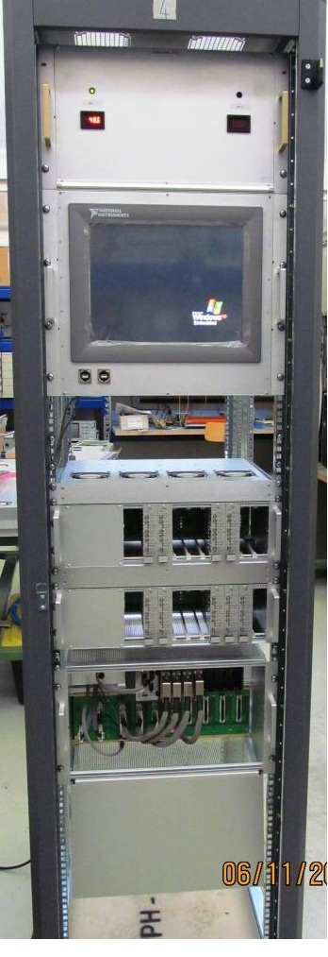
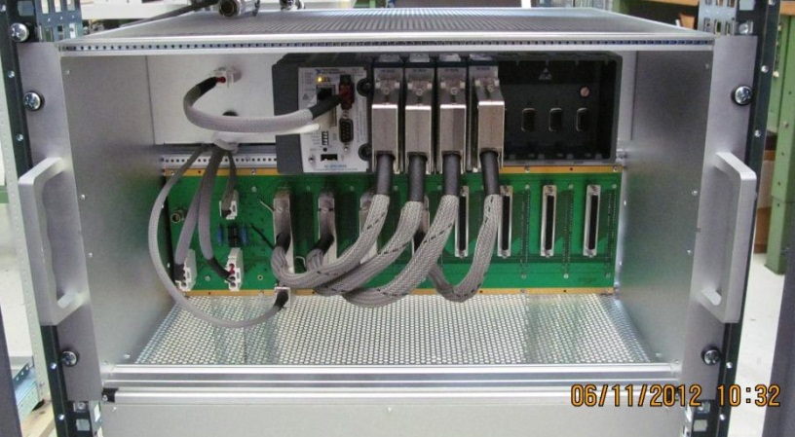
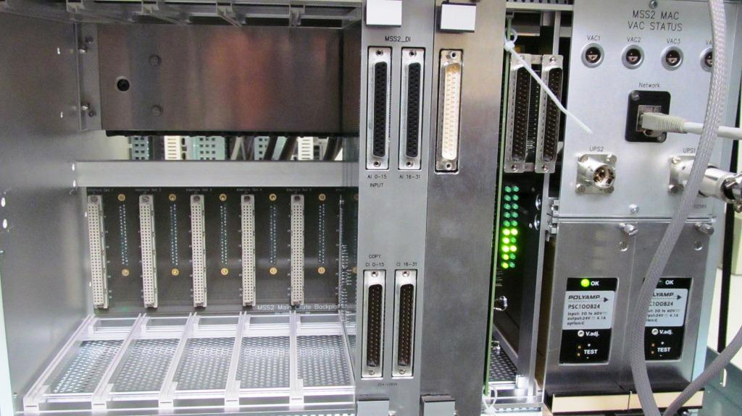
MSS2 Hardware Architecture Overview
MSS2 Main crate
  Following L. Deront design
  6U crate size for 19’ rack assembly compatible with all MSS
  cRIO FPGA installed in the front side
  Input/Output Interface board in the back side
  Redundant Power supply
MSS2 cRIO crate. Front Side view
MSS2 cRIO crate. Front Back Side view
MSS2 Prototype

Slide 19

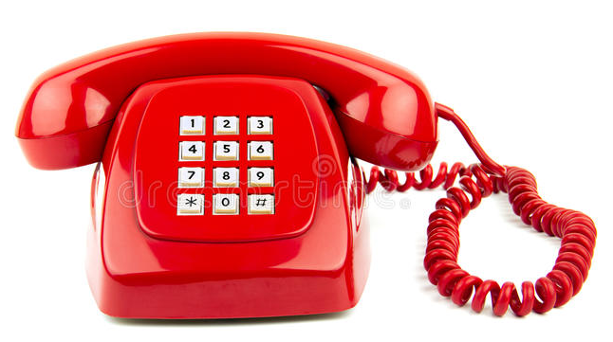

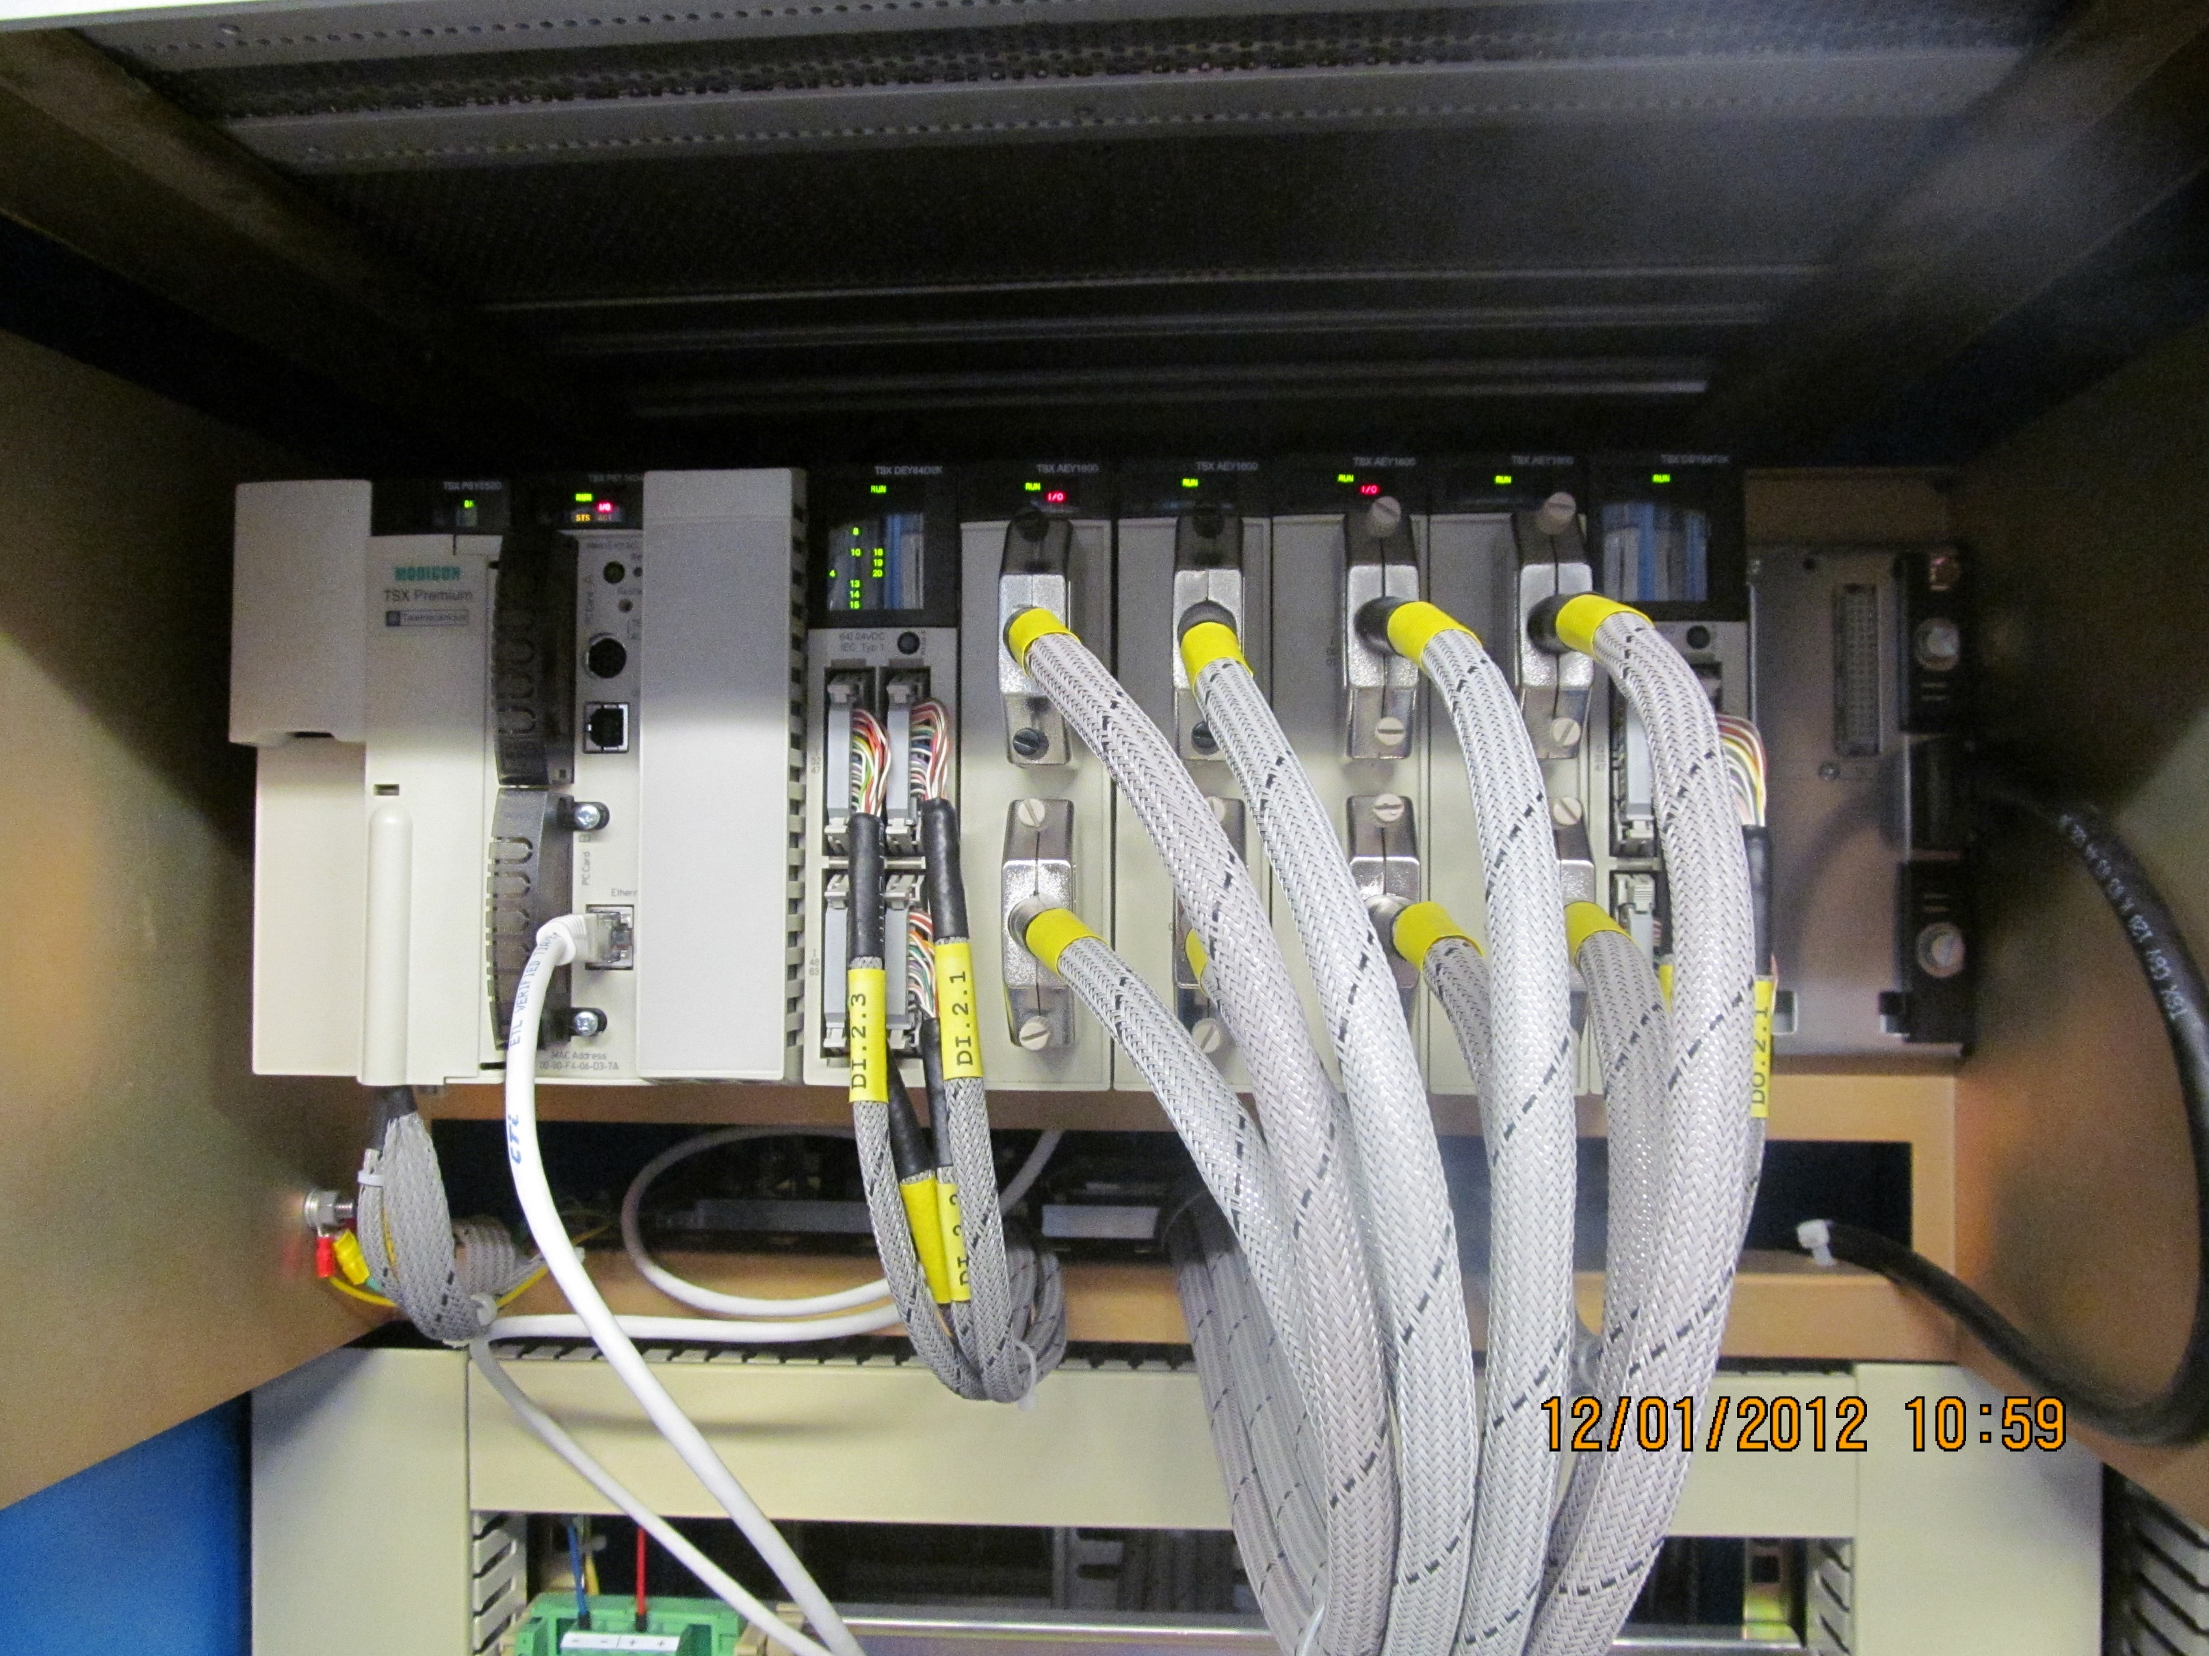
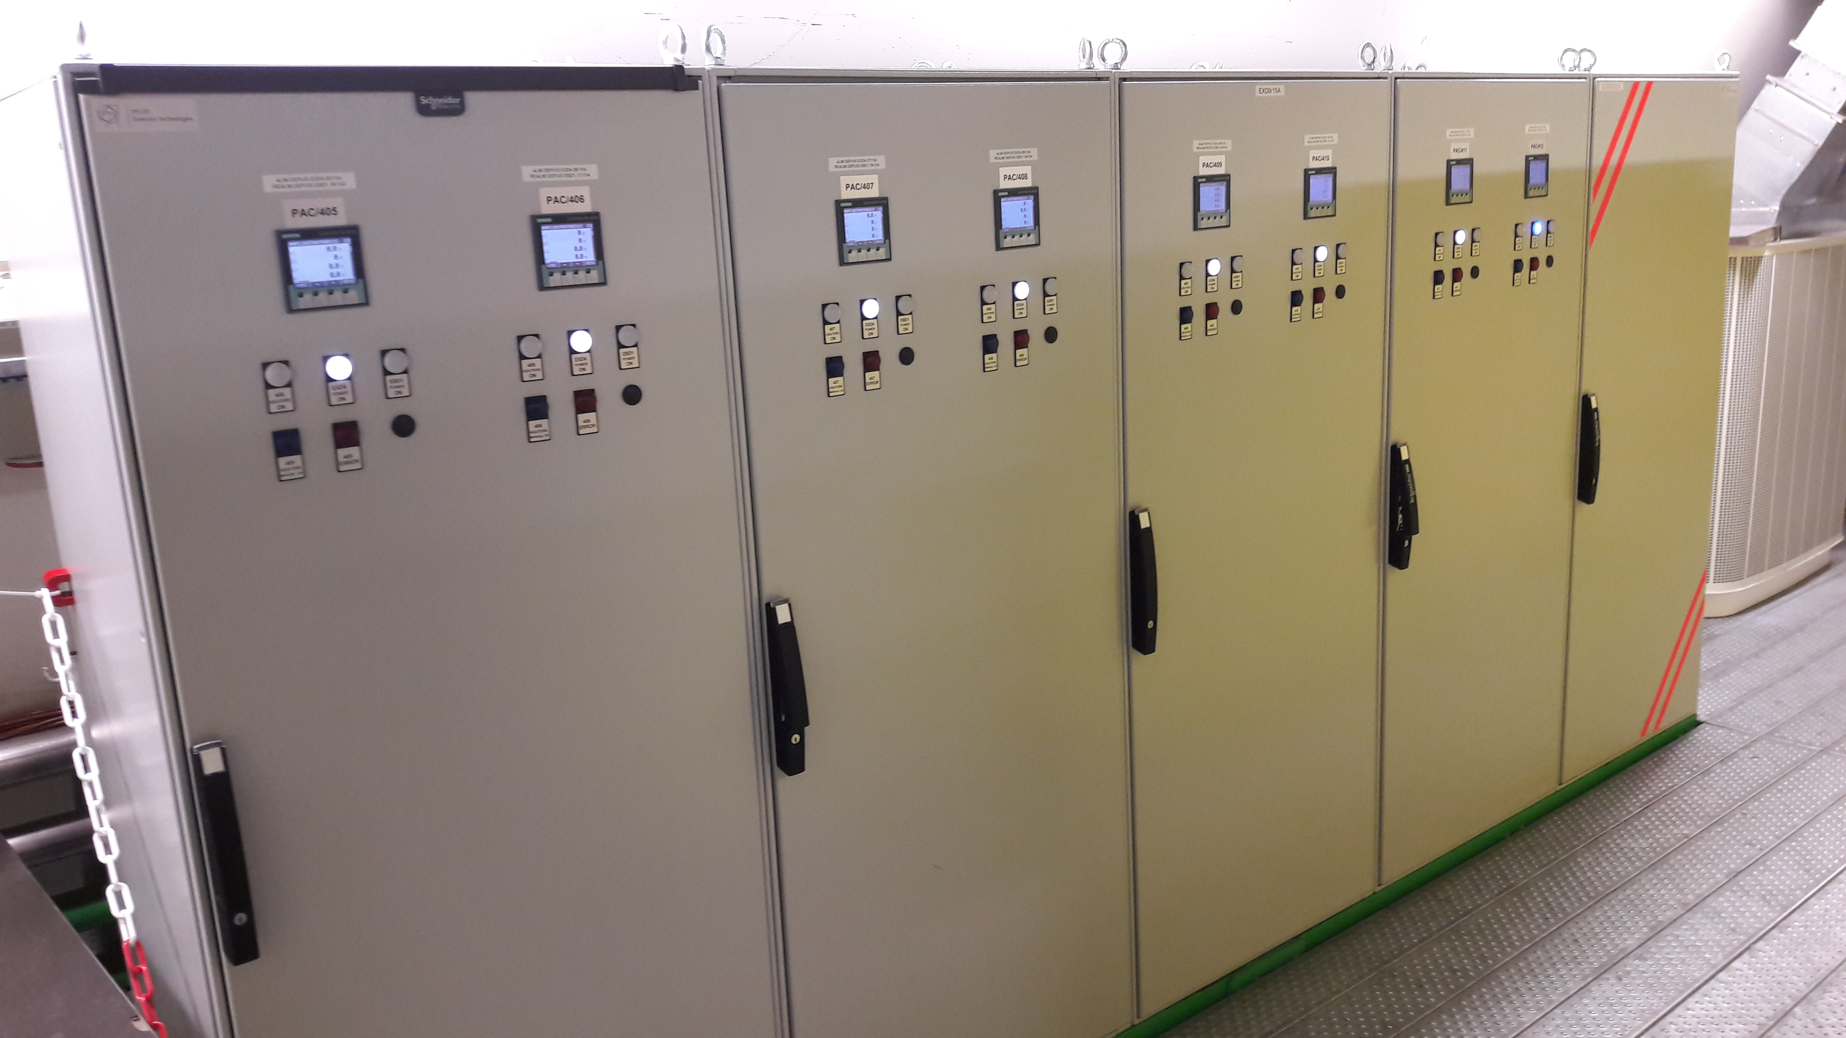
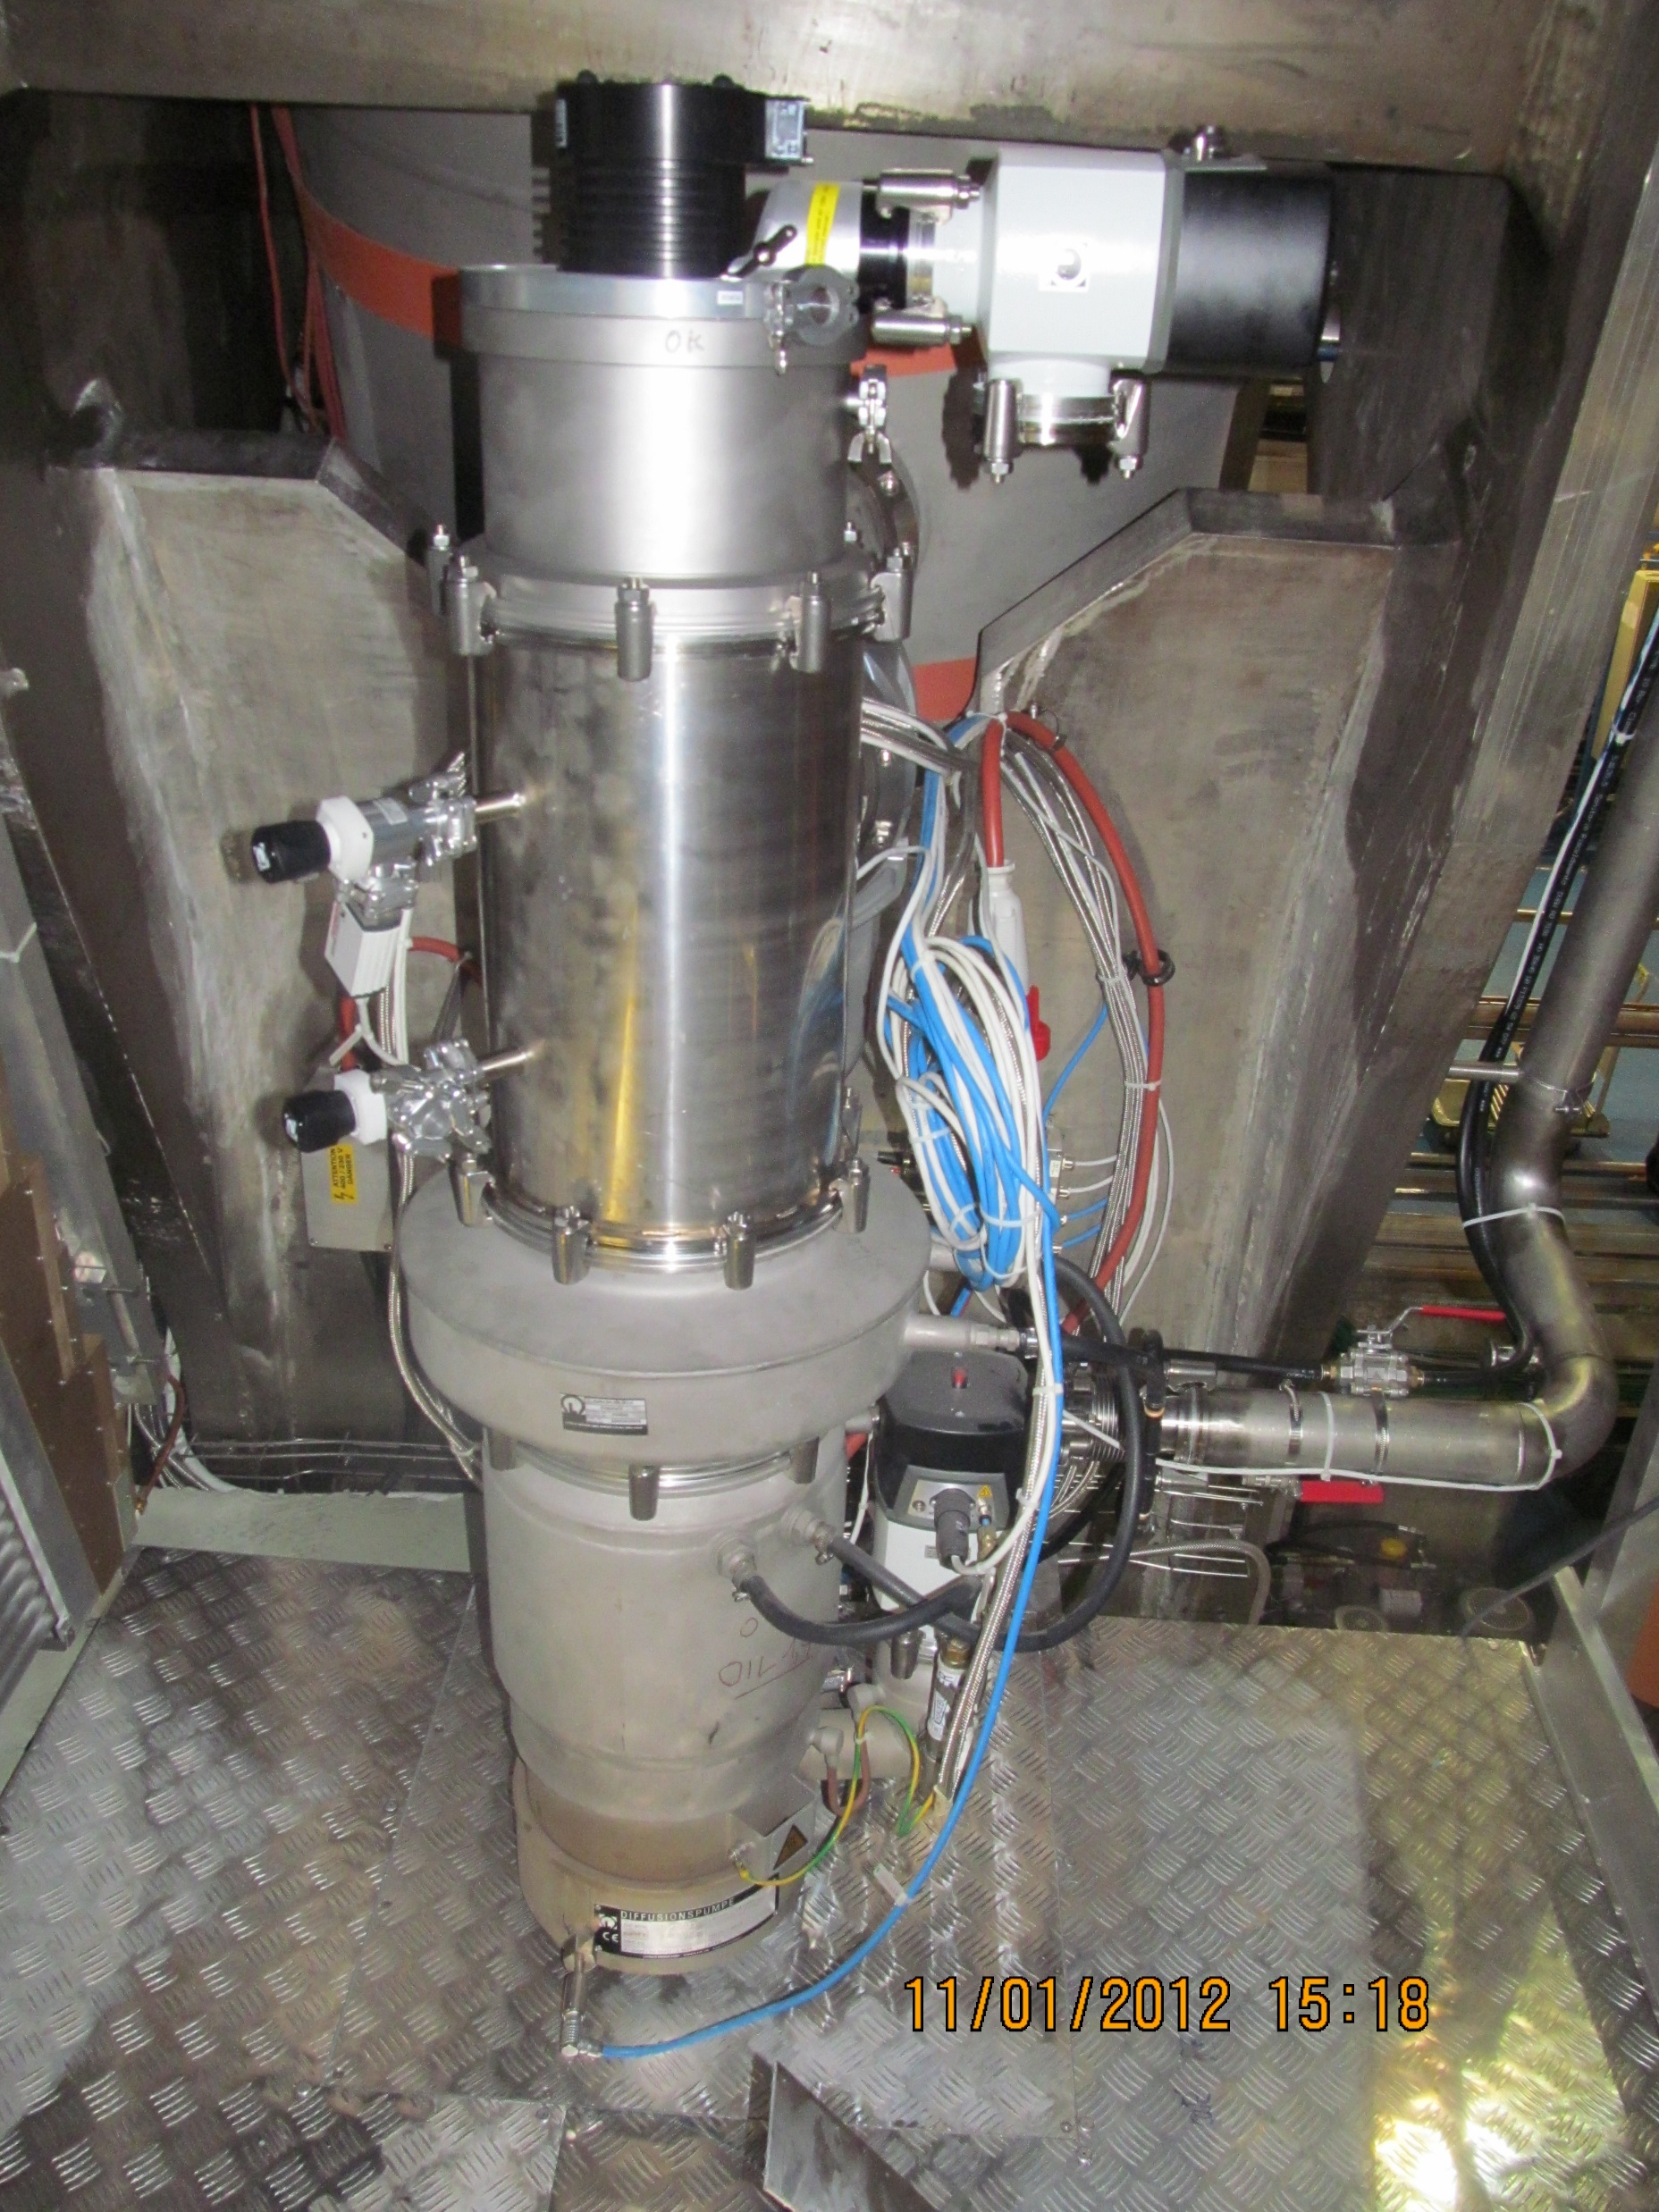
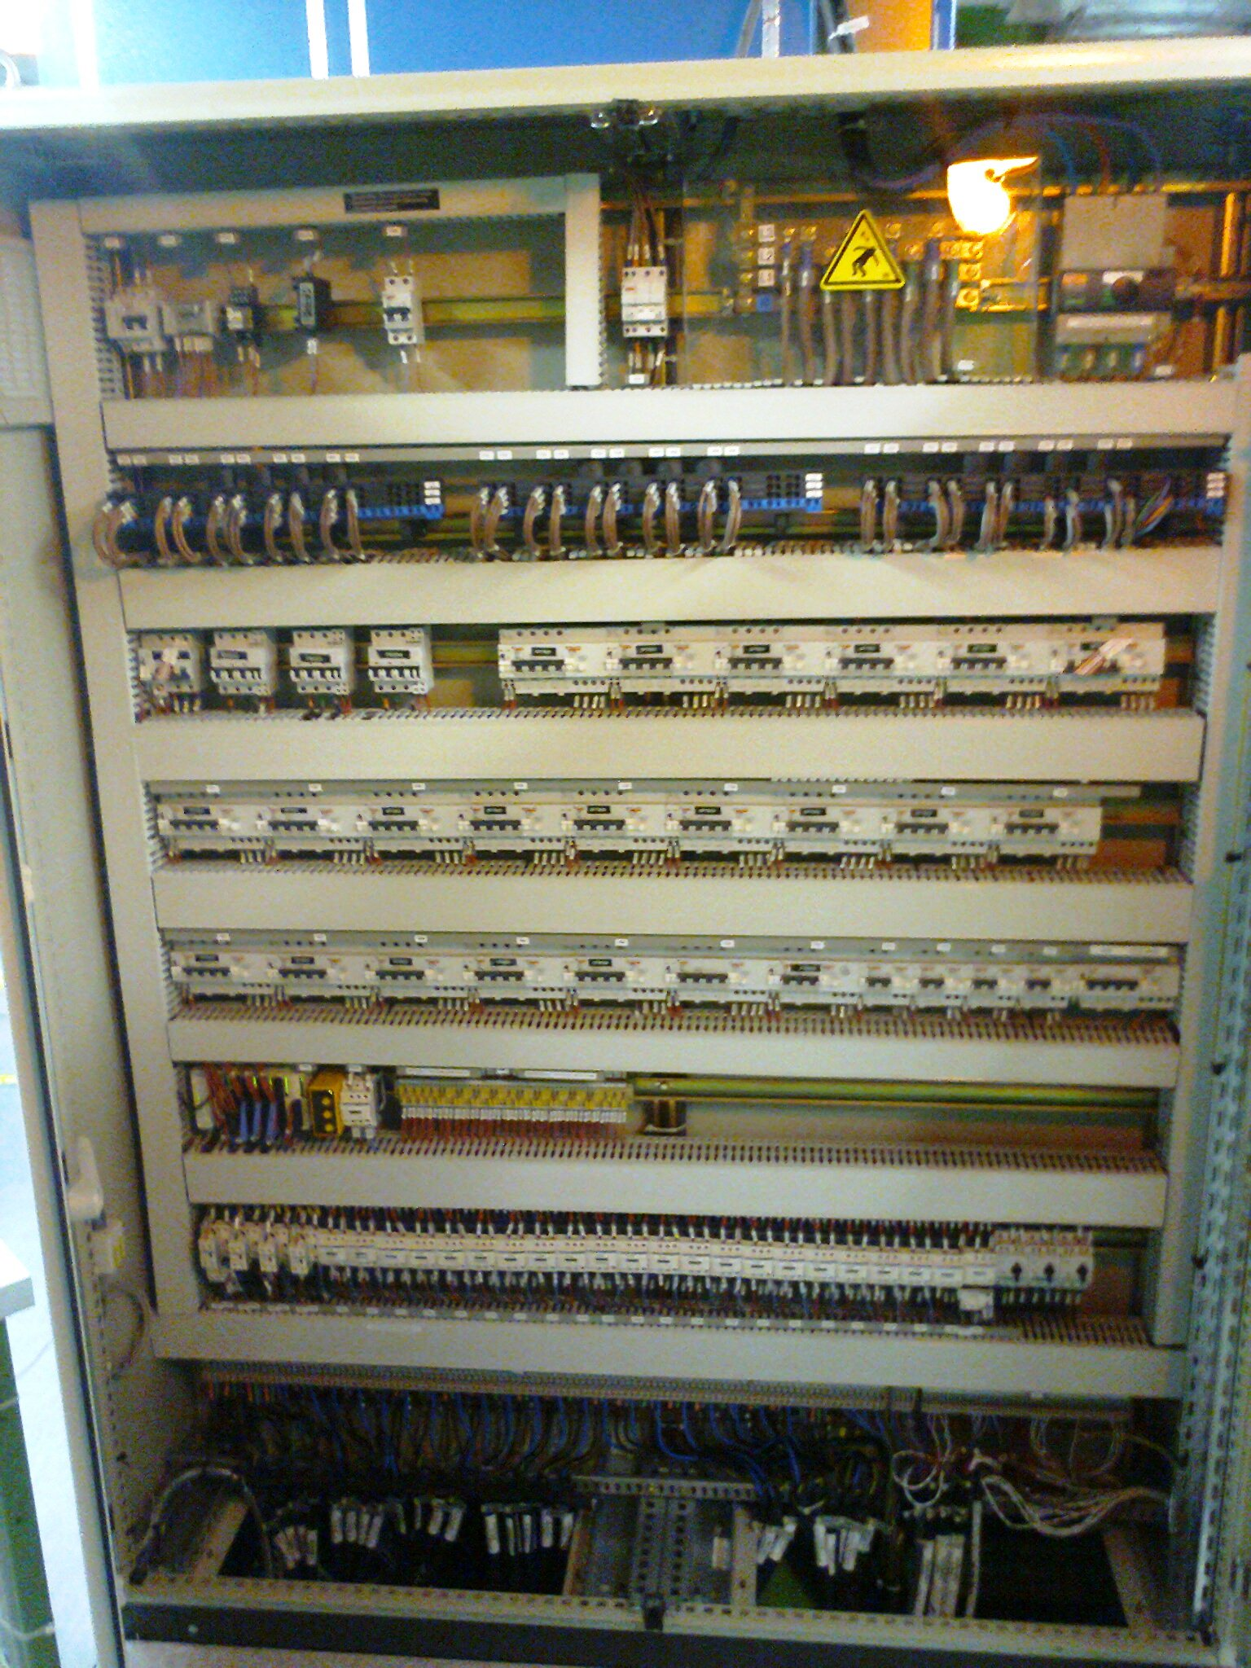
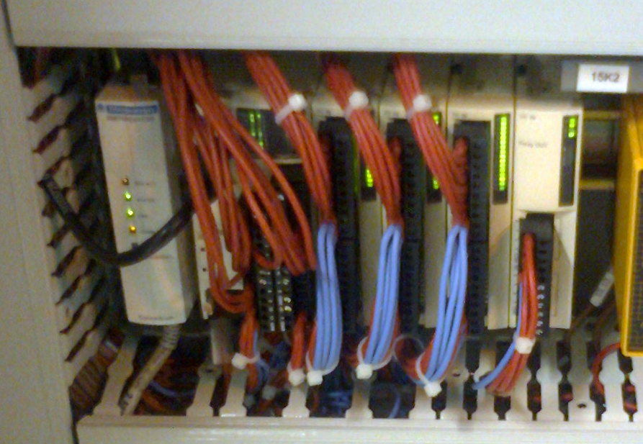
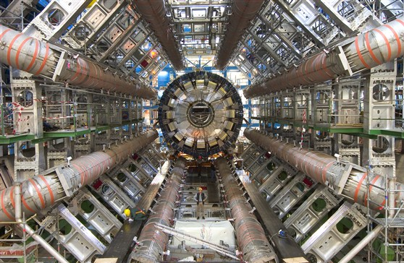
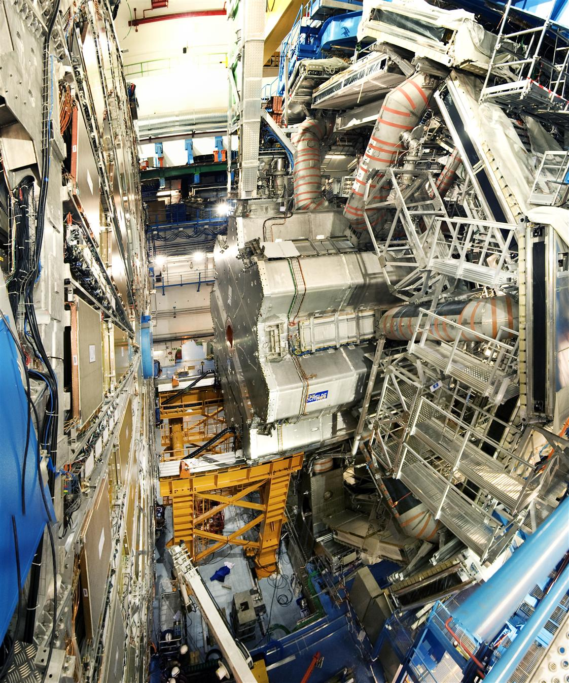
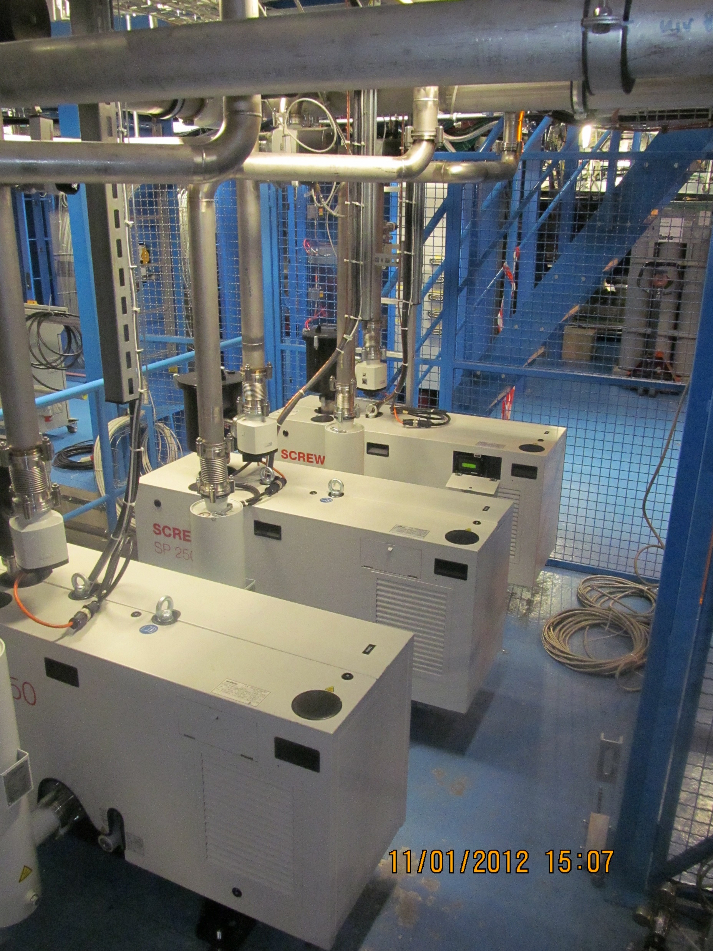
Hardware Vacuum Control system Layout
Remote Access
Terminal Server
Automatic Notification System
Piquet
CCC
WINCC Dataserver cs-ccr-mads3
ANS
Hardwired
CERN TN
Modbus Driver
CERN TN
Modbus Driver
USA15 Schneider Vacuum PLC
VHS Trigger, Hardware
USA15 Schneider VHS PLC
Hardwire
CERN TN
IOScanning
Hardwire
Turbo
ENEL TWIDO
Monitoring PLC
USA15 Green Zone 2 MW power distrib
Hardwire to UX15 Level 0 Patch Panel
USA15 EXD6 power control
Hardwire
Hardwire
Orange bands
On BT vessel
UX15 Vacuum Field

Slide 20
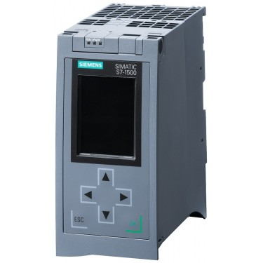
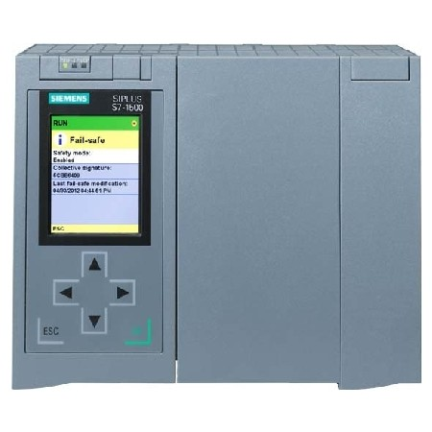

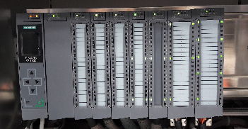
Upgrade approach
To split the Turbo Pump system in an independent and redundant control system
With an independent WINCC project
WINCC
CPU3
WINCC Dataserver cs-ccr-mads3
USA15
CPU
CPU2
USA15
USA15
Turbo
Vacuum
VHS
EXD6
X3 Remote I/O
Remote I/O
Remote I/O
USA15
USA15
USA15
UX15

Slide 21
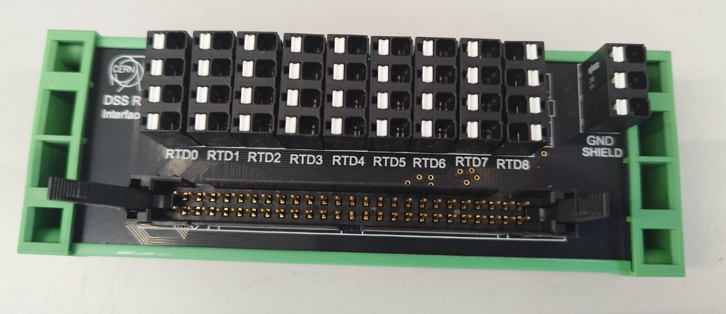
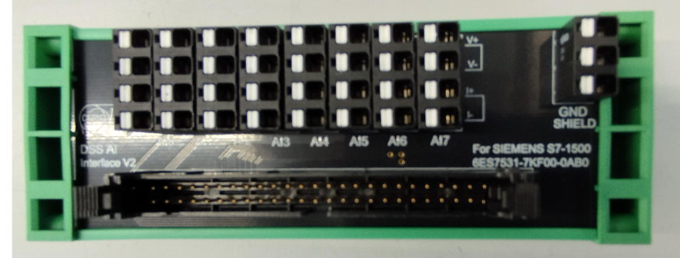
8 inputs 0-10V or 4..20mA
Possible to mix
45 mm wide
9 inputs RTD, PT100, PT1000
For Siemens 6ES7531-7PF00-0AB0
45 mm wide

Slide 22
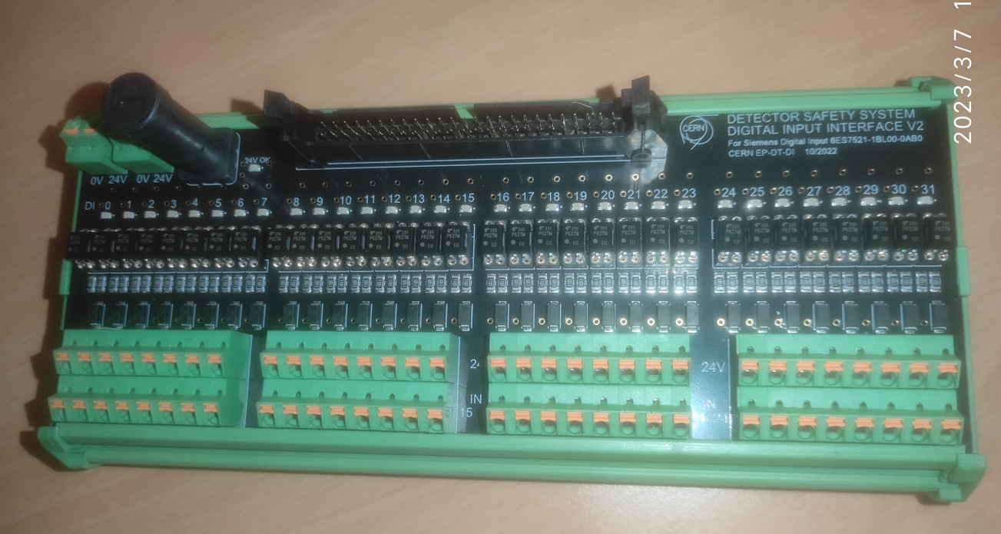
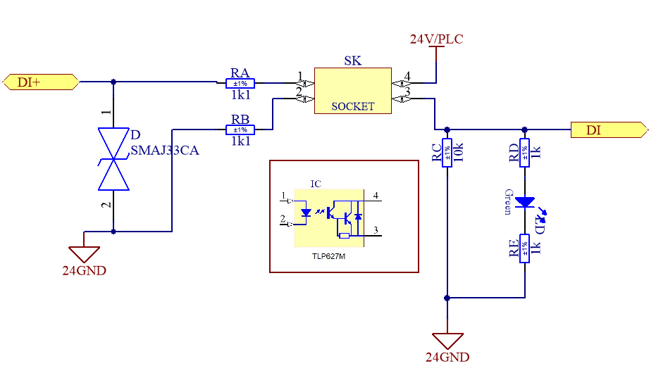
32 Digital Inputs – logic 0-24V
Optocoupled Toshiba TLP627M (=DSS)
Input overvoltage protection TVS 33V
Status LED for each DI
72 mm wide
Optocouplers individually replaceable
Module fuse protected
For Siemens 6ES77521-1BL00-0AB0

Slide 23
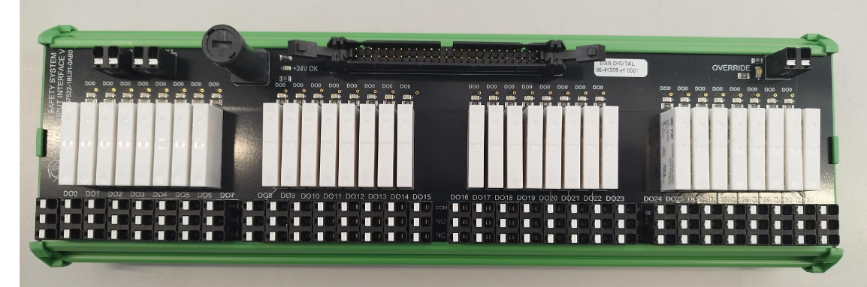
I/O Interfaces – Digital Output
32 Digital Output – Relay with COM, NO, NC contacts
Key Switch Override function, closes all the relays
Status LED for each DO
72 mm wide
Design finished,
Both Digital Input and Output interfaces are on endurance test
They require a new version wit cables entering from top

Slide 24
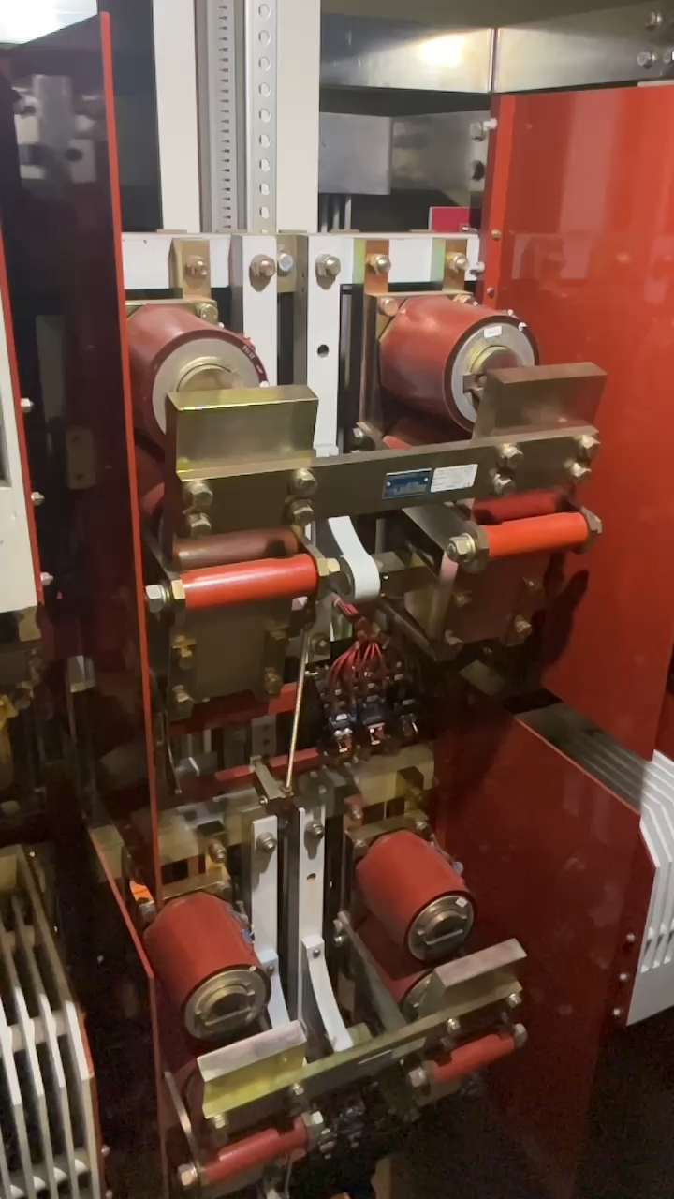
FD on 17.10.2024

Slide 25
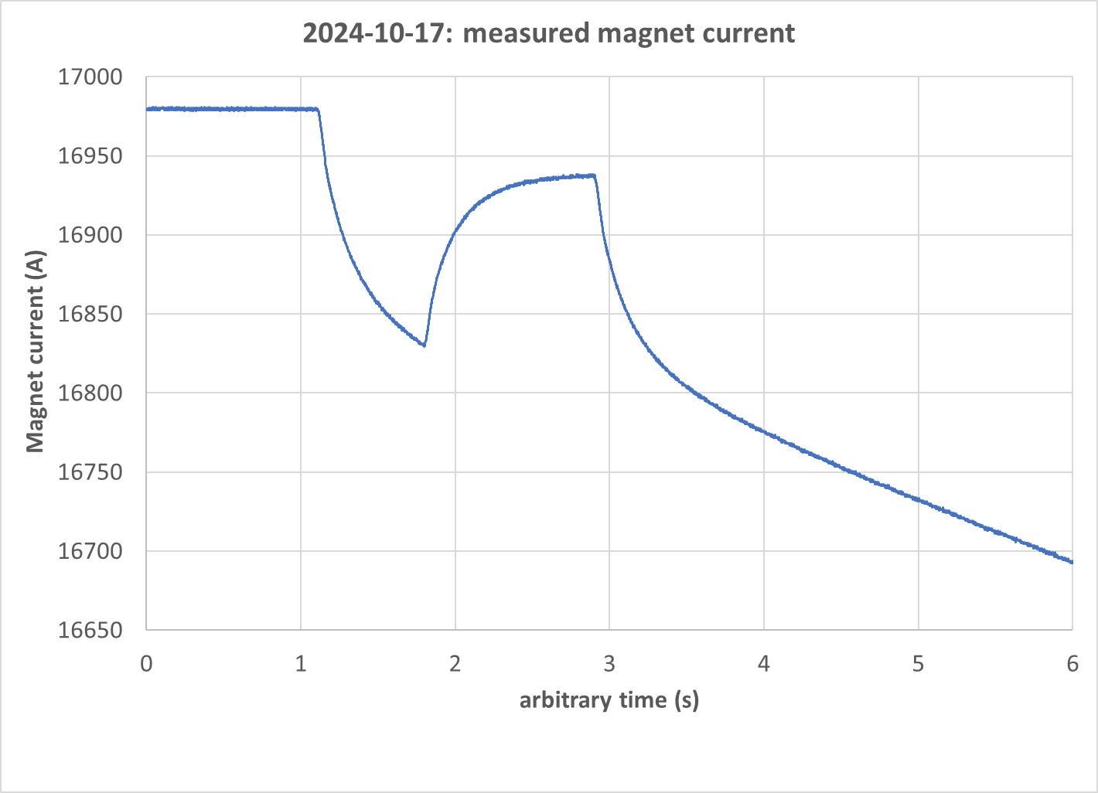
FD on 17.10.2024
CRs close command at 20:15:30.030
DSS alarm at 20:14:57.
FD took place after trigerring an SD, within 3s.
Magnet current was 16977 A (3.55T at IP).
CPs open command at 20:15:32.030
FD at 8:15:32.100
CRs open at 20:15:33.905 after quench detection on DT3a

