Slide 1

XRootD Admin Dashboard
Jyothish Thomas
jyothish.thomas@stfc.ac.uk,

Slide 2
Disclaimer
  This is a project in the very early stages
  Community inputs and feedback are welcome!

Slide 3
How it started
  There’s a bunch of scripts/dashboards/tools we use at RAL for managing our XRootD gateway clusters.
  These are currently sitting on my laptop, on a private repo on the STFC github, our configuration management system (Aquilon) or spread across multiple monitoring webpages
  35 and counting gateway servers spread across 3 XRootD clusters
  This makes it hard for someone with little or no knowledge of the service to address routine tasks or issues (e.g. for the group on-call or new starters)
  It would be great if all this could be automated in one place?

Slide 4
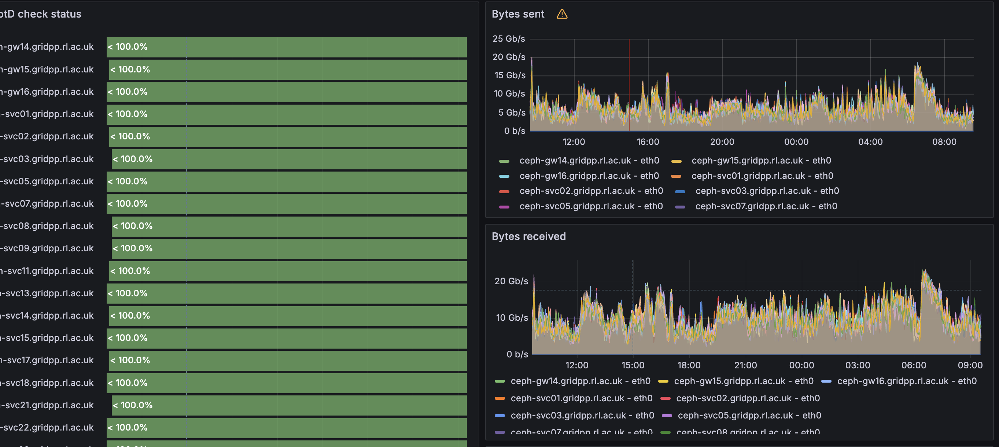
Our Grafana Dashboards

Slide 5
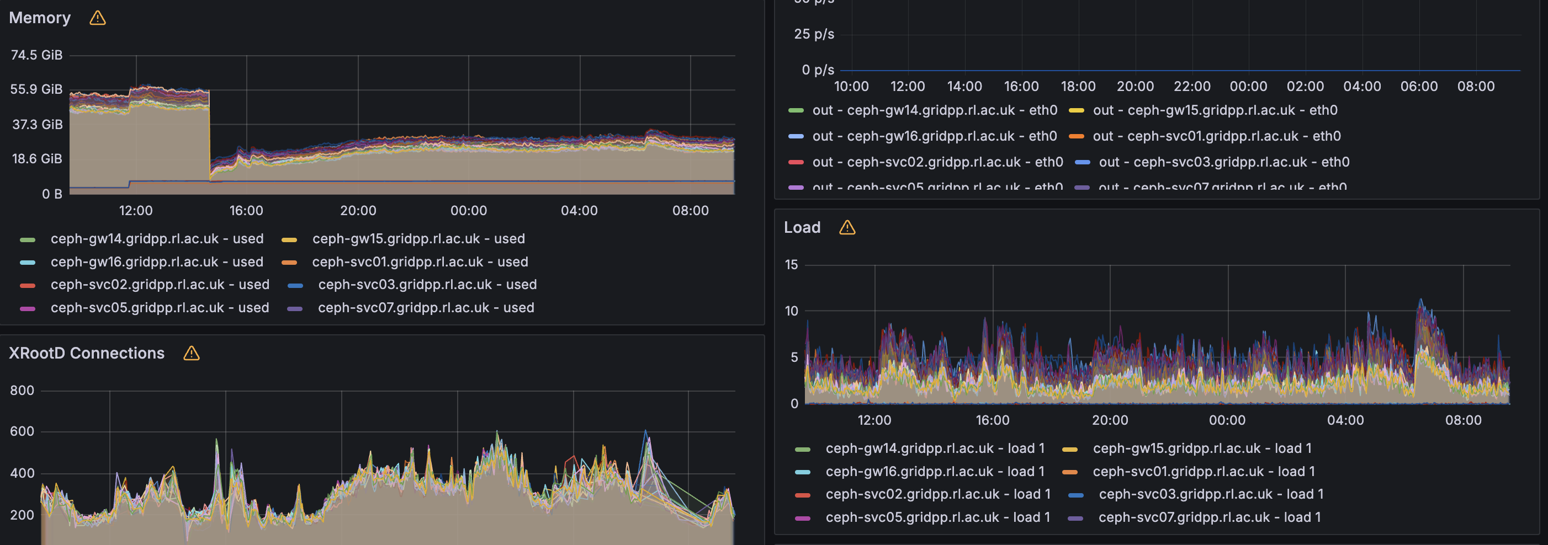
Our Grafana Dashboards

Slide 6
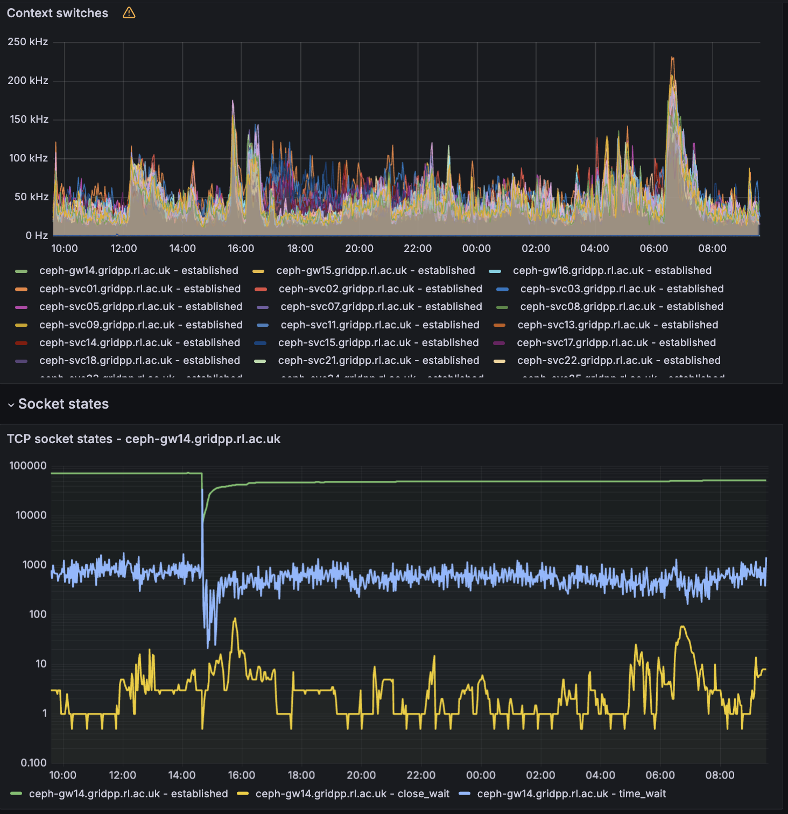
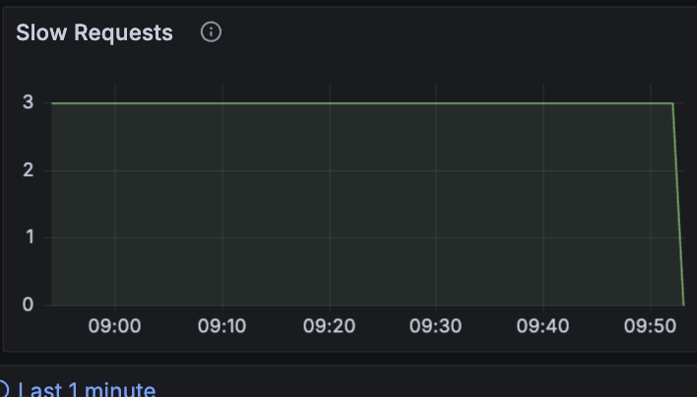
Our Grafana Dashboards

Slide 7
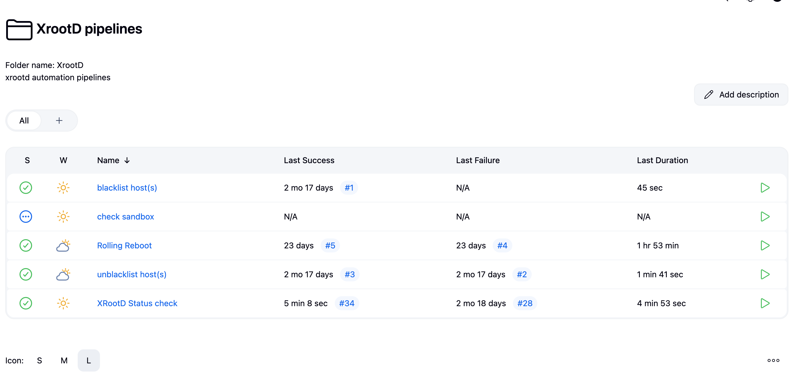
Jenkins pipeline prototype

Slide 8
Jenkins pipeline prototype
Status check is meant to be a ‘cluster state fetch’
It currently includes
  Fetch host IP addresses
  Disk usage
  Simple ping test
  Check configuration management logs
  Check ceph configuration files are present
  Check xrootd service status

Slide 9
Design principles
  This is primarily built for a RAL-type XRootD setup
    CMSD managers, XRootD servers with XrdCeph plugin, or XCache with XrdCeph origin.
    Aquilon configuration management
  But it’s planned to be modular such that it can be applied to create and manage a cluster from scratch so long as the hosts are reachable via ssh.
    The underlying scripts are in python/bash and can be ported into different automation pipelines (Jenkins/ansible)
    Currently only RHEL-based distributions are in scope
  Tabs separate monitoring, configuration overview and standard operations

Slide 10
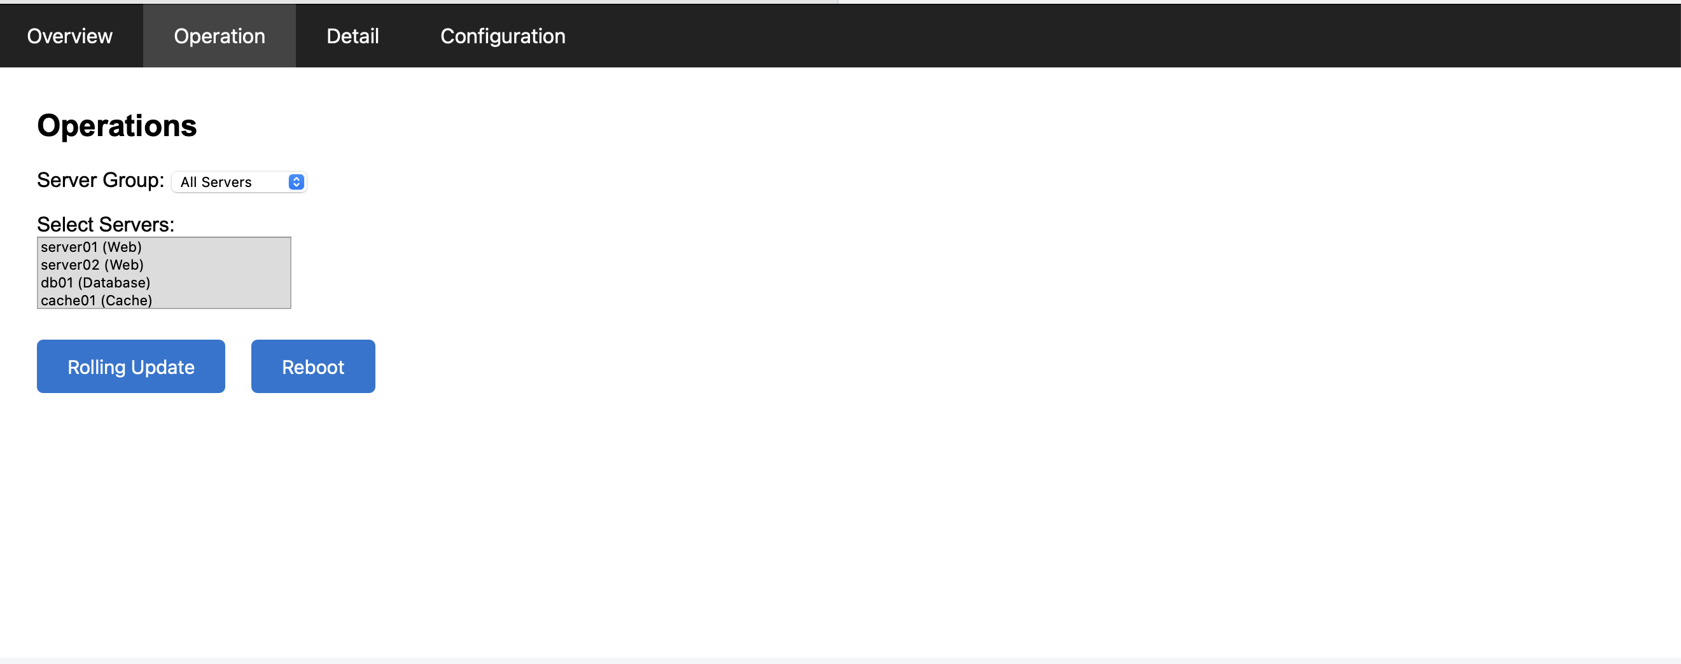
Initial mock prototype

Slide 11
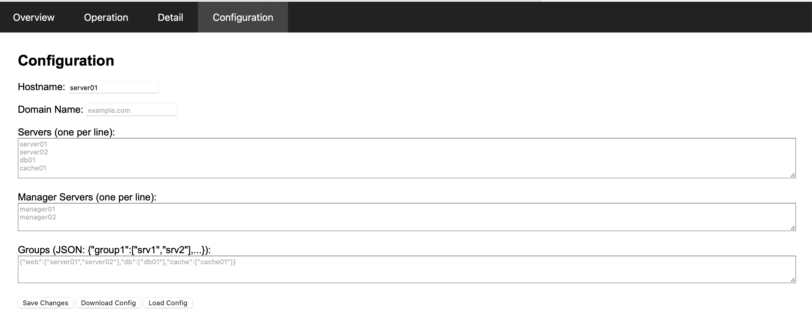
Initial mock prototype

Slide 12
Architecture
Internal site network
Traffic trough firewall
Web GUI
Accessed by
Admin host
CMSD
Server
Server
Server
Server
Server

Slide 13
Planned standard ops
  Rolling reboot of servers in a CMSD cluster
  Backup/Restore servers
  XRootD version upgrade (Aquilon managed or RHEL distribution)
  Blacklist/Whitelist servers
  Add new server to the cluster (this also deploys XRootD with Aquilon)
  Decommission server from cluster
  Move server between clusters
  Any other useful/desired feature?

Slide 14
Useful General metrics
  Boilerplate
    Network traffic
    Memory
    CPU load
  More specific useful metrics
    Socket states
    Number of XRootD connections
    Frequency of permission denied in the XRootD logs
    Ossstats Slow ops
    IO load

Slide 15
Thank you

