Slide 1
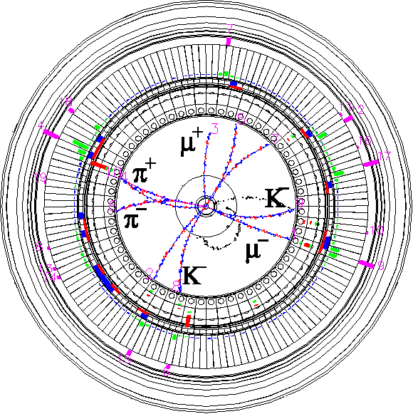


Introdutory remarks on beam-beam effects at SuperKEKB
Y. Funakoshi
2025.05.08 @CERN-KEK Meeting
Inter-University Research Institute Corporation High Energy Accelerator Research Organization (KEK)
大学共同利用機関法人 高エネルギー加速器研究機構 (KEK)

Slide 2
Contents
Crab waist ON and OFF (2024)
Terminology
Machine Parameters
Specific Luminosity
w/ and w/o Crab Waist Scheme
Beam-Beam Parameters
Beam Injection with Beam-Beam Effects

Slide 3
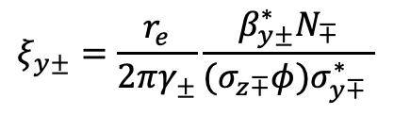
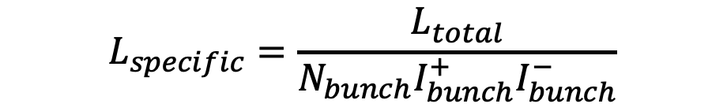
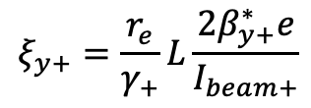
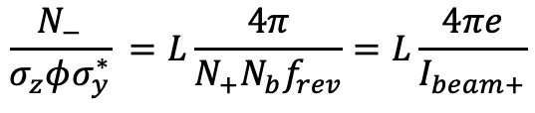
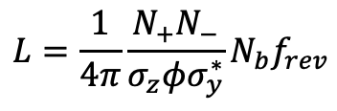
Terminology
Specific Luminosity
If beam sizes at IP is constant, the specifc luminosity is also constant.
Vertical Beam-Beam Parameter
Definition
Beam-Beam Parameter from Luminosity
Assume beam sizes at IP are equal for both beams
$$L_{specific}=\frac{L_{total}}{N_{bunch}I_{bunch}^{+}I_{bunch}^{−}}$$
$$ξ_{y±}=\frac{r_{e}}{2πγ_{±}}\frac{β_{y±}^{∗}N_{∓}}{(σ_{z∓}φ)σ_{y∓}^{∗} }$$
$$L=\frac{1}{4π}\frac{N_{+}N_{−}}{σ_{z}φσ_{y}^{∗}}N_{b}f_{rev}$$
$$\frac{N_{−}}{σ_{z}φσ_{y}^{∗}} =L\frac{4π}{N_{+}N_{b}f_{rev}}=L\frac{4πe}{I_{beam+}}$$
$$ξ_{y+}=\frac{r_{e}}{γ_{+}}L\frac{{2β}_{y+}^{∗}e}{I_{beam+}}$$

Slide 4
Machine parameters
 | SuperKEKB: Dec.27, 2024 |  | SuperKEKB: Design |  | Unit
Ring | LER | HER | LER | HER
Crossing angle (φ_{c}) | +/- 41.5 |  | +/- 41.5 |  | mrad
Beam energy | 4.0 | 7.0 | 4.0 | 7.0 | GeV
Beam current | 1632 | 1259 | 3600 | 2600 | mA
# of bunches | 2346 |  | 2500
IP ver. Cap sigma (Σ_{y}*)¹⁾ | 0.375 |  | 0.0788 |  | μm
Betatron tunes (ν_{x}/ν_{y}) | 44.525/46.589 | 45.531/43.599 | 44.53/46.57 | 45.53/43.57
β_{x}*/β_{y}* | 60/1.0 | 60/1.0 | 32/0.27 | 25/0.30 | mm
Crab waist ratio | 80 | 60 | 0 | 0 | %
Beam-Beam parameters ξ_{y} | 0.036 | 0.027 | 0.0881 | 0.0807
Luminosity | 5.11 x 10³⁴ |  | 8.0 x 10³⁵ |  | cm⁻²s⁻¹
1) The IP vertical Cap sigma_y was estimated from luminosity with assuming design bunch length.
φ_{piwinski} = ~16 (σz=6mm, εx= 4nm, βx*= 60mm)

Slide 5
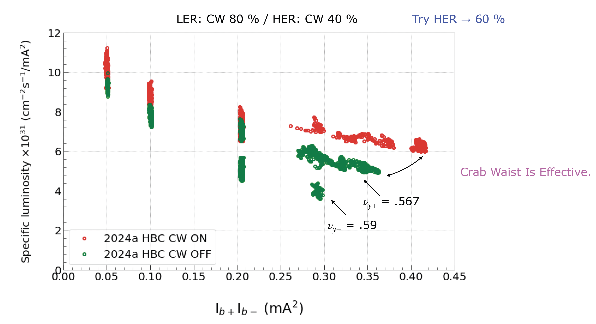
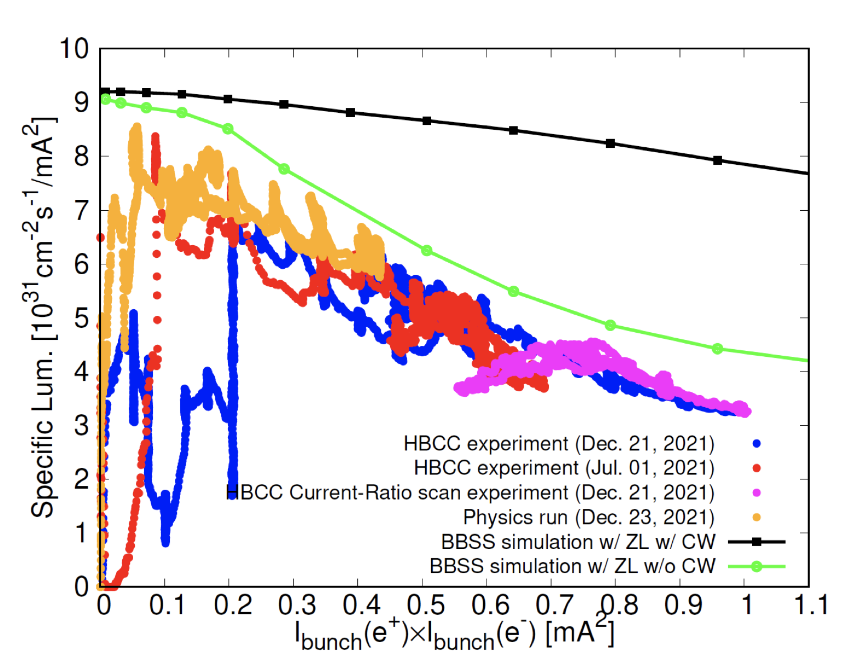
Specific luminosity w/ and w/o crab waist
Crab waist ON and OFF (2024)
The gain of the luminosity with CW is about 30 % at 0.35mA².
Strong-Strong Beam-Beam simulation (D. Zhou)
Crab waist:
LER:80%, HER:40%
Large discrepancy
Crab waist: off
CW off
data

Slide 6
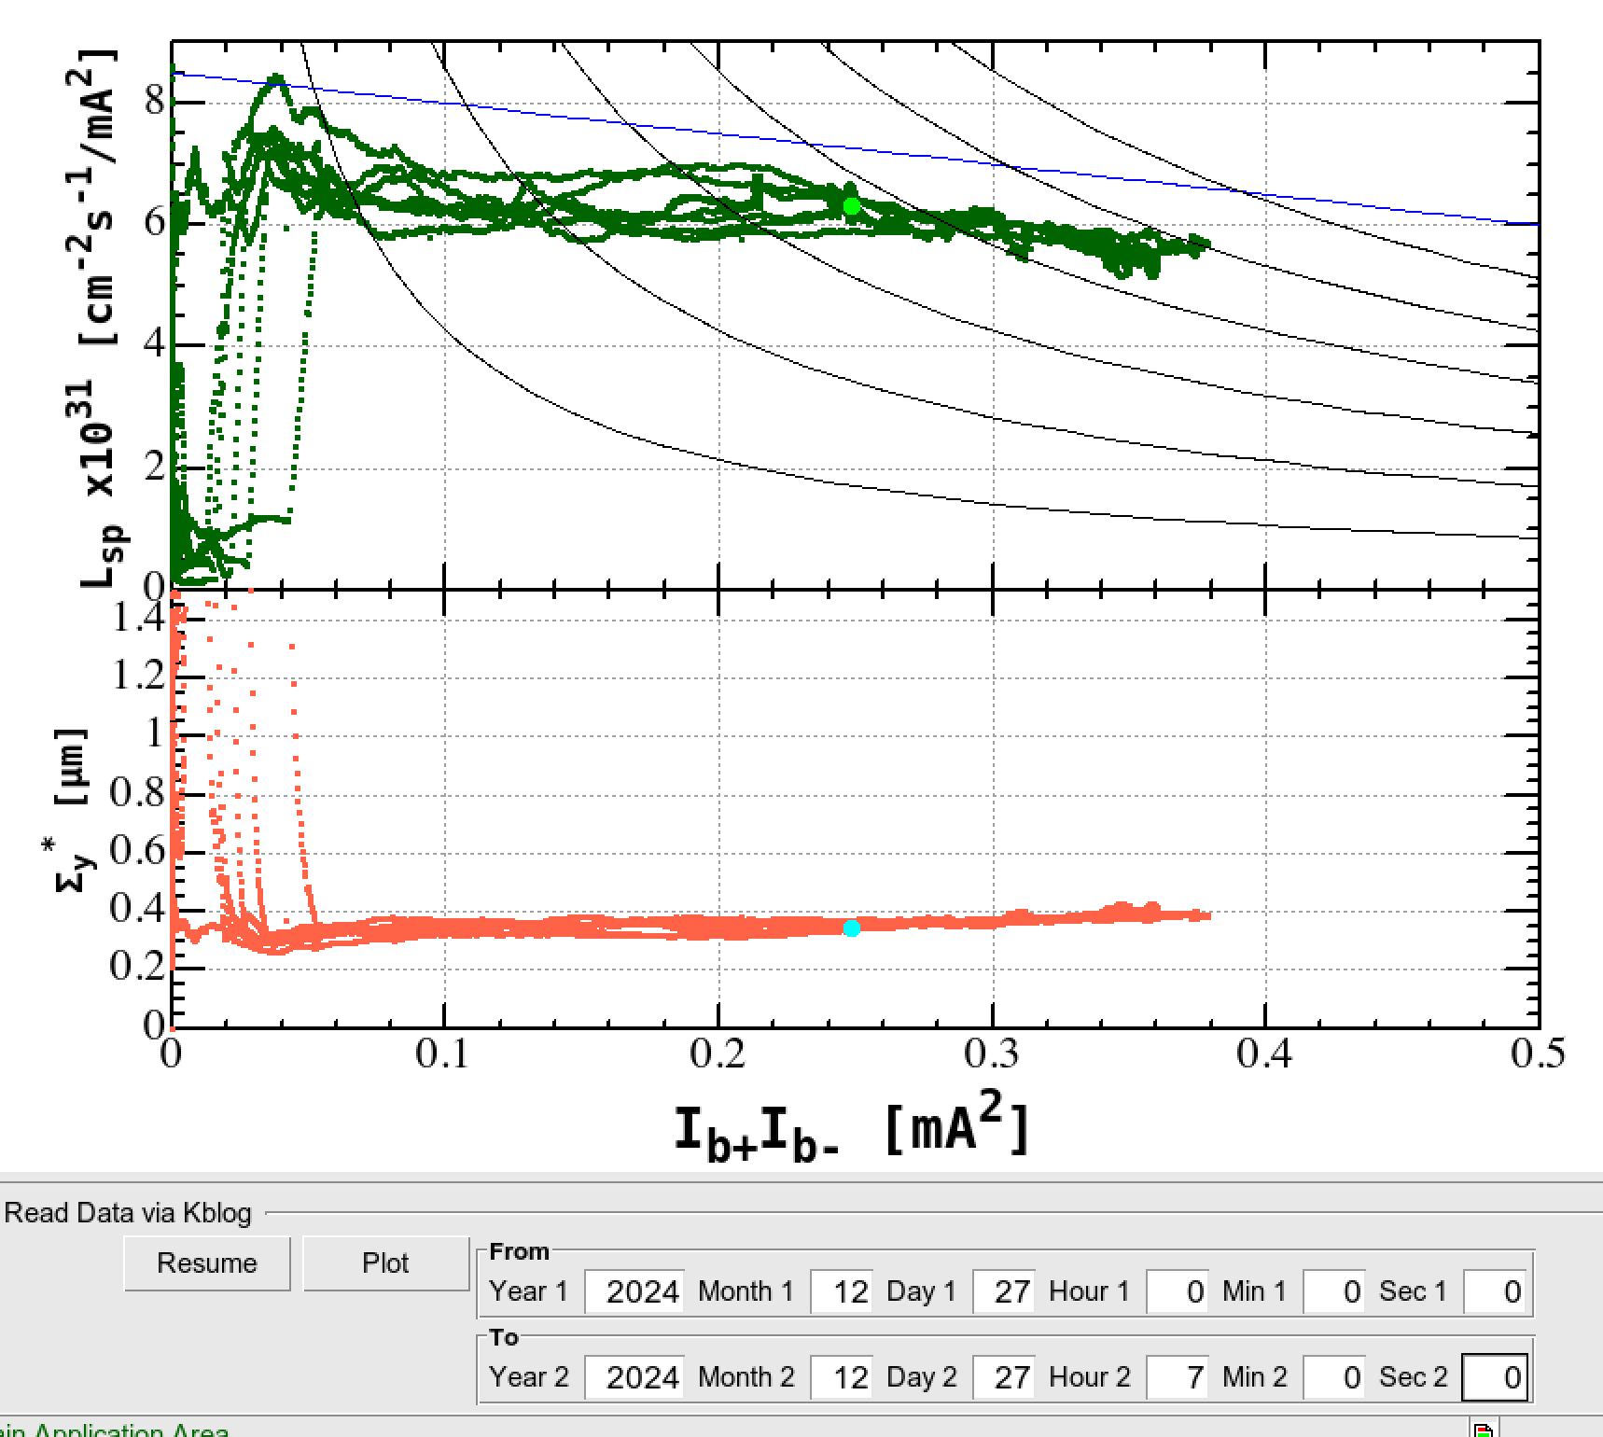
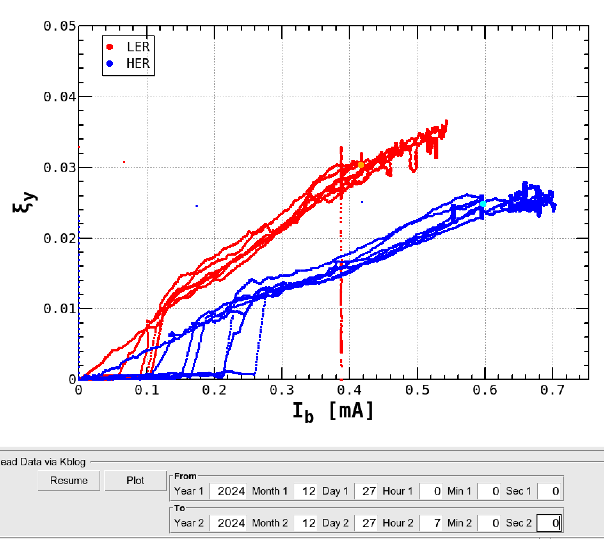
Specific luminosity and beam-beam parameter
At highest luminosity (5.11 x 10³⁴ cm⁻²s⁻¹): Dec.27th 2024
Reference:2022
Specific luminosity in 2024 was ~15% lower than that in 2022.

Slide 7
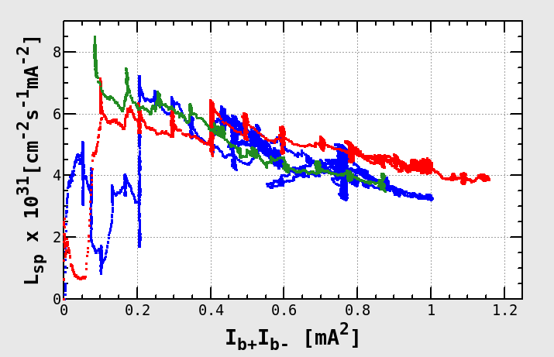
Comparison of specific luminosity)
Blue: 2021 Dec. 21st βy* = 1.0mm, H/L=0.667~0.8
Red: 2022 April 5th βy* = 1mm, H/L=~0.8
Green: 2024 June 27th βy* = 0.9mm, H/L=~0.7
Lspec = Lum/Nb/Ib+/Ib-

Slide 8
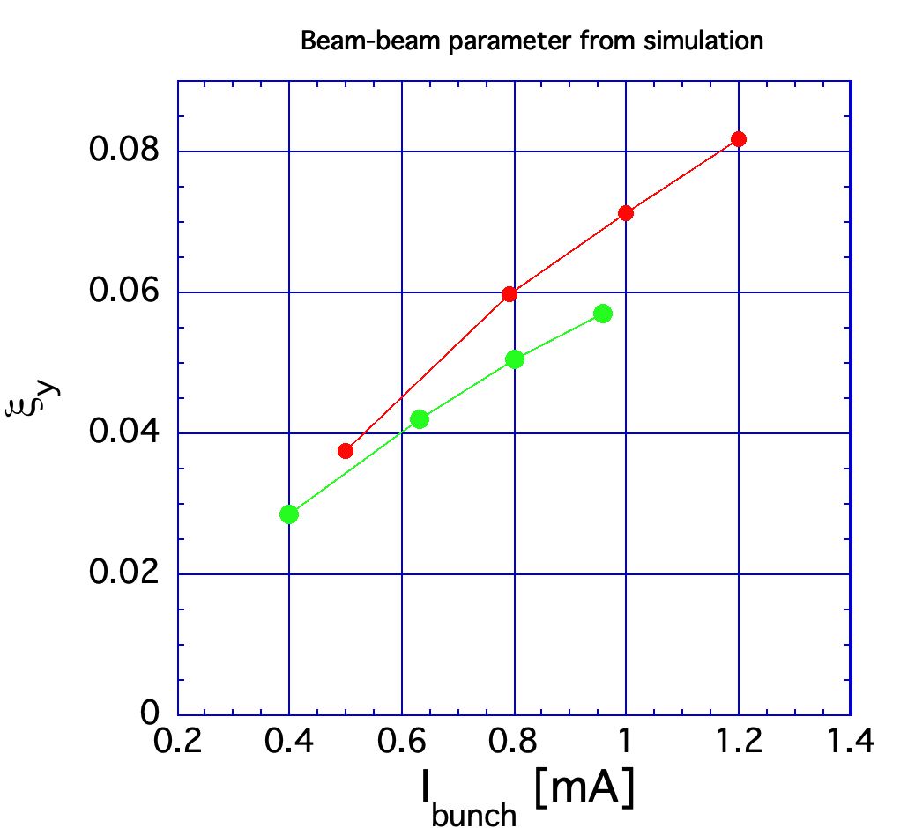
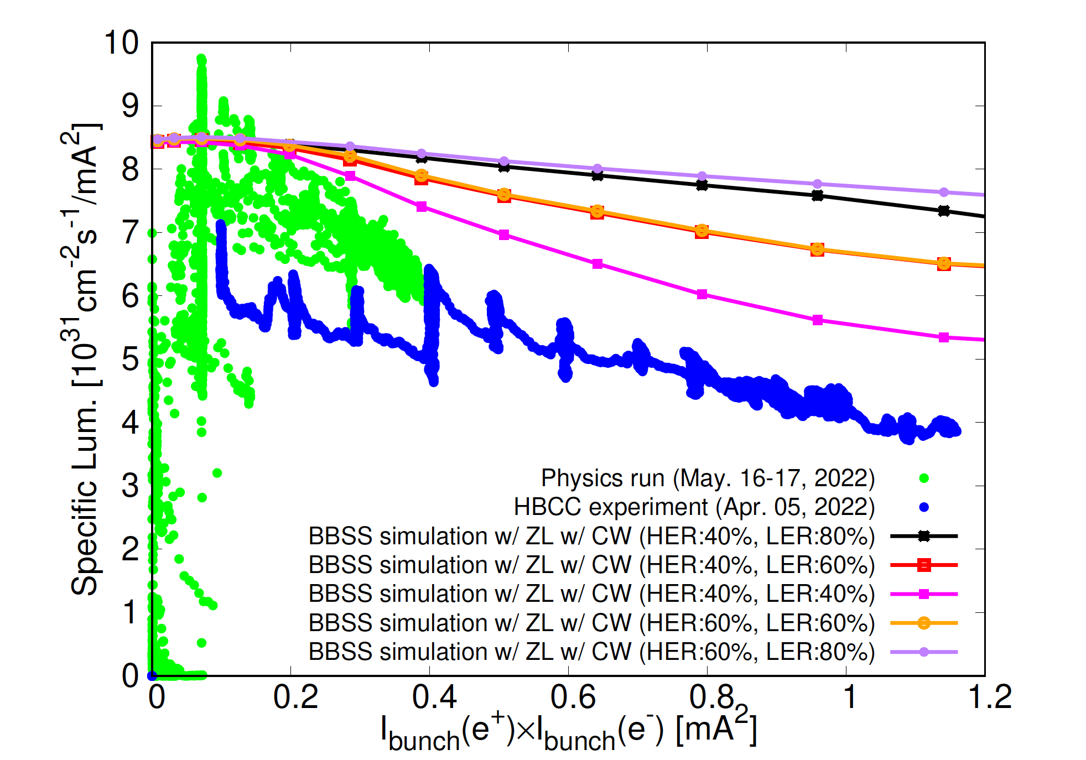
Beam-Beam Parameter calculation from simulation
Strong-Strong Beam-Beam simulation (D. Zhou)
Crab waist:
LER:80%, HER:60%
Crab waist:
LER:80%, HER:40%

Slide 9
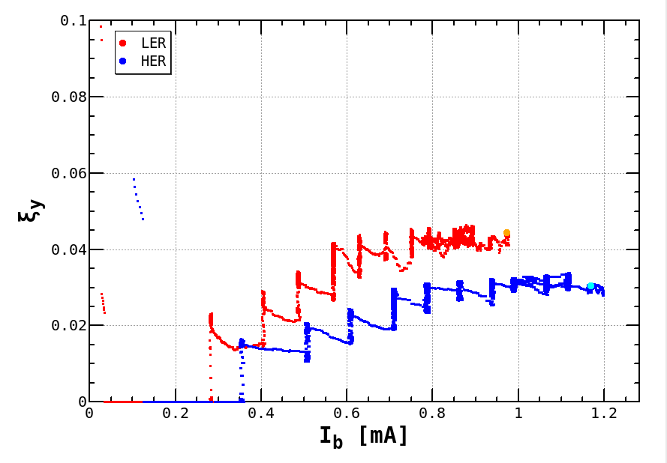
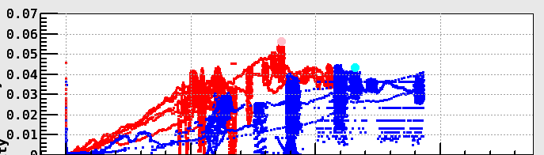
Beam-beam parameters
0.06
N_{bunch} = 31
2022 March 28th
Bunch-by-bunch FB:off
N_{bunch} = 393
2022 April 5th
ξ_{y}
Bunch-by-bunch FB:on
0.04
0.02
0
0
0.5
1
1.5
I_{bunch} [mA]
With smaller number of bunches (31 bunches), which allowed us to switch FB off, ξ_{y} of HER reached ~0.043. This is the highest value achieved ever at SuperKEKB.
Vertical beam-beam parameter (ξ_{y}) of HER is saturated around 0.03.

Slide 10
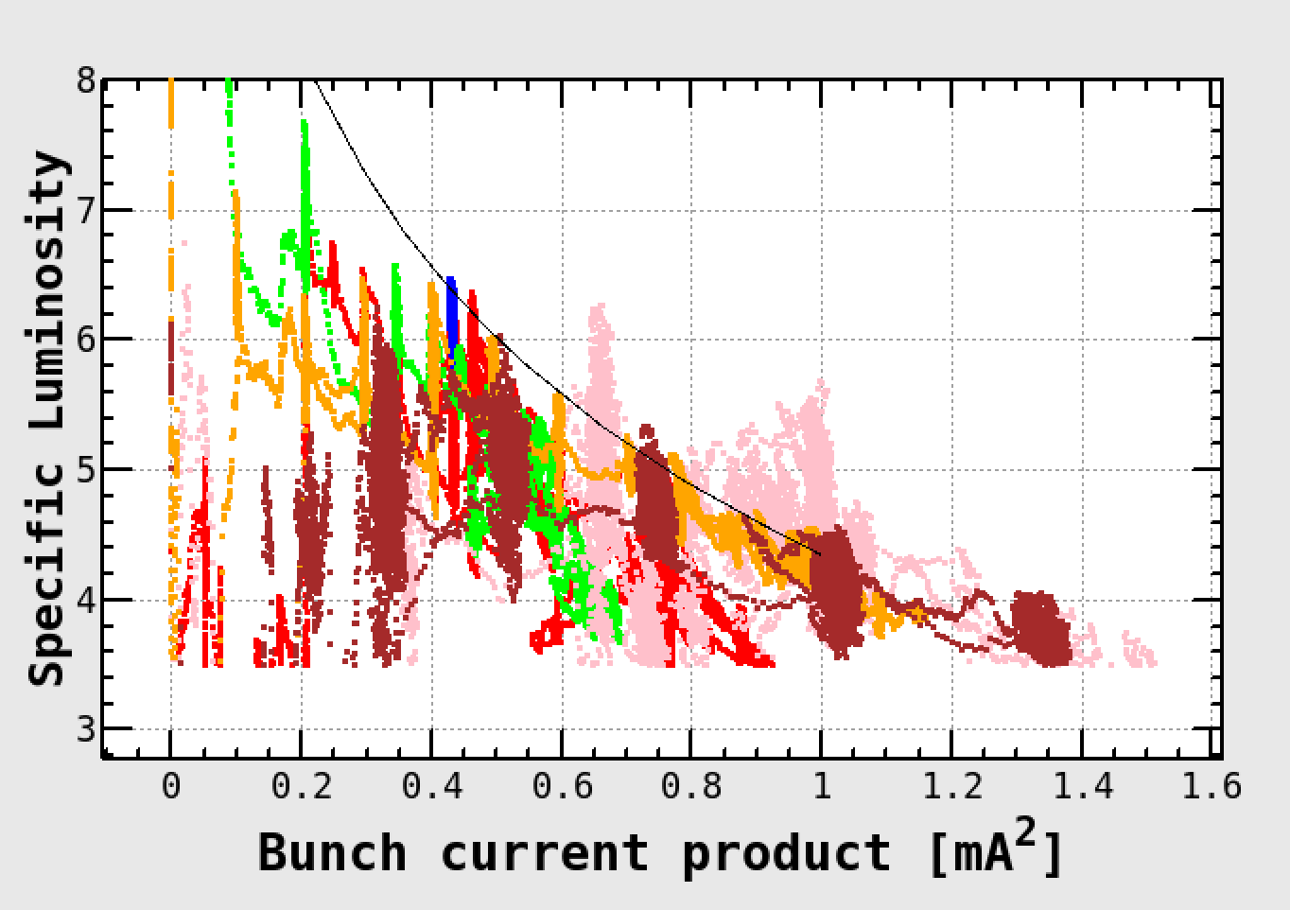
Specific luminosity
Crab waist: LER:80%, HER:40%
Pink: Nb=31, March 28th 2022
Brown: Nb = 61, April 5th 2022
Orange: Nb = 393, April 5th 2022
Nb = 1662, May 16-17th 2022 (physics run)
Nb = 393, April 5th 2022
There is a big discrepancy between simulation and experiment. This issue is very important.

Slide 11
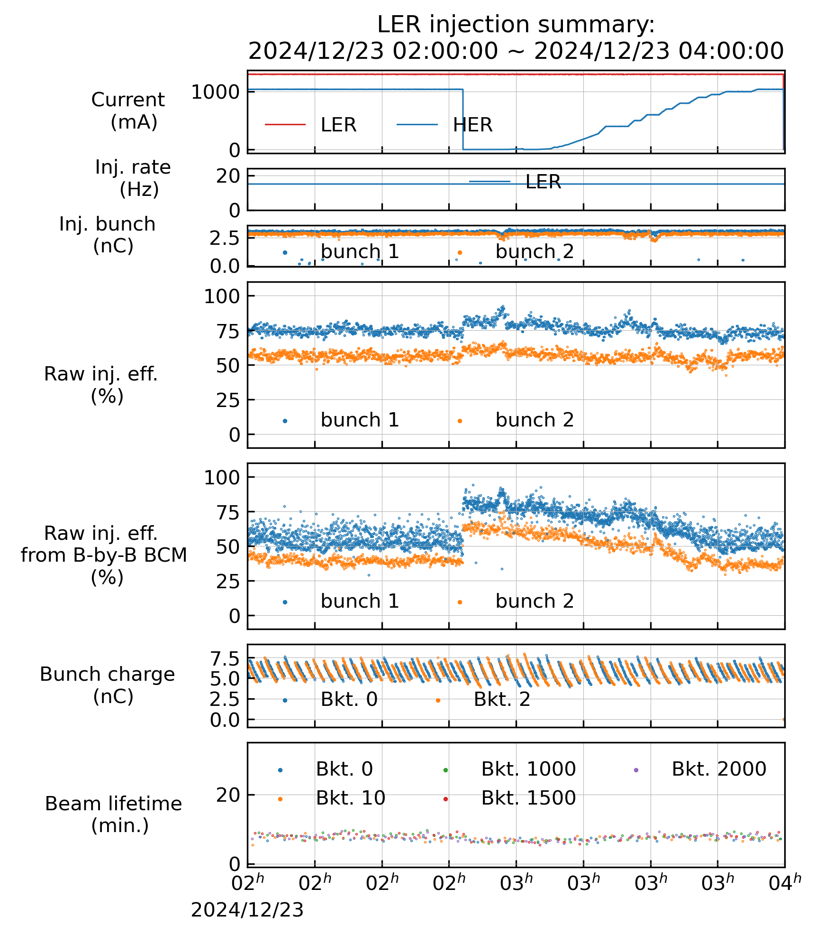
LER injection w/ beam-beam
LER 1300ｍA, HER 1000mA
w/ NLC optics
βx*=80mm
LER beam injection seems to be largely affected by beam-beam interaction.
LER injection efficiency w/ beam-beam is strongly dependent on betatron tunes.
HER beam abort
S Terui

Slide 12
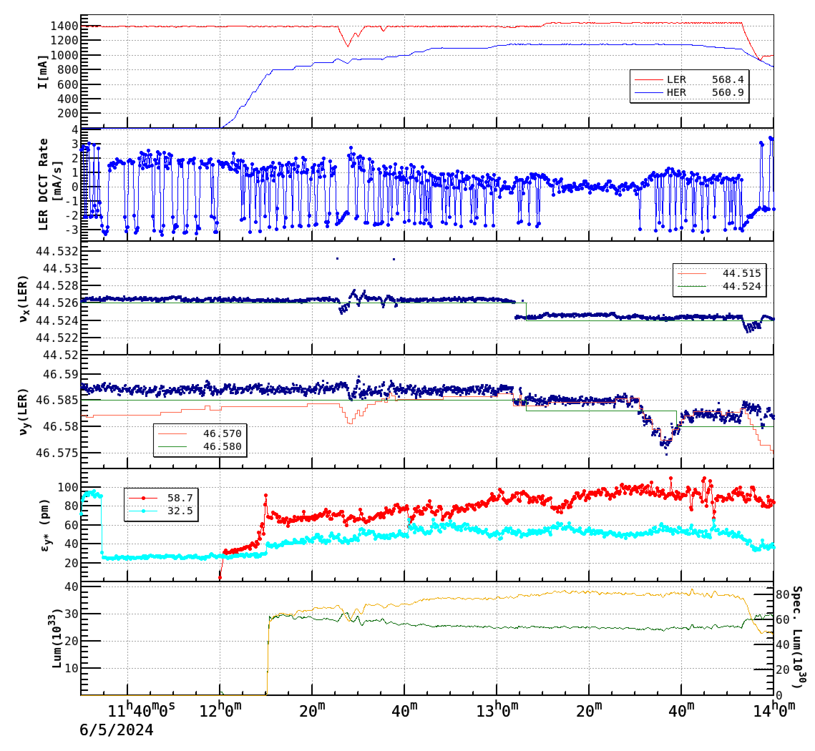
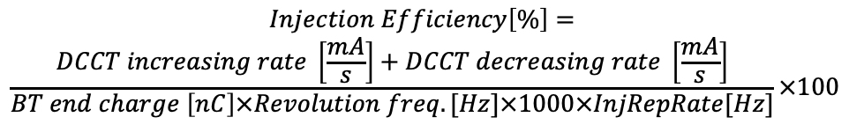
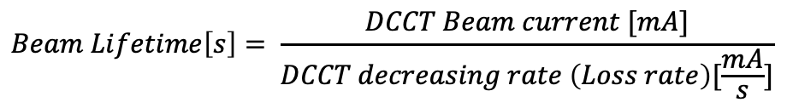
Experiment on beam injection of LER
(June 5th 2024)
w/ beam-beam
Beam lifetime increases w/ beam-beam blowup.
Injection efficiency get worse seriously → By optimizing working points, the injection efficiency is improved.
Nb =2346
(1)
(2)
(3)
 | Ibeam (LER) | Ibeam (HER) | IncRate (L) | Life (L) | InjEff (L)
(1) | 1395 mA | 0 mA | 1.68mA/s | 7.3 min. | 77.4%
(2) | 1395mA | 1100mA | 0.42mA/s | 8.9 min. | 48.0%
(3) | 1444mA | 1100mA | 1.02mA/s | 8.0 min. | 64.8%
$$Beam Lifetime\left[s\right]= \frac{DCCT Beam current [mA]}{DCCT decreasing rate \left(Loss rate\right)[\frac{mA}{s}]}$$
$$Injection Efficiency\left[\%\right]=$$
$$\frac{DCCT increasing rate \left[\frac{mA}{s}\right]+DCCT decreasing rate \left[\frac{mA}{s}\right]}{BT end charge \left[nC\right]×Revolution freq. [Hz]×1000×InjRepRate[Hz]}×100$$

Slide 13
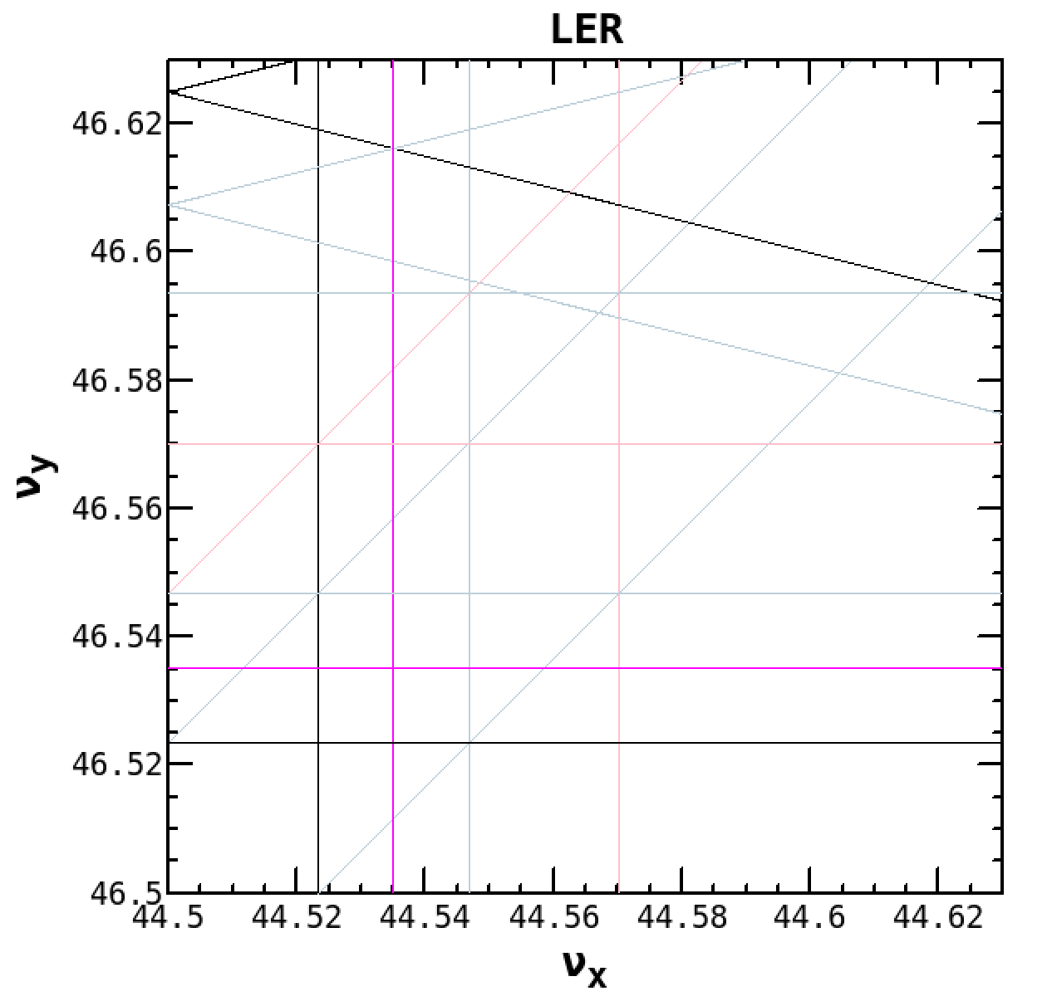
Summary of beam injection
Injection scheme of SuperKEKB
Usual betatron (horizontal) injection with stacking mode
With crab waist, the beam injection was improved.
Even with crab waist, LER injection efficiency was decreased by ~30% with beam-beam effects.
At the present SuperKEKB, the beam injection limits the storable beam currents and then luminosity.
The maximum LER beam current (and luminosity) is limited by the beam injection.
By changing working point, the injection efficiency was recovered by ~ 15%.
With this change in tunes, the beam sizes and luminosity did not change so much. The beam lifetime did not change so much either.
A simulation on the injection w/ beam-beam is going on.
Strong-weak simulatin with SAD lattice
tune survey, w/ impedance
Several measures for better injection have been be taken.
Reduce horizontal injection oscillation amplitude by increasing βx at injection point (~100m -> 160m)
Reduce βx* at the IP (80mm -> 60mm: LER)
(.5265,.587)
(.524,.577)

Slide 14
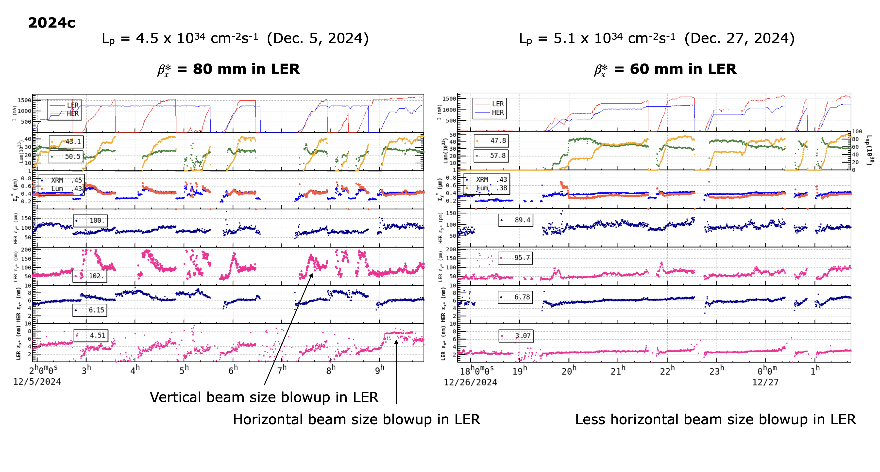
Beam-beam blowup (2346 bunches)
I_{beam}
Luminosity
Σy*
εy(HER)
HER
Vertical blowup
εy(LER)
LER
εx(HER)
εx(LER)
Injection efficiency of LER was improved. (Yoshimoto’s talk)

Slide 15
Summary
There has been a large discrepancy in specific luminosity between experimental data and strong-strong beam-beam simulations.
Simulation study with lattice nonlinearity and ring impedance is underway-> Ohmi’s talk
The specific luminosity has been slowly(?) degraded as time goes by (2025).
Achieved beam-beam parameters (~<0.03 in usual) is much lower than the initial expectations.
With fewer bunches (~30) and with bunch-by-bunch FB off, we achieved ξy ~0.043. We will try this experiment again in the next run.
The beam injection is largely affected by the beam-beam interaction in LER.
Simulations is underway. -> Yamamoto’s talk
Squeezing βx* in LER (80 -> 60mm) seems to be effective to improve the beam injection efficiency. -> Yoshimoto’s talk, Li’s talk
The international collaboration (KEK, CERN, IHEP, USTC) has been established. Beam-beam issues have been discussed in the collaboration meeting.

Slide 16
Fin.
Thank you for your attention.
Inter-University Research Institute Corporation High Energy Accelerator Research Organization (KEK)
大学共同利用機関法人 高エネルギー加速器研究機構 (KEK)

Slide 17
Task List (1/2)
Simulations | Effects |  | Single | WS | SS
 | Lattice nonlinearity and/or machine errors (βy*=1mm)
 |  | Full lattice | ○ | ○ | △
 |  | HER cancel coil fabrication errors | ○ | ○
 |  | QC2RE fringe field
 |  | Belle-II detector mis-alignments | ○
 |  | Imperfection of crab waist scheme |  | ○
 |  | Mis-alignments of arc and IR
 | Beam injection |  | ○ | ○
 | Impedance
 |  | Longitudinal | ○ |  | ○
 |  | Transverse | ○ |  | ○
 | Others
 |  | Space charge, electron clouds |  | △
 | Bunch-by-Bunch feedback system
 |  | FB noise

Slide 18
Task List (2/2)
Experiments | Effects |  | Single | collision
 | Lattice nonlinearity and/or machine errors (βy*=1mm)
 |  | Amplitude dependent tune shift, decoherence of dipole oscillations | △ (charge dependence)
 |  | HER cancel coil fabrication errors | Need corrections | Need corrections
 |  | Dynamic aperture | △ (charge dependence)
 |  | Large single beam emittance issue (HER) | △
 |  | Belle-II detector mis-alignments
 |  | Imperfection of crab waist scheme
 | Impedance
 |  | Single bunch instability | -1 mode | TMCI-like
 | Beam-Beam Effects
 |  | Collision with small number of bunches, FB: ON/OFF | - | △
 |  | More tune survey, high bunch current collision | - | △
 |  | Improvements in IP knob tuning | -

Slide 19
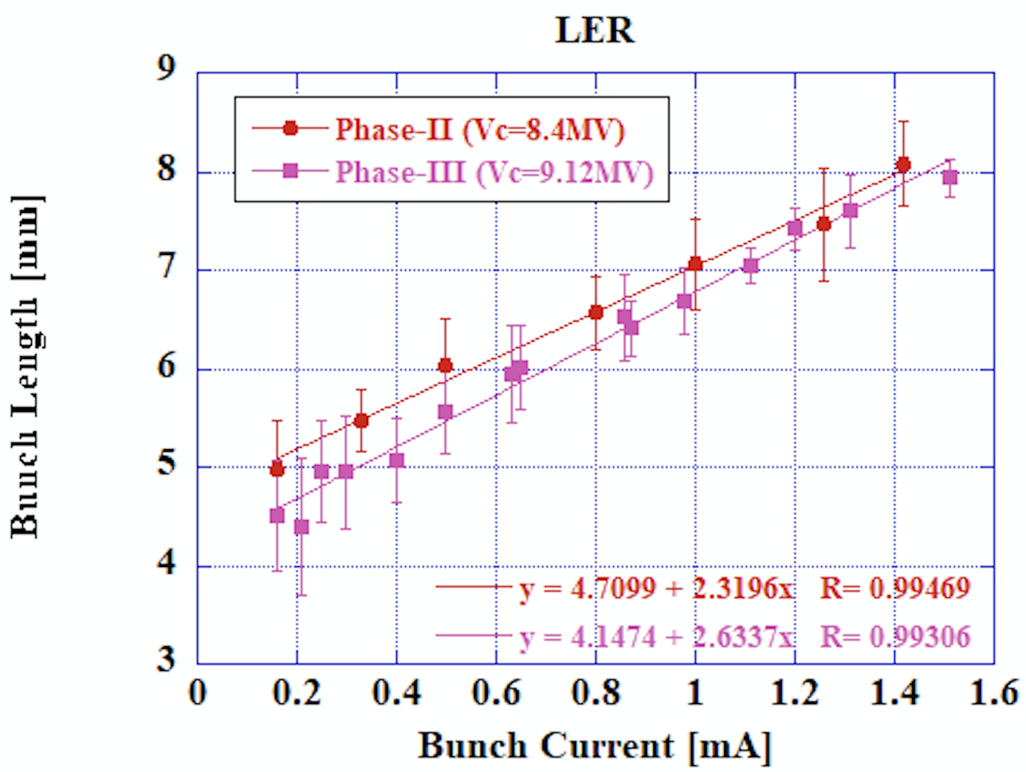
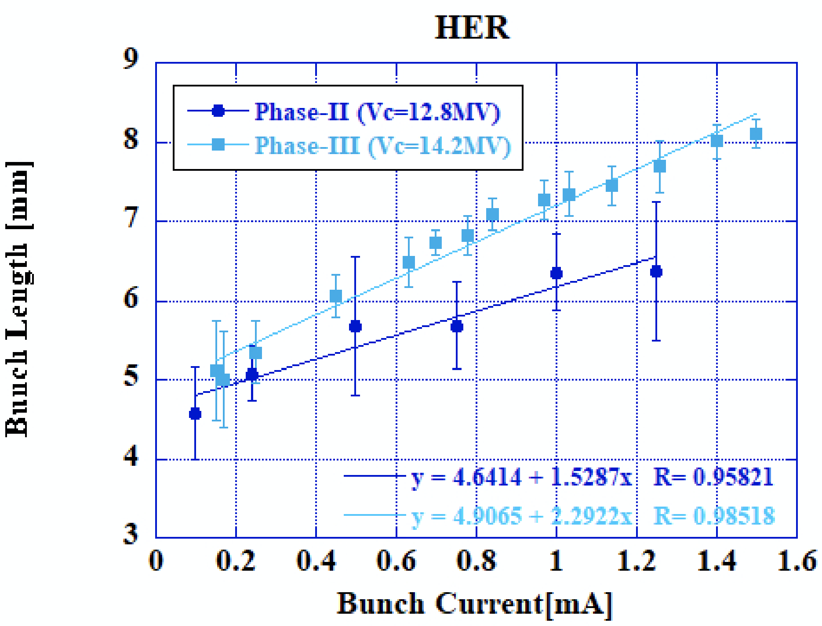
Bunch length measurement by streak camera

