Slide 1

Vacuum system and vacseal (or not ?) for FCC-ee
C. Garion, V. Baglin (CERN/TE/VSC)
Mini-workshop on “SuperKEKB and implications for the FCC-ee”, Zoom meeting, 8th May 2025

Slide 2
Outline
SuperKEKB flanges
FCC-ee vacuum layout and connections
VSC approach in case of leaks
VSC experience with VACSEAL

Slide 3
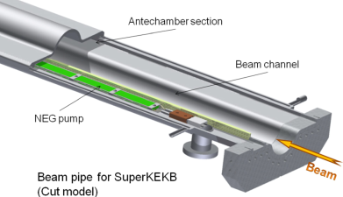
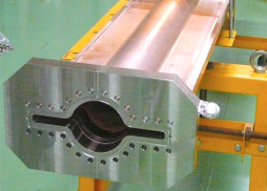
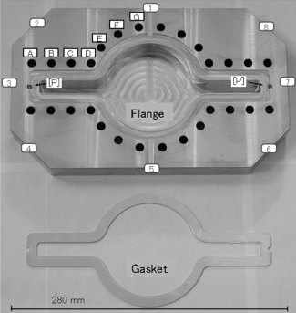
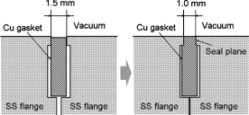
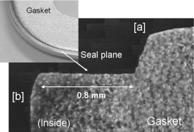
SuperKEKB flanges
Vacuum chamber based on:
Antechamber with distributed NEG strip pump
Antechamber with distributed synchrotron radiation
Matsumoto-Ohtsuka-type vacuum flange based on:
Bolted connection
Copper gasket
Local compression between flat surfaces on the flanges
Design and construction of the SuperKEKB vacuum system, J. Vac. Sci. Technol. A 30, 031602 (2012); https://doi.org/10.1116/1.3696683, Yusuke Suetsugu, Ken-ichi Kanazawa, Kyo Shibata, Takuya Ishibashi, Hiromi Hisamatsu, Mitsuru Shirai, and Shinji Terui
Application of a Matsumoto-Ohtsuka-type vacuum flange to beam ducts for future accelerators, J. Vac. Sci. Technol. A 23, 1721–1727 (2005), https://doi.org/10.1116/1.2101808 , Y. Suetsugu; M. Shirai; M. Ohtsuka
Development of copper-alloy Matsumoto–Ohtsuka-type vacuum ﬂanges and its application to accelerator beam pipes, J. Vac. Sci. Technol. A 27, 1303 (2009); https://doi.org/10.1116/1.3237149, Y. Suetsugu, M. Shirai, M. Ohtsuka, T. Nishidono, K. Watanabe, Y. Suzuki, M. Tsuchiya, A. Yonemoto, K. Sennyu, and H. Hara

Slide 4
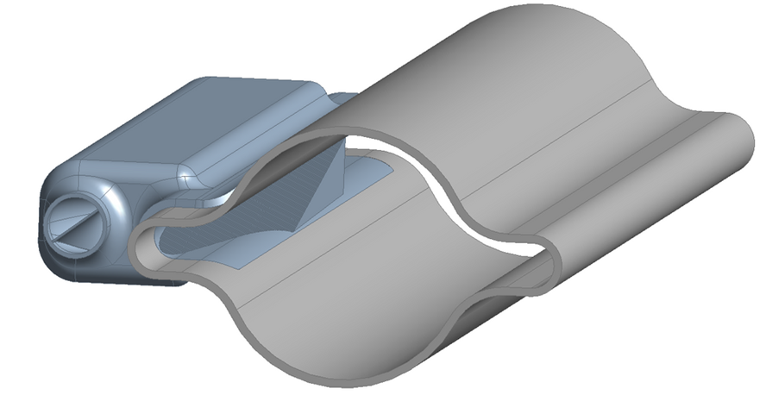
FCCee functional layout
Shielded bellows
BPM
Dipole
Dipole
Quad & correctors
Girder
Synchrotron radiation absorber
~11 m
Girder
Flange connection
~6 m
Synchrotron radiation absorbers are installed in dipoles, shielding also the interconnections and quad/correctors
→ no synchrotron radiation on the flanges.
Vacuum chambers are NEG coated requiring a thermal cycle to 230 °C +/- 20 °C.
→ 65 mm axial stroke for the shielded bellows.
Vacuum chamber with a synchrotron radiation absorber

Slide 5
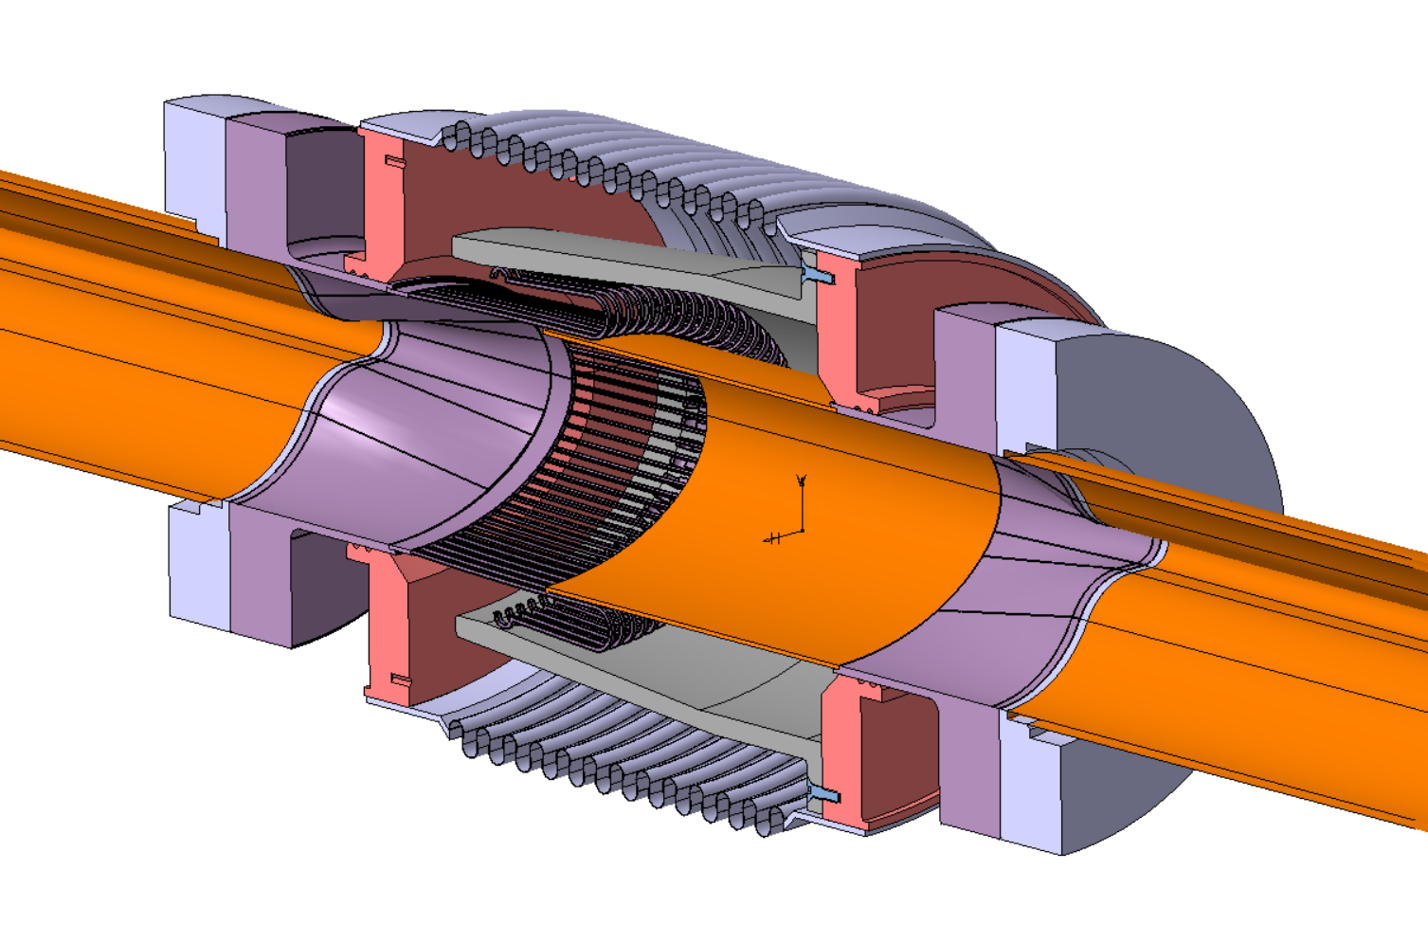
FCCee vacuum chamber connections
Conceptual design for illustration only.
Oval flanges
Connections:
Baseline design: Shape Memory Alloy connector
Alternative design: CF like, knife edge oval flange
Oval RF fingers and insert
Copper transition Oval – Circular+ winglet

Slide 6
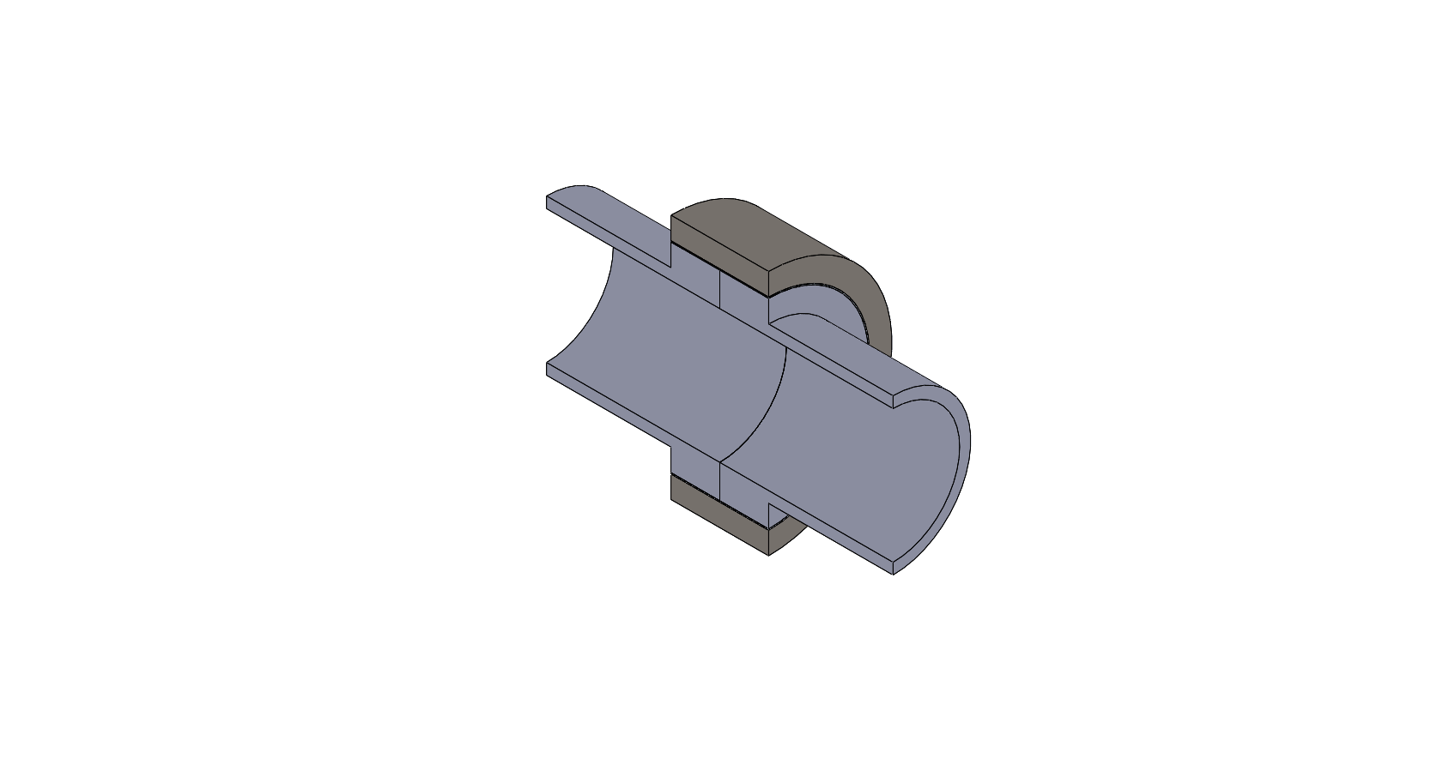
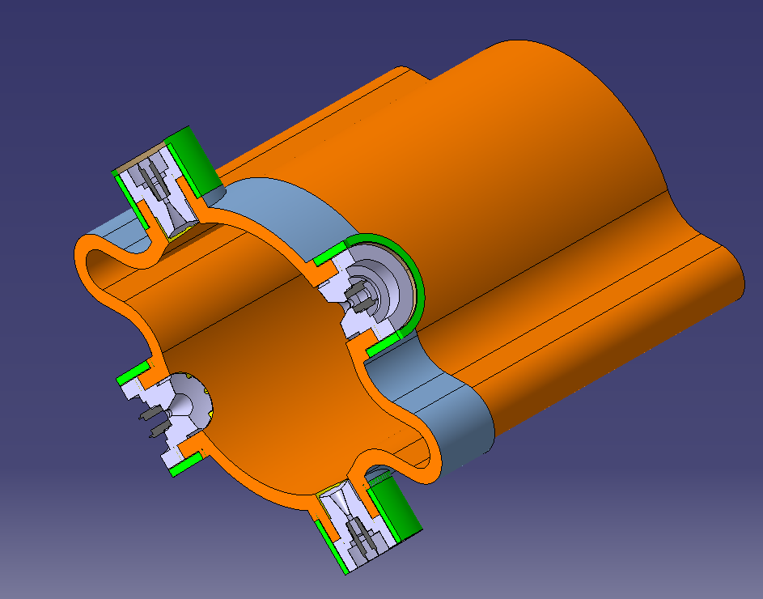
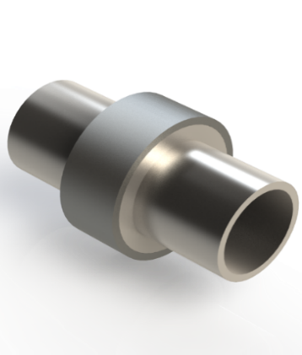
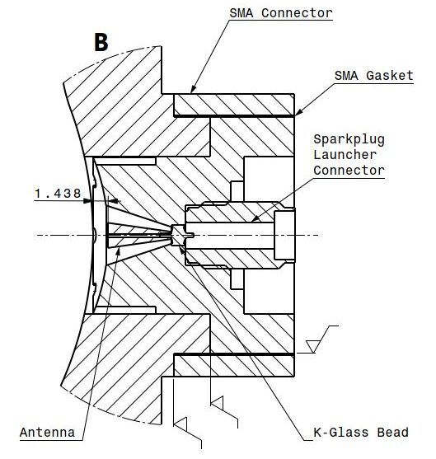
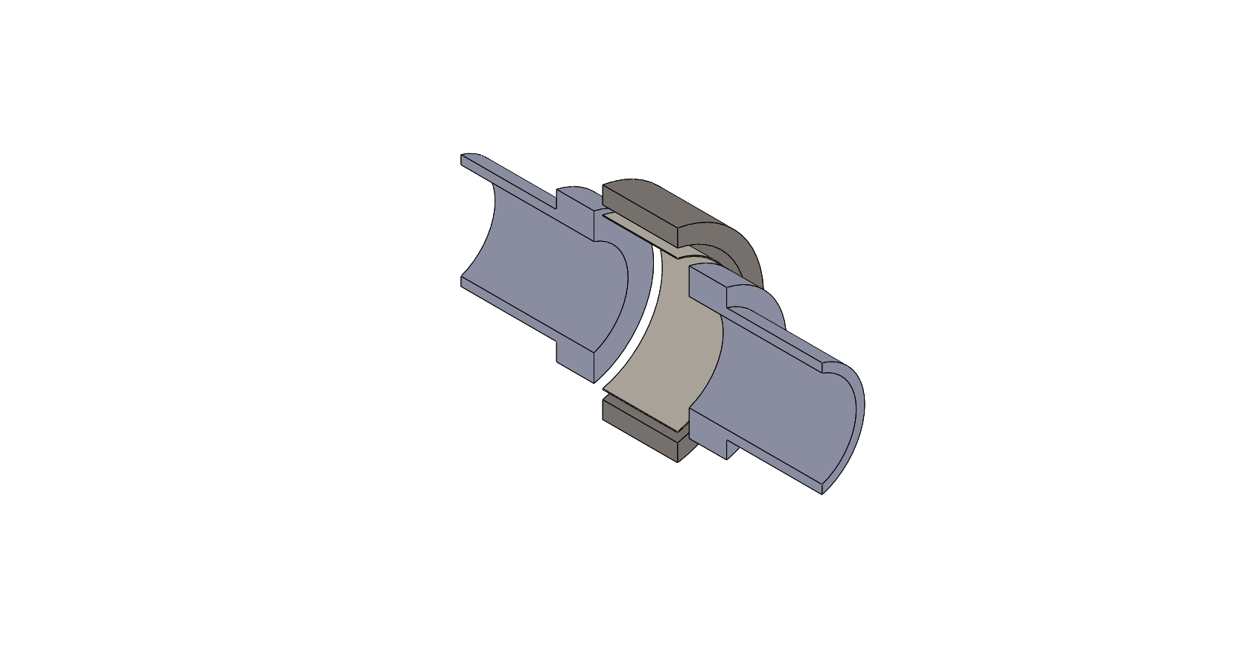
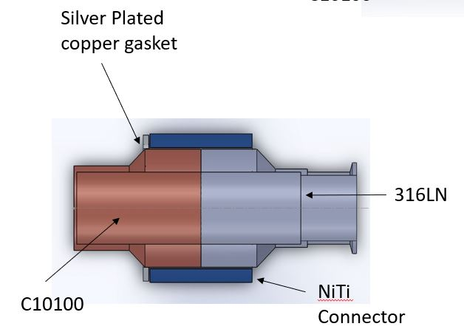
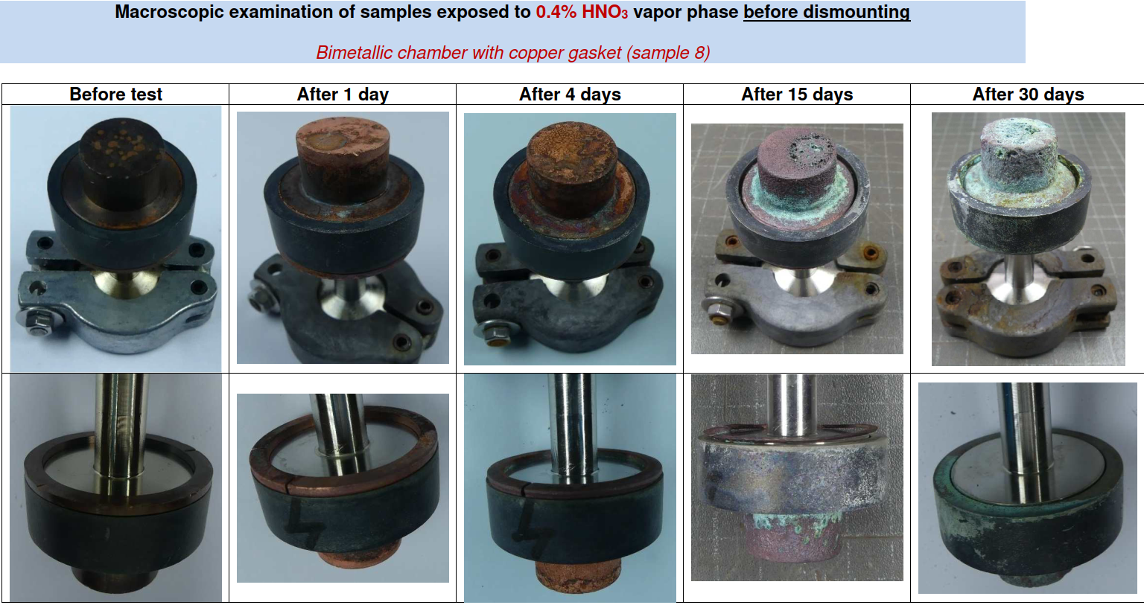
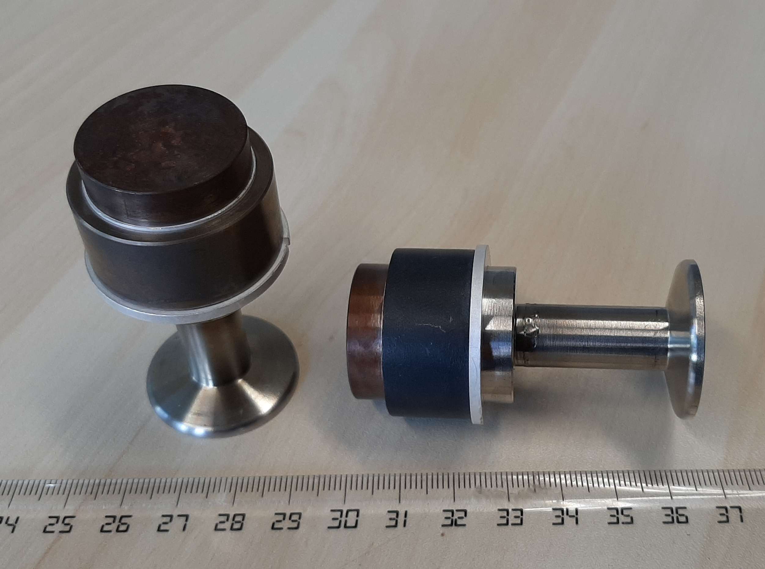
Shape Memory Alloy connectors
Compact and bi-material UHV connections are required and are done by SMART connectors.
Austenitic contracted
hot shape
Heating/mounting
Cooling/dismounting
SMA ring coupler (NiTi)
Thin cylindrical gasket
Martensitic enlarged
cold shape
Compact bi-metallic (Cu/St. St.) connection of the BPM pick-up
Al, Cu, Ag plated Cu gaskets with Stainless steel / Stainless steel, copper chambers
Accelerated corrosion tests in harsh environment

Slide 7
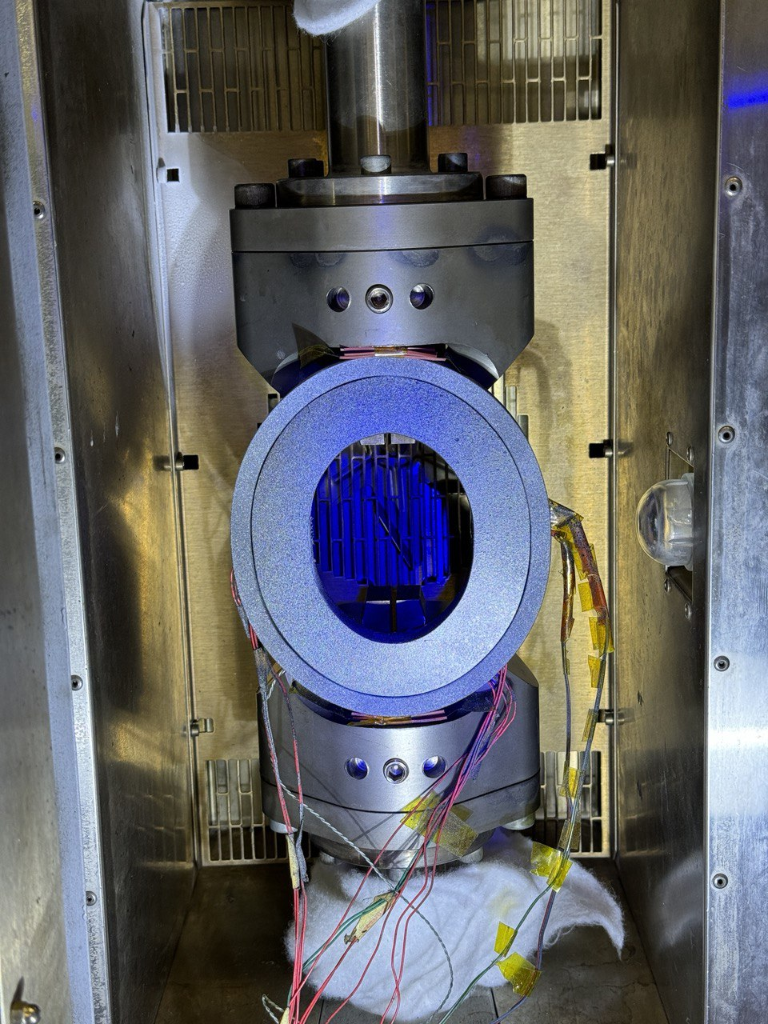
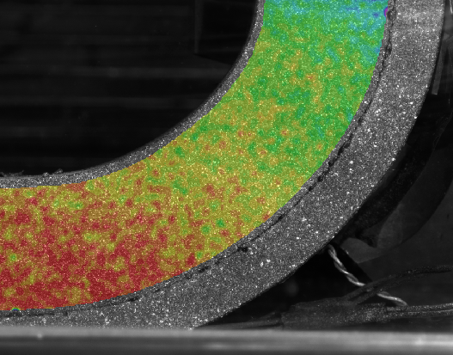
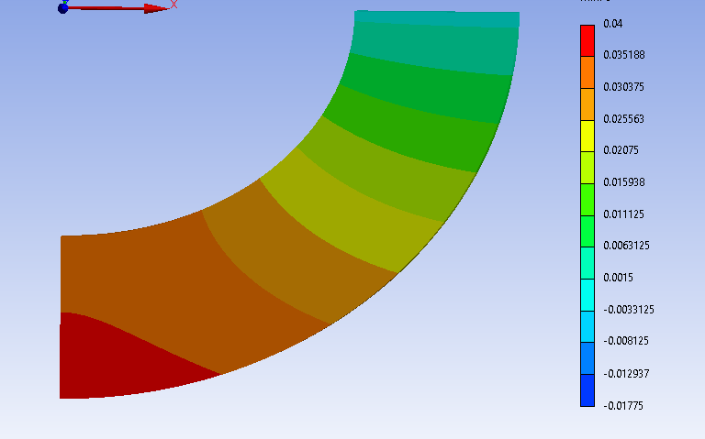
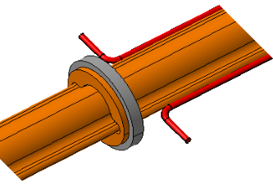
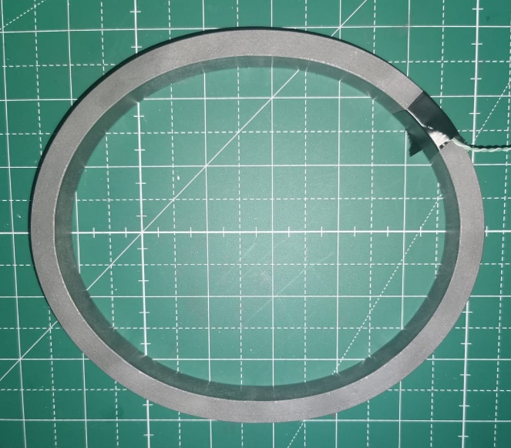
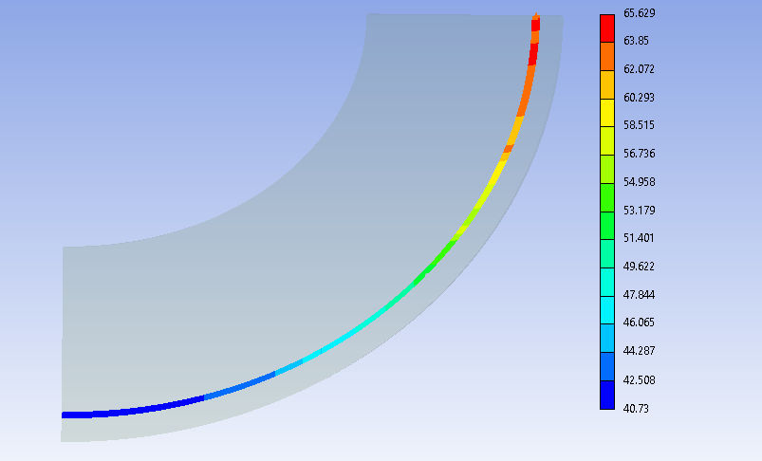
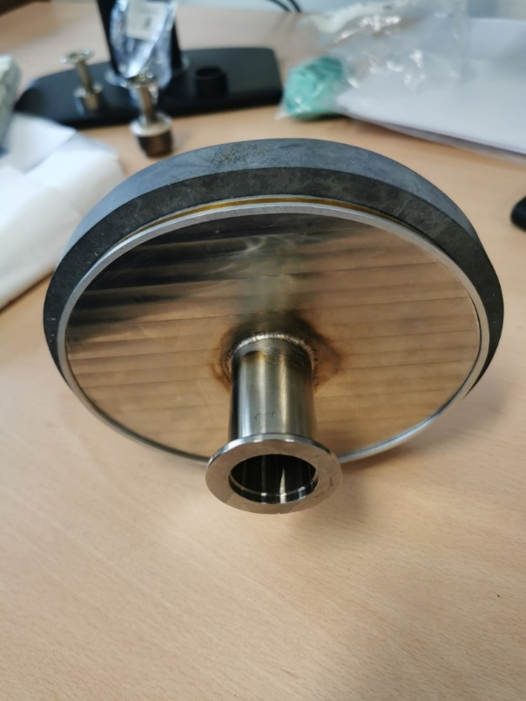
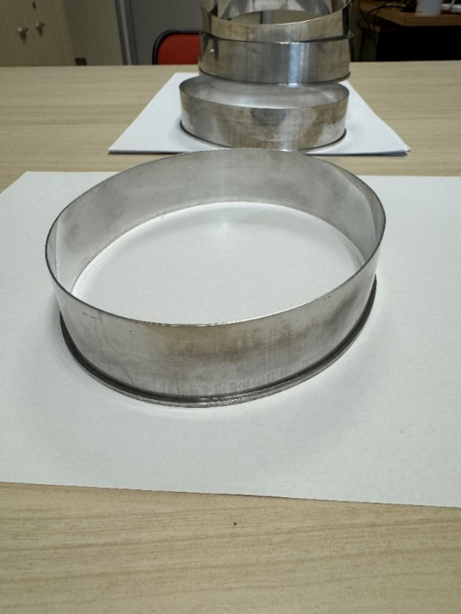
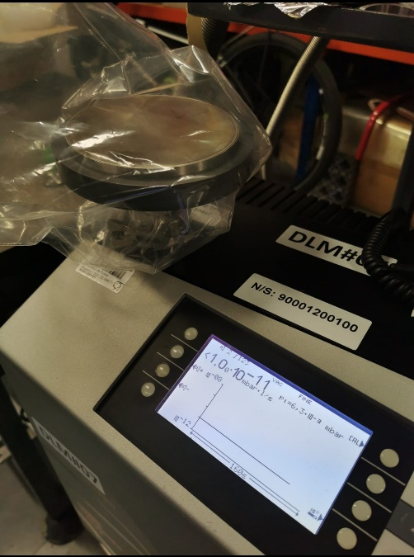
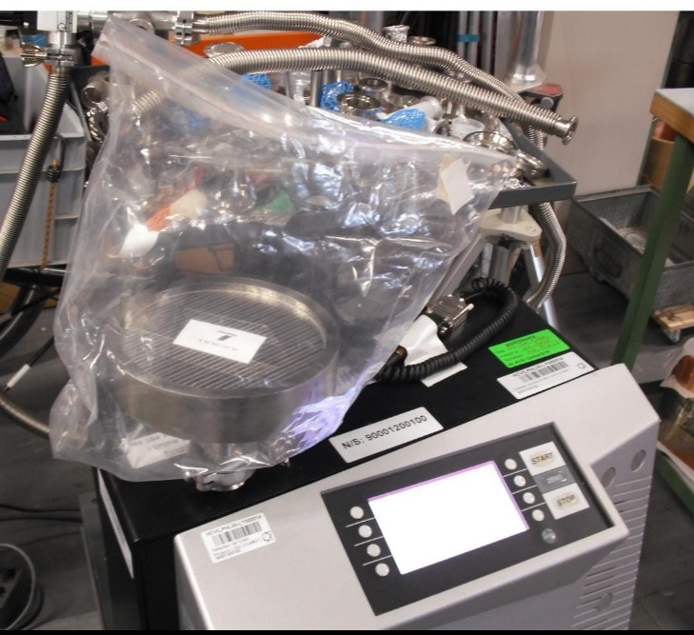
Shape Memory Alloy connectors
Compact and bi-material UHV connections are required and are done by SMART connectors.
Comparison of displacements
Oval rings for chamber connections (Cu/Cu & Cu/St. St.)
Assessment of the contact pressure
Prototype #3 :
chamber with elliptic profile, aluminum gasket t=1.1 mm
Prototype #4 :
chamber with doubly symmetric
spline profile, aluminum gasket t=1.1 mm
Manufacturing and assembly of the oval connections
After some iterations, successful proof of principle tests. Further studies and development are required to ensure reliability of oval connectors.

Slide 8
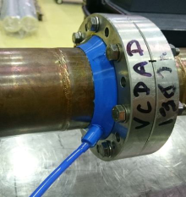
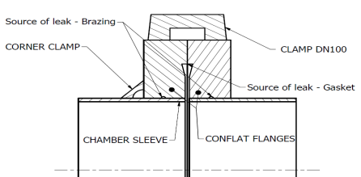
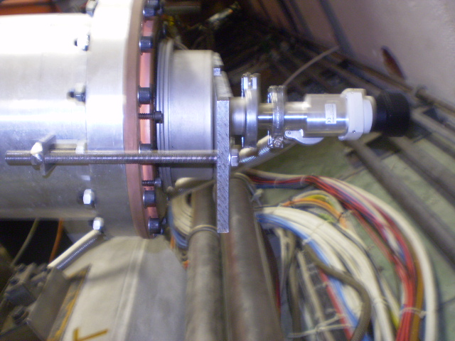
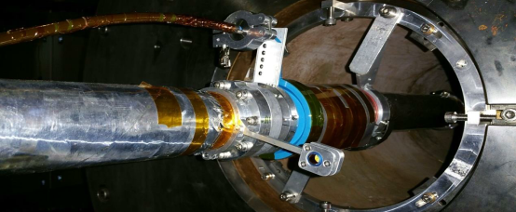
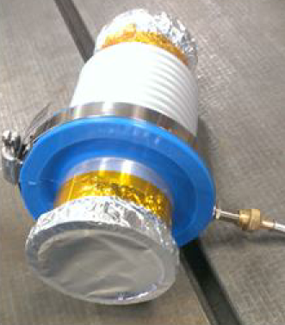
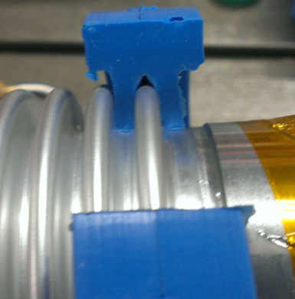
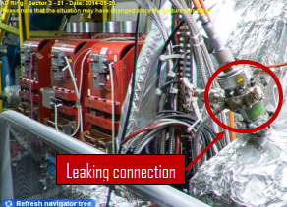
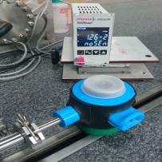
Approach in case of leaks
Dismount, remount components or connections
(Reheat SMA connections)
Use differential pumping (a few examples shown)
Primary vacuum
LHC LSS chamber
Linac II: Bell on top of the leaking element (bellows of an actuator)
ATLAS: Silicone clamshell around a damaged convolution on an aluminium bellows
AD: leaking tee connector
When not possible, use VACSEAL sealant as backup solution and for local and temporary fixation.

Slide 9
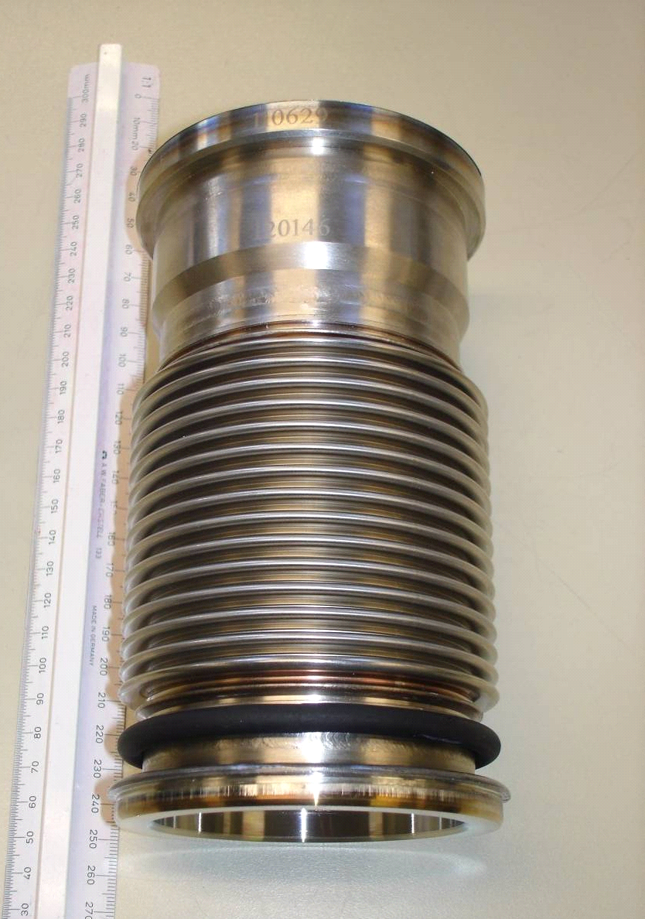
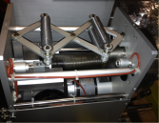
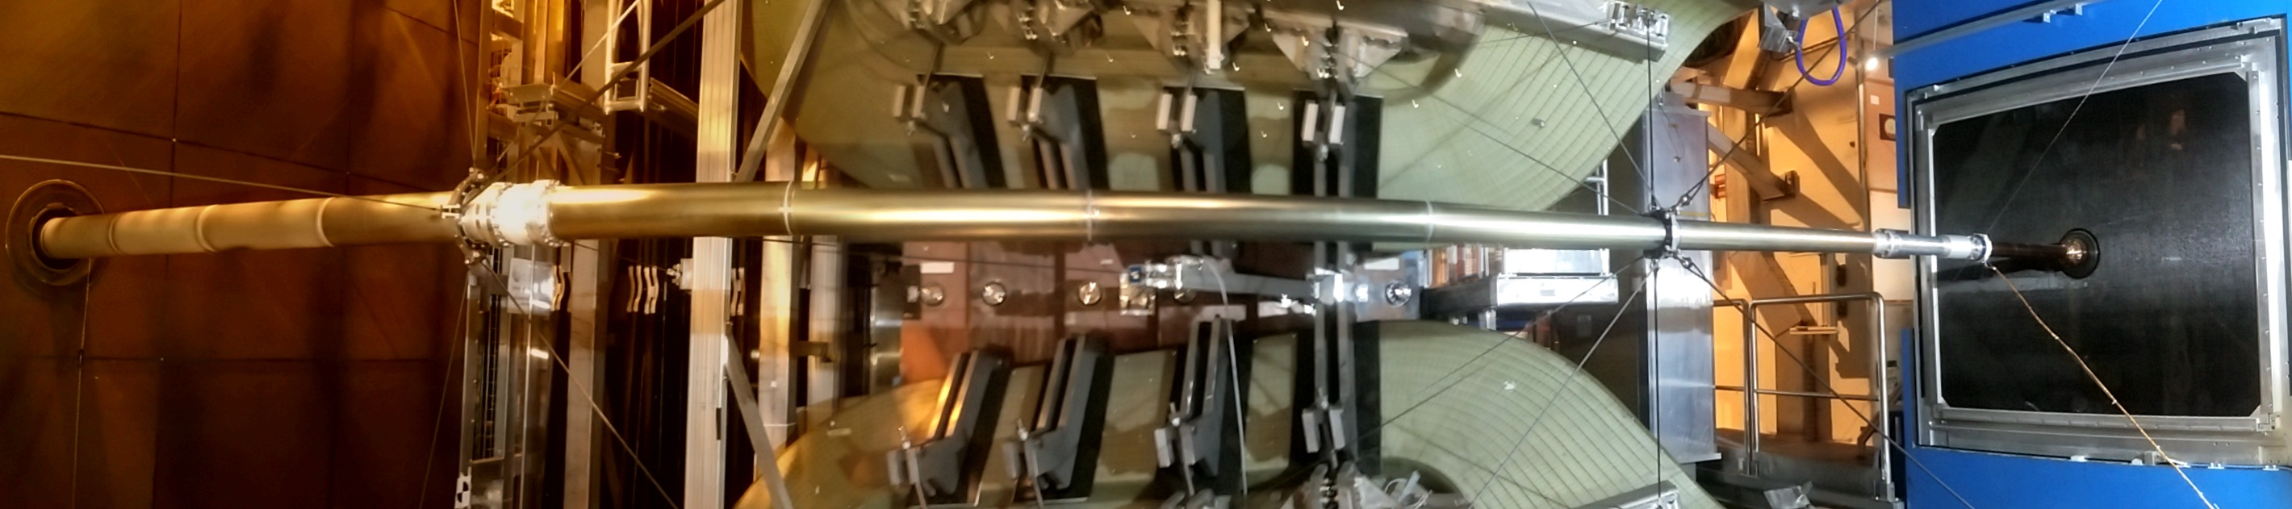
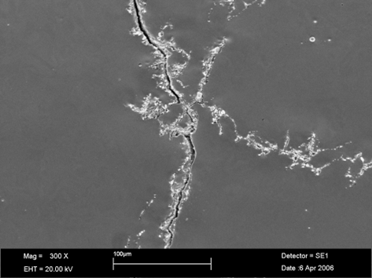
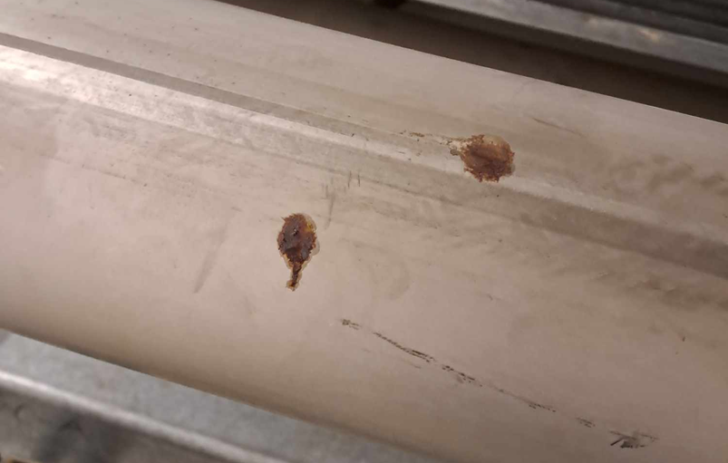
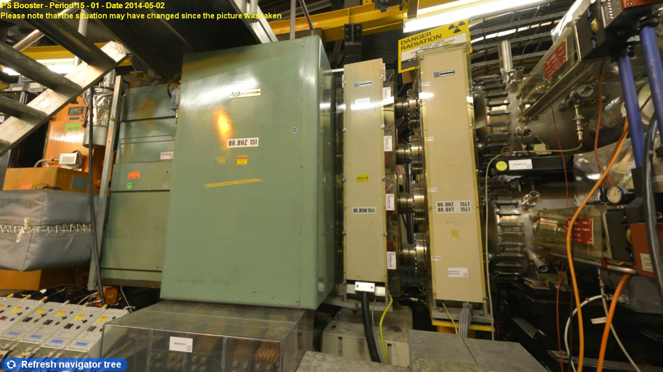
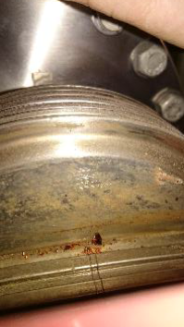
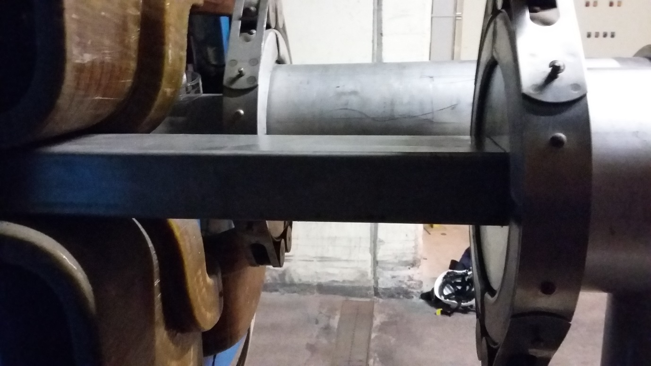
Some experiences of VACSEAL at CERN
Porosity in bulk beryllium material. Leak temporaly closed with VacSeal
Long inclusion in St. St. flanges. Leak closed with VacSeal
Leak on an edge welded bellows on a wire scanner, unsuccessful varnishing
LEAK
SPS RING
TT40 line
Corrosion spots on SPS vacuum chamber. Leak temporaly closed with VacSeal
Corrosion spots on PBS vacuum chamber. Leak temporaly closed with VacSeal
Crack on a SPS vacuum chamber weld. Leak temporaly closed with VacSeal

Slide 10
Some experiences of VacSeal at CERN
… list non-exhaustive:
Leak tight welds of edge welded bellows and Y chamber
Leak tight ion pumps feedthrough of vacuum gauge glass feedthrough
Some large leaking flange of the Booster.
Some leaking flanges using diamond like seal in the SPS .
It was used also in the past in LEP to close leaks, feedthrough, welds, but as well helicoflex type flanges
… and, most likely, many more…
Different VACSEAL applications from different teams:
Under vacuum, pumps off
At atmospheric pressure
Mixing the Vacseal with acetone to allow a better deposition around the flange.

Slide 11
Conclusion
The baseline for the FCC-ee arc vacuum system design is that no direct synchrotron radiation hits the connection flanges.
Dismountable UHV connections are based on Shape Memory Alloy rings, as a baseline, or on knife edge flanges (CF like) as a backup.
VacSeal is usually only used as a last chance for temporary repair to save operation.
This approach shall be the baseline for FCC-ee.

Slide 13
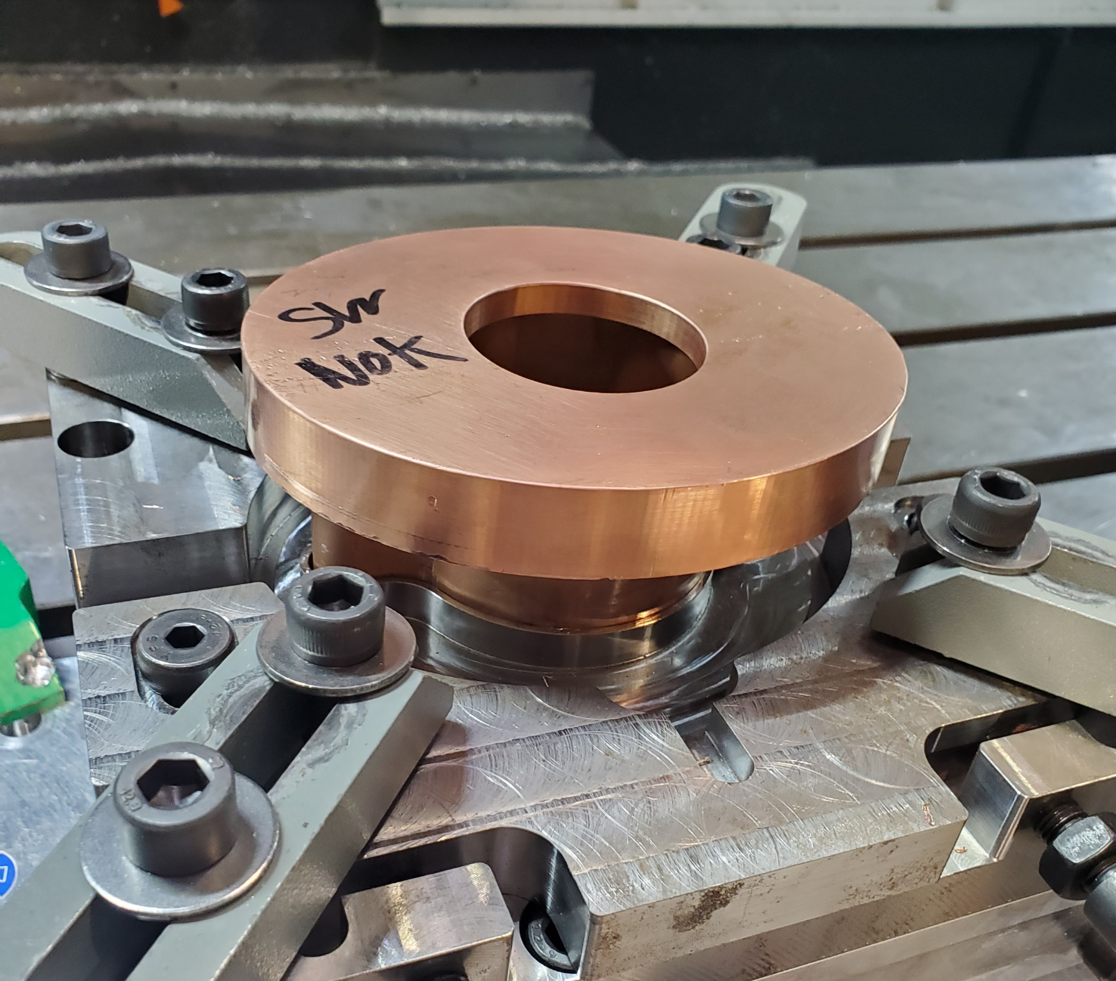
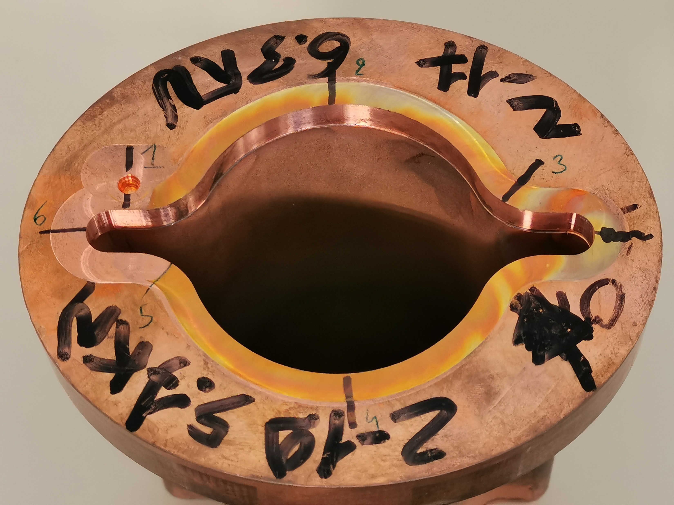
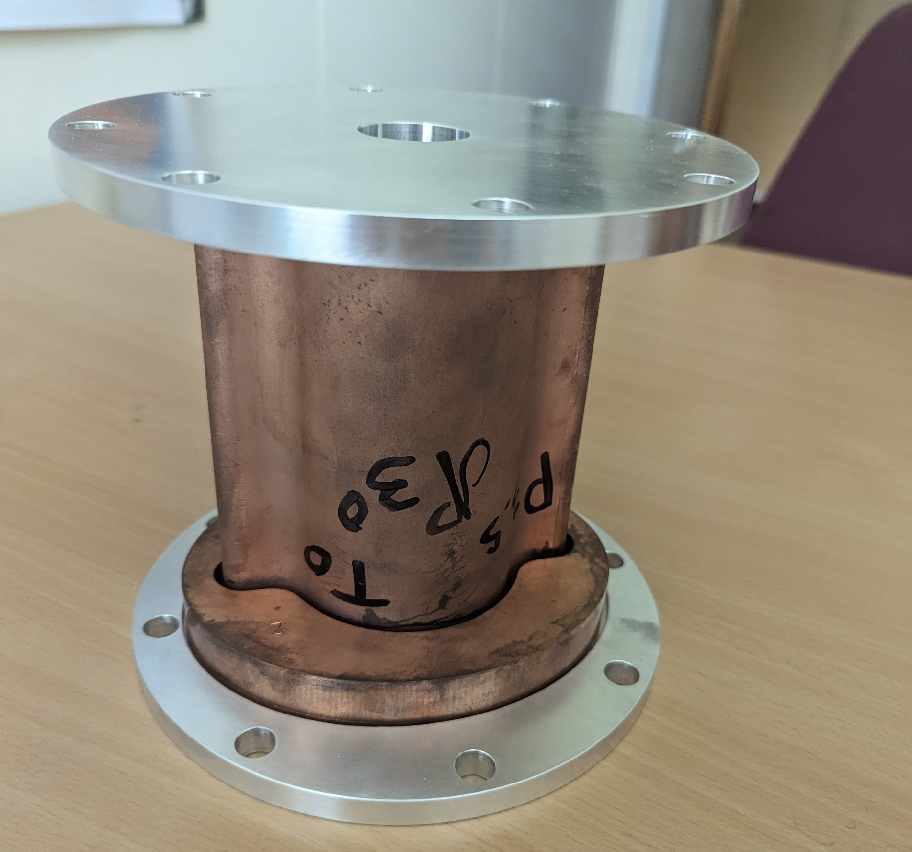
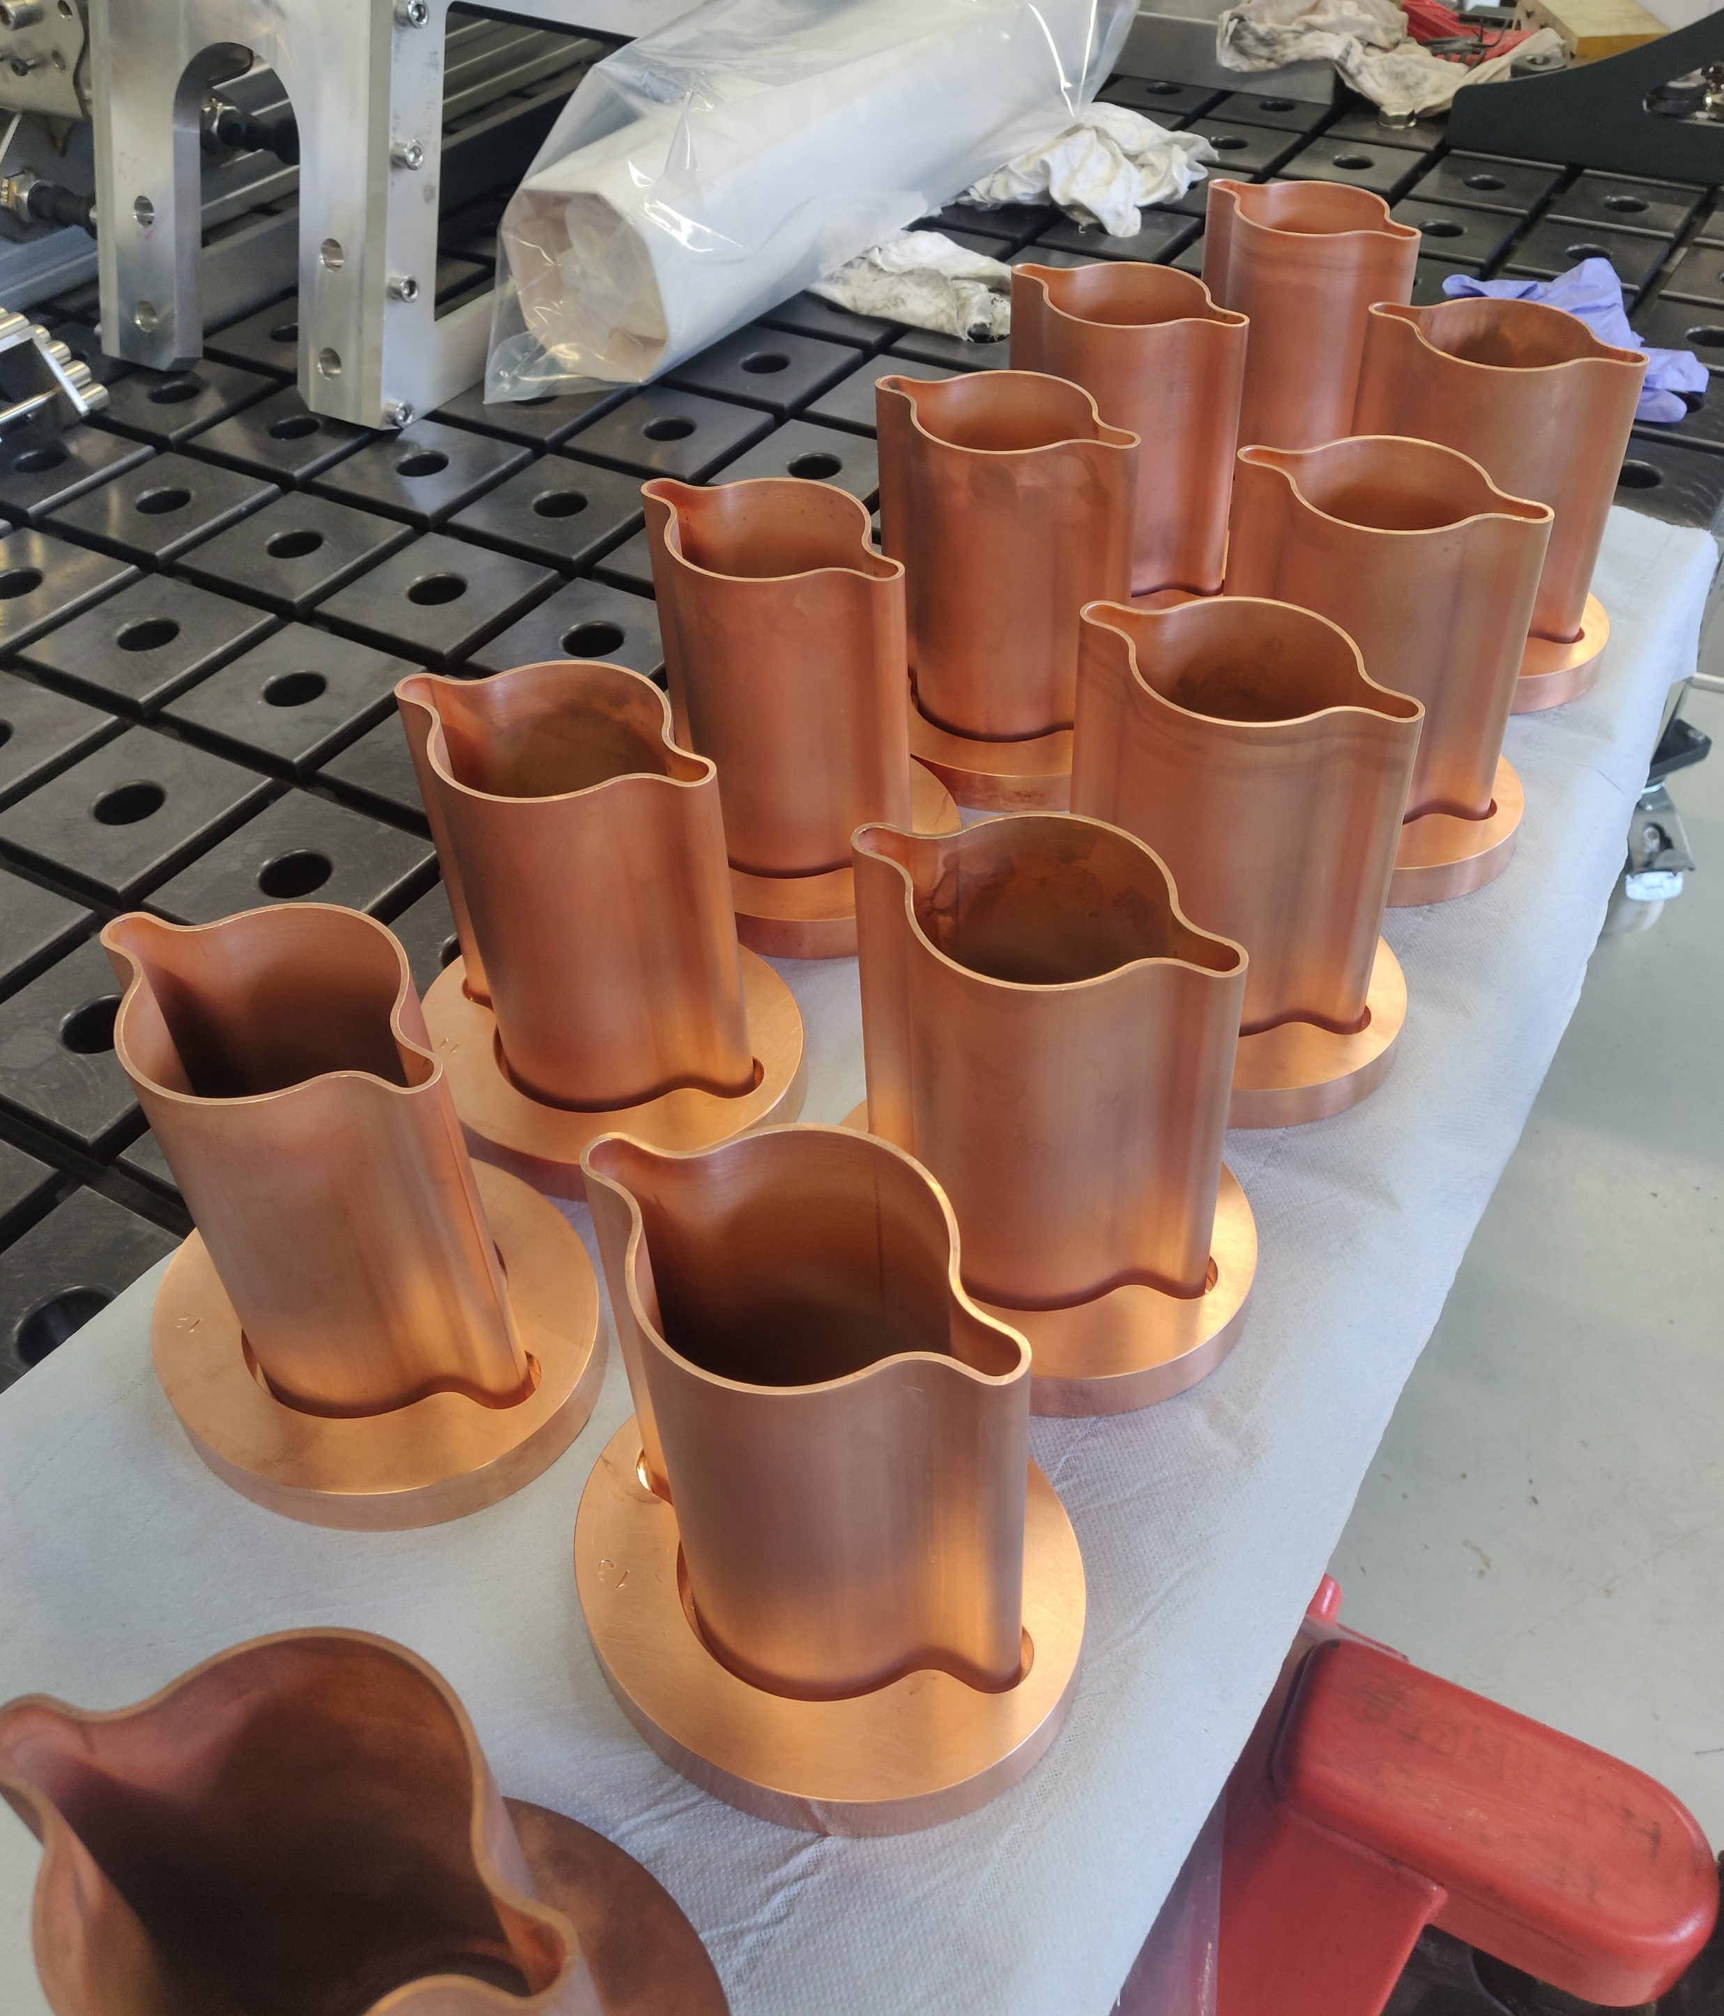
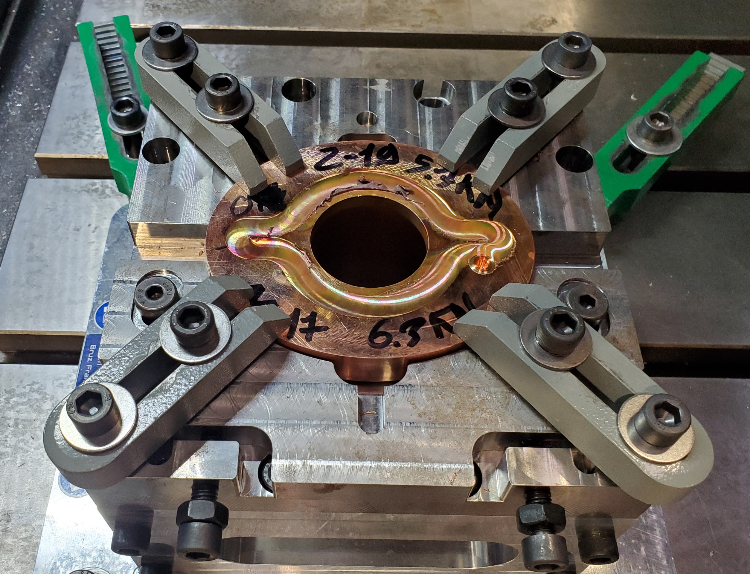
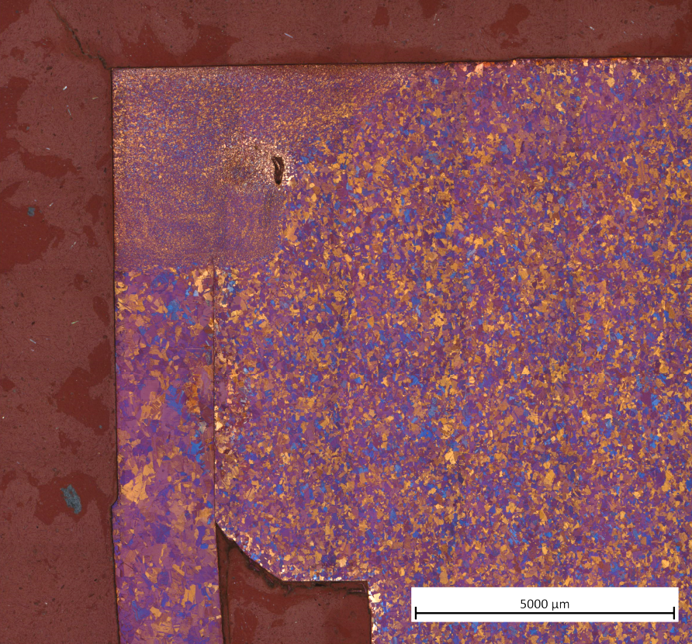
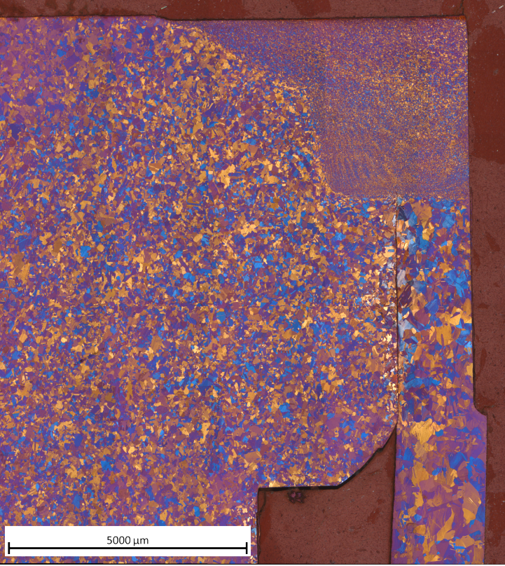
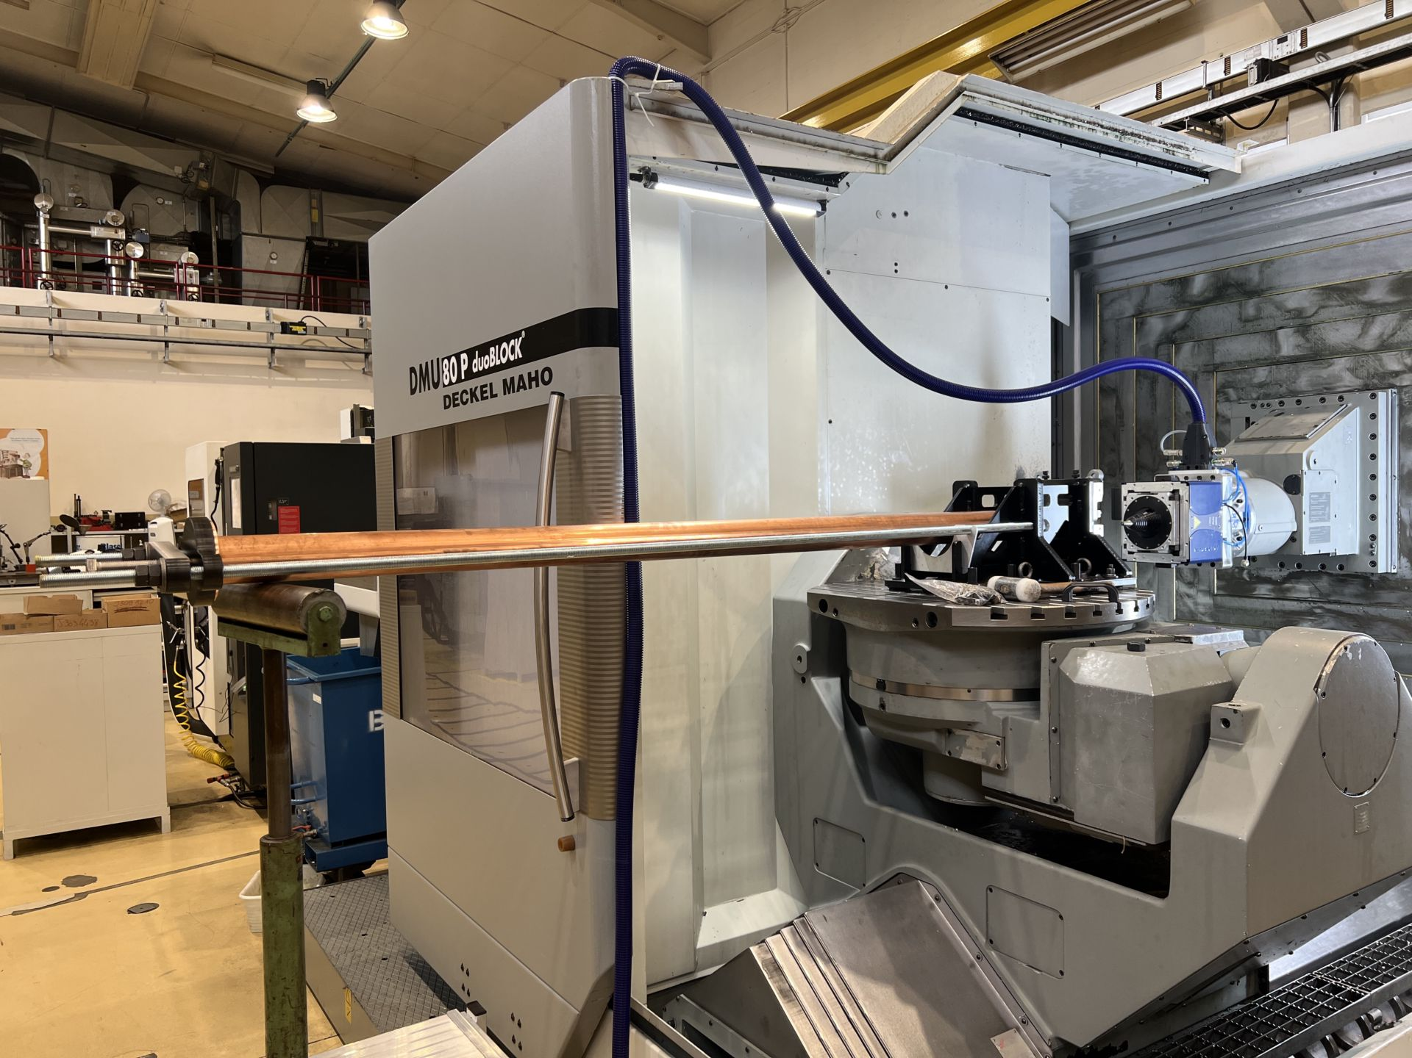
Friction stir welding
FSW is a fast and robust industrial process, suitable for copper, which allows final precise machining of the interfaces on the same machine.
1
2
3
6
5
4
Stir welded flange after local remachining
Leak testing carried out on completed assemblies
Weld parameters determined
Metallurgical observations
First test in horizontal configuration
Notes:
Tests done in vertical configuration → Tests in horizontal configuration to be done at CERN

