Slide 2
SIS status for first stable beam
J. Wenninger, A. Calia

Slide 3
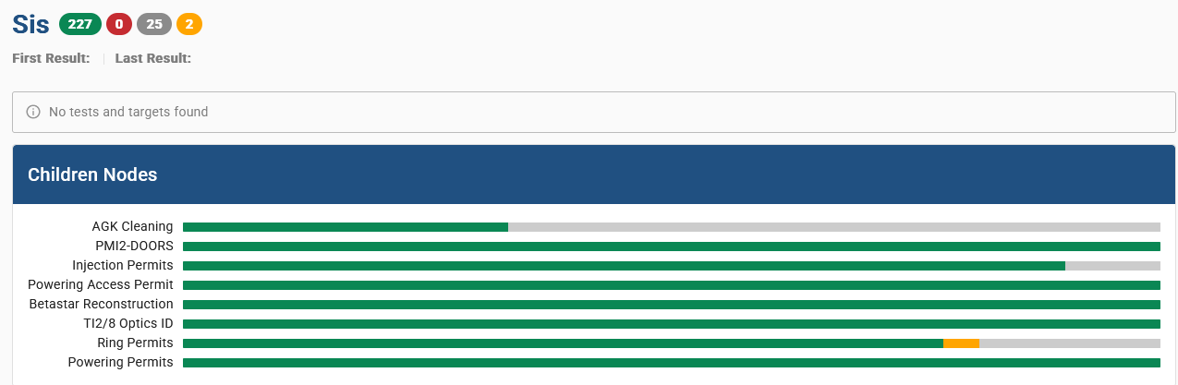
SIS test status
Almost all SIS tests and associate interlock setups have been completed.
Issue with new beta* UCAP reconstruction (not used in SIS/SMP – only diagnostics) solved by moving to a single PC data concentrator.
The missing tests require more beam or more stable conditions.

Slide 4
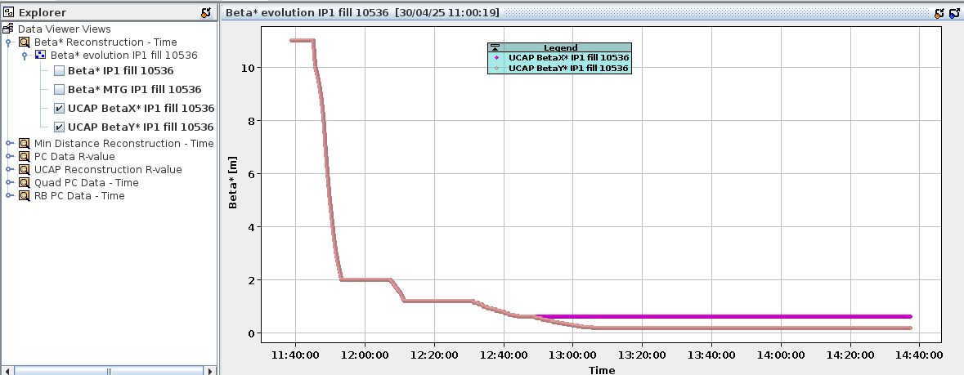
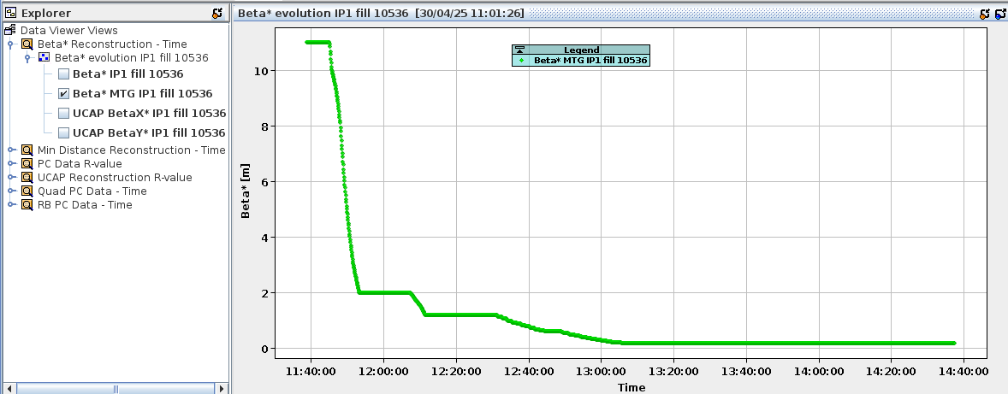
Beta* reconstruction
UCAP reconstruction with both planes
MTG/SMP with plane of lowest beta*

Slide 5
SIS test status
Almost all SIS tests and associate interlock setup had been completed.
Issue with new beta* UCAP reconstruction (not used in SIS/SMP – only diagnostics) solved by moving to a single PC data concentrator.
The missing tests require more beam or more stable conditions:
AG cleaning at FT
  Individual components work (BSRA trigger, SIS action on ADT, ADT cleaning).
  Full integration and correct ADT settings to be checked with the first stable beams fills.
ADT intensity range (injection interlock)
Bunch length interlock with intensity
  New interlock proposal based on k*I² needs some 100’s bunches to deliver meaningful values k*I².
  Similar comments apply to the old-style interlock based on simple k (no bunches) thresholds.
  Plan to test by lowering thresholds at EoF or by temporarily masking the test in SIS.
Vacuum interlocks on MKI interconnects (injection interlock)
  No change in logic, perform type tests before scrubbing run on a sample of gauges.

Slide 6
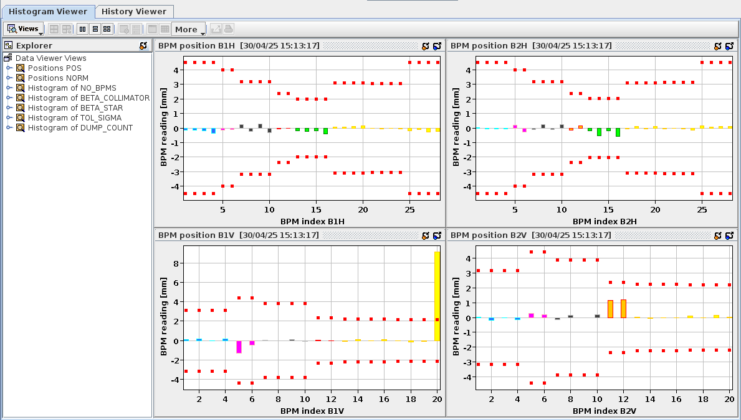
Collimator BPMs
New UCAP logic with associated JAVA UI in place, working well.
Interlock trigger during first SB at 450 GeV not understood.
Unfortunately, nxcals logging was not yet activated at the time (done now).
Missing (tomorrow / first stable beams):
Observe full cycle to spot unexpected position deviations or close to threshold conditions (should not be since we just aligned)
Bad BPM reading from spare system
TCTs open for injection
Example during injection

