Slide 1
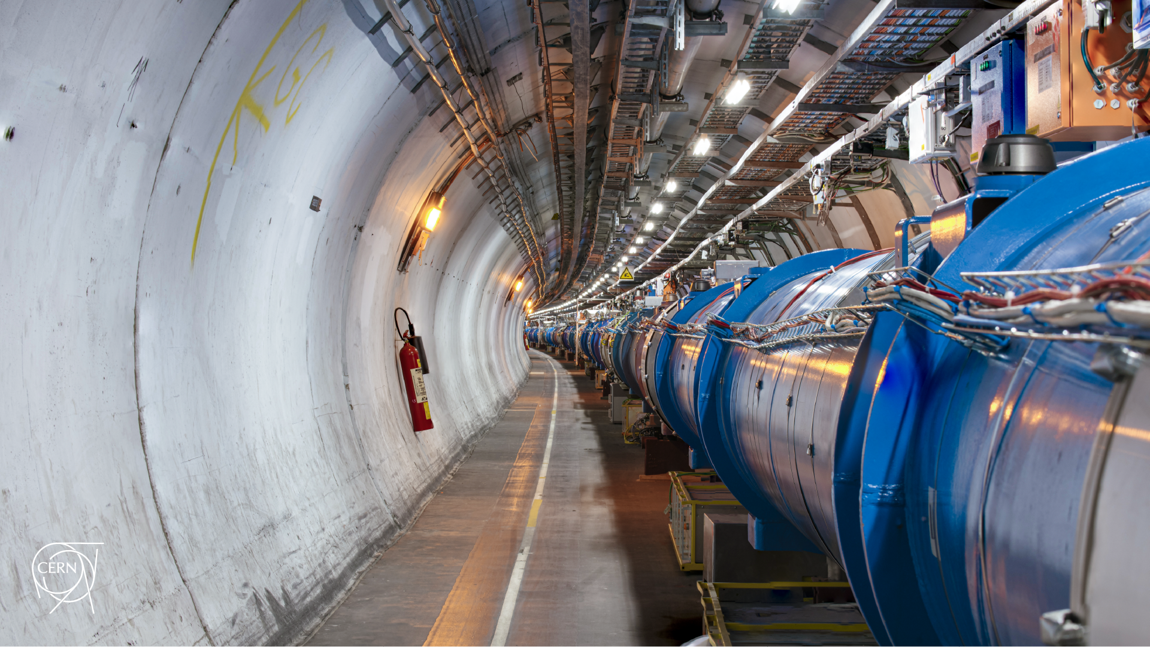
Possible procedures for MD 15209: IR3 operational losses limit
D. Mirarchi, R. Bruce, P. Hermes, B. Karlsen, A. Lechner, S. Morales, S. Redaelli, B. Salvachua, M. Solfaroli,
K. Taylor, H. Timko, J. Wenninger
Joint BLMTWG – ColUSM meeting

Slide 2
Introduction
Off-momentum losses at start of ramp can be a limitation to handle HL-LHC beams
The main aim of the MD is to demonstrate that the IR3 collimation system
can sustain 200 kW losses at start of ramp
Different approaches are under investigation, MD approved for MD1 block, detailed procedure needed by 13th of May, to be finalized based on outcomes in stocking filler tests done in 2025 beam commissioning:
  Artificial loss generation with scraping with IR3 primary collimators
  Artificial loss generation via off-momentum loss maps
  Accumulate enough debunched beam and start an energy ramp
All of them have pro and cons, let’s try to summarized them

Slide 3
Scraping
Some preparatory numbers:
Loss rate needed to get 200 kW losses injection: 200e3/(450*1.6e-10) ~ 2.8e12 p/s ➔ ~18 INDIVs of 1.6e11p
Max jaw speed 2 mm/s (~2 σ/s) ➔ Gaussian beam: ~95.4% of population in 2 σ ➔ ~20 INDIVs to get 200 kW
Possible procedure (first B1 only, then B2 only):
Inject 1 “weak” INDIV of 1.0e11
Perform full scraping with right(left) jaw in B1(B2) to probe -δp/p side
Check obtained loss rate and BLM/thl response
Inject 5 “weak” INDIVs (still below SBF)
Perform full scraping with right(left) jaw in B1(B2)
Check losses and BLM/thl scaled as expected
Inject 10 INDIVs of 1.6e11
Perform full scraping with right(left) jaw in B1(B2)
Check losses and BLM/thl scaled as expected
Inject >=18 INDIVs of 1.6e11
Perform full scraping with right(left) jaw in B1(B2)
Changes needed during MD:
Parking limits for inner right jaw (and gap)
Dedicated BLM threshold
To be checked prior MD:
Loss pattern representative of start of ramp losses?
Loss pattern around the ring and limiting thresholds
Is the movement fast enough to avoid BPM interlock?

Slide 4
δp/p loss map
Some preparatory numbers:
Max radial loop speed ~100 Hz/s (~2 σ/s) ➔ Same considerations apply, i.e. ~20 INDIVs to get 200 kW
Possible procedure (first B1 only, then B2 only):
Inject 1 “weak” INDIV of 1.0e11
Perform RF shift of +400 Hz with radial loop to probe -δp/p
Check obtained loss rate and BLM/thl response
Inject 5 “weak” INDIVs (still below SBF)
Perform RF shift of +400 Hz with radial loop
Check losses and BLM/thl scaled as expected
Inject 10 INDIVs of 1.6e11
Perform RF shift of +400 Hz with radial loop
Check losses and BLM/thl scaled as expected
Inject >=18 INDIVs of 1.6e11
Perform RF shift of +400 Hz with radial loop
Changes needed during MD:
Interlock BPM of orbit shift
Interlock on RF (max shift <90 Hz allowed)
Dedicated BLM threshold
To be checked prior MD:
Loss pattern representative of start of ramp losses?
Loss pattern around the ring and limiting thresholds
Is the RF shift fast enough to avoid BPM interlock?

Slide 5
Ramp
Some preparatory numbers (see Sara’s presentation):
Beam | Fraction of debunched beam lost at peak loss rate | Debunched beam needed to get 200 kW at peak losses | In equivalent number of 1.6e11 bunches
1 | 40 % | 7.0e12 p | 44
2 | 30 % | 9.3e12 p | 58
Possible procedure (both beams):
Inject 2x36 INDIVs of 1.6e11
RF manipulation to debunch half bunch
Start ramp
Check obtained loss rate and BLM/thl response
Inject 3x36 INDIVs of 1.6e11
RF manipulation to debunch half bunch
Start ramp
Changes needed during MD:
Dedicated BLM threshold
To be checked prior MD:
Loss pattern around the ring and limiting thresholds
Any interlock that could prevent debunching so much?
Adapt filling scheme wrt debunching capabilities

Slide 6
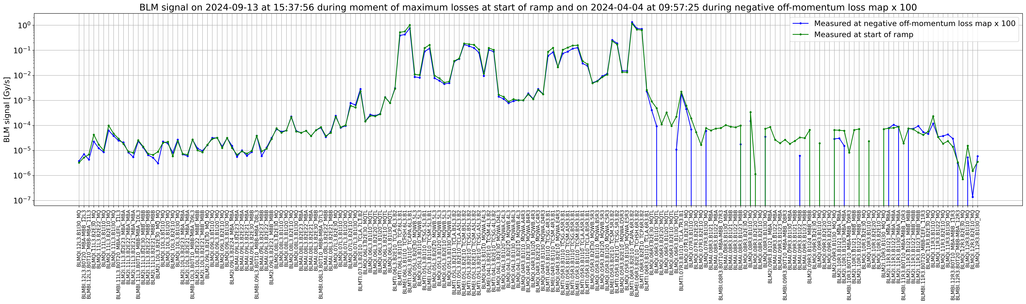
First loss pattern comparison
S. Morales
Very nice agreement between IR3 loss pattern seen at start of ramp and in -δp/p loss maps!

Slide 7
Comparison
Pro
Cons
Scraping
Fast
Precise knowledge of p loss
Representative loss pattern?
If not, scaling needed
δp/p loss map
Fast
Precise knowledge of p loss
Interlock manipulations
Long
Uncertainty on fraction of debunched beam lost at peak loss rate
Ramp
Most representative scenario

Slide 8
Conclusions
Key MD in view of HL-LHC
Approved for MD1 slot
Procedure to be submitted by 13th of May:
  dp/p loss map look the most promising presently, interlock handling to be careful evaluated
  Pending analysis of scraping, it can be also a suitable approach easing interlock handling
  Real ramp also appealing and can be tested if enough time left, pending RF debunching capabilities
Dedicate BLM thresholds needed for any approach

Slide 9
Outline
BACKUP

Slide 10
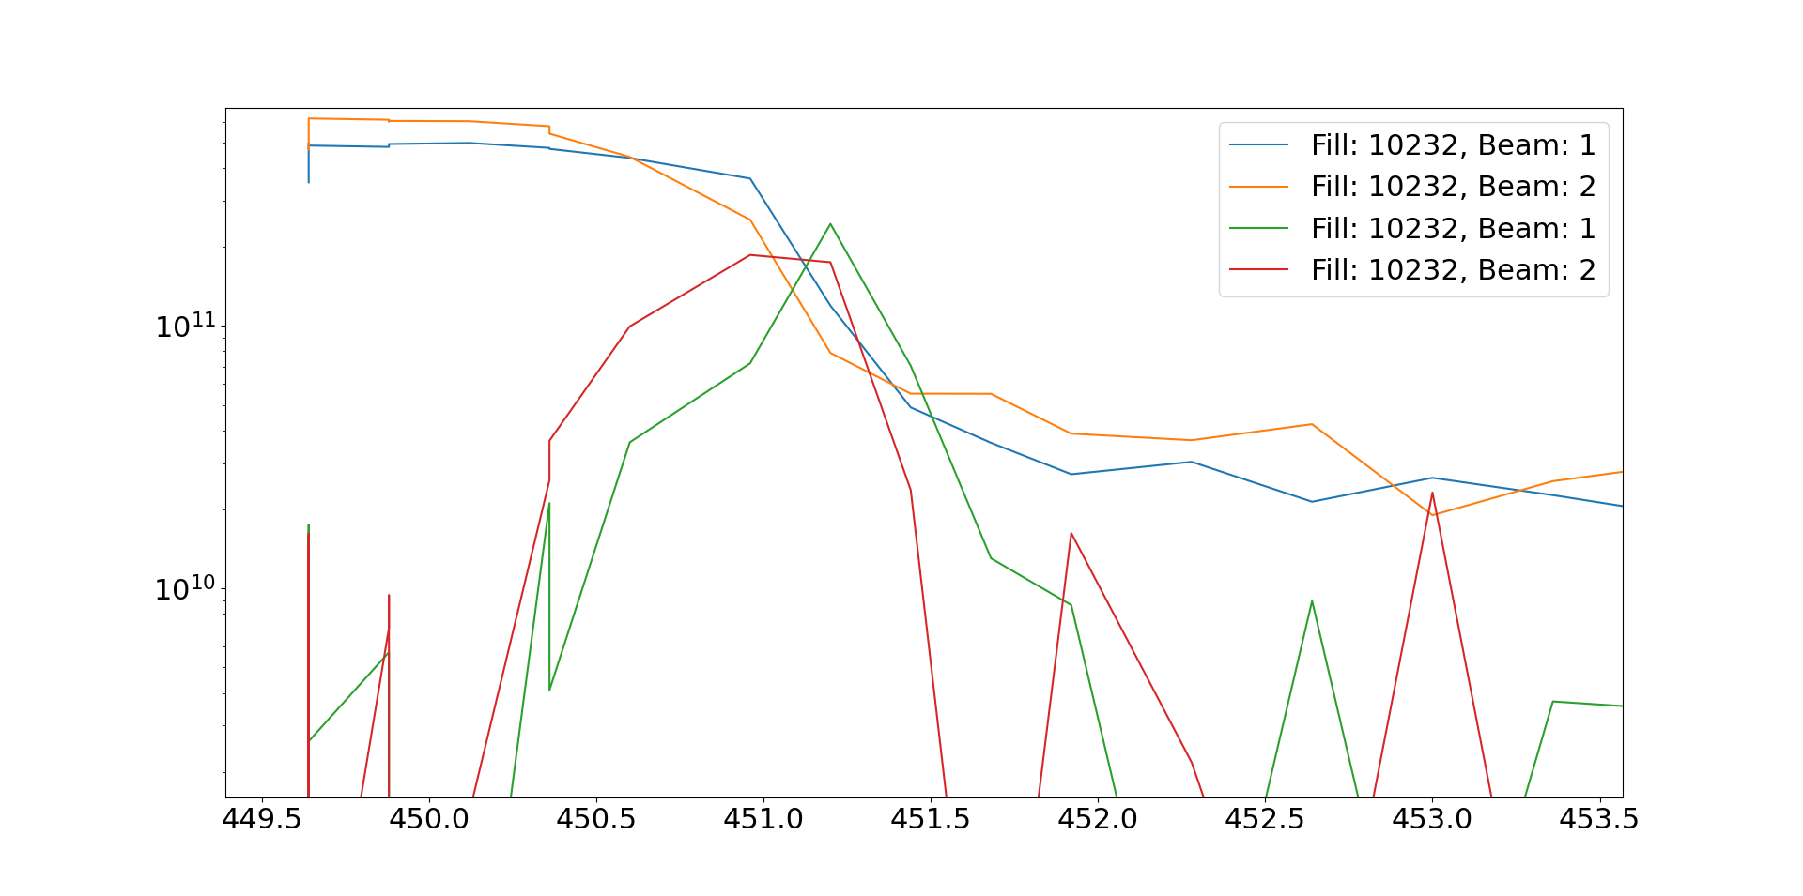
Loss distribution - example
How much of this
Is lost at peak loss rate?

Slide 11
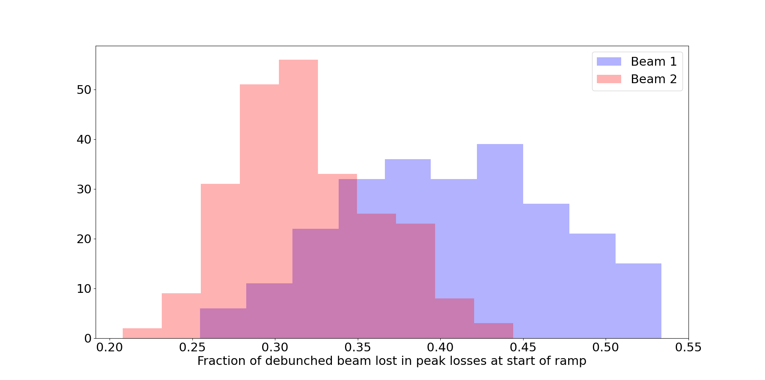
Loss distribution (all 2025 physics fill – from BCT)
Why the difference between beams?

Slide 12
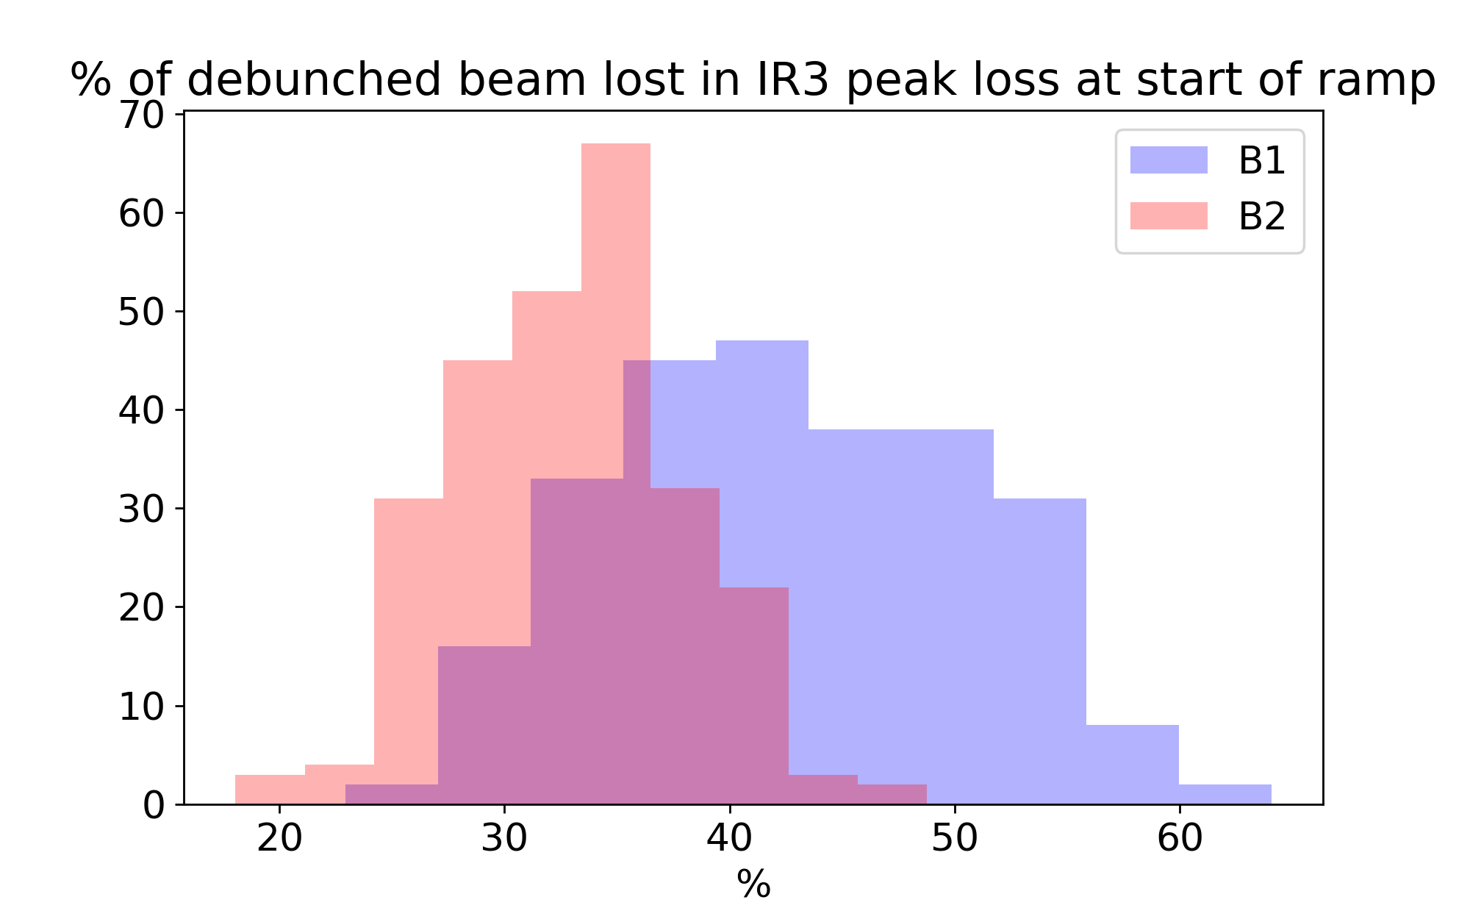
Loss distribution (all 2025 physics fill – from BCT)
Why the difference
between beams?

