Slide 1
First Estimates of Longitudinal Beam Loss Projections for HL-LHC Beams
Birk Emil Karlsen-Bæck, H. Timko
5th May 2025
Acknowledgments: S. Morales, B. Salvachua, M. Zampetakis

Slide 2
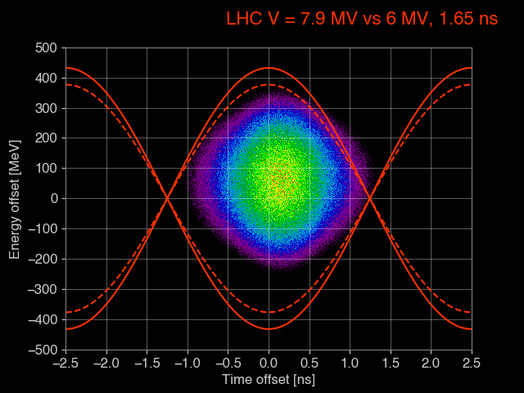
RF Power Limitations at Injection
HL-LHC bunch intensity will give very large beam-loading
  RF voltage will be limited
More voltage is beneficial
  To capture momentum spread from the SPS
  To counteract debunching caused by IBS and RF noise
Finding an exact number of losses for HL-LHC is very hard due to
  Contribution from both short term (capture losses) and long term (IBS and RF noise) effects
  Cleaning from the ADT
From H. Timko “Preparing the RF for Post-LS3 Operation”, Chamonix 2025

Slide 3
Scaling Momentum Spread from Run 3 Operation to HL-LHC
First order estimate
  Gives an order of magnitude
Scale RF voltage with momentum spread (Run 3 -> HL-LHC)
A capture voltage of ~7.9 MV is required
When | Bunch parameters | SPS | LHC parameters
 | Bunch intensity | Momentum spread | Main RF voltage | Bunch length | Average power
2018 | 1.4x10¹¹ p/b | 3.74x10⁻⁴ | 4 MV | 1.22 ns | 84 kW
Run 3 | 1.8x10¹¹ p/b | 4.59x10⁻⁴ | 6 MV | 1.22 ns | 161 kW
Run 3 | 1.8x10¹¹ p/b | 4.95x10⁻⁴ | 7 MV | 1.28 ns | 183 kW
HL-LHC | 2.3x10¹¹ p/b | 5.32x10⁻⁴ | 7.8 MV | 1.24 ns | 265 kW
From B. E. Karlsen-Baeck, “RF power reach”, JAP Workshop 2023

Slide 4

Folding in RF Power Limitations
RF Voltage | Bunch length | Relative increase
7.9 MV | 1.246 ns | 1
6.2 MV | 1.339 ns | ~3.5
7.1 MV | 1.287 | ~2
RF power is limited -> voltage is limited
From RF calibration campagin
  Worst case available voltage*: 6.2 MV
  Best case available voltage*: 7.1 MV
From observation
  Start-of-ramp losses correlate with bunch length
Scaling bunch length with voltage
  Get relative increase in losses due to limited voltage
NB! Does not take into account contribution from debunching
*with high-efficiency klystrons
BLM threshold to dump in IR3 at $1.6×{10}^{11}$ p/b

Slide 5
Results from MDs in 2024
First capture of HL-LHC beam
Correlation with off-position beam
  gives estimate of start-of-ramp losses with current voltage (6.5 MV without OTFB)
From off-position beam scaled to full HL-LHC beam:
  Most of the MD beams would cause a dump
  Worst case: a factor 1.7 above threshold
First direct meaurement of SOR losses with 2.0 x 10¹¹ and 2.3 x 10¹¹ p/b
Off-position beam scaled to HL-LHC full beam
From H. Timko “Preparing the RF for Post-LS3 Operation”, Chamonix 2025

Slide 6
Direct Measurement of Start of ramp Losses
From ramp with 2.3 x 10¹¹ p/b
  Losses dominated by uncaptured beam due to very little debunching
  Capture losses cannot be seen by off-position beam analysis
Some variation in off-position beam for similar fills
7 MV with 2.0 x 10¹¹ p/b
6.5 MV with 2.3 x 10¹¹ p/b
Beam 1
MD block | Fill | Bunch charge | Number of bunches | Time at flat-bottom | Off-position beam | Start-of-ramp losses | Ratio to dump
MD#3 | 10028 | 2.0 x 10¹¹ p/b | 348 | 26.5 min. | 0.60 x 10¹¹ p | 0.48 x 10¹¹ p | 1.6%
MD#3 | 10029 | 2.0 x 10¹¹ p/b | 348 | 17.4 min. | 1.23 x 10¹¹ p | 0.78 x 10¹¹ p | 2.4%
MD#4 | 10154 | 2.3 x 10¹¹ p/b | 252 | 36.3 min. | 0.18 x 10¹¹ p
MD#5 | 10250 | 2.3 x 10¹¹ p/b | 348 | 5.9 min. | 3.90 x 10¹¹ p | 12.0 x 10¹¹ p | 48%
MD#4 | 10155 | 2.3 x 10¹¹ p/b | 348 | 67.9 min. | 5.88 x 10¹¹ p
MD#4 | 10160 | 2.3 x 10¹¹ p/b | 348 | 53.1 min. | 11.4 x 10¹¹ p
MD#5 | 10254 | 2.3 x 10¹¹ p/b | 972 | 72.2 min. | 28.4 x 10¹¹ p

Slide 7
Direct Measurement of Start of ramp Losses
From ramp with 2.3 x 10¹¹ p/b
  Losses dominated by uncaptured beam due to very little debunching
  Capture losses cannot be seen by off-position beam analysis
Some variation in off-position beam for similar fills
7 MV with 2.0 x 10¹¹ p/b
6.5 MV with 2.3 x 10¹¹ p/b
Beam 2
MD block | Fill | Bunch charge | Number of bunches | Time at flat-bottom | Off-position beam | Start-of-ramp losses | Ratio to dump
MD#3 | 10028 | 2.0 x 10¹¹ p/b | 348 | 25.9 min. | 0.32 x 10¹¹ p | 0.45 x 10¹¹ p | 1.7%
MD#3 | 10029 | 2.0 x 10¹¹ p/b | 348 | 16.9 min. | 1.11 x 10¹¹ p | 0.65 x 10¹¹ p | 3.2%
MD#4 | 10154 | 2.3 x 10¹¹ p/b | 252 | 63.7 min. | 5.60 x 10¹¹ p
MD#5 | 10250 | 2.3 x 10¹¹ p/b | 348 | 5.6 min. | 6.31 x 10¹¹ p | 12.2 x 10¹¹ p | 47%
MD#4 | 10155 | 2.3 x 10¹¹ p/b | 348 | 67.5 min. | 13.6 x 10¹¹ p
MD#4 | 10160 | 2.3 x 10¹¹ p/b | 348 | 54.4 min. | 15.3 x 10¹¹ p
MD#5 | 10254 | 2.3 x 10¹¹ p/b | 972 | 72.5 min. | 39.0 x 10¹¹ p

Slide 8
Conclusions
Computing start of ramp losses is tricky
  Many moving parts
Simple scaling with momentum spread gives a factor 2 – 3.5 needed
  7.9 MV is the current estimated requirement
  RF calibration: can only supply 6.2 – 7.1 MV with HE klystrons due to very high beam loading
Observations during HL-LHC MDs in 2024
  Scaling off-position beam to full beam gives a factor 1.7 above dump threshold
  Direct measurements of the ramp with 348 bunches already give 48% of dump threshold
    Likely dominated by uncaptured beam
To be continued
  More accurate estimates are being made using macro-particle tracking simulations

