Slide 1
BOND
Results of the basic mock-ups
N. Lusa and J. Ferradas Troitino
25/04/2025

Slide 2
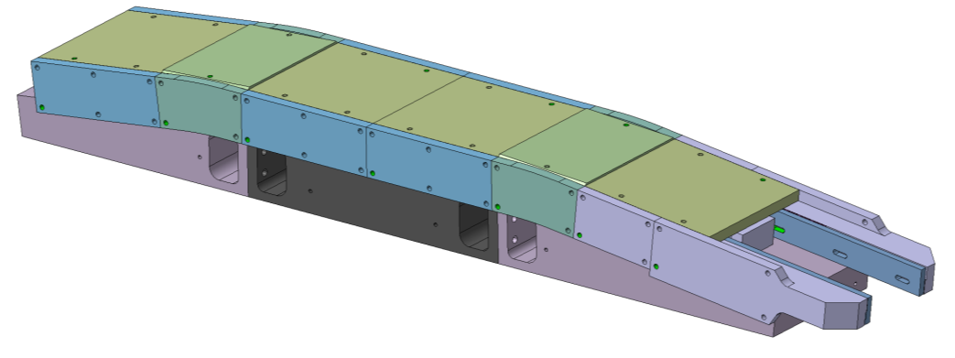


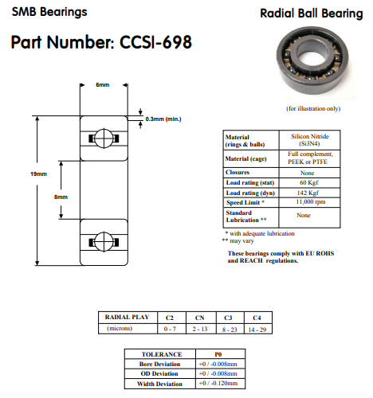
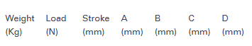
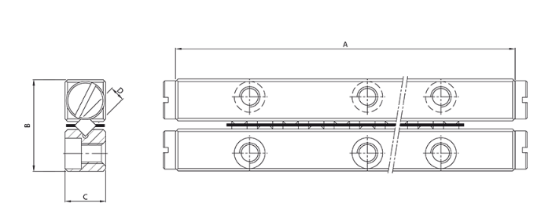
Selected solutions and mock-ups
The sliding system will be independently implemented to the reaction mold based on the mock-up results
Courtesy of N. Peray
Selected products based on mock-up purposes (size, load, etc…)
Linear Ceramic Bearings
1 set CRZ-3075x10AA-SI:
  4 pcs ZrO₂ rails (Si₃N₄ rails available upon request and for a MOQ)
  2 pcs stainless steel roller cage and Si₃N₄ rollers
Circular Ceramic Bearings
Full Si₃N₄ bearings without cage CCSI-698

Slide 3
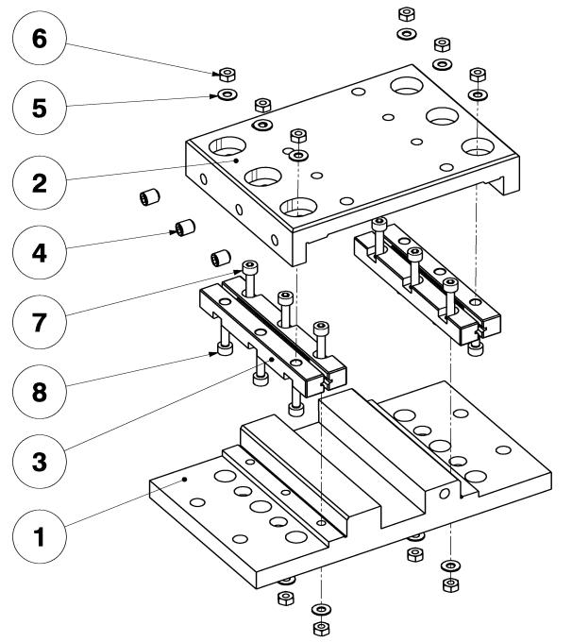
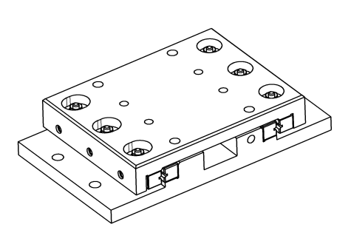
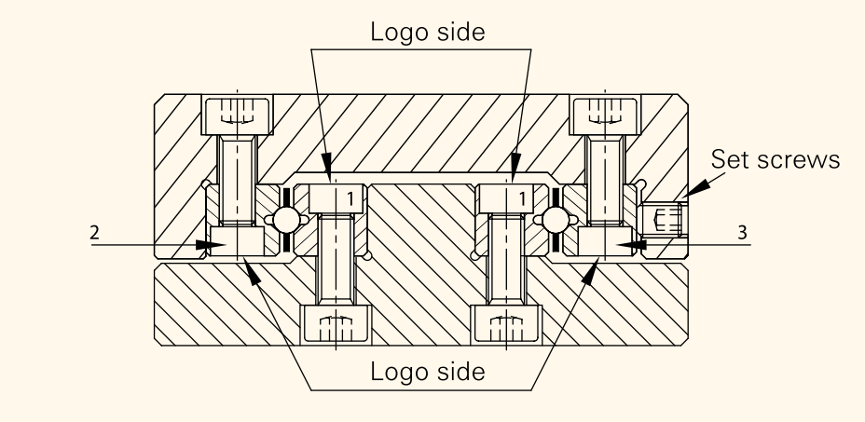
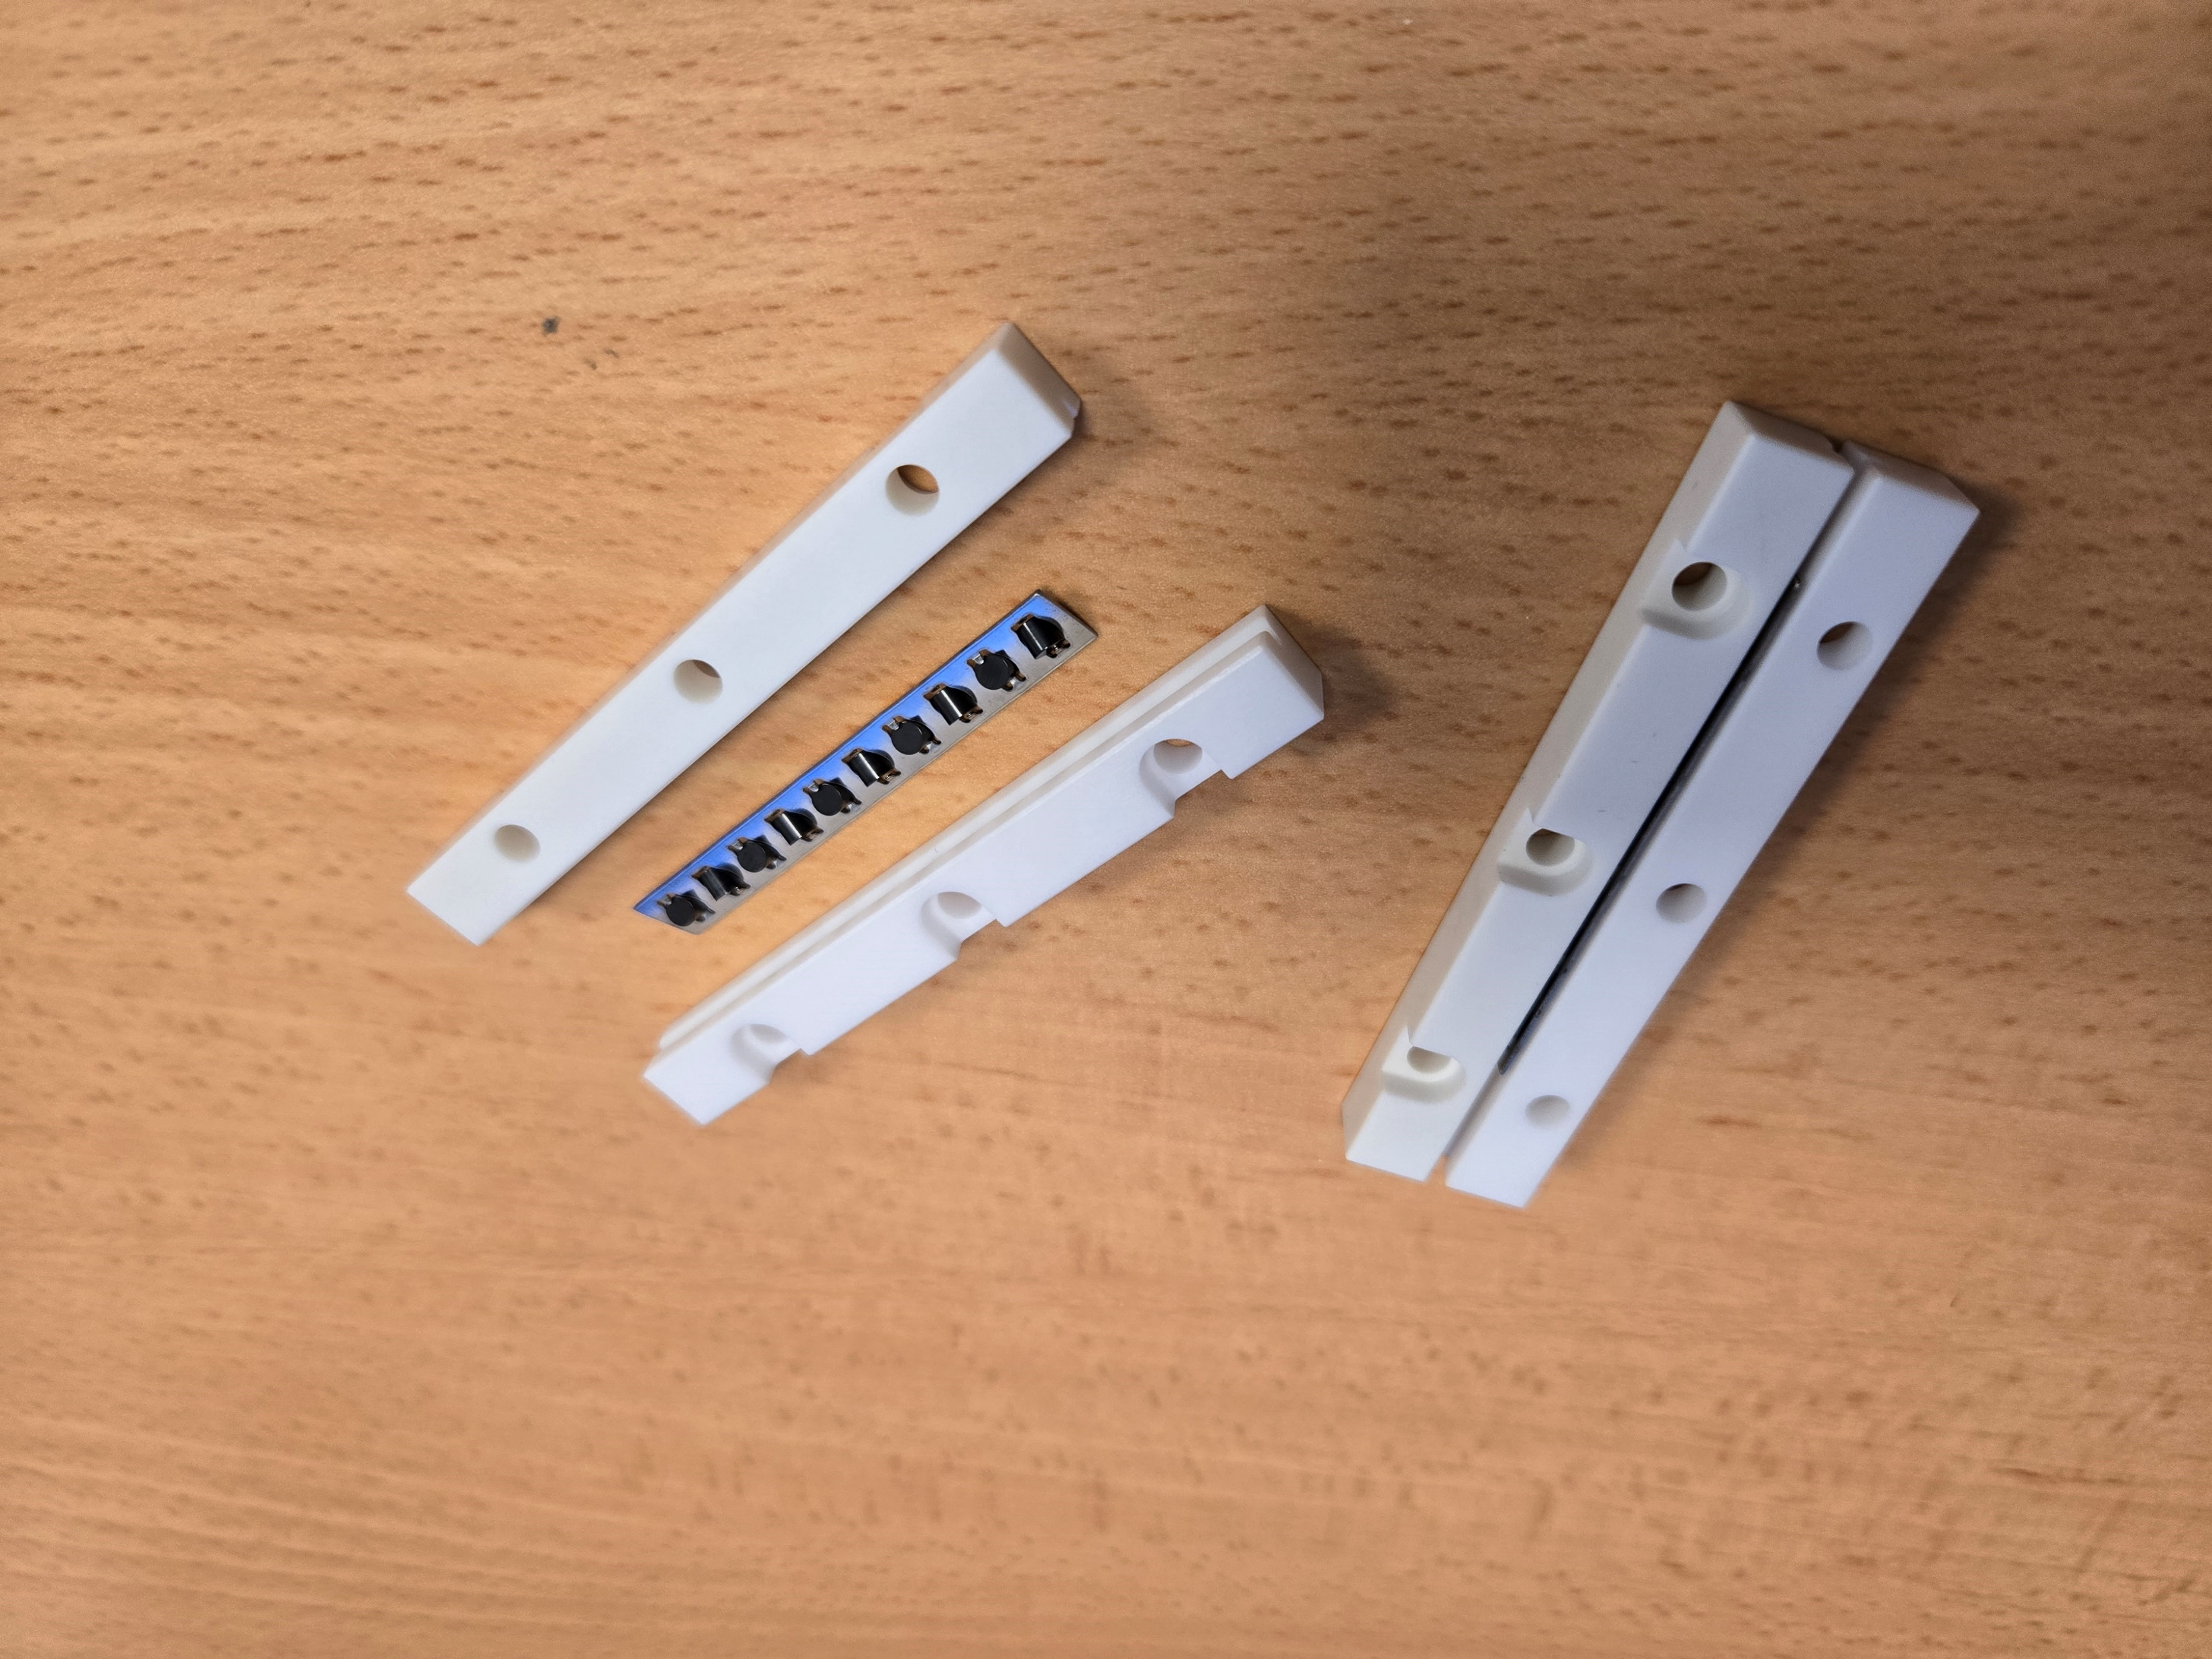
Linear Ceramic Bearings
The system is composed by 3 different materials
  Rails made by ZrO₂ (Supplier CTE 10.3 x 10⁻⁶/°C)
  Rollers made by Si₃N₄ (CTE 3 x 10⁻⁶/°C)
  Roller cage made by 304 stainless steel
The implementation and assembly of such system requires to follow the supplier’s guidelines
  To ensure a proper installation, the system needs to be preloaded via the set screws (recommended torque)
  In our mock-up the parts #A and #B are made of titanium to be as close as possible to the rail material in terms of CTE
  1 system per side is enough for the longitudinal alignment/guiding
B
A
Courtesy of B. Pellet

Slide 4
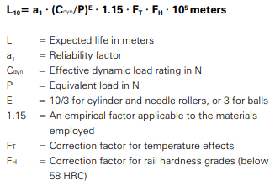
Linear Ceramic Bearings
Expected lifetime
  Compliant with DIN ISO standard 14728-1:2017
  Fatigue
    Load applied onto the rails
    Amount of acceleration and speed
    Quality and age of the lubricant
  Short stroke
    When the rolling element fail to roll completely, and the stroke is lower w.r.t. the diameter of the roller/ball
Nominal operational calculation life (L₁₀)
  Assuming the supplier’s guidelines are respected
  The expected lifetime is expressed in meters
  Considering the same type of rails but made of stainless steel (conservative assumption)
      L₁₀ = 603 m (90% reliability)
      L₁ = 126 m (99% reliability)
  Tests should be carried out to assess the real lifetime
Neglected in our case

Slide 5
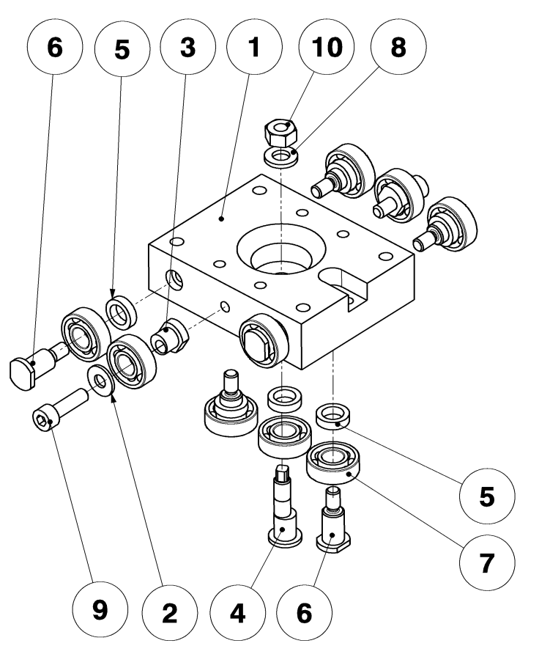
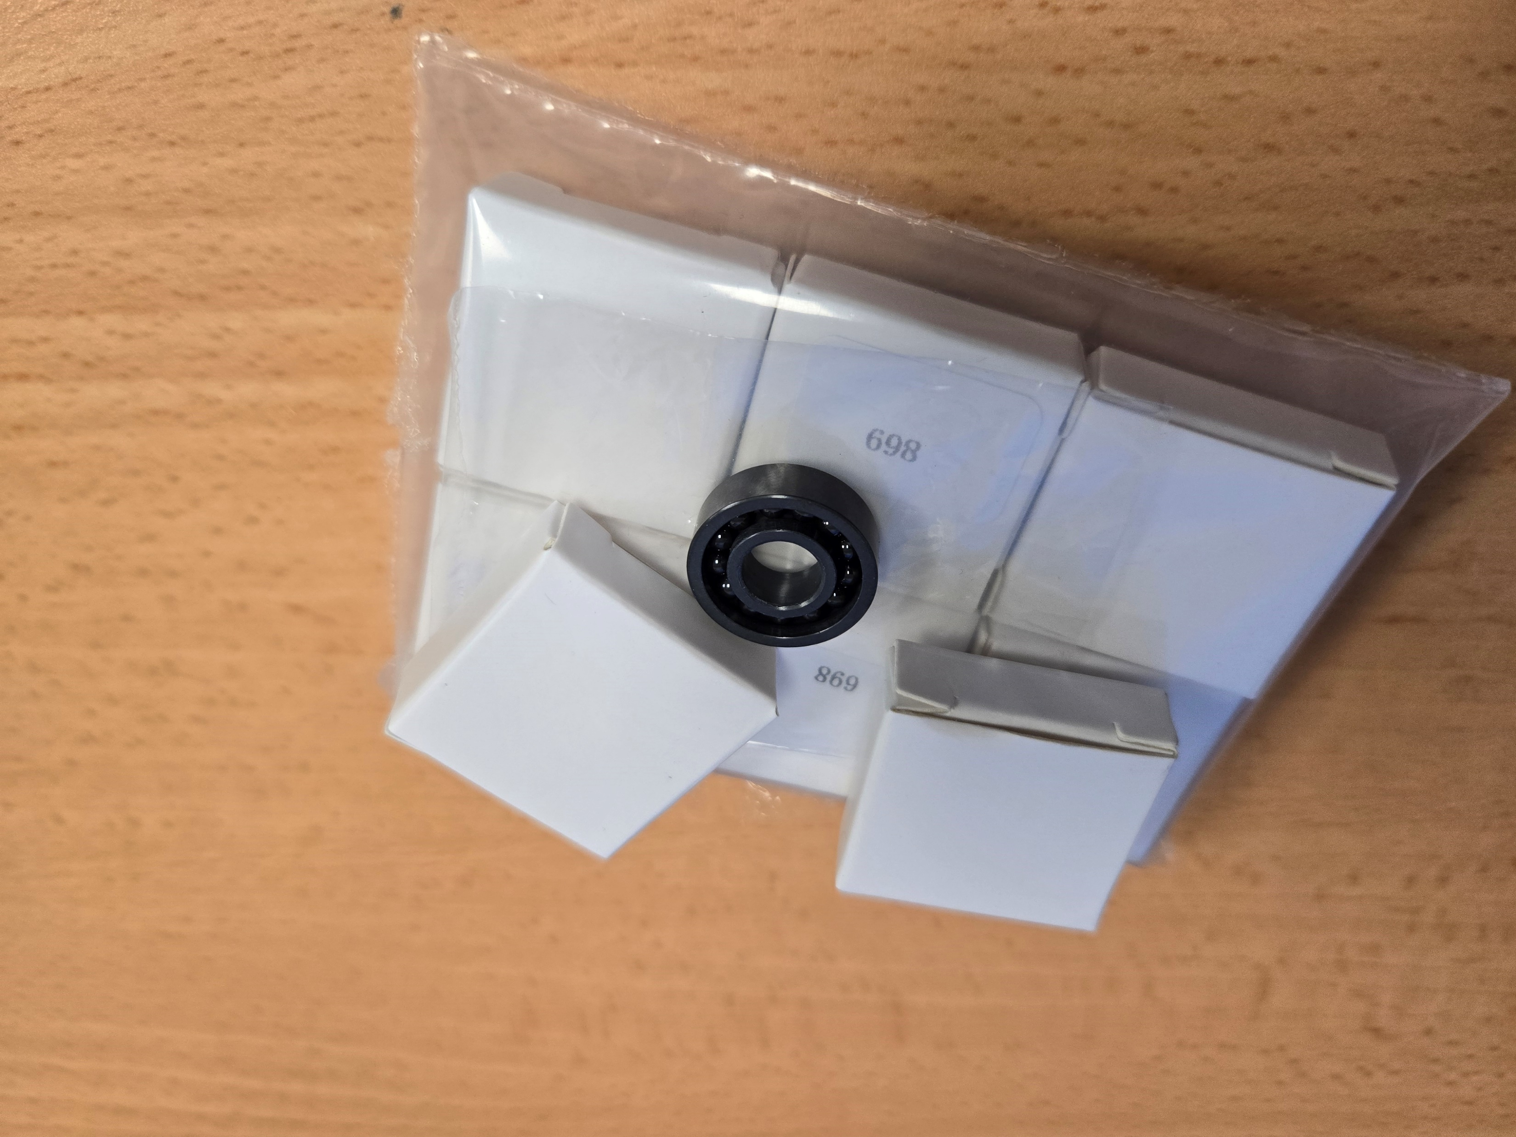
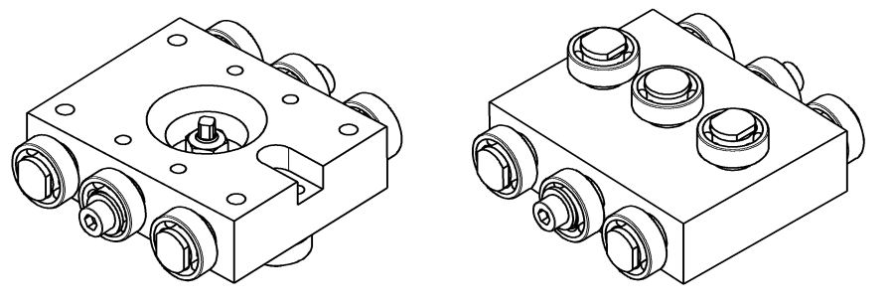
Circular Ceramic Bearings
Full Si₃N₄ ball bearings without cage
  Can be used up to 1200°C at low speed and low axial loads
  In principle for temperatures between 500-900°C a GH4099 nickel-based alloy cage could be used (not stored at the time of the PO)
The implementation and assembly of such system could be more challenging w.r.t. another system
  Fitting shaft/bearing must be careful check both at ambient and high temperatures to
    Ensure the alignment of the mold parts during the whole reaction cycle
    Make sure that interference fits due to differential thermal expansions do not reduce the radial play of the bearing to an unacceptable level (or shaft and housing fits should always accommodate for differences in expansion coefficients)
  3 bearings per raw where the central one is installed in an eccentric axis for alignment
  Parts #2, #3, #4, #5, #6 are made of Invar
Courtesy of B. Pellet

Slide 6
Circular Ceramic Bearings
Based on supplier’s exchanges, the theoretical lifetime (in hours) with
  60kgf radial load
  1kgf axial load
  100rpm speed
    L_{90% reliability} = 455h
    L_{95% reliability} = 291h
    L_{99.5% reliability} = 35h
The actual theoretical life is longer if we consider negligible speed
  At 10rpm speed → L_{99.5% reliability} = 350h
In our case the bearings will not even complete 1 turn:
  About 18° rotation (≈ 3mm) for basic mock-ups
  About 30° rotation (≈ 5mm) for racetrack coil mock-up
  At 1rpm speed → L_{99.5% reliability} = 3500h
  Tests should be carried out to assess the real lifetime

Slide 7
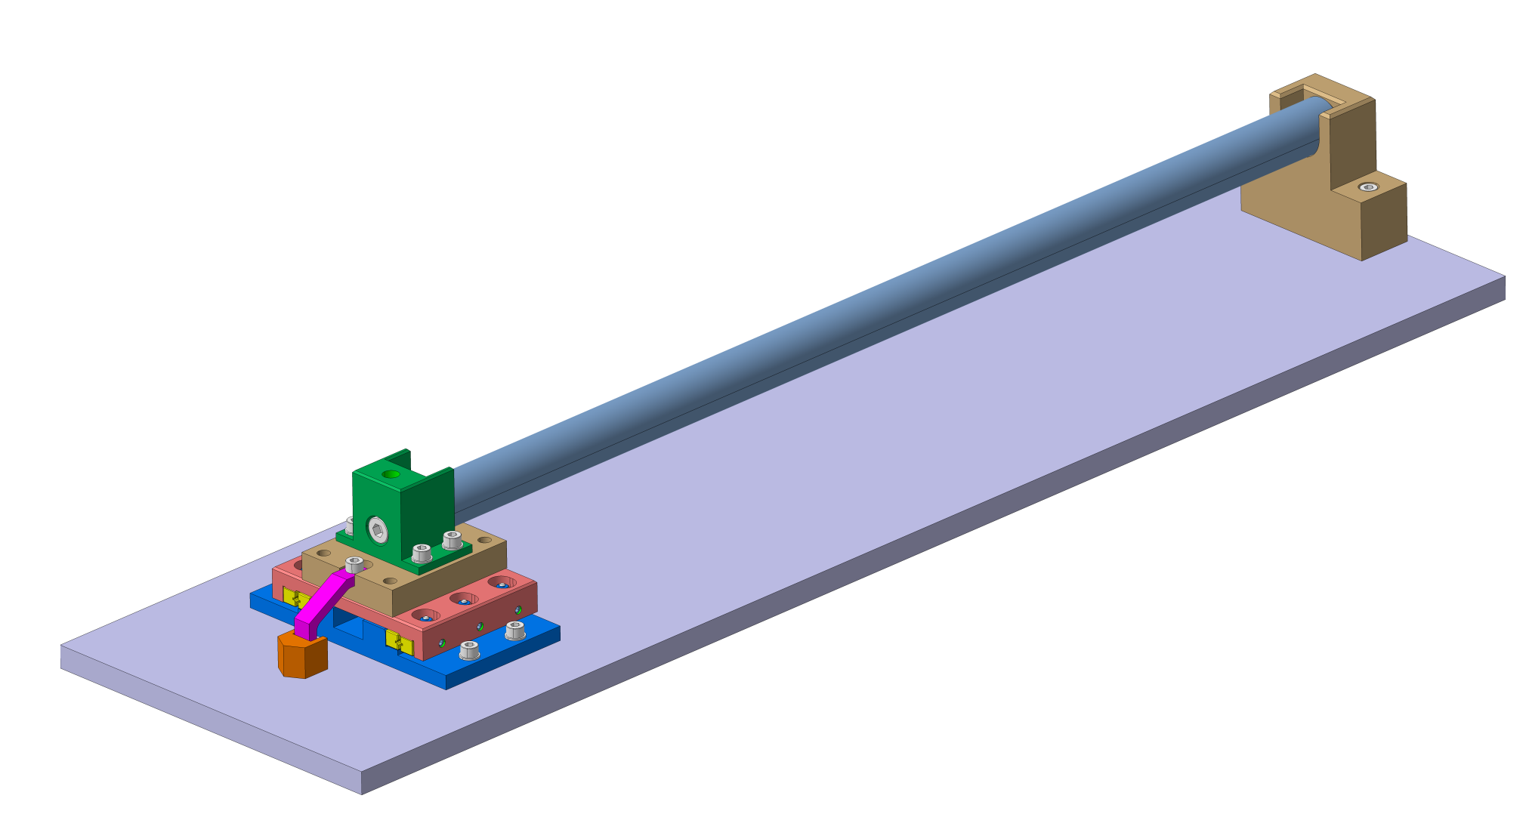
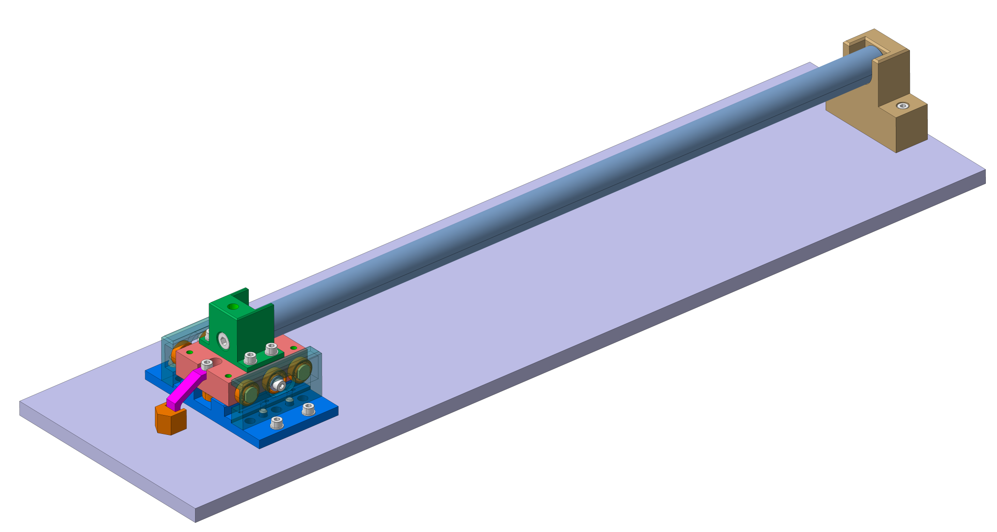
Mock-ups
Linear Ceramic Bearings
Mock-ups are built to
  Assess the behavior of the sliding systems during a RHT cycle
  Check the assembly of the sliding systems (weaknesses if any)
  Determine the most suitable solution to be implemented to the reaction mold
The basic mock-ups feature
  A 500mm long 304 stainless steel bar
  The sliding system (either linear or circular ceramic bearings)
  All the rest of the components made by titanium (or Invar)
  About 13kg of weight on top of the floating mass
The differential expansion between 304SS and titanium at 650°C, considering a length of 500mm, is about 2.3mm
Circular Ceramic Bearings
Courtesy of B. Pellet

Slide 8
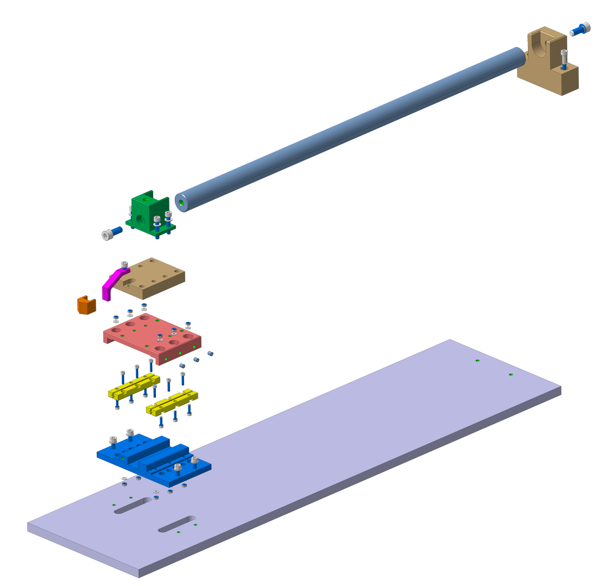
Mock-ups: Linear Ceramic Bearings
Courtesy of B. Pellet

Slide 9
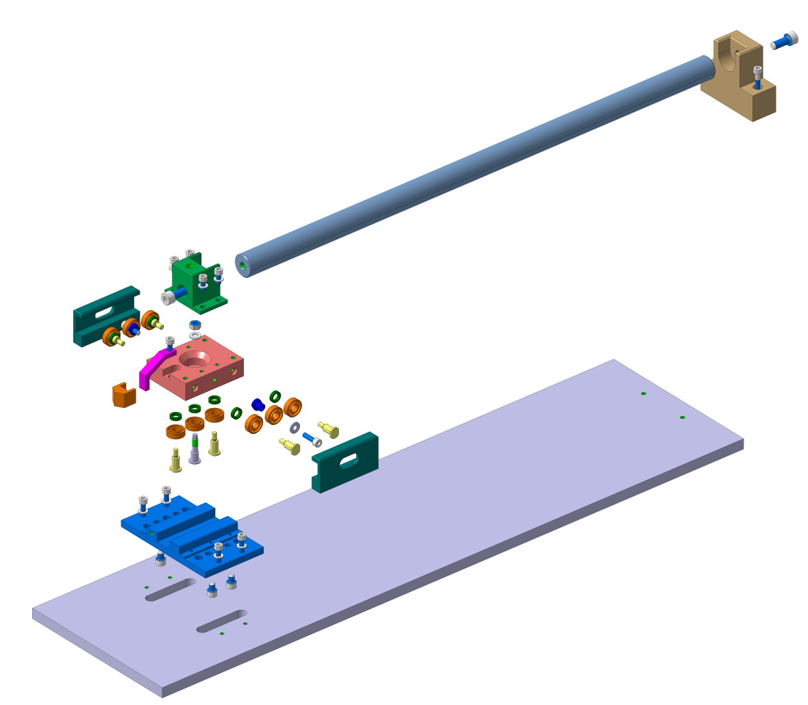
Mock-ups: Circular Ceramic Bearings
Courtesy of B. Pellet

Slide 10
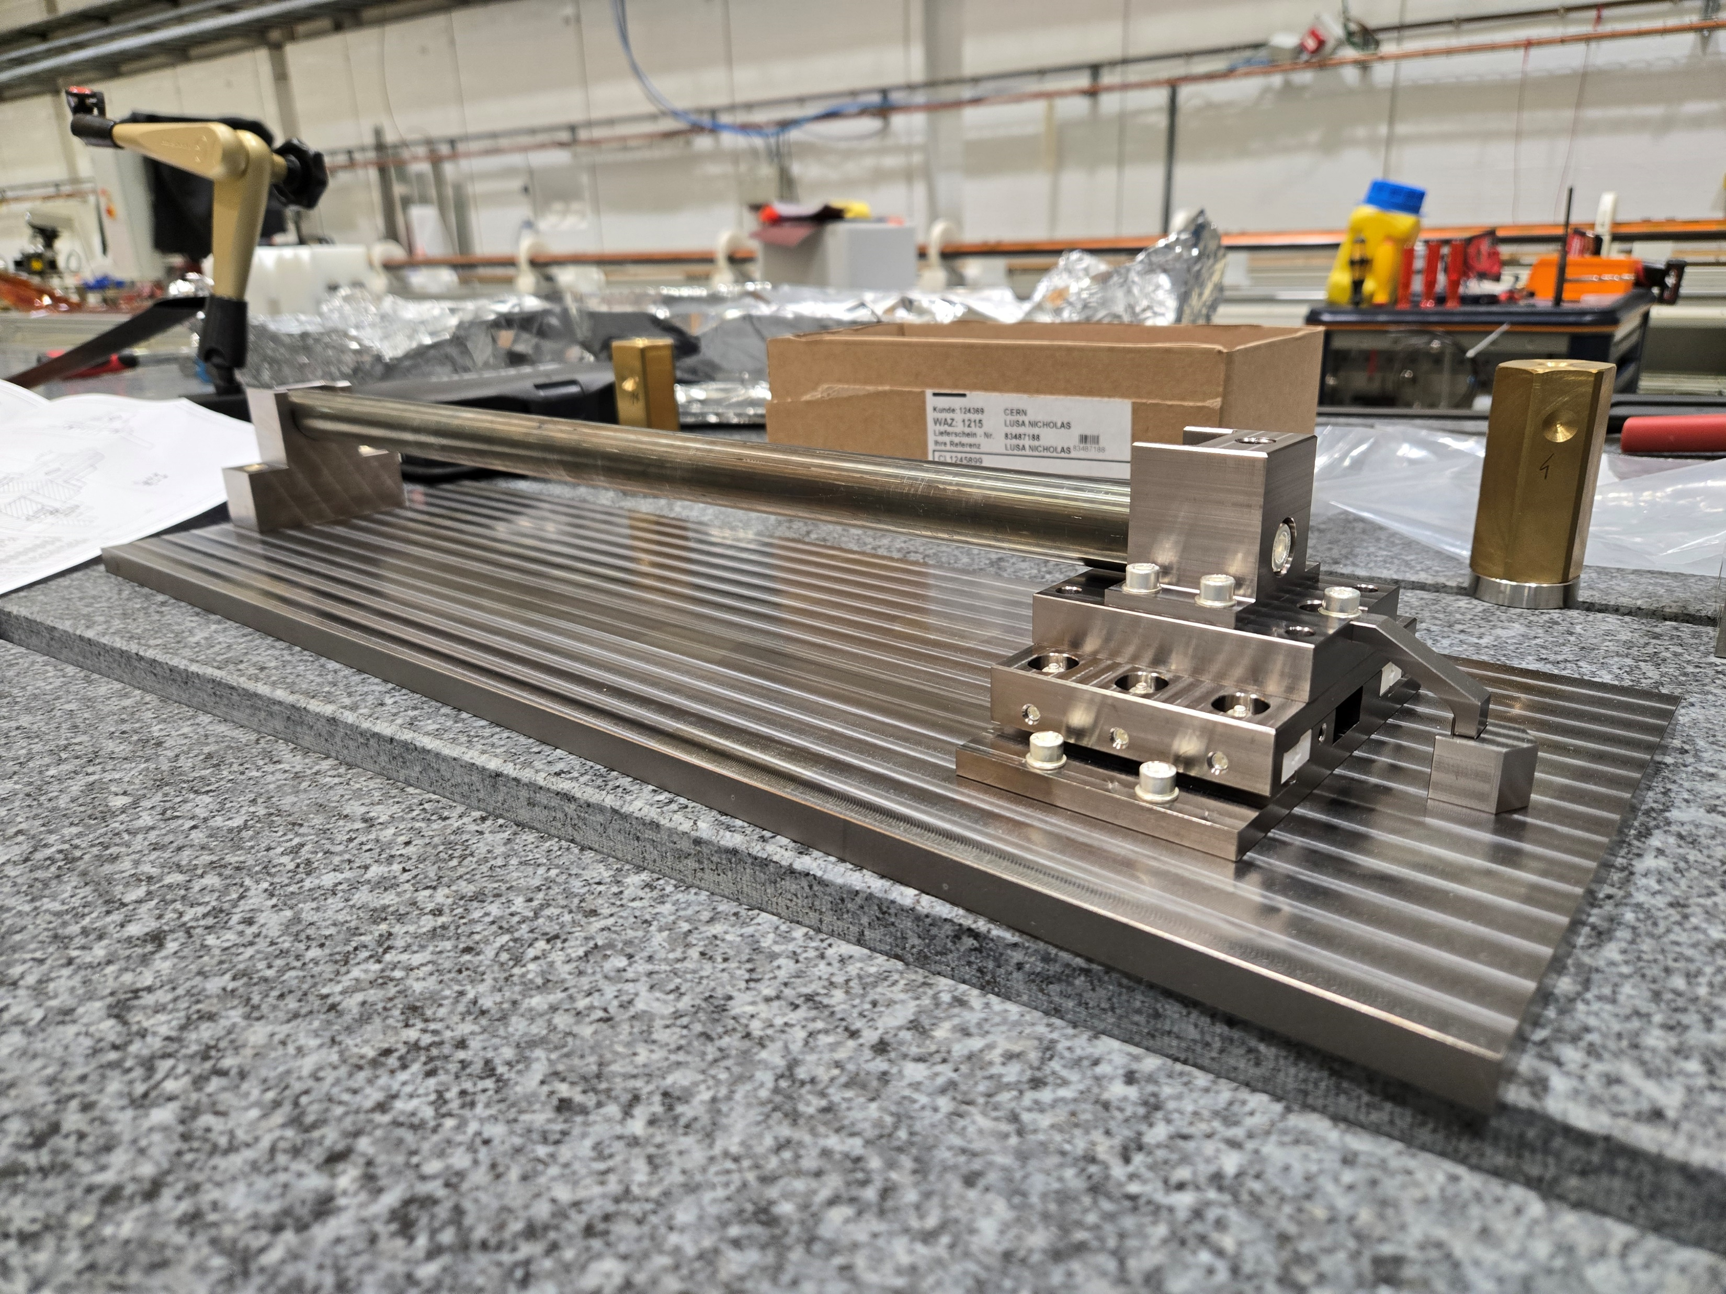
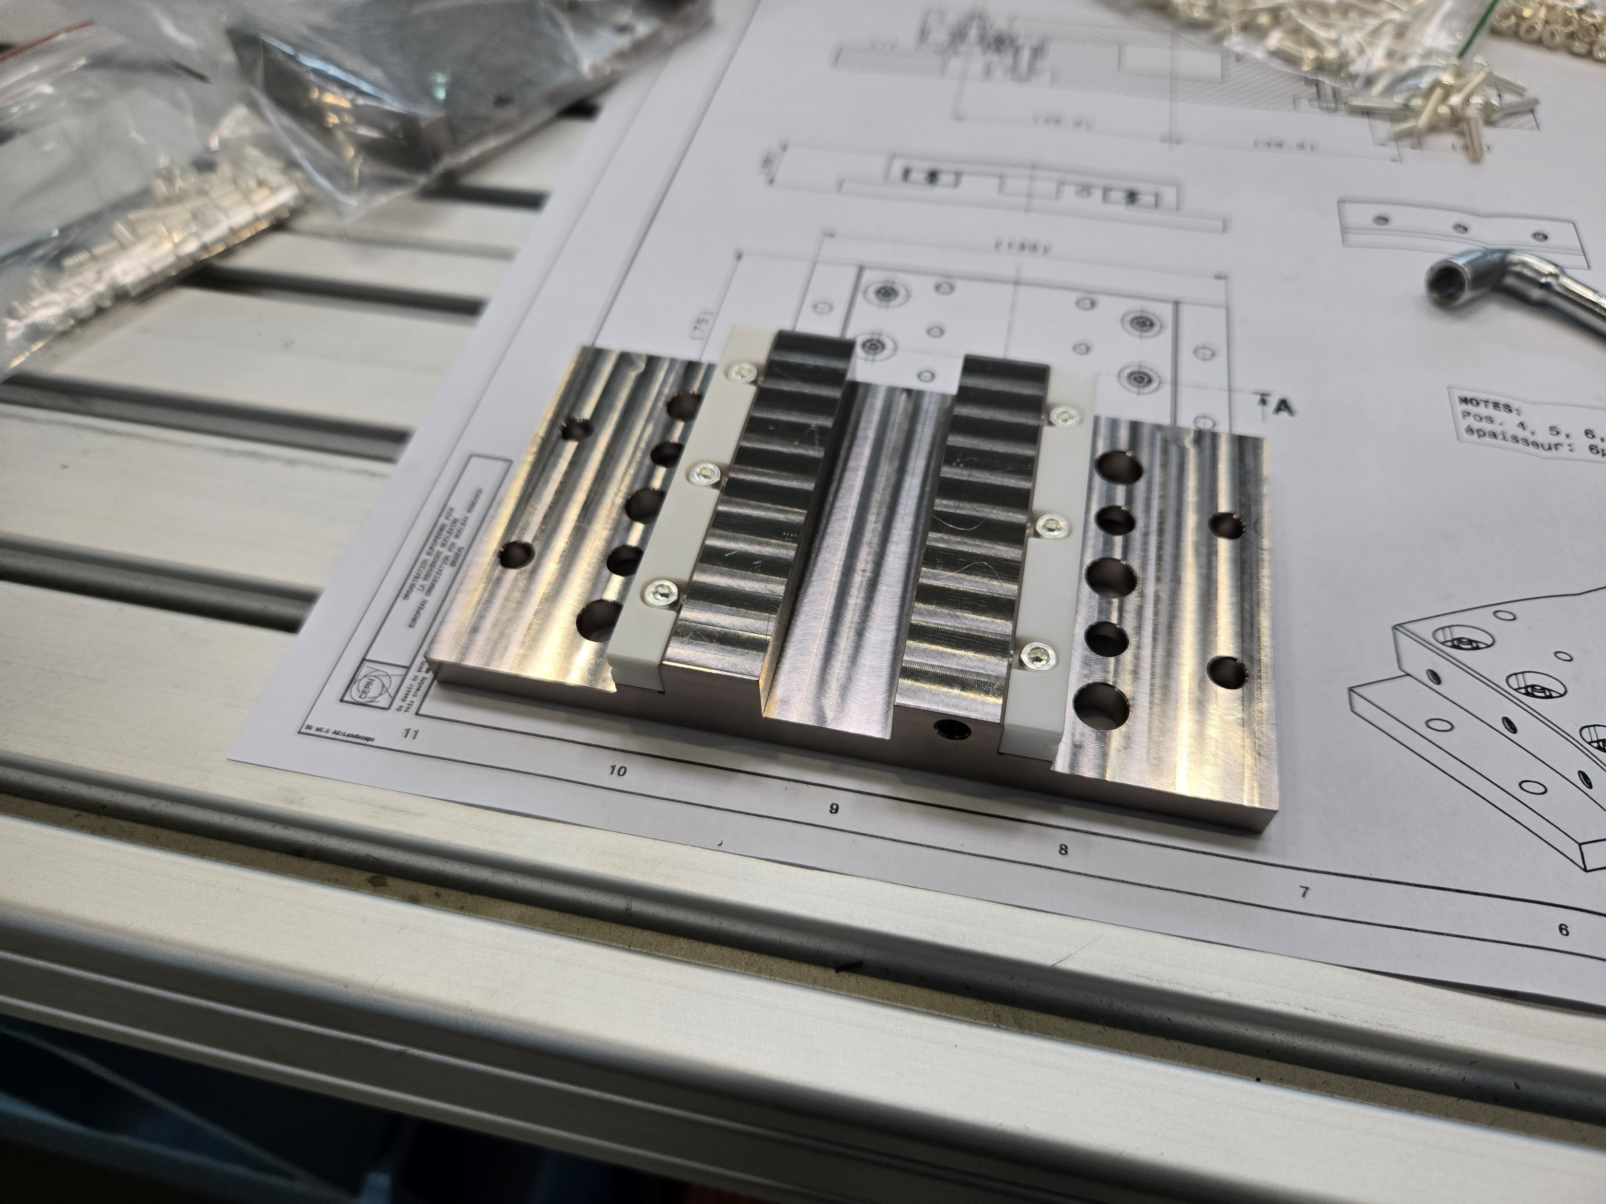
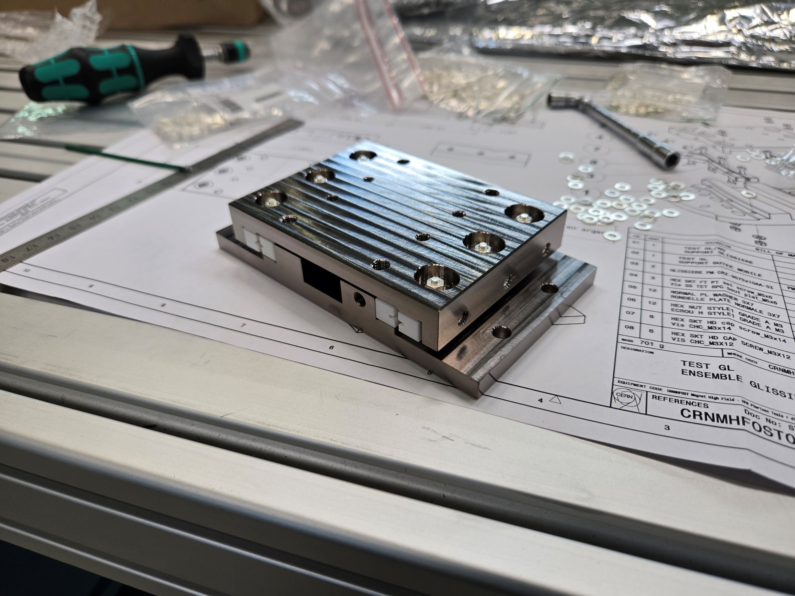
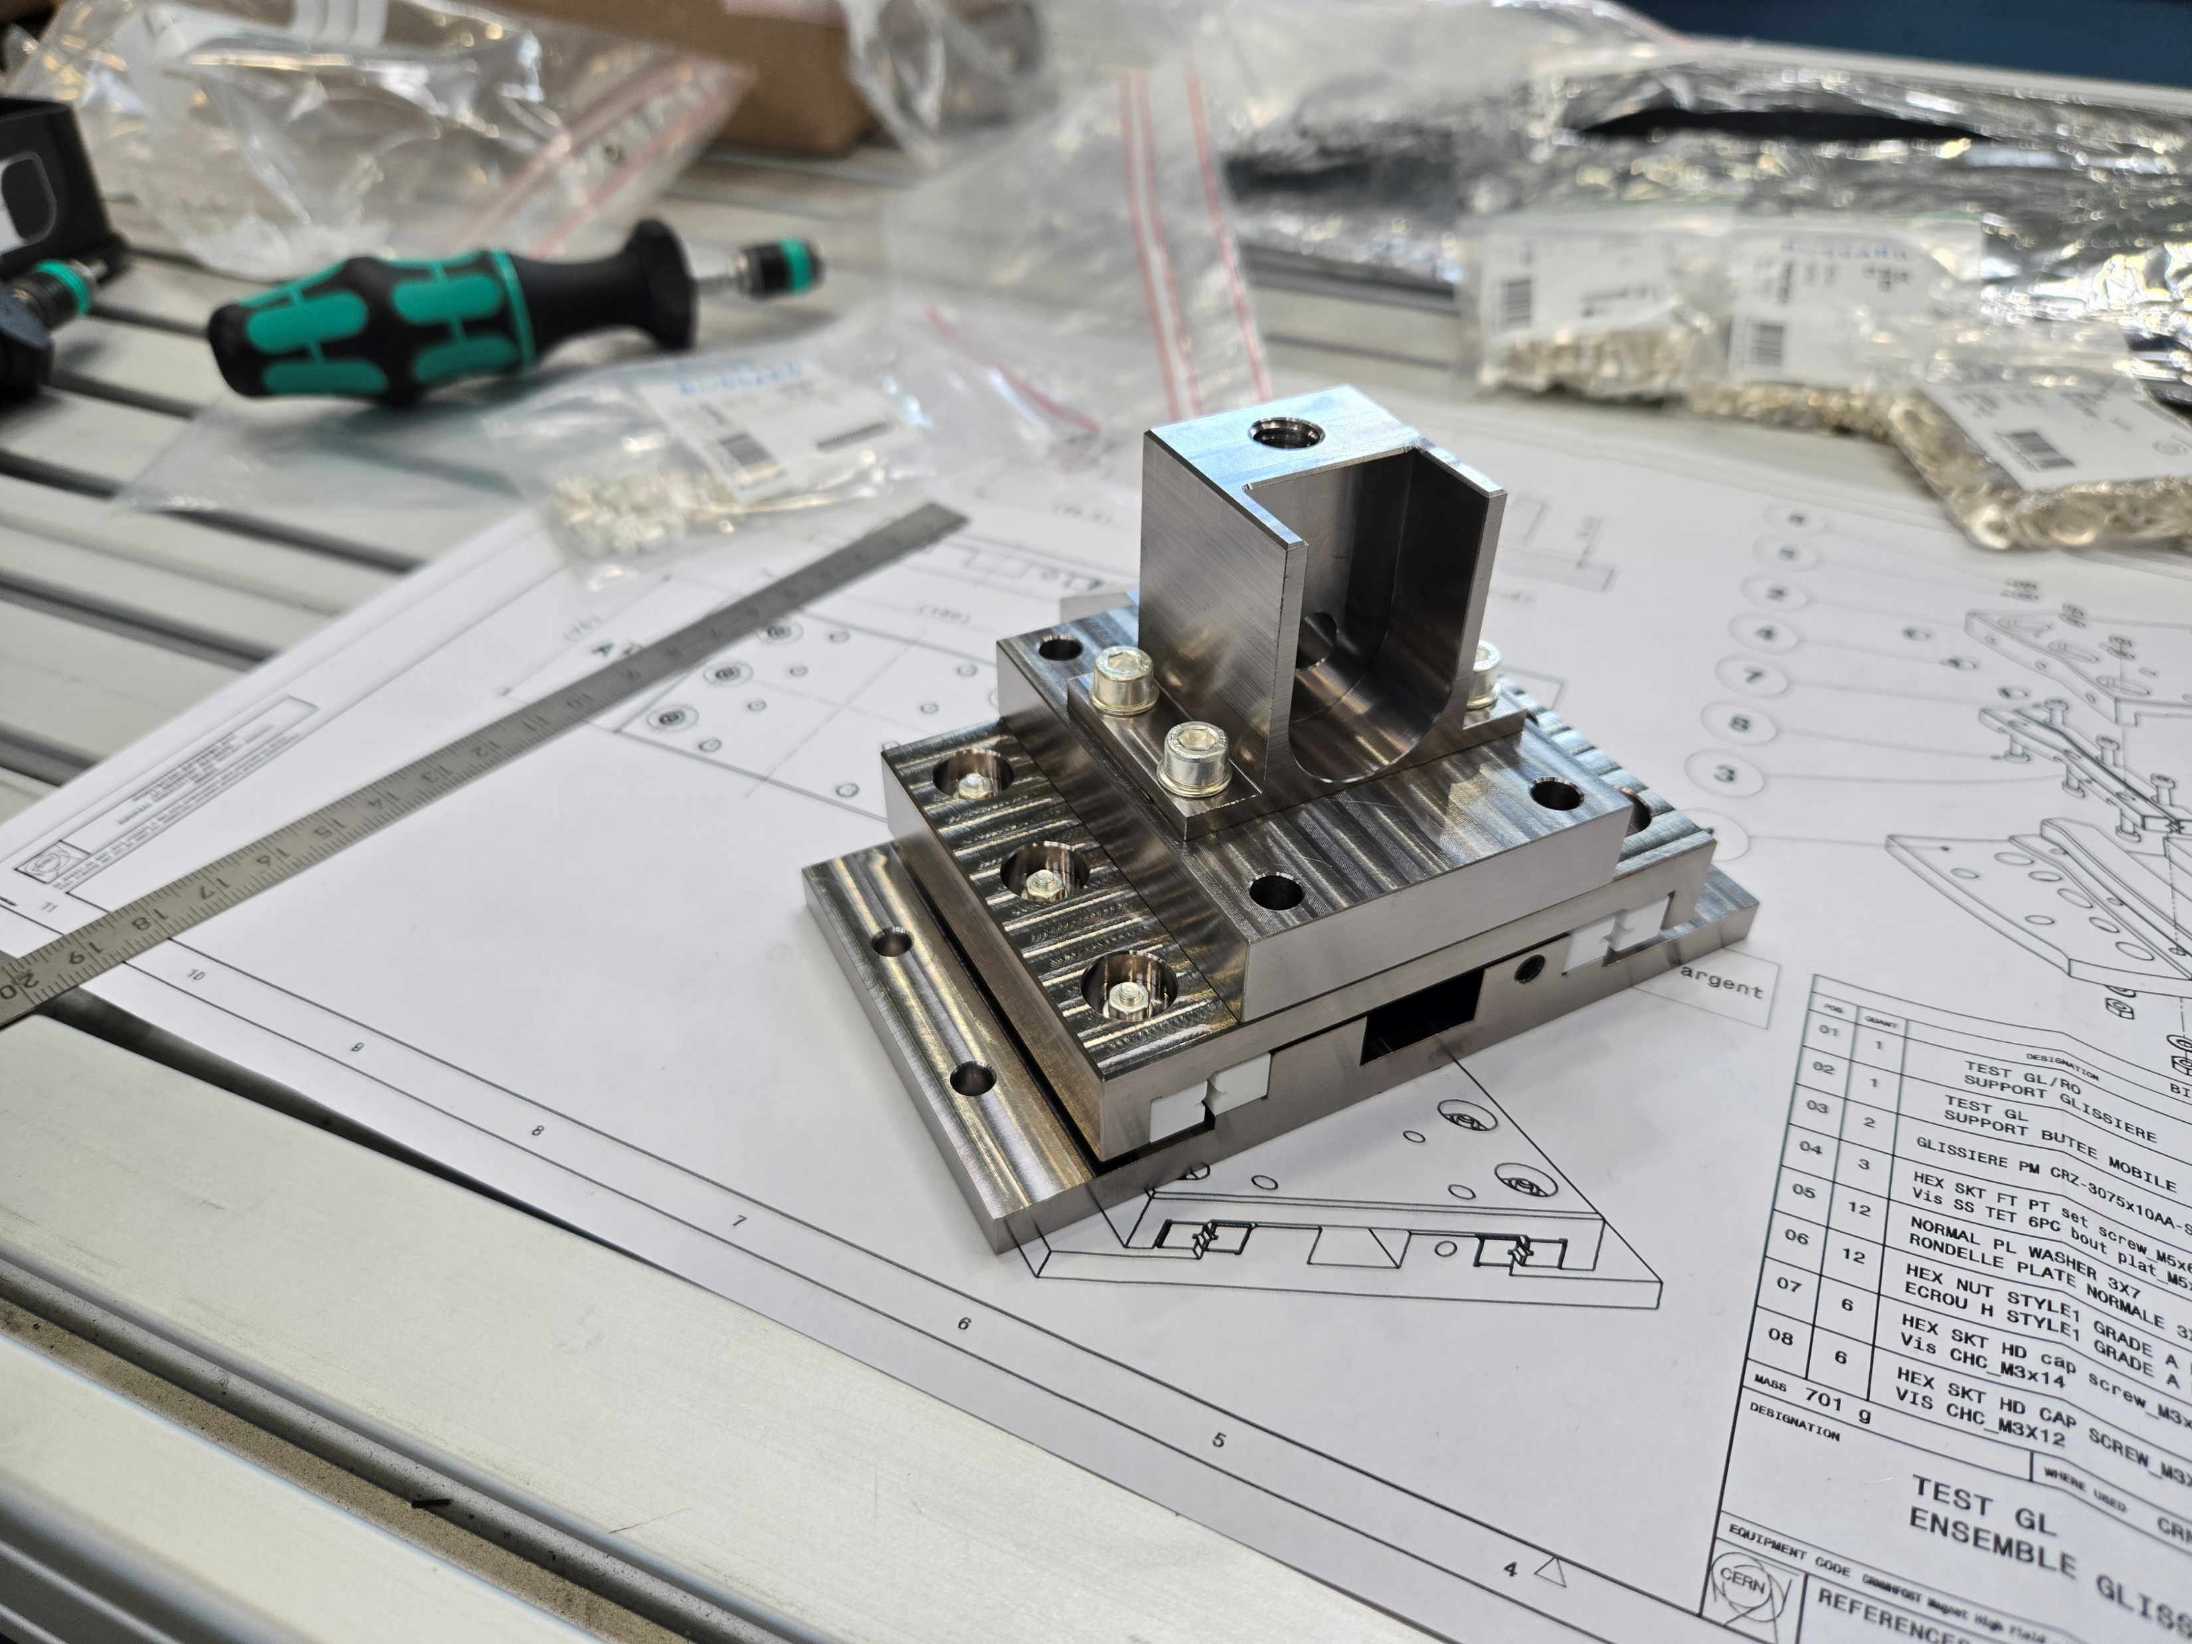
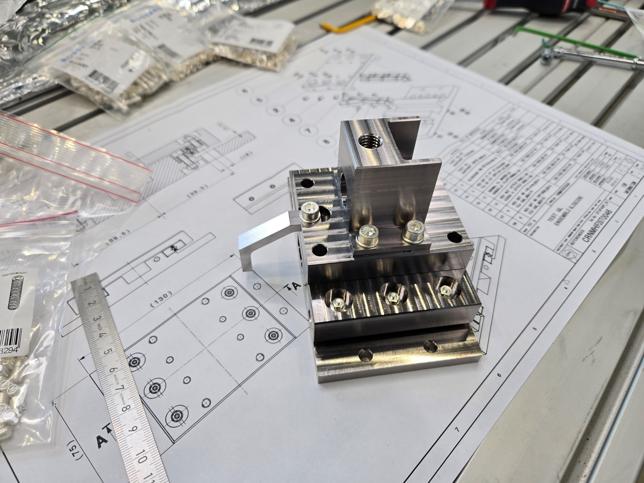
Assembly of the mock-up with linear bearings
Observations:
  Parts easy to install
  In case this solution will be adopted, threaded holes in the rails are recommended
  The installation is done in such a way that tightening torque can be fixed and applied (2 Nm for the M3 screws and 0.5 Nm for the lateral ones)
  I had the feeling that with a charge on top of the chariots, the movement of bearings was more smooth

Slide 11
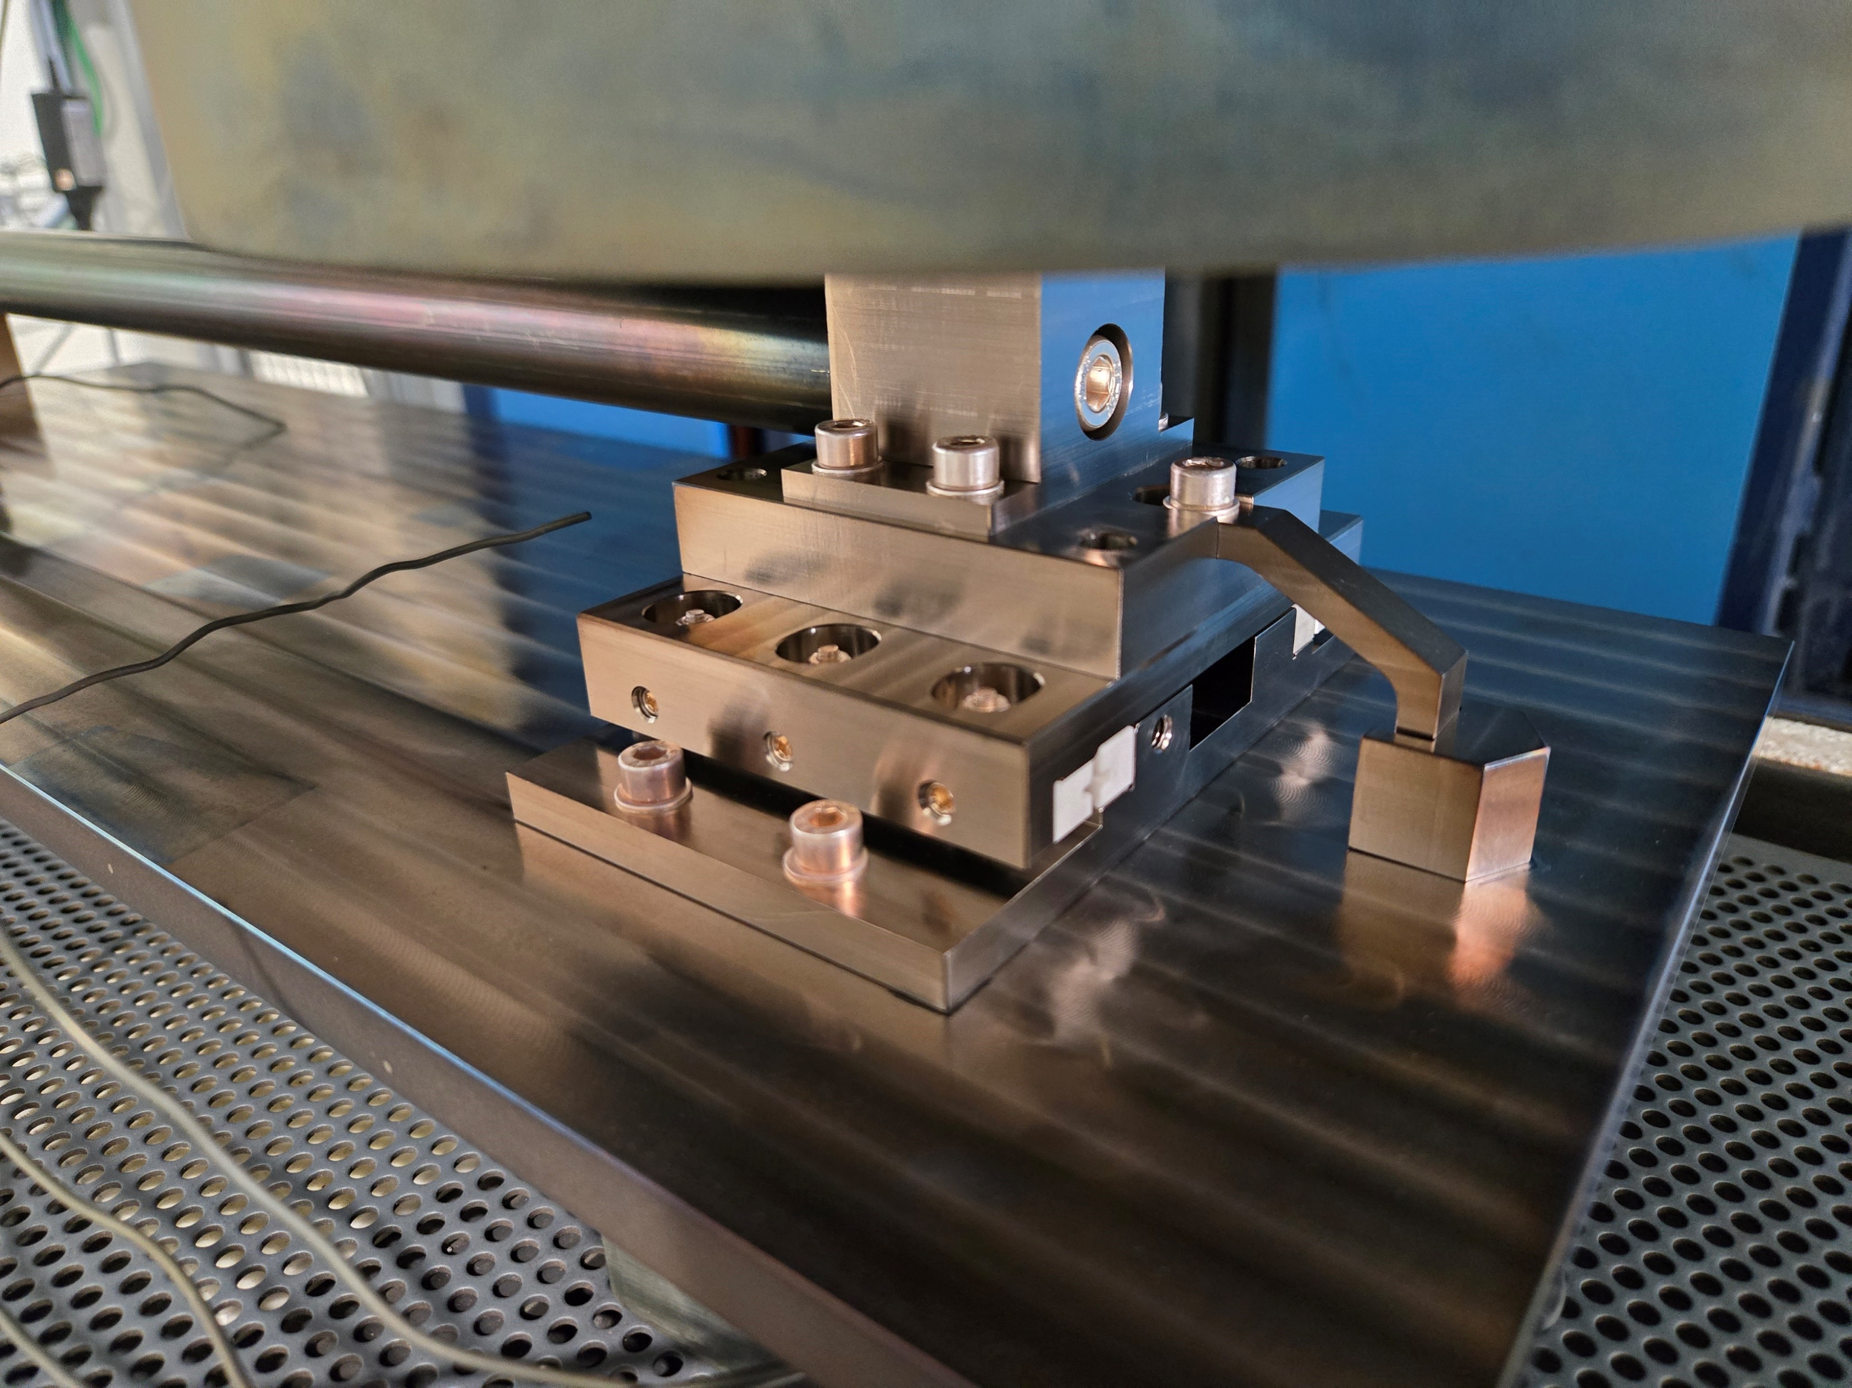
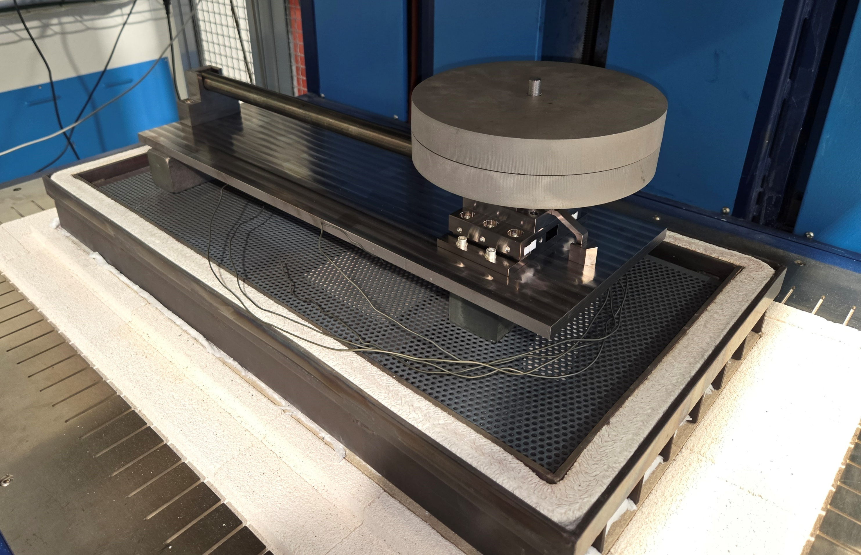
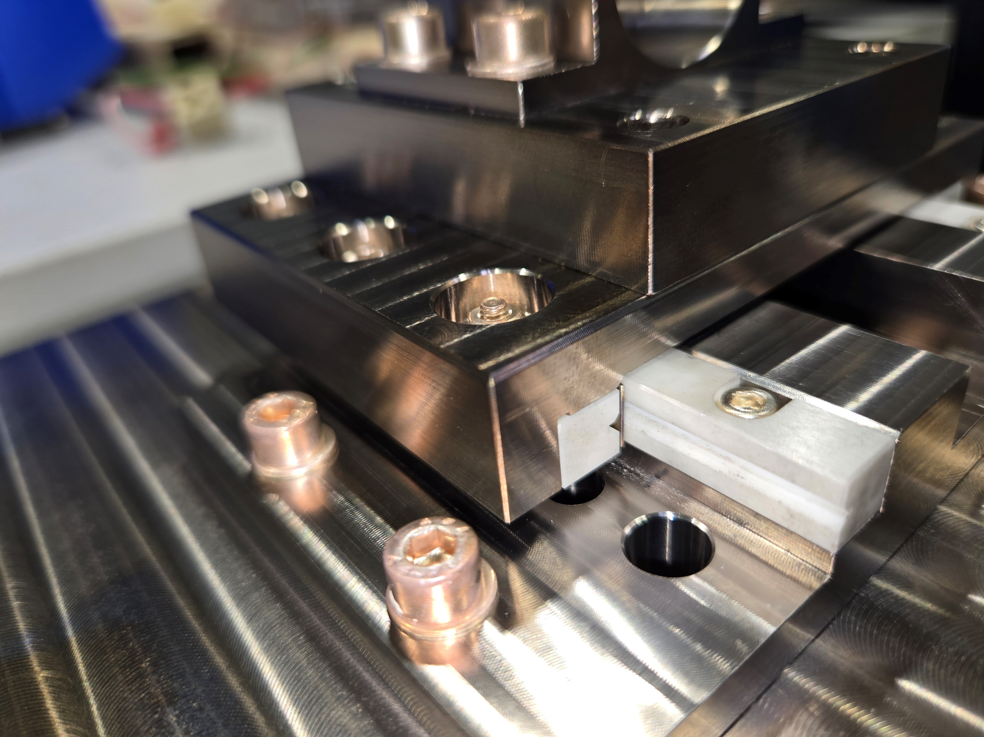
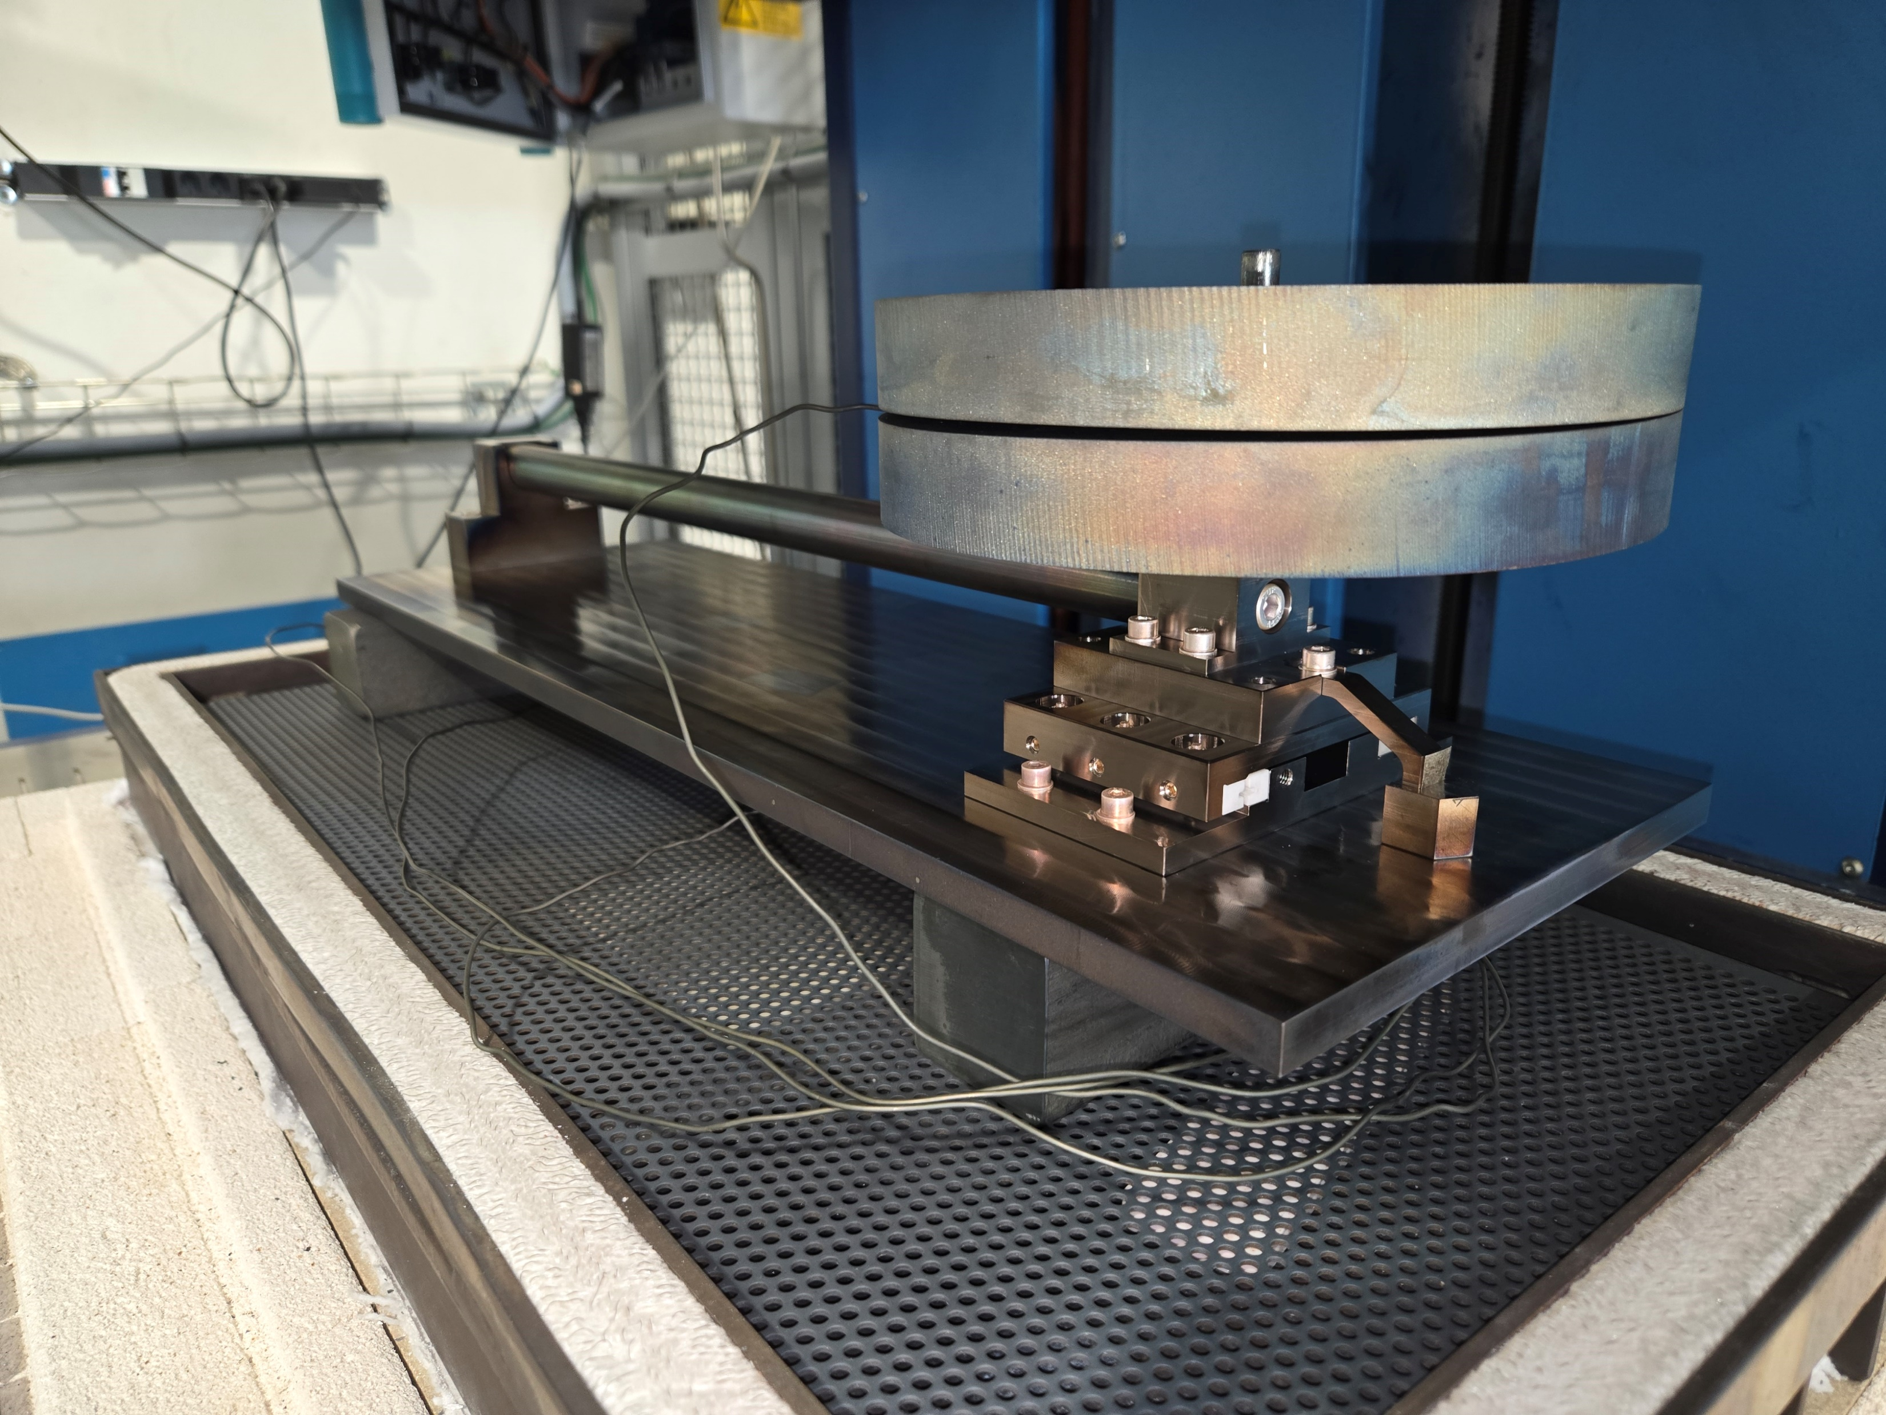

HT of the mock-up with linear bearings
The thermal cycle was launched in B. 927 using the oven Gero 750
  Ramp up from room temperature to 650°C with 50°C/h
  Plateau at 650°C for 10h
  Free cool-down in the oven
  Cycle under Argon atmosphere
RESULTS:
  At the end of the cycle we saw that the witness was stuck to the “finger” (even if the parts where heat treated under vacuum prior to be used, maybe due to oxydation)
  The sliding system was inspected, and we noticed some debris next to the rails (most probably ceramic debris)
  We manually tried the sliding motion of the system, and it was not 100% smooth but still very good
Due to the sticking of the witness to the “finger”, a layer of mica was added in between prior to relaunch a second heat treatment cycle
The debris were cleaned as well

Slide 12
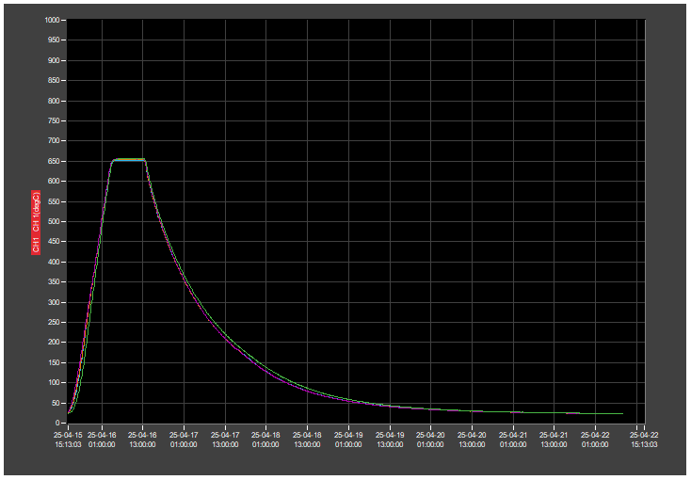
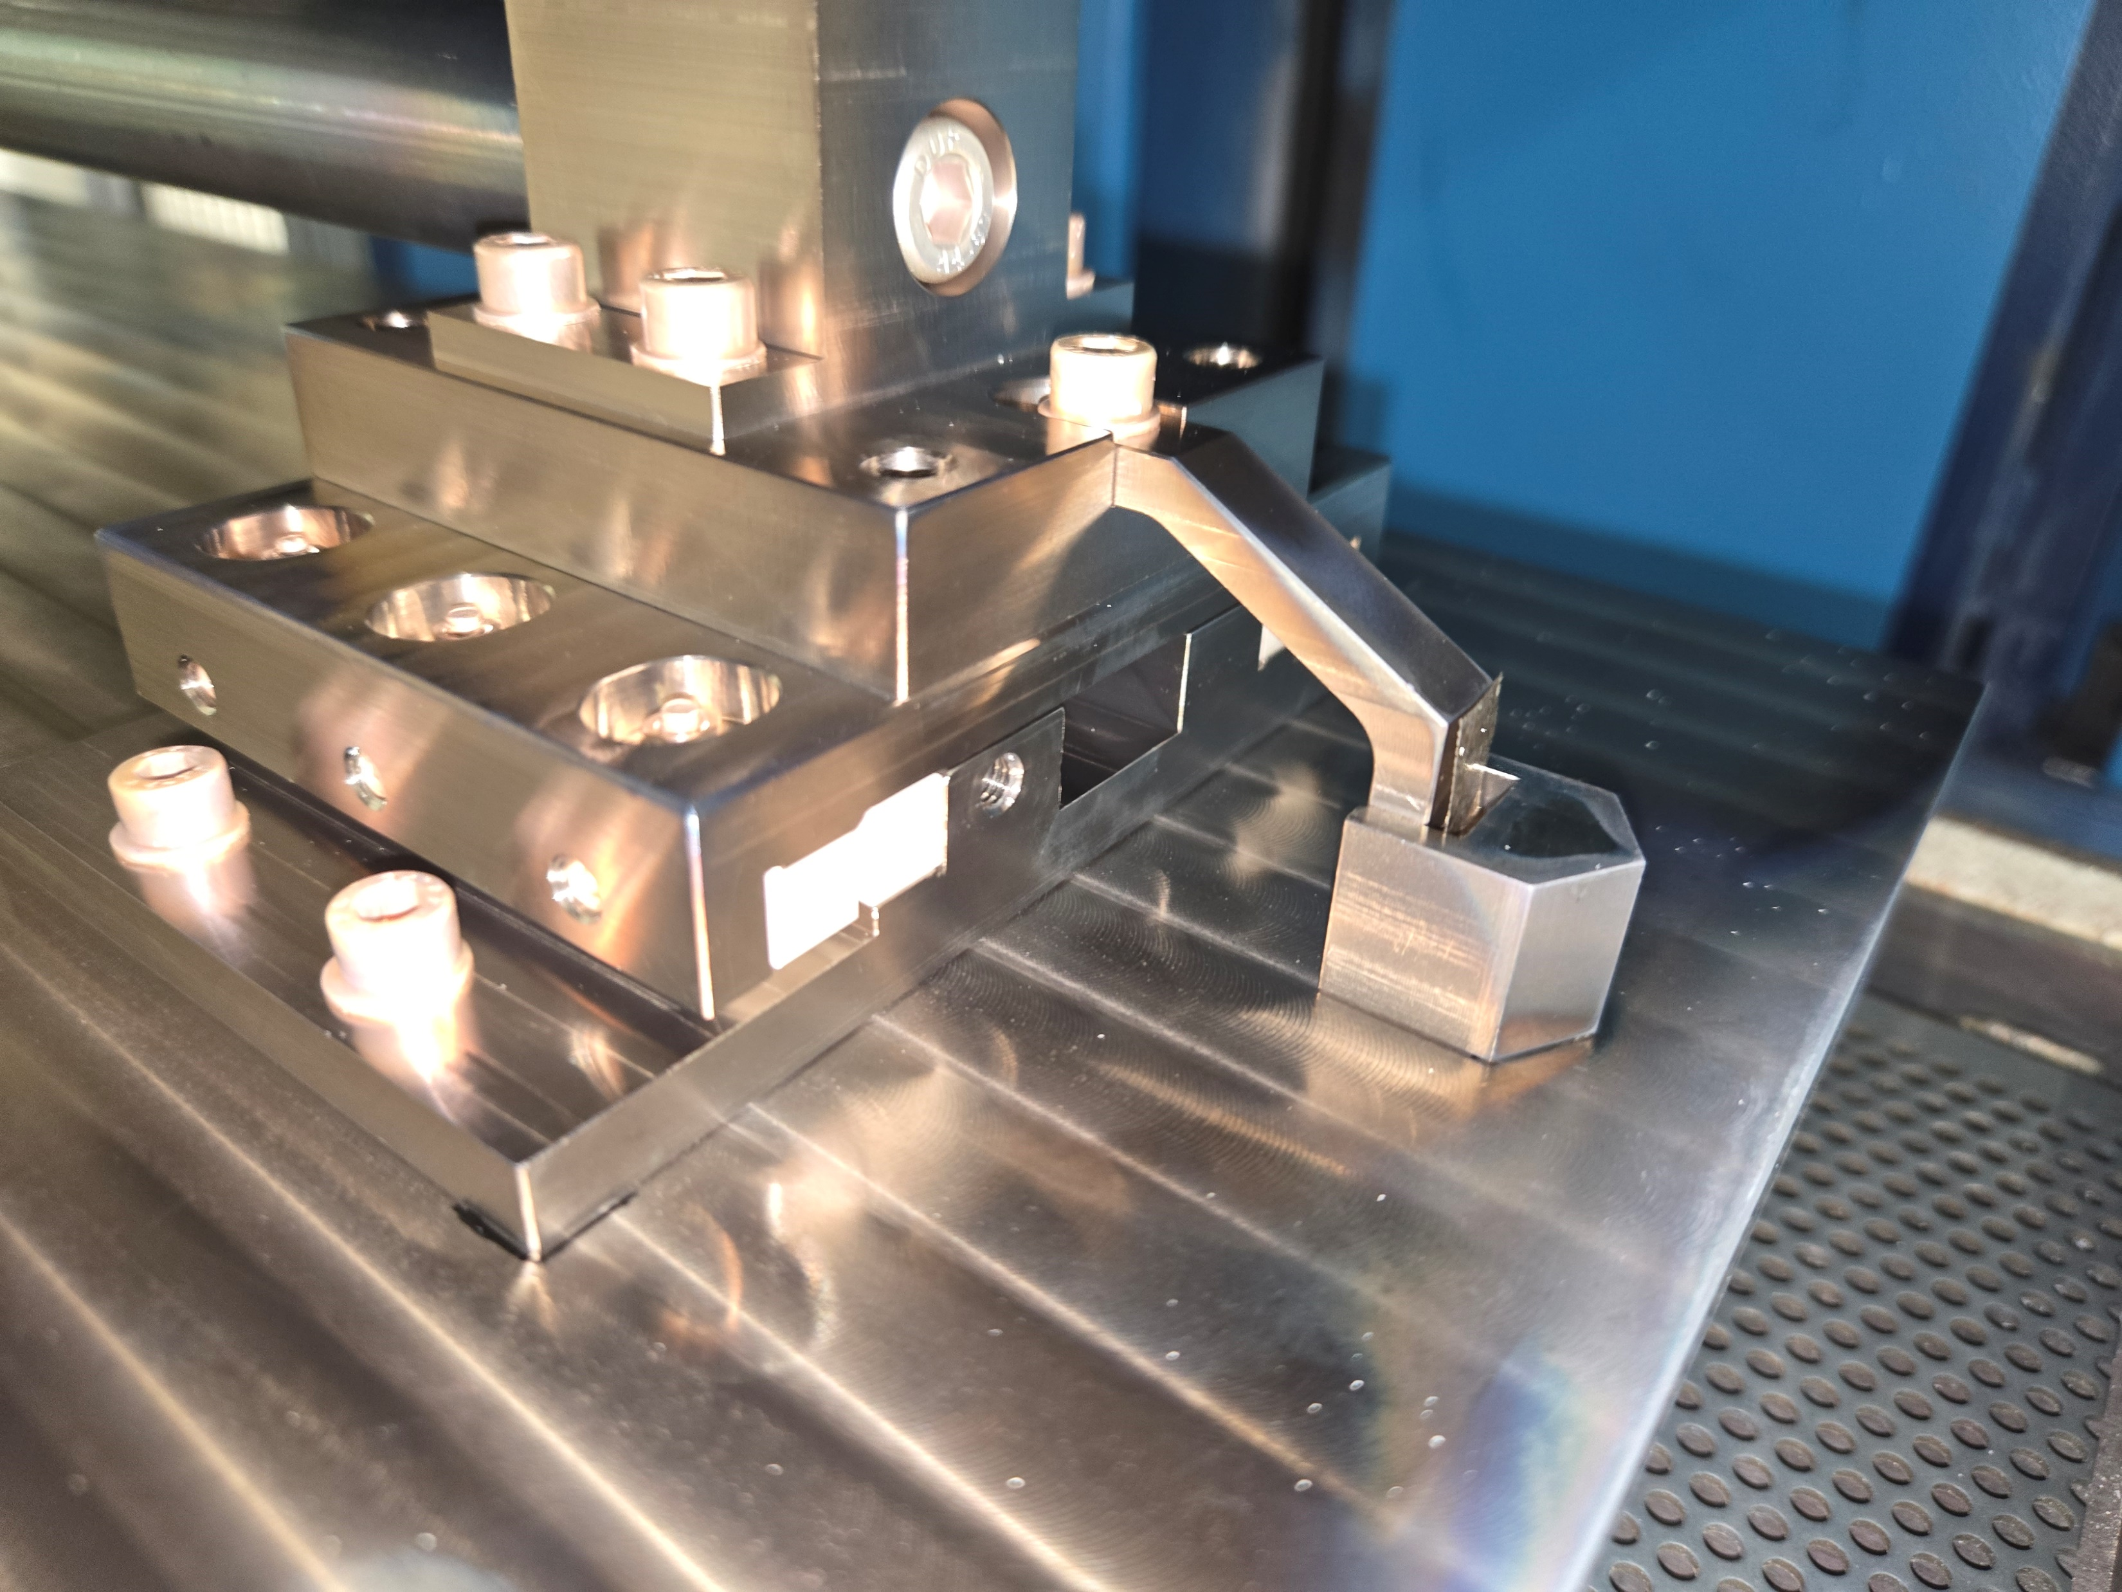
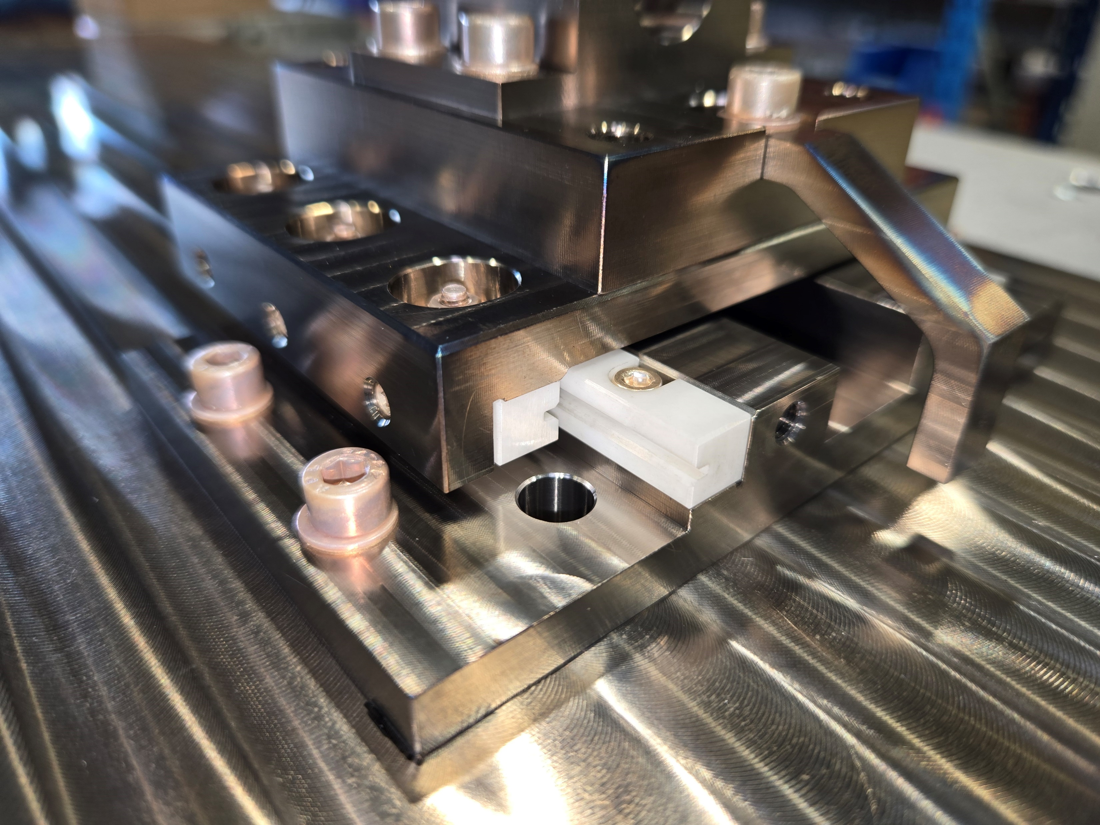
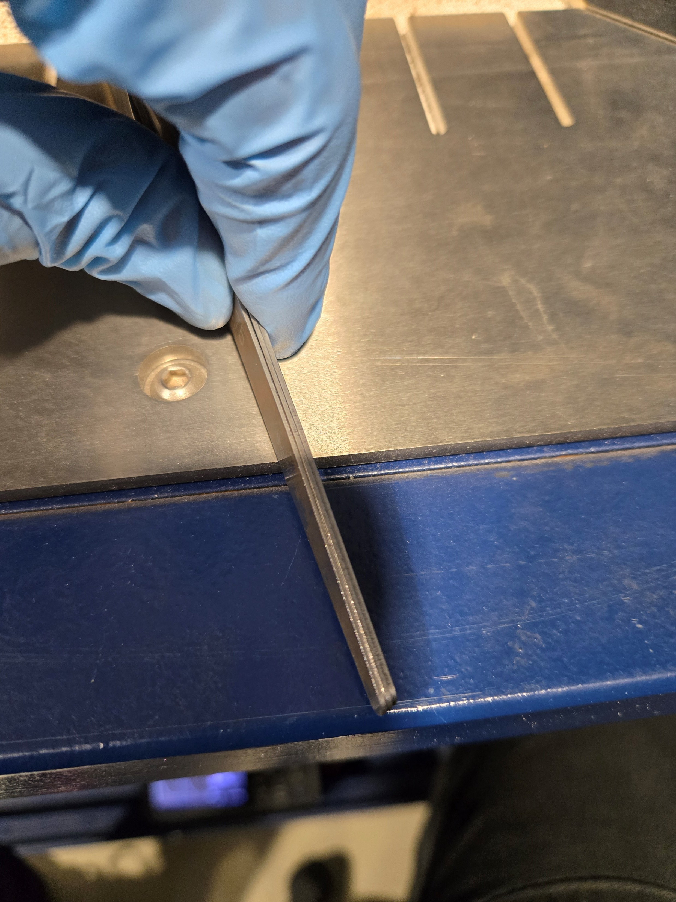
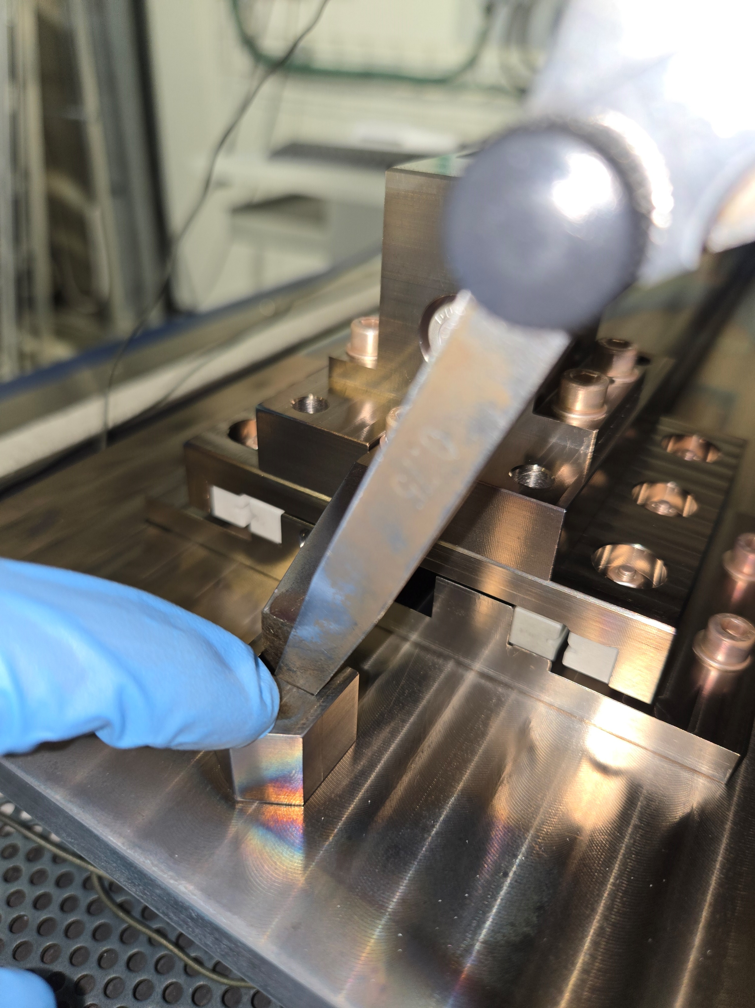
HT of the mock-up with linear bearings
RESULTS 2nd heat treatment:
  The mica sheet was effective, in fact the witness was not in contact with the “finger”
  A gap of 2.5 mm could be measured with feeler gauges (consistent with the theoretical one)
  The sliding system was inspected, and no debris were noticed
  We manually tried the sliding motion of the system, and it was 100% smooth like if the first cycle helped in adjusting a bit the set-up and/or the parts

Slide 13
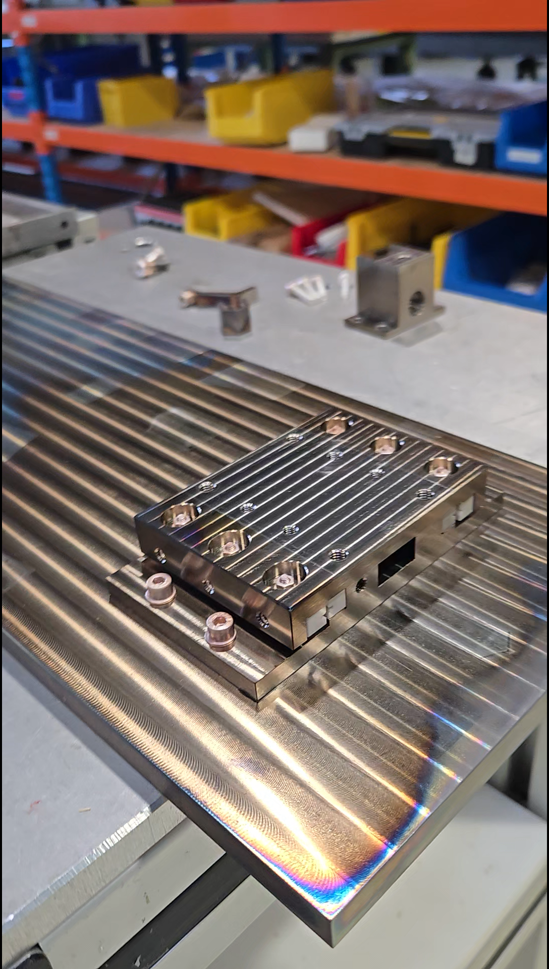
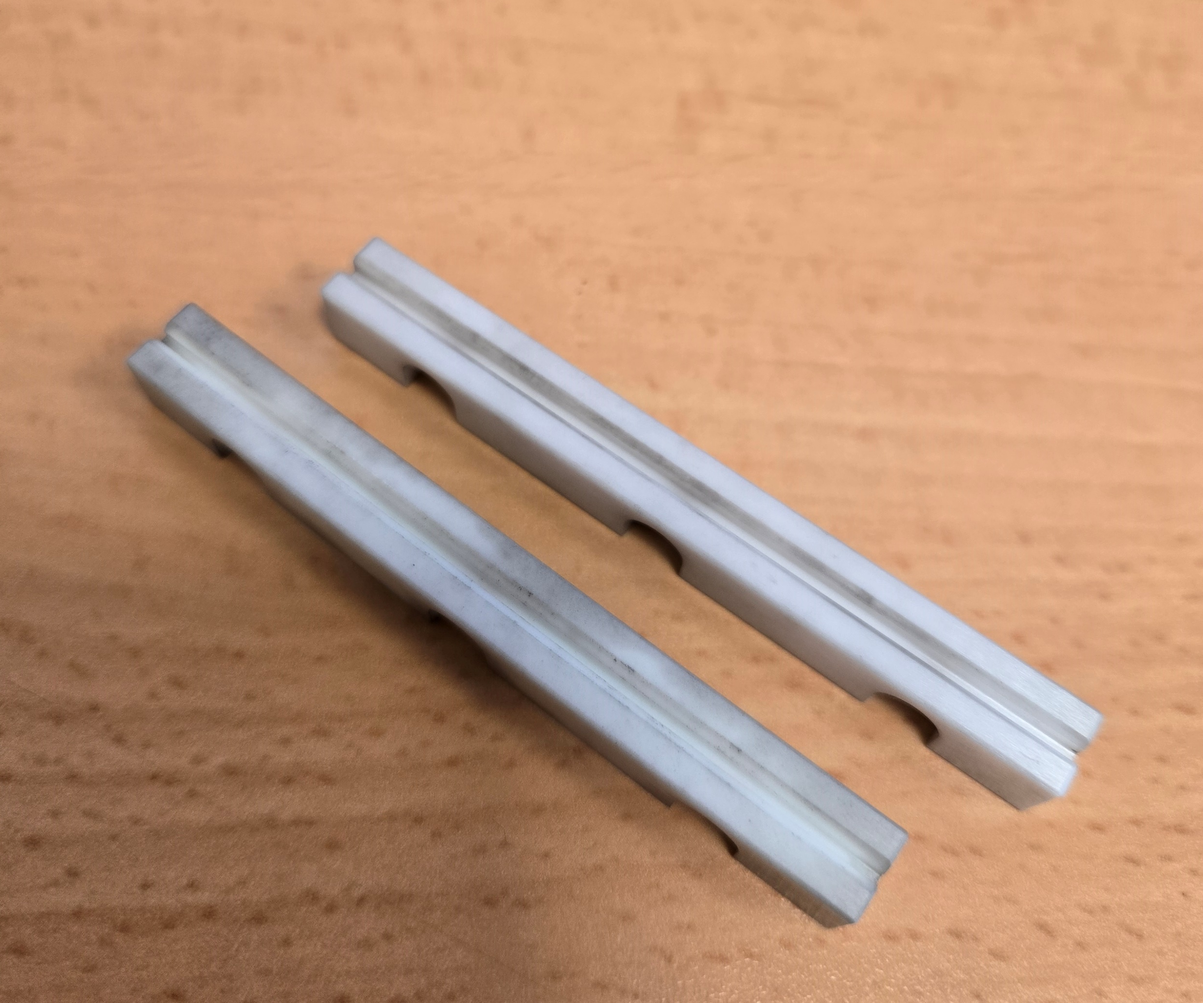
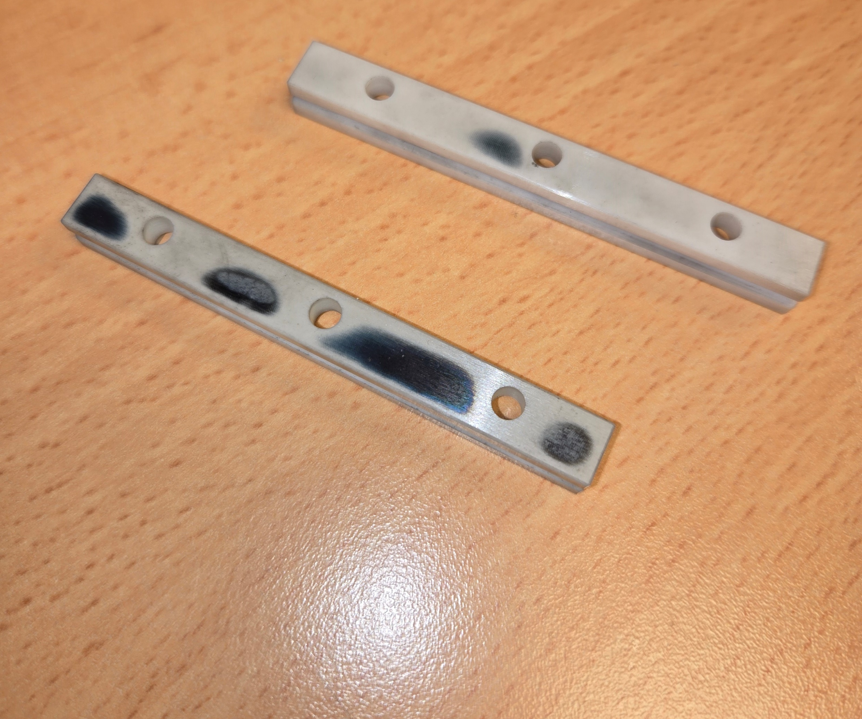
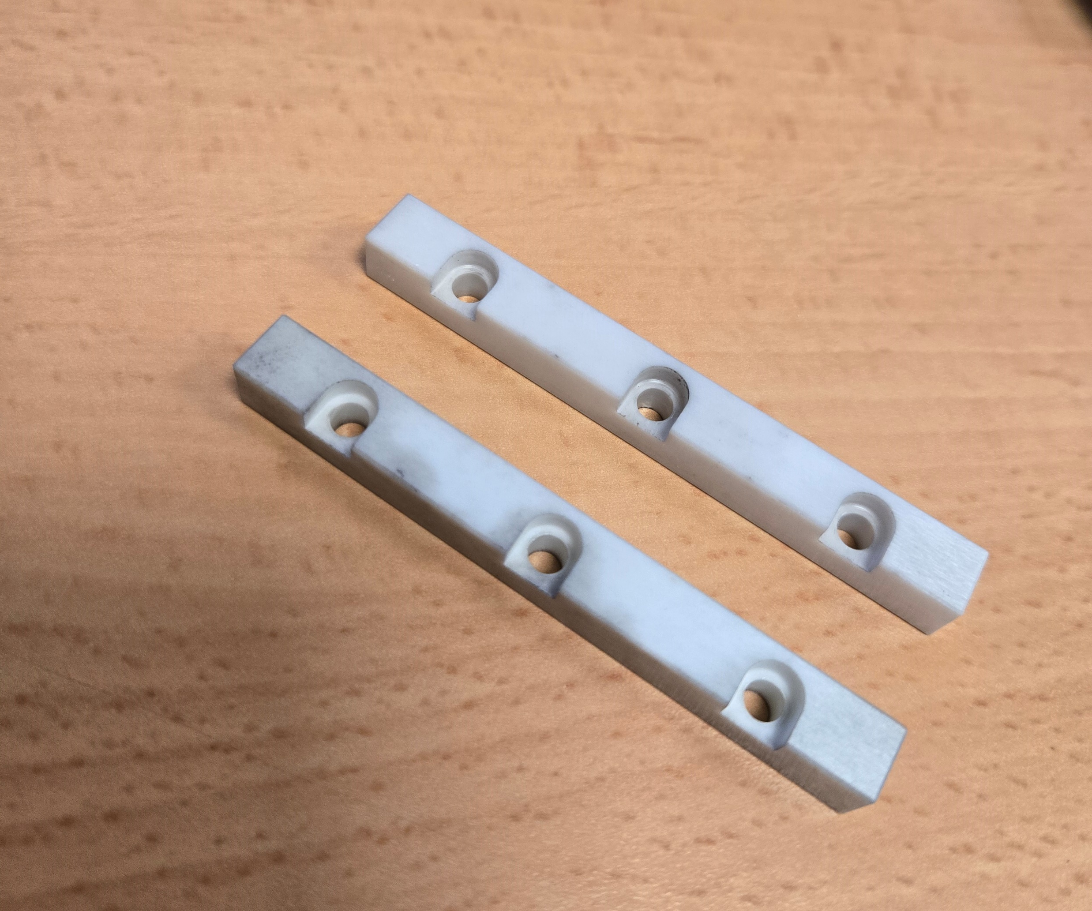
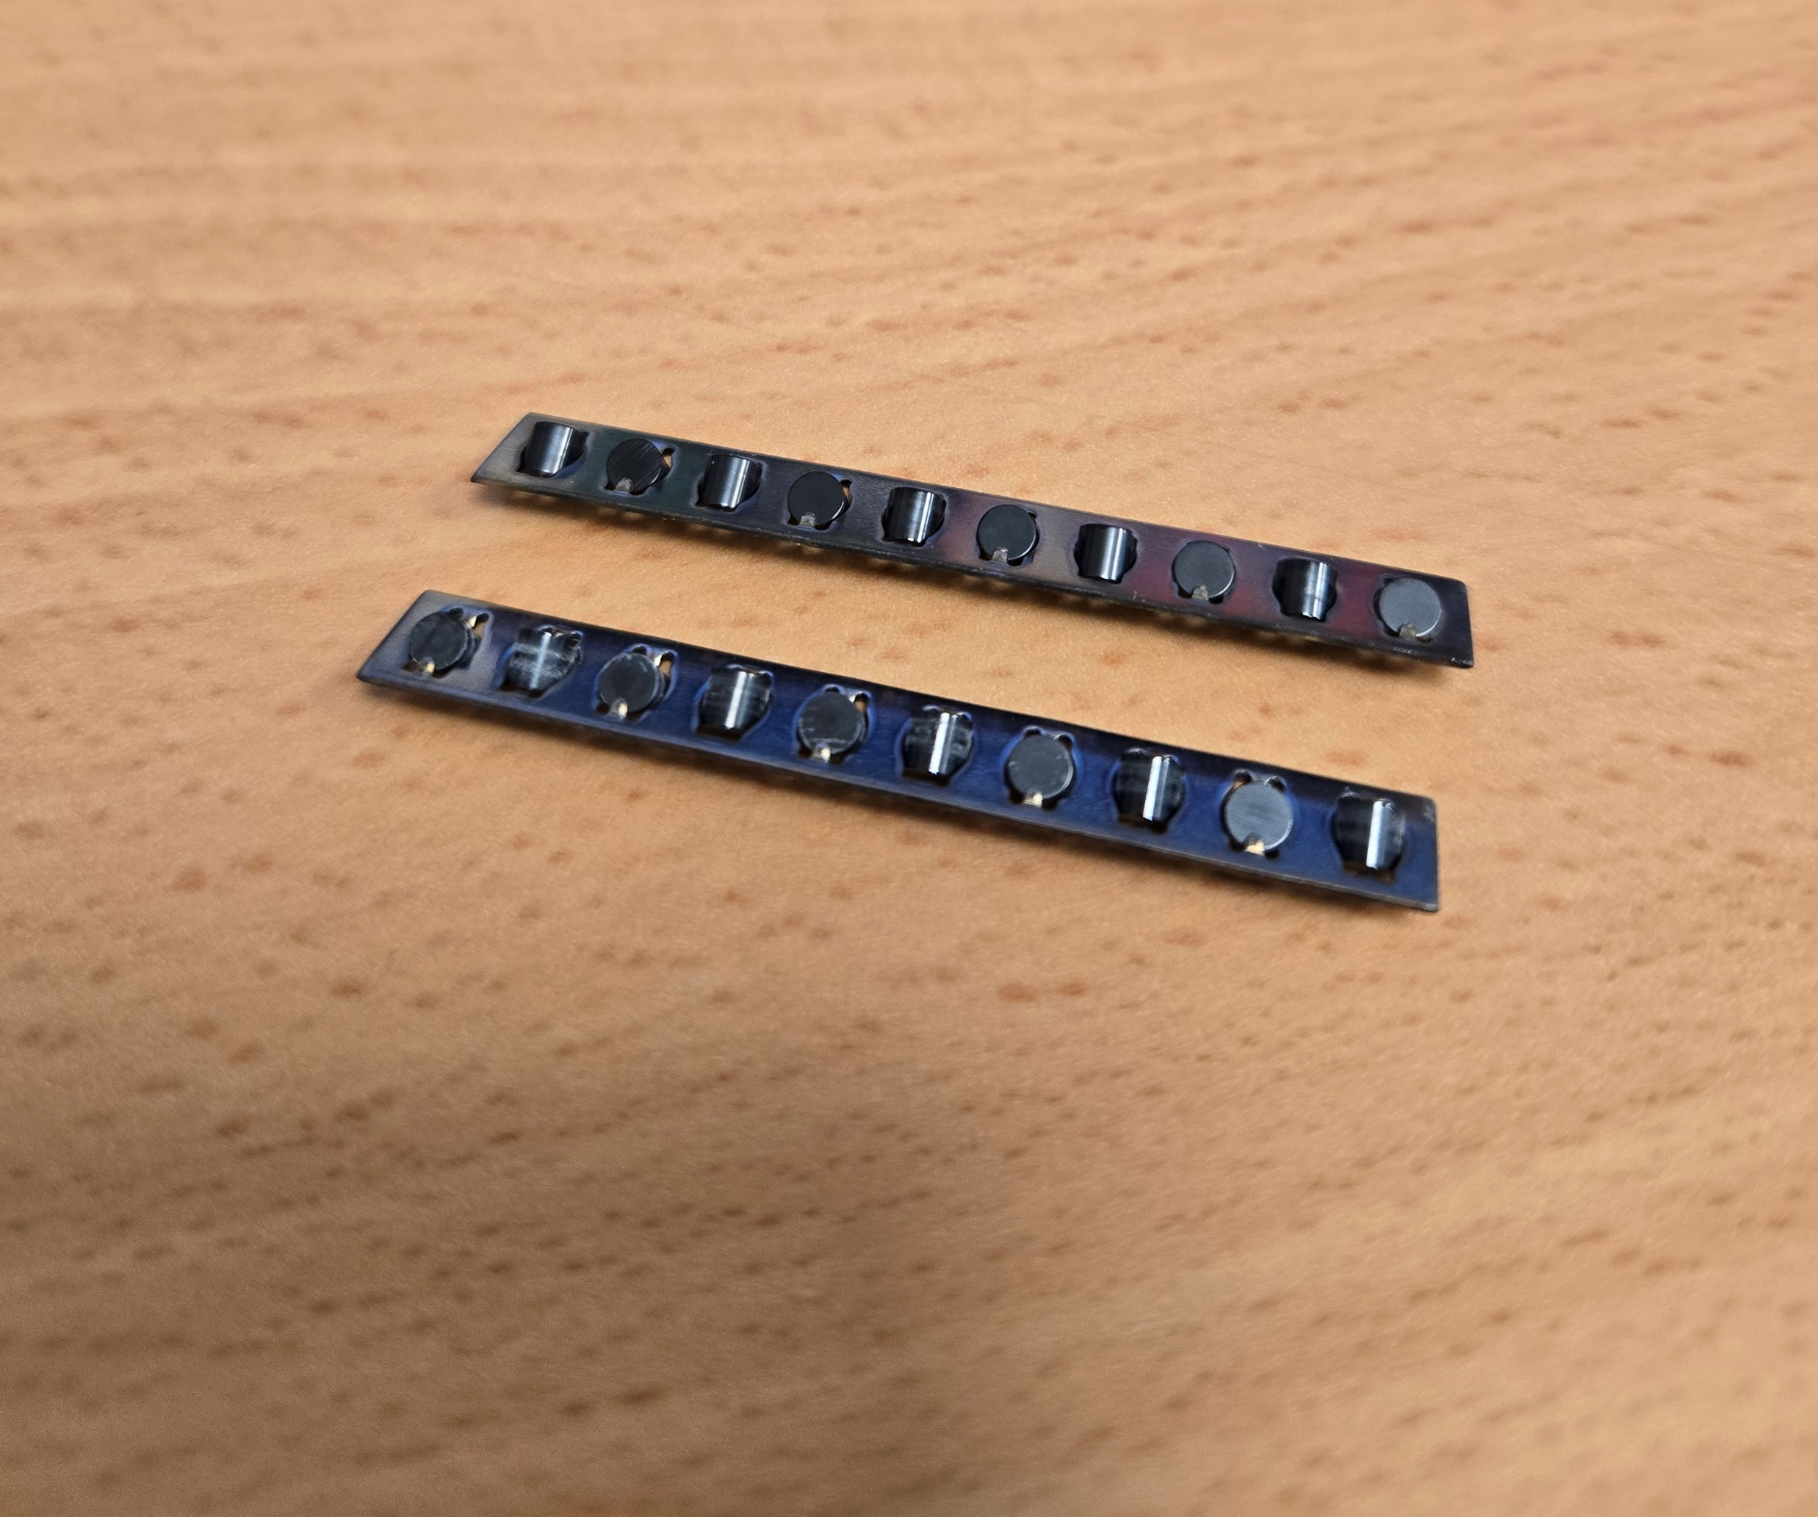
Disassembly of the mock-up with linear bearings
Observations:
  Parts easy to remove
  Rails seem to be not damaged, they got darker especially on the base in contact with the titanium part
  One set of rollers made by Si₃N₄ seems to be slightly wore

Slide 14
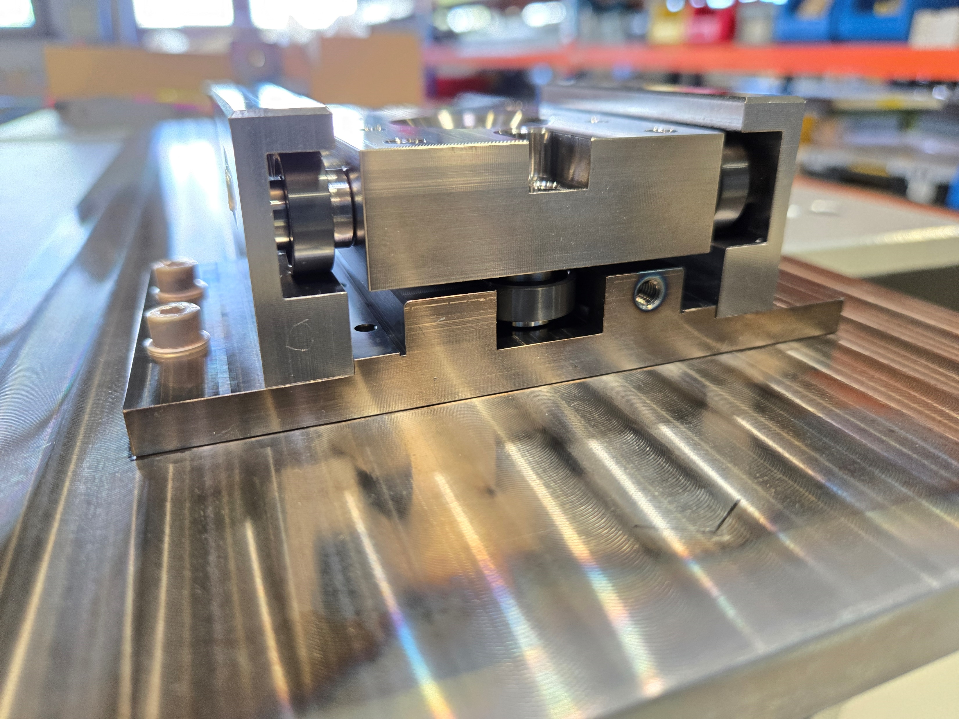
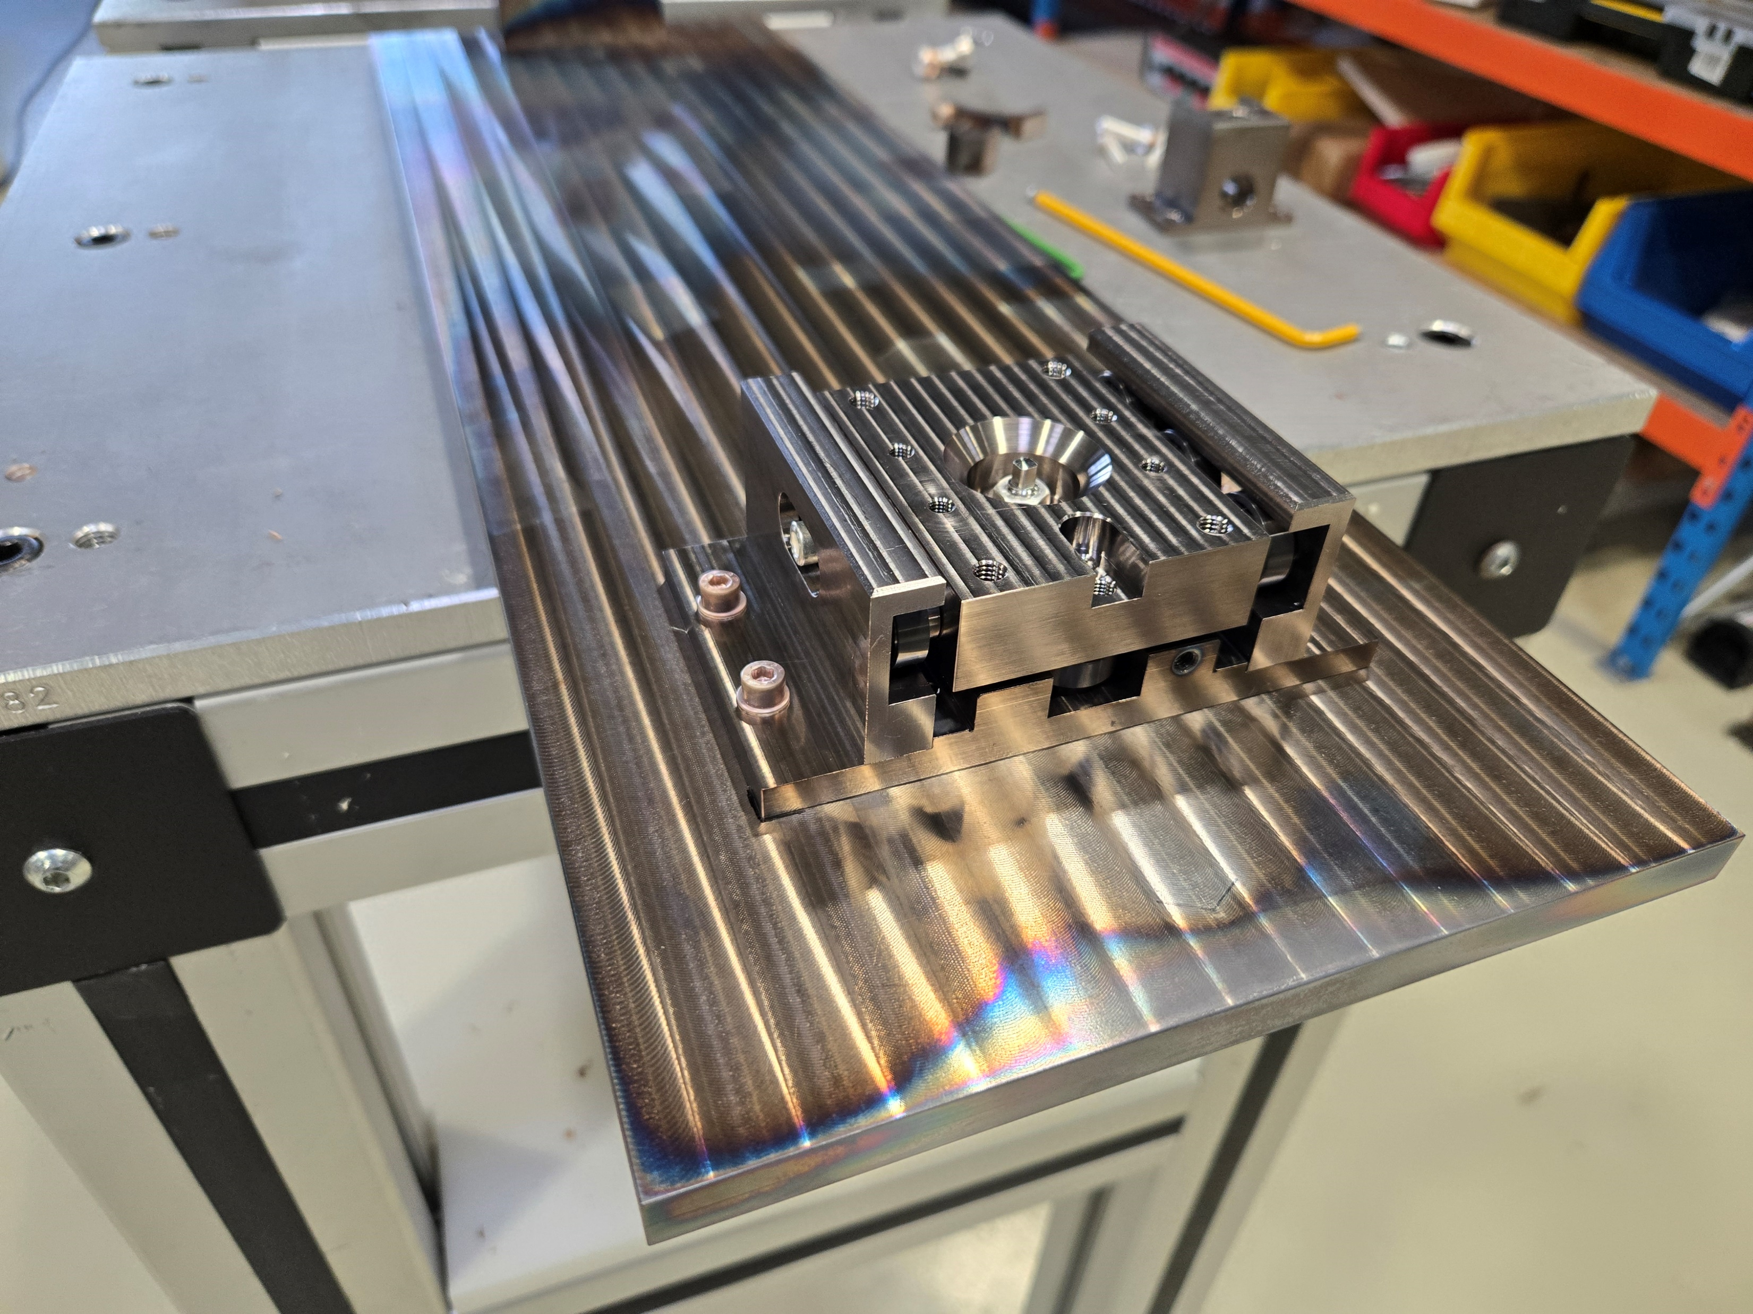
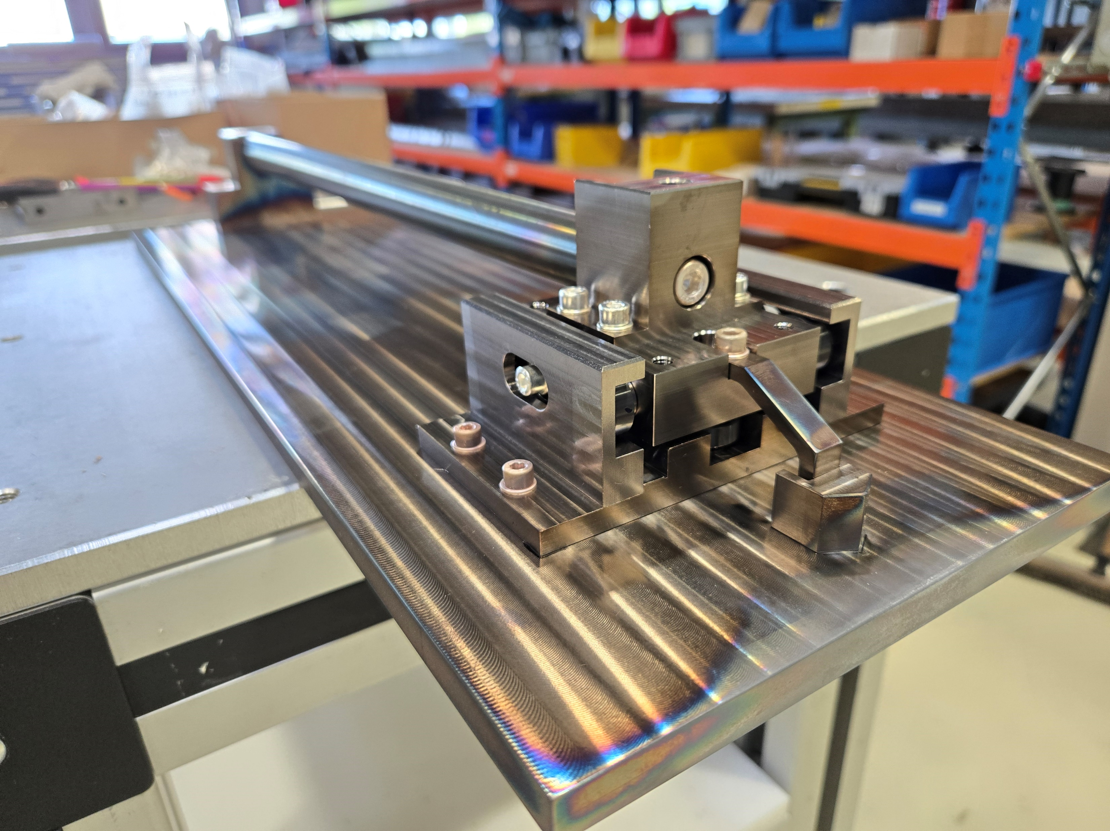
Assembly of the mock-up with circular bearings
Observations:
  Based on what was experienced during the first HT with the linear bearings, all the bearing’s axes are made of Invar (even better for the lower CTE w.r.t. titanium)
  In case this solution will be adopted, we may avoid having the mid bearings for the vertical alignment and a second eccentric bearing for the horizontal alignment is needed
  The alignment via the eccentric axes was done to have a smooth sliding at room temperature and, personally, it was a bit more delicate w.r.t. the other system
    Too much pressure → no sliding at RT
    Not enough pressure → lack of alignment

Slide 15
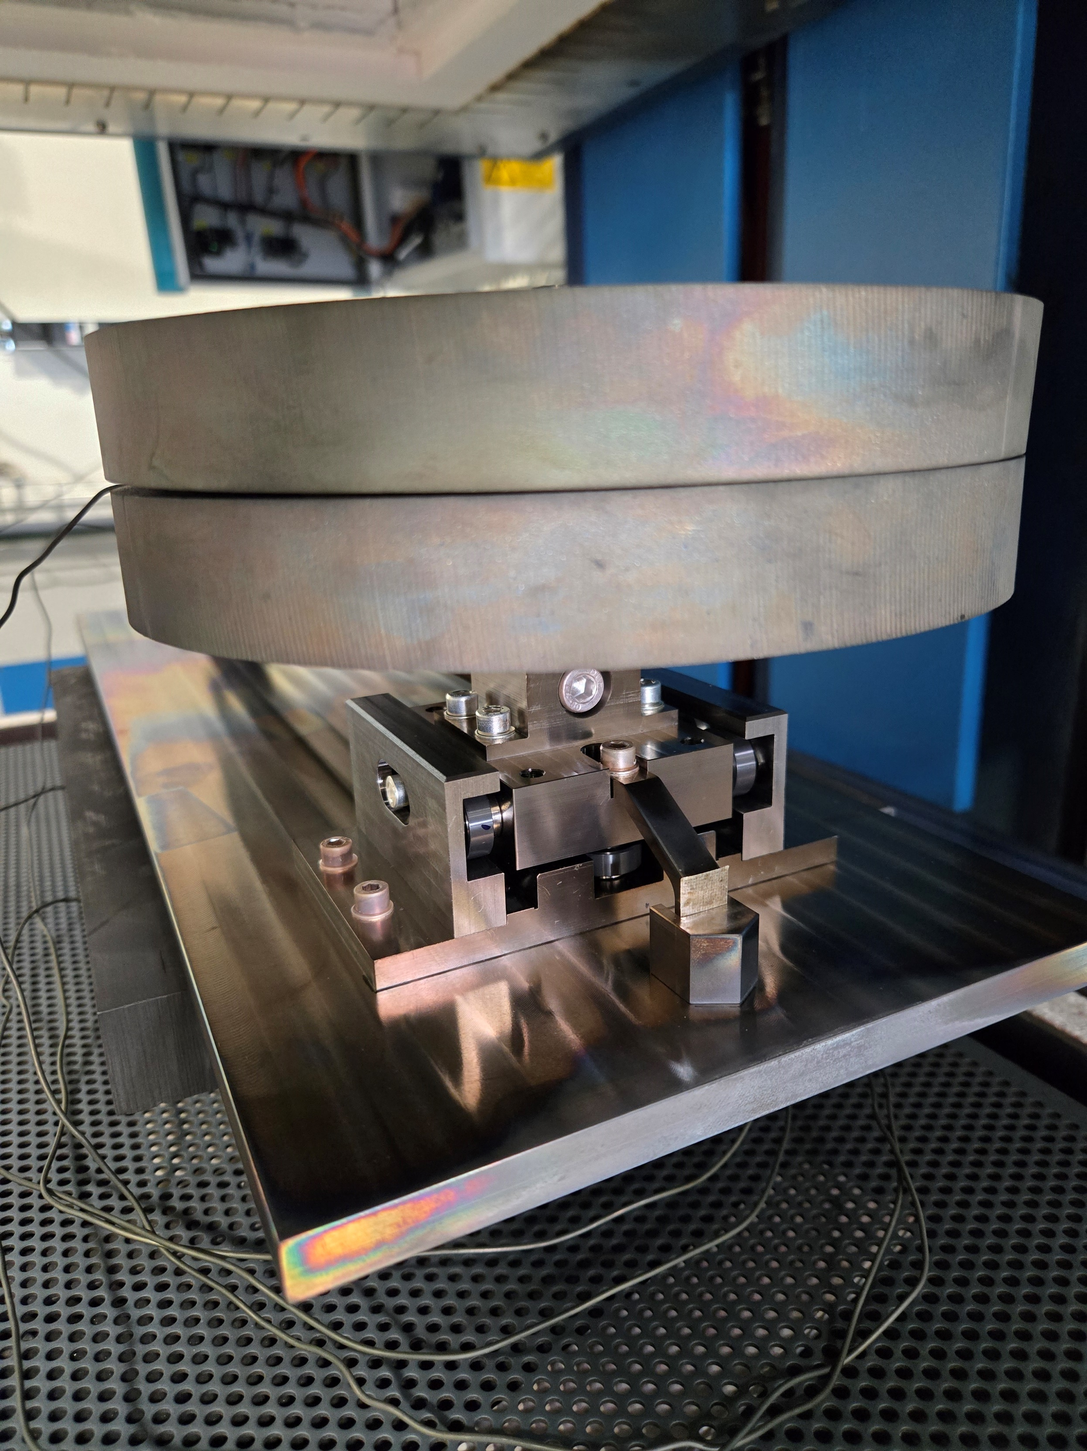
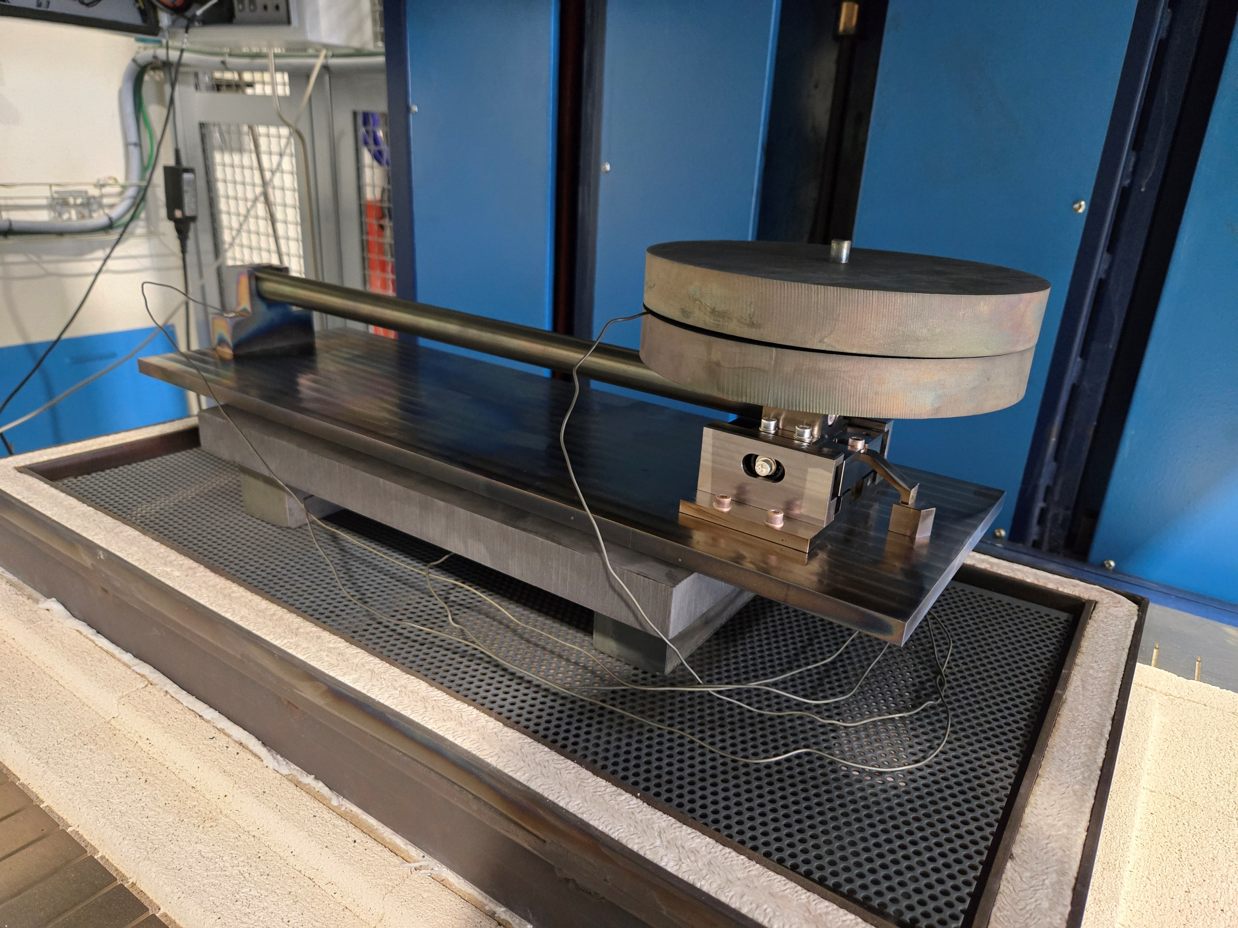
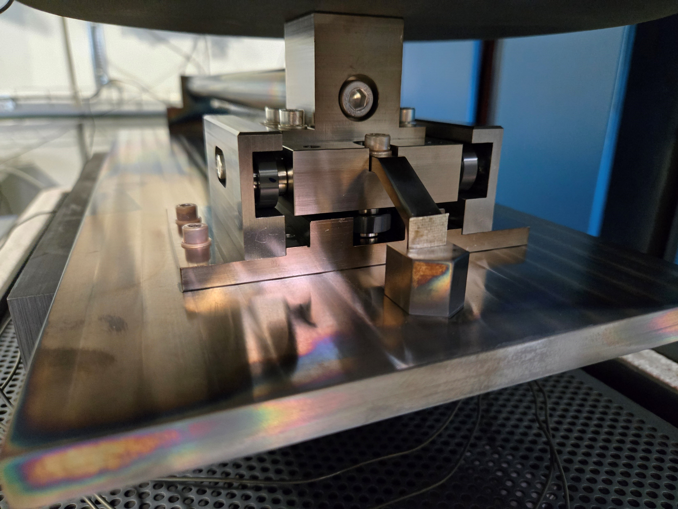
HT of the mock-up with circular bearings
The thermal cycle was launched in B. 927 using the oven Gero 750 on 25/04/2025
  Ramp up from room temperature to 650°C with 50°C/h
  Plateau at 650°C for 10h
  Free cool-down in the oven
  Cycle under Argon atmosphere
Mica layer

Slide 16
Thank you

Slide 17
Spare slides

Slide 18
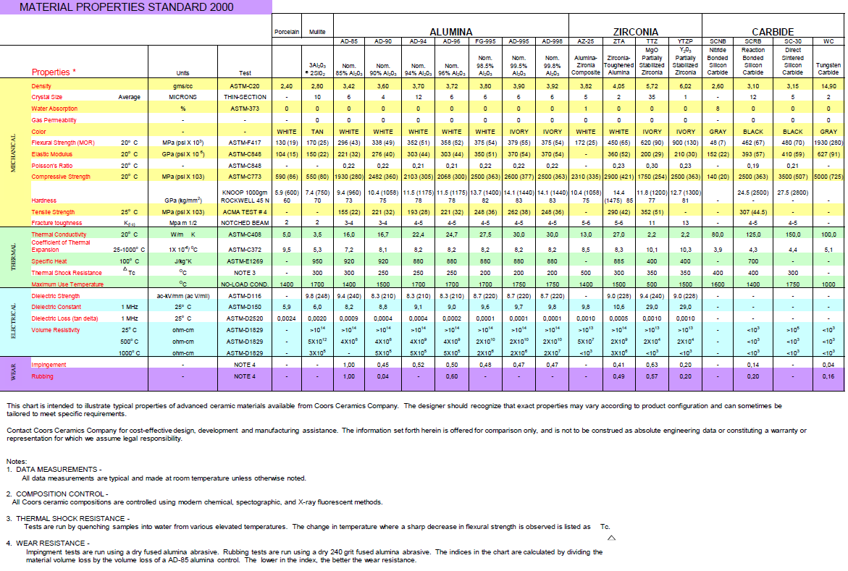
ZrO₂ properties (supplier datasheet)

