Slide 1





What is matRad?
Particle therapy Masterclass
Nermine Muradi,
University of Tetova &
Medical High school Nikola Stein
Slides by:
Nermine Muradi
Aris Mamaras
Viridiana Badillo
Enrique Sánchez
Yiota Foka

Slide 2
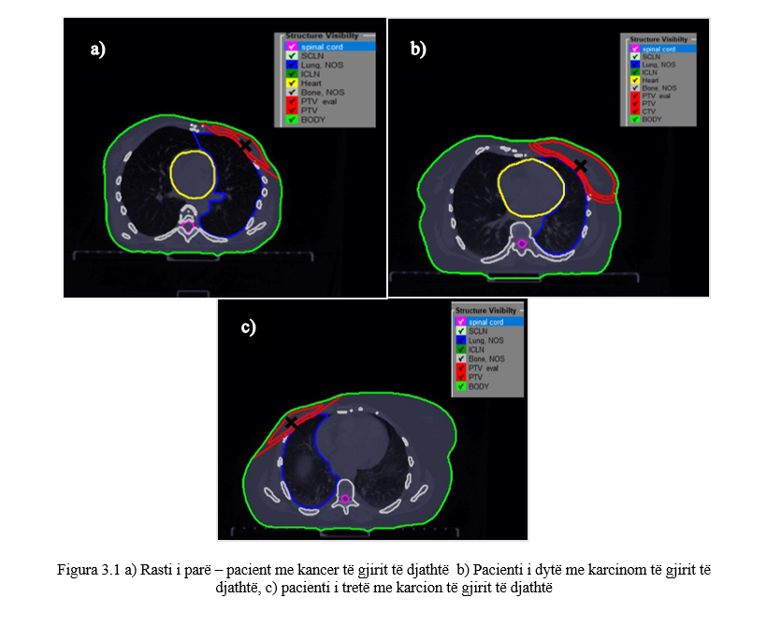
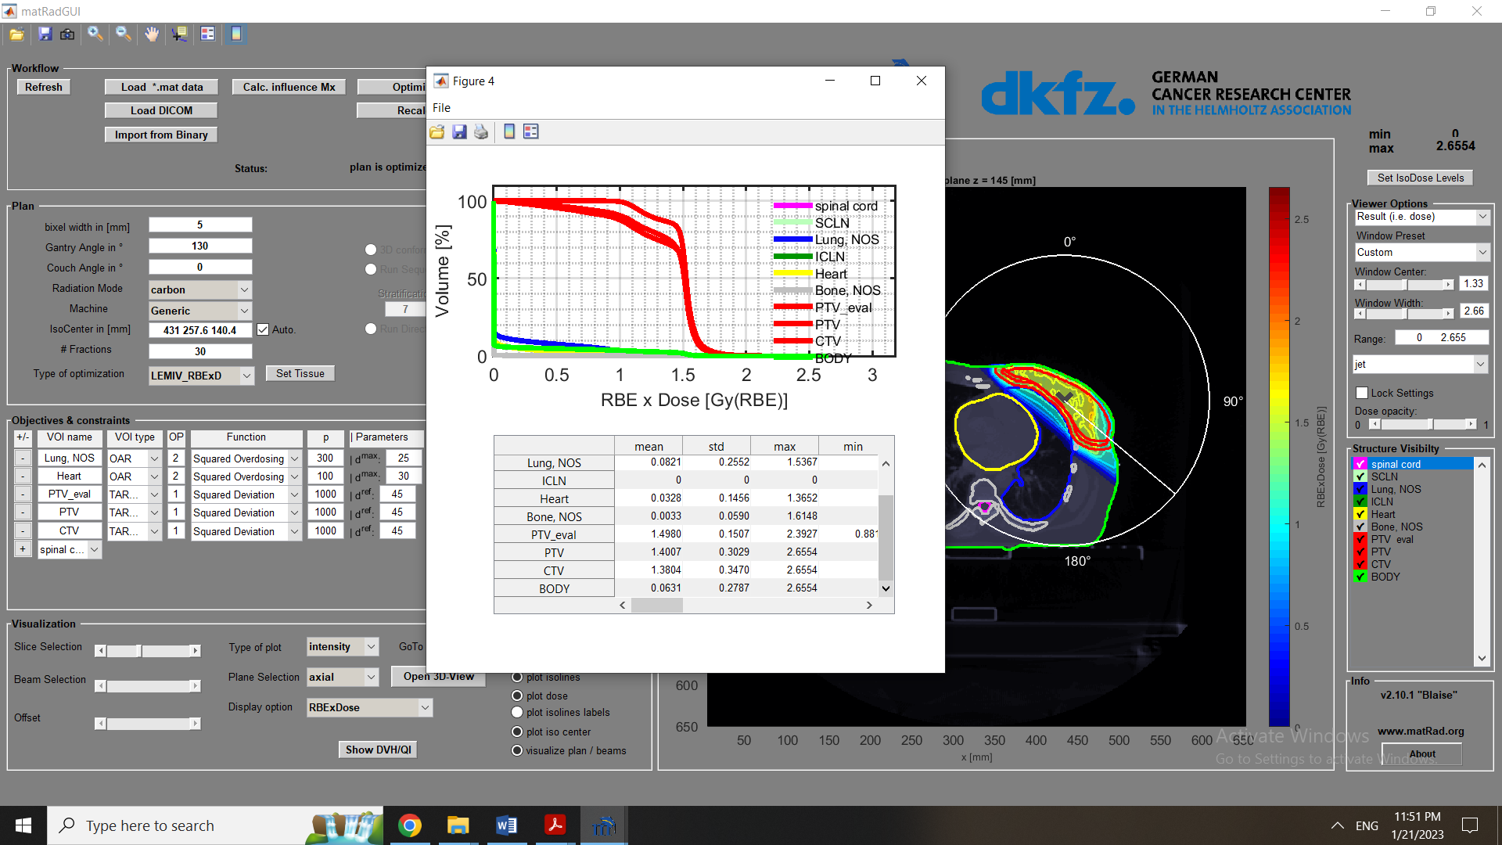


Particle Therapy Masterclass 2021
“Simulations of treatment planning of breast cancer and comparison with real cases”

Slide 3
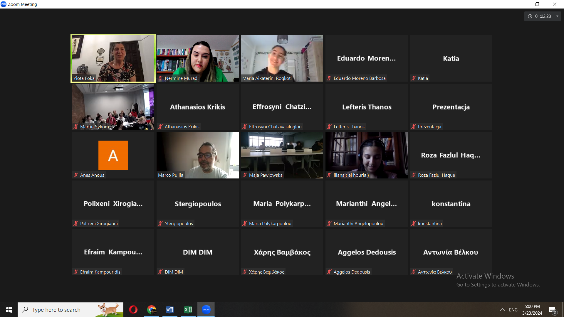
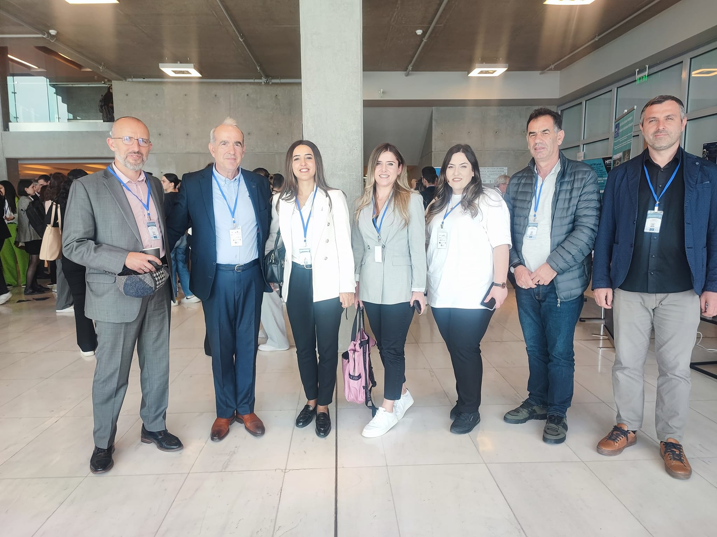
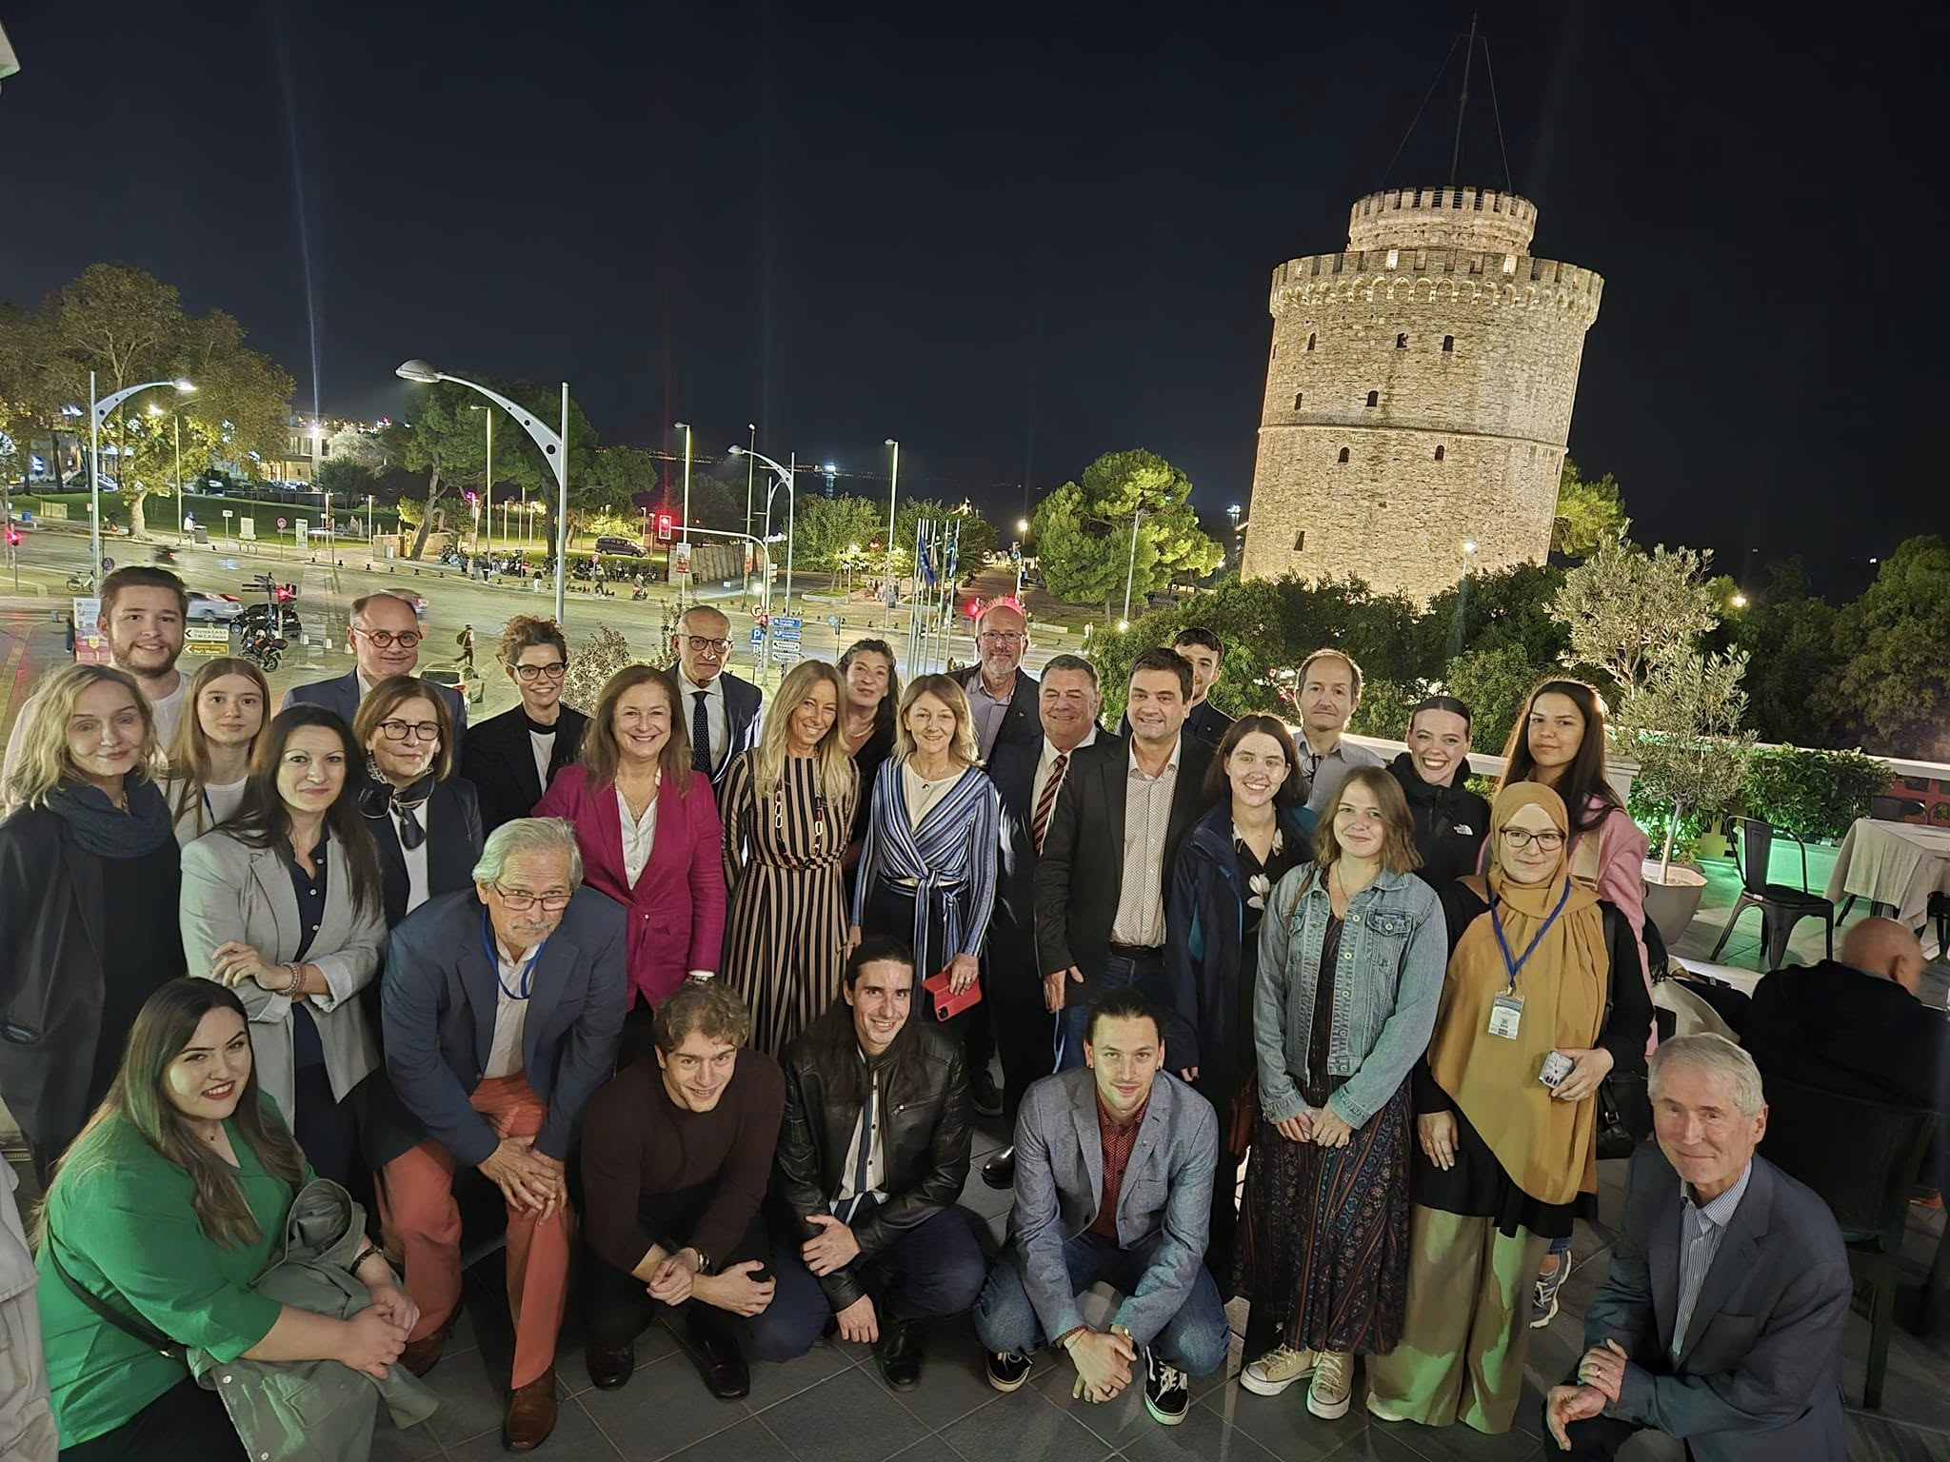
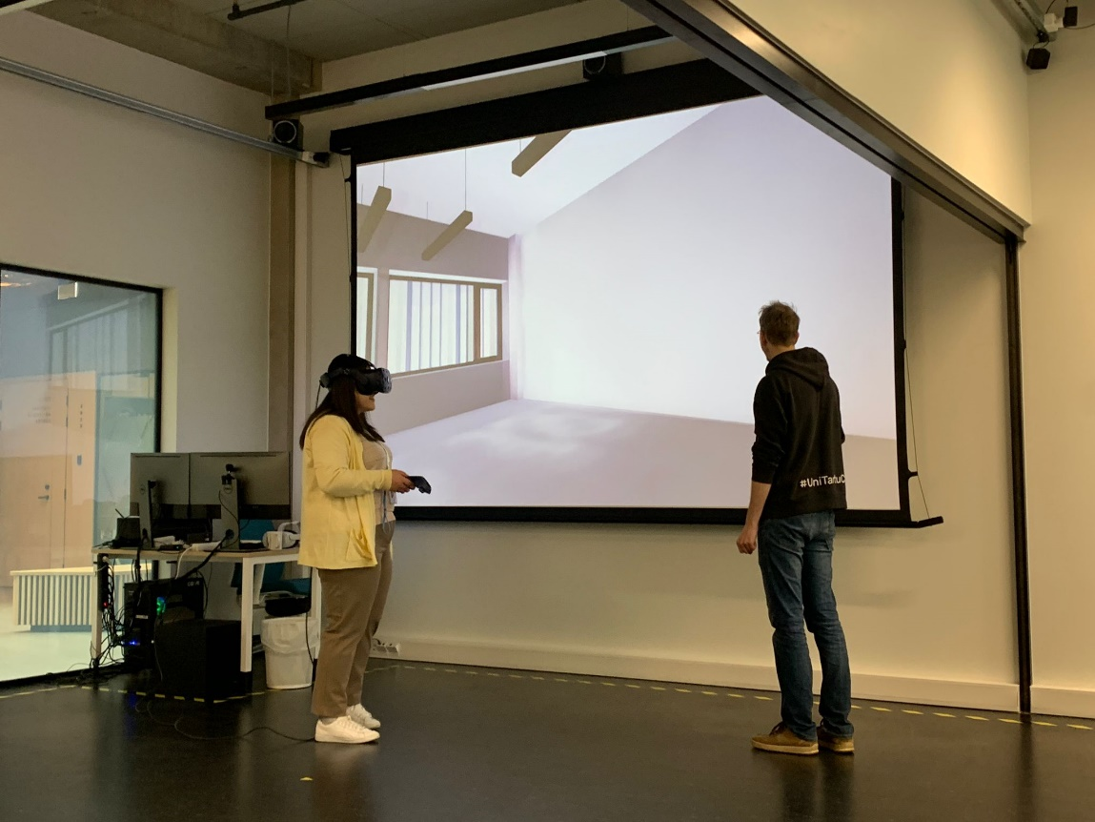
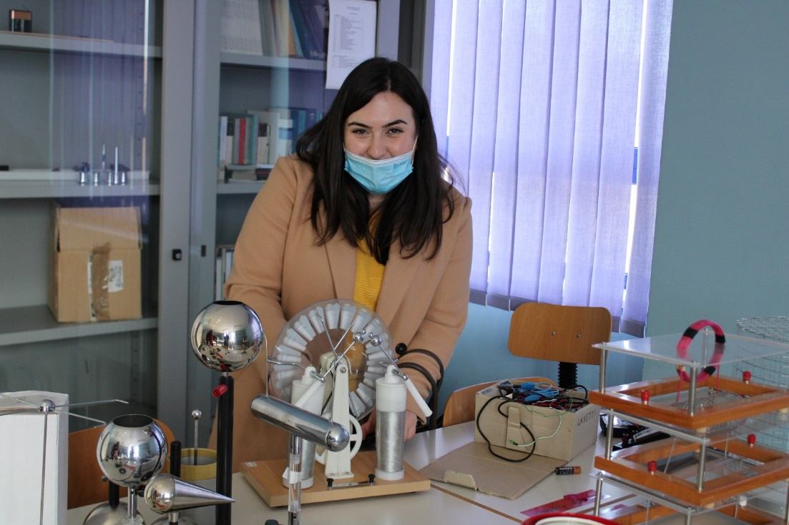

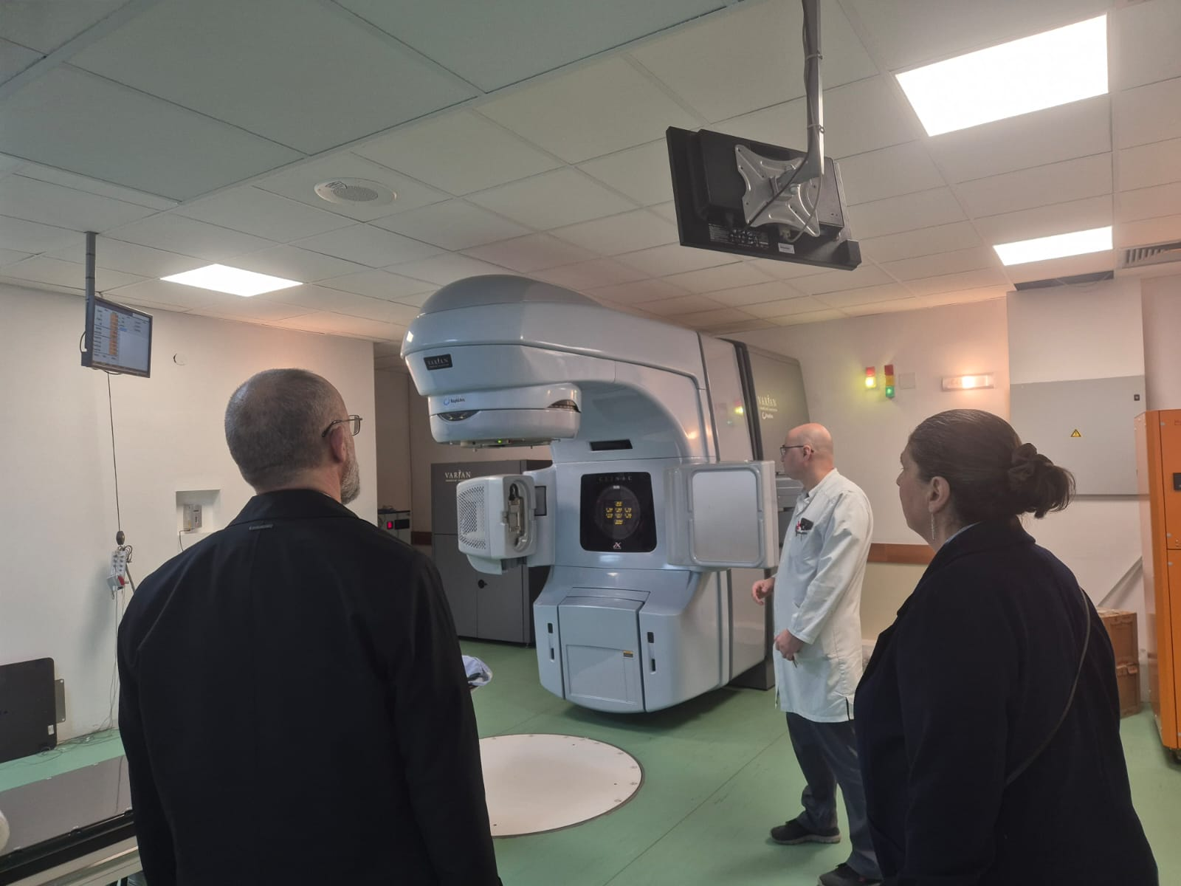
Erasmus+
PTMC
HITRIplus project
Learning never exhaust the mind.

Slide 4








Radiotherapy
Patient fixation
Imaging (esp. CT, but also MRT or PET)
Identification & delineation of tumor volume and organs on 3D image
Treatment Planning
Verification & quality assurance
Patient positioning
Irradiation (several “fractions“)
Adapted from W. Schlegel & A. Mahr: 3D Conformal Radiation Therapy Springer Multimedia DVD & from the presentation of Joao Seco and Niklas Wahl

Slide 5
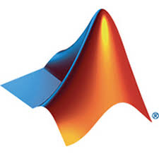


What is MatRad?
matRad is an open source software tool for designing radiation therapy plans with a modulated beam of photons, protons and carbon ions.
Its name derives from the combination of two words:
MatLab + Radiation = MatRad
Developed by scientists at the German Cancer Research Center, DKFZ in Darmstadt.
Implemented for educational and research purposes
Source: http://bit.ly/3sX756v
Source: http://bit.ly/3uXfNDt

Slide 6
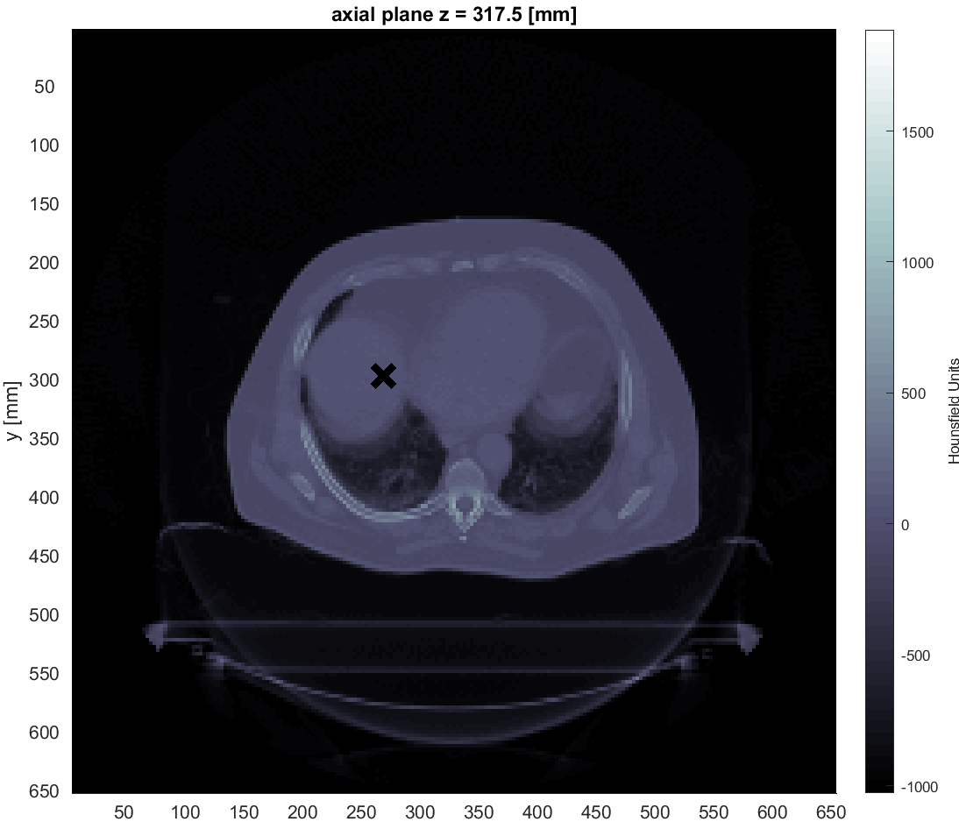
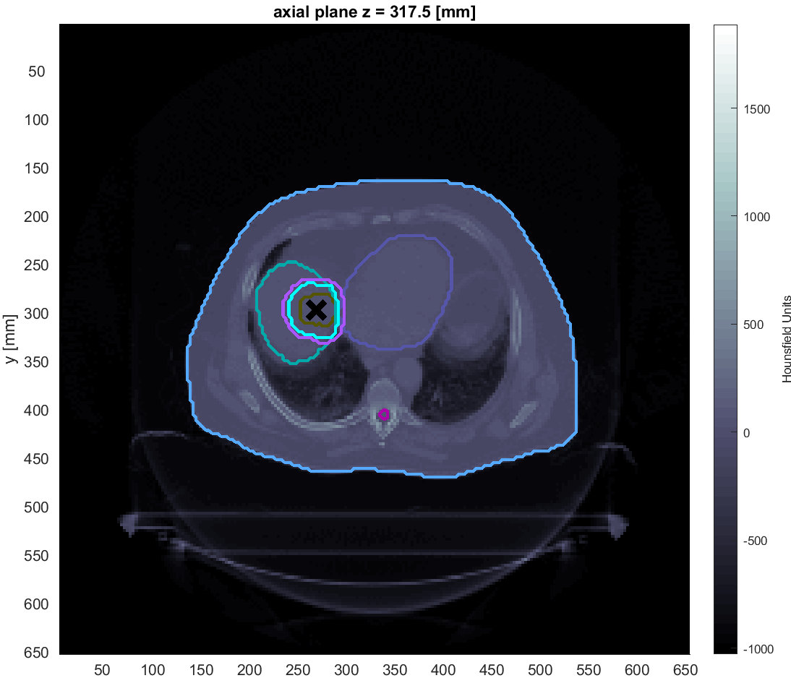
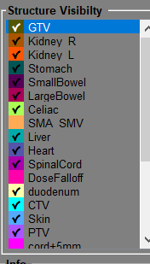
Images

Slide 7
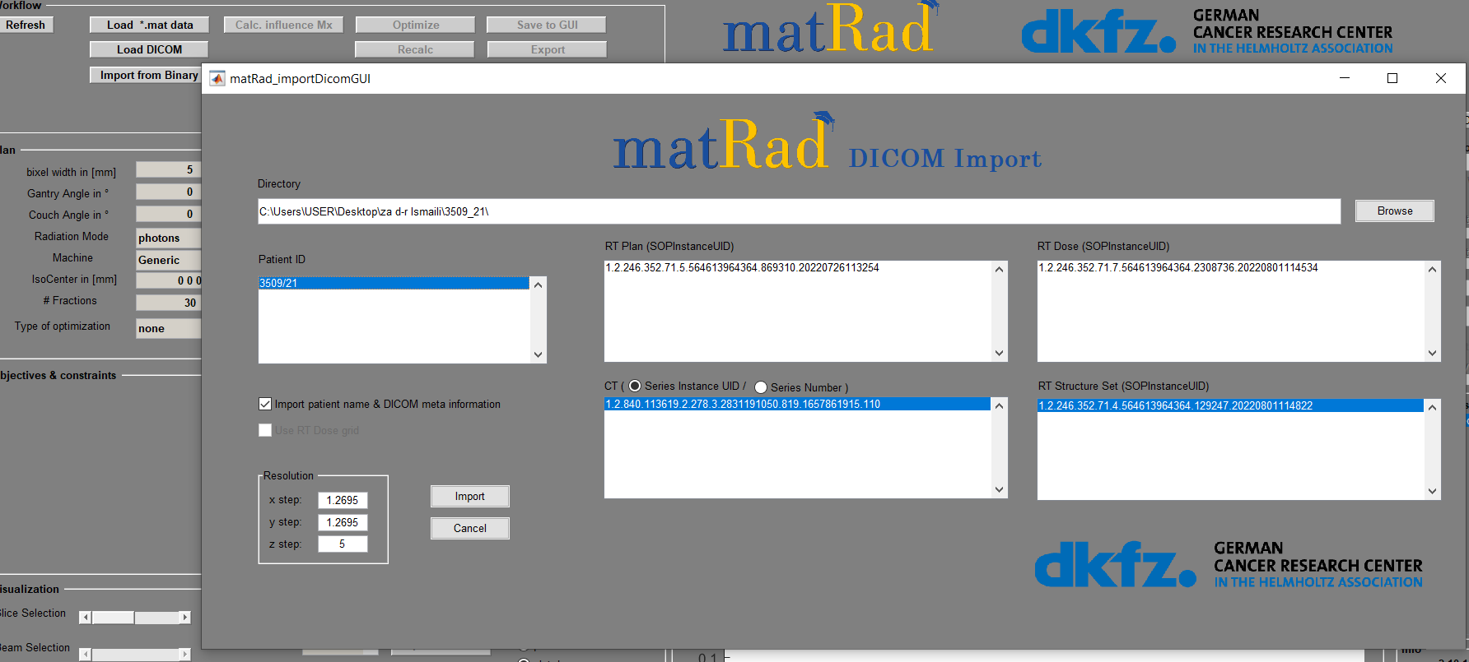
Import of images (CT) , structure set and RT plans

Slide 8
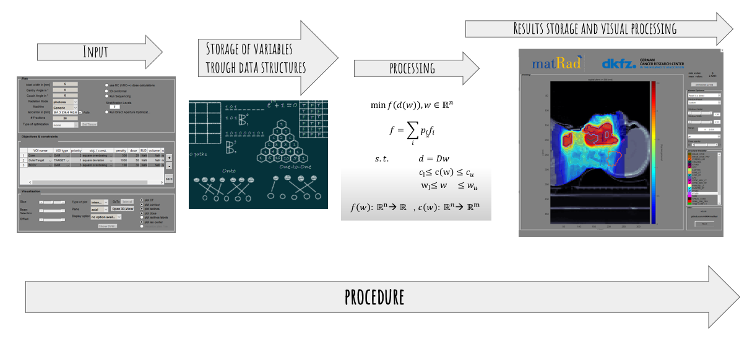
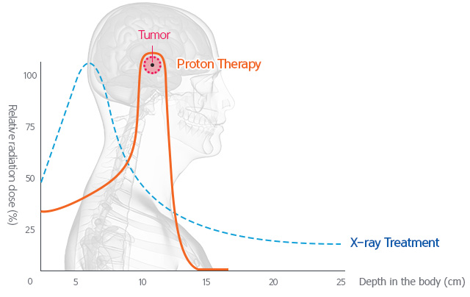
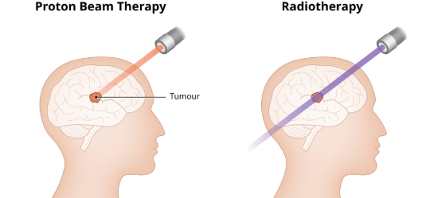
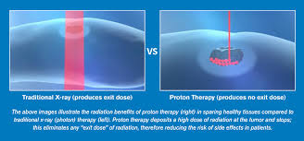
Treatment Planning System
– TPS matRad
Photons: Base data for the photon dose calculation algorithm are obtained from the clinically approved photon dose calculation engine PDC++ and describes the decomposed lateral scattering kernels and depth dose components as detailed in for a 6 MV linear accelerator for multiple source to surface distances (SSDs).
Protons: Analytical calculations according are
used to approximate integrated proton depth dose profiles in water for 114 proton beam energies ranging from 31.72 MeV to 236.1 MeV which correspond to peak positions from 7 mm to 347 mm.
Carbon ions: Integrated carbon ion depth dose profiles
are based on FLUKA Monte Carlo simulations. Monte Carlo simulations were performed in water. In total, 121 carbon ion depth dose profiles linearly spaced from 115.23 MeV to
398.84 MeV depicting peak positions from 32 mm to 294 mm are part of the carbon ion base data file.

Slide 9
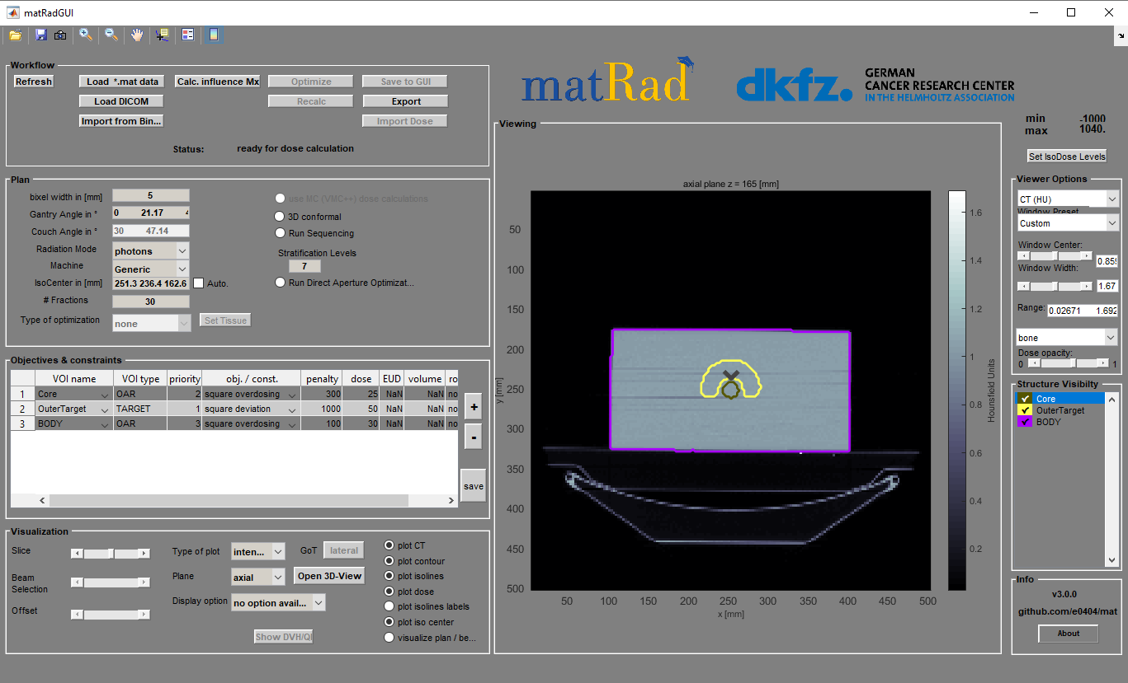
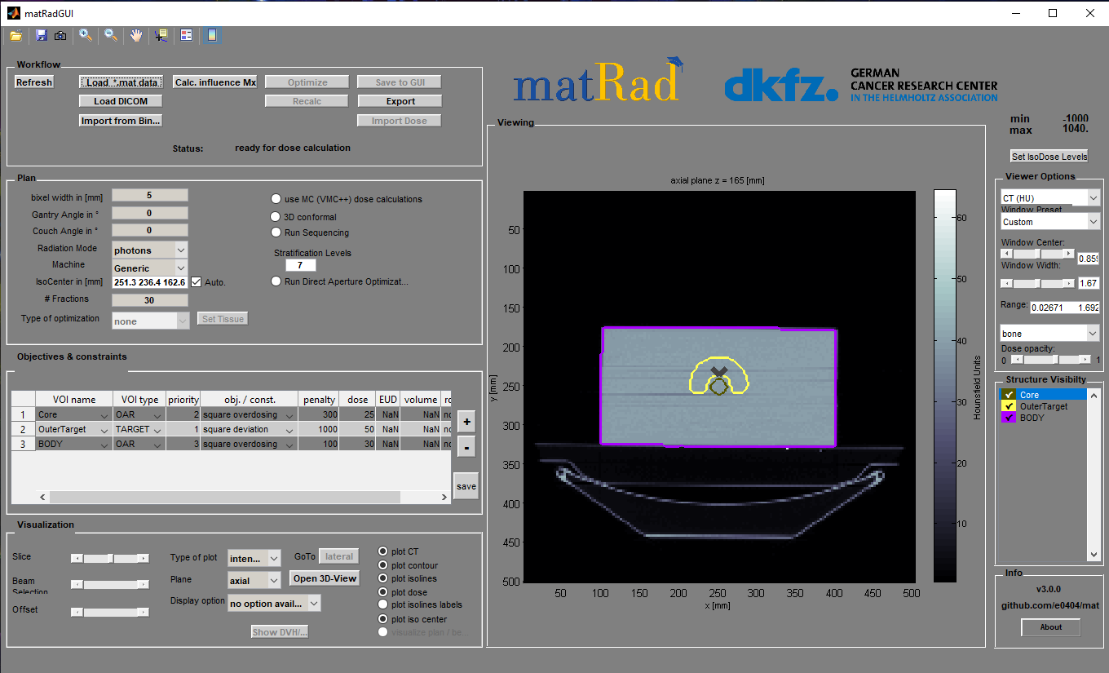
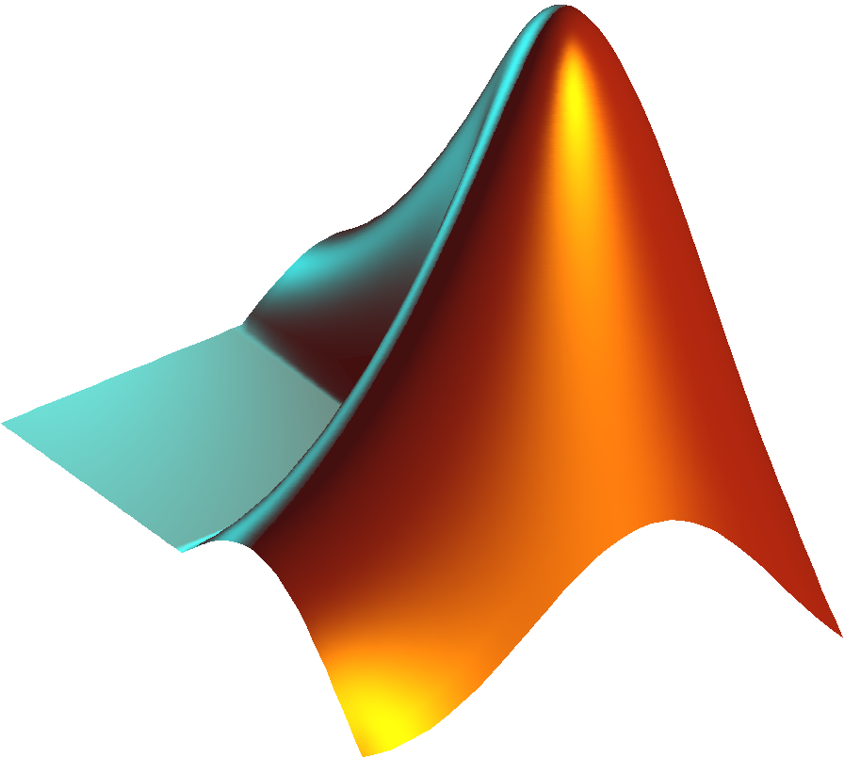

How can you use the software?
For research purposes:
The program gives the possibility to use many parameters, for more realistic simulations.
- Uses the complete Mat Lab code for detailed analysis.
- Requires more computing power.
For educational use:
For educational use, the simplified form of the software on Windows, Linux, Mac is recommended.
Requires less storage space and computing power.
Does not require IDE (integrated development environment) for the use of the software.
⚡⚡⚡
-Computing Power
⚡⚡⚡⚡⚡⚡
+Computing Power

Slide 10
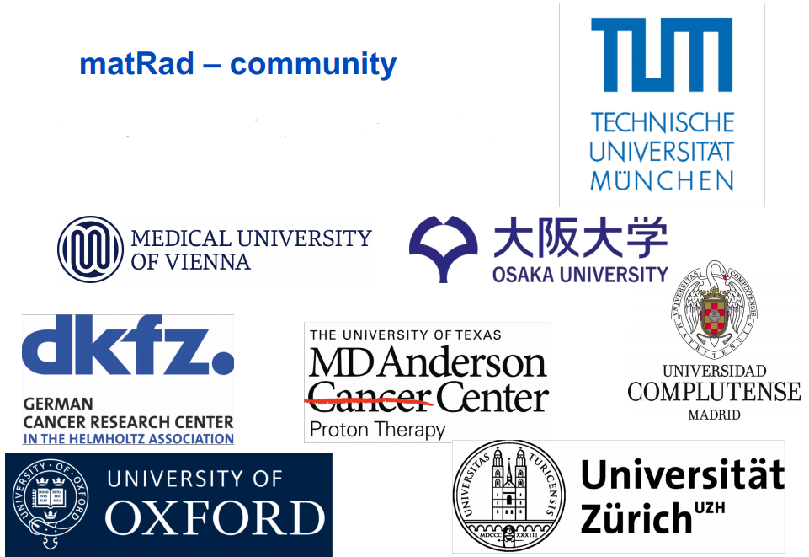
Where is Matrad used today?
+30 INSTITUTES
With thousands of users worldwide.
For more information visit the map at the following link:
Link: https://bit.ly/MatRadUsers

Slide 11
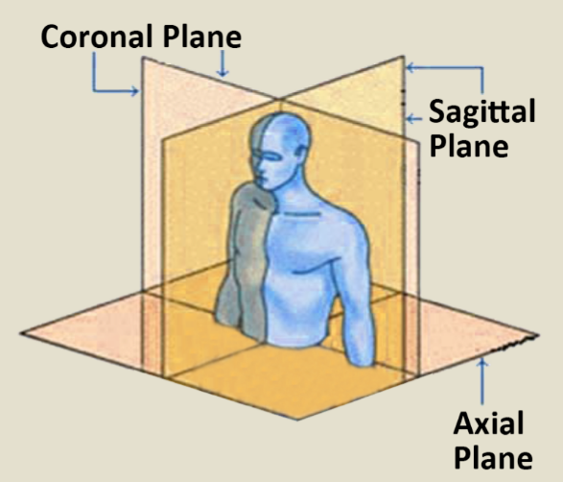
matRad cases for PTMC
The program installation package comes with 6 case studies::
  TG 119 or phantom C
  Liver
  Prostate
  Head & Neck (H&N)
  Box phantom
  Alderson case

Slide 12
How is data processing carried out?

Slide 13
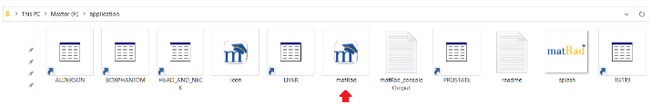
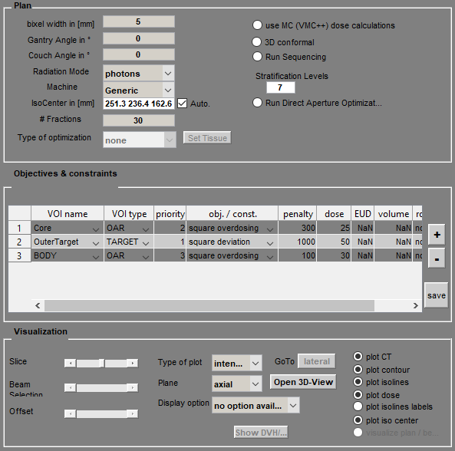
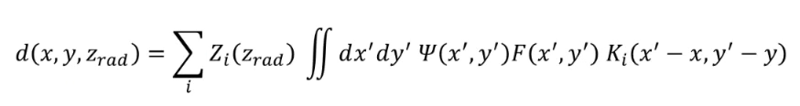
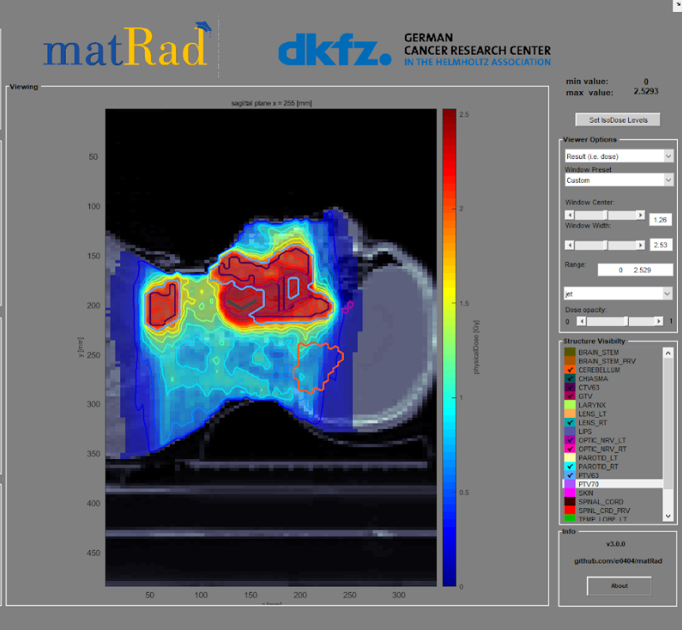
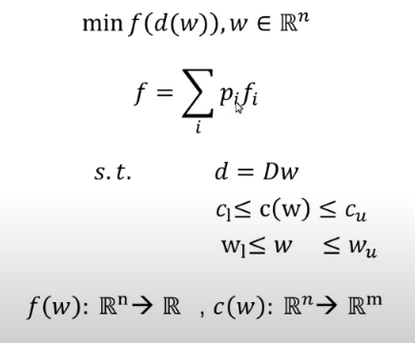
How does MatRad work?
We enter the patient data
Data files:
Test Sample (C-phantom)
Liver
Head n Neck
We set the parameters of the treatment plan (Radiation geometry etc.)
Procedure
We calculate the dose of distribution to the cancerous tissue through algorithms
Visualization of the plan with the reverse planning technique (Inverse planning)
Completion of Simulation

Slide 14

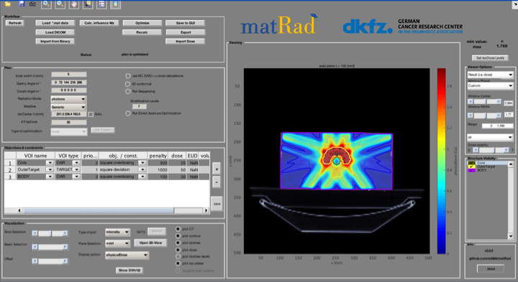
Graphical interface ot matRad
It can be used with
Matlab or with matRad GUI

Slide 15
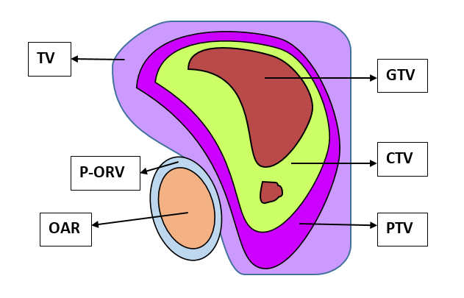
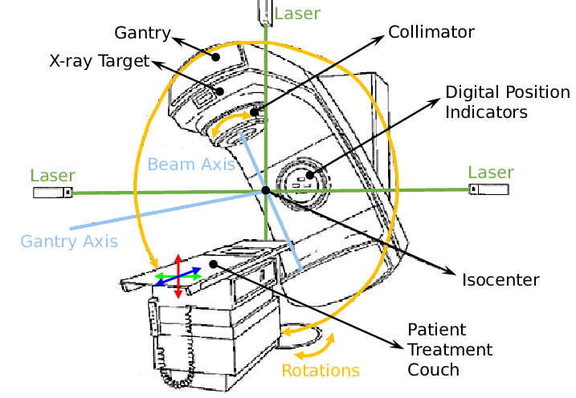
Fundamental definition used by MatRad
GTV or gross tumor volume is defined as the macroscopic target tumor and is the exact location of the malignancy, as evidenced by imaging methods. It may consist of the inital tumor, metastatic lymphadenopathy or other meatastases.
CTV or clinical target volume is defined as the target clinical tumor, where the radio physicist assumes that cancerous tissue is still present. It consist of the tumor that is shown, if there is any, and any tissue with suspected tumor.
CTV = GTV + 1 cm – 2 cm,
PTV or "Planning Target Volume” is defined as the target volume for design. Includes CTV with an internal margin IM and an additional margin for placement which refers to patient movement and placement error.
OAR or “Organs At Risk", which are the organs that are more sensitive compared to healthy tissue. Organs in danger need adequate protection. Once the endangered organs are identifies an extra safety margin should be added to include their movement.
Gray (Gy) is a unit of measurement of energy absorption derived from ionizing radiation. Is equal to the energy absorption of one joule of matter with a mass of one kilogram 1Joule/kg

Slide 16
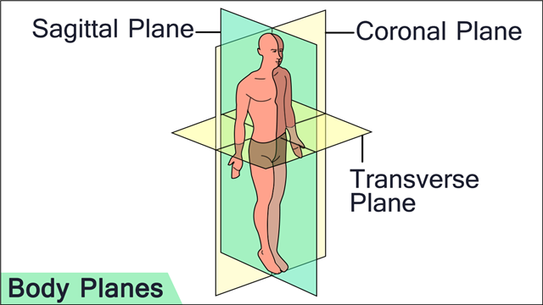
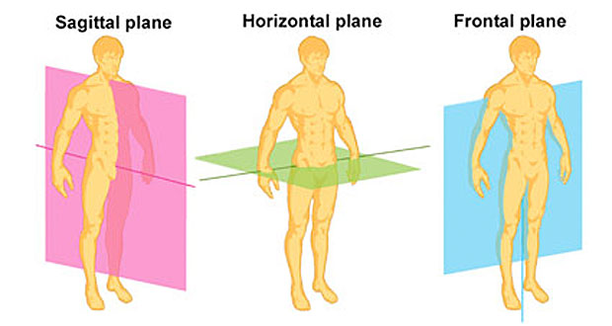
Planes
Source: https://bit.ly/3cZqM72
Source: https://bit.ly/3tY42v1
Sagittal plane: It separates the body equally in left and right parts.
Coronal plane: It separates the body into two parts, anterior and posterior.
Transverse/Axial/Horizontal plane: It separates the body at the upper and bottom parts.

Slide 17
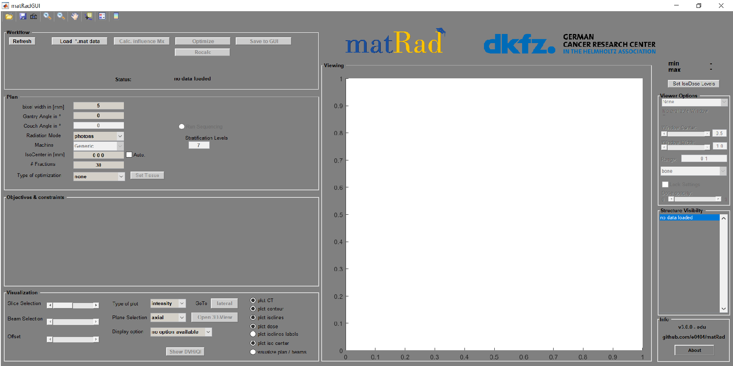
Starting the program

Slide 18
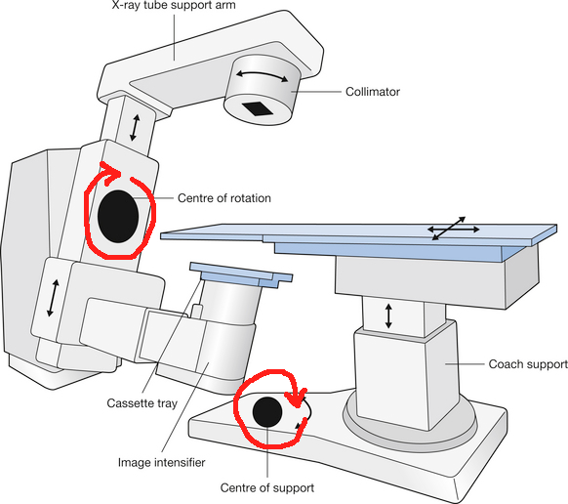
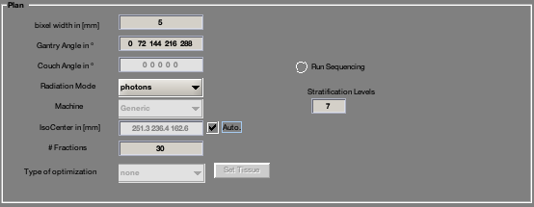
Panel: Plan
Bixel width: square size.
Gantry and couch angles: Set the angle values ​​for the Gantry and the couch (patient's bed). If 5 angles are used for the Gantry, then we will have 5 angles for the bed as well. These angles have values ​​from 0º to 359º.
Radiation mode: what particle will be used.
Isocenter: Always verify that “automatic isocenter” is active. It is the center where the radiation beam passes.
Fractions: Number of fractions = number of “slices” or slices that will be used to visualize 3D graphics.
Run sequencing: used to collimate the beam (in our case it is not active)

Slide 19
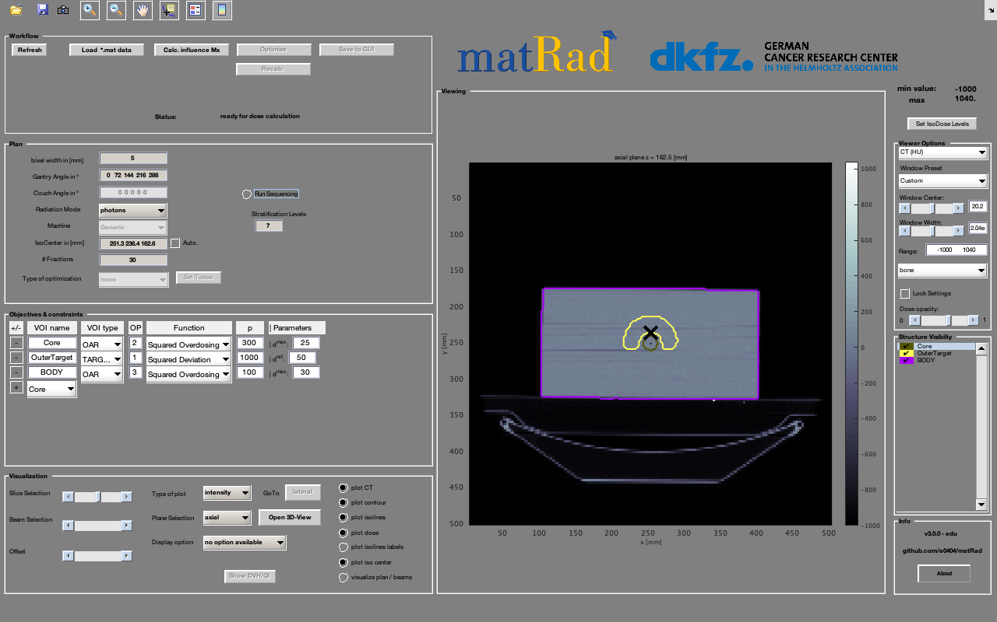
Isocenter

Slide 20
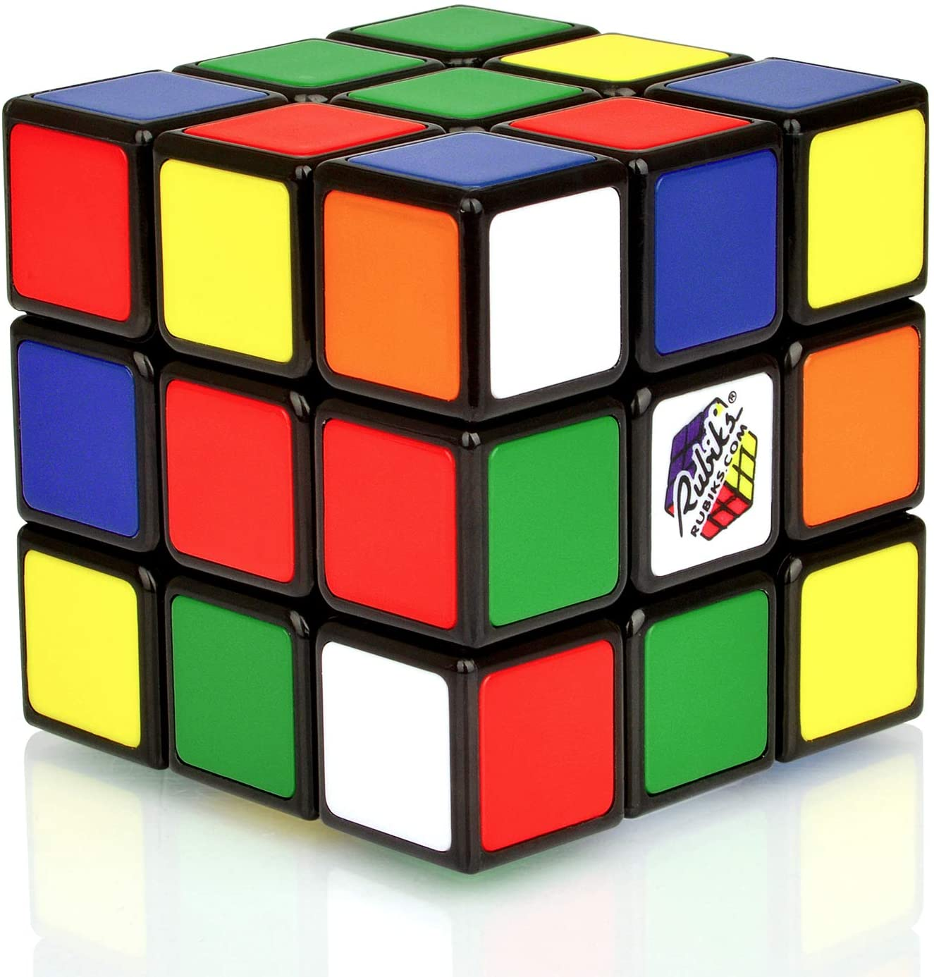
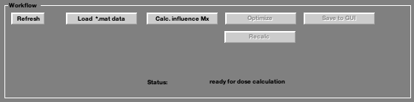
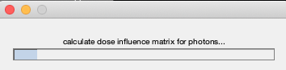
Panel: Workflow
Load > This PC> WIN (C)> program files>matrad>application
Load > My computer> (LOCAL DISK c)>program files>matrad>application

Slide 21
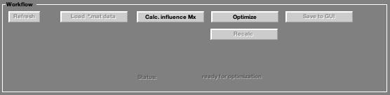
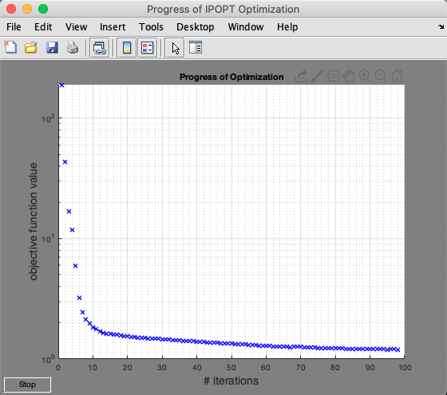
Panel: Workflow
Here the program will look for the minimum
radiation flux per bixel.

Slide 22
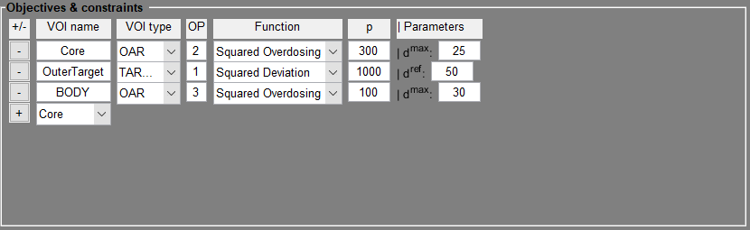
Workflow – Exponential distribution
The optimizer optimizes a non-linear constrained optimization problem with an interior-point algorithm. The objective function and constraint functions are built from the specific objectives one can set in the table.
Objectives and constraints include the organs of interest (e.g target), as well as the organs at risk (e.g body, core etc.) that are about to be irradiated and also, we want to avoid obtaining more dose.

Slide 23
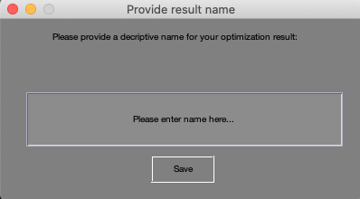
Workflow: Save to GUI
This command save the set-up and requires to name it..
This step is important so the DVH can be shown.

Slide 24
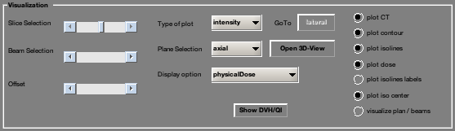
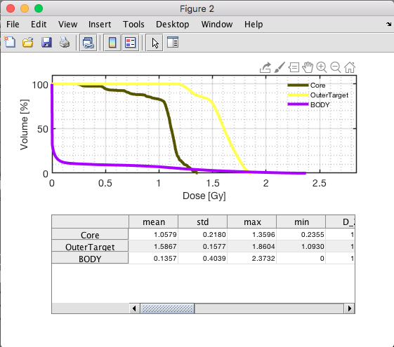
Visualization
Show DVH/QI: shows the volume-dose histogram.

Slide 25
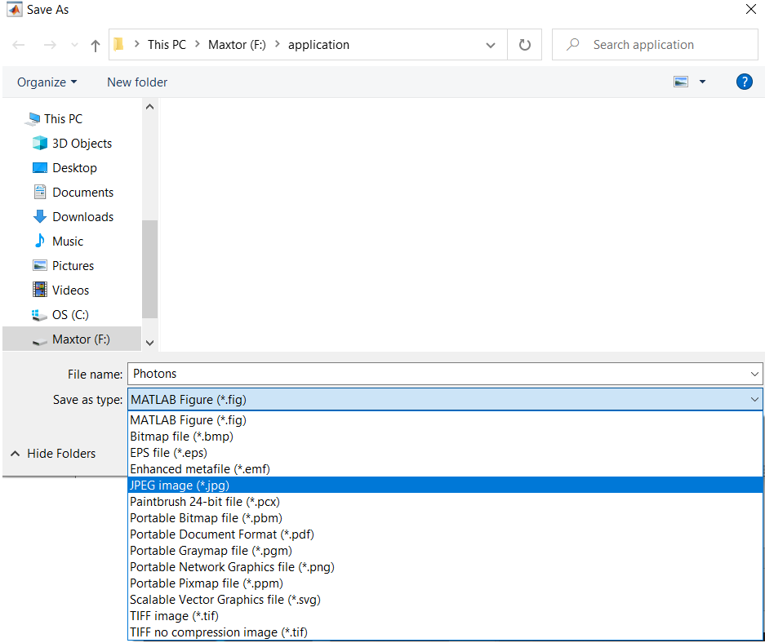
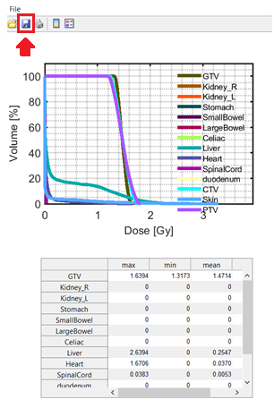
DVH for each case of study

Slide 26
Summary of the processes
Choose the plan settings
*
Choose a study case
Repeat every time you change a setting

Slide 27
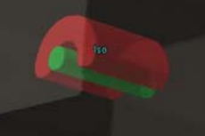
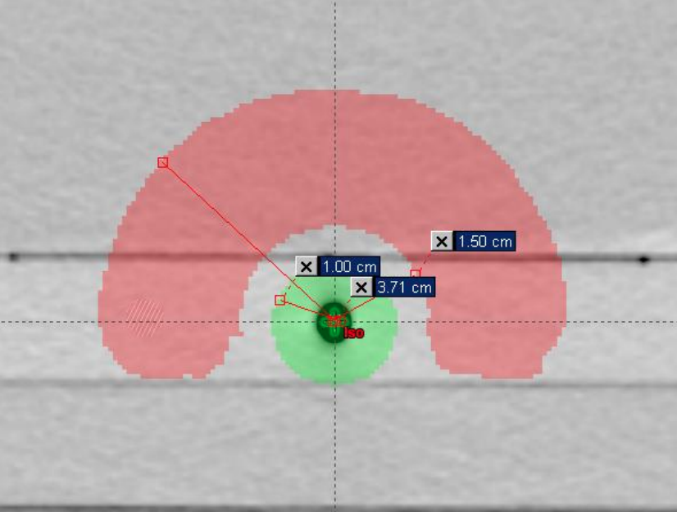
TG119 Phantom case
Phantom TG119 or phantom C used by professionals to verify that equipment is functioning properly. They have standard shape and dimensions.
The purpose of use is to irradiate the “C” shaped area and avoid the central area
Irradiation part
Avoid the center

Slide 28
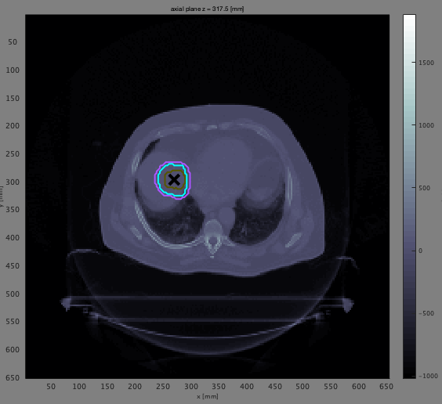


Liver case
Axial view
Sagittal view
Coronal view

Slide 29



Prostate case
Axial view
Sagittal view
Coronal view

Slide 30



Head & Neck case
Axial view
Sagittal view
Coronal view

