Slide 1
1
General Information
follow up FCC Week 2025, IPAC’25, STCF review, and fCC retreat
Frank Zimmermann
208th FCC-ee Accelerator Design Meeting
19 June 2025

Slide 2
minutes from previous meeting – thanks Peter Kicsiny !
regular reports from other FCC working groups
filling patterns with a new larger number of bunches
(How) can we generate these in the injector ?
stray field for CLD and other detectors; shield might change field in the detector
gravity orientation needs to be taken into account when the machine is tilted

Slide 3
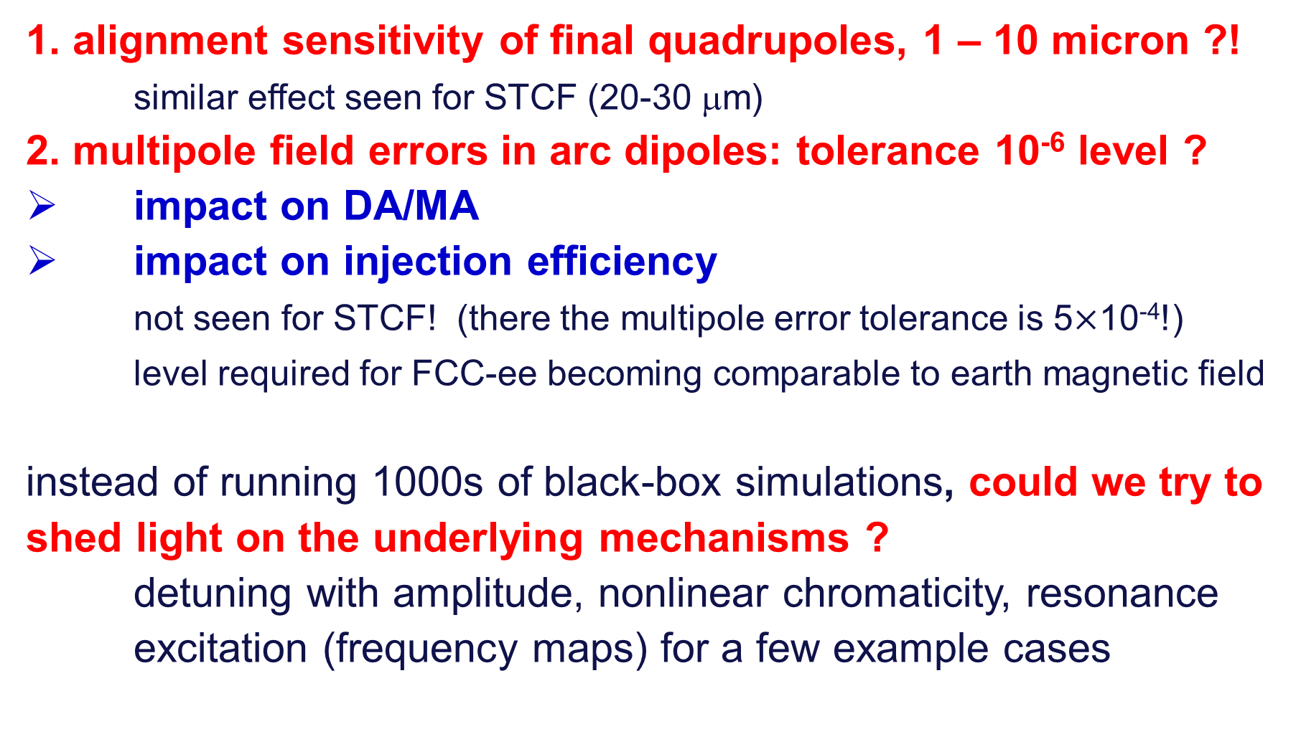
FCC Week 2025 and STCF review
1. alignment sensitivity of final quadrupoles, 1 – 10 micron ?!
similar effect seen for STCF (20-30 μm)
2. multipole field errors in arc dipoles: tolerance 10⁻⁶ level ?
impact on DA/MA
impact on injection efficiency
not seen for STCF! (there the multipole error tolerance is 5$×$10⁻⁴!)
level required for FCC-ee becoming comparable to earth magnetic field
instead of running 1000s of black-box simulations, could we try to shed light on the underlying mechanisms ?
detuning with amplitude, nonlinear chromaticity, resonance excitation (frequency maps) for a few example cases

Slide 4
STCF review
STCF DA studies include kinematic terms and nonlinear magnet fringe fields
fringe fields make a large impact (while multipole errors at 1e-4 level do not)
We need to check these effects for FCC-ee
best would be inclusion in Xsuite
references
fringe fields: E. Forest, J. Milutinovic, NIM A 269 (1988) 474 [K. Oide]
kinematic terms: K. Ohmi, H. Koiso, IPAC’10 [K. Ohmi]

Slide 5
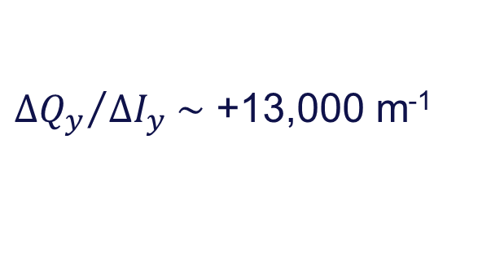
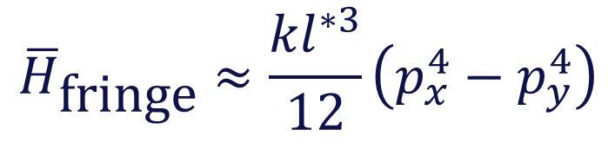
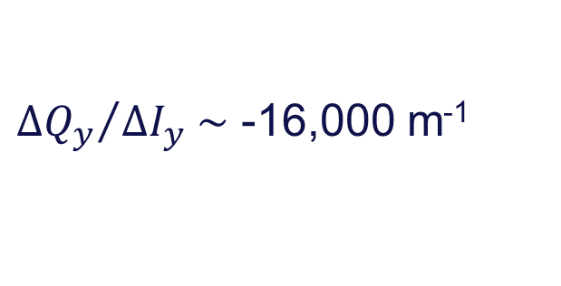
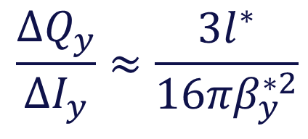
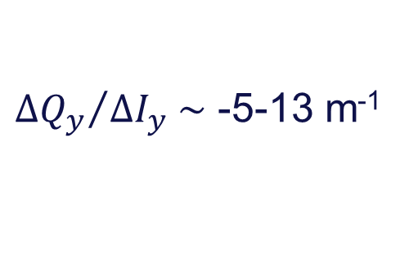
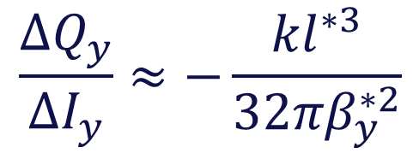
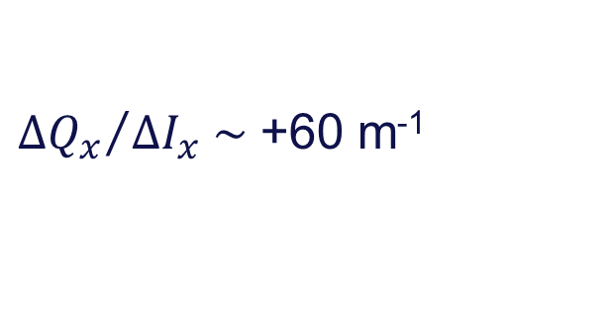
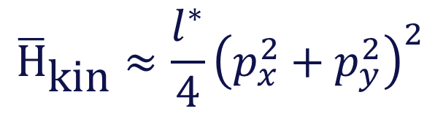
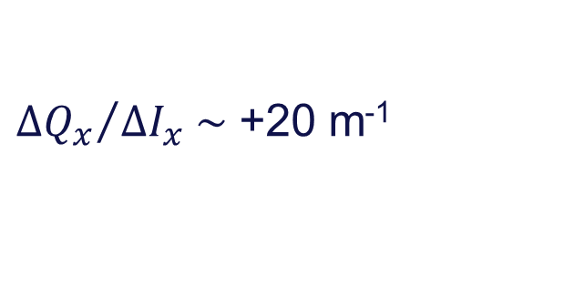
nonlinear design Hamiltonian and tune shift w. amplitude
kinematic term for final drift
→ e.g.
$${\overline{\text{H}}}_{\text{kin}}≈\frac{l^{∗}}{4}{\left(p_{x}^{2}+p_{y}^{2}\right)}^{2}$$
$$\frac{∆Q_{y}}{∆I_{y}}≈\frac{{3l}^{∗}}{16πβ_{y}^{∗2}}$$
FCC-ee: l*~2.2 m, k~0.15 m⁻², β_{y}*~1 mm
→
${∆Q_{y}}/{∆I_{y} \sim }$ +13,000 m⁻¹
SuperKEKB HER: l*~1.2 m, β_{x}*~60 mm
→
${∆Q_{x}}/{∆I_{x} \sim }$ +20 m⁻¹
SuperKEKB LER: l*~0.7 m, β_{x}*~60 mm
→
${∆Q_{x}}/{∆I_{x} \sim }$ +60 m⁻¹
Q1 fringe
$${\overline{H}}_{\text{fringe}}≈\frac{{kl}^{∗3}}{12}\left(p_{x}^{4}−p_{y}^{4}\right)$$
→ e.g.
$$\frac{∆Q_{y}}{∆I_{y}}≈−\frac{{kl}^{∗3}}{32πβ_{y}^{∗2}}$$
LHC: l*~23 m, k~0.01 m⁻², β*~0.3-0.5 m
→
${∆Q_{y}}/{∆I_{y} \sim }$ -5-13 m⁻¹
FCC-ee: l*~2.2 m, k~0.15 m⁻², β*~1 mm
→
${∆Q_{y}}/{∆I_{y} \sim }$ -16,000 m⁻¹

Slide 6
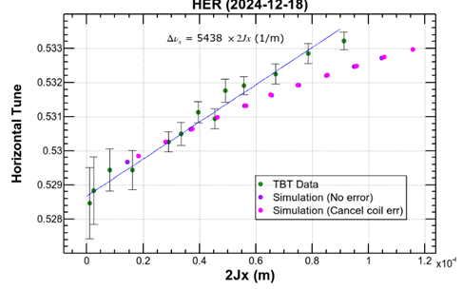
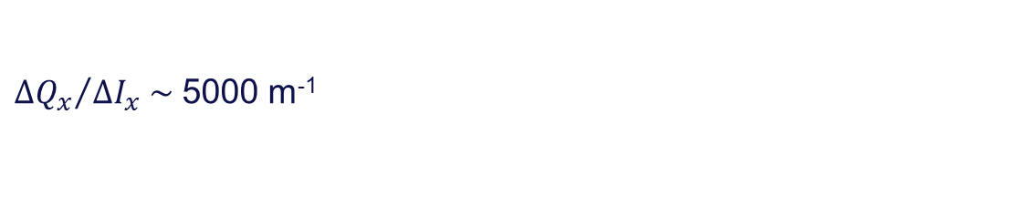
SuperKEKB HER detuning w amplitude
eeFACT25, Y. Ohnishi
${∆Q_{x}}/{∆I_{x} \sim }$ 5000 m⁻¹

Slide 7
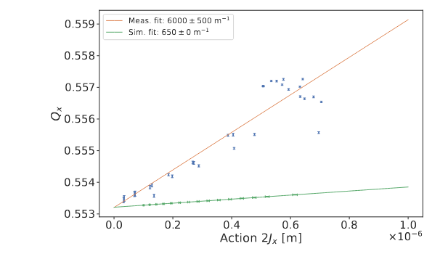
SuperKEKB LER detuning w amplitude
M. Le Garrec, PhD
Simulation: 10x expected kinematic effect
Measurement: 100x expected kinematic effect

Slide 8
FCC Week 2025 & revised LEP3 proposal
FCC-ee ZH at 230 GeV c.m. energy ?
Katsunobu’s rough estimation says we need 1.76 GV to ensure 2% bucket height at 115 GeV.
We could reduce RF voltage by 1.76/2.1 or 16%; reducing cost for first phase and gaining important space in the RF straight
The WW RF voltage is 1 GV; could we reduce this to 0.88 GV ??
Energy loss per turn is only 0.369 GeV.
That is we have an enormous RF overhead.
So, the question is for the polarisation team.
Ivan Koop: “First impression – not much difference between 1 GV and 0.88 GV. FSP looks better than RDP.”

Slide 9
proposed deliverables for pre-TDR phase
Consolidated baseline optics for the collider
Consolidated design of the booster
Consolidated design of the injector complex
Validation of the collider RF system
Finalized collider vacuum system

Slide 10
proposed milestones for pre-TDR phase: D1
1.a decision on new baseline optics, GHC vs LCC, after completing both optics, by March 2026
1.b decision on IR solenoid compensation scheme, also by March 2026
1.c review tolerances, e.g. multipole errors, and “understand” the underlying physical mechanisms plus develop mitigation/correction measures

Slide 11
proposed milestones for pre-TDR phase: D2
2.a choice baseline optics – FODO or HFD by March 2026
2.b adjust circumference and bypass detectors on the inside, match dispersion in experimental straights and insert wigglers
2.c review tolerances and operation modes

Slide 12
proposed milestones for pre-TDR phase: D3
3.a finalize damping ring design with sufficient DA and MA, estimate positron transmission
3.b use results from PSI P3 experiment for revised performance estimate
3.c complete concept & design for prepolarised pilot bunches from injector complex, including spin transport up to collider ring

Slide 13
proposed milestones for pre-TDR phase: D4
4.a prototype tristron
4.b prototype 400 MHz cavity
4.c prototype 800 MHz cavity

Slide 14
proposed milestones for pre-TDR phase: D5
5.a consolidated photonstop design and photonstop placement for collider rings
5.b preparation/concept for industrialisation of chamber production and NEG coating
5.c consolidated vacuum system for booster

Slide 15
interfaces for pre-TDR phase
Tunnel integration
Cost estimates
TI

Slide 16
regular reports at the ADC / optics design meeting
Layout and Optics Design
Optics Correction & Tuning
MDI
EPOL
Beam-beam
Electron Cloud

