Slide 1
IdeaSquare -
The Innovation Space at CERN

Slide 2
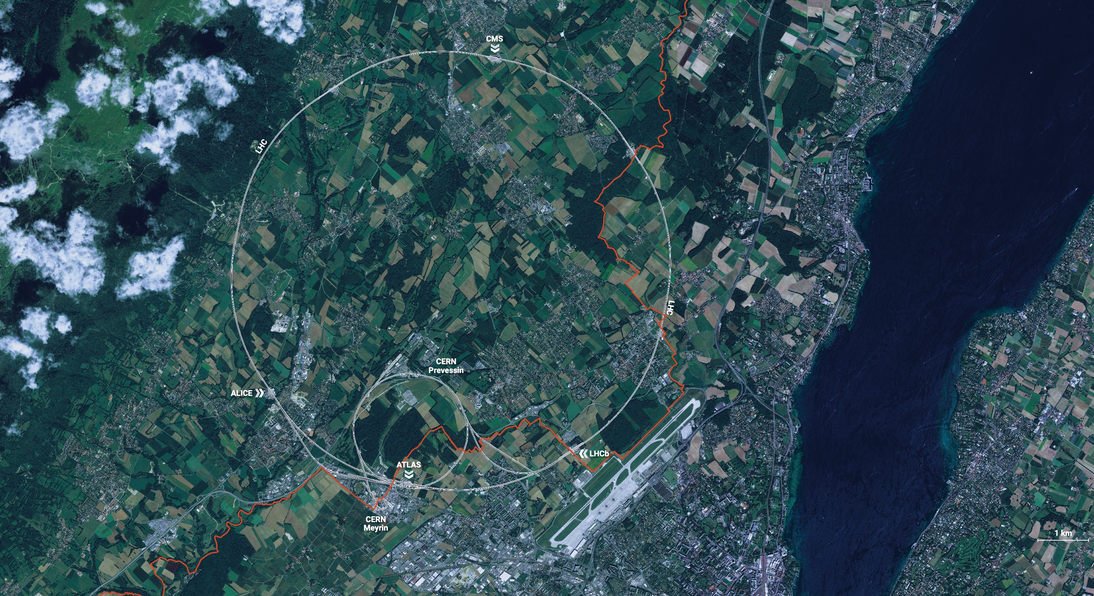
CERN is the world’s biggest laboratory
for particle physics.
Our goal is to understand the most fundamental particles and laws
of the universe.

Slide 3
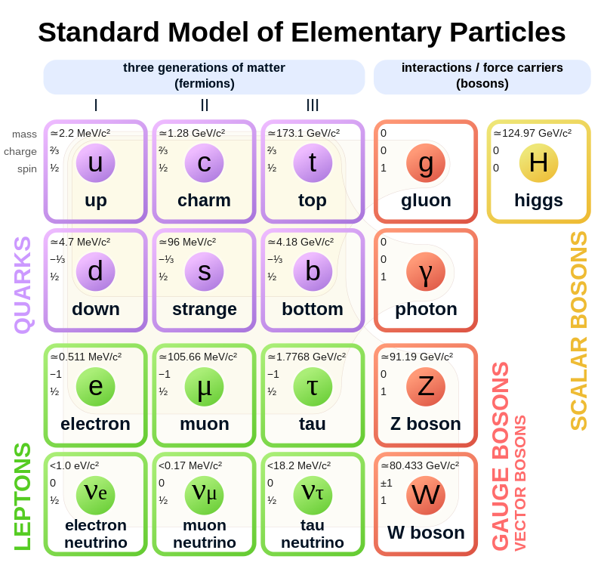
What is the universe made of?
Notes:
This slide and the next address the questions that underpin research in particle physics.
One of the questions is “What are we made of?”
To answer this question, we study the fundamental particles that make up matter.
The speaker takes the visitors on a brief journey from visible matter to the electron and the quark: electrons and quarks are the fundamental particles of matter

Slide 4
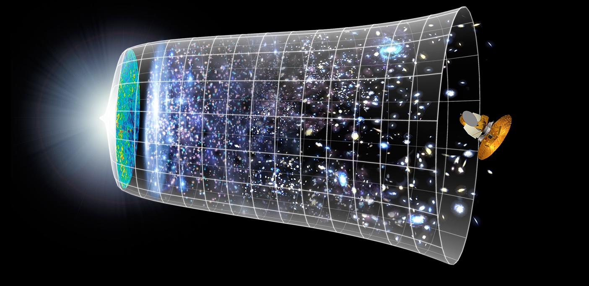

How did the universe begin?
Big Bang
We reproduce the conditions a fraction of
a second after the Big Bang, to gain insight into the structure and evolution
of the universe.
Telescopes
Accelerators
380 000 years
13.8 Billion Years (+/- 1B Years)
Today
10²⁸ cm
Notes:
The other question that underpins research in particle physics is “How did the Universe begin?”
We gain insight into the structure and evolution of the Universe, from the first billionth of a second (10⁻¹²s) after the Big Bang.
From the very small (particle physics at modern accelerators allows us to study the fundamental laws of nature on scales down to smaller than 10⁻¹⁸ m) to the very big (telescope-based astrophysics), we gain knowledge about the laws and evolution of the universe.

Slide 5
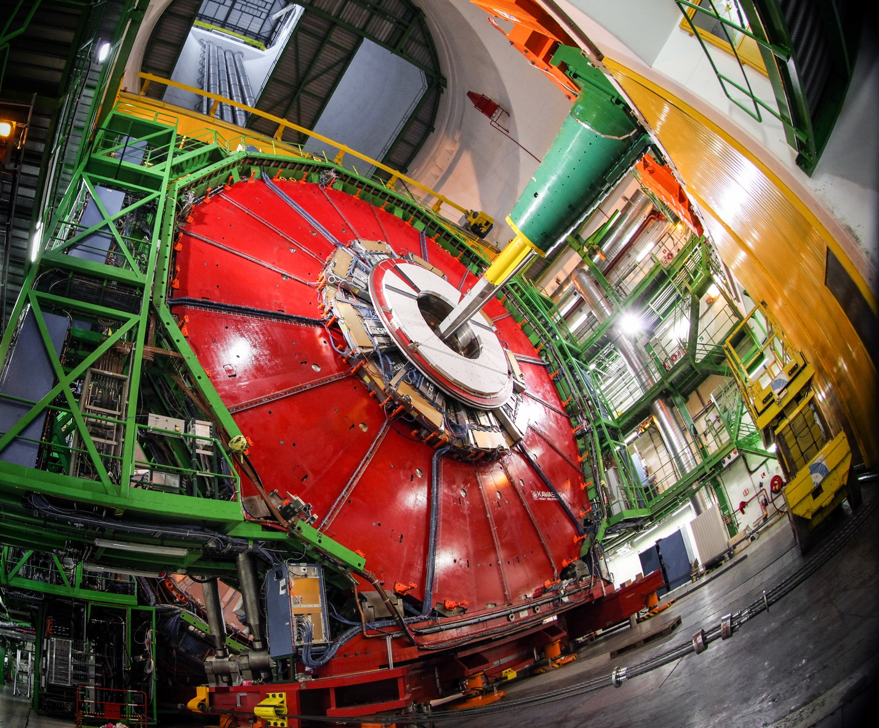
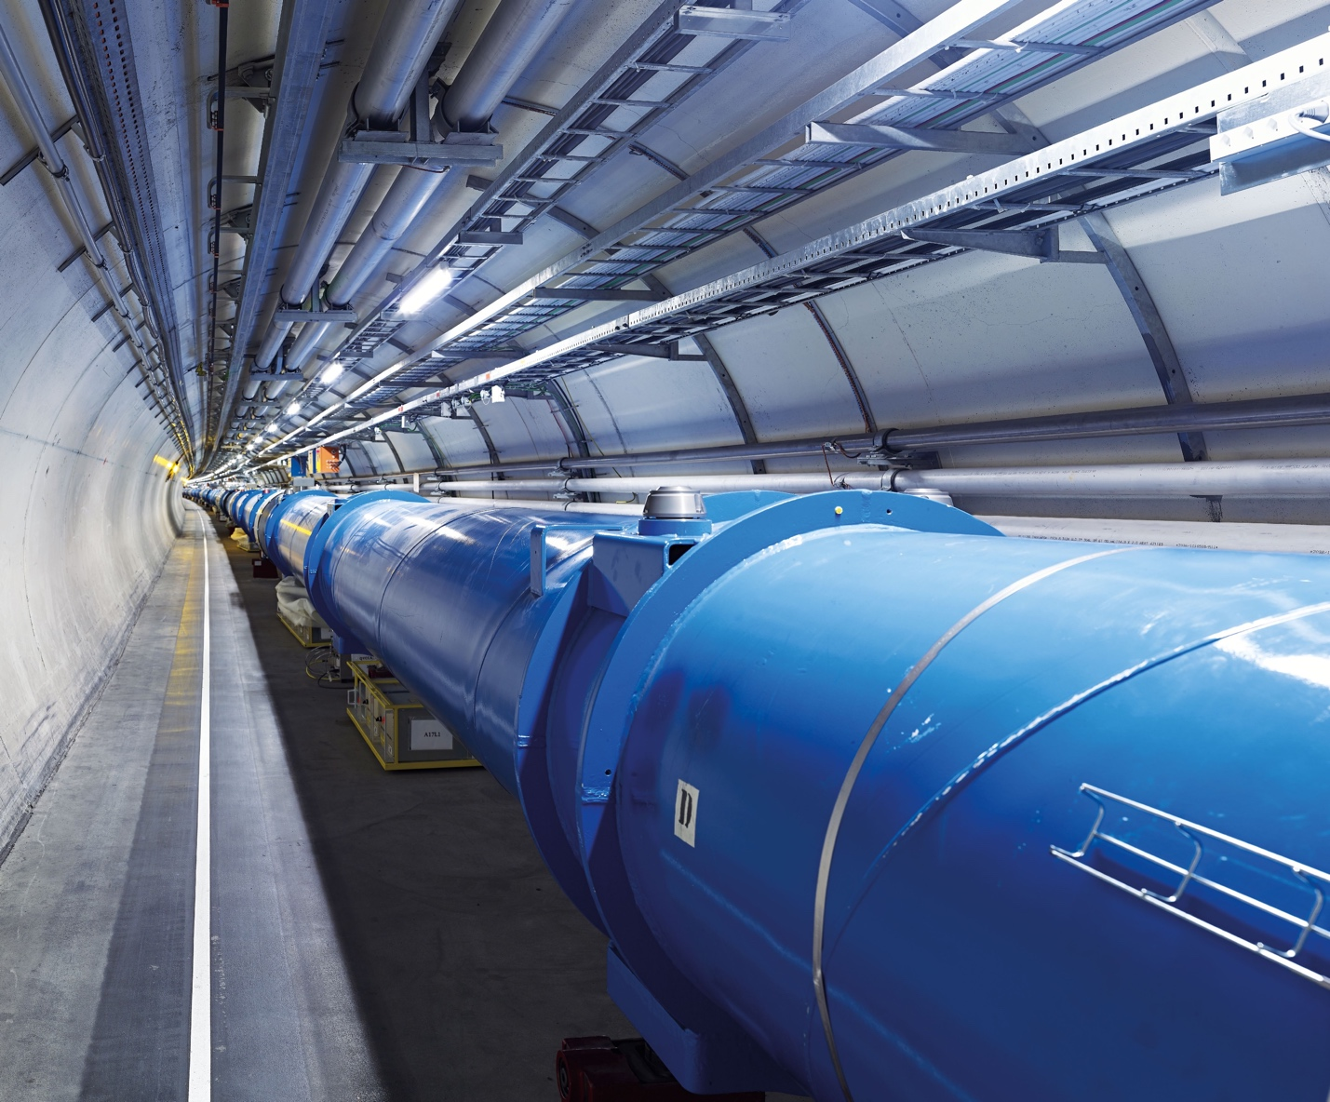
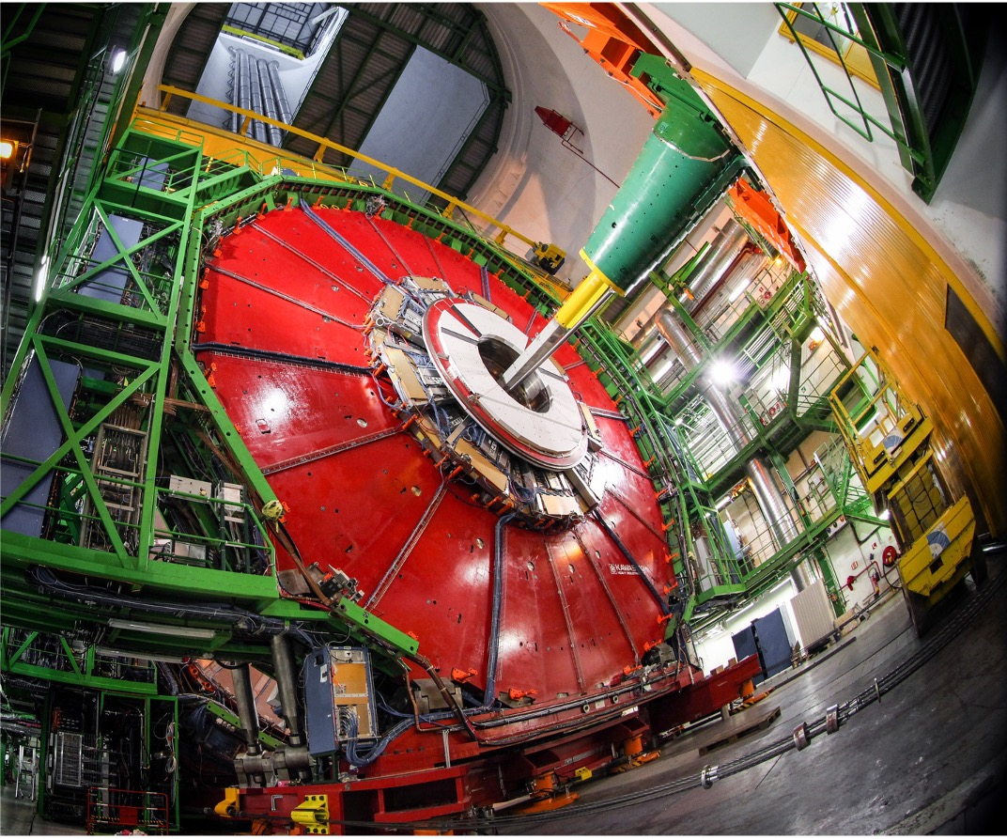
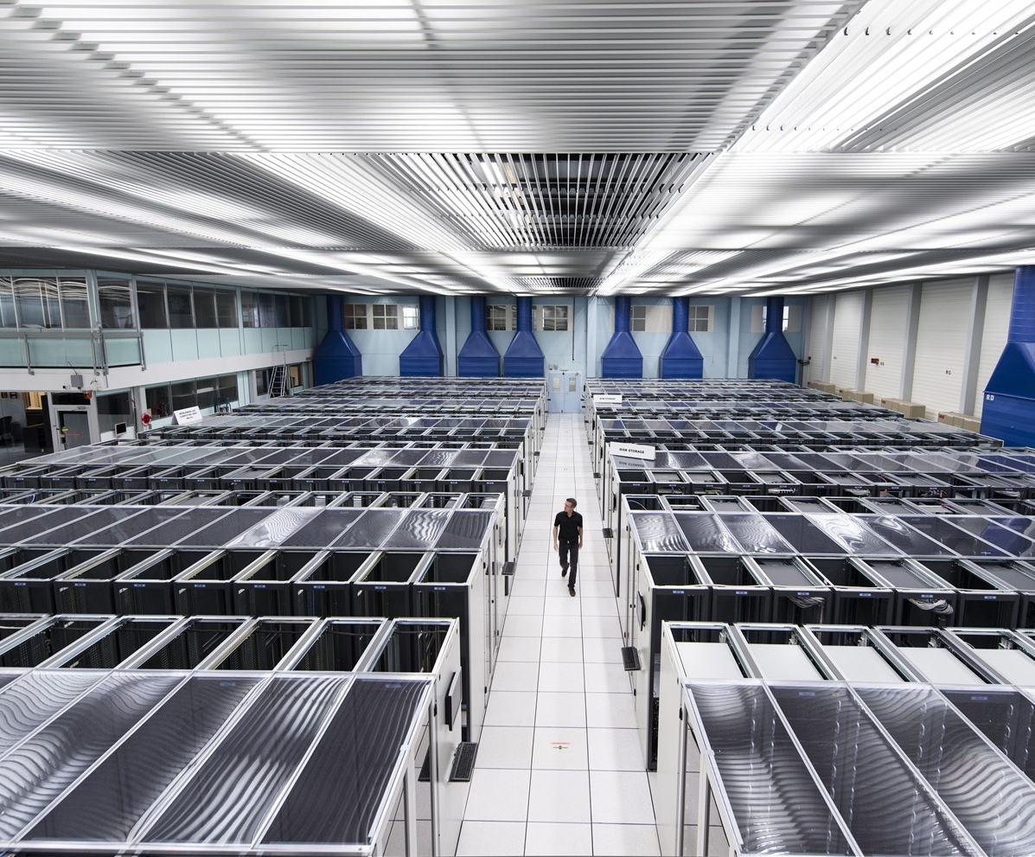
How do we do it?
We build the largest machines to study the smallest particles in the universe.
We develop technology to advance the limits of what is possible.
ACCELERATORS
DETECTORS
COMPUTING
Notes:
This slide presents the three technological fields that allow CERN to answer the questions presented earlier.
The following slides focus on each of these fields, so here the speaker should give a 1-2 sentence description of each.
For example:
Accelerators - We build and maintain a range of particle accelerator facilities, where particles are accelerated to almost the speed of light
Detectors – built by consortia of physicists and engineers from across the globe, this is where collisions occur and where new, hitherto unknown particles may be formed, and new interactions between particles identified.
Computing – experiments at CERN generate enormous amounts of data. This data is collected at CERN and sent around the world to be processed and stored.

Slide 6
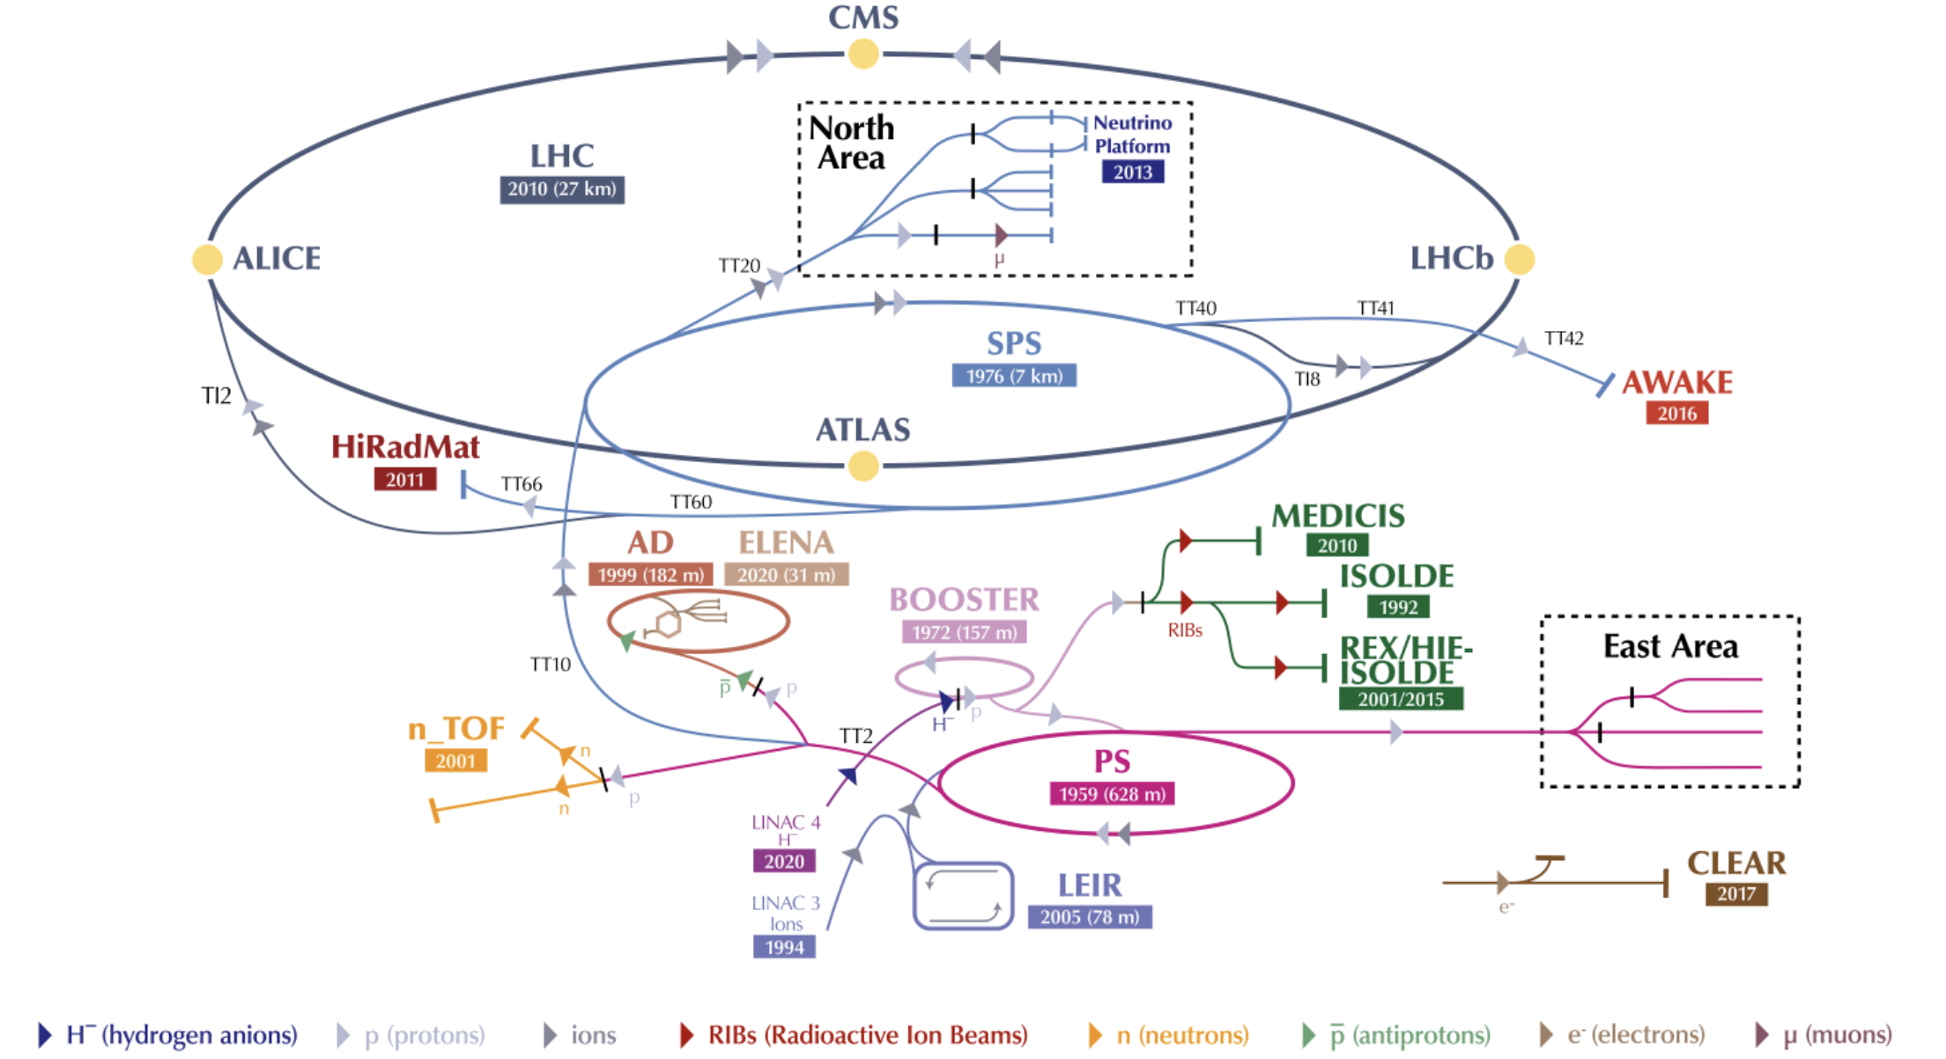
CERN’s “orchestra” of accelerators

Slide 7
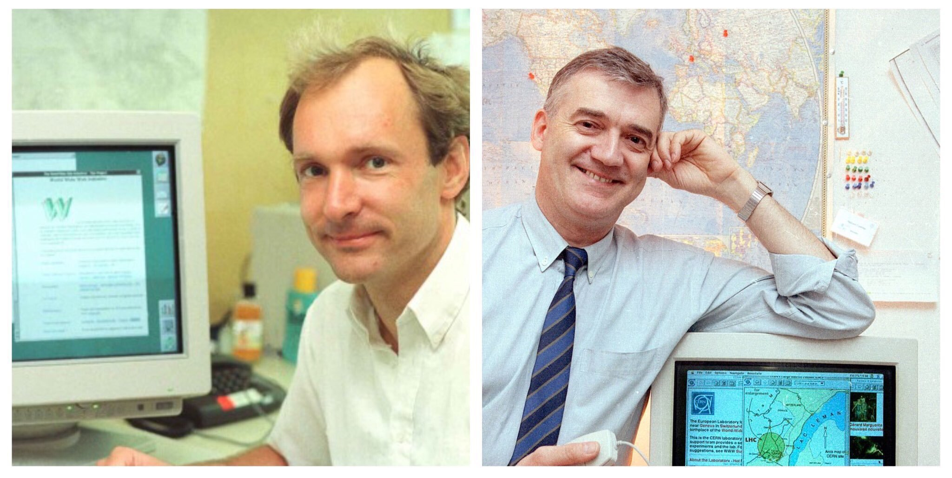
Notes:
Challenging assumptions.
The researchers accessed the information via computer tape copies, remote access to databases, email and file transfer. I must admit that even for me it is hard to picture how the world functioned at this point in time.
I talked to Robert, and he said “we would send files to our printers to print out paper, so why could we not send files between computers?
In 1989, Tim Berners Lee wrote a proposal for a new information management system. By 1990, Tim and Robert had formalised a management proposal and put up the first server and browser running at CERN.
Sources:
https://liu.se/en/news-item/i-did-not-like-the-namn-world-wide-web-robert-cailliau
https://home.cern/science/computing/birth-web/short-history-web

Slide 8
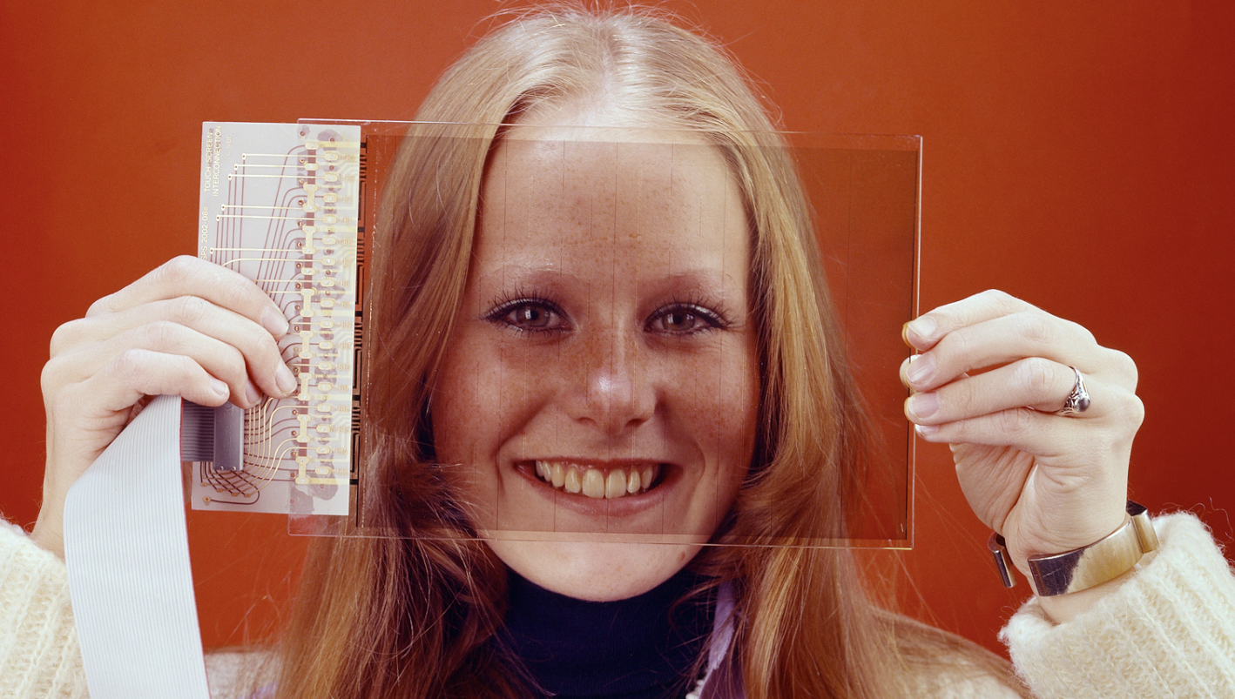
Notes:
First touch screen in the 1970s/80s; the touch screen would make it possible for a single operator to access a large look-up table of controls using only a few buttons.

Slide 9
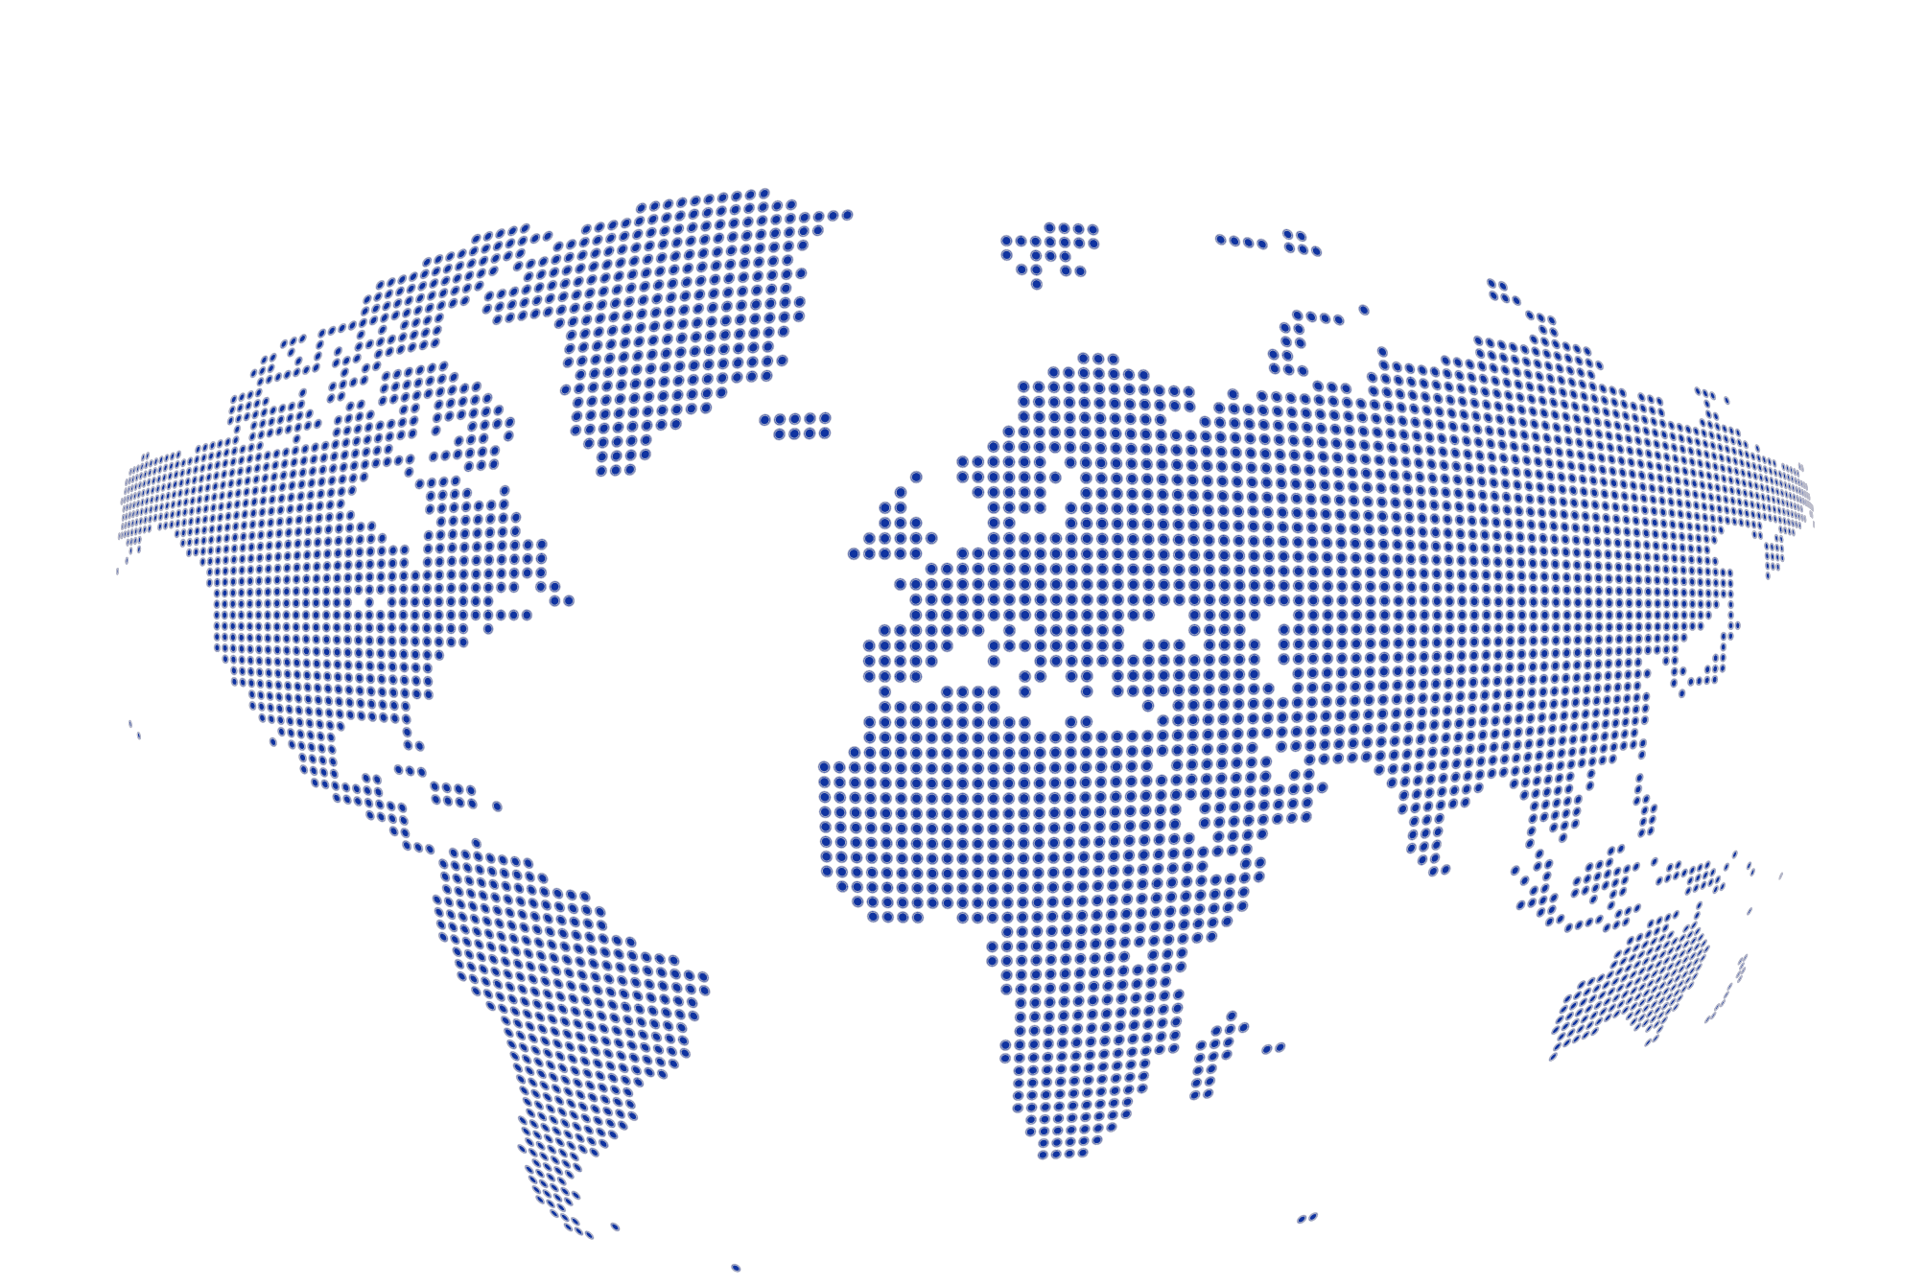
A laboratory for people around the world
Geographical & cultural diversity
Users of 110 nationalities
~ 23% women
Member States 6632
Austria 82 – Belgium 122 – Bulgaria 37 – Czech Republic 221 Denmark 35 – Finland 79 – France 794 – Germany 1185 Greece 138 – Hungary 67 – Israel 63 – Italy 1388
Netherlands 166 – Norway 78 – Poland 272 – Portugal 80 Romania 99 – Serbia 35 – Slovakia 66 – Spain 325
Sweden 96 – Switzerland 329 – United Kingdom 875
Associate Member States 27
in the pre-stage to membership
Cyprus 11 – Slovenia 16
Associate Member States 390
Croatia 38 – India 151 – Lithuania 13 – Pakistan 35
Turkey 124 – Ukraine 29
Observers 3071
Japan 211 – Russia 1021 – United States of America 1839
Other countries 1279
Algeria 2 – Argentina 15 – Armenia 10 – Australia 23 – Azerbaijan 2 – Bahrain 2 – Belarus 26 – Brazil 108 Canada 196 – Chile 22 – Colombia 15 – Cuba 3 – Ecuador 4 – Egypt 14 – Estonia 26 – Georgia 35
Hong Kong 20 – Iceland 3 – Indonesia 7 – Iran 13 – Ireland 6 Kuwait 2 – Latvia 6 – Lebanon 17
Malaysia 4 – Malta 3 – Mexico 49 – Montenegro 5 – Morocco 18 – New Zealand 11 – Oman 1
People’s Republic of China 334 – Peru 2 – Puerto Rico 2 – Republic of Korea 132 – Singapore 3
South Africa 57 – Sri Lanka 8 – Taiwan 50 – Thailand 16 – United Arab Emirates 2
Notes:
THIS SLIDE WILL INCLUDE THE NUMBER OF MEMBERS OF PERSONNEL OF THE VISITORS’ COUNTRY OF ORIGIN

Slide 10
IdeaSquare
IdeaSquare is the innovation space at CERN using
collaborative methodologies,
access to CERN expertise and
cross-connectivity
to ideate solutions for the future of humankind.
A place where people have the licence to dream.
Notes:
Future of humankind: The activities carried out at IdeaSquare tie science innovation to the United Nations’ Sustainable Development Goals (SDGs), and work towards laying out a better future for our society

Slide 11
Why IdeaSquare?
We believe that for fundamental change, we need more than traditional innovation methods and mindsets.
We enable students and innovators to imagine a future worth fighting for, and we give them the tools and confidence to start building that future.
IdeaSquare is our human experiment for “colliding” minds and ideas towards laying out a better future

Slide 12
Project-based student courses
tackling challenges derived from the United Nation’s Sustainable Development Goals
Executive programmes
for business schools and corporates embracing uncertainty as a key capability for product and organizational innovation
Notes:
Student programmes:
CBI: +22 active program collaborations;
Universities from 8 different countries;
Design Thinking methods to solve global challenges, intersected with deep tech;
UN Sustainable Development Goals as a lens in the process;
Multidisciplinary teams of students: business, design, engineering, social sciences…
Moving to I2P: What if we could begin again, how would you build society?
Executive programmes:
In embracing increasing uncertainty, people need to embrace orders of magnitude thinking instead of incremental change. In the executive programmes we harness this orders of magnitude thinking of CERN that is required to imegine and build collaborations years in the future.

Slide 13
ATTRACT
Creating a co-innovation ecosystem between fundamental research and industrial communities to develop breakthrough detection and imaging technologies.
Green Village
In collaboration with SCE: Using the CERN campus as a testbed for sustainability innovation.
Notes:
ATTRACT: Funding instrument aimed at absorbing and reducing risk to market.

Slide 14
Neutrino Platform
CERN & IdeaSquare provide a facility for R&D on future technologies (HW and SW) and partner in several neutrino research programs.

Slide 15
Like yours!
Innovation events, workshops, and hackathons for scientists, students, and innovators to meet to push the boundaries of knowledge.

Slide 16
Spaces
Open space for ideation and labs for 3D-printing, mechanical, and electric work
Courses
Trainings organized monthly to CERNies by our prototyping Huldra to use the machines
Notes:
CLEAR is doing research in medical radiation therapy. Put very simply they research the impact of doing radiation therapy in short, intense bursts, compared to the conventional way of giving small doses of radiation over a longer period of time.
In order to test this they have built a robot which picks up a sample and places it in front of their beam, since they cannot be in the room while the beam is running. The collaboration with IdeaSquare consisted mostly of prototyping parts for the robot. Many different iterations of the sample holders were tested before a final design was chosen. The holders were 3D printed, along with the gripper of the robot. The laser cutter was also used to cut radiation sensitive film, which could not be cut with conventional tools.

Slide 17
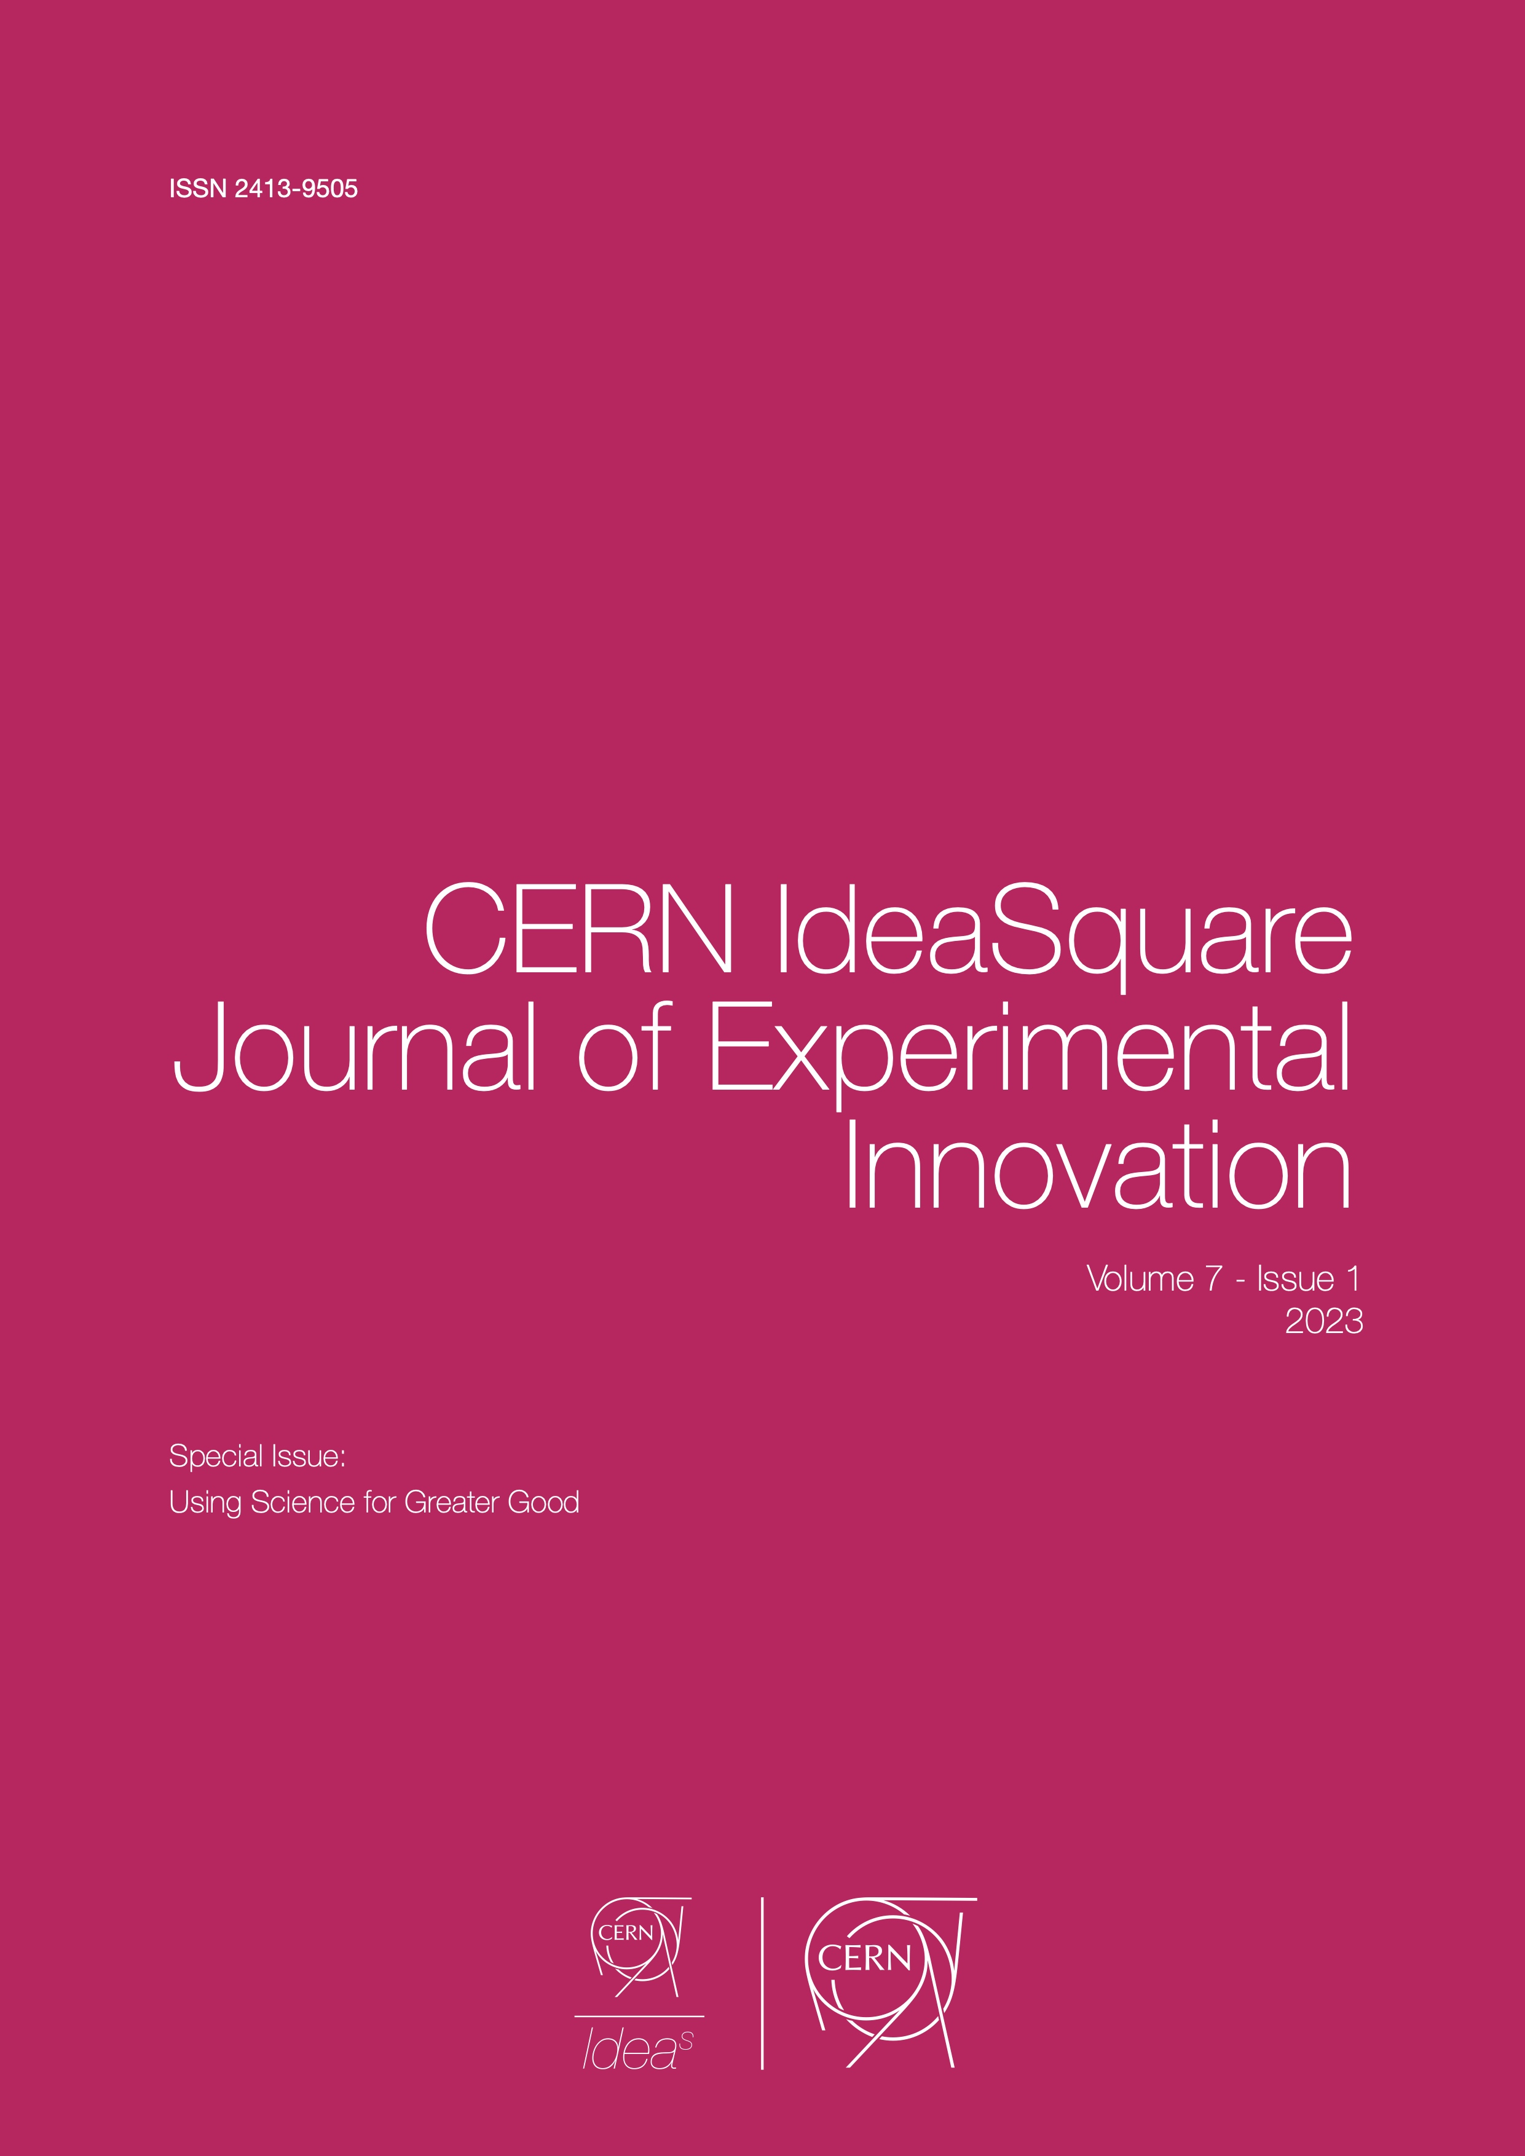
The CERN IdeaSquare Journal of Experimental Innovation
CIJ communicates thought-provoking, contemporary, and recent findings in experimentation-driven innovation research.
Notes:
Innovation knowledge: I2 is uniquely positioned to collect and share knowledge generated about innovation.
Open access journal with three issues published per year.

Slide 18
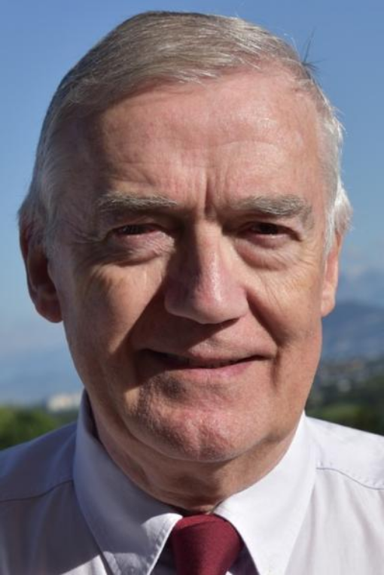
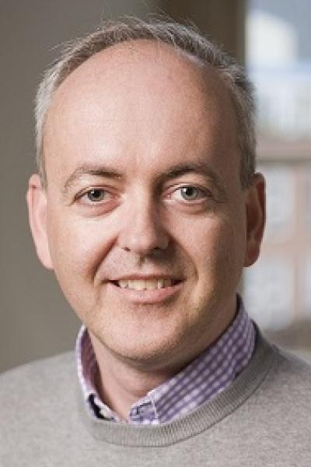
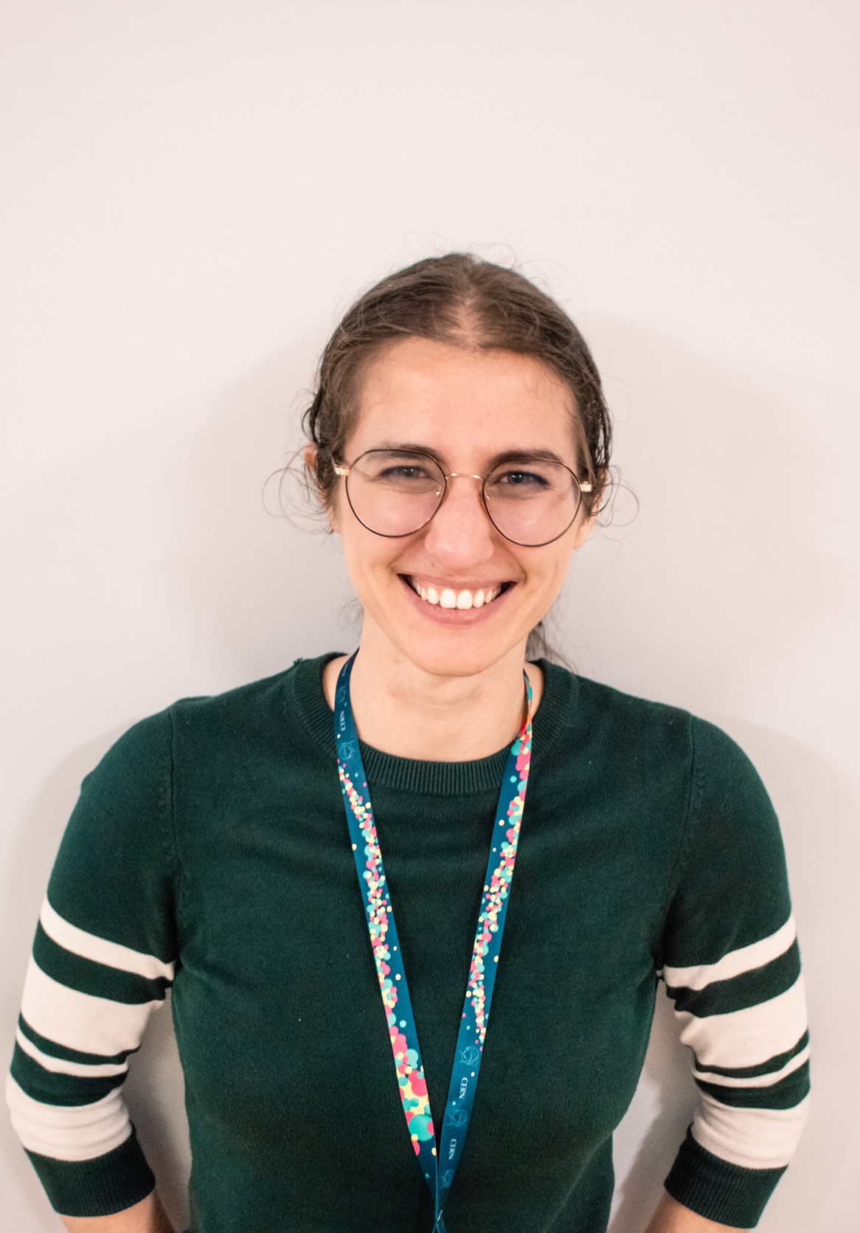

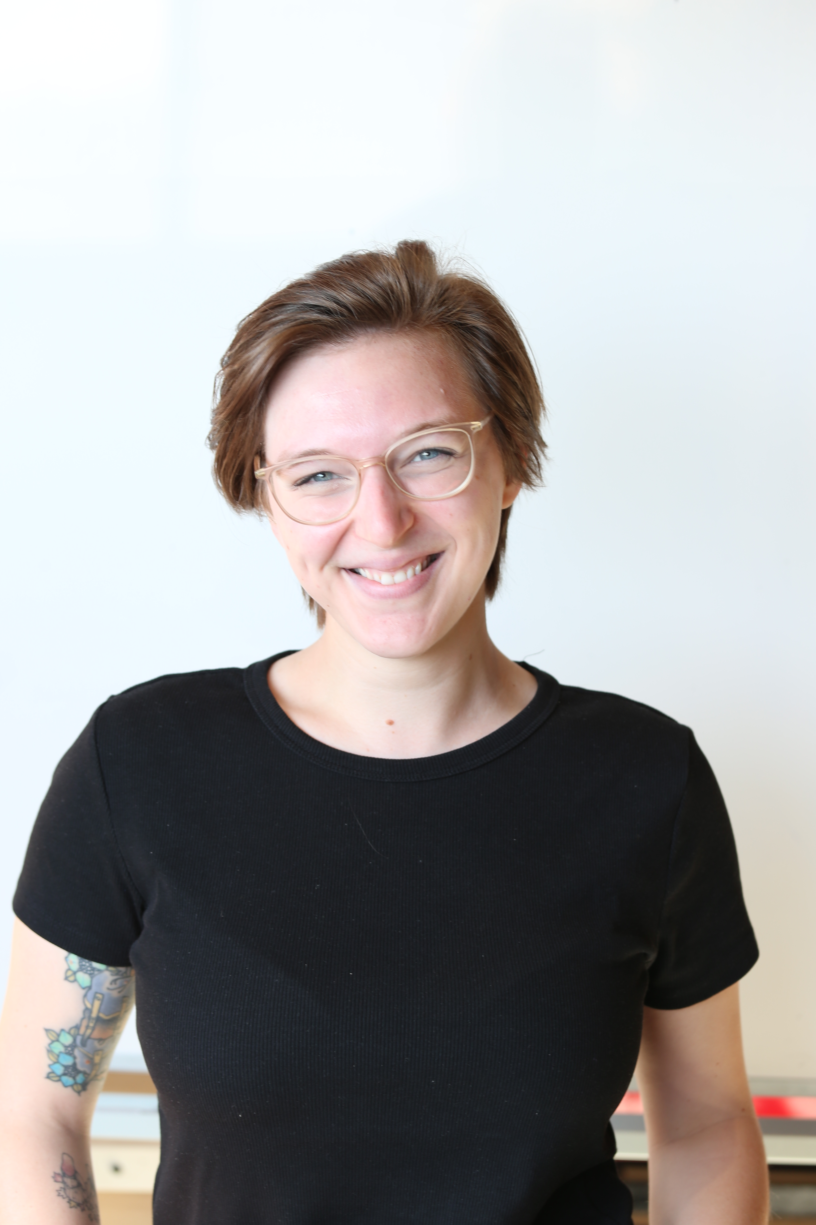
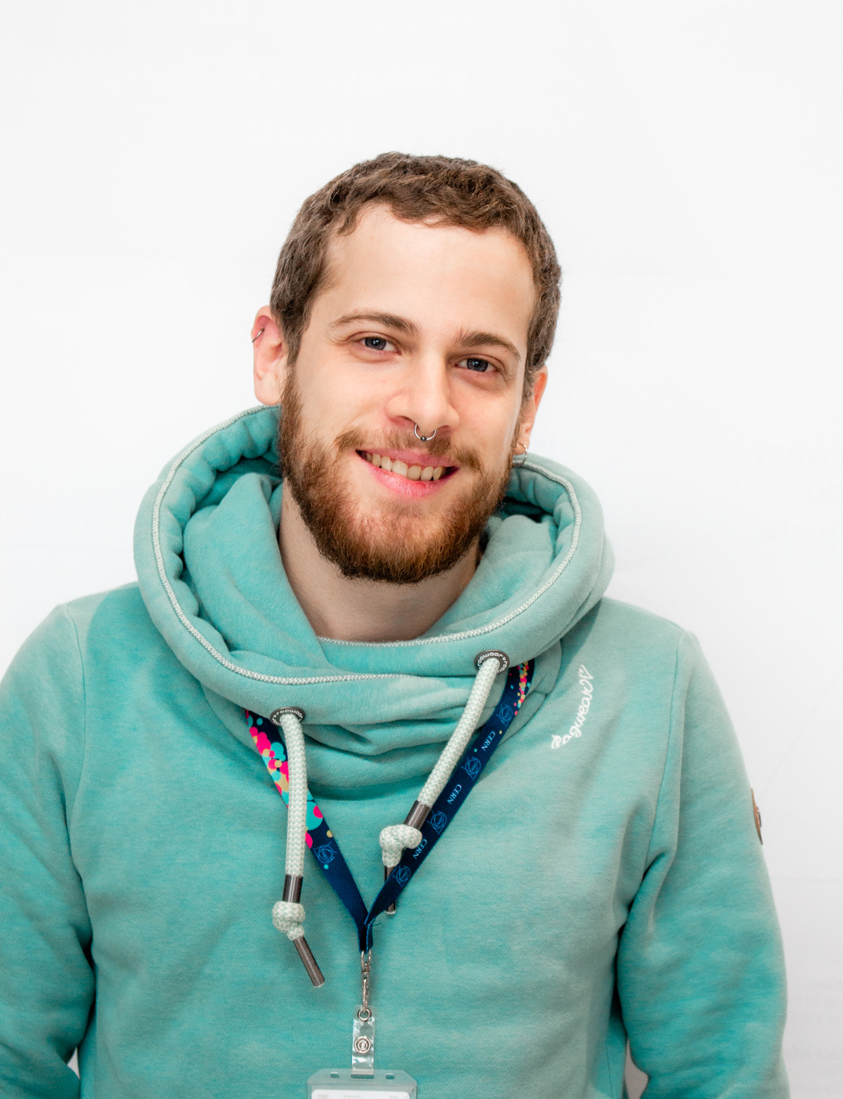
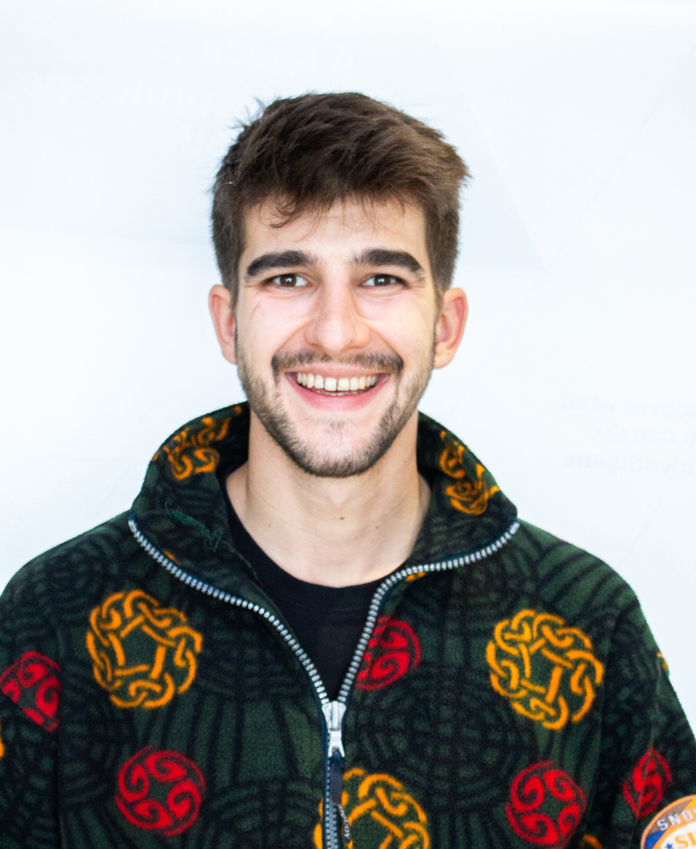
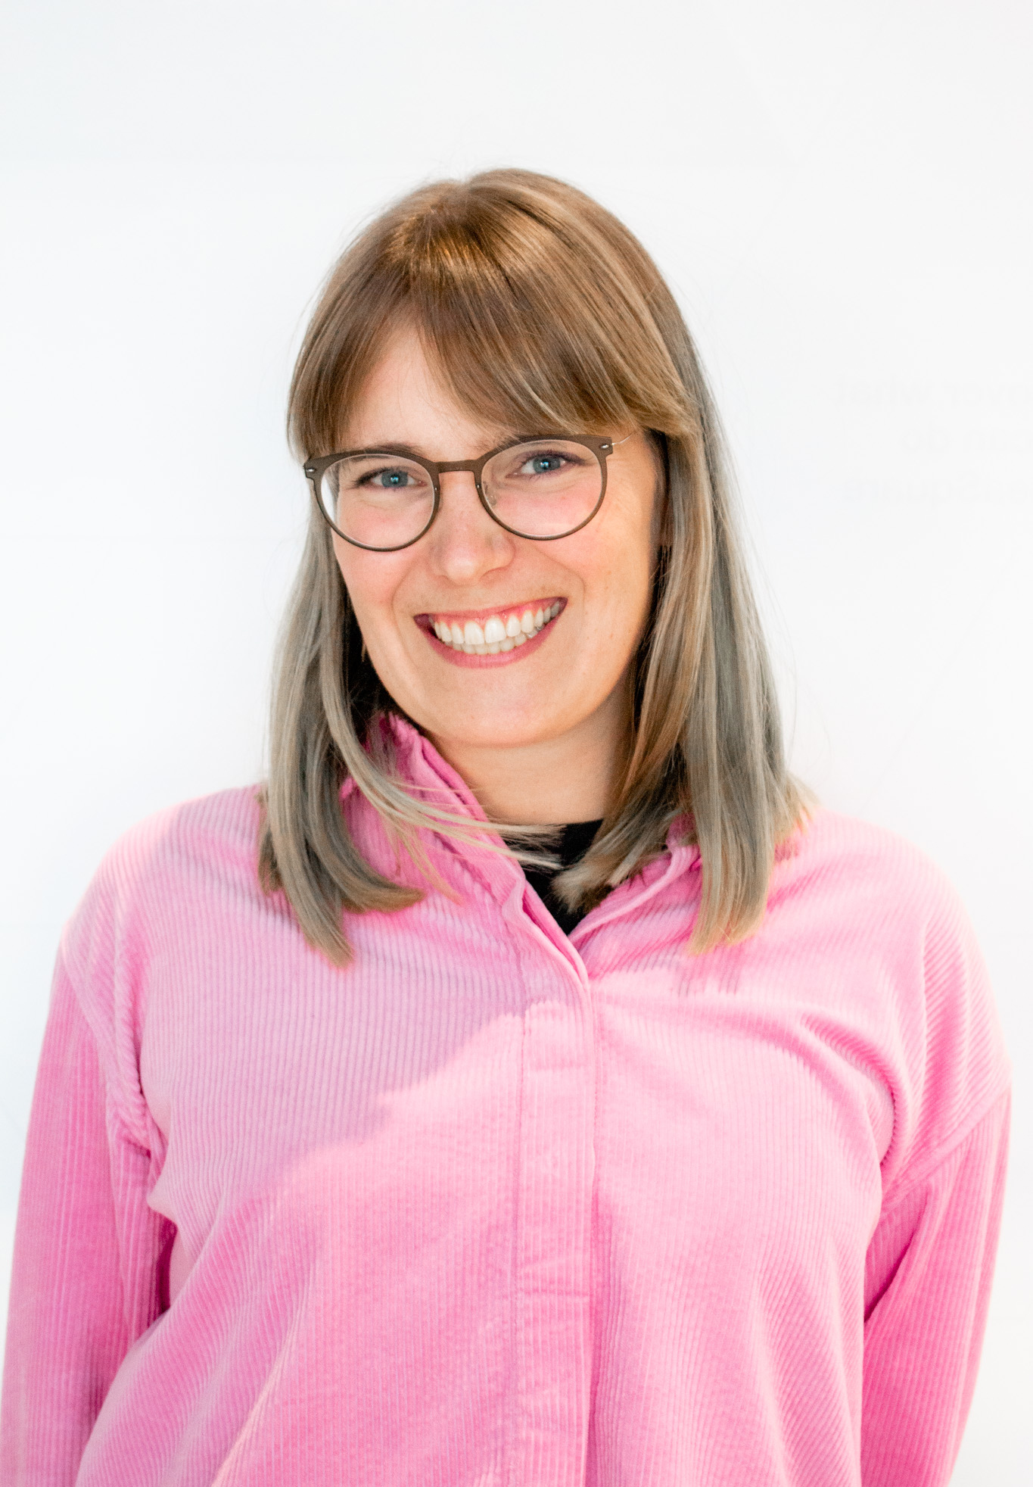
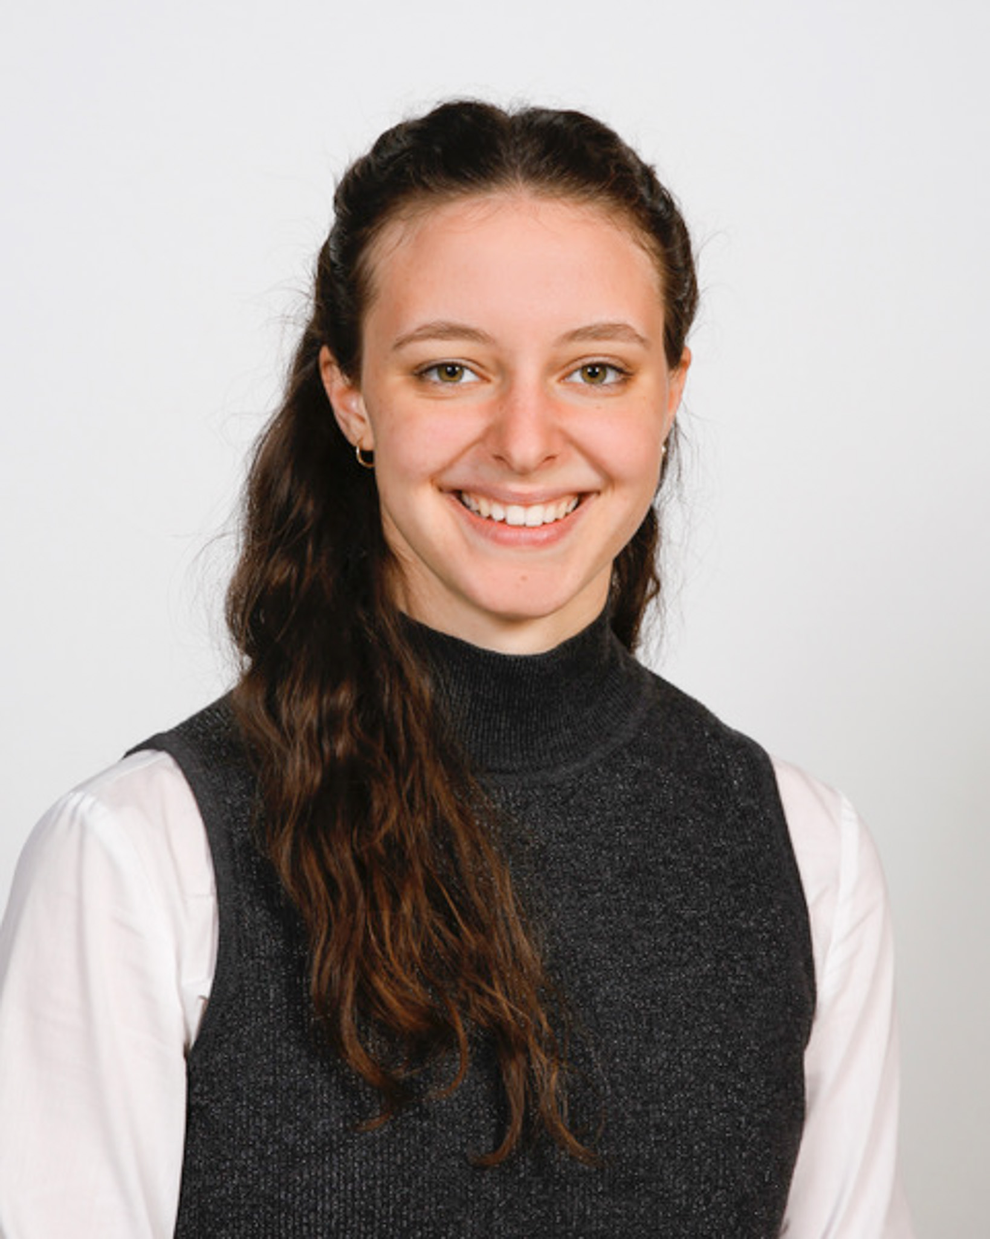
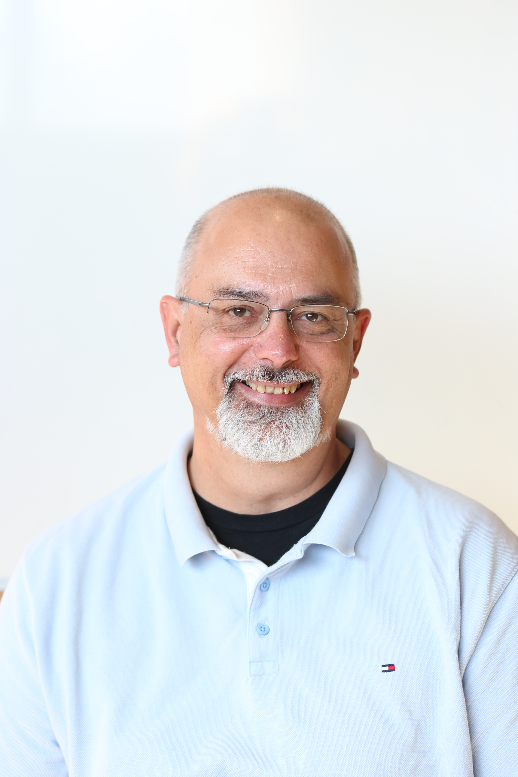
The CREW at IdeaSquare
Mirabelle Breidvik
Communications
Catarina Batista
Edu programmes
Robert Cailliau
Resident Provocateur
Roy Pennings
Project Projector
Giulia Gaddi
People watcher
Jimmy Poulaillon
Communications
Pablo Garcia Tello
Wizard of EU
Saamiya Adow
Administration
Ole Werner
Edu Programmes
Laura Wirtavuori
Edu programmes
Dina Zimmermann
Prototyping
Notes:
CHANGE DESCRIPTIONS

Slide 19
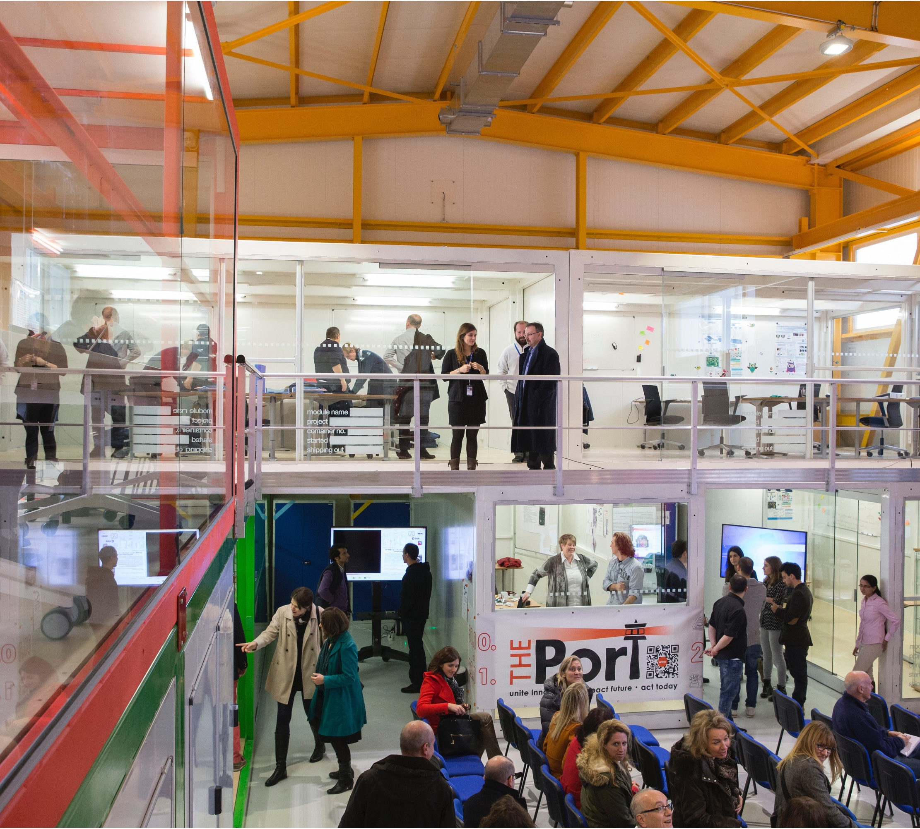
B3179: Building safety
In all inside areas of Building 3179 smoking & alcoholic beverages is strictly forbidden.
Working is possible 24/7 with CERN access card, sleeping is prohibited as in all CERN buildings.
Eating, drinking, coffee breaks are encouraged in the kitchen (and open) area. But not in the Red Bus, please!

Slide 20
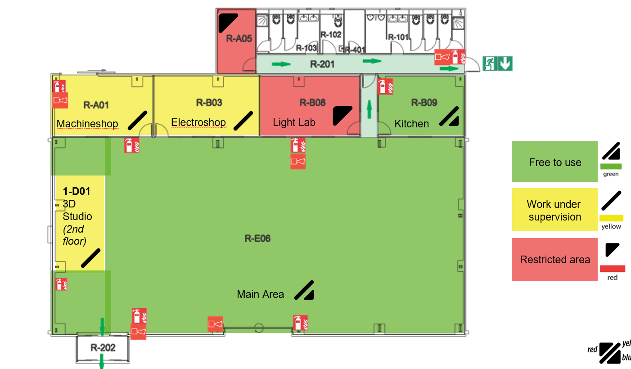


Slide 21
In the kitchen
You are encouraged to use the kitchen, fridges and appliances. Here are a few things to keep in mind:
Food should be labelled
Only use the dishwasher with the status “dirty” – if there is no available “dirty” dishwasher, handwash.
Leave the place cleaner than you found it ☺

Slide 22
Welcome to IdeaSquare
We’re happy to have you here!

