Slide 1

Design Science Methodology
CERN IDEA SQUARE, 9th of June 2025
Dr. Raymond Opdenakker, University Lecturer
Construction Management and Engineering Lecture 1

Slide 2
1. Introduction Dr. Raymond Opdenakker
Dr. Raymond Opdenakker
Bachelor HRM (1990)
Master Labor- and Organisation Psychology (1995)
PhD Business administration (2012)
Co-CEO of Bureau Lara (founded in 2000)
65 artikels
12 books

Slide 3

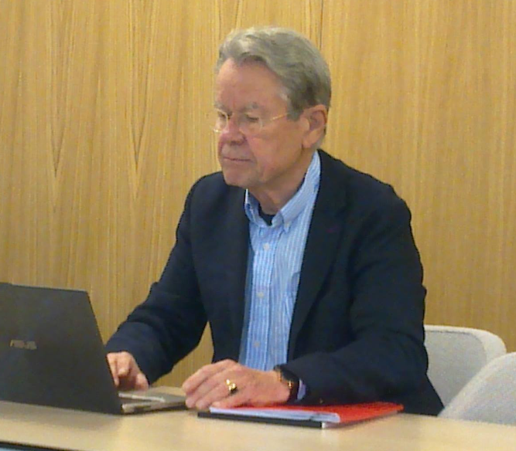
Opdenakker, Raymond and Carin Cuijpers (2019). Effective Virtual project teams. Heidelberg: Springer.

Slide 4

Opdenakker, Raymond and Carin Cuijpers (2025).Design science methodology for the management sciences. Heidelberg: Springer.

Slide 5
What is Science?
Science is a systematic and logical approach to discovering how things in the universe work.
(Source: https://www.livescience.com/20896-science-scientific-method.html)

Slide 6
What is Design Science Methodology?
Design science as a concept: first introduced
by Herbert Simon in his book ‘The Sciences
of the Artificial’ in 1969.

Slide 7
Herbert Simon (1969):
Knowledge questions are concerning what is, or studying the world-as-it-is.
Design problems are about what can be, or designing the world-as-it-can-be.

Slide 8
Two kinds of research problems
Knowledge questions
– Describe, explain, predict
– Questions, research design, research execution, data, analysis
– Empirical research cycle
– ‘Truth’ is the goal
– Utility is a side‐effect

Slide 9
Design problems
Improve something, design something , how‐to‐do something
Problem, design of an artifact (solution concept) for a field problem, validation of the artifact (solution concept)
Design cycle
‘Utility’ is the goal (contribution to ‘a better world’)
Knowledge is a side‐effect

Slide 10

What is design science?
• Design science is the design and investigation of artifacts in
context
Research problems are design problems
Artifacts interact with their context to deliver a service (an ‘Outcome’)
• The social context of a design science project consists of stakeholders and their goals and budgets.

Slide 11

Questions?

