Slide 1

“
What do we talk about
when we talk about
design (science) research?
”

Slide 2

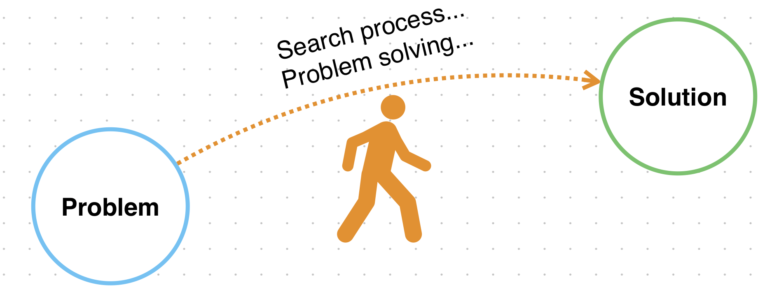
A problem solving paradigm
Simon, H. (1996). The sciences of the artificial (3rd ed.). MIT Press.
Dorst, K. (2006). Design problems and design paradoxes. Design Issues, 22(3), 4-17.
Purao, S., Rossi, M., & Bush, A. (2002). Towards an understanding of the use of problem and design spaces during object-oriented system development. Information and Organization, 12(4), 249-281.

Slide 3

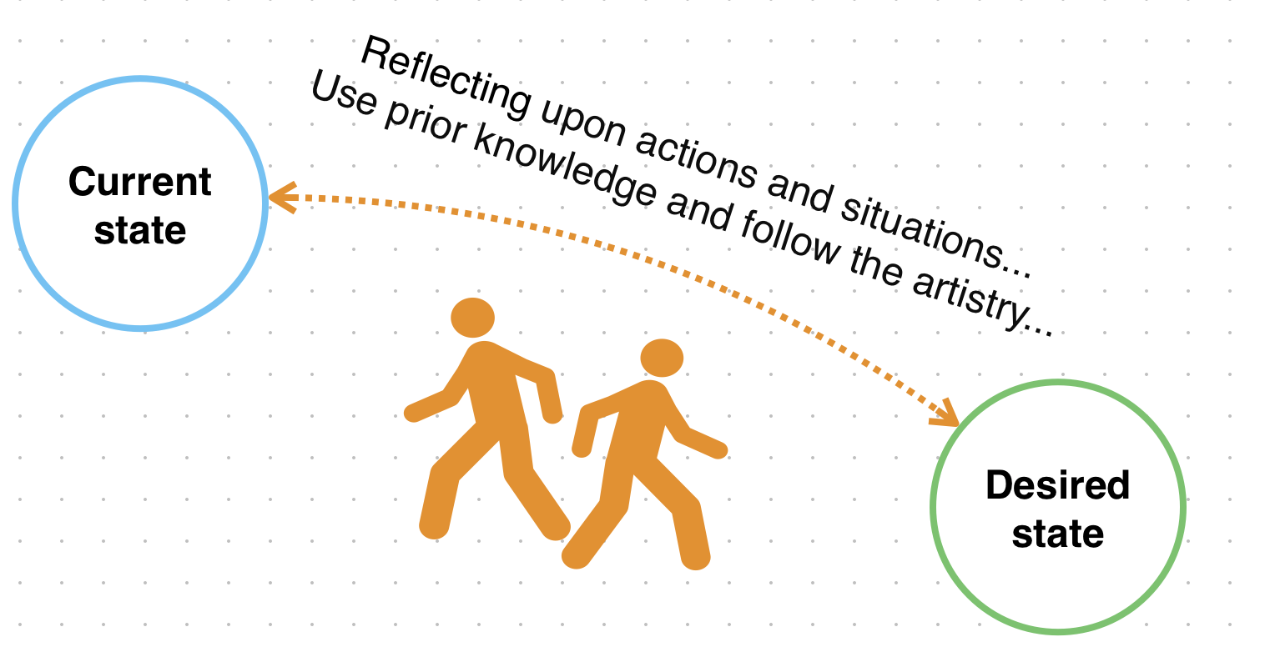
It is a reflective practice
Schön, D. A. (1983). The reflective practitioner. Basic Books.
Mathiassen, L., & Purao, S. (2002). Educating reflective systems developers. InformationSystems Journal, 12(2), 81-102.
Dorst, K. (2006). Design problems and design paradoxes. Design Issues, 22(3), 4-17.

Slide 4
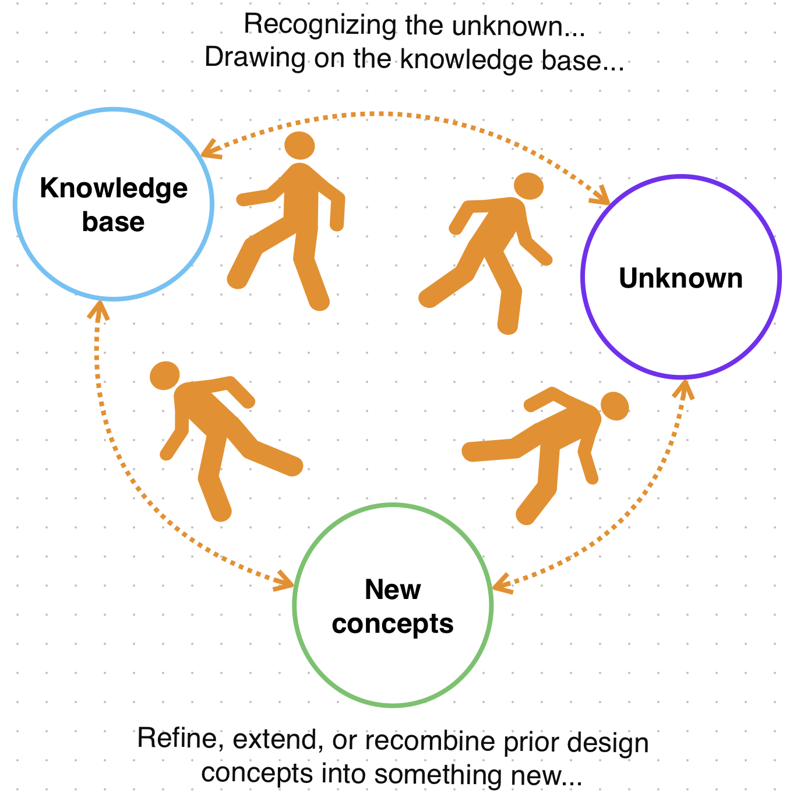
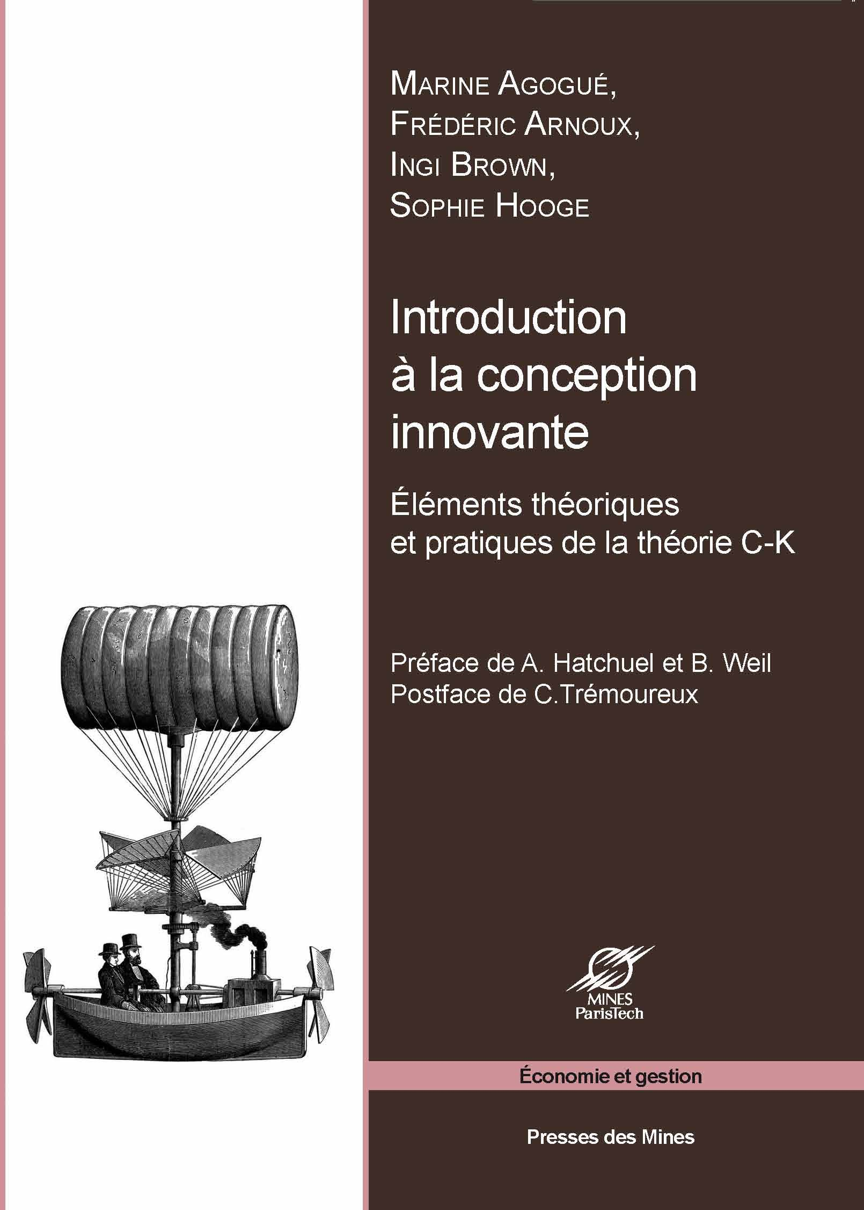
Design is generative practice!
Le Masson, P., Dorst, K., & Subrahmanian, E. (2013). Special issue on design theory: history, state of the arts and advancements. Springer.Issues, 22(3), 4-17.
Hatchuel, A., & Weil, B. (2002). CK theory. Proceedings of the Herbert Simon International Conference on Design Sciences.

Slide 5
Design research as a knowledge expansion paradigm
Unknown
Expansion
Designing
Design theorizing
Known

Slide 6

“Knowledge about creating other instances of artifacts
that belong to the same class”
(Sein, et al., 2011, p. 39; Purao, 2002)
Design knowledge

