Slide 1
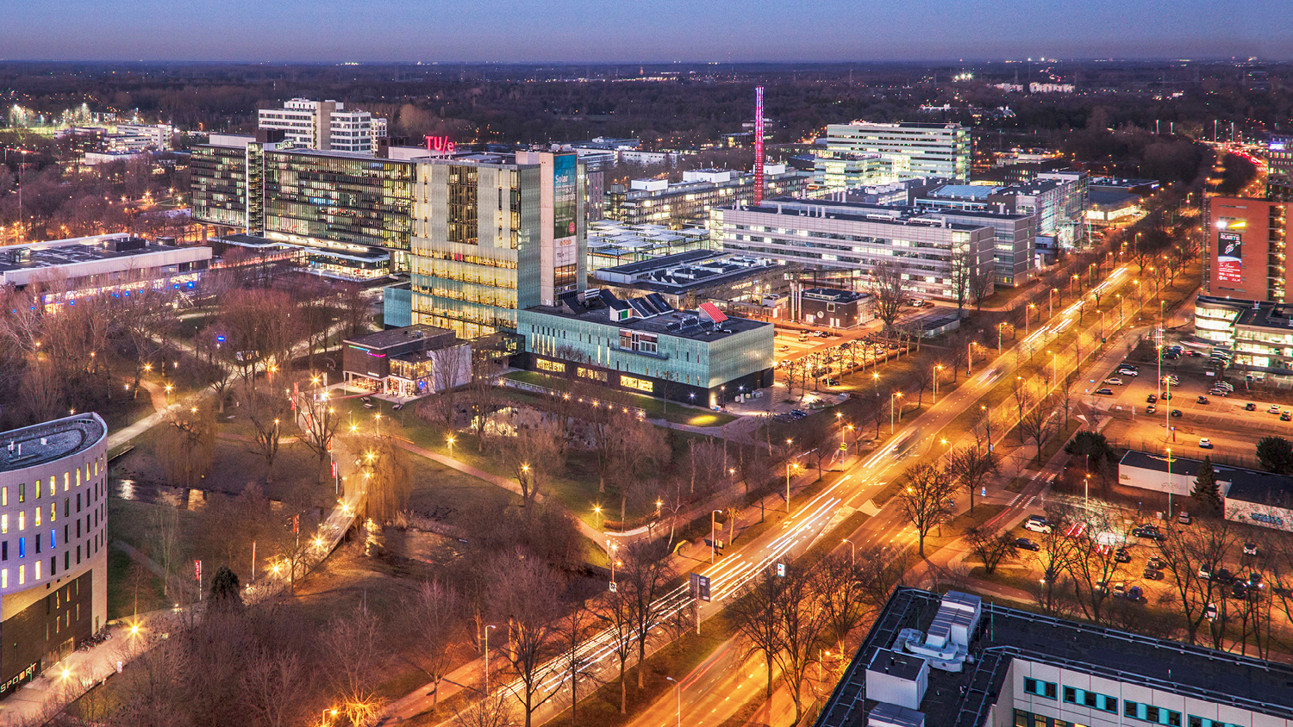
Design Science Methodology : ‘It’s a small step for a man to apply design science research. It’s a giant leap for mankind when it becomes “common science”’ (Raymond Opdenakker, 2024; free after Neil Armstrong, July 1969)
CERN Idea SQUARE, 9th of June 2025
Dr. Raymond Opdenakker, University Lecturer

Slide 2
Program
    What is design science methodology?
    Generic Design Science Cycle

Slide 3
1. What is design science methodology
Definition Design Science Research/Methodology:
‘Methodology/Research that aims to link science and design through the development of design knowledge, to be used for creating artifacts’ (Keskin and Romme, 2020).

Slide 4
Field problem
‘A field problem is a problematic state in social or material reality’ (van Aken and Romme, 2009)
According to the Greek philosopher Epictetus ‘It's not the things that shock people, but the opinions they have about them’.
So, a ‘field problem’ is always subjective.
Therefore, it is important to work on such a design science research project with relevant stakeholders in the field (‘participative mindset’).
Class of problems: (Business) problems that are experienced in different contexts, but share common characteristics (Dresch et al., 2015).

Slide 5
Artifacts
Artifact is a human creation!
Tangible artifacts and intangible artifacts, like:
Model
Procedure
Policy

Slide 6
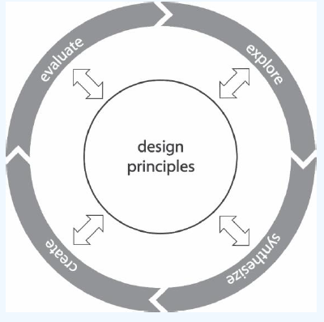
2. Generic Design Science Cycle
Figure 1. The generic design science cycle (Keskin and Romme, 2020)

Slide 7
Design princples
Prescriptive design principles (or rule), grounded in research evidence, that serves to create and assess artifacts as well as generalize these artifacts in knowledge that is more broadly applicable. Design principles can be formulated using CAMO logic (Denyer et al., 2008).
Context: the context of the problem
Agent (Or Intervention): The Agent that introduces an intervention in the specific context
Mechanism: A theoretical construct that explains why a particular agency (i.e. actor and its action) in a specific context leads to a particular outcome (pattern) (Keskin and Romme, 2020).
Outcome: A desired future state that an actor seeks to achieve through a particular action (Denyer et al., 2008; Holmström et al., 2009; Van Burg and Romme, 2014).

Slide 8
Design principles
Van den Berg (2020):
Field problem: “How to create efficient and effective stakeholder engagement during infrastructural road projects to decrease time and cost overrun?”
The design principle according to the CAMO-logic: If there is an (infrastructural road) project with cost and time overrun due to inefficient stakeholder engagement (C), use an elaborate stakeholder analysis (A) to determine an effective and efficient, project and stakeholder specific stakeholder engagement strategy (M) so that the effectiveness and efficiency of the project increases (O).
Broader class of problems: (infrastructural road) projects with cost and time overrun.

Slide 9
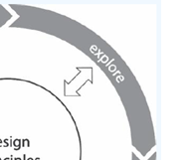
Exploration phase
The first step in a Design Science research cycle is exploration: drawing the boundaries of the problem space, and in the end frame the problem.
Goal of this step: to create an in-depth understanding of a perceived problem in its context (f.e. by interviewing relevant stakeholders) and define a broader class of problems that represents this specific problem.
This step involves information gathering about people and systems (f.e., societal, organizational, technical) through literature review and field research.

Slide 10

Exploration phase
Outcome of exploration phase:
Framing the problem: relating the problem to an existing frame of reference, f.e. communication problem, sustainability problem, engagement problem, strategy problem, behavior problem, etc.
Defining the field problem
F.e. : “How to create efficient and effective stakeholder engagement during infrastructural road projects to decrease time and cost overrun?” (van den Berg, 2020)

Slide 11
Exploration phase
Defining the field problem
‘How can a complex products and systems organization develop a circular business case for their complex high-tech systems that can ensure the reduction of environmental impact and financial improvement?’ (van Bommel, 2022)
‘How can change agents measure the behavioral change performance of employees within organizational change initiatives?’(Feddes, 2020)
Wishes from important stakeholder (When dealing with a ‘participative mindset’)

Slide 12
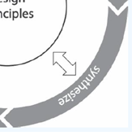
Synthesize phase
Conducting literature research and conducting field research; analysing data from exploration phase.
Research synthesis
Design principles (in this phase based on literature research; initial design principles) can be formulated by using the CAMO logic developed by Denyer, Tranfield and Van Aken (2008)

Slide 13
Synthesize phase
Design synthesis
Design requirements are properties of the artefact (or solution concept) desired by some stakeholders, who has committed resources (time, money) to realize the property.
Design requirements define the expected outcomes and desired states in practice (the goals), and in turn, help in scoping the design principles. (based on wishes from stakeholders ‘translated’ by the design science researcher)
Several types of requirements (e.g., Van Aken, et al. 2018, p 101)
• Functional requirements
• User requirements
• Boundary conditions
• Design restrictions

Slide 14
Synthesize phase
There are different categories of design requirements, as brought forward by Van Aken and Berends (, p. 101–102):2018
Functional requirements: these are the core of the requirements, as they are performance demands. For example, a freezer design: the temperature shall be controlled between 100 °C and – 100 °C. Or a building design: the building must present working space for between 75 and 125 employees. Or operational management: the amount of failures in the production process may not exceed 1%. Or HRM: the amount of women in the board room of the multinational must be 50%.
User requirements: These are from the viewpoint of the user. For example, the freezer must be easy to defrost. Or the building must be user-friendly for people with a wheelchair. Or HRM: the intranet of the organization, with crucial information about all kinds of rights and procedures in the field of HRM, must be understood by everyone in the organization from top to bottom and must easily be accessed.

Slide 15
Synthesize phase
Boundary conditions: These need to be met unconditionally. For example, the freezers system will use 220 volts of power supply. Or the building must consist of reusable/reused materials. Or employees are not allowed to send work-related emails after working hours (AD, 2016)
Design conditions: These compromise the design space preferred by the principal (one or more stakeholders that play a very decisive role in the research). For example, the newly designed freezer makes use of the existing compressor; the principal does not want to bear the costs of developing a new compressor. Or the building should be built upon the stripped former building. This means that the building is stripped till only the concrete framework remains. Then the building is rebuilt, as was, for example, the case with the Atlas building of the Eindhoven Technical University. Or HRM: individual development of employees must be conducted by their own corporate university. The principal does not pay for the costs of external development.

Slide 16
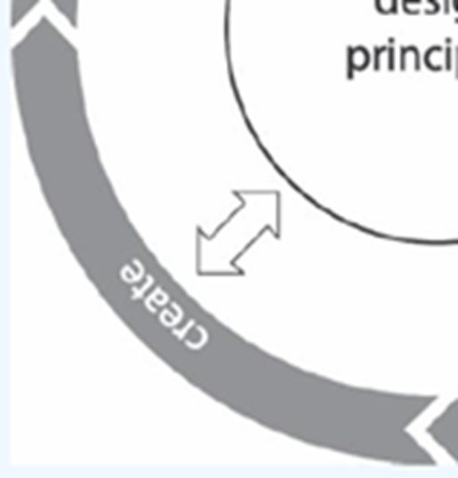
Creation phase: determine solution direction
Solution direction is related to the type of thing you will design, and depends on the domain (e.g., Information Systems, HPM, Innovation management, ...)
Examples:
  Knowledge management approach
  Organizational structure
  Internationalization strategy
  Business model innovation
Main solution direction defines the design space and determines the design parameters

Slide 17
Creation phase: Define design parameters
Design parameters are dimensions of a design where choices can be made to define the artefact (Baldwin & Clark 2000).
Design parameters interval/values
Example:
Design requirements define what the solution should do or achieve. They are sort of the goals of design and do not include solution aspects.
f.e. "a bottle should keep the liquid warm” (Keskin, 2024)
Design parameters are on the other hand the aspects of the solution; they define the solution.
f.e. material: value inner part: glass; outer part: plastic. (Thermo flask)

Slide 18
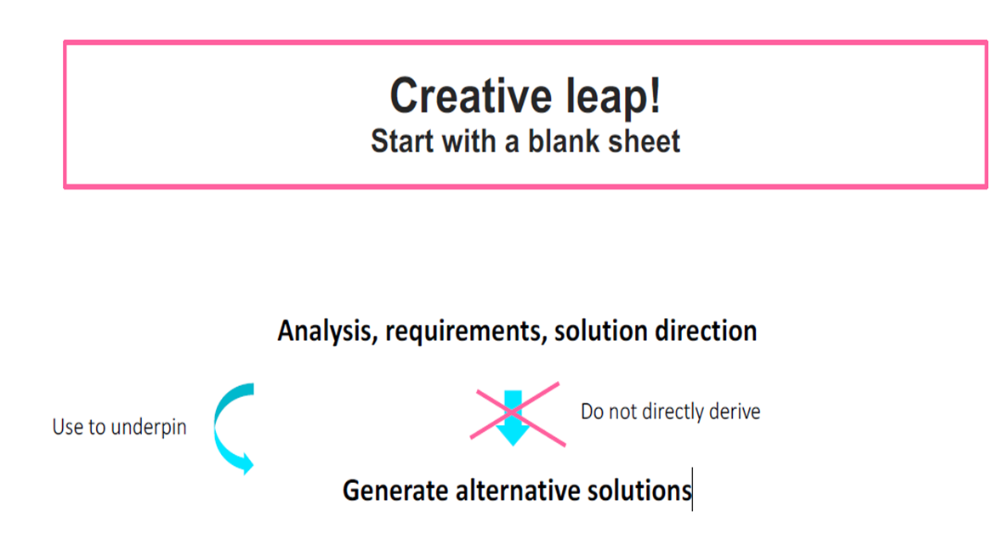
Creation phase

Slide 19
Creation phase
Core of designing: create what should be, things that do not yet exist
Input:
▸ Current situation (problem diagnosis, model of existing situation)
▸ Desired situation (requirements)
▸ Design ideas:
- (Initial) Design principles/models from literature
- Design parameters
- Own creativity
Output:
▸ Different solutions (alternatives)
▸ Each solution be an integral design (tackling several causes of the problem; being a synthesis)

Slide 20
Creation phase: Creativity
Biomimicry: ‘Humanity’s Biggest Challenges. Nature’s Proven Solutions.
We are the bridge between biology and design, advancing the adoption of nature-inspired strategies to help solve the most pressing problems of our time’. See: https://biomimicry.org/

Slide 21
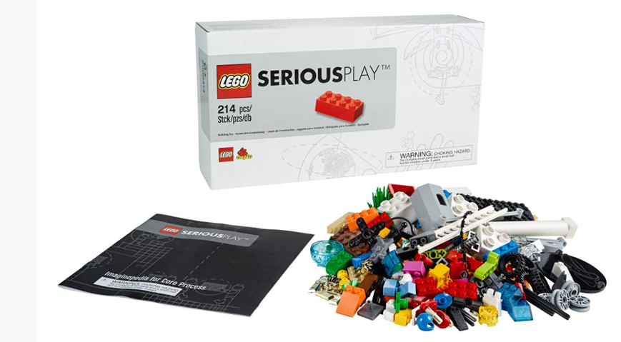
Creation phase: Creativity
Lego Serious play ©

Slide 22
Creation phase
Select a solution:
Select criteria (f.e. requirements) for comparing the solution concepts
Compare solutions concepts based on these criteria
Choose the solution that rates best on the criteria

Slide 23
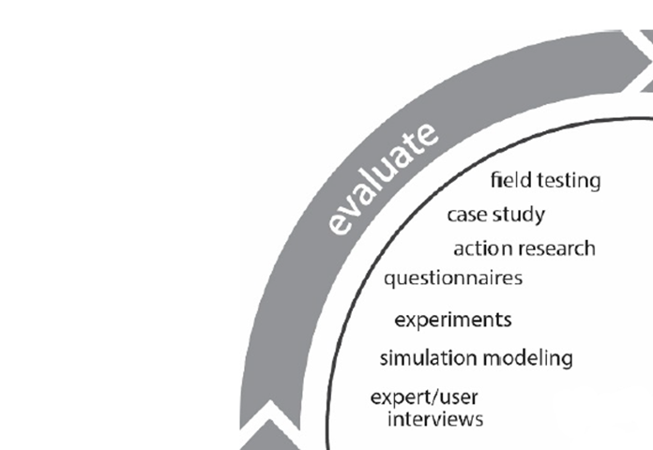
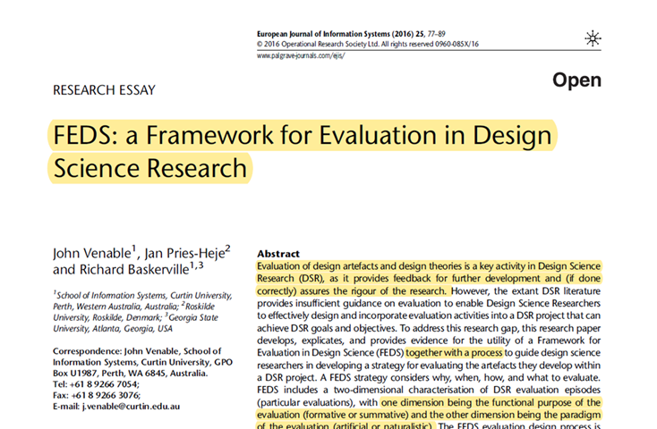
Evaluation phase
Venable et al. (2016)

Slide 24
Evaluation phase
Alpha testing: is to confirm that your intervention is likely to work, checking flaws, incompleteness, and application issues by ‘peers’ (i.e., colleagues)
Beta testing: the intended audience (stakeholders) tries out your intervention, to give some feedback about the intervention (real-world check)

Slide 25
Evaluation phase: How to evaluate/validate?
Qualitative methods:
- Thought experiment (logic) / scenarios
- Role playing
- Pilot
- Focus groups
- Expert interviews
- Case-based reasoning
Quantitative methods:
- Simulation
- Generalisation

Slide 26
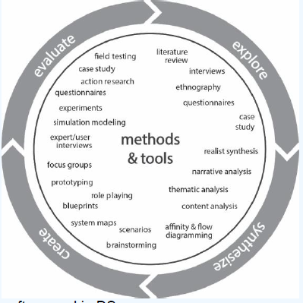
Methods and tools often used in Design Science Research (Keskin and Romme, 2020)

Slide 27
Relevant literature:
Dresch, A., Lacerda, D. P., Antunes Jr, J. A. V., Dresch, A., Lacerda, D. P., & Antunes, J. A. V. (2015). Design science research (pp. 67-102). Springer International Publishing.
Denyer, D., Tranfield, D., & Van Aken, J. E. (2008). Developing design propositions through research synthesis. Organization studies, 29(3), 393-413.
Keskin, D., & Romme, G. (2020). Mixing oil with water: How to effectively teach design science in management education?. BAR-Brazilian Administration Review, 17.
Opdenakker, R., & Cuypers, C. (2019). Effective virtual project teams: a design science approach to building a strategic momentum. Springer.
Opdenakker, R., & Cuijpers, C. (2025). Design science methodology fro the management sciences. Springer.

Slide 28
Van Aken, J. E., & Romme, G. (2009). Reinventing the future: adding design science to the repertoire of organization and management studies. Organization Management Journal, 6(1), 5-12.
Venable, J., Pries-Heje, J., & Baskerville, R. (2016). FEDS: a framework for evaluation in design science research. European journal of information systems, 25, 77-89.
Romme, A. G. L., & Dimov, D. (2021). Mixing oil with water: Framing and theorizing in management research informed by design science. Designs, 5(1), 13.

Slide 29

Questions?

