Slide 1


Experimentation
Pablo Garcia Tello, IdeaSquare, CERN

Slide 2

Change, uncertainty and the invisible
(a physicist perspective on experimentation)
Pablo Garcia Tello
(CERN)

Slide 3

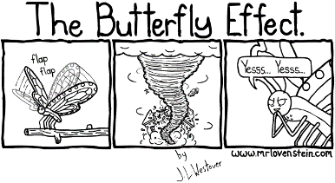
Some things physicists have learnt about Change
Messy is the natural way to be.
Things are totally unpredictable.

Slide 4
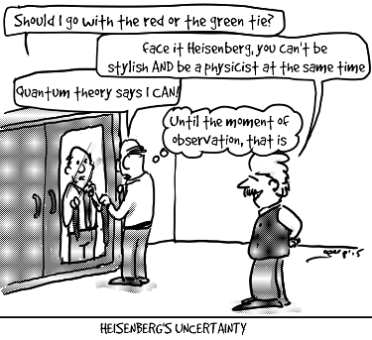
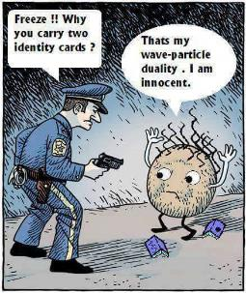
Some things physicists have learnt about Uncertainty
You can't have your cake and eat it.
The answers you get depend on how you ask.

Slide 5
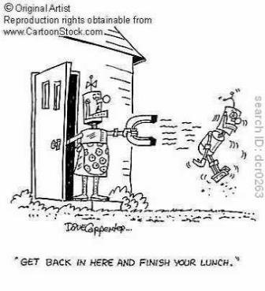
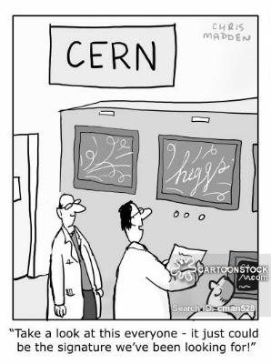
Some things physicists have learnt about Invisible
The is more than meets the eye.
It is possible to see the invisible.

Slide 6
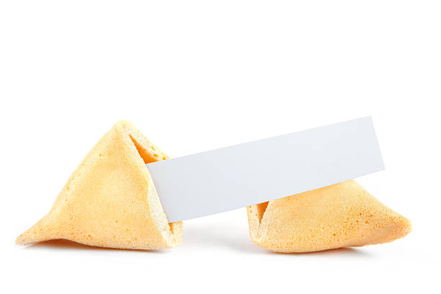
Let’s think about Uncertainty

Slide 7
1
Uncertainty =
Knowledge
Notes:
One thing physicists do is changing variables to make a problem more palatable or familiar.

Slide 8

…and Knowledge is very
related to Curiosity

Slide 9
Curiosity
Curiosity=f(Knowledge)
Pablo Garcia Tello
(CERN)
Knowledge

Slide 10


The Scientific Method
Trick that scientists have for pushing and keeping Curiosity to the maximum leveraging on Knowledge
Curiosity
Curiosity
Curiosity
Pablo Garcia Tello
(CERN)
Knowledge

Slide 11
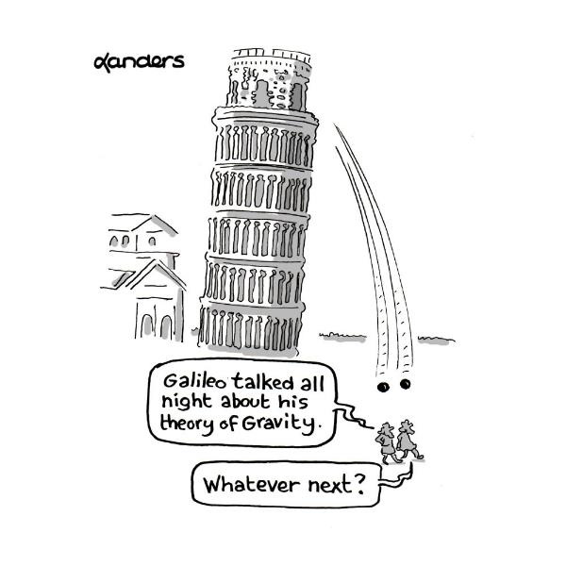
Experimenting is a key step in the
Scientific Method
It is the only way to tame uncertainty…
…but it is risky

Slide 12
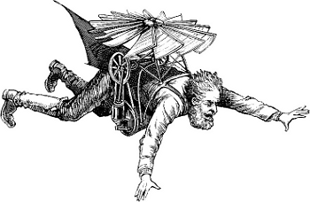
Experiments…
Deliver unexpected results
Cost money & resources
Prove our assumptions wrong

Slide 13
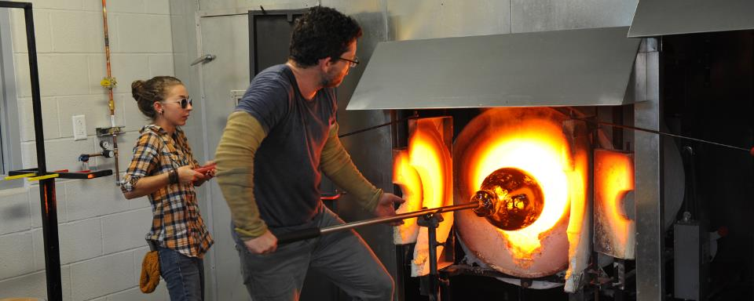
…and the most important thing…
…experiments are craftwork…
(No universal recipe available)

Slide 14
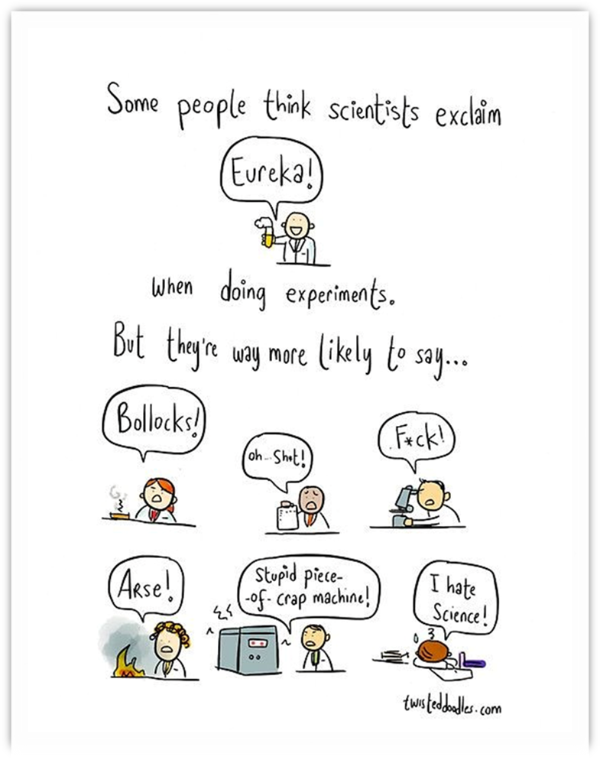


Slide 15
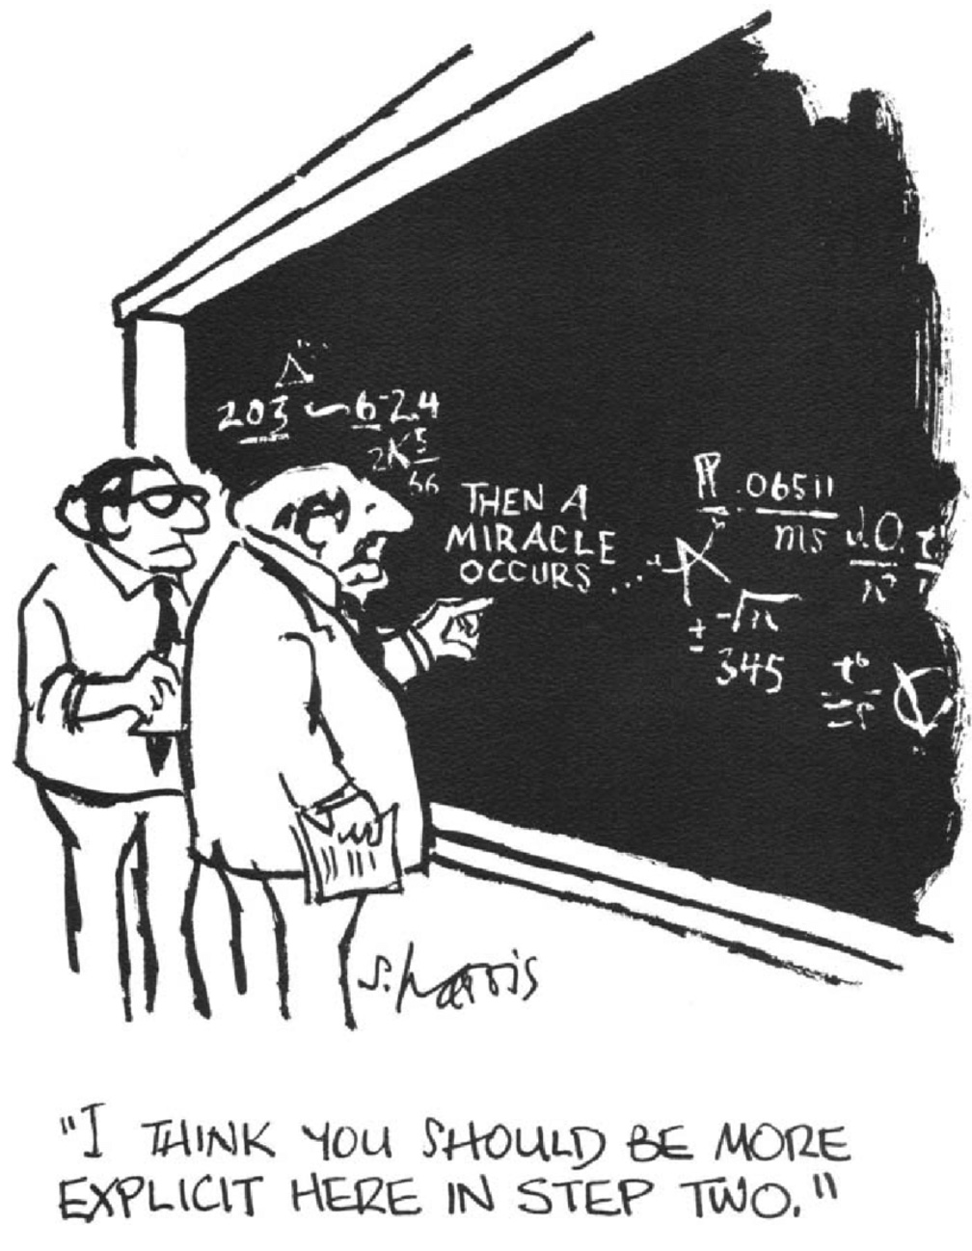
How science happens…for real (I)

Slide 16
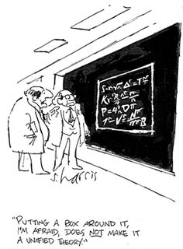
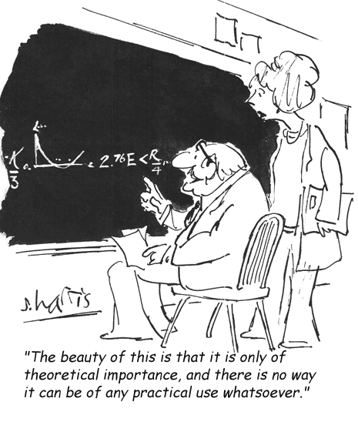
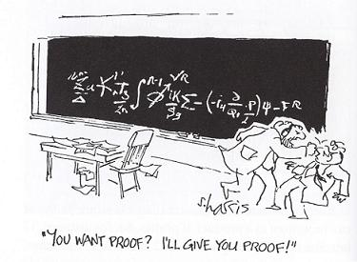
How science happens…for real (II)

Slide 17
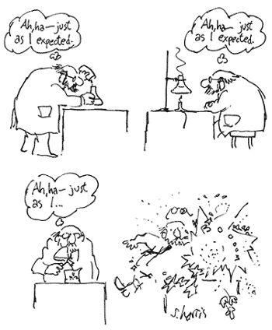
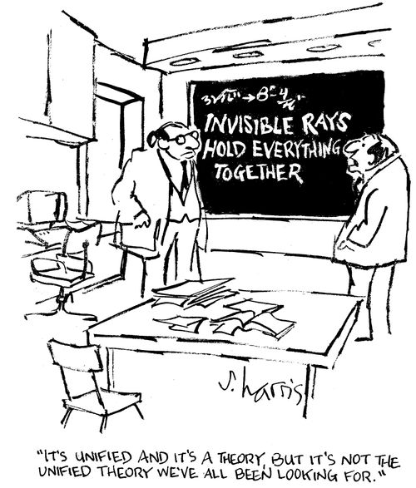
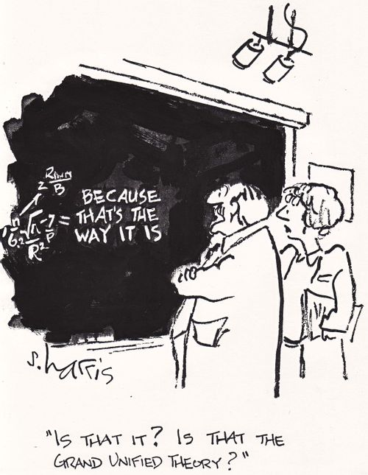
How science happens…for real (III)

Slide 18
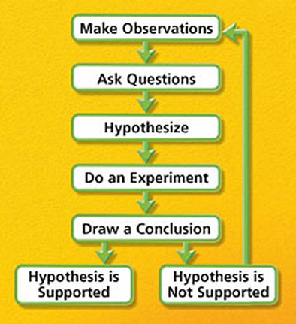
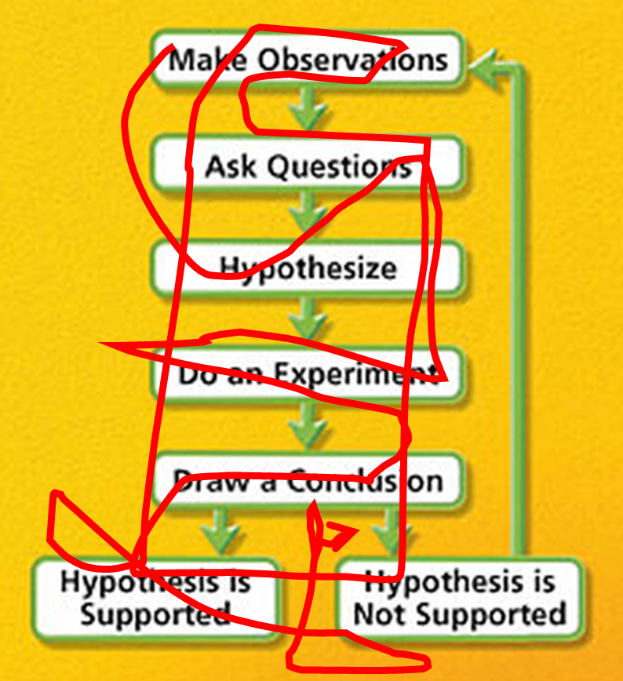
The unbearable myth of linearity…
vs. reality

Slide 19
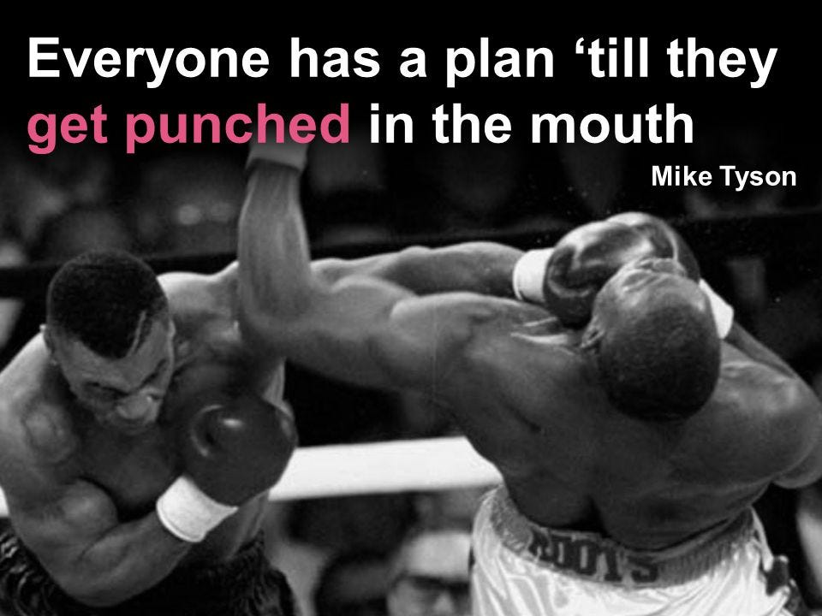
An honest lesson on how the scientific method works

Slide 20

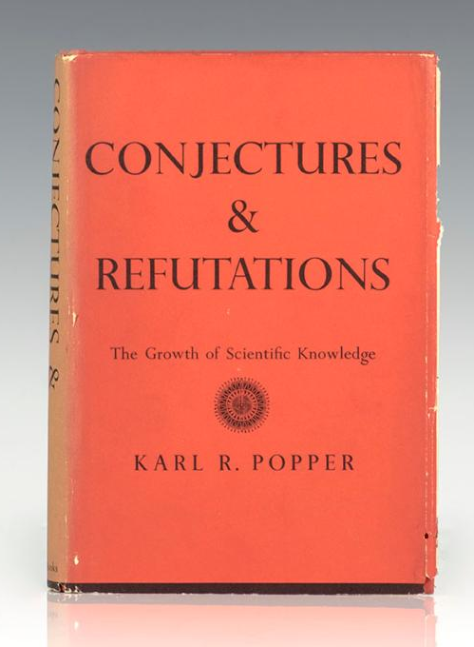
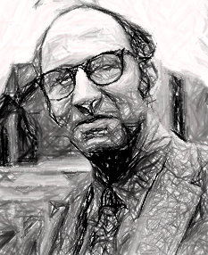
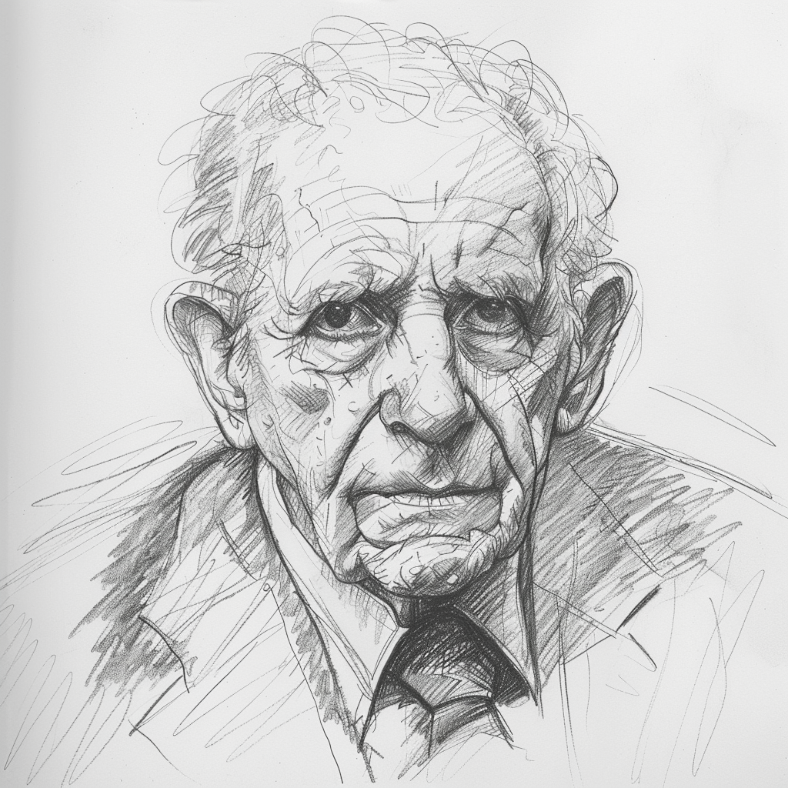

Slide 21

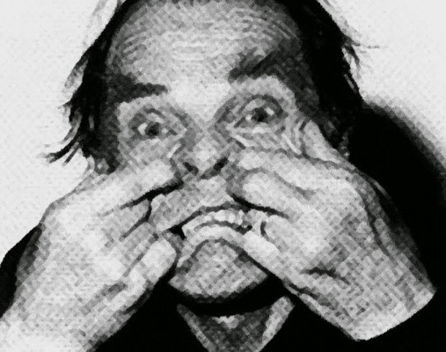

Slide 22
Thanks and Questions

