Slide 1
Magneto-Thermal Stability of Nb₃Sn Wires: a Laser-Induced Quench Approach
J. H. Kuczynska, S.C. Hopkins, C. Senatore, T. Boutboul
10 July 2025

Slide 2


Outline
Motivation
Test Station for Laser-Induced Quench Stability Measurements
Resolution of the Measurements and Data Reporting
Test Procedure
Sample Results
Stability vs. Heat Treatment Temperature
Stability vs. Diameter Reduction
Stability of R&D wire designs (Hypertech)
Outlook
Summary

Slide 3
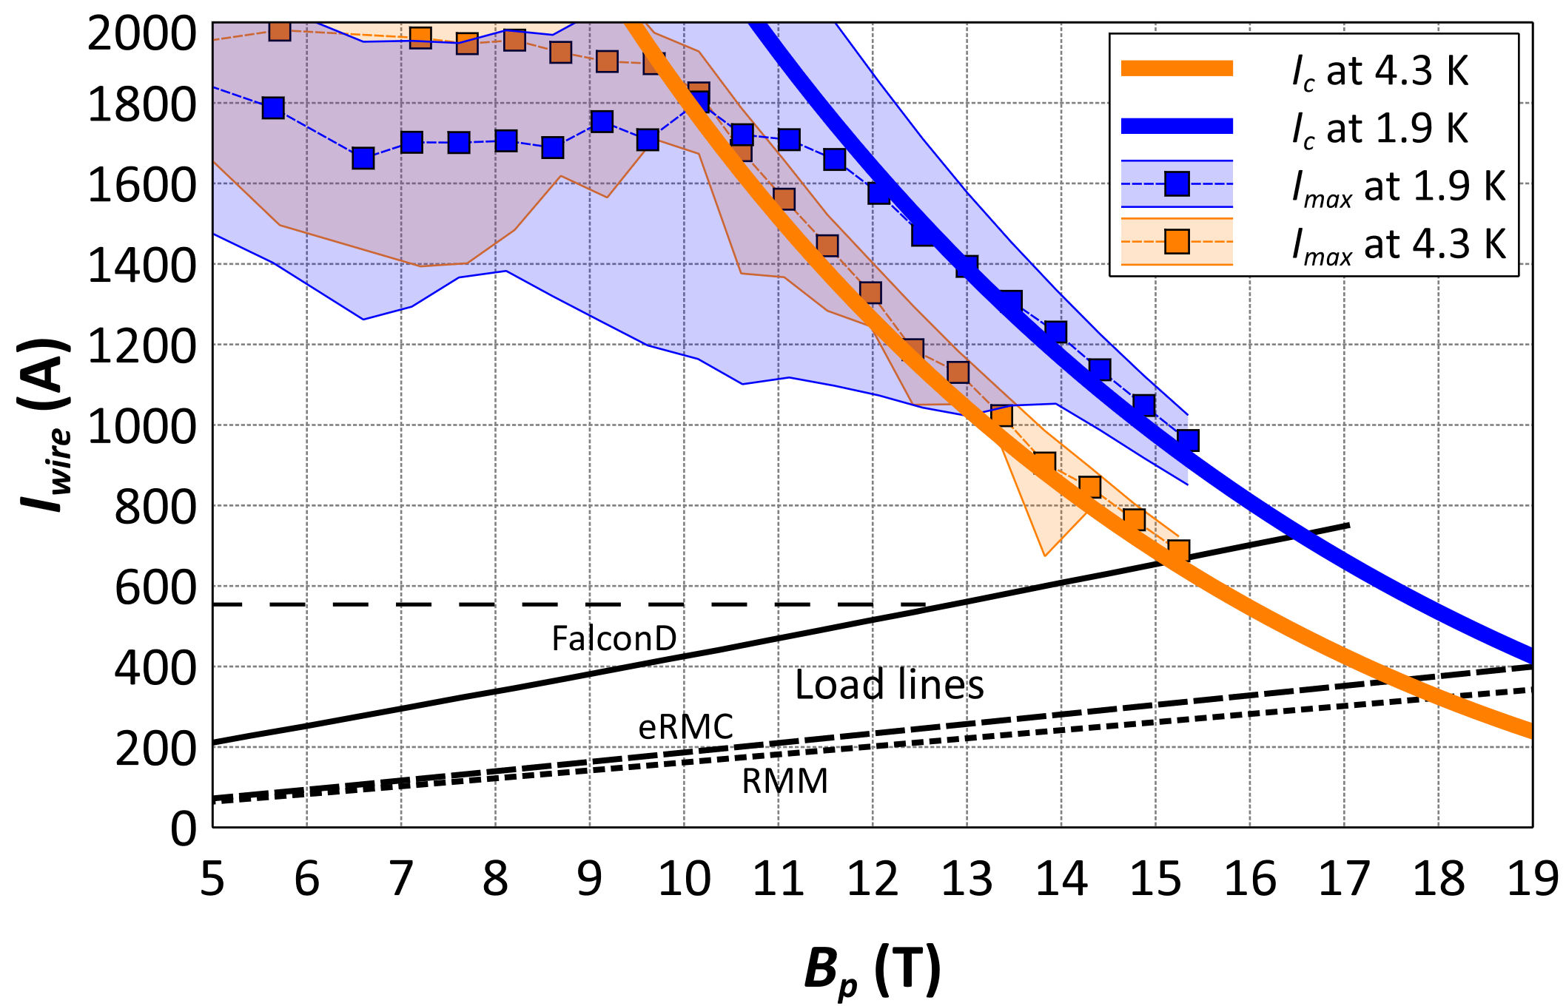
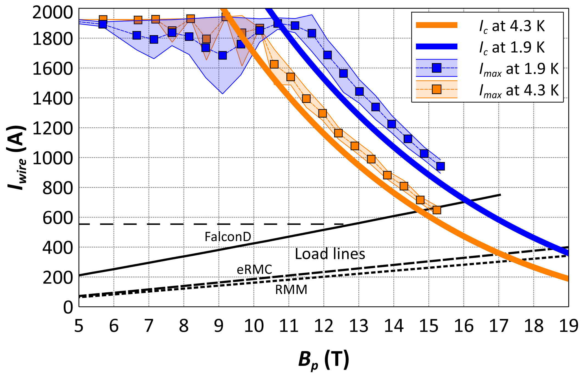
Motivation
Stable superconductors are essential to ensure the reliable operation of superconducting magnets, where instabilities can lead to premature quenches — sudden transitions from the superconducting to normal state, accompanied by the rapid release of energy.
Stability of 1.0 mm Wire: 162/169 RRP®
Signature
of instability
650°C 50 h
650°C 30 h
S. C. Hopkins, Influence of Sub-Element Layout on Nb₃Sn Restacked Rod Process Wire Performance and Cabling Characteristics, ASC 2024

Slide 4
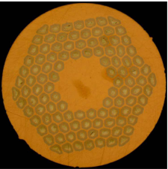

Motivation
Wire Design Considerations in the Context of Stability
` | Optimized for M-T Stability | Cost of optimization
RRR | HT time or temperature Sn content in Nb:Sn ratio | SC fraction B_{c2} J_{c}
Cu:nonCu | Cu content | SC fraction J_{e}
d_{eff} | Sub-element size | Challenging production: yield cost J_{c}
d_{eff}
RRR
Cu Area
=
Cu:nonCu
nonCu Area
Cross section of the RRP® 108/127
(employed in the MQXF magnets of High Luminosity LHC Project)
Optimum between stability and the required high J_{c}.

Slide 5
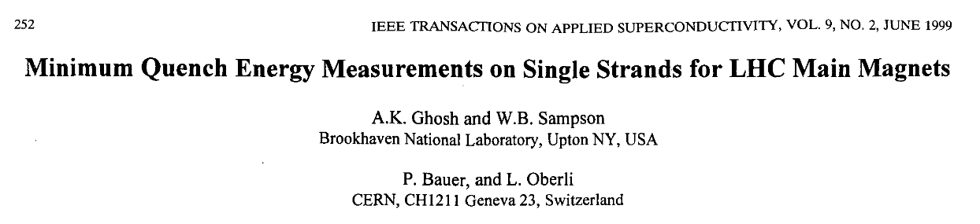
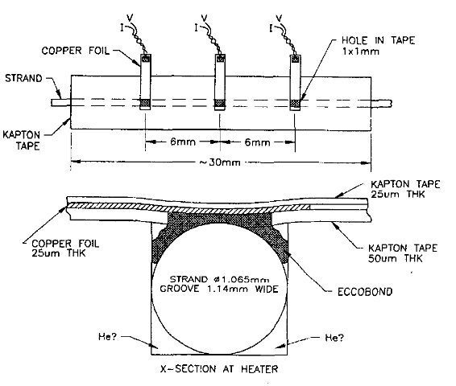
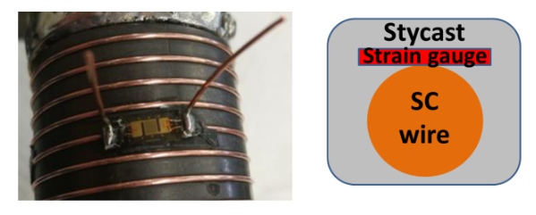
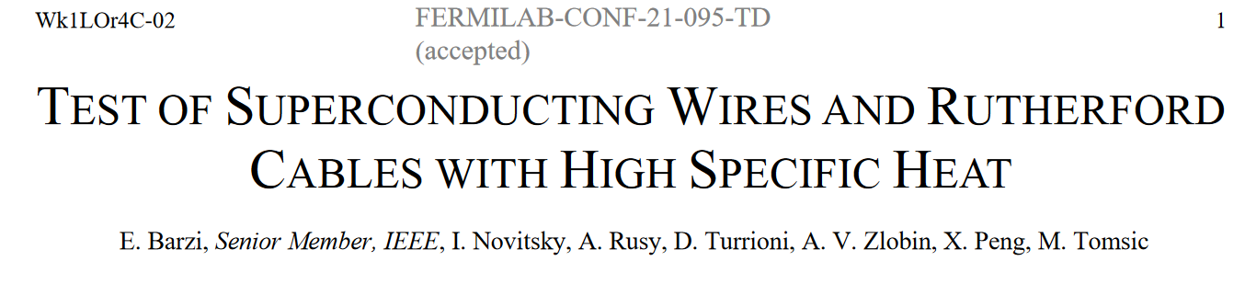
Motivation
Quantify stability by: Minimum Quench Energy (MQE): the smallest amount of energy sufficient to induce a quench.

Slide 6
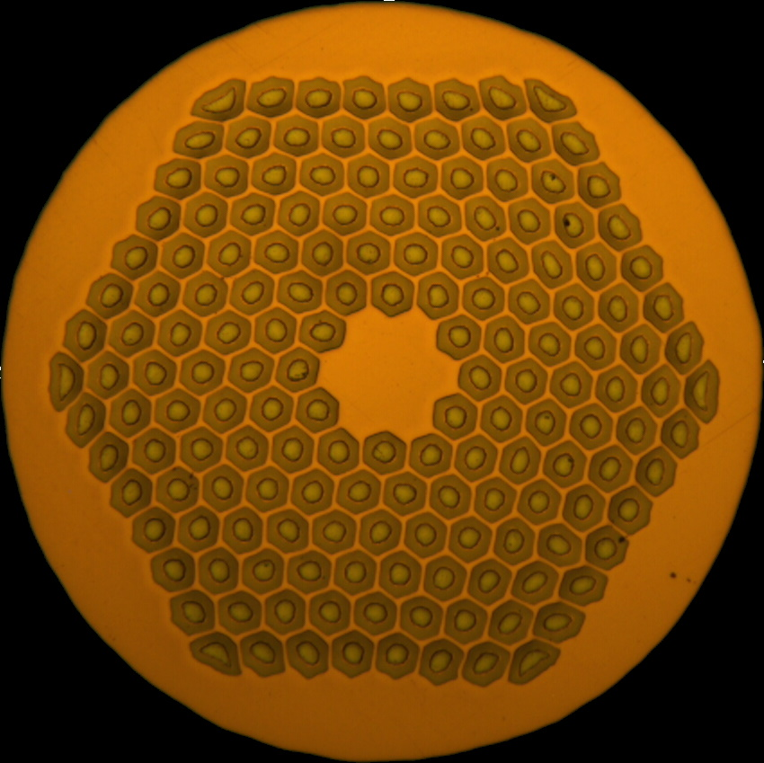
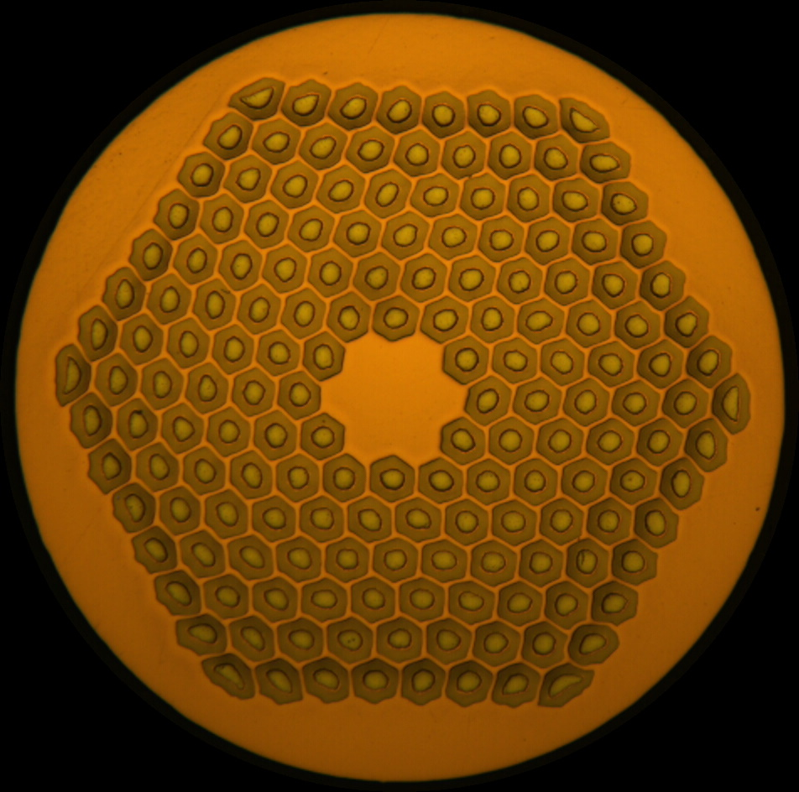
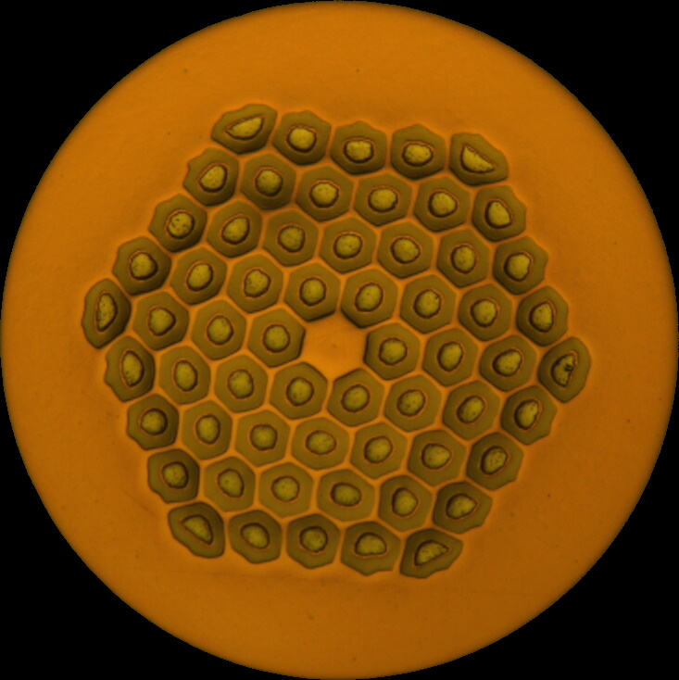
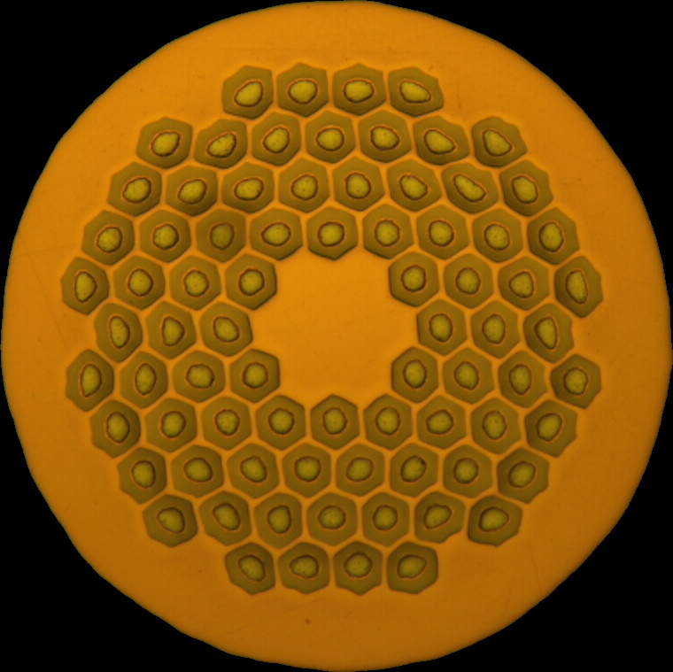
Motivation
Quantify stability by: Minimum Quench Energy (MQE): the smallest amount of energy sufficient to induce a quench.
Wire Designs Currently in Use
HFM low field coils
HL-LHC ref.
HFM high field coils (or ungraded)
 | DEM-0.7 | ERMC-0.7 | MQXF | ERMC-1 | DEM-1.1
d (mm) | 0.7 |  | 0.85 | 1.0 | 1.1
Layout | 60/91 | 78/91 | 108/127 | 162/169
d_{s} (µm) | 54 |  |  | 58 | 64
Cu/non-Cu | 1.8 (≥ 1.6) | 1.2 ± 0.2 | 1.2 ± 0.1 | 0.9 ± 0.2
Nb:Sn | 3.6 (reduced Sn) |  |  | 3.4 (standard Sn)
Heat treatment | 665 °C 50 h |  |  | 650 °C 50 h | 665 °C 50 h
Laser-induced MQE test:
Fast energy deposition: approximative to adiabatic condition
Spatially concentrated
Complementary to the traditional, heater-based measurements
S. C. Hopkins, Influence of Sub-Element Layout on Nb₃Sn Restacked Rod Process Wire Performance and Cabling Characteristics, ASC 2024
This work aims to identify how wire design impacts stability, guiding the development of optimized conductors balancing stability and high J_{c} for future high field magnets.

Slide 7
Motivation
Wire Designs Currently in Use
So far, 10 types of wires have been tested for laser-induced MQE, differing by:
Wire technology
Restacked Rod Process – RRP®
Powder In Tube Bundle-Barrier – PIT BB
R&D wire designs
Layout of RRP® wires
Cu:nonCu ratio
Heat Treatment (HT) temperature
HFM low field coils
HL-LHC ref.
HFM high field coils (or ungraded)
 | DEM-0.7 | ERMC-0.7 | MQXF | ERMC-1 | DEM-1.1
d (mm) | 0.7 |  | 0.85 | 1.0 | 1.1
Layout | 60/91 | 78/91 | 108/127 | 162/169
d_{s} (µm) | 54 |  |  | 58 | 64
Cu/non-Cu | 1.8 (≥ 1.6) | 1.2 ± 0.2 | 1.2 ± 0.1 | 0.9 ± 0.2
Nb:Sn | 3.6 (reduced Sn) |  |  | 3.4 (standard Sn)
Heat treatment | 665 °C 50 h |  |  | 650 °C 50 h | 665 °C 50 h
S. C. Hopkins, Influence of Sub-Element Layout on Nb₃Sn Restacked Rod Process Wire Performance and Cabling Characteristics, ASC 2024
This work aims to identify how wire design impacts stability, guiding the development of optimized conductors balancing stability and high J_{c} for future high field magnets.

Slide 8
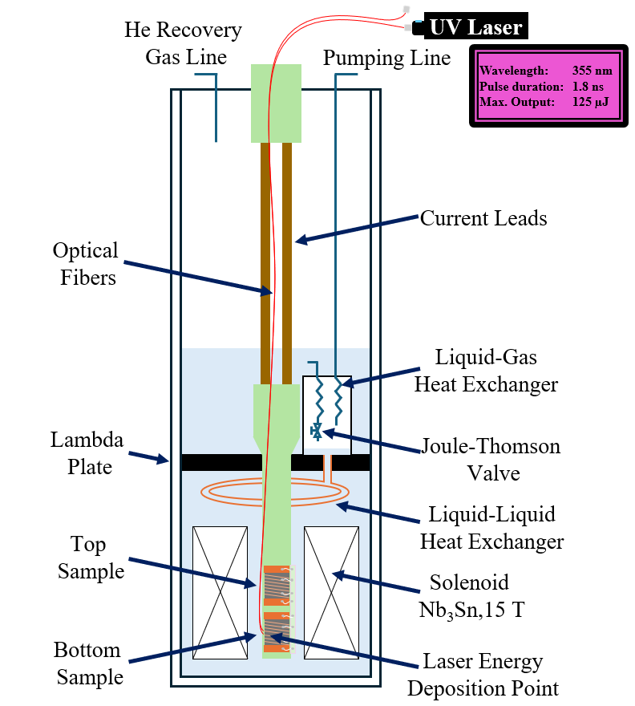
Test Station for Laser-Induced Quench Stability Measurements
Sample is immersed in liquid or superfluid helium, in a bore of a magnet reaching up to 15 T.
A maximum of ~2000 A can be delivered to the sample.
Approximately 1 meter of sample length is mounted on an ITER-type barrel (VAMAS).
2 pairs of voltage taps are mounted at 90 cm distance (at current injection) and at 60 cm distance. Quench is detected and current cut once voltage taps read 30 mV.
Sample is mostly covered in GE varnish to limit its movement during the current ramps, except for areas of laser light deposition.

Slide 9
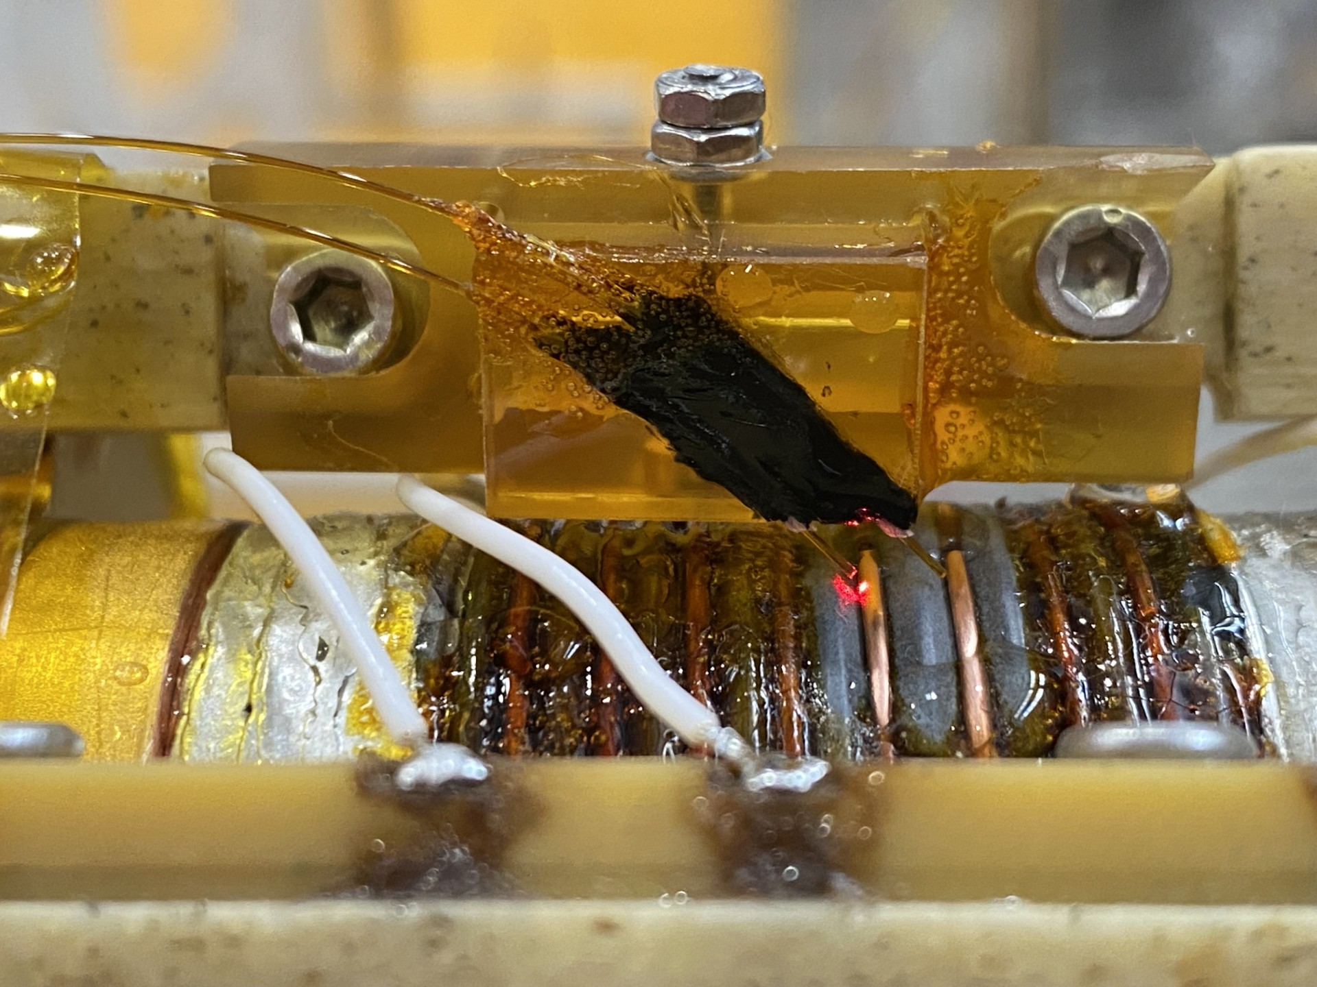
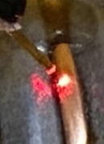
Test Station for Laser-Induced Quench Stability Measurements
2 optical fibers (Ø300 µm) reach sample region in liquid or superfluid helium.
Fiber cleaved end is positioned approx. 0.4 mm away from the sample surface.
Sample surface is cleaned with acetone, then polished in 3 steps with different polishing cloth gradation (500, 1000, 2000).
Laser emits ultraviolet light (355 nm), 1.8 ns pulse width, up to 125 µJ.
Two fibers have been employed for each cooldown, providing two sets of data for majority of test conditions (magnetic field, current, temperature)
Optical fibers
Deposition Spots
Sample Mounted for the Laser MQE Test

Slide 11
Test Station for Laser-Induced Quench Stability Measurements
Total area of the affected surface closely corresponds to the fiber size.
Highly altered zone in the center of the deposition spot.
Possible local melting of the copper.
“Halo” effect beyond the highly affected center of the spot.
Ø200 µm

Slide 12
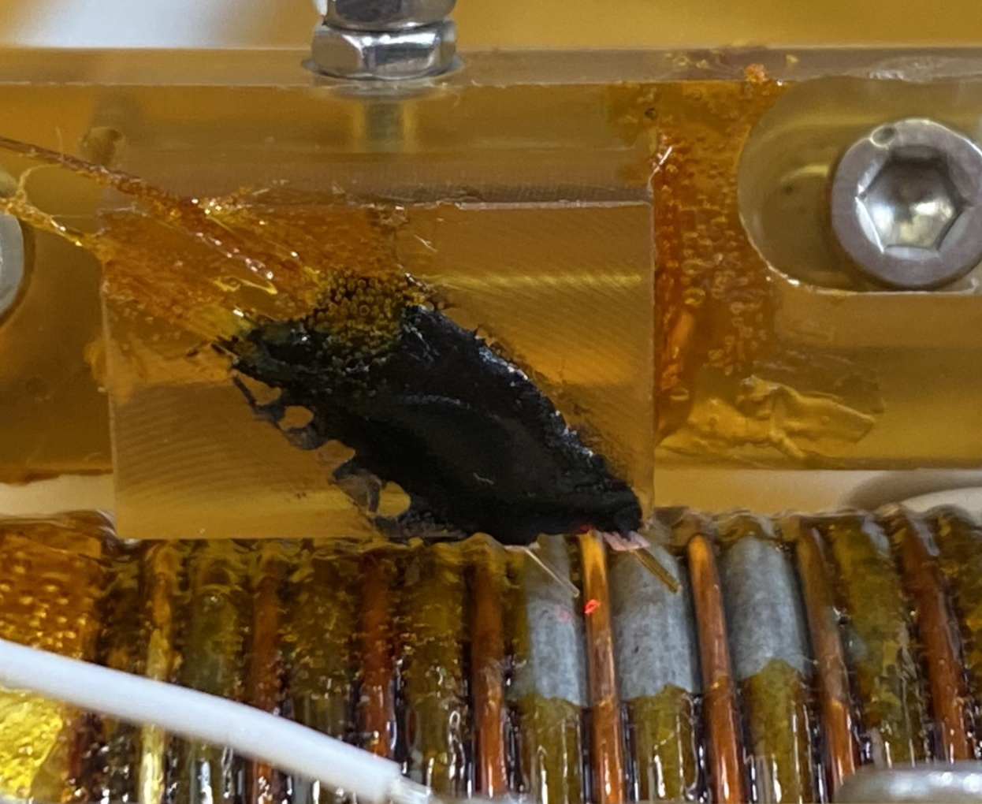

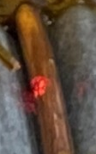
Test Station for Laser-Induced Quench Stability Measurements
Total area of the surface modification closely corresponds to the fiber size.
Highly altered zone in the center of the deposition spot.
Possible local melting of the copper.
“Halo” effect beyond the highly condensed center of the spot.
Fiber
Ø300 µm
Fiber
Ø200 µm

Slide 13
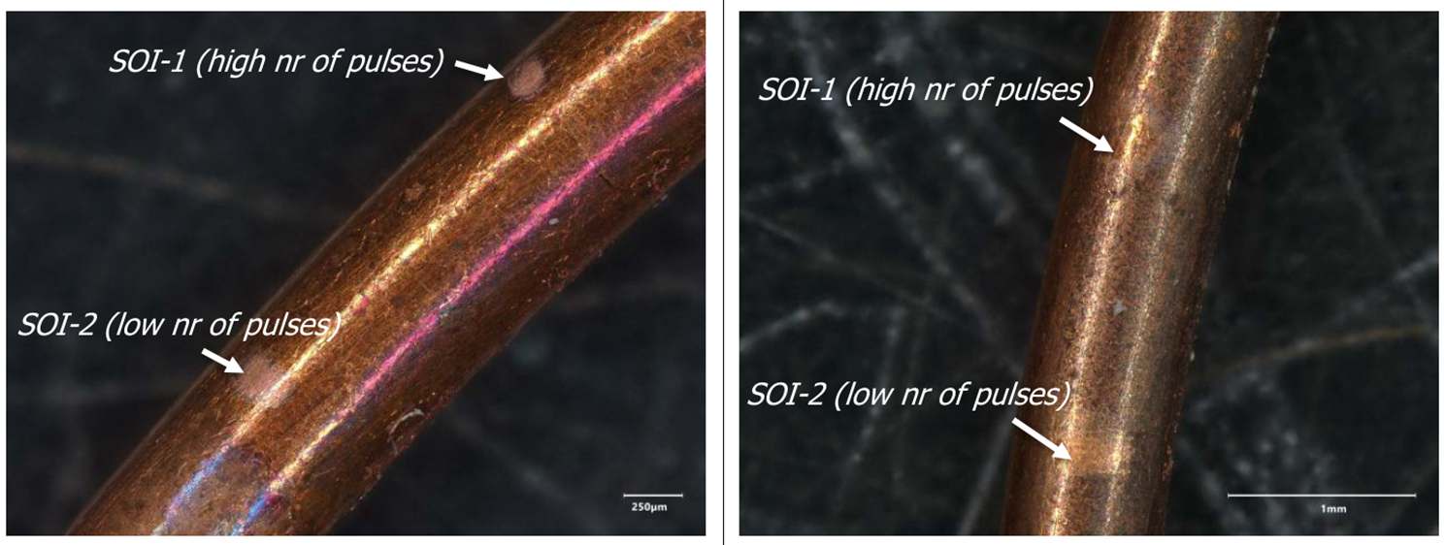
Test Station for Laser-Induced Quench Stability Measurements
Ø200 µm
Low: 8.0 mJ
High: 14.9 mJ
Ø300 µm
Low: 3.8 mJ
High: 15.5 mJ
Courtesy of Ana Teresa Perez Fontela, EN-MME

Slide 14
Test Station for Laser-Induced Quench Stability Measurements
Ø200 µm
Low: 8.0 mJ

Slide 15
Test Station for Laser-Induced Quench Stability Measurements
Ø200 µm
Low: 8.0 mJ

Slide 16
Test Station for Laser-Induced Quench Stability Measurements
Ø200 µm
High: 14.9 mJ

Slide 17
Test Station for Laser-Induced Quench Stability Measurements
Ø300 µm
High: 15.5 mJ

Slide 18
Test Station for Laser-Induced Quench Stability Measurements
Ø300 µm
High: 15.5 mJ

Slide 19
Test Station for Laser-Induced Quench Stability Measurements
Ø200 µm
High: 14.9 mJ
Ø300 µm
High: 15.5 mJ
300 µm, LE
Ø200 µm
Low: 8.0 mJ
Ø300 µm
Low: 3.8 mJ

Slide 20
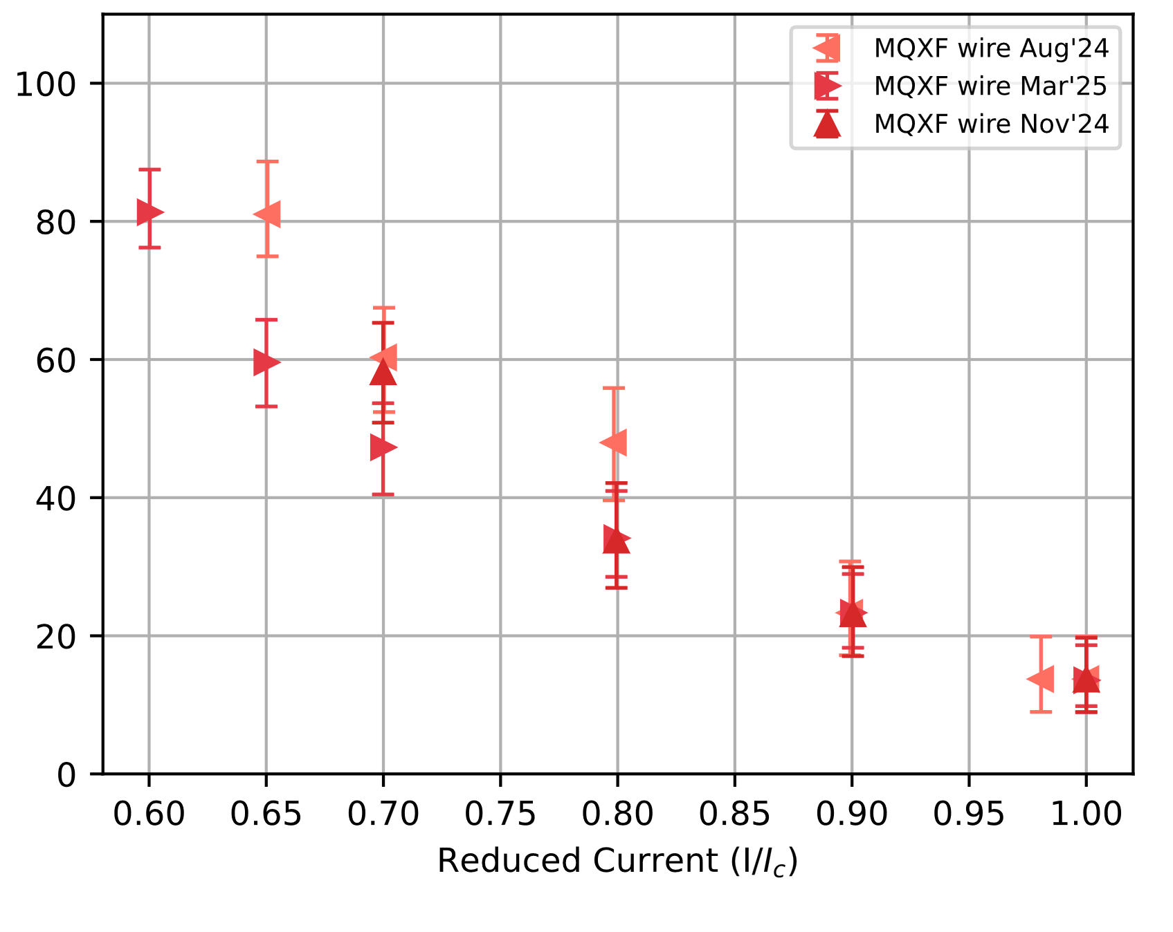
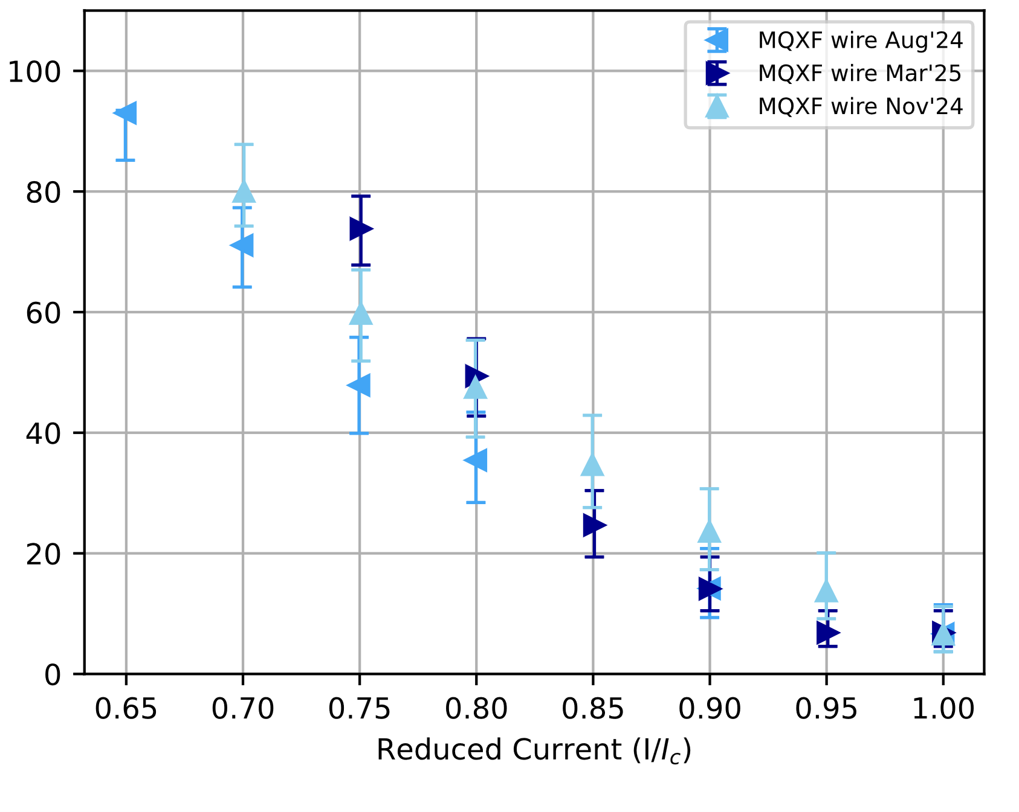
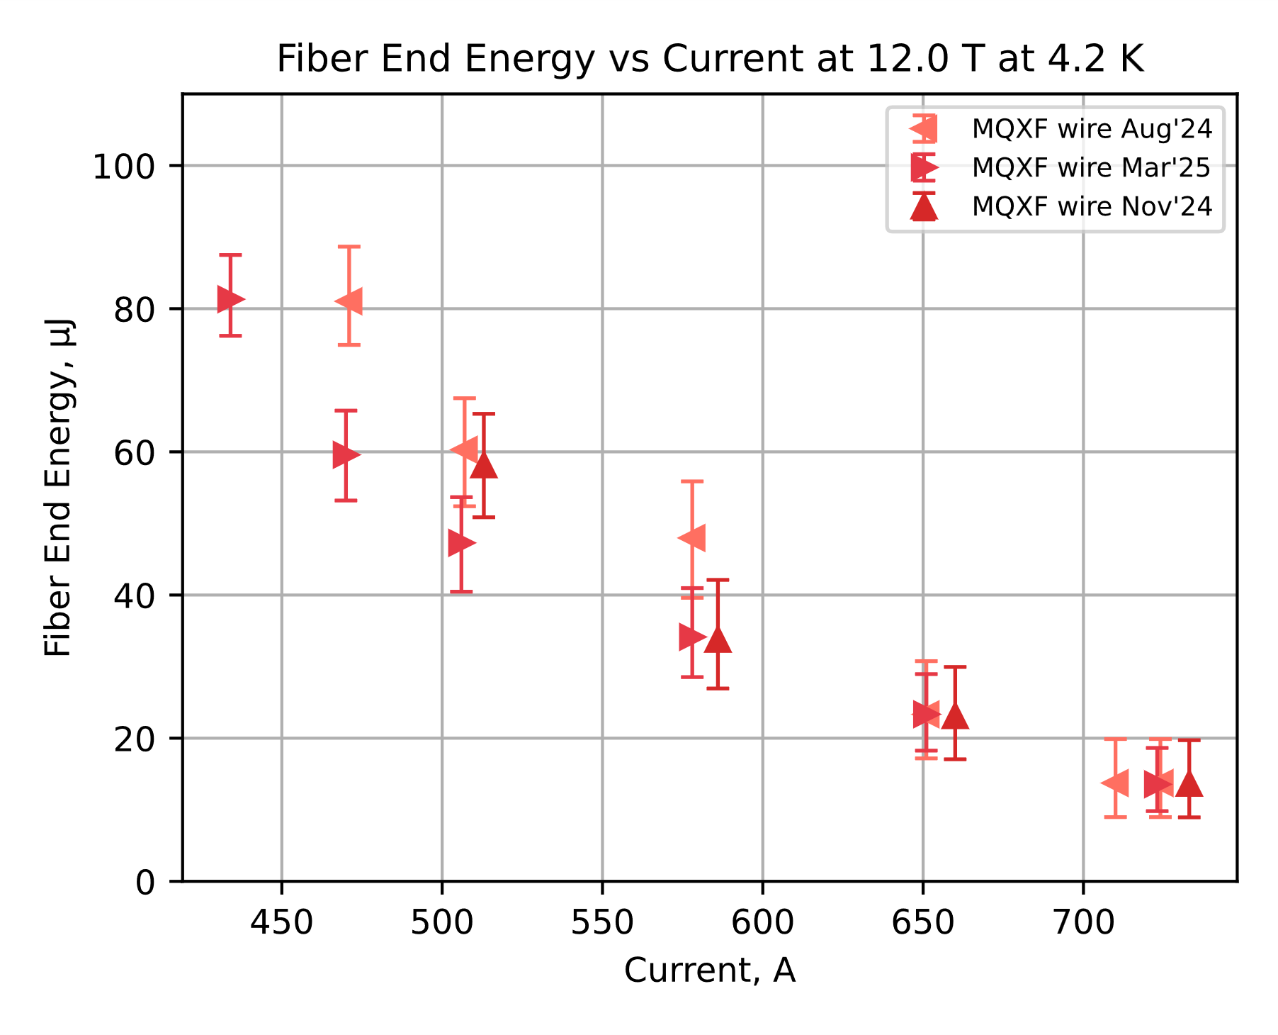
Test Station for Laser-Induced Quench Stability Measurements
Stability of Ø0.85 mm Wire: 108/127 RRP®
12 T @4.2 K
12 T @1.9 K

Slide 21
Test Station for Laser-Induced Quench Stability Measurements
Sample is immersed in liquid or superfluid helium, in a bore of a magnet reaching up to 15 T.
A maximum of ~2000 A can be delivered to the sample.
Approximately 1 meter of sample length is mounted on an ITER-type barrel (VAMAS)
2 pairs of voltage taps are mounted at 90 cm distance (at current injection) and at 60 cm distance. Quench is detected and current cut once the 60 cm voltage taps read 30 mV.
Sample is mostly covered in GE varnish to limit its movement during the current ramps, except for areas of laser light deposition.

Slide 22
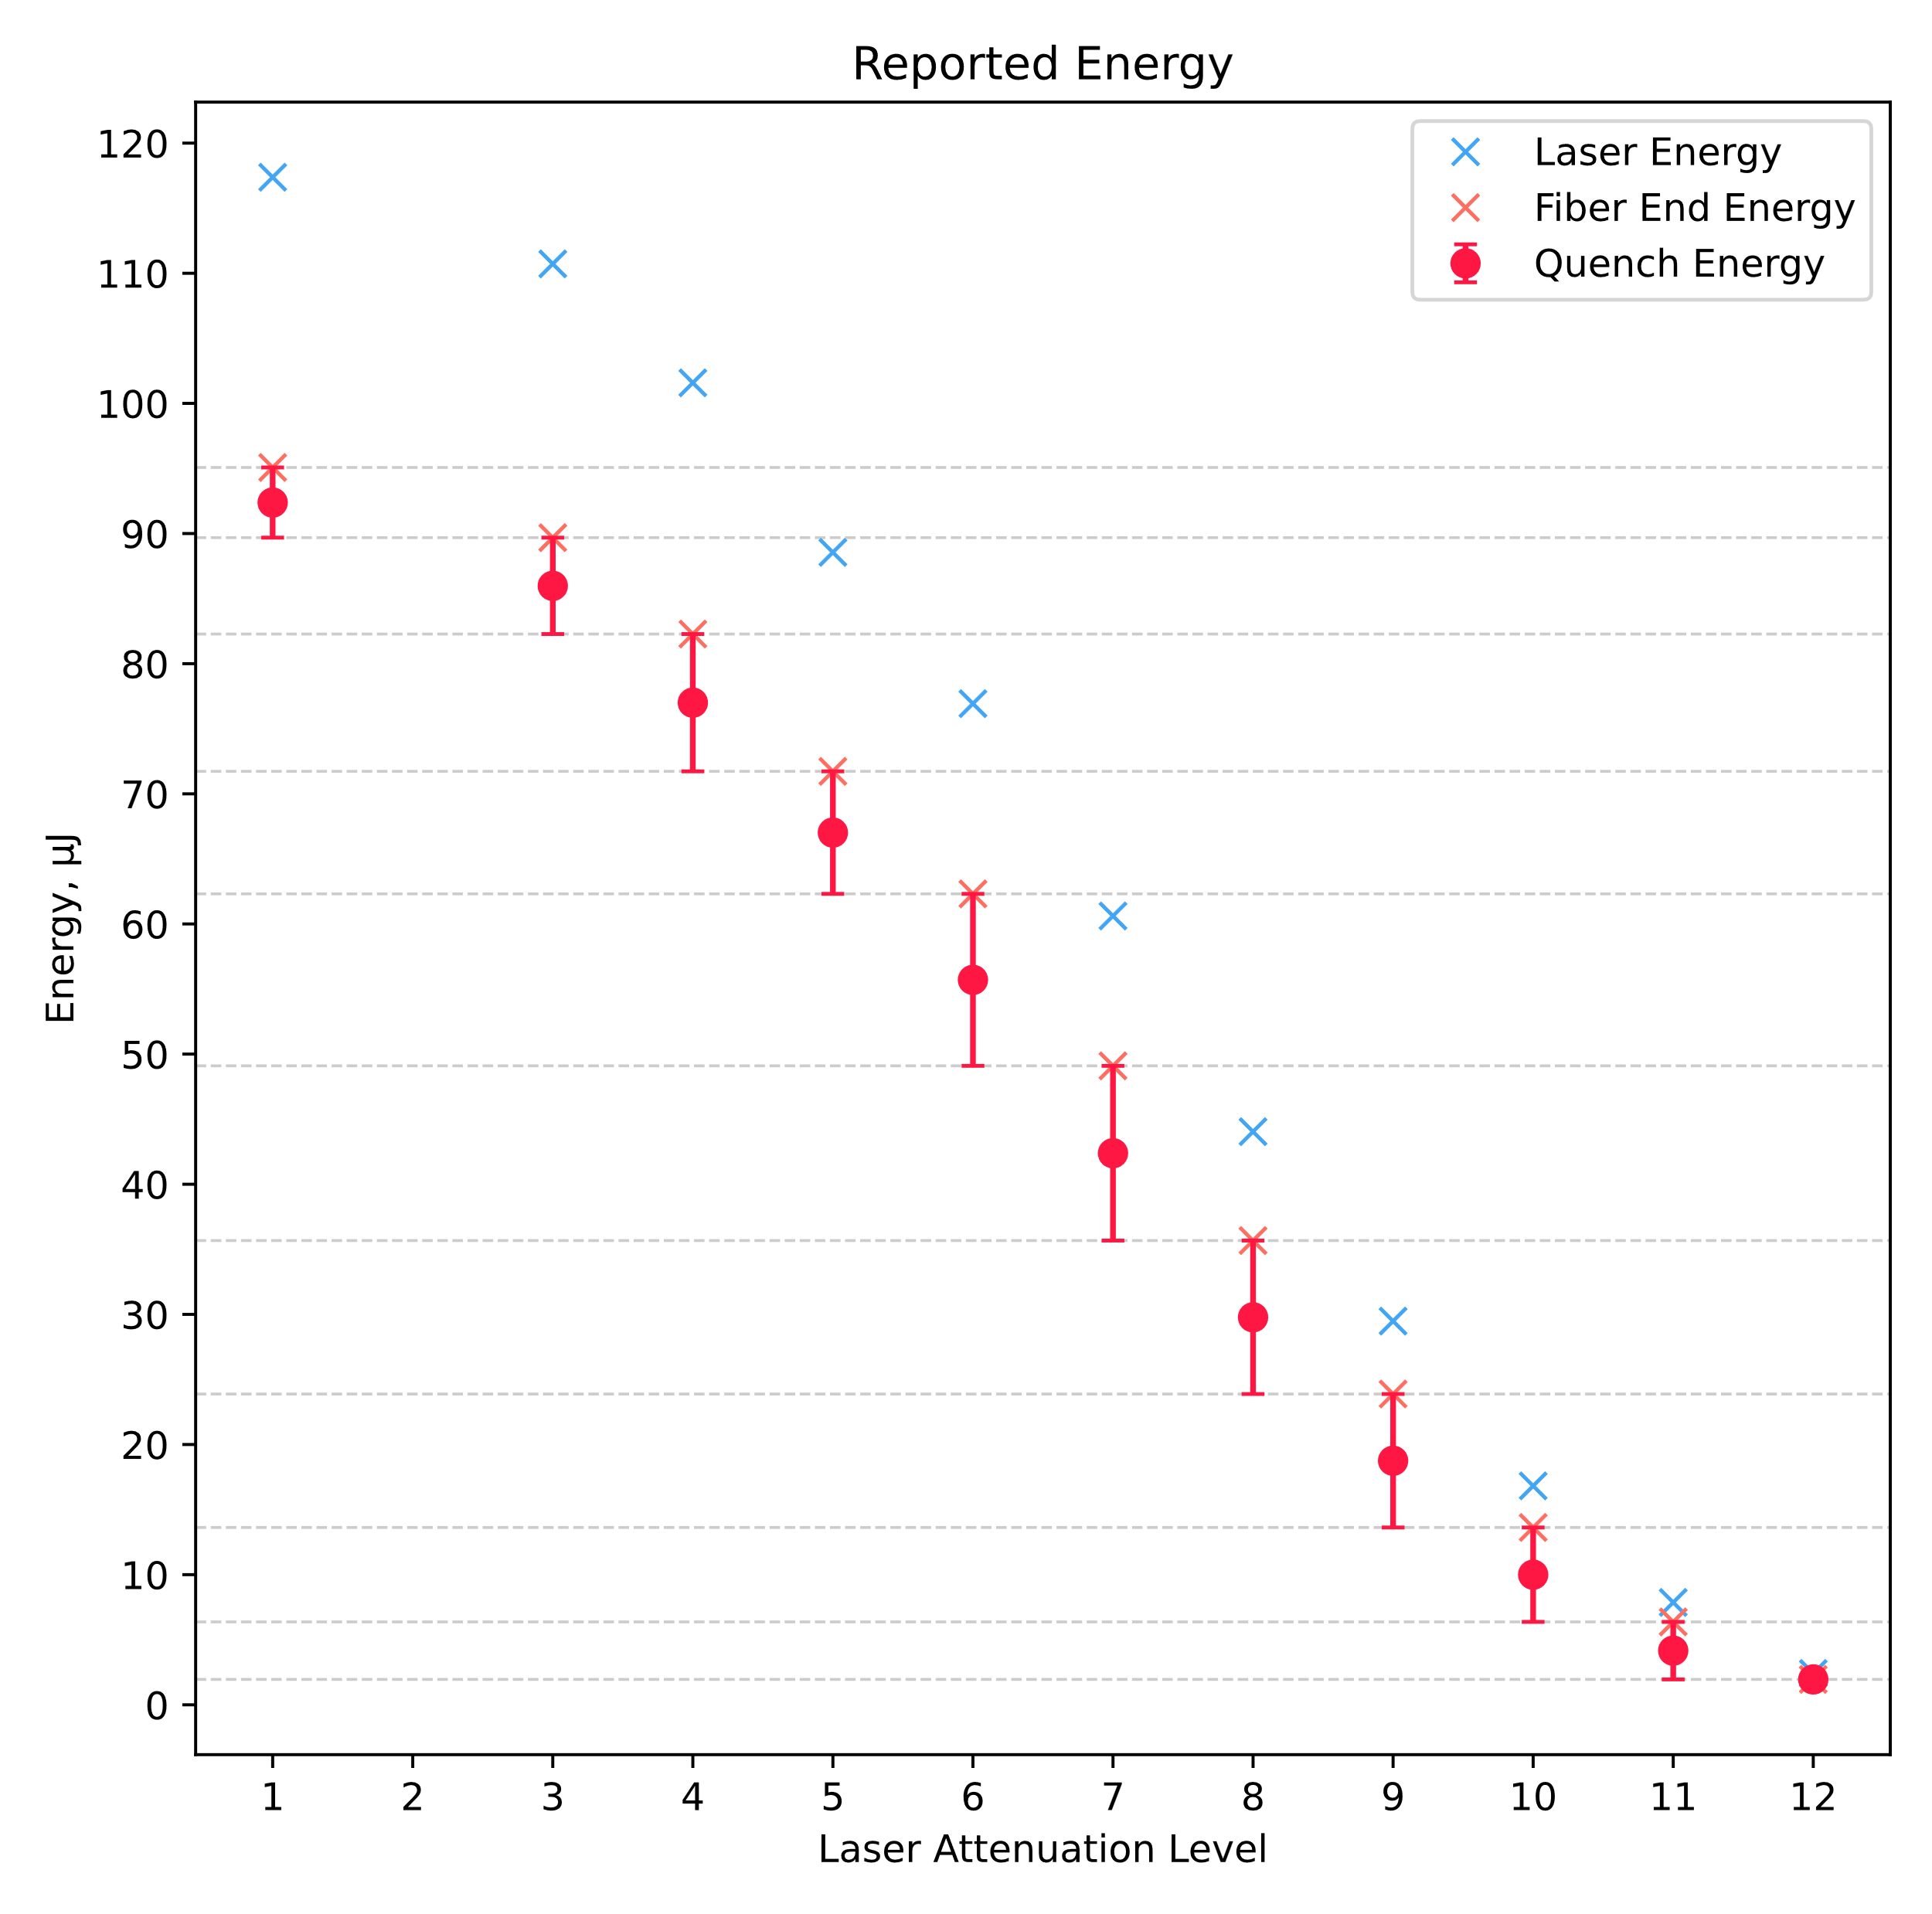
Resolution of the Measurements and Data Reporting
12 discrete levels of Laser Energy are available with laser’s attenuator.
On average, 81% of laser energy is emitted at the end of the fiber in room temperature - Fiber End Energy.
For each testing condition, laser energy sufficient and not sufficient to induce a quench is determined. The energy reported as Quench Energy is the midpoint between the relevant Fiber End Energy values.
Available Discrete Energy Levels

Slide 23
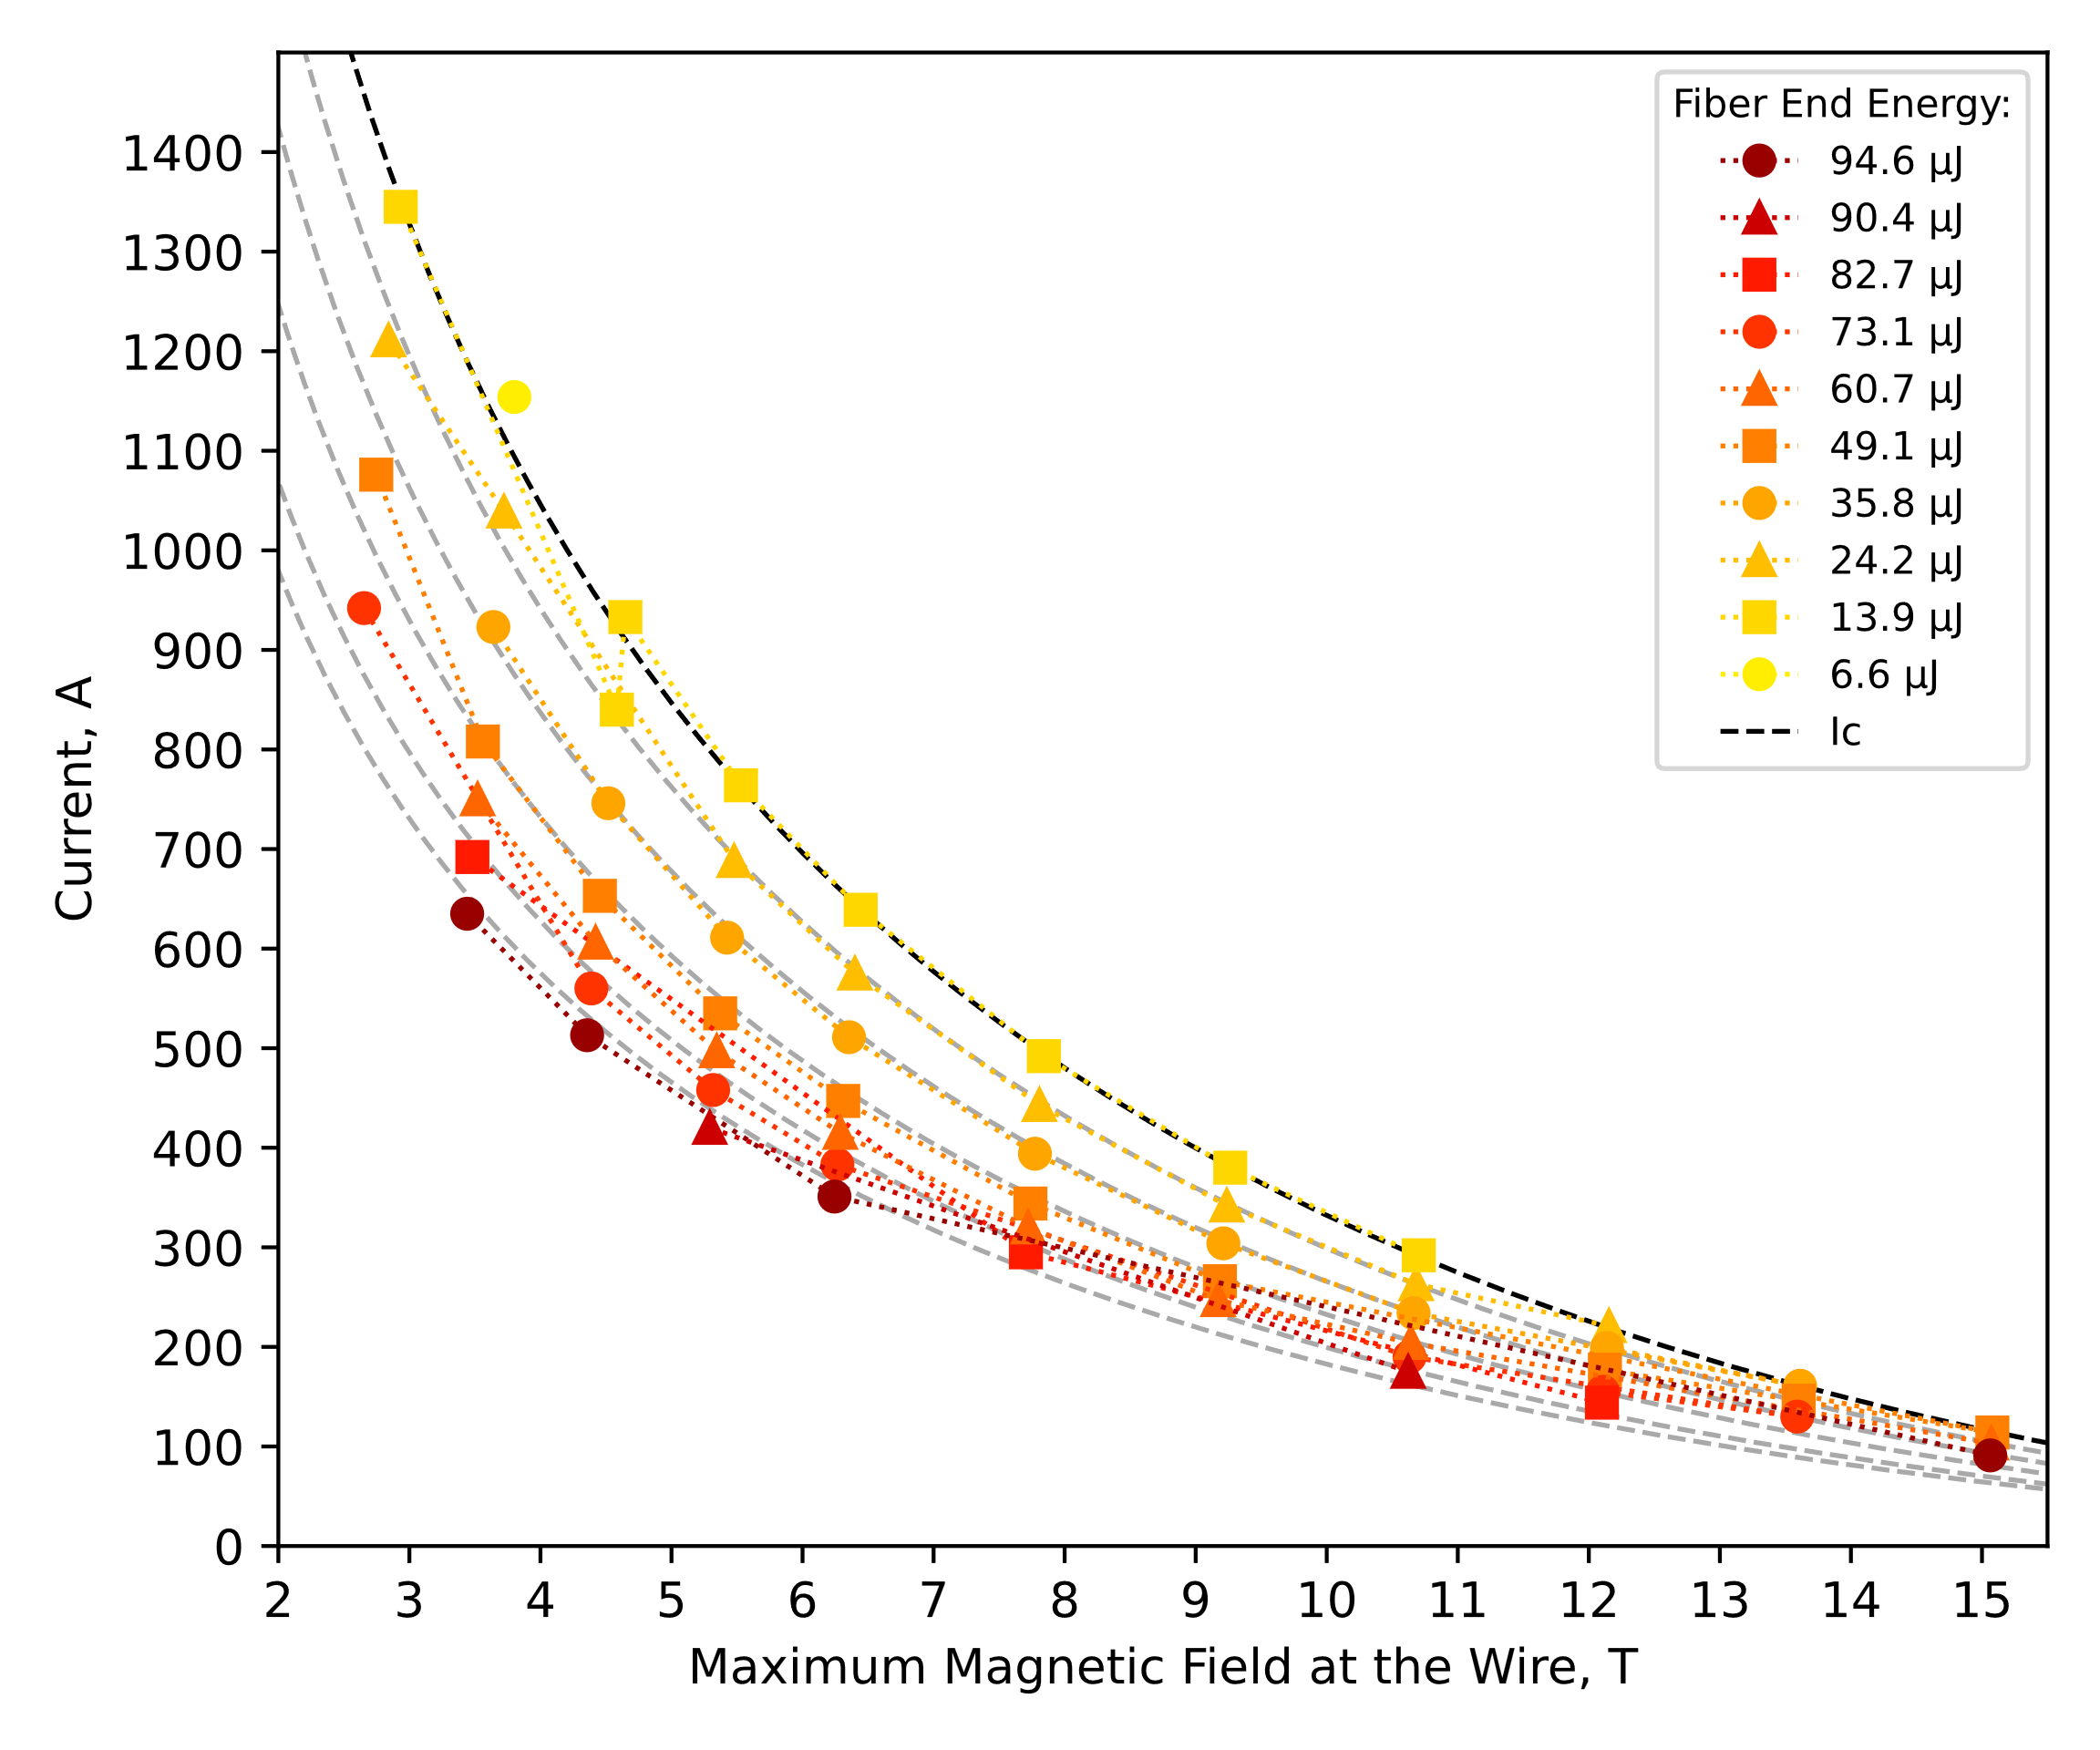
Test Procedure
At each field in the range of 6 T – 15 T with a 1.5 T step, quench energy is determined at fixed increments of the I_{c} (5% or 10%).
The test continues until the maximum laser energy available is not sufficient to induce a quench.
The range of results obtained is determined by the maximal current deliverable in the station (~2000 A) and maximal laser energy.
90%
80%
70%
60%
55%
Example of a Complete Data Set of a Laser-Induced Quench Stability Test at 4.25 K

Slide 24
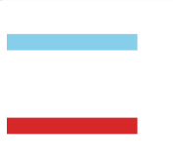
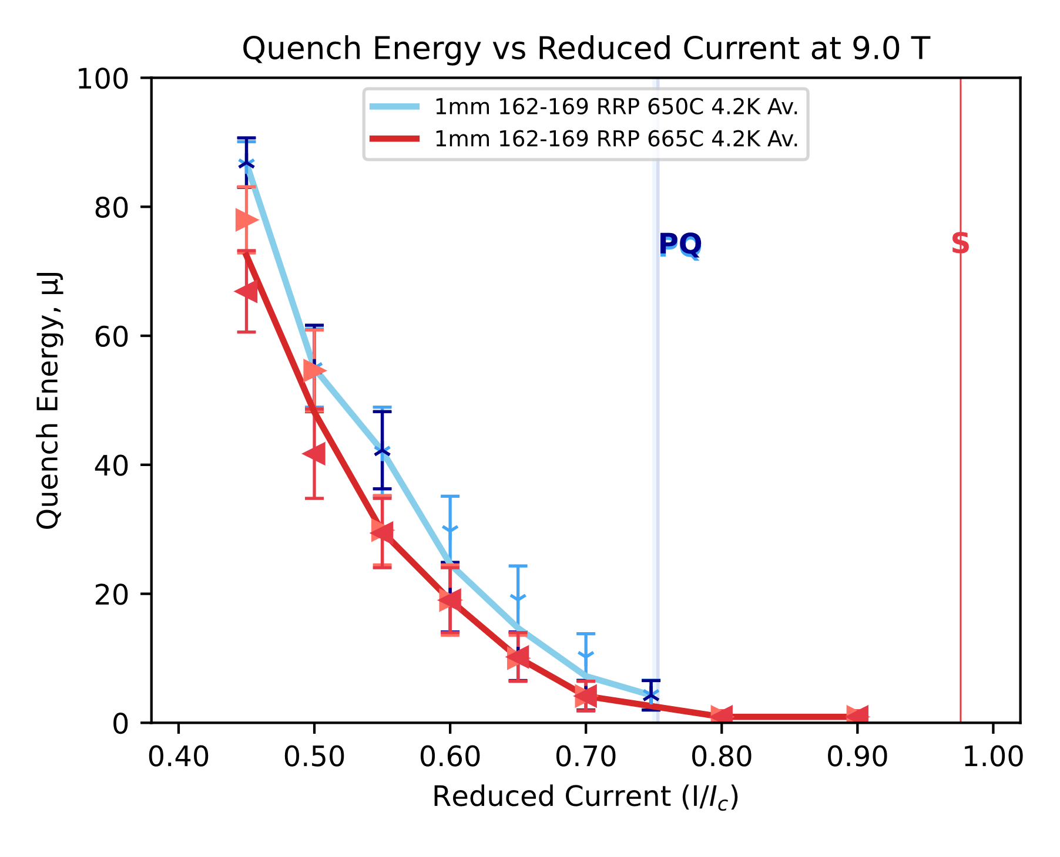
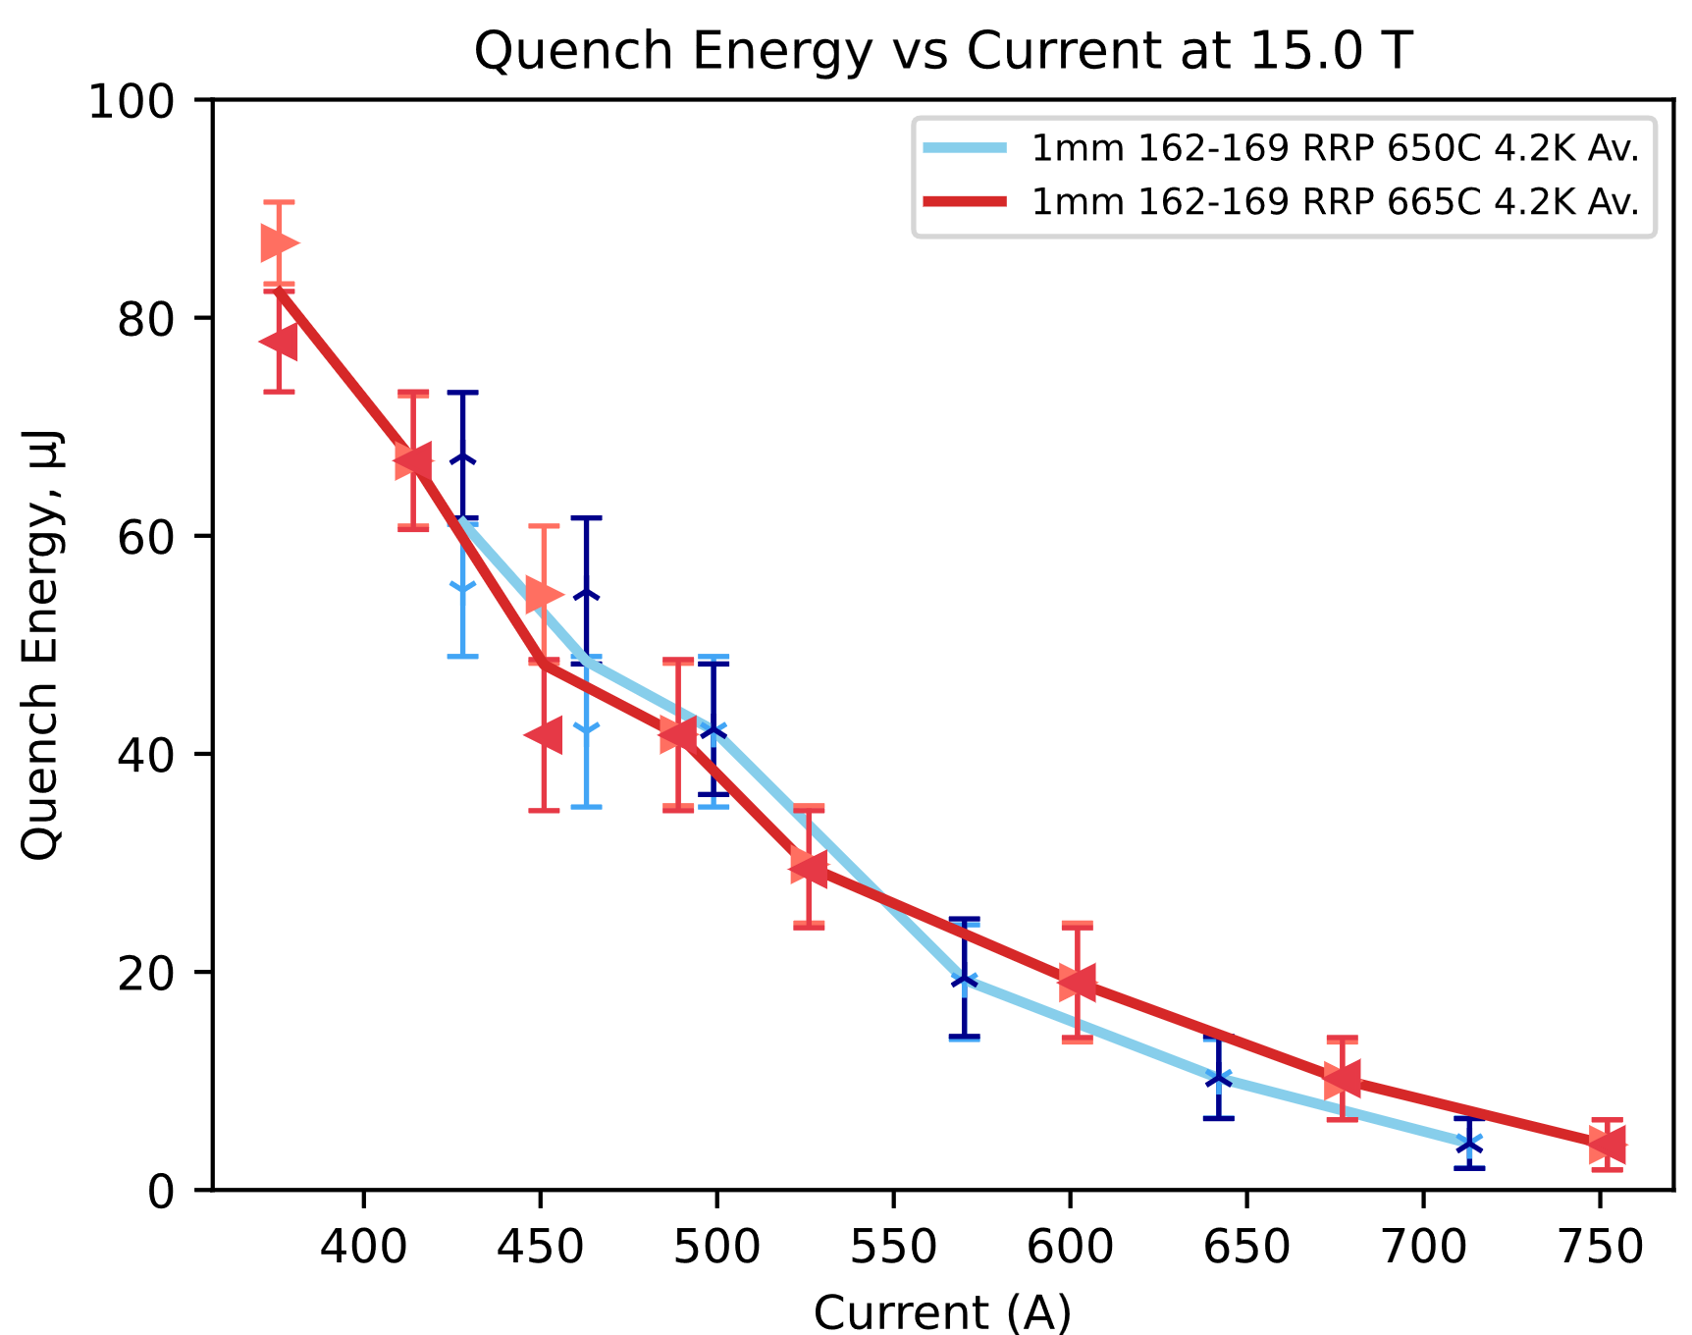
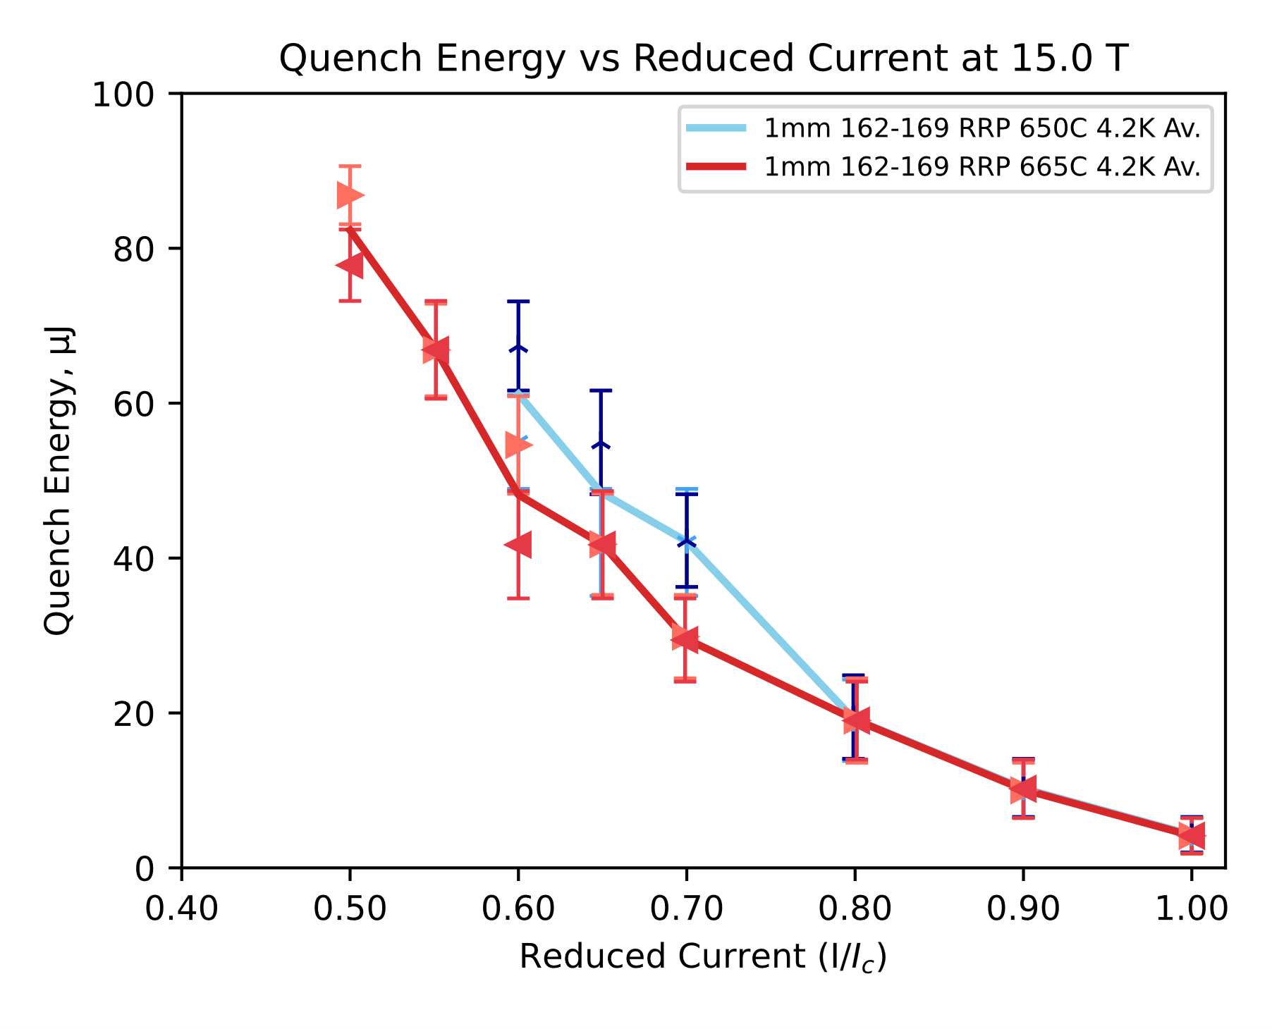
Sample Results
 | ERMC-1 | ERMC-1
d (mm) | 1.0
Layout | 162/169
d_{s} (µm) | 58
Cu/non-Cu | 0.9 ± 0.2
RRR | 283 | 109
Nb:Sn | 3.4 (standard Sn)
Heat treatment | 650°C 50 h | 665 °C 50 h
Stability vs. Heat Treatment Temperature
162/169 RRP® Bruker, last HT step 650°C 50 h
162/169 RRP® Bruker, last HT step 665°C 50 h
650°C
665°C

Slide 25
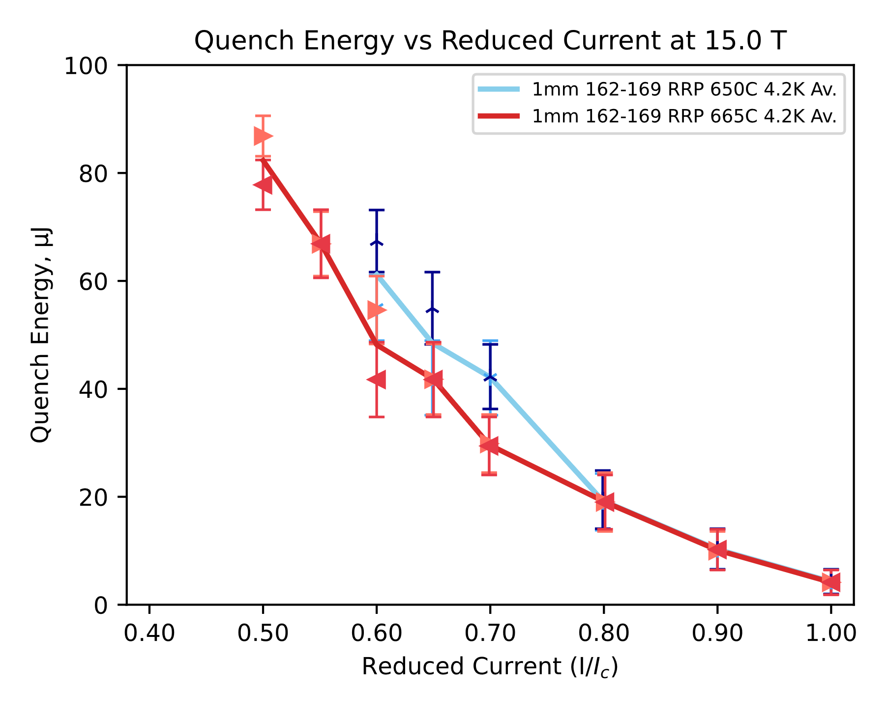
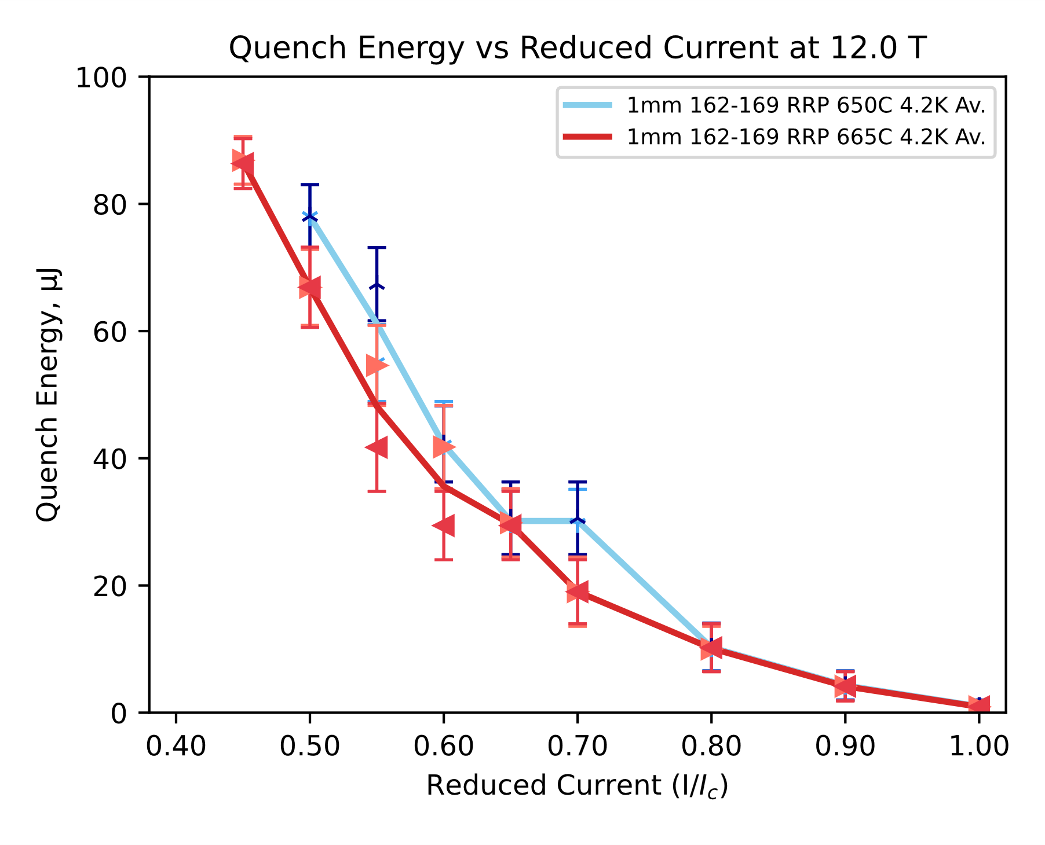
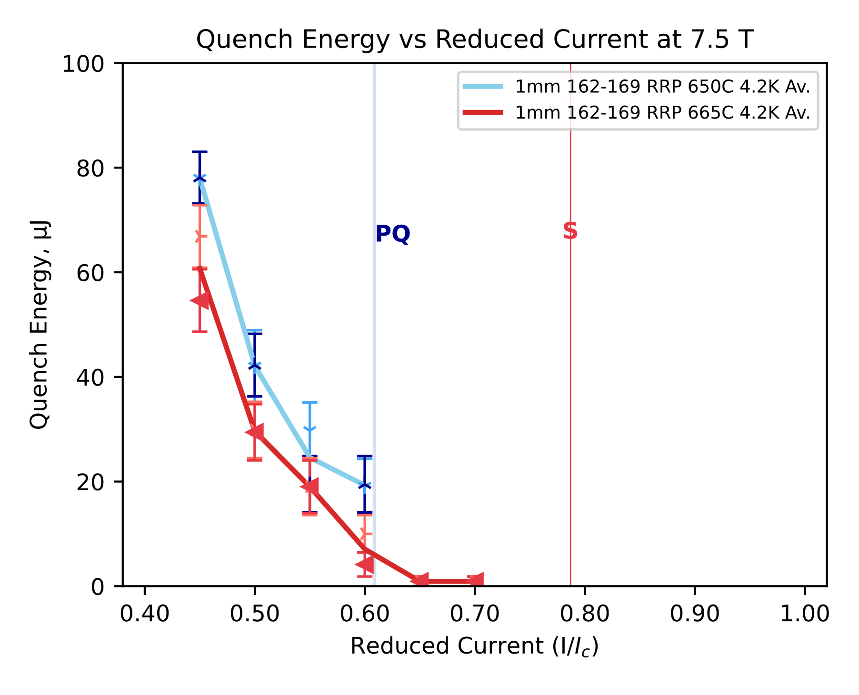
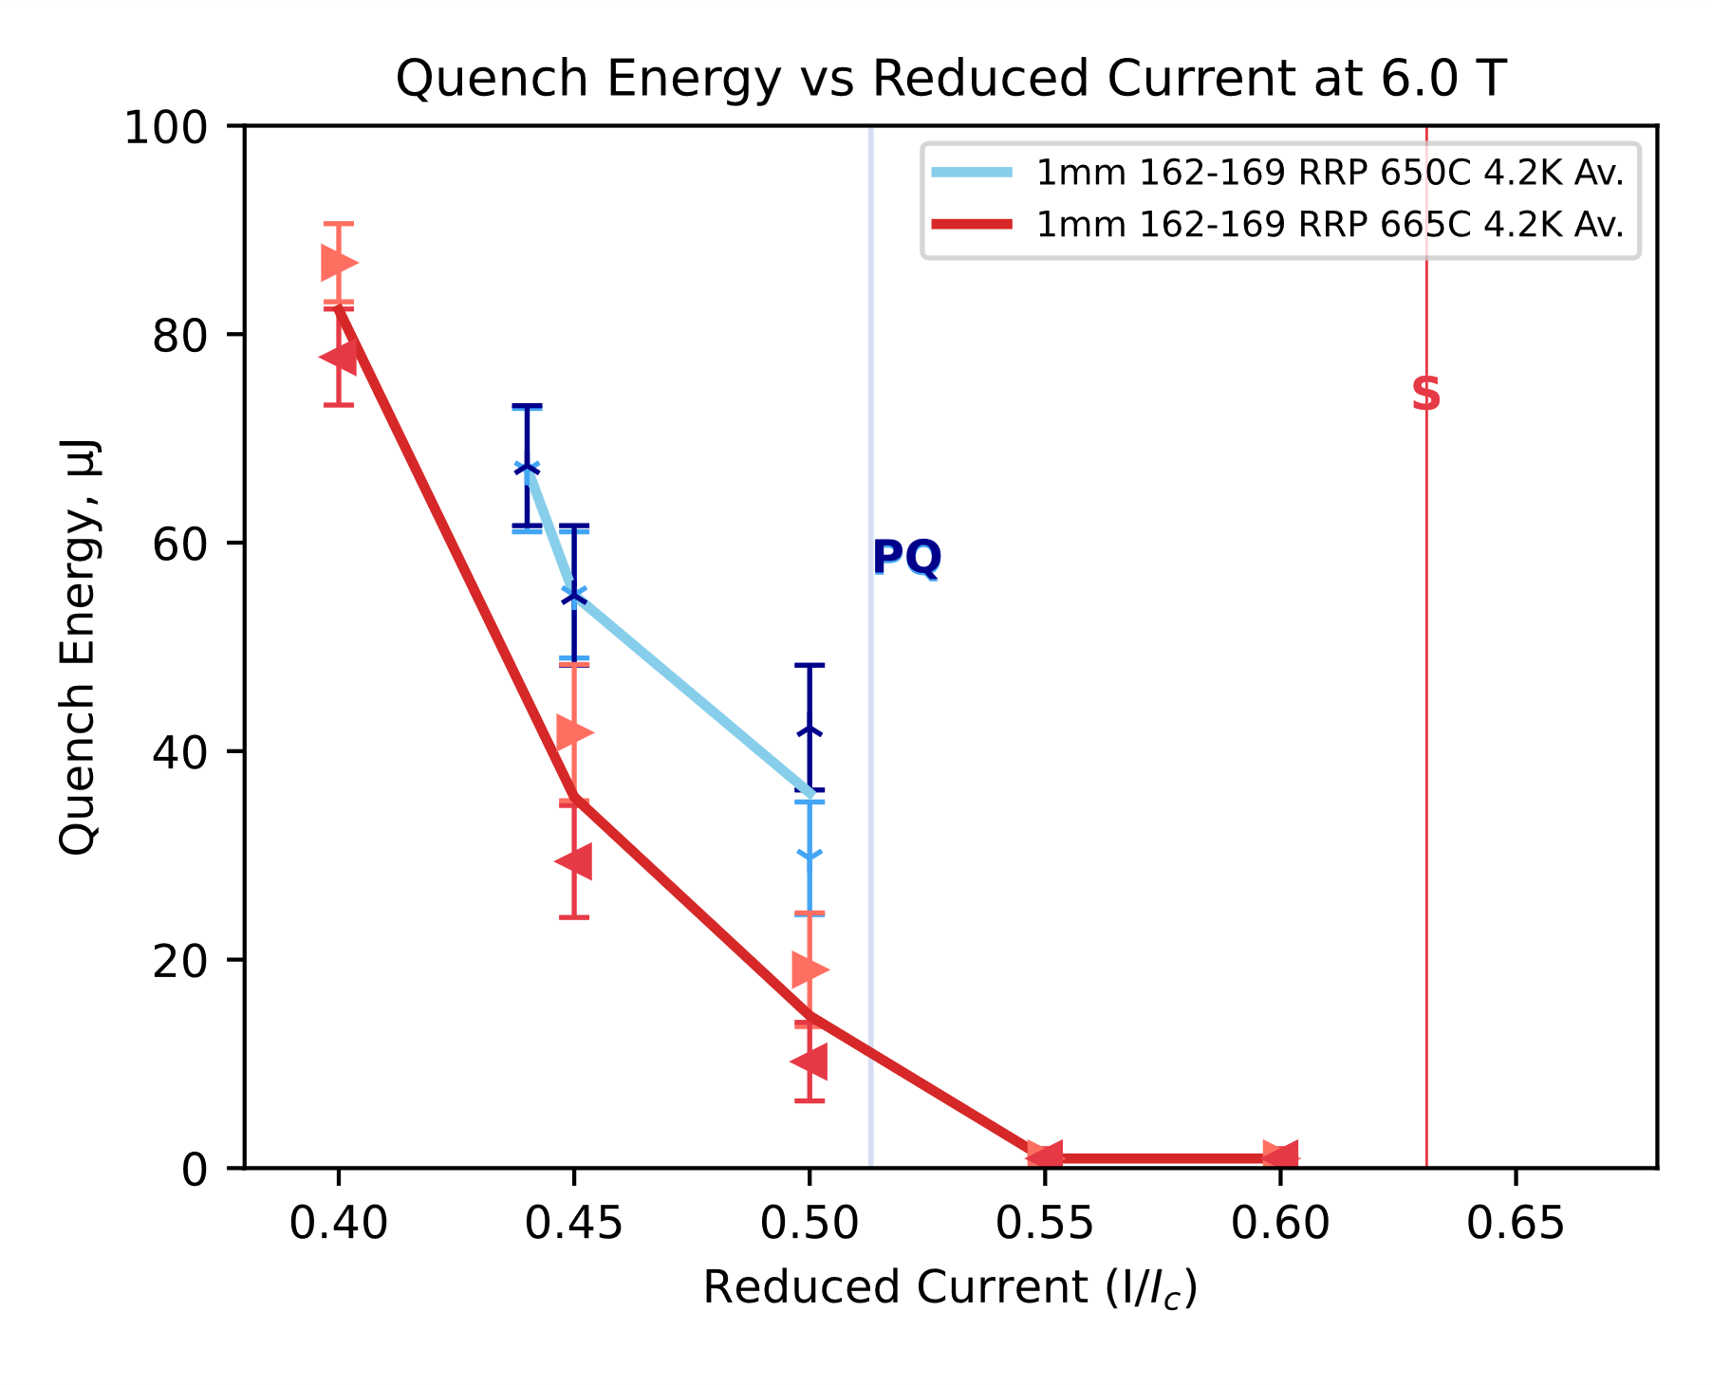
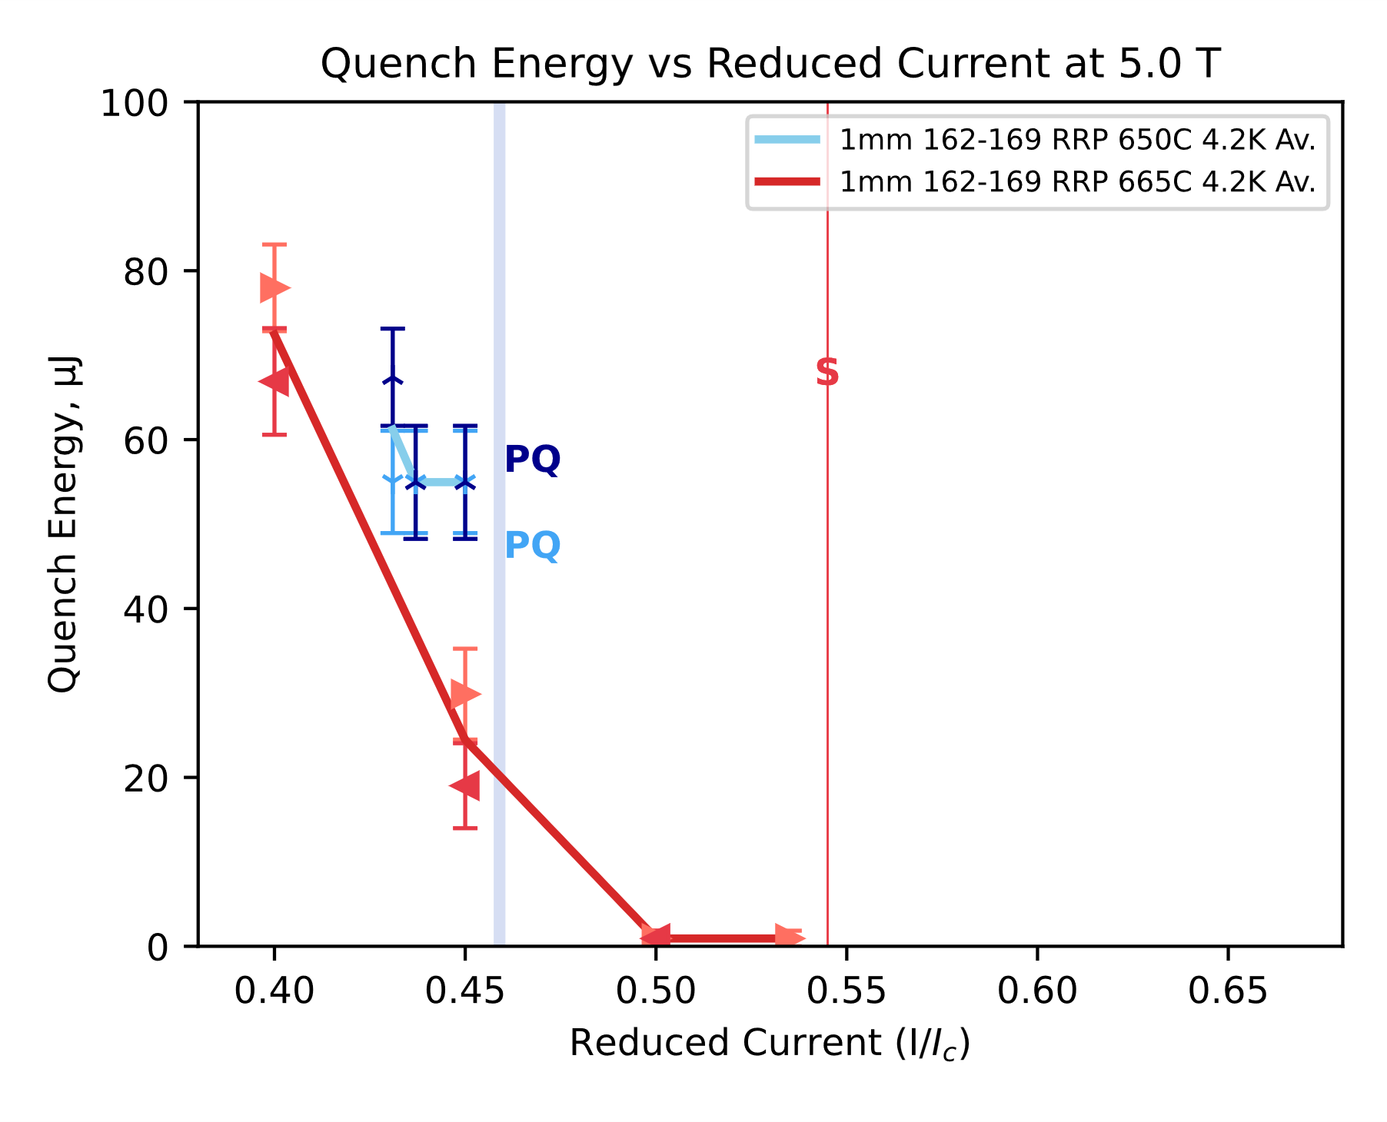
Sample Results
 | ERMC-1 | ERMC-1
d (mm) | 1.0
Layout | 162/169
d_{s} (µm) | 58
Cu/non-Cu | 0.9 ± 0.2
RRR | 283 | 109
Nb:Sn | 3.4 (standard Sn)
Heat treatment | 650°C 50 h | 665 °C 50 h
Stability vs. Heat Treatment Temperature
162/169 RRP® Bruker, last HT step 650°C 50 h
162/169 RRP® Bruker, last HT step 665°C 50 h
650°C
665°C

Slide 26
Sample Results at 4.2 K

Slide 27
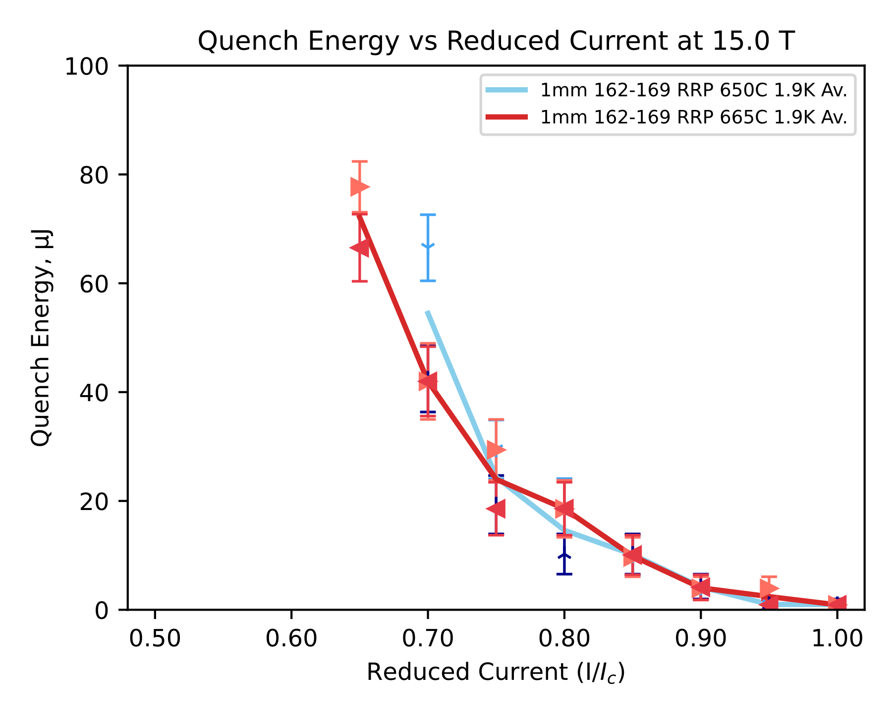
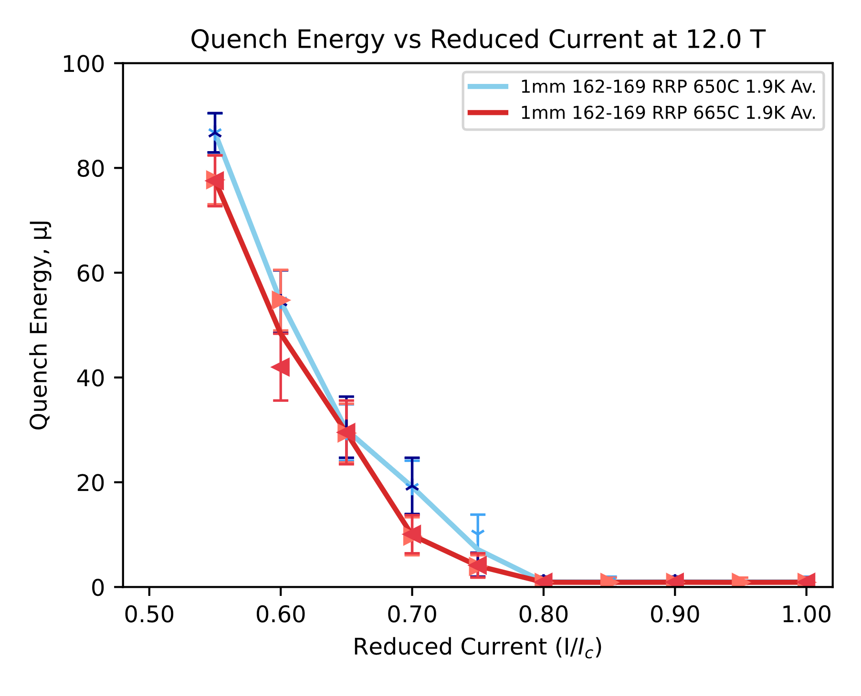
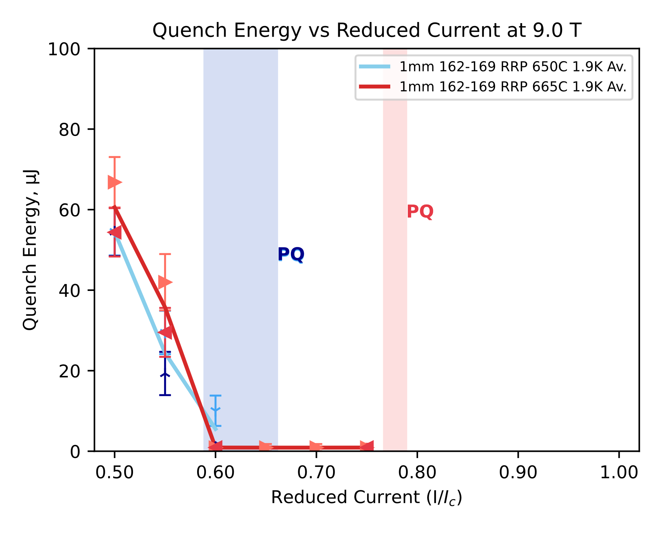
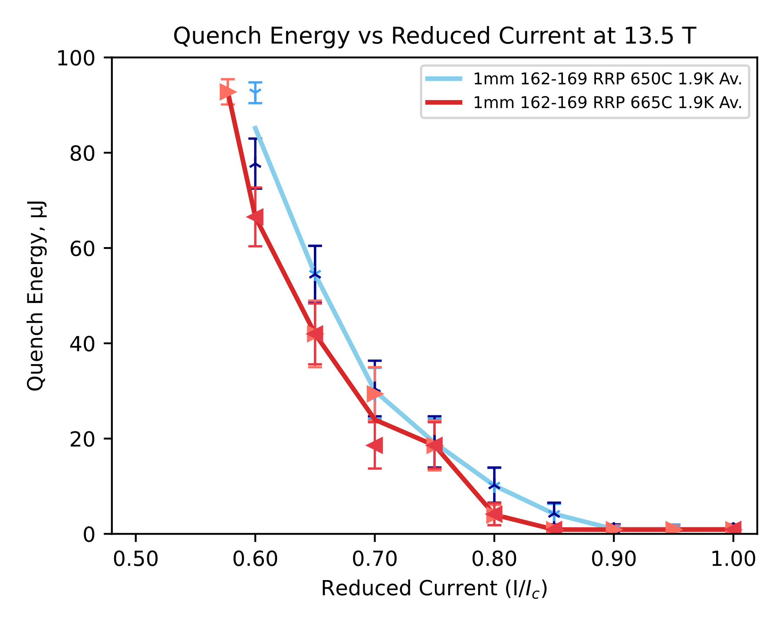
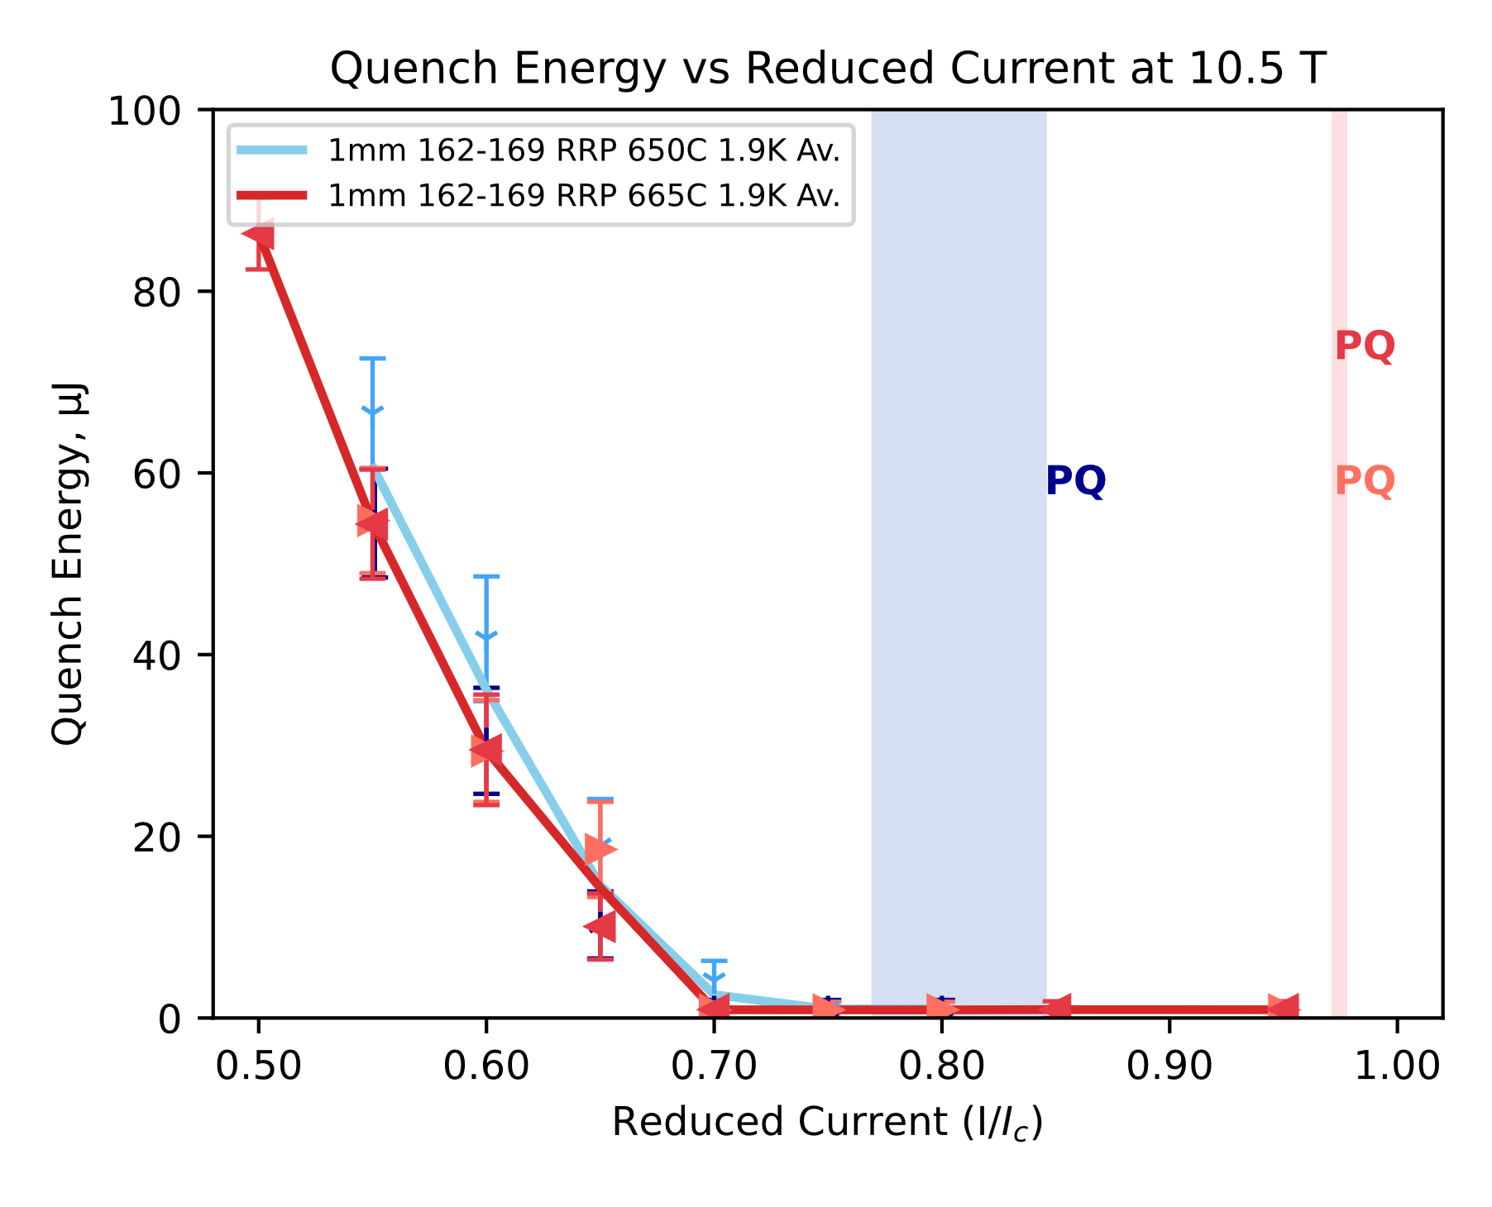
Sample Results at 1.9 K

Slide 28
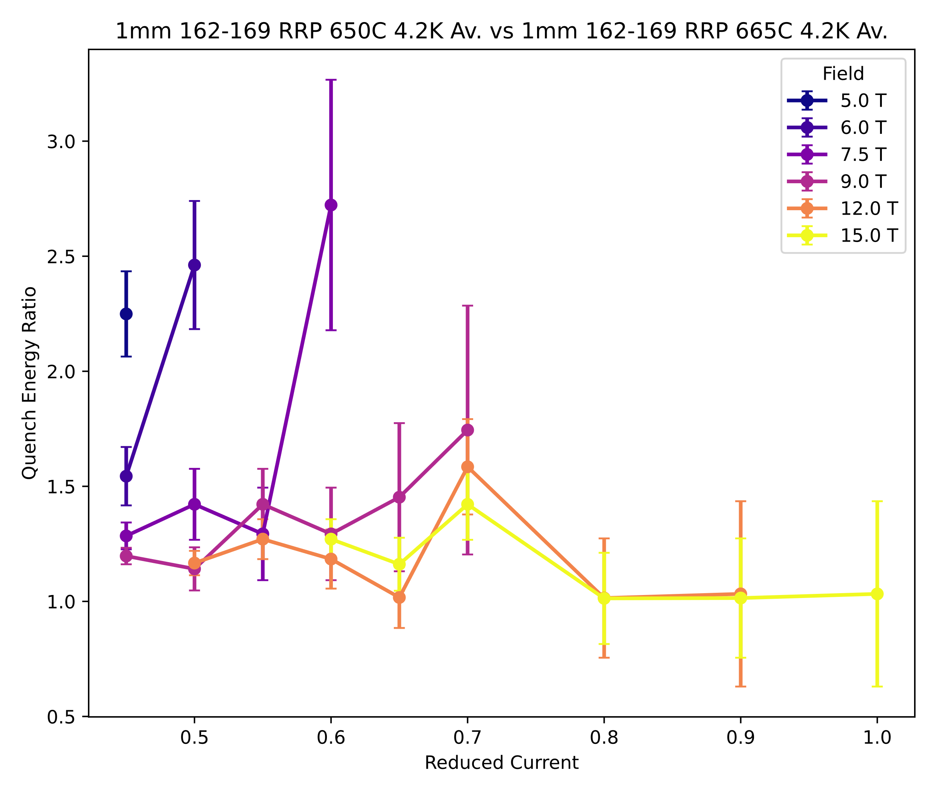
Sample Results
 | ERMC-1 | ERMC-1
d (mm) | 1.0
Layout | 162/169
d_{s} (µm) | 58
Cu/non-Cu | 0.9 ± 0.2
RRR | 283 | 109
Nb:Sn | 3.4 (standard Sn)
Heat treatment | 650°C 50 h | 665 °C 50 h
Stability vs. Heat Treatment Temperature
162/169 RRP® Bruker, last HT step 650°C 50 h
162/169 RRP® Bruker, last HT step 665°C 50 h
4.2 K
650°C
665°C
ratio =
7.5 T
6 T
Summary
Higher temperature of the last HT step significantly affected the RRR but this did not impact the Quench Energy in the range of 9 T – 15 T at 4.2 K, which can be attributed to copper’s magneto-resistance
Up to 2.5-fold increase in Quench Energy was observed at 4.2 K at 6 T and below
At 1.9 K, no significant difference in Quench Energy has been observed in the investigated range of 9 T – 15 T
9 T
15 T

Slide 29

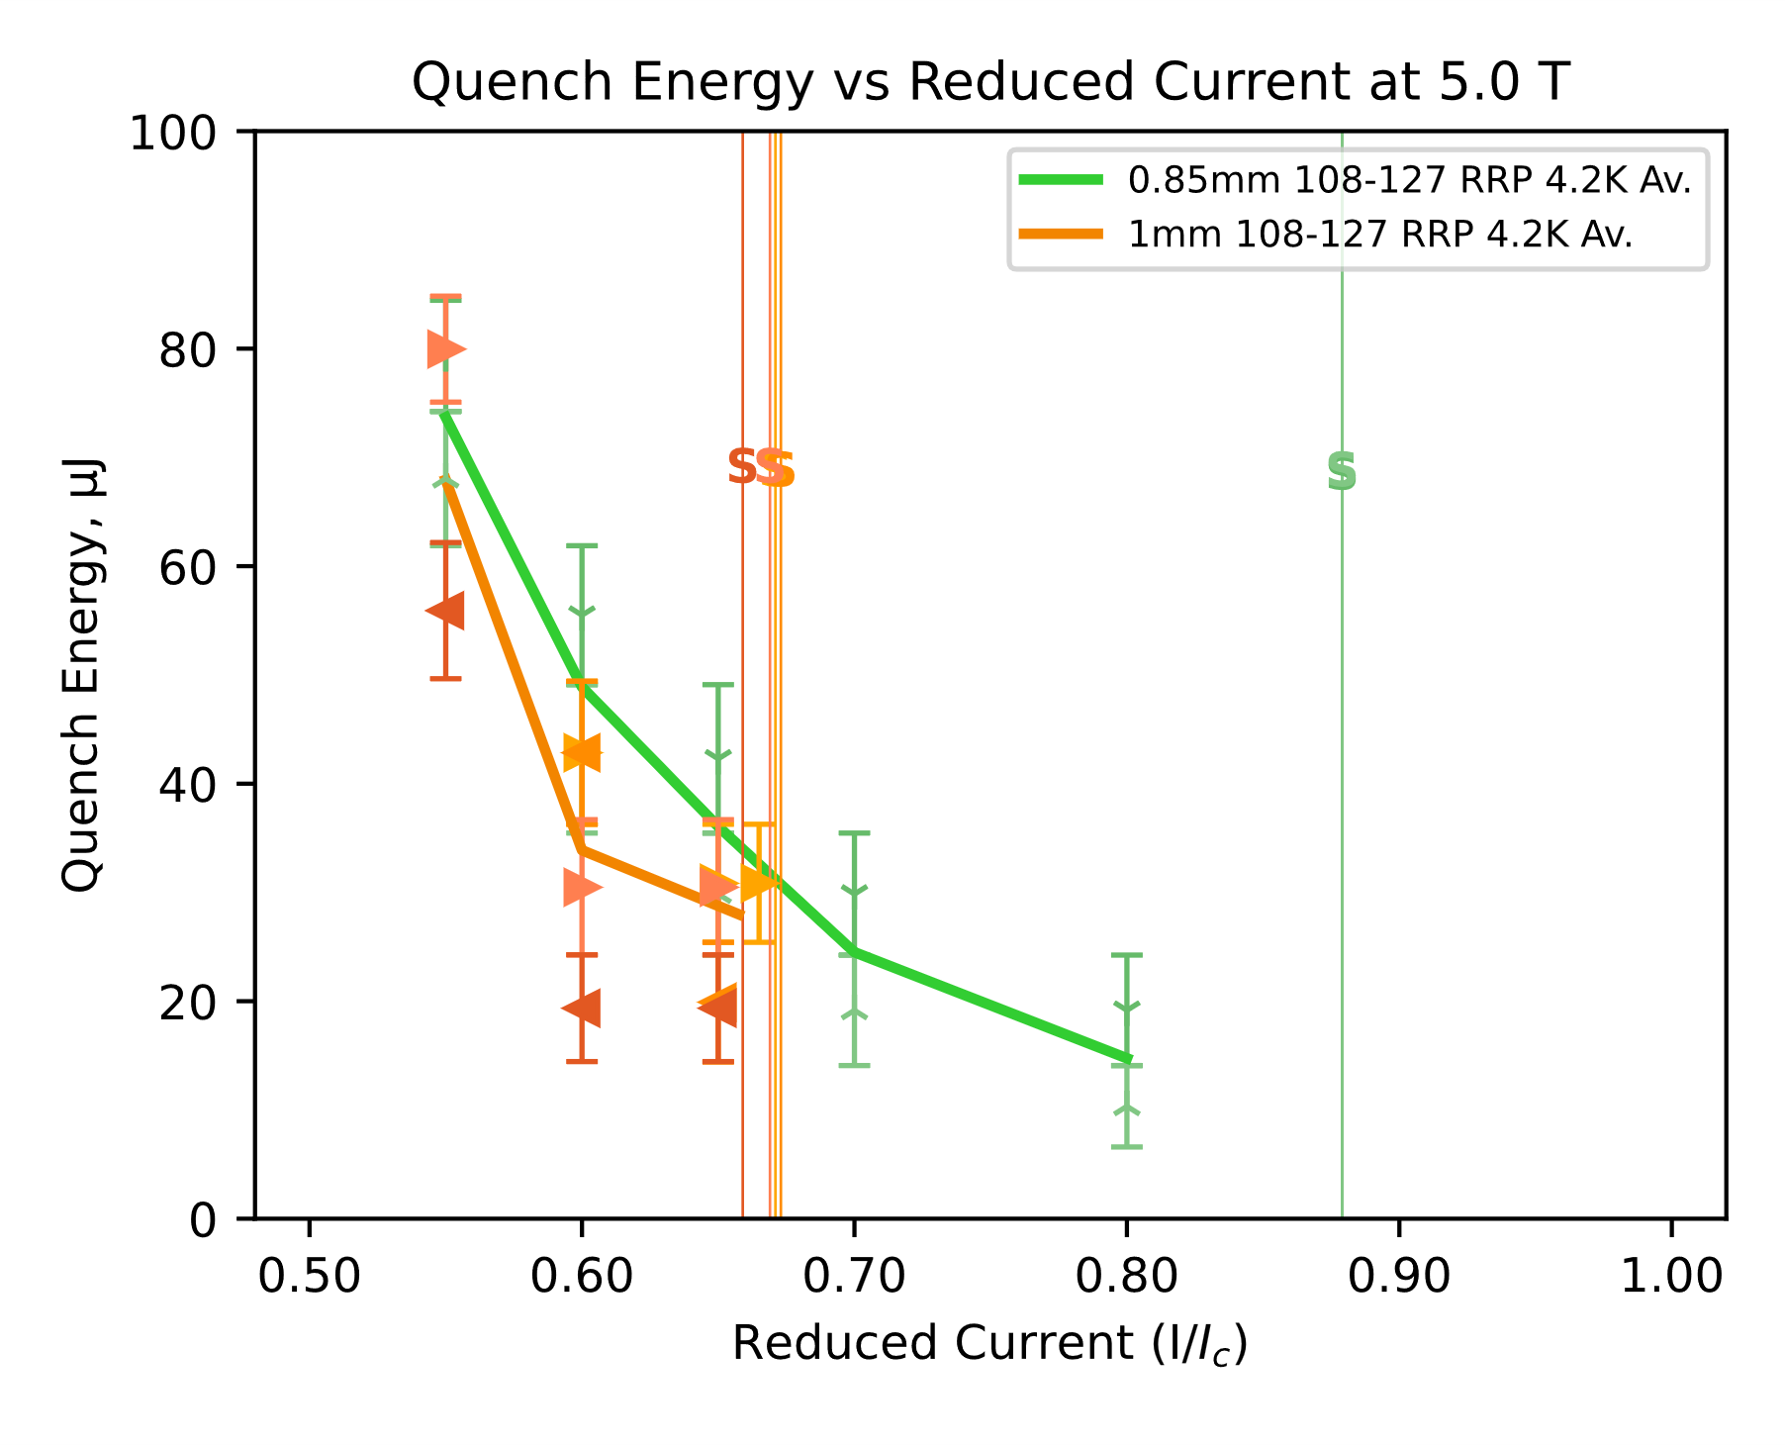
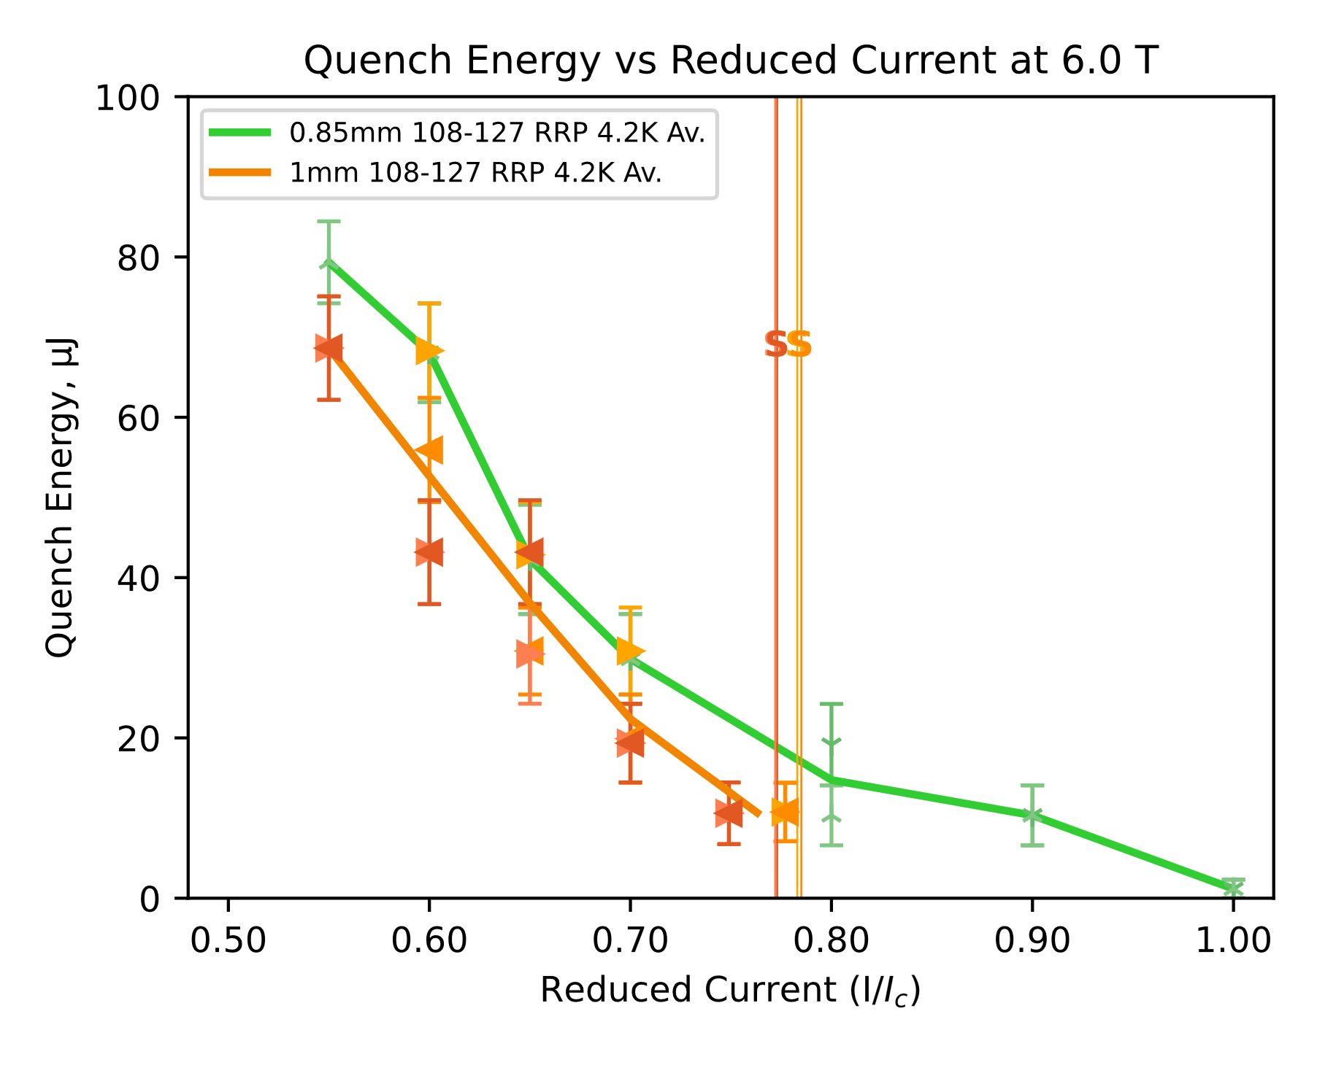
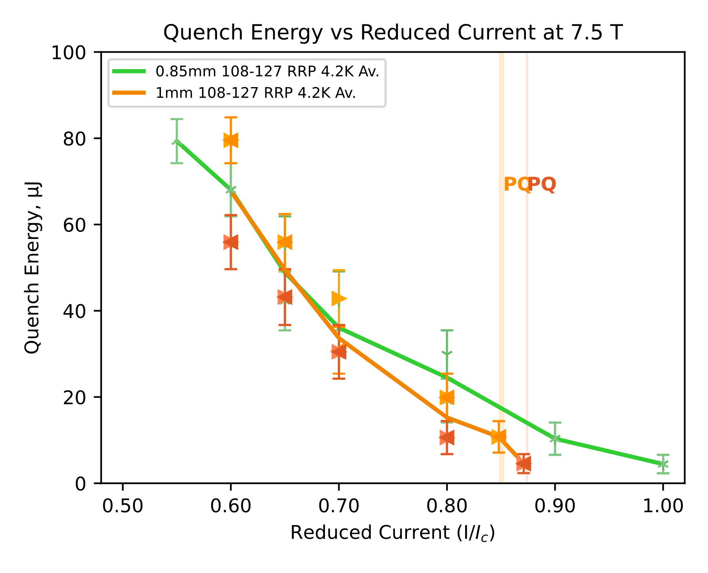
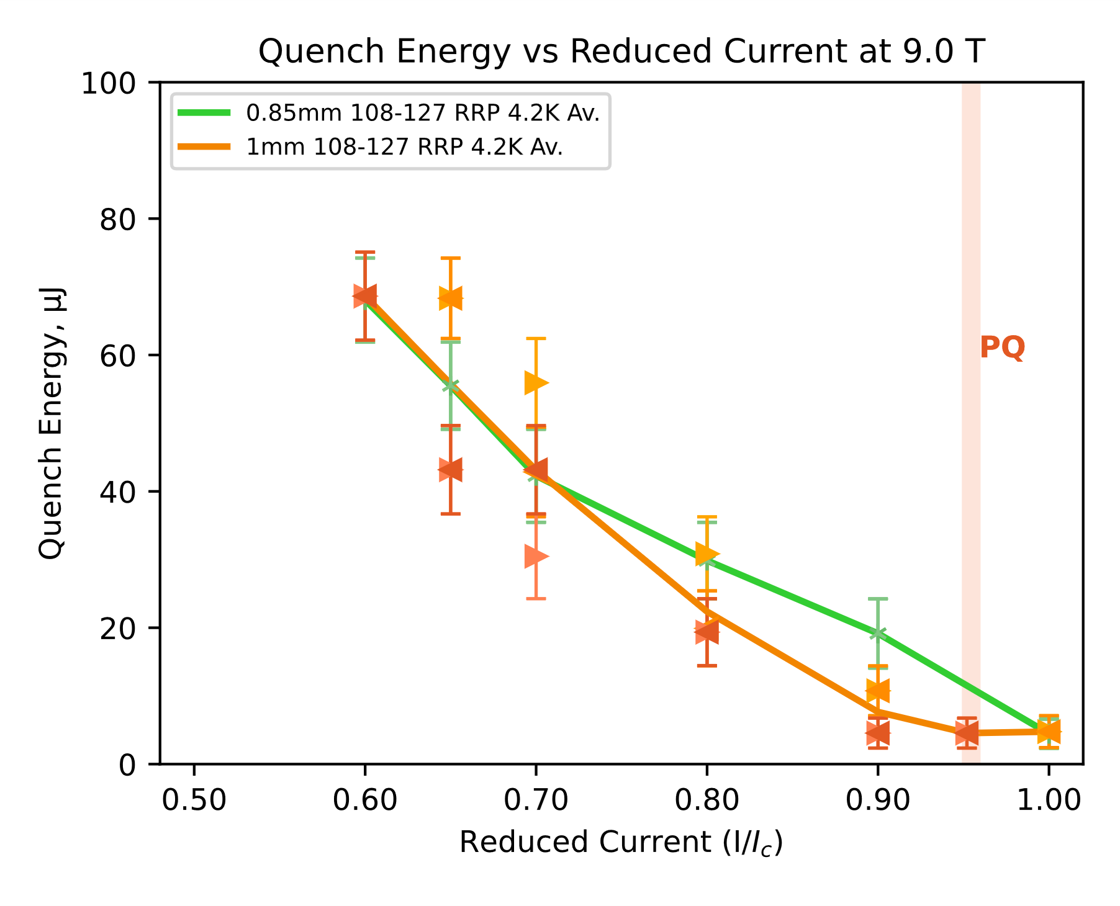
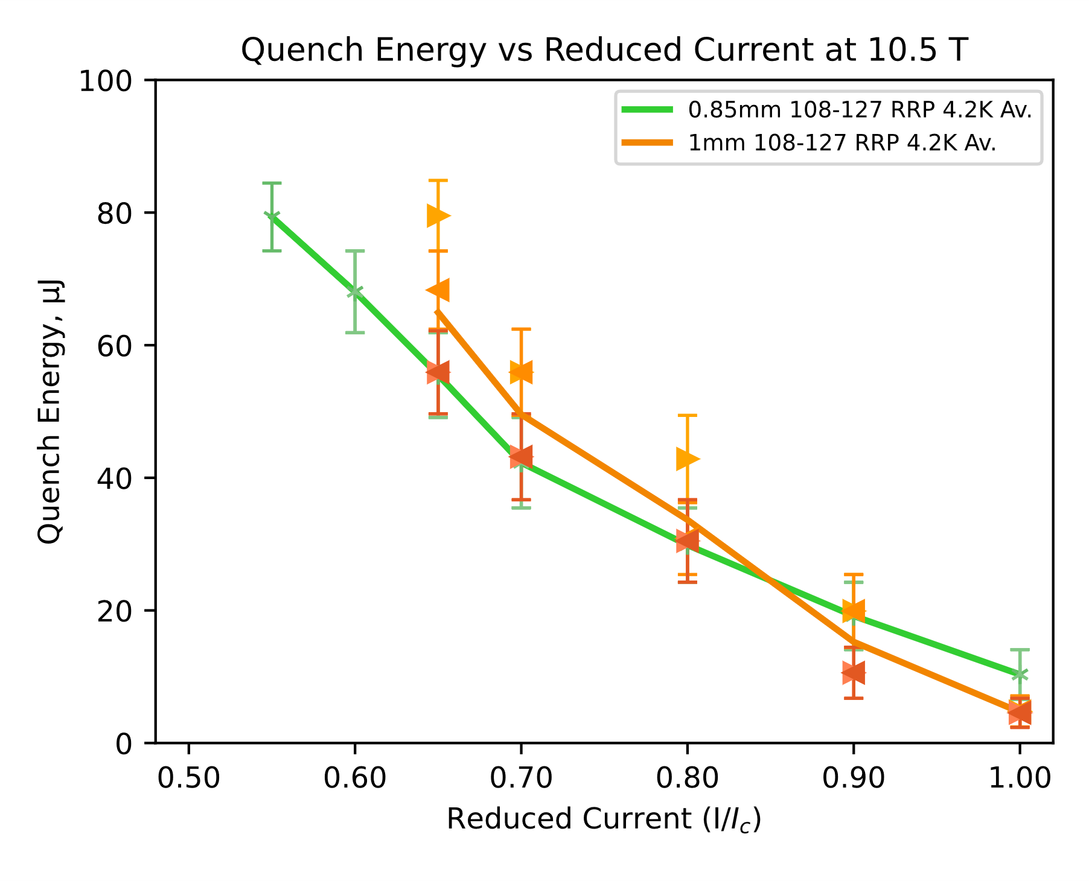
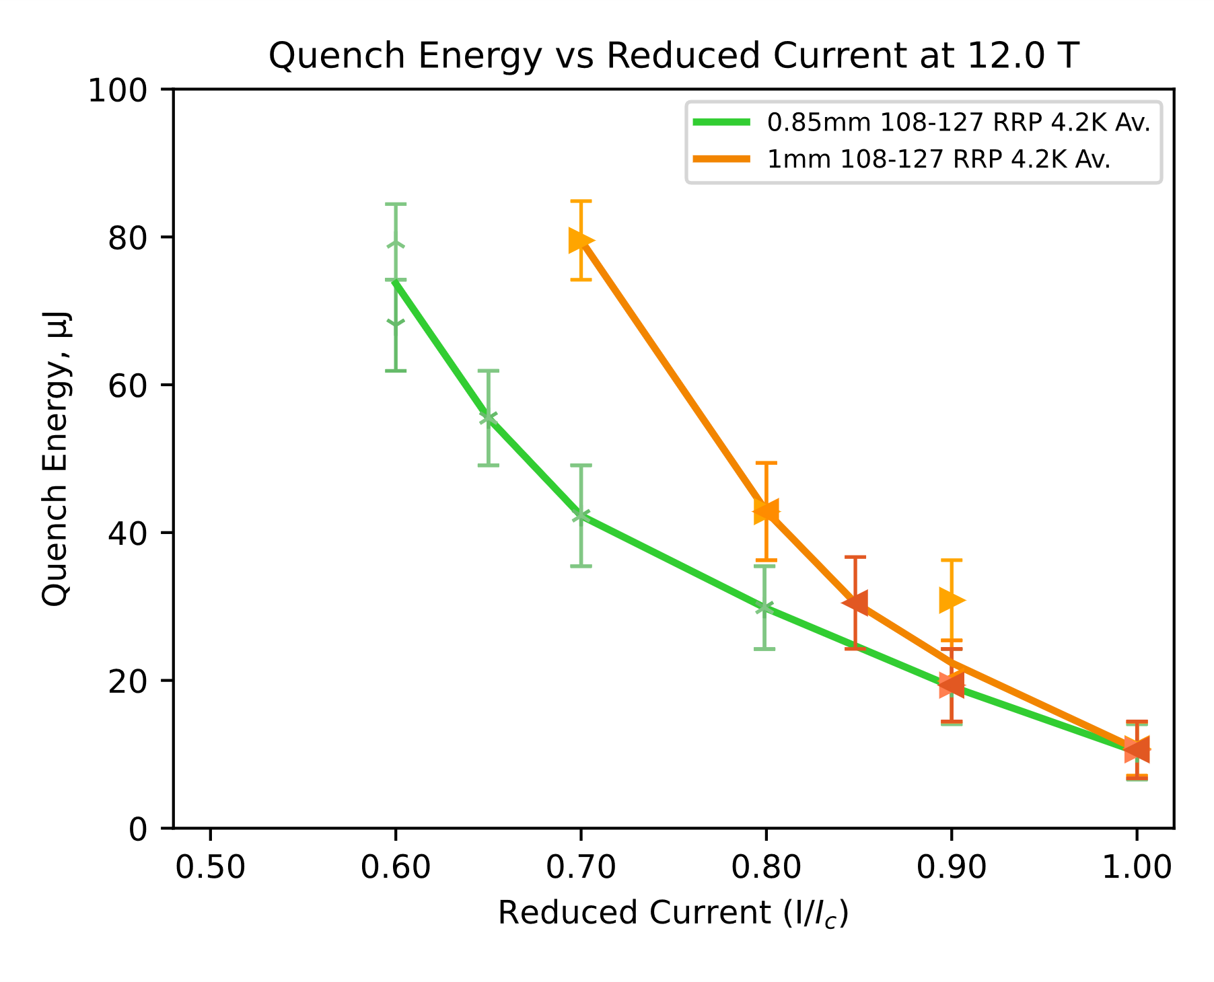
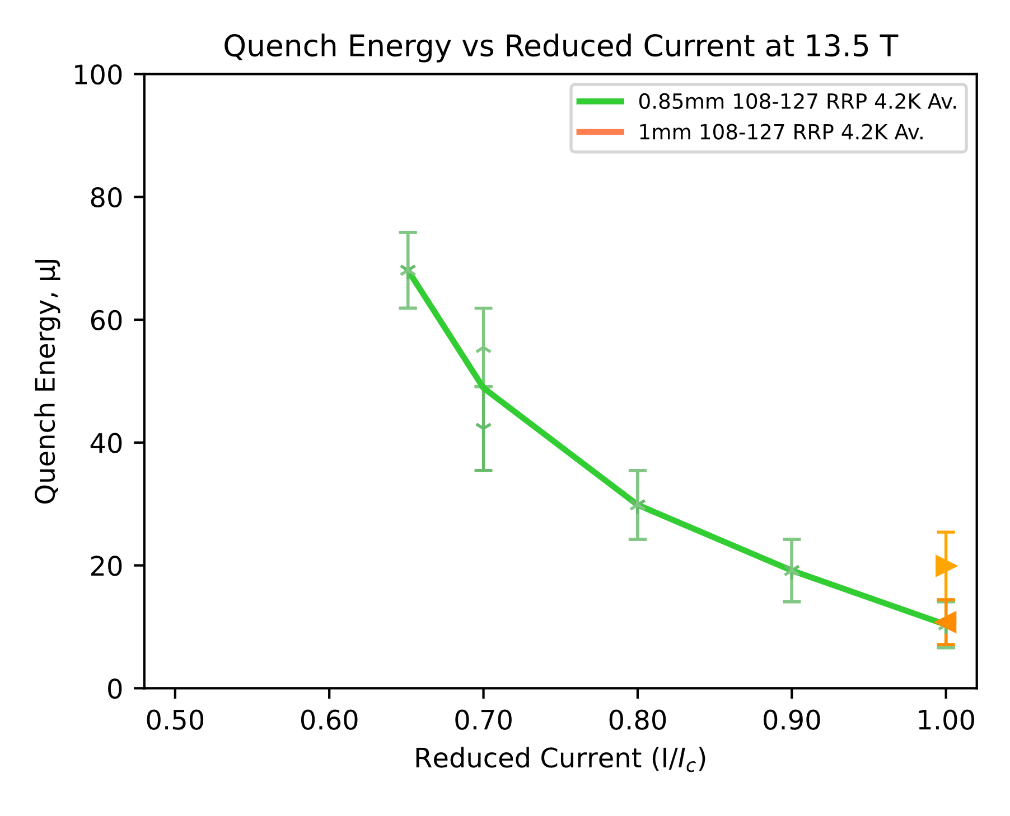
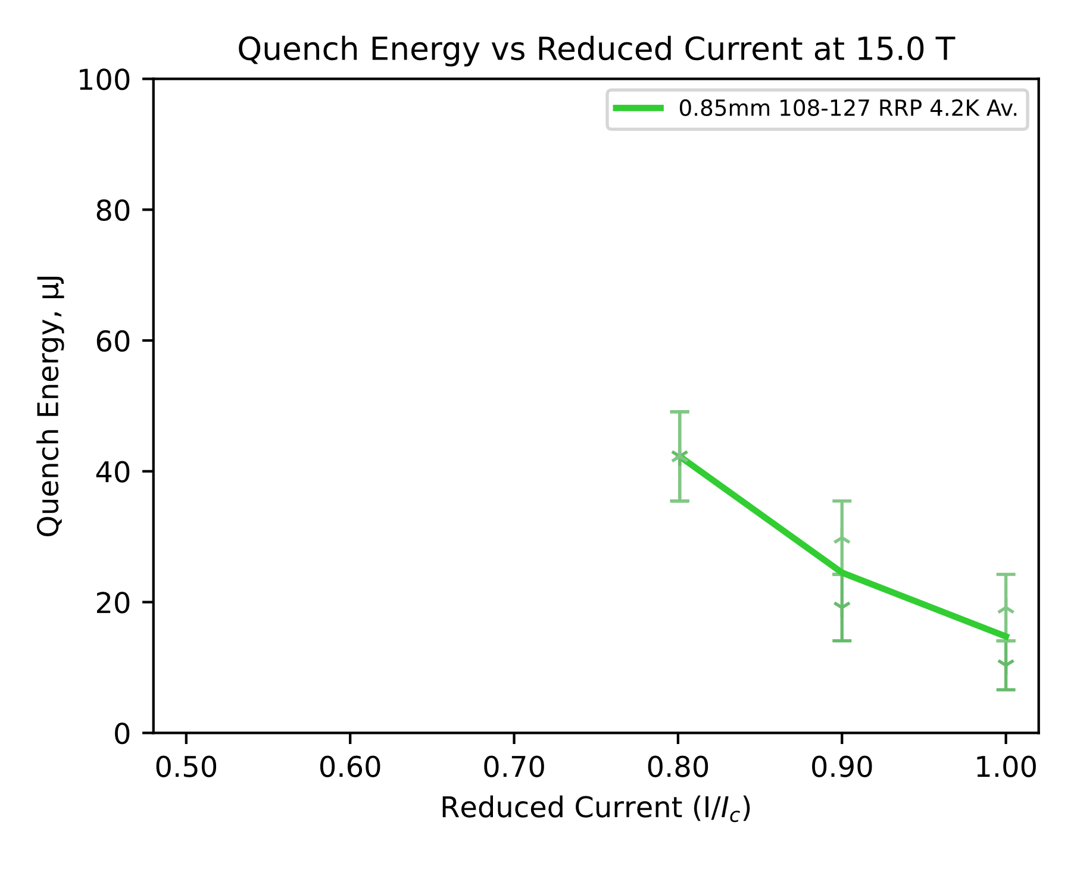
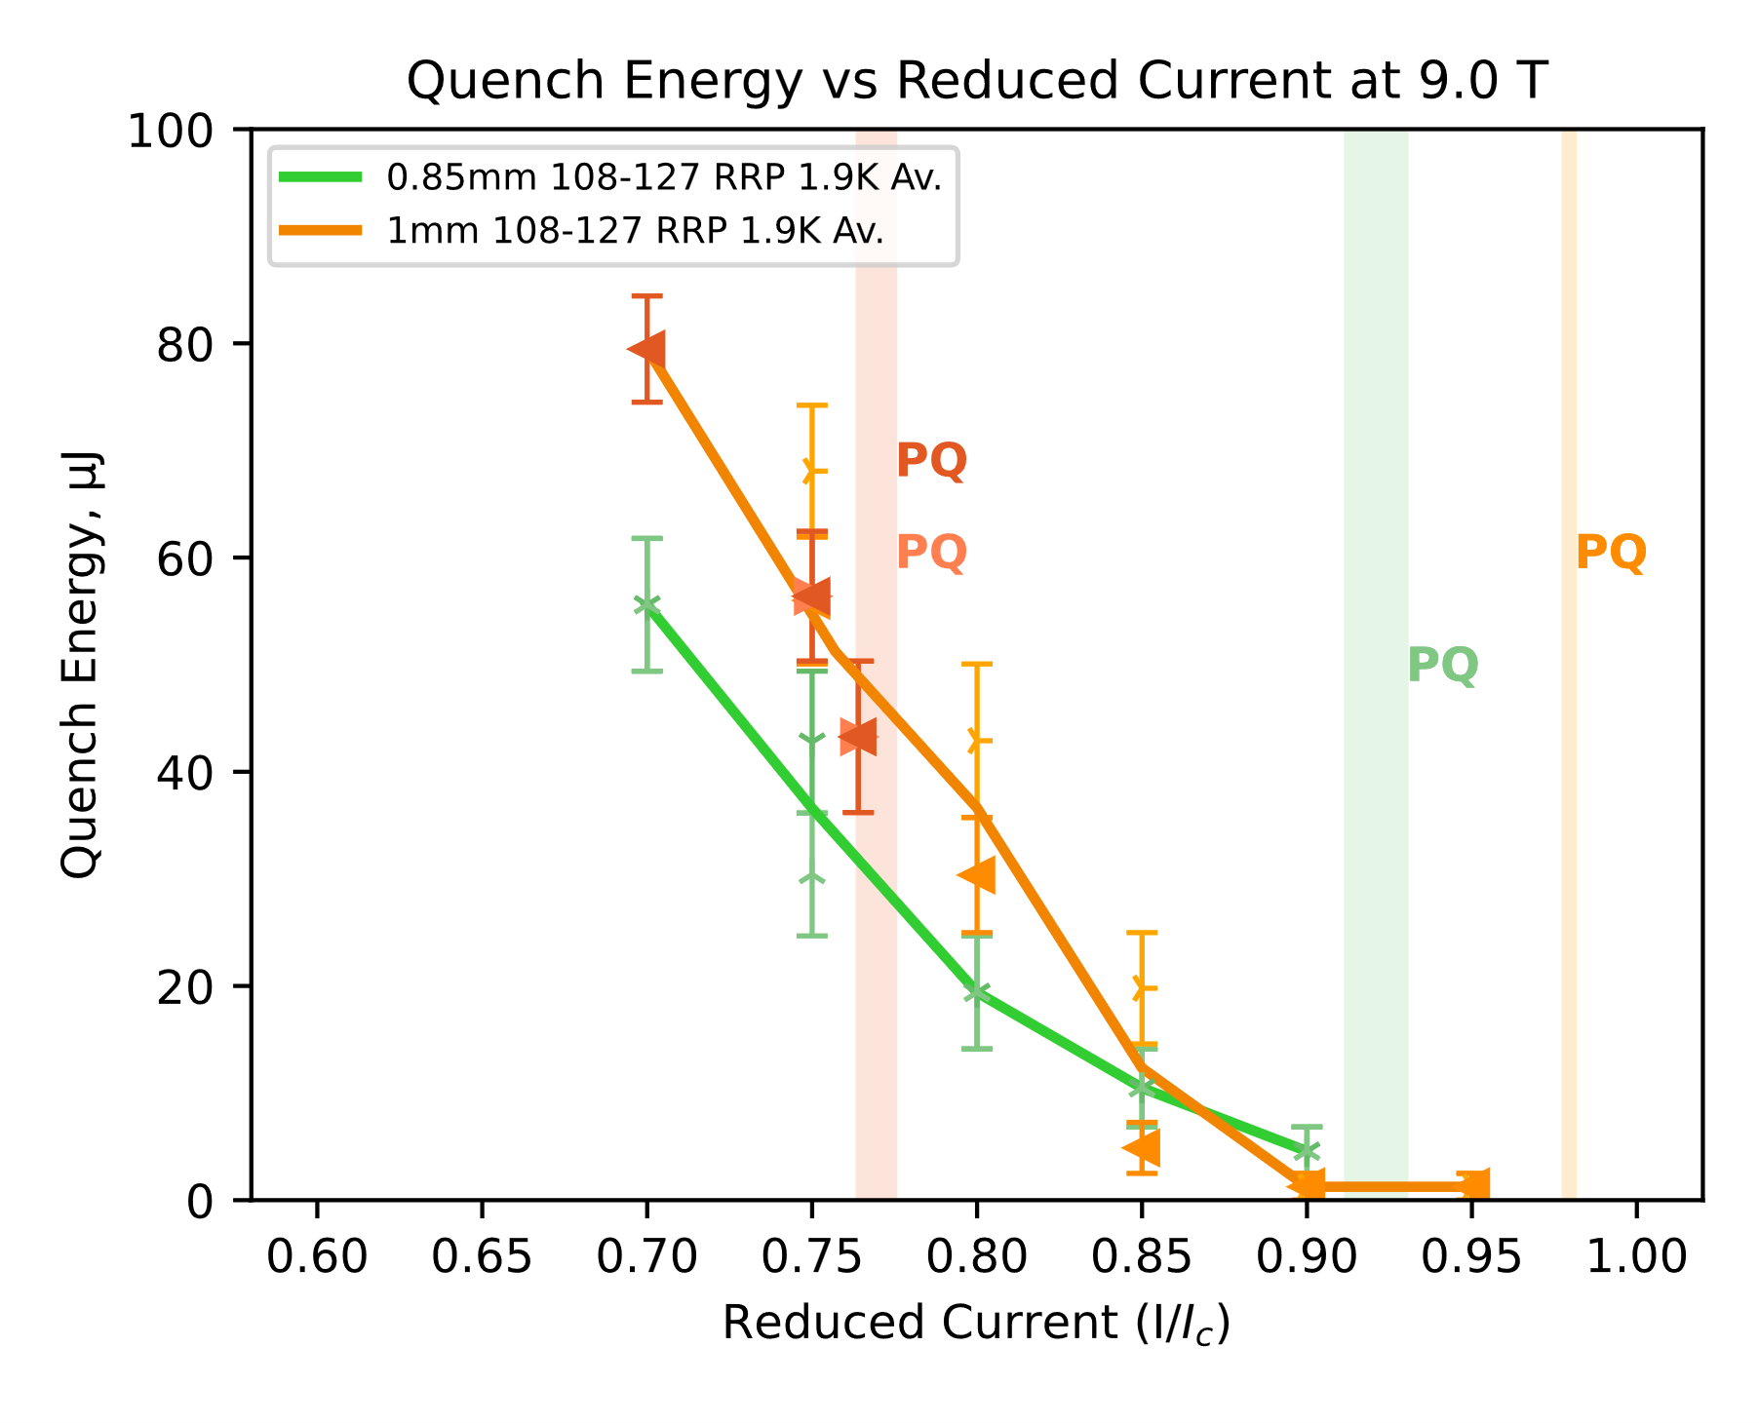
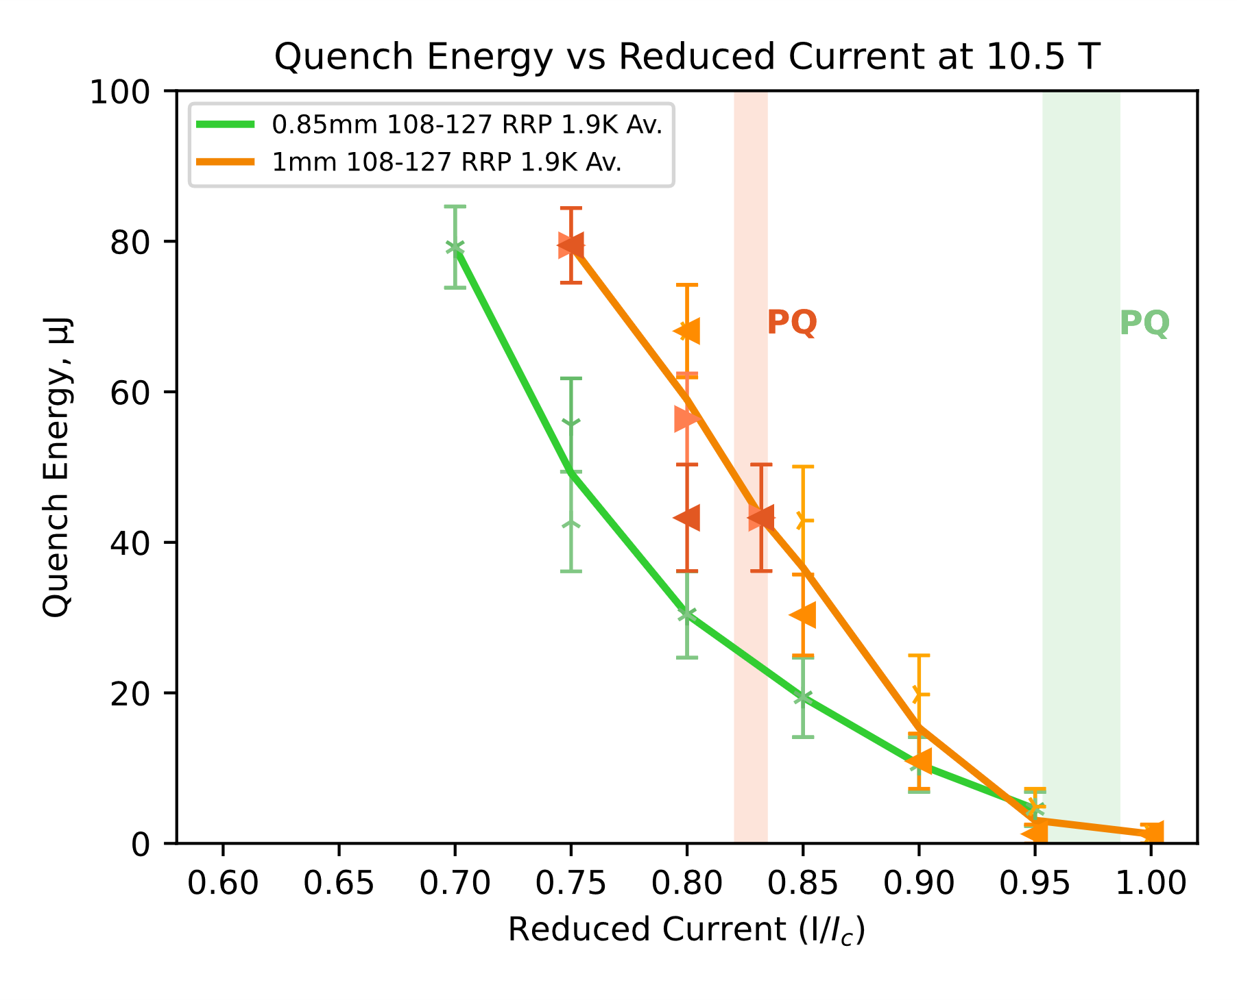
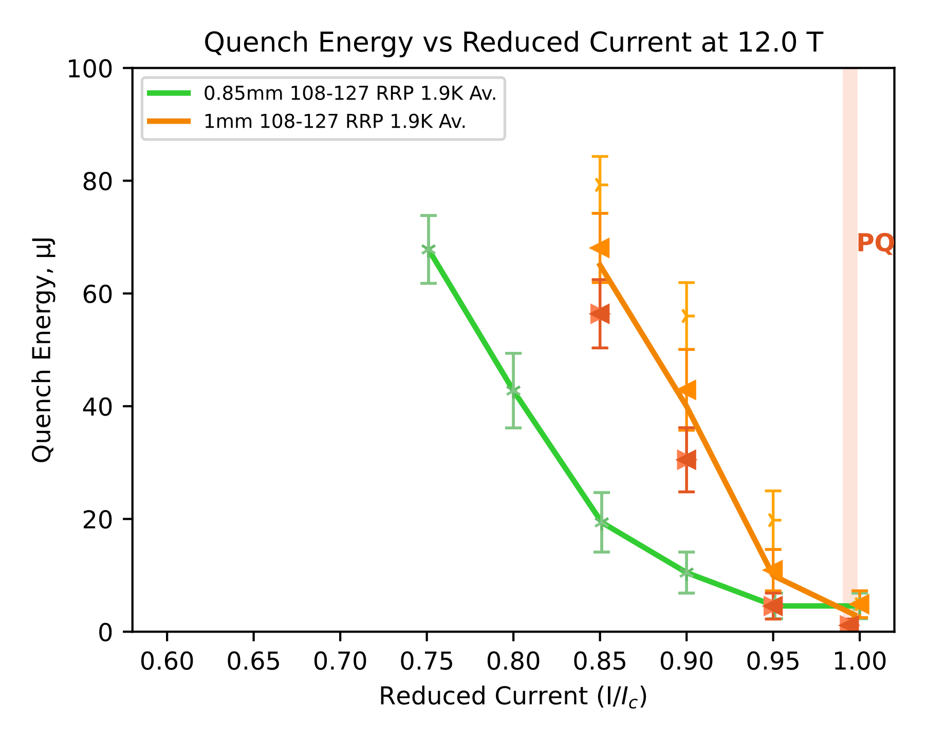
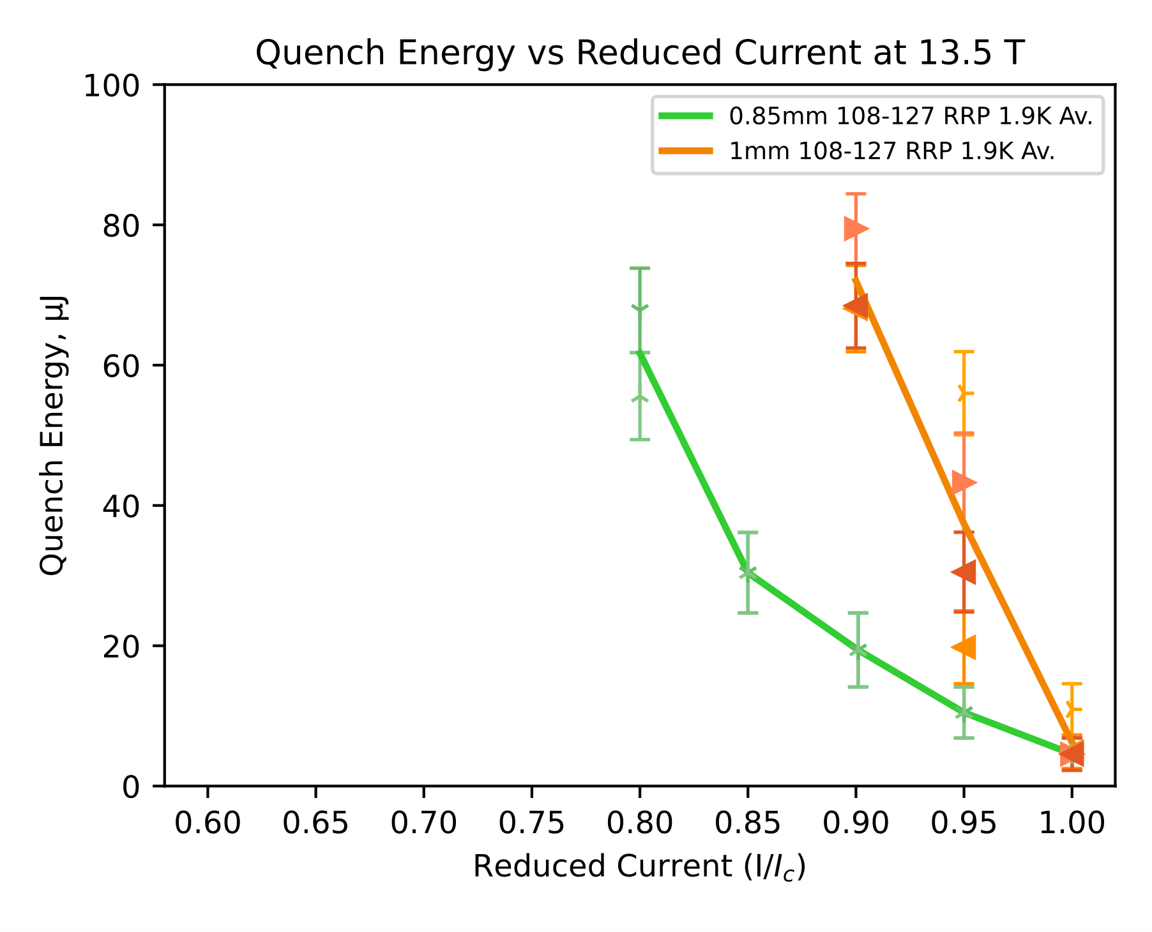
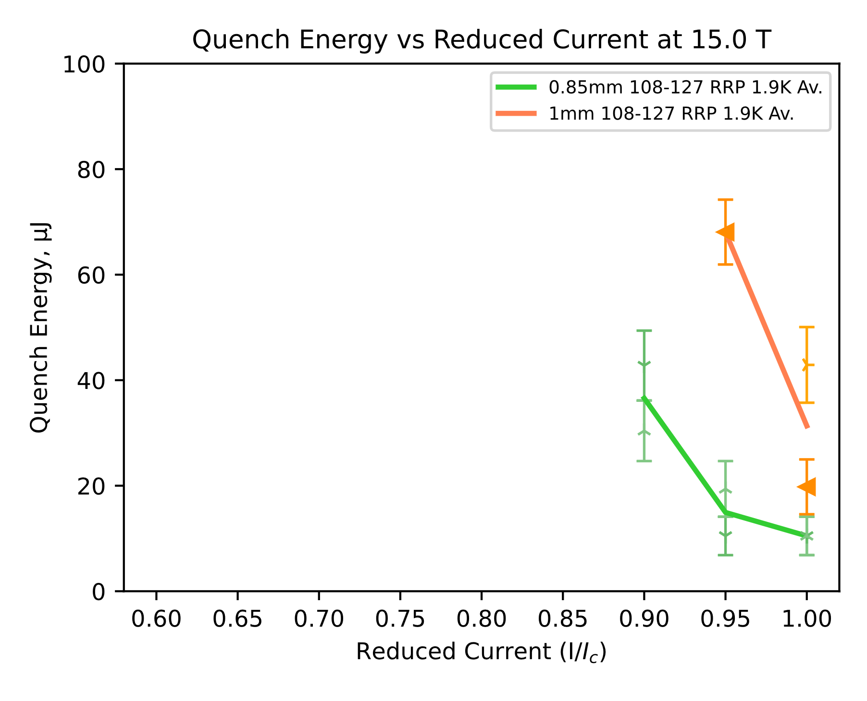
Sample Results
 | MQXF wire | 1 mm
d (mm) | 0.85 | 1.0
Layout | 108/127
d_{s} (µm) | 54 | 64
Cu/non-Cu | 1.2 ± 0.1
RRR | ~300
Nb:Sn | 3.6 (reduced Sn)
Heat treatment | 665 °C 50 h
Stability vs. Diameter Reduction (108/127 RRP Bruker)
0.85 mm 108/127 RRP® Bruker
1.00 mm 108/127 RRP® Bruker
0.85 mm
1.0 mm
4.2 K
1.9 K

Slide 30
Sample Results at 4.2 K

Slide 31




Sample Results at 1.9 K

Slide 32

Sample Results
 | MQXF wire | 1 mm
d (mm) | 0.85 | 1.0
Layout | 108/127
d_{s} (µm) | 54 | 64
Cu/non-Cu | 1.2 ± 0.1
RRR | ~300
Nb:Sn | 3.6 (reduced Sn)
Heat treatment | 665 °C 50 h
Stability vs. Diameter (108/127 RRP® Bruker)
0.85 mm 108/127 RRP® Bruker
1.00 mm 108/127 RRP® Bruker
1.0 mm 0.85 mm
1.9 K
ratio =
15 T
12 T
Summary
Comparison of different diameter wires revealed two opposing trends affecting the stability:
Advantage of 0.85 mm wire at fields below 6 T is consistent with magnetization-driven instability related to the sub-element diameter
1 mm wire was generally more stable at fields above 9 T (1.9 K) and 10.5 T (4.2 K). Possible explanation is the higher absolute Cu volume supporting stability of 1 mm wire, which may become relevant in case of spatially concentrated disturbances
10.5 T
9 T

Slide 33


Sample Results
 | High C_{p} wire | Control wire
d (mm) | 0.6
Cu:nonCu | 1.06 | 1.10
RRR | 203 | 255
Stability of R&D wire designs (produced by Hyper Tech)
High C_{p} Inserts Wire
Control Wire
Gd₂O₂S + Cu
X. Xu et al, Recent Progress in Developing Nb₃Sn Conductors With Increased Specific Heat, IEEE Trans. Appl. Supercond. 33, DOI:6000405
Courtesy of Xingchen Xu (Fermilab)

Slide 34






Sample Results at 4.2 K

Slide 35






Sample Results at 1.9 K

Slide 36


Sample Results
 | High C_{p} wire | Control wire
d (mm) | 0.6
Cu:nonCu | 1.06 | 1.10
RRR | 203 | 255
Stability of R&D wire designs (Hyper Tech)
High C_{p} Inserts Wire
Control Wire
High C_{p}
Control
ratio =
4.2 K
1.9 K
5 T
3 T
4 T
9 T
5 T
13.5 T
6 T
15 T
7.5 T

Slide 37

Sample Results
 | High Cp wire | Control wire
d (mm) | 0.6
Cu:nonCu | 1.06 | 1.10
RRR | 203 | 255
Stability of R&D wire designs (Hyper Tech)
High C_{p} Inserts Wire
Control Wire
Summary
The study revealed that high C_{p} inserts enhance stability, with Quench Energy observed to be up to four times higher for the high C_{p} insert wire. This finding is even more significant given the lower RRR of the high C_{p} wire.
The advantage increases as the magnetic field decreases, which is consistent with the measured relationship between the wire's specific heat and magnetic field.

Slide 38


Outlook
Next in the pipeline:
Analysis of the impact of Cu:nonCu on stability – etching external Cu to compare different Cu:nonCu fractions for the same wire.
First trial of etching I_{c} samples:
Reduction of RRR due to lower Cu content
 | RRR | RRR, etched sample
0.85 mm | 291 | 185
1.0 mm | 254 | 259
Cross section of the 0.85 RRP® 108/127
etched to Cu:nonCu ratio of 1.05 (?)
Cross section of the 1.0 RRP® 108/127
etched to Cu:nonCu ratio of 1.09 (?)

Slide 39
Outlook
Next in the pipeline:
Analysis of the impact of Cu:nonCu on stability – etching external Cu to compare different Cu:nonCu fractions for the same wire.
 | DEM-0.7 | DEM-0.7 | DEM-0.7
d (mm) | 0.7
Layout | 60/91
d_{s} (µm) | 54
Cu/non-Cu | 1.8 | 1.2 | 0.9
RRR | 504 | 468 | 380
Nb:Sn | 3.6 (reduced Sn)
Heat treatment | 650°C 50 h

Slide 40
Outlook
Next in the pipeline:
Analysis of the impact of Cu:nonCu on stability – etching external Cu to compare different Cu:nonCu fractions for the same wire (DEM-0.7).
Effect of HT on stability (650°C vs. 665°C) for a larger diameter 162/169 wire (DEM–1.1).
Development and validation of a wire stability model with M. Wozniak (TE-MPE).
 | DEM-0.7 | DEM-0.7 | DEM-0.7 | DEM-1.1 | DEM-1.1
d (mm) | 0.7 |  |  | 1.1
Layout | 60/91 |  |  | 162/169
d_{s} (µm) | 54 |  |  | 64
Cu/non-Cu | 1.8 | 1.2 | 0.9 | 0.9 ± 0.2
RRR | 504 | 468 | 380 | 325 | 260
Nb:Sn | 3.6 (reduced Sn) |  |  | 3.4 (standard Sn)
Heat treatment | 650°C 50 h |  |  | 650°C 50 h | 665°C 50 h

Slide 41
Summary
The laser-induced quench method has been proven to provide reproducible results by repeated testing of the same types of wire.
Decreasing the fluence of the beam (by decreasing the size of the fiber) limited the extent of the superconductor’s surface alteration.
The setup developed is sensitive to differences in stability originating from different wire design characteristics.
Wires of significantly different RRR (resulting from different peak HT temperature) showed no difference in MQE at fields above 9 T at both 1.9 K and 4.2 K .
Magnetization-induced instability for large sub-element wires has been observed at fields at and below 6 T. Another effect has been prevalent at larger fields and its origin remains under study.
High specific heat inserts have been confirmed to enhance stability at both temperatures.

