Slide 1


Project: 101079696 — ET-PP — HORIZON-INFRA-2021-DEV-02
ETO Task Force – Risk – Flexibility - TRL
Ghada Mahmoud on behalf of the Project Office
ghada.mahmoud@apc.in2p3.fr
14. 4 . 2025
Horizon Europe: Coordination
and Support Actions

Slide 2
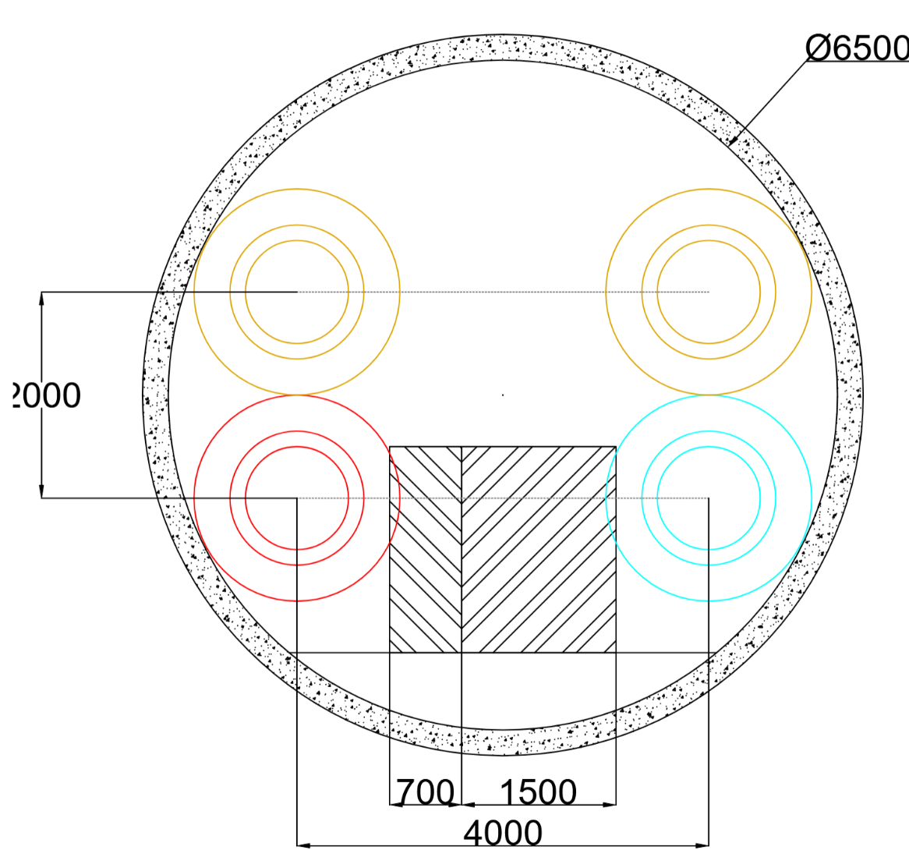
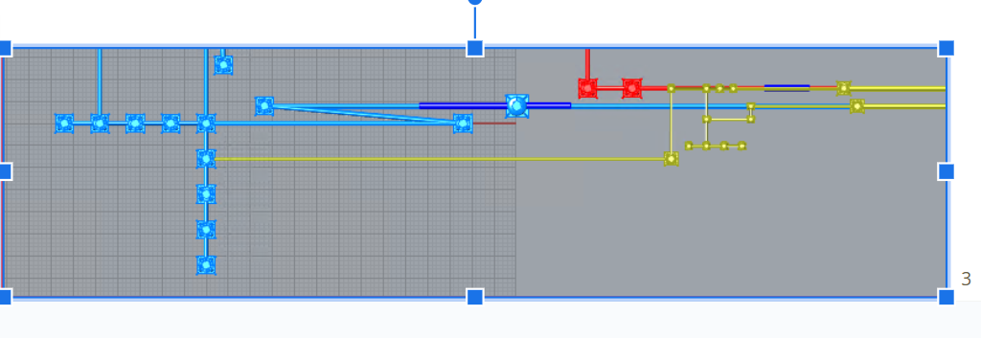

Einstein Telescope
14. 4 .2025
ET-2L-Conf-1-1
Filter Cavity in the main tunnel
HFI and LFI in the same plane, LF_FC plane at higher level
routing to OFI through SEM tower
Shorter LF input mode-cleaner 120 m
Narrower filter cavities pipe - 650 mm diameter
HF IMCs in the same tunnel
Reducing LF Test mass towers to 13 m height

Slide 3
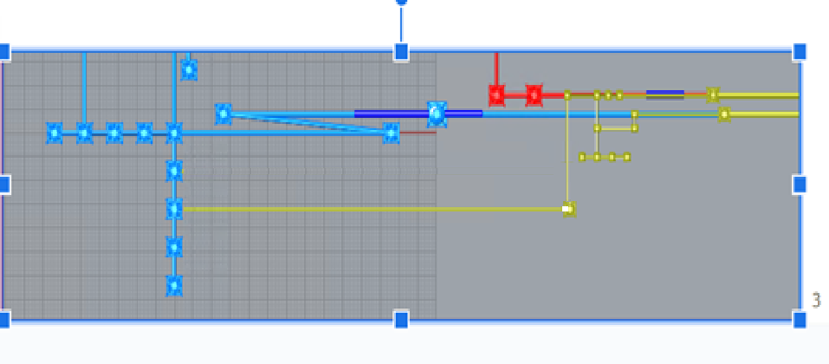
Einstein Telescope
14. 4 .2025
ET-2L-Conf-1-2
Filter Cavity in the main tunnel
HFI and LFI in the same plane, LF_FC plane at higher level
routing to OFI through independent pipe
Same as 1-1 but directly enter LSQI rather than LSEM node.
Shorter LF input mode-cleaner 120 m
Narrower filter cavities pipe - 650 mm diameter
HF IMCs in the same tunnel
Reducing LF Test mass towers to 13 m height

Slide 4
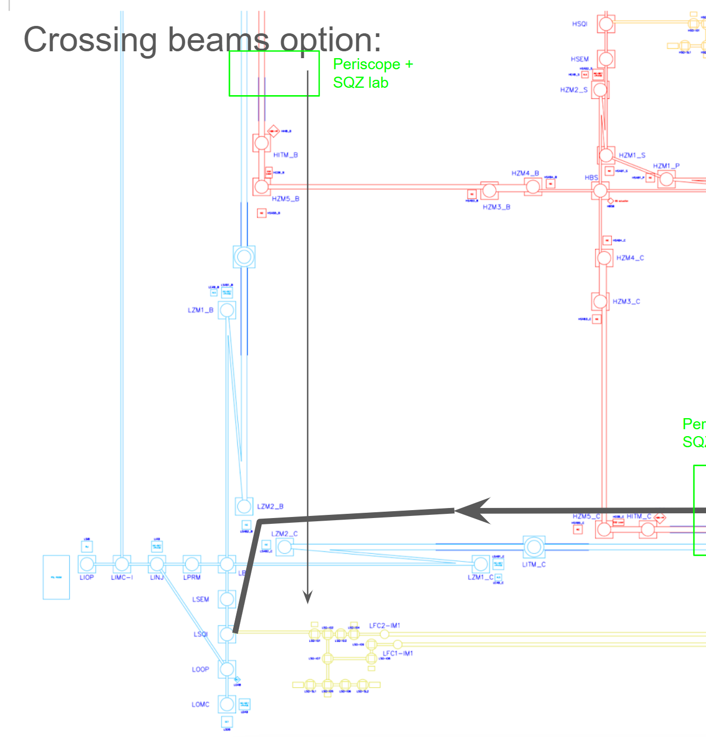
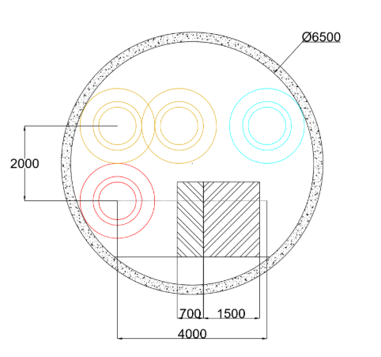
Einstein Telescope
14. 4 .2025
ET-2L-Conf-1-3
Filter Cavity in the main tunnel
LFI plane at higher level than HFI plane
Routing to OFI through BS tower
Shorter LF input mode-cleaner 120 m
Narrower filter cavities pipe - 650 mm diameter
HF IMCs in the same tunnel
Reducing LF Test mass towers to 13 m height

Slide 5
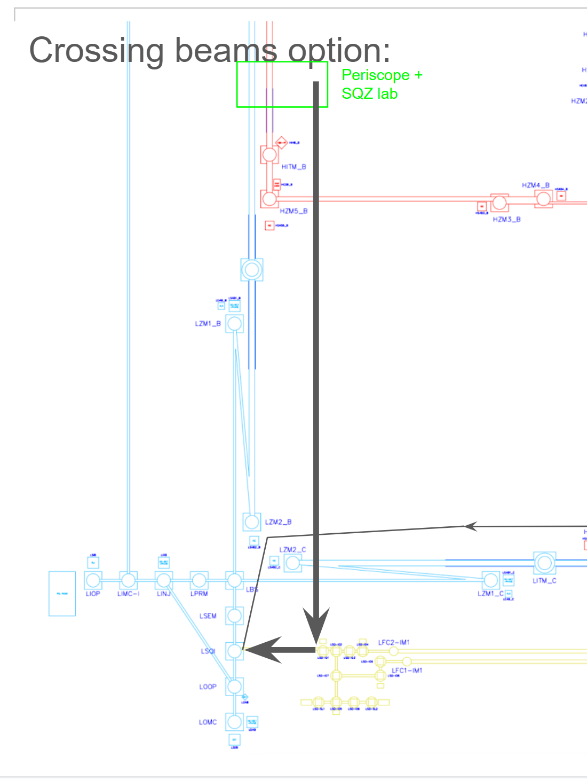
Einstein Telescope
14. 4 .2025
ET-2L-Conf-1-4
Filter Cavity in the main tunnel
LFI plane at higher level than HFI plane
routing to OFI through independent pipe
Shorter LF input mode-cleaner 120 m
Narrower filter cavities pipe - 650 mm diameter
HF IMCs in the same tunnel
Reducing LF Test mass towers to 13 m height

Slide 6
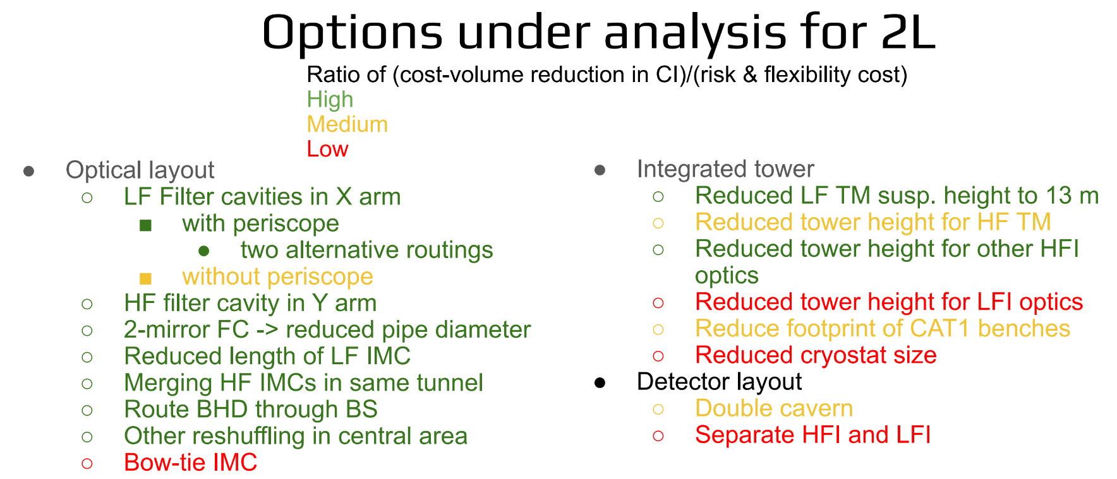
Einstein Telescope
14. 4 .2025
(ET-2L-Conf-2-1) (ET-2L-Conf-2-2) (ET-2L-Conf-2-3) (ET-2L-Conf-2-4) (ET-2L-Conf-2-5) (ET-2L-Conf-2-6) (ET-2L-Conf-2-7)

Slide 7
Einstein Telescope
14. 4 .2025
Examples on Risks

Slide 8
Einstein Telescope
14. 4 .2025
1. ET-2L-Conf-2-1 and ET-2L-Conf-2-2 – Use of Periscopes in Squeezing Injection (Risk Register Line 70 – 71 )
Risk Identified: Phase noise-induced degradation of squeezing performance due to mechanical instability and vibration of periscope structures.
Impact:
ET-LF (Low-Frequency): Especially vulnerable, as squeezing is more critical at low frequencies.
ET-HF (High-Frequency): Also affected, but with moderately lower impact.
Criticality Scores:
ET-2L-Conf-2-1: 15 (Severity 5 × Likelihood 3)
ET-2L-Conf-2-2: 12 (Severity 4 × Likelihood 3)
Mitigation Strategies:
Eliminate periscopes entirely by adopting a horizontal (same-plane) routing of the filter cavity and squeezing optics, reducing vertical beam steering elements.
Prototype the periscope setup in existing detectors (AdvVirgo) to empirically assess mechanical coupling and phase noise.
Advanced seismic isolation and active control of periscope tilt may be explored, though this adds system complexity.
Acceptability Consideration:
Given the high sensitivity of squeezing to phase noise and the proven susceptibility of periscopes to mechanical instability, retaining periscopes is not advisable for ET-LF. Alternatives should be pursued unless empirical testing shows otherwise.

Slide 9
Einstein Telescope
14. 4 .2025
2. ET-2L-Conf-2-4 – Reduced Length of Input Mode Cleaner (IMC) (Risk Register Line 72 – 73 )
Risks Identified:
Insufficient filtering capability due to shortened IMC length (300 m → 120 m).
  Criticality: 10
  Mitigation: Use a high-finesse cavity to enhance filtering despite the reduced length.
  Trade-off: A high-finesse IMC is harder to control and lock (more sensitive to small fluctuations), so requires better feedback control systems. Increased sensitivity to control noise and complexity in locking systems.
Upgrade constraints due to short tunnel infrastructure.
  Criticality: 15
  Mitigation: Plan for tunnel extension (up to 500 m) from the outset to ensure long-term compatibility with future upgrades.
Acceptability Consideration:
The shorter IMC is acceptable only if high-finesse designs are proven controllable. However, the short tunnel option poses a strategic risk and should be rejected unless longer-term civil engineering costs are considered upfront.

Slide 10
Einstein Telescope
14. 4 .2025
3. ET-2L-Conf-2-5 – Shared HF IMC Tunnel (Risk Register Line 74– 75)
Risks Identified:
Limited beam steering capability due to removal of one vacuum tower.
  Criticality: 12
  Mitigation: Perform high-precision simulations of the mode-matching telescope to ensure optical compatibility.
Space constraints from additional optical elements.
  Criticality: 12
  Mitigation: Employ compact, integrated optical mounts and conduct detailed 3D mechanical layouts.
Acceptability Consideration:
This configuration is conditionally acceptable provided simulations confirm that alignment tolerances can be met without compromising optical flexibility.

Slide 11
Einstein Telescope
14. 4 .2025
4. ET-2L-Conf-2-6 – Balanced Homodyne Detection (BHD) Routed through Beam Splitter ( Risk Register Line 76-77-78)
Risks Identified:
Optical congestion in LBS towers, including possible beam overlap.
  Criticality: 16
  Mitigation: Advanced ray-tracing simulations and beam clearance studies to define safe optical paths and minimize interference.
Crowding in LSEM and LSQI towers reduces alignment flexibility.
  Criticality: 12 each
  Mitigation: Rigorous 3D simulations of beam layout to preserve required space and tolerances for beam steering.
Acceptability Consideration:
This option is only acceptable if validated by simulation and mock-up studies that confirm spatial feasibility and stability under operational conditions.

Slide 12
Einstein Telescope
14. 4 .2025
5. ET-2L-Conf-2-7 – Bow-Tie IMC Geometry ( Risk Register Line 79 - 80 - 81)
Risks Identified:
Reduced tunnel length due to compact cavity limits upgradability.
  Criticality: 16
  Mitigation: Optical simulations must confirm performance and future compatibility.
Higher optical losses due to 4-mirrors geometry.
  Criticality: 8
  Mitigation: Procure high-spec mirrors with minimized scattering and absorption.
No experimental demonstration of long bow-tie IMC.
  Criticality: 15
  Mitigation: Develop test benches or prototypes to evaluate performance prior to adoption.
Acceptability Consideration:
This configuration poses significant technical and strategic risks due to its untested nature and structural constraints. It should be considered experimental unless supported by a dedicated R&D program and/ or confirmed optical simulation results.

Slide 13
Einstein Telescope
14. 4 .2025
Penalty of Change

Slide 14
Einstein Telescope
14. 4 .2025
LIMC Length : 120 m → 500 m ( 300 m )
Arm Length Reduction and Optics Change
Change: ET LF Arm cavity reduced from 15 km to 10 km due to LF TM diameter constraint ( if the ET LF TM diameter is reduced from 450 mm to 350 mm , if reduced more the arm cavity length will be also reduced) .
Penalty: Reduced sensitivity at low frequencies due to the shorter ET LF Arm cavity ; sensitivity in interferometers improves with arm length.
Cost : we suggest taking into consideration the differential cost estimate between 10 Km to 15 Km ET LF Arm length . Also we suggest taking into consideration some strategies regarding the civil engineering infrastructure taking a decision on which option to go for regarding the length of ET arm cavities Length in general and ET LF configuration (with respect to future upgrades).

Slide 15
Einstein Telescope
14. 4 .2025
Periscope Use and Squeezing Quality
Issue: Periscopes may introduce vibrations, especially critical at Low Frequencies (LF) where quantum noise dominates.
Penalty: Degraded squeezing level and thus quantum noise suppression essential at LF. Quantum noise suppression via squeezing is highly sensitive to mechanical stability.
Option A: Periscope for HF Only, Return to Baseline for LF
Impact: Simplifies the LF path, reducing vibration risks, but adds complexity in having two different setups.
Penalty: Operational complexity and potential alignment issues.
Cost : Additional cost for ET LF Squeezing FC ( same as baseline)

Slide 16
Einstein Telescope
14. 4 .2025
Option 1: Reroute Squeezing Through BS , Folded periscopes Length Increase
Impact:
  Increases length of the signal recycling cavities (folded telescopes near the LBS) by 10 m on both LF recycling cavities and HF recycling cavities.
Penalty: Longer ET HF SRC may degrade sensitivity.
Cost : adding 10 m on both ET LF and HF recycling cavities
Option 2: Reroute and Shift LZM2_ X and LZM2_Y by 10 m , Increased Astigmatism
Impact: Increased angles in folded telescopes lead to astigmatic beams.
Penalty: increase the astigmatism in the LF recycling cavities
Cost : remain the same
LBS Tower and Optical Bench Space
Common Impact in Both Options 1 & 2:
  More optics in LBS.
Penalty: Structural redesign and cost, as well as alignment risk with more optics.
Cost : May require increasing optical bench diameter by 10 to 20 cm in the LF BS Tower, LF SEM Tower , LF SQI tower.

Slide 17
Einstein Telescope
14. 4 .2025
LIMC Length : 120 m → 500 m ( 300 m )

Slide 18
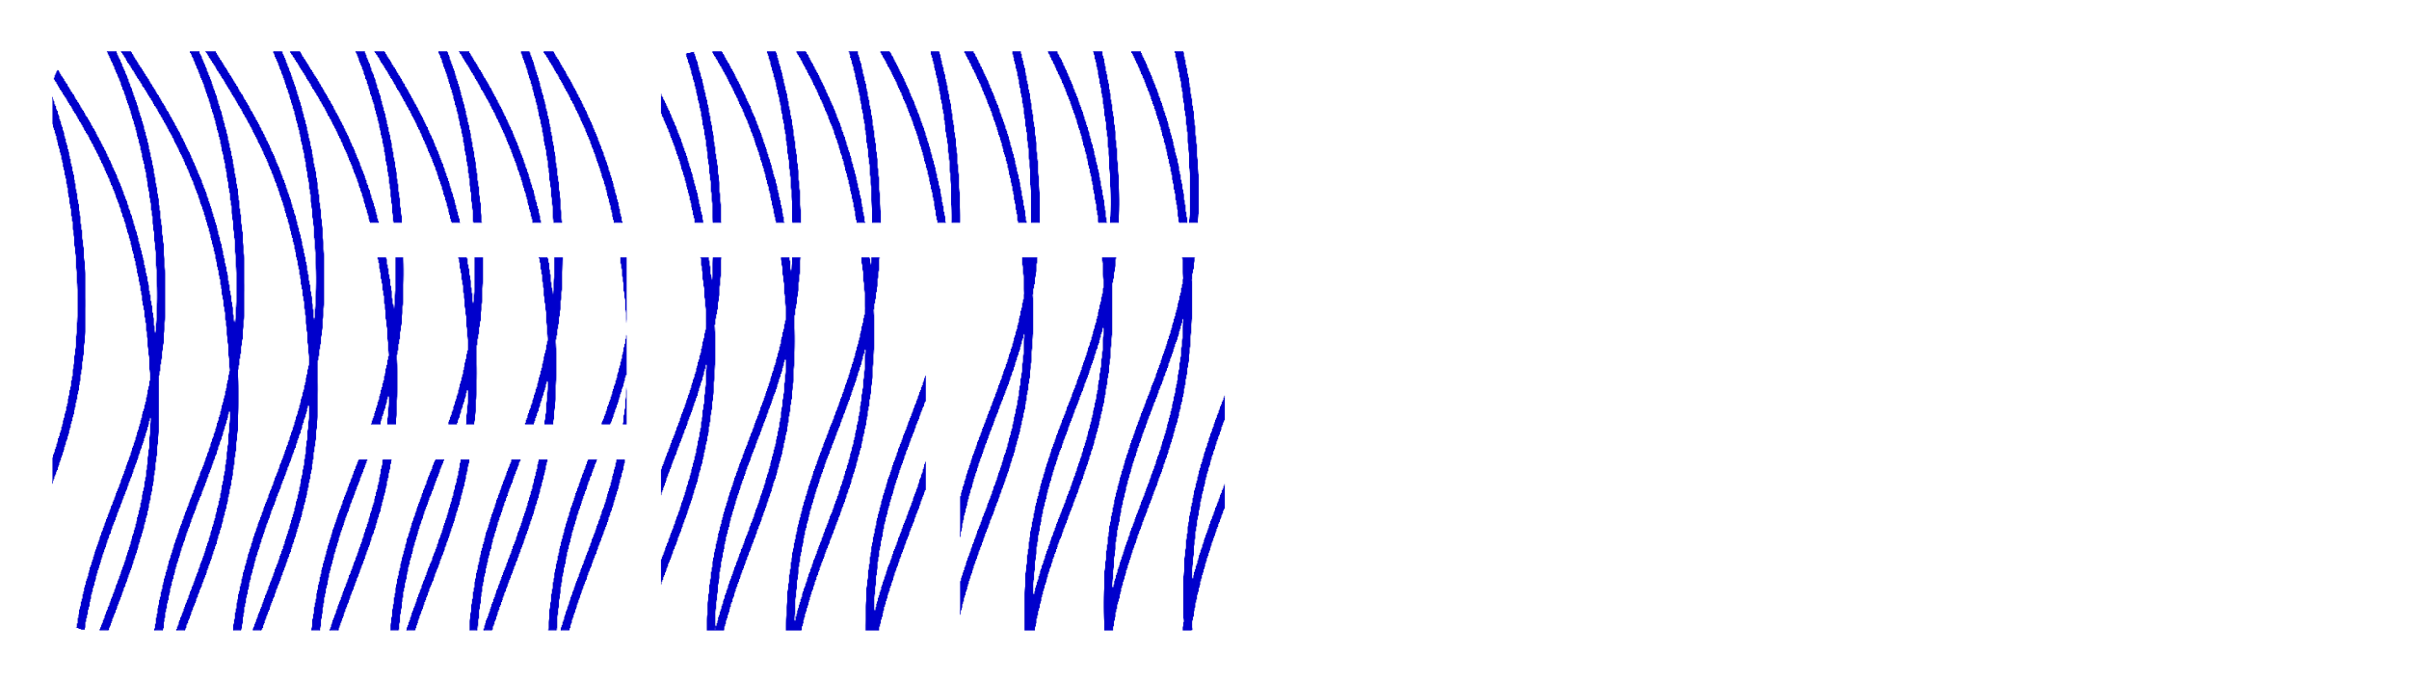
Thank you!
Email address
ghada.mahmoud@apc.in2p3.fr

Slide 19
Einstein Telescope
14. 4 .2025
Risks :
Conf-1-1 and Conf-1-2 were found to depend on the use of periscopes to raise the squeezed vacuum beamline by approximately 2 meters; an approach not yet demonstrated at the required scale in gravitational wave detectors. This introduces potential delays due to the need to validate the periscope design, with identified risks including loss of squeezing performance from pointing errors and polarization mixing.
Conf-1-3 was found to be particularly problematic, with two major issues: the first being the physical obstruction of access to the LZM2_C tower and associated optical benches, and the second being an increase in astigmatism in the Y arm due to necessary repositioning of the LZM2_Y mirror.
Conf-1-4, meanwhile, introduced risks related to the vacuum environment of the LF interferometer. The introduction of the squeezed vacuum beamline, which operates under less stringent vacuum requirements, could degrade the overall vacuum quality of the central interferometer, necessitating the addition of cryo-pumps and vacuum viewports to maintain adequate separation.

