Slide 1
Radiation Effects on COTS Microcontrollers: Test Methodology, Qualification Results, and Mitigation Strategies
Alessandro Zimmaro
Rudy Ferraro
Salvatore Danzeca
BE-CEM-EPR
06/05/2025

Slide 2
Agenda
Introduction
Radiation Effects on Microcontrollers
Microcontrollers Testing Results
Mitigation Schemes
Conclusions

Slide 3
Introduction

Slide 4













Microcontrollers in Particle Accelerators: Pros. and Limit.
Compactness & Low Power
Limited Speed
In terms of speed, the sequential operation of MCUs represents a significant bottleneck compared to the parallelism offered by FPGAs
Ideal for distributed systems and tight spaces
Lowly costumizable
Cost Effective
Affordable solution for specific tasks, even in redundant configurations.
SAMD21 : 4 € Vs M2GL025T : 70 €
Compared to FPGAs, development on MCUs is limited by the available hardware peripherals.
EASILY COSTUMIZABLE
Radiation Sensitivity
The various available peripherals, combined with libraries and drivers, enable Easy and Fast application development.
In commercial MCUs, implementing hardware-based Triple Modular Redundancy (TMR) is not feasible.

Slide 5
Radiation Effects on Microcontrollers

Slide 6
Radiation Effects on Microcontrollers: Cumulative Effects
Trapped
Electrons
e-
p+
+ + + + + + + + +
+ + -+- + -+- - -
Total Ionizing Dose (TID)
Oxide
Effect: electron-hole pair generation in silicon oxide
positive charge trapped
Units: Gray (Gy) → 1 Gy = 100 rad = 1J/kg
Device Affected: MOSFET, Bipolar Junction Transistor (BJT)
Interface
Traps
Silicon
Degradation in Microcontrollers
Increased Leakage Currents
GPIO Output State Degradation
Flash
Analog Performance Degradation
Peripheral Malfunction or Degradation
Greater Susceptibility to Corruption
Loss of Writability

Slide 7
Radiation Effects on Microcontrollers: Stochastic Effects
Charged Particle
Oxide
+N
+N
Single Event Effects (SEE)
+ -
+ -
+ -
+ -
Effect: Create defect in crystal lattice by atom displacement
Metric: High Energy Hadron Fluence (>20 MeV) (HeH)
Unit: HeH.cm-2
Device Affected: MOSFET, BJT, Optoelectronic
+ -
+ -
+ -
+ -
Non- Destructive
Destructive
SOFT ( May not Require RST)
HARD (SEFI - Require RST)
Single Event Latchup
Bitflip in Configuration
Bitflip in SRAM stored variable
Failure in instruction Process (e.g. Program Counter (PC) Bitflip, Failure in Fetch-Decode-Execution Cycle, Wrong PC Increment)
Peripheral crash
Flash corruption

Slide 8
Radiation Effects on Microcontrollers: Test Methodology
The methodology can be divided in 3 Main Tests
  CPU+ALU performance is tested using Coremark → meaningful comparison of performance across different MCUs
  SRAM Sensitivity is evaluated through a specific Write/Read operation on part of the SRAM through an in-flux test.
  The Peripheral Test Part is normalized based on the project’s requirements → Can require more than 10 different tests according to the project.
  All Tests are carried out at PSI with 200 MeV Proton Beam
Dedicated designs are used to evaluate performance
This approach allows:
  Better observability
  Easier reconfiguration for failure investigation
The operational cross-section can only be tested through testing the project’s gateware.
Microcontrollers Test Methodology
CPU
SRAM
Peripherals
Test Strategies
Coremark
- Performance Degradation (Score)
- Hard/Soft Failure Cross-Section
-SEL Cross-section
- Change Config (e.g. Cache, ECC)
Continous write-read
Hard/Soft Failure Cross-Section
Register Corruption
Lifetime
SEL Cross-section
Evaluate Mitigation Schemes
Dedicated Design
Hard/Soft Failure Cross-Section
Register Corruption
Lifetime
SEL Cross-section
Flash Writability: checked at the end of each run
Test Project Gateware

Slide 9
Microcontrollers Testing Results

Slide 10
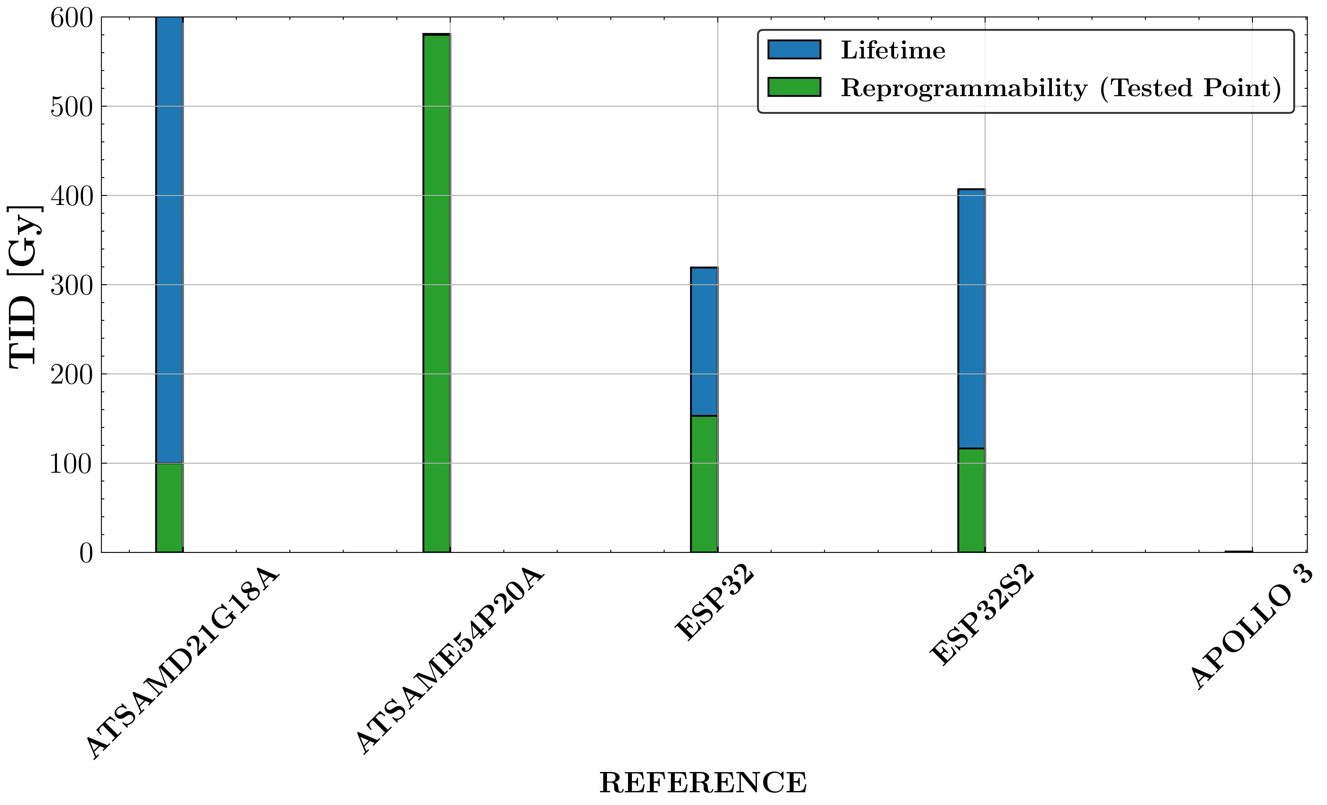
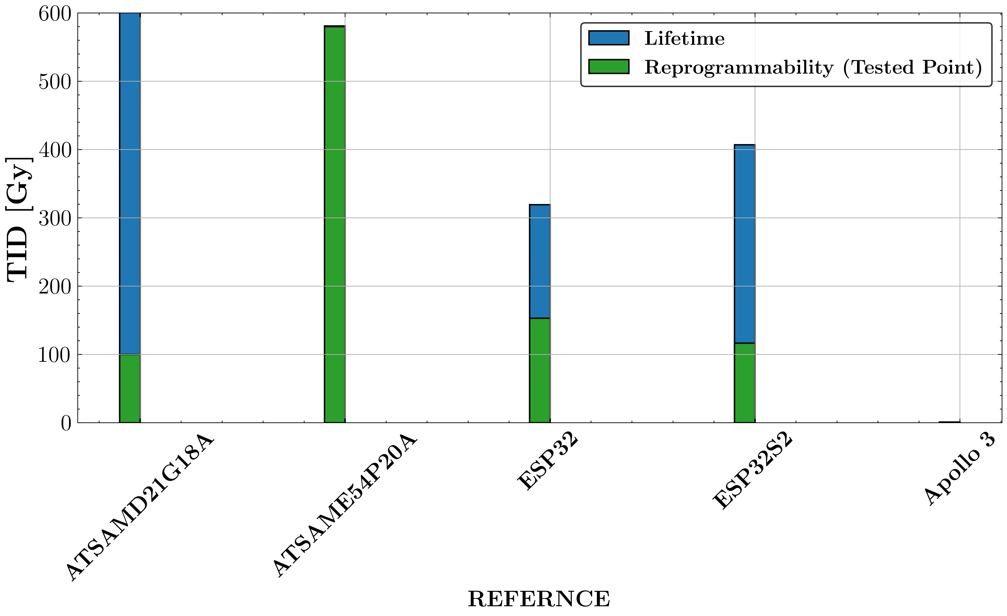
Microcontrollers Testing: TID Degradation
No CPU degradation has been observed on the different References Tested Except on the Apollo 3
No Current consumption increase
SAMD21:
Longer lifetime
Low Programmability
SAME54:
Programmability > 580 Gy
@580 Gy Flash Corruption → Near End of Life
Flash Not writable

Slide 11
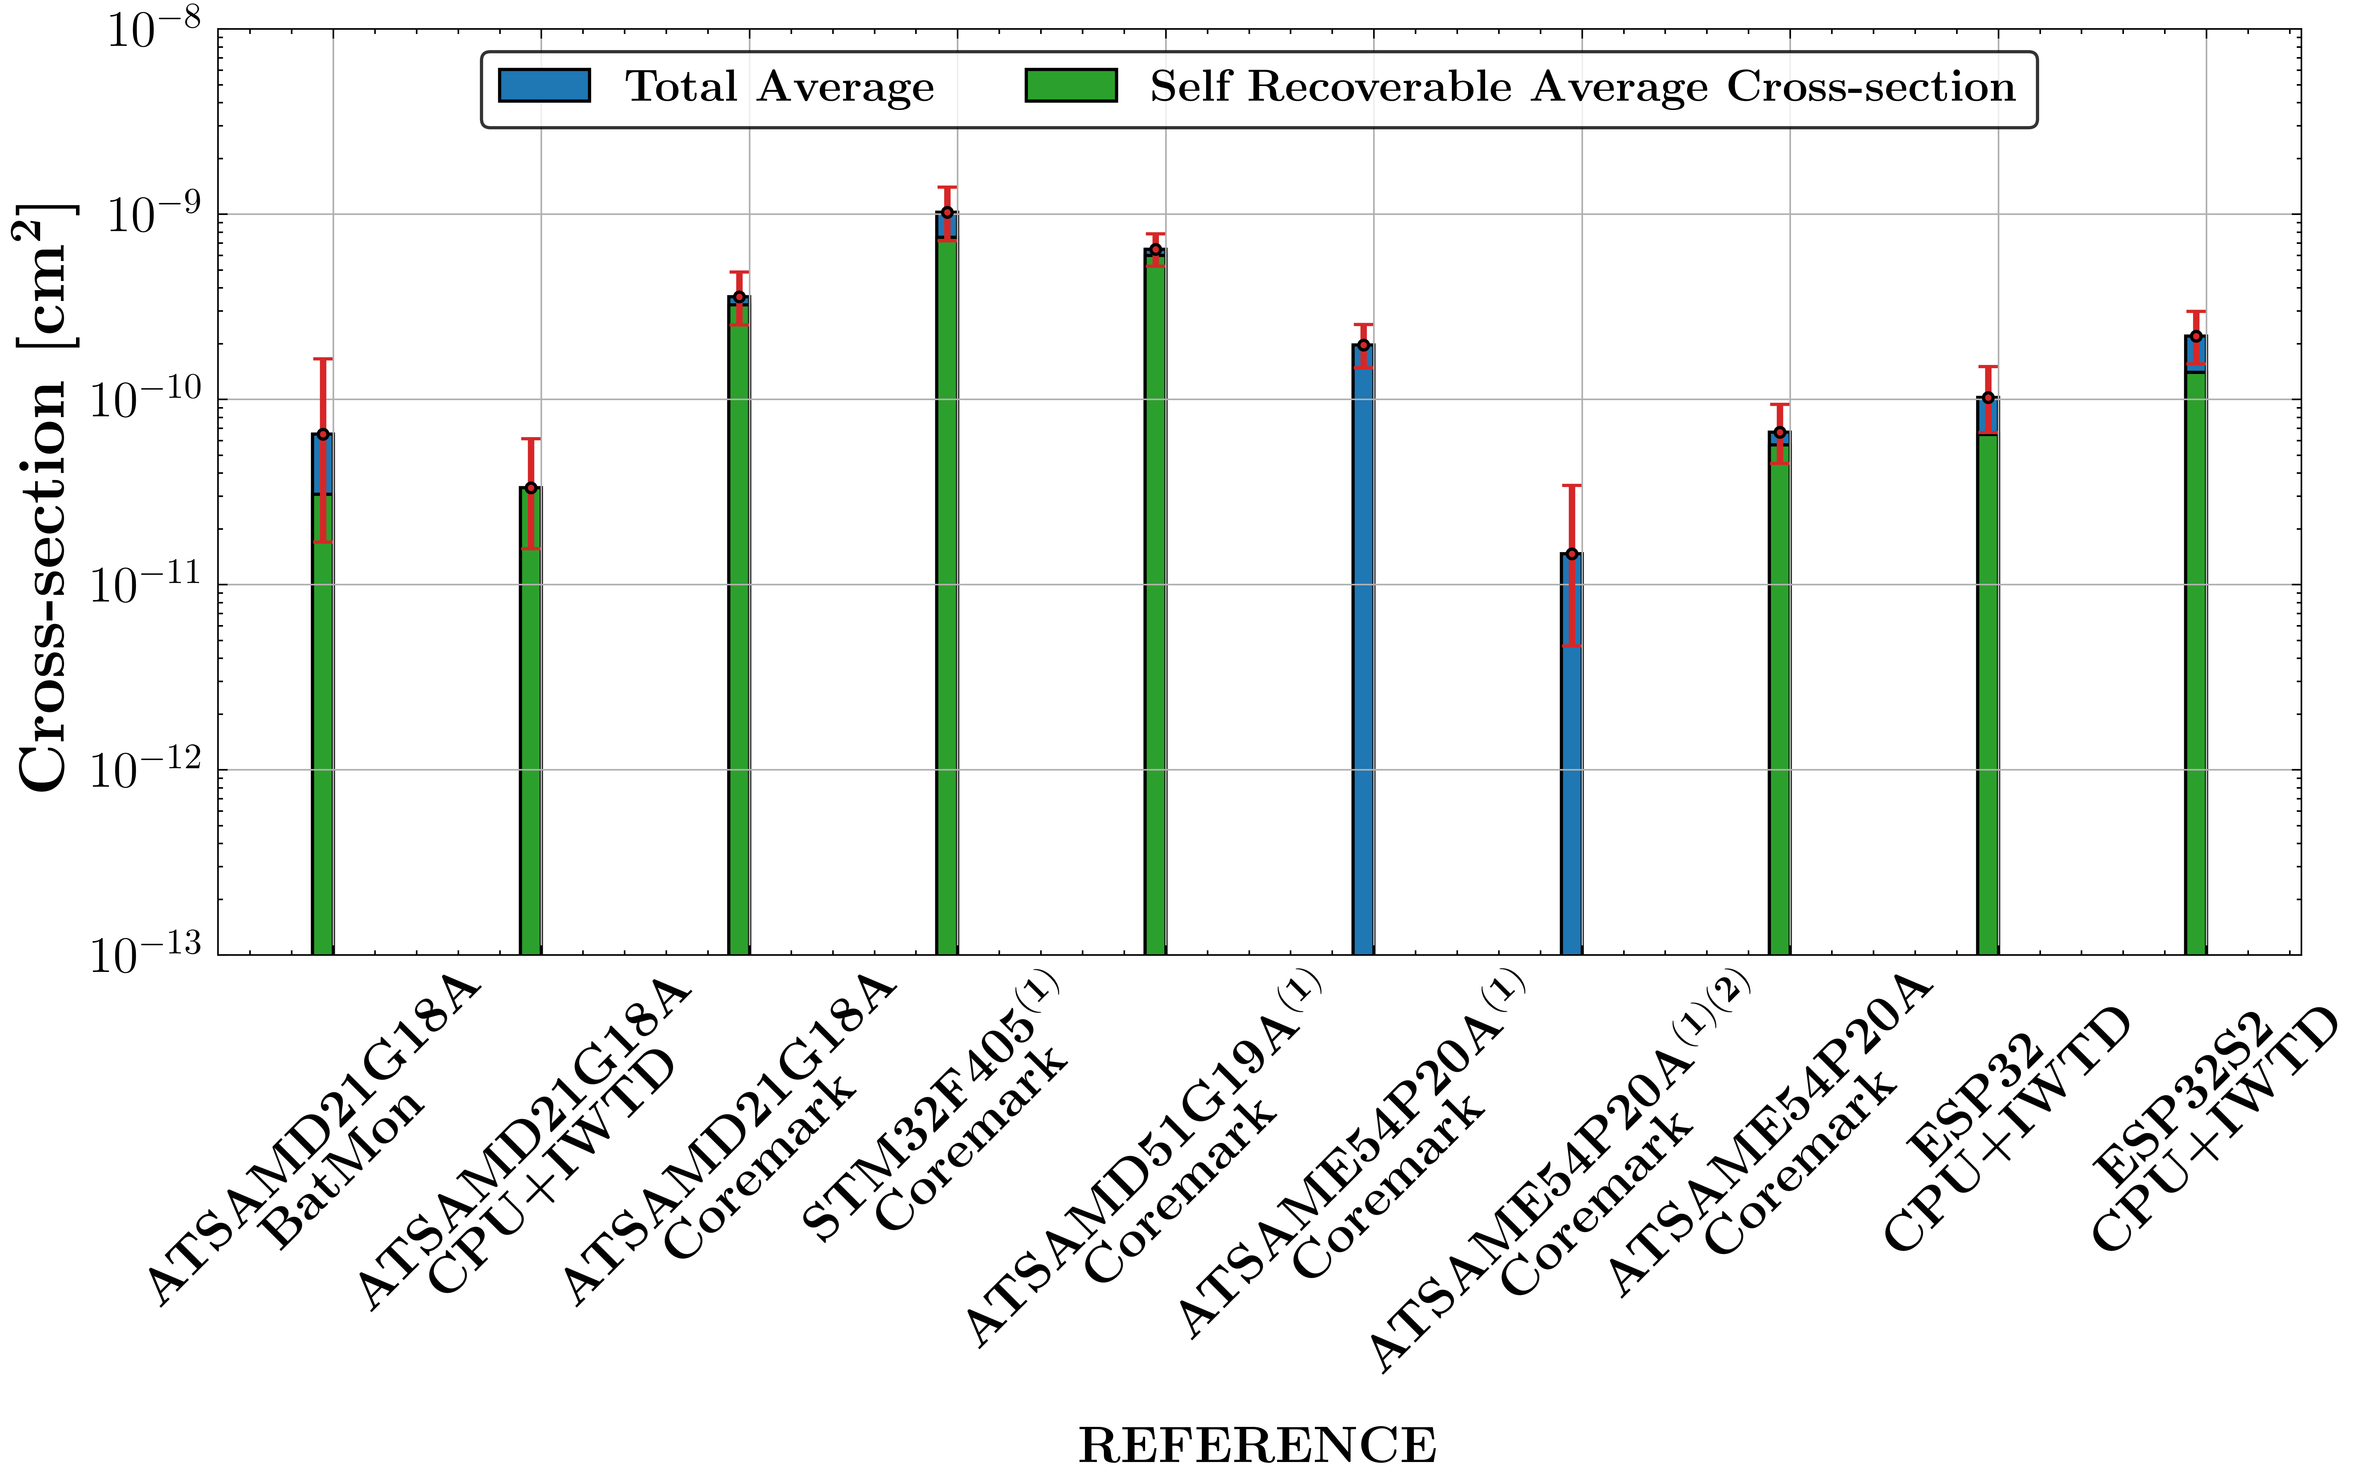
Microcontrollers Testing: CPU SEE Sensitivity
Configuration can impact the sensitivity → Operational cross-section cannot be known from component-level testing data
Usage of cache is not recommended
IWTD allows recovering most failures
  Still required additional Mitigation
  Additional Issues:
  IWTD TID degradation (SAMD21)
  Permanent Failure Induction (SAME54)
    →If disabled, Ext RST was restoring MCU functionalities
    SEL can be mitigated only with Power Cycle
Use of Cache
Use of ECC
x10
Different Config
Different Config

Slide 12
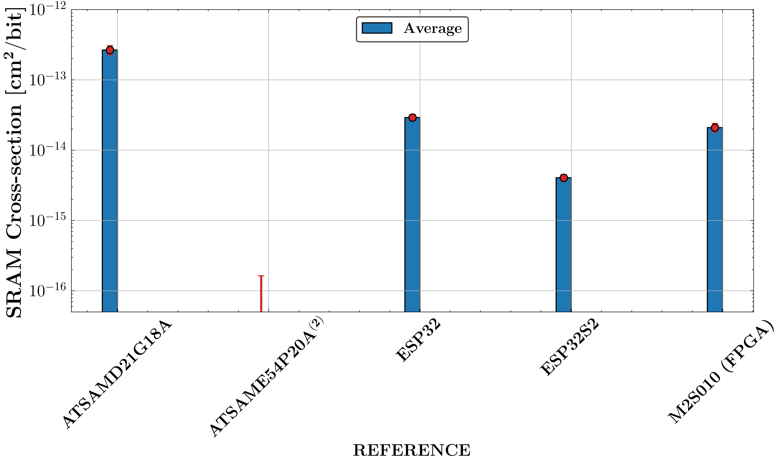
Microcontrollers Testing: SRAM SEE Sensitivity
In terms of SRAM SEE sensitivity, SAMD21G18 exhibited the highest sensitivity.
Although the ESP32 and ESP32-S2 share the same 40 nm technology node, the latter demonstrated better performance.
ESP32 exhibited similar performance to M2S010 (65 nm) FPGA
When available, such as in SAME54, ECC (type SECDED) should be enabled
  For this reference, ECC was always successful.

Slide 13
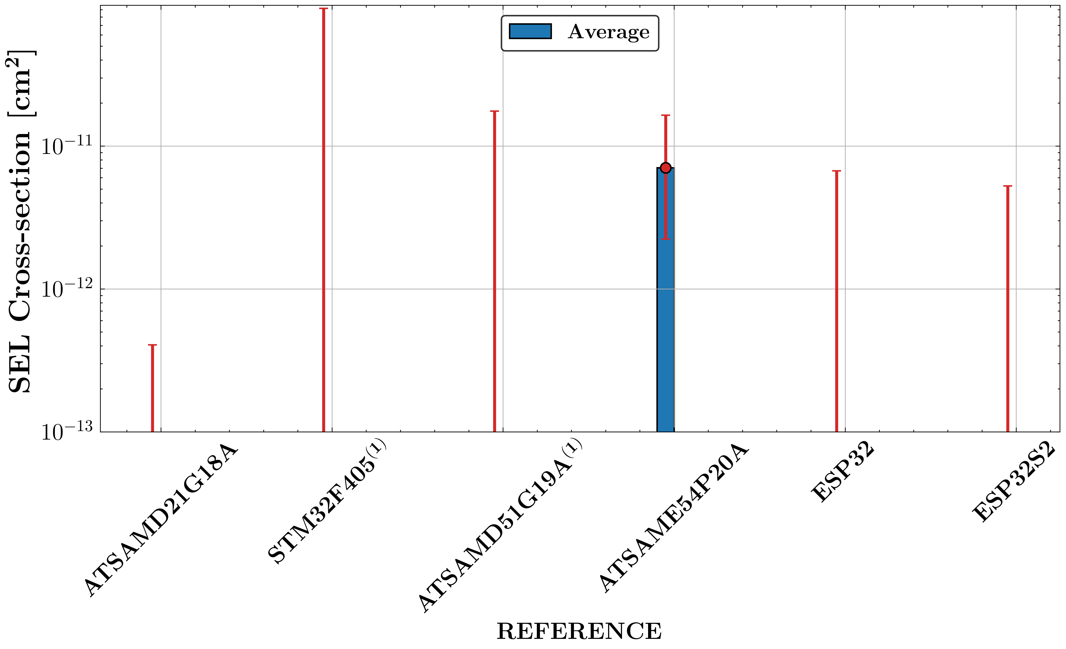
Microcontrollers Testing: SEL Sensitivity
On most of the references tested no SEL were experienced except for SAME54 (Test Carried out with 200 MeV Proton Beam)
SAMD21:
Extensively tested
SAME54:
SELs observed: Not destructive and limited to 500 mA
If IWTD used → cannot be recovered via External Reset

Slide 14
Mitigation Schemes

Slide 15


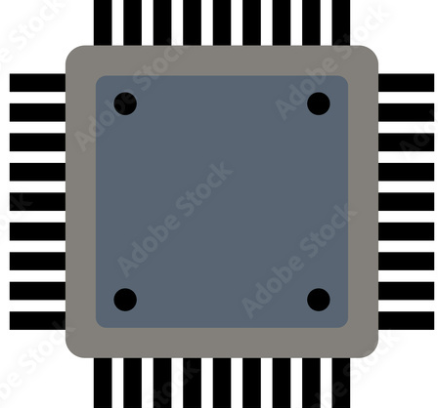

Mitigation Schemes: Main Failure Detection Mitigation Schemes
An External Watchdog (EXTWTD) used to mitigate failures
Working principle:
  2 GPIOs are used by the Microcontroller (MCU) to feed EXTWTD
  If the EXTWTD receives no responses, it resets the MCU
Can the EXTWTD mitigate all failures? The answer is No! → Software Mitigation Schemes (SMS):
Developed and implemented in Microcontroller (MCU)
Legend:
Data
Confirmed Uplink
reset

Slide 16
Software Mitigation Scheme: Software Watchdog
Bitflips in MCU’s SRAM or internal configuration registers → the MCU’s malfunctions
An Internal Software Watchdog (MCU-Real Time Clock Based) used to detect such failures
  A variable used to store the RTC time when the system wakes up or sleep
  MCU does not exit sleep mode or stays awake for longer time? Software Watchdog detects the fault and self-reset the MCU
Legend:
Data
Confirmed Uplink
reset

Slide 17
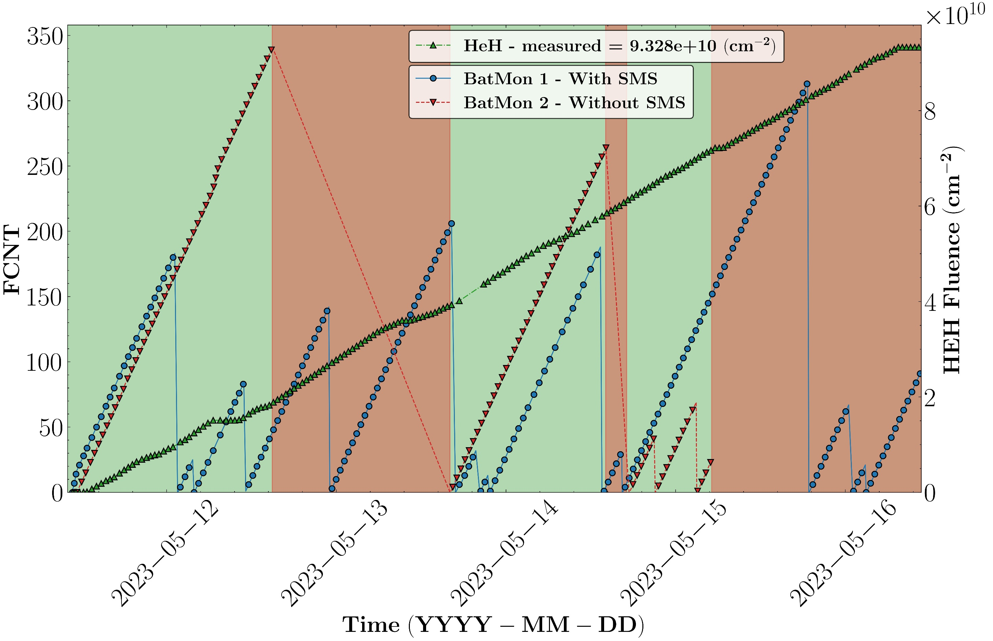

Impact of Software Mitigation Schemes on BatMon
Other protection mechanisms:
  A management function via attribute instruction is assigned to all handler function definitions in the code and protects incorrect configurations that could result from SEEs.
  TMR applied to critical counters.
  Critical Variables stored internal MCU Flash and are only read.
  Protect mechanisms to fault reading are applied.
SEFI
SEFI
SEFI
Device | Downtime Period [Minute] | Downtime/Uptime [%] | Mitigation Used
BatMon 1 | 187 | 2.58 | All
BatMon 2 | 3517 | 48.82 | Ext Wtd

Slide 18
Conclusions

Slide 19
Conclusions
The Pros. and Limit. of using microcontrollers within the accelerator environment have been outlined.
Both cumulative and stochastic radiation effects on microcontrollers have been discussed.
A test strategy for MCU qualification has been presented.
Results from various tested references have been compared and analyzed.
  The SAMD21 currently represents the best parts both in terms of TID and Single Event Latch-up (SEL) Sensitivity.
  The use of the SAME54 is limited due to non-destructive SEL.
  The proposed test strategy, thanks to its enhanced observability, allowed identification of the root cause of permanent failures in the SAME54 (internal watchdog Reset triggered following SEL).
  It has been demonstrated that the use of an external watchdog (ExtWTD) is always necessary.
Mitigation schemes developed by the EPR section and currently adopted in the BatMon design provide alternatives to relying solely on the internal watchdog (IWTD).
Further tests are planned to investigate new references to expand the available resources.

Slide 20
Thank you for your attention!

Slide 21
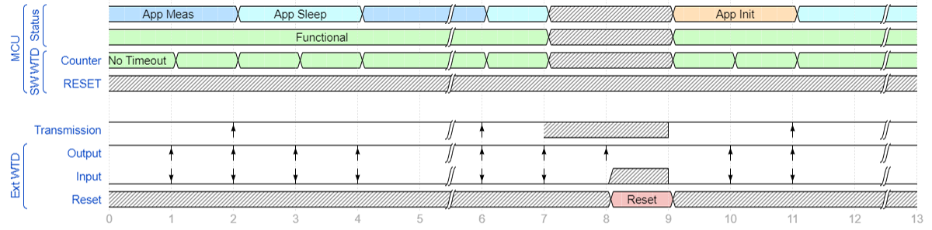
Mitigation Technique for Hard/Soft Errors
An External Watchdog (EXTWTD) used to mitigate failures
Working principle:
  2 GPIOs are used by the Microcontroller (MCU) to feed EXTWTD →If the EXTWTD receives no responses, it resets the MCU
Can the Ext WTD mitigate all failures? The answer is No!
In normal conditions system passes through two operating modes feeding the Ext WTD.
SEFI
No Response

Slide 22
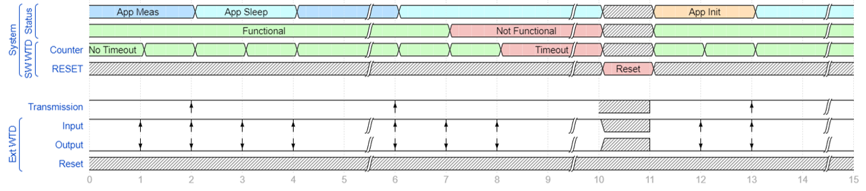
Mitigation Technique for Hard/Soft Errors
Bitflips in MCU’s SRAM or internal configuration register → the MCU’s malfunctions
An Internal Software Watchdog (MCU-Real Time Clock Based) used to detect such failures
  A variable used to store the RTC time when the system wakes up or sleep
  MCU does not exit sleep mode or stays awake for longer time? Software Watchdog detects the fault and self-reset the MCU
SWTD Timeout
SEFI
Ext WTD still fed by MCU

Slide 23
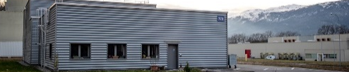


Radiation Effects on Microcontrollers: Test Facility
Testing Microcontrollers can be trivial, requiring several qualification campaigns.
In terms of R2E effects, PSI Allows complete qualification of Microcontrollers
However:
  If B10 → SEEs From Th → Test required at ILL
  Alternative solution: CHARM
  LDR Effects should be assessed → CO60
Microcontrollers
TID
SEE
LDR
Thermal neutrons
Thermal neutrons
PSI
Thermal neutrons
CC60
ILL
CERN Cobalt 60 Facility
Geneva, Switzerland
100 Tbcq Co60 Source
Proton Irradiation Facility
Paul Scherrer Institute
Viligen, Switzerland
TENIS: Thermal And Epi-thermal Neutron Irradiation Station, Grenoble France
https://www.psi.ch/en/pif
https://www.ill.eu/

