Slide 1
SOCRATES: System-On-Chip RAdiation Tolerant EcoSystem for ASIC designs and microcontrollers in HEP applications
R2EWG Workshop
6 May. 2025
Kostas Kloukinas
EP-ESE-ME

Slide 2

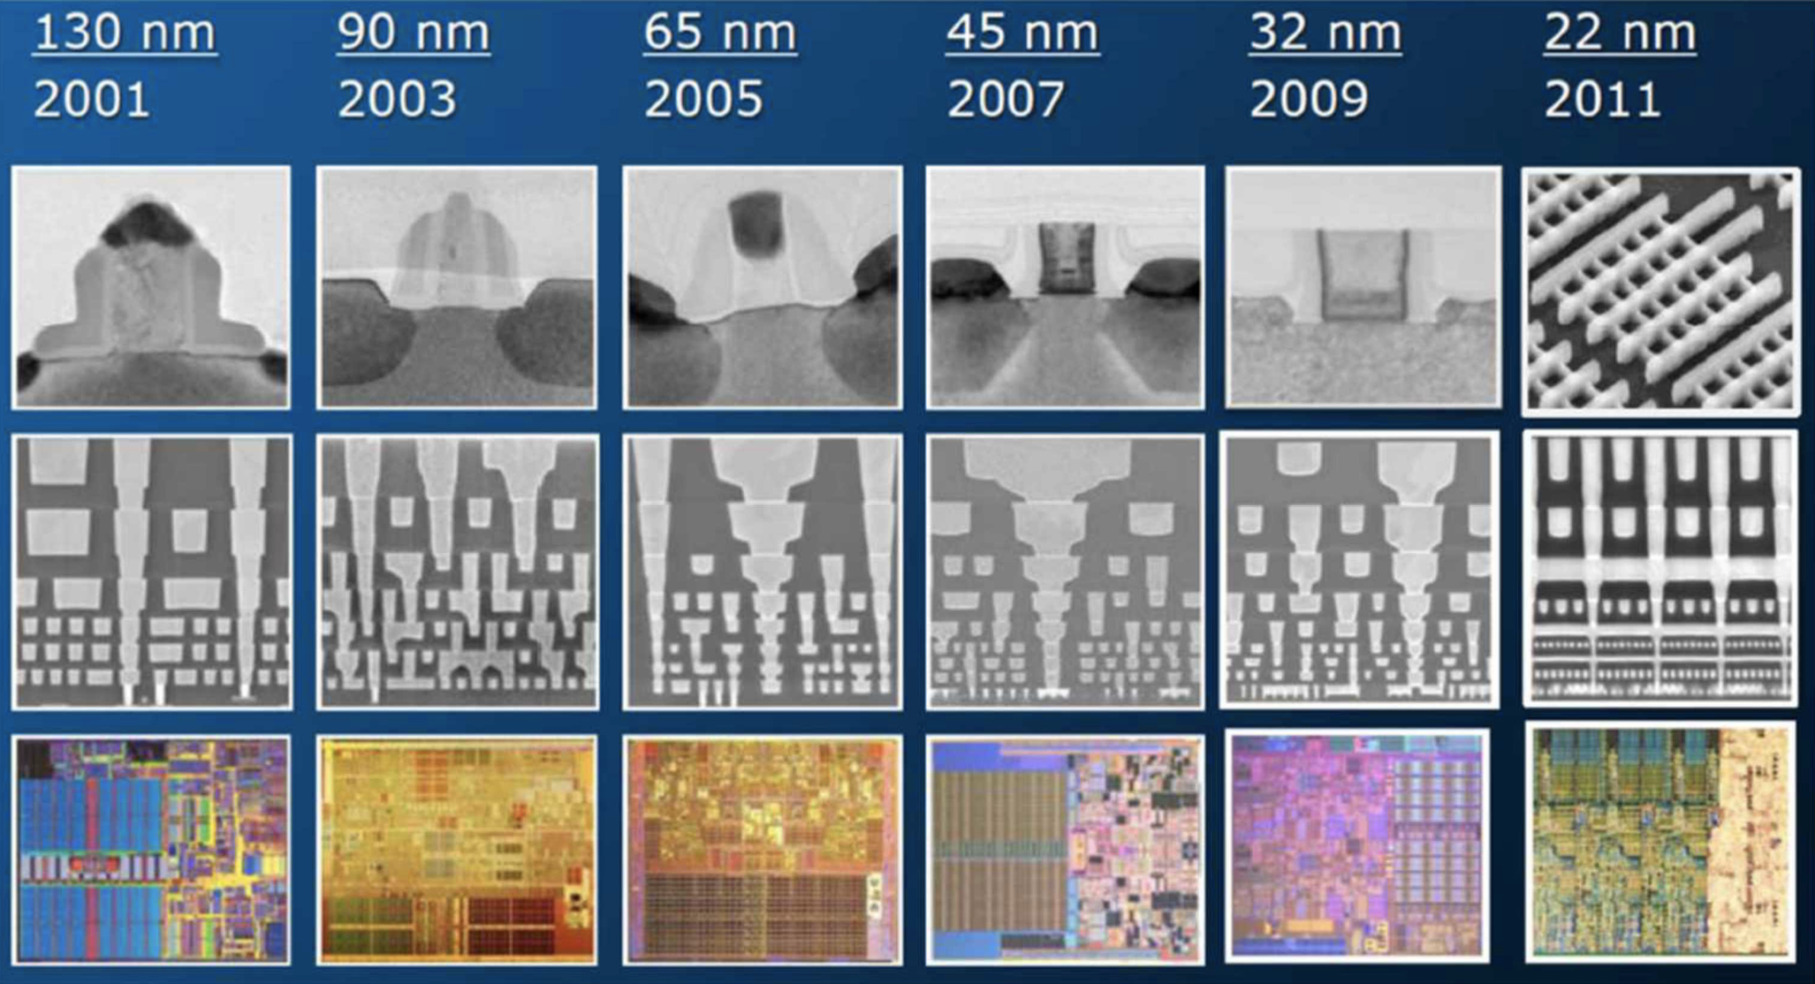
Challenges in ASIC design @ HEP
Technology Challenges
  Complex deep-submicron silicon manufacturing processes
  Powerful, Flexible but highly Complex EDA Tools
Design Challenges
  Designs of increasing complexity and size
  Novel designs for scientific instrumentation
  Radiation Tolerance
Productivity Requirements
  Large, fragmented, multinational design teams
  Designers with different levels of expertise
  Work on common design projects
  Costly technologies
  Importance of 'first-time-right’ designs !
EDA software Tools
Design Methodologies
90 nm
45 nm
14 nm
130 nm
65 nm
28 nm
Technology scaling
Notes:
After a couple of the years on the service I realized that the design teams (CERN and institutes) were facing significant challenges in their design work especially with the advent of HL-LHC electronics.

Slide 3
EP R&D WP5 “IC TECHNOLOGY”
CERN EP department launched a strategic R&D programme on technologies for future experiments.
https://ep-dep.web.cern.ch/rd-experimental-technologies
WP5: Research novel solutions for ASIC design, powering, and interconnects
Lead by K. Kloukinas, D. Ceresa (deputy)
5.1 Technology Evaluation | 5.2 IP block development | 5.3 Intelligence on Detector (IoD) | 5.4 Powering solutions | 5.5 3D Interconnect solutions
G. Borghello | R. Balabriga | A. Caratelli, D. Ceresa | S. Michelis | K. Wyllie
K. Sarbandi | F. Bandi* | M. Andorno | P. Antoszczuk | M. Campbell
G. Termo* | T. Hoffman* | B. Denkinger | G. Bantemits | K. Kloukinas
G. Ciachera* | M. Piller* | M. Zahedi | S. Koseoglou | F. Piernas Diaz
 |  | J. Dhaliwal | G. Ripamonti | J. Alozy
 |  | A. Nookala | M. Macaluso | M. Kovacs
 |  | F. Brambilla K. Kloukinas | A. Ocarino | S. Al-Tawil X. Llopart
NEW!
Concluded
* Concluded their contract

Slide 4
On Detector Intelligence
CERN EP R&D activities
EP R&D WP5.3 “On Detector Intelligence” incorporates
TWO COMPLEMENTARY R&D ACTIVITIES:
PixESL
SOCRATES
Virtual Prototyping
RISC-V SoC
Virtual Prototyping Framework for Pixel Detectors
Applying System Level modeling concepts on
pixel detectors readout systems
Cycle-accurate simulations
From analog front-end to chip/system readout
Open Source
SOC Radiation Tolerance EcoSystem
Standardized Hardware IPs
Generate custom SoCs
Radiation Tolerant
Open Source

Slide 5
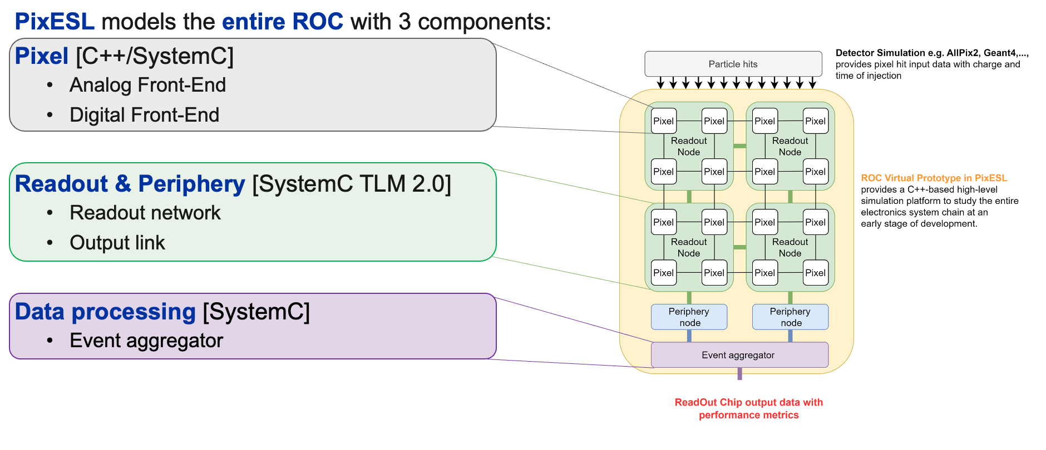

PixESL - Methodology
For more details:
Virtual Prototyping Framework for Pixel Detector Electronics in HEP,
F. Brambilla, DVCON Europe 25 (Best Research Paper award)

Slide 6
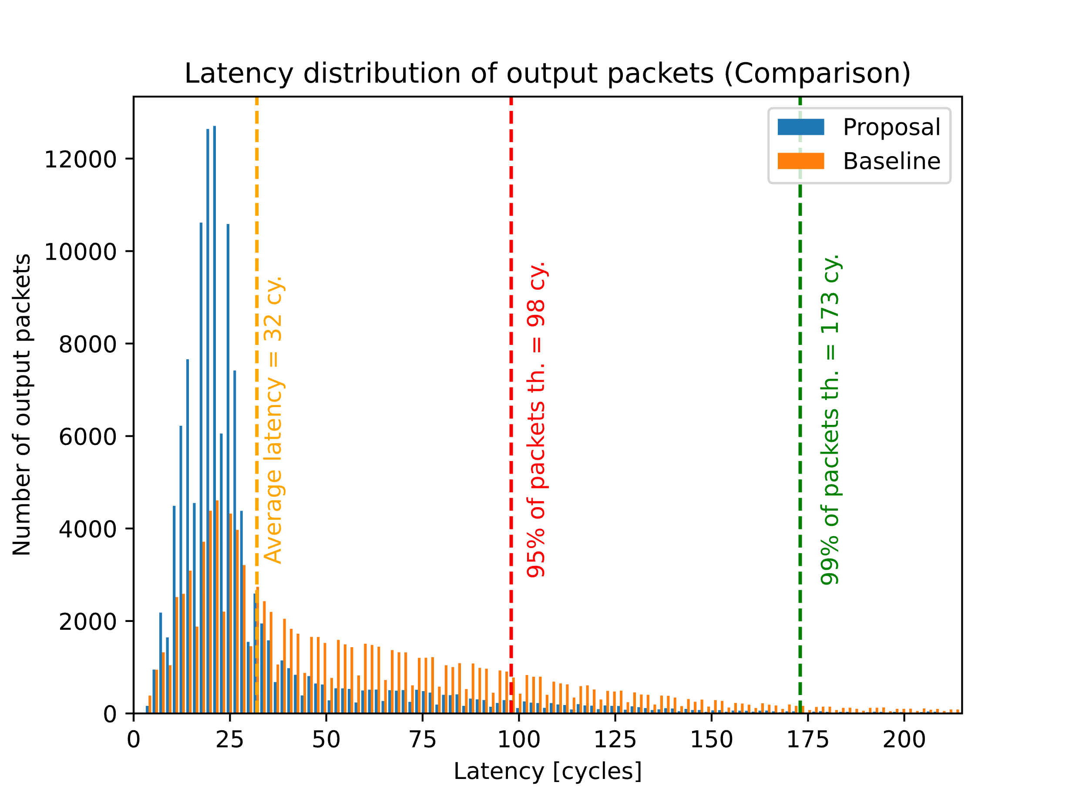
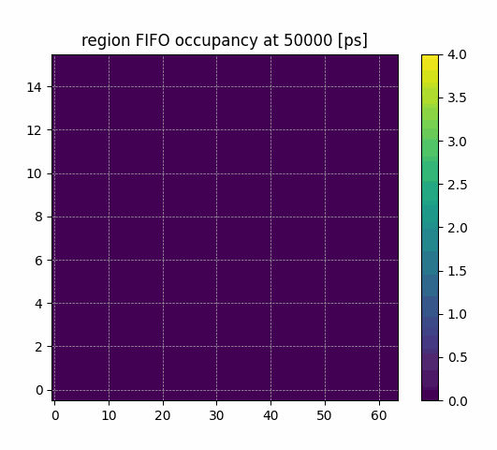
PixESL - Methodology
A virtual prototype allows for exploring different
architectures without defining the design details.
Network connection and hierarchy
Memory sizing
Arbitration
 | Velopix | Proposed
Pixel | 256x256 | 256x256
SP | 128x128 | 128x128
Regions | 64x8 | 128x8 *
EoC | 64 (8 ch.) | 128 (16 ch.)
Arbitration | Round-robin | Back-pressure
Readout eff. | 90 % | 99 %
Avg. latency | ~100 cy. | ~30 cy.
For more details:
Applications of PixESL framework on pixel detectors for HEP experiments,
J. Dhaliwal, TWEPP 24 (Oral Presentation Award)

Slide 7



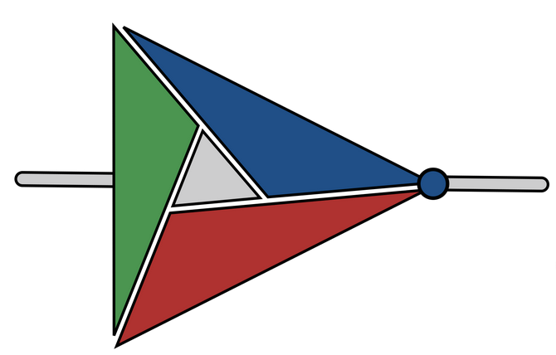




The SOCRATES platform
DEVELOPMENT STAGE:
Advanced
In progress
Future developments
HW/SW build system
(SoCMake )
Pre-verified
IP block library
Radiation
hardening
Hardware composition
Software generation
Verification
Implementation
Generate the top-level SoC
Integrate IP blocks
Infer interconnects
(crossbars, adapters)
Fault tolerant interconnects
Automatic TMR of IP blocks
Invoke toolchain
Generate Hardware Abstraction Layer (HAL)
Generate linker scripts
Functional testing environment
SystemC-UVM environment
FPGA prototyping
Fault injection framework
Formal verification for TMR
Run synthesis and physical implementation flow on targets
Generate constraints
Constraints for fault tolerance

Slide 8
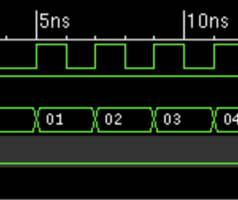
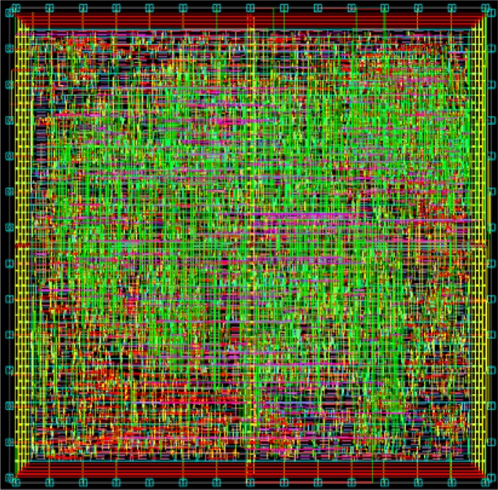
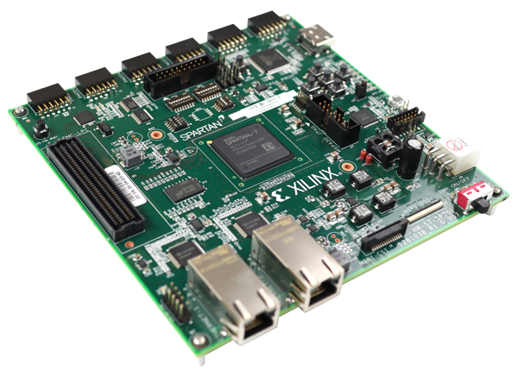

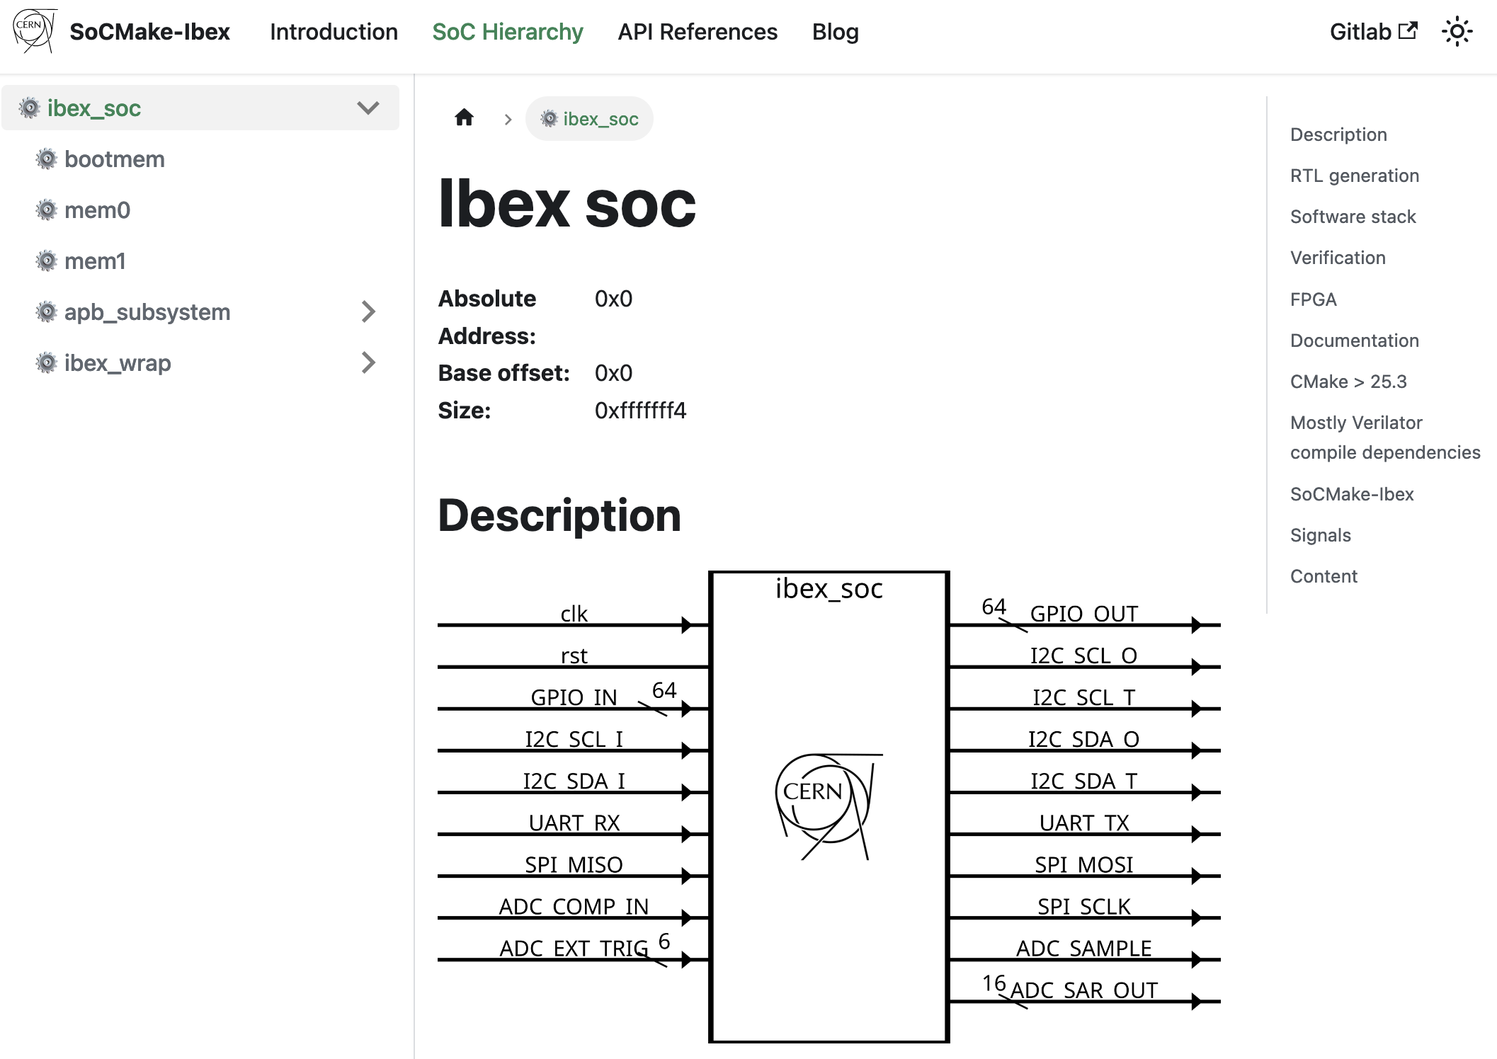
SoCMake build system
IP blocks and hardware accelerators (*.sv)
SIMULATE
Verilator
Xcelium
VCS
*.sv
CMake-based HW/SW build system
generator for SoCs
Supports SystemRDL as an input configuration
  Register Description Language
  extended for supporting SoC description
  Used as top-level architecture description
Rapid prototyping of SoCs:
  Quick composition of IP blocks into full systems
  Quickly build different architectures with different IP blocks,
  hardware accelerators or different CPUs
  Dependency management
Open-source
  SoCMake: github.com/HEP-SoC/SoCMake
  Toolkit and implementation: gitlab.cern.ch/socrates
Software application
*.cpp
Top level HDL (*.v)
IMPLEMENT
Cadence
...
*.rdl
Register file and Interconnections (*.v)
FPGA
Vivado
Hardware abstraction layer
RDL toolchain
Linker scripts generation
Software application
UVM testbench (SystemC)
and SEE injection utilities
Config files for synthesis and implementation (*.yaml, *.tcl)
Documentation - website
(*.html, *.md)
Credits to Risto Pejasinovic, Benoit Denkinger, Alessandro Caratelli, Marco Andorno, Anvesh Nookala

Slide 9




Towards System-on-Chips
Turning our custom ASICs into programmable SoCs will provide:
Quick prototyping
Smaller number of more capable ASICs
Faster design and verification turnaround time
Cost effective development
Where are SoC ASICs applicable for the HEP community?
Standalone Rad-Hard
microcontrollers
Embedded controllers
in front-end ASICs
Advanced on-detector
data processing
On-detector monitoring
& control
Beam monitoring
Pixel chip calibration
Control and monitoring
Back-end tasks on chip
Data aggregation ASICs
Custom HW accelerators
Machine Learning appl.

Slide 10

TriglaV: from SOCRATES to silicon
Goals:
  Build a radiation-tolerant microcontroller-like SoC with the SOCRATES tools
  Validate the toolkit and demonstrate the feasibility of using programmable logic inside front-end ASICs
  Validate the 28 nm CMOS technology Common Design Platform
  Test the radiation performance and gather experience on SoC designs
Specifications:
  Fully generated out of the SOCRATES platform
  Suitable peripherals and architecture for a pixel readout ASIC embedded controller applications
  Radiation-tolerant design up to CMS Inner Tracker levels, with testability features to trace faults under irradiation
  Implemented on 28 nm bulk CMOS technology
  Prototyped on an MPW November 27th 2024

Slide 11
TriglaV architecture
JTAG debug unit
RISC-V Ibex
CPU
TIMER-0
UART
SoC
control
PLIC
TIMER-1
GPIO
OBI TMR crossbar
APB-RT interconnect
I-MSPU
Master port
Slave port
Bootloader
32 kB SRAM
D-MSPU
32 kB SRAM

Slide 12
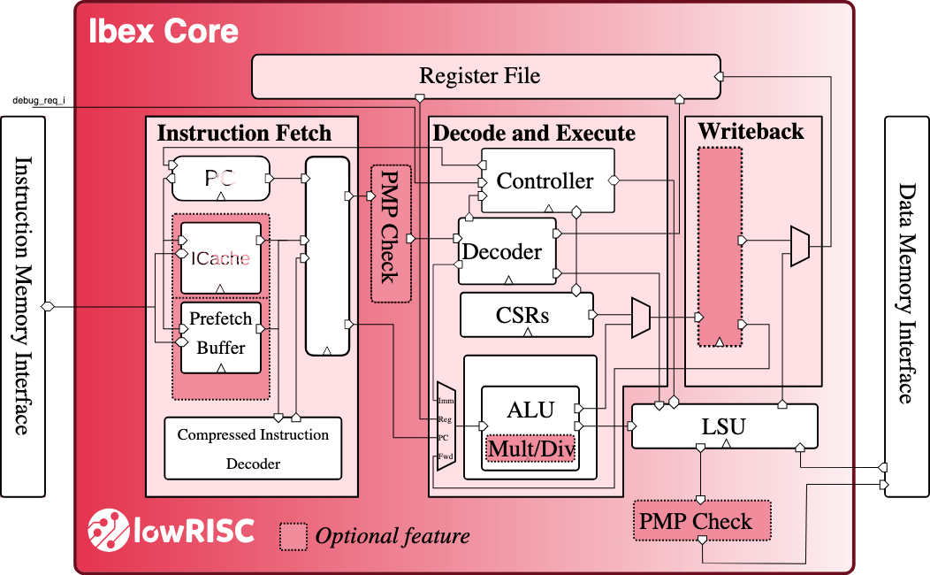
TriglaV architecture
Open-source high-TRL RISC-V core by lowRISC^{[1]}
  RV32IMC ISA
  2-stage pipeline
Full TMR at Flip/Flop level
  4x area overhead for TMR,
  ~6x final area including SEU observability circuitry
TMR formal verification^{[2]} and fault injection^{[3]}
JTAG debug unit
RISC-V Ibex
CPU
TIMER-0
UART
SoC
control
PLIC
TIMER-1
GPIO
OBI TMR crossbar
APB-RT interconnect
I-MSPU
Bootloader
32 kB SRAM
D-MSPU
32 kB SRAM
[1] P. Davide Schiavone et al., Slow and steady wins the race? A comparison of ultra-low-power RISC-V69cores for Internet-of-Things applications, PATMOS (2017) pp. 1-8.70
[2] A. Pulli, M. Lupi, A simulation methodology for verification of transient fault tolerance of ASICs designed for high-energy physics experiments, 2023 JINST 18 C01038
[3] A. Nookala et al., Soft-error Reliability Analysis and Error Rate Estimation for RISC-V Processors in High Energy Physics Environments, NSREC (2024), draft for IEEE TNS 2025

Slide 13
TriglaV architecture
JTAG debug unit
RISC-V Ibex
CPU
TIMER-0
UART
SoC
control
PLIC
TIMER-1
GPIO
OBI TMR crossbar
Hardwired bootloader loads the memories through the UART
Memory Scrubbing and Protection Unit (MSPU)
for instruction and data:
  Dual port foundry SRAM (2x 32 kB blocks)
  Physical bit interleaving
  ECC and SECDED: Hamming(13,8) at byte-level
  Periodic scrubbing with configurable period
APB-RT interconnect
I-MSPU
Bootloader
32 kB SRAM
D-MSPU
32 kB SRAM

Slide 14
TriglaV architecture
Open Bus Interconnect (OBI)
  Core-memory local fast bus
  Standard by OpenHW Group similar to AXI
  Full TMR for fault tolerance
  Multi-master crossbar
JTAG debug unit
RISC-V Ibex
CPU
TIMER-0
UART
SoC
control
PLIC
TIMER-1
GPIO
OBI TMR crossbar
APB-RT interconnect
I-MSPU
Bootloader
32 kB SRAM
D-MSPU
32 kB SRAM

Slide 15

TriglaV architecture
APB-RT
  Peripheral bus
  Radiation-tolerant version of the AMBA APB standard
  Data and address bytewise encoding with Hamming(13,8)
  Single Error Correction, Double Error Detection (SECDED)
  Triplicated control signals
JTAG debug unit
RISC-V Ibex
CPU
TIMER-0
UART
SoC
control
PLIC
TIMER-1
GPIO
OBI TMR crossbar
APB-RT interconnect
I-MSPU
Bootloader
32 kB SRAM
D-MSPU
32 kB SRAM
Propose this interconnect for adoption by all
IP blocks developed within the HEP community.

Slide 16
TriglaV architecture
JTAG debug unit
RISC-V Ibex
CPU
TIMER-0
UART
SoC
control
PLIC
TIMER-1
GPIO
OBI TMR crossbar
APB-RT interconnect
Minimal set of peripherals:
  Platform-level Interrupt Controller (PLIC) - OpenTitan
  Timers - OpenTitan
  GPIO - PULP
  UART - OpenTitan
I-MSPU
Bootloader
32 kB SRAM
D-MSPU
32 kB SRAM

Slide 17
TriglaV architecture
JTAG port for general software debug (non-TMR)
Triplicated SoC control unit with a dedicated I2C interface
  Provides a redundant booting mechanism
  SEU counters and decoding error count readout
  Stream out some key CPU signals to compare with a golden simulation during radiation testing
JTAG debug unit
RISC-V Ibex
CPU
TIMER-0
UART
SoC
control
PLIC
TIMER-1
GPIO
OBI TMR crossbar
APB-RT interconnect
I-MSPU
Bootloader
32 kB SRAM
D-MSPU
32 kB SRAM

Slide 18
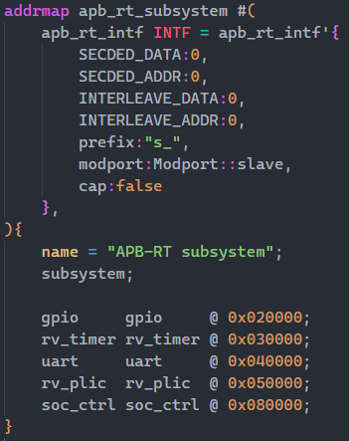
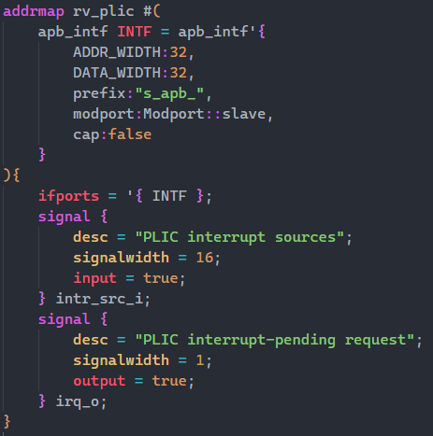
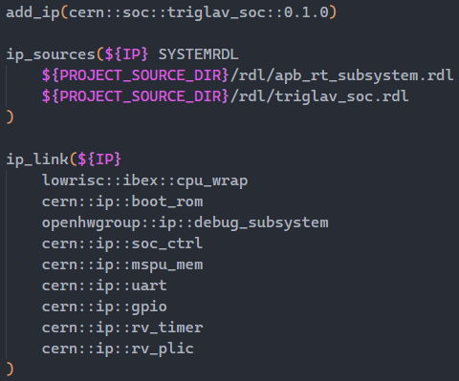
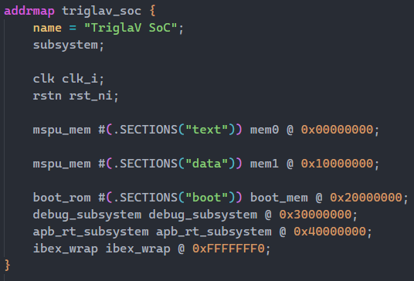
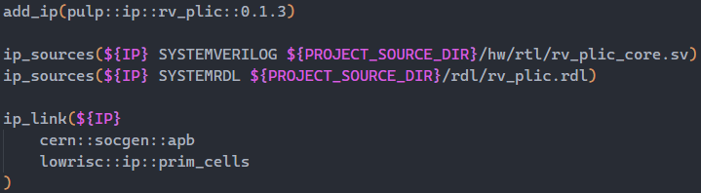
What does SoCMake generate?
UART
uart.sv
uart.rdl
CMakeLists.txt
any other IP block
Top SoC
apb_subsystem.rdl
triglav_soc.rdl
CMakeLists.txt
PLIC
plic.sv
plic.rdl
CMakeLists.txt

Slide 19


cmake ../

Slide 20
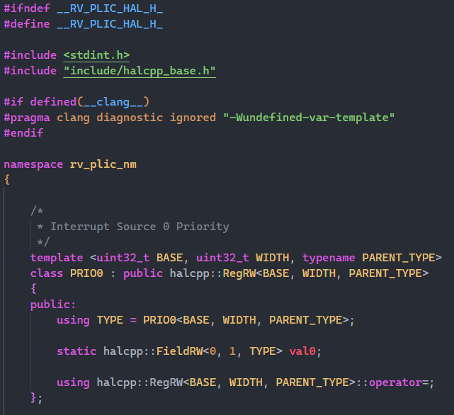
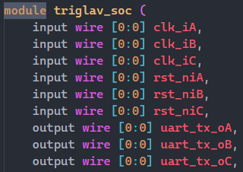
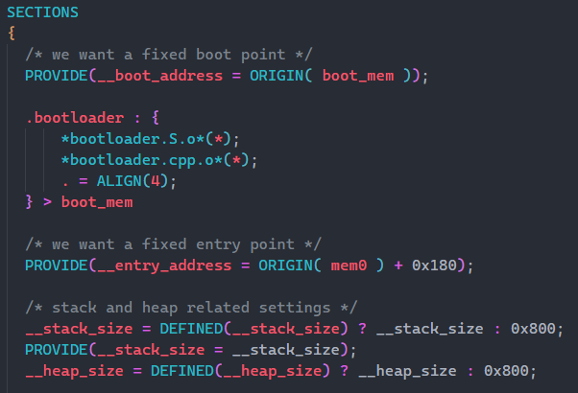
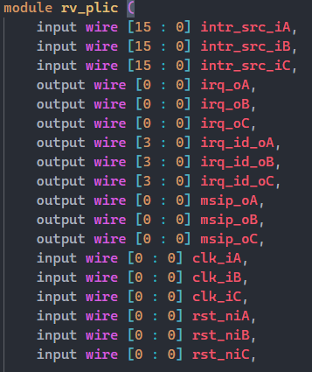
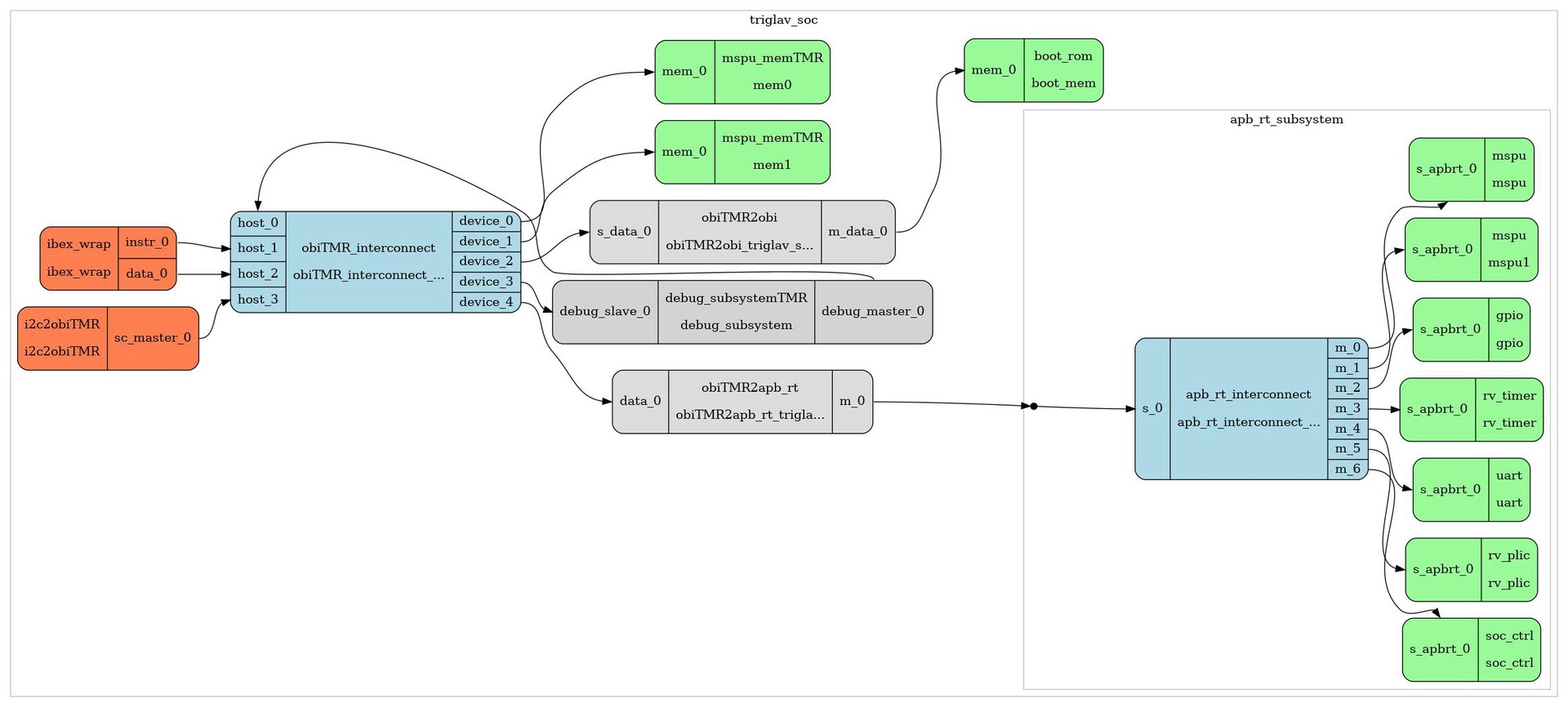
What you get in output from the tools
Top SoC Verilog
Linker script
Peripheral HAL
TMR peripherals
A nice block diagram

Slide 21
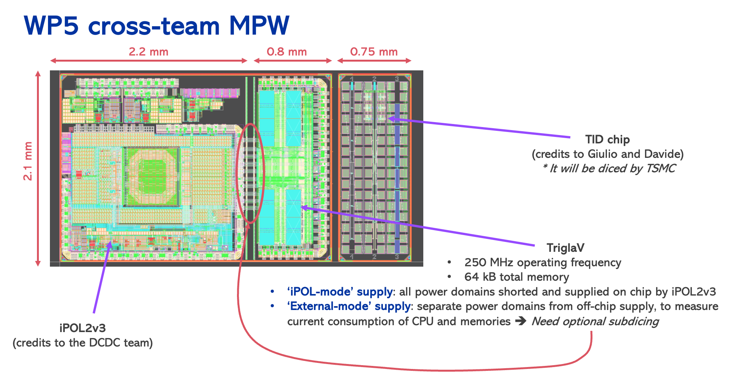
TriglaV: first SOCRATES silicon prototype
Physical implementation
  Area: 1 mm x 2 mm
  ~300k instances
  64kB SRAM memory
  Operating frequency: 250 MHz
  28nm CMOS MPW with an
  integrated DC/DC converter
  (2.3V to 0.8V)
  Credits to:
  the current team Alessandro Caratelli, Anvesh Nookala, Benoît Denkinger, Davide Ceresa, Marco Andorno
  and past colleagues Risto Pejasinovic, Georgios Nikolaidis, Viktoriia Tarasenko

Slide 22
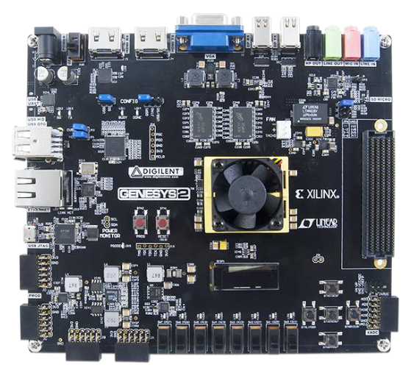
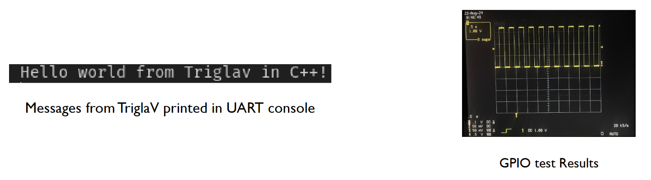
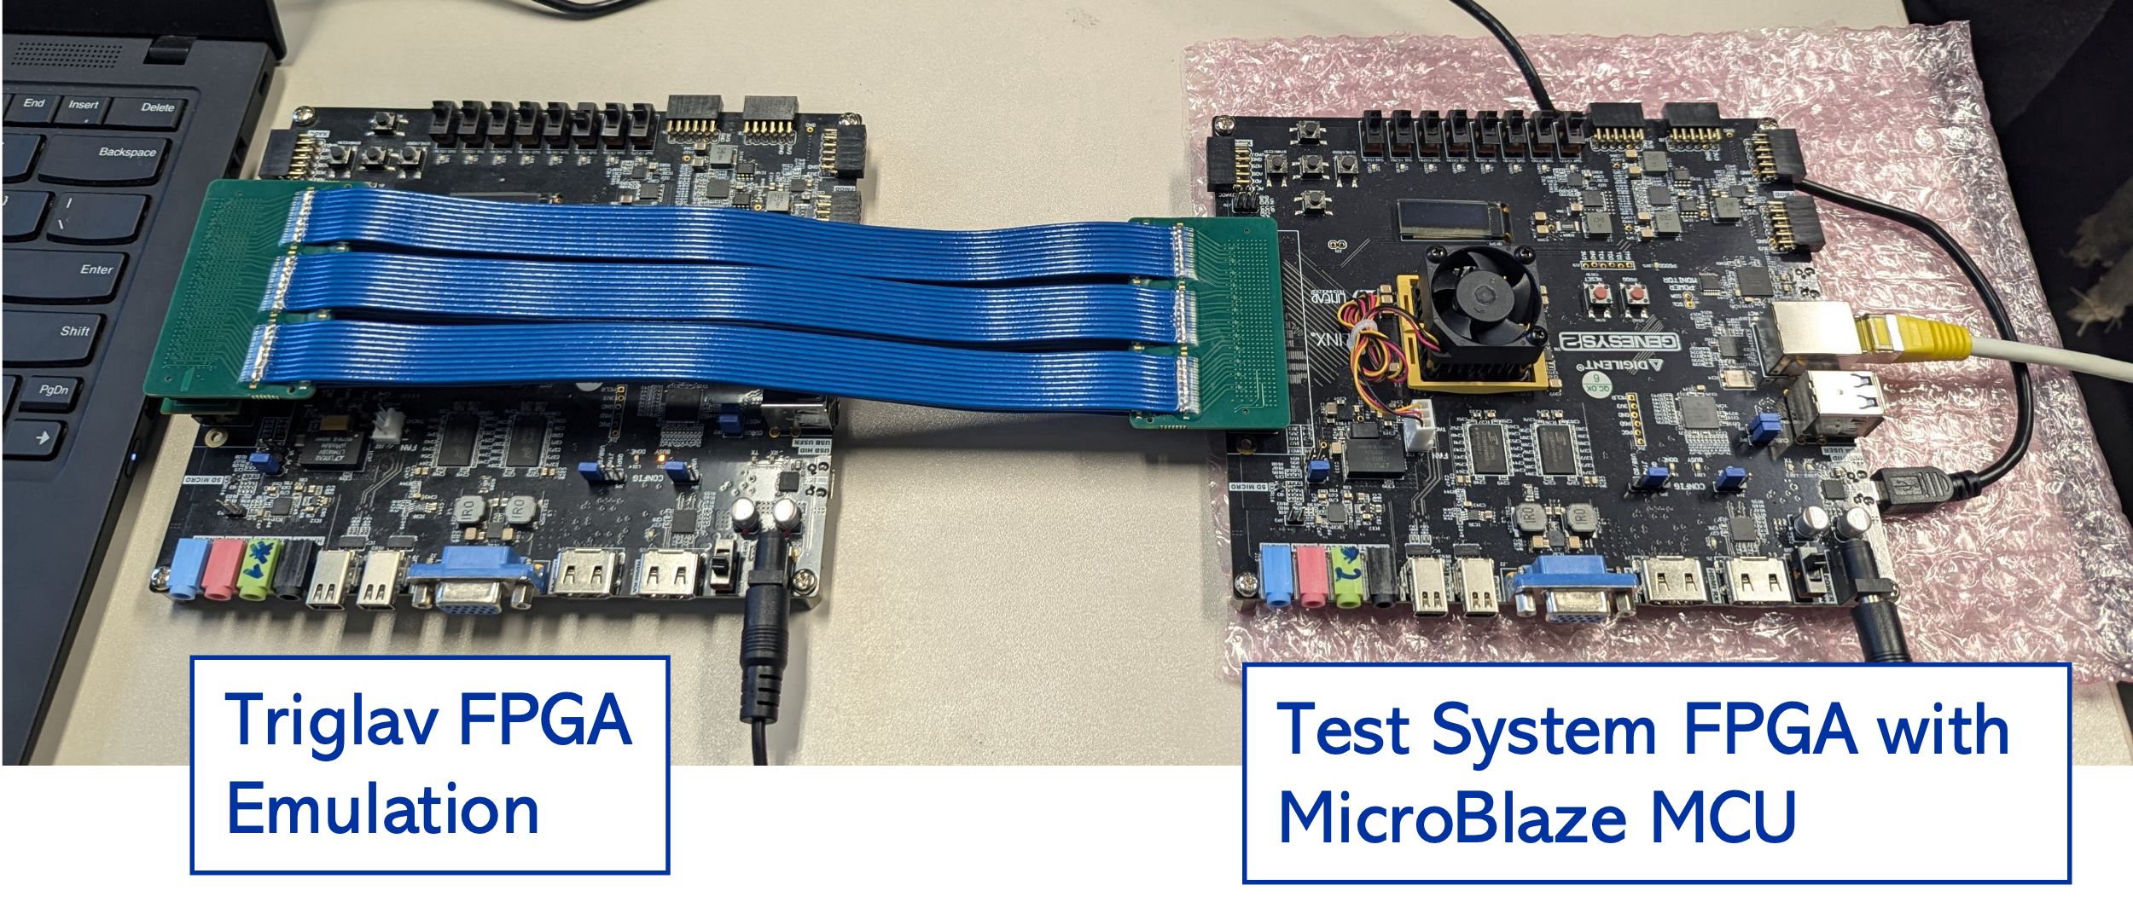
TriglaV silicon prototype
Before Tape Out Functional Verification
  FPGA emulation setup
    ~10³ faster than simulation
    Increased confidence in the RTL to real HW
  Functional verification
    Random verification of peripherals
    Simulation of the top level
Evaluation of Silicon Prototype
  Functional Tests
  TID Tests
  SEU and SET evaluation Tests
  Lessons learned !

Slide 23
Future Plans
EP R&D WP5.3 “On Detector Inteligence” framework & alocated resources
Evaluate the TriglaV prototype
SOCRATES platform developments
  Develop further SoCMake, augment Documentation and Ease of Use
  Develop Comprehensive Verification at the SoC level
  Support Data Processing applications (convergence of PixESL with SOCRATES)
Future Silicon Implementations
  Embedded μController for “PicoPIX” Pixel Readout ASIC (28nm CMOS)for LHCb Velo detector upgrade
  Standalone μController component (on 28nm CMOS or 65nm CMOS)
Participate in Rigoletto project HORIZON Chips JU 2025
  RISC-V generation of high-performance processors optimised and intelligent automotive platform
  Rigoletto aims at developing RISC-V intellectual property (IP) components, including processor cores,
  accelerators, interconnects, memory hierarchy and peripheral subsystems.
  CERN participates as beneficiary along with 64 other partners (Industry and Academia) with a budget of €60M
  Participation will enhance CERN's expertise and supply resources to speed up developments.

Slide 24

Thank You
  Credits to the EP R&D WP5.3 Team

