Slide 1
Magnetised Tracking Calorimeter @ Fairship

Slide 2
MTC

Slide 3
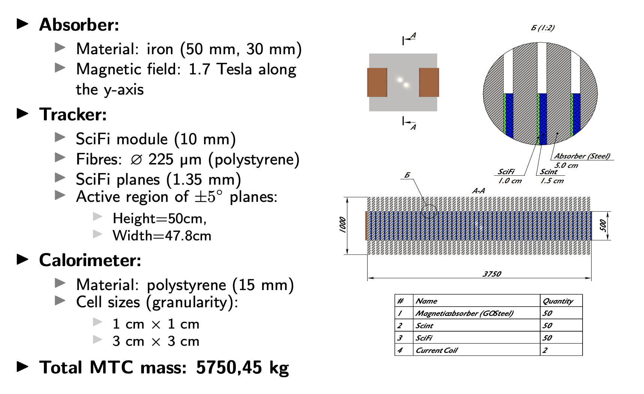

45 SciFi planes = DD (0..44)
  2 planes U + V per each plane = C (0 or 1)
    6 layers in each plane = B (0..5)
      1825 fibers per layer = AAAA
EDDCBAAAA
E = unique ID of MTC
~1e6 fibres

Slide 4
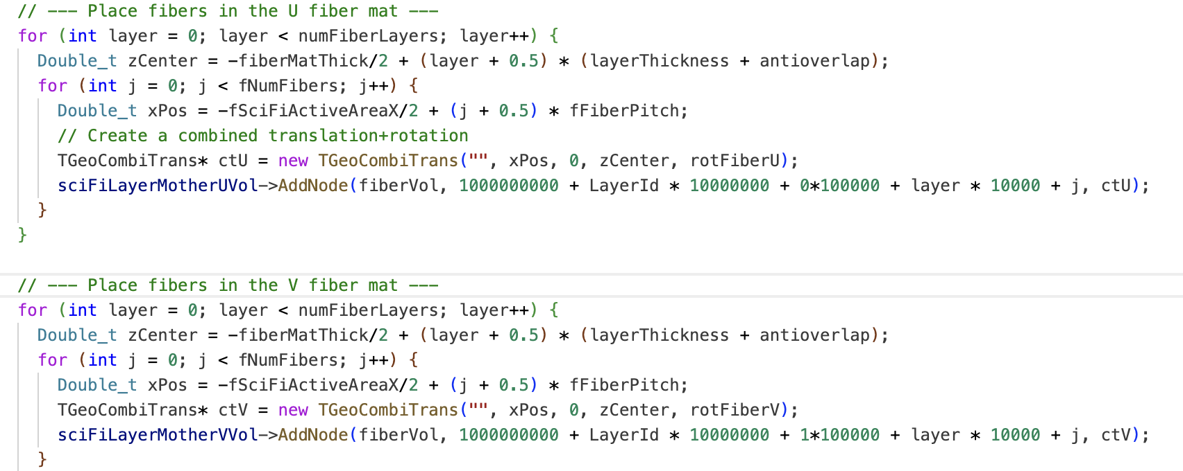
45 SciFi planes = DD (0..44)
  2 planes U + V per each plane = C (0 or 1)
    6 layers in each plane = B (0..5)
      1825 fibers per layer = AAAA
EDDCBAAAA
E = unique ID of MTC

Slide 5
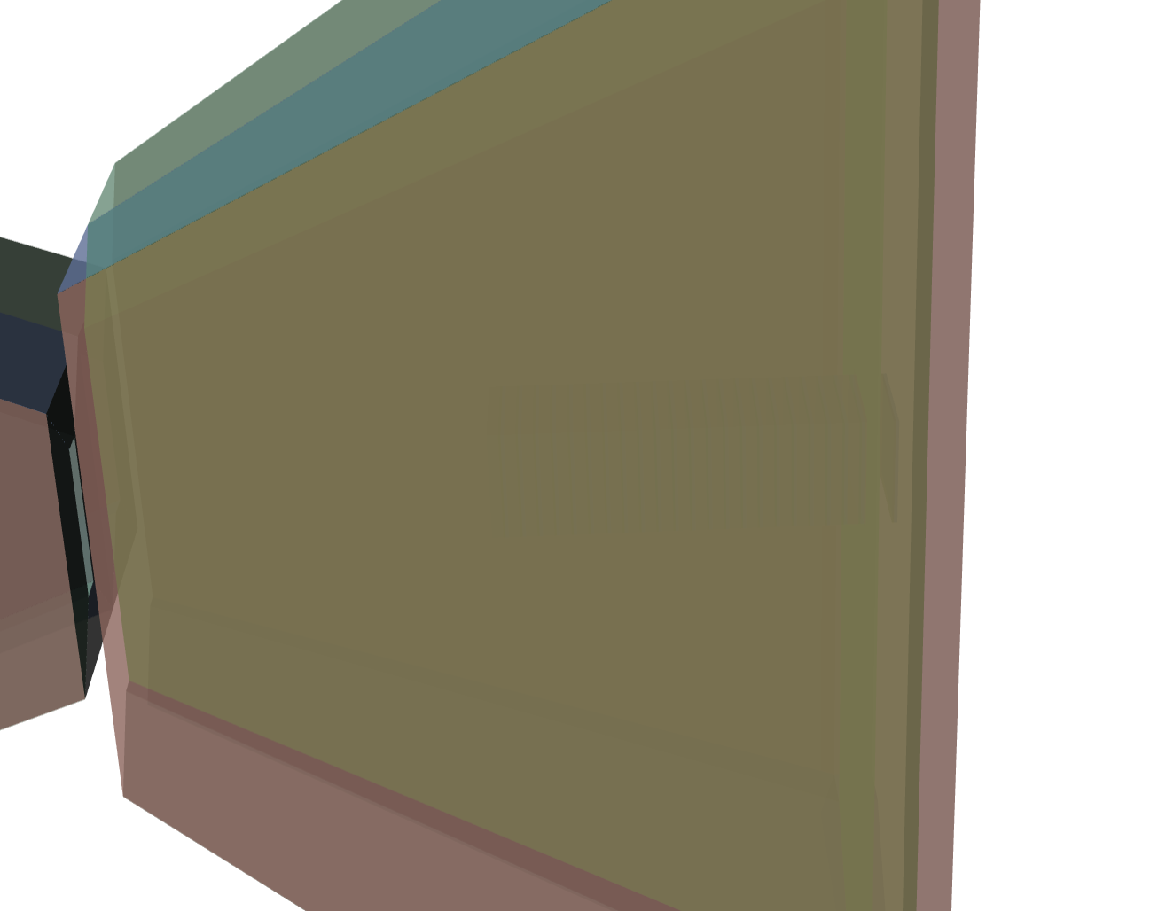

MTC @ Fairship
Scifi
Scint

Slide 6
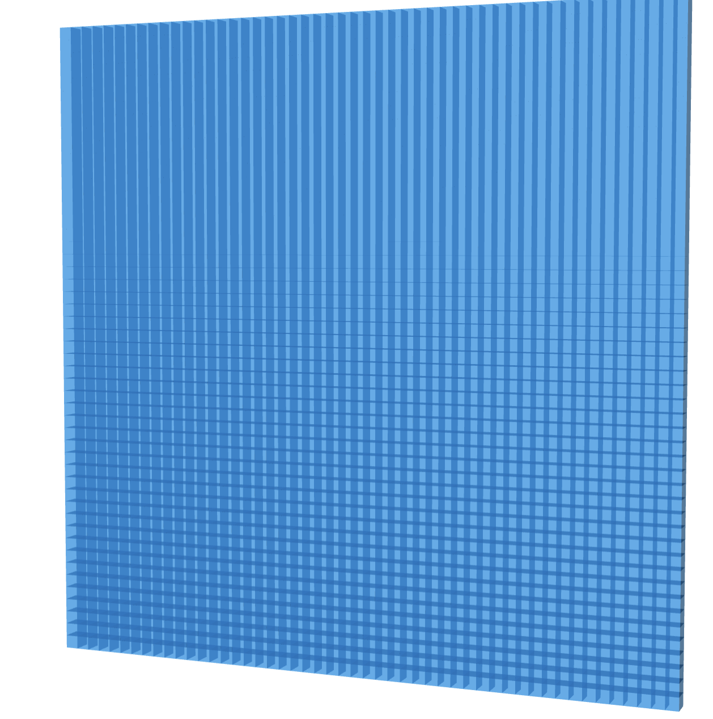
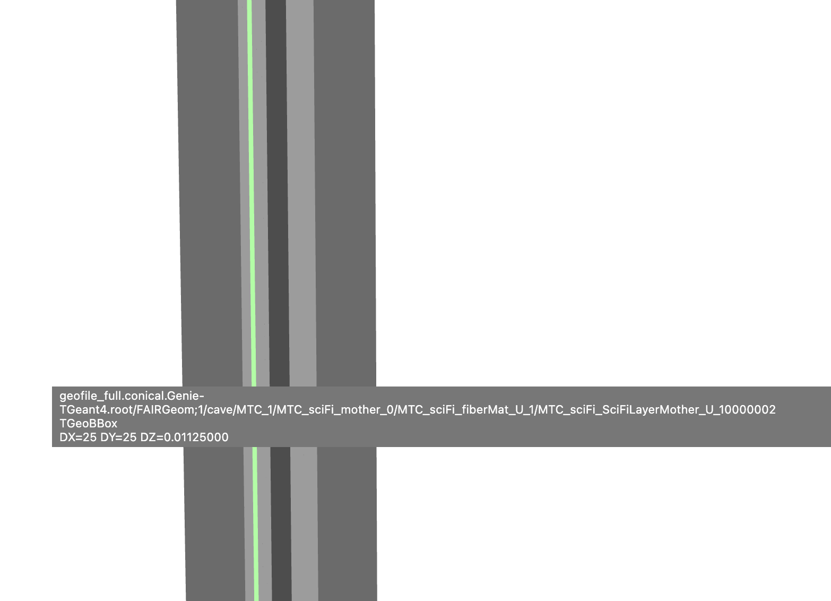
MTC @ Fairship
Scifi
Scint
Scint layer
1 cm x 1cm? Too expensive?
CALICE has 3 cm x 3 cm

Slide 7
MTC @ Fairship
Scifi
Scint
2 Scifi Mats with 6 layers each
Slicing planes on the digi step into fibers
Physics of the light collection?

Slide 8
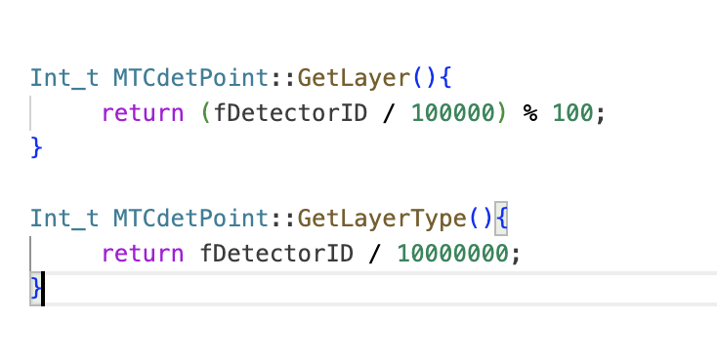
Technical details
X0000000 + LayerId * 100000 + j
  X = 1 – Scifi U mat, 2 – Scifi V mat, 3 – Scint Layer
  LayerId = 0..N, N – number of layers in MTC
Digitization:
  Split Scifi Mats into fibers
  Conversion of the Edep in fibers

Slide 9
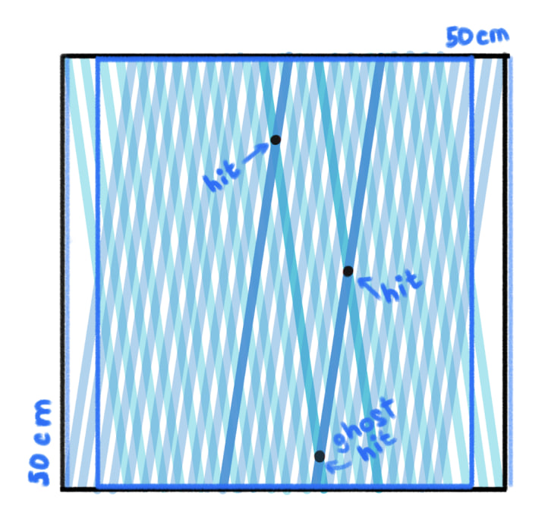
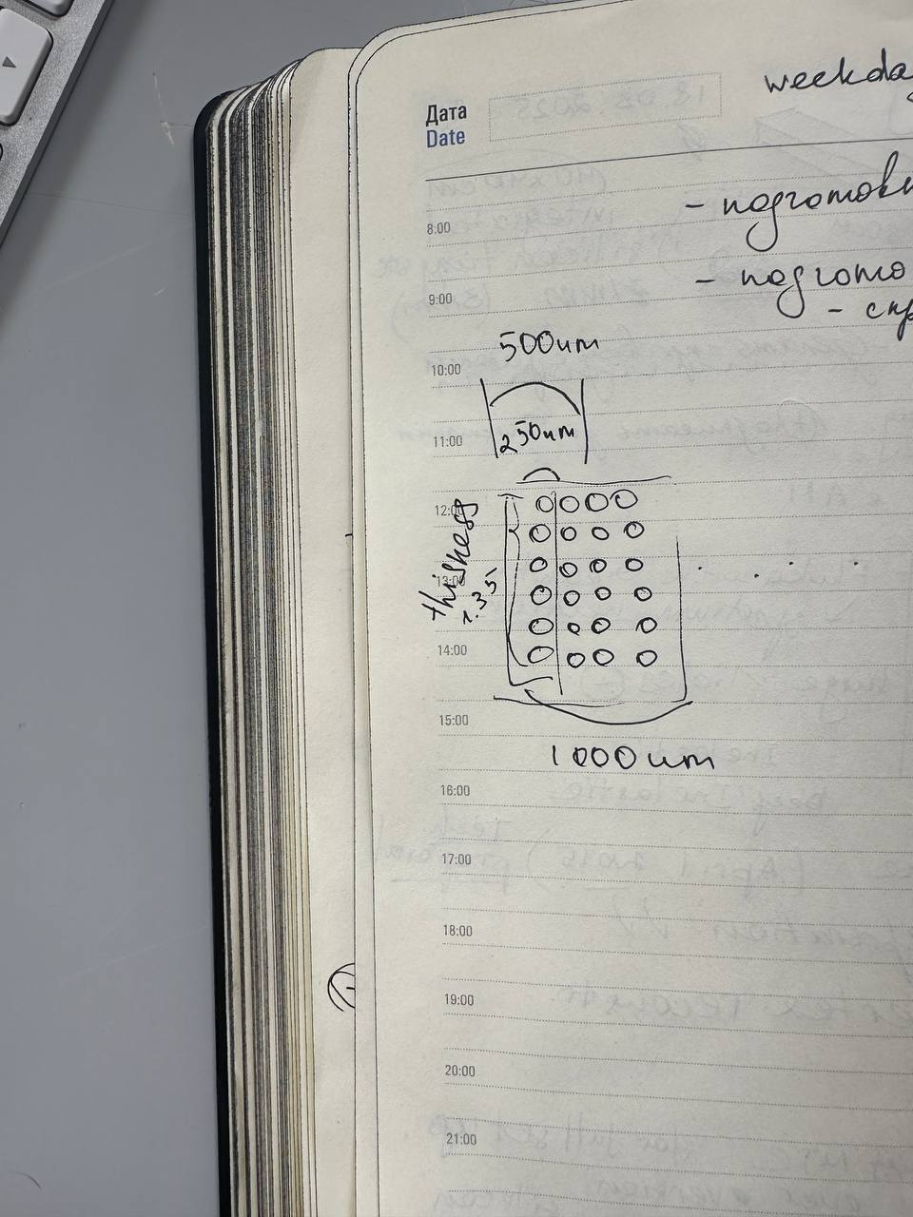

Slide 10
Event displays

Slide 11
Simulation issue
Simulation samples neutrino interactions within z_range
So, interactions take place everywhere where the material is located
A lot of events in the surrounding magnet
Method ReadEvent is called externaly -> impossible to make acceptance check on the high level
(x, y) is sampled according to the sampled Pt -> resample Pt until (x,y) are good?
Real time 781 s, CPU time 770 s — 36% ineffiecency — sampler on
Real time 253 s, CPU time 248 s — 62% ineffiecency — sampler off

Slide 12
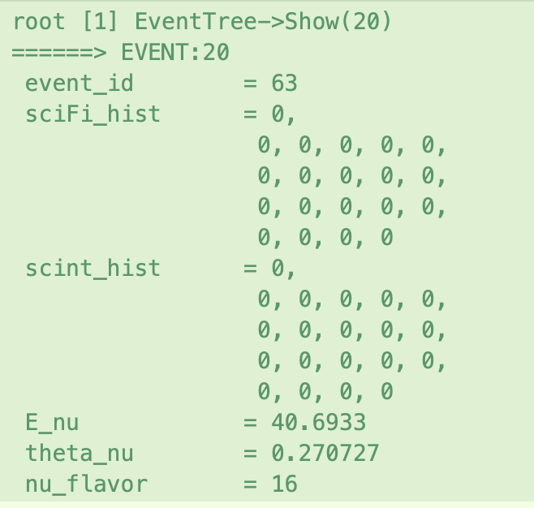
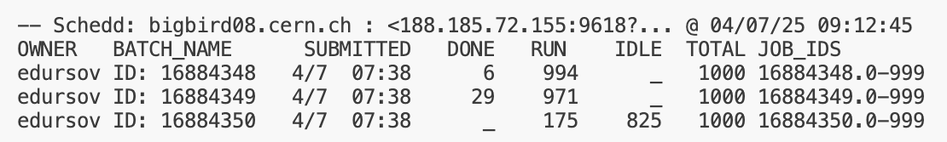
Digitization
runSim_script.py
digitize_analyse_nu.py
Sample int. point
Propagate products
Python based (so far)
Convert true data into 2 2d histograms

Slide 13
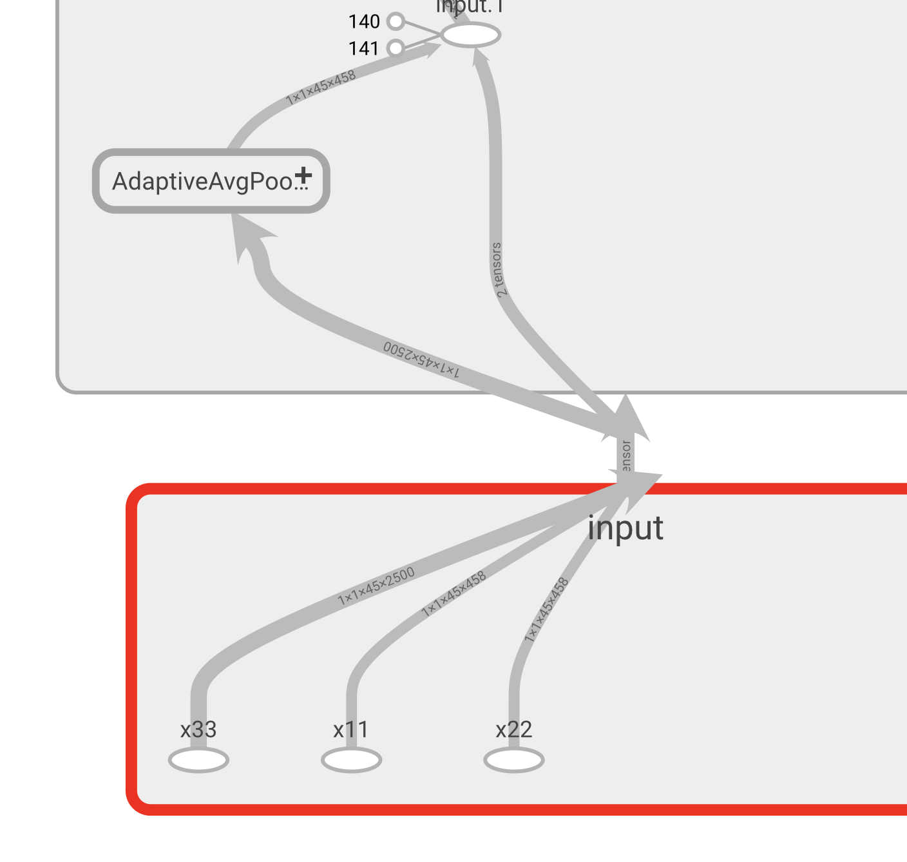
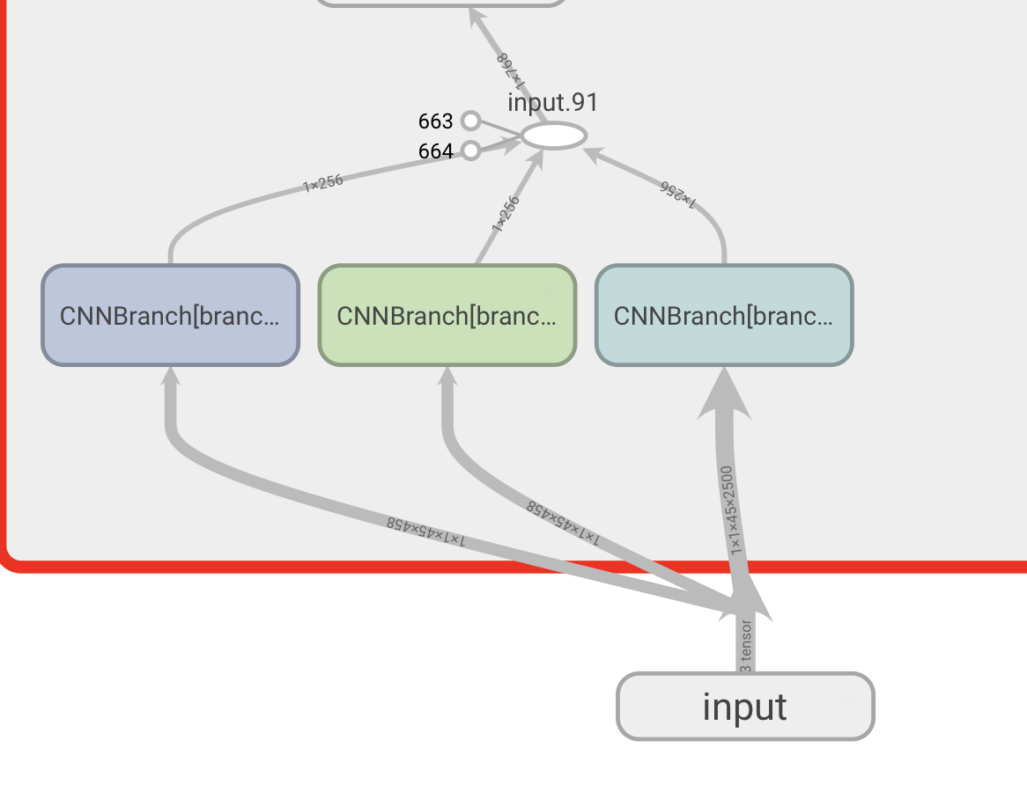
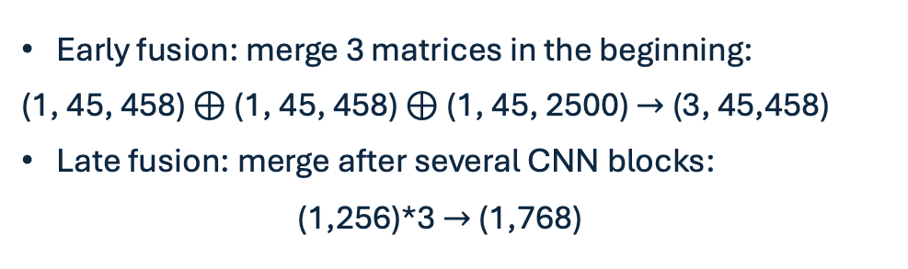
CNN: 2 options
Early fusion: merge 3 matrices in the beginning:
(1, 45, 458) $⊕$ (1, 45, 458) $⊕$ (1, 45, 2500) $→$ (3, 45,458)
Late fusion: merge after several CNN blocks:
(1,256)*3 $→$ (1,768)
Early fusion of data
Late fusion of data

Slide 14
Sensitivity plots and EM bkg

Slide 15
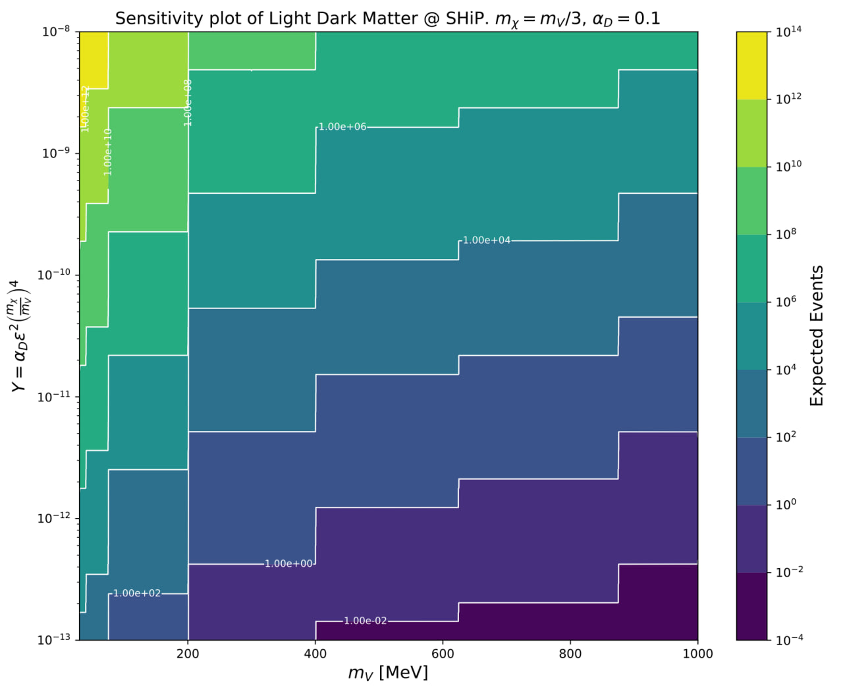

Slide 16
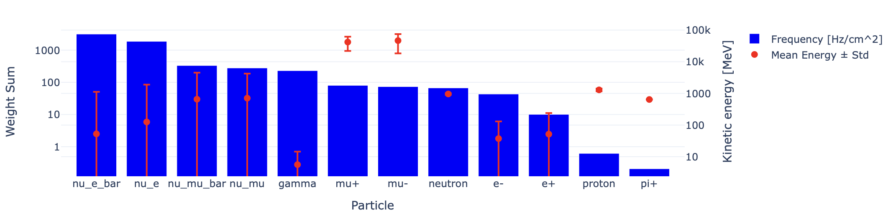
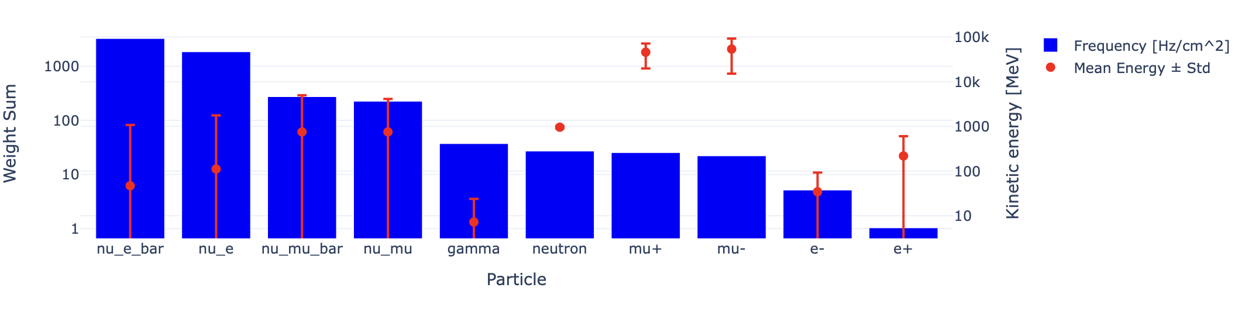
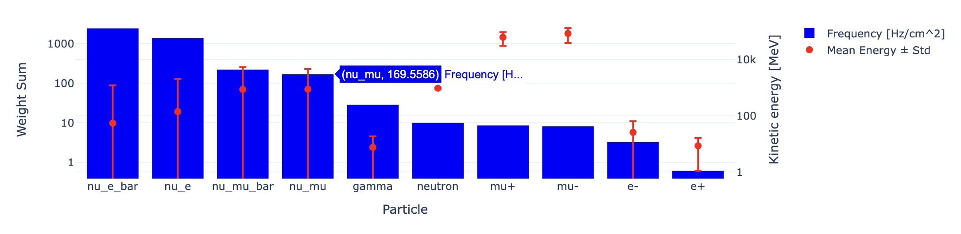
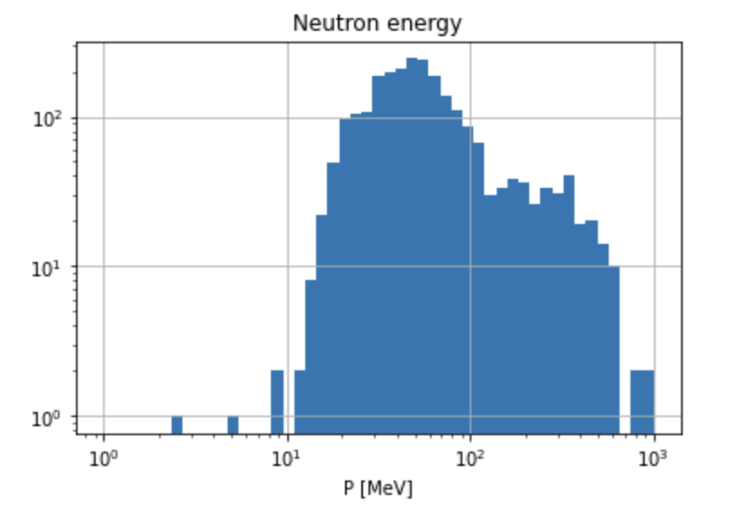
Background in the last magnet
Beginning
Muon rate is 10-100 [Hz/cm^2]
Neutron rate is comparable (Vasilisa: energy deposit is very low, low significance)
EM background:
  ~50 [Hz/cm^2] very low energy gammas
  ~10 [Hz/cm^2] ~50 MeV e+-
Center
End
Fully warm option

Slide 17
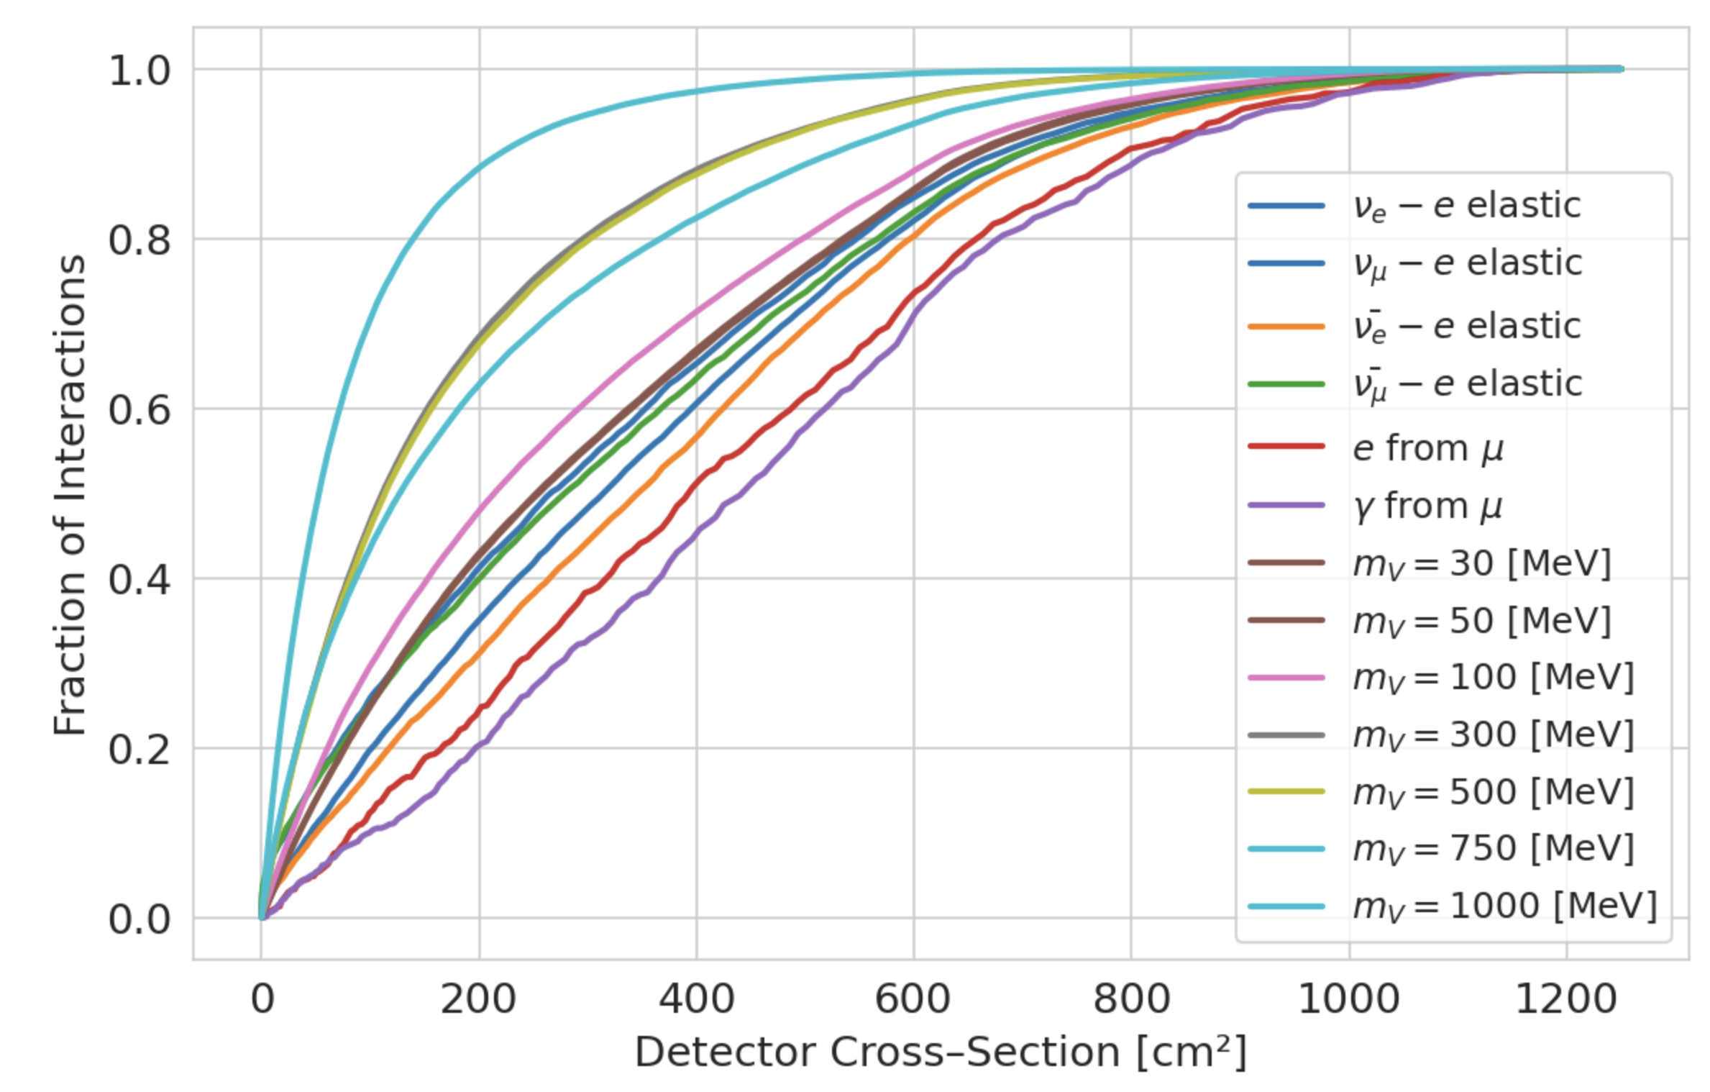
Radial distribution
Distance from the center can be a perfect variable for high DP mases since they are more collimated.
Cares information about directionality of neutrino/LDM

Slide 18
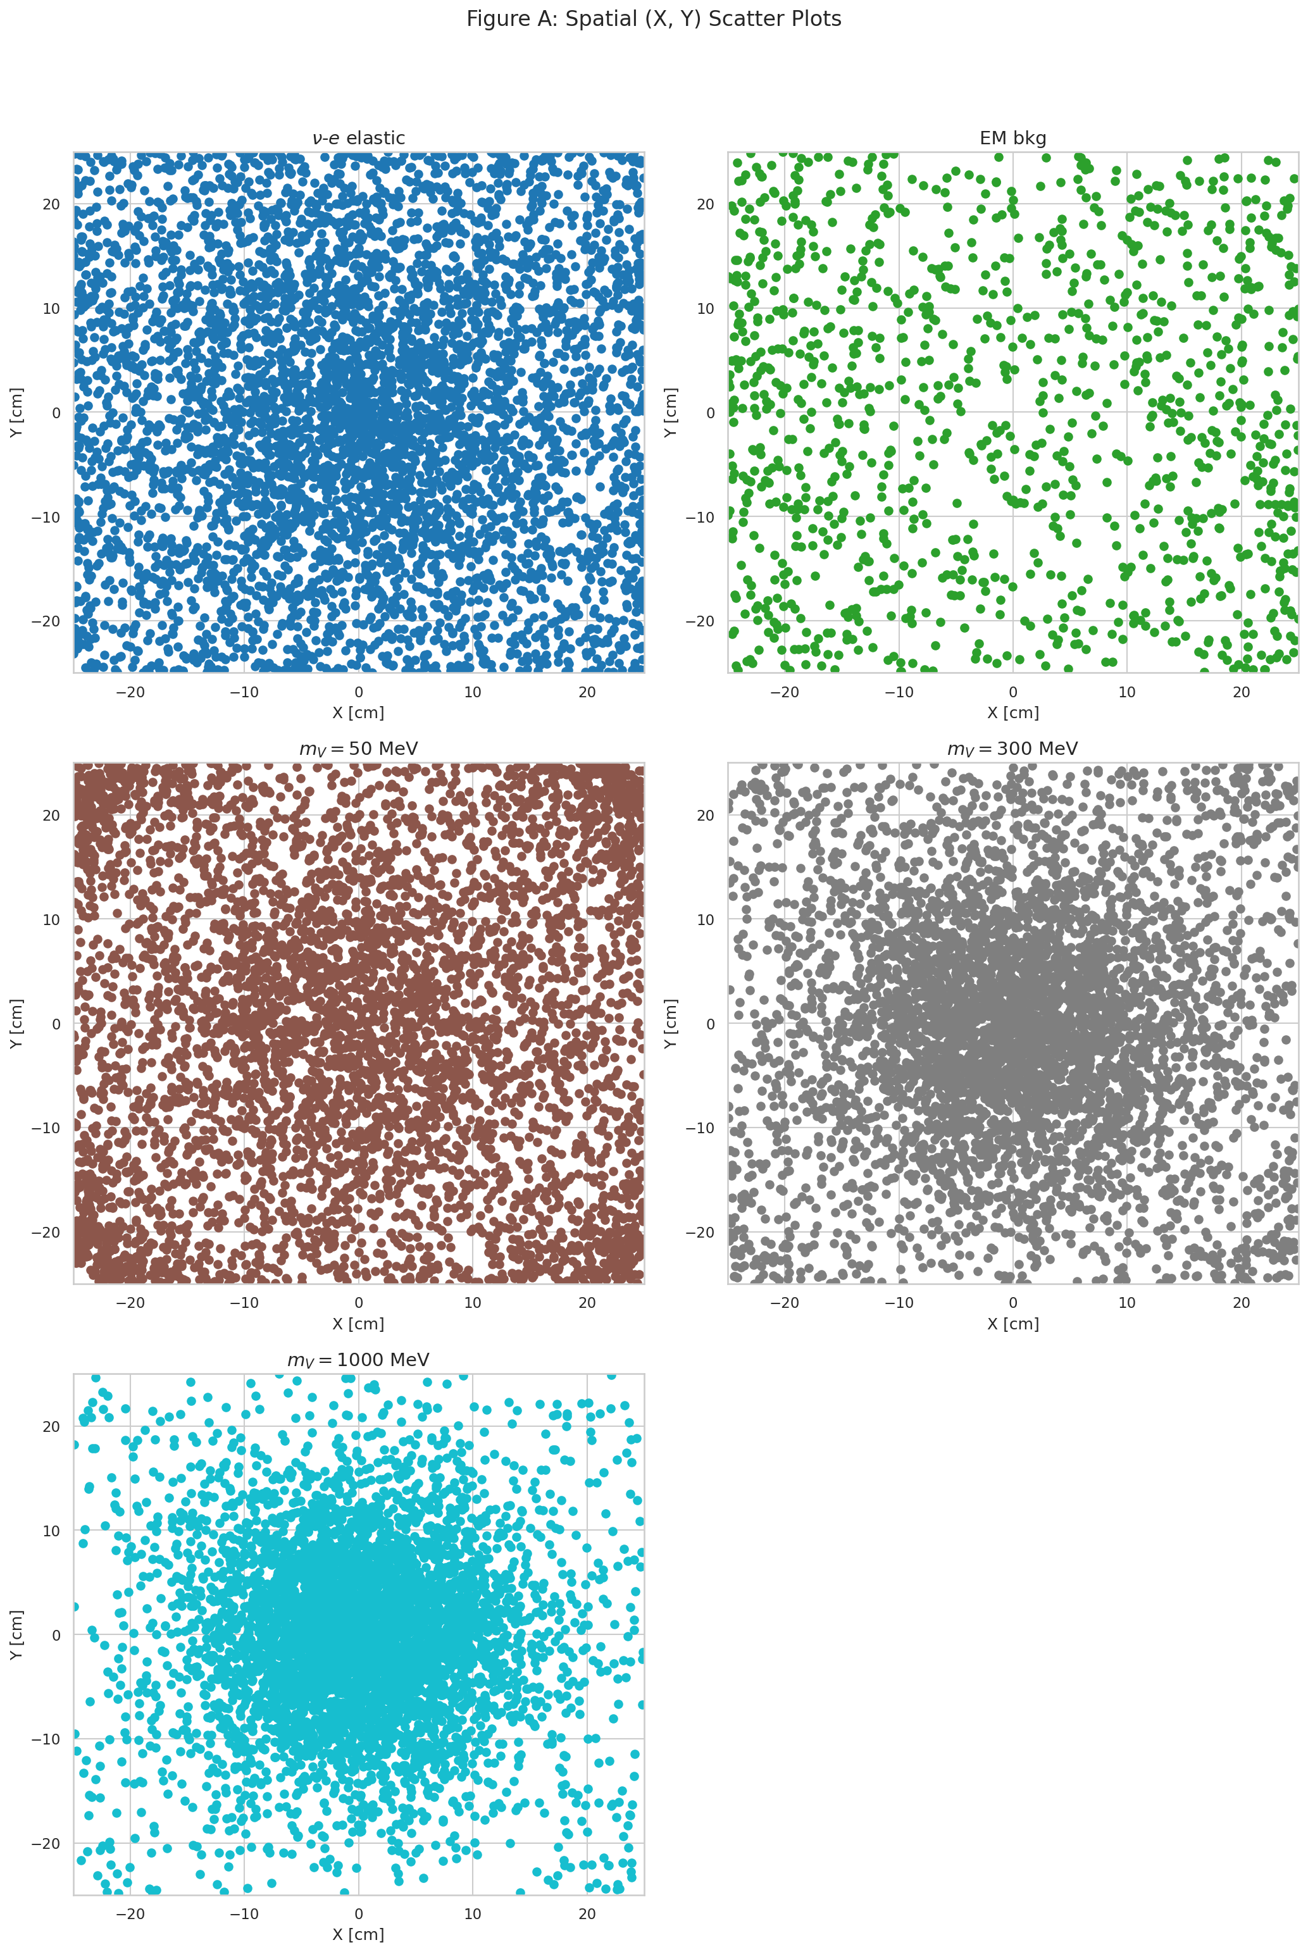
Radial distribution
Different production mechanisms for different DP masses

Slide 19
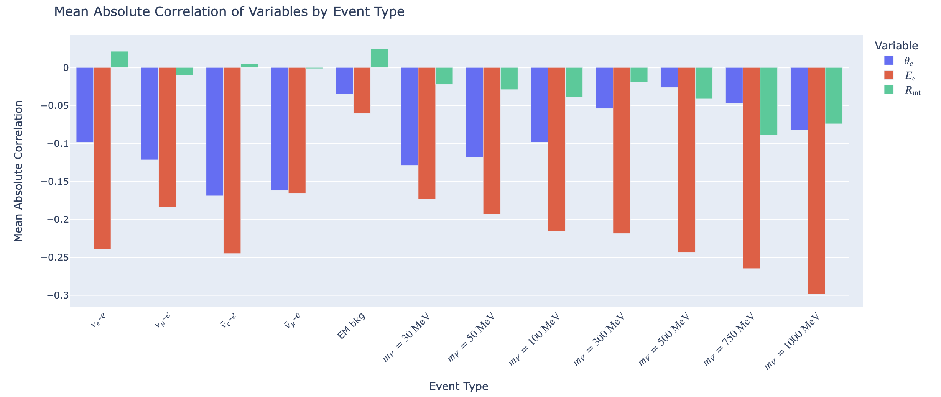
Radial distribution

Slide 20
Correlation

Slide 21
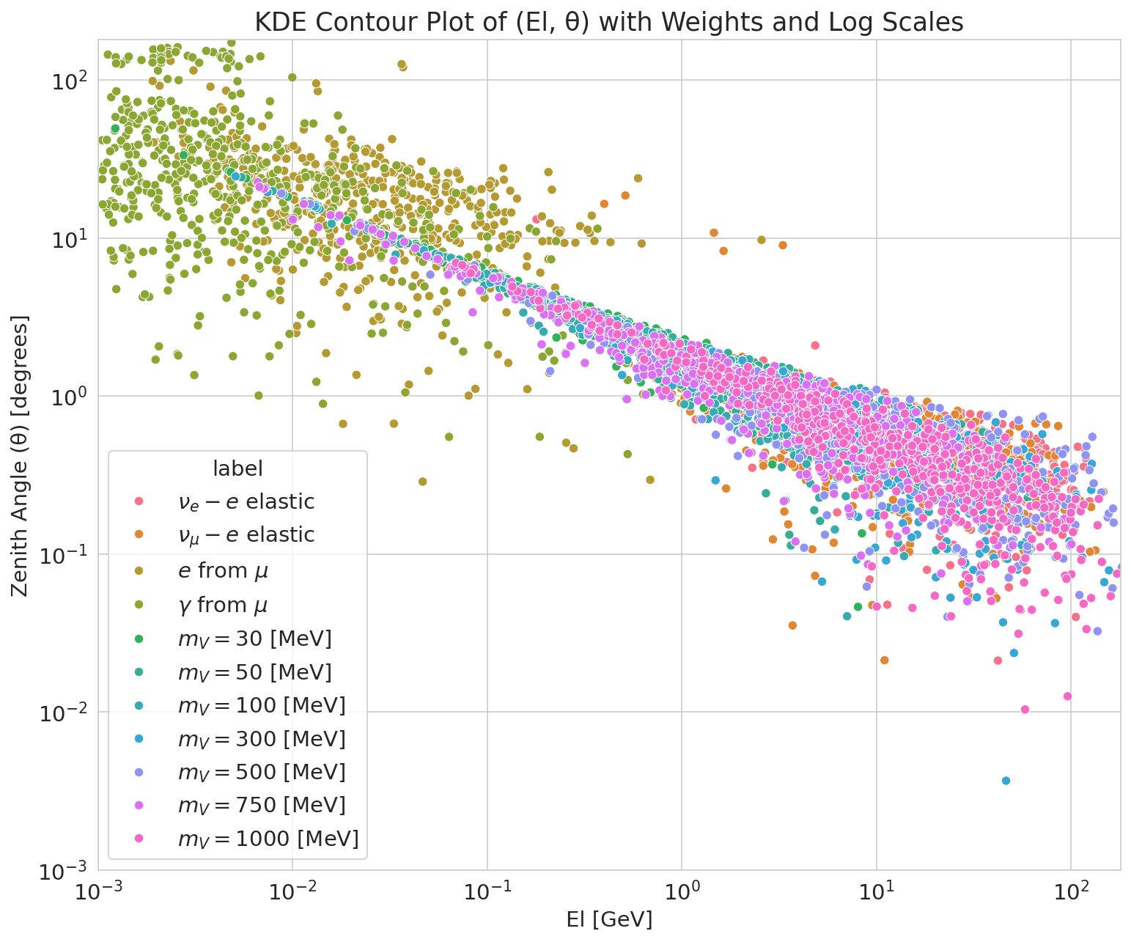
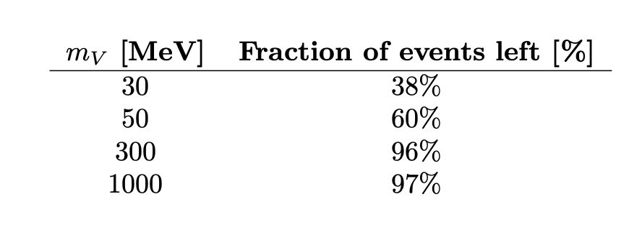


EM background
$E_{e}>1.0$ GeV & $θ_{e}<5°$
Signficant for low DP masses, though not dangerous (not orders of magnitude decrease)
$$114⋅{10}^{12}⇒ 0.23⋅{10}^{12}$$
Hits/y

Slide 22
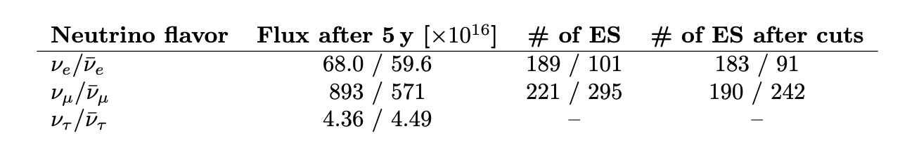
Neutrino Background

Slide 23
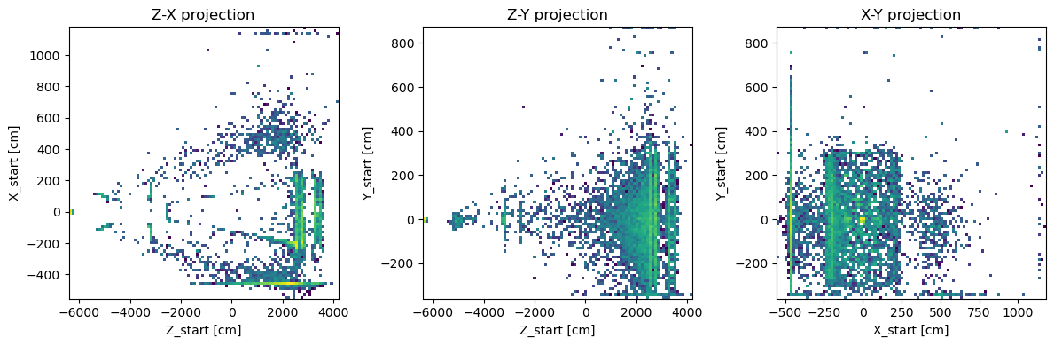
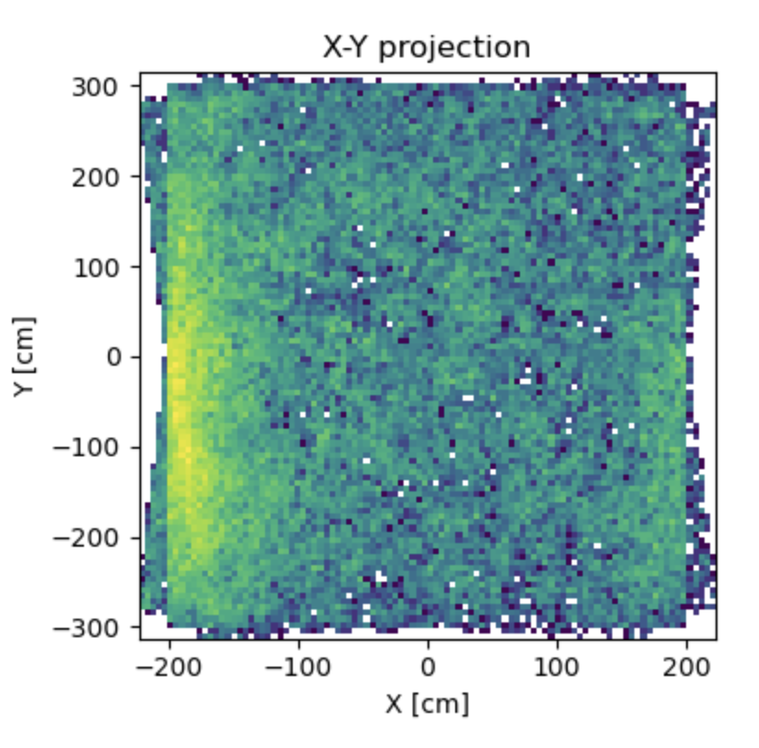
Straw trackers
Coordinates of EM sources
Cavern wall

Slide 24
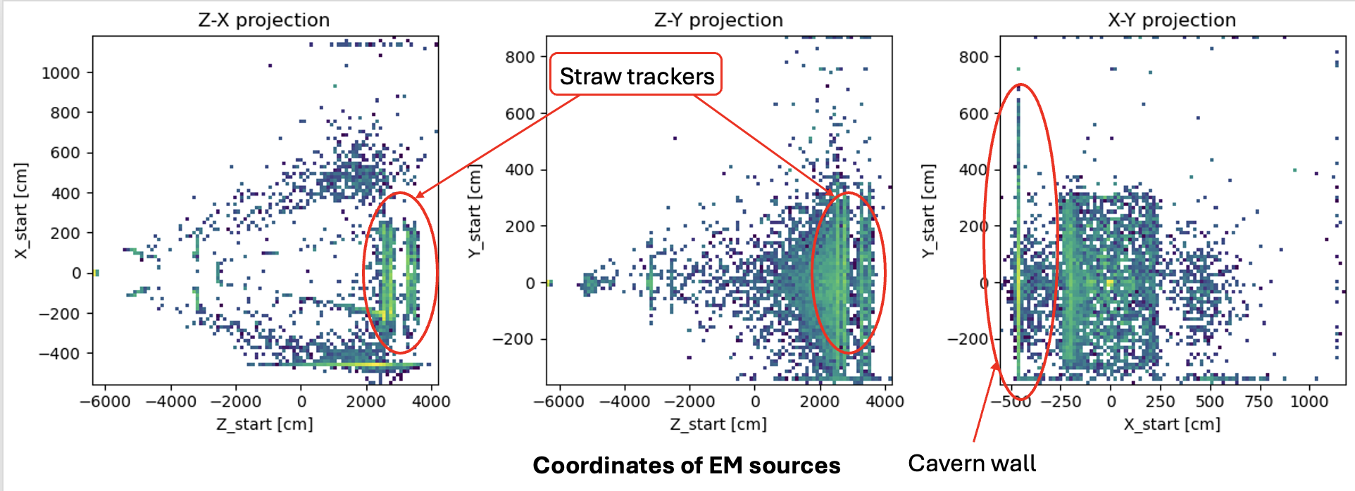
Loads in SST from EM debris

