Slide 1
LHC experimental beam vacuum systems
Run 4 layout configurations
Josef Sestak on behalf of TE-VSC
9th of May 2025

Slide 2
General information
The LHC experimental beam vacuum system is considered an LHC beam vacuum sector (operating at room temperature or detector temperature) traversing the experimental cavern.
Its equipment contributes directly to detector physics performance or is, by its function, indispensable for the operations and maintenance of the experimental beam vacuum system.
TE-VSC is responsible for upgrade, consolidation, maintenance and operations of experimental beam vacuum systems. This includes vacuum chambers, instrumentation, supporting structures, controls and bake-out services, Gas injection system etc.
LHC experimental beam vacuum systems installed around IP1, IP2, IP5 and IP8 are part of the LHC beam vacuum system managed by TE-VSC

Slide 3

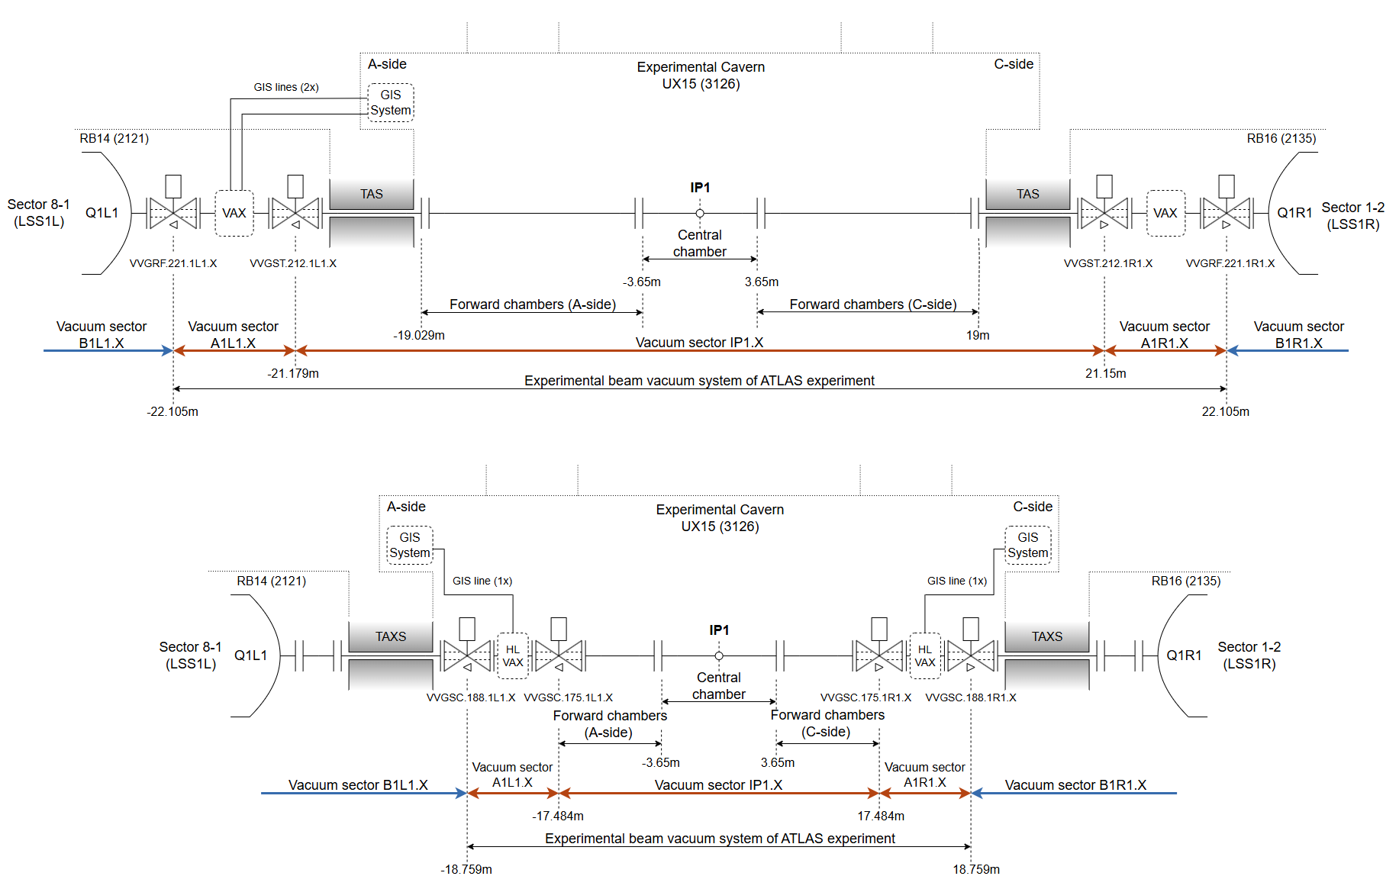
Run 3
Run 4

Slide 4

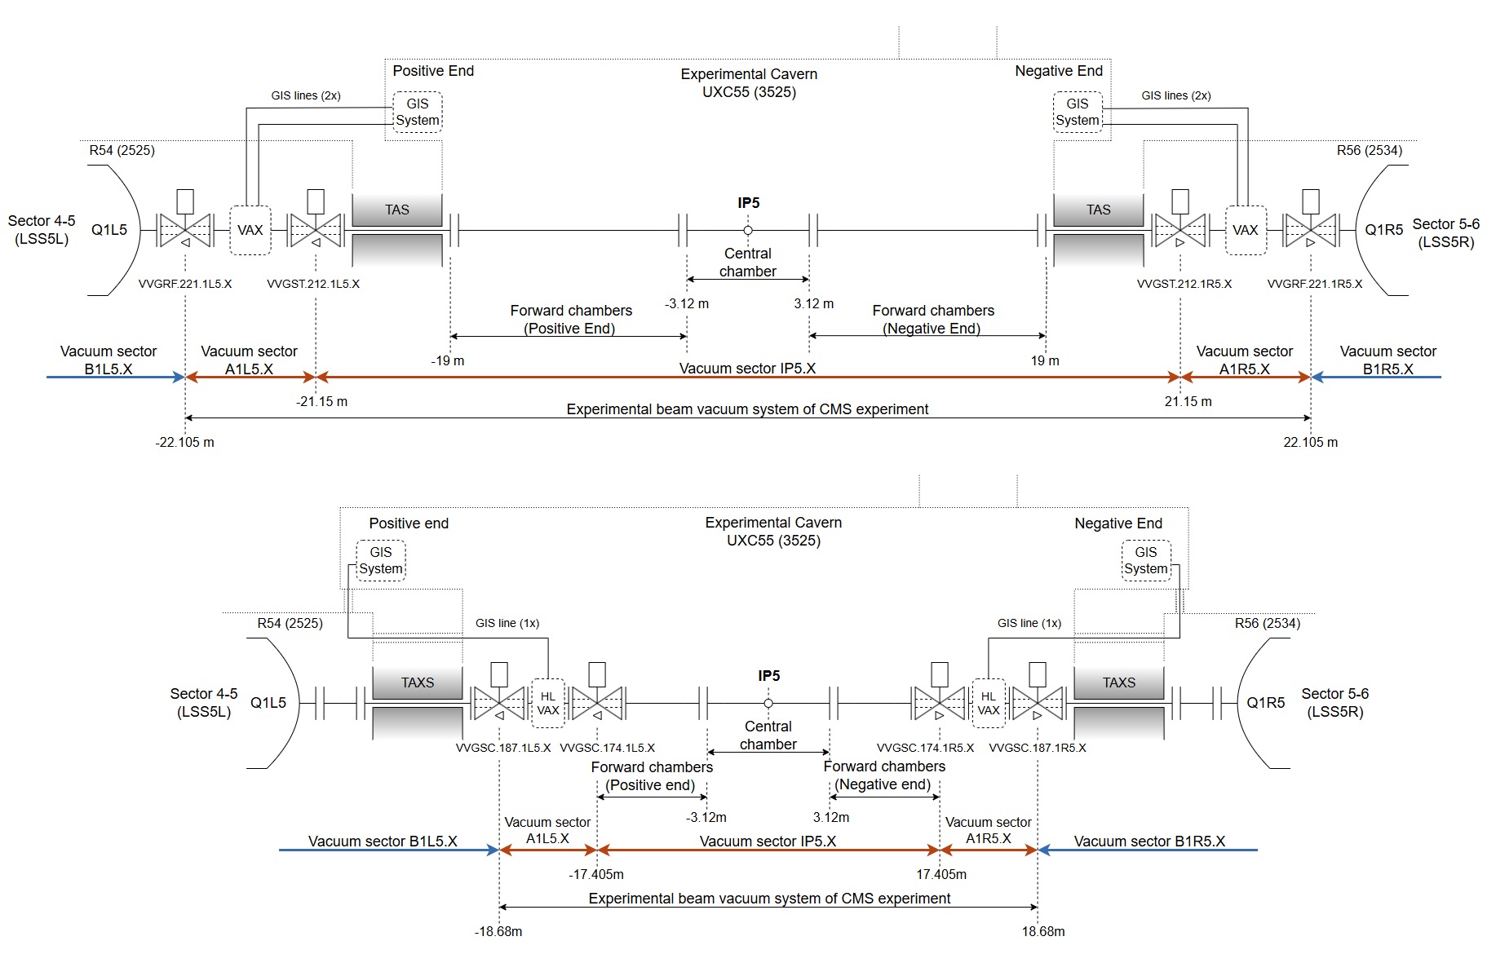
Run 3
Run 4

Slide 5
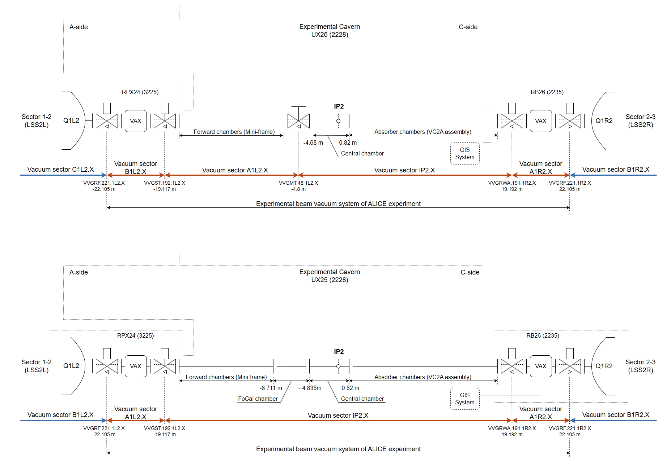

Run 3
Run 4

Slide 6

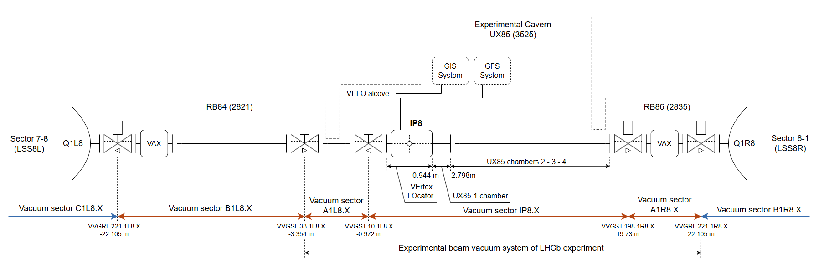
Run 3 & Run 4

Slide 7
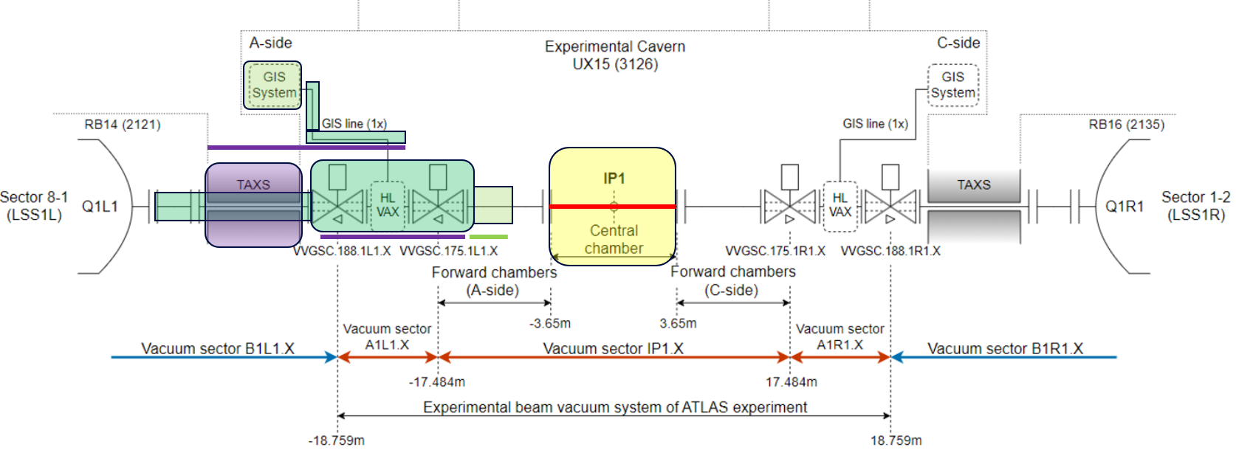
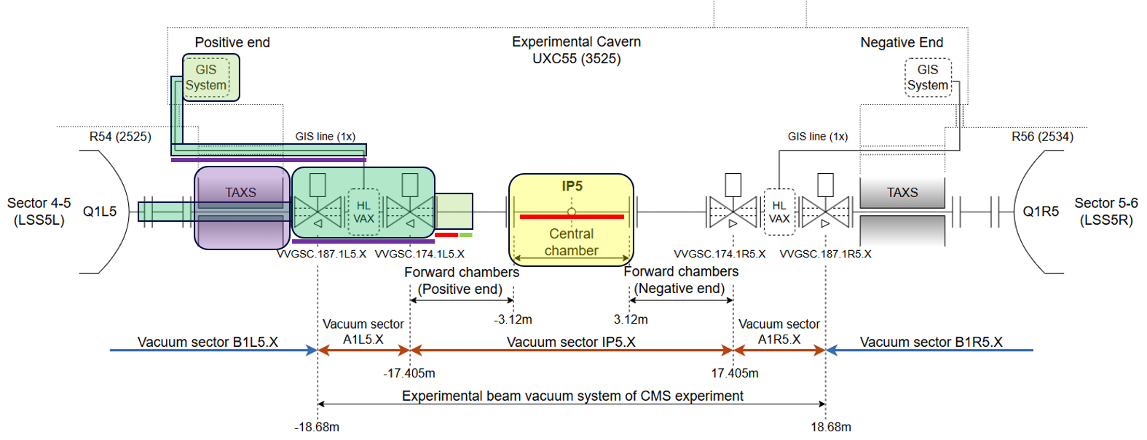
Mutual interfaces
Evolution of the layout from Run 3 to Run 4 involves of several stakeholders and interfaces:
  Experiments (via HostLab project) with contribution from TE-VSC.
  HL-LHC project (ATLAS & CMS - VAX, TAXS, GIS, Forward region changes).
  ATS Beryllium facility project (production of ATLAS, ALICE and CMS central chambers).

Slide 8
HL-LHC upgrade baseline
VAX assembly relocation and consequential modification of GIS lines routing
  HL-LHC TDR Chapter 8 (§ 8.2.1.1); Chapter 12 (§12.5.1).
Modification of vacuum chambers for the forward region
  HL-LHC ECR - WP1, WP8, W12 - Vacuum chambers for the forward region of ATLAS and CMS, EDMS 2938377.
For ATLAS & CMS
ECRs describing evolution of experimental beam vacuum layouts between Run 3 and Run 4 are both requests but also references to the HL-LHC baseline.

Slide 10
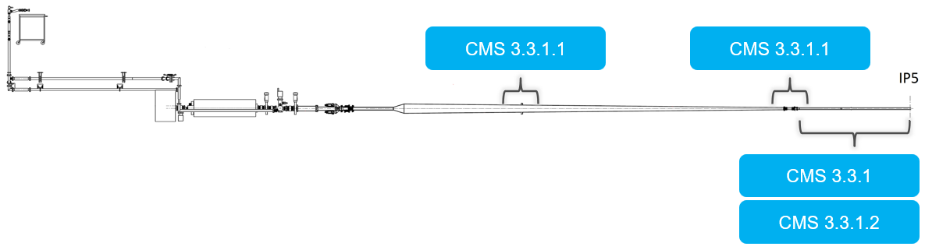
Experimental Beam Vacuum Systems - CMS
Deliverables included / excluded within the HostLab Phase 2
HL-WP12
3.3.1.1 CMS
Content included within the HostLab
3.3.1 Spare Central chamber
Covers design, procurement and testing of a spare central beryllium chamber.
3.3.1.1 Consolidation of operational vacuum supports
Covers design, procurement, testing and installation of new supporting system in the tracker bulkhead zone.
3.3.1.2 Central chamber installation and bake-out tooling
Covers design, procurement and testing of insertions and bake-out system compatible with new tracker geometry.
3.3.1.1 ATS Be
Formal agreement on the Interface within the CMS tracker region still missing. To be written and agreed still during 2024.

Slide 11
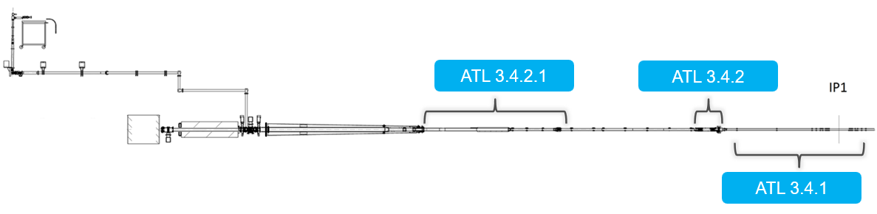
Experimental Beam Vacuum Systems - ATLAS
Deliverables included / excluded within the HostLab Phase 2
HL-WP12
Content included within the HostLab
3.4.1 Spare Central chamber
Covers design, procurement and testing of a spare central beryllium chamber.
3.4.2.1 Replacement of the VC1AP by VC1AE chamber
Covers design, procurement, testing and installation of new extension chamber replacing annular ion pump assembly.
3.4.2.2 Consolidation of OP vacuum supports
Covers design, procurement, testing and installation of consolidated supports for ALARA interventions.
3.4.1 ATS Be

Slide 12
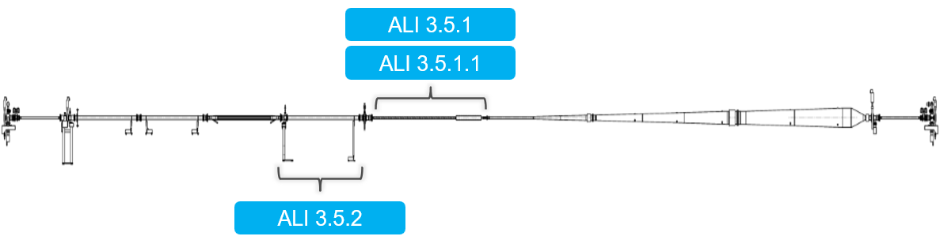
Experimental Beam Vacuum Systems - ALICE
Deliverables included / excluded within the HostLab Phase 2
3.5.1 ATS Be
Support for ALICE3 IRIS project
is still not included within the HostLab
Content included within the HostLab
3.5.1 Central chamber
Covers design, procurement and testing of a central beryllium chamber compatible with LS3 ITS.
3.5.1.1 Remote bake-out system for central chamber
Covers design, procurement, testing of removable remotely inserted bake-out oven for new central chamber.
3.5.2 Forward region vacuum layout upgrade
Covers design, procurement, testing and installation of vacuum system upstream of IP2 (FoCal zone).

