Slide 1
LHC experimental beam vacuum systems
ATLAS IP1 layout configuration for Run 4
Josef Sestak, Tomas Raska, Alessio Galloro on behalf of TE-VSC
9th of May 2025

Slide 2
Content
Evolution of the layout and overview of changes.
Central region changes (VI central chamber and VA extension chamber).
Forward region evolution.
Other activities considered during the Long Shutdown 3.
Installation, handling, planning.

Slide 3
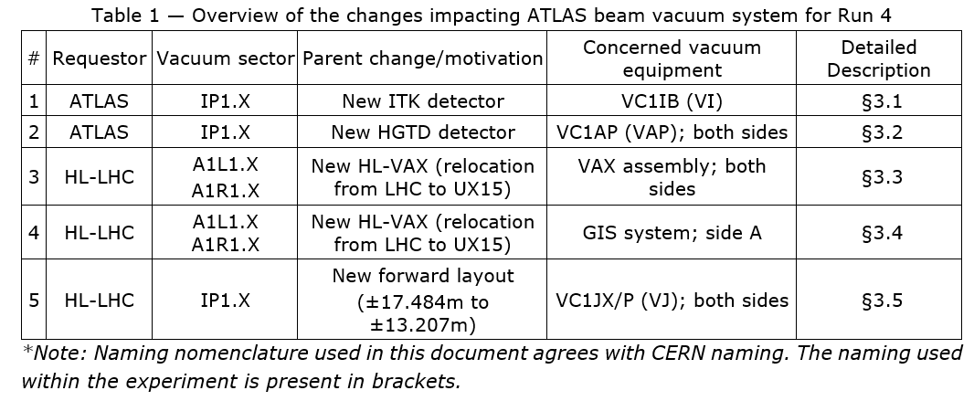
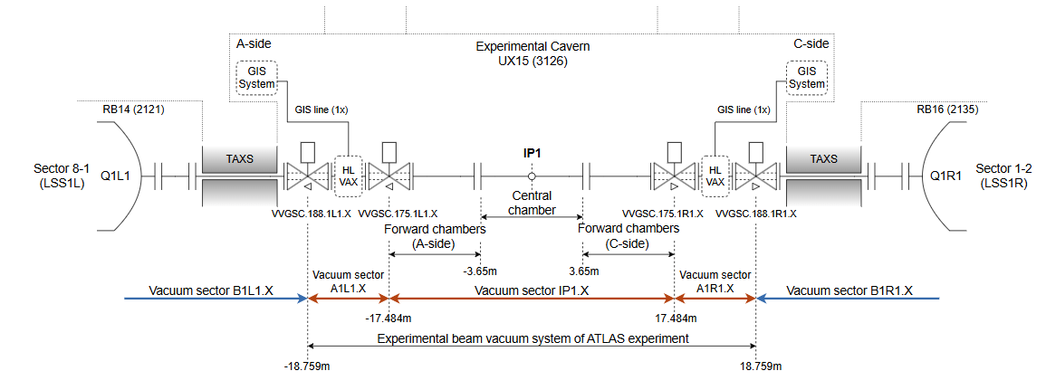
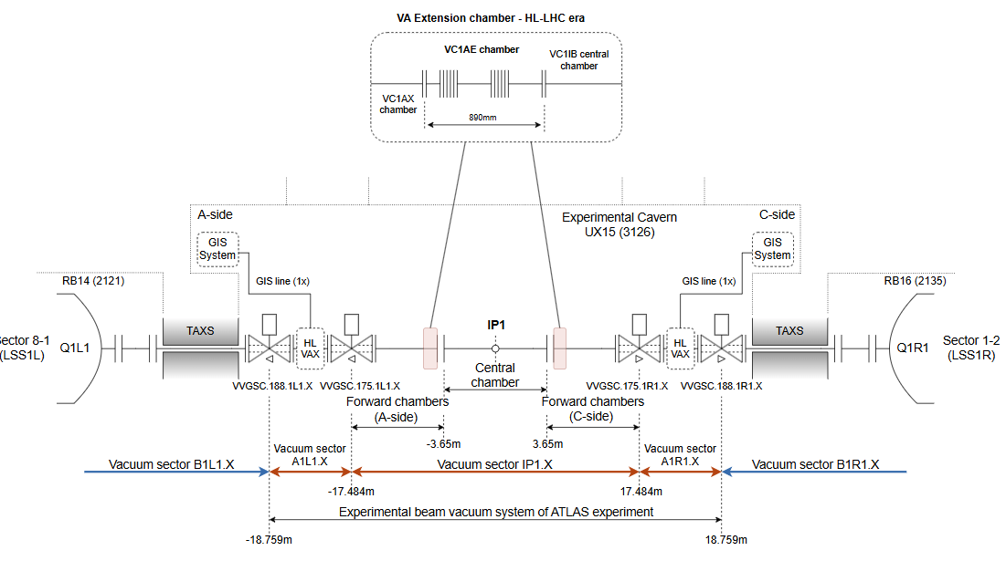
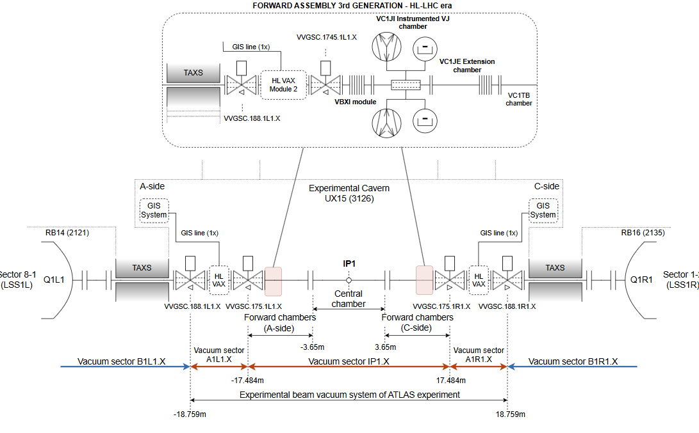
Evolution of the layout and overview of changes.
Run 4
2
5

Slide 4
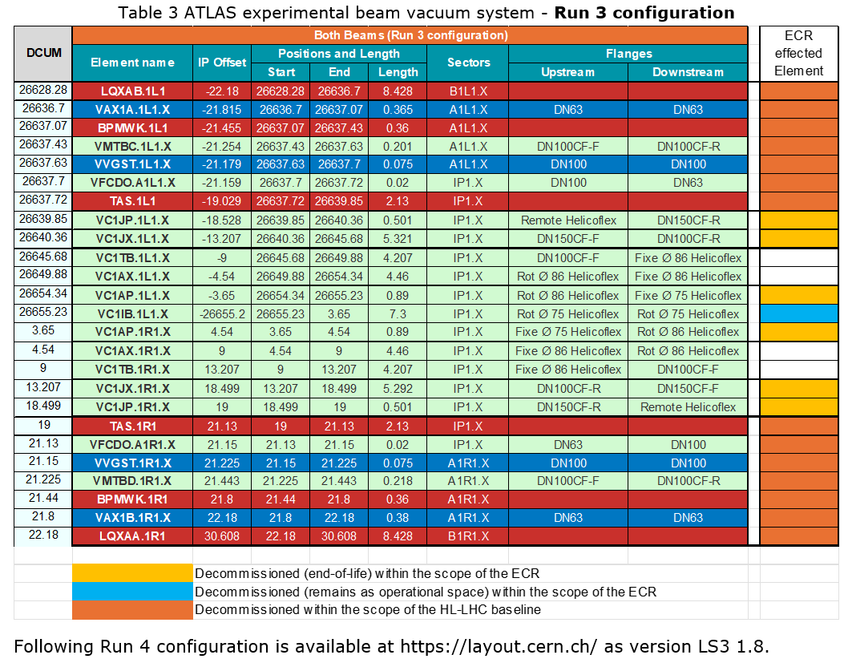
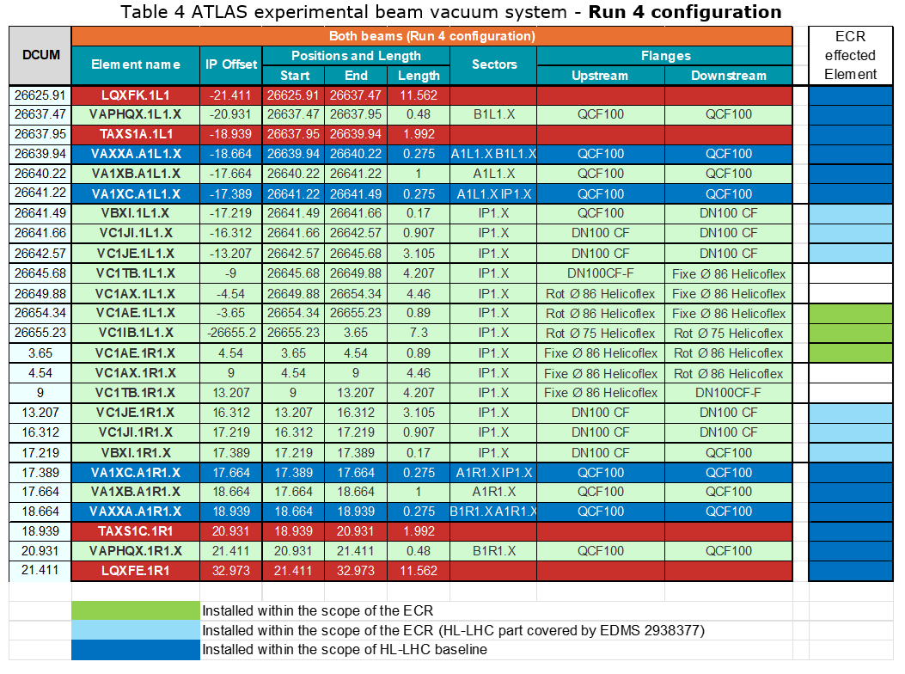
Evolution of the layout and overview of changes.

Slide 5
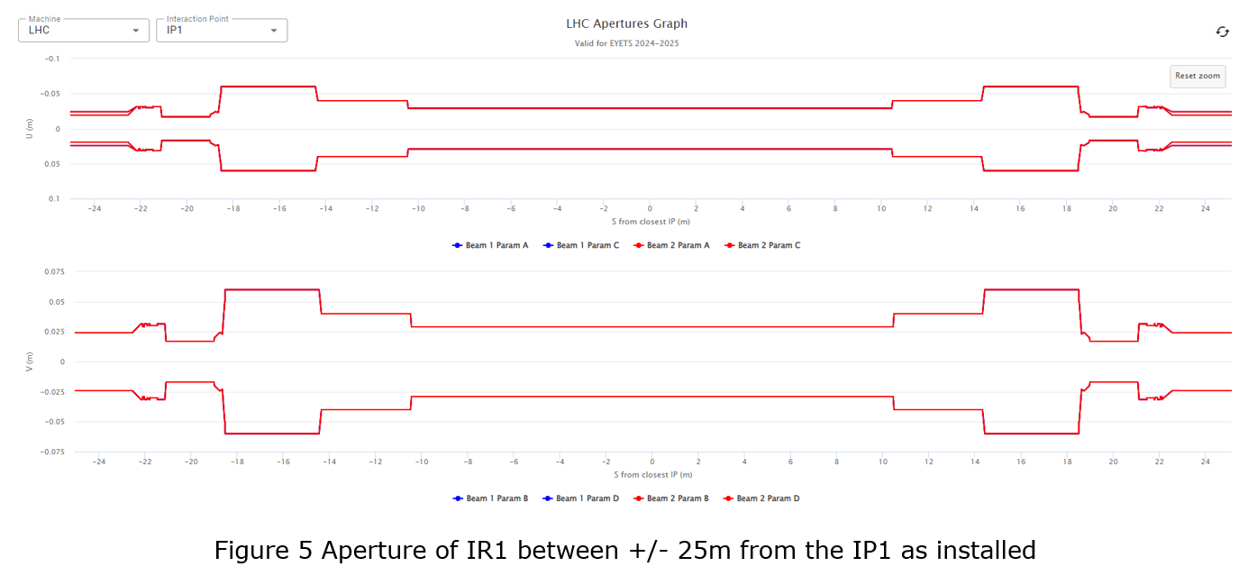
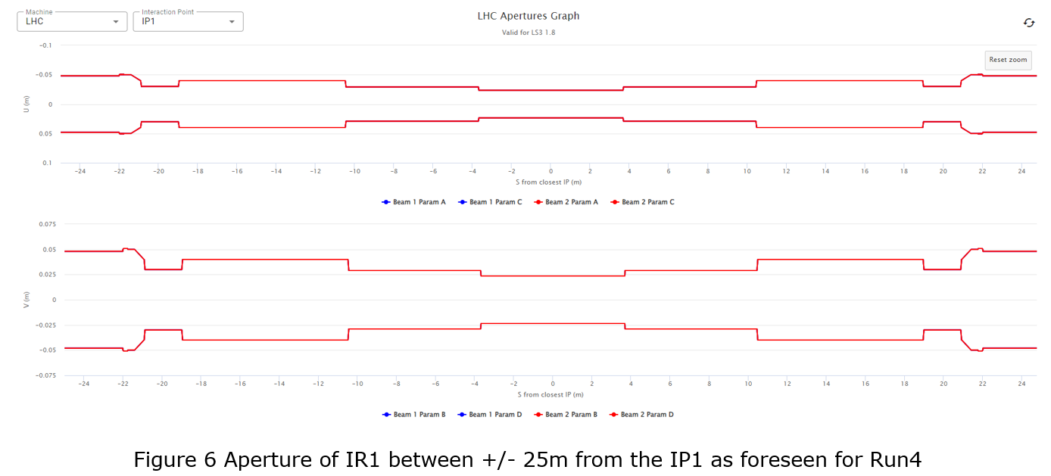
Mechanical aperture of the IP1.X
Current installation apertures show a discrepancy between the reality and the installed stated. Diameter of VI is incorrectly corresponding to 57mm instead of 47mm and were be modified during the YETS 2024/2025 (details can be found in EDMS 3280964).
Run 4 aperture available within layout database
VAX zone ID80mm cylindrical aperture.
Forward zone ID80mm cylindrical aperture.
Central region without changes.

Slide 6
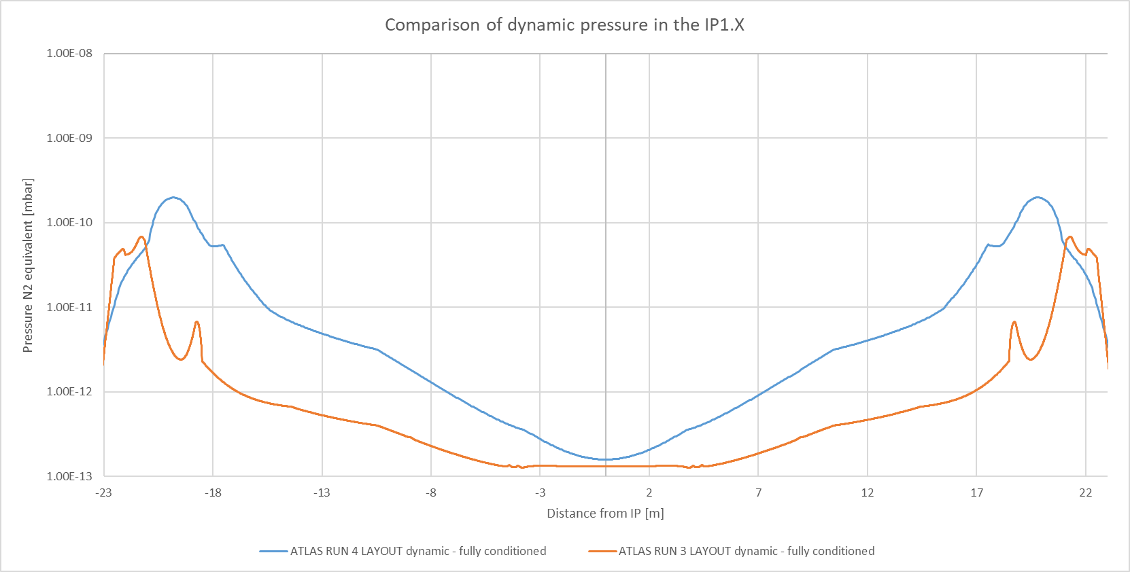
Expected IP1. X vacuum pressure profile
Difference between Run 3 and Run 4 is driven by:
Presence of unbaked Q1 – TAXS sector between VAX and IT (aC coated).
Presence of the new VAX assembly.

Slide 7
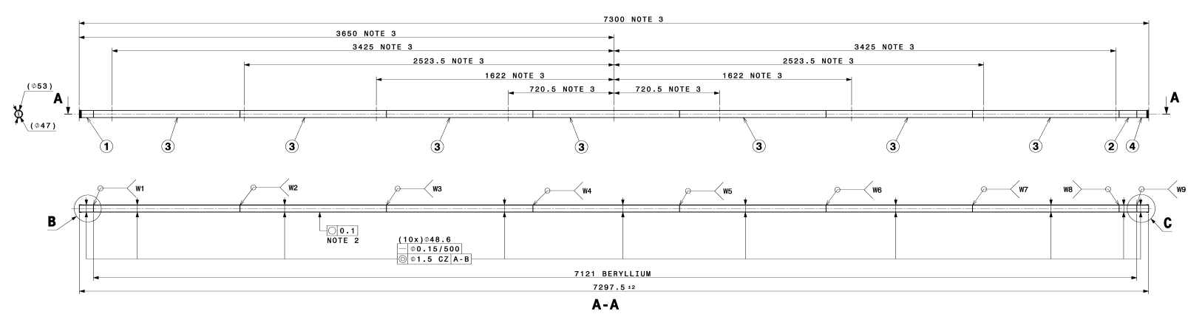
Central region changes
VI central chamber and VA extension chamber
Central chamber VC1IB (or VI chamber)
  ID47mm 7300mm long Beryllium chamber with aluminium end parts. Fully NEG coated.
  Identical geometry, aperture a surfaces as for existing chamber.
  Integrated bake-out services; Supporting in IST and bulkheads shall provide identical positioning precision.

Slide 8
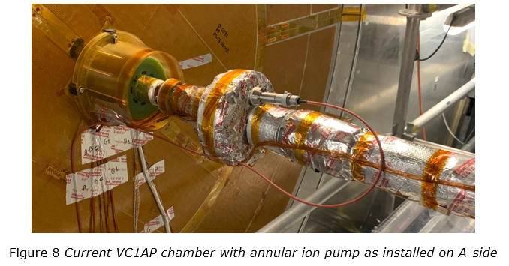
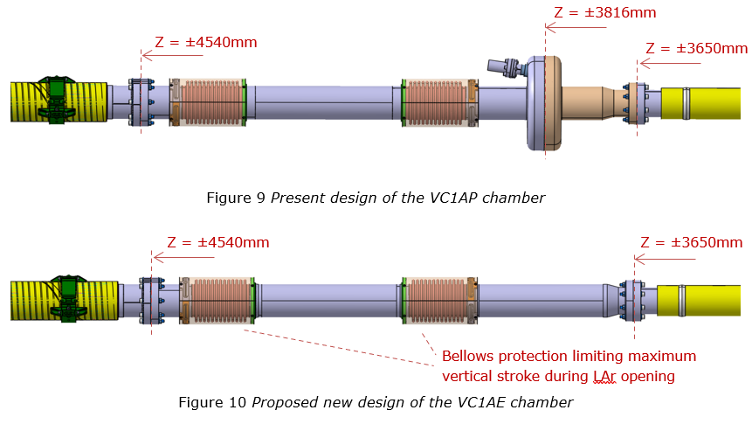
Central region changes
VI central chamber and VA extension chamber
VA extension chamber – replacing annular ion pump chamber VC1AP
  Suppressed to make space for ATLAS HGTD.
  Aperture, position of bellows, surfaces remains as for Run 3.
  Bake-out services and temperature limitation for HGTD TBD.

Slide 9
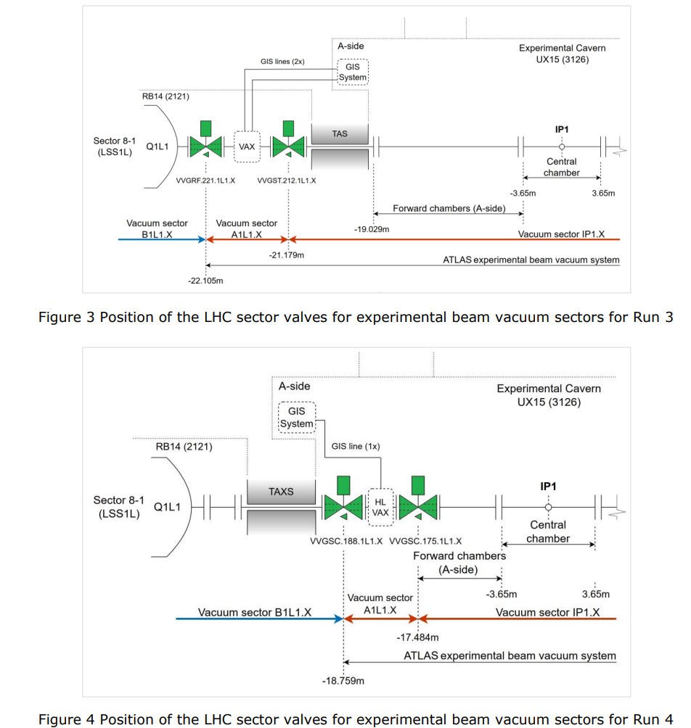
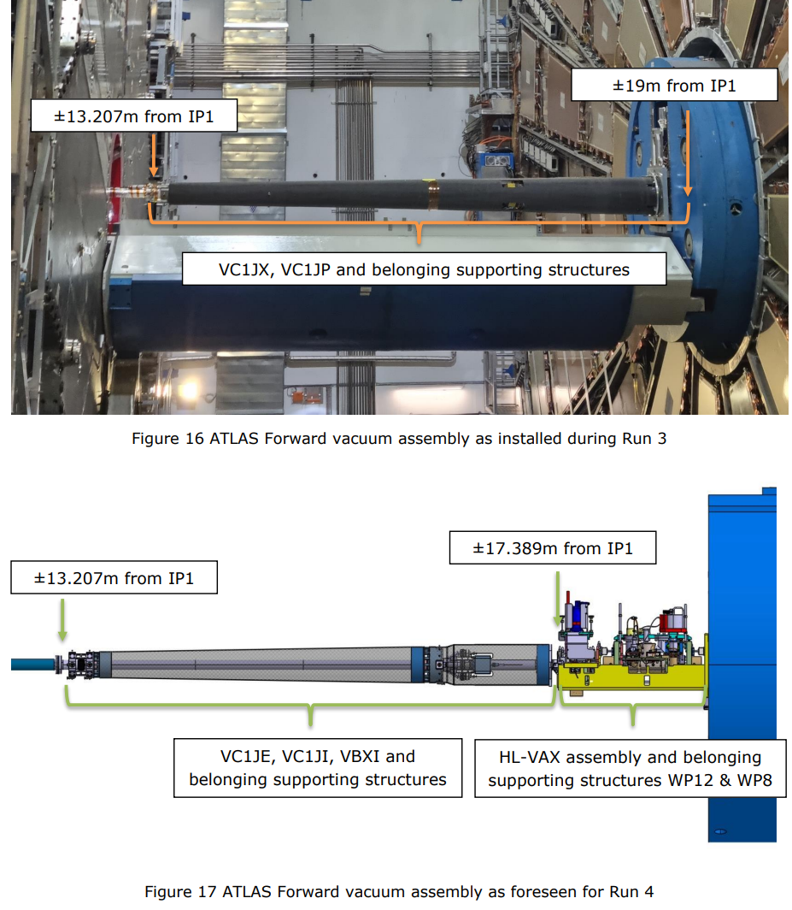
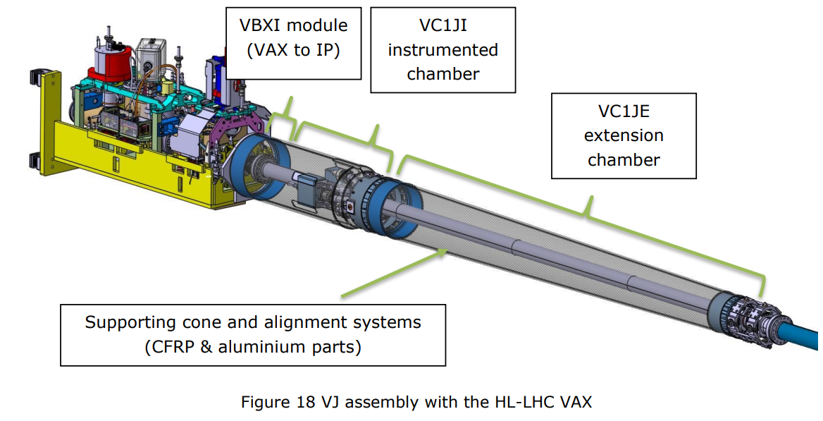
Forward region evolution (VA1J assembly)
Evolution of the ATLAS forward zone layout from Run 3 to Run 4 (to ensure HL-LHC VAX compatibility)
The proposed layout complies with the demanding requests of ATLAS Lucid
Approved by ATLAS TC

Slide 10
Forward region evolution (VA1J assembly)
HL-VAX module 2 & module 3
VAX box support anchored on VJ interface plate
Precise fast - alignment support assembly
Precise fast - alignment support assembly

Slide 11
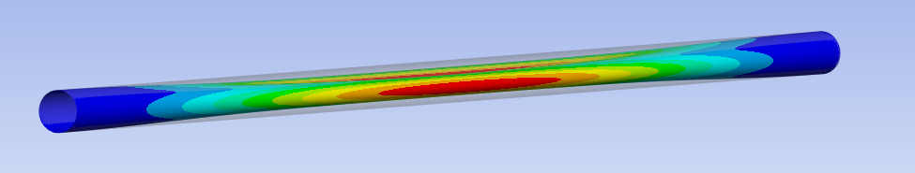
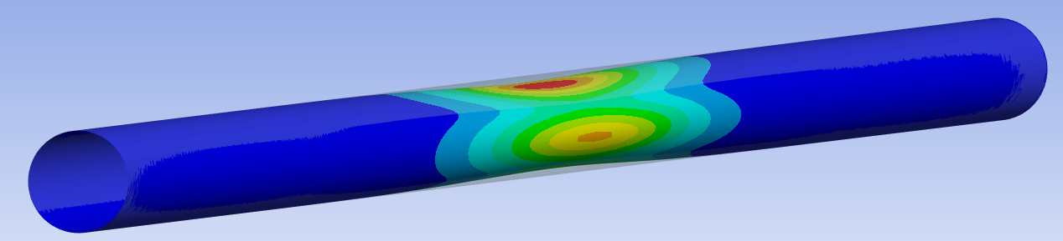
VC1JE chamber
Existing EN AW-5083 bellow design will be used (all VJ bellows)
  Tube Ø80 mm - Aluminium 2219-T6 || NEG coated;
  Wall thickness modified – 1.1 mm;
    Critical absolute external pressure
      Linear analysis: 3.2 bar
      Non-linear analysis: 4.0 bar
    Critical absolute external pressure considering
    reduced material properties during bake-out
      Linear analysis: 2.8 bar
      Non-linear analysis: 3.2 bar
Fix point shoulder – same functionality as current VJ
Aluminium Bellow ID 80, stroke -15/+5 mm
Constant aperture 80 mm
~ 3100 mm
Sliding point shoulder
Linear buckling mode
Non-linear buckling mode

Slide 12
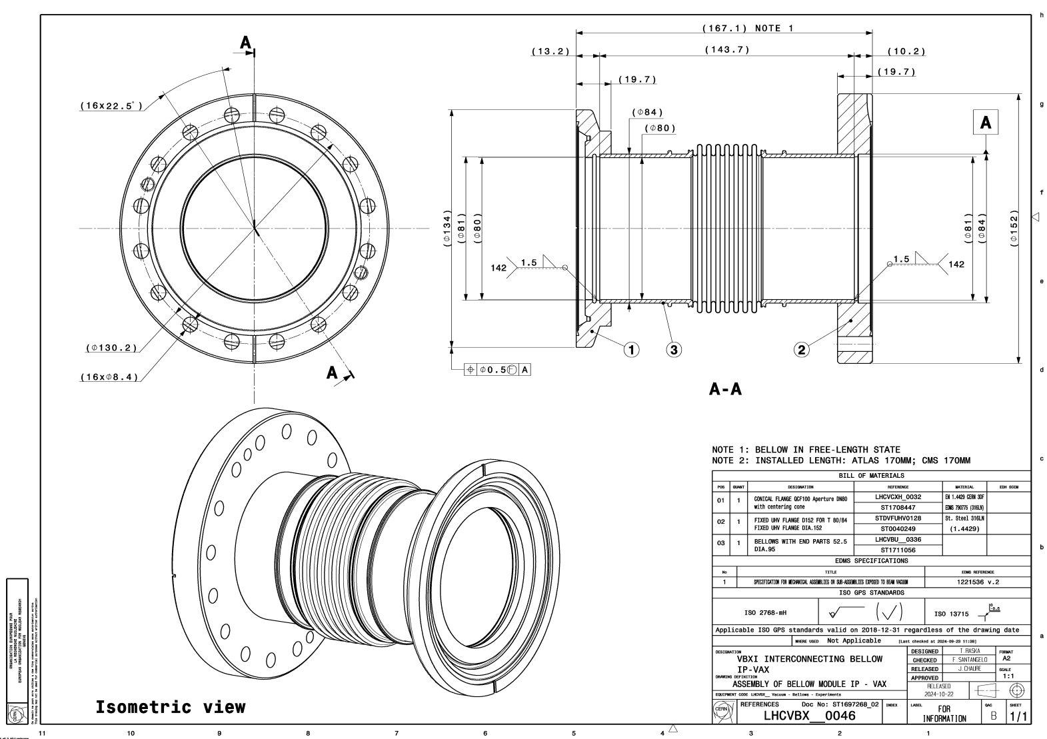
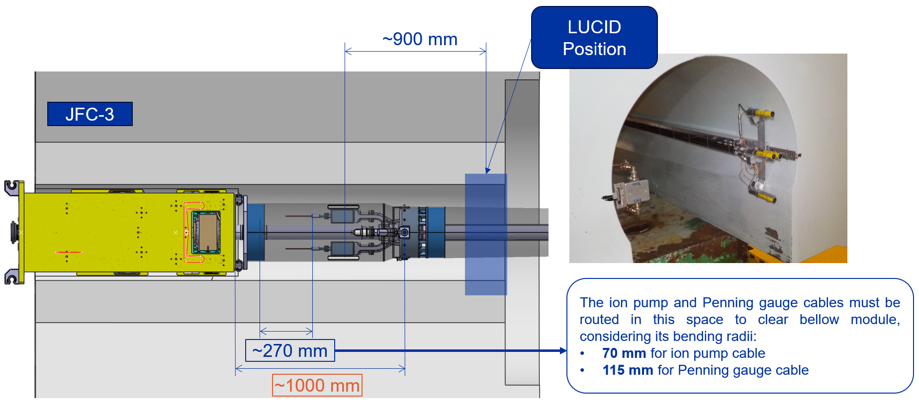
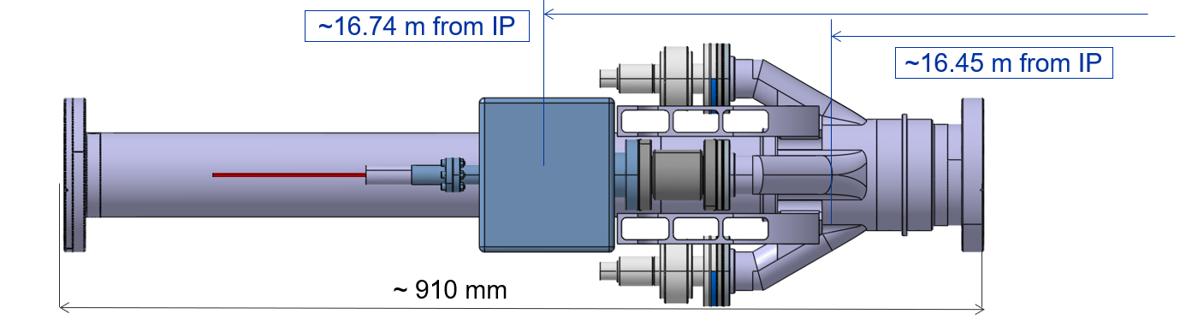
VC1JI chamber
VBXI unshielded compensator connecting VC1JI with VAX-M3
New instrumented assembly for the IP1.X (the only instrumented assembly)
  Tube Ø80 mm - Aluminium 2219-T6 || NEG coated; RF screen at the position of VPIs.
  Wall thickness – 1.5 mm;
  Fix point assembly at 16.4m for fast alignment (ALARA – close to VAX).
  Ion pumps relocated further away from IP compared to previous iteration
    Currently at ~16.74 m;
    Body hub machined out of bulk aluminium (to minimize welding).
    Pumps not supported via flanges but using dedicated support.

Slide 13
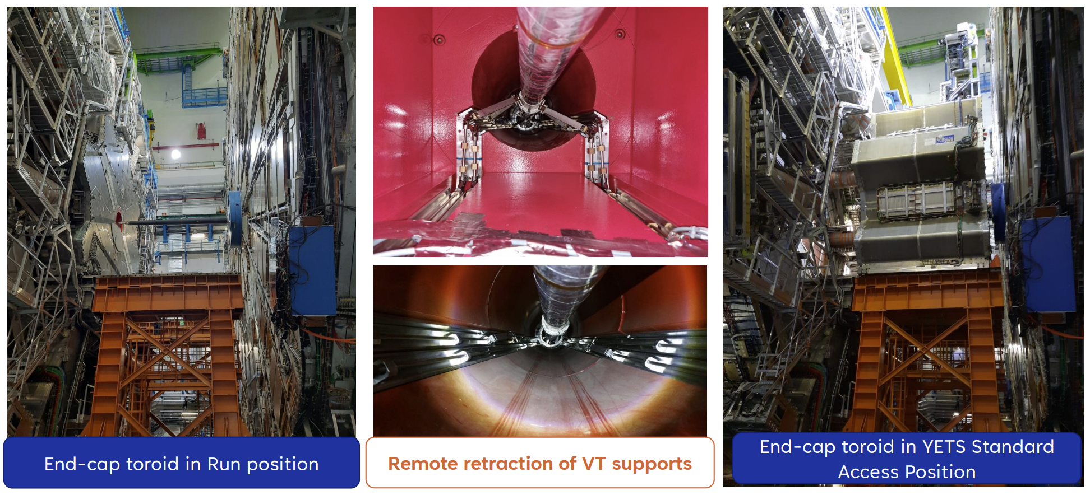
Other activities considered during LS3
Installation of HL-LHC VAX nor the GIS lines is not scope of this discussion.
Corrective actions on the VT supporting system – full retraction of the pantograph.
Upgrade of the VA Fix point supporting collar (improve ALARA).

Slide 14
Installation work stream ATLAS
Before we start with the installation of the IP1.X
  All services (signal, power and bake-out cabling) to be in place.
  TAXS installed
  Q1 installed
  HL-VAX M1 installed
  GIS lines installed
  Q1-TAXS-VAX-M1 connections validated
2. Installation of the central chamber
3. Installation of the VA-VAE chambers
4. Installation of the VT chambers
5. Installation of the VJ assembly with HL-VAX M2 & M3
6. Bake-out of the IP1.X and VAX

Slide 15
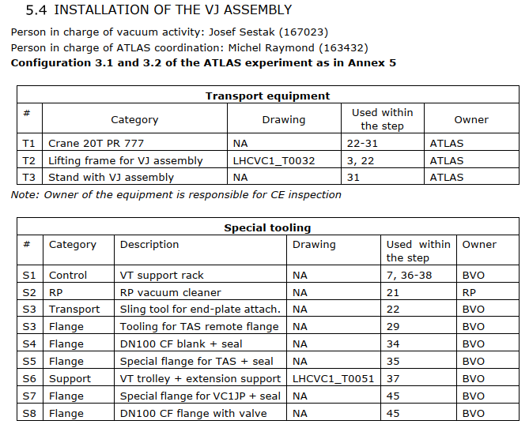
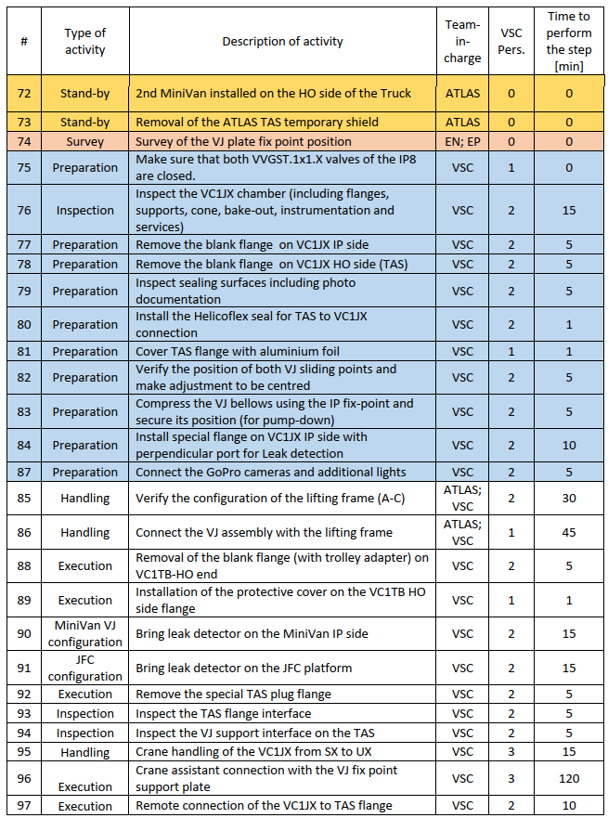
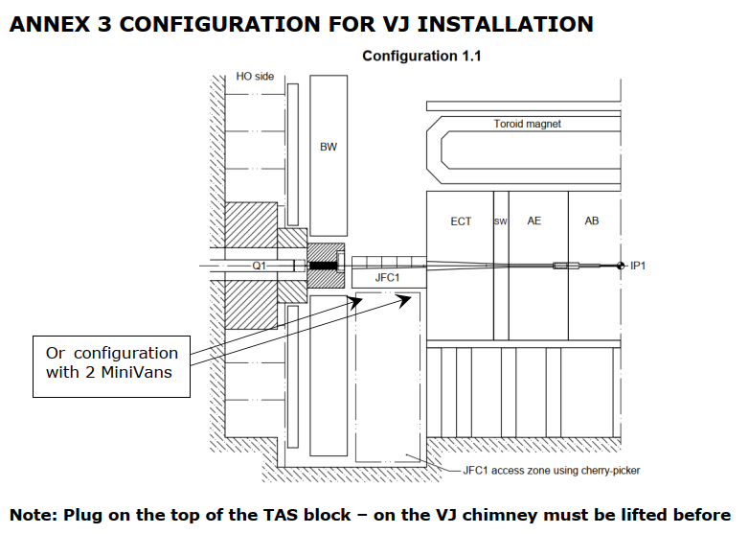
Example VJ installation

Slide 16
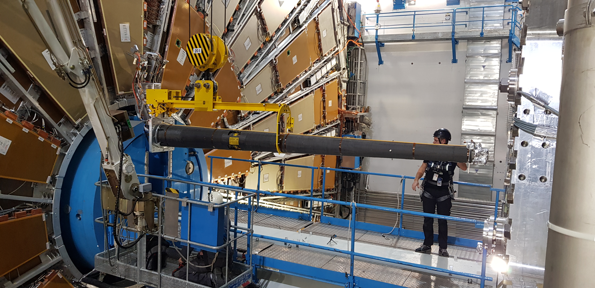

Slide 17
Bake-out programs for ATLAS IP1.X
Program | Description | Step 1 | Step 2 | Step 3
1 | NEG (global) | 130 °C; 20 °C/h | 200 °C; 20 °C/h | 20 °C; 20 °C/h
2 | Stainless steel (collars; warm modules; gauges; ion pumps) | 250 °C; 50 °C/h | 150 °C; 50 °C/h | 20 °C; 30 °C/h
4 | Sector valves; VPN | 140 °C; 30 °C/h | 140 °C; 30 °C/h | 20 °C; 20 °C/h
6 | RGA (Hiden – pumping line) | 180 °C; 50 °C/h | 150 °C; 50 °C/h | 20 °C; 30 °C/h
7 | Aluminium bellows | 130 °C; 20 °C/h | 160 °C; 20 °C/h | 20 °C; 20 °C/h
8 | BPM (only A1L1; A1R1) | 130 °C; 30 °C/h | 180 °C; 30 °C/h | 20 °C; 20 °C/h
9 | NEG (experimental chamber) | 130 °C; 20 °C/h | 200 °C; 20 °C/h | 20 °C; 20 °C/h
Interlocks:
Program 7 (bellows) – interlock temperature to be set at 190°C;
Program 8 (BPM) – interlock temperature to be set at 200°C;
Program 9 – interlock temperature to be set at 230°C.
Degassing steps to be set for all channels as a function of pressure in the IP1.X
(maximum slope 20 °C/h)

Slide 18
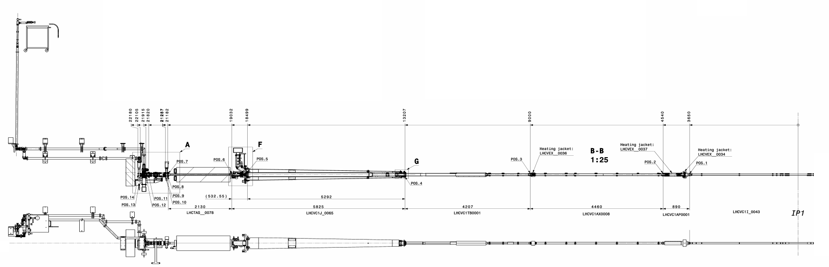
Beam vacuum system bake-out (symmetrical except GIS)
Rack 1 – GIS (only for A-side)
Rack 2 – Q1-TAS A1L1.X
Rack 3 – TAS
Rack 4 – VJ & VT chambers
Rack 5 – VA, VAP and VI chambers
Rack 9 – Q1-TAS A1L1.X
Rack 8 – TAS
Rack 7 – VJ & VT chambers
Rack 6 – VA, VAP and VI chambers
Installation of the bake-out equipment, connection and testing
1
2
3
4
5
Pumping and injection lines + GIS table
Stainless steel (250°C )+ instrumentation
NEG 200°C maximum
VJ chamber
VT chamber
VA chamber
VI chamber
A1L1.X & TAS
VAP chamber

Slide 19
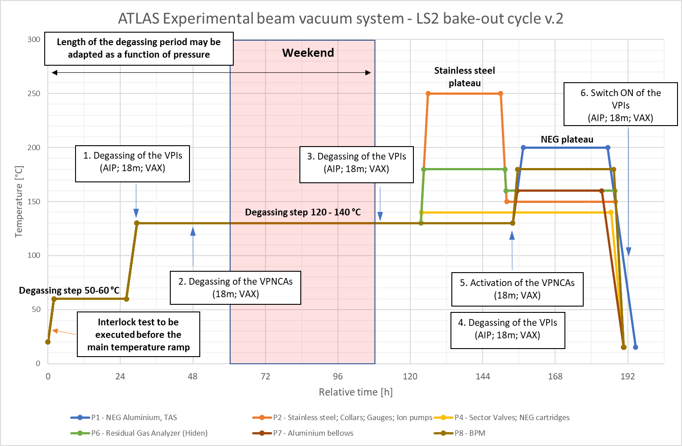

Slide 20
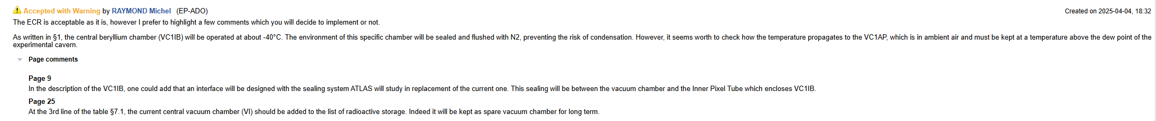
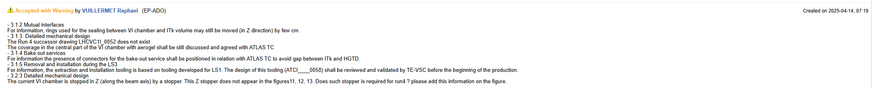
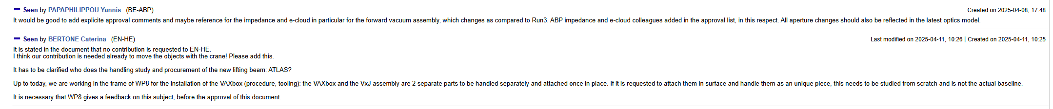
Conclusion
Concept of the ECR is to cover full IP1.X despite it is not mandatory
Changes in the central region are important for ATLAS with no impact expected for the machine, changes within the forward region described within the ECR.
Any additional details can be provided on demand

