Slide 1
May 09th 2025
Overview of machine Requests: Status, Reminders and Plans
TREX Meeting
Marija Majstorovic & Oliver Boettcher

Slide 2
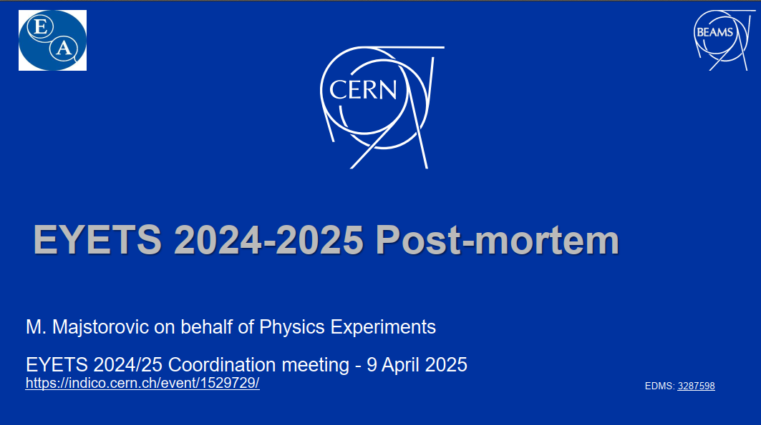
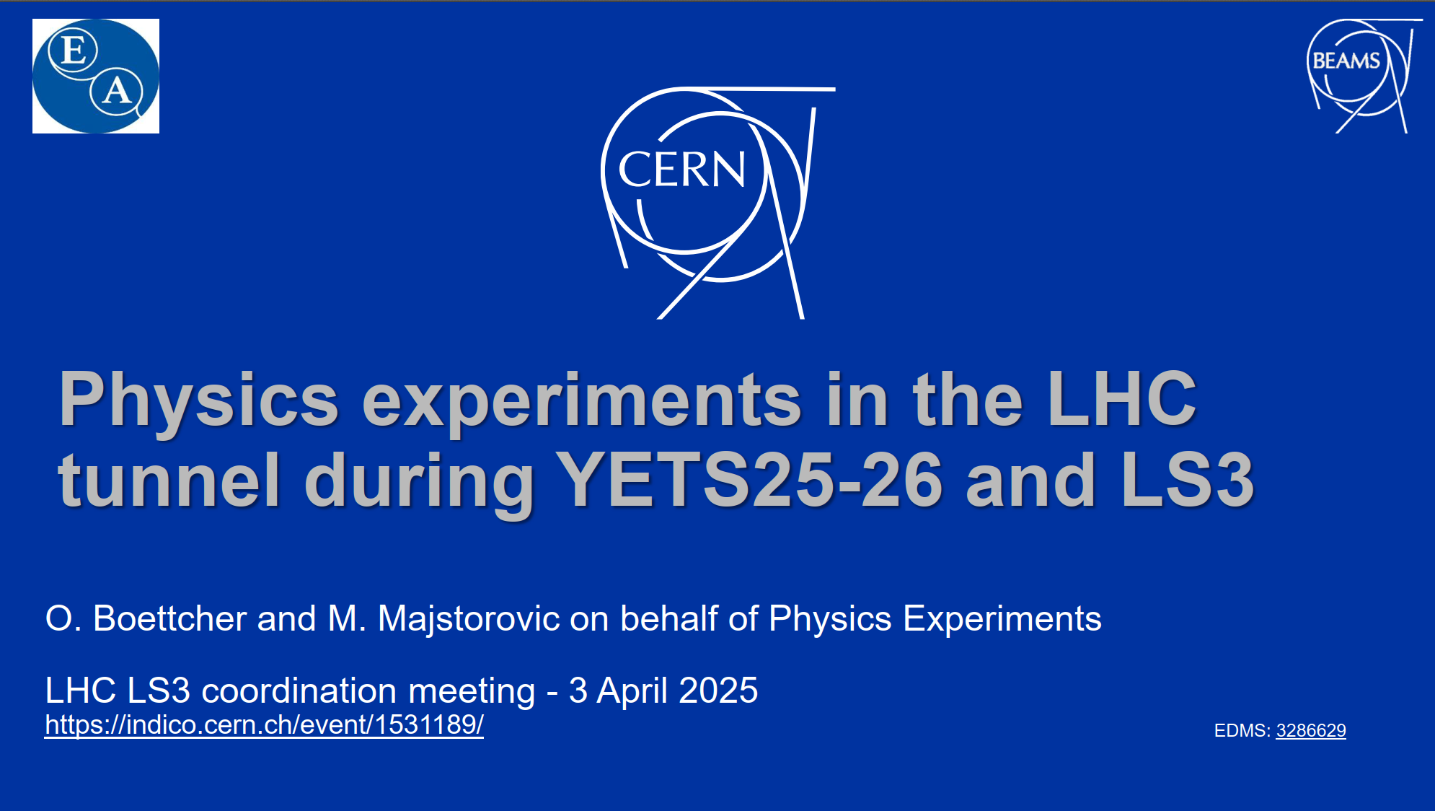
Follow-ups
LHC Coordination meeting
“Post-mortem” EYETS 24-25 activities: 1529729
LHC Coordination meeting
PLAN activities for TS 2025, YETS 25/26 and LS3 – 1531189
- All planned activities for each experiment are listed in
the presentation,
- If you cannot access the PLAN activity, submit a
SNOW ticket to request viewer rights,
- If there are any changes to the activities, please
inform us so we can update the PLAN accordingly.
EDMS: 3287598
EDMS: 3286629
LHC Tunnel Region Experiments Working Group (TREX)

Slide 3
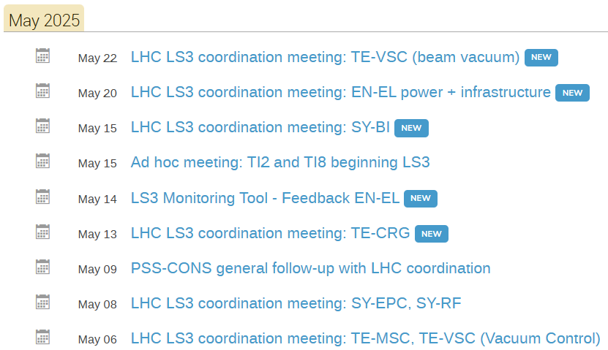
Useful links
LHC Coordination meetings
  Currently all sections presenting their activities in the next period,
  Where the information about contacts, ticket system, plans etc. can
  be found.
Meetings and contributions
Link to the official LHC schedule (EN-ACE/EN-IM)
For any unforeseen situations where you may need to contact an expert, you can find their contact through the following link:
  By clicking the “Select a View” – Planning Dashboard
LHC Tunnel Region Experiments Working Group (TREX)

Slide 4
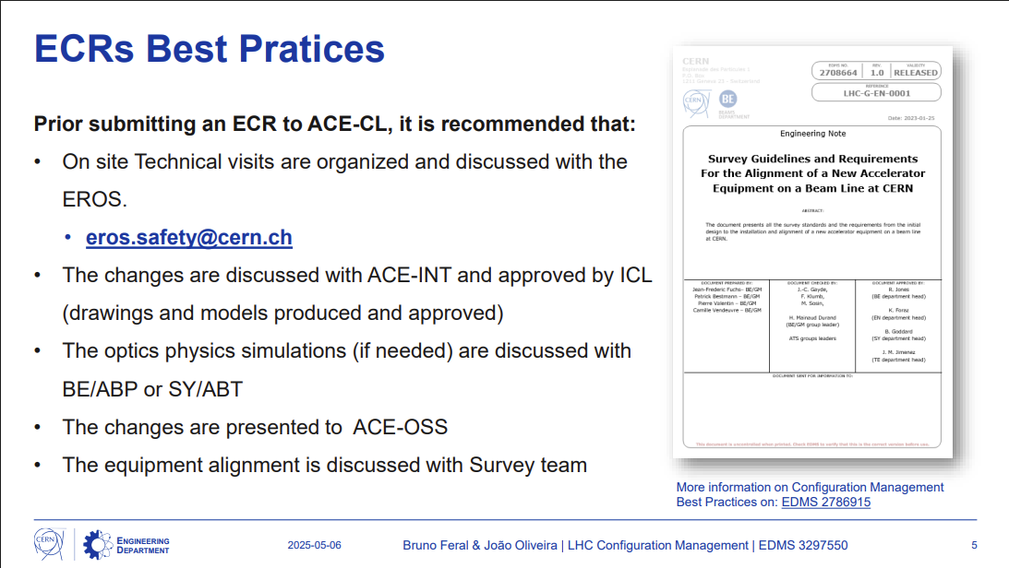
Requests/Reminders
To start establishing the ECRs for the activities
planned for EYETS 25/26 and LS3
Question about ECR, Test Procedure,
Risk Assessment, Eng. Documents (Engineering
Specification, Note, or Report) - contact:
bruno.feral@cern.ch & joao.oliveira@cern.ch
New Version 1.7 of the ECR template is released: link
ECR’s in work to be finalized,
Next step to plan the activities for the TS1 – with LHC coordination.
EDMS 3297550
LHC Tunnel Region Experiments Working Group (TREX)

Slide 5
Thank you for your attention!

