Slide 1
HL-LHC BGI
Some Inputs for HL LHC BGI Requirements
28th April 2025, James Storey

Slide 2
Milestones 2025
30.05.2025 : Fix conceptual HL-LHC BGI design for impedance studies.
30.05.2025 : Write an ECR for HL-LHC BGI for HL integration team.
24.06.2025 : Fix the SPS BGI-H instrument in Technical Stop.
22.09.2025 : HL-LHC Beam size review.
YETS 25/26 : No in-vacuum installation in the LHC.

Slide 3
Inputs to the Design (I)
Magnet
Aperture = 140 mm
  Does this include stay-clear?
  Does this include bakeout equipment?
Beam Aperture
Aperture = 50 mm
  Is this the aperture required after fabrication & misalignment errors?
Field cage
Cathode with/without wings? Stainless steel or Ceramic with aC or NEG coating?
  Inevitably requires iteration following Impedance study.
How well must the field cage be aligned to the magnetic field?
How to remove heat? How to ensure cathode can never block the beam?

Slide 4
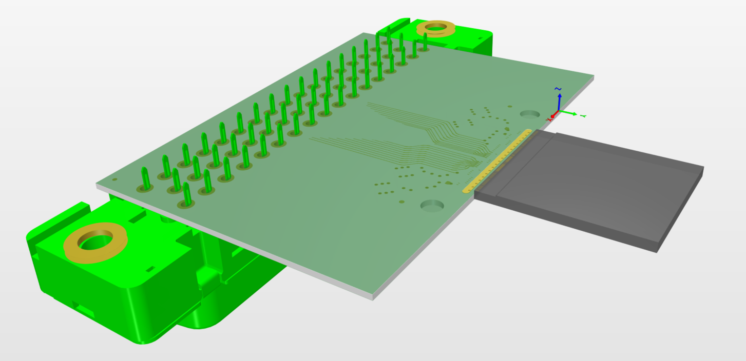
Inputs to the Design (II)
Ionisation Electron Detector
Will be based on a single Timepix4 HPD (24.7 x 30.00 mm).
Should be maximally shielded, with minimum of transmission lines.
  Is there space for an electrical feedthrough in the vacuum chamber?
Need to optimise design for:
  UHV compatible materials;
  Bakeout;
  Heat dissipation;
  Signal transmission & power distribution;
  Ease of assembly & maintenance.
Exact DSub connector needs to be defined but can assume for the moment a single DSub-78.
Need Faraday cage dimensions for Impedance study, but not detailed design.
Faraday Cage
Minimise volume in order to move eigenmodes to as a high frequency as possible.
Eigenmodes should be as far as possible from the beam power spectrum & Timepix4 operating frequencies.
Maximise transmission of ionisation electrons through the Faraday cage to the detector.
Timepix3 based design (Mark)

Slide 5
Impedance Studies
What we need like to know for the instrument design:
Wakefields inside the instrument
Wakefields inside the Faraday cage
RF-power into the instrument
RF-power into the cathode

