Slide 1
First look at analog scan in PS proton beam
P.Breugnon, A.Rozanov
07.09.2011

Slide 2
Conditions
Beam centered near the chip center, run 171, Chip ID=27
Proton intensity ~50 10¹⁰ protons/spill
All pixels disabled after each spill
Analog scan with 200 events after each spill
Overlap of the second spill is not completely excluded – to be checked in next runs

Slide 3
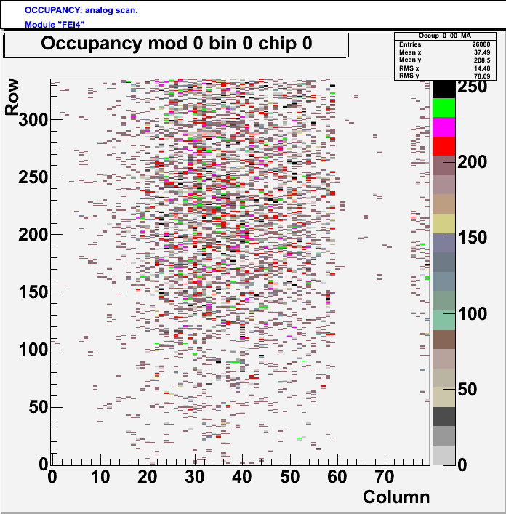
Spill 1

Slide 4
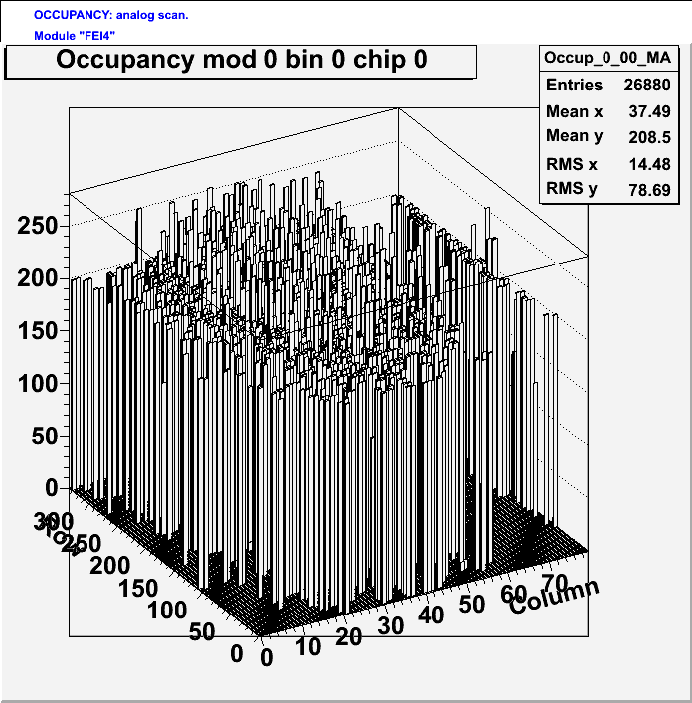
Spill 1 in lego

Slide 5
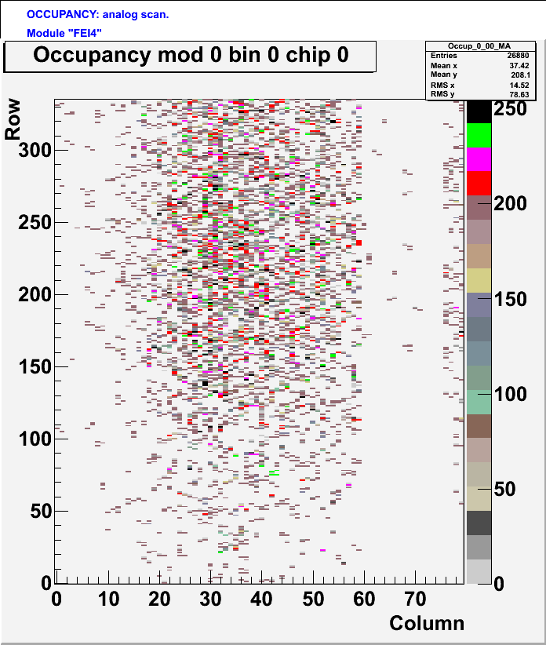
Spill 2

Slide 6
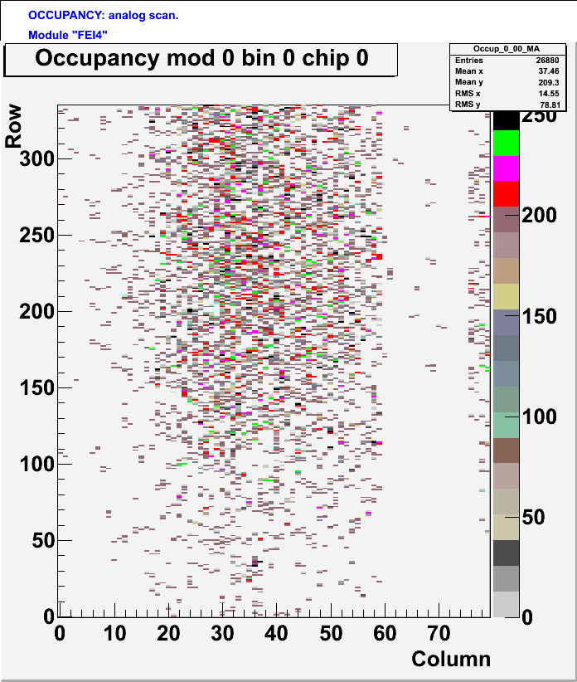
Spill 3

Slide 7

Spill 4

Slide 8

Spill 5

Slide 9
Discussion
Lower SEU rate clearly seen in CPPM columns
Beam profile observable
After 40-50 spills analog scan does not work anymore due to fatal errors (probably GR corrupted by SEUs)
Most of the hits with 200 counts as expected
Some entries with ~1 count. SEUs in digital part ?
Some entries with 201-250 counts. Is is also SEU’s in digital ?

Slide 10
To be done
Reconfigure chip after 10 spills to take longer runs
Watch if there are second spill overlaps from time-stamps
Try faster runs with 20, 10 pulses instead of 200
Calculate absolute cross-section both both types of DICE latches

