Slide 1


Temperature monitoring update
30/04/2025
Agenda
Production Progress
2. Temperature offset study
Speaker: David FLOREZ
Assistant Professor – Team leader
Pontificia Universidad Javeriana

Slide 2
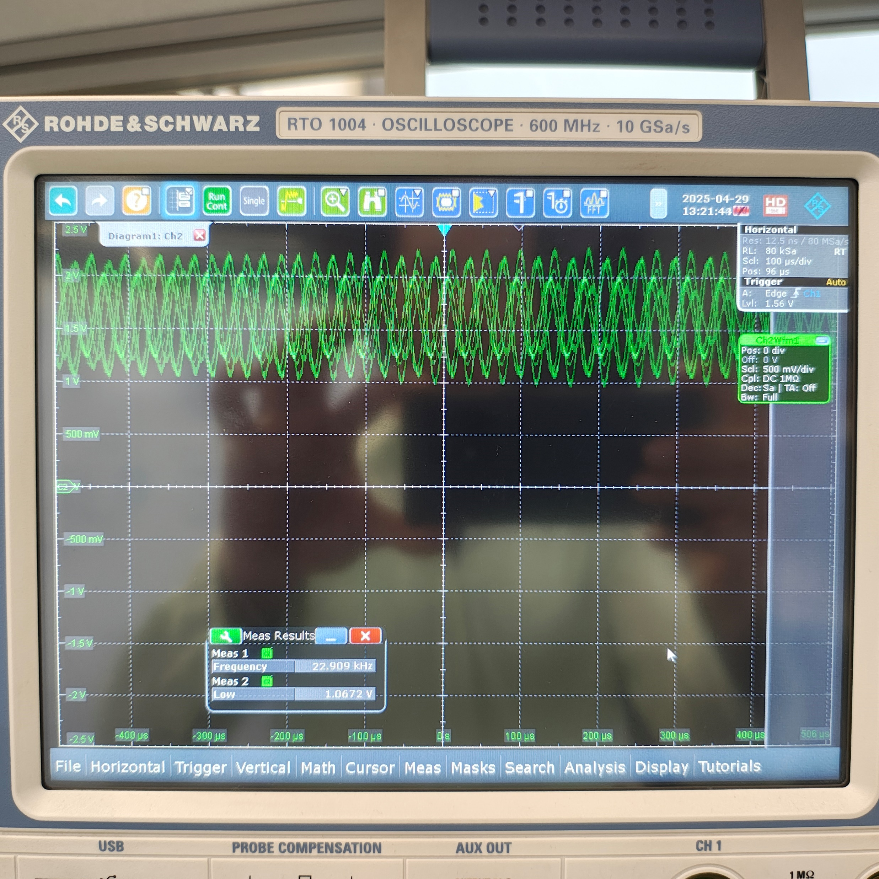
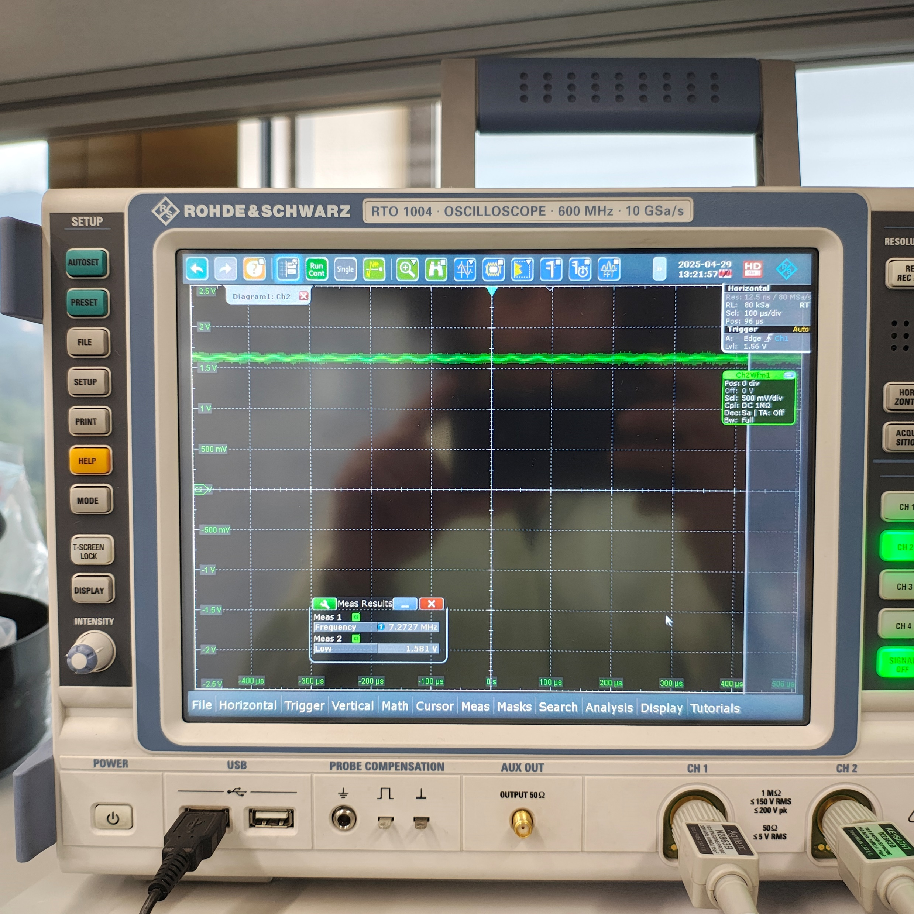
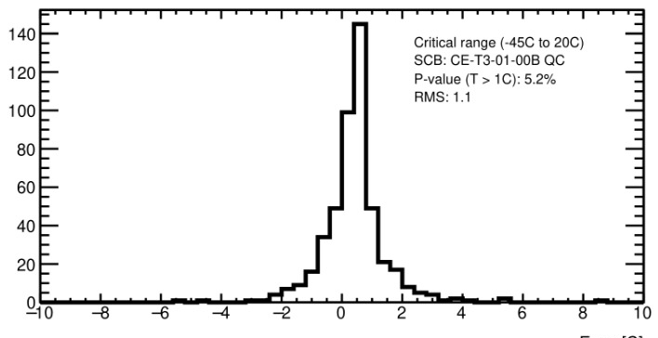
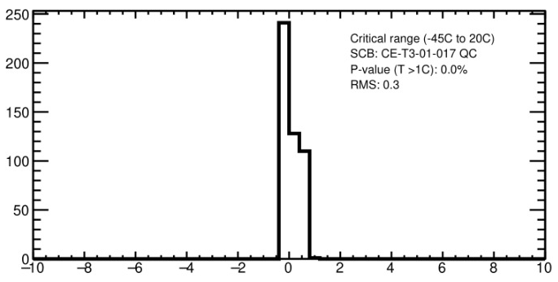
Production Progress
Production available
  70 Signal Conditioning boards
  35 ELMB CB
  3 Back planes
Pending
  35 Back planes: connectivity test
Quality control
  15 SCB + ELMB CB done
  Oscillations during QC were identified and investigated
Op amps floating inputs generate oscillations and noise in all the outputs.
This shouldn’t happen in operation…

Slide 3
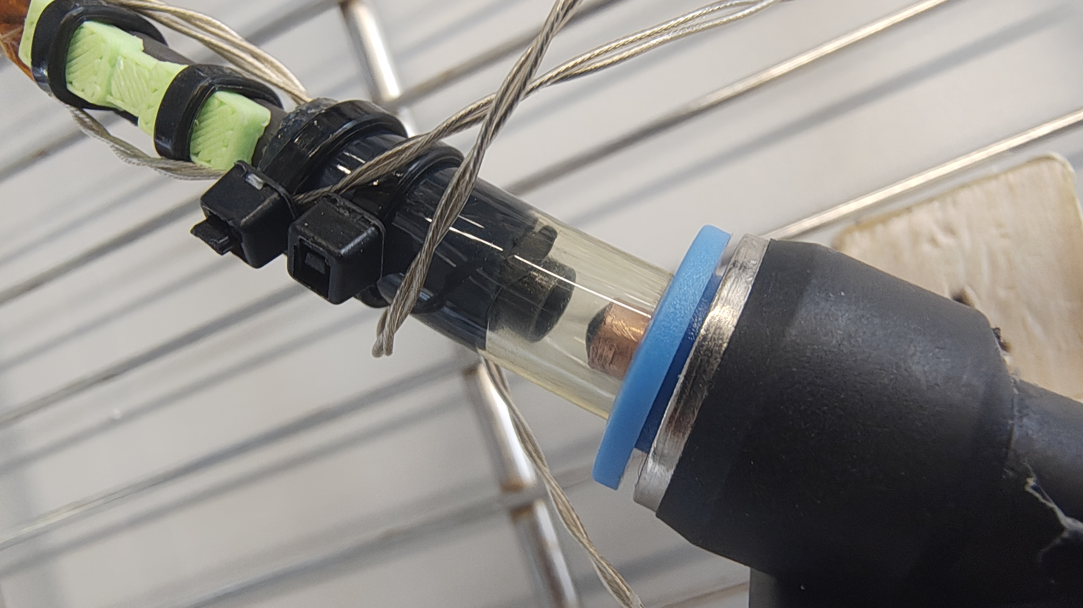
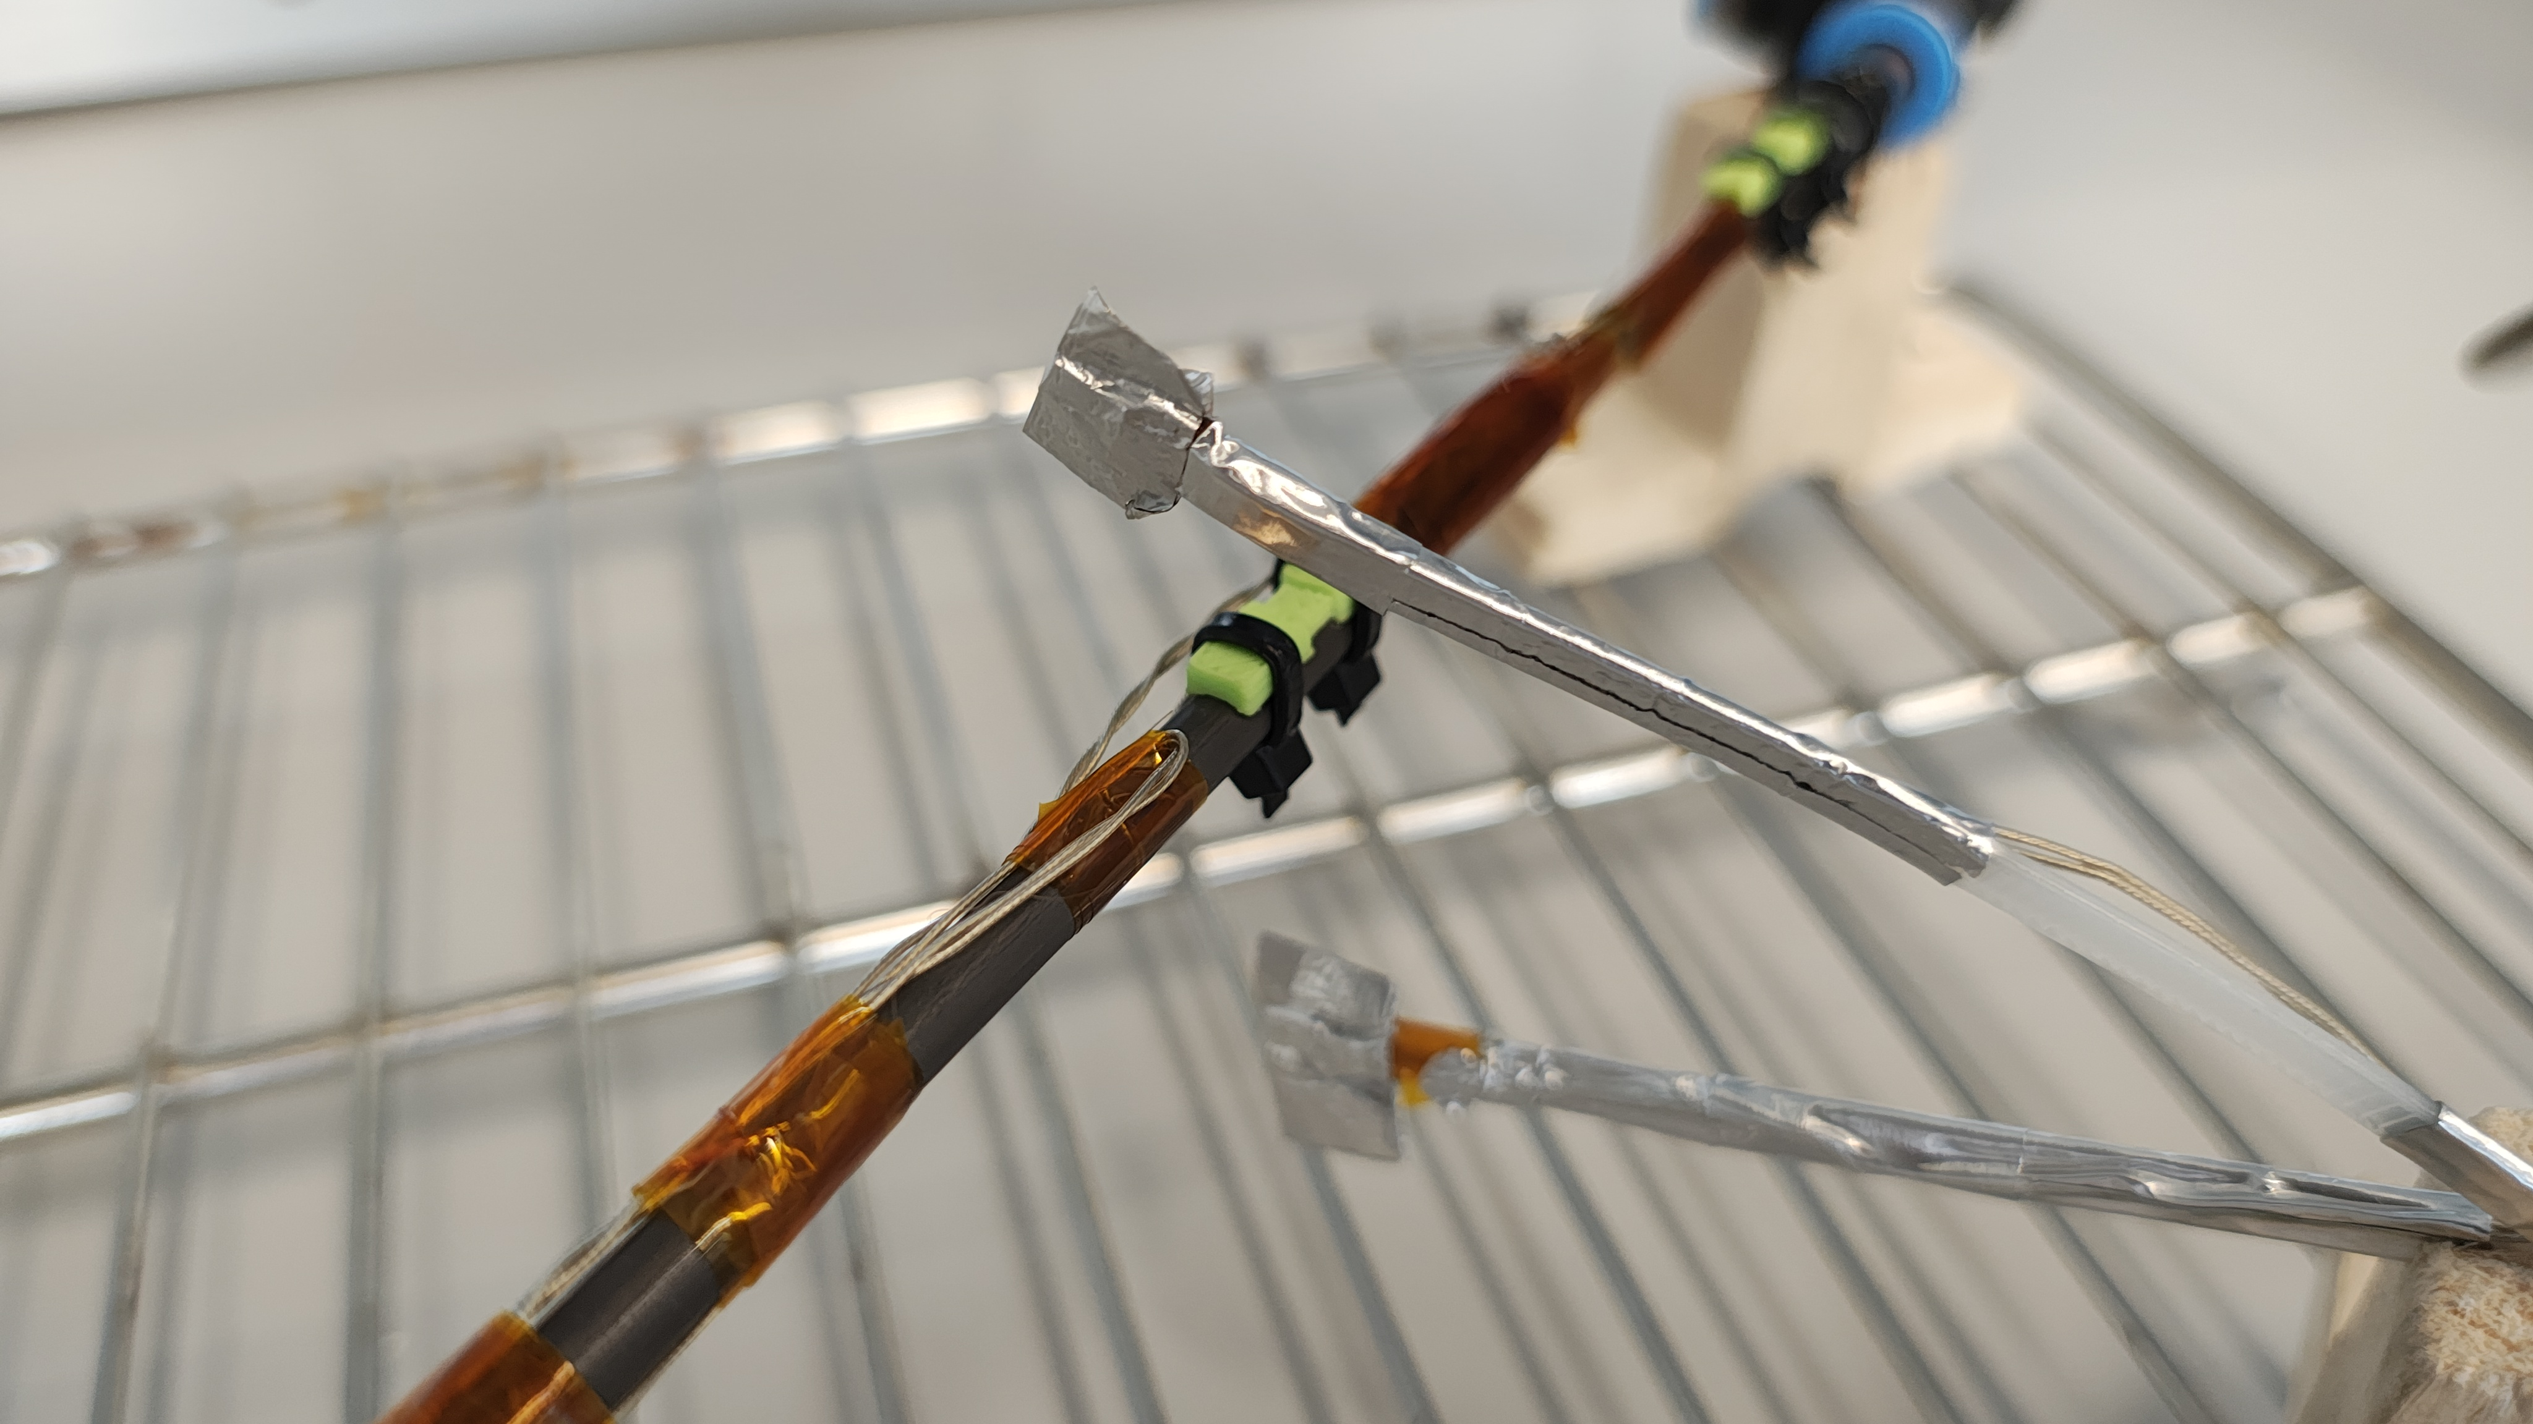
Temperature offset study
Outstanding question: what is the worst case offset between flow and surface temperature?
T_{flow}
Goal proposed by cooling team:
  T_{flow}-T_{surface} = +/- 0.5°C → for dT <= 20°C to environment temperature
T_{surface}
Operating points | 1 | 2 | 3
T_{flow} | -45°C | 0°C | 20°C
T_{atm} | <=-25°C | <=20°C | <=40°C
T_{atm}

Slide 4
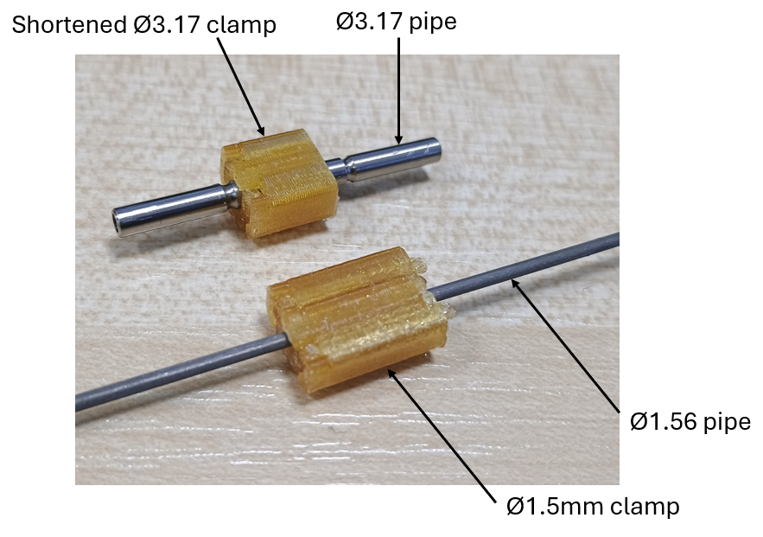
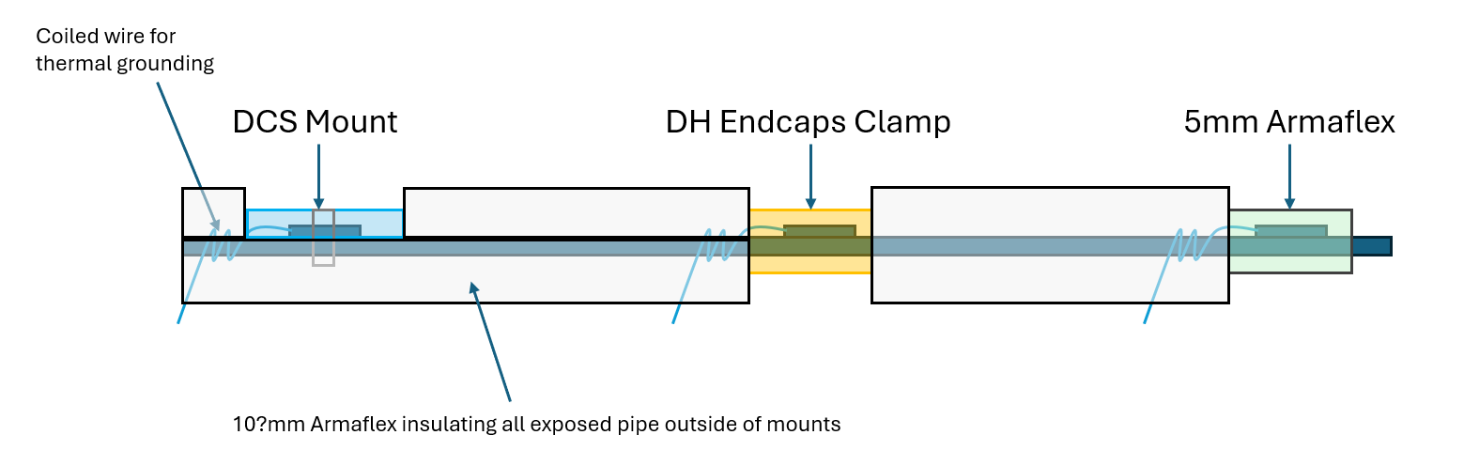
Temperature offset study
Materials
?
Test sketch by D. Howgill

Slide 5
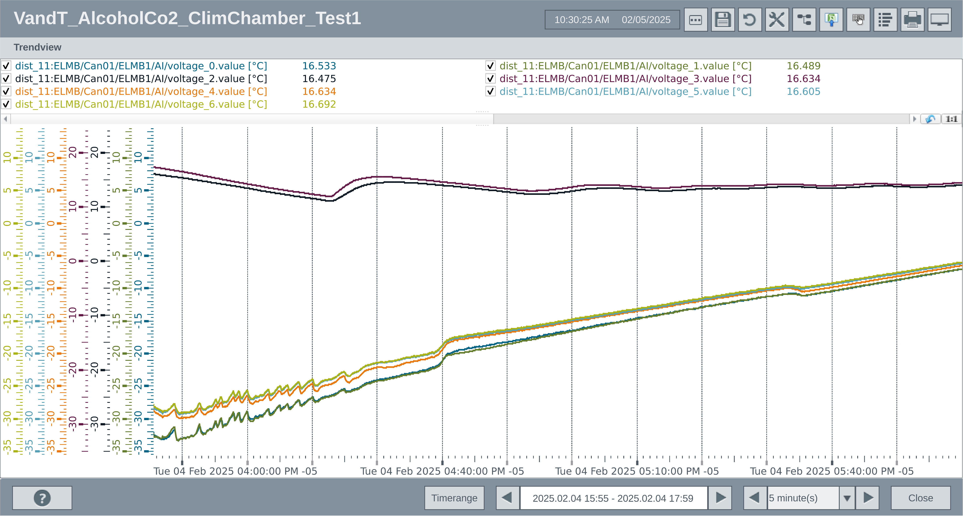
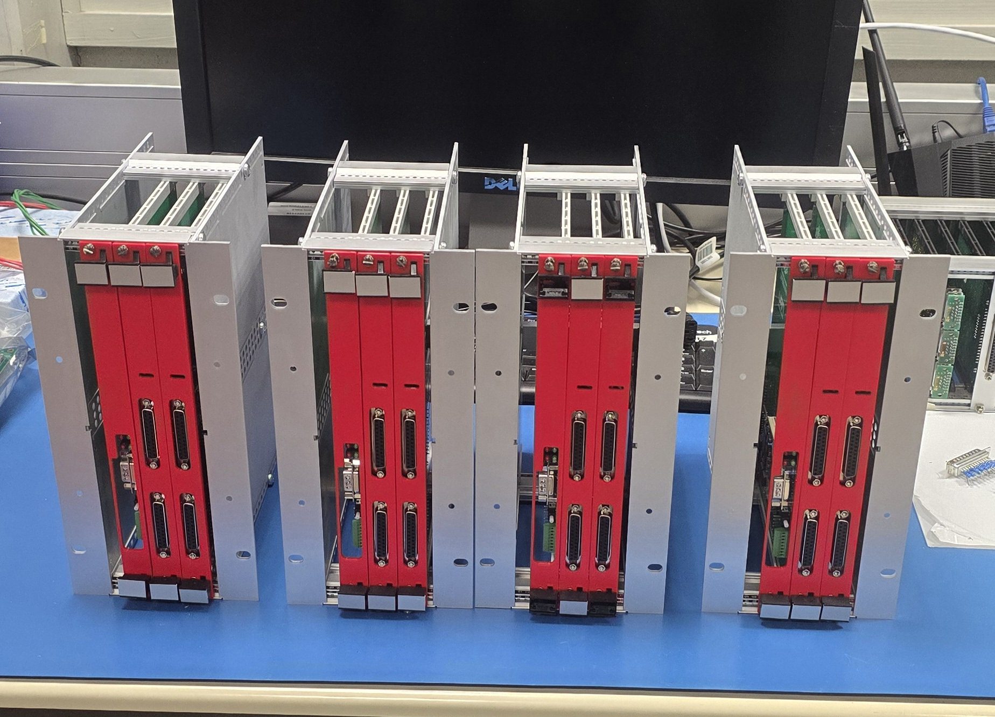
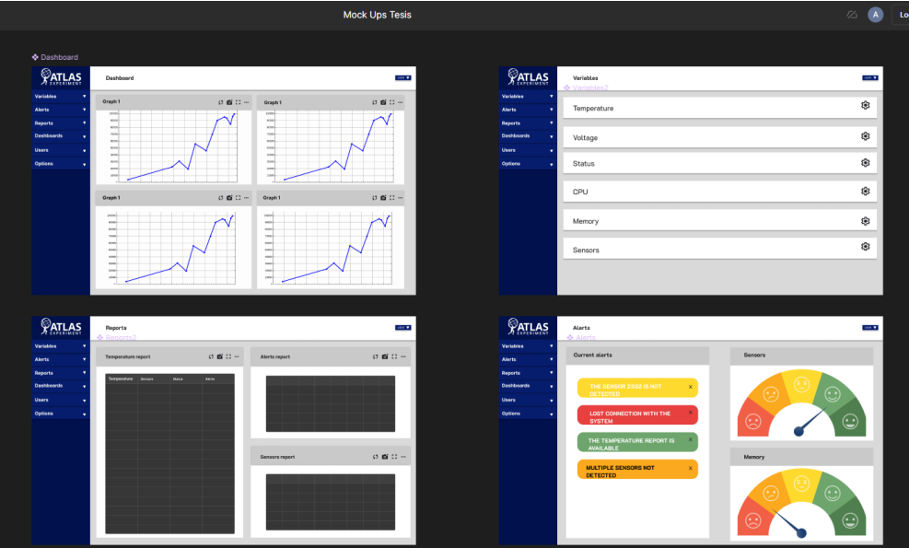
Temperature offset study
Materials
Read-out:
Amplifiers + ELMB + CANbus
WinCC Project
Influx DB
7x Pt10k
sensors
Monitoring and Analysis
(Python)

Slide 6
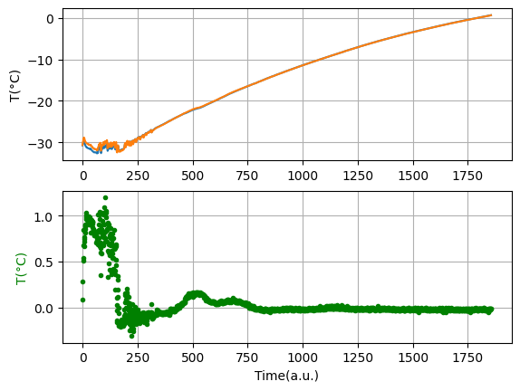
Temperature offset study
Preliminary result with CO2 + Methanol recirculation (from data presented Jan. 2025)
Pipe Input-Output flow temperature
T_{flow input}
Tflow output
T_{surface}
Tflow input
Out-In
T_{atm}=~7°C

Slide 7
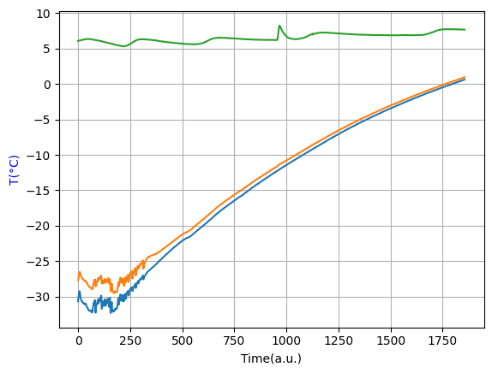
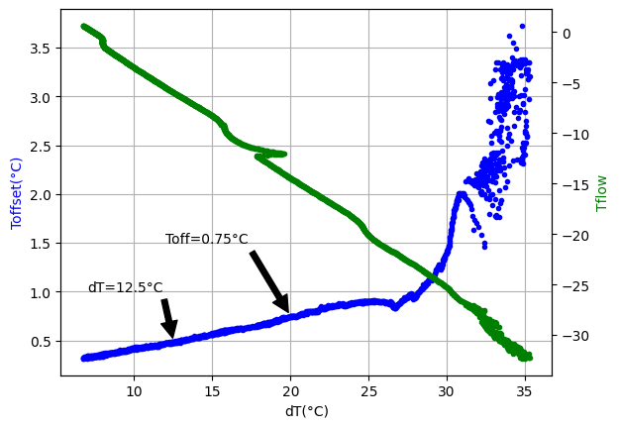
Temperature offset study
Preliminary result with CO2 + Methanol recirculation (from data presented Jan. 2025)
T_{atm}
T_{surface}
T_{flow}
For the small sensor clamp, 0.5°C offset goal was evidenced for dT < 12.5°C
Expectation: With better insulation, 0.5°C offset goal for dT < 20°C
Samples sent by Dominic Howgill to Bogota

Slide 8
Thanks for your attention.

Slide 9
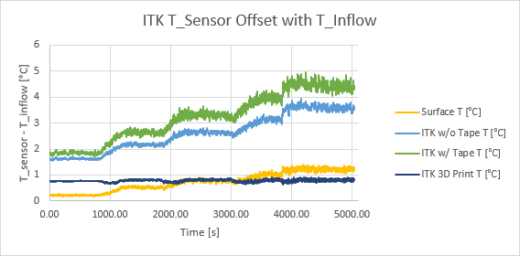
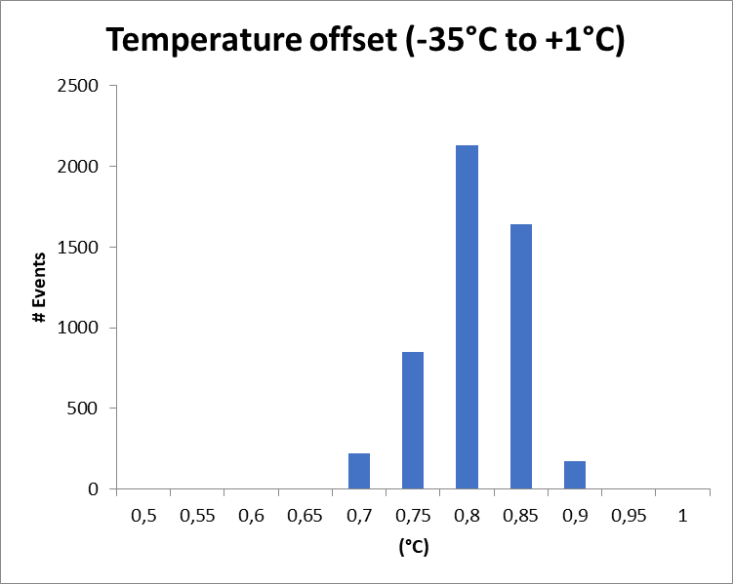
3. Sensors production: progress
Atm.: 5°C
Flow temperature = (point of contact temperature) – 0,78°C

Slide 10
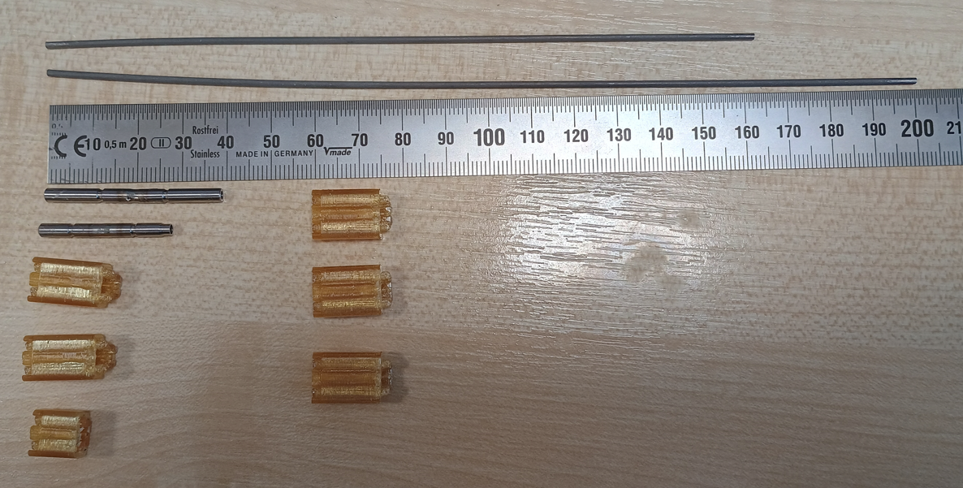

Temperature offset study
Samples prepared by Dominic Howgill to be sent to Bogota

Slide 11
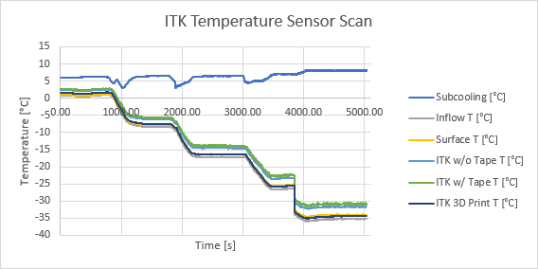
3. Sensors production: progress
Sensors PRR passed (Oct. 2022) -> Temperature offset study
Thanks to Joao Noite and Enrico Piperno: Baby demo setup and Labview Project design

Slide 12
REFERENCES
[1]: C. J. Yeager and S. S. Courts, "A review of cryogenic thermometry and common temperature sensors," in IEEE Sensors Journal, vol. 1, no. 4, pp. 352-360, Dec. 2001, doi: 10.1109/7361.983476.
[2]: M. González-Guerrero, M. T. Álvarez, J. J. Jiménez, J. Sánchez-Páramo and H. Guerrero, "The effect of proton and gamma radiation on different types of temperature sensors," 2009 European Conference on Radiation and Its Effects on Components and Systems, Brugge, Belgium, 2009, pp. 41-45, doi: 10.1109/RADECS.2009.5994550.
[3]:S. S. Courts, D. S. Holmes, and P. R. Swinehart, “Neutron and gamma radiation effects on cryogenic sensor,” in Temperature: Its Measurement and Control in Science and Industry, J. F. Schooley, Ed. New York: A/P., 1992, vol. 6, pp. 1237–1249.
[4]: S. S. Courts and D. S. Holmes, “Effects of cryogenic irradiation on temperature sensors” Adv. Cryogenic Eng., vol. 41, pp. 1707–1714, 1996.
[5]: T. Junquera, J. F. Amand, J. P. Thermeau, and J. Casas-Cubillos, “Neutron irradiation tests of calibrated cryogenic sensors at low temperatures,” Adv. Cryogenics Eng., vol. 43, pp. 765–772, 1998.
[6]: J. F. Amand, J. Casas-Cubillos, T. Junquera, and J. P Thermeau, “Neutron irradiation tests in superfluid helium of LHC cryogenic thermometers,” Cryogenics, to be published.
[7] T. Tominaka et al., "Radiation effects on cryogenic temperature sensors of Cernox, CGR and PtCo," in IEEE Transactions on Applied Superconductivity, vol. 14, no. 2, pp. 1802-1805, June 2004, doi: 10.1109/TASC.2004.831117.
[8] https://twiki.cern.ch/twiki/bin/viewauth/Atlas/RadiationBackgroundSimulationsStep3X
[9] https://indico.cern.ch/event/689443/contributions/3204436/attachments/1753229/2841546/Electronics-AUW-2018-11.pdf
[10] AT2-I-ES-0001
[11] Study of solder alloy ductility for cryogenic applications, A. Lupinacci, A. A. Shapiro, J-O. Suh, A.M. Minor
[12] https://www.lakeshore.com/products/categories/overview/temperature-products/cryogenic-accessories/solder
[13] https://edms.cern.ch/document/348204/2

Slide 13
https://www.qima.com/aql-acceptable-quality-limit

Slide 14

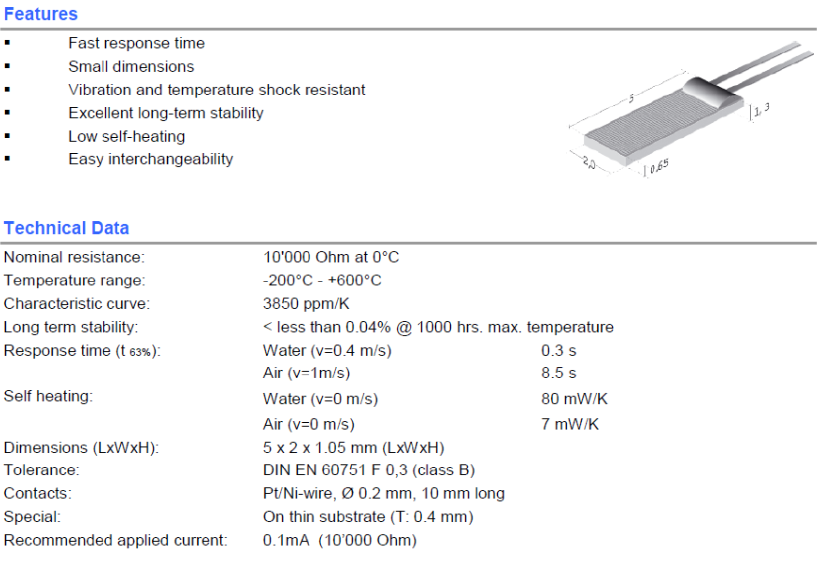
1. Readout Chain Overview
Requirements (PDR)
Selected sensor
Cooling pipes sensors: 1040
Atm. sensors: 530
Manufacturer: IST-AG
P10K.520.6W.Y.015.D
(IEC 60751 F 0.1)
Theoretical error limits*
Expected drift / year:
0.02ºC @ 25ºC **
worst case <2.1ºC / year @ 600ºC
Accuracy compliance demonstrated theoretically.
Precision and Radiation hardness: validated on laboratory .
Considering:
DIN B F0,1 tolerance
Read-out components tolerance
Quadratic fit for temperature computation
Cooling group (ca. 22 Units at outlet manifolds of every pixel sub-detector)
Category A
References: Specifications for ITk Environmental Monitoring System: Temperature Rev. 2.0 AT2-IE-ES-0001
* Peter Kind, U. Wuppertal
**C. J. Yeager and S. S. Courts, "A review of cryogenic thermometry and common temperature sensors," in IEEE Sensors Journal, vol. 1, no. 4, pp. 352-360, Dec. 2001. doi: 10.1109/7361.983476

