Slide 1
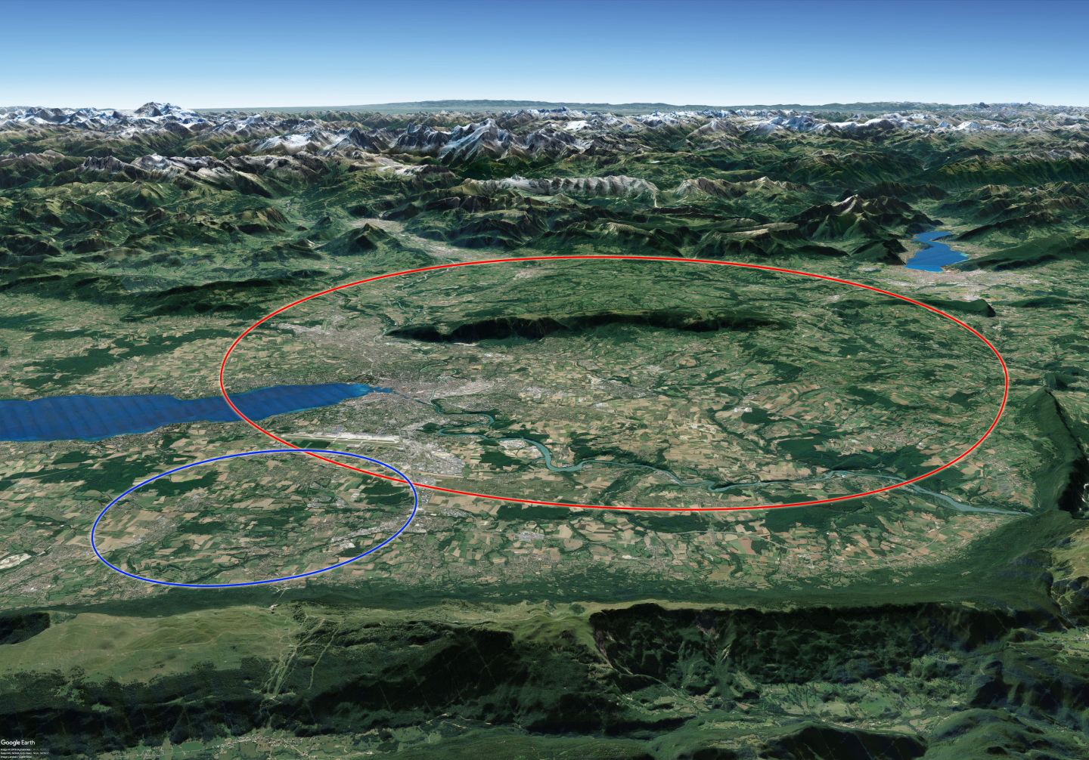




Beam-Beam and Wakefield-Induced Collective Instabilities and Mitigation Strategies in the FCC-ee at Z Energy
FCC week 2025 – May 20th
Roxana SOOS, Xavier BUFFAT, Angeles FAUS-GOLFE, FCC-ee collective effects study group

Slide 2
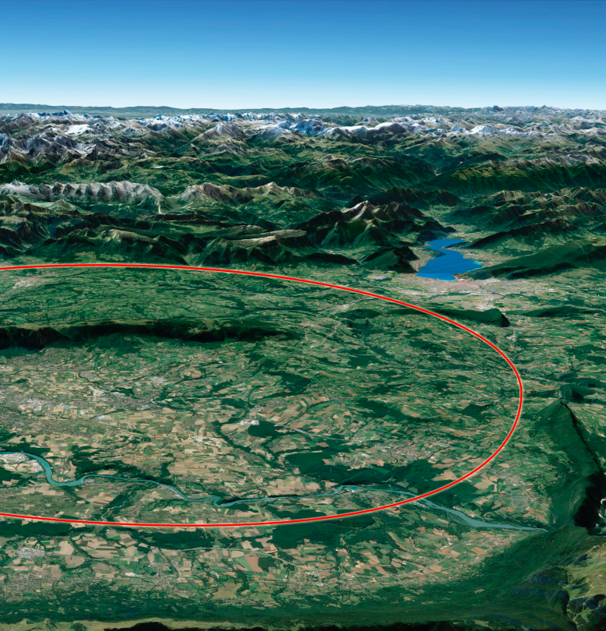
Overview
XX
  XX
  XXX
XXX
  XXX
  XXX
XXX
  XXX
  XXX
XX
  XX
  XXX
Summary
  Summary and outlook
Beam-Beam and Wakefield-Induced Collective Instabilities and Mitigation Strategies in the FCC-ee at Z Energy
FCC week 2025 – May 20th
Roxana SOOS, Xavier BUFFAT, Angeles FAUS-GOLFE, FCC-ee collective effects study group

Slide 3
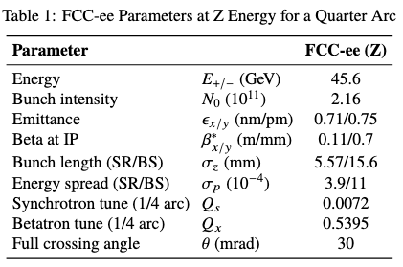
Beam-Beam and Wakefield-Induced Collective Instabilities and Mitigation Strategies in the FCC-ee at Z Energy
Roxana SOOS, May 20th, FCC-week 2025
Introduction
Study of the collective effects is important in the design phase of the FCC-ee, as instabilities depend on the parameters coming from the optics design.
Considering interplay between beam-beam effects and impedance:
Horizontal plane is dominated by the coherent <x-z> instability, driven by beam-beam effects, much influenced by longitudinal wakefields
Vertical plane is dominated by the transverse mode coupling/repulsion instability, driven by impedance and enhanced by beam-beam effects
Simulations are carried out using multiparticle tracking with Xsuite [1]:
Strong-strong soft-Gaussian beam-beam model
Linear transfer map exploiting 4-fold symmetry
→ More accurate (NL forces) but slower
The CMM, linear mode analysis method [2]:
Linear transfer map exploiting 4-fold symmetry
No non-linear elements (Crab sextupole, ...)
→ Very fast but approximate (linear)

Slide 4
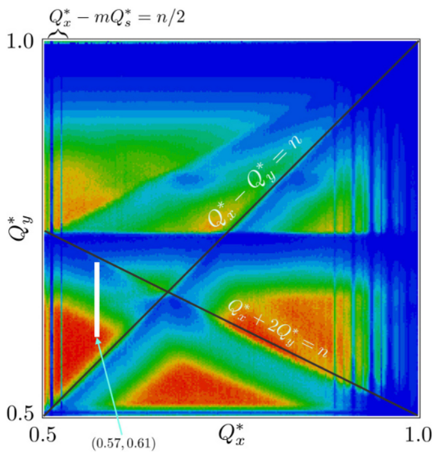
Beam-Beam and Wakefield-Induced Collective Instabilities and Mitigation Strategies in the FCC-ee at Z Energy
Roxana SOOS, May 20th, FCC-week 2025
Horizontal plane instability
Coherent <x-z> instability study with the CMM
Coherent <x-z> instability is the most intensity limiting factor for the FCC-ee in the horizontal plane. Due to the crossing angle, the longitudinal parameters affect resonances, and unstable synchro-betatron resonances appear.
D. Shatilov (CDR)
In general, the working point should be chosen such that the tune footprint could fit between resonances including:
Main resonances (integer, half integer)
Coupling resonances between vertical and horizontal tunes
Synchro-betatron resonances (<x-z> instability)

Slide 5
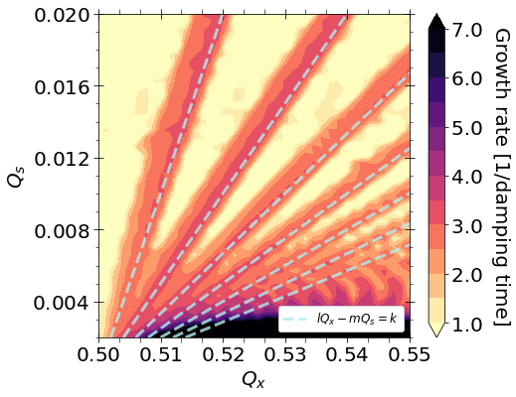
Beam-Beam and Wakefield-Induced Collective Instabilities and Mitigation Strategies in the FCC-ee at Z Energy
Roxana SOOS, May 20th, FCC-week 2025
Horizontal plane instability
Coherent <x-z> instability study with the CMM
Coherent <x-z> instability is the most intensity limiting factor for the FCC-ee in the horizontal plane. Due to the crossing angle, the longitudinal parameters affect resonances, and unstable synchro-betatron resonances appear.
CMM
The working point should be chosen such that the tune footprint could fit between synchro-betatron resonances.
The available tune space should be maximised.

Slide 6
Beam-Beam and Wakefield-Induced Collective Instabilities and Mitigation Strategies in the FCC-ee at Z Energy
Roxana SOOS, May 20th, FCC-week 2025
Horizontal plane instability
Coherent <x-z> instability study with the CMM
Coherent <x-z> instability is the most intensity limiting factor for the FCC-ee in the horizontal plane. Due to the crossing angle, the longitudinal parameters affect resonances, and unstable synchro-betatron resonances appear.
CMM
The working point should be chosen such that the tune footprint could fit between synchro-betatron resonances.
The available tune space should be maximised.
→This is a complicated task, adapting parameters comes with numerous side effects.
FCC-ee (Z) working point

Slide 7
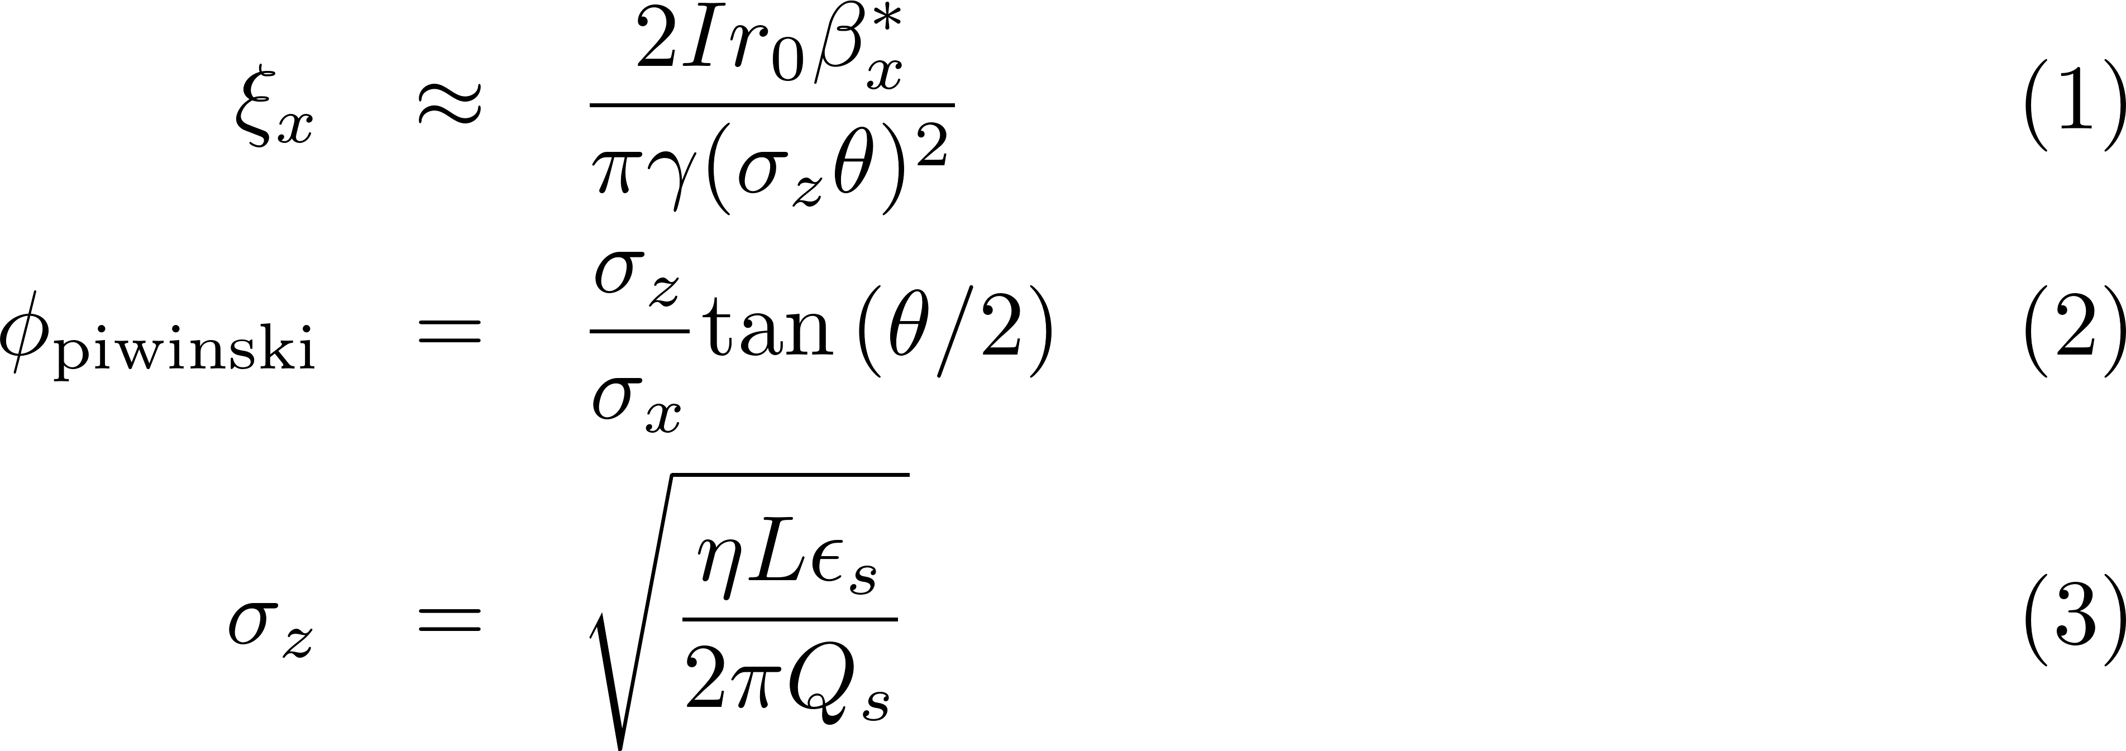
Beam-Beam and Wakefield-Induced Collective Instabilities and Mitigation Strategies in the FCC-ee at Z Energy
Roxana SOOS, May 20th, FCC-week 2025
Horizontal plane instability
Coherent <x-z> instability study with the CMM
Coherent <x-z> instability is the most intensity limiting factor for the FCC-ee in the horizontal plane. Due to the crossing angle, the longitudinal parameters affect resonances, and unstable synchro-betatron resonances appear.
The main parameters involved in the instability are the beam-beam parameter, the Piwinski angle and the synchrotron tune [3].
beta at IP
intensity
beam-beam parameter
full crossing angle
r.m.s. bunch lenght
r.m.s. horizontal size
momentum compaction factor

Slide 8
Beam-Beam and Wakefield-Induced Collective Instabilities and Mitigation Strategies in the FCC-ee at Z Energy
Roxana SOOS, May 20th, FCC-week 2025
Horizontal plane instability
Coherent <x-z> instability study with the CMM
Coherent <x-z> instability is the most intensity limiting factor for the FCC-ee in the horizontal plane. Due to the crossing angle, the longitudinal parameters affect resonances, and unstable synchro-betatron resonances appear.
The main parameters involved in the instability are the beam-beam parameter, the Piwinski angle and the synchrotron tune.
The CMM allows fast simulations, with a good control on the parameters (not a dynamic system)
→ efficient testing of the different contribution of parameters
Understanding the parameters is important to reduce the instability by adapting the design.
beta at IP
intensity
beam-beam parameter
full crossing angle
r.m.s. bunch lenght
r.m.s. horizontal size
momentum compaction factor

Slide 9
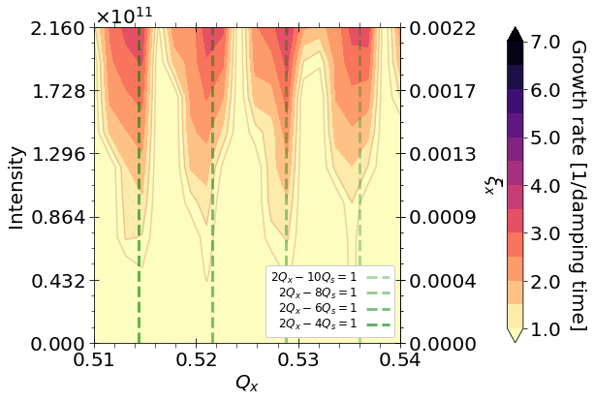
Beam-Beam and Wakefield-Induced Collective Instabilities and Mitigation Strategies in the FCC-ee at Z Energy
Roxana SOOS, May 20th, FCC-week 2025
Horizontal plane instability
Coherent <x-z> instability study with the CMM
Coherent <x-z> instability is the most intensity limiting factor for the FCC-ee in the horizontal plane. Due to the crossing angle, the longitudinal parameters affect resonances, and unstable synchro-betatron resonances appear.
Intensity scan.
The main parameters involved in the instability are the beam-beam parameter, the Piwinski angle and the synchrotron tune.
beta at IP
intensity
Resonances increases with the beam-beam parameter, almost no available tune space at nominal intensity → beam-beam parameter needs to be reduced without decreasing the intensity (Luminosity, Electron cloud (L. Sabato))
Reducing the beta at the IP (requires change in the IR optics, increases beamstrahlung)
Increasing the bunch length
beam-beam parameter
full crossing angle
r.m.s. bunch lenght
r.m.s. horizontal size
momentum compaction factor

Slide 10
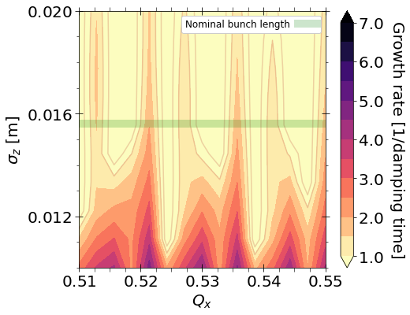
Beam-Beam and Wakefield-Induced Collective Instabilities and Mitigation Strategies in the FCC-ee at Z Energy
Roxana SOOS, May 20th, FCC-week 2025
Horizontal plane instability
Coherent <x-z> instability study with the CMM
Coherent <x-z> instability is the most intensity limiting factor for the FCC-ee in the horizontal plane. Due to the crossing angle, the longitudinal parameters affect resonances, and unstable synchro-betatron resonances appear.
Bunch length scan at fixed Q_{s} .
The main parameters involved in the instability are the beam-beam parameter, the Piwinski angle and the synchrotron tune.
beta at IP
Bunch length plays an important role in reducing the beam-beam parameter. Momentum compaction factor must be reduced to keep Q_{s} large enough and separate resonances. (Causes larger transverse emittances)
High order RF cavities (but potentially expensive) ?
Changing partition numbers (was done in LEP)?
intensity
beam-beam parameter
full crossing angle
r.m.s. bunch lenght
r.m.s. horizontal size
momentum compaction factor

Slide 11
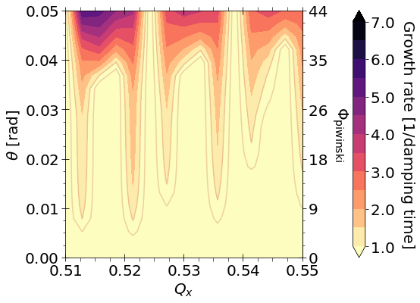
Beam-Beam and Wakefield-Induced Collective Instabilities and Mitigation Strategies in the FCC-ee at Z Energy
Roxana SOOS, May 20th, FCC-week 2025
Horizontal plane instability
Coherent <x-z> instability study with the CMM
Coherent <x-z> instability is the most intensity limiting factor for the FCC-ee in the horizontal plane. Due to the crossing angle, the longitudinal parameters affect resonances, and unstable synchro-betatron resonances appear.
Crossing angle scan, fixed beam-beam parameter
The main parameters involved in the instability are the beam-beam parameter, the Piwinski angle and the synchrotron tune.
beta at IP
intensity
beam-beam parameter
full crossing angle
Reducing the crossing angle, reduces the longitudinal contribution, therefore the <x-z> instability.
r.m.s. bunch lenght
r.m.s. horizontal size
momentum compaction factor

Slide 12
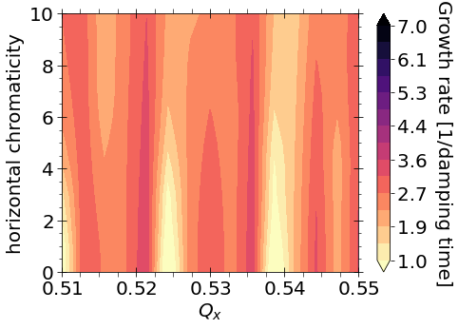
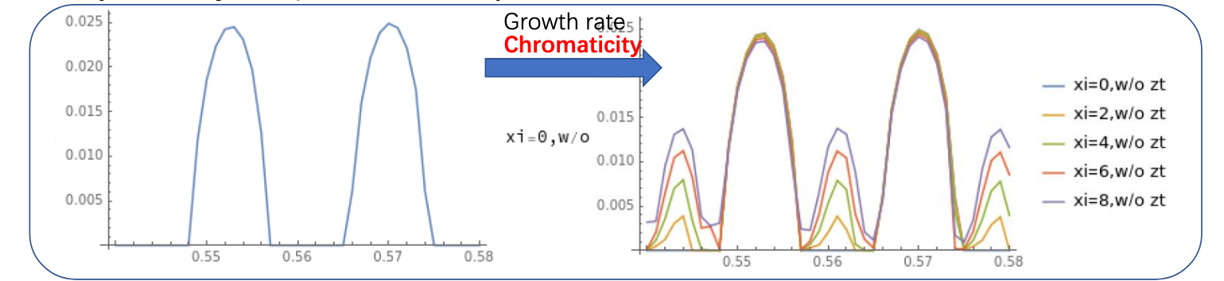
Beam-Beam and Wakefield-Induced Collective Instabilities and Mitigation Strategies in the FCC-ee at Z Energy
Roxana SOOS, May 20th, FCC-week 2025
Horizontal plane instability
Coherent <x-z> instability study with the CMM
Other means to reduce the instability could be chromaticity and transverse dampers.
Without longitudinal impedance, the chromaticity is not a good mitigation method.
Stable regions tend to become unstable (A), and instability is only faintly reduced (B).
Q’_{x}^{1/4} scan at nominal parameters (FCC-ee Z, Table1)
A
B
Y. Zhang eeFACT 2025
beta at IP
intensity
beam-beam parameter
full crossing angle
r.m.s. bunch lenght
r.m.s. horizontal size
momentum compaction factor

Slide 13
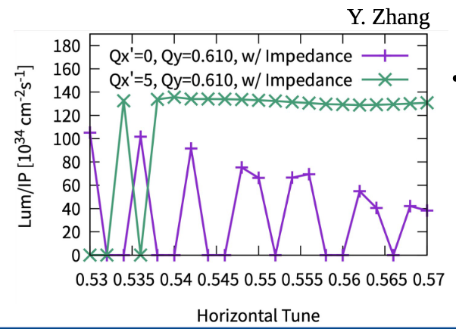
Beam-Beam and Wakefield-Induced Collective Instabilities and Mitigation Strategies in the FCC-ee at Z Energy
Roxana SOOS, May 20th, FCC-week 2025
Horizontal plane instability
Coherent <x-z> instability study with the CMM
Other means to reduce the instability could be chromaticity and transverse dampers.
Without longitudinal impedance, the chromaticity is not a good mitigation method.
Stable regions tend to become unstable (A), and instability is only faintly reduced (B).
First studies show that if longitudinal impedance is considered, chromaticity is a good candidate. [1] Q’_{x}^{1/4}~5 is still high: Q’_{x}^{tot}~20, limit given by lifetime should be defined.
Q’_{x}^{1/4} scan at nominal parameters (FCC-ee Z, Table1)
A
B
beta at IP
intensity
beam-beam parameter
full crossing angle
r.m.s. bunch lenght
r.m.s. horizontal size
momentum compaction factor

Slide 14
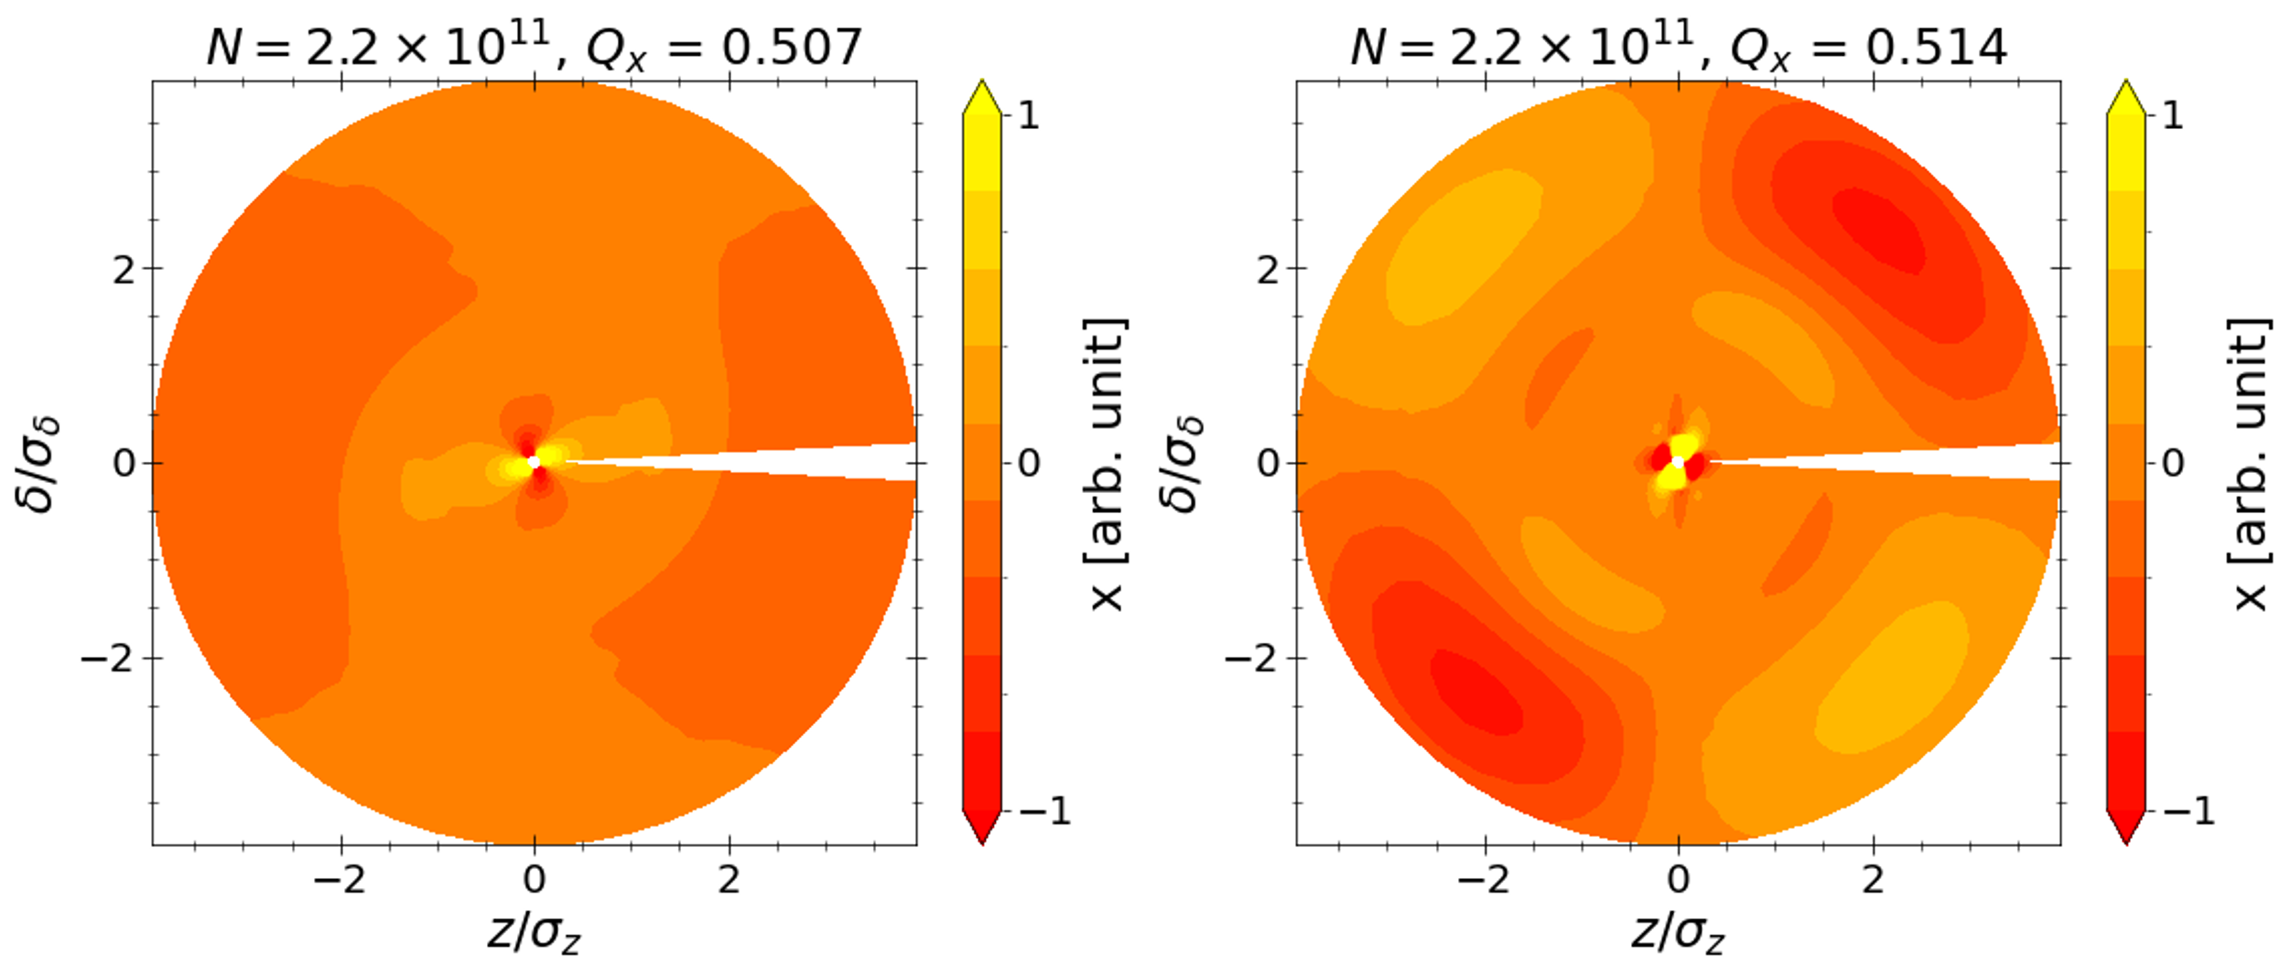
Beam-Beam and Wakefield-Induced Collective Instabilities and Mitigation Strategies in the FCC-ee at Z Energy
Roxana SOOS, May 20th, FCC-week 2025
Horizontal plane instability
Coherent <x-z> instability study with the CMM
Other means to reduce the instability could be chromaticity and transverse dampers.
Without longitudinal impedance, the chromaticity is not a good mitigation method.
Stable regions tend to become unstable (A), and instability is only faintly reduced (B).
Transverse dampers not promising in the absence of longitudinal impedance. This is likely due to the nature of the instability.
Q’_{x}^{1/4} scan at nominal parameters (FCC-ee Z, Table1)
A
B
Intra bunch motion at the resonances m=2 and m=4, w/o chromaticity
beta at IP
intensity
beam-beam parameter
full crossing angle
r.m.s. bunch lenght
r.m.s. horizontal size
momentum compaction factor

Slide 15
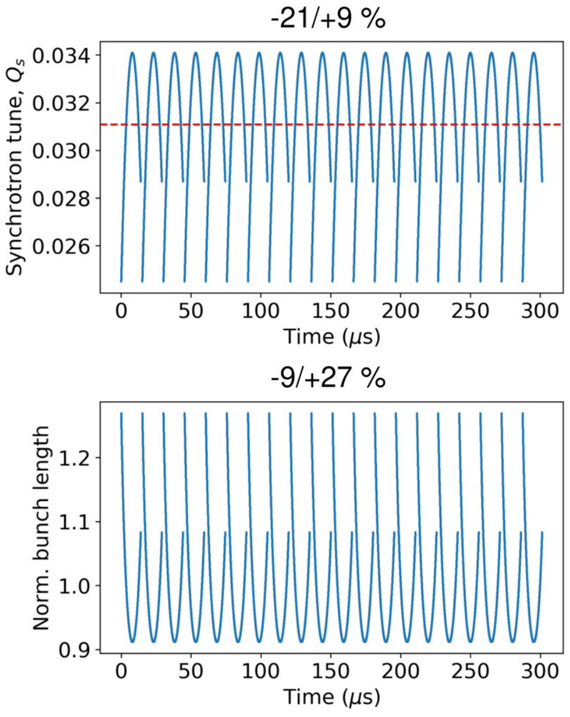
Beam-Beam and Wakefield-Induced Collective Instabilities and Mitigation Strategies in the FCC-ee at Z Energy
Roxana SOOS, May 20th, FCC-week 2025
Horizontal plane instability
Coherent <x-z> instability and reverse polarity operation 2-cell cavities at Z energy
To reduce hardware costs, same cavities were proposed for all operation energies. Transient beam loading becomes significant, and bunch length/ Q_{s} varies along the beam. A working point must be found for all bunches. (see I. Karpov on XX)
I. Karpov (FCC general design meeting)

Slide 16
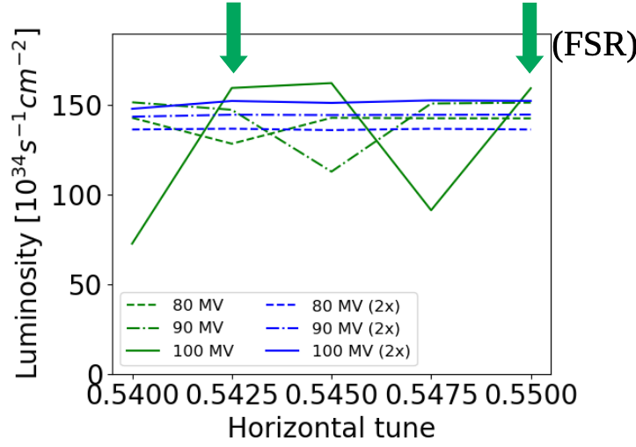
Beam-Beam and Wakefield-Induced Collective Instabilities and Mitigation Strategies in the FCC-ee at Z Energy
Roxana SOOS, May 20th, FCC-week 2025
Horizontal plane instability
Coherent <x-z> instability and reverse polarity operation 2-cell cavities at Z energy
To reduce hardware costs, same cavities were proposed for all operation energies. Transient beam loading becomes significant, and bunch length/ Q_{s} varies along the beam. A working point must be found for all bunches.
I. Karpov (FCC general design meeting)
Xsuite simulation seem to show that a working point can be chosen
Strong-strong soft-Gaussian beam-beam model
Effective lattice model for ¼ machine (linear / non-linear RF), Q’x1/4 = 5
Longitudinal and transverse wakefields based on FCC Week 2024 model
Transverse ‘dipole mode’ damper

Slide 17
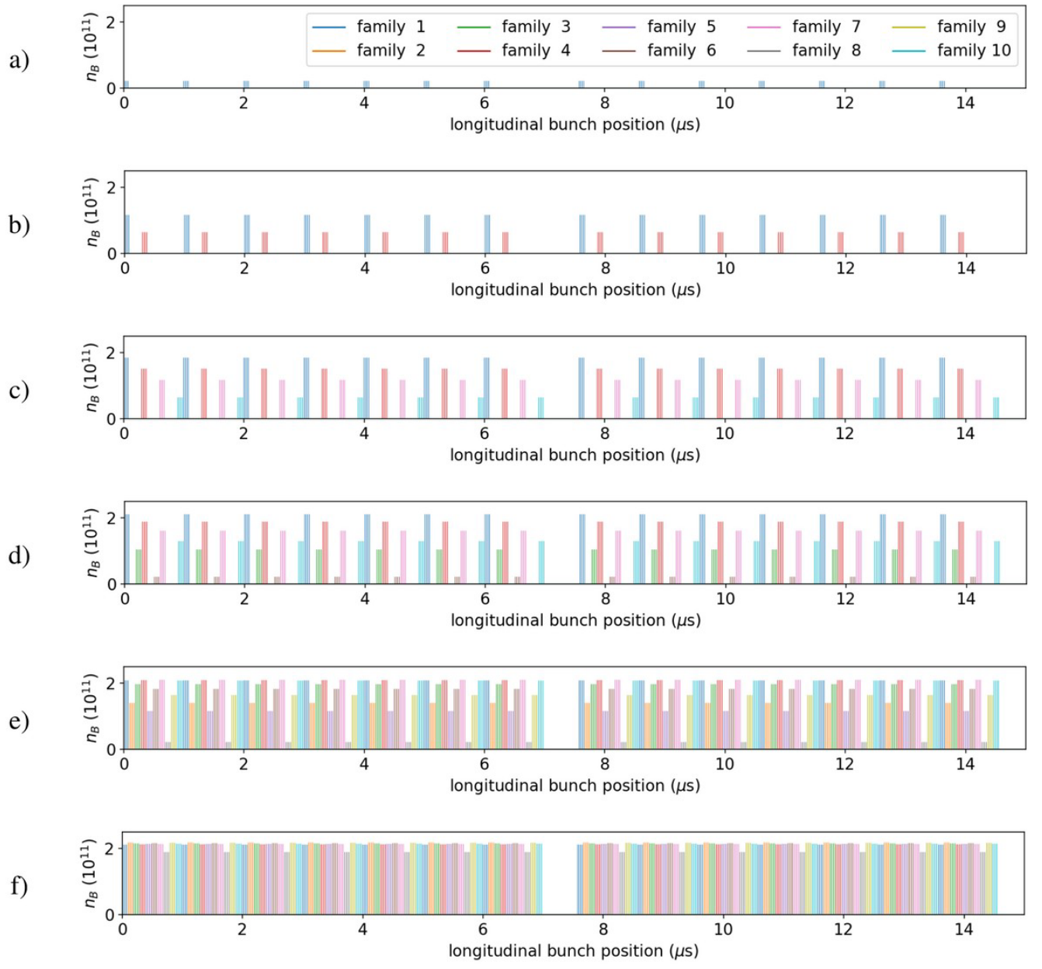
Beam-Beam and Wakefield-Induced Collective Instabilities and Mitigation Strategies in the FCC-ee at Z Energy
Roxana SOOS, May 20th, FCC-week 2025
Horizontal plane instability
Coherent <x-z> instability and non-uniform bootstrap injection
If the beam is injected at full intensity, short bunch length and high intensity leads to very high beam-beam parameter. To compensate this effect, bootstrap injection was proposed. Because of electron cloud effects constraint, it must be non-uniform.
H. Bartosik et al. (XXXX)

Slide 18
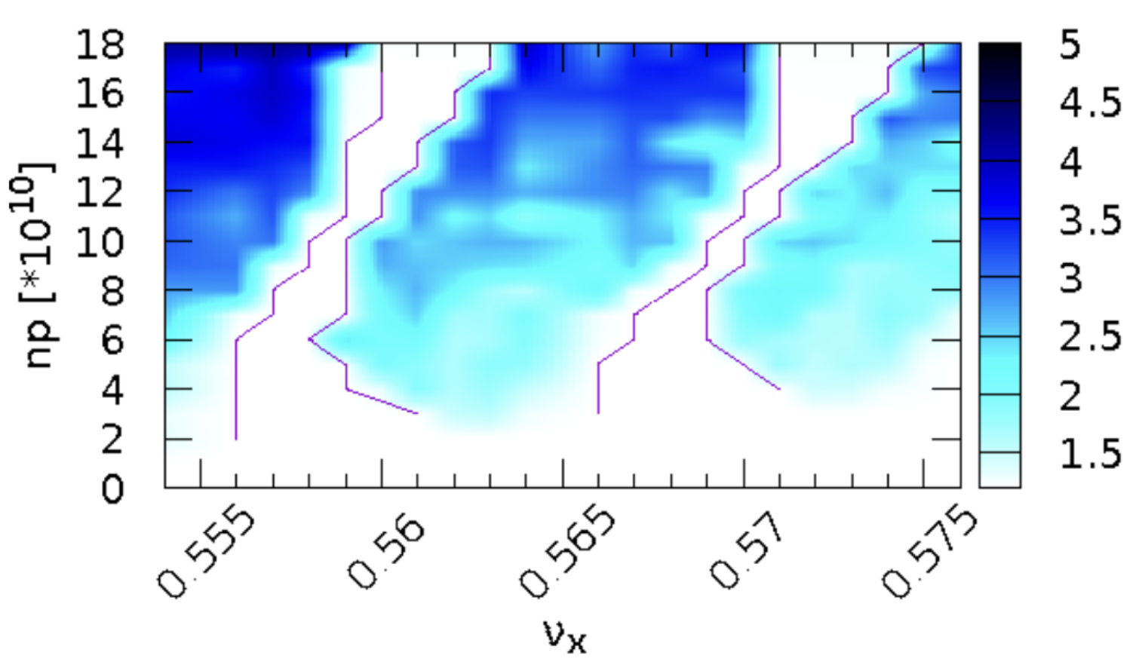
Beam-Beam and Wakefield-Induced Collective Instabilities and Mitigation Strategies in the FCC-ee at Z Energy
Roxana SOOS, May 20th, FCC-week 2025
Horizontal plane instability
Coherent <x-z> instability and non-uniform bootstrap injection
If the beam is injected at full intensity, short bunch length and high intensity leads to very high beam-beam parameter. To compensate this effect, bootstrap injection was proposed. Because of electron cloud effects constraints, it is proposed to be non-uniform.
Difficult to find a tune stable at all intensities
Y. Zhang IPAC 2021
H. Bartosik et al. (XXXX)

Slide 19
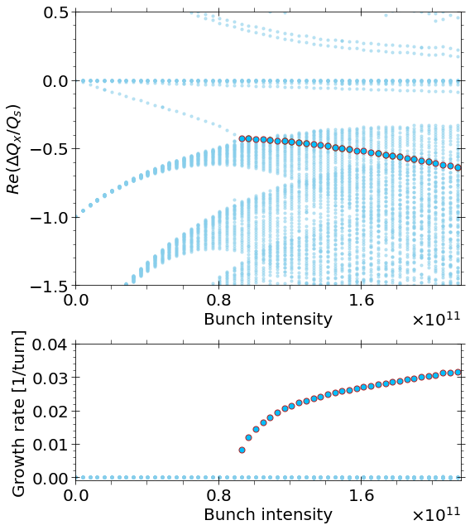
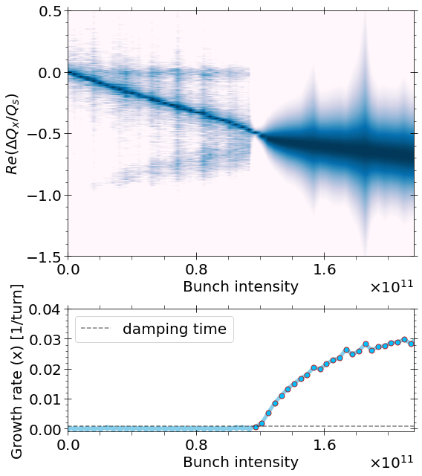
Beam-Beam and Wakefield-Induced Collective Instabilities and Mitigation Strategies in the FCC-ee at Z Energy
Roxana SOOS, May 20th, FCC-week 2025
Horizontal plane instability
Longitudinal wakefields in CMM
Longitudinal impedance effects have been implemented in CMM and successfully benchmarked for the FCC-ee at Z energy [2]. Could be applied to the study of the <x-z> instabilities, having fast simulations on parameters sets.
CMM transverse mode coupling instability w/o beam-beam (transverse + longitudinal impedance)
Xsuite (xwakes) transverse mode coupling instability w/o beam-beam (transverse + longitudinal impedance)
beta at IP
intensity
beam-beam parameter
full crossing angle
r.m.s. bunch lenght
r.m.s. horizontal size
momentum compaction factor

Slide 20
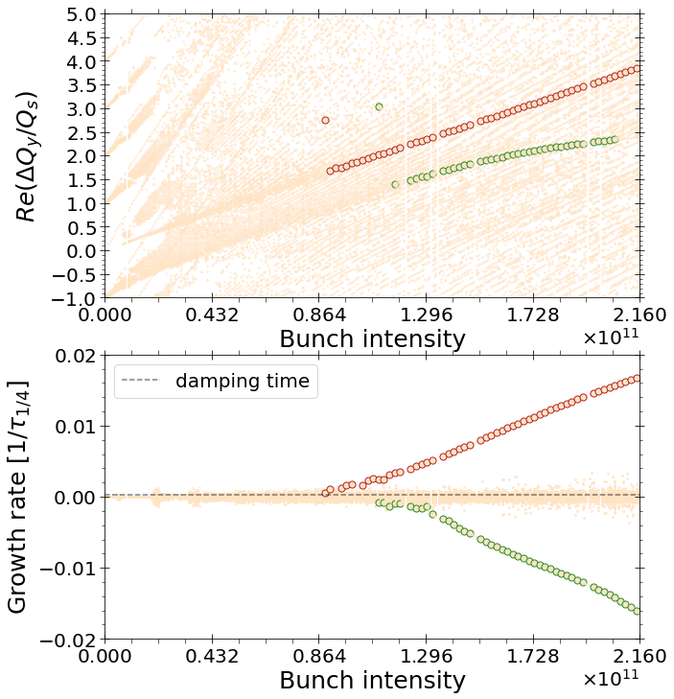
Beam-Beam and Wakefield-Induced Collective Instabilities and Mitigation Strategies in the FCC-ee at Z Energy
Roxana SOOS, May 20th, FCC-week 2025
Vertical plane instability
TMRI instability
In the vertical plane, the TMRI, driven by impedance is the most critical [3].
CMM, beam-beam plus transverse wakefields, TMRI
Transverse mode coupling instability (TMCI) becomes a transverse mode repulsion instability (TMRI) in the presence of transverse impedance and beam-beam with strong hourglass effects and crossing angle
Modes 0 and -1 repulse each other due to the phase advance at the IP and become unstable due to the contribution of the transverse wakefields.

Slide 21
Beam-Beam and Wakefield-Induced Collective Instabilities and Mitigation Strategies in the FCC-ee at Z Energy
Roxana SOOS, May 20th, FCC-week 2025
Vertical plane instability
TMRI instability
In the vertical plane, the TMRI, driven by impedance is the most critical [3].
CMM, beam-beam plus transverse wakefields, TMRI
TRACKING SIMULATION HERE
Benchmark is difficult with multiparticle tracking. Landau damping is not featured in the CMM, and instability is over the decoherence threshold. Crab sextupoles also seem to impact the effect. This impacts the tune shift and instability growth rate.
Model can’t be used for exact simulations, gives more pessimistic predictions.

Slide 22
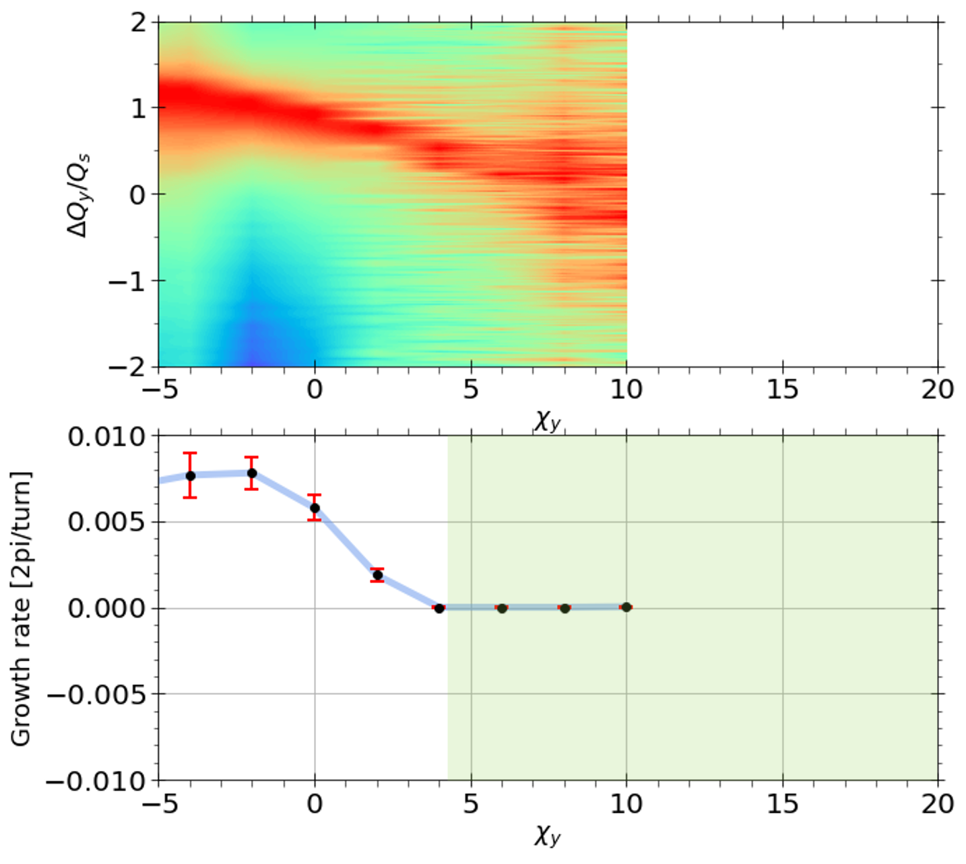
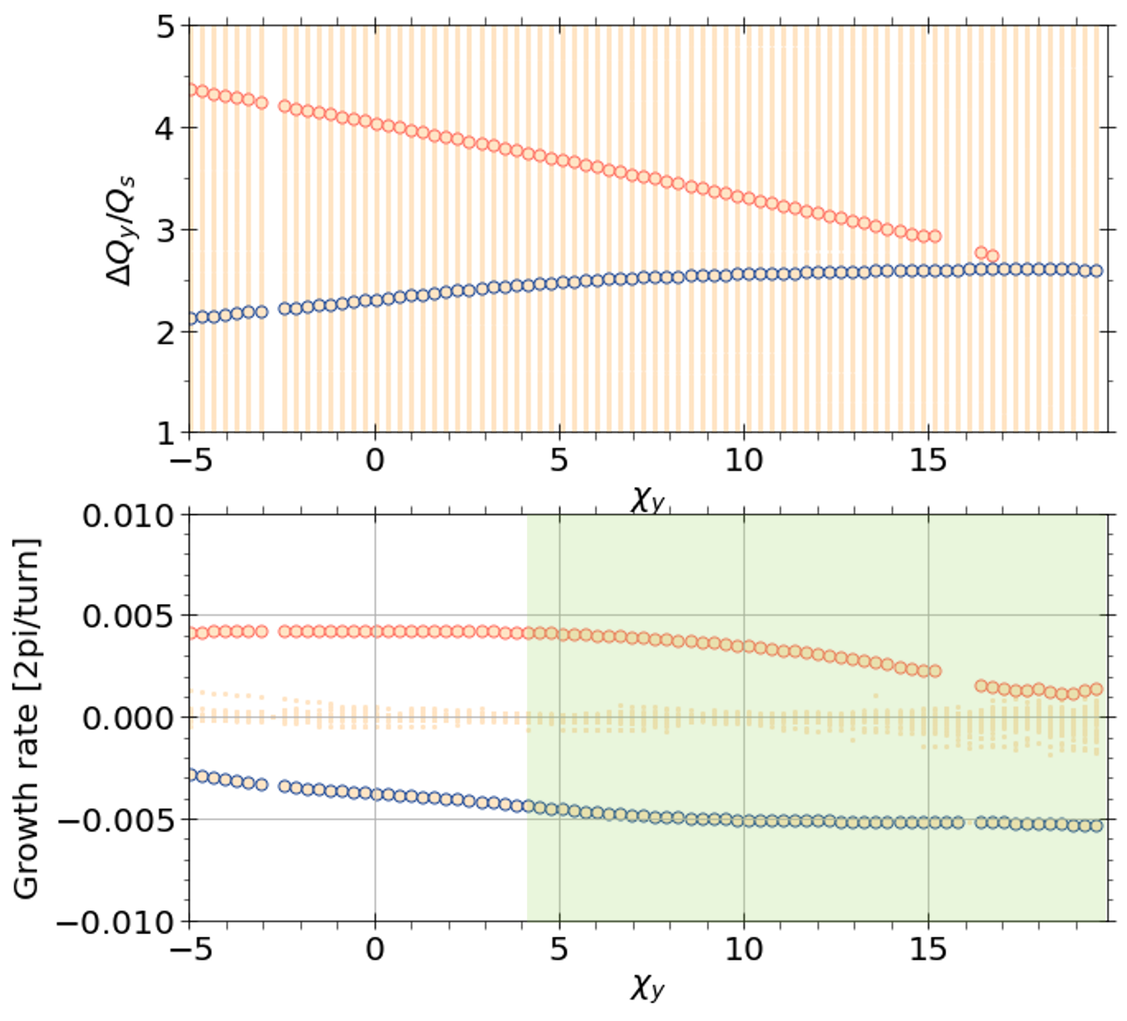
Beam-Beam and Wakefield-Induced Collective Instabilities and Mitigation Strategies in the FCC-ee at Z Energy
Roxana SOOS, May 20th, FCC-week 2025
Vertical plane instability
TMRI instability
In the vertical plane, the TMRI, driven by impedance is the most critical [3].

Slide 23
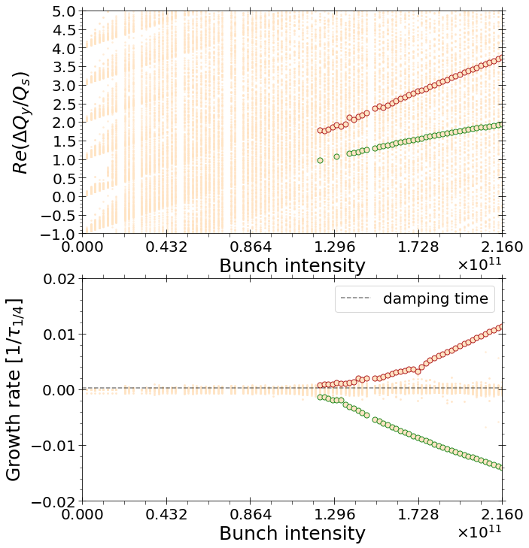
Beam-Beam and Wakefield-Induced Collective Instabilities and Mitigation Strategies in the FCC-ee at Z Energy
Roxana SOOS, May 20th, FCC-week 2025
Vertical plane instability
TMRI instability
In the vertical plane, the TMRI, driven by impedance is the most critical [3].
CMM, beam-beam plus transverse wakefields, TMRI
CMM, beam-beam plus transverse wakefields, TMRI, damper (g_{x}=1, phase = 0)
Resistive damper has a clear impact on the instability. Instability threshold is increased by 15%.
Different types of damper may be investigated to optimize the effect, also together with chromaticity.
0.87x10¹¹
1.2x10¹¹

Slide 24
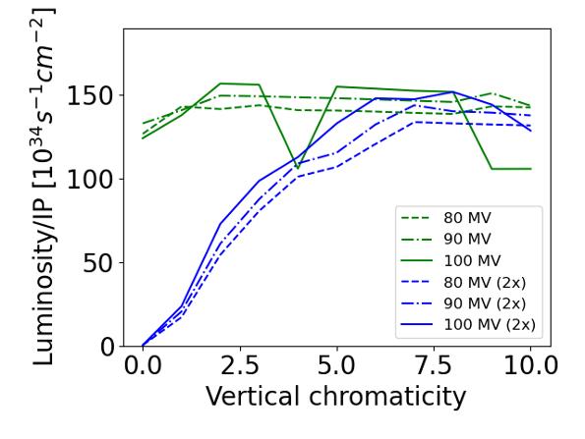
Beam-Beam and Wakefield-Induced Collective Instabilities and Mitigation Strategies in the FCC-ee at Z Energy
Roxana SOOS, May 20th, FCC-week 2025
Vertical plane instability
TMRI instability
In the vertical plane, the TMRI, driven by impedance is the most critical [3].
Chromaticity (needed to stabilise the vertical motion) needs to be highly increased if impedance is doubled.
Too high chromaticity can practically unacceptable due to its impact on beam quality.
Impedance is therefore an intensity limiting contributor, a careful design is necessary to limit instabilities.

Slide 25
Beam-Beam and Wakefield-Induced Collective Instabilities and Mitigation Strategies in the FCC-ee at Z Energy
Roxana SOOS, May 20th, FCC-week 2025
Vertical plane instability
TMRI instability
In the vertical plane, the TMRI, driven by impedance is the most critical [3].
Oide’s new parameters, Mauro’s new wakes with what is inside and comparison CMM to CMM

Slide 26
Beam-Beam and Wakefield-Induced Collective Instabilities and Mitigation Strategies in the FCC-ee at Z Energy
Roxana SOOS, May 20th, FCC-week 2025
Conclusion and outlook
ADD conclusions and outlooks

