Slide 1



Numerical tools for beam-beam studies
Peter Kicsiny, G. Broggi, X. Buffat, V. Gawas, G. Iadarola, S. Kostoglou, K. Oide, T. Pieloni, J. Salvesen, K. Skoufairs, R. Soos, L. van Riesen-Haupt
for the beam-beam working group, with special thanks to:
H. Burkhardt, C. Carli, F. Carlier, M. Hofer, D. Schulte, M. Seidel, D. Shatilov, D. Zhou
FCC Week
20 May 2025

Slide 2

Overview
errors &
misalignments
  FCC-ee will be a highly complex machine
  Interplay of various effects
  Presence of beam-beam collisions
  further complicates beam dynamics
  Self-consistent simulations are challenging
electron cloud
impedances
beam-beam
collimation
radiation
lattice nonlinearities
Notes:
the presence of beambeam collisions makes the dynamics even more complicated as they interplay with all these other components of the machine. Because of this complex dynamics the self consistent simulation of the machine is very challenging but crucial for the success of the design study.

Slide 3

3
Tools
 | Weak-strong 6D | Quasi-strong-strong 6D | Strong-strong 6D |  | Beamstrahlung | Bhabha-scattering | Transverse wakefields | Longitudinal wakefields | Linear tracking | Nonlinear tracking | Open source
GUINEA-PIG [1]
COMBI [2]
BBWS [3]
BBSS [4]
SCTR [5]
IBB [6]
LIFETRAC [7]
BeamBeam3D [8]
Xsuite [9]
Strong-strong 6D SG
Strong-strong 6D PIC
Quasi-strong-strong 6D
Longitudinal wakefields
Runs on GPU
Beamstrahlung
Transverse wakefields
Lattice tracking
Weak-strong 6D
Bhabha-scattering
Linear tracking
Open source
Different beam-beam codes exist, with different features
FCC-ee: self-consistent & fast modeling needed including many effects
Xsuite: development driven by needs for FCC-ee
G. Iadarola talk @ this conference
Available
Not available
Notes:
There exist several numerical tools to model the fccee beam-beam effects that are collected in this table. The columns show the various features that are important for the FCC-ee. You can see that each of them has different features but none is able to tick all the boxes. Therefore for many of these studies we are using xsuite, a new general purpose beam dynamics simulation tool, developed at CERN, that is developed by taking into account the simulation needs of the FCC-ee. We have a dedicated beam-beam working group working on various aspects of beam-beam effects.

Slide 4
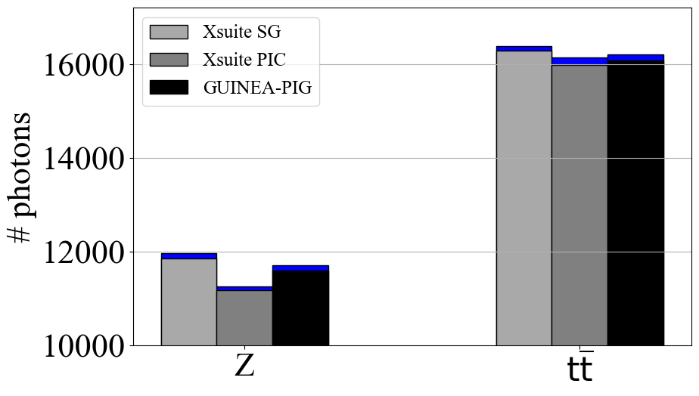
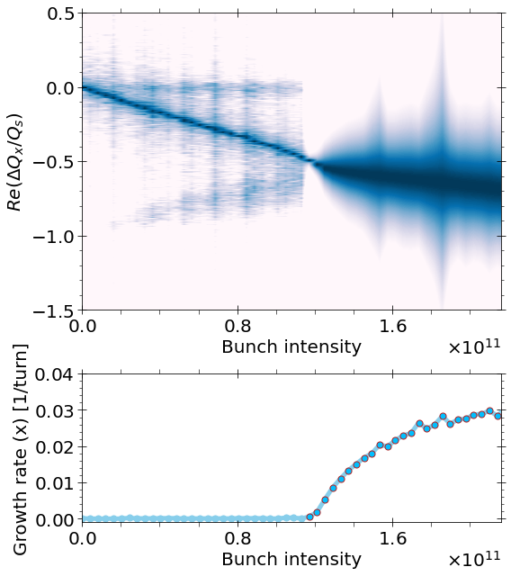
Transition to Xsuite
Xsuite PIC
Phase out legacy codes
Integrate their features into Xsuite
Thorough benchmark of features
Xsuite advantages:
  Self contained
  Maintenance & user support
  Growing community
  Python based
COMBI, SixTrack [1], GUINEA-PIG, PyHEADTAIL [2]
Xwakes
R. Soos
Notes:
other tools are not supported anymore

Slide 5
Studies made possible by Xsuite beam-beam [1]
Lattice optimization
Luminosity and beam lifetime [2]
Footprint & FMA
Lattice interplay with beam-beam (e.g. emittance) [1]
Dynamic aperture / momentum acceptance [3]
Errors & corrections
Top-up injection [4]
Collective effects and instabilities
3D flip-flop [5, 6]
Incoherent and coherent X-Z instability [6, 7]
Collimation and MDI
Loss maps
Detector background
IP tuning & feedback
G. Broggi, talk @ this conference
J. Salvesen talk & V. Gawas poster @ this conference
Notes:
other tools are not supported anymore

Slide 6
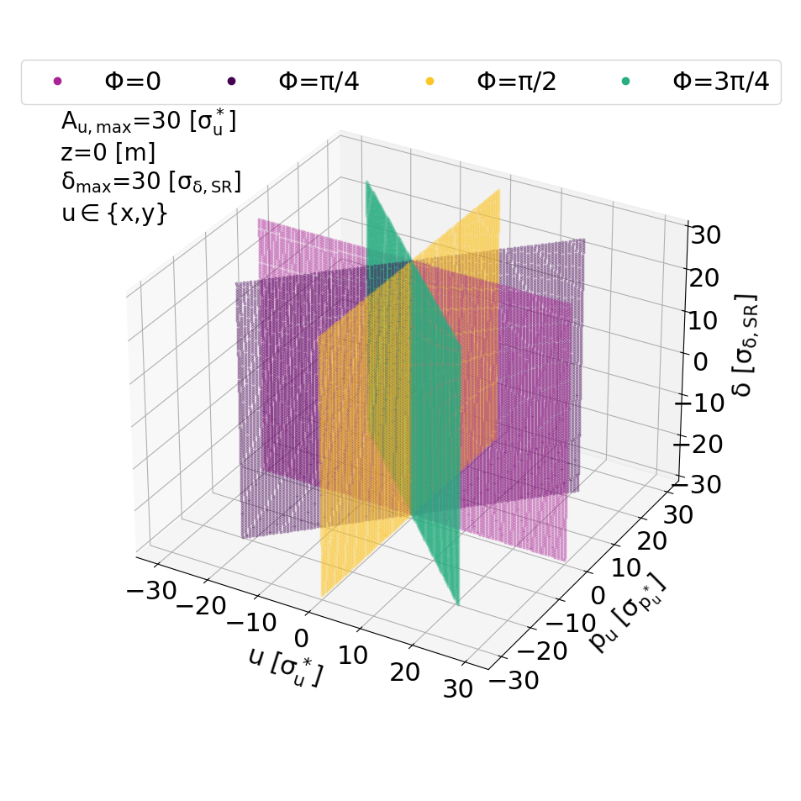
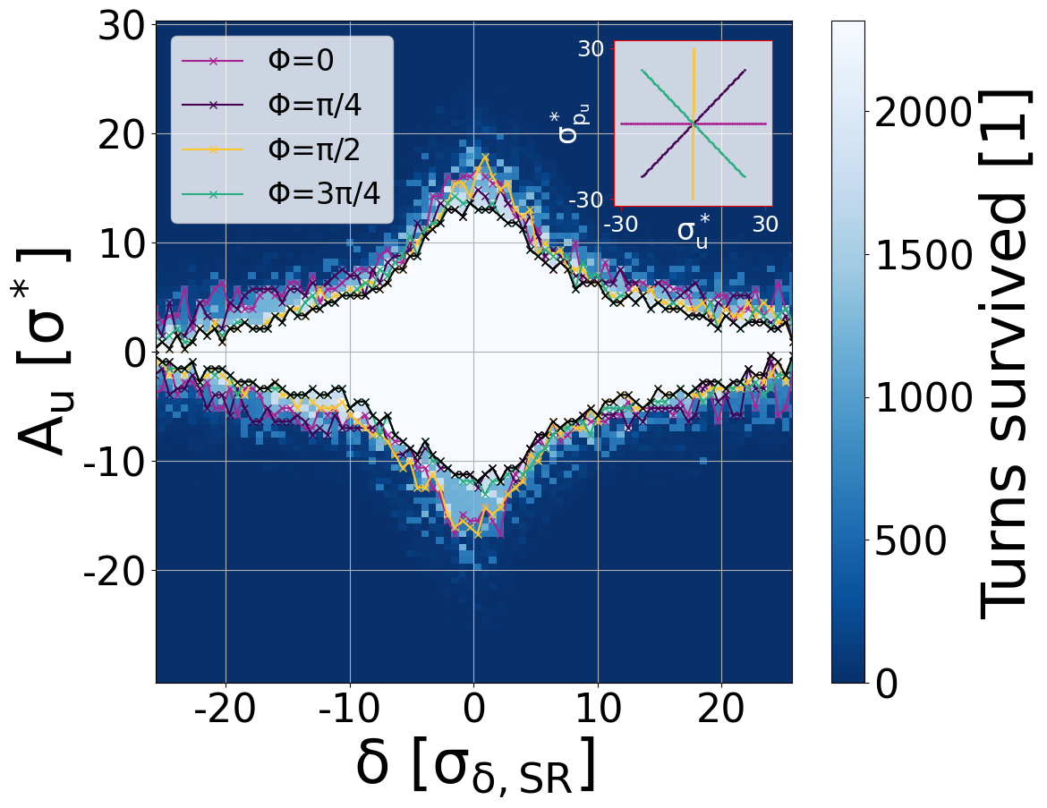
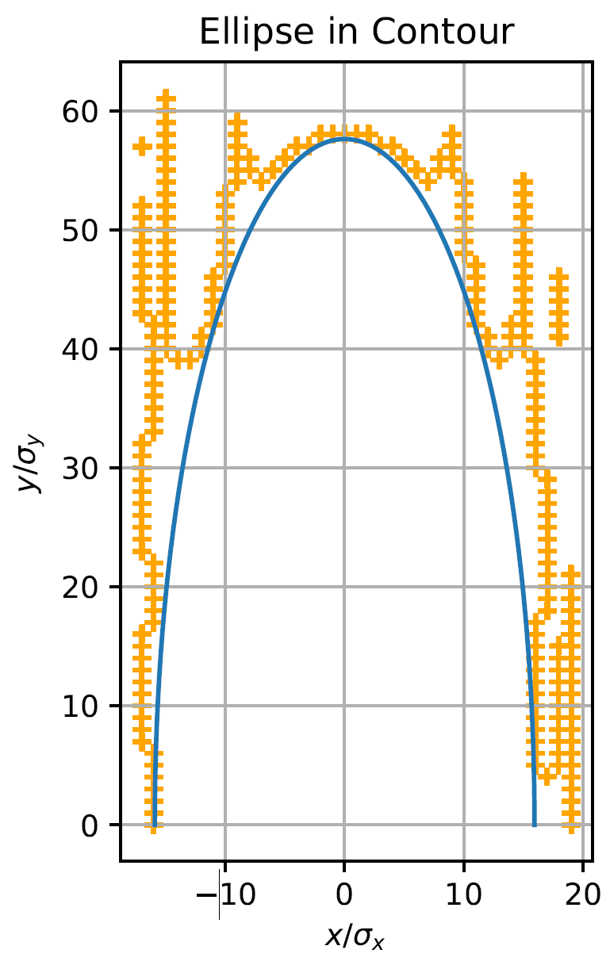
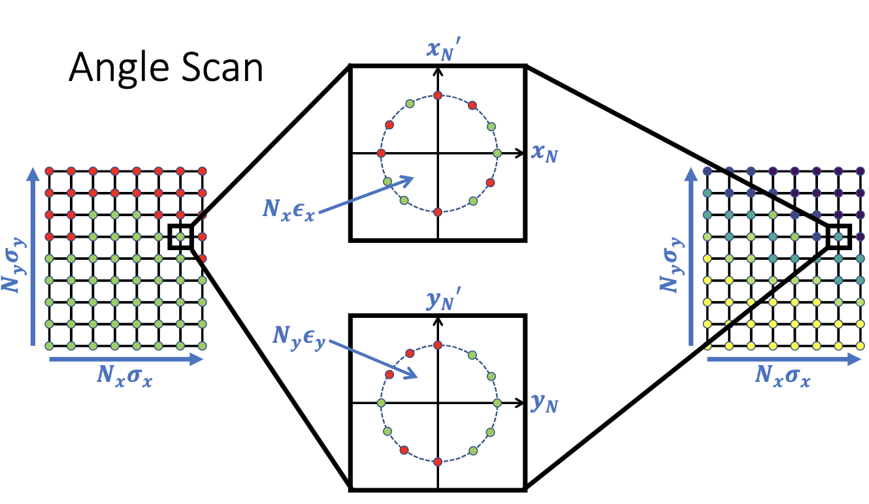
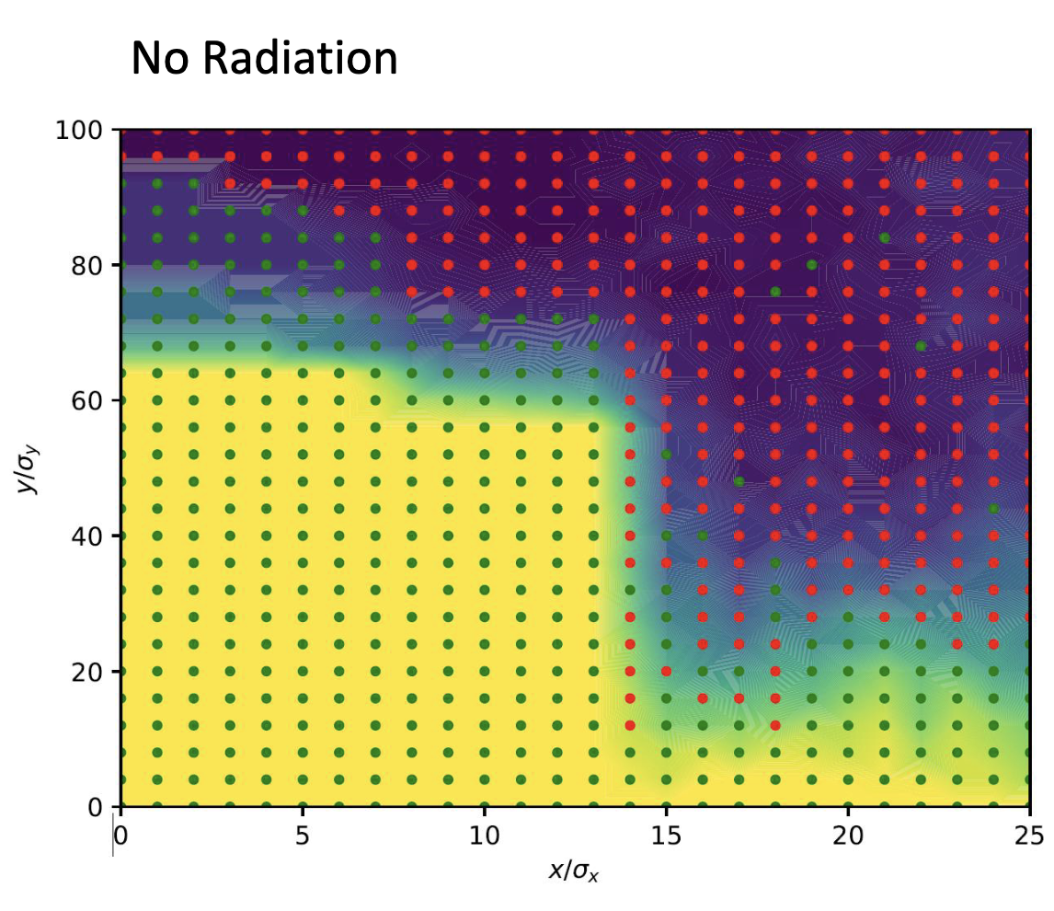
Standardizing performance evaluation: DA/MA
A. Piveteau
L. van Riesen-Haupt
Notes:
DA/ MA calculation: several methods exist
Joint DA + MA plots from 4 phases + delta offset
Sampling phase space grid
Fit largest ellipse

Slide 7
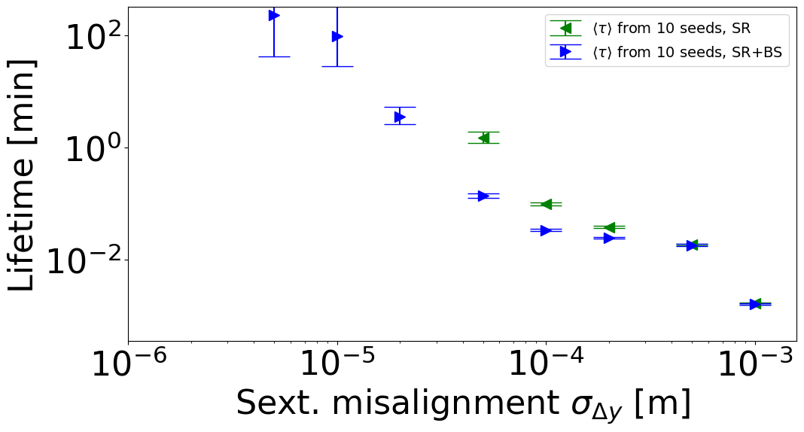
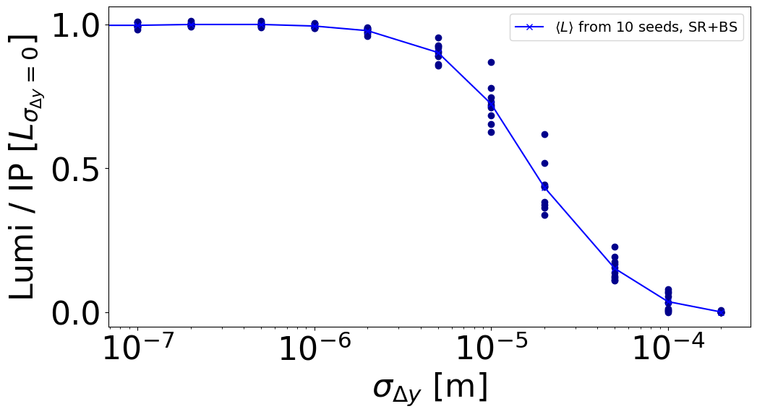
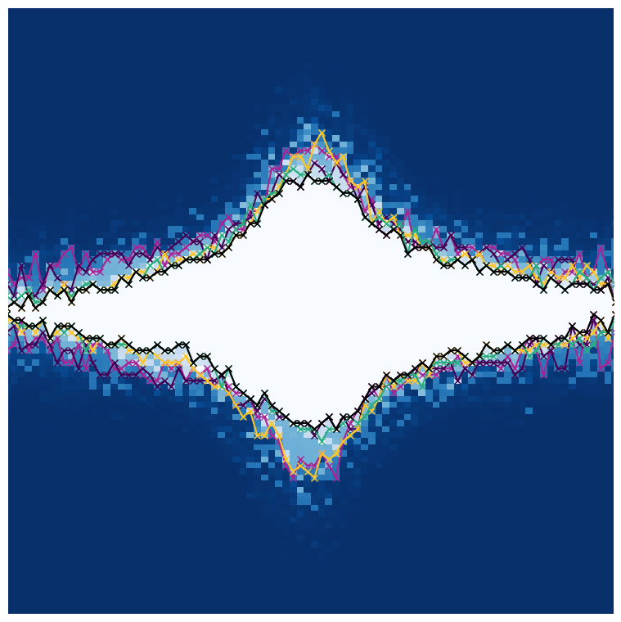
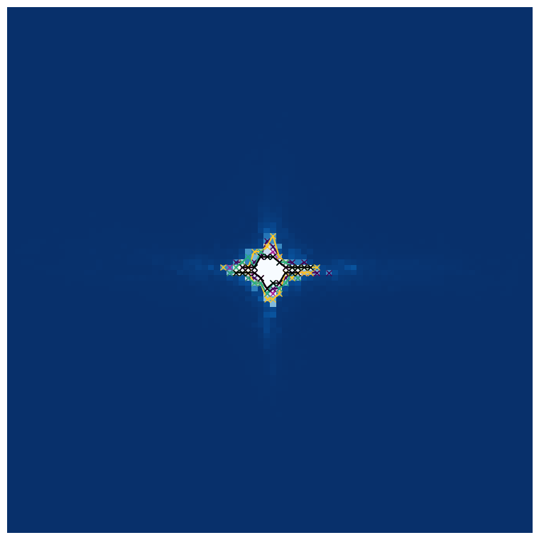
Standardizing performance evaluation: correlations
Main FCC-ee metrics: luminosity and lifetime
Lattice optimization to be done including beam-beam
Ongoing studies with errors & corrections
  Need standardized way to do DA, MA, FMA
Idea: exploit correlations between various metrics could speed up optimization process
  E.g. lifetime vs DA studies
Z
L. van Riesen-Haupt talk @ this conference
Notes:
view what people are doing what time leon table take it
add to table collimation time with bb
e.g. SAD and MAD-X still used for DA/MA

Slide 8
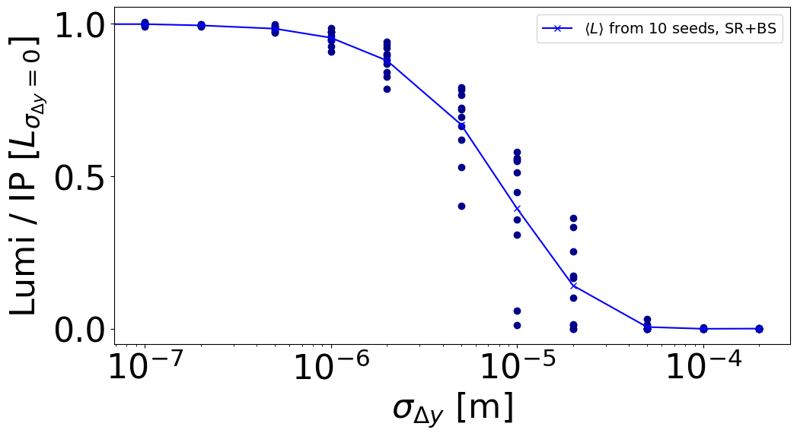
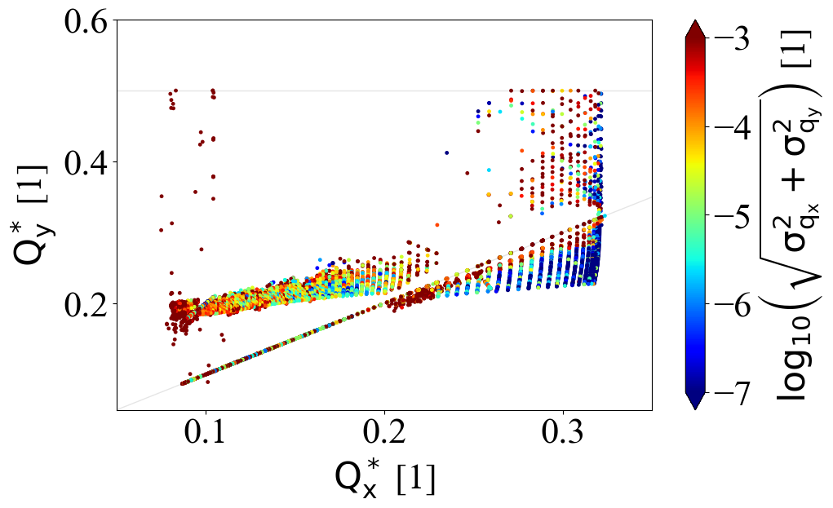
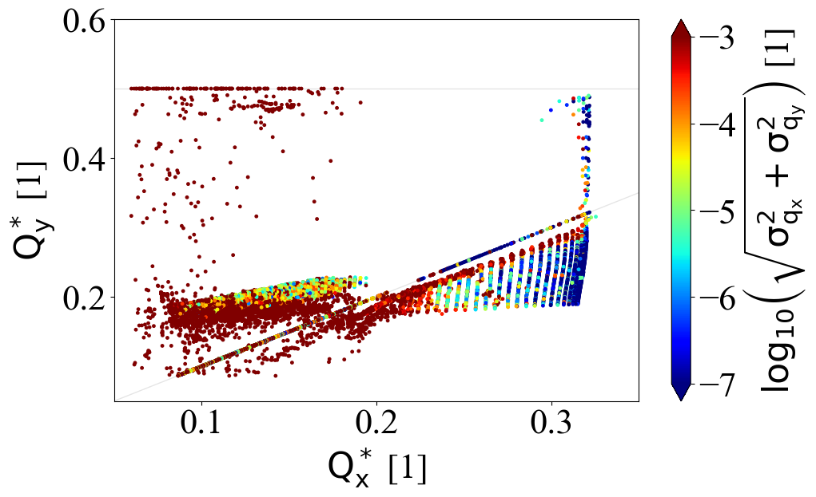
Standardizing performance evaluation:
Footprint & FMA
Different libraries (harpy, nafflib)
  Same thing, difference in maintenance
Ongoing work on built-in tool to compute footprint + FMA
  Linear/nonlinear lattice
  Compute diffusion
  Noise or different filters
  GPU support
ttbar
best seed
worst seed
Notes:
where are the limits
current tool in xsuite is slow 1 core doesn’t do diffusion
option to use different filters, interpolation nafflib to this builtin tool
noise
make them work for gpu

Slide 9
Standardizing performance evaluation
Simulation | Number of Particles | Number of Turns | Model | Typical timescale
Optics | ~1 | ~few | full lattice + WS BB | sec
Emittance – Matrix | ~1 | ~few | linear map + WS BB | sec
Dynamic Aperture | ~100 | ~𝜏_{SR} (50-5000) | full lattice + WS BB | min
Emittance – Tracking | ~1k | ~𝜏_{SR} (50-5000) | full lattice + WS BB | min
DA / MA | ~10k | ~𝜏_{SR} (50-5000) | full lattice + WS BB | min
Luminosity | ~10k | ~𝜏_{SR} (50-5000) | linear map / full lattice + WS BB | hour
Collective effects | ~1M | ~𝜏_{SR} (50-5000) | linear map + SS BB | week
Footprint + FMA | ~10k-1M | ~1-10k | linear map / full lattice + WS BB | hour
Lifetime | ~100k | ~20k | full lattice + WS BB | day
Notes:
collective effects are:
vertical mode coupling instab
x-z instab
strong-strong bb, linear map
1M particles
few damping times tracking
HTCOndor 16 cores CPU ~1week for Z
GPU not yet used
Collective effect studies are done less often so I can accept long sim time without GPU. The things we do often should be made fast like lifetime, emittance.
full lattice + ss we dont do
at some poont we need some banchmarks but this has to be on gpu, future work
we have capability but its not the priority study, like PIC
PIC is difficult for Z

Slide 10
Standardizing performance evaluation
Simulation | Number of Particles | Number of Turns | Model | Typical timescale
Optics | ~1 | ~few | full lattice + WS BB | sec
Emittance – Matrix | ~1 | ~few | linear map + WS BB | sec
Dynamic Aperture | ~100 | ~𝜏_{SR} (50-5000) | full lattice + WS BB | min
Emittance – Tracking | ~1k | ~𝜏_{SR} (50-5000) | full lattice + WS BB | min
DA / MA | ~10k | ~𝜏_{SR} (50-5000) | full lattice + WS BB | min
Luminosity | ~10k | ~𝜏_{SR} (50-5000) | linear map / full lattice + WS BB | hour
Collective effects | ~1M | ~𝜏_{SR} (50-5000) | linear map + SS BB | week
Footprint + FMA | ~10k-1M | ~1-10k | linear map / full lattice + WS BB | hour
Lifetime | ~100k | ~20k | full lattice + WS BB | day
Currently for most studies weak-strong beam-beam is used
For longer studies (lifetime) GPUs are necessary but currently not exploited
For most studies GPUs are not necessary but would boost productivity
Studies which have to be performed often (lifetime, lumi, emittance) should exploit GPU power
Notes:
collective effects are:
vertical mode coupling instab
x-z instab
strong-strong bb, linear map
1M particles
few damping times tracking
HTCOndor 16 cores CPU ~1week for Z
GPU not yet used
Collective effect studies are done less often so I can accept long sim time without GPU. The things we do often should be made fast like lifetime, emittance.
full lattice + ss we dont do
at some poont we need some banchmarks but this has to be on gpu, future work
we have capability but its not the priority study, like PIC

Slide 11
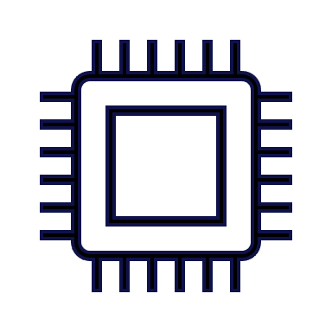
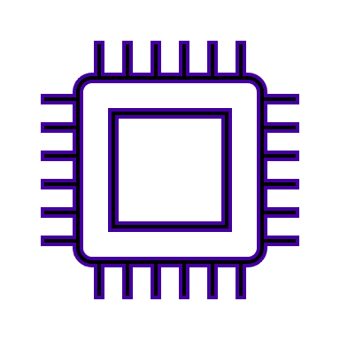
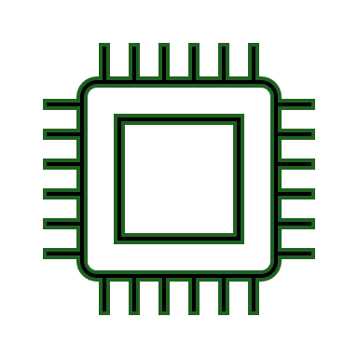
Exploiting hardware infrastructure
CERN cluster (HTCondor)
~10⁵ CPU cores
~100 (modern) GPUs
Group priority system
Xsuite GPU capabilities ready, but unexploited by community
INFN Bologna cluster (slurm)
~800 CPU cores
4 GPUs
Designed for many-core CPU jobs (MPI, OpenMP)
No priority system (first come first served)
Other resources
CEA cluster in France
Xboinc: volunteer computing
CSCS: Swiss National Supercomputing Centre
Notes:
Different commands and setup scripts are needed for each. We need to have out of the box examples and submission scripts.
xboinc, refresh for collimation, little work needed to upgrade, ml to optimize, case study on lhc DA with surroagate models
storage of simulation data, big parameter scans
120k volunteers previously
with python compilation benchmark on different platforms not easy
exploring optimization algorithms and new cscs potential future
cea booster guys questionnaire
criann adnan optics meeting 195
smart algorithm to reduce number of simulations needed

Slide 12

Development priorities
SAD-like solenoid (coordinates transformed depending on orbit) for polarization studies
Pair production
Standardized lattice knobs for IP tuning & correction
Better structuring of most common simulations with Xutil [1]: example scripts, tutorials
Y. Wu talk @ this conference
J. Salvesen talk & W. Gawas poster @ this conference
J. Keintzel, S. Jagabathuni, L. van Riesen-Haupt, talk @ this conference
Notes:
radiation from solenoid no right vector potential
synrad integrals are there, there was an update,
standardized tuning tools
xsuite multisetter does not give correct results: add shift in all elements, faster, not correct
shift misalignments work in regular way including solenoid
add shifts madx translate into xsuite. madx works. reproduce same error in different lattices.
corrections are done in mad. people have scripts.
no xsuite to sad error translation. need script but doable
xsuite had nothing until last year.
ground wave orbit feedback needs twiss every 2 ms. static ones dont care make lattice once.
feature 606 I1 to I5. damping times partition numbers characterize the lattice.
ws ss pic which is good for which studies, who needs what.
mdi might do pic
ss for luminosity.
not enough gpus.
utilization of multi cpu on gpu.
pair prod in pic
computing time in pic
conversion to cpu array if on gpu
track core it diffuses into halo then throw away core
expensive
they are interested in halo only
but bb for diffusion need core ask giacomo how they do it
ws easy dont need the core of weak beam
lifetime with 96 cores takes 1 h; 2400 particles, Z 50000 turns; due to dist we need many turns; 25k turns;
- 1h / 50000 = 0.072 s per turn - -> 0.21 s per turn on 32 cores
xsuite 32 cores 2e3 macroparts takes 1s per turn,
DA: shorter, Z 4000 turns, tt 40 turns 400 particles, 1 min for Z, 96 core.
in lhc nonlinearity is small so simplified lattice works but not in fcc bc of many nonlinearities
reweighting uniform dist doesnt work bc we have damping so particles move from tail to core
in tools be precise how to set up lattice how to init the beam etc
plot showing gpu usage last year
pyat and madx have correction shcemes

Slide 13
Summary
Xsuite: main tool for self consistent FCC-ee beam dynamics studies
Most studies use weak-strong beam-beam model
Longer studies (lifetime) could be replaced by shorter studies (DA)
Standard setup and submission scripts, DA/MA, FMA evaluation tools are being developed
GPUs are needed but currently under utilized for FCC-ee studies
Thank you!
Notes:
Xsuite is main tool for self consistent FCC-ee beam dynamics studies studies, already replaces several older legacy tools.

Slide 14
References slice 3
  [1] D. Schulte, GUINEA-PIG
  https://cds.cern.ch/record/331845/files/shulte.pdf
  [2] T. Pieloni, W. Herr, COMBI
  https://accelconf.web.cern.ch/p05/PAPERS/TPAT078.PDF
  [3] K. Ohmi, BBWS
  https://indico.cern.ch/event/438918/contributions/1085290
  [4] K. Ohmi, BBSS
  https://oraweb.cern.ch/pls/hhh/code_website.disp_code?code_name=BBSS
  [5] K. Ohmi, SCTR
  https://indico.cern.ch/event/1398060/contributions/5876155
  [6] Y. Zhang, IBB
  https://journals.aps.org/prab/pdf/10.1103/PhysRevAccelBeams.23.104402
  [7] D. Shatilov, LIFETRAC
  http://cds.cern.ch/record/1120233/files/p65.pdf
  [8] J. Qiang, BeamBeam3D
  https://amac.lbl.gov/~jiqiang/BeamBeam3D/
  [9] G. Iadarola et al., Xsuite
  https://doi.org/10.18429/JACoW-HB2023-TUA2I1

Slide 15
References slide 4
  [1] SixTrack
  https://sixtrack.web.cern.ch/
  [2] PyHEADTAIL
  https://github.com/PyCOMPLETE/PyHEADTAIL

Slide 16
References slide 5
  [1] P. Kicsiny, PhD thesis
  https://infoscience.epfl.ch/entities/publication/9f194f9b-76e8-4ba8-ab62-b19b17597ccc
  [2] P. Kicsiny et al., Multiturn simulation of radiative Bhabha scattering in the equivalent photon approximation
  Phys. Rev. Accel and Beams https://doi.org/10.1103/PhysRevAccelBeams.27.091001
  [3] L. van Riesen-Haupt, Impact of lattice errors and correction with beam-beam
  eeFACT 2025 https://indico.jacow.org/event/75/contributions/6860/
  [4] P. Kicsiny et al., Impact of beam asymmetries at the Future Circular Collider 𝑒+𝑒−
  Phys. Rev. Accel and Beams https://doi.org/10.1103/PhysRevAccelBeams.27.121001
  [5] K. Le Nguyen Nguyen et al., Impact of bunch intensity asymmetry in colliders featuring strong beamstrahlung
  https://arxiv.org/abs/2404.09012
  [6] P. Kicsiny et al., Incoherent horizontal emittance growth due to the interplay of beam-beam interaction and longitudinal wakefield in crab-waist colliders
  Phys. Rev. Accel and Beams
  [7] R. Soos, Impedance and beam-beam effects for FCC-ee
  eeFACT 2025 https://indico.jacow.org/event/75/contributions/6848/

Slide 17
References slide 12
  [1] K. Skoufaris, Xsuite utility toolkit (Xutil)
  https://indico.cern.ch/event/1545057/contributions/6503334

Slide 18
backup

Slide 19
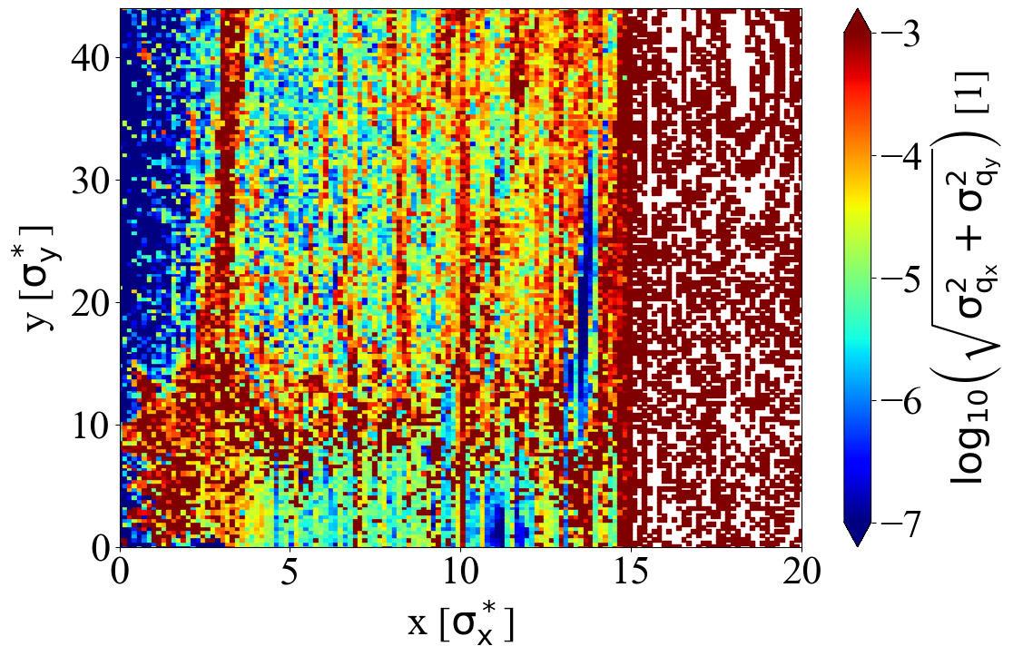
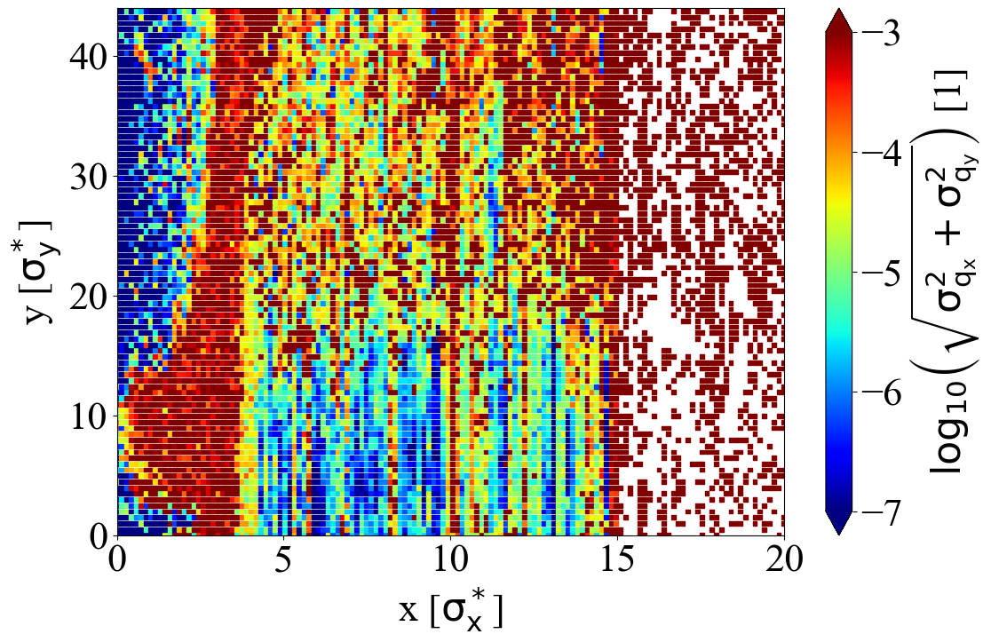
best seed
worst seed
Notes:
where are the limits
current tool in xsuite is slow 1 core doesn’t do diffusion
option to use different filters, interpolation nafflib to this builtin tool
noise
make them work for gpu

Slide 20
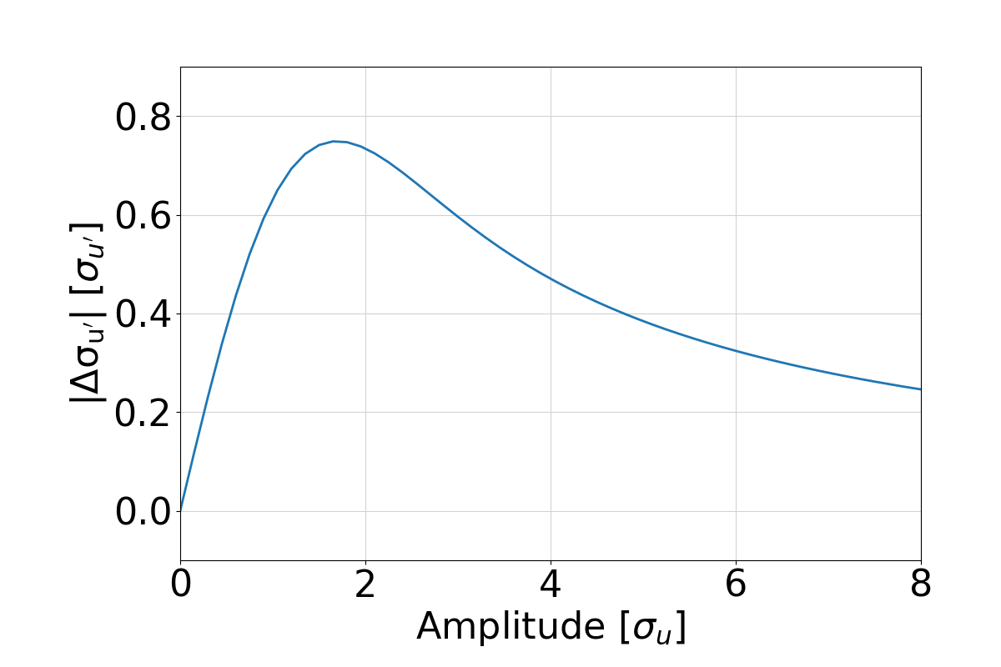

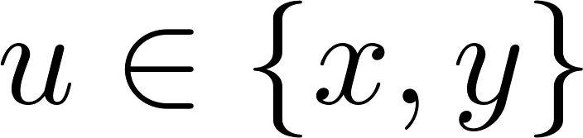
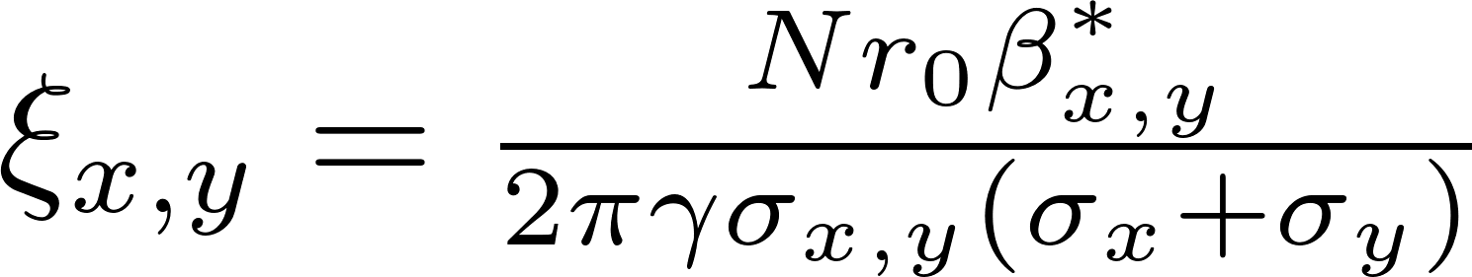
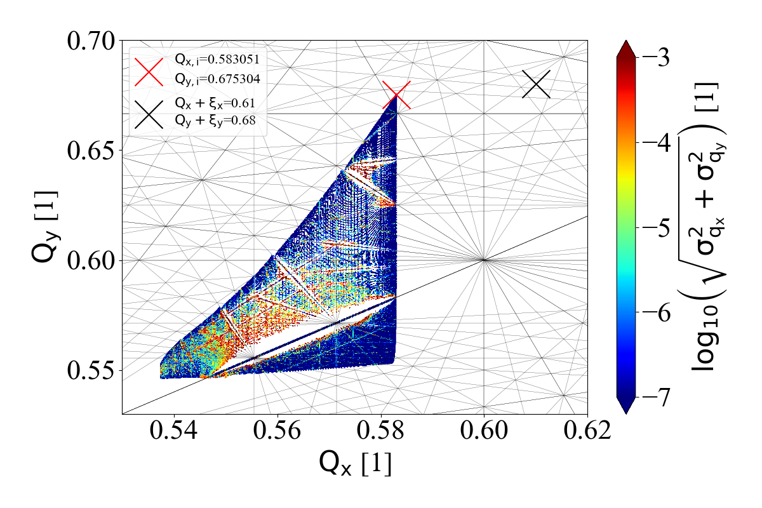
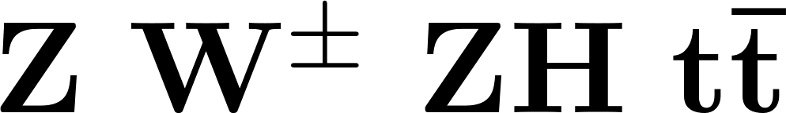
Beam-beam force
High lumi strong beam-beam force
Consolidation...
Radiation (synchrotron radiation, beamstrahlung, Bhabha)
IP tuning & feedback
Beam asymmetries
Top-up injection
linear model
w/o radiation
Notes:
optmizations of the machine for high luminosity have already done for baseline design. but high lumi implies a strong bb force which can be characterized by the xi. but we want to consolidate these estimates eg lumi lifetimes with more detailed models using simulatons of radiation ip tuning topup and beam symm so these are the studies that i will highlight in this preso.
during beambeam collisions the beams experience the EM field of each other. This perturbation leads to a change in the optical beta function, called beta beating and causes an amplitude dependent tune shift. The consequnece of this is that the beam will have a lartge tune footprint which potentially crosses many resonance lines which can be dangeorus for the beam stability. the beambeam force that the particles experience from each other at collisions is highly nonlinear. For small amplitudes this beambeam force can be characterized by this parameter xi, shown in the top right plot, which can be expressed in terms of the beam parameters.
For the machine design a small value for xi is crucial, but at the same time luminosity has to be maximized. This is challenging as you can see the luminosity can be expressed as a function of the xi, so on one hand we minimize xi but also want to keep L at maximum.

Slide 21
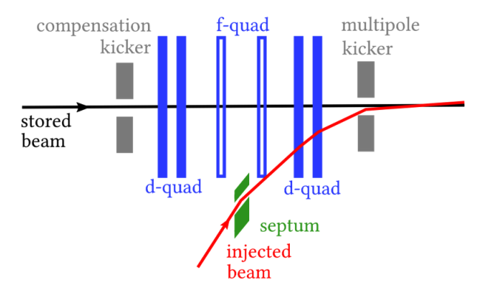
Top-up injection
  Maintains luminosity levels & compensates for decreased beam lifetime
  Single booster feeds both beams
Longitudinal top-up simulated with Xsuite
Perturbed bunch init. with 95% intensity
Track till equilibrium & top-up
Luminosity lower than in symmetric case (L₀)
  This reduction cannot be avoided
  but currently not taken into account in design
0.95N₀
lower due to
asymmetric setup
N₀

Slide 22
Simulation parameters
Slide # | 9 | 11/upper | 11/lower | 12
Machine setup | FCC 4 IP baseline | FCC 4 IP baseline, W | FCC 4 IP baseline | SuperKEKB LER
Lattice model | nonlinear | linear | linear | linear
Beam-beam model | weak-strong | 1st part: quasi-strong-strong (f_{update}=100), 2nd part: strong-strong | quasi-strong-strong (f_{update}=100) | strong-strong
# slices in beam-beam | 100 (300 for Z) | 100 | 100 (300 for Z) | 100
# macroparticles | 4e4 | 1e5 | 1e5 | 1e5
# turns | 2x SR damping time | 2e4 | 1e4 (Z, W), 5e3 (H, T) | 2e4

Slide 23
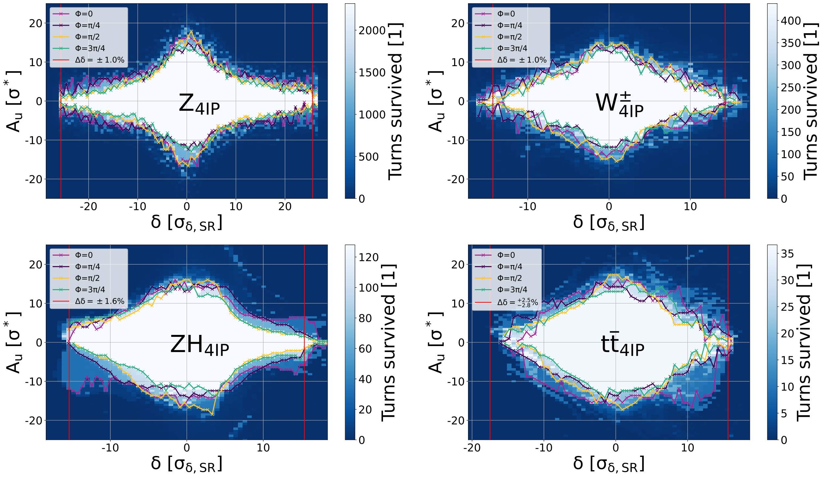
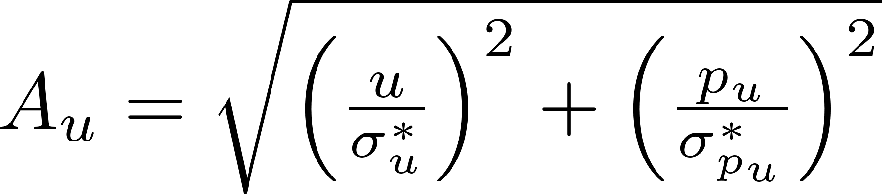
Dynamic aperture with beam-beam

Slide 24
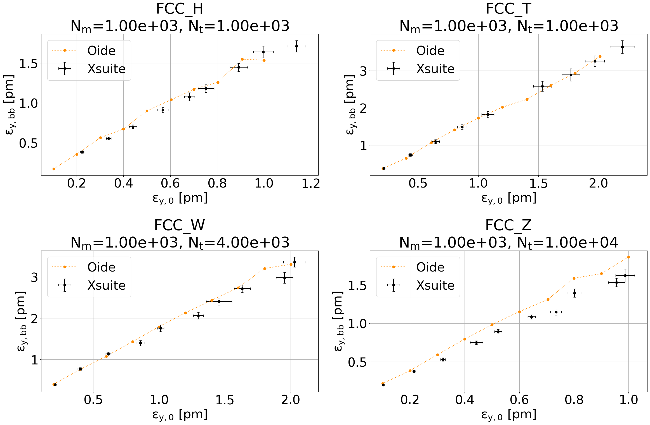
Vertical emittance
w/ beam-beam
+beamstrahlung
Xsuite tracking
error bars:
stat. of last 2500 turns
Reference data
by K. Oide
full lattice
Independent benchmarks with SAD & Xsuite
Good agreement

Slide 25
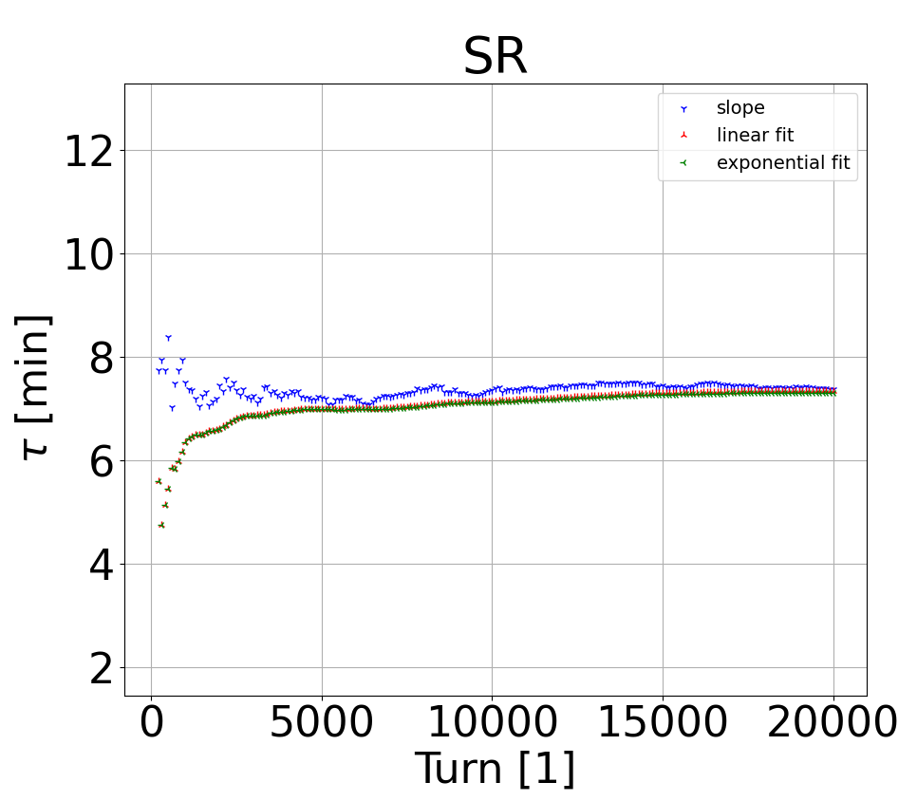
SR lifetime from loss rate
full lattice
w/ quantum SR
w/o beam-beam
Beam lifetime
Synchrotron radiation seems to be dominating
  Discrepancy w.r.t. SAD results from K. Oide
  Work in progress
Bhabha lifetimes simulated & compare well to reference estimates (GUINEA-PIG + BBBREM)
1.
2.

Slide 26
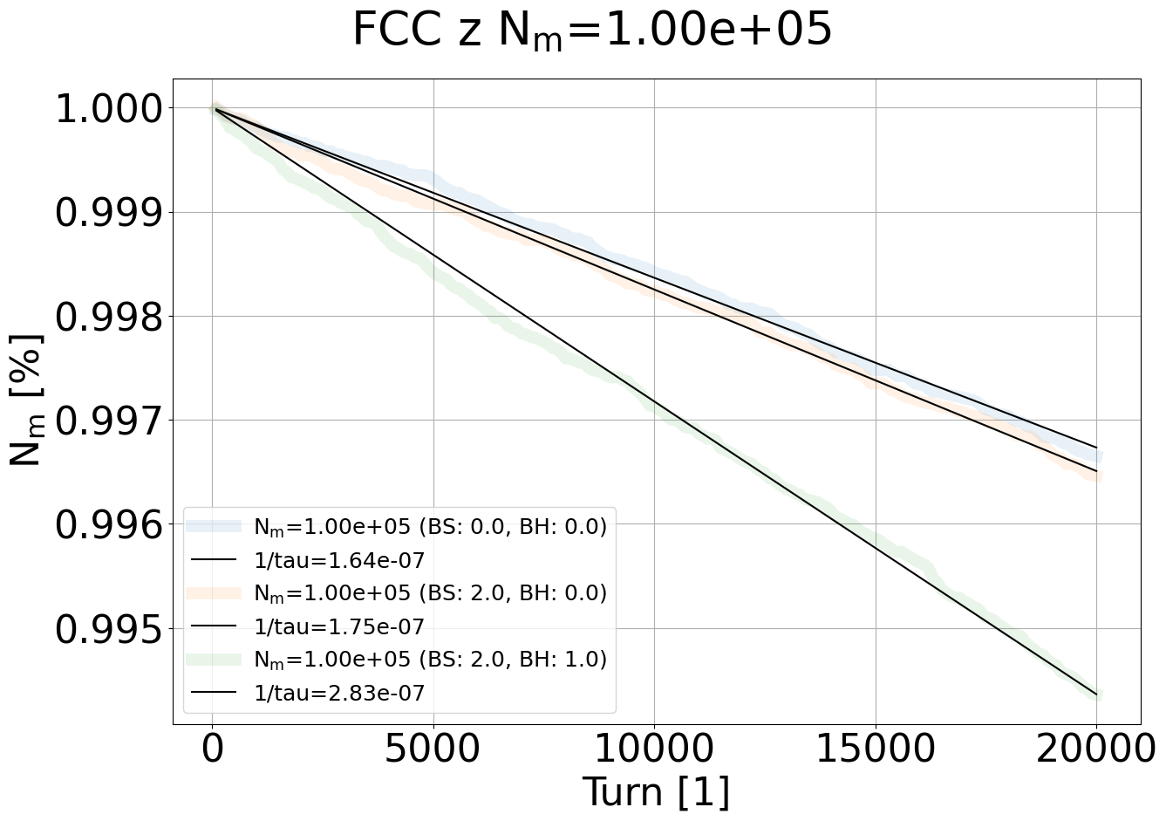
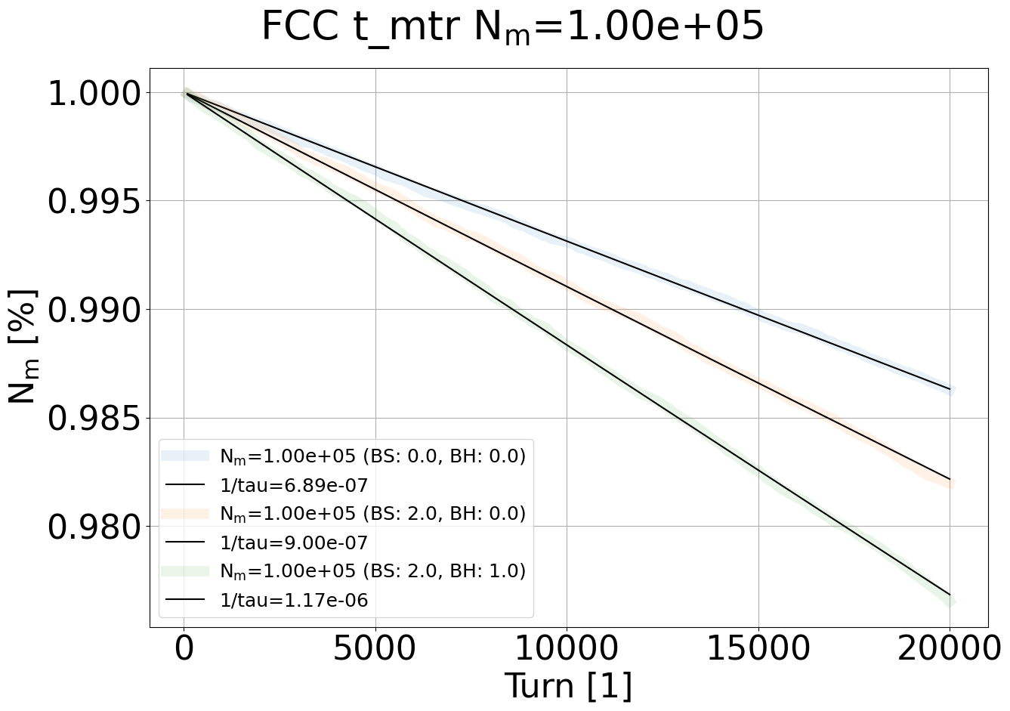
Bhabha lifetime: loss rates

Slide 27
Tolerances to parameter asymmetries
fixed bunch: init. with nominal parameter u₀
perturbed bunch: init. with u=ζu₀ & scan ζ
Track with linear transfer map until equilibrium
Tolerance: 50% blowup in σ_{y} w.r.t. ζ=1 case
50% blowup

Slide 28
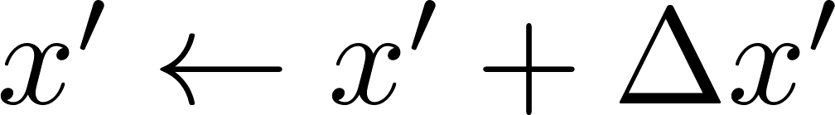
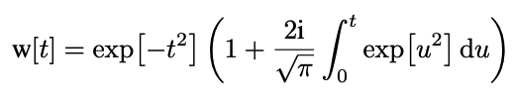

Beam-beam in Xsuite
  Lorentz transform into head-on frame
  Longitudinal slicing
  Beam-beam kick in soft-Gaussian approximation [4]
Notes:
1 min
In Xsuite we model the collision of two bunches at a time. We have a collision with a crossing angle and first we perform a lorentz boost and a rotation to move to a head-on frame where the description of the EM potential is easier.
Then we slice the bunches longitudinally and slide them across each other in discrete steps. At each step there will be a number of slices from bunch 1 overlapping with bunch 2. For these overlapping slices we compute the statistical moments and apply the beambeam kick on the particles of the opposite slice.
This beambeam kick is computed using the so called soft Gaussian approximation, which assumes a Gaussian transverse beam profile. This is a fast and accurate way of getting the force but it is valid only for Gaussian bunches. You can see the formula for the soft-gaussian kick. In red you see that it uses the statistical moments of the opposite slice. In blue I denoted the coordinates of a single particle that interacts with hte slice. The w is the complex error function.

Slide 29
Simplified tracking simulations with Xsuite
  First studies with 2 IP baseline from CDR [5]
  Recent studies with 4 IP design from [6]
  Xsuite tracking setup:
    1 IP + tracking over arc superperiod
    with linear transfer matrix
    Arc split into 3 segments
    2 crab sextupoles between arc segments (β_{x}=3 m, β_{y}=500 m)
    Each iteration begins in front of the right sextupole
      Observation point for coordinates
    Synchrotron radiation (damping+noise) in arc, beamstrahlung+bhabha scattering in beam-beam element
IP + BS | lin. arc | sext. | lin. arc + SR | sext. | lin. arc
START
repeat
Notes:
1 min
Next I will explain our tracking setup in xsuite. In our first studies we used the baseline FCC setup which has 2 Ips, but in our newer studies we switched to the more recent 4IP design. In any case the tracking setup contains one 1 ip followed by a linear transfer map representing a half or a quarter ring, depending on the setup.
The arc is split into 3 segments and 2 sextupoles are inserted between the segments to implement the crab waist scheme.
Then each tracking iteration begins in front of the right sextupole and this point is chosen of observation of the beam coordinates.
The synchrotron radiation is implemented by an effective model of the damping and gaussian noise for quanctum excitation in the middle arc element and at the ip in the beambeam element we have the option to simulate beamstrahlung or bhabha scattering.

Slide 30
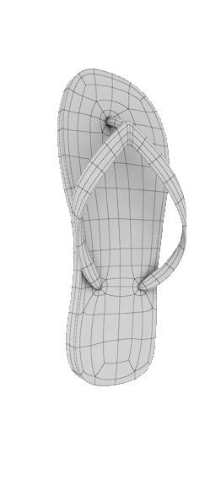
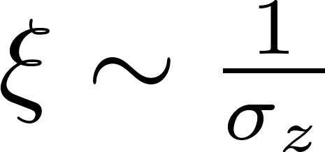
Flip-flop
Flip-flop instability (1D) observed in other colliders (VEPP-2000) [7]
For FCC-ee: 3D flip-flop - direct consequence of beamstrahlung, triggered by an initial asymmetry in bunch intensity [8]
Inflation of one bunch beam loss
Above a threshold ξ₀ longitudinal blowup drives transverse diffusion 3D flip-flop
Relevant for FCC-ee top-up injection
Slightly less populated bunch: N_{b}-ΔN
Undergoes more intense beamstrahlung
Bunch length increases
Undergoes even more Beamstrahlung
Bunch length increases even more
ξ < ξ
Slightly more populated bunch: N_{b}+ΔN
Undergoes less intense beamstrahlung
Bunch length decreases
Undergoes even less Beamstrahlung
Bunch length decreases even more
“weak bunch”
N_{b}-ΔN
ξ < ξ
“strong bunch”
N_{b}+ΔN
Notes:
2 min
The flipflop instability it the blowup of one bunch and the while the other bunch shrinks or remains unchanged. It has been observed in previous machines like veep where this effect is 1D caused by the nonlinear dynamics.
In the fcce flip flop has been observed in simulations and here it is a direct consequence of BS. It is triggered by an initial small asymmetry in the bunch intensities and this initial perturbation determines which of the bunches will blow up. The bunch intensity is directly related to the intensity of beamstrahlung.
So when we have a collision with a slight asymmetry in the charge. The bunch which experiences a stronger beambeam force from the other beam will undergo more beamstrahlung so its bunch length will increase while the bunch which undergoes a slightly less beamstrahlung than the equilibrium will experience a reduction of the bunch length.
Since we collide with a crossing angle, the beambeam force will depend on the bunch length. Therefore the now shorter bunch will exert an even stronger beambeam force on the other bunch so that will undergo an even stronger BS and the cycle repeats. This process eventually leads to the inflation of one bunch which will lose particles. It is called 3D flipflop because above a certain threshold in the strnegth of the beambeam force, the change of the bunch length is coupled to the change of the transverse beam sizes. So the beam which blows up longitudinally will also experience a transverse blowup.
This effect hasnt been studied before FCC but with the fcc it is open question whether this dynamics is triggered during the topup injection of the machine, where a small intensity bunch is injected and merged with the higher intensity stored bunch. So now that we have the tools it is very important to study this mechanism in this context.

Slide 31
Workflow for emittance scan – everything in Xsuite
Prepare Xtrack line once [6]:
Loop over a range of ε_{y} values:
load MAD-X sequence [7]
load Xtrack line
...
add observation point @ RF
add beam-beam element (optional)
add wigglers
convert to Xtrack line
build + twiss 4D
build
twiss 6D mean synrad + tapering
set quantum synrad
build + twiss 4D
match ε_{y}
track
slice sequence
twiss 6D mean synrad + tapering
repeat with next ε_{y}
build + twiss 4D
save Xtrack line
...

Slide 32
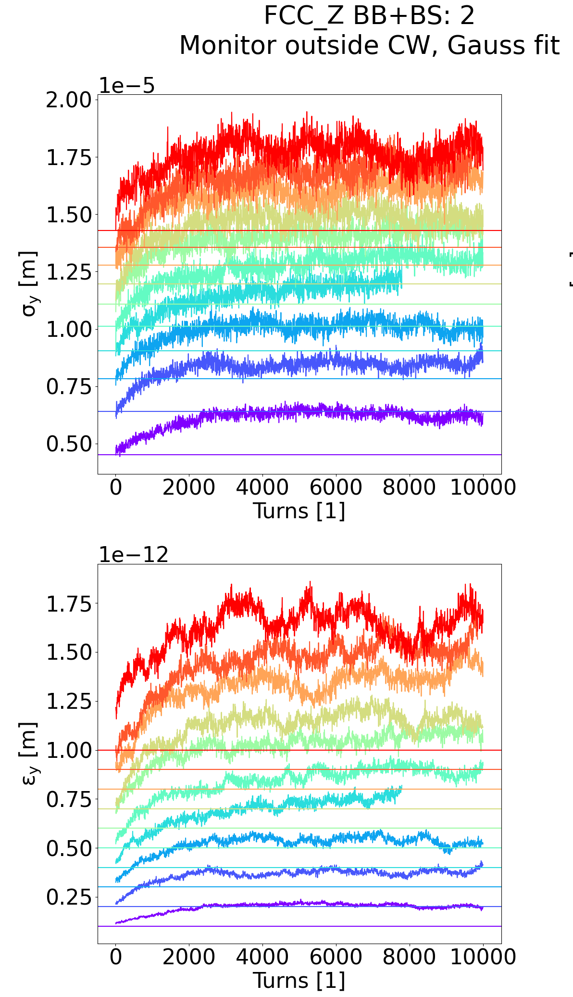
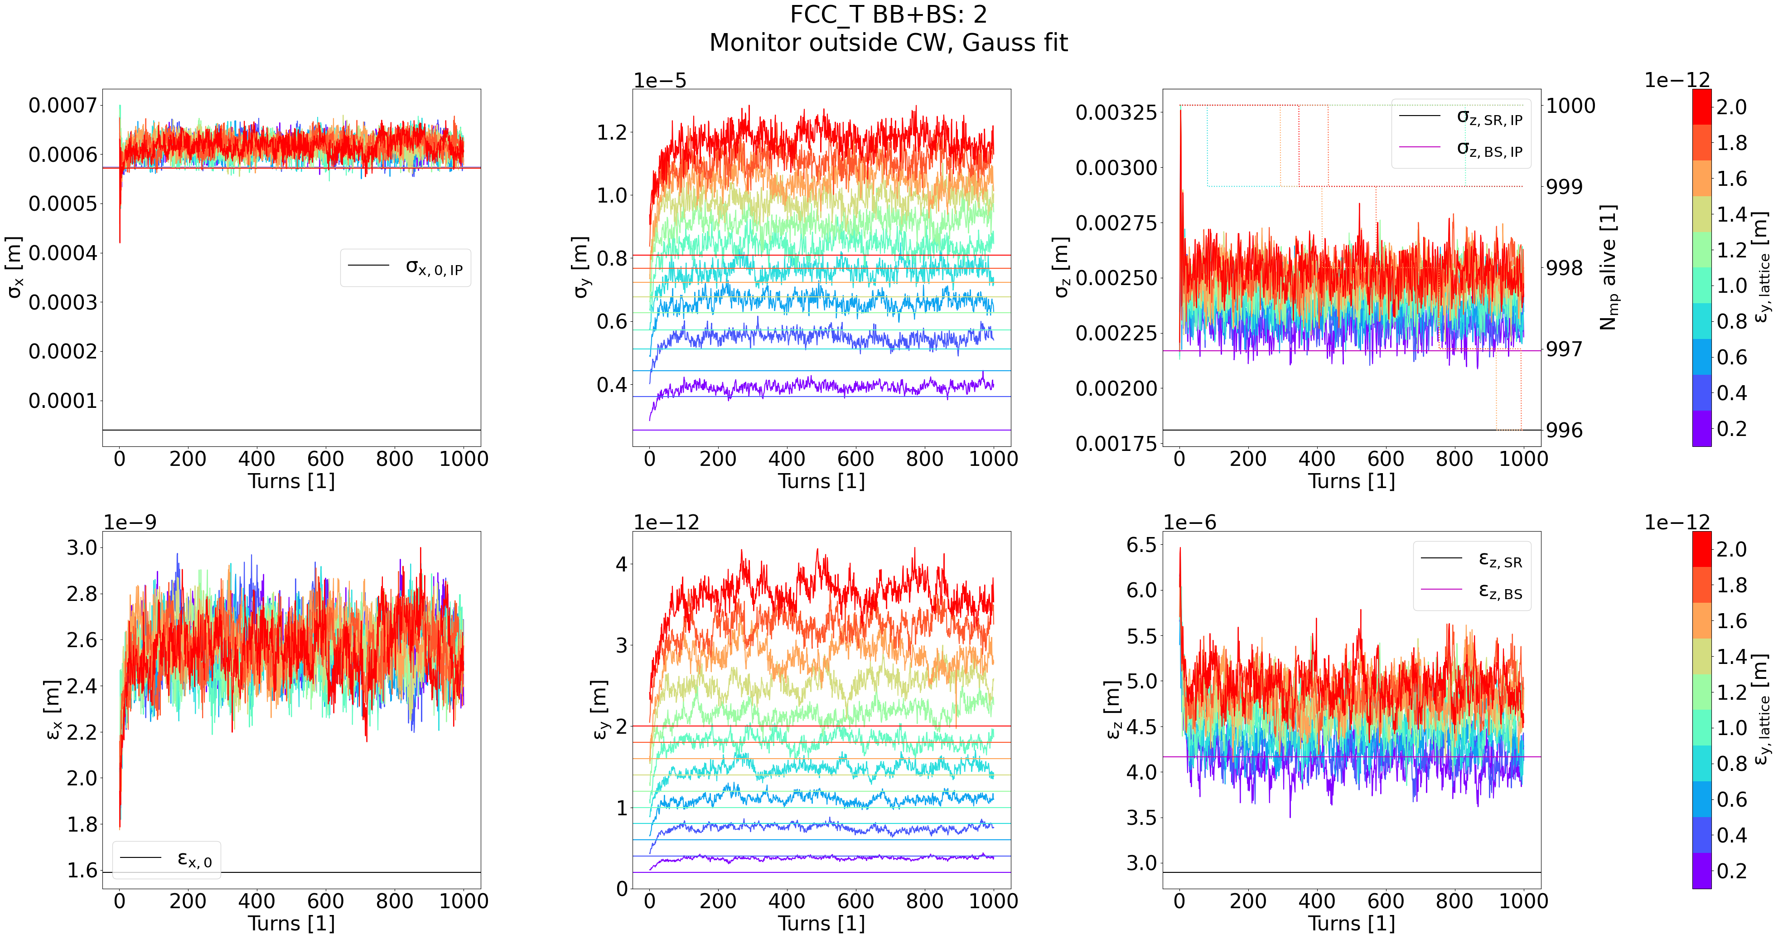
Emittance scan results
Small discrepancy compared to SAD results
Xsuite likely not yet converged
Need more turns to see fully converged emittances

Slide 33
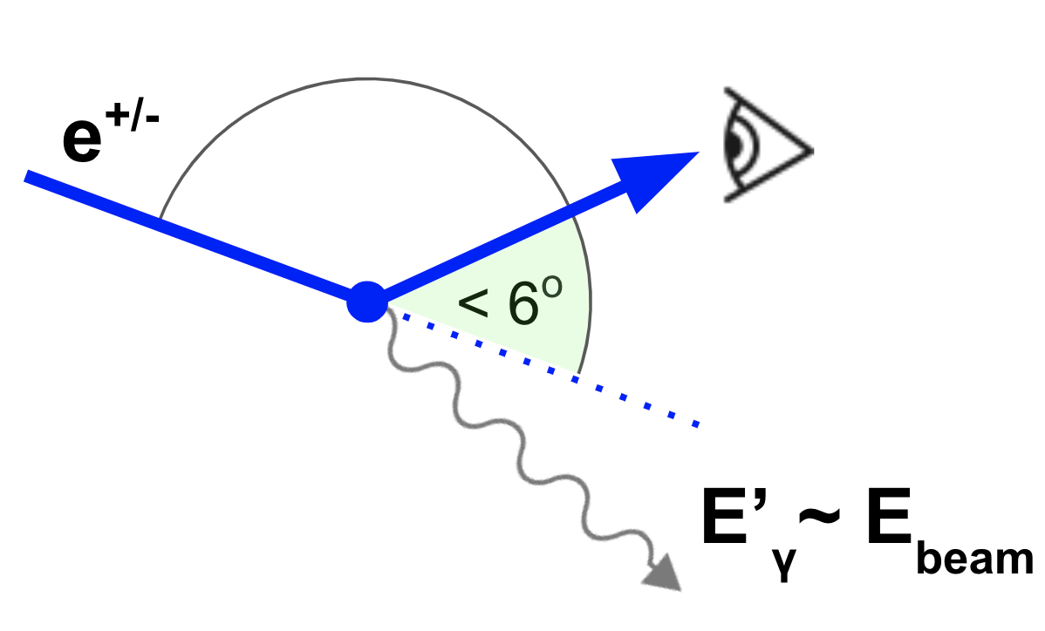
Small angle Bhabha scattering [6]
Dominated by t-channel (scattering) process
luminosity in lepton colliders
primary particles lost within a turn
Main limitation of FCC-ee beam lifetime (alongside beamstrahlung)

Slide 34
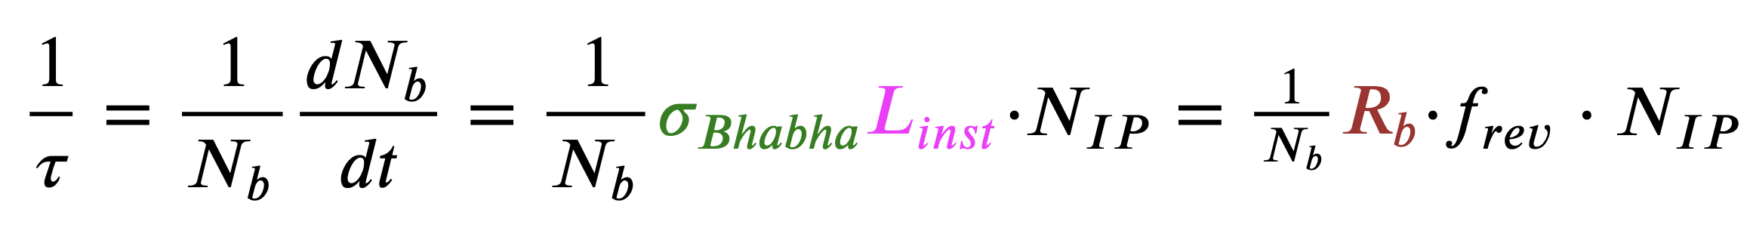
Bhabha lifetimes
τ: Bhabha lifetime [s]
N_{b}: bunch intensity [1]
σ_{Bhabha}: Bhabha cross section [m^2]
N_{IP}: number of Ips [1]
L_{inst}=L*f_{rev}: instantaneous lumi of 1 bunch crossing [m^-2 s^-1]
L: integrated lumi of a single collision (luminosity per bunch crossing) [m^-2]
f_{rev}: revolution frequency [s^-1]
R_{b}= σ_{Bhabha}*L: number of emitted Bhabha photons with E above mom. acceptance [1]

Slide 35
Dynamic aperture test grid

Slide 36
Beam-beam in Xsuite
Multiturn tracking
t
IP | arc | IP | arc | IP ...
Faster & less accurate
...
Weak-Strong
(WS)
Quasi-Strong-Strong (QSS)
...
FCC-ee
Strong-Strong
(SS)
(e.g. f_{update}= 2)
...
Slower & more accurate
: untracked bunch
with fixed moments
: bunch slice with
macroparticles
: soft-Gaussian kick
: compute statistical
moments of slice
Notes:
2 min
Next i will try to demonstrate in graphically how a single collision is simulated in xsuite. Lets take for example a simple setup wherre each bunch is sliced into 2 longitudinal slices. Then we have 3 steps in time, as the bunches pass through each other. In the code we can perform the beambeam interaction in 3 ways.
In the weak-strong approximation we track only one beam and the other beam is frozen. For this frozen bunch we input the statistical moments of the slices manually and they stay hardcoded for the whole simulation. The particles of the other beam are just passed through these slices and at every step the soft-Gaussian kick is applied. For multiturn tracking it would look like this on this simplified drawing.
The second model is the quasi strong strong. In this one we track both beams and at he beginning of the collision we compute the statistical moments of each slice of both beams. Then we use these moments in the soft-gaussian kick. In multiturn tracking this will look something like this. The frequency of recomputing the moments can be varied depending on the simulation.
The third model is the strong-strong where we recompute the moments before each timestep to model the variation of the beambeam force within a single collision.
In general there is a speed versus accuracy tradeoff between the models. The weakstrong model is the fastest but the least accurate, and the strongsterong is the most realistic but slowest. The best choice to use depends on the instability and the beam configuration we want to study. In general for the FCC-ee the quasi strong strong model is an optimal choice.

