Slide 1

Building towards AIE4ML – Generating, Benchmarking and Profiling AIE Graphs
Alex Lozano

Slide 2
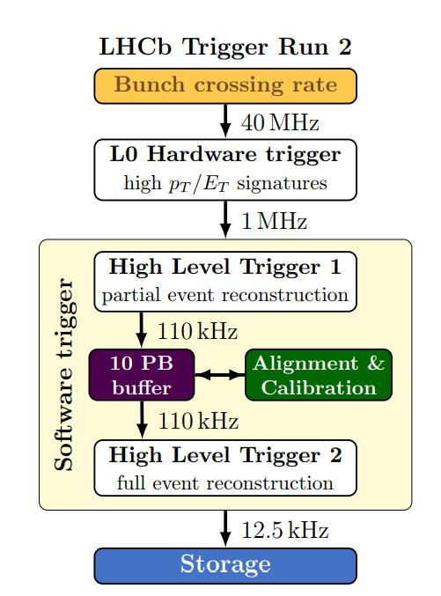

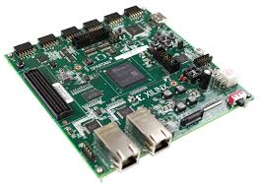
Current Triggers
11/08/2025
2
Notes:
Current low-level triggers use FPGAs, with hardware code synthesized from Python models via the HLS4ML package. A new generation of hardware, known as ACAPs, theoretically provides an alternative low-latency filtering solution.

Slide 3
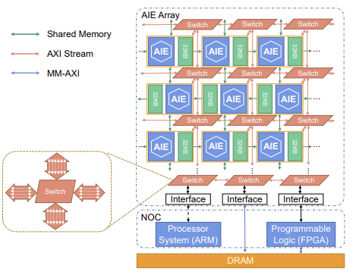
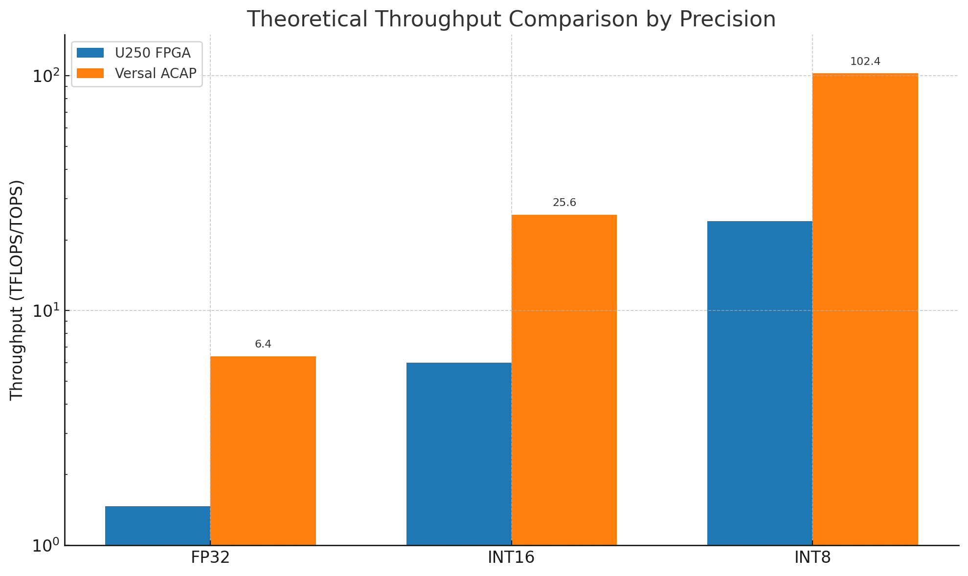
Why ACAPs?
Zhuang, J. (2023) High performance, low power matrix multiply design on ... (Accessed: 06 August 2025).
11/08/2025
3
Notes:
ACAP’s AI Engine kernels (shown on righthand diagram) provide optimized matrix multiplication execution, ideal for many ML layer types. As shown by this paper, their theoretical implementation tops high-end FPGAs with a significant margin, especially at higher bit precisions. Although, this needed to be validated for ourselves.

Slide 4
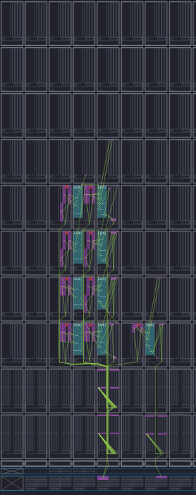
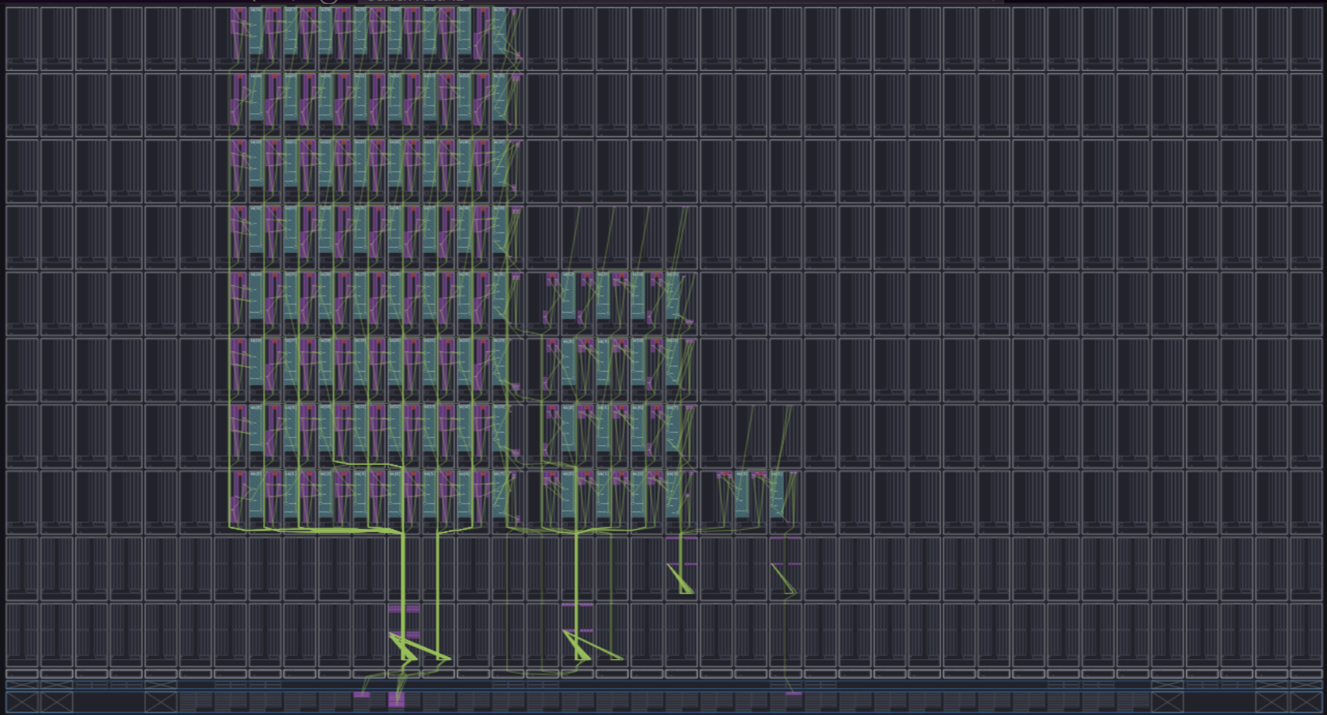
Generating N-Layers
11/08/2025
4
Notes:
My contribution was extrapolating a hand written 1 and 2 layer hardware implementation, into an N layers generation tool to evaluate AIE performance against current MLPs. This tool allowed for parametrized intrinsics and model configuration supporting a range of operation precisions as well as bias and relu operations. Quantisation via a bit shifter was added rudimentarily to avoid saturation, although the value of shifts need to be optimized prior to compile time to minimize quantisation losses.

Slide 5
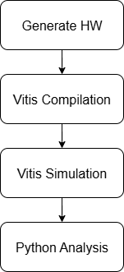
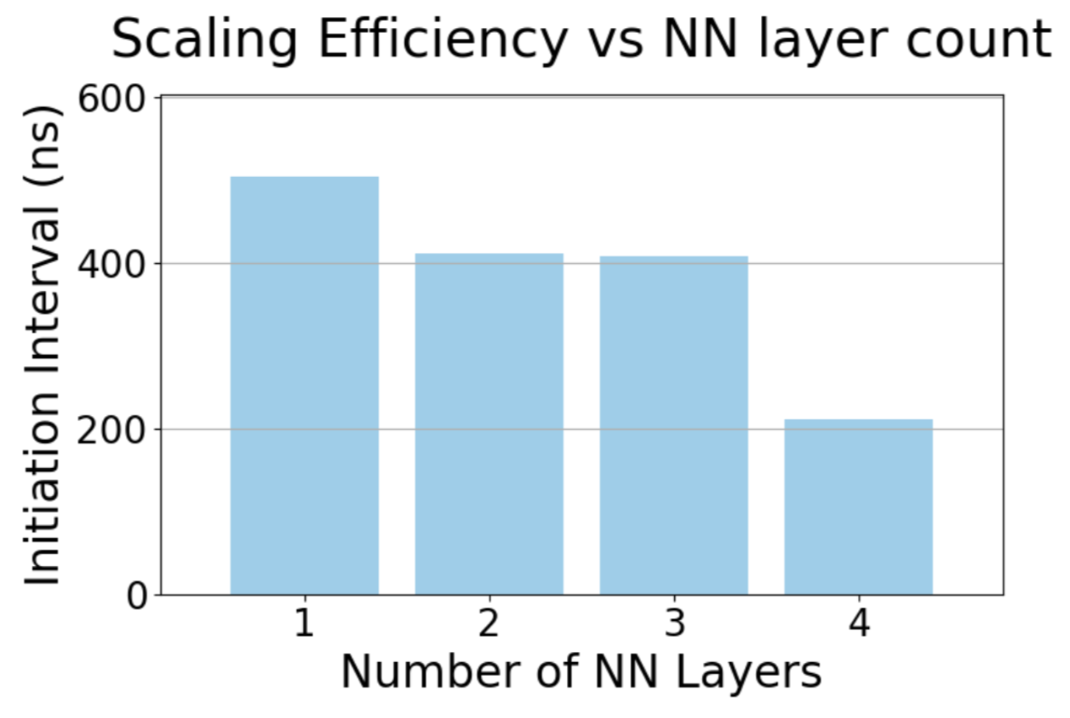
Benchmarking
11/08/2025
5
Notes:
After developing the core MLP generation tool, a benchmarking suite was put together to explore the scaling efficiency of larger grap hs easily. This tool allowed for concurrent runs to be done easily, speeding up evaluation time significantly. Our ACAP MLP execution performed at between 70-90% of the theoretical maximum with some unexplained stalls hindering our ability to achieve the theoretical performance.

Slide 6
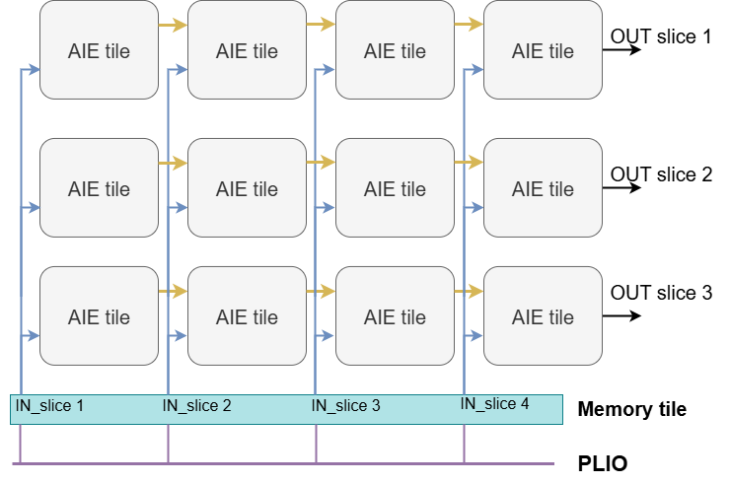

Transition to AIE
11/08/2025
6
Notes:
Once ACAPs were proven viable, we’ll need to transition from FPGAs to ACAPs. ATLAS being the biggest experiment wanted to transition first, selecting the 1st gen ACAPs from Xilinx for a progressive transition since they have a good balance of FPGA and ACAP material. Unfortunately porting from FPGAs to ACAPs wasn’t a matter of dropping in our new HW code since 1st gen ACAPs don’t having memory tiles. These didn’t have mem tiles which allow for read-time transposition, so a dedicated HLS kernel had to be developed to do the windowing from PLIO to AIE.

Slide 7
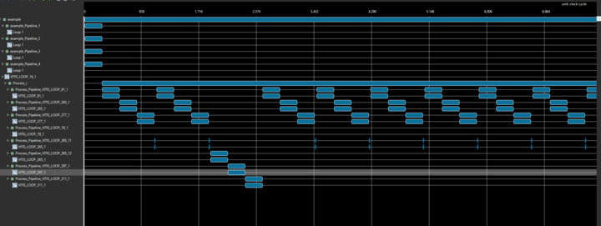
Profiler
11/08/2025
7
Notes:
As a side quest, I put together a stall detection tool to supplement the built-in profiler. The tool gave more insight into resource states during stalls done by combining post-sim trace parsing with sim-time triggers. The stalls were found to be erratic rather than deterministic, and I’ve yet to find a fix – that’s for future work, alongside extending the hardware to support sparse kernels.

Slide 8
Thank you!
Q&A

Slide 9
Sparse Kernels
11/08/2025
XXXXXXXXXXXXXXX
9
Notes:
Another exploration avenue is to evaluate sparse execution in AIE MMs.

