Slide 1

Abuse and Anomaly Detection Using Machine Learning for GitLab runners
Diana Nersesyan
Supervisors: Subhashis Suara, Ismael Posada Trobo

Slide 2
Table of Contents
01
Introduction to the CERN’s GitLab Infrastructure
02
Goals of the Project
03
Technical Challenges
04
Milestones Achieved
05
Further Work
06
Q&A
12/08/2025
Diana Nersesyan
‹#›

Slide 3

Introduction to the Infrastructure
Scale of Operations
  > 17k active GitLab users
  > 170k projects
  > 20k pipelines triggered per month
  > 50k jobs executed every day
12/08/2025
Diana Nersesyan
‹#›

Slide 4
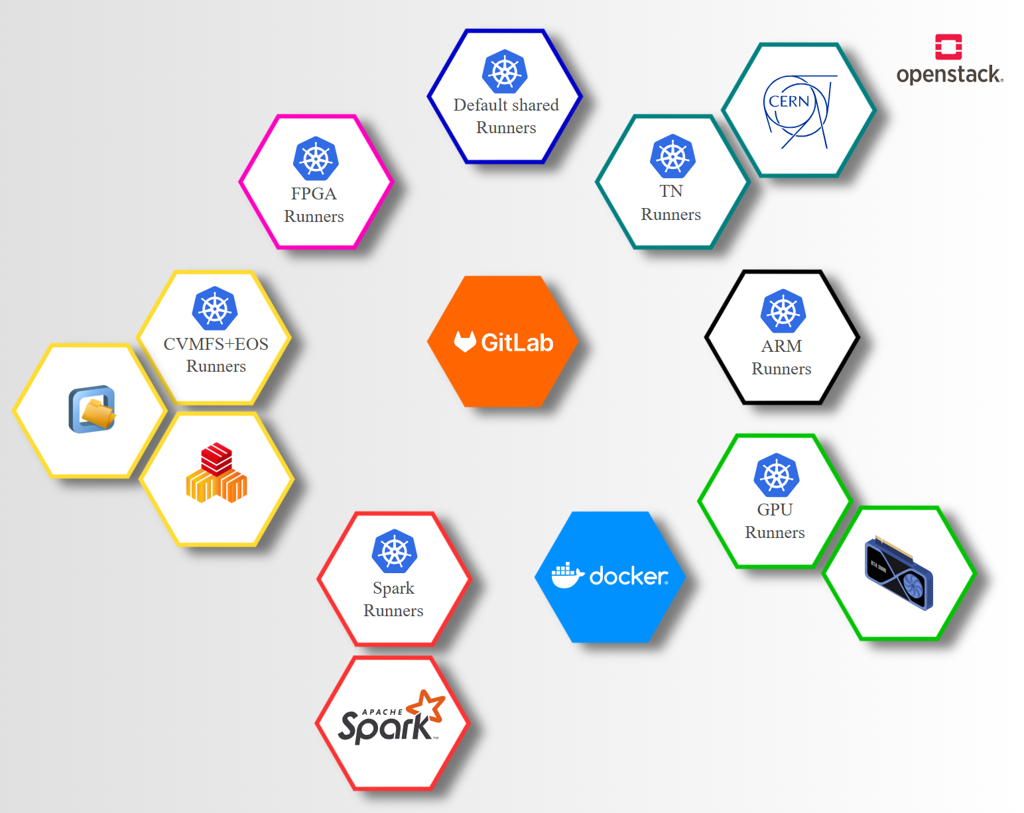
Introduction to the Infrastructure
12/08/2025
Diana Nersesyan
‹#›

Slide 5
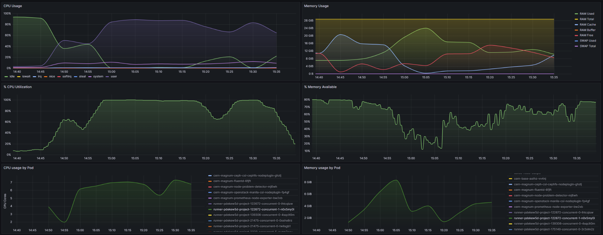
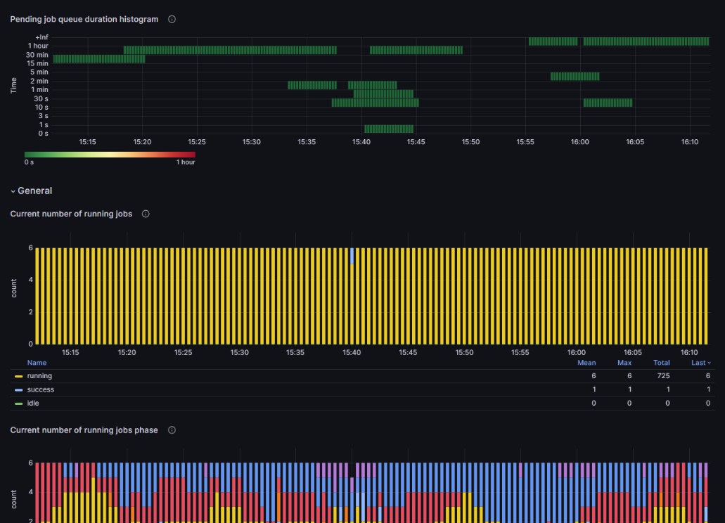
Grafana Dashboards
12/08/2025
Diana Nersesyan
‹#›

Slide 6
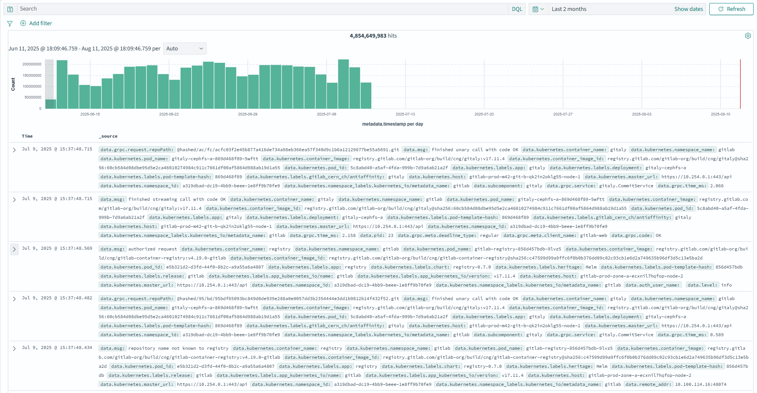
OpenSearch Logs
12/08/2025
Diana Nersesyan
‹#›

Slide 7

Goals of the project
Detect and pinpoint resource abuse or misuse at the project level, including identifying the responsible user.
Provide timely alerts to the GitLab team when abuse or critical anomalies are detected.
Build and deploy a real-time anomaly detection pipeline capable of processing and analyzing metrics continuously.
Seamlessly integrate the detection system into the existing monitoring stack (Prometheus, Grafana, OpenSearch) without introducing overhead.
12/08/2025
Diana Nersesyan
‹#›

Slide 8
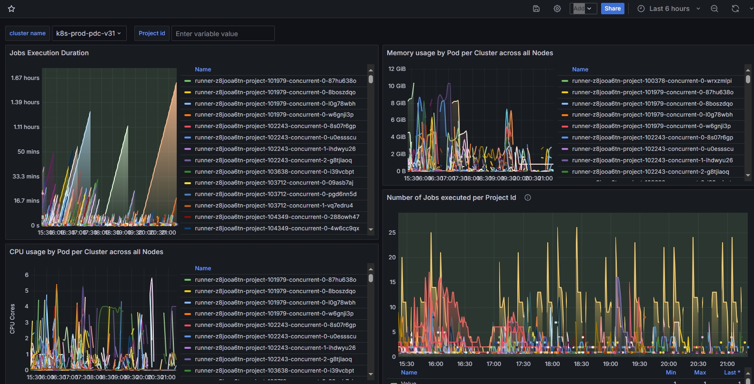
Technical Challenges
Selecting the Right Metrics
Mapping Metrics to Projects
Exporting Large Datasets
Preprocessing Time-Series Data
Choosing and Testing Anomaly Detection Models
12/08/2025
Diana Nersesyan
‹#›

Slide 9
Milestones achieved
Researched Grafana and OpenSearch solutions for anomaly detection
Planned the full system workflow from data collection to alerting
Designed a unified data preprocessing pipeline
Explored multiple anomaly detection approaches for time-series (both univariate and multivariate)
Testing Isolation Forest in a multivariate setup
12/08/2025
Diana Nersesyan
‹#›

Slide 10

Further Work
Model Selection and Optimization
OpenSearch Logs Integration for Security
Real-Time Pipeline Deployment
12/08/2025
Diana Nersesyan
‹#›

Slide 11
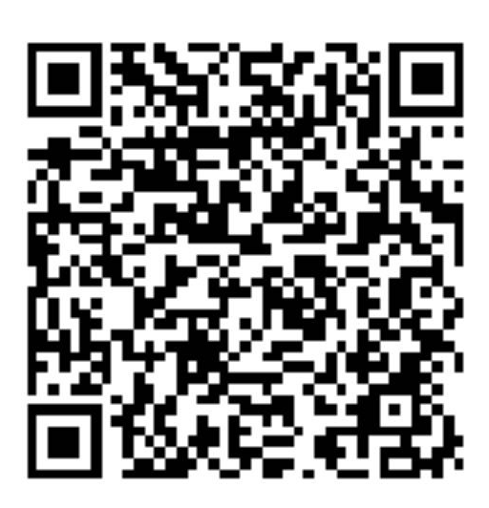
Thank you!
Questions?
Email: diana.nersesyan@cern.ch
LinkedIn: use QR

