Slide 1


AI-Enhanced Operator Assistance for UNICOS Applications
Bernard Tam
MCybersec, University of Sydney
BAdvComp, University of Sydney
Supervisor: Dr Jean-Charles Tournier

Slide 2

What is UNICOS?

Slide 3
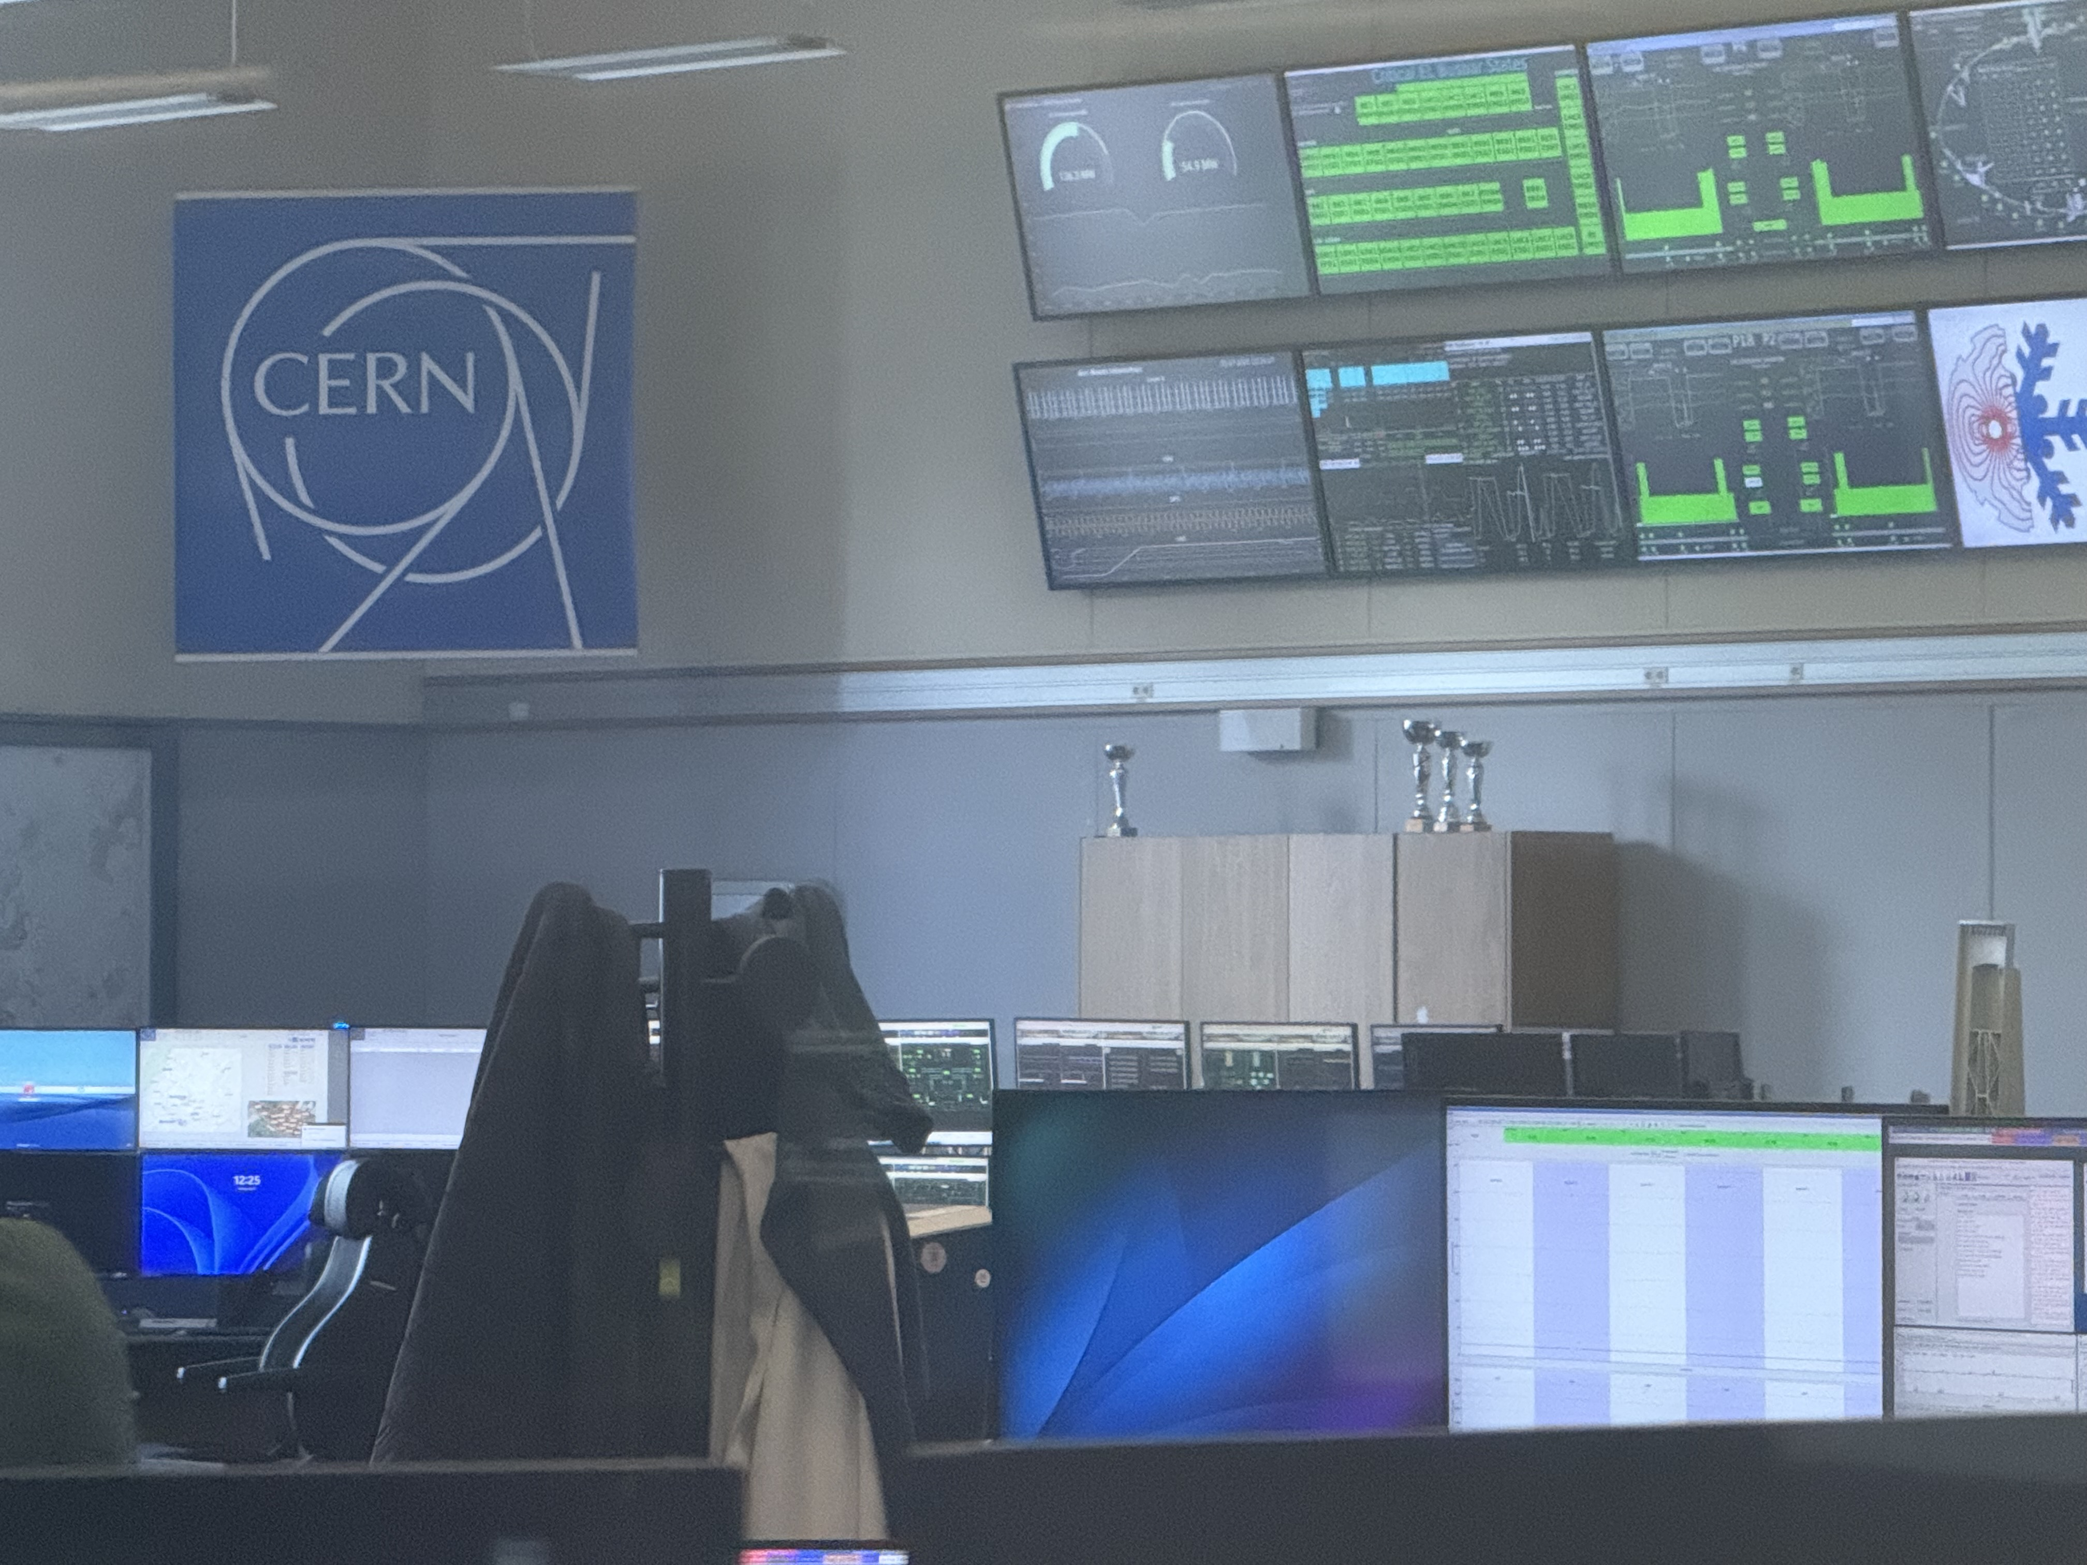
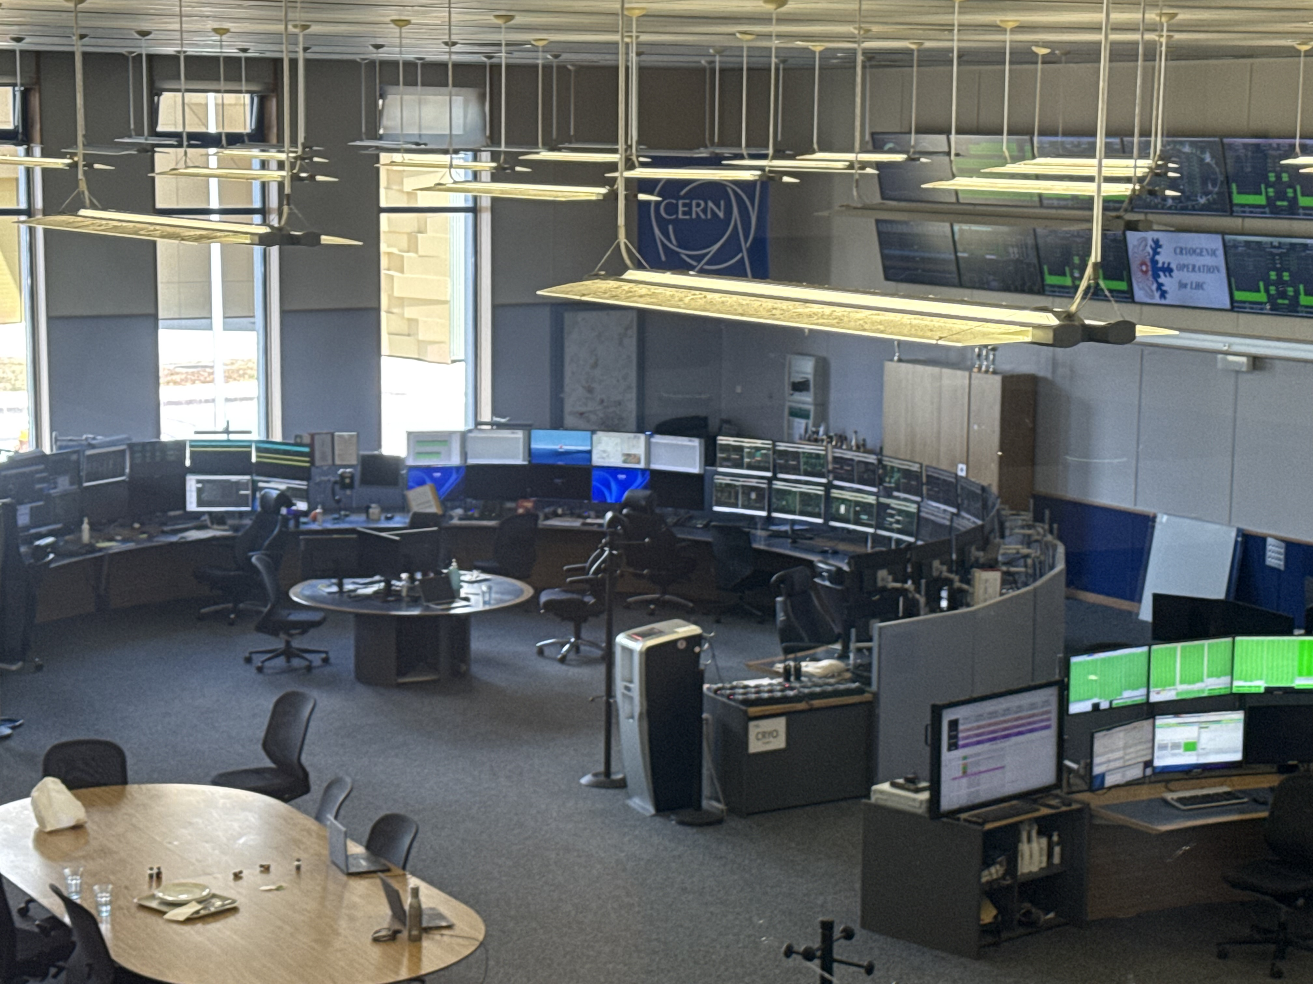
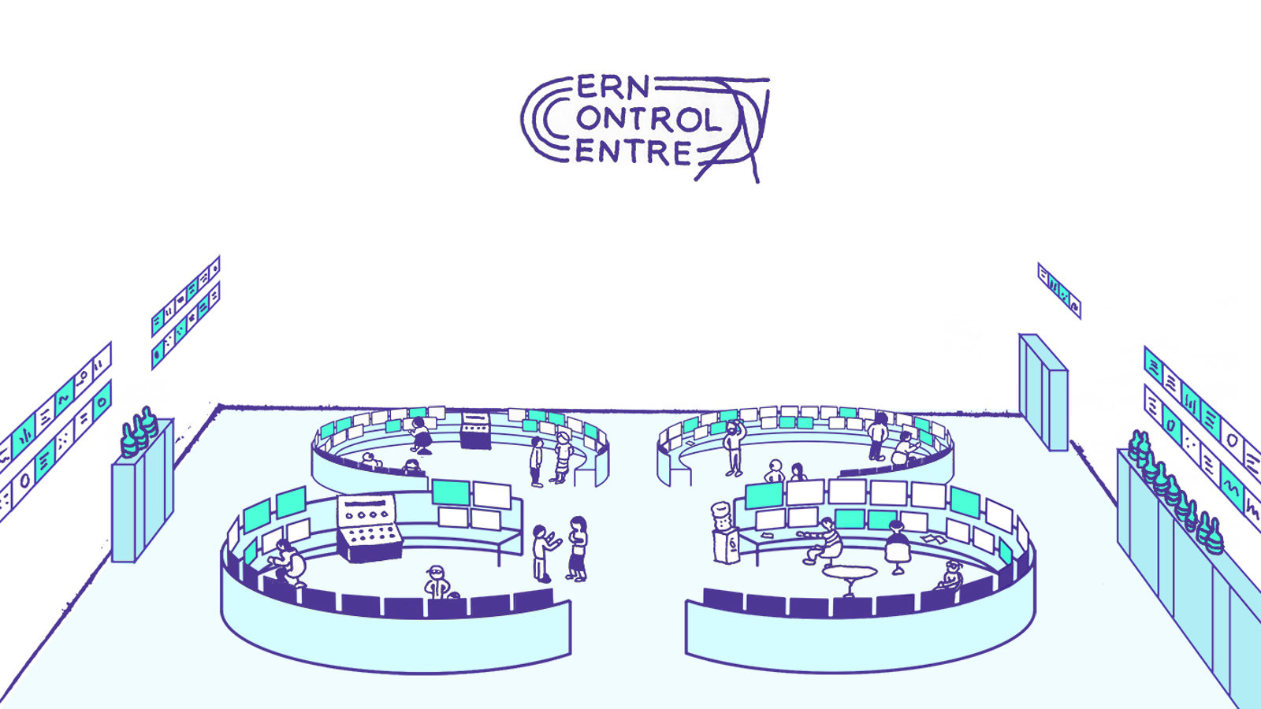
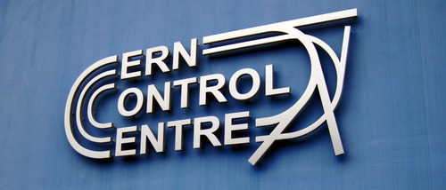
Notes:
Unicos is a framework to build industrial control systems at CERN
As Lasse showed, more than 800 systems at CERN use WinCC OA 250 of those systems are implemented in UNICOS

Slide 4
Let’s take a closer look

Slide 5
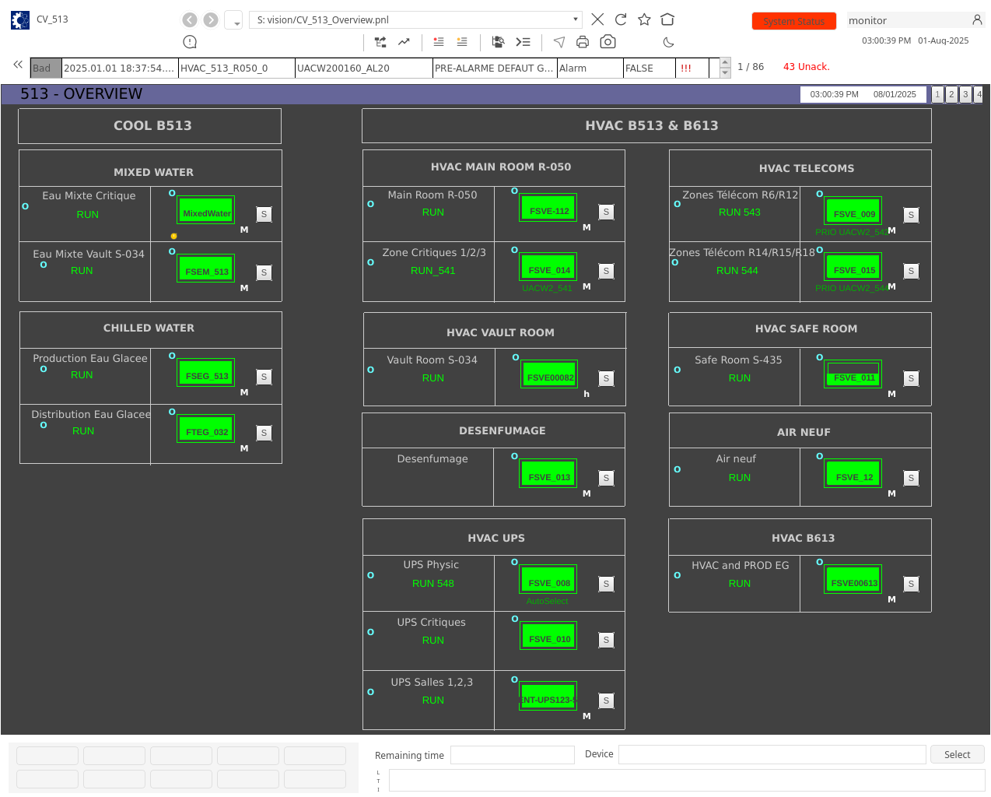

Slide 6
Why do we need AI?

Slide 7

12/08/2025

Slide 8
What does this even mean?
12/08/2025

Slide 9
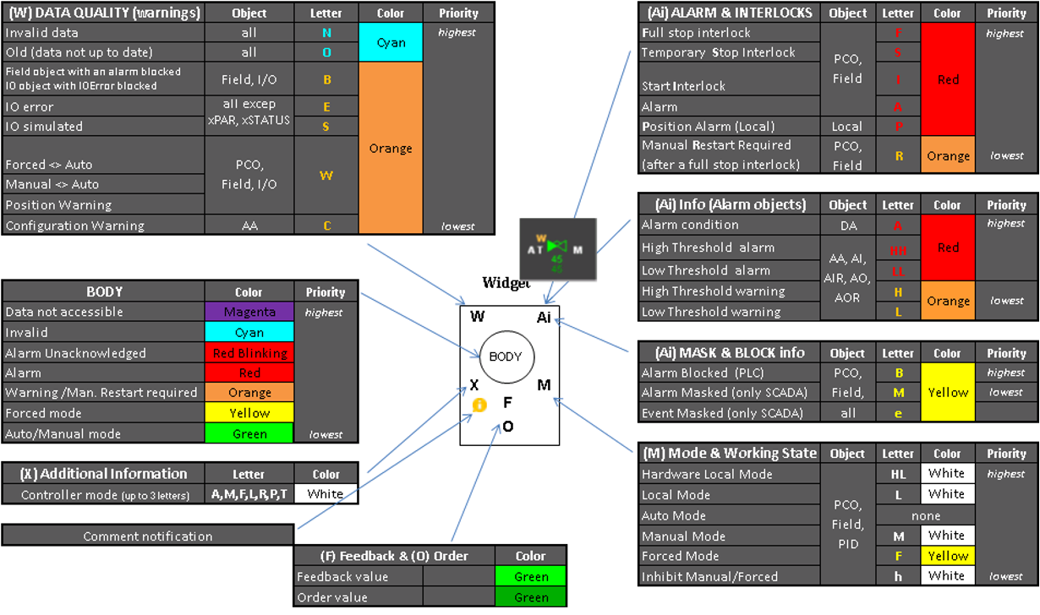
12/08/2025

Slide 10
Pain Point Analysis
Information overload and high cognitive load when decoding widget
Solution: AI Widget Decoding
Manual effort and time-consuming to diagnose the root cause of an issue
Solution: AI Root Cause Analysis
Complex codebase structure and spaghetti code stand in the way of determining which data point elements animate different parts of a widget
Solution: AI Tracing of Widget Part Animation DPEs

Slide 11
AI Widget Decoding
Widget Image Manipulation
Image Segmentation
Image Upscaling
Data Extraction
ReAct Agent and Tool Calling
Retrieval Augmented Generation (RAG)
Query Documentation Tool

Slide 12
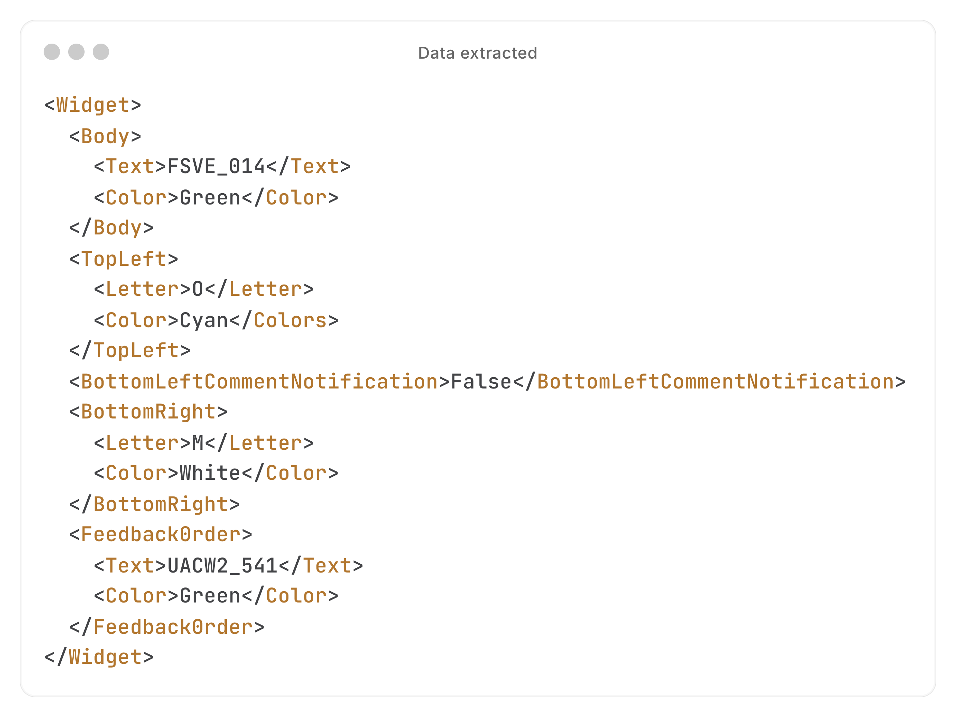

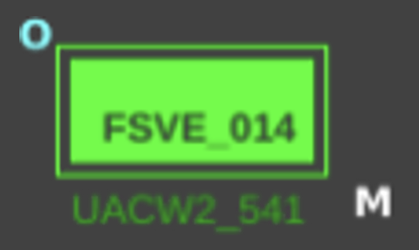




AI Widget Decoding
Image Segmentation
Image Upscaling
Data Extraction
Tool
Calling
Summary Generation

Slide 13
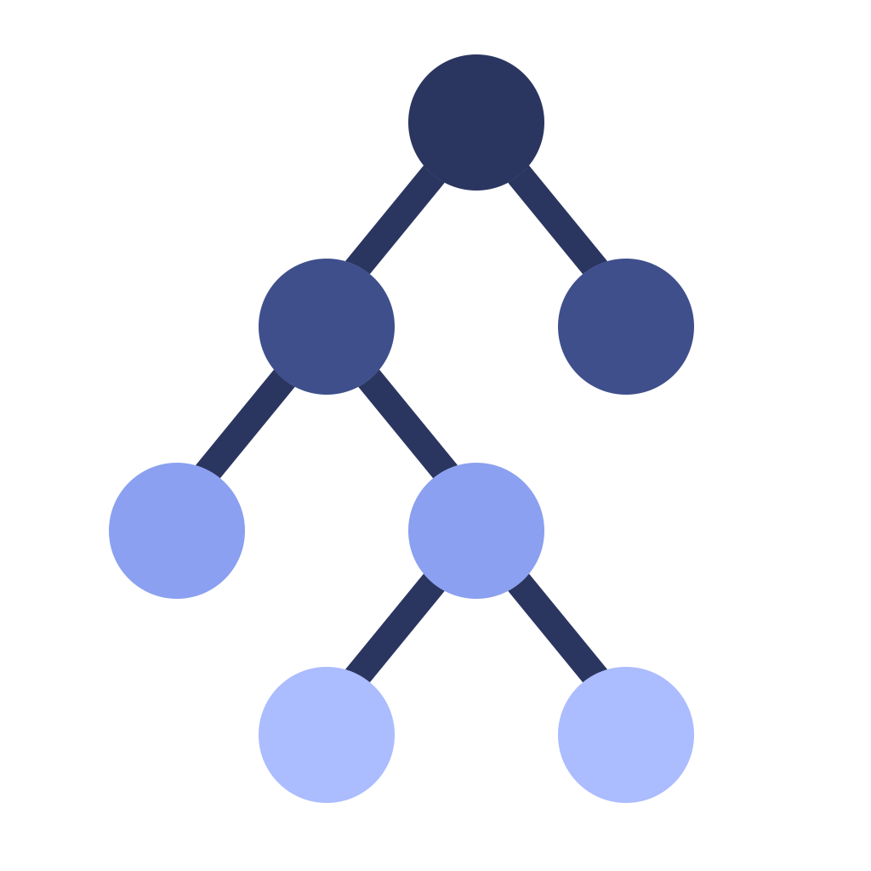
AI Root Cause Analysis
ReAct Agent and Tool Calling
Retrieval Augmented Generation (RAG)
Query Documentation Tool
UNICOS REST API Endpoints
Get Widget Master/Parents
Get Widget Children
Get Widget Alarms
Get Widget Frontend/Device Status
Get Widget Device Type
Notes:
Mention hierarchy of devices→ in UNICOS there is a hierarchy of devices which affect each other, agent will use endpoints to traverse such hierarchy and attempt to diagnose root cause
UNICOS tends to represent complex devices at an atomic level – a widget could represent either a device or a signal coming from a device

Slide 14
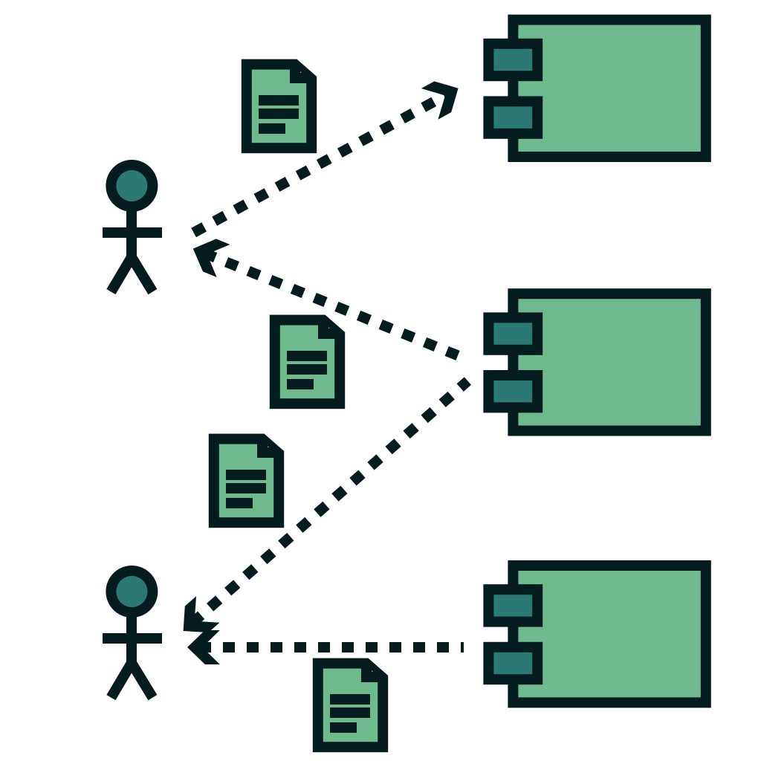
AI Tracing of Animation DPEs
ReAct Agent and Tool Calling
Retrieval Augmented Generation (RAG)
Query Codebase Tool
Filter by semantic similarity
Filter by name of file
Filter by name of method
Combination of the above
Notes:
Signals from control room used to animate those widgets
To debug problem, need to know what signal is animating it
Say signal instead of DPEs for clarity

Slide 15
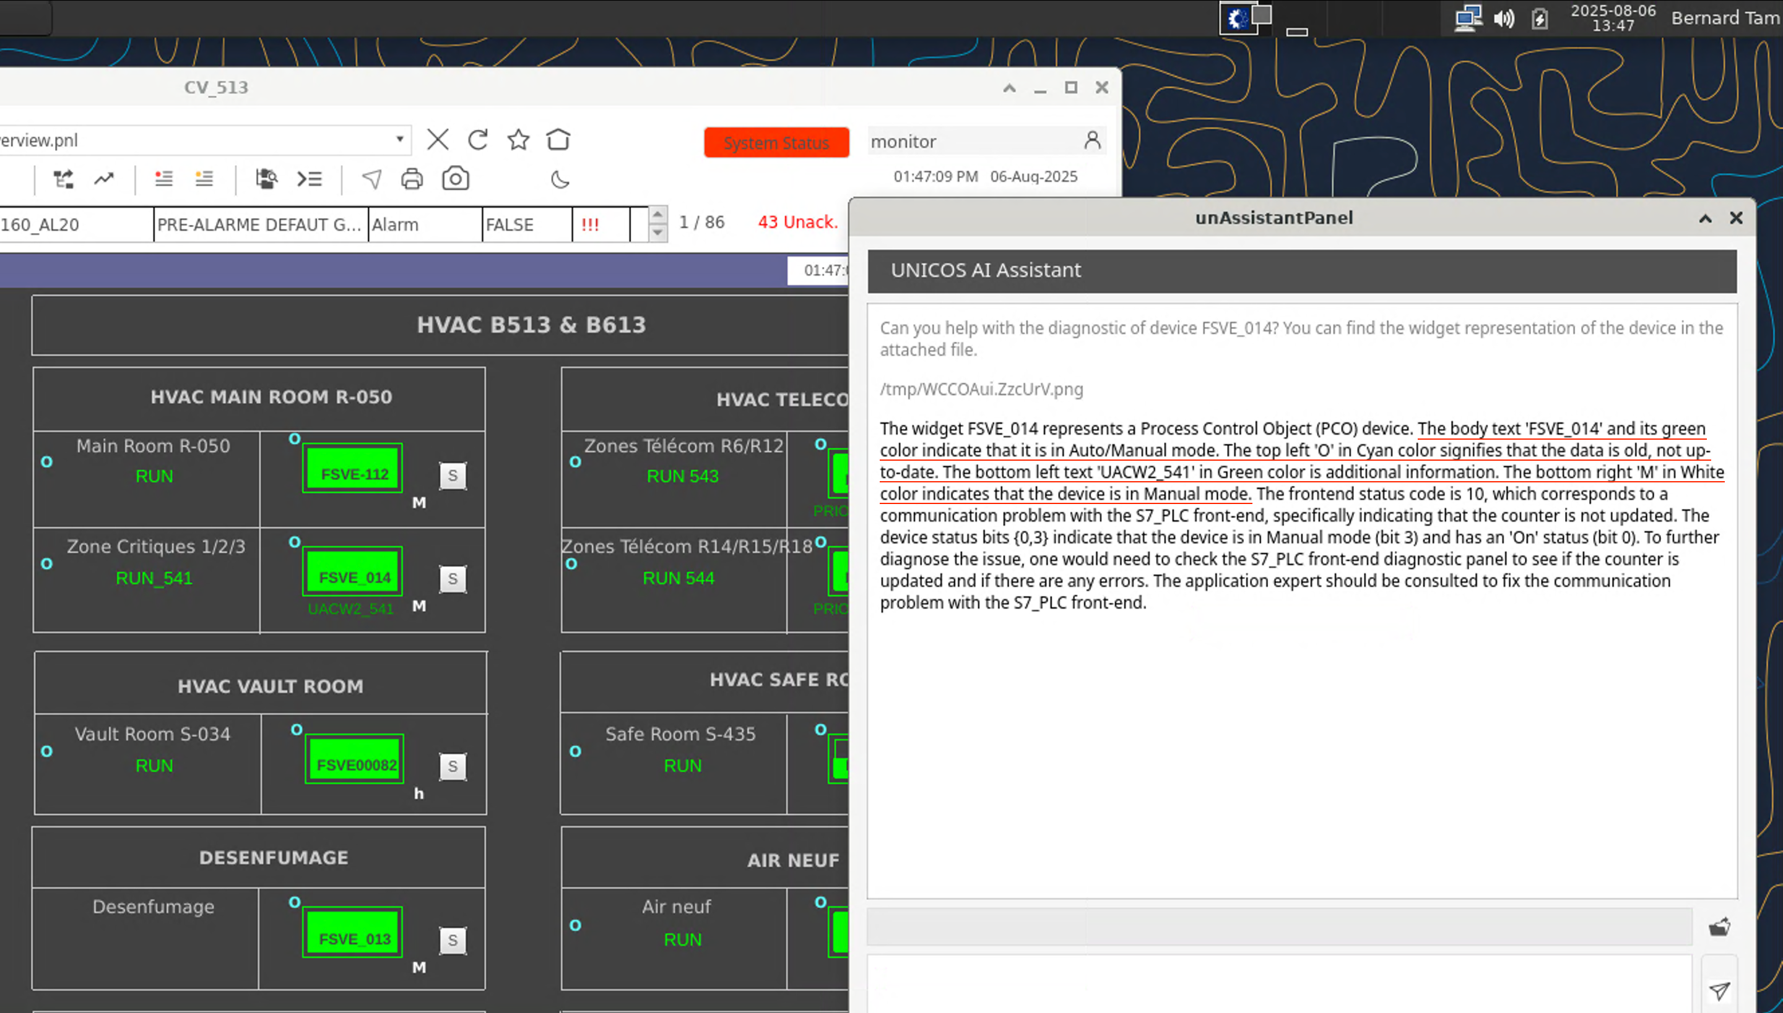
Demo

Slide 16
Achievements
Multi-agent system that addresses the 3 pain points mentioned
First step in providing AI powered assistance to operators in the CCC
Future Work
Fine-tuning models with domain-specific data
Extending usage of the vector database storing the codebase to different contexts and purposes
Developing CI/CD pipelines to update the vector database
Changes in the production codebase must automatically be synchronized

Slide 17


Thank you!

