Slide 1


\\\\]\\
\
\
\]]]]]]]]]]]]]]]]]]
Energy Efficiency and Performance Analysis of
Monte-Carlo Event Generators for HEP
Raisa Rahman Richi, Franklin and Marshall College
Supervisors: Daniele Massaro, Stefan Roiser, Markus Schulz
Notes:
Add date, slide number

Slide 2

Objective
Study of power consumption and energy usage of Madgraph event generators
Vectorized CPU architecture like AVX2 and AVX512
Using parallel GPU architecture
Notes:
Backends> gpu programming language

Slide 3
Big Picture
Particle Accelerators e.g LHC
Event Generator- Madgraph
Detectors: ATLAS, CMS,
LHCb, ALICE
Detector Simulation
Event Reconstruction
Physics Analysis
Notes:
Remove animations
Double arrow , different type
Here’s the big picture: You start with particle accelerators like the LHC—these smash particles together. On the right side, we have event generators like MadGraph, which simulate what those particle collisions would produce. These simulated outcomes go through detector simulation, which models how detectors like ATLAS or CMS would ‘see’ these events. Finally, both real and simulated data feed into event reconstruction and then into physics analysis, helping us test theories or discover new particles.

Slide 4

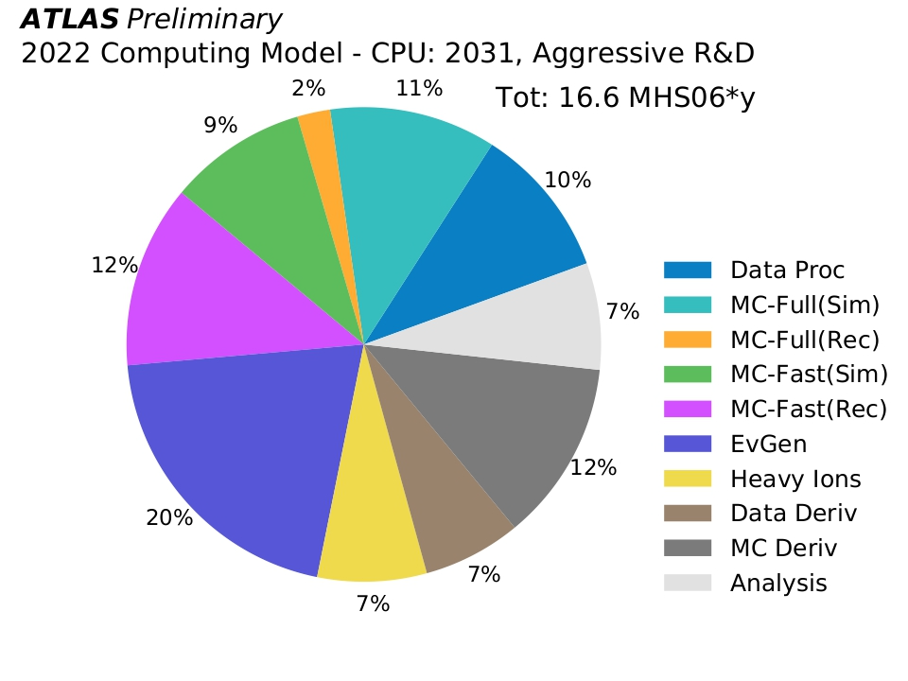
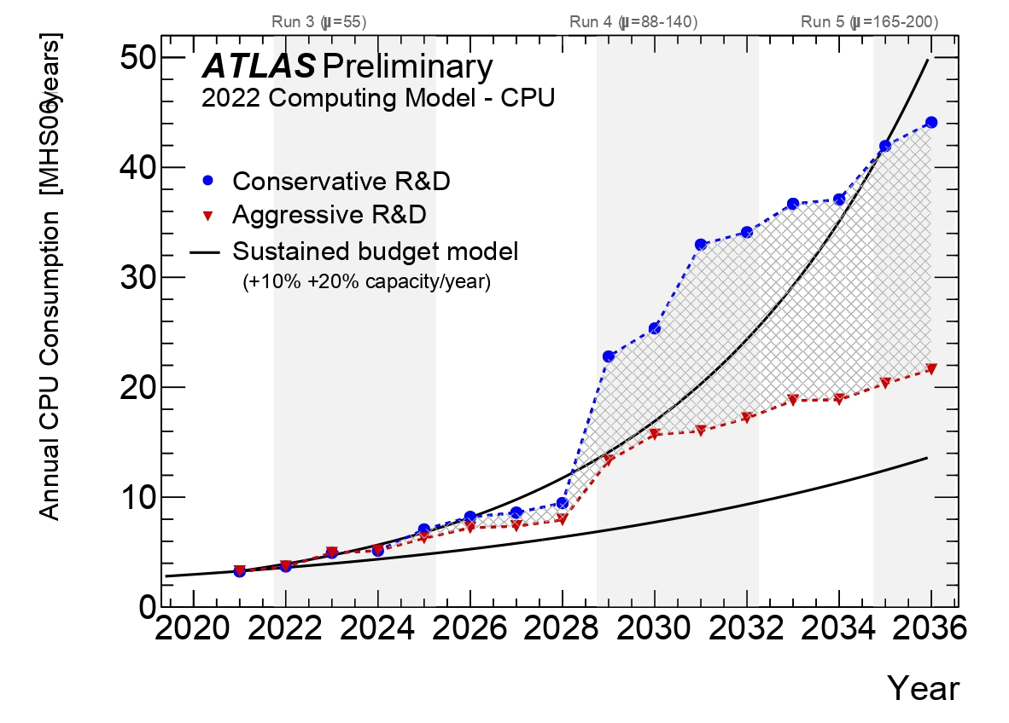
MOTIVATION
Monte Carlo generators like MadGraph use 20% of computing resources
More CPU or alternative hardware is needed
Consider environmental impact
[ATLAS HL-LHC Computing Conceptual Design Report,2022]
Approach
Use SIMT GPUs like Nvidia and AMD
Use SIMD CPUs like AVX2 and AVX-512
Notes:
This graph shows We need to be more efficient with our hardware choices

Slide 5
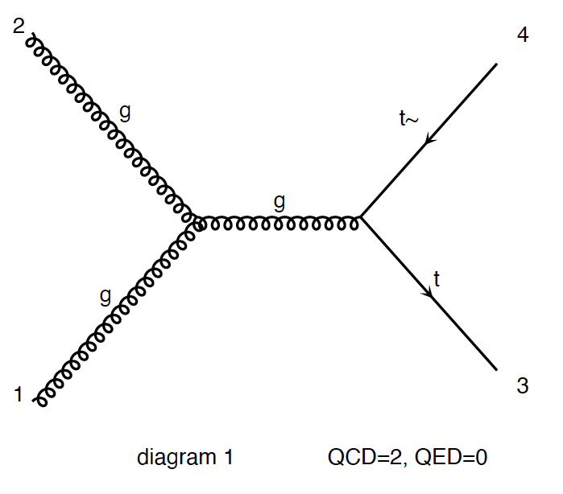
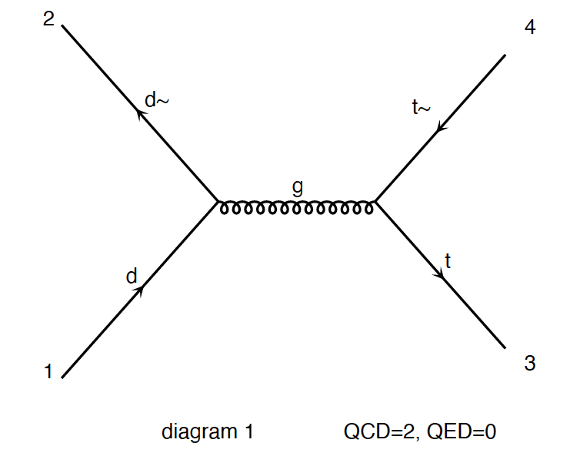
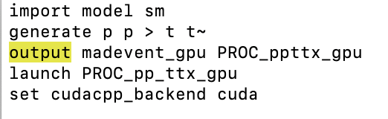
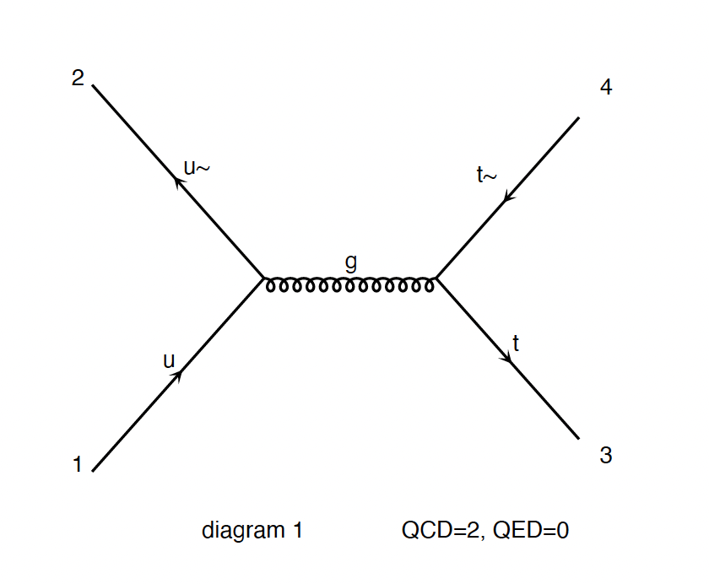
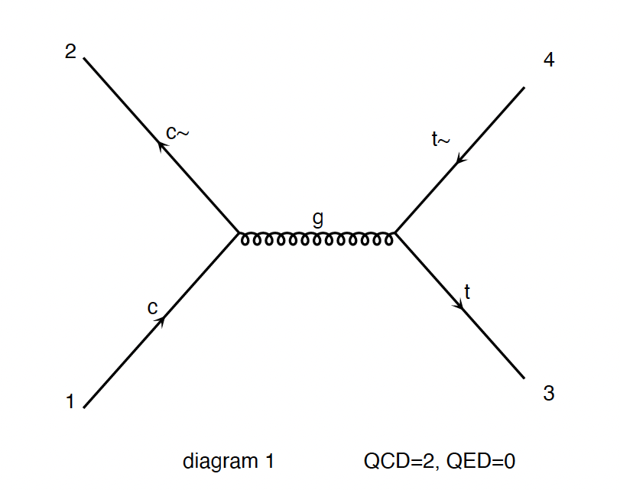
STEPS
1. Single Thread Madevent:
Madevent_gpu: to run processes on GPU
Madevent_simd: to run processes on vector CPUs
Runs the madevent generator for a single scattering sub-process
2. WITH GRIDPACK: (Used by Experiments)
Pre-compiled package
Runs on multiple sub-processes

Slide 6
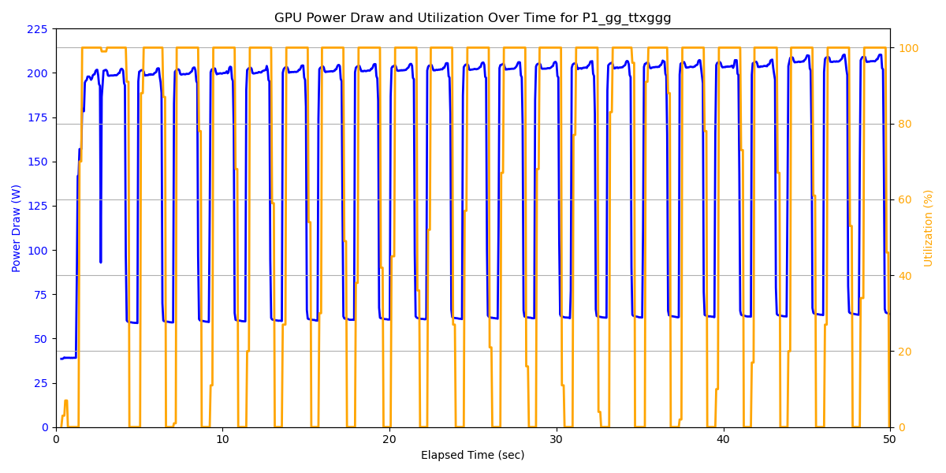
GPU Power and Utilization
Single thread run done using Nvidia V100 GPU
Notes:
GPUs run events in Batches so Events are sent to gpu and then they are sent back to us - the reason for fluctuations,
Event num- 1M
Max power for Nvidia-250W
Single thread run done using Nvidia V100 GPU- write using textbox

Slide 7

Reliable Power Measurements on Gridpacks
Use Cluster – CISM
Execute commands via Slurm (with --exclusive flag)
Generate gridpacks for various hardware and processes
- Hardware: cuda, fortran, cppavx2
- Node : mb-mil101
- Processes: g g > t t~ ng, u u~ > e+ e- ng
Developed automated scripts for gridpack generation and job launching
Run the run.sh on a single node for:
- Different values of threads and event number
- Log start and end times of each execution
Notes:
Explain why we can’t use cpu here because it is running on a shared resource
Don’t talk about slurm in detail
No need to talk about system administrator
Slurm acts as a job scheduler so it allows the user to submit jobs to the cluster using slurm commands,
Calcul Intensif et Stockage de Masse(Cluster)

Slide 8
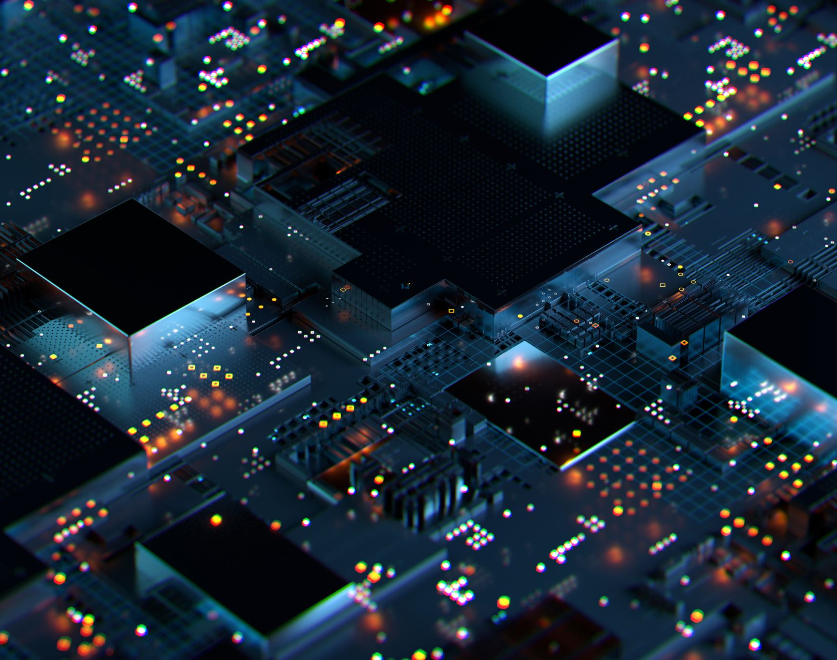
Future Steps
Record the power consumption of GPU and CPU on gridpacks and produce plots
Calculate energy by integrating power over time
Calculate the CO2 emissions from the energy https://app.electricitymaps.com/map/72h/hourly
Notes:
Scripts are running on the cluster and they have finished running previous week
The machines use electrical energy and we have the option to see how much CO2 is emitted per KwH and we can then multiply can calculate the amount of C02

Slide 9

Thank you!
Email | raisa.rahman.richi@cern.ch
LinkedIn | Raisa Rahman Richi
Website | openlab.cern
Scan Me!

Slide 10
Backups

Slide 11
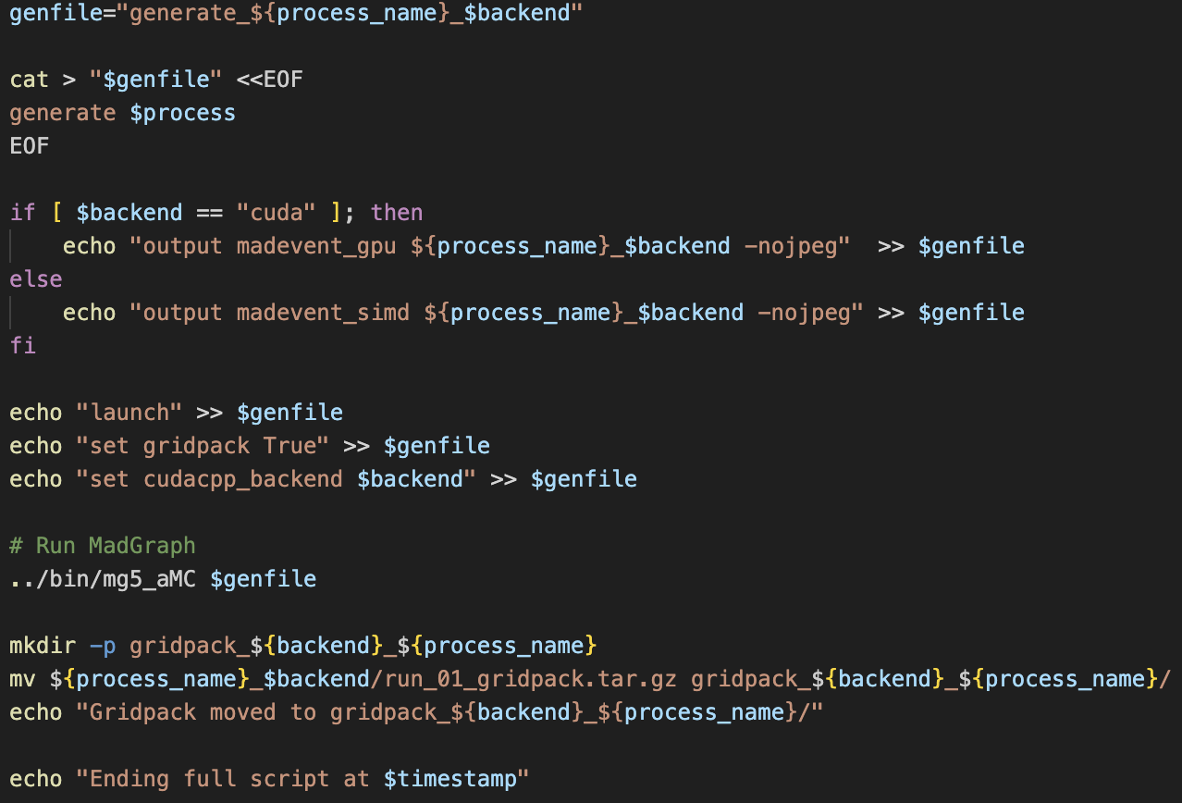
Generating Gridpacks
Notes:
Scripts to automate

Slide 12
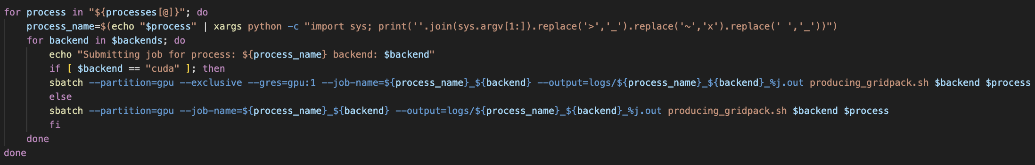
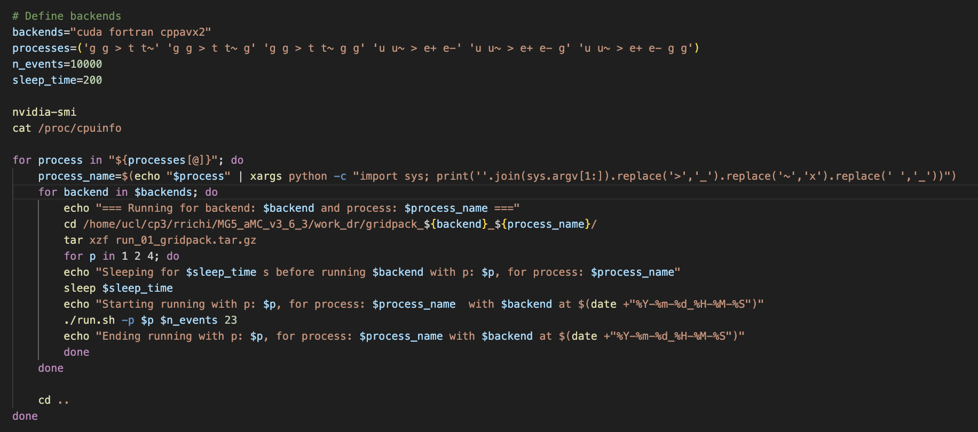
Launching with Sbatch

Slide 13
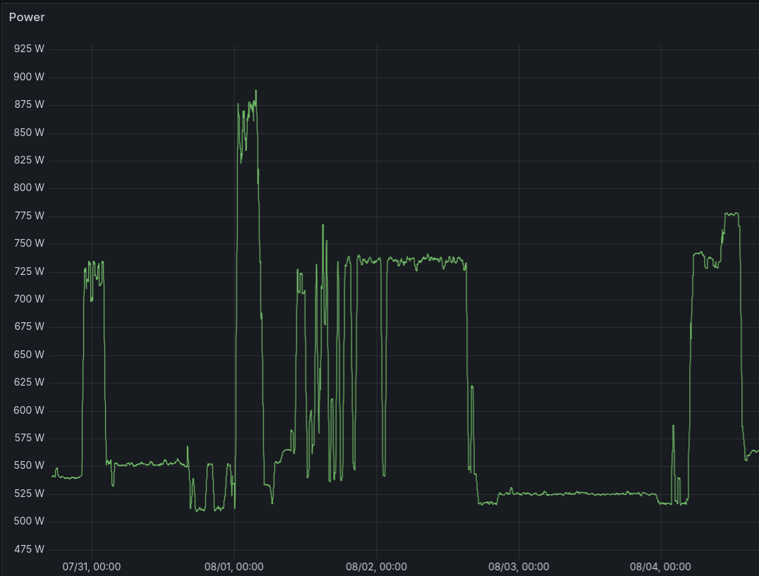
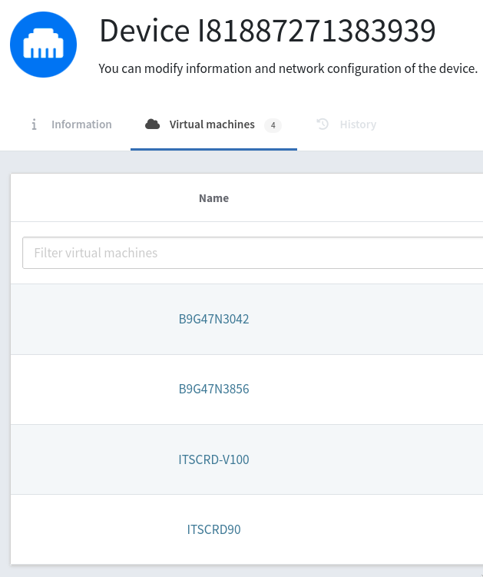
CPU- Reliable?
No Because Shared!

Slide 14
What is MadGraph?
Simulates Particle Collision
Generates Feynman Diagrams
Calculates physical quantities like cross sections
Matrix Element Event Generator
User defines initial and final particles

Slide 15

WHY MADGRAPH?
Vector CPUs & GPUs are hard to utilize in HEP due to complex software workflows
MC detector simulations involve stochastic branching, limiting data-parallel (SIMD) processing
Matrix Element Event Generators (like MadGraph) compute scattering amplitudes at independent phase-space points. This makes them ideal for SIMD & GPU acceleration
Leverage hardware accelerators to reduce compute time & energy consumption
Notes:
As particles move through the detector in simulation, each one might:
Scatter
Decay
Absorb
Pass through
Create secondary particles
Whether and how this happens depends on probabilities (i.e., random numbers) at each step.
This means the execution path for each simulated particle can be very different — called branching.
Each phase-space point calculation is completely independent of the others.
No branching or decision-making depends on other points’ results.
You simply apply the same mathematical formula repeatedly, just with different inputs.
SIMD and GPUs excel when you apply the same operation to many data points simultaneously.
Since ME event generators run the same formula at many independent points, they perfectly fit the SIMD model.
This means you can:
Use vector instructions on CPUs (SIMD),
Or launch thousands of GPU threads, each computing a phase-space point,
All without worrying about divergence or branching.

Slide 16
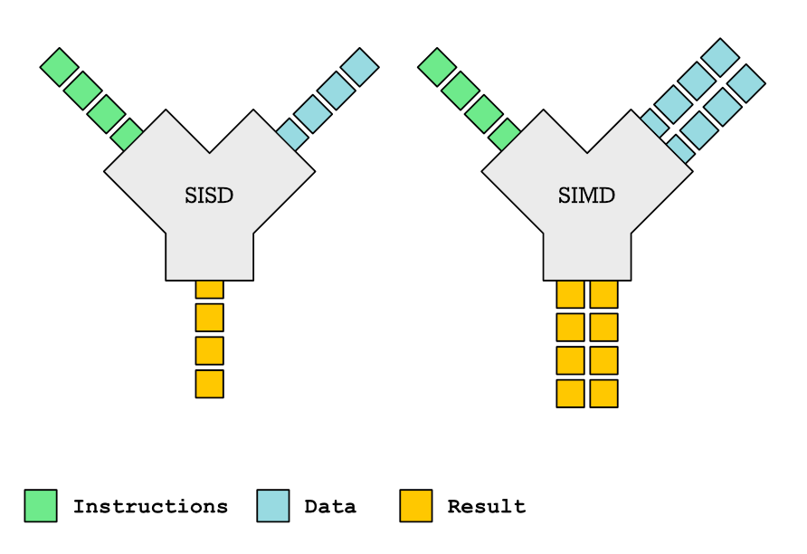
SISD (Single Instruction Single Data):
Single processor executes
one instruction at a time
Requires more execution time
Cannot scale well with increased computational needs
SIMD (Single Instruction Multiple Data):
Process data points in parallel
Excels in tasks requiring repetitive operations, reducing execution time
Ensures proper memory alignment for faster execution
Notes:
Remove this slide

Slide 17
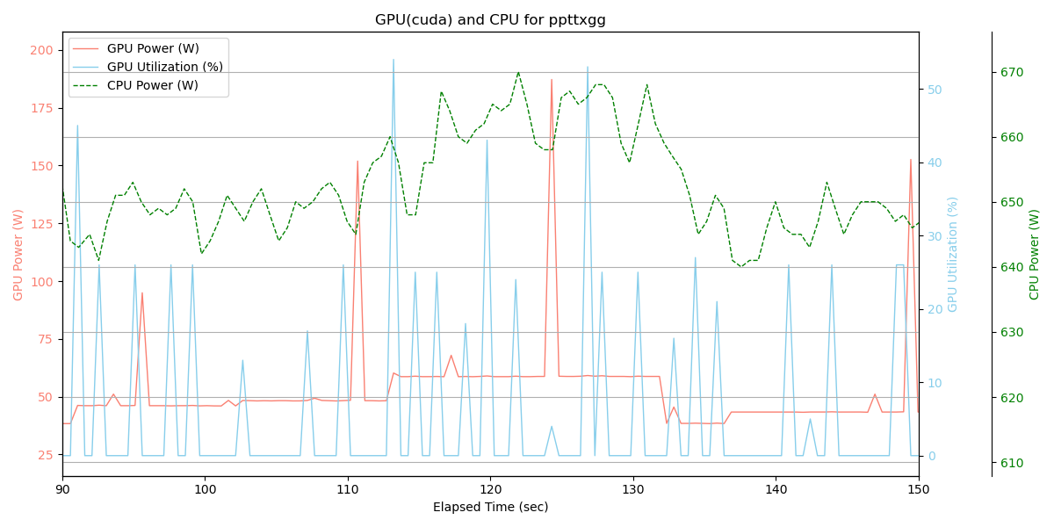

Slide 18
