Slide 1

Flash Storage Potential in Large-Scale Physics Workflows
Robert-Paul Pașca
Supervisors:
Andreas Joachim Peters
Luca Mascetti

Slide 2


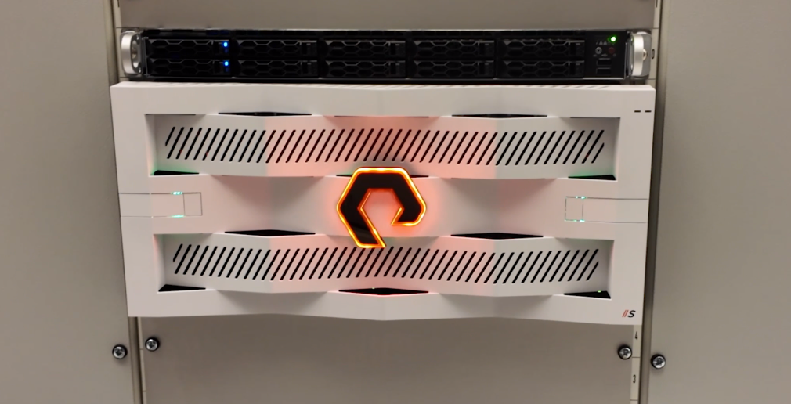


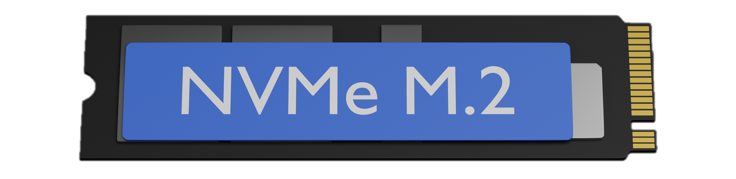



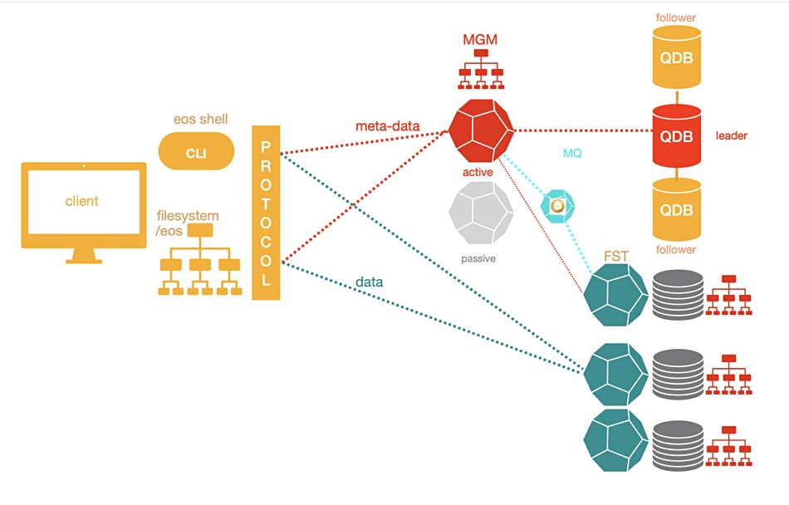


Roadmap
MPI
12/08/2025
Flash Storage Potential in Large-Scale Physics Workflows
2

Slide 3
Pure Storage Appliance
Specifications:
Model: Purestorage Flashblade S
Storage Capacity:
  Raw 3 PB (40x75TB)
  Usable 2 PB (Erasure Coding)
Protocol Support: NFS3/4, SMB, S3
Networking: 8x100GE bonded interfaces with virtual IP
12/08/2025
Flash Storage Potential in Large-Scale Physics Workflows
3

Slide 4
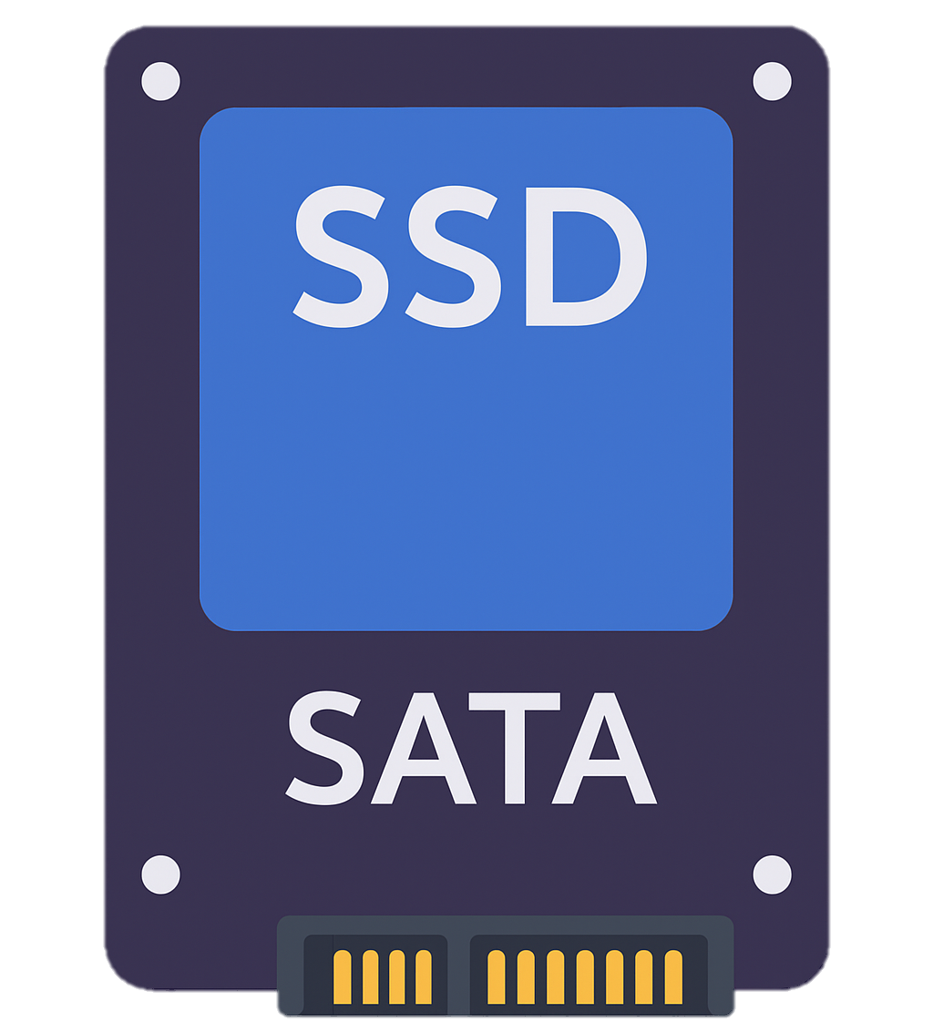



Idea of the project
Different storage devices:
SSD – High Performance (High Bandwidth, High IOPS)
  NVMe M.2
      💰 ~$60 per TB
      Expensive, shorter lifespan
  SATA
      💰 ~$50 per TB
      Moderate cost, good performance
HDD – Low Performance (Low Bandwidth, High Capacity)
      💰 ~$15 per TB
      Very cheap, long lifespan
LTO Tape – Very Low Performance
      💰 ~$5 per TB
2x speed
1,000-5,000MB/s
1x speed
300-500MB/s
0.2x speed
50-120MB/s
* Values compared with SSD SATA
12/08/2025
Flash Storage Potential in Large-Scale Physics Workflows
4

Slide 5

Phase 1: MPI
  Goal: Stress-test the system under realistic distributed workloads using MPI.
  Scenario: Simulate multiple nodes concurrently reading and writing files to evaluate the system’s durability, scalability, and fault tolerance under I/O pressure.
MPI
Medium
Catastrophic
Easy
12/08/2025
Flash Storage Potential in Large-Scale Physics Workflows
5

Slide 6
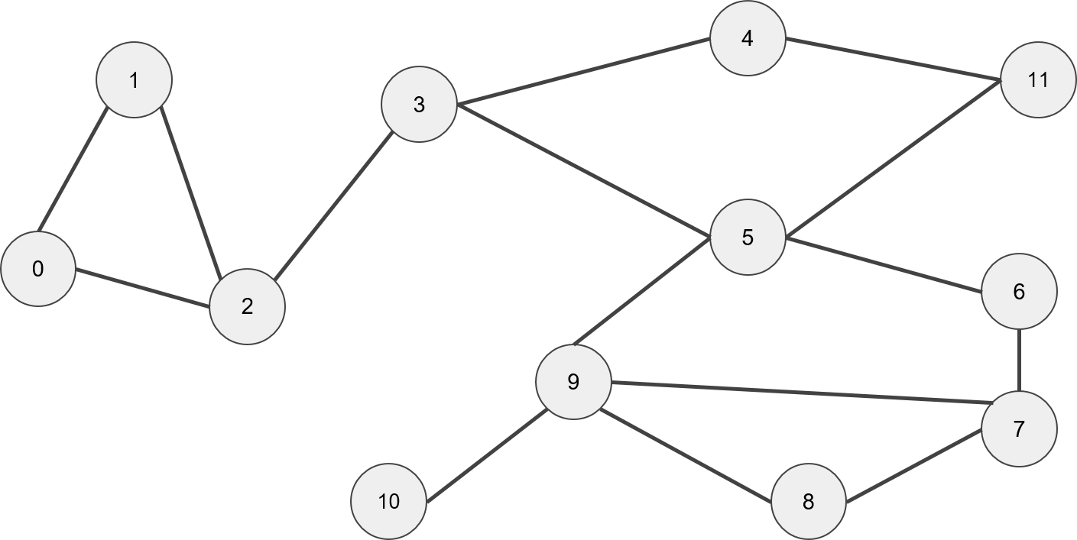
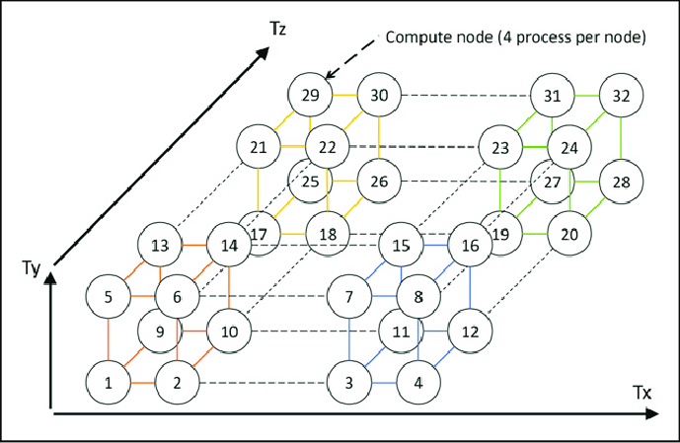
What is MPI?
  Message Passing Interface (MPI):
  standardized and portable framework used in parallel computing
  multiple computing nodes, which can be either separate machines or processor cores within the same machine
MPI
12/08/2025
Flash Storage Potential in Large-Scale Physics Workflows
6

Slide 7





MPI Benchmarking
MPI
…
Worker Process
…
Master Process
Write
Bandwidth
IOPS
Worker Process
Read
.conf
Worker Process
12/08/2025
Flash Storage Potential in Large-Scale Physics Workflows
7

Slide 8
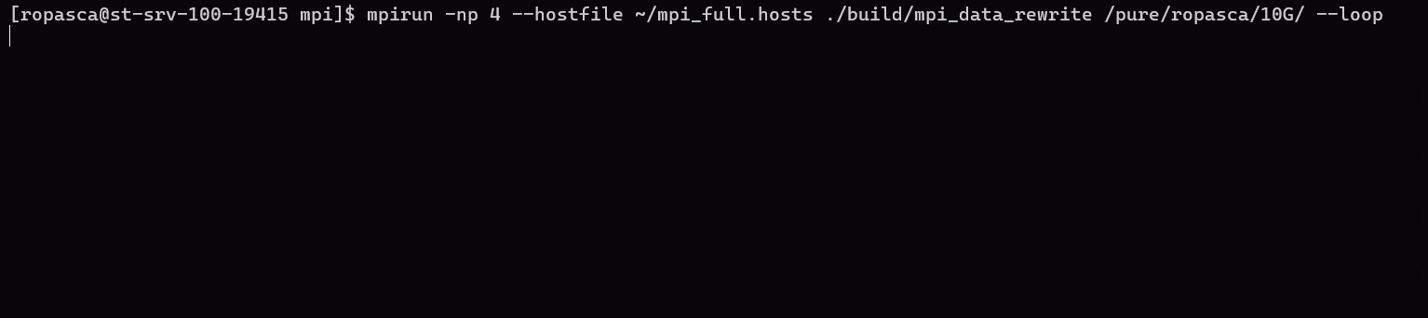
MPI Results
mpirun -np <nr_of_processes> --hostfile <host_file> ./build/mpi_data_rewrite <target_directory> [--loop] [--rate-limit=<rate_limit>]
MPI
12/08/2025
Flash Storage Potential in Large-Scale Physics Workflows
8

Slide 9


Phase 2: IO500
  Goal: Benchmark the performance and behavior of the storage system using IO500.
  Scenario: IO500 combines a mix of real-world I/O patterns (sequential and random reads/writes, metadata operations, and small file handling). It was used to go beyond raw throughput and test more subtle behaviors
  Benchmarking
12/08/2025
Flash Storage Potential in Large-Scale Physics Workflows
9

Slide 10
IO500 - Overview
IO500 is a widely used benchmarking suite designed to evaluate the performance of HPC storage systems. It combines multiple workloads that reflect real-world patterns, including metadata operations, read/write throughput, and small file performance.
The standard test suite includes:
• IOR Easy
• IOR Hard
• MDTest Easy
• MDTest Hard
• Find
Bandwidth-focused, sequential access pattern
Bandwidth test with more challenging access patterns
Metadata performance on separate directories
Metadata performance on shared directories
Filesystem traversal and pattern matchin
12/08/2025
Flash Storage Potential in Large-Scale Physics Workflows
10

Slide 11
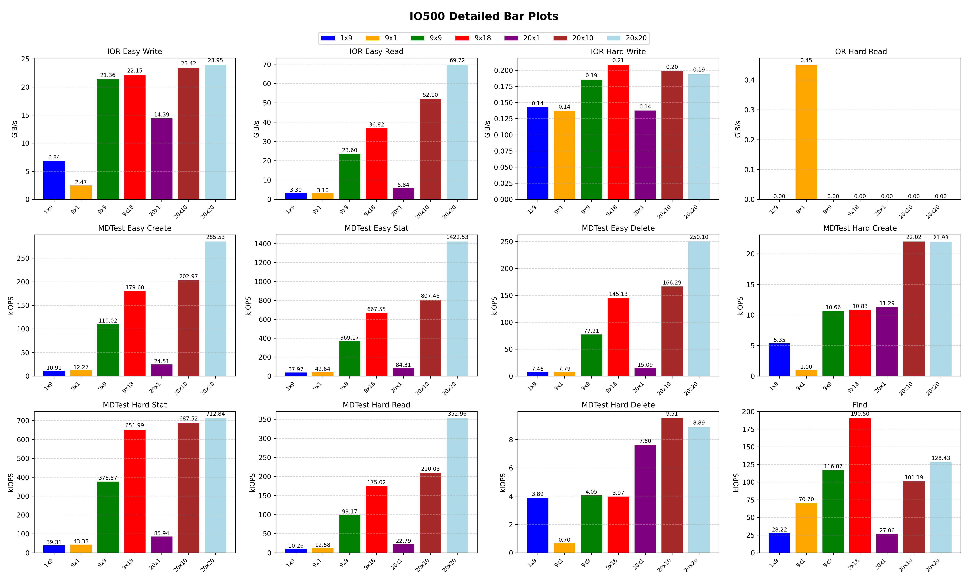
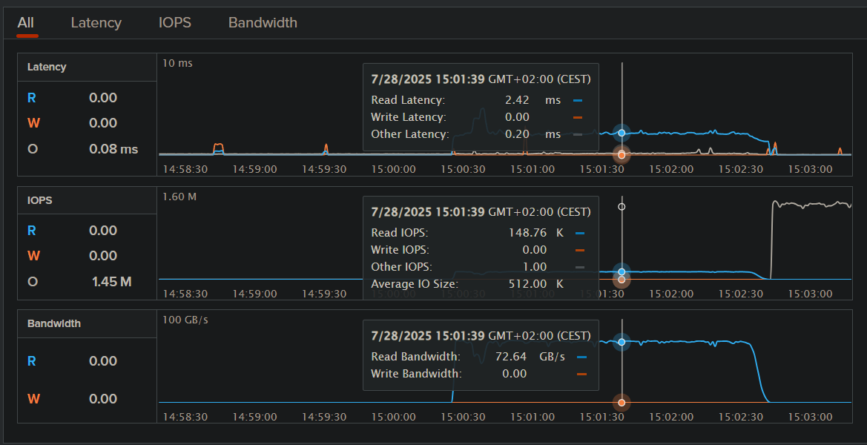
IO500 – Results
20x20 configuration reaches peak performance:
~70 GiB/s in IOR Easy Read
Noticeable scaling from 1x9 to 20x20 across all metrics
Monitoring confirms sustained high bandwidth (72.64 GiB/s) and IOPS (148.76k)
Note : The legend should be interpreted as “Node x Processes” (e.g. 20x1 - 20 nodes with 1 process)
12/08/2025
Flash Storage Potential in Large-Scale Physics Workflows
11

Slide 12

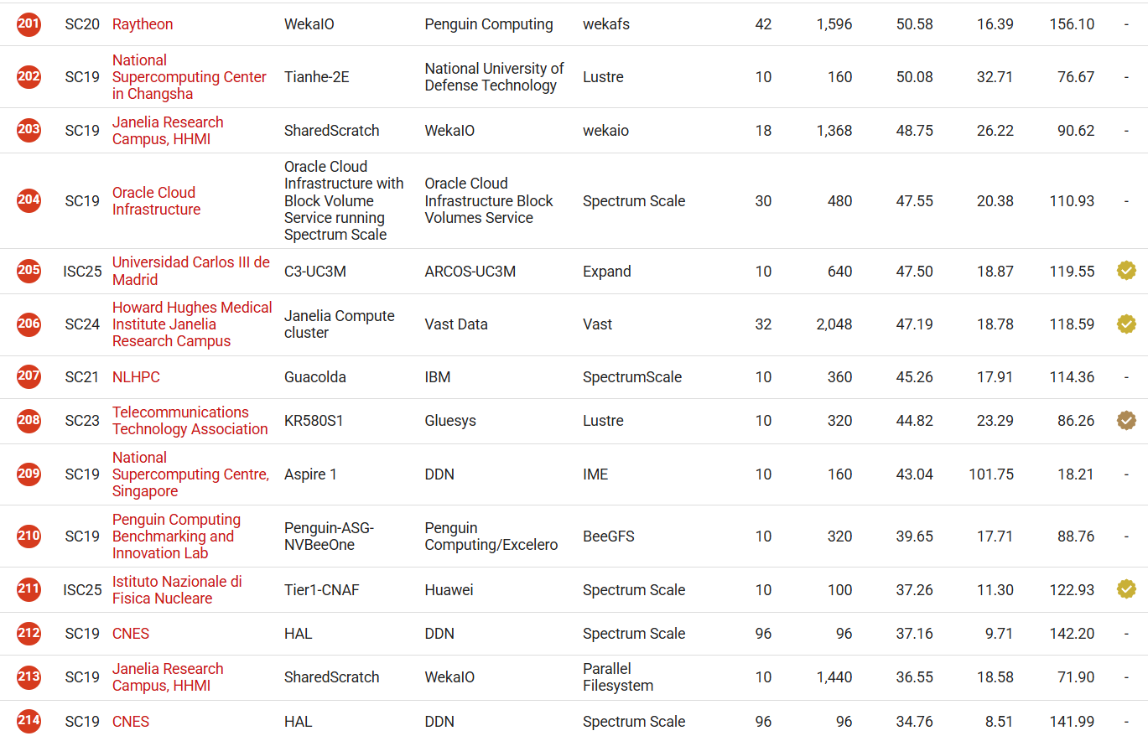
IO500 – Ranking Results
#27 in Production
#106 in Research
#211 in all
Pure Storage Appliance
(Score: 38.81 with 20x20)
12/08/2025
Flash Storage Potential in Large-Scale Physics Workflows
12

Slide 13



Phase 3: EOS integration
  Goal: Integrate Pure Storage into the EOS, create a tiering system and benchmark its performance across storage classes.
  Scenario: Connect the Pure Storage to EOS and evaluated its behavior in a realistic physics data workflow by simulating loads and demonstrating the system’s efficiency in handling both large and small files at scale.
12/08/2025
Flash Storage Potential in Large-Scale Physics Workflows
13

Slide 14
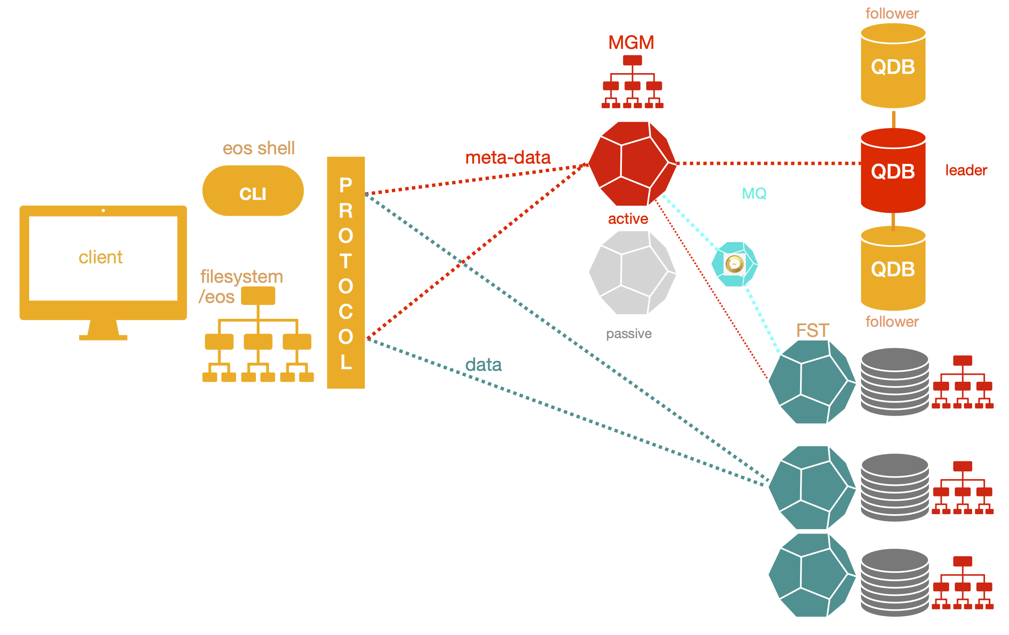
What is EOS?
  EOS (EOS Open Storage) [2] is CERN’s open-source, high-performance distributed storage system, developed to handle the massive data volumes produced by the Large Hadron Collider(LHC) and its experiments.
12/08/2025
Flash Storage Potential in Large-Scale Physics Workflows
14

Slide 15
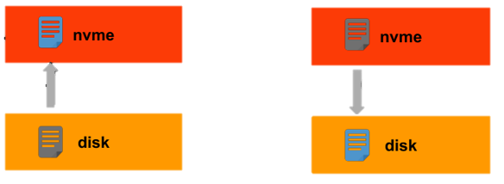

Pure Storage integration with EOS
Storage tiering is a mechanism that optimizes how data is placed across differenttypes of storage media, balancing performance, capacity, and cost.
Hot Tier: Fast devices such as NVMe or SSDs, suitable for high workloads.
Warm Tier: Conventional HDDs used for less frequently accessed data.
Cold Tier: Archival storage like tape used for long-term preservation.
12/08/2025
Flash Storage Potential in Large-Scale Physics Workflows
15

Slide 16
References:
Large-scale ab initio simulation of light–matter interaction at the atomic scale in Fugaku - Scientific Figure on ResearchGate. Available from: https://www.researchgate.net/figure/Schematic-diagram-of-MPI-process-mapping-to-3D-network-system-is-shown-Each-circled_fig5_357535374 [accessed 31 Jul 2025]
CERN. EOS - Open Storage Documentation. url: https://eos-docs.web.cern.ch/diopside/
Julian M. Kunkel et al. Establishing the IO-500 Benchmark. url: https://www.vi4io.org/_media/io500/about/io500-establishing.pdf.
Andreas Joachim Peters. Storage Tiering in EOS during EOS 2025 Workshop. url: https://indico.cern.ch/event/1483930/overview
12/08/2025
Flash Storage Potential in Large-Scale Physics Workflows

Slide 17
Thank you!
Robert-Paul Pașca|robert-paul.pasca@cern.ch

Slide 18



Appendix 1 : Topology
Alma Linux
Alma Linux
Alma Linux
Alma Linux
Alma Linux
Alma Linux
Alma Linux
NFSv3
Alma Linux
Alma Linux
8x100GE
Alma Linux
Switch Network
Alma Linux
Alma Linux
Alma Linux
Alma Linux
Alma Linux
Alma Linux
Alma Linux
Alma Linux
Alma Linux
Alma Linux
20 Nodes
12/08/2025
Flash Storage Potential in Large-Scale Physics Workflows

Slide 19
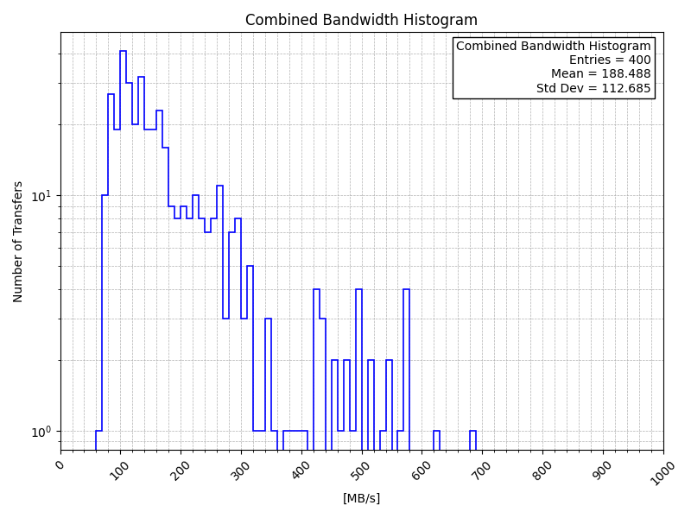
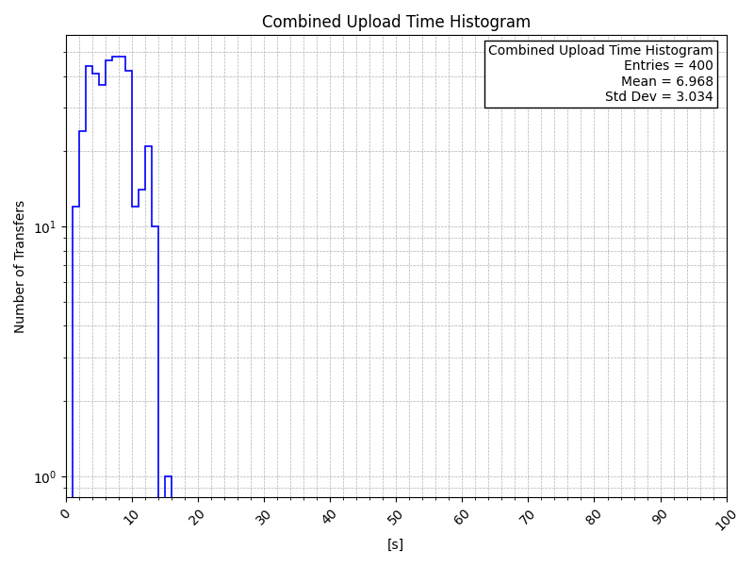
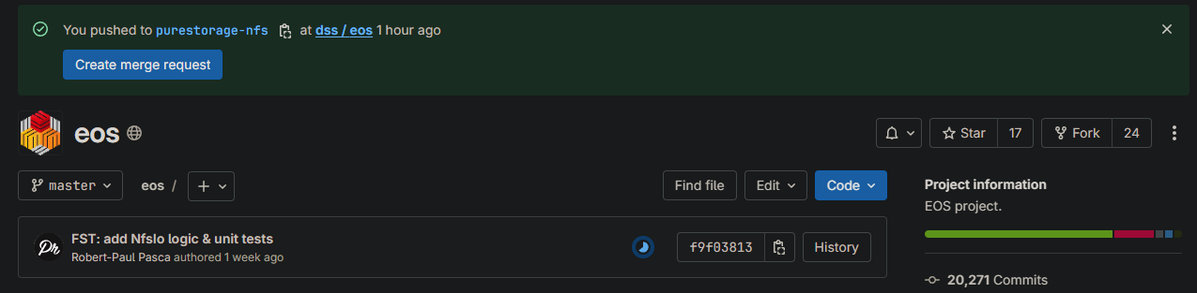
Appendix 2 : Phase 3 Details
Problem encountered during EOS:
NFSv3 + NFSv4.1 doesn’t support .xttr files
Solutions:
NFSv4.2 Extended attributes | TR-4962 | NetApp solves .xttr problem
EOS NFS plugin
12/08/2025
Flash Storage Potential in Large-Scale Physics Workflows

