Slide 1


CERN Digital Twin: CAD-to-USD with Dynamic LOD Rendering
Noa Emien Ette
emien.ch

Slide 2
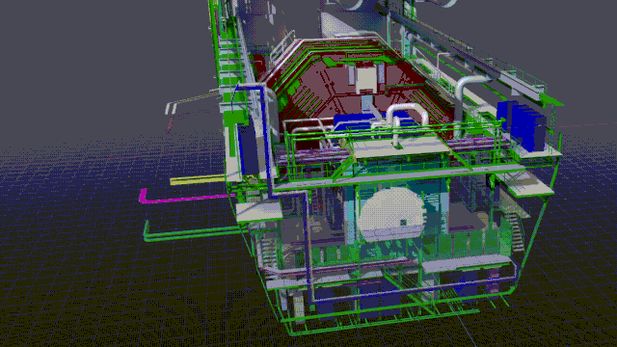
Digital Twins
CERN as a video game level
Practical utilisation (interventions, outreach, simulations)
Thanks to PLM section (git for CAD models), >200k models

Slide 3

CAD-to-USD with Dynamic LOD Rendering
CAD to USD Conversion pipeline
Step 1:
Extension for large scene visualisations in NVIDIA Omniverse
Step 2:

Slide 4
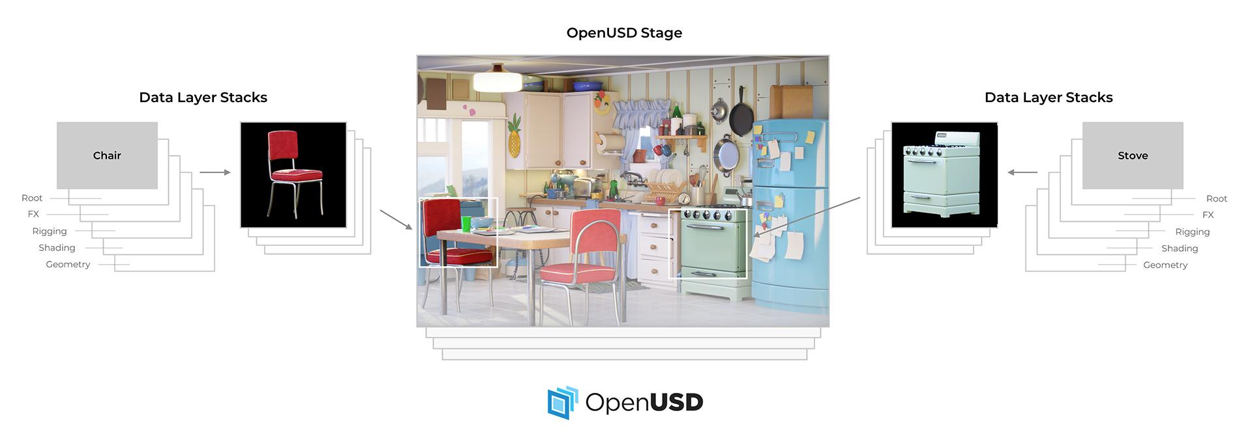
OpenUSD
Software platform developed by Pixar
Designed for high performance and collaboration in large 3d scenes
Application agnostic
Composability
Task: Write script to convert from CATIA to USD using Hoops

Slide 5
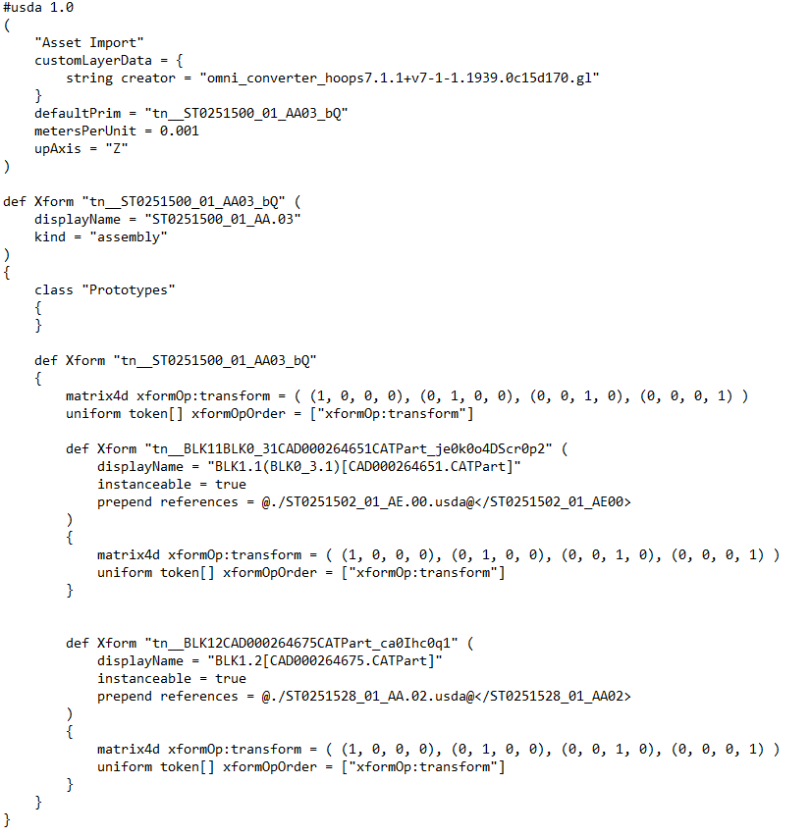
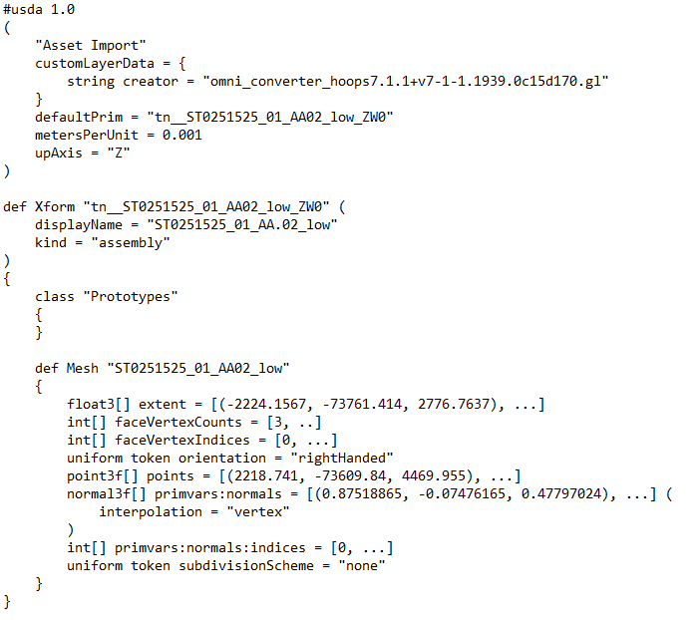
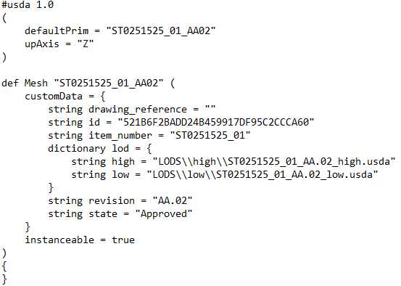
USD Structure
assembly
part
mesh

Slide 6
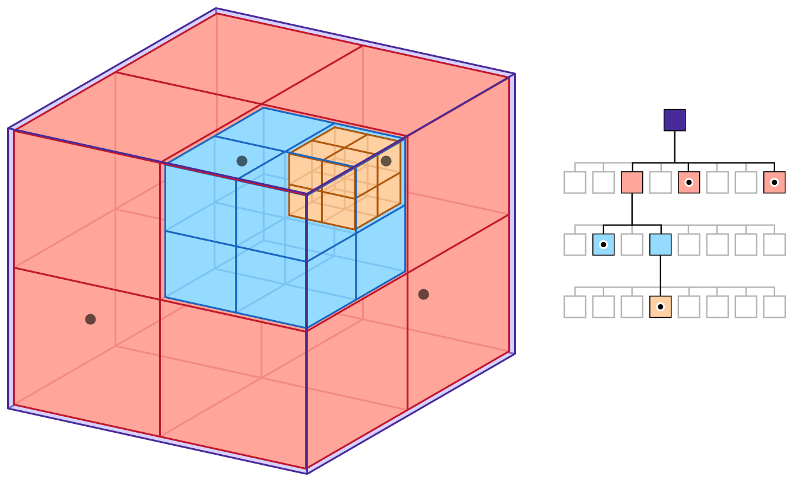
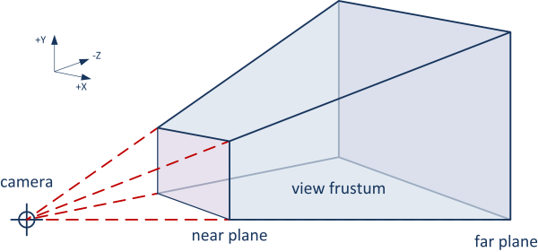
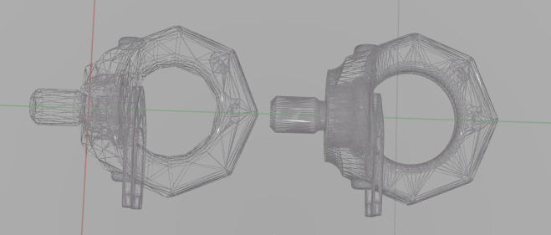
Visualisation
Recommendations: 10GB min, 24–48GB Recommended
Running on A2000 (6GB VRAM)
→ Need for Optimization
Asynchronous LOD Switching
Hierarchical space partitioning: O(n) → O(log(d))
Frustum culling

Slide 7
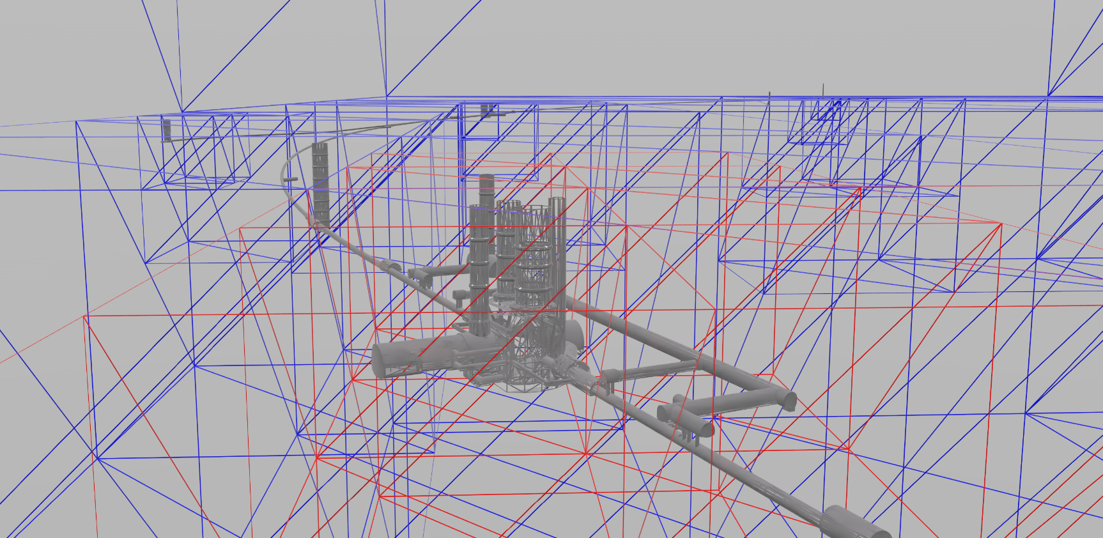
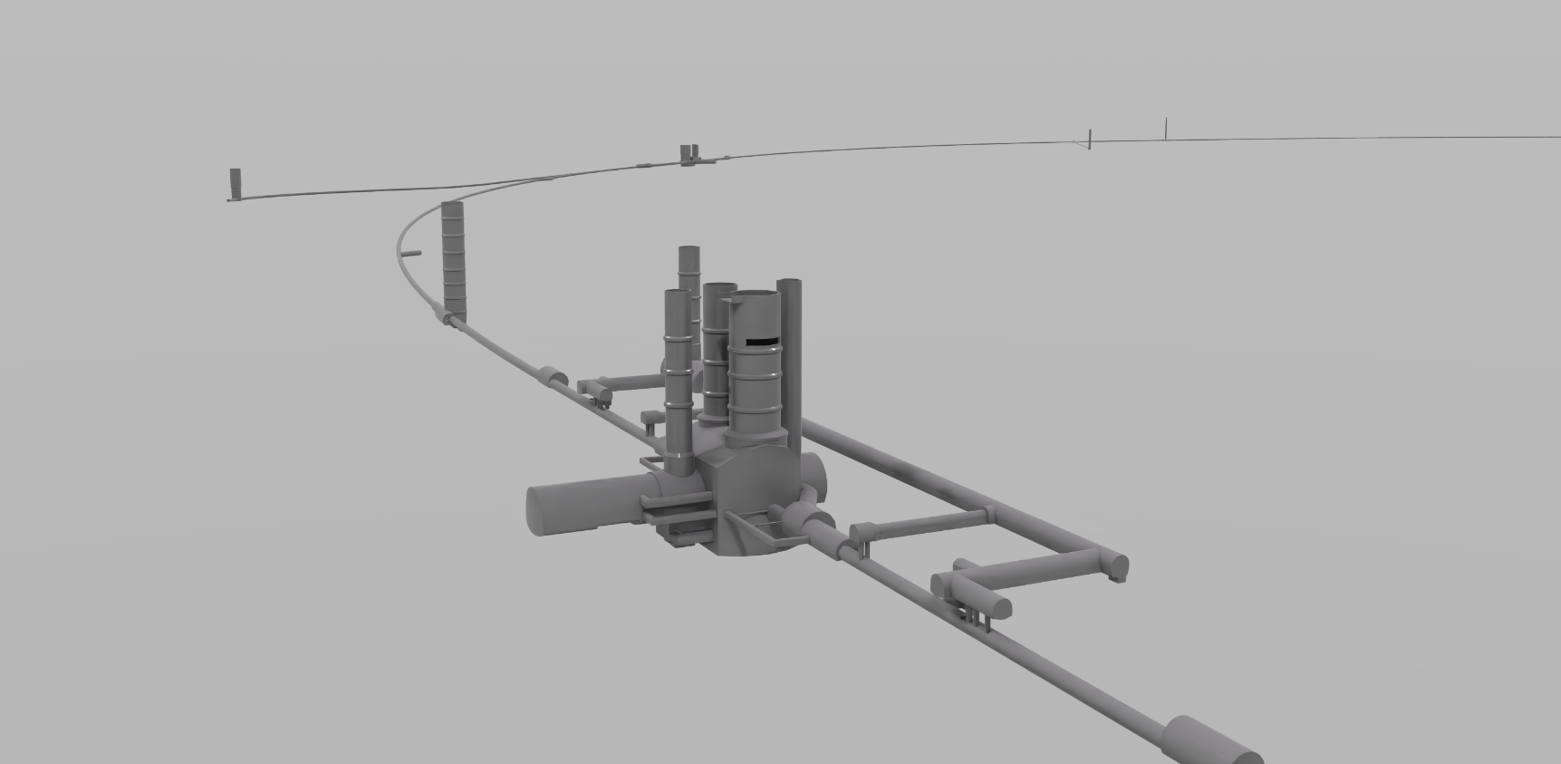
Octree

Slide 8
Thank you!
Email | noaemien@gmail.com
Website | emien.ch

