Slide 1




IDENTIFY AND CATEGORIZE JOURNALS ON
Karlo Vrancic
karlovrancic@g.harvard.edu
supervisors: Yash Lamba, Alex Ioannidis, Pablo Tamarit
Notes:
Hey everyone, let’s categorize and identify journals on Zenodo.
But first we must understand what Zenodo even is.

Slide 2
400 000 users
world’s largest general-purpose
research repository
Notes:
is the world’s largest general-purpose research repository with 400 000 users

Slide 3
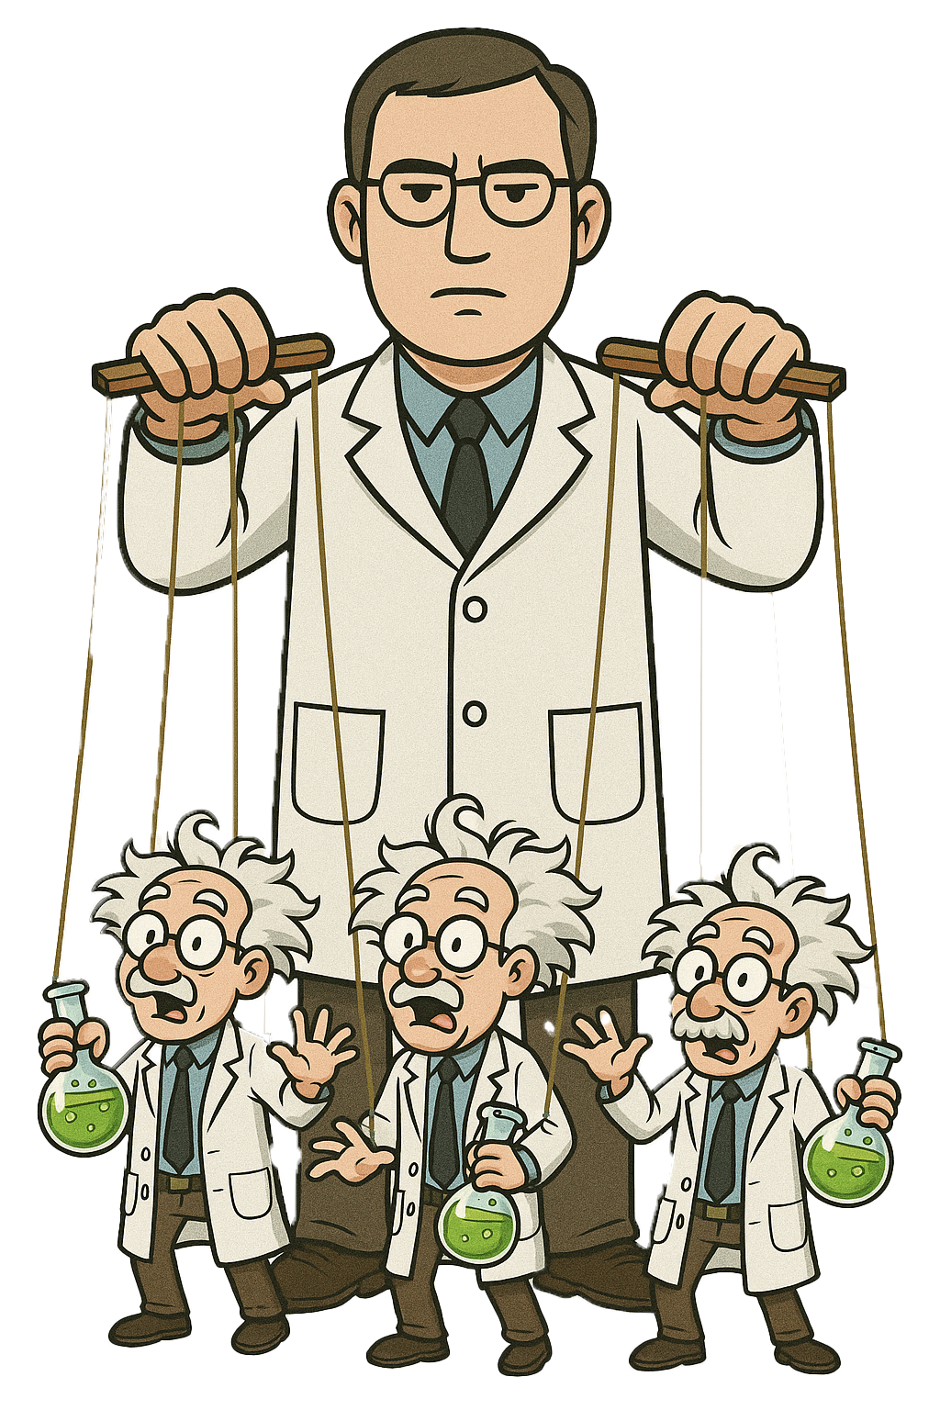

400 000 users
individual users posting their papers
users posting papers on other people’s behalf
Notes:
out of those, some are inidivduals posting their own work, while some post for others

Slide 4




Notes:
That doesn’t necessarily make them bad. For example, CERN will publish our reports on Zenodo, and many legitimate institutions do it.
However, some use it for free DOI acquisition and as a legitimacy source so then they can ask for money from desperate scientists looking to get their work published.

Slide 5
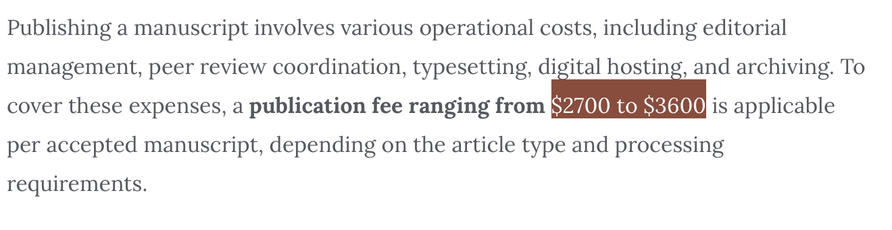
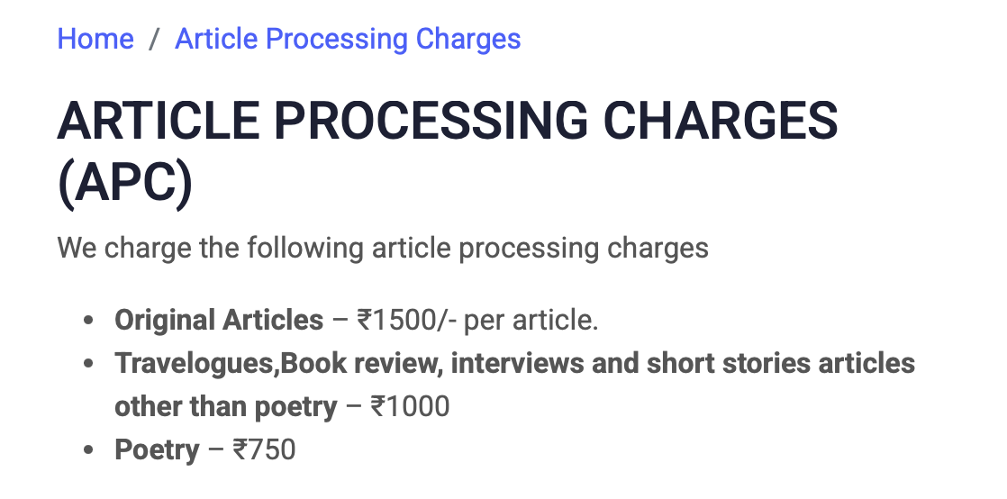

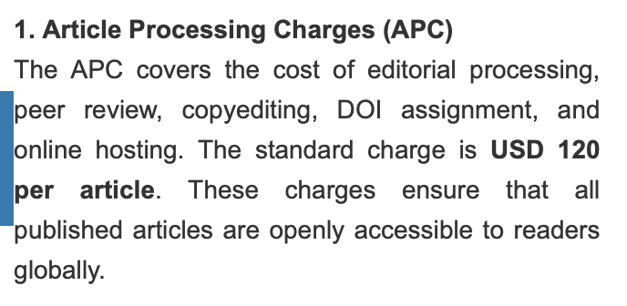
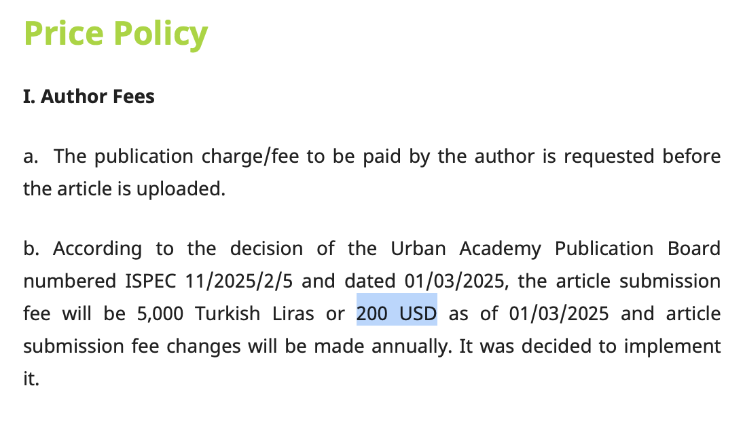

Notes:
and these fees range from hundreds of dollars to couple of dollars. either way, people shouldn’t be paying anything for this and in order to keep the academic integrity, we should stop this.

Slide 6
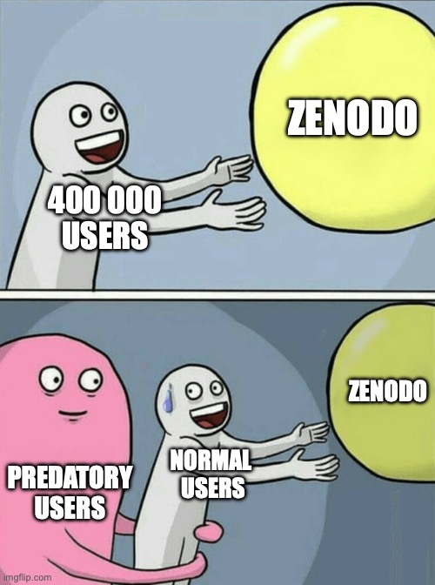
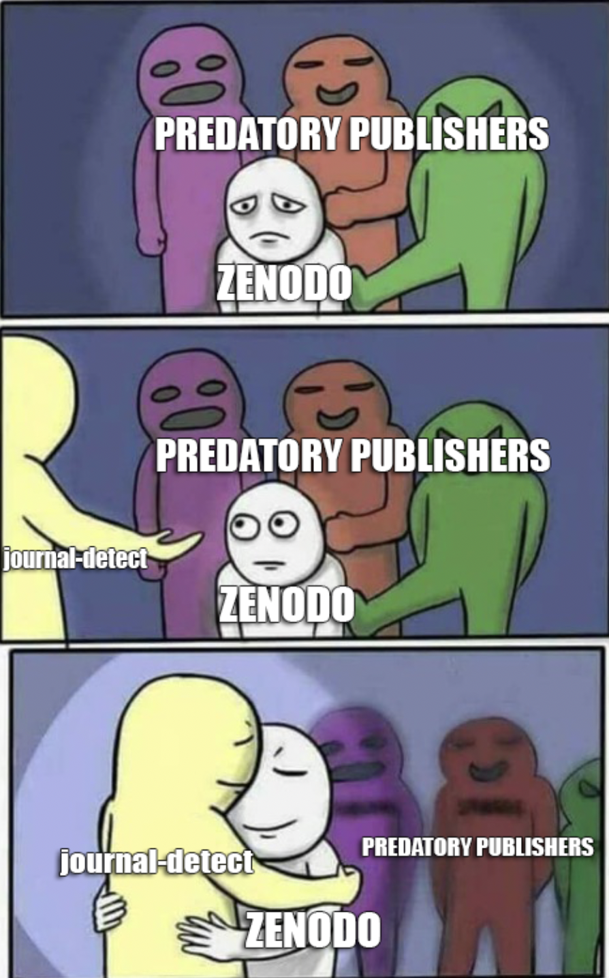
Notes:
so our goal is to get rid of predatory users on zenodo.
and that’s why i created a tool called journal detect.

Slide 7
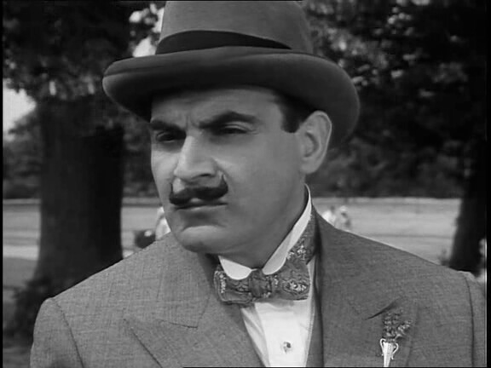
HOW?
Notes:
The first question we can pose is HOW
Let’s first take a step back.
when i was a kid, i loved watching poirot and using my grey cells to solve murder mysteries. soon after starting on this project, i figured out the exact same systematic approach can be applied here

Slide 8

THE GAME PLAN
Explore culprit’s
behavioral patterns
Lead validation
METADATA
LLMs
1
2
3
4
PDFs
WEB SCRAPING
Accusation material
HOWEVER…
Looking for leads
Notes:
First we can use basic metadata to find some behavioral and temporal patterns typical of culprits.
Then we can use PDFs as our crime scene, here we find leads.
LLMs are almost like forensics, they will help us validate our leads.
And finally, web content is like a check-mate. Case closed.
However, there was one thing I did not account for in the beginning.

Slide 9

pov: my laptop when trying to extract 4 million jsons from a single archive
Notes:
zenodo database has millions of records, and there is no way to proccess all of those in the way i just described.
for metadata, i figured out i can stream files directly from .tar.gz archive, but still i cannot download and analyze 20 million pdfs. so i used it to narrow down the choice first.

Slide 10
265 874
STARTING NUMBER OF USERS:
MIN 20 RECORDS
FIRST FILTER:

Slide 11
265 874
WE ARE LEFT WITH:
11 582
NEXT FILTER:
MAX 5 DOI PREFIXES

Slide 12
265 874
WE ARE LEFT WITH:
11 582
10 929
NEXT FILTER:
MIN 30% DISTINCT AUTHORS

Slide 13
265 874
WE ARE LEFT WITH:
11 582
3 034
10 929
NEXT FILTER:
REMOVE SAFE COMMUNITIES

Slide 14
265 874
(FINALLY)
WE ARE LEFT WITH:
11 582
2 875
10 929
NEXT UP:
HARD NAME EVIDENCE
2 875

Slide 15
HARD NAME EVIDENCE
If user has journal-like keywords in his (user)name: journal, editor, publisher -> GREAT EVIDENCE
706
journal names
245
self-authors
If user’s full name matches the most common author in his uploads -> EVEN BETTER EVIDENCE
Notes:
so i made a dataframe with every user as a single datapoint, and after caluclating all of the behavior features, i connected to zenodo api to fetch his full name and username

Slide 16
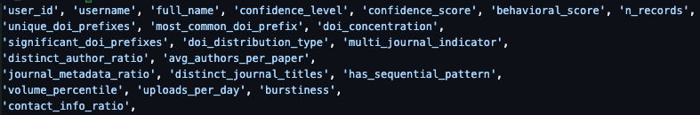

Slide 17
PDFs – look for leads
E-MAILS
URLs
ZENODO_DOI
Free domain emails such as @gmail.com are mega sus
Needed for web analysis
Means the user uses Zenodo for publishing
PDF METADATA
KEYWORDS
STRUCTURE MATCHING
Needed for web analysis
Means the user uses Zenodo for publishing
Assuming journals have consistent structure

Slide 18


LLMs – validate leads
GOAL
Check if journal names and URLs match on sampled PDFs
How?
Extract first page header of all samples and plug them to an LLM with a structured output.
Why?
Performs 40% better than fuzzy manual matching and 80% better than GROBiD

Slide 19
WEB INTELLIGENCE - CHECKMATE
01
02
03
04
FEE KEYWORDS
IMPACT FACTOR
Journals explicitly mentioning processing fees
Very suspicious metric that correlates with predatoriness
WEIRD SUBMISSIONS
FREE EMAILS
Yeah for sure it looks legit if you submit your paper through Viber 💀💀
You have your web domain but you use @hotmail in 2025?

Slide 20
THE PIPELINE
METADATA
Behavioral and temporal analysis
JOURNAL
DETECTION
PDFs
Extract factual leads
LLMs
PREDATORY
DETECTION
it’s 2025 bruh
journal-detect
features
WEB
Scraping predatory evidence

Slide 21
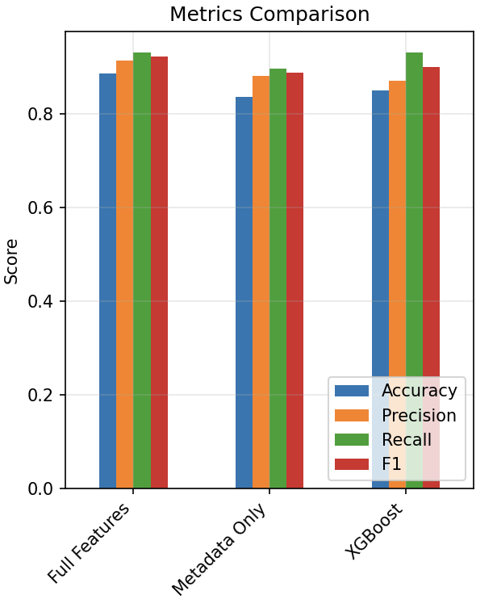
JOURNAL
DETECTION
(full features and metadata
only use Random Forest)
Notes:
or to make it a bit simpler our feature extraction pipeline looks like this we use metadata, pdfs and llms for journal detection
and we use pdfs, llms and web for predatory detection

Slide 22

2171 journal runners
JOURNAL
DETECTION
Notes:
ultimately, this resulted in 2171 users being flagged as journal runners
now, out of these, we need to find the predatory ones. first we had to remove all of those where we didn’t have a reliable webpage URL, but then the party could begin.

Slide 23

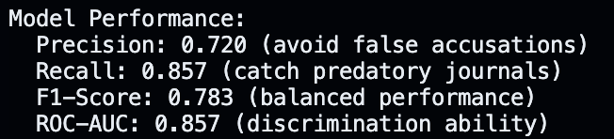
PREDATORY JOURNAL
DETECTION
(insert not great not terrible meme)
Notes:
i sacrificed precision a bit because all of these will be manually checked by a human since it is not a small thing to ban someone with thousands of records

Slide 24
281 users flagged as predatory
PREDATORY JOURNAL
DETECTION

Slide 25
134 681 records by users flagged “predatory”
PREDATORY JOURNAL
DETECTION
Notes:
which translates to 134 681 predatory RECORDS. Now you do the math and tell me how much money we could possibly save from the wrong hands with this project.
and i hope we eventually do.

Slide 26
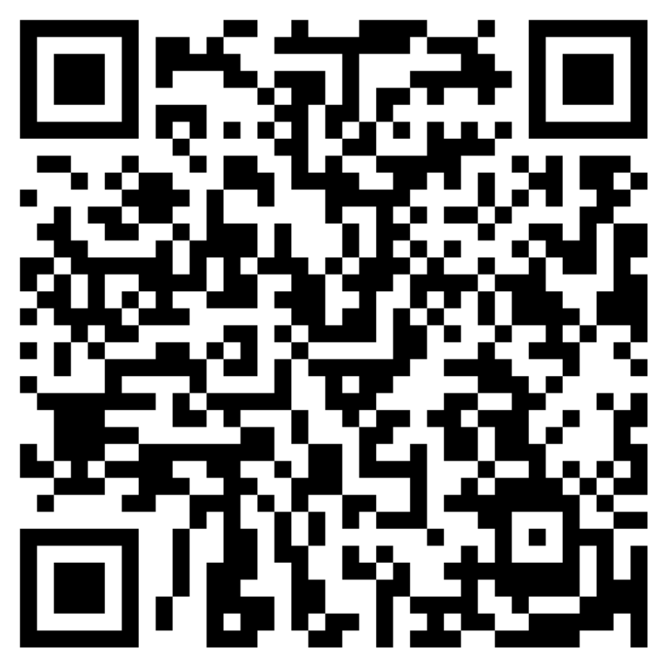
THANK YOU!
P.S. Thanks for the cool
summer as well :)
Coupons for free pizza in R1

