Slide 1


Cross-Site Data Integrity Check with Ceph and Kafka
12.08.2025
Dawid Grabowski
Supervisor: Enrico Bocchi

Slide 2


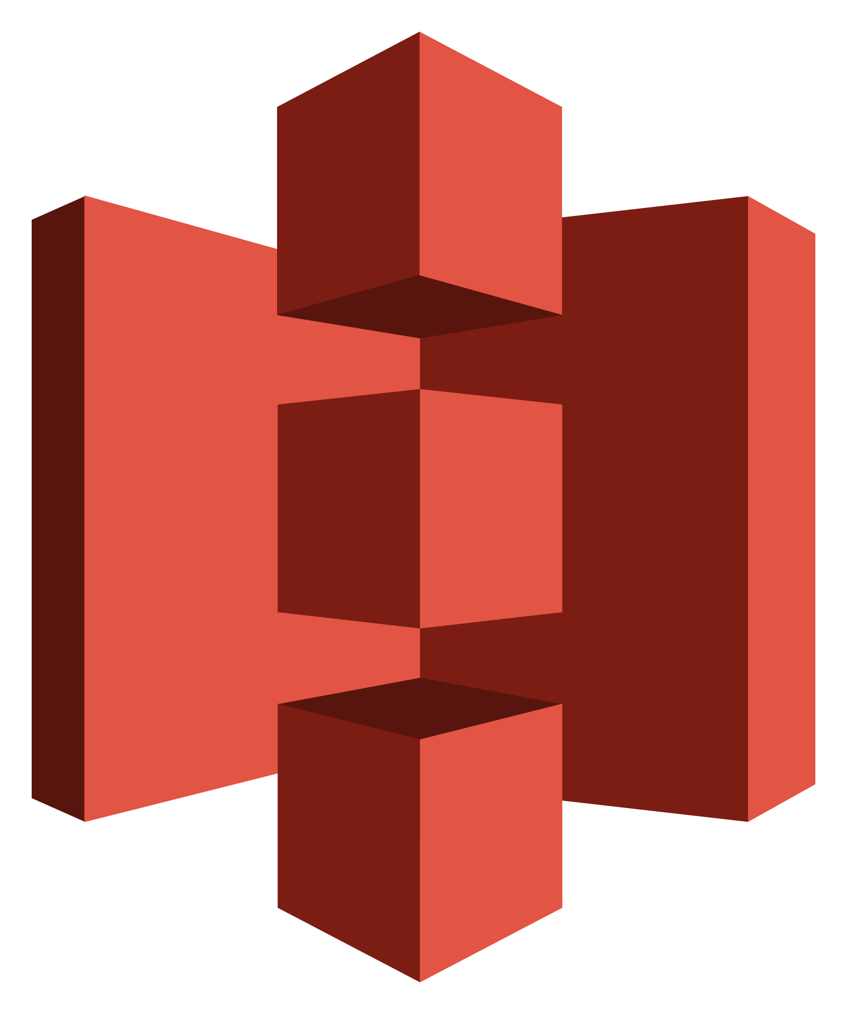
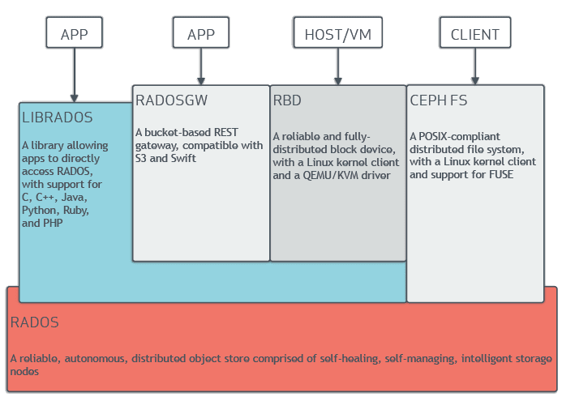
Open-Source Distributed Storage Platform
Applications/Tools → S3 Protocol → Any Storage System
├── AWS S3
├── Ceph RGW ← Our focus
├── CERN EOS
├── MinIO
└── Other systems
S3 Protocol
S3 Protocol = Widely-adopted way to manage objects
Simple HTTP-based commands:
PUT (upload),
GET (download),
DELETE (remove)
Thousands of existing tools and libraries
Provides familiar interface for users and tools
No vendor lock-in - standard protocol everyone implements
Easy integration with existing workflows
Ceph
Open-source software to provision and orchestrate distributed storage
Self-managing: Handles failures and replication automatically
S3-compatible: RGW component provides familiar S3 interface
Multisite: Built-in object replication between 2 or more data centers

Slide 3
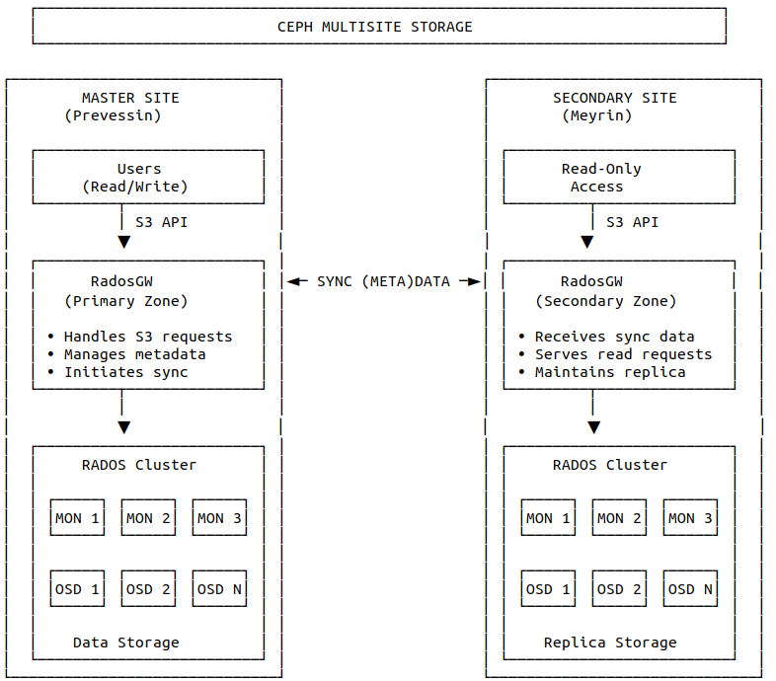
Multisite: Built-in replication between data centers — The Problem
Problem 1: Missing Replication After Creation
Scenario: Object successfully created on master (Prevessin)
Issue: Sync process fails silently → no replication to secondary
Result: Object exists only on master, missing from Meyrin completely
Detection Challenge: Absence of expected sync events
Problem 2: Incomplete Delete Propagation
Scenario: Object deleted on master successfully
Issue: Delete operation not replicated to secondary site
Result: Stale object persists on Meyrin after master deletion
Detection Challenge: Secondary shows outdated state
Problem 3: Multipart Upload Failures
Scenario: Large objects uploaded in multiple parts (1+ GB files)
Issue: Multipart upload incomplete or failed during transfer
Result: Partial objects on master, no replication to secondary
Detection Challenge: Missing multipart completion events
Problem 4: Failover Data Loss Risk
Scenario: Master zone (Prevessin) fails before completing ongoing replication
Issue: Objects created just before failure not yet synced to secondary
Result: Data permanently lost if master doesn't recover
Detection Challenge: Identifying non-replicated objects during failover window

Slide 4
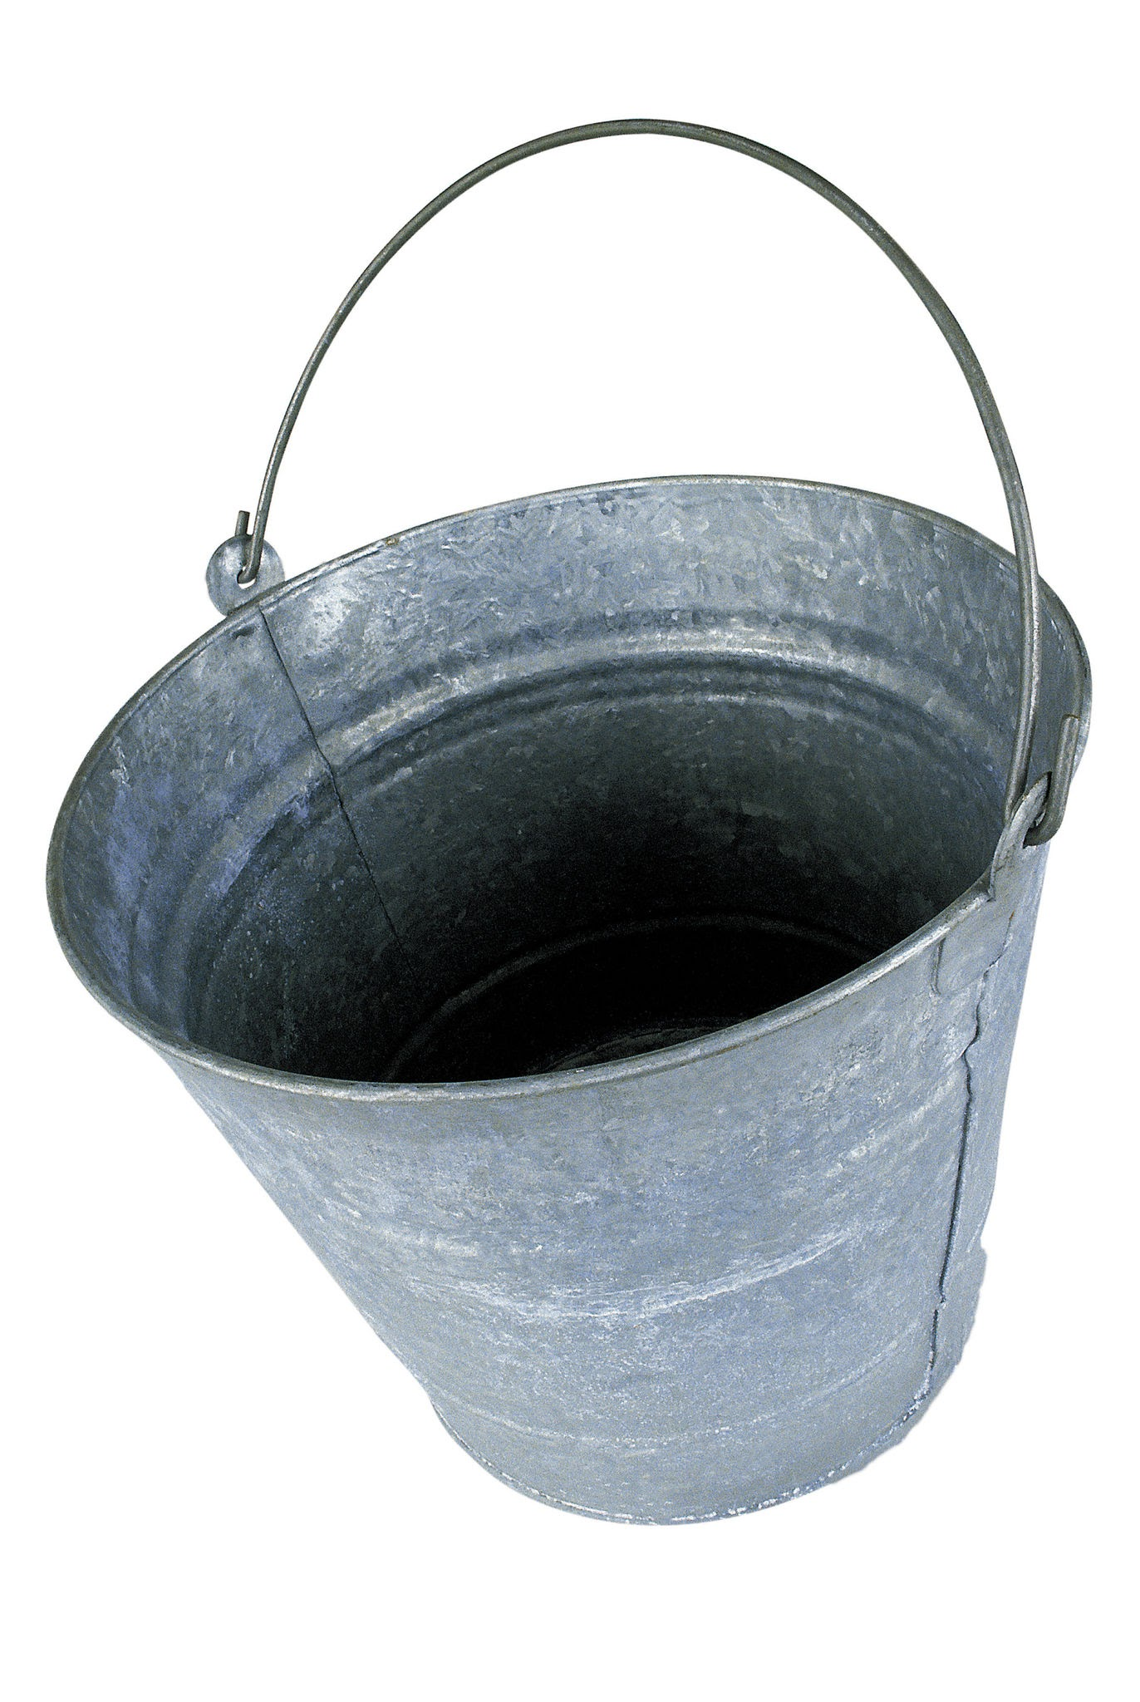
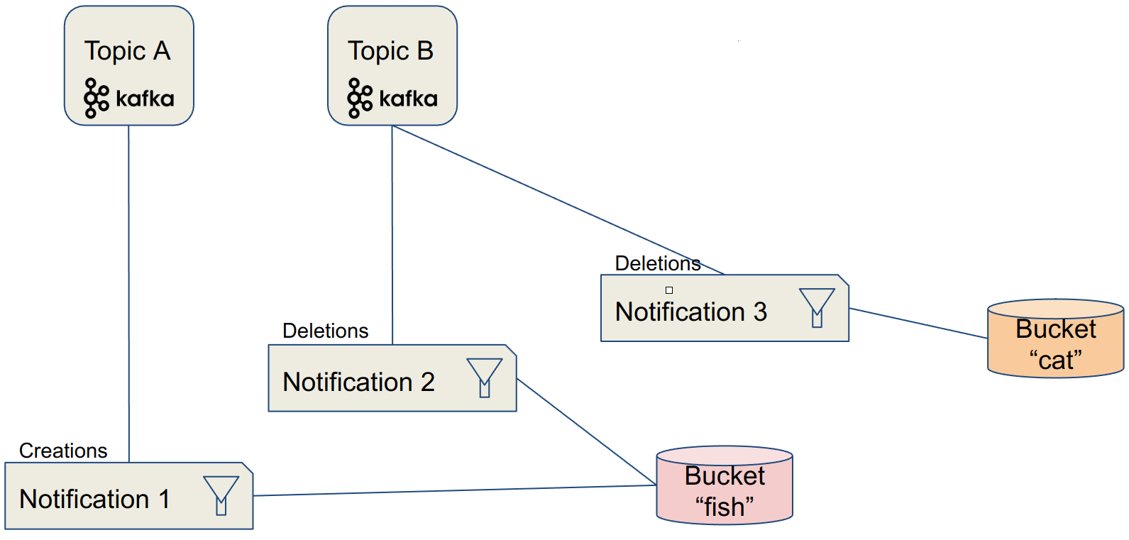
Real-time Event Monitoring with Bucket Notifications
Ceph Buckets: Where Data Lives
Bucket = Container for your objects (e.g. fish)
Configured with notification rules that define what events to track
Generates events when objects are created, deleted, or modified
Each bucket can have different notification settings
Kafka Topics: Where Events Are Collected
Topic = Named stream of events (e.g. TopicA)
Central collection point for notifications from multiple sources
Persistent storage - events stay available for processing
Multiple consumers can read the same events
How Buckets & Topics Work Together
Step 1: User performs operation on bucket (e.g. PUT/DELETE object)
Step 2: Ceph RGW detects operation and generates notification
Step 3: Notification sent directly to Kafka topic over network
Step 4: Monitoring system reads notifications to analyze events
Our Test Setup
Two Ceph clusters in two regions
One bucket for each cluster
One Kafka topic
Monitor System reading Kafka topic
Source: https://ai-on-openshift.io/patterns/bucket-notifications/bucket-notifications/
⇐ Development effort

Slide 5
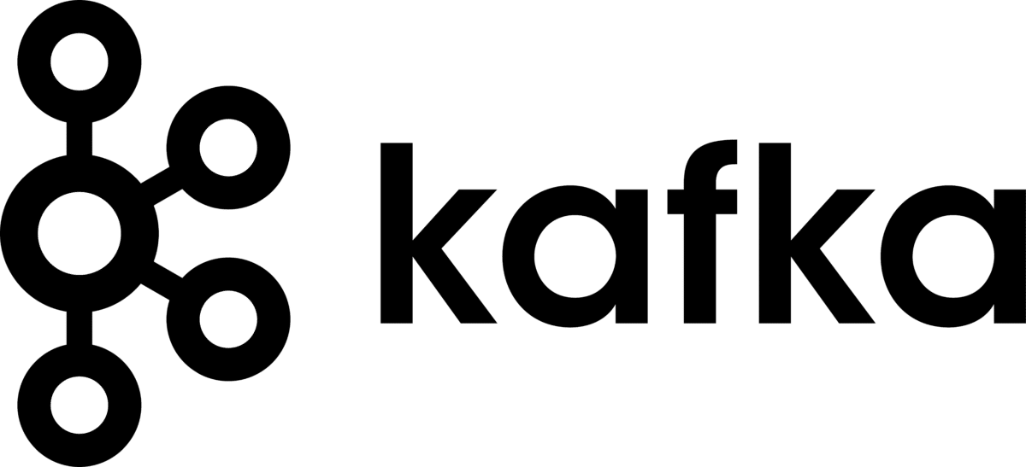
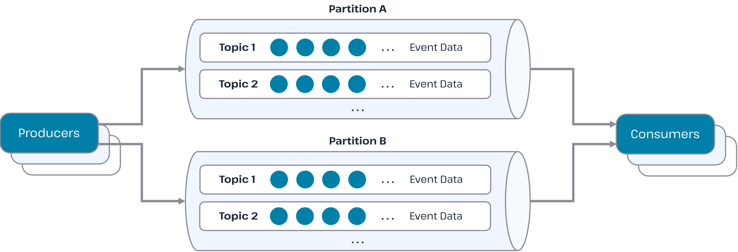
Stream processing Platform for Event Collection
What Kafka Does for Us
Collects notifications from both Ceph sites
Stores all events in one central topic
Reliable delivery ensures we don't miss critical events
Why We Need Kafka Here
Single Source of Truth: All storage events from Prevessin + Meyrin in one place
Comparison Enabled: Lets us compare master events vs secondary sync events
How It Fits Our Architecture
Both Ceph RGW instances send notifications directly to Kafka over network
We consume events from Kafka clients to detect missing or mismatched events.
Monitoring System
Source: https://hazelcast.com/foundations/data-and-middleware-technologies/kafka/

Slide 6
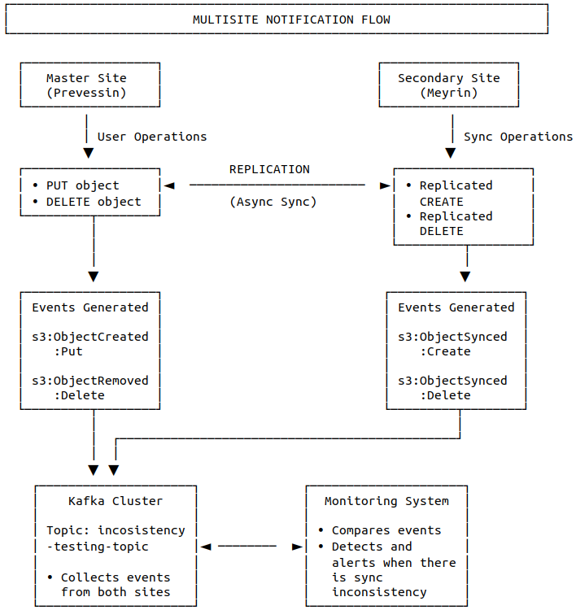
Prevessin ↔ Meyrin Data Replication
Monitoring Service

Slide 7
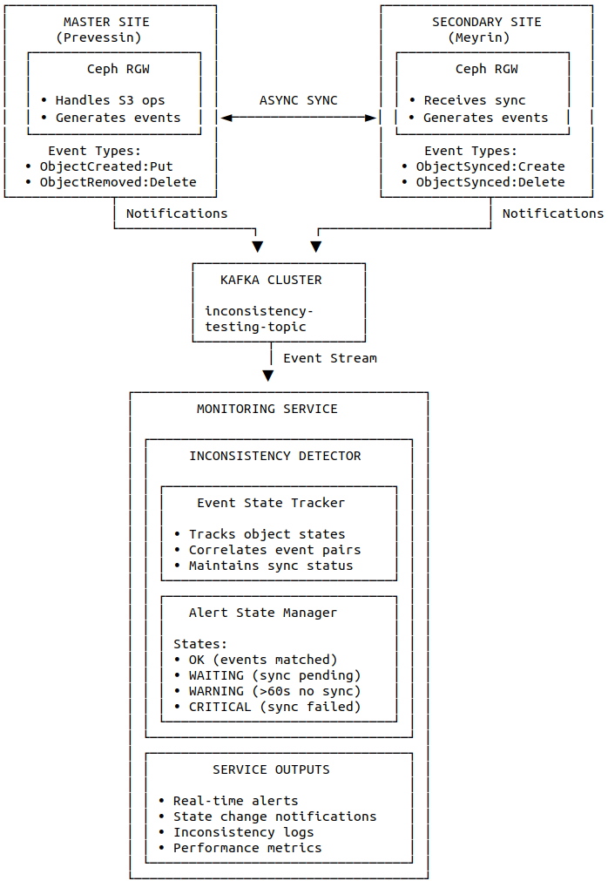
Detecting Data Inconsistencies: Our Mission
Our Solution: Beyond Basic Monitoring
Active stress testing: Concurrently sending upload and delete requests to main storage site
Real-time sync monitoring: Continuously tracking replication process across all operations
Comprehensive log collection: Gathering RGW logs, Synchronization logs, and network metrics
System state monitoring: Tracking cluster health, network latency, and storage performance
Alerting about any inconsistencies
Development effort ⇒

Slide 8

Thank you!
Email | dawid.wiktor.grabowski@cern.ch
LinkedIn |www.linkedin.com/in/dawidgraabowski

