Slide 1

REANA Auth Layer Modernization
Tomas Ondrejka
Supervisors:
Enrique Garcia Garcia
Giovanni Guerrieri

Slide 2
Table of Contents
01
Background
02
Goal
03
Auth Concepts
04
Approach
05
Design
06
VRE + REANA Demo
07
REANA CLI Demo
12/08/2025
‹#›

Slide 3
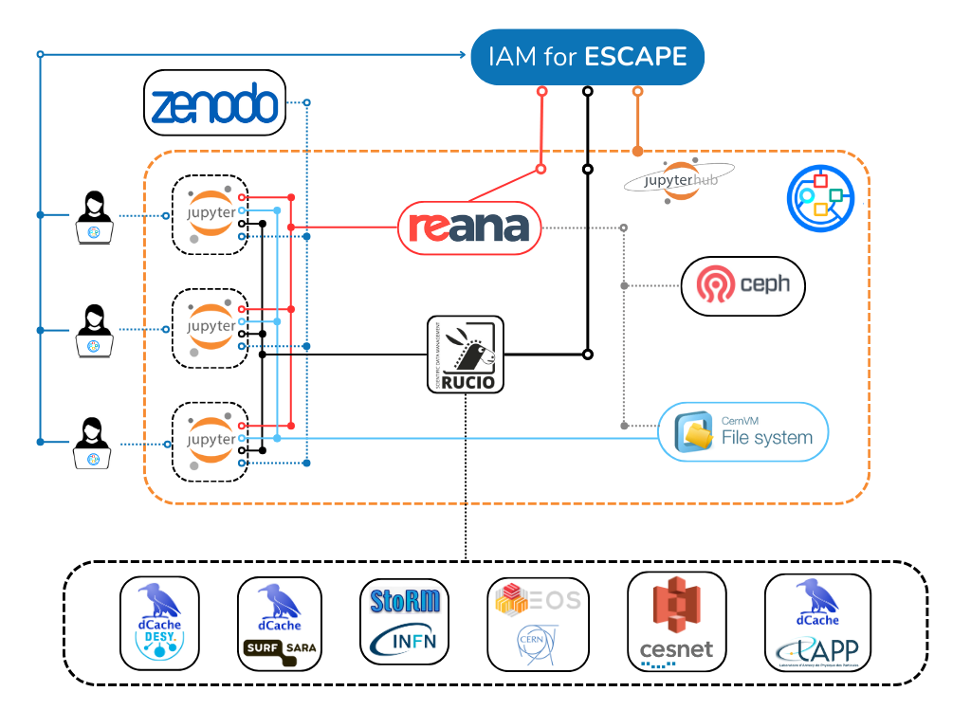
Background
Virtual Research Environment (VRE)
Analysis facility developed under the European ESCAPE project
Platform for creating and running reproducible workflows
Integrates with JupyterLab for full-environment access
Uses a common authentication system (ESCAPE IAM)
Aggregates multiple services, including REANA
REANA
Open-source platform for reusable and reproducible research data analysis
Executes and manages scientific workflows
Developed at CERN, active since January 2017
Composed of over 10 components
Notes:
Analysis facility, developed during european project, escape
Within the jlab UI, aggregation of different services, to connect full environment using authentication and authorization inrfastructure
Authnz equivalent to CERN SSO, we are using ESCAPE IAM
One of the services beside of rucio that VRE is connecting to is reana,

Slide 4
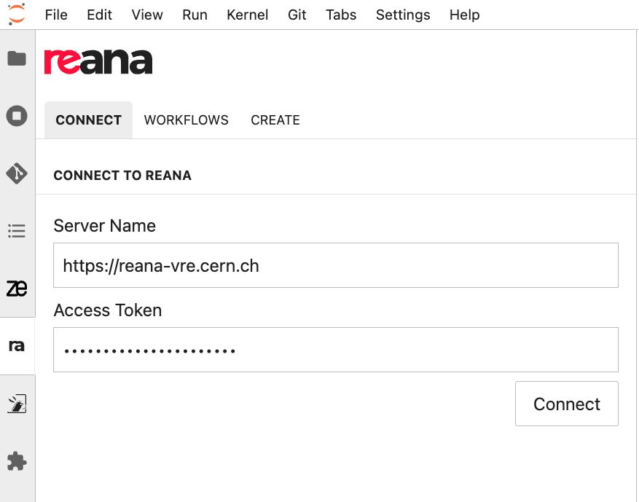
Goal
To integrate REANA authentication in VRE without requiring re-login, so users can access it seamlessly, eliminating the current manual process of copying server URLs and tokens and removing unnecessary friction.

Slide 5
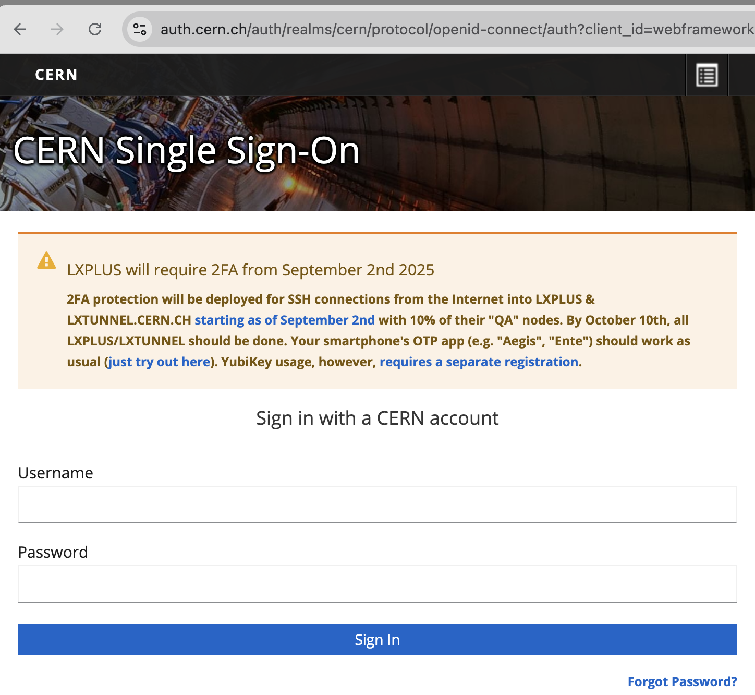
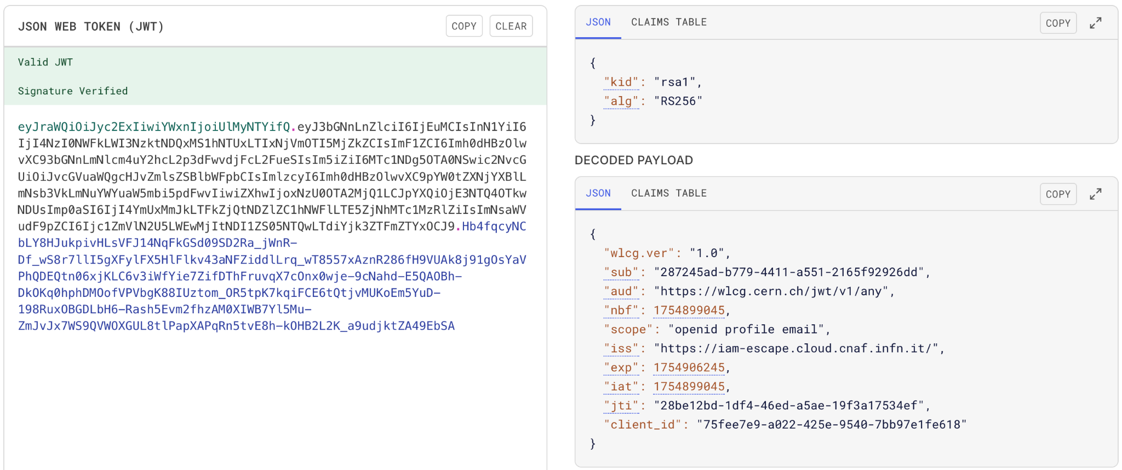
Auth Concepts
Identity Provider (IdP) Server
Issues and signs JWTs
Uses OAuth2 / OIDC protocols
Examples: CERN, universities, GitHub SSO
OAuth2 / OIDC
Industry standard for authentication and authorization
Retrieve basic user info (name, email, roles)
Supports multiple apps with one login
JWT (pronounced "jot")
Portable digital ID card
Contains user claims (ID, roles, expiry)
Sent with each request to an API

Slide 6
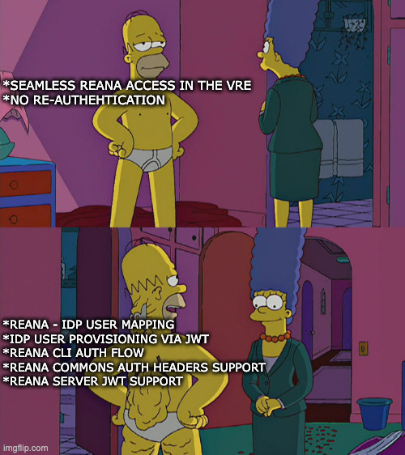
Approach
Looked simple: omit direct login, reuse token
Hidden backend complexity
Touched many REANA components
Onboarded future-ready features
Long-term value for REANA
REANA CLI Device Auth Flow
REANA Ecosystem

Slide 7
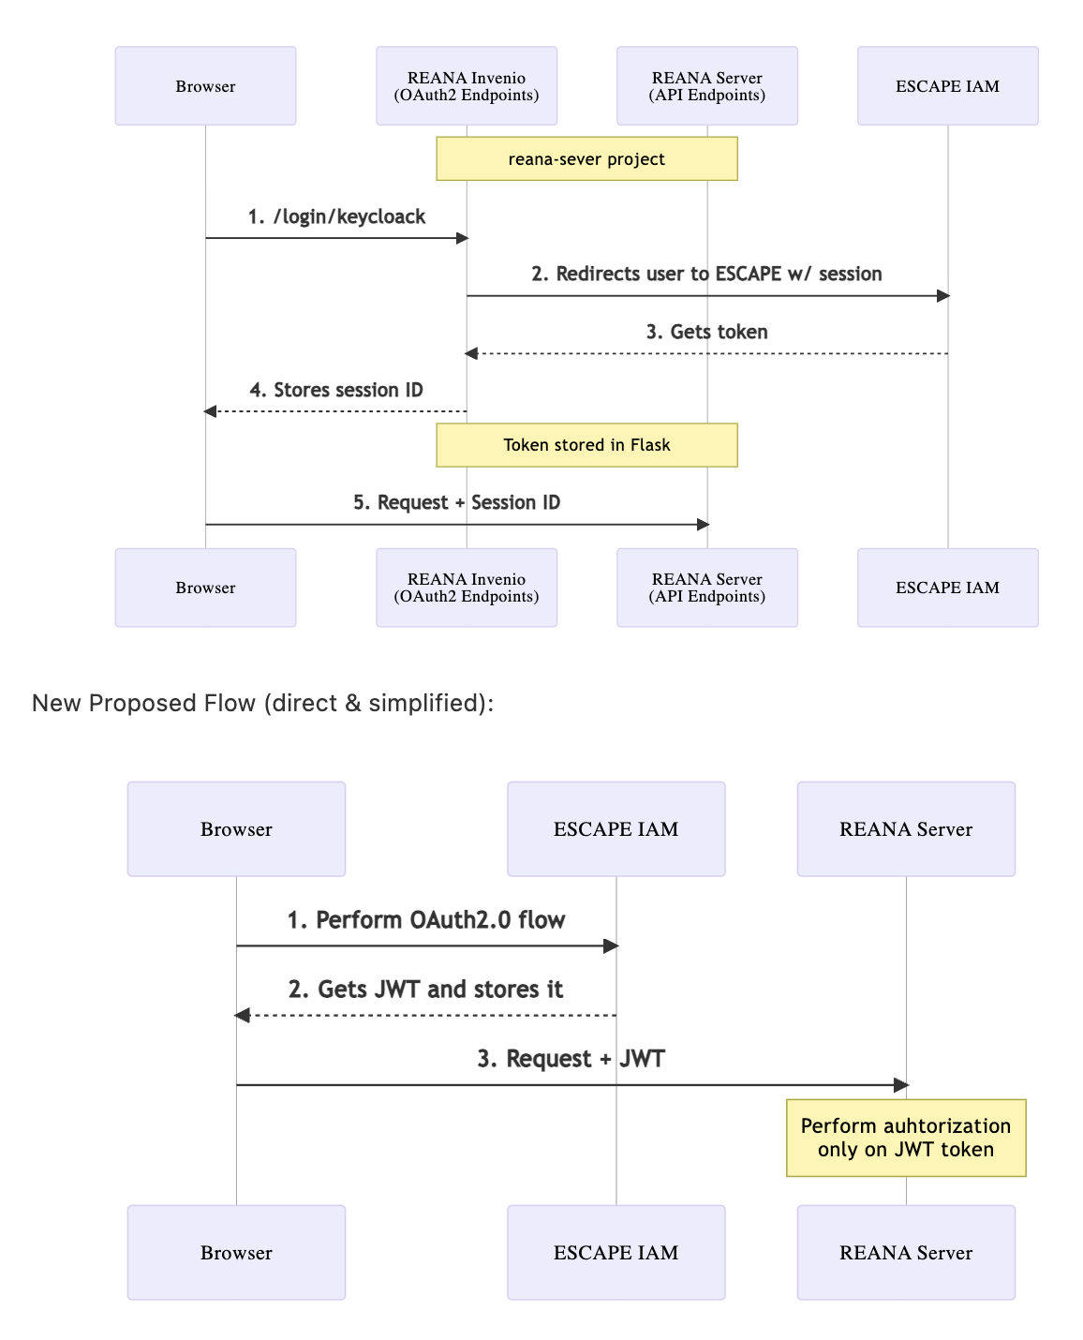
Design
Adopt OAuth2/OIDC industry standards in REANA
Remove legacy Invenio auth package
  Uses ½ of DB tables only for auth & authz
  Increases codebase size and complexity
  Duplicates responsibilities already handled by IdP
Use JWTs for UI, CLI, and automation tools
  Meets all REANA requirements and needs
Unify fragmented login methods into one flow (JWT)
  Custom REANA Access Tokens
  GitLab Access Tokens
  Flask Sessions IDs
Before:
After:
Notes:
Change reana server to be compatible with oAuth2 and OIDC tokens
Improved the REANA API to compatible with JWT tokens
At the same time that adapted the REANA CLI to communicate via tokens
Improved the REANA DB to be compatible with these changes

Slide 8
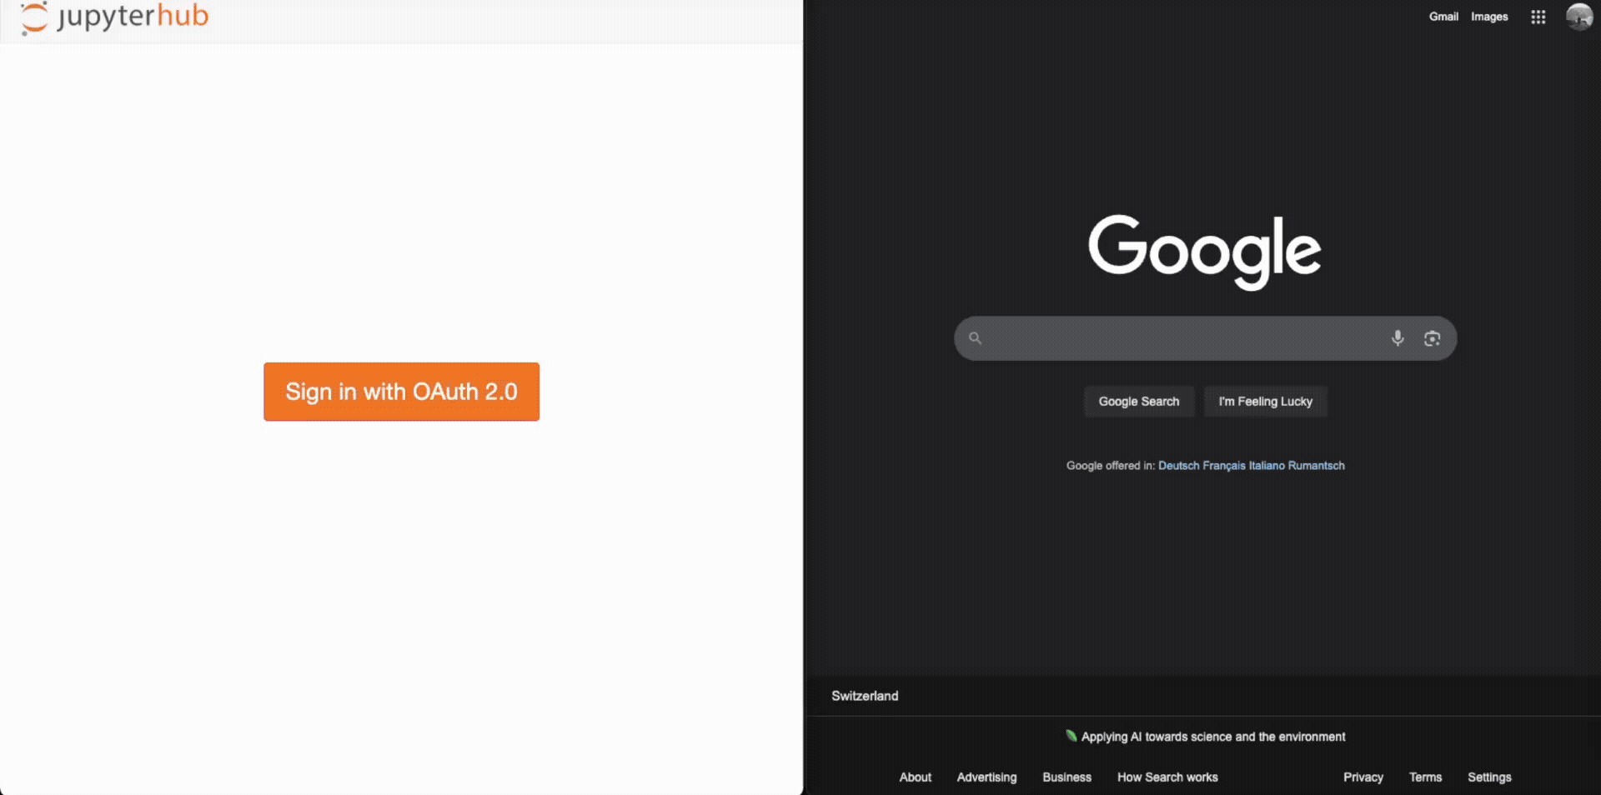
VRE + REANA Demo
Before:
Log in to the VRE
Open the REANA UI
Manually copy each credential
Access REANA + VRE integration

Slide 9

VRE + REANA Demo
Before:
Log in to the VRE
Open the REANA UI
Manually copy each credential
Access REANA + VRE integration
After:
Log in to the VRE
Access REANA + VRE integration

Slide 10

REANA CLI Demo
Before:
Open the REANA UI
Copy each environment variable
Export them in the CLI environment
Use the REANA CLI

Slide 11
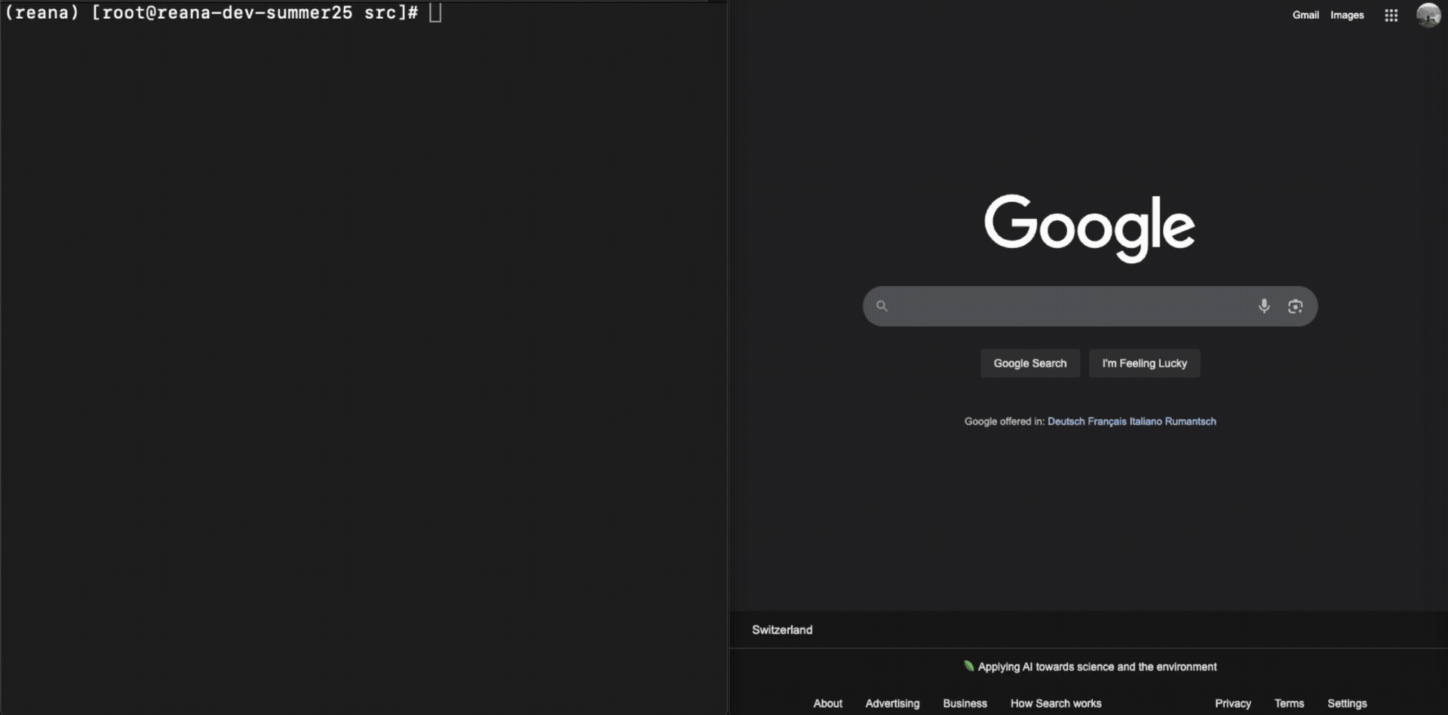
REANA CLI Demo
Before:
Open the REANA UI
Copy each environment variable
Export them in the CLI environment
Use the REANA CLI
After:
Run reana-client auth
Open the generated URL
Use the REANA CLI

Slide 12
Summary
We integrated REANA in the VRE with seamless, standards-based authentication: no more re-authentication or manual token copying.
Key Outcomes:
Adopted OAuth2/OIDC + JWT for REANA flows
Removed Invenio auth, reducing codebase size and complexity
Unified login across UI, CLI, and automation tools
Implemented VRE integration for instant REANA access
Impact:
Researchers can now run reproducible workflows faster, easier, and more securely
REANA now features a future-proof OAuth2/JWT authentication setup, ready for diverse environments and planned complex features.

Slide 13

Merci beaucoup !
Big thanks to:
Enrique Garcia Garcia
Giovanni Guerrieri
Tibor Simko
Cameron Duncan McClymont
Michael Buchar

Slide 14
More Reading
Documentation: https://codimd.web.cern.ch/pb_arxC5RWSZwbXY9HSGIg
GitHub Project: https://github.com/orgs/vre-hub/projects/7/views/1
OAuth2.0: https://auth0.com/intro-to-iam/what-is-oauth-2
OpenID: https://openid.net/
JIT: https://www.openiam.com/what-is-just-in-time-provisioning

