Slide 1
BLM system for FCCee
B.Salvachua
With inputs from the Machine Protection Task Force and contributions from:
B.Humann, A.Lechner, T.Lefevre, F.Titz, C.Zamantzas

Slide 2
Outline
Main purpose and functionality of a beam loss system
Proposal of BLM system layout for FCC-ee
Considerations on BLM electronics
Defining or finding BLM specifications

Slide 3
  Beam Loss Monitoring on Particle Accelerators
The main functionality of the beam loss system is:
  Detect beam losses fast enough to protect accelerator components and trigger a beam extraction for machine protection.
  Provide regular measurements of the amount and location of beam losses for machine optimisation and performance.
The requirements of the beam loss system will depend on:
Required time resolution: how fast or slow the beam can be lost ?
Required sensitivity: what is the smallest loss that needs to be detected?
Required signal resolution: what is the smallest difference that needs to be detected?
Required dynamic range: what is the largest loss that needs to be detected?
This depends on the type of losses we need to detect: at warm magnets, at super-conducting magnets, at collimators, etc…

Slide 4
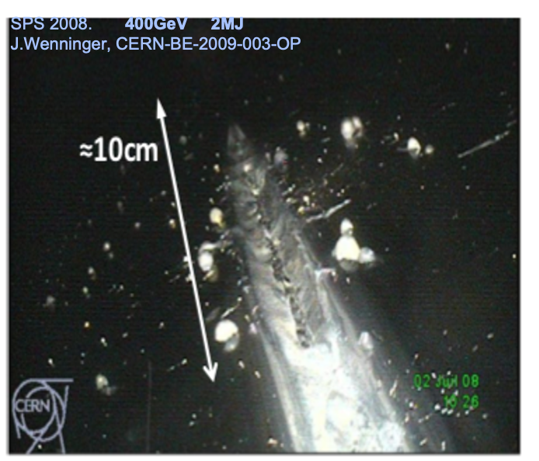
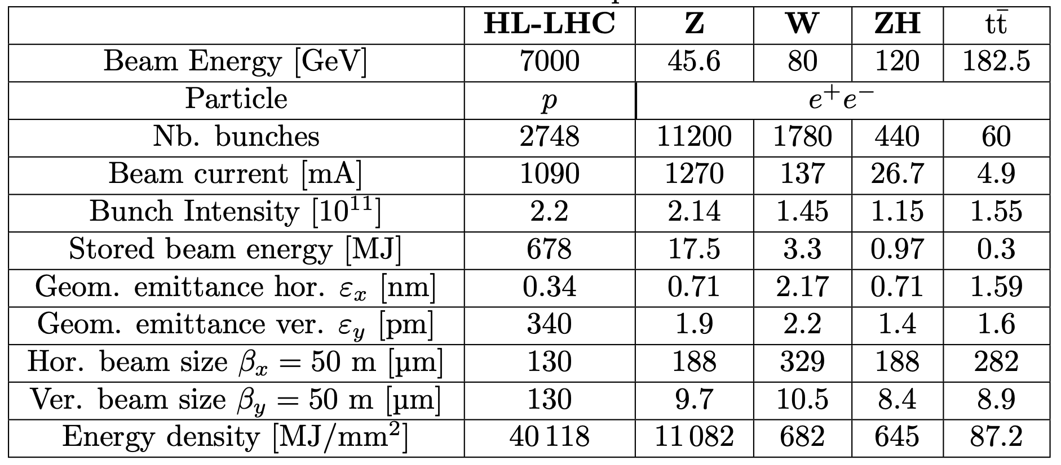
FCCee beam parameters
Uncontrolled damage
Vacuum chamber to atmospheric pressure, downtime ~ 3days
FCC_turn (325.8us)
Energy densities at the Z-pole configuration of the same order of the HL-LHC.
Active Protection is needed to minimise failure occurrence

Slide 5
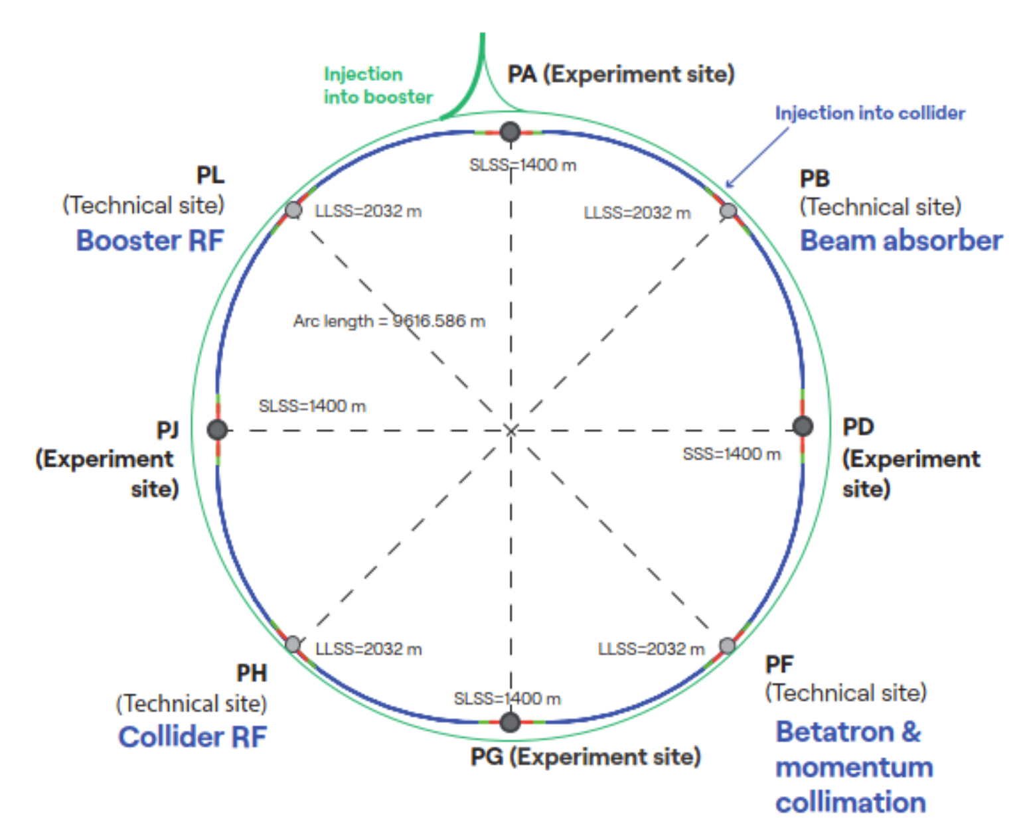
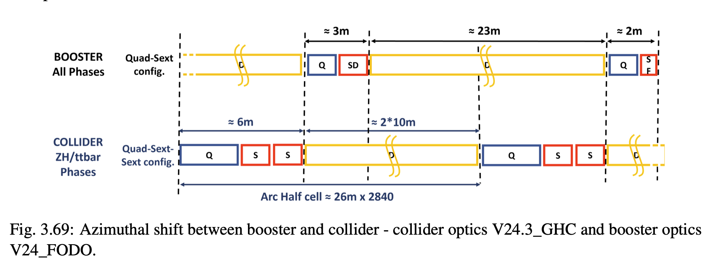
Where do we need to measure Beam Losses?
 | Elements | Protected or Monitored Element | Desired time
8 ARCs | ~1500 | Arc cell of collider ring | Slow (µs) | Per turn measurement
8 ARCs | ~1500 | Arc cell of booster ring | Slow (µs) | Per turn measurement
PA/PD/PG/PJ + PF | ~100 | Collimators and absorbers | Fast (ns) | Per bunch measurement
PA/PB | ~200 | Injection and Extraction system | Fast (ns) | Per bunch measurement

Slide 6
FCC-ee proposal of a BLM system in the ARC
Generic Beam Loss System covering an ARC cell. The final detector technology will depend on the beam loss measurement requirements (time and signal resolution, etc.)
BLM system = 3 BLM read-out channels (black boxes)
Proposal of 2 BLM systems / arc cell /beam
3 read-out channels/beam (minimum to localise losses)
Final location being studied (see next slides)
Slow read-out: per turn (µs)
SR background needs to be considered
Q
DIPOLE
Q
DIPOLE
Booster Ring
one beam
S
S
S
S
6 m
2x11 m
Collider Ring
two beams
Q
S
S
DIPOLE
Q
S
S
DIPOLE
BLM crate (18 channels)
collider and booster rings
2 BLM systems/ARC cell/beam
ARC cell

Slide 7
BLM read-out electronics for the ARC
Long copper cables need to be avoided:
  Signal deterioration: very low signals [pA-mA] range
  Cable trays capacity overload
Electronics in the tunnel will need to withstand high levels for radiation and high temperatures.
  Radiation tolerante electronics
  Active cooling
Proposal is to place the acquisition electronics close to the detectors and transport the measurements & diagnostics over digital optical links.

Slide 8
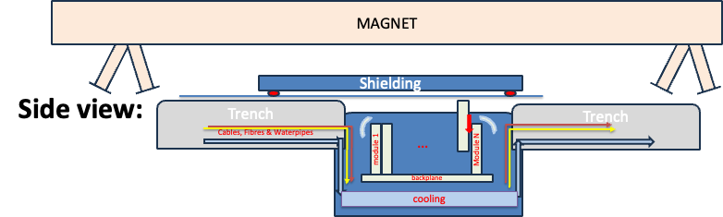
FCC BI Tunnel crate proposal
Proposal to install radiation tolerant electronics in racks below the magnets. Integration studies are on-going, evaluating the building of an electronics bunker to host the racks. Key points should be to incorporate in the design a robotic solution for replacement of cards, opening the bunker, etc.
Shielding: movable on top of a rail. Robotic solution to open sarcophagus.
Electronic Modules: robotic solution to replay modules. Insert from the top side, front-panel at the top. Connections (Cooper and fibre) from the bottom.
Backplane: provides all cabling and fibre connections.
Cooling: circulator and fans at the side (horizontal airflow). Accessible for exchange from the top.

Slide 9
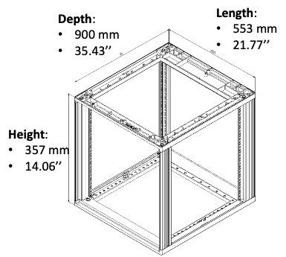
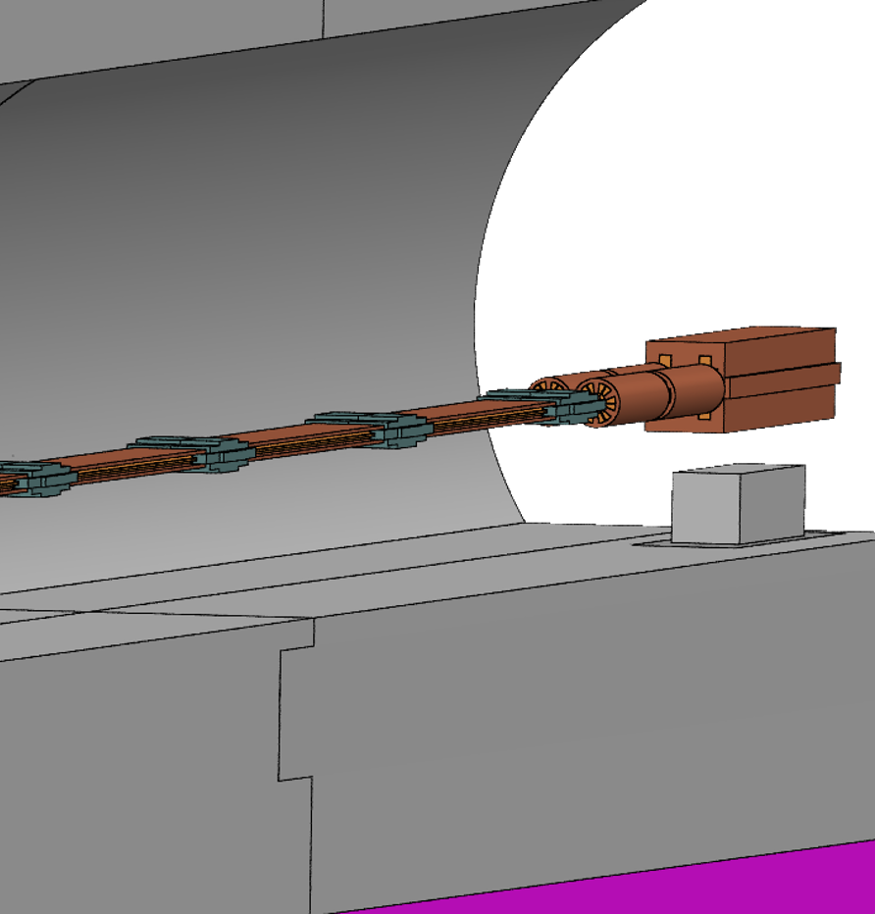
FCC BI rack dimensions
Electronics bunker, placed below the quadrupole
Front-panel on top
Connections and cooling on the bottom
A solution with an electronics bunker below the magnets (but not underground due to access constrains) is being investigated to host the electronics

Slide 10
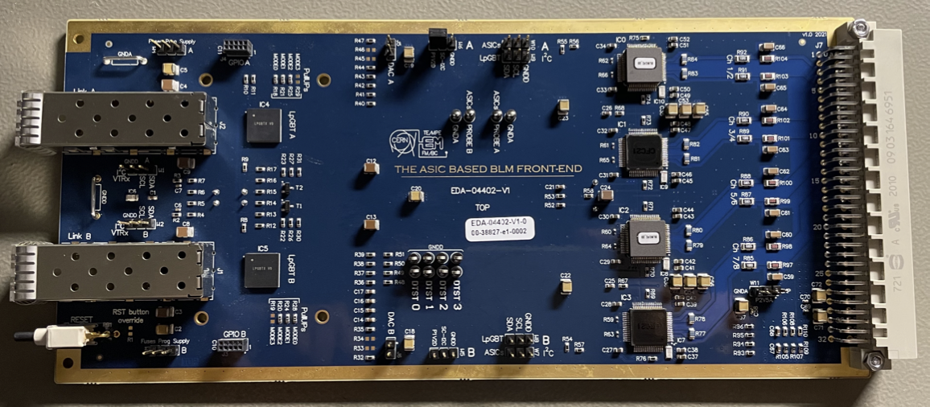
BLMASIC - present levels of rad. Hardness
R&D on BLM radiation tolerant electronics (CERN-THESIS-2022-333 F.Martina)
  HL-LHC and SPS upgrade during LS3 (2026-2029)
  20 years lifetime with TID 6 x 6kGy
  Commercial products cannot fulfil this requirement
  Design of a new front-end board with an application-specific integrated circuit (BLMASIC)
  BLMASIC tested for TID up to 1MGy
  Complete front-end board tested for TID up to 3.3kGy
Top view of BLM front-end
Optical transceivers
BLMASIC
(v2 and v3)
Expected Yearly dose levels:
At the tunnel walls: from <10kGy to 20kGy (B.Humann @ 13th FCC-ee Radiation and Shielding Meeting)
Inside the electronics bunker: around 10 Gy (A.Lechner: FCC-ee Radiation Environment and Shielding - IPAC 2025)

Slide 11
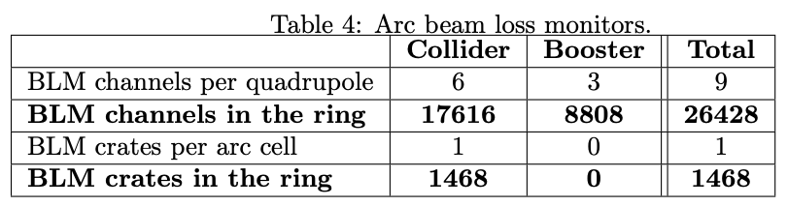
FCC BLM detector counting
For BI equipment 1-2 racks is needed per quadrupole, to read-out Beam Loss Monitors and Beam Position Monitors

Slide 12
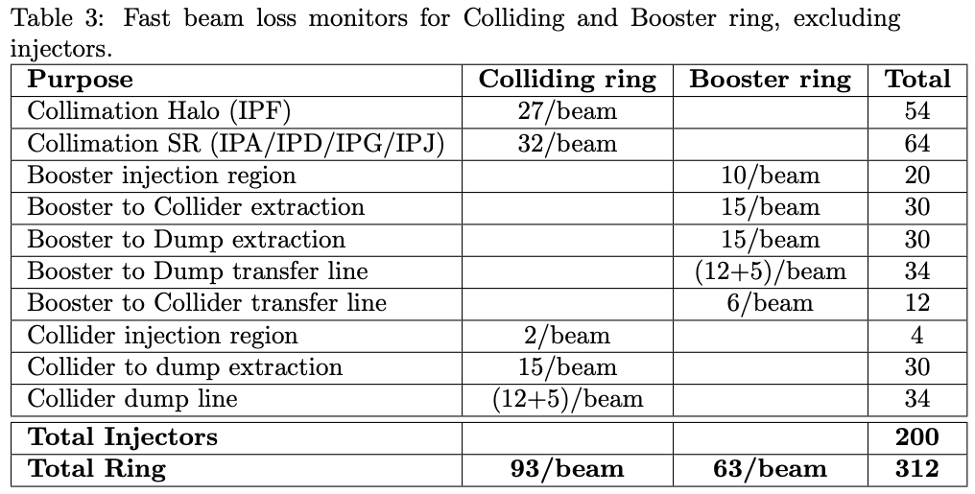
Fast Beam Loss monitors
A bunch-by-bunch system is proposed to monitor the losses at the injection/extraction and the circulating beam collimation system.
Collimator system:
  Beam halo cleaning, designed to protect the machine against beam losses
  SR cleaning, design to protect the experiment detectors against SR photons
Injection and Extraction:
  Monitoring is needed at the location of collimators, beam masks, absorbers and kickers and septum magnets.

Slide 13
Beam Loss Measurements specifications
What are the beam loss scenarios?
Where is the beam lost? And How?
What is the Machine Protection strategy?
Currently, all this is not yet defined
But we still need to certain specifications in order to start the needed R&D on a Beam Loss System for the FCCee.

Slide 14
Beam loss scenarios
 | Reason | Source of losses | Location of losses
Steady losses | Nominal machine - unavoidable | Beam halo at collimators | Collimators in PF Collimators in PA/D/G/J
 |  | Beam gas interaction | Everywhere
 |  | Synchrotron radiation | Everywhere
 |  | Collisions and beam-beam products | Around colliding points PA/D/G/J
 | Degraded machine | Vacuum degradation ,i.e. when installing new equipment | Local - several meters
Slow transient losses | Beam manipulations and measurements | Local orbit bumps, collapsing beam separation, squeeze, etc. | Local - several meters Collimators in PF
 |  | Injection | Injection points
 |  | Global corrections (tunes, coupling, etc.) | Collimators in PF
 |  | Beam scans with wires, gas jets, etc. | Local - several meters
Fast losses | Kickers failure | Injection error | Injection points and Collimators in PF
 |  | Dump error | Dump point and Collimators in PF
 | Power converter trip | Magnets | Collimators in PF
 | Degraded machine | Beam dust particle interations | Local - several meters and Collimators in PF
 | Beam Instabilities | Drifting beam or transverse blow-up | Collimators in PF
Not an exhaustive list but just a starting point

Slide 15
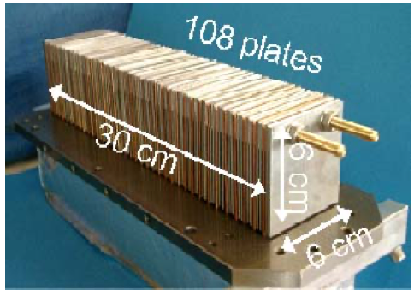
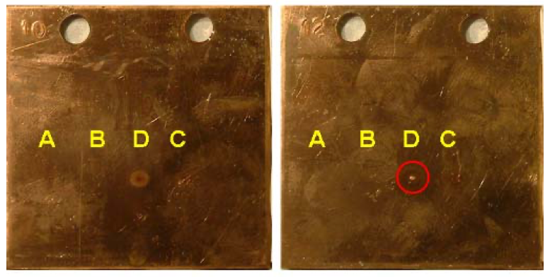
Beam effect on material damage
Design of the LHC protection system is based on the assumption of damage limits
Simulations studies and beam tests have been done for more than 20 years:
  Multi-turn tracking simulations (in particular for Collimators)
  Energy deposition simulations (Monte Carlo)
  Thermo-mechanical simulations (finite element, heat and stress)
  Verification with beam tests
7.9x10¹² protons @ 450 GeV
Example: Material damage test with 450 GeV protons on copper (link)
Remarkable agreement with simulations!
Discolouration but not melting
Melting
Sandwiched target irradiated with different intensities

Slide 16
BLM in the ARC
Nearly 18000 BLMs are planned to cover the Colliding Ring Arc.
Being warm magnets the Beam Loss Monitoring strategy should be to avoid damage to the vacuum chambers and interconnects.
Direct beam impact into the magnet, which could be:
  In the synchrotron radiation absorbers: copper
  In the beam screener: copper
When this happens we expect sudden energy deposition and increase of temperature.
While detail studies need to be considered for the fine tuning of the amount of losses that can be withstand (thermal expansion, thermal shock, etc.). We can still make some approximations to estimate the maximum and minimum detection ranges based on previous studies.

Slide 17
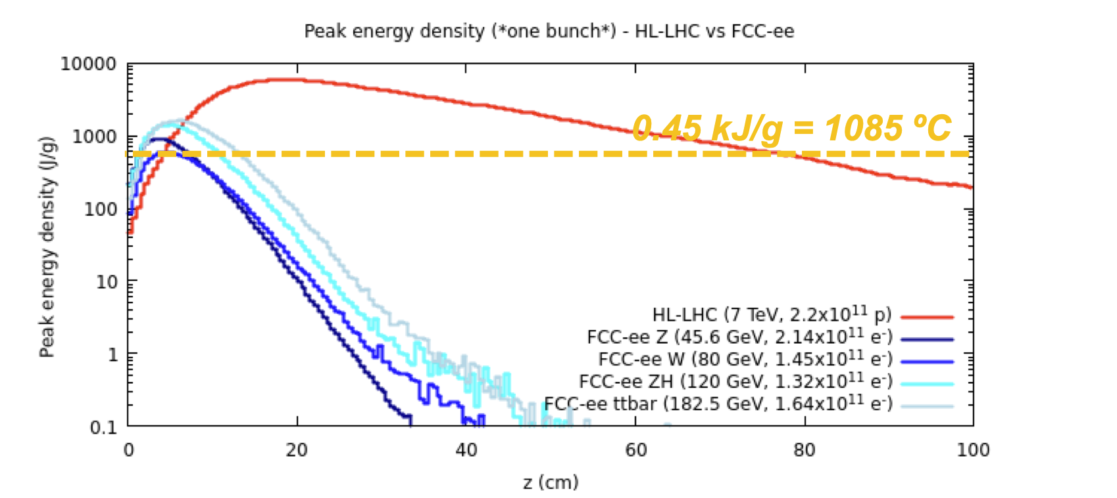
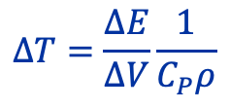
Beam impacts needed to melt copper
As a 1st approximation, one can calculate the melting point and the equivalent energy deposition needed to reach the melting temperature.
1st approximation
 | Copper | Tungsten
Melting temperature of materials | 1084.62 C | 3422 C
Melting temperature of materials | 1357.79 K | 3695.15
Densities, ⍴ | 8.96 g/cm³ | 19.3 g/cm3
Heat Capacity, CP | 0.385 J/g/K | 0.134 J/g/K
Energy Deposition for Melting | 4.5 kJ/cm³ | 9.4 kJ/cm³
BLM Detection (5%) | 0.2 kJ/cm³ | 0.45 kJ/cm³
$$ΔT=\frac{ΔE}{ΔV}\frac{1}{C_{P}ρ}$$
Peak energy density for 1 bunch impacting in copper at the different FCCee beam energies.
https://www.americanelements.com/meltingpoint.html
https://www.engineersedge.com/materials/densities_of_metals_and_elements_table_13976.htm
 | Energy | Bunch Intensity | Bunch fraction needed to melt copper
HL-LHC | 7 TeV | 2.2x10¹¹ p | 7%
FCC-ee (Z) | 45.6 GeV | 2.14x10¹¹ e⁻ | 50%
FCC-ee (W) | 80 GeV | 1.45x10¹¹ e⁻ | 75%
FCC-ee (ZH) | 120 GeV | 1.32x10¹¹ e⁻ | 30%
FCC-ee (ttbar) | 182.5 GeV | 1.64x10¹¹ e⁻ | 28%
A.Lechner
First specifications for the ARC BLM is that it should be able to detect:
  at least 5% of this type of losses
  Up to 10 times this damage limit

Slide 18
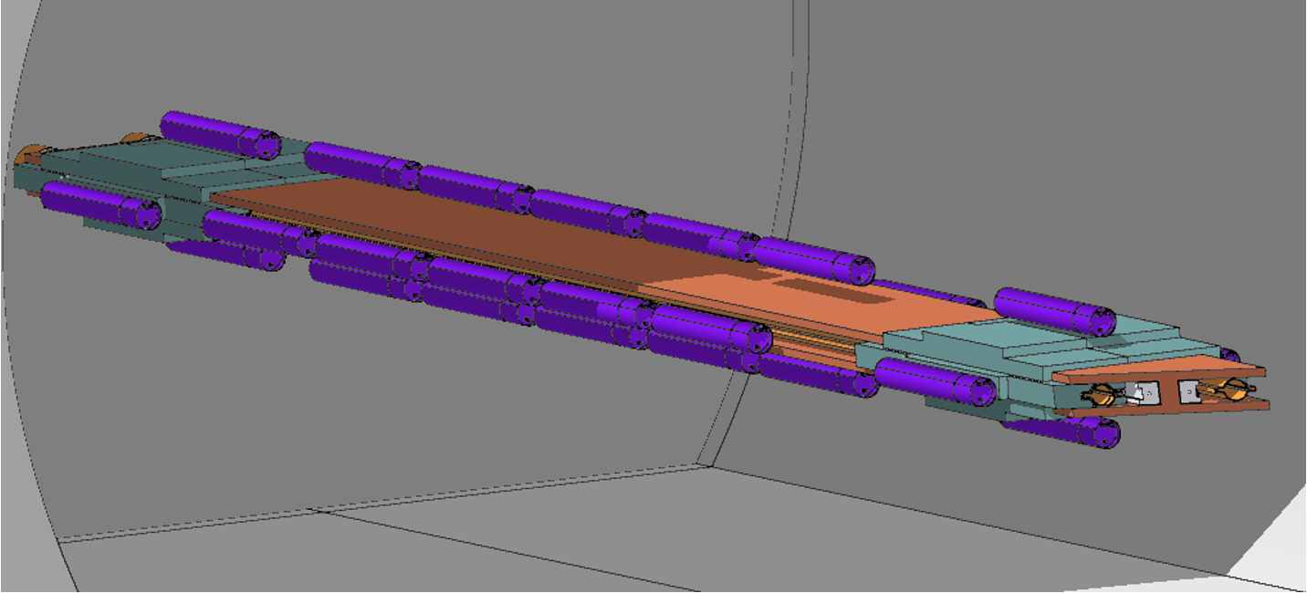
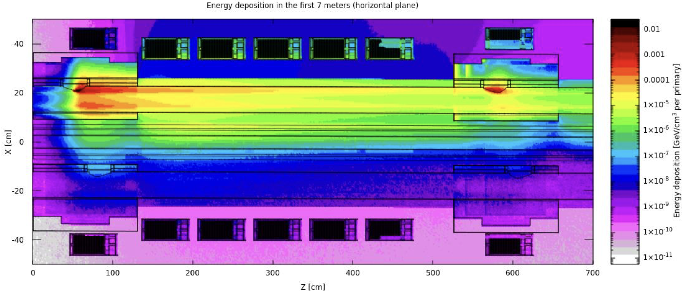
Simulation of beam losses and detector signal
Fabian Titz (see poster session)
Study basic parameters and ideas:
  Quantify if the assumption of 3 monitors / beam / half-cell is acceptable.
  Quantify the response of ionisation chambers to impacts on different locations of half-cell.
  Quantify the signal range of ionisation chambers by comparing them to existing systems.
How:
  Start with the Fluka simulation of LHC-type ionisation chambers along the FCC-ee dipole and quadrupole.
  Simulate different impact locations (i.e. SR absorbers, beam pipe, top, side, etc.) and compare the expected signal with BLMs located around and along the magnet.
  Compare the expected signal for different beam energies (i.e. Z-pole, W-pole, ZH, ttbar)

Slide 19
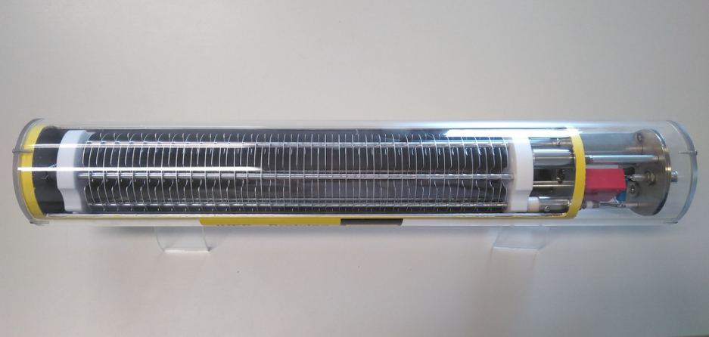
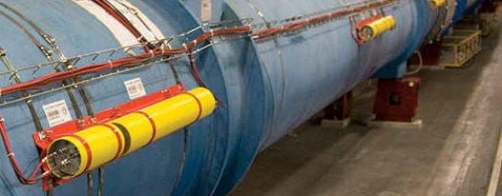
LHC Beam Loss Monitors
Ionisation chamber (3600 detectors):
    50 cm cylindrical tube with parallel aluminium electrodes plates (each 0.5 cm)
    Filled with N2 gas at 100mbar overpressure (1.1 bar) and HV 1.5 kV
    1.5 L of sensitive volume
Read-out:
    Charge-to-Frequency conversion using radiation tolerant electronics with dynamic range > 10⁸ (from 10 pA to 1 mA)
    Measurements in Gy/s in 12 moving windows ranging from 40 us to 83.9 s
50 cm
Dynamic range defined by quench curves + 2 additional orders of magnitude
LHC turn is 89 𝜇s
Beam extracted in ~ 3 LHC turns

Slide 20
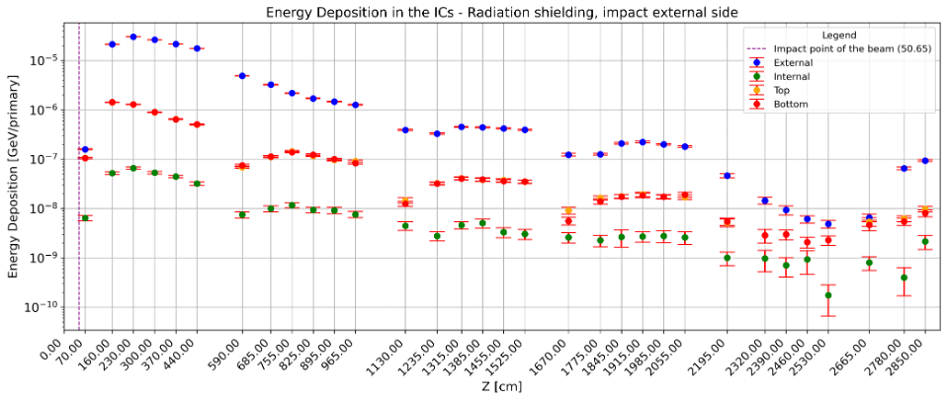
Simulations results
Expected energy deposition in each of the ionisation chambers per primary electron impacting on the SR absorber.
Expected BLM signal could be derived from this quantity.
Expected BLM signal comparable to LHC values.
Next steps include to convert the signal to expected current, assess the impact of the SR and beam gas interactions, study other detector responses and the combination of losses from different beams and rings.
Fabian Titz
ARC half-cell
 | Energy | Bunch Intensity | Bunch fraction needed to melt copper | 5 % detection | Number of particles 5% detection | 10 x damage
HL-LHC | 7 TeV | 2.2x10¹¹ p | 7% | 0.35% | 7.7E+08 | 1.54E+11
FCC-ee (Z) | 45.6 GeV | 2.14x10¹¹ e⁻ | 50% | 2.5% | 5.4E+09 | 1.08E+12
FCC-ee (W) | 80 GeV | 1.45x10¹¹ e⁻ | 75% | 3.75% | 5.4E+09 | 1.08E+12
FCC-ee (ZH) | 120 GeV | 1.32x10¹¹ e⁻ | 30% | 1.5% | 2.0E+09 | 4.0E+11
FCC-ee (ttbar) | 182.5 GeV | 1.64x10¹¹ e⁻ | 28% | 1.4% | 2.3E+09 | 4.6E+12

Slide 21
Summary
The FCC-ee beams have enough energy to damage machine componets.
A Beam Loss System is proposed as part of the Machine Protection strategy at:
  All Collimators and absorbers
  Injection and Extraction equipment
  Collider and Booster Ring
With this information estimated number of monitors has been proposed, together with cabling and electronics.
Specifications for the Beam Loss Systems are still to be defined but first studies and discussions on the Collider Ring expected beam losses have started.

