Slide 2
Notes:
Before we begin, I invite you to gently close your eyes, just for a few seconds. Just shift your attention inside yourself

Slide 3
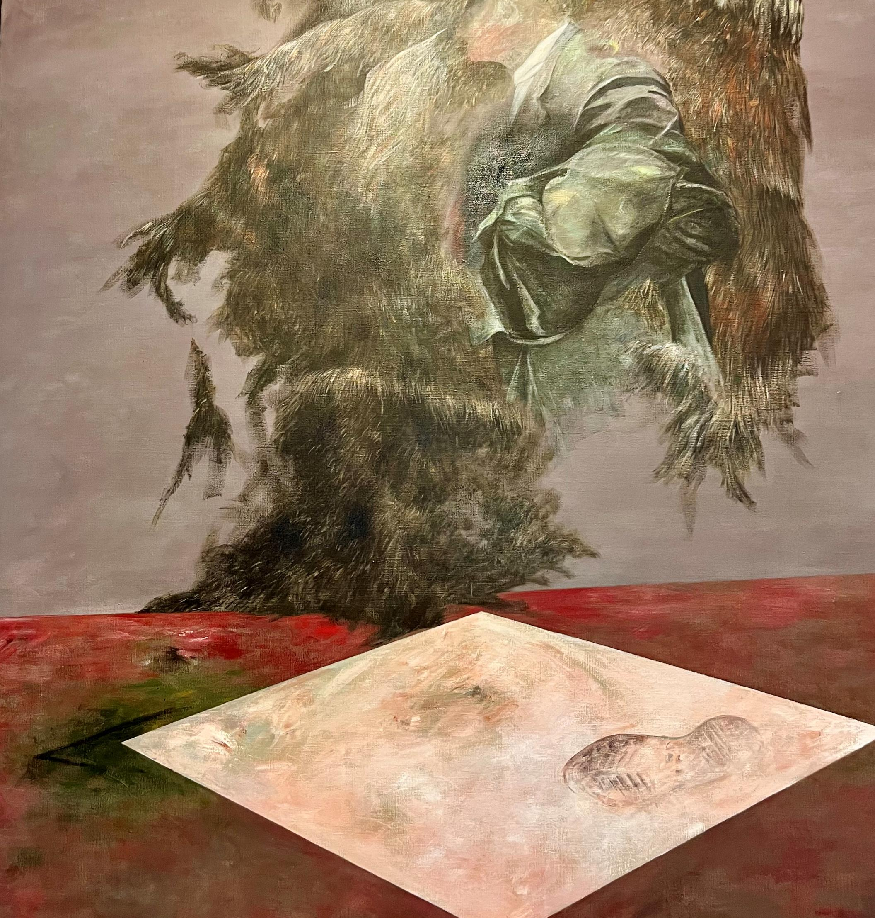
Not only I Am but
I’ m aware
that I Am
Dimensions of Self-awareness
Self-brain areas
Heart-brain link
Self-voice

Slide 4
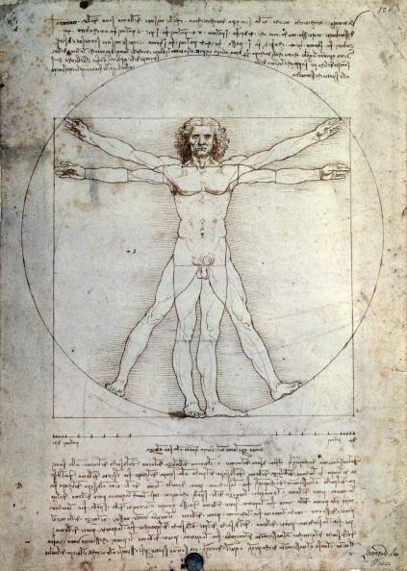
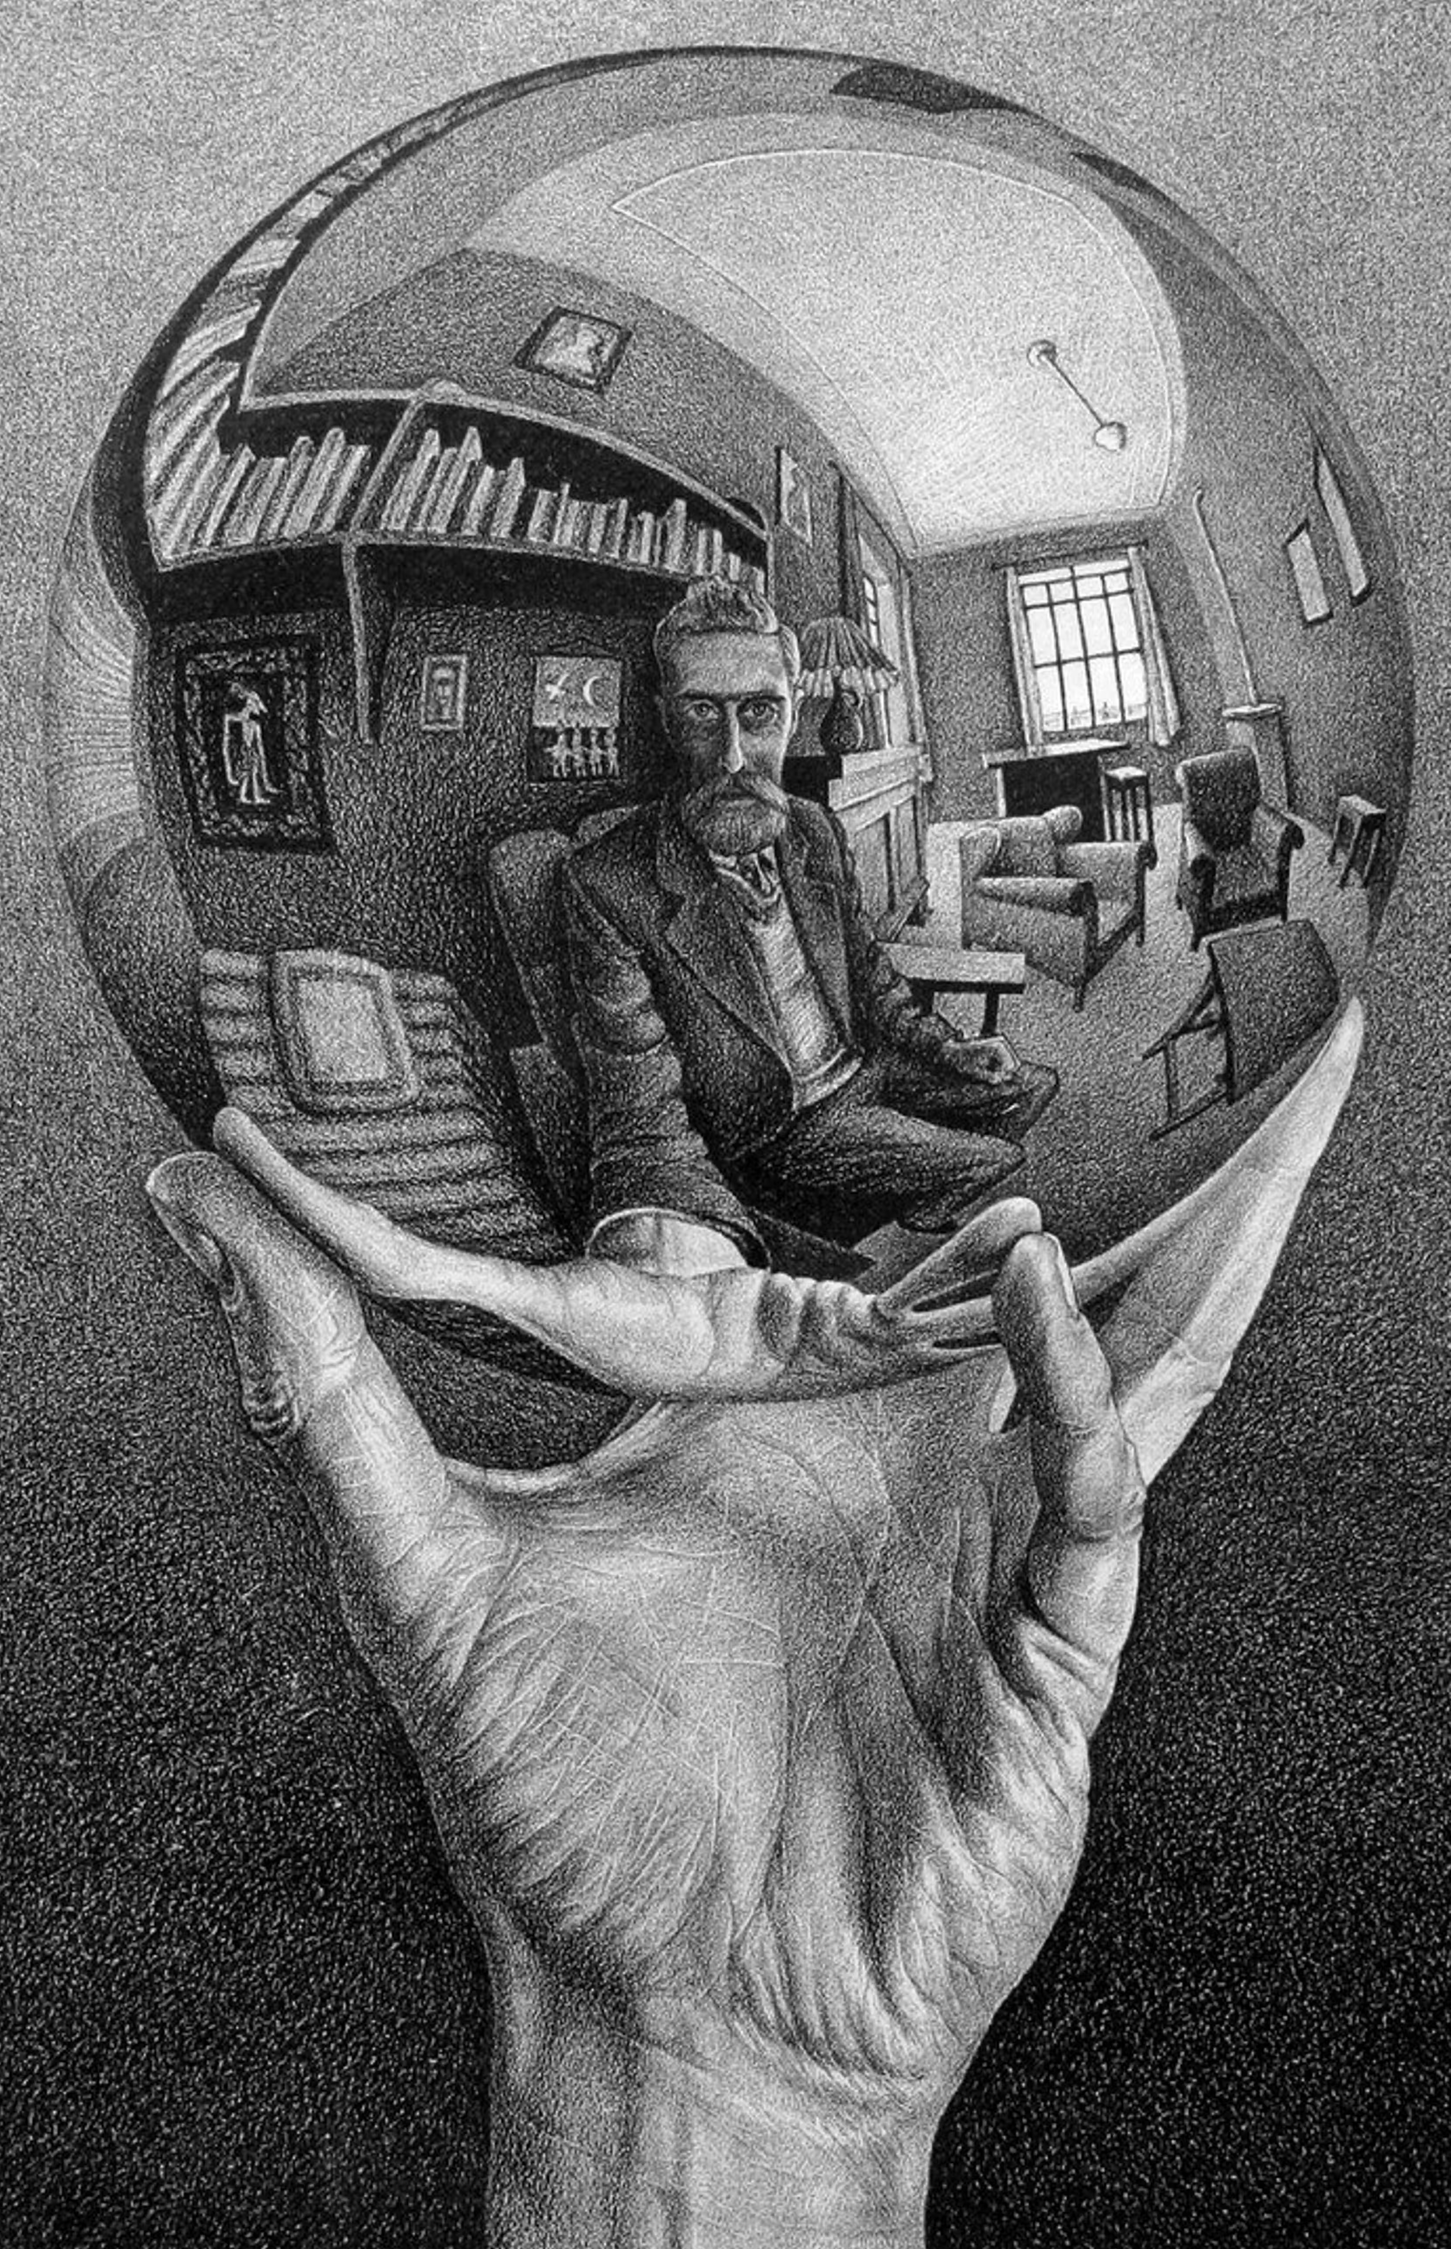
Self Awareness
A state of mind in which there is knowledge of one's own existence and of the existence of surroundings ^{[1]}
Two levels ^{[2,3]}
  Bodily self awareness
    Integration of external and
    internal stimuli
    Ex. self-location, self-identification
  Cognitive self
    High-order processess
    Ex. Autobiographic memory,
    recognition of own face/voice
Interoception ^{[4]}
  A bridge between both
[1] Damasio A, 1999; [2] Caio A, 2022; [3] Park HD, 2019; [4] Azzalini D, 2019

Slide 5
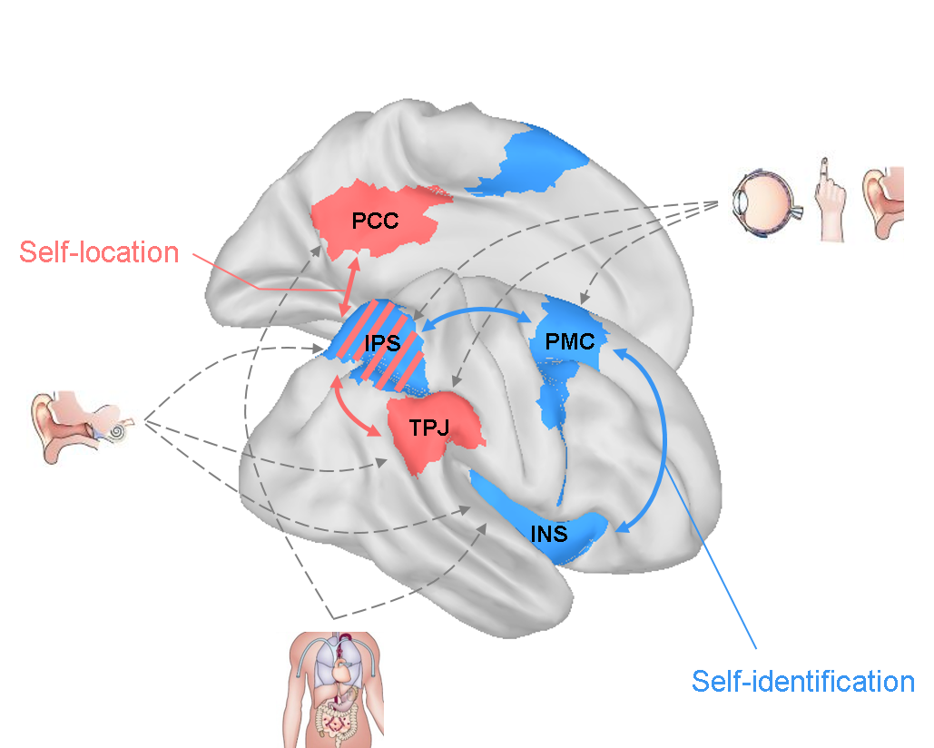

Brain-Body in Dialogue
1
Visceral signals continuously inform brain on body internal state ^{[5]}
  Ex. heartbeat, respiration, gastric rhythm
Dynamic dialogue via autonomic pathways (e.g., vagus nerve), ascending through the brainstem and thalamus to reach cortical regions
Main brain regions ^{[2,3]}: insula (INS), posterior cingulate cortex (PCC), temporo-parietal junction (TPJ), and premotor cortex (PMC)
3
2
In particular: heart & brain
Adapted from [3]
[5] Engelen T, 2023

Slide 6
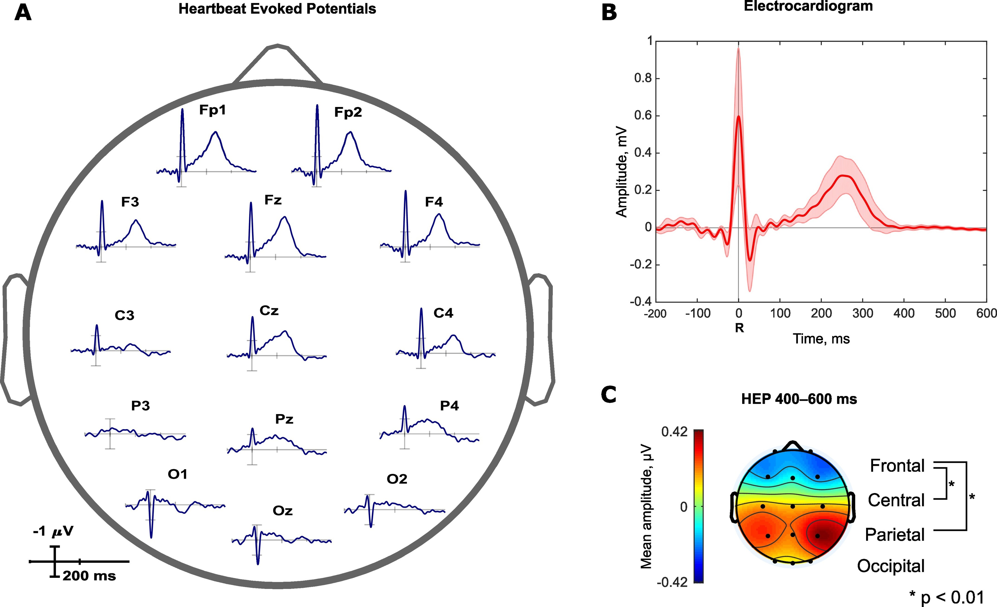
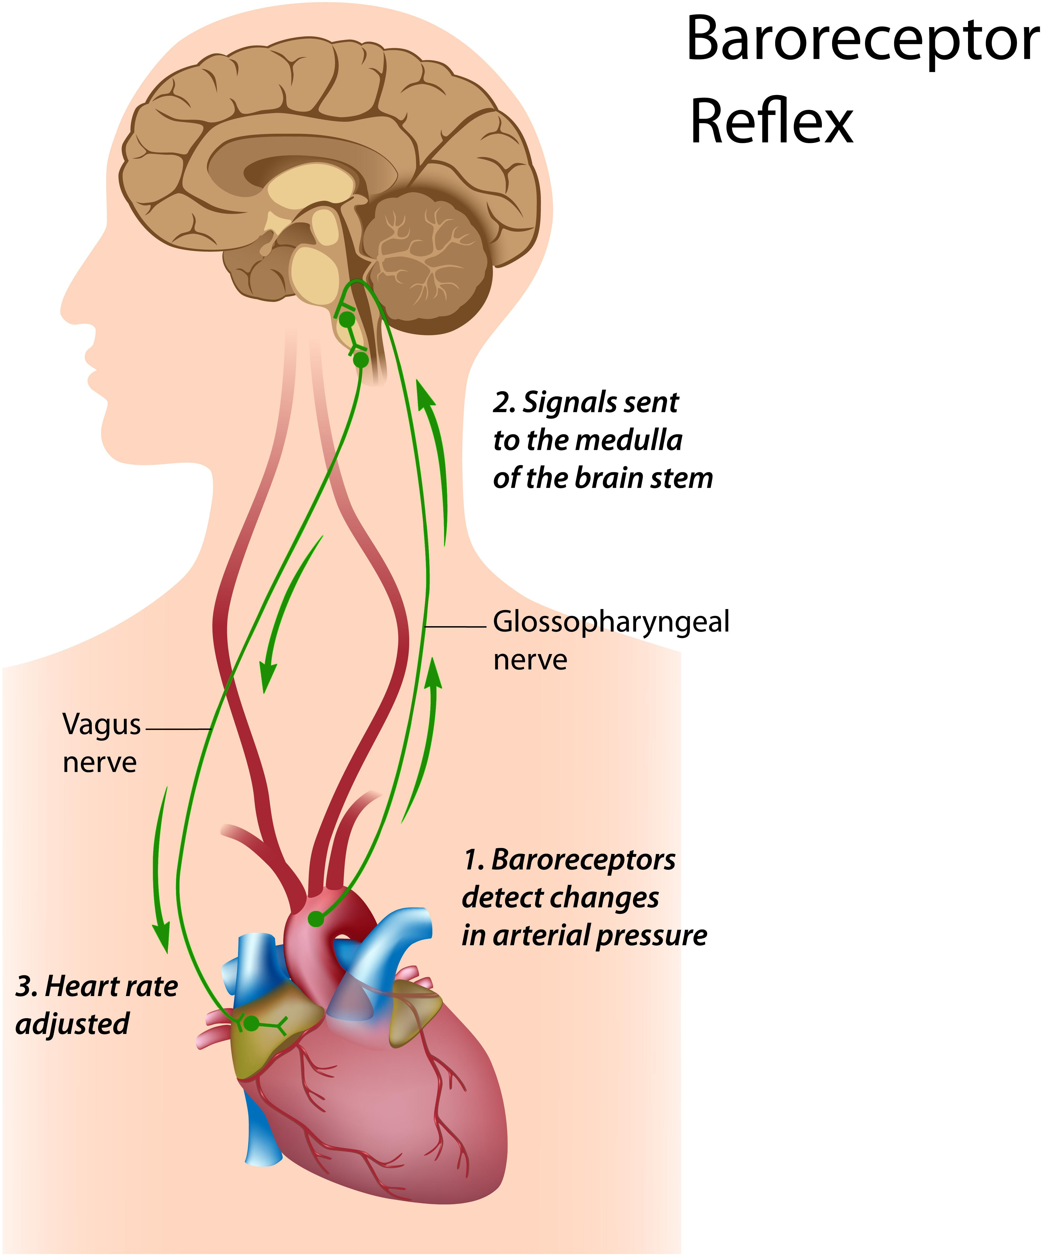
Heart-Brain & HEP
EEG
HEP
Closed-loop for blood pressure regulation
If blood pressure rises
  Baroceptors send signals to the brain
  Brain releases norepinephrine
  Norepinephrine contract vessels walls
In neuroscience a measurable bioelectrical loop
Synchronized electroencephalogram and electrocardiogram (EEG+ECG)
  Heartbeat-Evoked Potentials (HEPs)
    200-400 ms after heart R peak
HEP reflects cortical processing of internal bodily signals ^{[6]}
ECG
[6] Park HD, 2019
Adapted from [7]

Slide 7
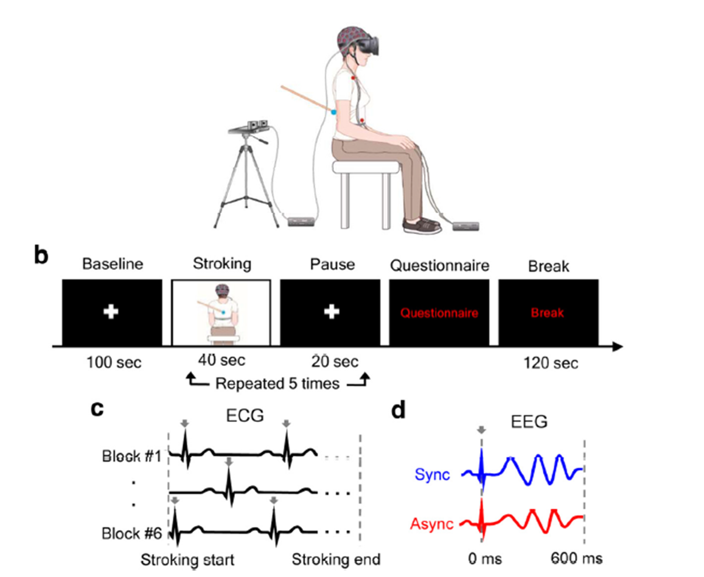
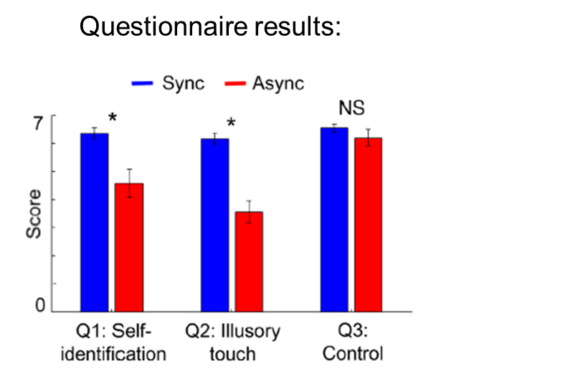
Full Body Illusion (FBI)
Visuotactile stimulation ^{[8]}
  Tactile strokes + visual feedback of back
  Strokes asynchronously (Async) or syncronously (Sync) to visual feedback
    Questionnaire to measure perception
  ECG recording + HEP computation in Async vs Sync
Stronger self-identification during the synchronous versus asynchronous visuotactile
1
Multisensorial integration contributes
to shape (bodily) self-awareness
[8] Park HD, 2016

Slide 8
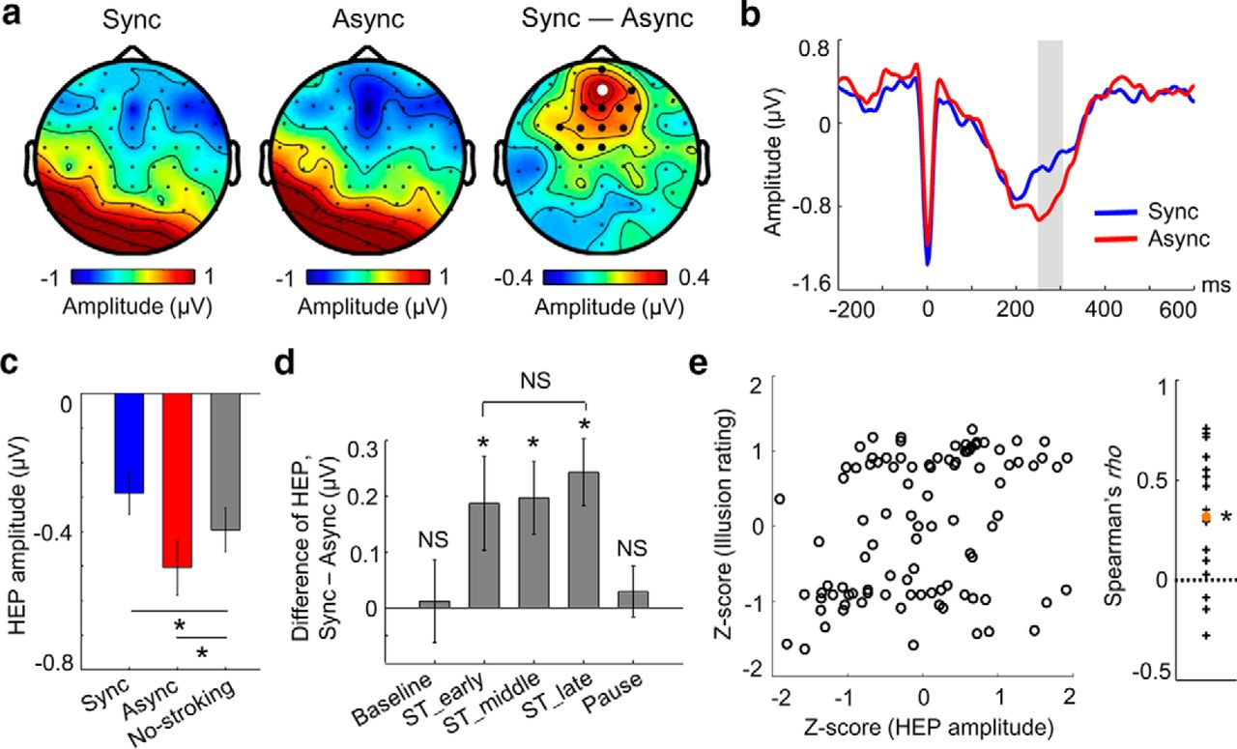
HEP in FBI
HEP amplitude differed between Async vs Sync ^{[8]}
  250–305 ms time
  Central electrode = PCC
Difference in HEP
2
Brain response to heartbeats would reflect the altered state of (bodily) self-awareness
[8] Park HD, 2016

Slide 9
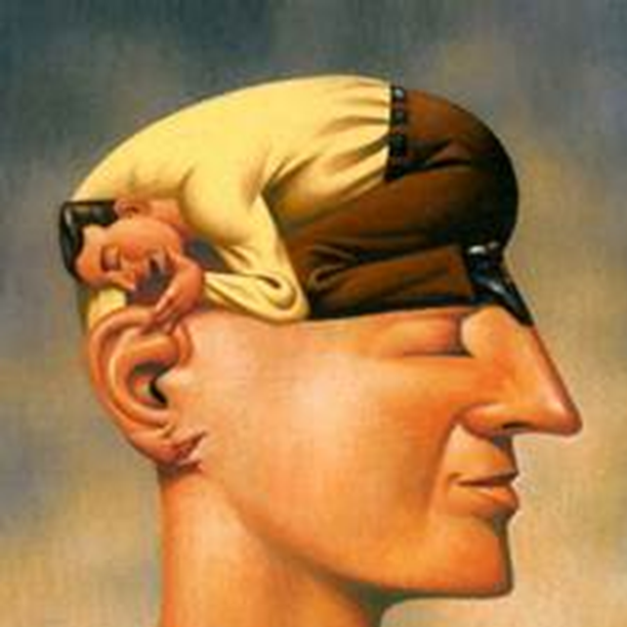
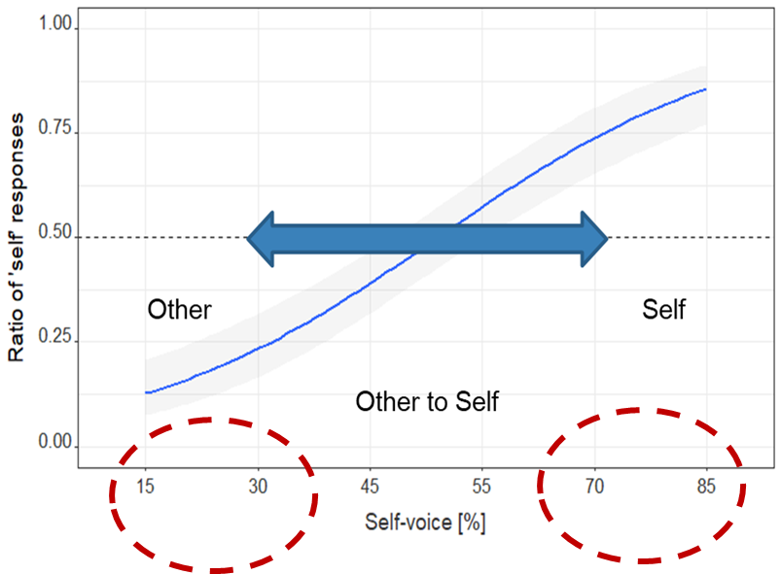
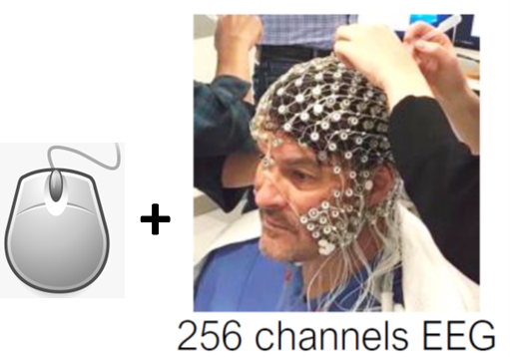
Self Voice as proxy for identity
18 healthy participants ^{[9]}
  R handed; mean age=37y (range: [20,60]y); 9 female
Own’s subject + gender matched voice pronouncing ‘a’ vocal (15%-85% self voice)
  Binary answer: <it’s my voice> OR <it’s someone else voice>
Behaviour (mouse) + EEG
SELF voice vs OTHERS’ voice
[9] Iannotti GR, Orepic P, 2022
Notes:
Self-awareness also extends to cognitive processes like recognizing our own voice

Slide 10
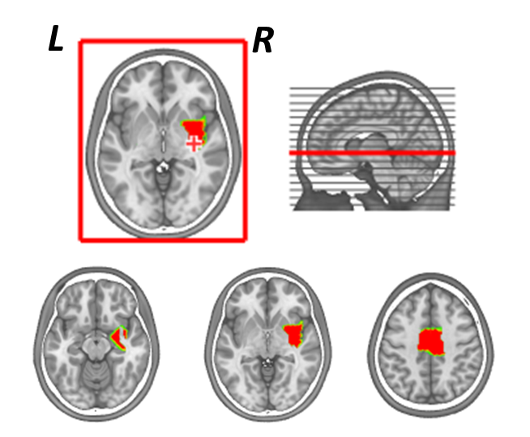
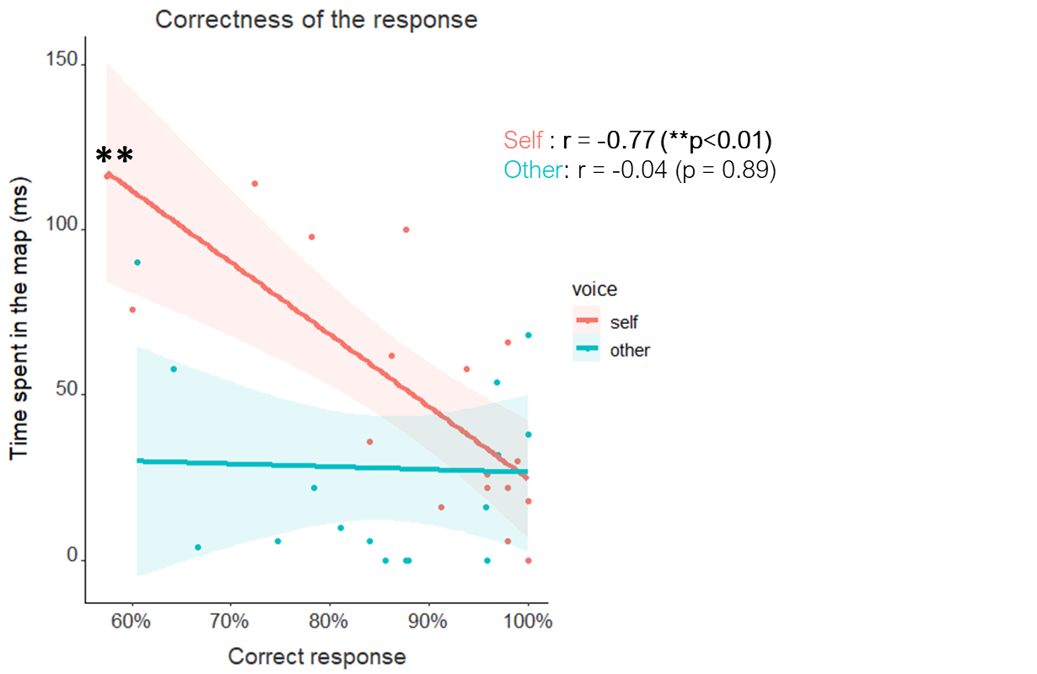
Specific Localization of Self-Voice
Self-voice network
Between 270-400 ms after the stimulus ^{[9]}
Functional network for the self-voice:
  R insula (posterior)
  PCC
  R limbic and para-limbic structures (hippocampus, para-hippocampus)
Correlated with the own perception of self voice
3
Duration of network activation (ms)
The more we “know” how we sound like,
the less we need to use this process
Correct response
[9] Iannotti GR, Orepic P, 2022

Slide 11
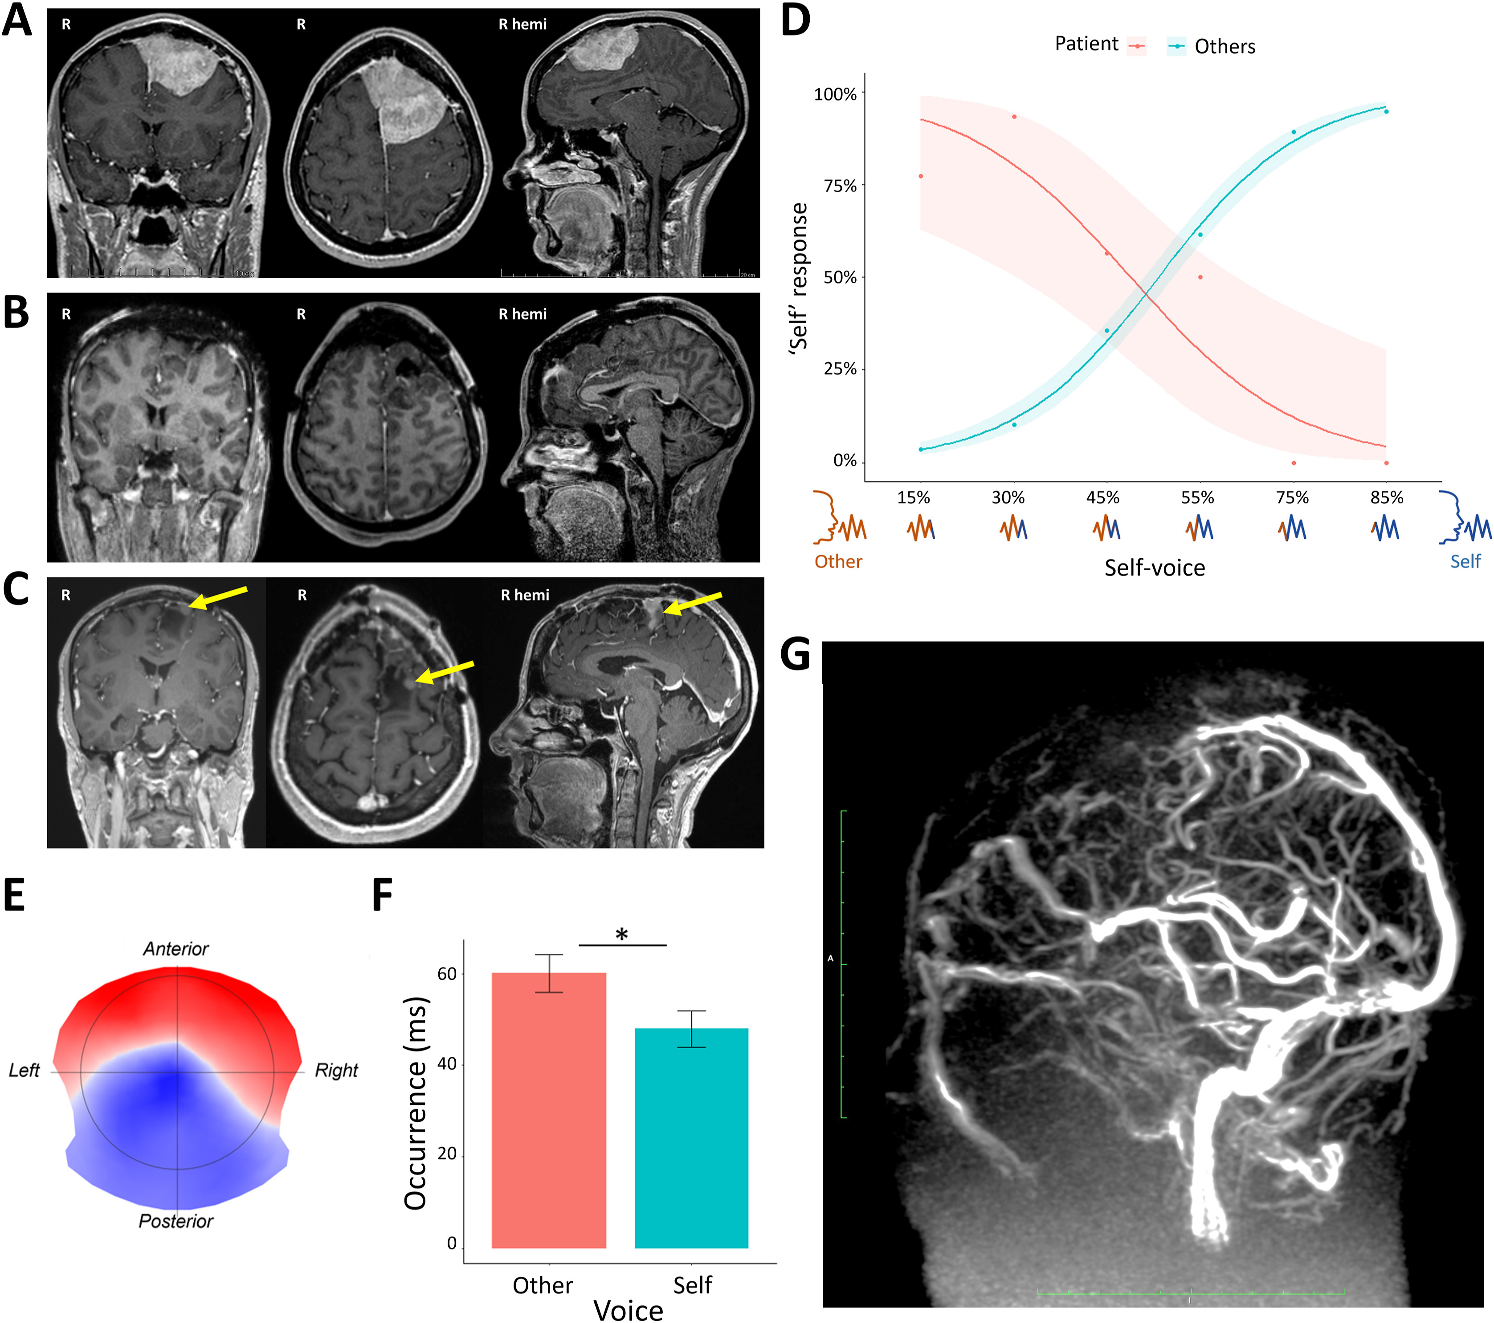

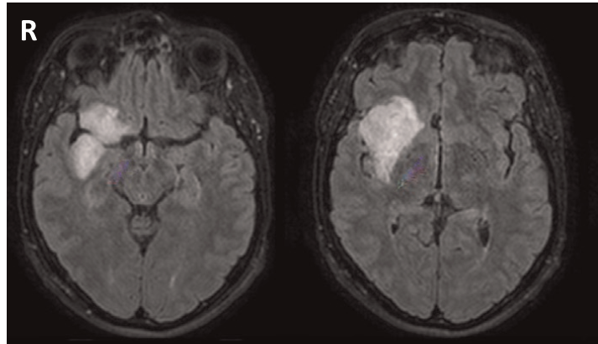
Clinical Relevance ^{[10]}
Self voice for psychotic traits after surgery ^{[11]}
  Patient with resection of part of self voice network
    Post operative borderline personality
    Reverted patterns in respect to healthy subject in self voice recognition
Impaired body ownership in insula tumor
  Patient with tumor in R insula tumor ^{[12]}
    After resection less cardiac awareness
    Both before and after avatar body
“I felt as though I was in two places at the same time”
Adapted from [13]
[10] Schaller K, Iannotti GR, 2021; [11] Orepic P, Iannotti GR, 2023; [12] Ronchi R, 2015; [13] Aspell J, 2013

Slide 12

Conclusion
Self-awareness is a measurable phenomenon
Neuroscience provides integrative approach
  Neuropsychology, psychometric tools, electrophysiology, neuroimaging
To objectify the characteristics of self-awareness
Especially relevant for understanding subtle and aspects of pathologies

Slide 13
References
Damasio A., The feeling of what happens: Body and emotion in the making of consciousness, Book, 1999
Caio A. Lage, et al. An evolutionary view of self-awareness, Behavioural Processes,2022, https://doi.org/10.1016/j.beproc.2021.104543
Park HD, Blanke O. Coupling Inner and Outer Body for Self-Consciousness. Trends Cogn Sci. 2019. https://doi.org/10.1016/j.tics.2019.02.002
Azzalini D, Rebollo I, Tallon-Baudry C. Visceral Signals Shape Brain Dynamics and Cognition. Trends Cogn Sci. 2019. https://www.cell.com/trends/cognitive-sciences/fulltext/S1364-6613(19)30089-0
Engelen T, Solcà M, Tallon-Baudry C. Interoceptive rhythms in the brain. Nat Neurosci. 2023. https://www.nature.com/articles/s41593-023-01425-1
Park HD, Blanke O. Heartbeat-evoked cortical responses: Underlying mechanisms, functional roles, and methodological considerations. Neuroimage. 2019. 10.1016/j.neuroimage.2019.04.081
Baranauskas M , Grabauskaitė A, Griškova-Bulanova I. Brain responses and self-reported indices of interoception: Heartbeat evoked potentials are inversely associated with worrying about body sensations. Physiology & Behavior, 2017. 10.1016/j.physbeh.2017.07.032
Park HD, Bernasconi F, Bello-Ruiz J, Pfeiffer C, Salomon R, Blanke O. Transient Modulations of Neural Responses to Heartbeats Covary with Bodily Self-Consciousness. J Neurosci. 2016. 10.1523/JNEUROSCI.0311-16.2016
Iannotti GR, Orepic P, Brunet D, Koenig T, Alcoba-Banqueri S, Garin DFA, Schaller K, Blanke O, Michel CM. EEG Spatiotemporal Patterns Underlying Self-other Voice Discrimination. Cereb Cortex. 2022. 10.1093/cercor/bhab329
Schaller K, Iannotti GR, Orepic P, Betka S, Haemmerli J, Boex C, Alcoba-Banqueri S, Garin DFA, Herbelin B, Park HD, Michel CM, Blanke O. The perspectives of mapping and monitoring of the sense of self in neurosurgical patients. Acta Neurochir, 2021. 10.1007/s00701-021-04778-3
Orepic P, Iannotti GR, Haemmerli J, Goga C, Park HD, Betka S, Blanke O, Michel CM, Bondolfi G, Schaller K. Experimentally-evidenced personality alterations following meningioma resection: A case report. Cortex. 2023. 10.1016/j.cortex.2023.08.006
Ronchi R, Bello-Ruiz J, Lukowska M, Herbelin B, Cabrilo I, Schaller K, Blanke O. Right insular damage decreases heartbeat awareness and alters cardio-visual effects on bodily self-consciousness. Neuropsychologia, 2015. 10.1016/j.neuropsychologia.2015.02.010
Aspell, J. E., Heydrich, L., Marillier, G., Lavanchy, T., Herbelin, B., & Blanke, O. (2013). Turning Body and Self Inside Out: Visualized Heartbeats Alter Bodily Self-Consciousness and Tactile Perception. Psychological Science, 2013. https://doi.org/10.1177/0956797613498395

