Slide 1


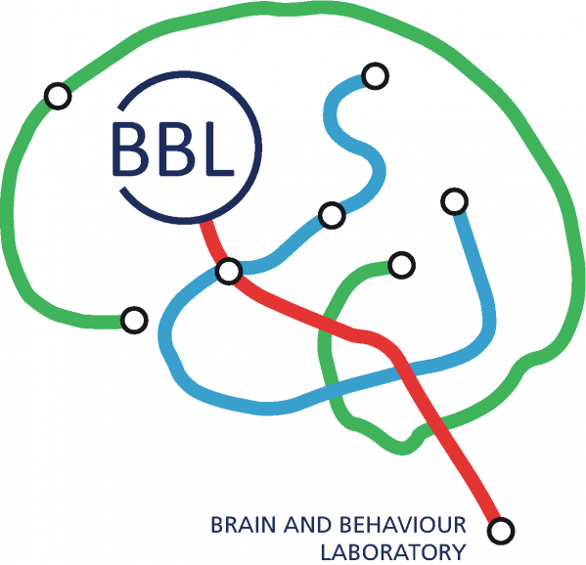


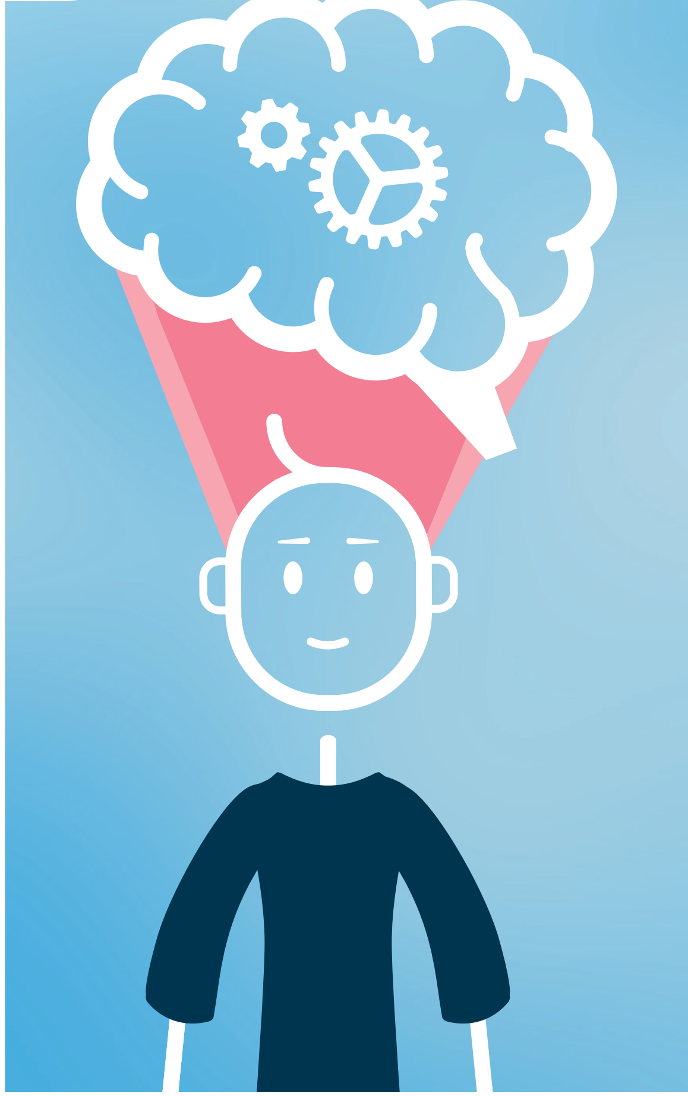
How does thinking more positively change our mind?
Chunyan Shi
03.07.2025
Me and my brain campaign

Slide 2

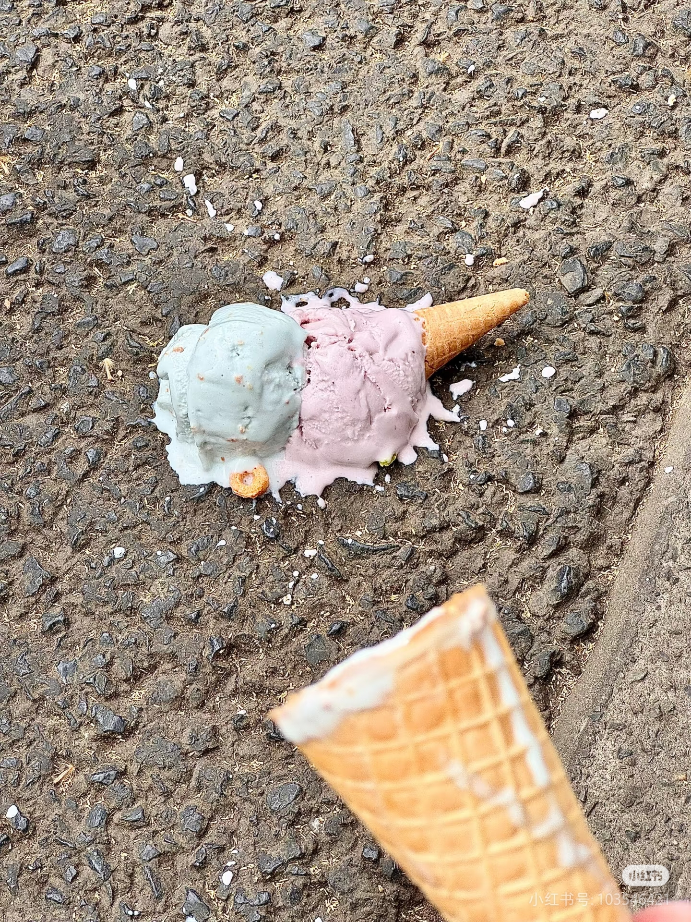
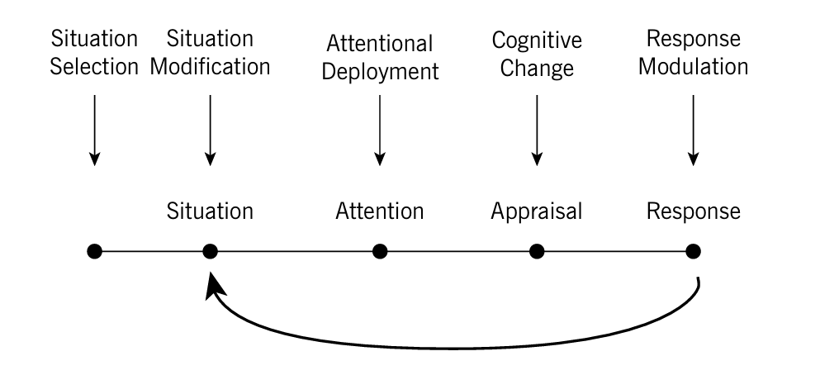
What is emotion regulation?
Reappraisal
Gross, J. J. (2024). Conceptual foundations of emotion regulation. In J. J. Gross & B. Q. Ford (Eds.), Handbook of emotion regulation (3rd ed., pp. 3–12). The Guilford Press.

Slide 3
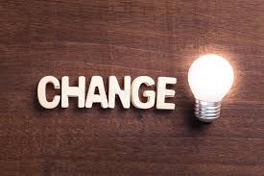
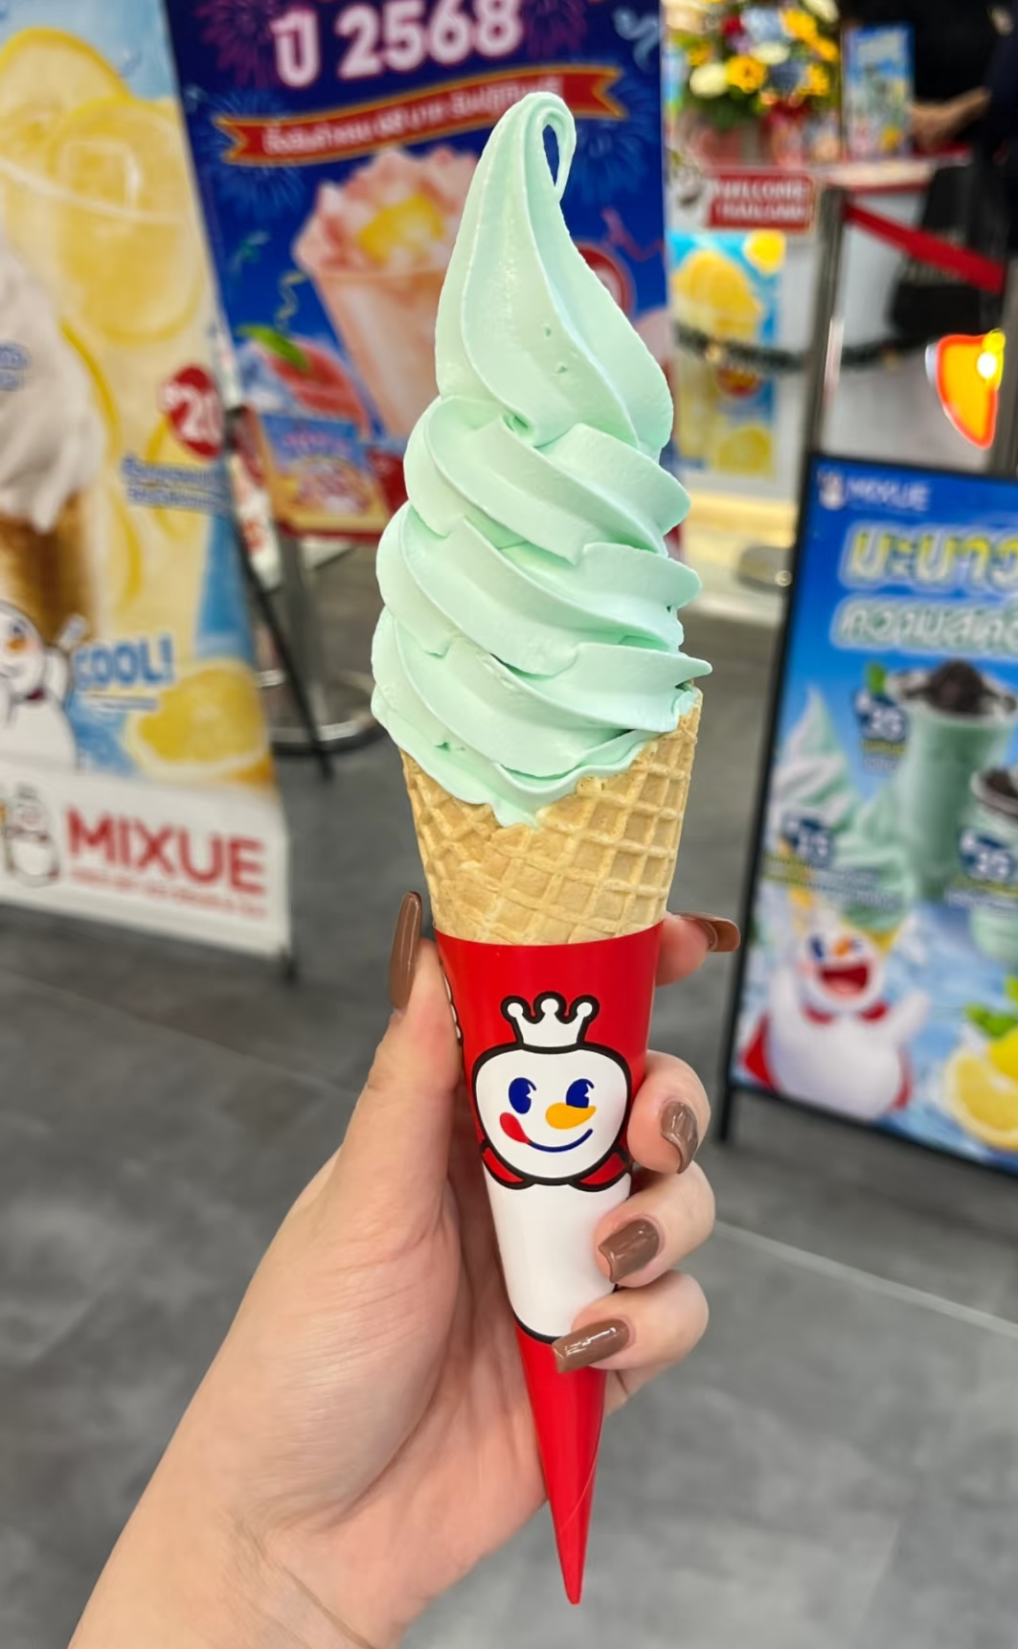

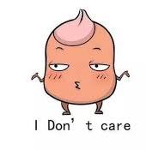

What is reappraisal?
More Positive Reappraisal
Less Negative Reappraisal

Slide 4

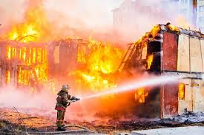

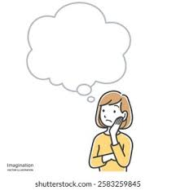

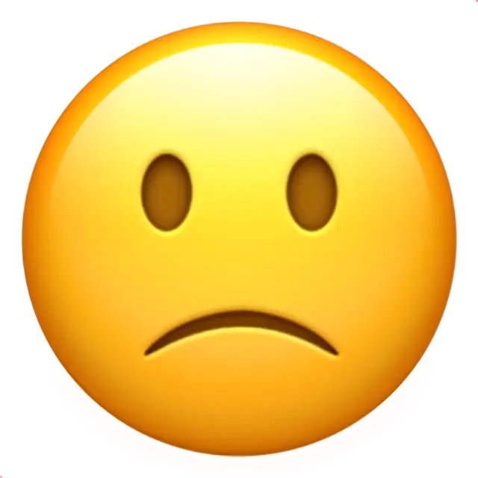

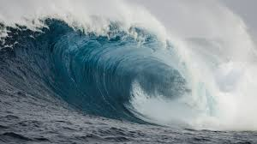
How did we investigate?
Watch
More Positive Reappraisal
Less Negative Reappraisal
6s picture presentation
OR
OR
Rating
AND
AND

Slide 5
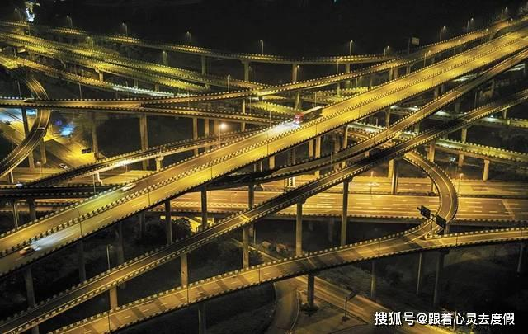
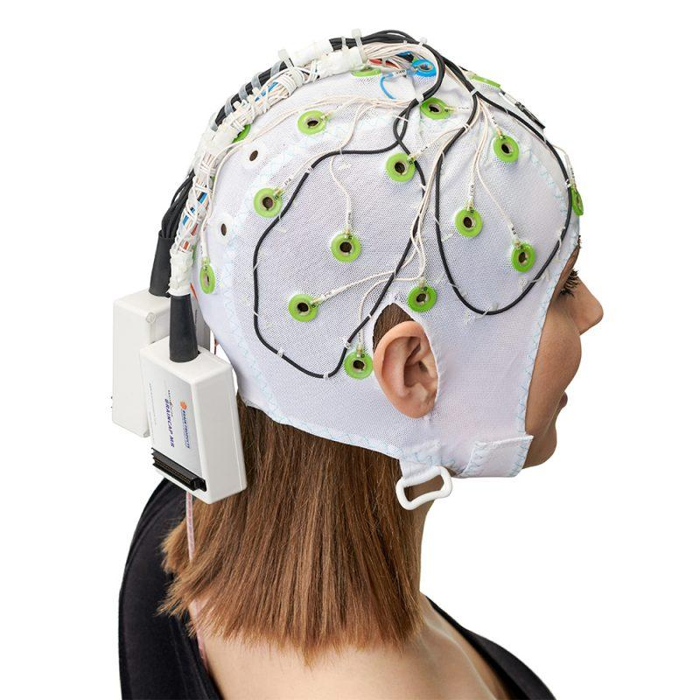
Electroencephalogram recording

Slide 6
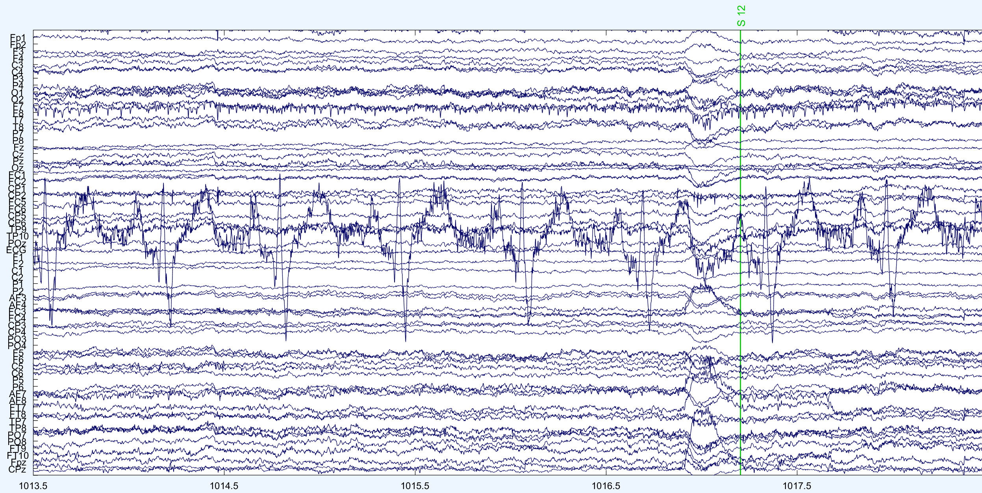

Slide 7


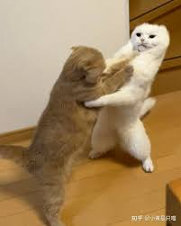
What did we find?
Less Negative Reappraisal
More Positive Reappraisal
Conflict monitoring

Slide 8

Take-home message
If you want to calm down and have less negative emotion.
Less Negative Reappraisal
More Positive Reappraisal
?
Pretending something is not that severe may be shameful, but it’s useful.
We can solve it with less negative emotion and more peaceful state.

Slide 9
Thank you for your listening!

