Slide 1
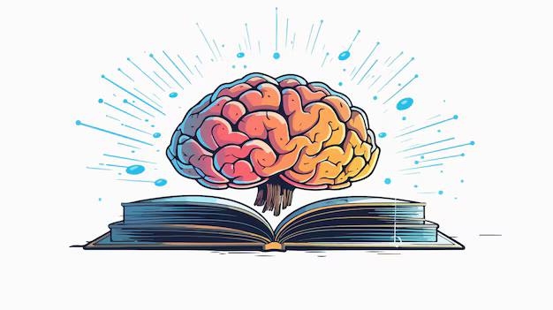
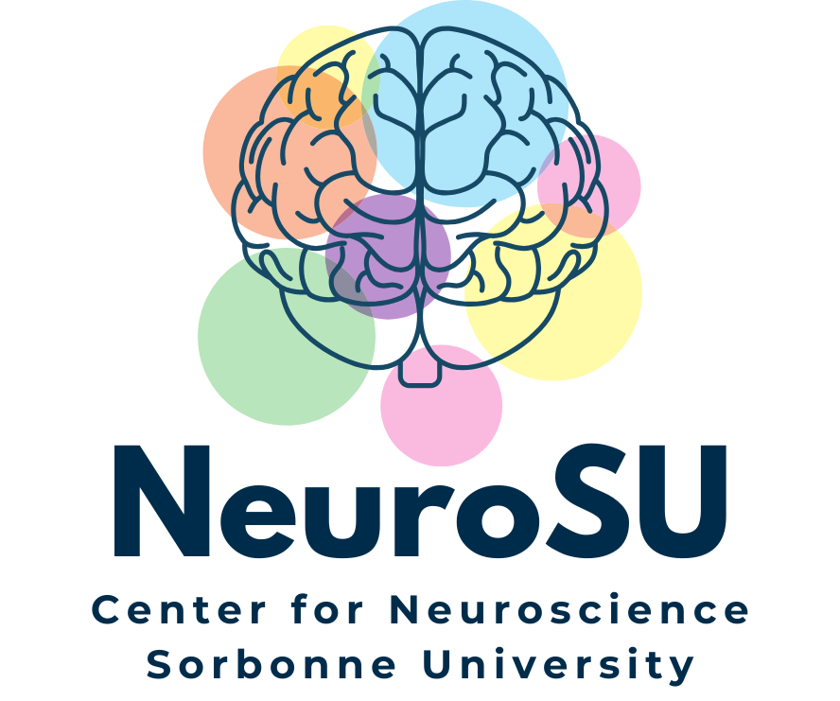


The Memory puzzle Sleep, Diet, Stress and the Brain
Prof. Stéphanie Daumas
CERN, Geneva, July 3rd, 2025

Slide 2
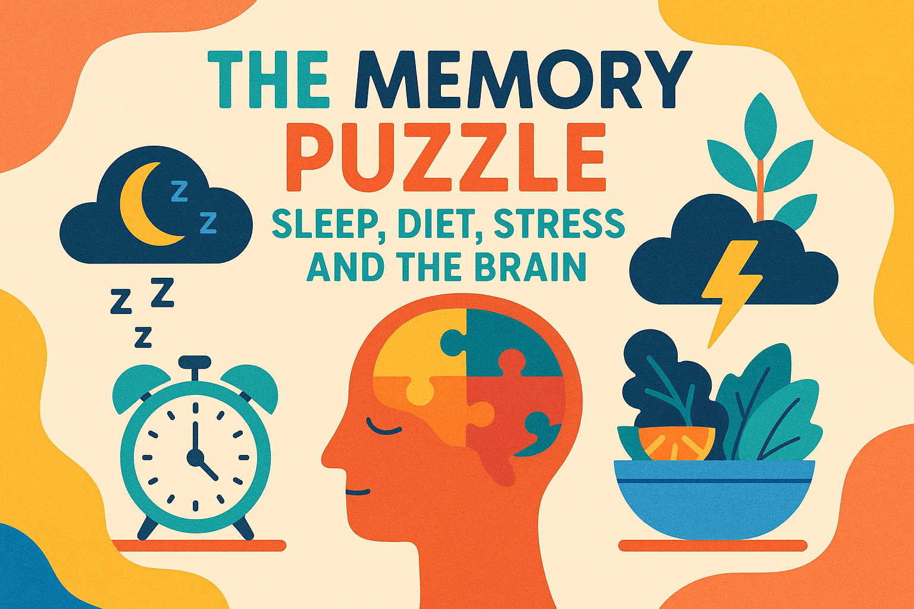
Prof. Stéphanie Daumas
CERN, Geneva, July 3rd, 2025
Notes:
Thanks so much for joining me. Today, I want to talk about something we all care about—memory. Whether it's remembering a loved one's birthday, a new colleague’s name, or just where we put the keys, memory is essential to daily life. But memory isn't just a switch in our brains—it’s a puzzle, shaped by many pieces.
Today, we’ll explore three of the biggest ones: sleep, diet, and stress
frc: French foundation whose mission is to better understand the brain and its dysfunctions, whether of neurological or psychiatric origin.

Slide 3

is a resource that keeps track of the past to help us live in the present and imagine the future
What is Memory?
Prof. Stéphanie DAUMAS - CERN, Geneva, July 3rd, 2025
Notes:
Let’s start with the basics: what is memory?
Memory is your brain’s ability to store and retrieve information. But it’s not like a hard drive. It’s an active, creative process involving three key stages:

Slide 4

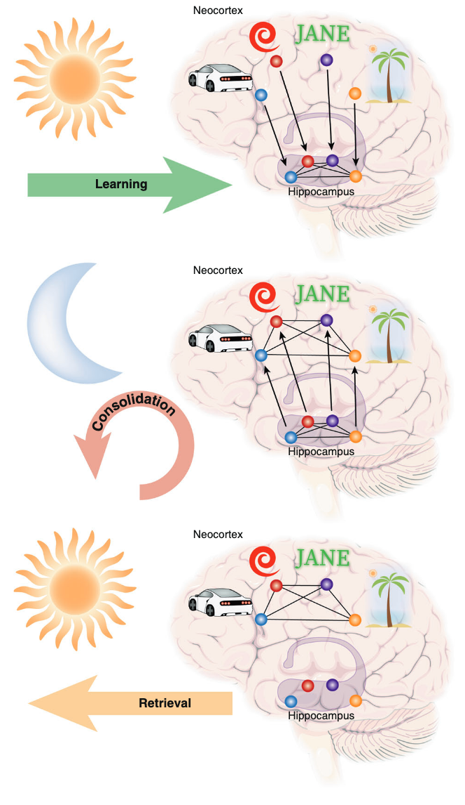
is a resource that keeps track of the past to help us live in the present and imagine the future
What is Memory?
1
Encoding
Prof. Stéphanie DAUMAS - CERN, Geneva, July 3rd, 2025
Notes:
Encoding – This is when you take in information. It could be what someone said, what you saw, or even how you felt.

Slide 5
is a resource that keeps track of the past to help us live in the present and imagine the future
What is Memory?
1
2
Encoding
Consolidation
Prof. Stéphanie DAUMAS - CERN, Geneva, July 3rd, 2025
Notes:
Storage – The brain processes and stores that info, mostly using networks of brain cells called neurons.

Slide 6
is a resource that keeps track of the past to help us live in the present and imagine the future
What is Memory?
1
2
3
Encoding
Consolidation
Retrieval
From Feld & Born, 2020
Prof. Stéphanie DAUMAS - CERN, Geneva, July 3rd, 2025
Notes:
Retrieval – Later, when you need it, your brain reactivates those networks to bring the memory back
Several parts of the brain work together here:
The hippocampus helps form new memories.
The prefrontal cortex helps focus and organize.
And the amygdala tags emotional memories with importance.
Importantly, memory is not fixed. It can be strengthened, weakened, or even reshaped over time.
And here’s where sleep, food, and stress come in—they affect every stage of that process

Slide 7
The importance of sleep
sleep is necessary to memory consolidation
2
Consolidation
Replay our day
Strengthen important connections
Move memories from short-term to long-term storage
Prof. Stéphanie DAUMAS - CERN, Geneva, July 3rd, 2025
Notes:
Let’s begin with sleep. Far from shutting down, your brain actually becomes incredibly active during sleep—especially in the deep stages.
Here’s what happens:
It replays your day, deciding what to keep and what to forget.
It strengthens important connections between neurons.
And it helps move memories from short-term to long-term storage.
Think of it like a librarian working the night shift—categorizing books and filing them in the right place.
When we don’t sleep enough, we may still form memories, but we’re more likely to forget, mix things up, or miss details. Poor sleep also affects attention—so we encode less in the first place.
So yes, the best thing you can do for your memory? Probably getting a good night’s sleep.

Slide 8
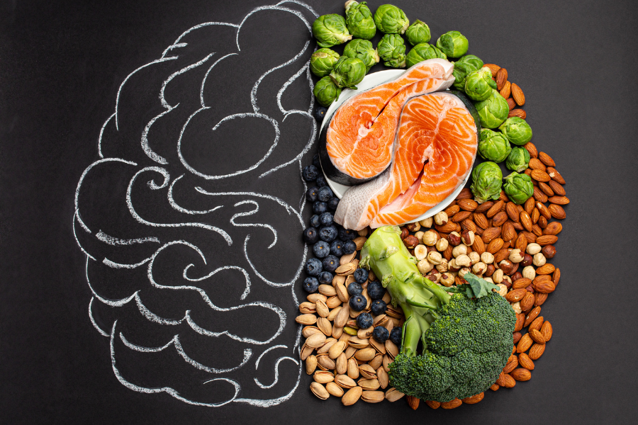
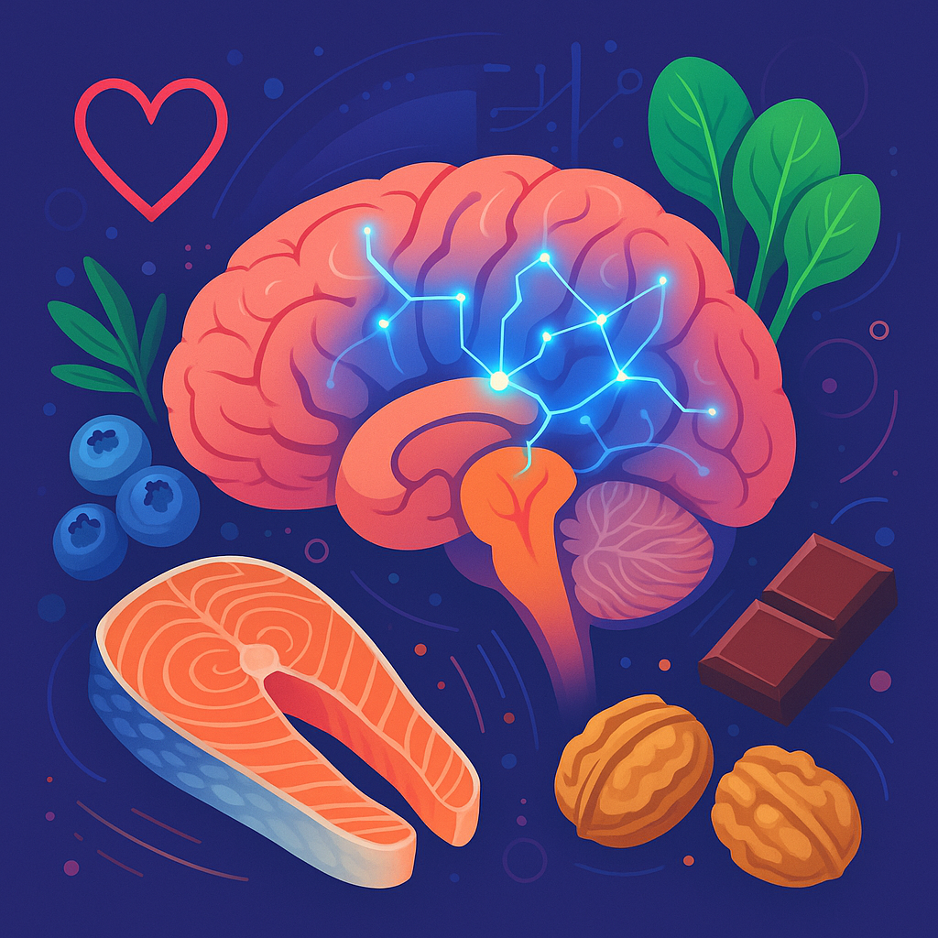
The importance of diet
food for thought, literally!
Vitamin K, folate, B caroten
Flavonoids
Polyphenols
Omega-3 fatty acids
Prof. Stéphanie DAUMAS - CERN, Geneva, July 3rd, 2025
Notes:
Next up is diet
Increasing evidence suggests that a lifestyle-related factor that potentially has a significant impact on memory and cognitive function is diet
Our brains are energy-hungry organs. Even though it’s just 2% of our body weight, it uses about 20% of our daily calories. That means what we feed our bodies really matters to how well our brains function—including memory
Just like junk fuel clogs up a car engine, a poor diet can clog up your brain’s ability to form memories. Diets high in sugar and saturated fats have been shown to impair learning and memory in both animals and humans.
But it’s not all bad news—certain nutrients have been scientifically linked to better memory and brain health.
Vitamin K, folate (in leafy greens…) reduce inflammation and promote cell signaling. Folate, in particular, is crucial for DNA repair and neurotransmitter synthesis.
Flavonoids (in berries…) are antioxidant that can cross the blood–brain barrier and directly affect areas involved in learning and memory, like the hpc
Polyphenols (in dark chocolate, green tea…) improve blood flow. Better circulation means more oxygen and nutrients for memory-related brain regions
Omega-3 fatty acids (in fatty fish, walnuts) are needed as structural component of brain cells
There’s growing evidence that diets like the Mediterranean diet, which emphasize whole foods, help protect memory as we age.
So, next time you're choosing between chips and a handful of berries, remember—you're not just feeding your stomach, you're feeding your brain.

Slide 9
Stress, the memory disruptor
Prof. Stéphanie DAUMAS - CERN, Geneva, July 3rd, 2025
Notes:
Finally, stress—especially chronic stress—can be a memory killer.
We’ve all had that moment where we blank during a high-pressure situation. That’s no coincidence.
Stress floods your brain with a hormone called cortisol.

Slide 10

Stress, the memory disruptor
Mild stress
helps to focus attention
Prof. Stéphanie DAUMAS - CERN, Geneva, July 3rd, 2025
Notes:
In small bursts, cortisol helps focus, it increases your attention, and paying attention is essential for the formation of memories.
In addition to mobilizing your body and brain for immediate action, cortisaol, together with adrenaline also activate the release of a neurotransmitter called norepinephrine in your amygdala.
In response, your amygdala sends a signal to your hippocampus, which essentially communicates, “Hey, this stressful thing that’s going on right now is probably vitally important – consolidate it! Make a memory!”
Cortisol can also act directly on receptors in the hippocampus to promote memory consolidation.”

Slide 11

Stress, the memory disruptor
BUT
Mild stress
helps to focus attention
High stress
disrupts learning & memory
Prof. Stéphanie DAUMAS - CERN, Geneva, July 3rd, 2025
Notes:
But if it sticks around too long—like in chronic stress—it starts to
damage the hippocampus, the very part of the brain we need for memory, but also
Disrupts sleep,
And makes it harder to concentrate or form new memories.
It’s like trying to plant seeds in a storm—nothing takes root.
Even children and teenagers under constant pressure show changes in memory and attention.
That’s why stress management—whether it’s through exercise, social support, or mindfulness—isn’t just for mental health, it’s for brain health too.”

Slide 12
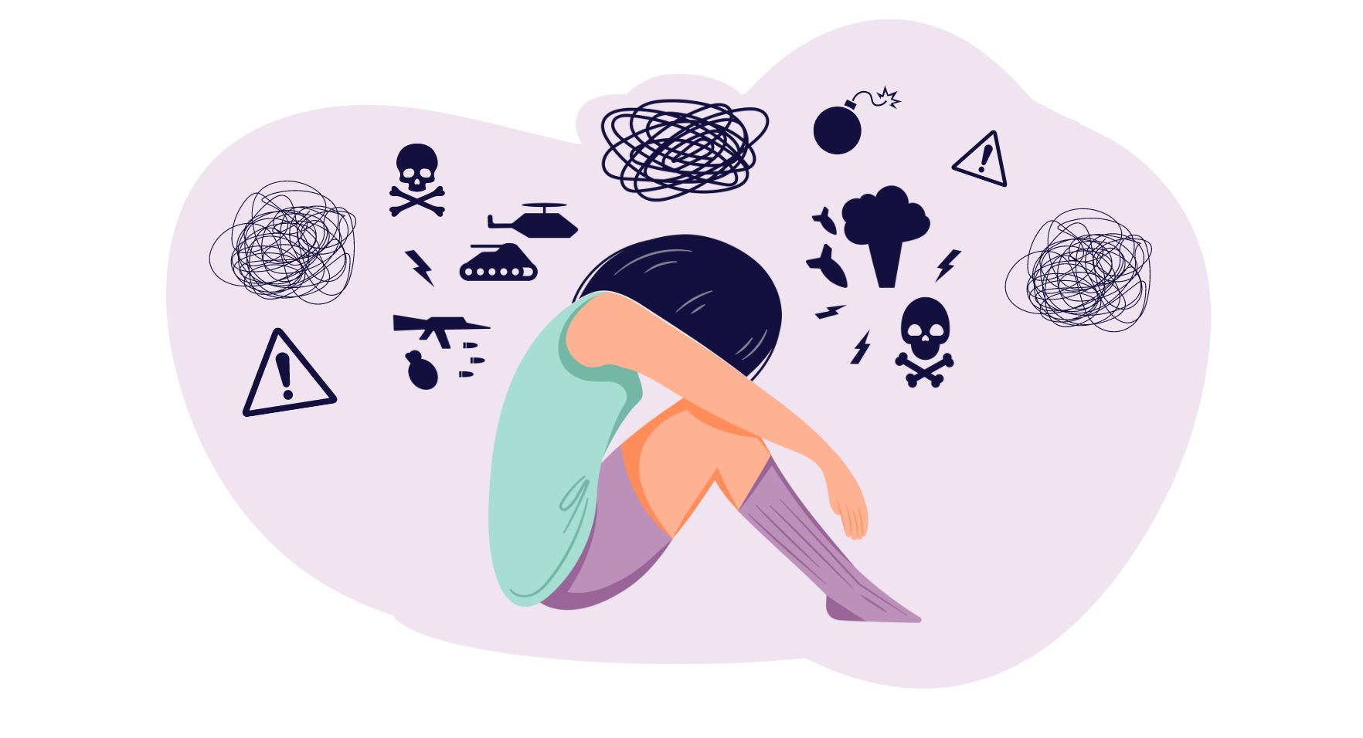
Stress, the memory disruptor
PTSD
Prof. Stéphanie DAUMAS - CERN, Geneva, July 3rd, 2025
Notes:
To conclude, I want to briefly highlight Post-Traumatic Stress Disorder (PTSD) as a striking example of how excessive stress can pathologically alter memory.
PTSD is often triggered by a highly traumatic event, and it's characterized by intrusive memories, flashbacks, hypervigilance, and avoidance behaviors. At its core, PTSD reflects a failure of the brain to properly regulate and contextualize a traumatic memory.
At the neural level, excessive stress impacts the amygdala, hippocampus, and prefrontal cortex—three key players in memory processing:
* The **amygdala**, which encodes emotional salience, becomes **hyperactive**, leading to an exaggerated fear response.
* The hippocampus, which normally helps contextualize memories in time and space, shows reduced volume and functional impairment, impairing the ability to recognize that the trauma is in the past.
* The prefrontal cortex, which normally inhibits the amygdala and helps extinguish fear, becomes hypoactive, weakening top-down control.
So, rather than memories being appropriately consolidated and updated over time, PTSD locks the brain into a state where the traumatic memory remains vivid, emotionally charged, and ever-present
This illustrates how stress, when excessive or poorly regulated, doesn't just impair memory—it can transform it into a source of dysfunction, turning memory into a trap instead of a tool.

Slide 13
Prof. Stéphanie Daumas
CERN, Geneva, July 3rd, 2025
Notes:
So, putting the puzzle together:
Memory is a reflection of your whole lifestyle. Therefore, I hope you I convinced u that
Sleep is not a luxury; it’s a necessity for memory.
Food isn’t just fuel; it’s brain fertilizer.
Stress isn’t just unpleasant; it’s toxic to memory when chronic.
If we care about remembering life’s moments, names, knowledge—and let’s face it, our passwords—we need to care about the bigger picture.
Taking care of your brain is like solving a puzzle. And you now hold three of the most important pieces.

