Slide 1
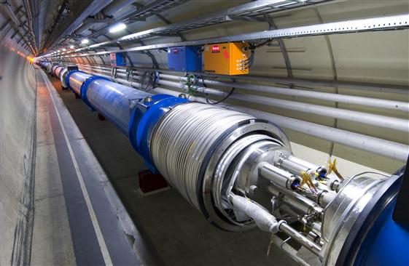
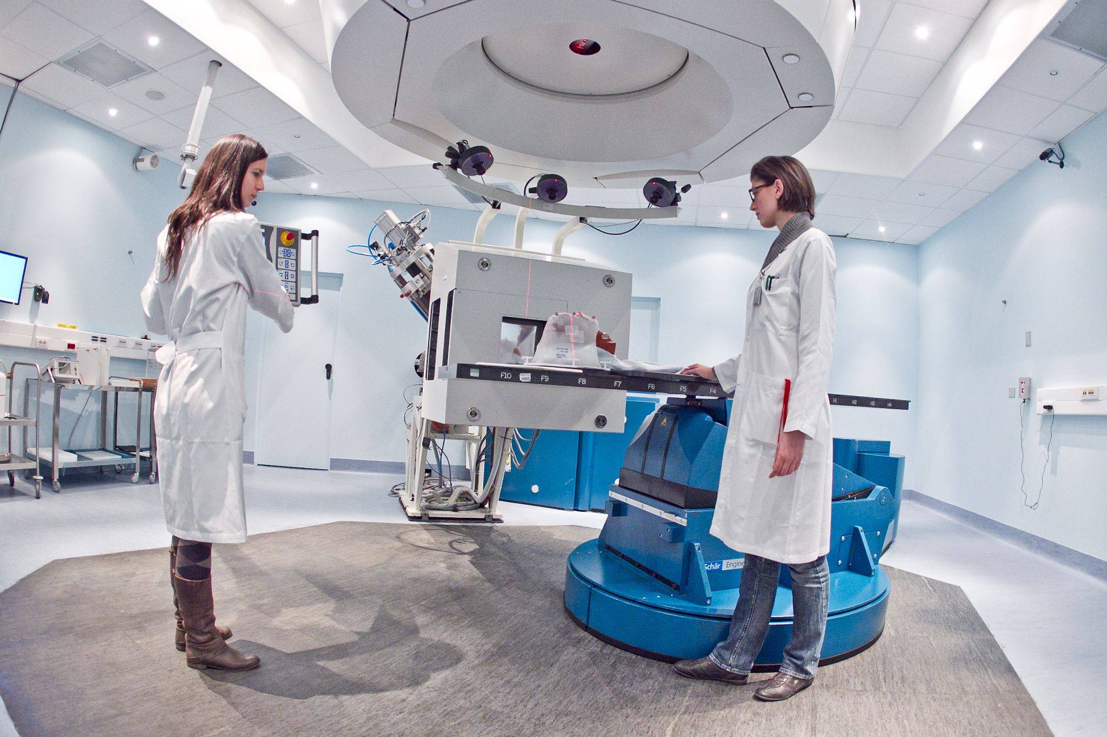

From Particle Physics to Brain-related Applications
03 July 2025
Image: CNAO
Mary Touranakou
Knowledge Transfer - Medical Applications
CERN Knowledge Transfer Group

Slide 2

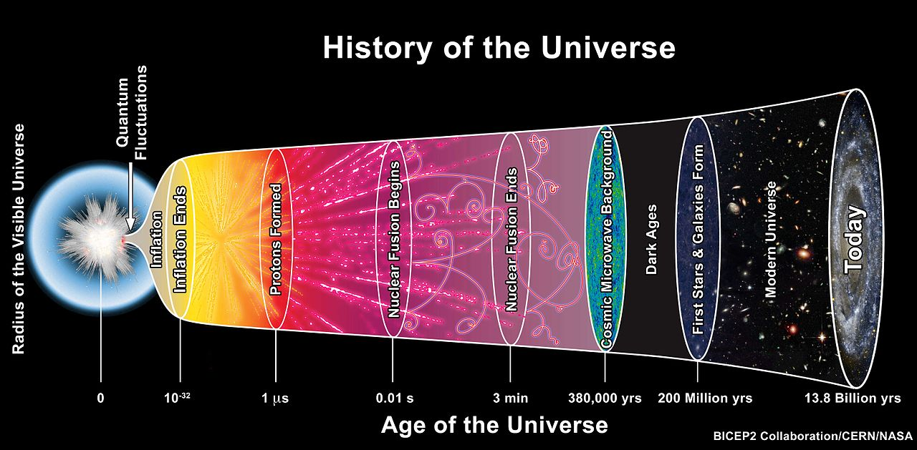
CERN – Conseil Européen pour la Recherche Nucléaire
Fundamental Science
What the universe is made of
How it works
CERN’s Mission
Research
Collaboration
Training & Education
Technology & Innovation

Slide 3
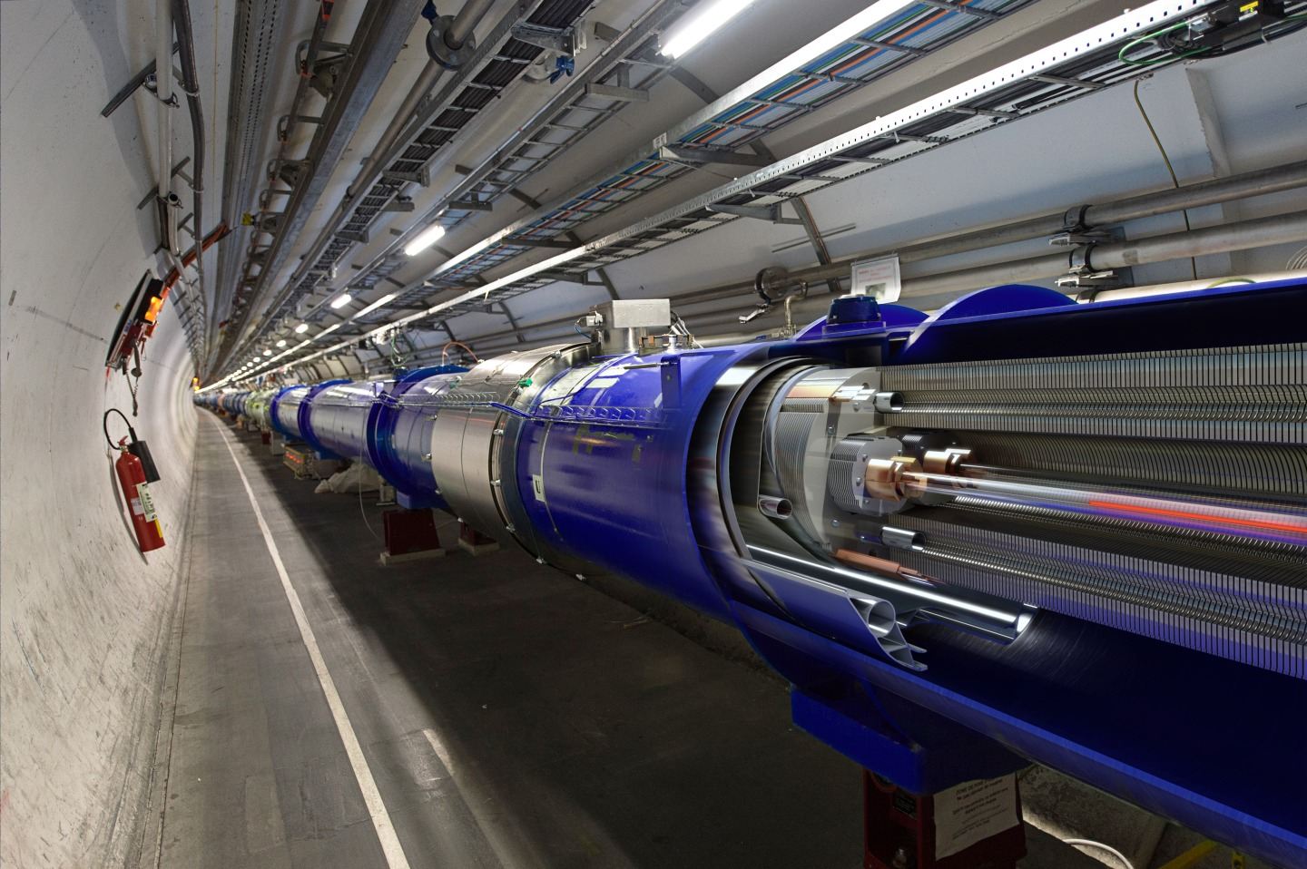
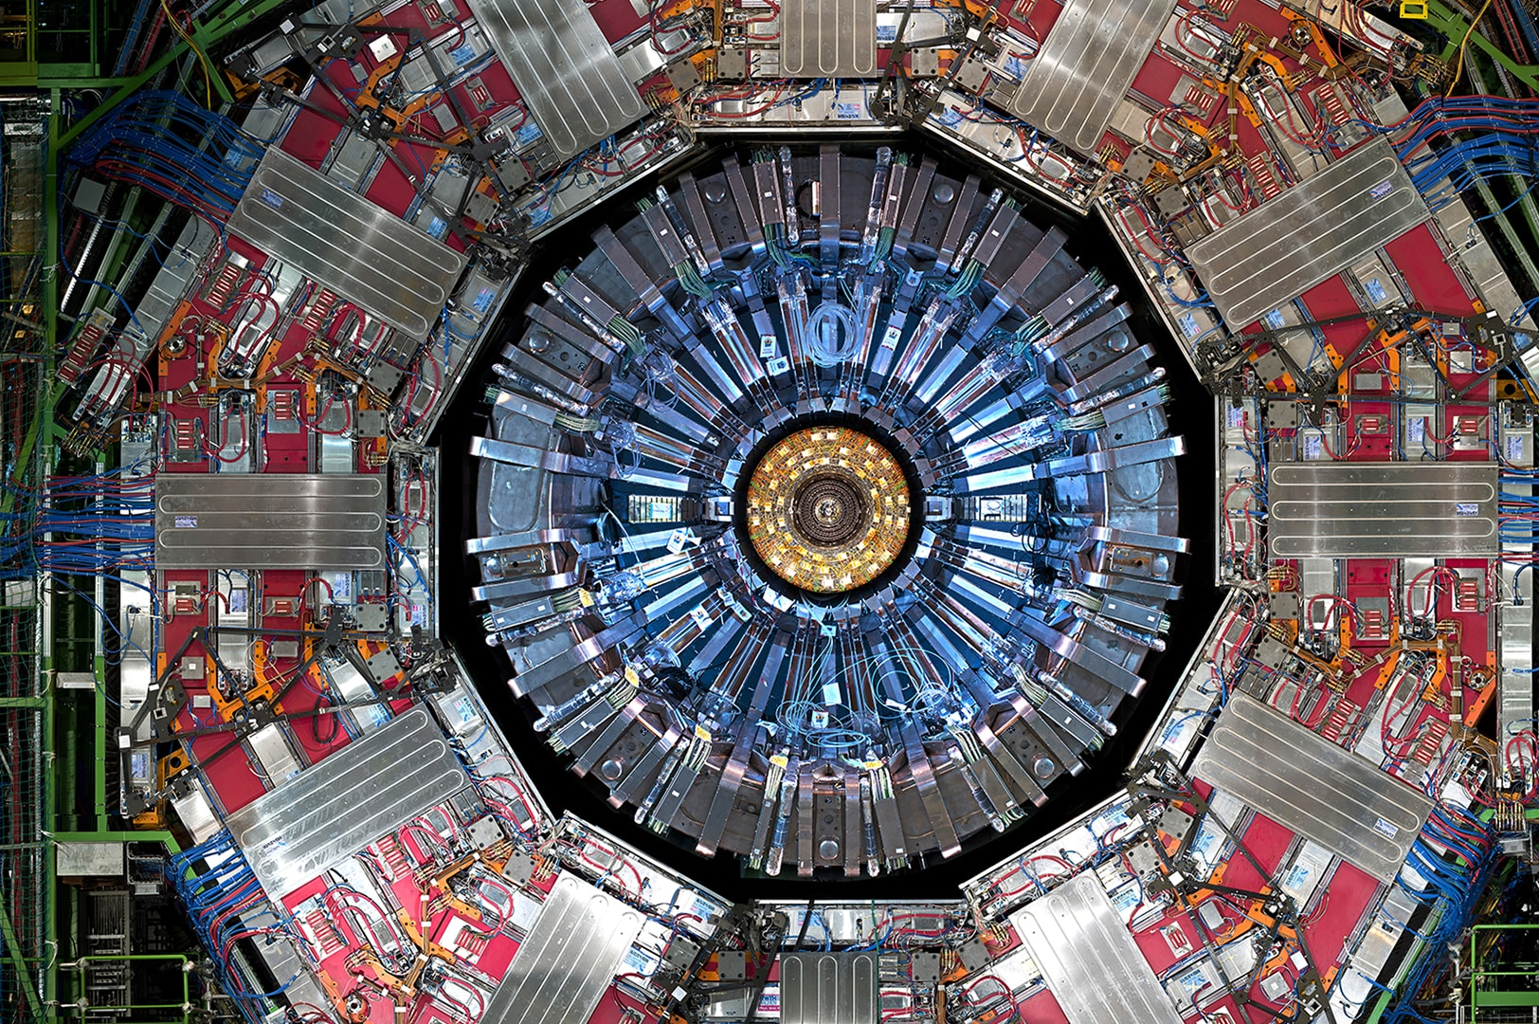
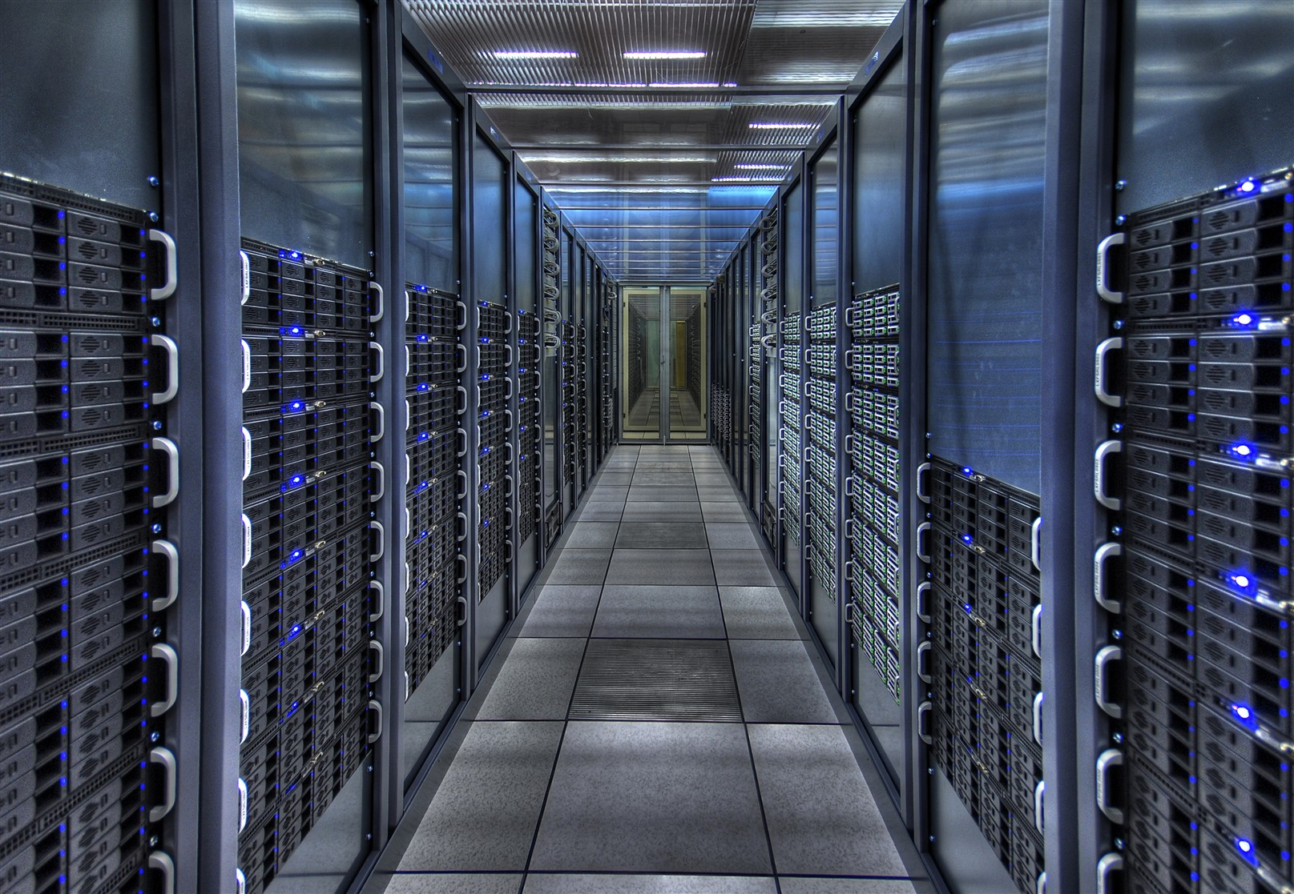
Technologies related to
Particle Accelerators
Particle Detectors
Computing

Slide 4
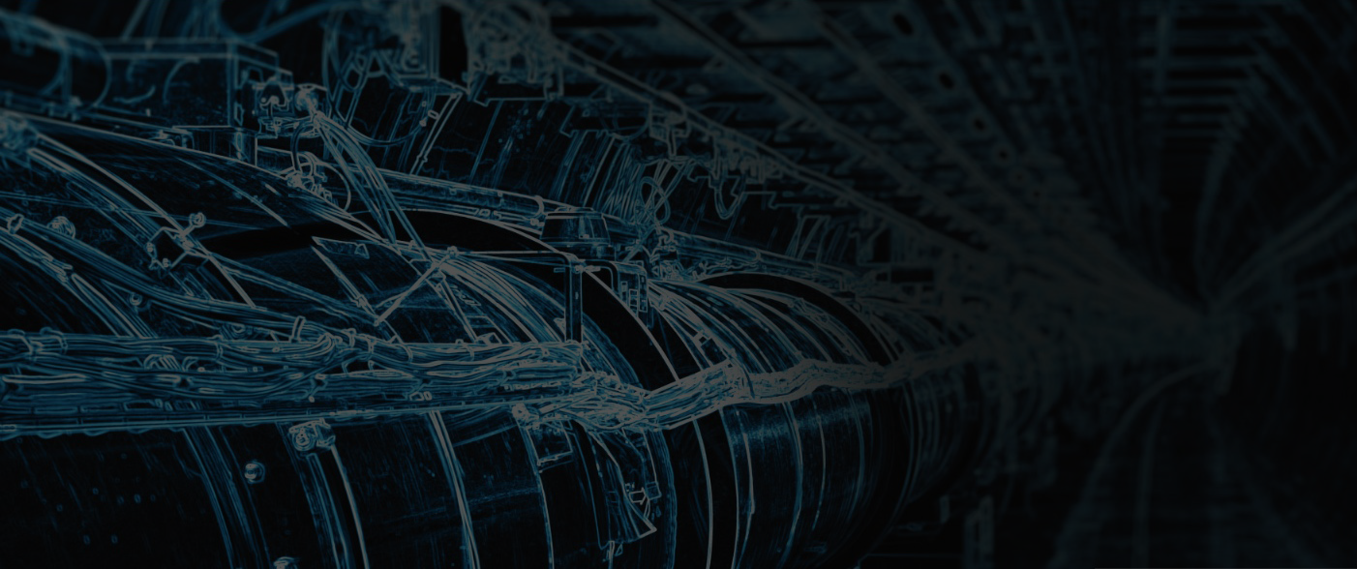
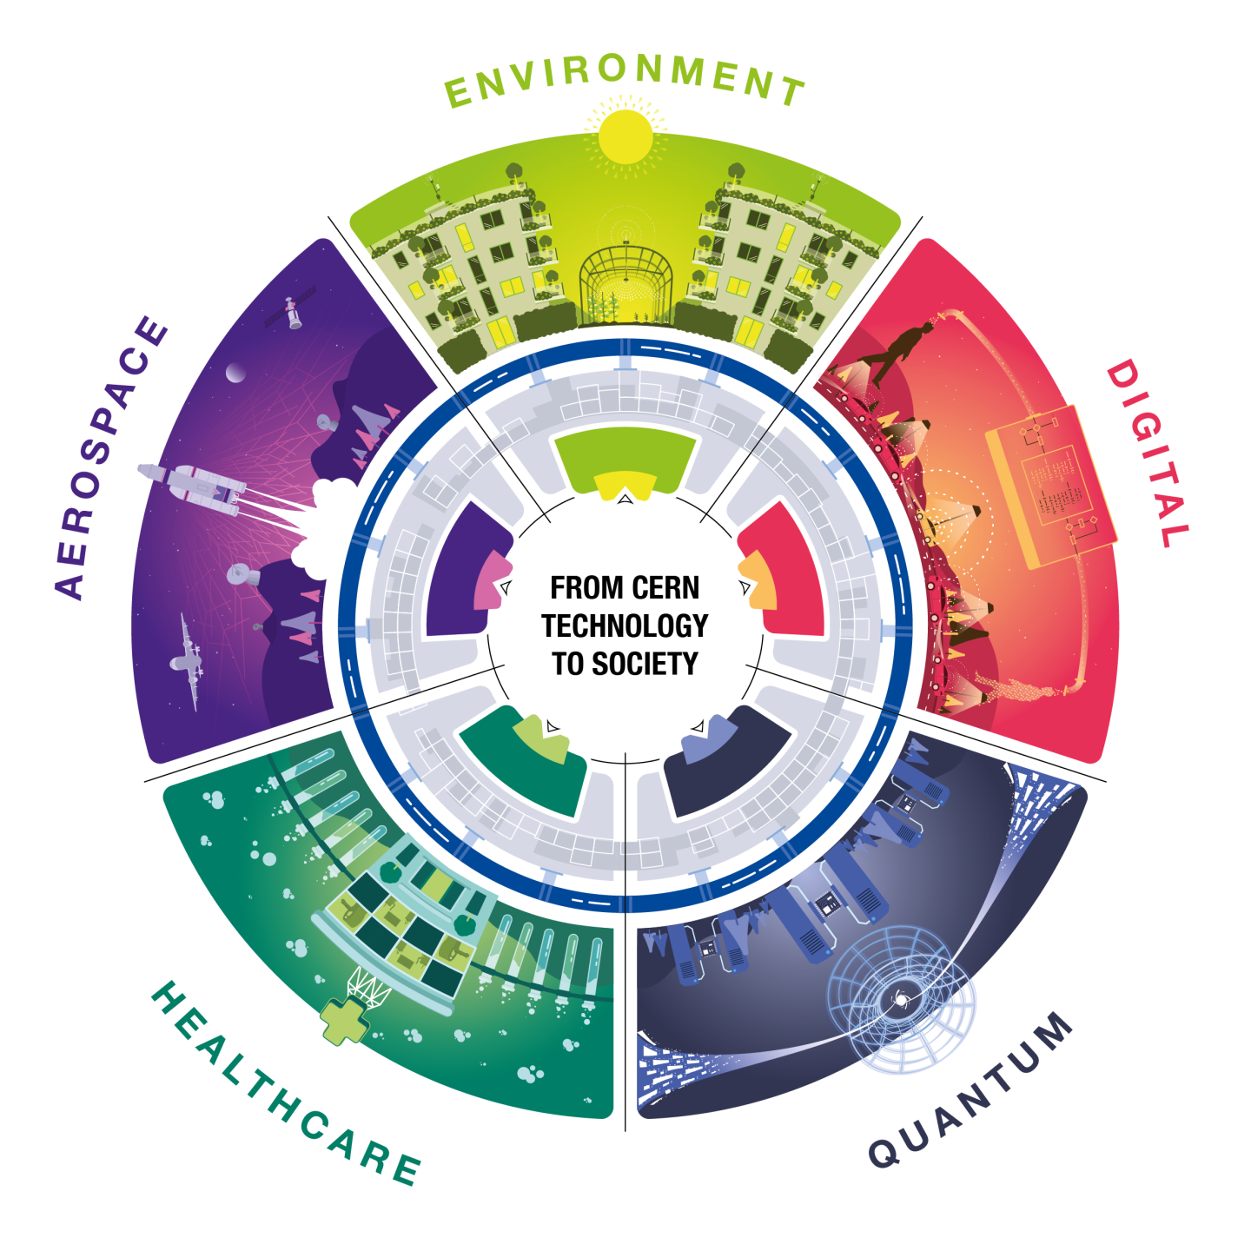
CERN Knowledge Transfer Group
Maximize technological and knowledge return to society
Promote CERN as a center of excellence for technology and innovation
Demonstrate the importance and positive impact of fundamental research on society

Slide 5
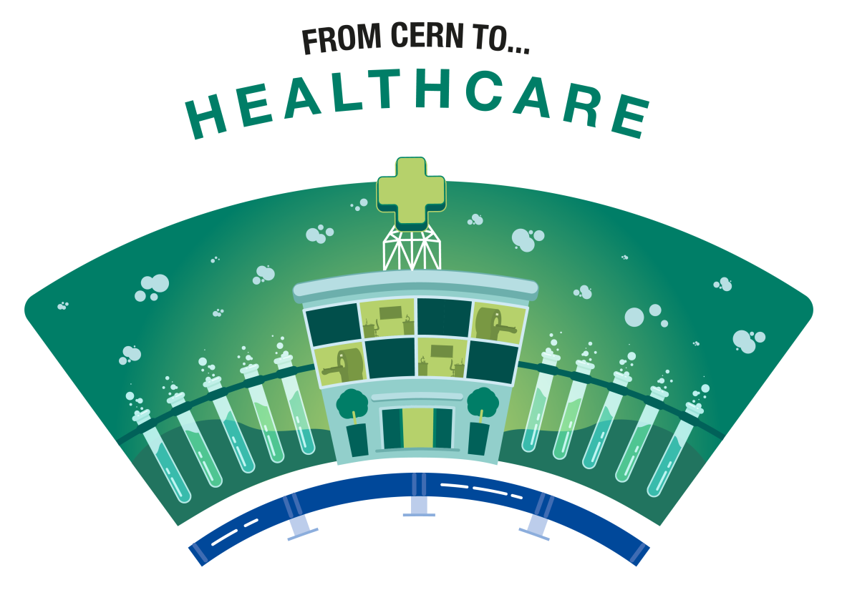
From Particle Physics to Medical Applications
Significant contributions to the diagnosis, therapy and management of medical conditions including:
Particle accelerator technologies for radiotherapy and cancer treatment
Advancements in medical imaging leveraging particle detector technology
Digital healthcare solutions to detect pathologies and provide personalized care stemming from expertise in computing

Slide 6
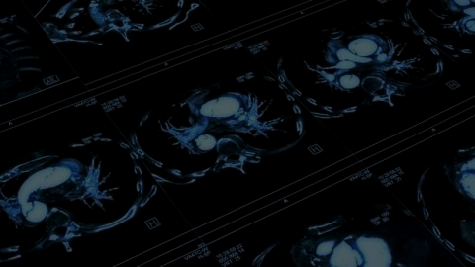
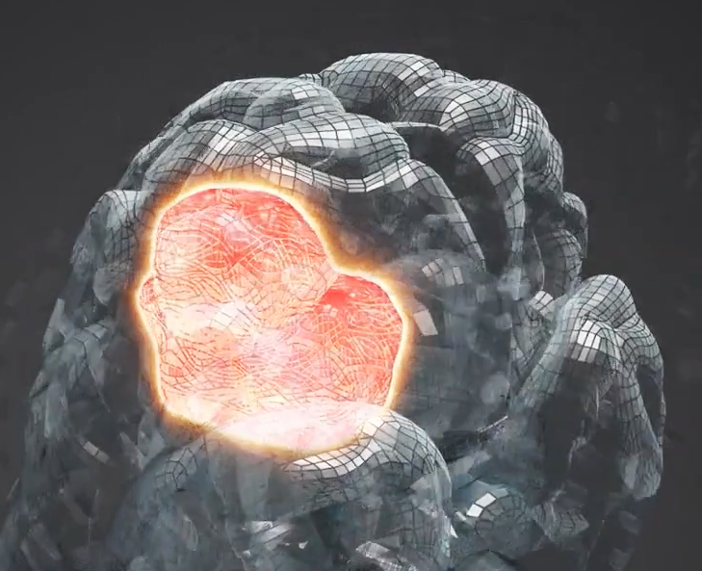
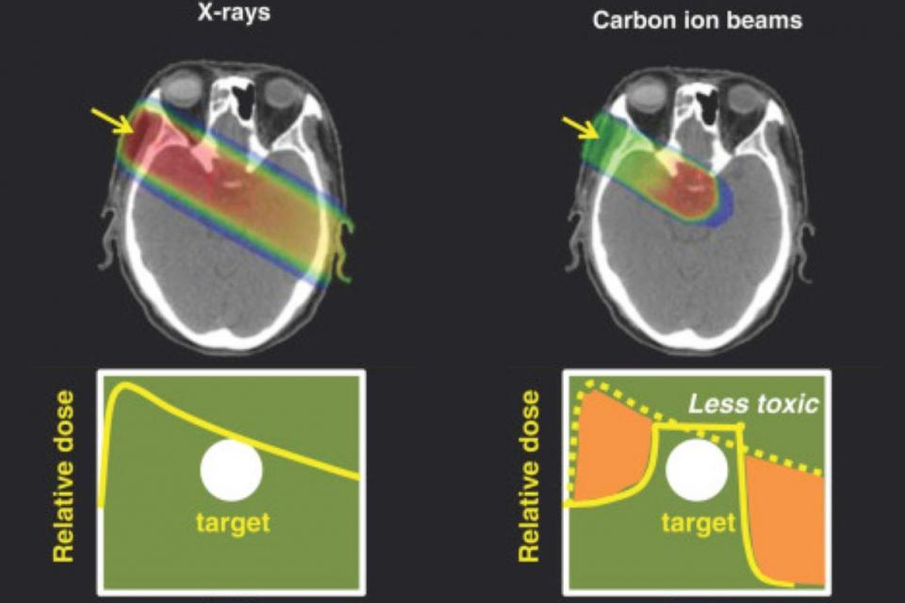
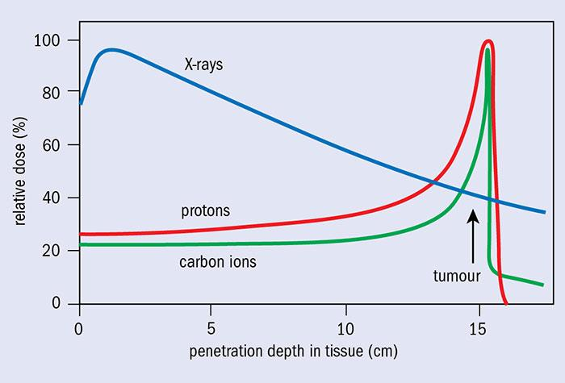
From Particle Accelerators to Cancer Treatment
Particle Therapy
Proton therapy to precisely target tumors treating various types of cancer
Heavy ion therapy (e.g., carbon ions) for challenging or radioresistant tumors
These therapies exploit the Bragg peak effect for highly targeted treatment minimizing radiation exposure to surrounding tissues.
Important for treating brain tumors where sparing healthy tissue reduces side effects.

Slide 7
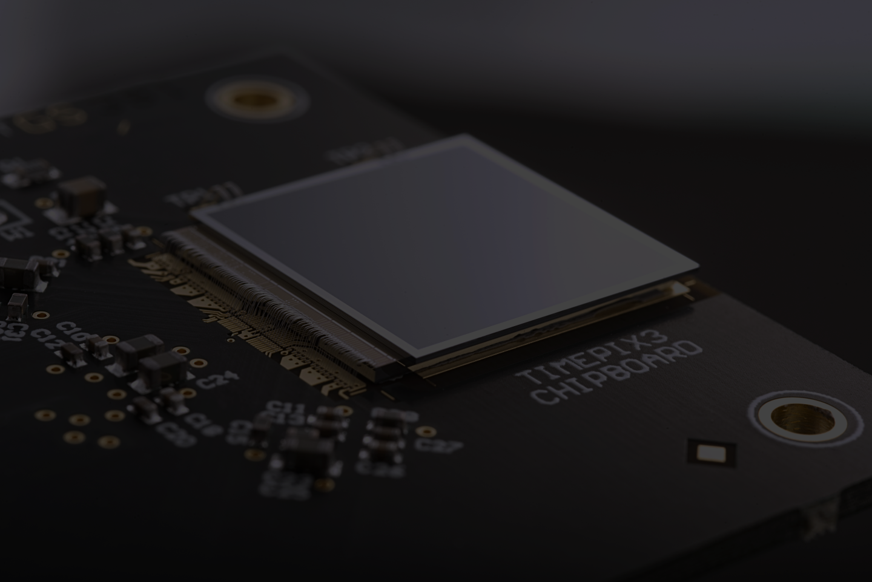
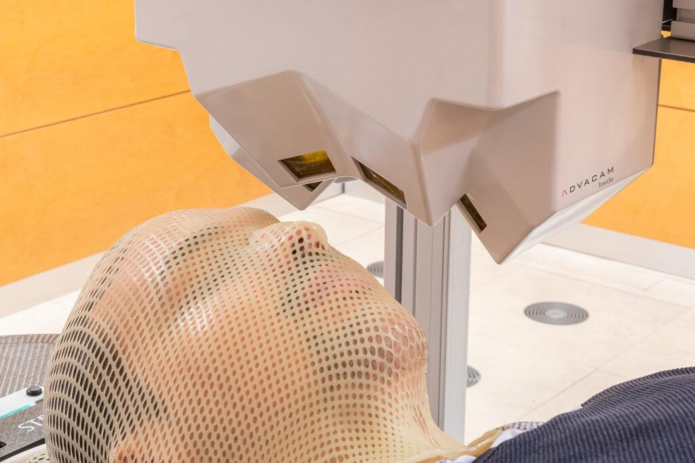
From Particle Detectors to Cancer Treatment
Medipix: A family of pixel detector read-out chips for particle imaging and detection developed by the Medipix Collaborations.
Miniaturized technology that can improve the navigation of ion beams inside the head by tracking the secondary particles created by the ions.
Improved safety and precision in head and neck tumor radiotherapy
Reduced risks of damaging healthy brain tissue minimizing side effects
Image: ADVACAM
Imaging device by ADVACAM tested with Timepix3 for head and neck tumors in ion radiotherapy
More information: https://kt.cern/medtech/medipix

Slide 8
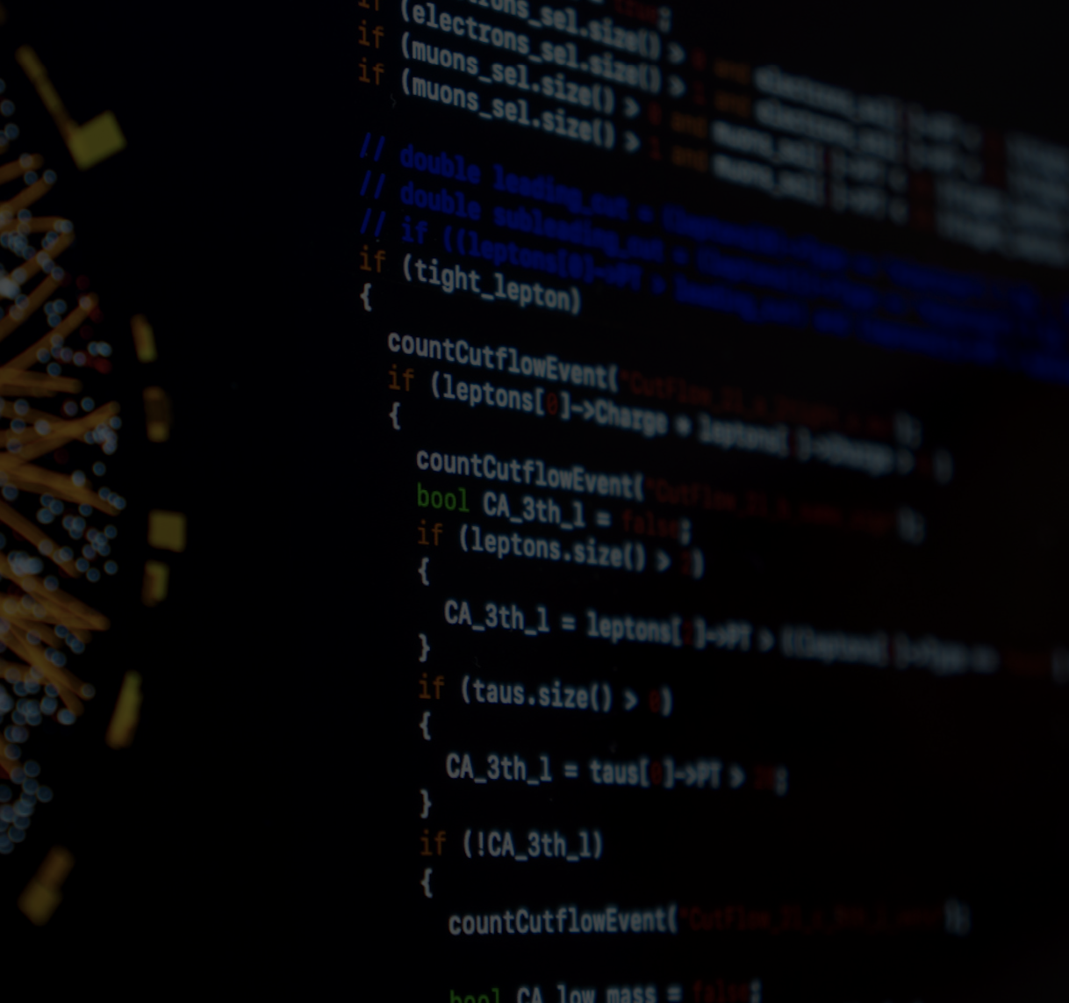

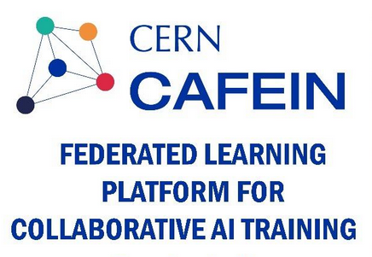

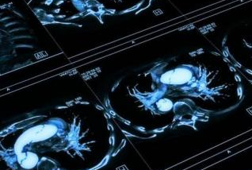

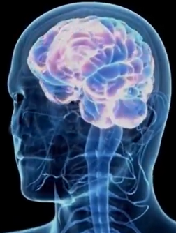
From Computing to Brain Pathologies Management
CERN’s CAFEIN Federated Learning platform enables the training of multiple local AI models without transferring data.
From predicting anomalies in CERN’s accelerator chain, CAFEIN now supports the management of brain pathologies such as stroke while keeping the data private.
Only the AI model parameters are transmitted while the data remains securely stored at the hospital.
TRUSTroke: EU-funded AI project aimed to optimise stroke treatment.
More information: https://indico.cern.ch/e/trustroke
Webinar: https://indico.cern.ch/e/trustrokewebinar

Slide 9
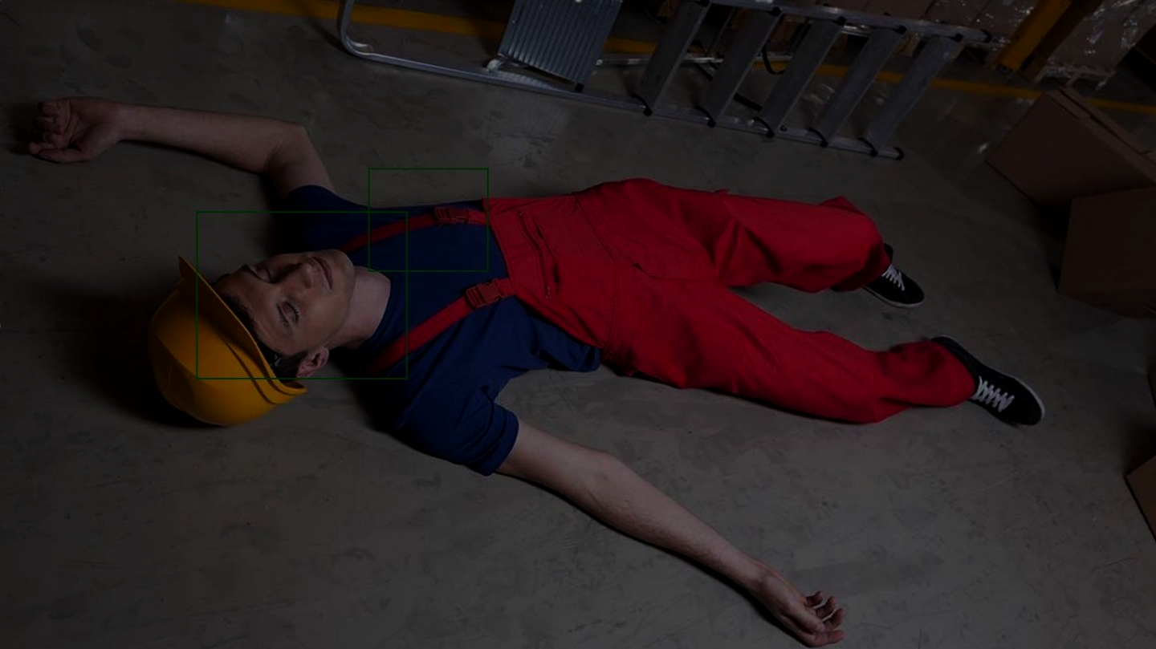
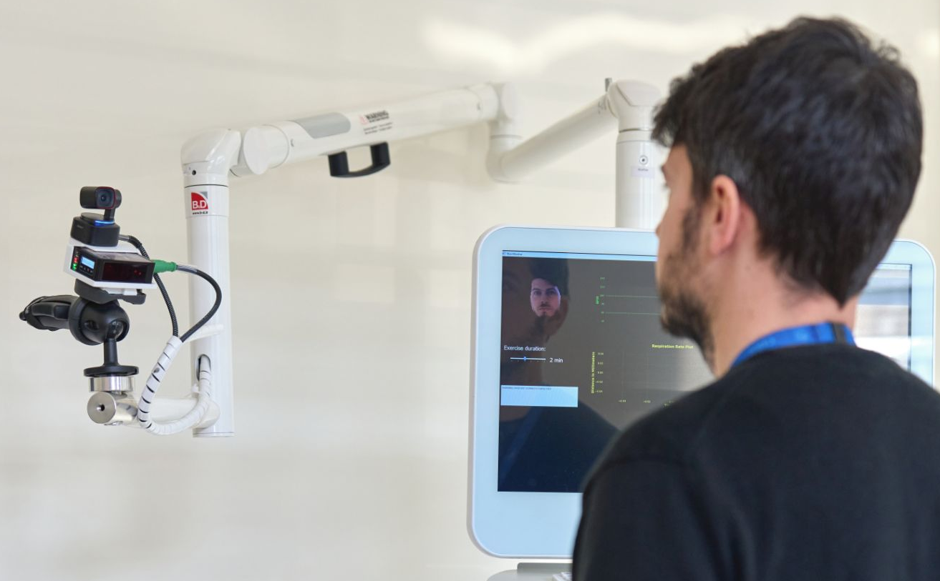
From Computing to Contactless Health Monitoring
MARCHESE’s contactless system allows for remote patient monitoring by tracking parameters and motion, sending timely alerts to medical staff for intervention.
Currently being tested in hospital settings, tailored to use cases including geriatrics
Optimized efficiency in medical care
Care tailored to patients’ needs
Potential applications for rehabilitation and palliative care.
Image: Cavazza, Marina
MARCHESE prototype to remotely monitor health parameters and track patient motion
More information: http://cds.cern.ch/record/2925951/

Slide 10
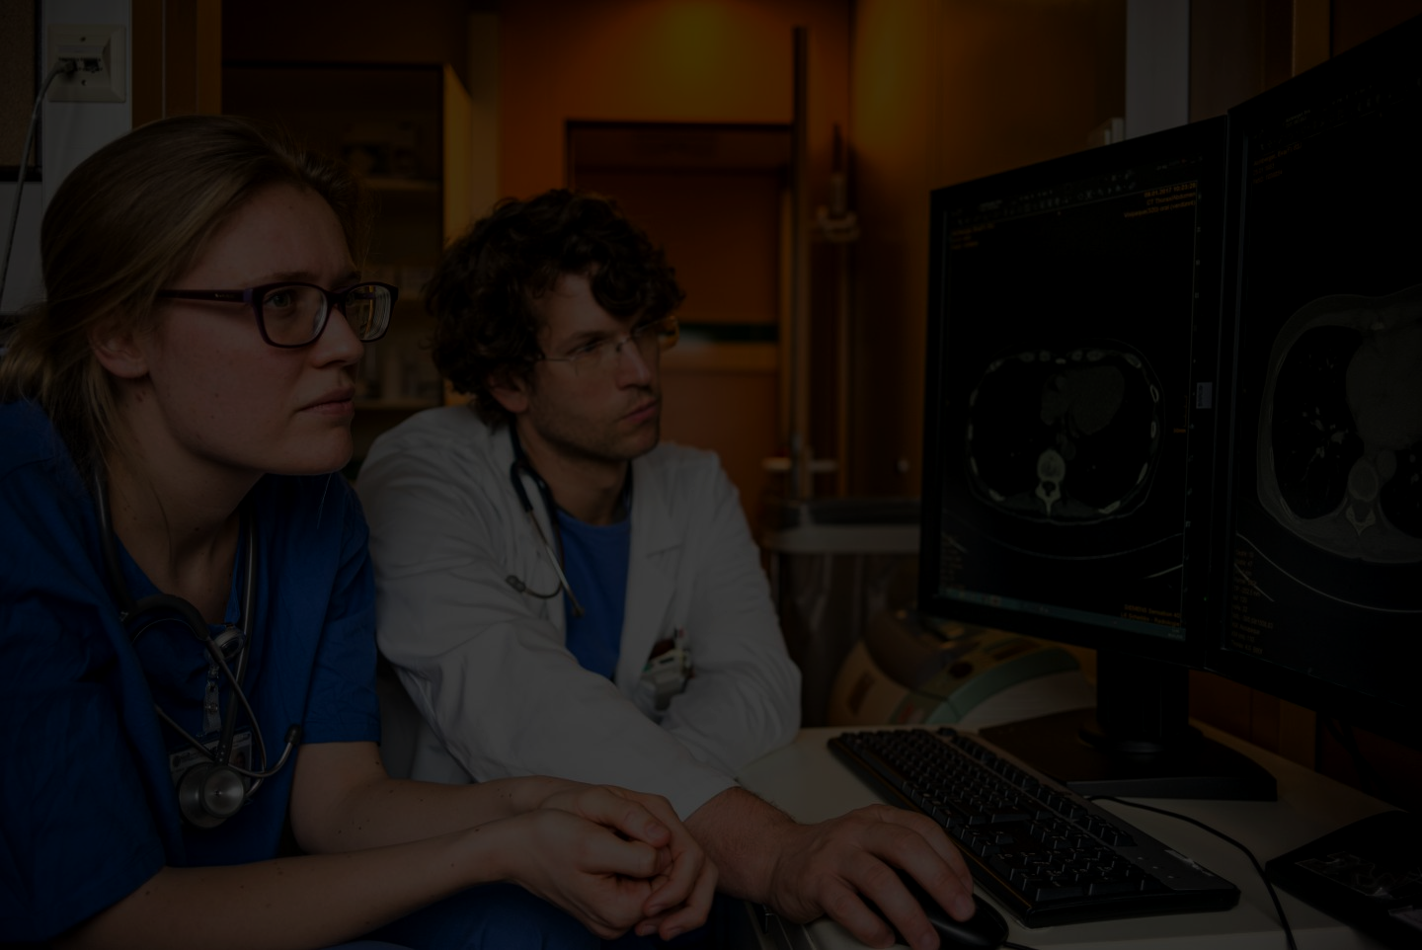
Interested in learning more?
CERN Innovation Partnerships
Knowledge Transfer 2024 Highlights
kt.cern | KT.MedicalApplications@cern.ch
From particle physics to medicine
CERN 70s event: From particle physics to medicine
“Places like CERN contribute to the kind of knowledge that not only enriches humanity, but also provides the wellspring of ideas that become the technologies of the future.”
— Fabiola Gianotti, Director-General of CERN

