Slide 1

Staying motivated: What the brain tells us about drive and how to keep it
03.07.2025
PD Dr Matthias Kirschner
FACULTÉ DE MÉDECINE
DÉPARTEMENT DE PSYCHIATRIE
Notes:
le titre de ma présentation est déficit de motivation et dysfonctionnement du système de récompense dans les psychoses

Slide 2

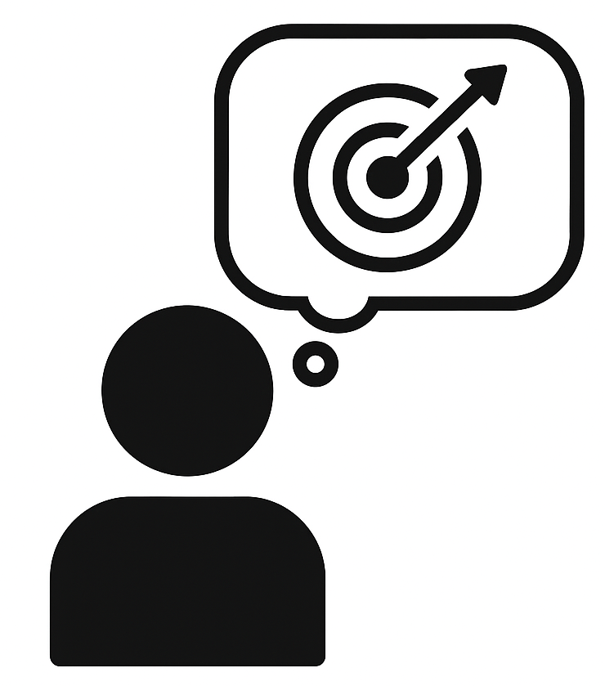



Un modèle pour le comportement dirigé vers un but
What is motivation
Motivation is the drive to achieve goals or meet our needs.
Anticipation
Behavior
Outcomes
Notes:
Give example

Slide 3


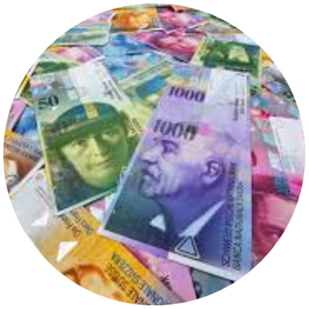


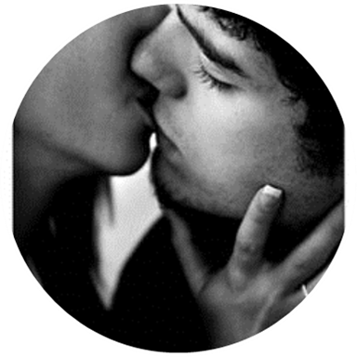

Un modèle pour le comportement dirigé vers un but
What is motivation
Anticipation
Behavior
Reward/Achievement

Slide 4
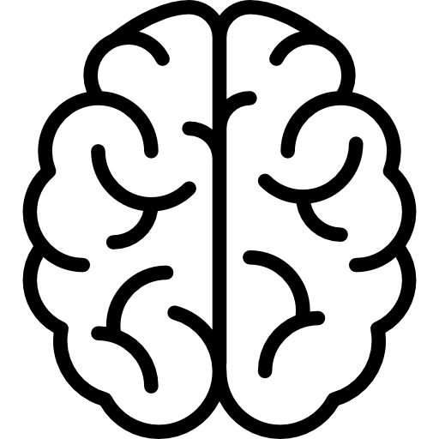




Why motivation matters
Drives our work, relationships, and well-being
Everyone struggles with it at times – about 1 in 3 adults show signs of reduced drive
Not just about willpower - influenced by biology, social and cultural factors
Notes:
Example for Biology – less motivated when sick, acute inflammation

Slide 5
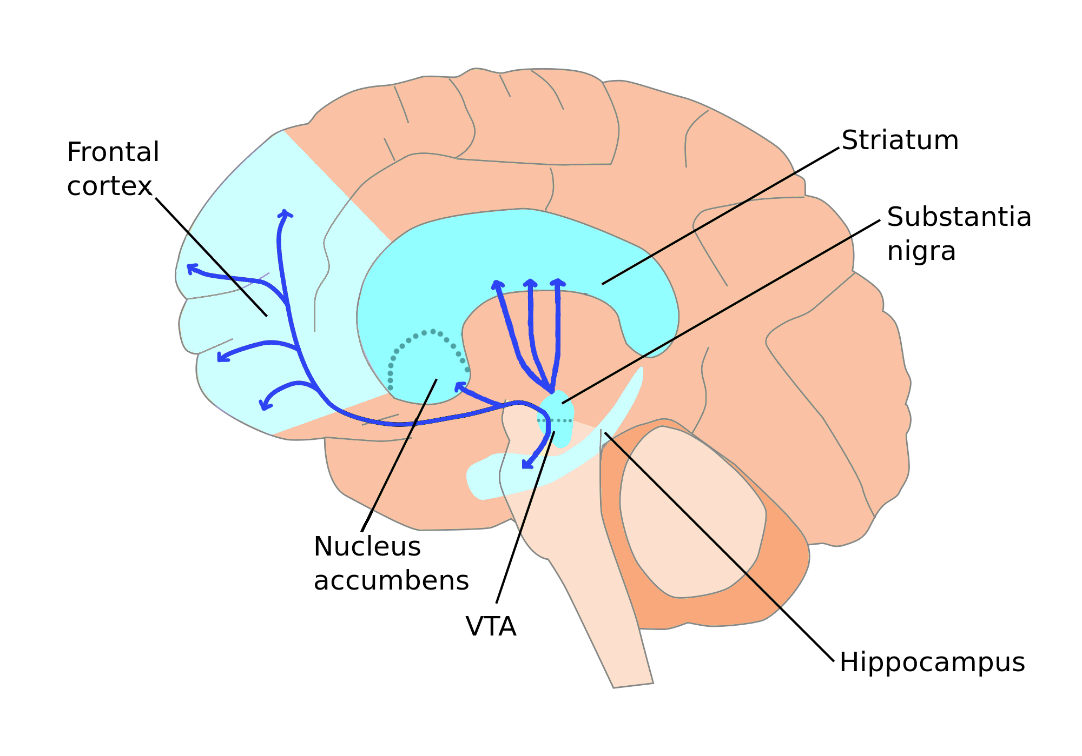
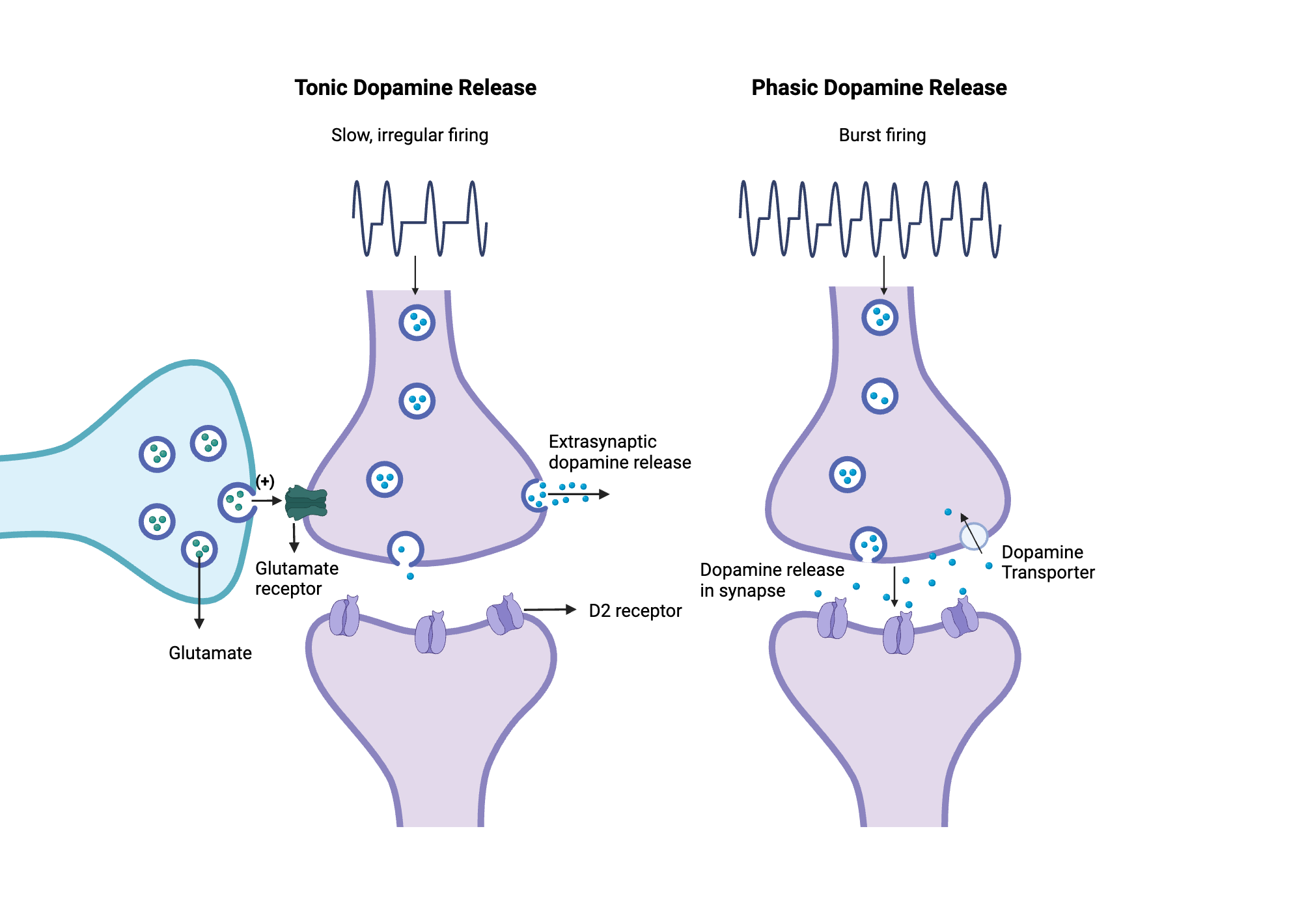
How motivation works in the brain
Dopamine system
Dopamine function
Key regions
Midbrain: VTA/ substantia nigra
Subcortex: nucleus accumbens
Cortex: prefrontal areas
Tonic dopamine Maintains baseline motivation and readiness to act
Phasic dopamine Signals important information for learning

Slide 6
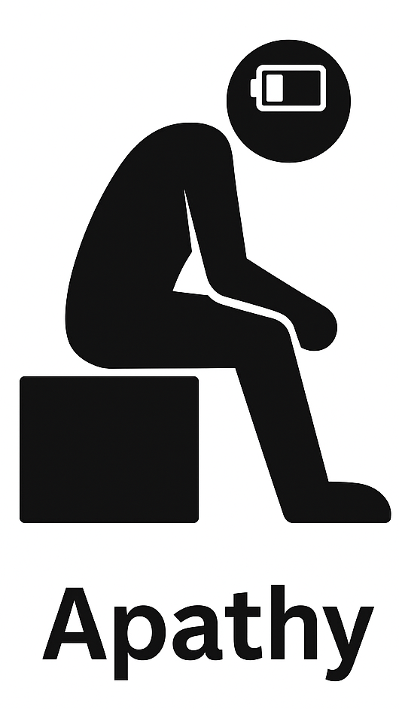
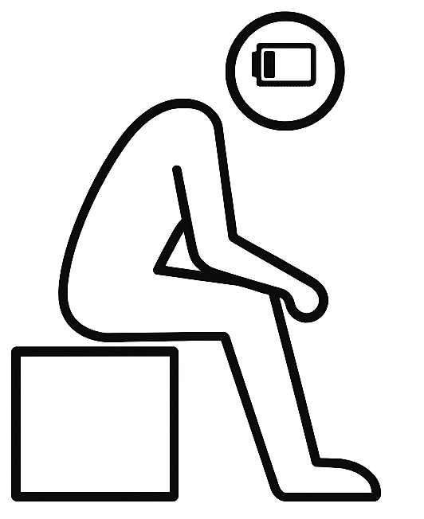
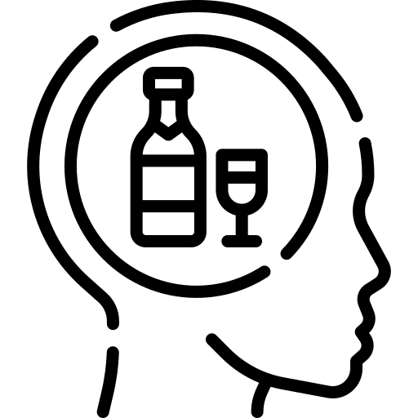
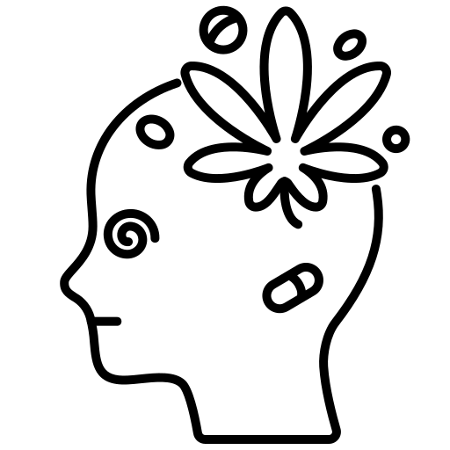

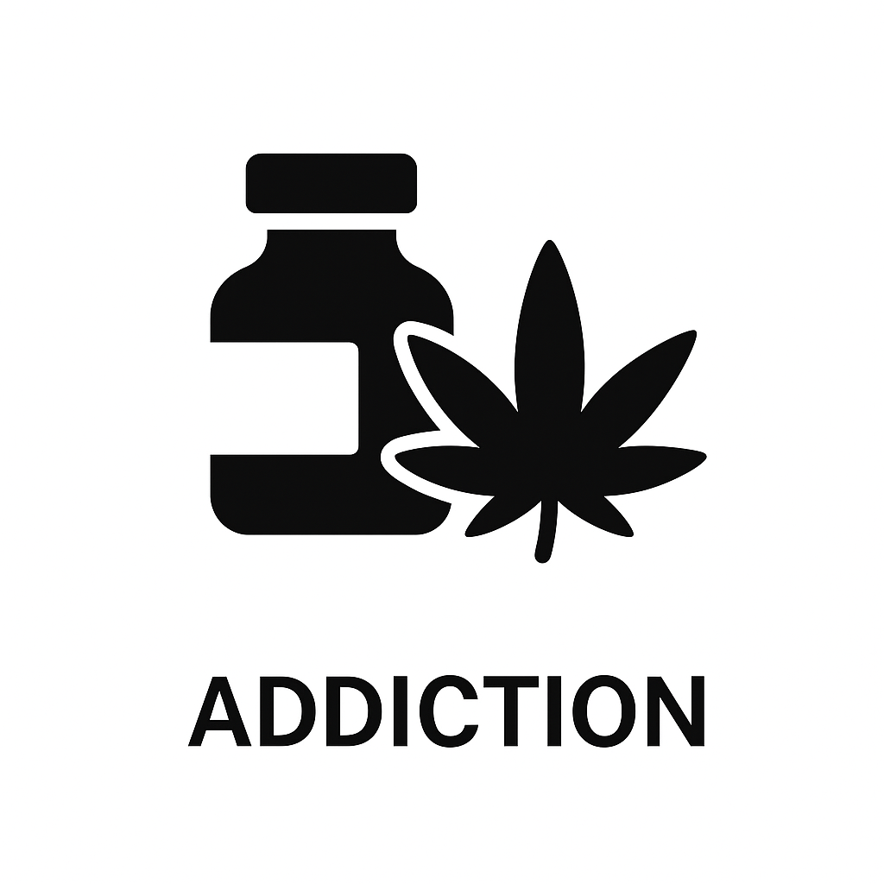
Disrupted motivation: apathy and addiction
Apathy
Addiction
Apathy: Motivation is blunted
Loss of drive or energy
Nothing seems worth the effort
Seen in: Depression, Schizophrenia, Parkinson’s disease …
Addiction: Motivation is hijacked
Strong drive for specific reward (e.g. alcohol) while other goals lose importance
Seen in: all types of addiction

Slide 7
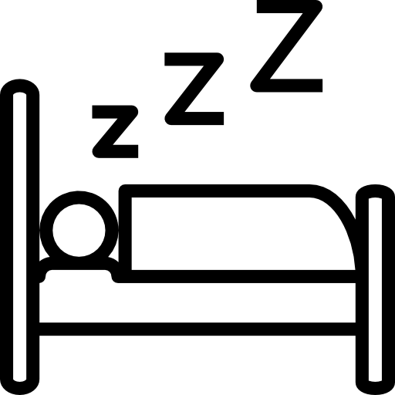
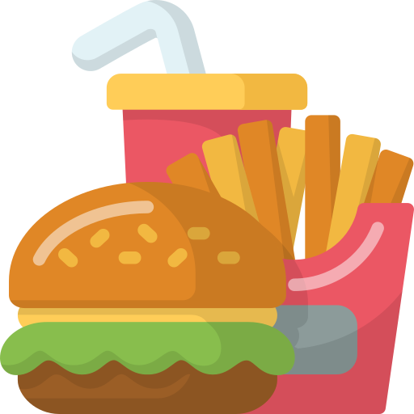
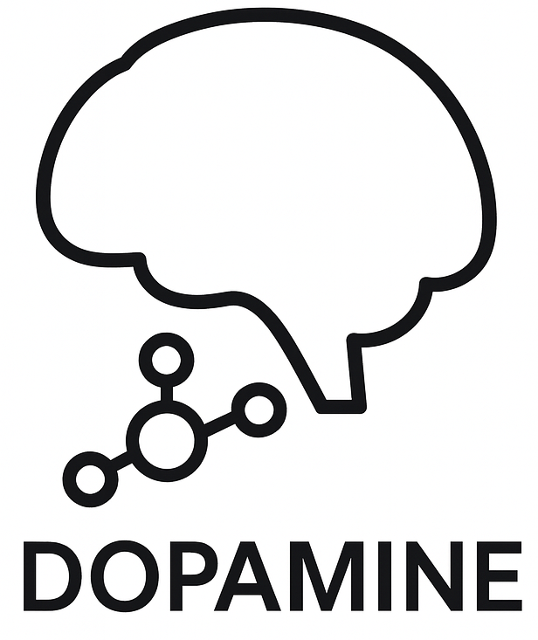


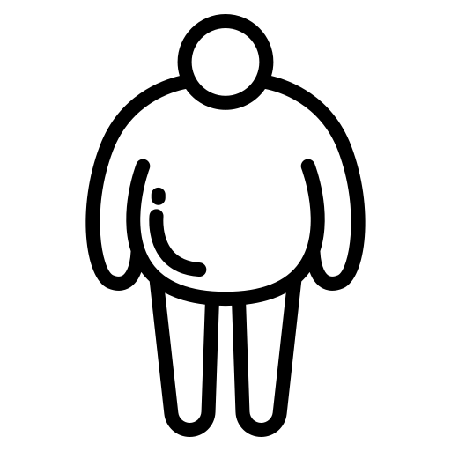


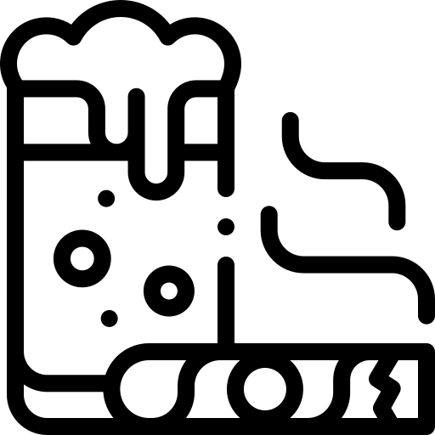

Modifiable risk factors for dopamine dysregulation
poor sleep
poor diet
mental
stress
physical inactivity
alcohol, nicotine,
drugs
social isolation

Slide 8

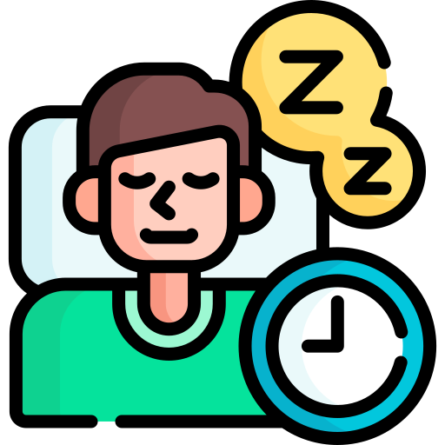
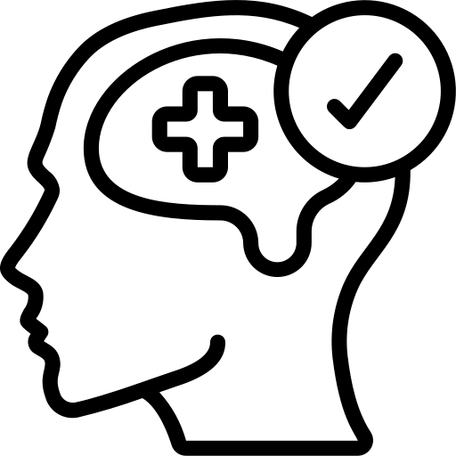




How to stay motivated and prevent dysfunction
enough
sleep
healthy diet
stress management
physical activity
social connection
“No silver bullet — balance works best.”

Slide 9
Key takeaways
Motivation relies on brain systems that track reward and effort.
Dopamine helps us initiate and sustain goal-directed behavior.
Disruptions in this system can lead to apathy or addiction.
Healthy lifestyle choices support the brain systems that drive motivation.

Slide 10
Thank you very much for your attention !
FACULTÉ DE MÉDECINE
DÉPARTEMENT DE PSYCHIATRIE

Slide 11
Key References:
Ang et al. (2017) https://doi.org/10.1371/journal.pone.0169938
Husain, M., & Roiser, J. P. (2018) https://doi.org/10.1038/s41583-018-0029-9
Salamone, J. D., & Correa, M. (2012) https://doi.org/10.1016/j.neuron.2012.10.021
Kirschner et al. (2020) https://doi.org/10.1016/j.pnpbp.2020.109926
Bègue et al. (2020) https://doi.org/10.1016/j.neubiorev.2020.06.004
Goldsmith (2023) https://doi.org/10.1016/j.biopsych.2022.11.003
Axelsson et al. (2019) https://doi.org/10.1093/sleep/zsz291
Massar et al. (2019) https://doi.org/10.1016/bs.pbr.2019.03.007

